Slide 1
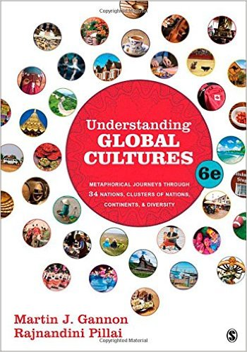
Start deck in “Slide Show” mode,
and use your up/down arrow keys and/or
your space bar to advance the slides
© 2010-2024 Timothy G. Roufs, University of Minnesota Duluth

Slide 2
REM
indicates that the materials
are a REMinder
and are thus being repeated . . .
REMinder

Slide 3
ANTH 1080
Global Cultures
© 2010-2024 Timothy G. Roufs, University of Minnesota Duluth

Slide 4
ANTH 1080
Global Cultures
Main
Characteristics of
Anthropology
© 2010-2024 Timothy G. Roufs, University of Minnesota Duluth

Slide 5
American
Main Characteristics of˄Anthropology
1. the four fields of general anthropology
culture as a primary concept
comparative method as major approach
holism as a primary theoretical goal
fieldwork as a primary research technique

Slide 6
American
Main Characteristics of˄Anthropology
1. the four fields of general anthropology
culture as a primary concept
comparative method as major approach
holism as a primary theoretical goal
fieldwork as a primary research technique

Slide 7
Main Characteristics of Anthropology
1. the four fields of general anthropology
culture as a primary concept
comparative method as major approach
holism or the study of "humankind" as a whole, as a primary theoretical goal
fieldwork as a primary research technique

Slide 8
with humans, in anthropology, holism looks at an item including the many subdisciplines in the areas of . . .

Slide 9
Holism tries to put all of the pieces together . . .
Global Cultures
and its . . .
cultural / social
physical
archaeology
linguistics
(Bio-physical)

Slide 10
let’s have a look at that on the
“Anthropology and . . . Its Parts” chart . . .

Slide 11
Main Characteristics of Anthropology
1. the four fields of general anthropology
culture as a primary concept
comparative method as major approach
holism as a primary theoretical goal
Anthropology and its Parts chart
fieldwork as a primary research technique

Slide 13
REM: We’re having a look at . . .
Global Cultures and their . . .
cultural / social
physical
archaeology
linguistics
and that would appear on the chart as . . .

Slide 14
NOTE:
usually anthropologists read charts from the bottom up
that has to do with the fact that in archaeology the oldest layers are at the bottom of a site and the newer ones are on top

Slide 15
. . . but first note that the two main divisions
of Anthropology are
Bio-physical and Cultural . . .

Slide 16
Understanding Global Cultures
Anthropology

Slide 17
Understanding Global Cultures
Anthropology

Slide 18
Understanding Global Cultures
Anthropology
Bio-physical

Slide 19
. . . Bio-physical involves things like . . .

Slide 20
http://news.bbc.co.uk/2/hi/health/7120564.stm

Slide 21
. . . but ultimately anthropologists seek to study phenomena in terms of both physical and cultural aspects
. . .

Slide 22
Understanding Global Cultures
Anthropology
Bio-physical
Cultural

Slide 23
for example, numerous studies have shown that exposure to images [cultural] of ultrathin models can lead to body dissatisfaction and eventually to unhealthy eating behaviors and physical illness [physical] . . .
The Cultural Feast, 2nd ed., p. 115

Slide 24
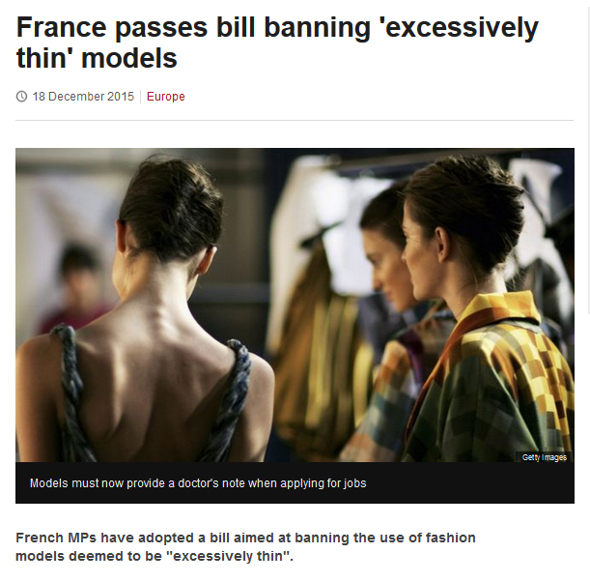
http://www.bbc.com/news/world-europe-35130792

Slide 25
Understanding Global Cultures
. . . and to understand a phenomena in terms of both physical and cultural aspects
. . .
. . . ultimately involves lots of subdisciplines . . .

Slide 26
ANTH 1080
GLOBAL CULTURES

Slide 27
NOTE:
There are four levels . . .
(REM: read from the bottom up)

Slide 32
HOLISM
Involves all four levels
and all
of the physical and cultural
components combined

Slide 33
holism
URL link to print: https://www.d.umn.edu/cla/faculty/troufs/anth1602/pchoebel.html#title

Slide 34
holism
holism

Slide 35
Anthropology

Slide 36
source

Slide 37
REM
. . . the two main divisions
of Anthropology are
Bio-physical and Cultural . . .

Slide 38
Understanding Global Cultures
Anthropology
URL link to print: https://www.d.umn.edu/cla/faculty/troufs/anth1602/pchoebel.html#title

Slide 39
Anthropology
Bio-physical
URL link to print: https://www.d.umn.edu/cla/faculty/troufs/anth1602/pchoebel.html#title

Slide 40
Understanding Global Cultures
Anthropology
Bio-physical
Cultural

Slide 41
. . . but, as mentioned above, ultimately anthropologists seek to study phenomena in terms of both physical and cultural aspects
. . .

Slide 42
Understanding Global Cultures
Anthropology
Bio-physical
Cultural

Slide 43
as in the example mentioned above, numerous studies have shown that exposure to images [cultural] of ultrathin models can lead to body dissatisfaction and eventually to unhealthy eating behaviors and physical illness [physical] . . .
The Cultural Feast, 2nd ed., p. 115

Slide 44
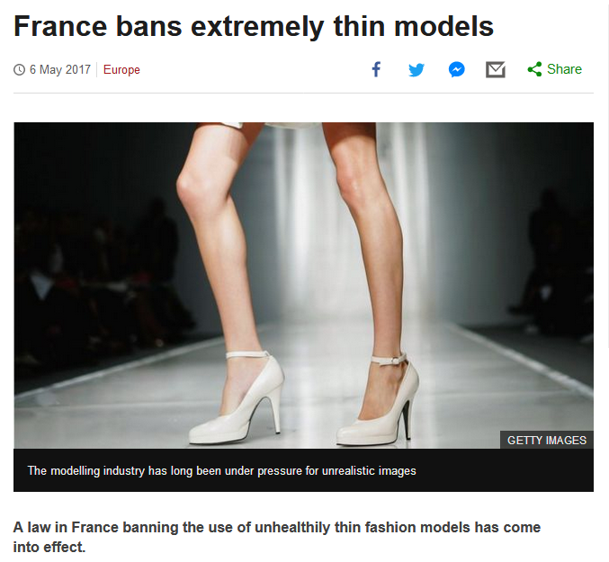
http://www.bbc.com/news/world-europe-39821036http://www.bbc.com/news/world-europe-39821036

Slide 45
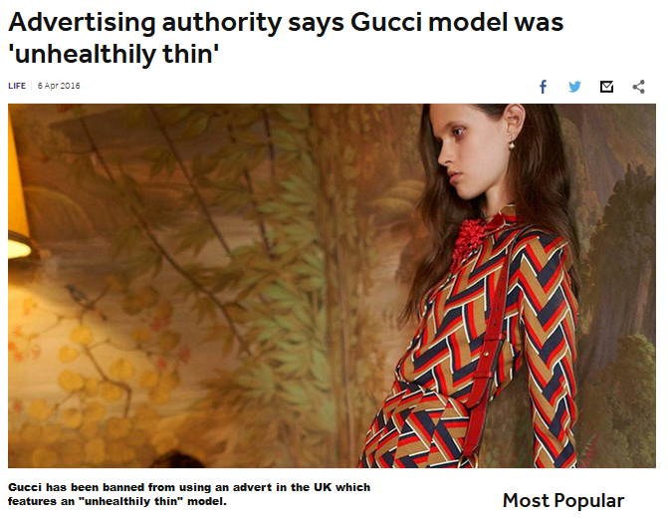
http://www.bbc.co.uk/newsround/35979565

Slide 46
Understanding Global Cultures
. . . and to understand a phenomena in terms of both physical and cultural aspects
. . .
. . . ultimately involves lots of disciplines and subdisciplines . . .

Slide 47
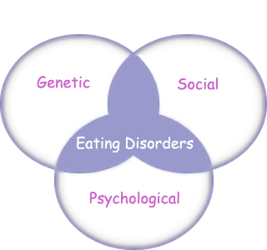
“Eating Disorders are about feelings, not food.”
The Eating Disorder Foundation
www.eatingdisorderfoundation.org/EatingDisorders.htm

Slide 48
. . . and that ultimately involves lots of subdisciplines . . .

Slide 49
Understanding Global Cultures
Anthropology
Bio-physical
Cultural

Slide 50
Understanding Global Cultures
Anthropology
Bio-physical
Cultural
measuring

Slide 51
Understanding Global Cultures
Anthropology
Bio-physical
Cultural
measuring
excavating

Slide 52
Understanding Global Cultures
Anthropology
Bio-physical
Cultural
measuring
excavating
participant /
observation

Slide 53
Understanding Global Cultures
Anthropology
Bio-physical
Cultural
body
size/shape,
etc.
measuring
excavating
participant /
observation

Slide 54
Understanding Global Cultures
Anthropology
Bio-physical
Cultural
body
size/shape,
etc.
nutrition,
etc.
measuring
excavating
participant /
observation

Slide 55
Understanding Global Cultures
Anthropology
Bio-physical
Cultural
body
size/shape,
etc.
nutrition,
etc.
hunting /
meat eating
measuring
excavating
participant /
observation

Slide 56
Understanding Global Cultures
Anthropology
Bio-physical
Cultural
body
size/shape,
etc.
nutrition,
etc.
hunting /
meat eating
the
“Agricultural
Revolution”
measuring
excavating
participant /
observation

Slide 57
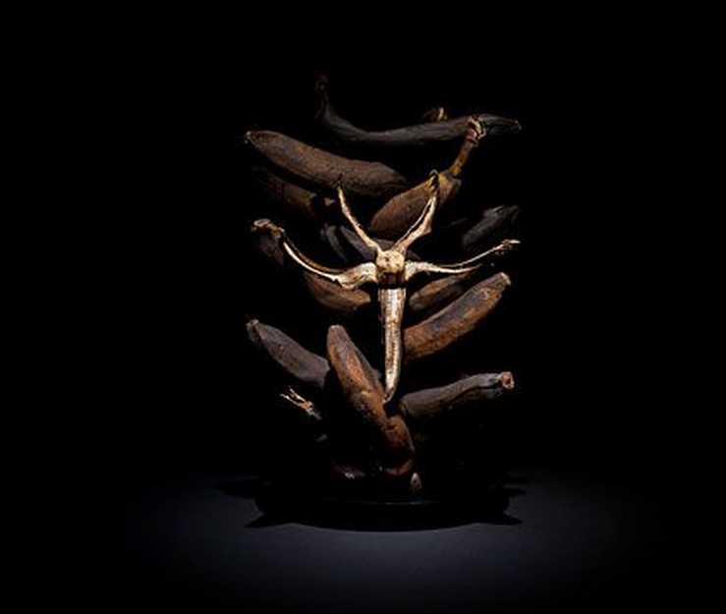

Slide 58
Understanding Global Cultures
Anthropology
Bio-physical
Cultural
body
size/shape,
etc.
nutrition,
etc.
hunting /
meat eating
the
“Agricultural
Revolution”
art
literature, etc.
measuring
excavating
participant /
observation

Slide 59
Understanding Global Cultures
Anthropology
Bio-physical
Cultural
body
size/shape,
etc.
nutrition,
etc.
hunting /
meat eating
the
“Agricultural
Revolution”
art
literature, etc.
kinship,
beliefs, etc.
measuring
excavating
participant /
observation

Slide 60
Understanding Global Cultures
Anthropology
Bio-physical
Cultural
body
size/shape,
etc.
nutrition,
etc.
hunting /
meat eating
the
“Agricultural
Revolution”
art
literature, etc.
kinship,
beliefs, etc.
language, history, structure, world view, etc.
measuring
excavating
participant /
observation

Slide 61
some examples of holistic comparative work include . . .

Slide 62
Penguin Avery, 2009

Slide 63
“I’m one of the few experts—if not the only expert—to have conducted large-scale, longitudinal surveys following obesity on a global scale.” (p. 2)
Penguin Avery, 2009

Slide 64
Barry Popkin’s work looks at . . .
(Trivia: Barry is from Superior, WI, and includes Superior in his comparisons in this book)

Slide 65
Understanding Global Cultures
Anthropology
Bio-physical
Cultural
body
size/shape,
etc.
nutrition,
etc.
hunting /
meat eating
the
“Agricultural
Revolution”
art
literature, etc.
kinship,
beliefs, etc.
language, history, structure, world view, etc.
measuring
excavating
participant /
observation

Slide 66
holism
holism

Slide 67
In some ways this chart business is all about
Theory
but key theory that is important to understanding Global Cultures

Slide 68
Understanding Global Cultures
theory
holism

Slide 69
Understanding Global Cultures
theory
holism
and the theory ultimately also includes the
results of interdisciplinary study,
esp. with history, biological studies, economics, marketing . . .

Slide 70
theory
One excellent example of holism in action is
Nassim Nicholas Taleb’s
INCERTO. . .

Slide 71
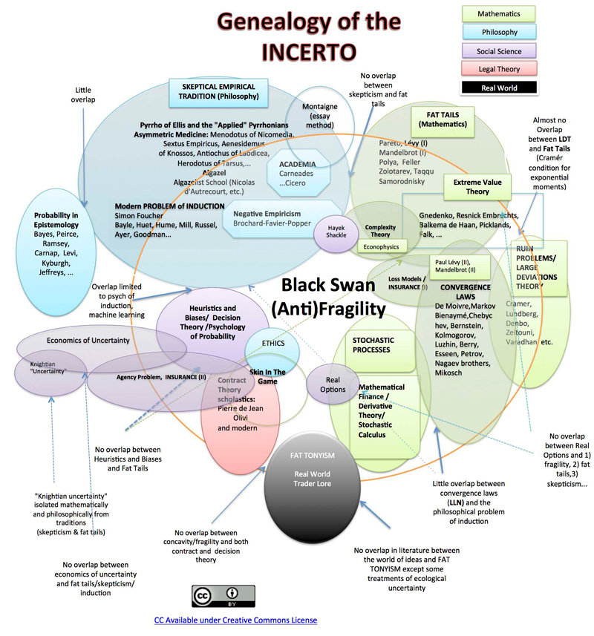

Slide 72
Main Characteristics
in a Nutshell

Slide 73
Main Characteristics of Anthropology
1. the four fields of general anthropology
culture as a primary concept
comparative method as major approach
holism as a primary theoretical goal
Anthropology and its Parts chart
fieldwork as a primary research technique

Slide 74
ANTH 1080
Global Cultures
The End
Main
Characteristics of
Anthropology
© 2010-2024 Timothy G. Roufs, University of Minnesota Duluth

