Slide 1
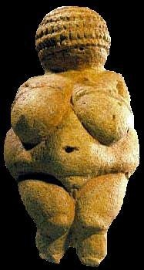

https://www5.nationalgeographic.com/genographic/
Tim Roufs
© 2012-2013

Slide 2

Ask Marilyn®
By Marilyn vos Savant
21 September 2008
Could A DNA Test Help You?
—By Dr. Ranit Mishori
Would you like to catch a glimpse of your own medical future? There are now DNA tests for more than 1500 diseases. By analyzing a sample of hair or blood or a swab of your cheek, researchers can determine the probability that your children will have cystic fibrosis or Fanconi anemia as well as predict the odds that, later in your own life, you will develop Alzheimer’s, cancer, or schizophrenia. . . .
www.washingtonpost.com/wp-dyn/content/article/2008/07/08/AR2008070802787.html
Notes:
2

Slide 3
DNA research
has become
increasingly important
in
Prehistoric Cultures
studies
Notes:
3

Slide 4
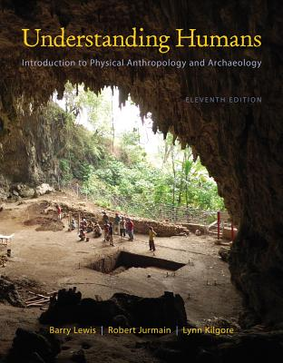

DNA research
has become
Increasingly important
in
Prehistoric Cultures
Prehistoric Cultures
University of Minnesota Duluth
Tim Roufs
© 2010-2013
http://www.d.umn.edu/cla/faculty/troufs/anth1602/

Slide 5
. . . throughout the text
you will find
information on DNA
in Ch. 3, for e.g.,
“Heredity and Evolution”
and results of DNA research...
in Ch. 12, for e.g.,
“The Origin and Dispersal of Modern Humans”

Slide 6

Did We Come Out of Africa?
Studies Collide”
“Out of Africa”
[“Replacement Theory”]
vs.
“Multi-Regional” Theory
New York Times
(12 January 2001)
Some of the earlier DNA research
by Rebecca Caan (1988)
resulted in the . . .

Slide 7
Resulting in the argument concerning
”Mitochondrial Eve” . . .
“Did We Come Out of Africa?
Studies Collide”
“Out of Africa”
[“Replacement Theory”]
vs.
“Multi-Regional” Theory
New York Times
(12 January 2001)

Slide 8
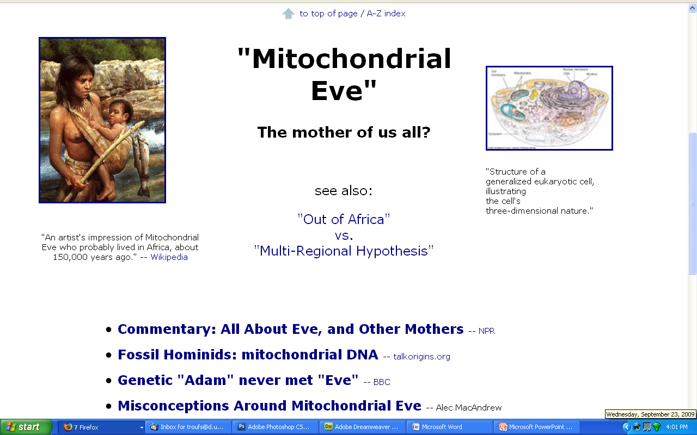
www.d.umn.edu/cla/faculty/troufs/anth1602/pcmitochondrialeve.html#title

Slide 9
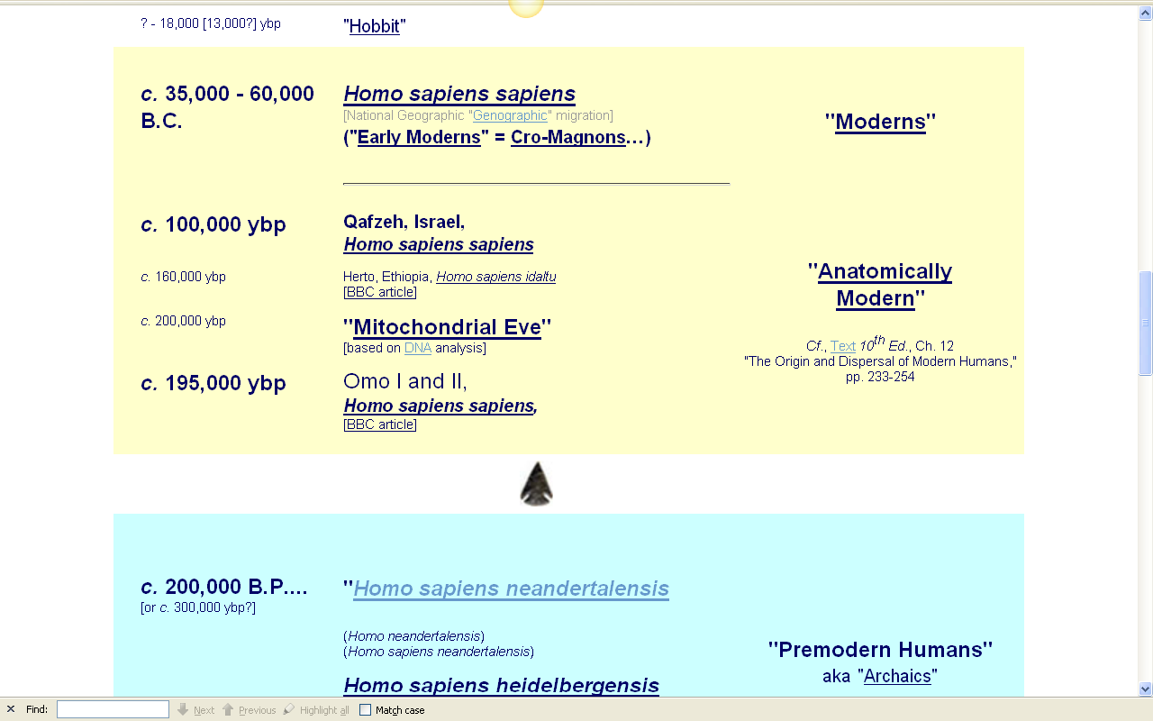
NG Genographic migration
www.d.umn.edu/cla/faculty/troufs/anth1602/pctimes.html#title

Slide 10
Resulting in the argument concerning
”Mitochondrial Eve”…
“Did We Come Out of Africa?
Studies Collide”
“Out of Africa”
[“Replacement Theory”]
vs.
“Multi-Regional” Theory
New York Times
(12 January 2001)

Slide 11
“Did We Come Out of Africa?
Studies Collide”
“Out of Africa”
[“Replacement Theory”]
vs.
“Multi-Regional” Theory
New York Times
(12 January 2001)
”Mitochondrial Eve” is related to the . . .
. . . where “Mitochondrial Eve” and
her folks are thought to have
left Africa ca. 150,000 – 200,000 ybp
and “replaced” everyone elsewhere . . .

Slide 12
“Did We Come Out of Africa?
Studies Collide”
“Out of Africa”
[“Replacement Theory”]
vs.
“Multi-Regional” Theory
New York Times
(12 January 2001)
”Mitochondrial Eve” is related to the …
. . . where “Mitochondrial Eve” and
her folks are thought to have
left Africa ca. 150,000 – 200,000 ybp
and “replaced” everyone elsewhere . . .

Slide 13
. . . “everyone elsewhere” . . .
are the descendents of an earlier wave
of migration out of Africa
involving the Homo erectus group,
about 1.8 mya
The Homo erectus people
were the first humans
to migrate out of Africa . . .

Slide 14
. . . “everyone elsewhere” . . .
are the descendents of an earlier wave
of migration out of Africa
involving the Homo erectus group,
about 1.8 mya
The Homo erectus people
were the first humans
to migrate out of Africa . . .

Slide 15
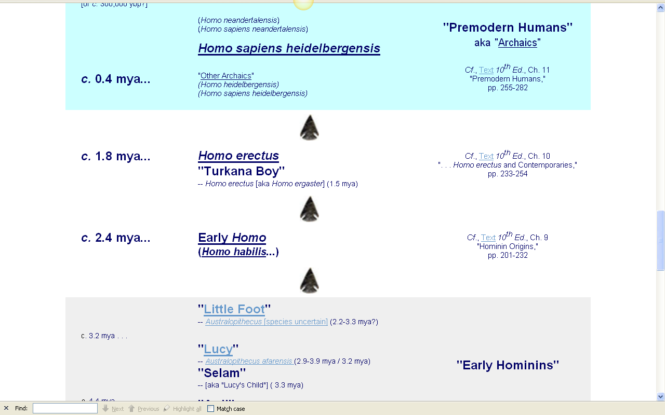
www.d.umn.edu/cla/faculty/troufs/anth1602/pctimes.html#title

Slide 16
involves the migration out of Africa
ca. 50,000 – 60,000 ybp
and is thus
at least the third wave . . .
https://www5.nationalgeographic.com/genographic/

Slide 17
NG Genographic migration
involves the migration out of Africa
ca. 50,000 – 60,000 ybp
and is thus
at least the third . . .
https://www5.nationalgeographic.com/genographic/

Slide 18
www.d.umn.edu/cla/faculty/troufs/anth1602/pctimes.html#title

Slide 19
NG Genographic migration
www.d.umn.edu/cla/faculty/troufs/anth1602/pctimes.html#title

Slide 20
NG Genographic migration
www.d.umn.edu/cla/faculty/troufs/anth1602/pctimes.html#title

Slide 21
. . . since the appearance of “Mitochondrial Eve”
DNA research has since become important with a wide variety of
related
Prehistoric Cultures
subjects . . .

Slide 22
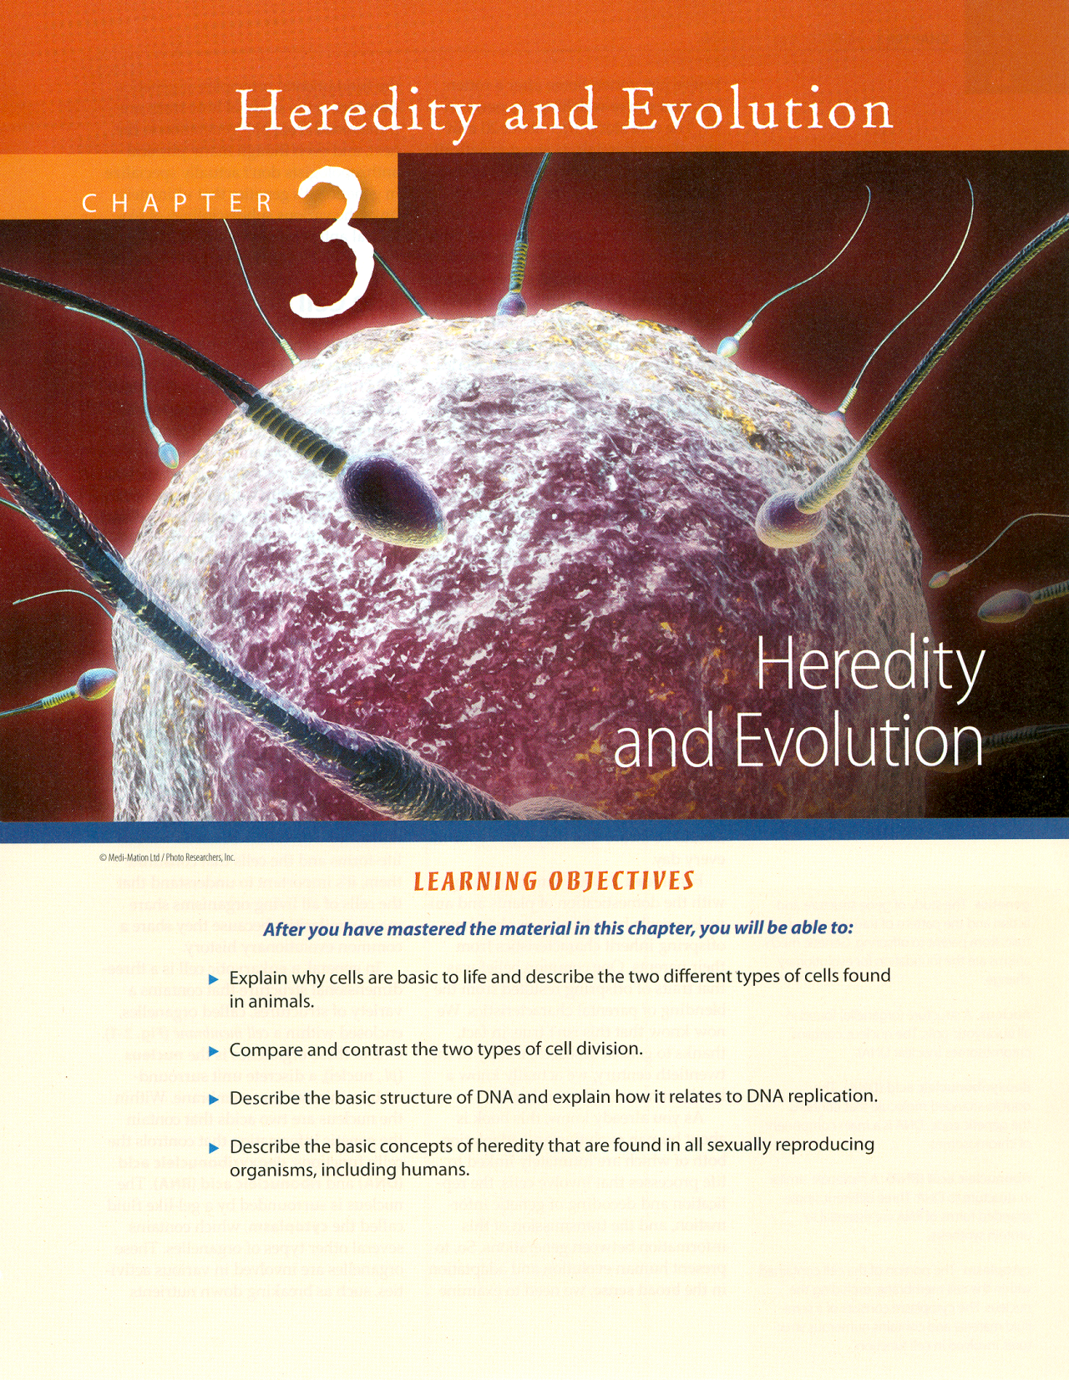
Notes:
22

Slide 23
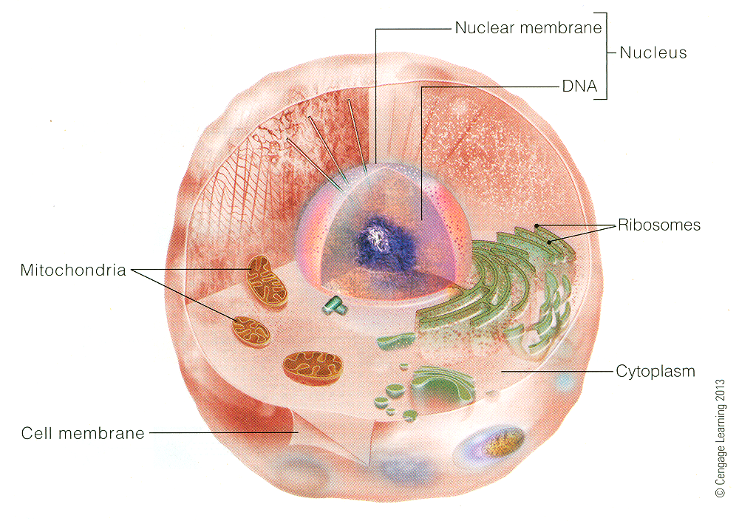
Understanding Anthropology and Archaeology, 11th edition, p. 39.

Slide 24
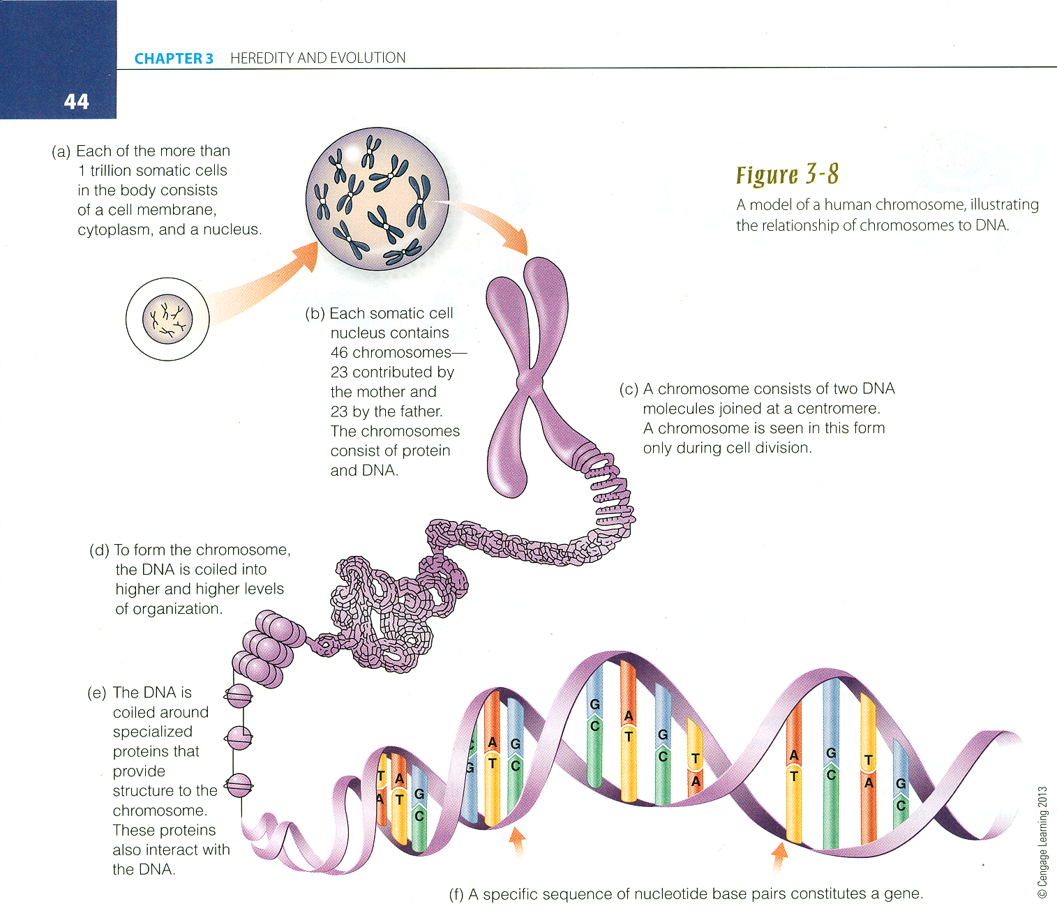
Understanding Anthropology and Archaeology, 11th edition, p. 41

Slide 25
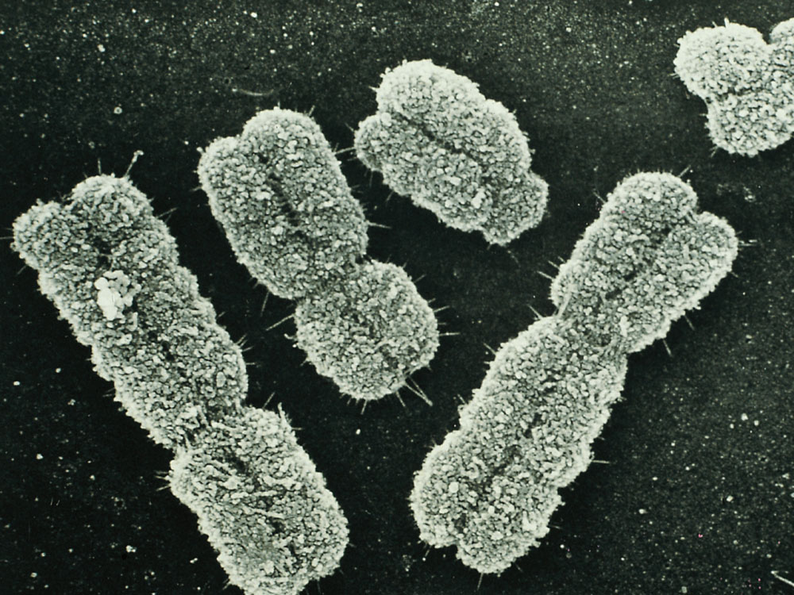
Understanding Anthropology and Archaeology, 10th edition, p. 45.

Slide 26
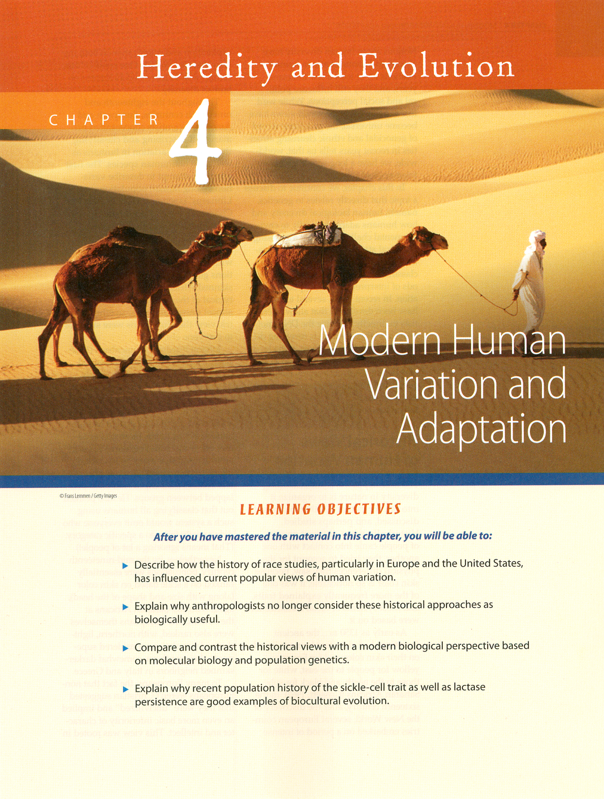
Notes:
26

Slide 27
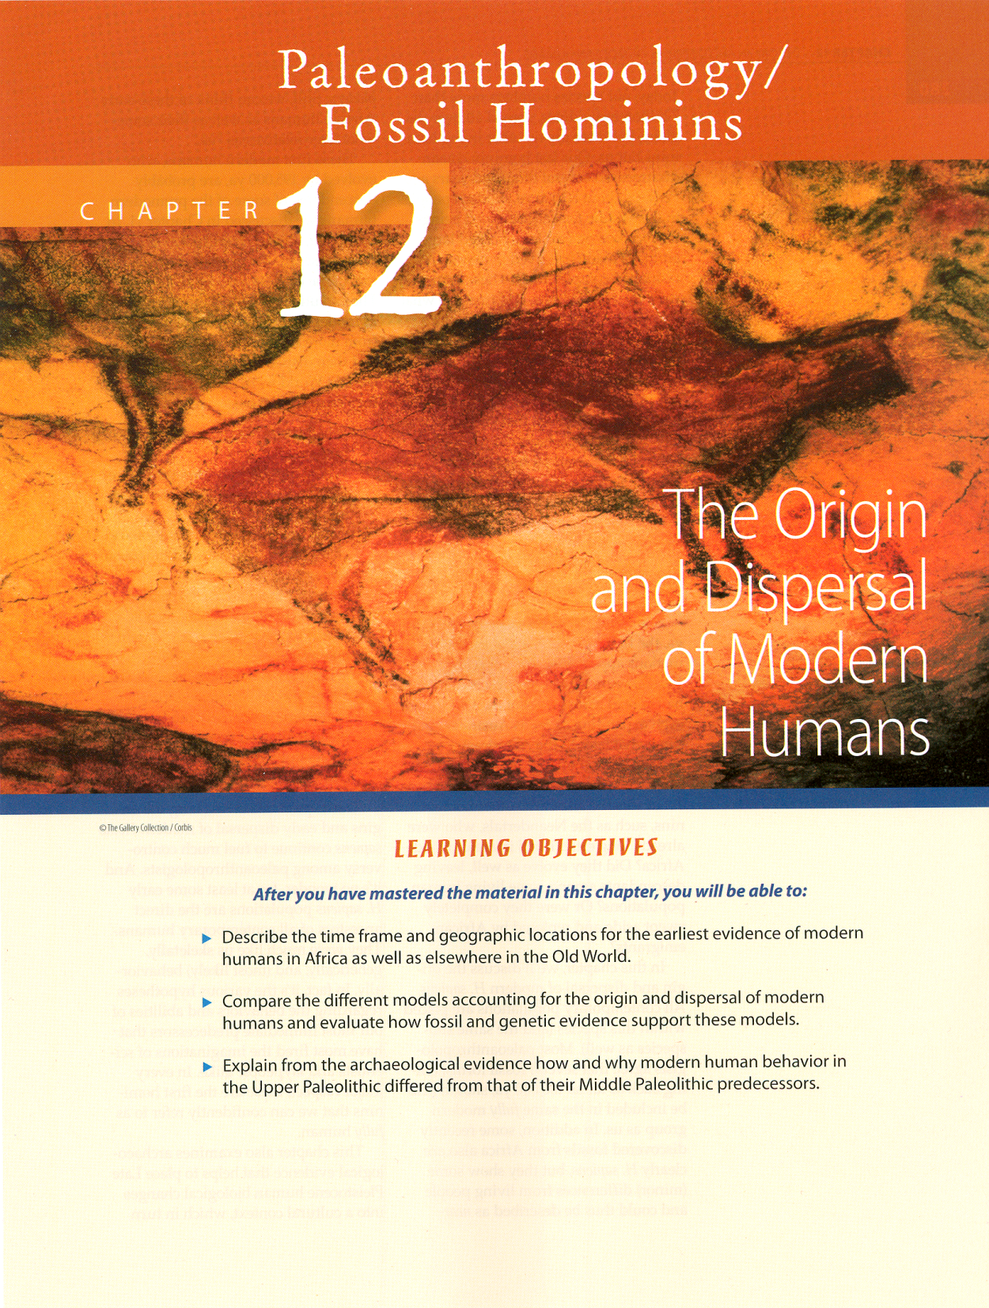
Notes:
27

Slide 28
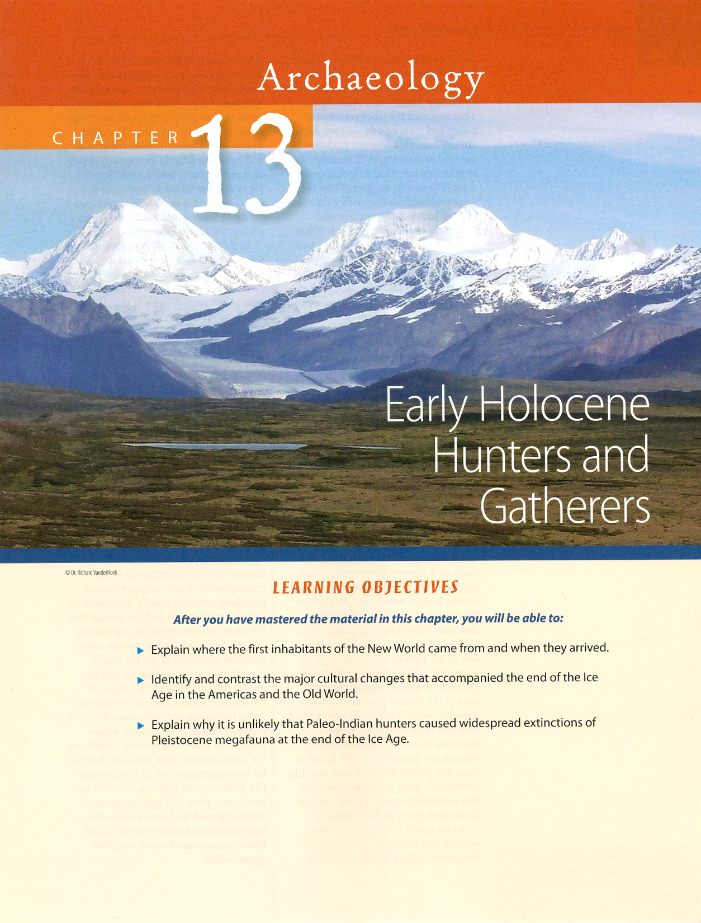
Notes:
28

Slide 29
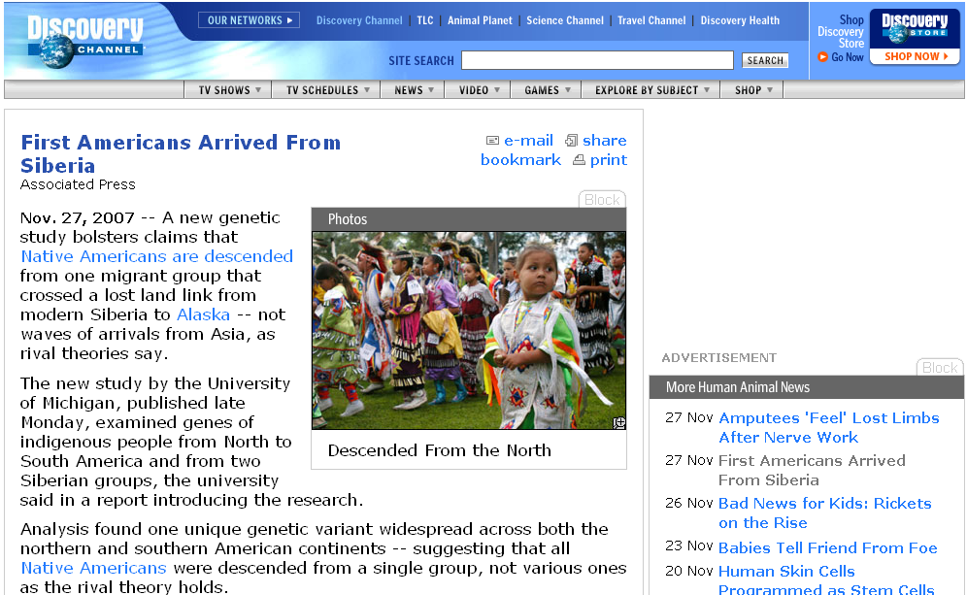
http://dsc.discovery.com/news/2007/11/27/native-america-siberia.html
Notes:
29

Slide 30
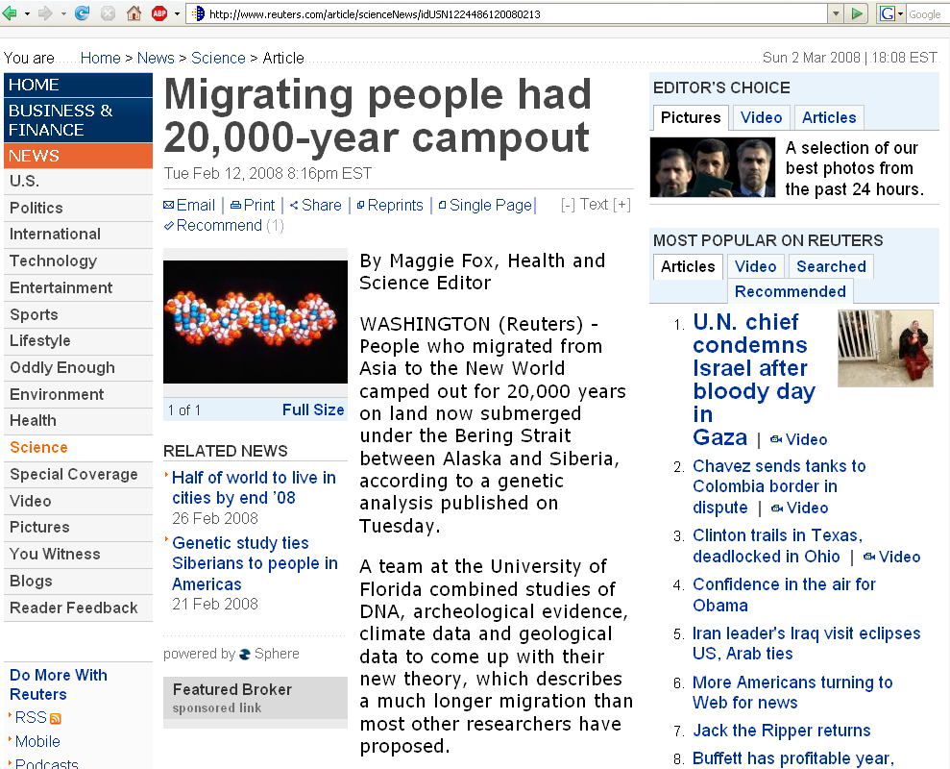
www.reuters.com/article/scienceNews/idUSN1224486120080213
Notes:
30

Slide 31
DNA research has also become important with a wide variety of
specialized
Prehistoric Cultures subjects . . .

Slide 32
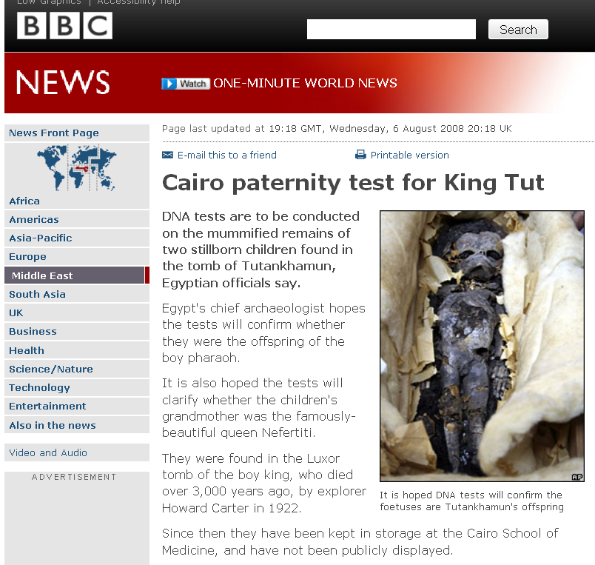
http://news.bbc.co.uk/2/hi/middle_east/7546041.stm /
Notes:
32

Slide 33
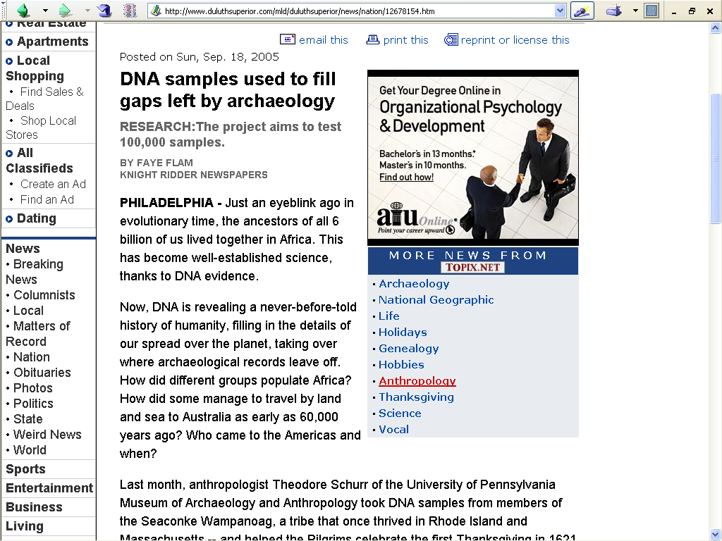
www.duluthsuperior.com/mld/duluthsuperior/news/nation/12678154.htm

Slide 34
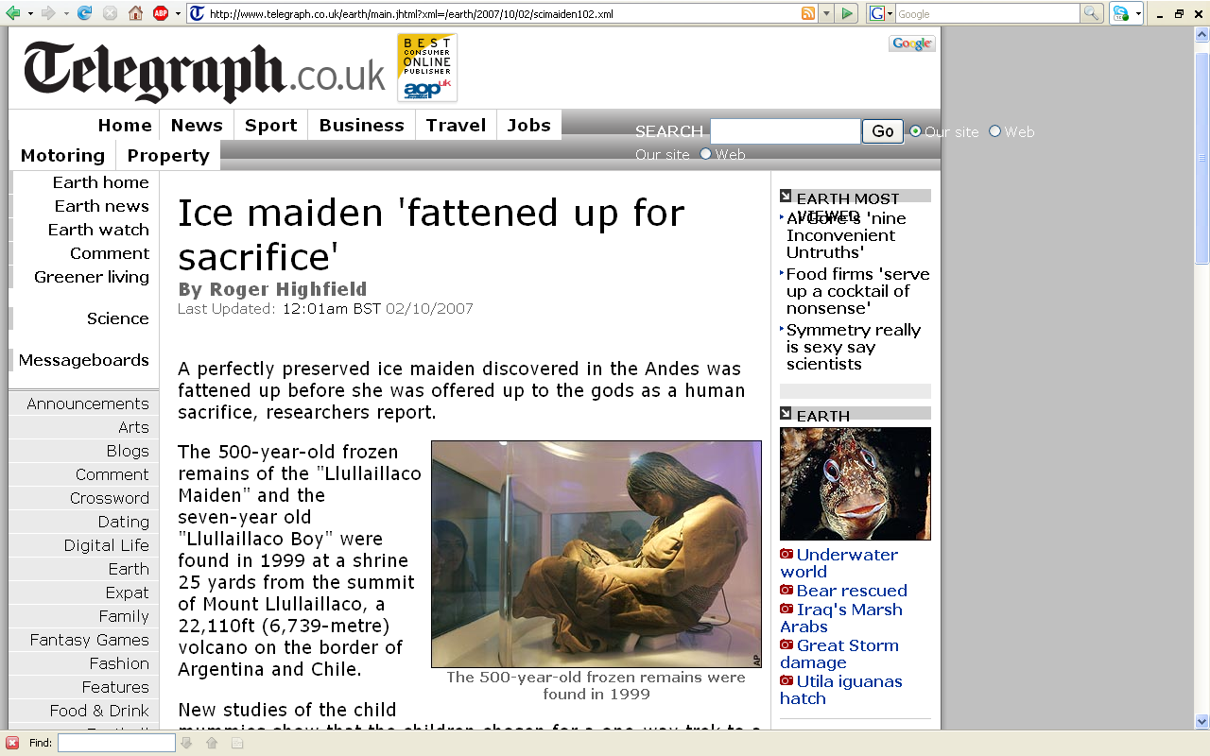
www.telegraph.co.uk/earth/main.jhtml?xml=/earth/2007/10/02/scimaiden102.xml

Slide 35
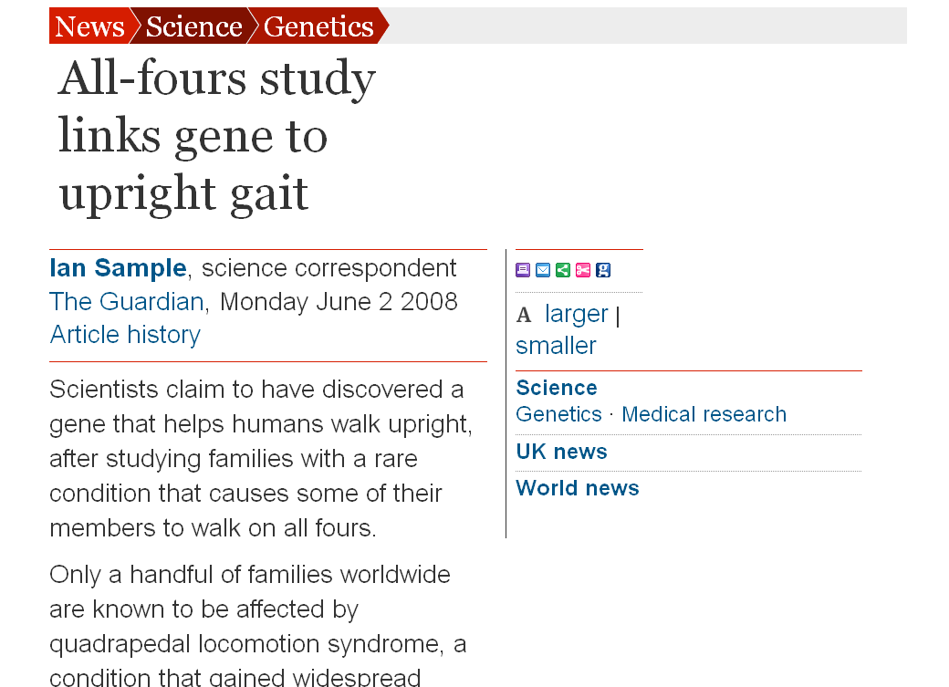
www.guardian.co.uk/science/2008/jun/02/genetics.medicalresearch
Notes:
35

Slide 36
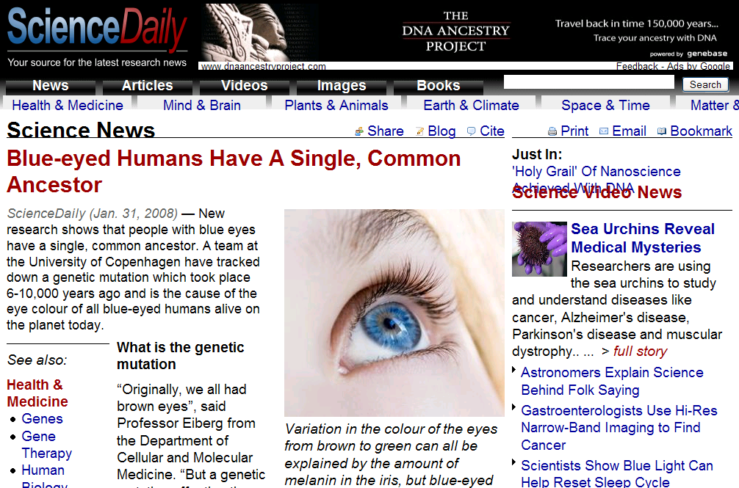
www.sciencedaily.com/releases/2008/01/080130170343.htm
Notes:
36

Slide 37
. . . since the appearance of “Mitochondrial Eve”
DNA research has since become important with a wide variety of
related
Prehistoric Cultures
subjects . . .
. . . lot of other things . . .

Slide 38
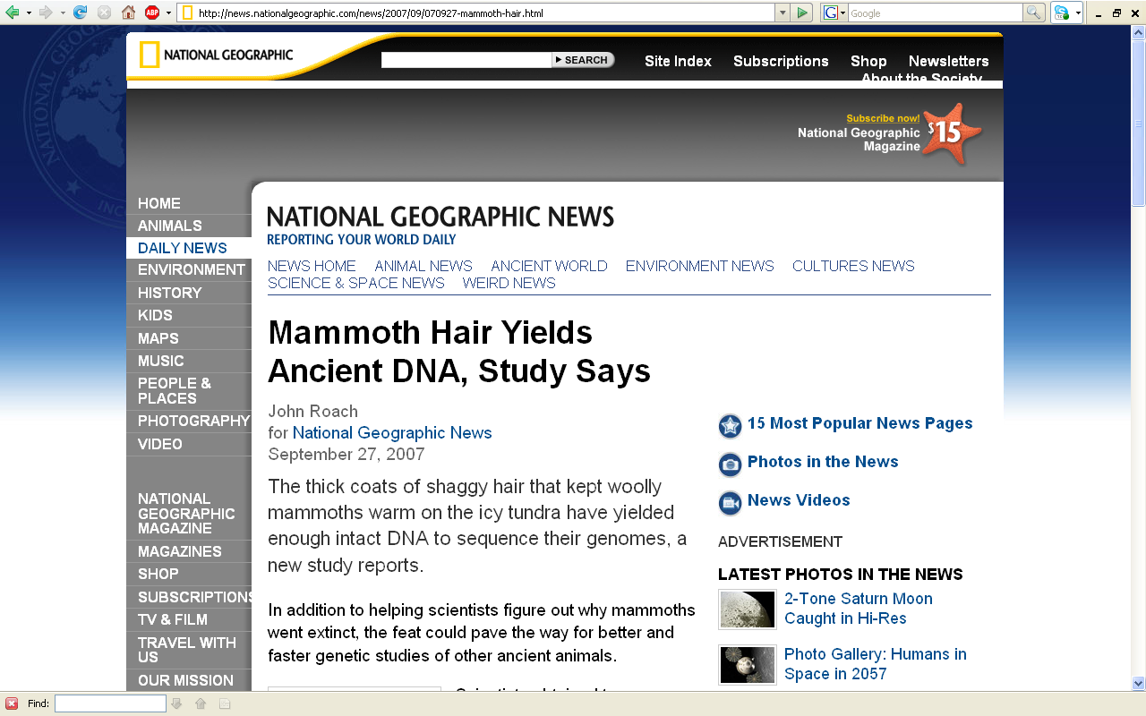
http://news.nationalgeographic.com/news/2007/09/070927-mammoth-hair.html

Slide 39
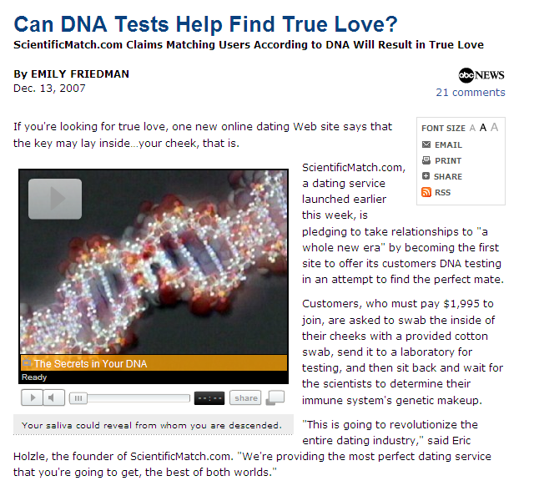
http://abcnews.go.com/Health/story?id=3991467&page=1
Notes:
39

Slide 40

www.latimes.com/news/science/la-sci-politics19-2008sep19,0,3127625,print.story

Slide 41
https://www5.nationalgeographic.com/genographic/

Slide 42
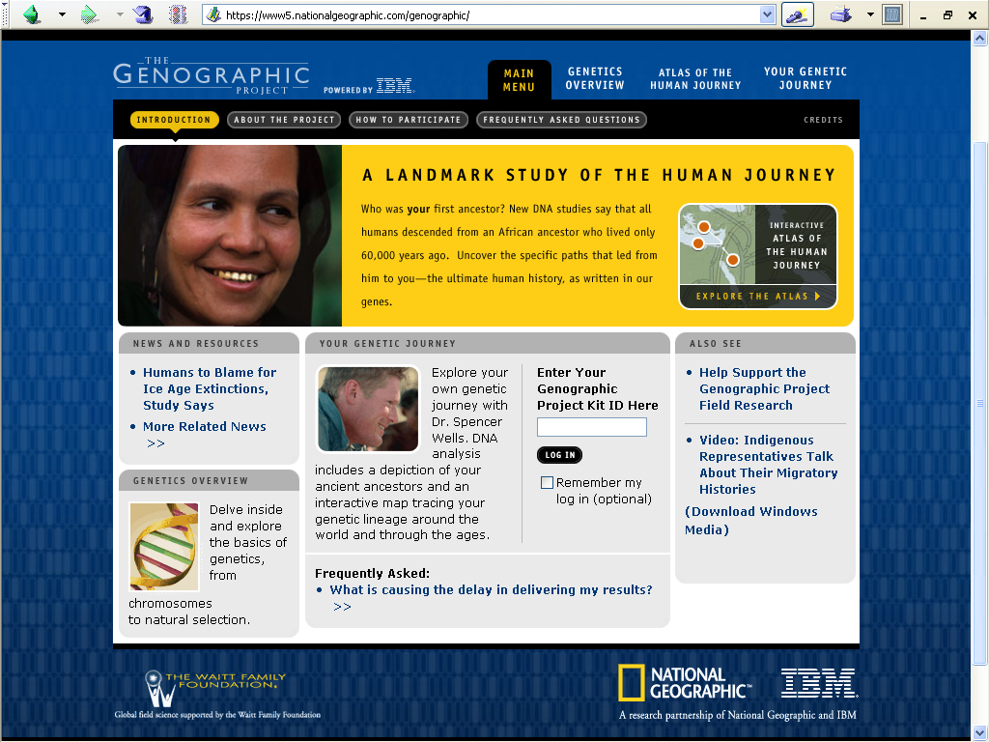
https://www5.nationalgeographic.com/genographic/

Slide 43
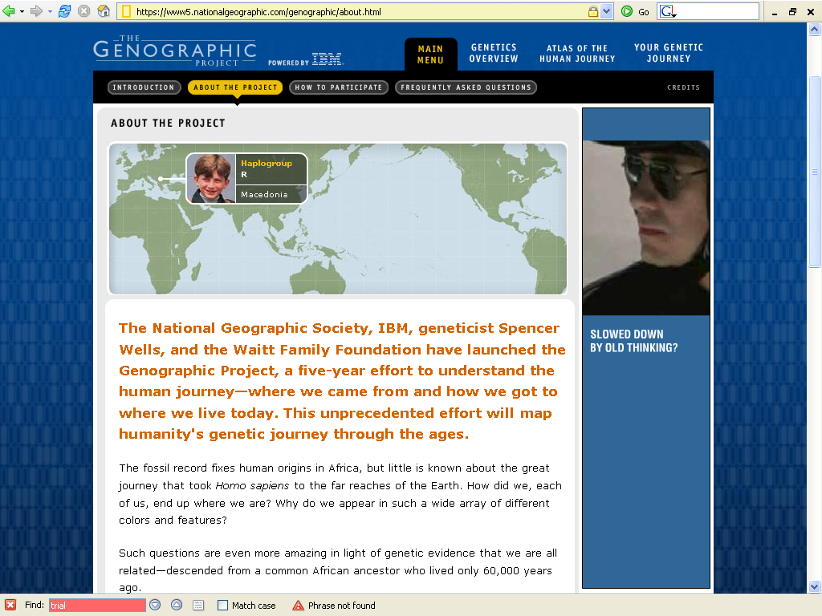
https://www5.nationalgeographic.com/genographic/about.html

Slide 44
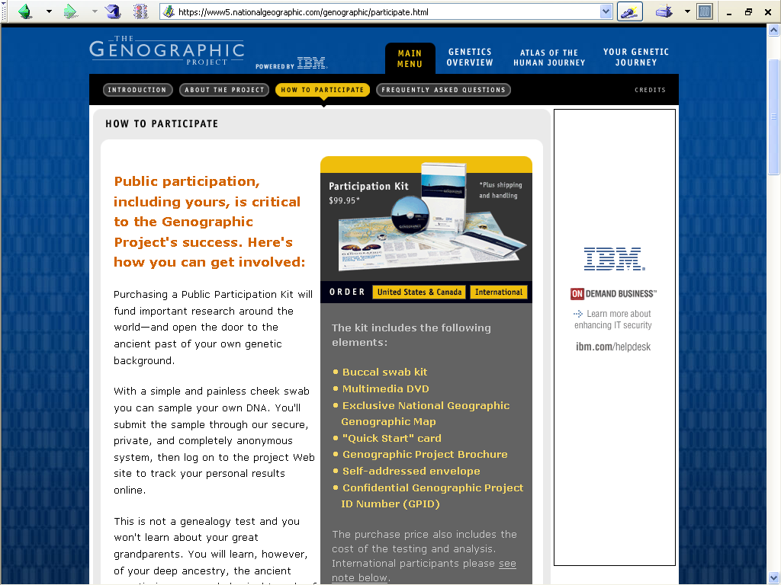
https://www5.nationalgeographic.com/genographic/participate.html

Slide 45
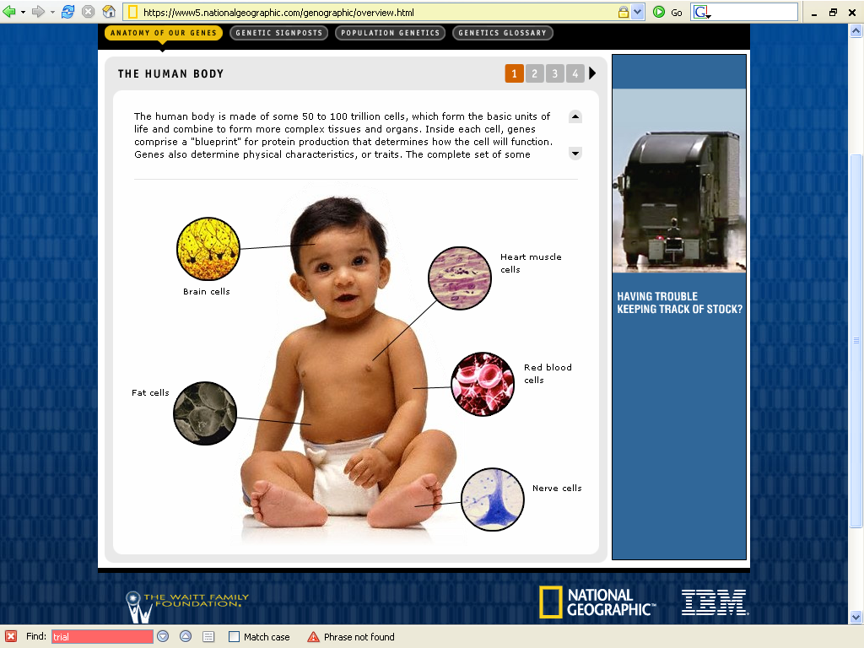
https://www5.nationalgeographic.com/genographic/overview.html

Slide 46
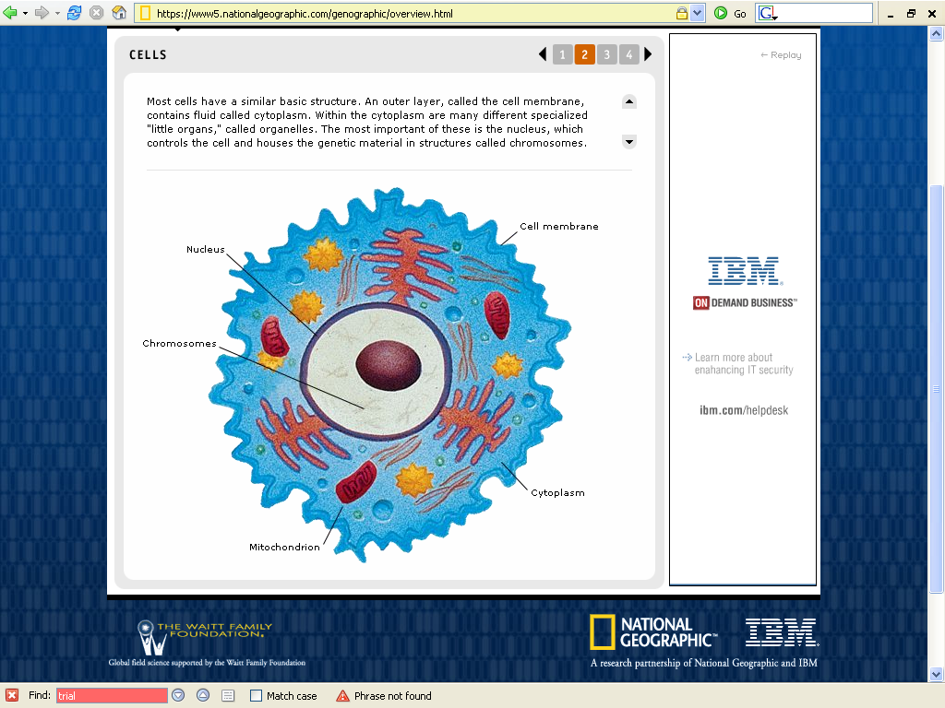
https://www5.nationalgeographic.com/genographic/overview.html

Slide 47
Understanding Anthropology and Archaeology, 11th edition, p. 39.

Slide 48
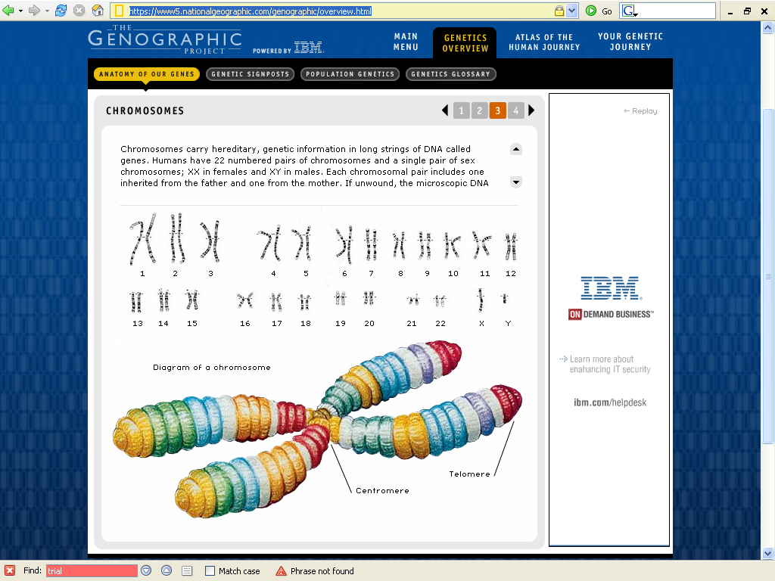
https://www5.nationalgeographic.com/genographic/overview.html

Slide 49
Understanding Anthropology and Archaeology, 10th edition, p. 45.

Slide 50
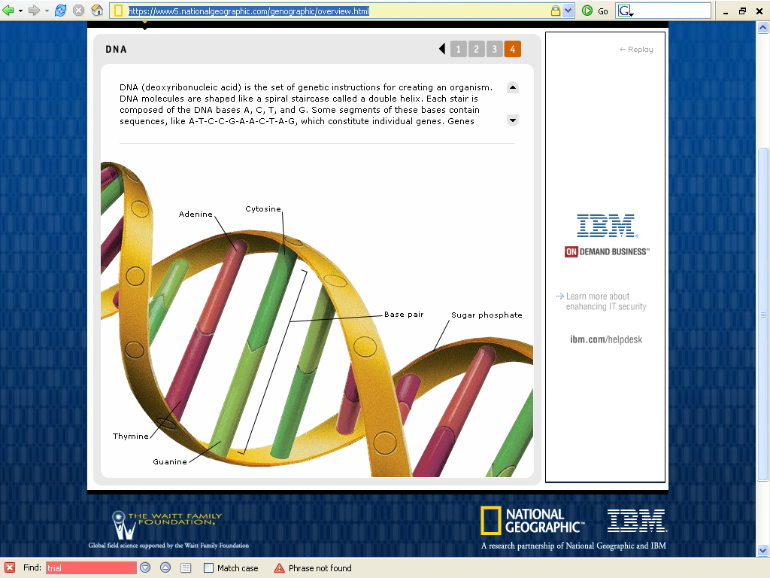
https://www5.nationalgeographic.com/genographic/overview.html

Slide 51
Understanding Anthropology and Archaeology, 11th edition, p. 41

Slide 52
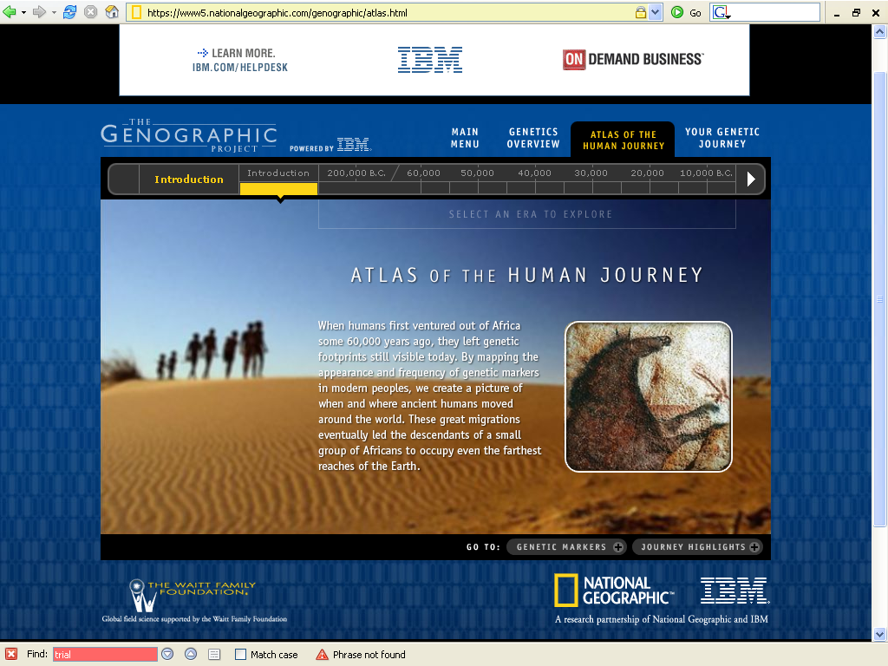
https://www5.nationalgeographic.com/genographic/atlas.html

Slide 53
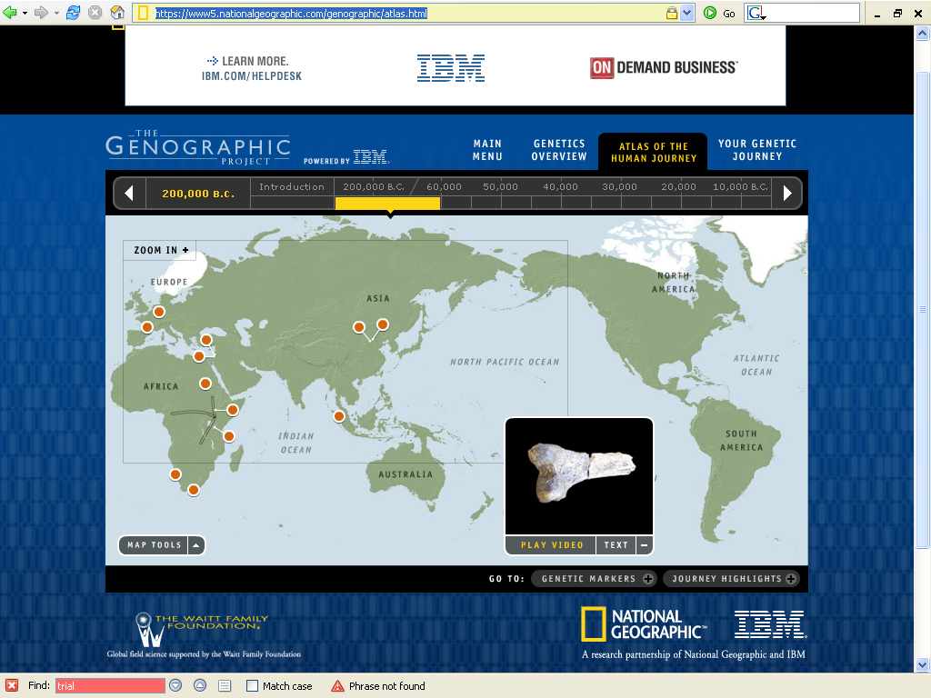
200,000 B.C.
https://www5.nationalgeographic.com/genographic/atlas.html

Slide 54
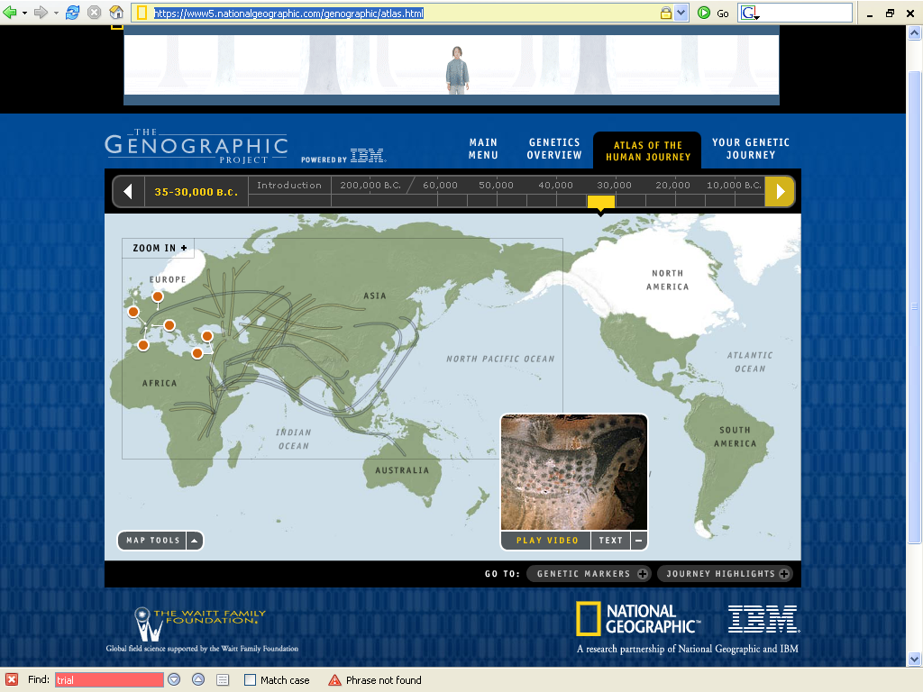
35-30,000 B.C.
https://www5.nationalgeographic.com/genographic/atlas.html

Slide 55
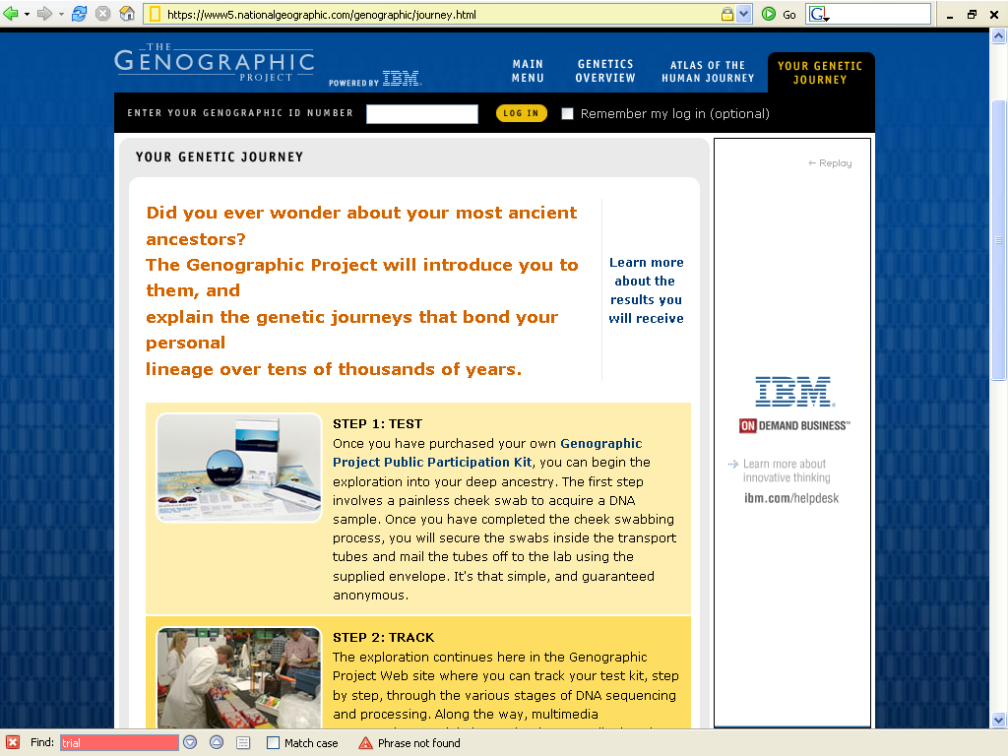
https://www5.nationalgeographic.com/genographic/journey.html

Slide 56

https://genographic.nationalgeographic.com/genographic/lan/en/index.html

Slide 57
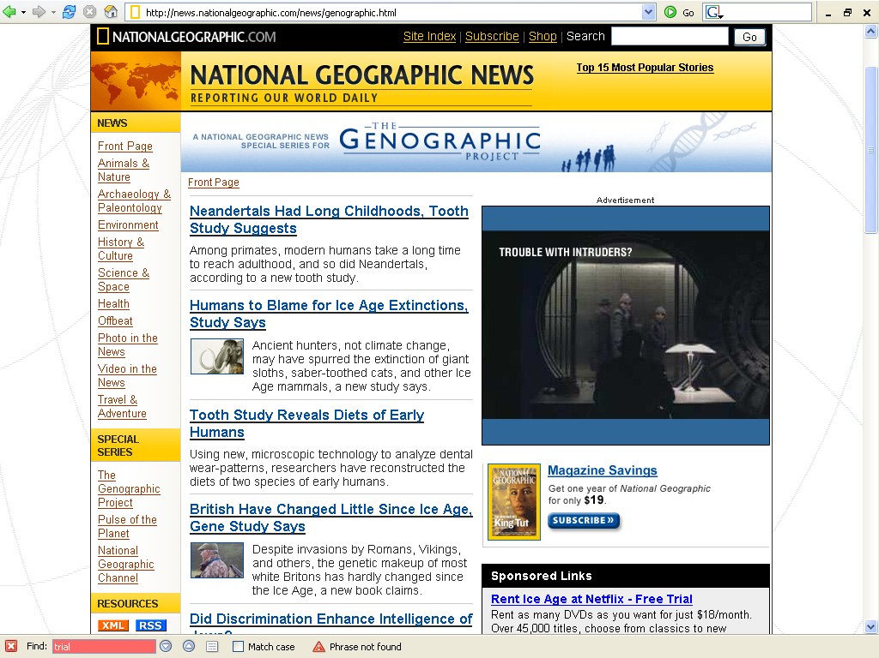
https://www5.nationalgeographic.com/genographic/

Slide 58
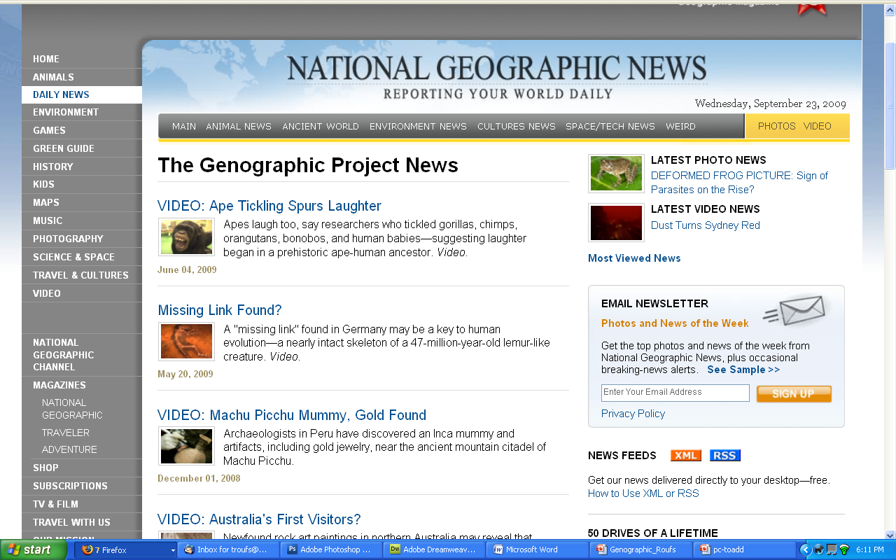
https://www3.nationalgeographic.com/genographic/resources.html

Slide 59
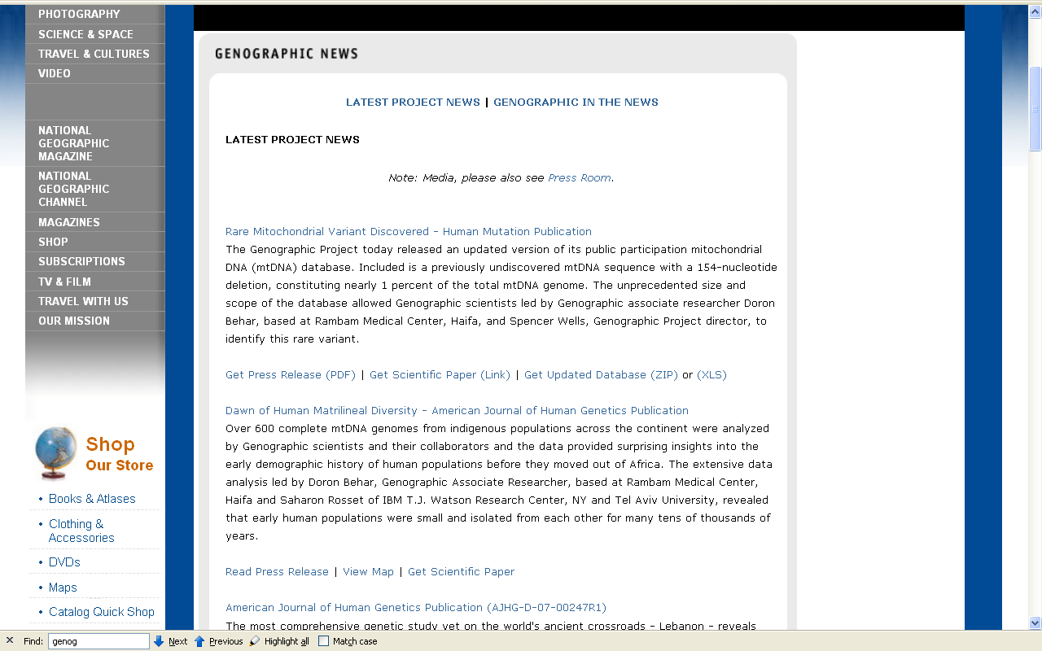
https://www3.nationalgeographic.com/genographic/resources.html

Slide 60
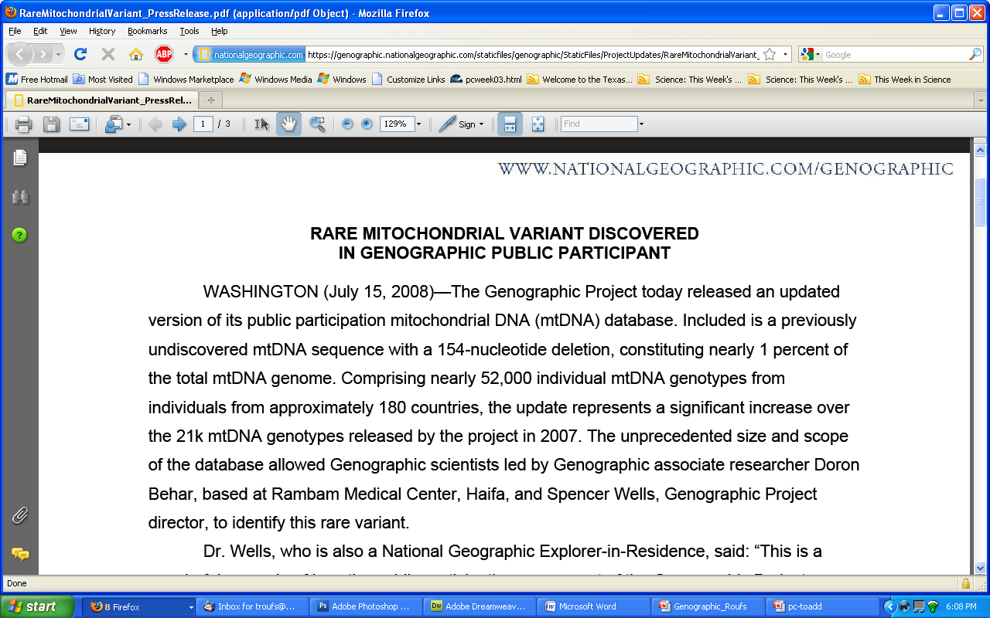
https://www3.nationalgeographic.com/genographic/resources.html

Slide 61
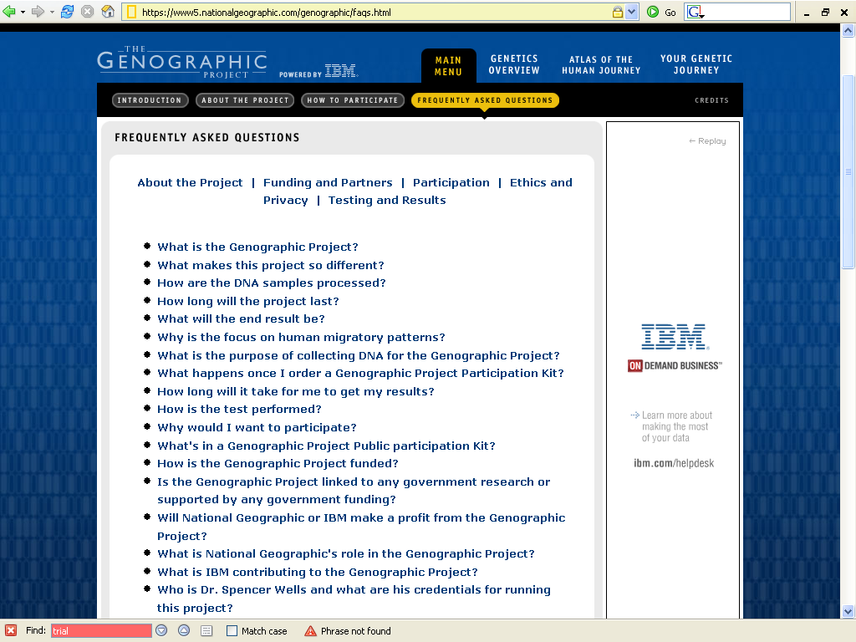
https://www5.nationalgeographic.com/genographic/faqs.html/

Slide 62
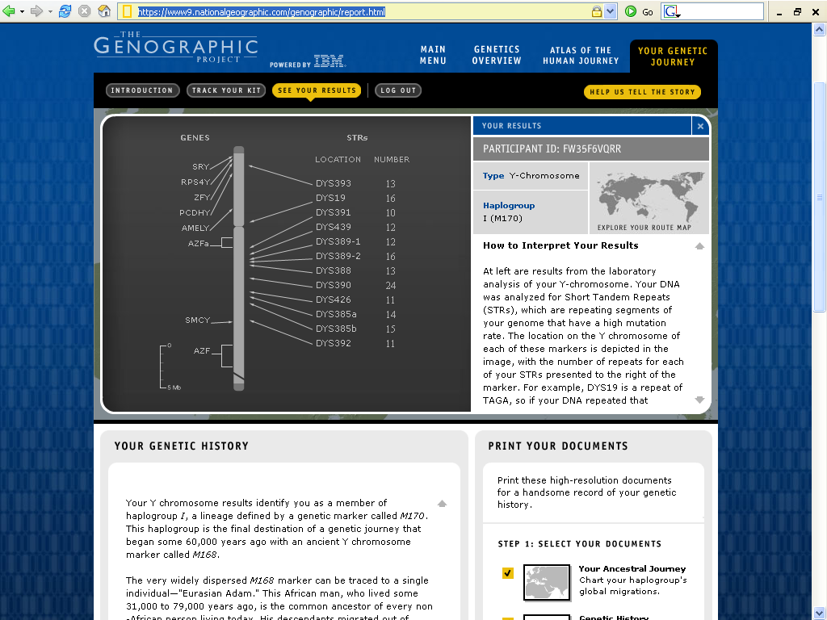
https://www9.nationalgeographic.com/genographic/report.html

Slide 63
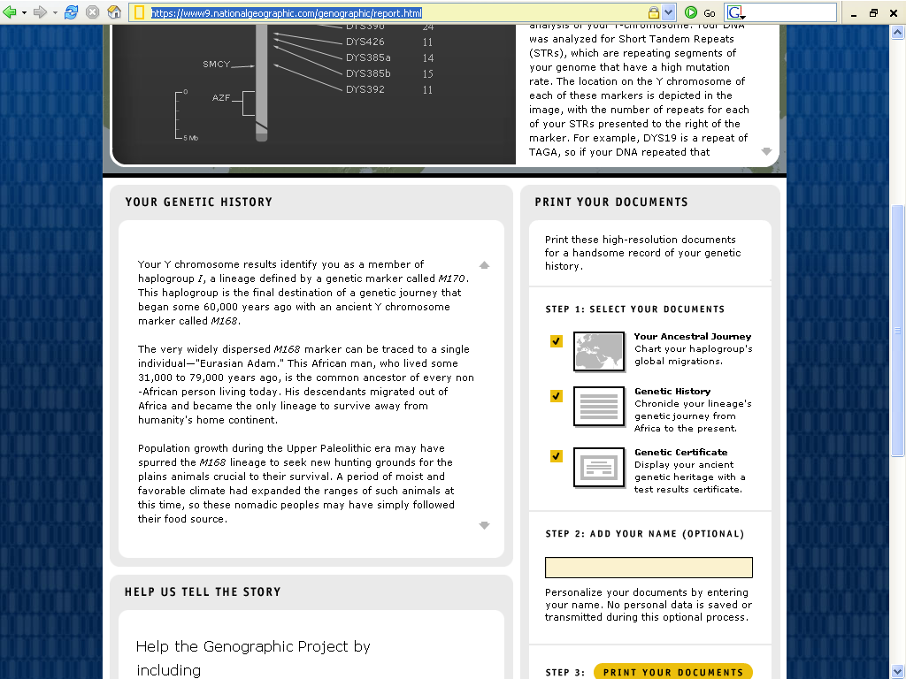
https://www9.nationalgeographic.com/genographic/report.html

Slide 64

https://www9.nationalgeographic.com/genographic/report.html

Slide 65
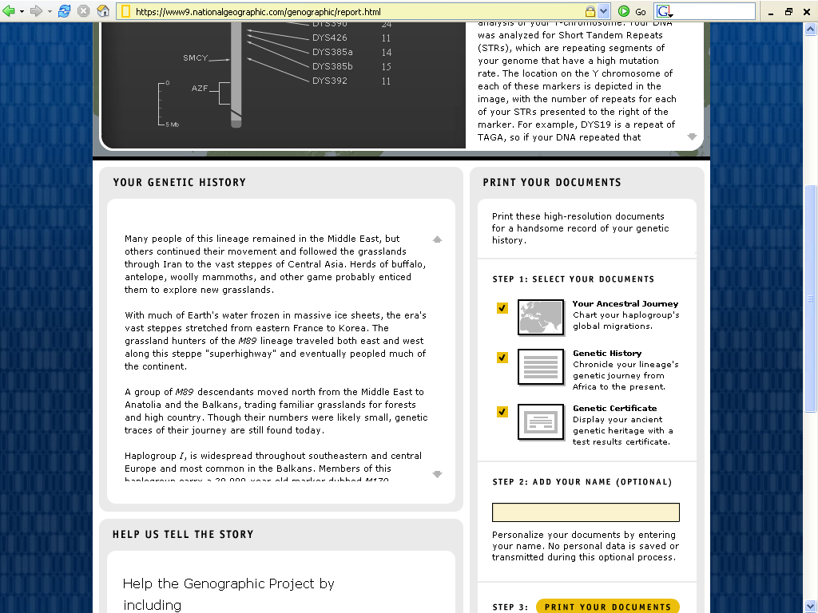
https://www9.nationalgeographic.com/genographic/report.html

Slide 66
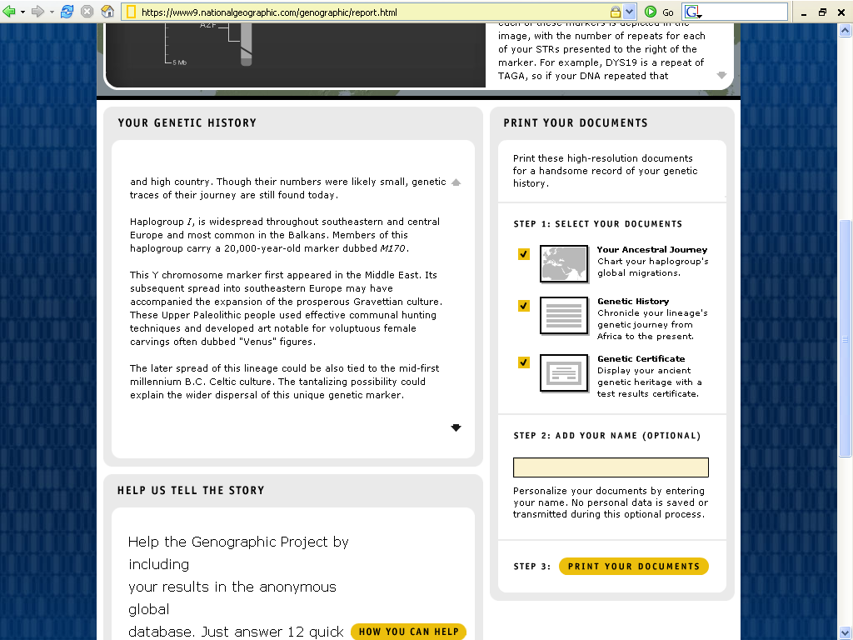
https://www9.nationalgeographic.com/genographic/report.html

Slide 67
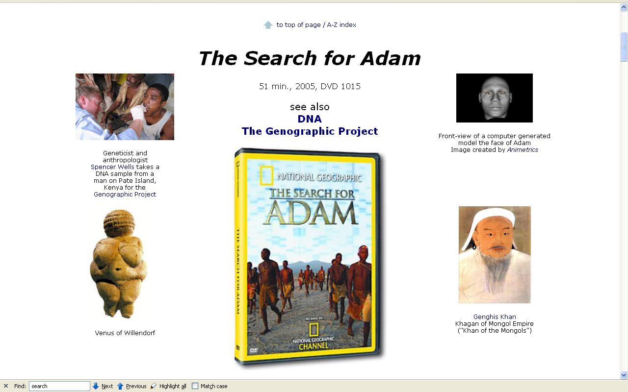
www.d.umn.edu/cla/faculty/troufs/anth1602/video/Search_for_Adam.html#title

Slide 68
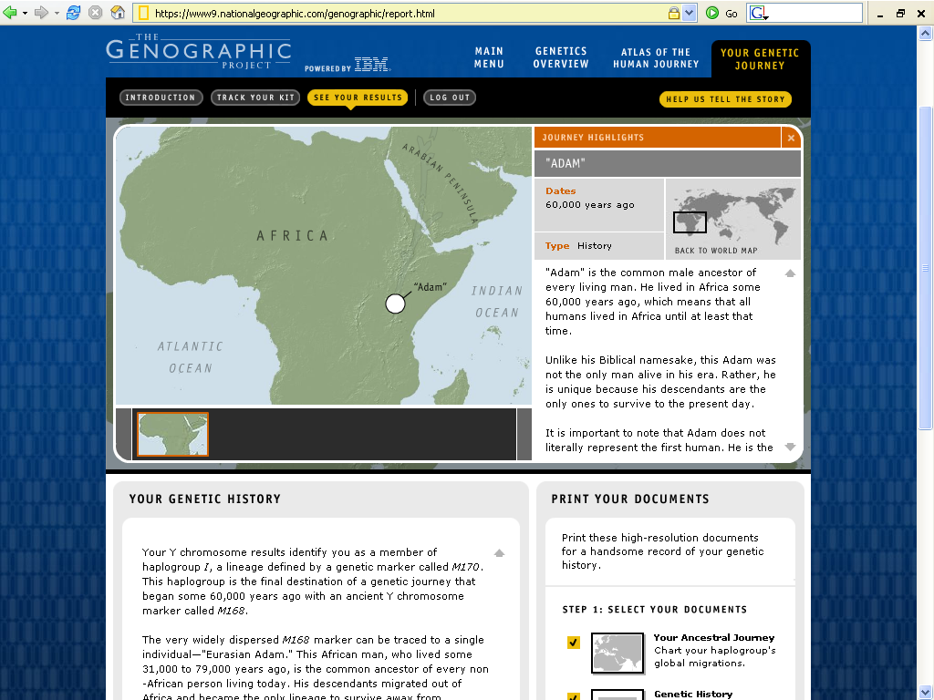
https://www9.nationalgeographic.com/genographic/report.html

Slide 69
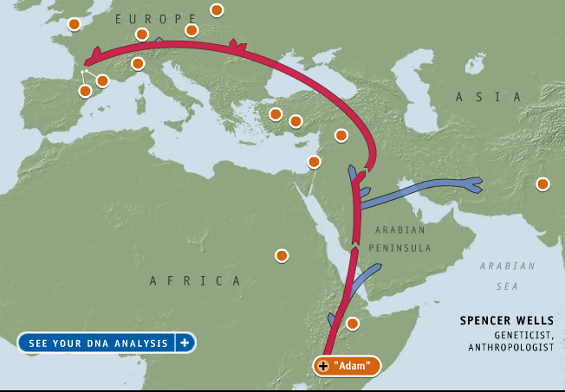
Tim Roufs
https://www9.nationalgeographic.com/genographic/report.html
Notes:
69

Slide 70

https://www9.nationalgeographic.com/genographic/report.html

Slide 71
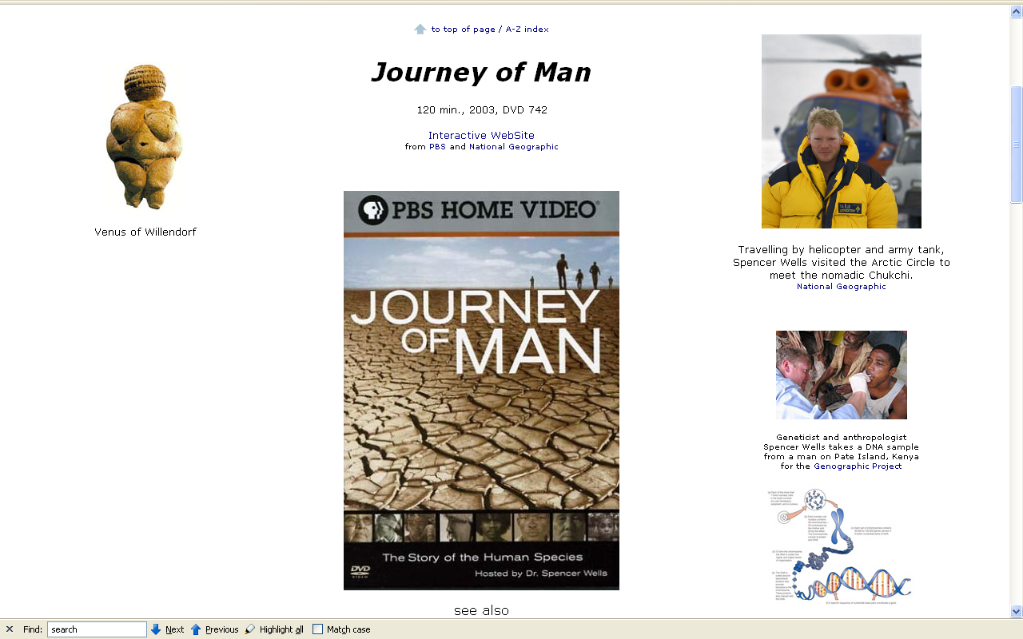
http://www.d.umn.edu/cla/faculty/troufs/anth1602/pcweek03.html#Day06

Slide 72
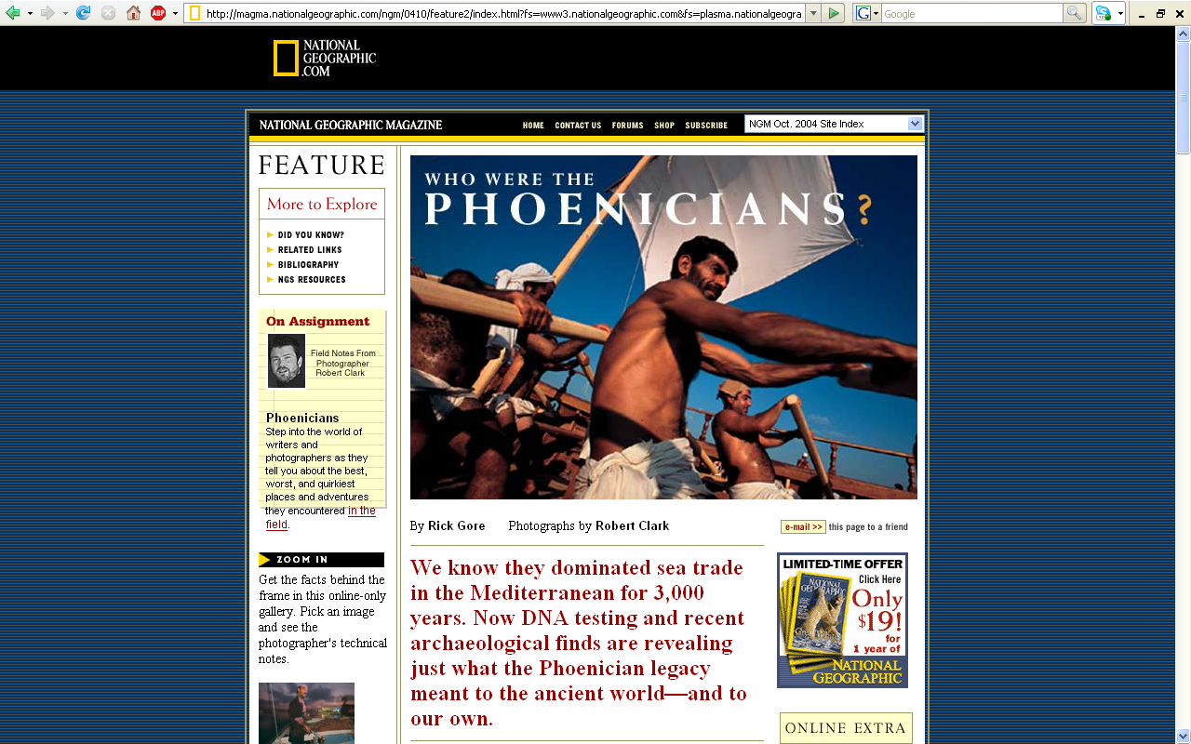
This would normally be shown
on Day 30, but with the Labor Day and Thanksgiving holidays we do not have a Day 30 this semester
It is available at the UMD Library
ca. 60 min., 2006, DVD 883
http://magma.nationalgeographic.com/ngm/0410/feature2/index.html?fs=www3.nationalgeographic.com&fs=plasma.nationalgeographic.com

Slide 73

The newest edition to the project
National Geographic (c) 2009
https://genographic.nationalgeographic.com/genographic/lan/en/index.html

Slide 74
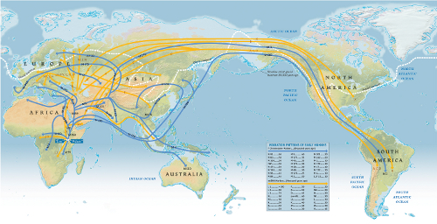
The Human Family Tree -- Generalized Migration Patterns
National Geographic (c) 2009
https://genographic.nationalgeographic.com/genographic/lan/en/index.html

Slide 75
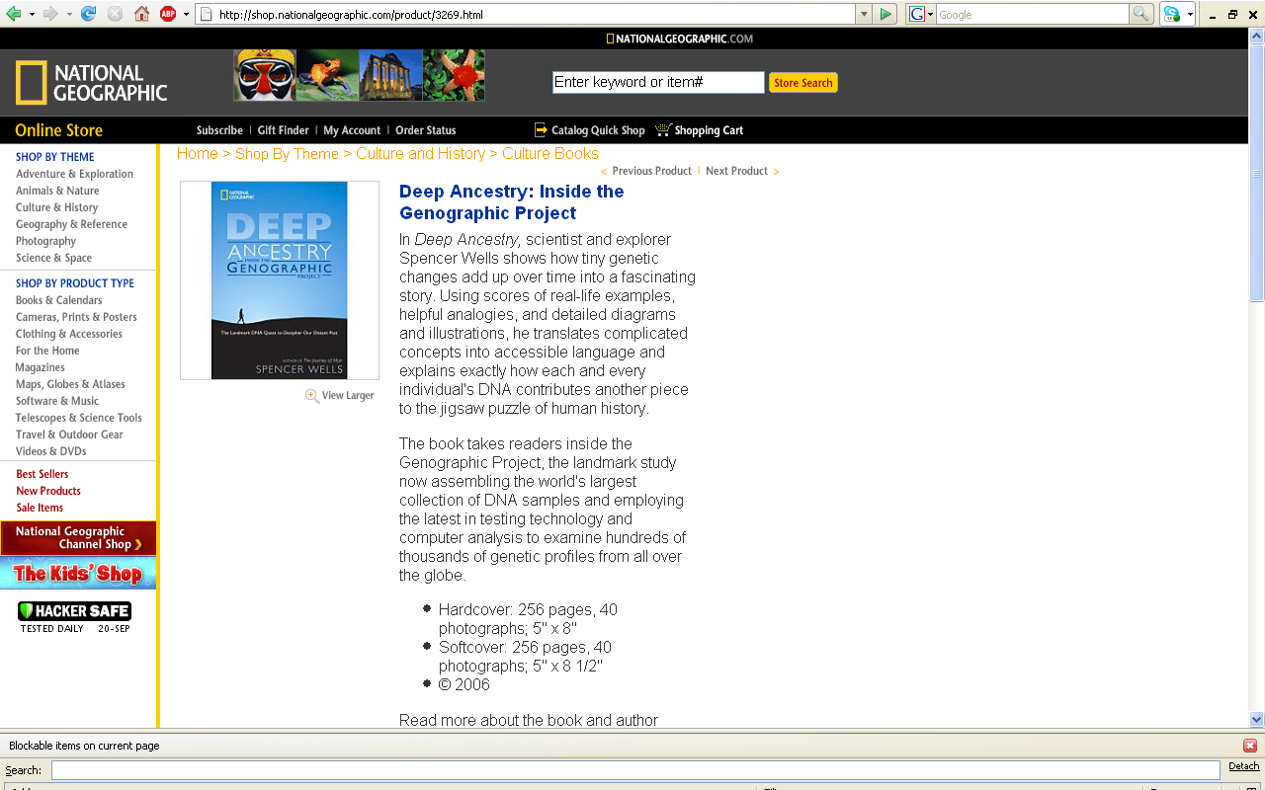
http://magma.nationalgeographic.com/ngm/0410/feature2/index.html?fs=www3.nationalgeographic.com&fs=plasma.nationalgeographic.com

Slide 76
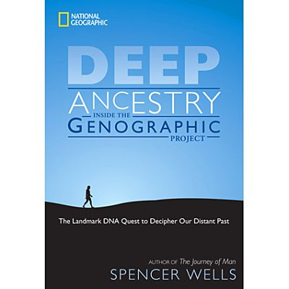
National Geographic
paperback
20 November 2007
http://magma.nationalgeographic.com/ngm/0410/feature2/index.html?fs=www3.nationalgeographic.com&fs=plasma.nationalgeographic.com

Slide 77

National Geographic
2nd edition
18 November 2008
http://shop.nationalgeographic.com/product/1062/4446/114.html

Slide 78
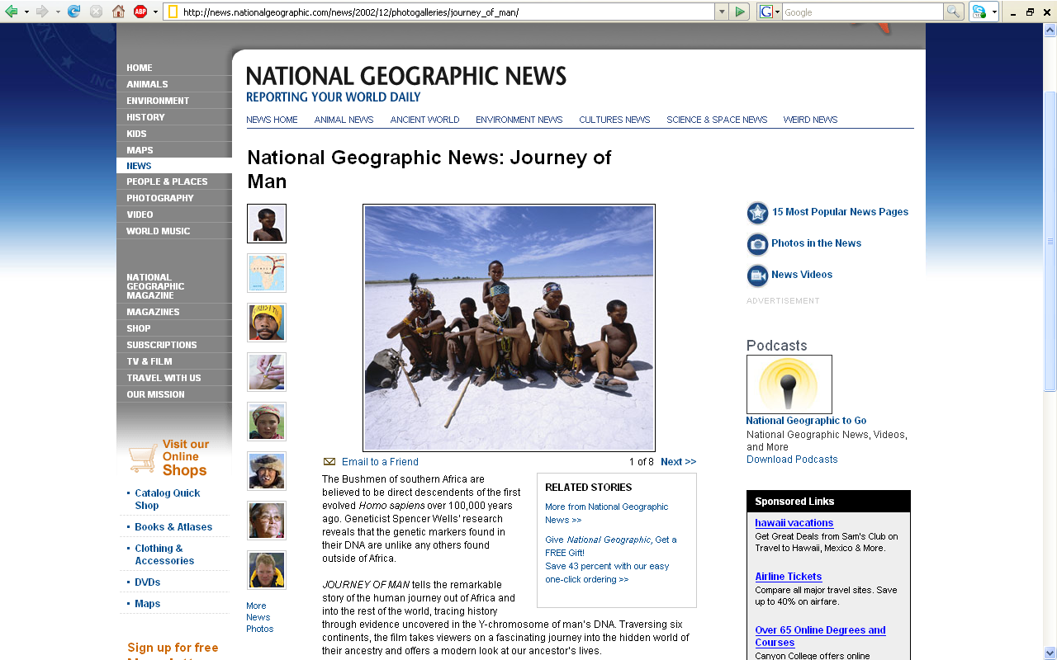
http://news.nationalgeographic.com/news/2002/12/photogalleries/journey_of_man/

Slide 79

www.linnaeus.uu.se/online/fysik/mikrokosmos/gifs/dna.gif

Slide 80

traces DNA through females
www.d.umn.edu/cla/faculty/troufs/anth1602/pcmitochondrialeve.html#title

Slide 81

Understanding Anthropology and Archaeology, 11th edition, p. 39.

Slide 82
Understanding Anthropology and Archaeology, 11th edition, p. 39.

Slide 83
traces DNA through females
The Genographic Project
traces DNA through males
www.d.umn.edu/cla/faculty/troufs/anth1602/pcmitochondrialeve.html#title

Slide 84

www.d.umn.edu/cla/faculty/troufs/anth1602/pcweek03.html#Day06

Slide 85



http://www.d.umn.edu/cla/faculty/troufs/anth1602/pcweek03.html#Day06

Slide 86

M168 = earliest ancestor
http://news.nationalgeographic.com/news/2002/12/photogalleries/journey_of_man/images/popup/jm2l.jpg

Slide 87

http://news.bbc.co.uk/2/hi/science/nature/4543767.stm
Notes:
87

Slide 88
M168 = earliest ancestor
http://news.nationalgeographic.com/news/2002/12/photogalleries/journey_of_man/images/popup/jm2l.jpg

Slide 89
The Human Family Tree -- Generalized Migration Patterns
National Geographic (c) 2009
https://genographic.nationalgeographic.com/genographic/lan/en/index.html

Slide 90
www.d.umn.edu/cla/faculty/troufs/anth1602/video/Search_for_Adam.html#title

Slide 91
earliest ancestor
https://www9.nationalgeographic.com/genographic/report.html

Slide 92

earliest ancestor
https://www9.nationalgeographic.com/genographic/report.html

Slide 93

M168 = earliest ancestor
https://www9.nationalgeographic.com/genographic/report.html

Slide 94
Roufs - Bacig
Notes:
94

Slide 95


Venus of Willendorf
c. 24,000 ybp
https://www5.nationalgeographic.com/genographic/
Roufs DNA results ID # = FW35F6VQRR
Bacig DNA results ID # = FWAG7649L5
Tim Roufs
Tom Bacig
https://www9.nationalgeographic.com/genographic/report.html

Slide 96
Tom Bacig
www.d.umn.edu/cla/faculty/troufs/anth1602/pcweek03.html#Day06

Slide 97

Tom Bacig
DNA results ID # = FWAG7649L5
https://www9.nationalgeographic.com/genographic/report.html

Slide 98
Tim Roufs
http://www.d.umn.edu/cla/faculty/troufs/anth1602/pcweek03.html#Day06

Slide 99

Tim Roufs
DNA results ID # = FW35F6VQRR
https://www9.nationalgeographic.com/genographic/report.html

Slide 100
NG Genographic migration
www.d.umn.edu/cla/faculty/troufs/anth1602/pctimes.html#title

Slide 101
NG Genographic migration
www.d.umn.edu/cla/faculty/troufs/anth1602/pctimes.html#title

Slide 102
Tom Bacig
Tim Roufs
http://news.nationalgeographic.com/news/2002/12/photogalleries/journey_of_man/images/popup/jm2l.jpg

Slide 103
Bacig
Notes:
103

Slide 104
Tom Bacig ?
http://news.nationalgeographic.com/news/2002/12/photogalleries/journey_of_man/images/popup/jm2l.jpg

Slide 105
http://news.nationalgeographic.com/news/2002/12/photogalleries/journey_of_man/images/popup/jm2l.jpg

Slide 106

https://www9.nationalgeographic.com/genographic/report.html

Slide 107
Tom Bacig
http://news.nationalgeographic.com/news/2002/12/photogalleries/journey_of_man/images/popup/jm2l.jpg

Slide 108

Tom Bacig
earliest ancestor = M168
time of emergence from Africa ca. 50,000 ybp
https://www9.nationalgeographic.com/genographic/report.html

Slide 109
Roufs
Notes:
109

Slide 110
Tim Roufs
http://news.nationalgeographic.com/news/2002/12/photogalleries/journey_of_man/images/popup/jm2l.jpg

Slide 111

Venus of Willendorf
Austria
24,000-22,000 B.C.
10th Ed., p. 305
Tim Roufs
http://news.nationalgeographic.com/news/2002/12/photogalleries/journey_of_man/images/popup/jm2l.jpg

Slide 112
2009
Tim Roufs
http://news.nationalgeographic.com/news/2002/12/photogalleries/journey_of_man/images/popup/jm2l.jpg

Slide 113

Tim Roufs

Slide 114
Tim Roufs
earliest ancestor = M168
time of emergence from Africa ca. 50,000 ybp
https://www9.nationalgeographic.com/genographic/report.html

Slide 115


www.d.umn.edu/cla/faculty/troufs/anth1602/pcweek03.html#Day06

Slide 116
Tom Bacig
Tim Roufs
http://news.nationalgeographic.com/news/2002/12/photogalleries/journey_of_man/images/popup/jm2l.jpg

Slide 117

Tim Roufs
Tim Roufs
earliest ancestor = M168
time of emergence from Africa ca. 50,000 ybp
https://www9.nationalgeographic.com/genographic/report.html

Slide 118
Tim Roufs
journey begins with
“Adam”
https://www9.nationalgeographic.com/genographic/report.html
Notes:
118

Slide 119
Tim Roufs
journey begins with
“Adam”
earliest ancestor = M168
time of emergence from Africa ca. 50,000 ybp
https://www9.nationalgeographic.com/genographic/report.html
Notes:
119

Slide 120

journey ends with
“Venus”
. . . well, actually,
in Duluth
https://www9.nationalgeographic.com/genographic/report.html
Notes:
120

Slide 121

https://www9.nationalgeographic.com/genographic/report.html

Slide 122
200,000 B.C.
https://www5.nationalgeographic.com/genographic/atlas.html

Slide 123
A closer look at the
journey
and what the
Bacig and Roufs
“clans”
see/encountered
“along the way” . . .
or . . .
Notes:
123

Slide 124
A preview of . . .
Ch. 12 The Origin and Dispersal of Modern Humans
Ch. 13 Early Holocene Hunters and Gatherers
Ch. 14 Food Production
Ch. 15 The First Civilizations
ca. 60,000 ybp – 22,000/20,000 B.C.
Notes:
124

Slide 125

Understanding Physical Anthropology and Archaeology, 11th Ed., p. 297

Slide 126

Understanding Physical Anthropology and Archaeology, 11th Ed., p. 297

Slide 127

Venus of Willendorf
Austria
24,000-22,000 B.C.
11th Ed., p. 301
Venus of
Brassempouy
France
ca. 25,000
11th Ed., p. 300
Understanding Physical Anthropology and Archaeology, 11th Ed., p. 297

Slide 128
Tom Bacig
Tim Roufs
http://news.nationalgeographic.com/news/2002/12/photogalleries/journey_of_man/images/popup/jm2l.jpg

Slide 129
1.
The beginnings
“Adam”
in the Garden of Eden . . .
M168
50,000 B.C.
Notes:
129

Slide 130
www.d.umn.edu/cla/faculty/troufs/anth1602/video/Search_for_Adam.html#title

Slide 131
the Bacig/Roufs
journeys both begin
with
“Adam”…
earliest ancestor = M168
time of emergence from Africa ca. 50,000 ybp
https://www9.nationalgeographic.com/genographic/report.html
Notes:
131

Slide 132

https://www9.nationalgeographic.com/genographic/report.html

Slide 133
https://www9.nationalgeographic.com/genographic/report.html

Slide 134

https://www9.nationalgeographic.com/genographic/report.html

Slide 135
https://www9.nationalgeographic.com/genographic/report.html

Slide 136
8.3
https://www9.nationalgeographic.com/genographic/report.html

Slide 137
https://www9.nationalgeographic.com/genographic/report.html

Slide 138
2.
The
“Great Leap Forward” . . .
language development
FOXP2
Notes:
138

Slide 139

https://www9.nationalgeographic.com/genographic/report.html
Notes:
139

Slide 140

https://www9.nationalgeographic.com/genographic/report.html

Slide 141

https://www9.nationalgeographic.com/genographic/report.html

Slide 142
Understanding Physical Anthropology and Archaeology, 11th Ed., p. 297

Slide 143
3.
“Saharan gateway”…
Haplogroup 1
M170
Notes:
143

Slide 144

https://www9.nationalgeographic.com/genographic/report.html
Notes:
144

Slide 145

https://www9.nationalgeographic.com/genographic/report.html

Slide 146

https://www9.nationalgeographic.com/genographic/report.html

Slide 147

https://www9.nationalgeographic.com/genographic/report.html

Slide 148

https://www9.nationalgeographic.com/genographic/report.html

Slide 149
4.
Modern Language . . .
The “Tower of Babel” . . .
Notes:
149

Slide 150

https://www9.nationalgeographic.com/genographic/report.html

Slide 151

https://www9.nationalgeographic.com/genographic/report.html

Slide 152
They continue
heading to the
Anatolia area
of
modern-day
Turkey
https://www9.nationalgeographic.com/genographic/report.html
Notes:
152

Slide 153
https://www9.nationalgeographic.com/genographic/report.html

Slide 154
M89 group
Notes:
154

Slide 155

https://www9.nationalgeographic.com/genographic/report.html

Slide 156

https://www9.nationalgeographic.com/genographic/report.html

Slide 157

https://www9.nationalgeographic.com/genographic/report.html

Slide 158

https://www9.nationalgeographic.com/genographic/report.html

Slide 159
Tom Bacig
https://www9.nationalgeographic.com/genographic/report.html

Slide 160

Tom Bacig
. . . in Anatolia Bacig heads east . . .
https://www9.nationalgeographic.com/genographic/report.html

Slide 161
Tom Bacig
. . . eventually
Bacig regains
his bearings and heads towards Italy . . .
https://www9.nationalgeographic.com/genographic/report.html

Slide 162
M170 group
Tim Roufs
Tom Bacig
. . . meanwhile…
Roufs heads north, looking for Duluth . . .
https://www9.nationalgeographic.com/genographic/report.html
Notes:
162

Slide 163
M170 group
Notes:
163

Slide 164

https://www9.nationalgeographic.com/genographic/report.html

Slide 165

https://www9.nationalgeographic.com/genographic/report.html

Slide 166

https://www9.nationalgeographic.com/genographic/report.html

Slide 167
Understanding Physical Anthropology and Archaeology, 11th Ed., p. 297

Slide 168

https://www9.nationalgeographic.com/genographic/report.html

Slide 169

https://www9.nationalgeographic.com/genographic/report.html

Slide 170

https://www9.nationalgeographic.com/genographic/report.html

Slide 171

https://www9.nationalgeographic.com/genographic/report.html

Slide 172
5.
Cro Magnon
Notes:
172

Slide 173
https://www9.nationalgeographic.com/genographic/report.html

Slide 174

M170 group
https://www9.nationalgeographic.com/genographic/report.html
Notes:
174

Slide 175

https://www9.nationalgeographic.com/genographic/report.html

Slide 176

https://www9.nationalgeographic.com/genographic/report.html

Slide 177

p. 289 Time line of Modern Homo sapiens discoveries.

Slide 178

Homo
sapiens
Sapiens
(“moderns”)
Understanding Anthropology and Archaeology, 10th edition, p. 293.

Slide 179

dates?
www.d.umn.edu/cla/faculty/troufs/anth1602/pctimes.html

Slide 180

Moderns
Homo sapiens sapiens
Cro-Magnon I
(France)
Understanding Physical Anthropology and Archaeology, 10th Ed., p. 297.

Slide 181

Understanding Physical Anthropology and Archaeology, 10th Ed., p. 296.

Slide 182

Cro-Magnon I
(France)
Understanding Physical Anthropology and Archaeology, 9th Ed., p. 285.

Slide 183

Understanding Physical Anthropology and Archaeology, 10th Ed., p. 298.

Slide 184
6.
Domestication
of Animals
Notes:
184

Slide 185
https://www9.nationalgeographic.com/genographic/report.html

Slide 186

M170 group
https://www9.nationalgeographic.com/genographic/report.html

Slide 187

Ch. 13
“Early Holocene
Hunters and
Gatherers”
Understanding Physical Anthropology and Archaeology, 10th Ed., p. 313.

Slide 188

Understanding Physical Anthropology and Archaeology, 11th Ed., p. 3139

Slide 189

https://www9.nationalgeographic.com/genographic/report.html

Slide 190

https://www9.nationalgeographic.com/genographic/report.html

Slide 191

“The Neolithic Revolution”
Ch. 14 “Food Production”
Understanding Physical Anthropology and Archaeology, 10th Ed., p. 347.

Slide 192
“The Neolithic Revolution”

Slide 193
7.
Catak Huyuk
(Çatalhöyük)
ca. 7500 B.C.
The largest and best preserved
Neolithic site to date
Notes:
193

Slide 194
https://www9.nationalgeographic.com/genographic/report.html

Slide 195

M170 group
https://www9.nationalgeographic.com/genographic/report.html
Notes:
195

Slide 196


Jericho
Sites associated with early civilizations in Mesopotamia and the Nile Valley.
Understanding Anthropology and Archaeology, 10th edition, p. 390.

Slide 197

Early Neolithic sites of the Fertile Crescent
Understanding Physical Anthropology and Archaeology, 10^{h} Ed., p. 363

Slide 198

Time line for Ch. 15 “Old World Civilizations”
Understanding Anthropology and Archaeology, 10th edition, p. 397.

Slide 199
Time line for Ch. 14 “Food Production”
Understanding Anthropology and Archaeology, 10th edition, p. 347.

Slide 200

https://www9.nationalgeographic.com/genographic/report.html

Slide 201

https://www9.nationalgeographic.com/genographic/report.html

Slide 202

Çatalhöyük, Anatolia, or Turkey
Shane, Orrin C. III, and Mine Küçuk.
"The World's First City."
Archaeology 51.2 (1998): 43-47.

Slide 203
Çatalhöyük, Anatolia, or Turkey
Shane, Orrin C. III, and Mine Küçuk.
"The World's First City."
Archaeology 51.2 (1998): 43-47.

Slide 204

Çatalhöyük, Anatolia, or Turkey
www.ccny.cuny.edu/architecture/archprog/slide-232/pages/002%20Catal%20Huyuk%20Map.htm

Slide 205
Çatalhöyük, Anatolia, or Turkey
www.ccny.cuny.edu/architecture/archprog/slide-232/pages/002%20Catal%20Huyuk%20Map.htm

Slide 206

Çatalhöyük, Anatolia, or Turkey
www.ccny.cuny.edu/architecture/archprog/slide-232/pages/002%20Catal%20Huyuk%20Map.htm

Slide 207

https://www9.nationalgeographic.com/genographic/report.html

Slide 208

www.telesterion.com/catal2.htm

Slide 209
More on Çatal Hüyük in the video
"Wisdom of the Stones: Life in the Neolithic Age"
Sites associated with early civilizations in Mesopotamia and the Nile Valley.
Understanding Anthropology and Archaeology, 10th edition, p. 390.

Slide 210
8.
Proto Indo European
Notes:
210

Slide 211
https://www9.nationalgeographic.com/genographic/report.html

Slide 212

M170 group
https://www9.nationalgeographic.com/genographic/report.html

Slide 213
8.
Proto Indo European
Notes:
213

Slide 214

https://www9.nationalgeographic.com/genographic/report.html

Slide 215

http://jonathan.beaton.name/archives/335
Notes:
215

Slide 216

http://commons.wikimedia.org/wiki/File:Indo-European_Groups_World_Distribution.gif
Notes:
216

Slide 217
https://www9.nationalgeographic.com/genographic/report.html

Slide 218

M170 group
https://www9.nationalgeographic.com/genographic/report.html

Slide 219

https://www9.nationalgeographic.com/genographic/report.html

Slide 220
10.
Czech Republic
Notes:
220

Slide 221
https://www9.nationalgeographic.com/genographic/report.html

Slide 222

M170 group
https://www9.nationalgeographic.com/genographic/report.html
Notes:
222

Slide 223

https://www9.nationalgeographic.com/genographic/report.html

Slide 224
https://www9.nationalgeographic.com/genographic/report.html

Slide 225


10th Ed. p. 305
https://www9.nationalgeographic.com/genographic/report.html
Notes:
225

Slide 226
https://www9.nationalgeographic.com/genographic/report.html
Notes:
226

Slide 227

Understanding Physical Anthropology and Archaeology, 10th Ed., p. 300.

Slide 228

https://www9.nationalgeographic.com/genographic/report.html
Notes:
228

Slide 229

10th Ed. p. 306
https://www9.nationalgeographic.com/genographic/report.html
Notes:
229

Slide 230

https://www9.nationalgeographic.com/genographic/report.html

Slide 231

https://www9.nationalgeographic.com/genographic/report.html
Notes:
231

Slide 232

https://www9.nationalgeographic.com/genographic/report.html

Slide 233
11.
Megafauna in Europe
Notes:
233

Slide 234
https://www9.nationalgeographic.com/genographic/report.html

Slide 235

M170 group
https://www9.nationalgeographic.com/genographic/report.html

Slide 236

https://www9.nationalgeographic.com/genographic/report.html

Slide 237

https://www9.nationalgeographic.com/genographic/report.html

Slide 238

https://www9.nationalgeographic.com/genographic/report.html

Slide 239
12.
Upper Paleolithic
Notes:
239

Slide 240

M170 group
https://www9.nationalgeographic.com/genographic/report.html

Slide 241
Understanding Physical Anthropology and Archaeology, 10th Ed., p. 300.

Slide 242

https://www9.nationalgeographic.com/genographic/report.html

Slide 243
https://www9.nationalgeographic.com/genographic/report.html
Notes:
243

Slide 244

https://www9.nationalgeographic.com/genographic/report.html

Slide 245

https://www9.nationalgeographic.com/genographic/report.html

Slide 246

https://www9.nationalgeographic.com/genographic/report.html

Slide 247

https://www5.nationalgeographic.com/genographic/

Slide 248
Understanding Physical Anthropology and Archaeology, 10th Ed., p. 300.

Slide 249

Solutrean laurel leaf points, France
Understanding Physical Anthropology and Archaeology, 10th Ed., p. 304.

Slide 250
13.
Migration
to Great Britain
Notes:
250

Slide 251

M170 group
https://www9.nationalgeographic.com/genographic/report.html

Slide 252

https://www9.nationalgeographic.com/genographic/report.html

Slide 253

http://news.nationalgeographic.com/news/2005/07/0719_050719_britishgene.html

Slide 254
14.
Gravettian Culture
Notes:
254

Slide 255

M170 group
https://www9.nationalgeographic.com/genographic/report.html

Slide 256

https://www9.nationalgeographic.com/genographic/report.html

Slide 257
Understanding Physical Anthropology and Archaeology, 10th Ed., p. 300.

Slide 258

https://www9.nationalgeographic.com/genographic/report.html

Slide 259

https://www9.nationalgeographic.com/genographic/report.html

Slide 260
15.
Fertility Figurines
Notes:
260

Slide 261
M170 group
https://www9.nationalgeographic.com/genographic/report.html
Notes:
261

Slide 262
https://www9.nationalgeographic.com/genographic/report.html
Notes:
262

Slide 263

https://www9.nationalgeographic.com/genographic/report.html
Notes:
263

Slide 264

https://www9.nationalgeographic.com/genographic/report.html

Slide 265

https://www9.nationalgeographic.com/genographic/report.html
Notes:
265

Slide 266

https://www9.nationalgeographic.com/genographic/report.html
Notes:
266

Slide 267
22,000/20,000 B.C.
https://www9.nationalgeographic.com/genographic/report.html
Notes:
267

Slide 268

Venus of Willendorf, Austria.
Understanding Physical Anthropology and Archaeology,10th Ed., p. 305.

Slide 269

Cave art
center
Understanding Physical Anthropology and Archaeology, 10th Ed., p. 306.

Slide 270
Grotte Chavet
Understanding Physical Anthropology and Archaeology, 10th Ed., p. 306.

Slide 271
Lascaux
Understanding Physical Anthropology and Archaeology, 10th Ed., p. 306.

Slide 272
M170 group
the journey ends
with “Venus” . . .
https://www9.nationalgeographic.com/genographic/report.html
Notes:
272

Slide 273

. . . well,
actually,
in Duluth

