Slide 1
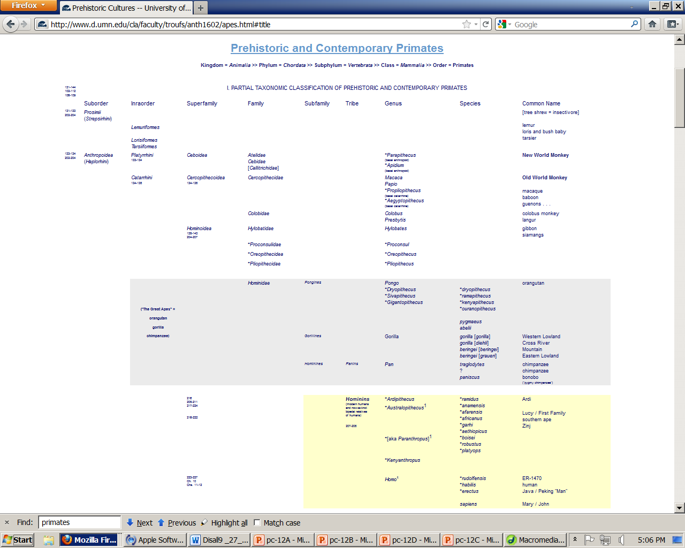

Slide 2
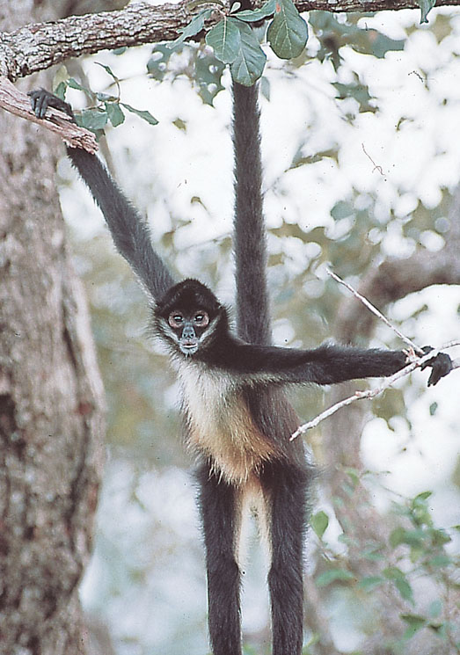
Monkeys
Understanding Humans 10th Ed., p. 136
Prehistoric Cultures Tim Roufs’ section ©2009-2012

Slide 3
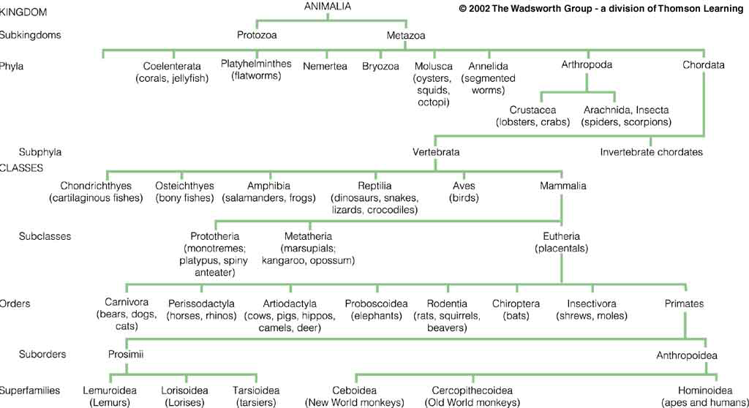
Classification chart (after Linnaeus)
Understanding Humans, 10th ed., p. 101

Slide 4
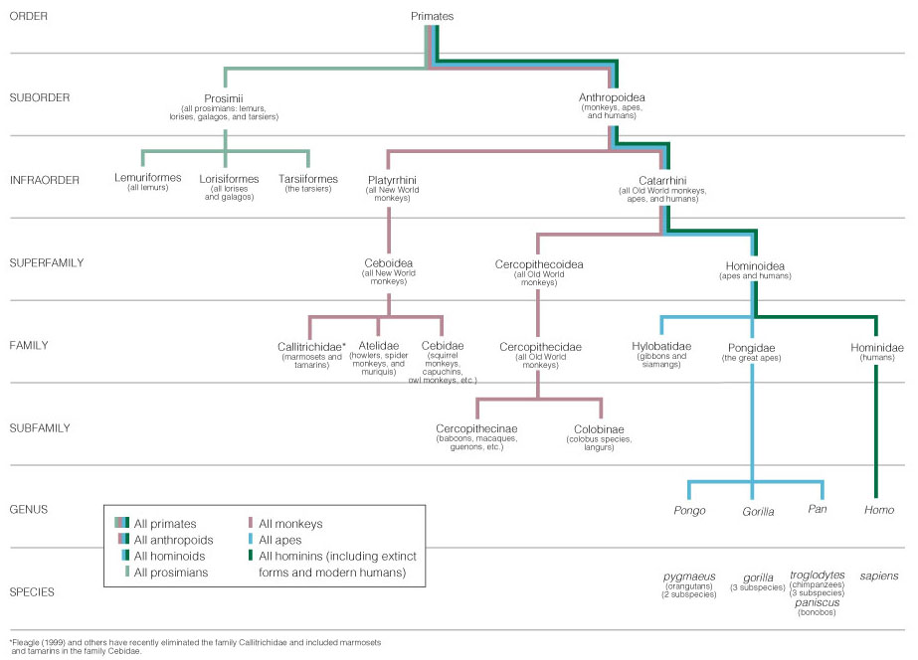
Monkeys
Primate taxonomic classification
Understanding Humans, 10th ed., p. 129

Slide 5
Anthropoids
Primate taxonomic classification
Understanding Humans, 10th ed., p. 129

Slide 6
New World
Monkeys
Primate taxonomic classification
Understanding Humans, 10th ed., p. 129

Slide 7
Old World
Monkeys
Primate taxonomic classification
Understanding Humans, 10th ed., p. 129

Slide 8
Apes
and
Humans
Primate taxonomic classification
Understanding Humans, 10th ed., p. 129

Slide 9
Primates -- Monkeys
A. PROSIMII
B. ANTHROPOIDS
1. Platyrrhines (“flat-nosed”)
a. Ceboidea
(New World monkeys)
2. Catarrhines (“down-nosed”)
a. Cercopithecoids
(Old World monkeys)
b. Hominoidea (apes and humans)

Slide 10
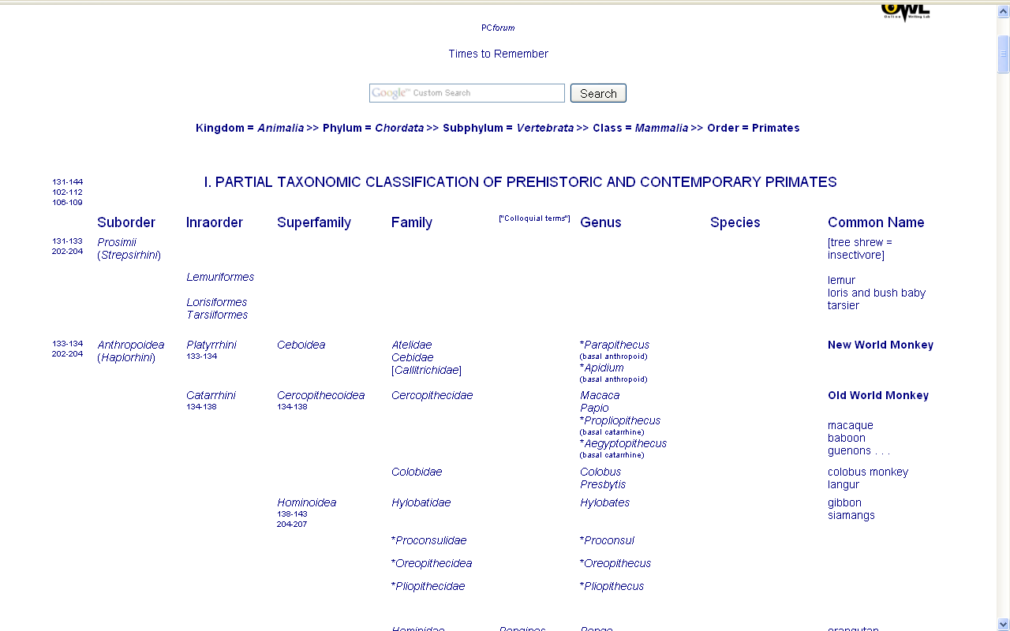

Slide 11
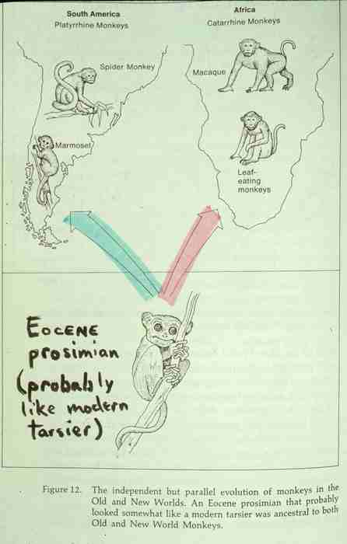
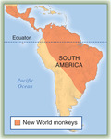
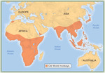
New World
Monkeys
Old World
Monkeys
ca. 50 mya
p. 133
p. 136

Slide 12
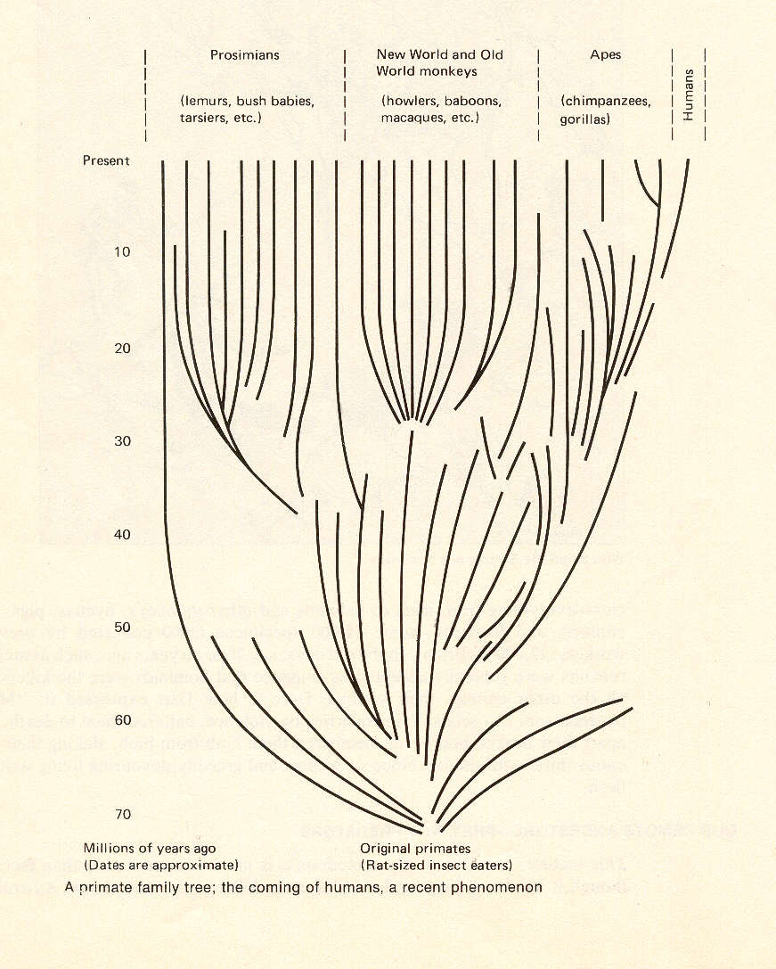
ca. 50 mya
A Primate Family Tree
The Emergence of Humankind, 4th ed., p. 64

Slide 13
New / Old World Monkeys
New World Monkeys
Old World Monkeys
found only in South and Central America

Slide 14
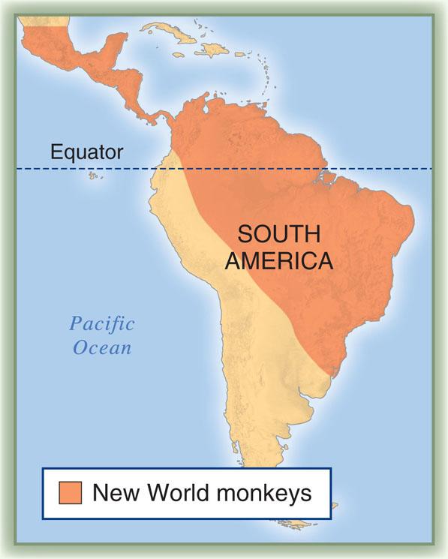
Understanding Humans, 10th ed., p. 133

Slide 15
New / Old World Monkeys
New World Monkeys
Old World Monkeys
found only in South and Central America
Found in the tropical and temperate climates of “The Old World” and the Far East

Slide 16
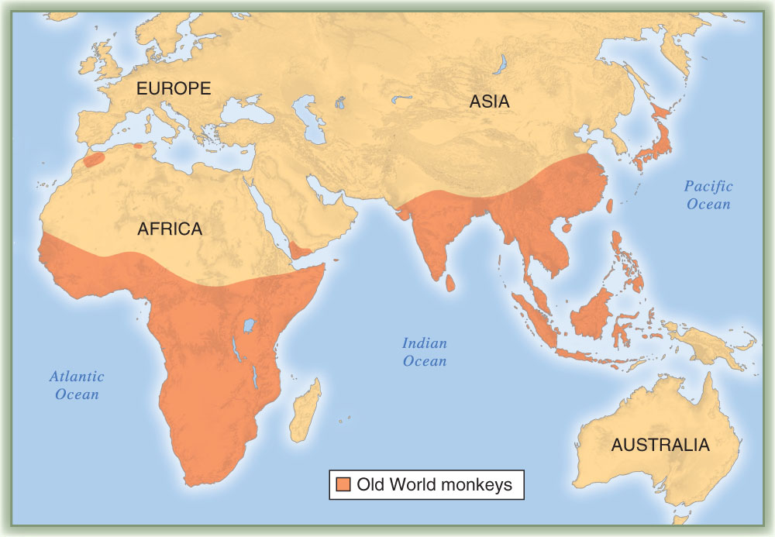
Understanding Humans, 10th ed., p. 136

Slide 17
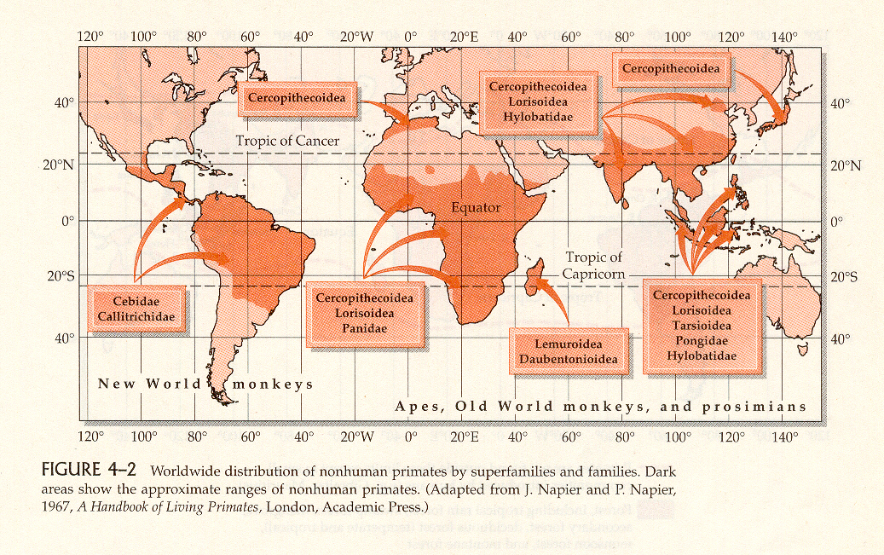
Primates are tropical and temperate climate creatures
Distribution of Nonhuman Primates
Humankind Emerging, 7th ed., p. 93

Slide 18
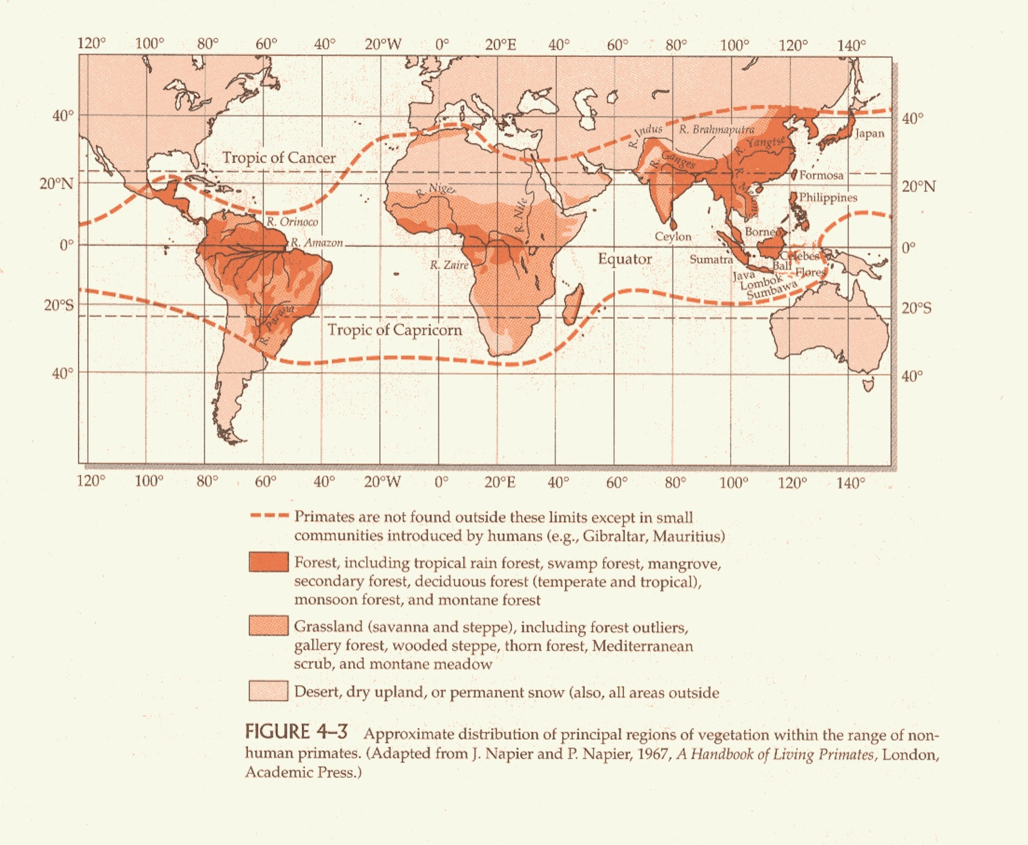
Vegetation Regions and Nonhuman Primates
Humankind Emerging, 7th ed., p. 94

Slide 19
New / Old World Monkeys
New World Monkeys
Old World Monkeys
smallest and most divergent group of all anthropoids

Slide 20
New / Old World Monkeys
New World Monkeys
Old World Monkeys
some have lost prehensile tail
tails are shorter and never prehensile

Slide 21
p. 128
p. 133
New World Monkey:
Spider monkey (note prehensile tail)
Understanding Humans, 10th ed., p. 136

Slide 22
New / Old World Monkeys
New World Monkeys
Old World Monkeys
flat faces with nostrils separated with wide septum and directed more to the side
nostrils are much closer together and are directed forward and down

Slide 23
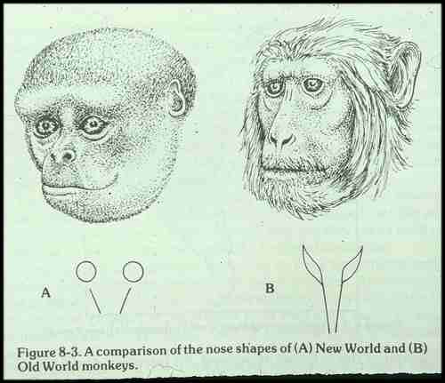
p. 133
p. 136

Slide 24
New / Old World Monkeys
New World Monkeys
Old World Monkeys
arboreal
except for baboon and mandrills the old world monkeys are usually arboreal

Slide 25
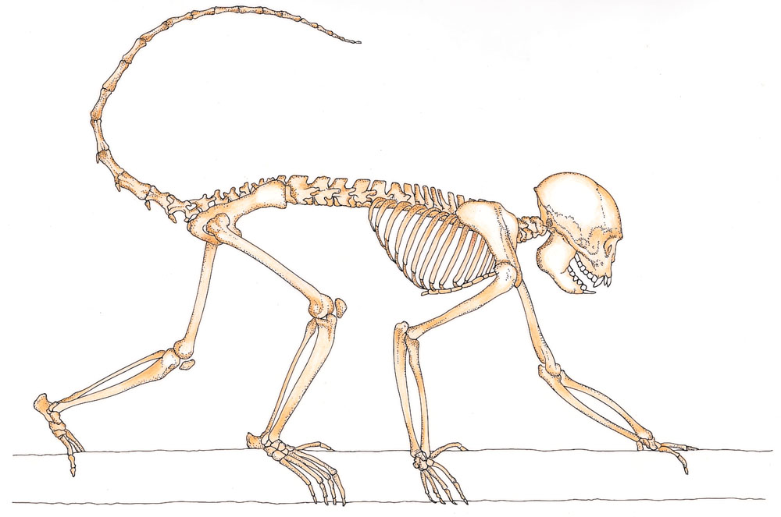
p. 133
Skeleton of an arboreal New World monkey
(New World Monkey: Bearded saki)
Understanding Humans, 10th ed., p. 127

Slide 26
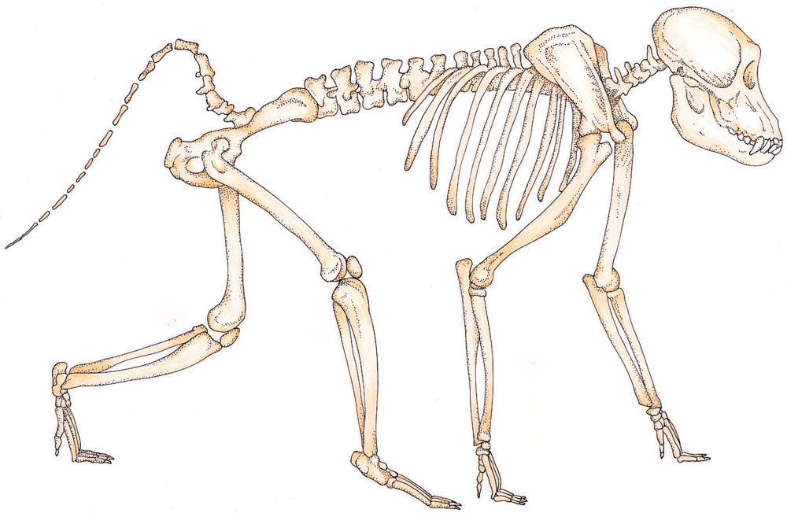
p. 133
Skeleton of a terrestrial quadruped
(Old World Monkey: Savanna baboon)
Understanding Humans, 10th ed., p. 127

Slide 27
New / Old World Monkeys
New World Monkeys
Old World Monkeys
very reduced thumb
in some, the thumb is reduced
but in others it is not

Slide 28
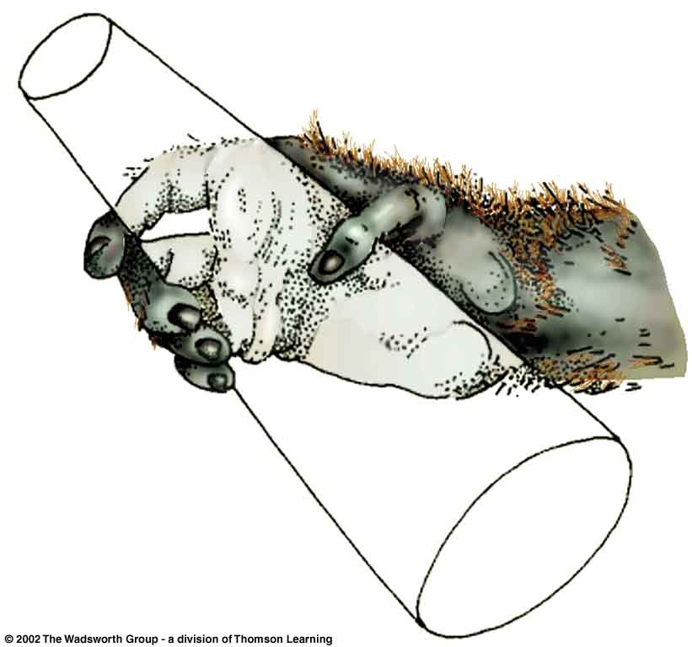
p. 136
Old World Monkey: Macaque

Slide 29
New / Old World Monkeys
New World Monkeys
Old World Monkeys
usually have thick fur
hair cover is light

Slide 30
New / Old World Monkeys
New World Monkeys
Old World Monkeys
lead away from main line of evolution

Slide 31
New World Monkeys
New World Monkeys

Slide 32
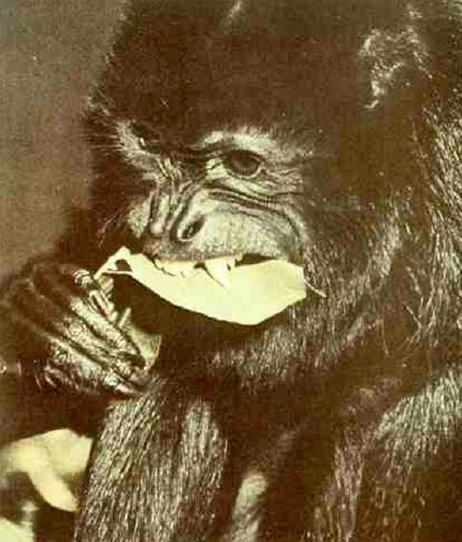
p. 133
New World Monkey: Black Howler Monkey
The Primates, Time-Life (1974) p. 47

Slide 33
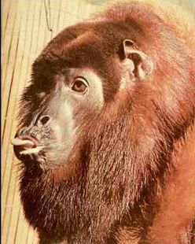
p. 133
New World Monkey: Red Howler Monkey
The Primates, Time-Life (1974) p. 47

Slide 34
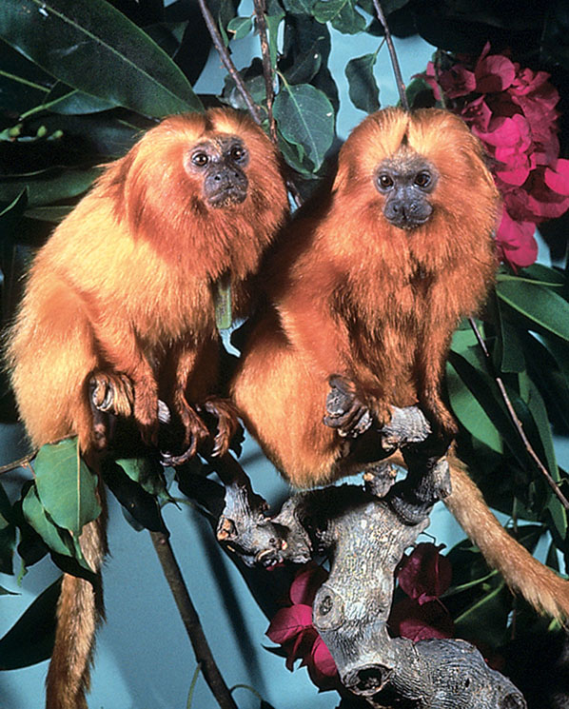
p. 133
New World Monkeys:
A pair of golden lion tamarinds
Understanding Humans, 10th ed., p. 134

Slide 35
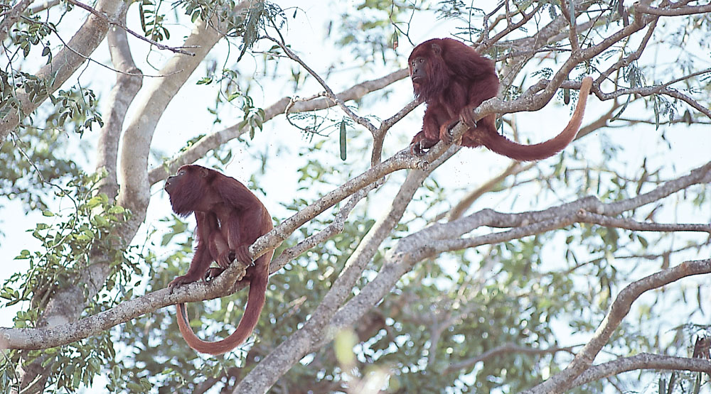
p. 133
p. 133
New World Monkeys:
Howler monkeys
Understanding Humans, 10th ed., p. 134

Slide 36
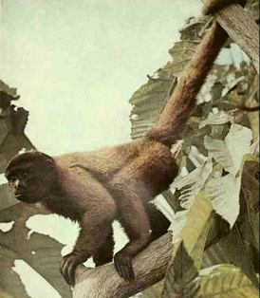
p. 133
New World Monkey: Woolly Monkey
The Primates, Time-Life (1974) p. 47

Slide 37
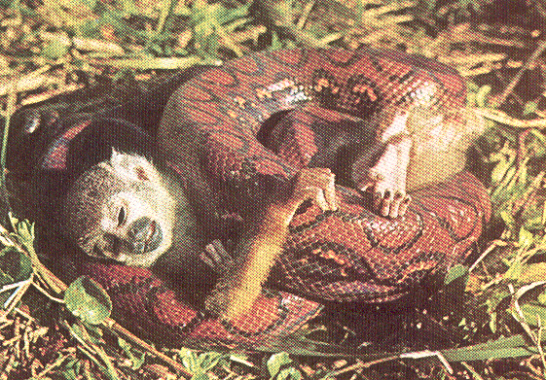
p. 133
New World Monkey: Squirrel Monkey
The Primates, Time-Life (1974) p. 49

Slide 38
Old World Monkeys
Old World Monkeys

Slide 39
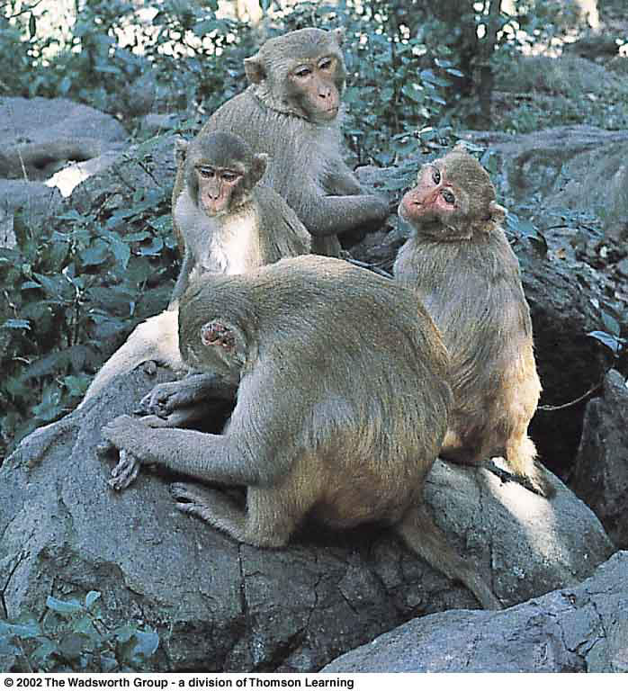
p. 136
Old World Monkeys: Macaques
Understanding Humans, 10th ed., p. 125

Slide 40
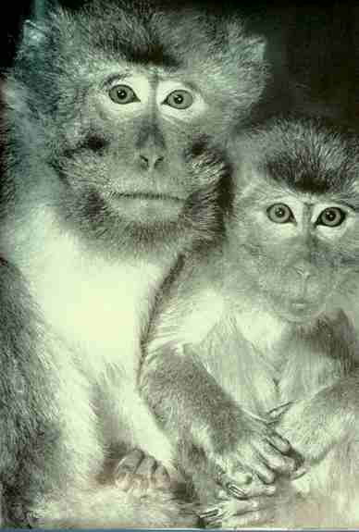
p. 136
p. 129
Old World Monkeys: Macaques

Slide 41
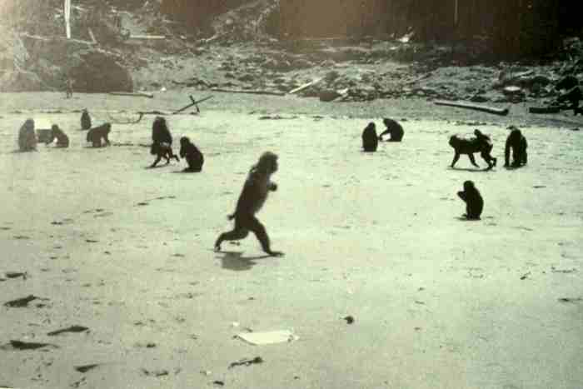
p. 136
Old World Monkeys: Macaques

Slide 42
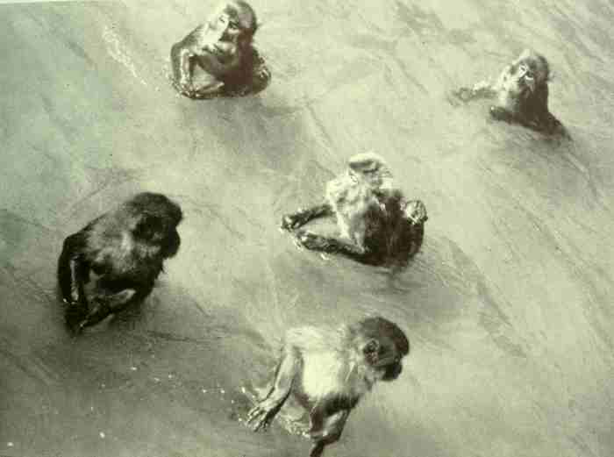
p. 136
Old World Monkeys: Macaques

Slide 43
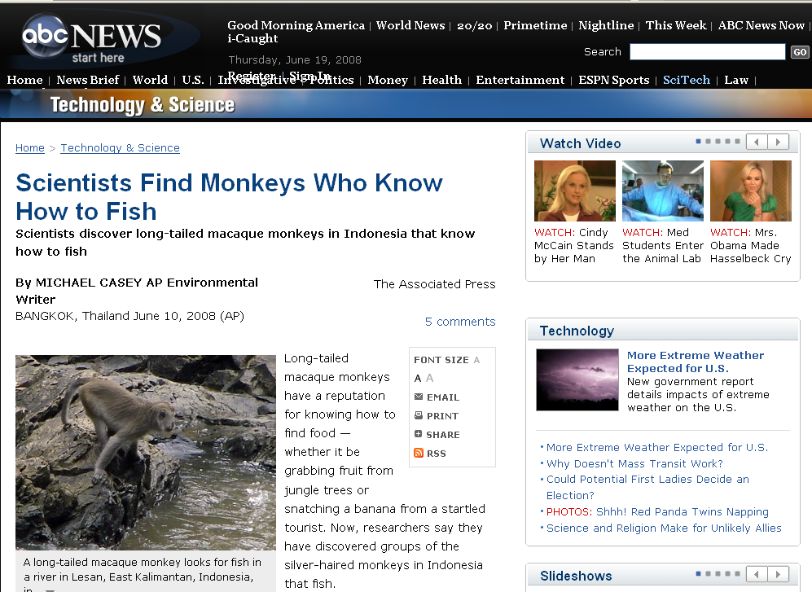
p. 136
abcnews.go.com/Technology/wireStory?id=5035837
Notes:
43

Slide 44
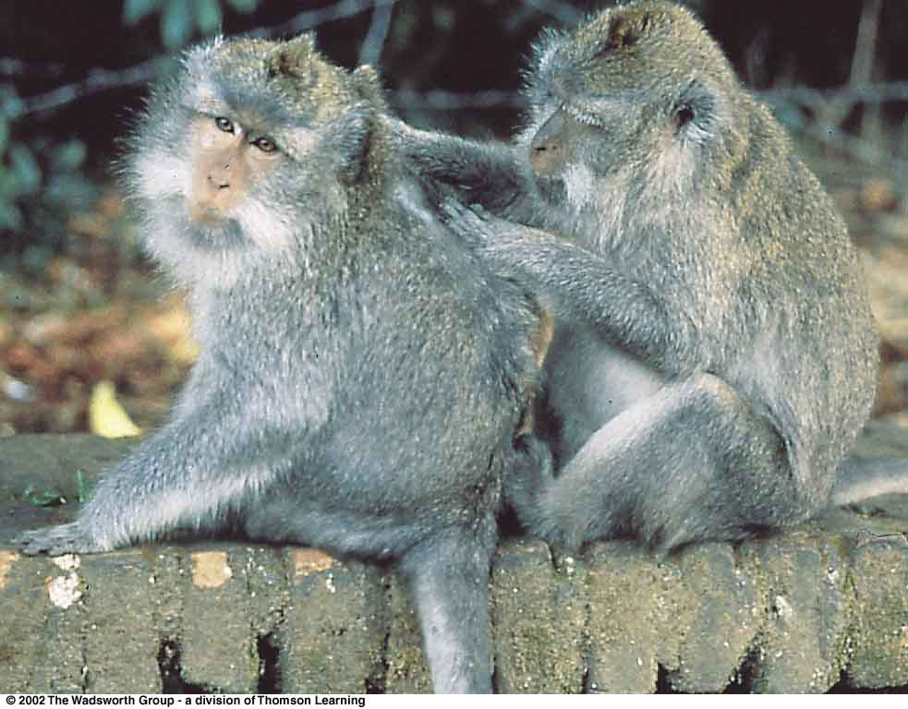
p. 136
Old World Monkeys: Longtail macaques
Understanding Physical Anthropology and Archaeology, 9th ed., p. 151

Slide 45
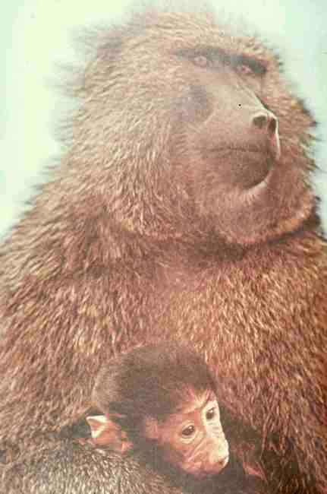
p. 136
Old World Monkeys: Baboons

Slide 46
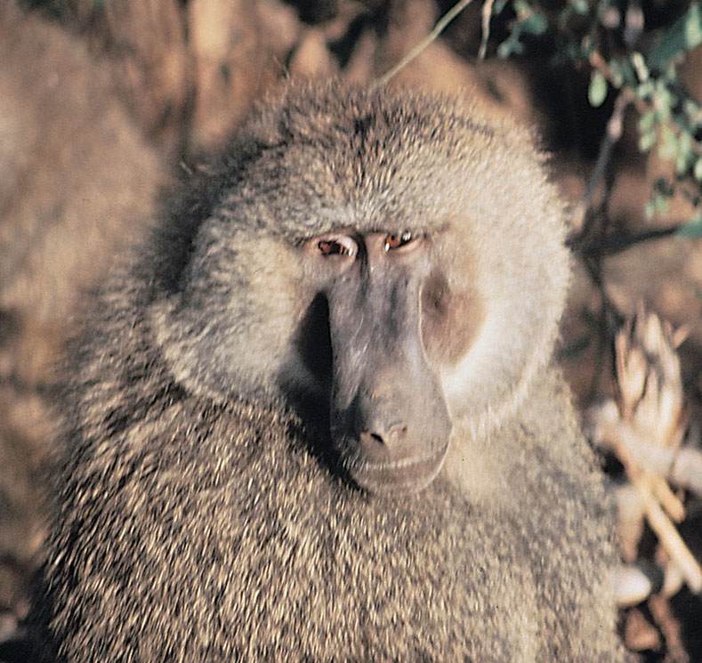
p. 136
Old World Monkey: Savanna baboon (male)
Understanding Humans, 10th ed., p. 137

Slide 47
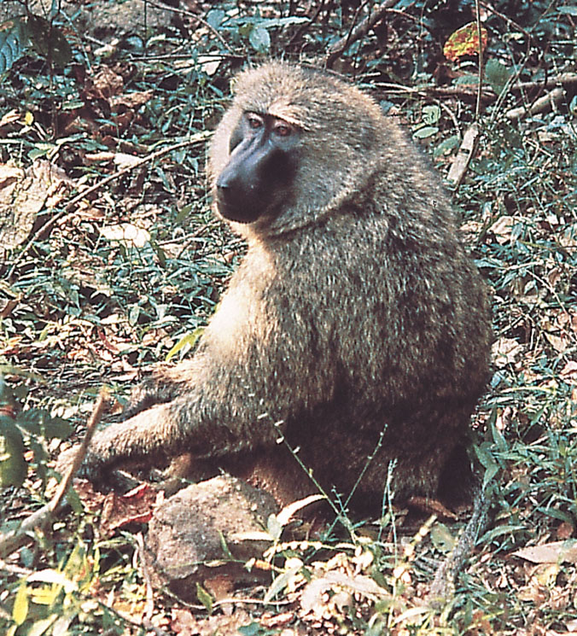
p. 136
Old World Monkey: Savanna baboon (female)
Understanding Humans, 10th ed., p. 137

Slide 48
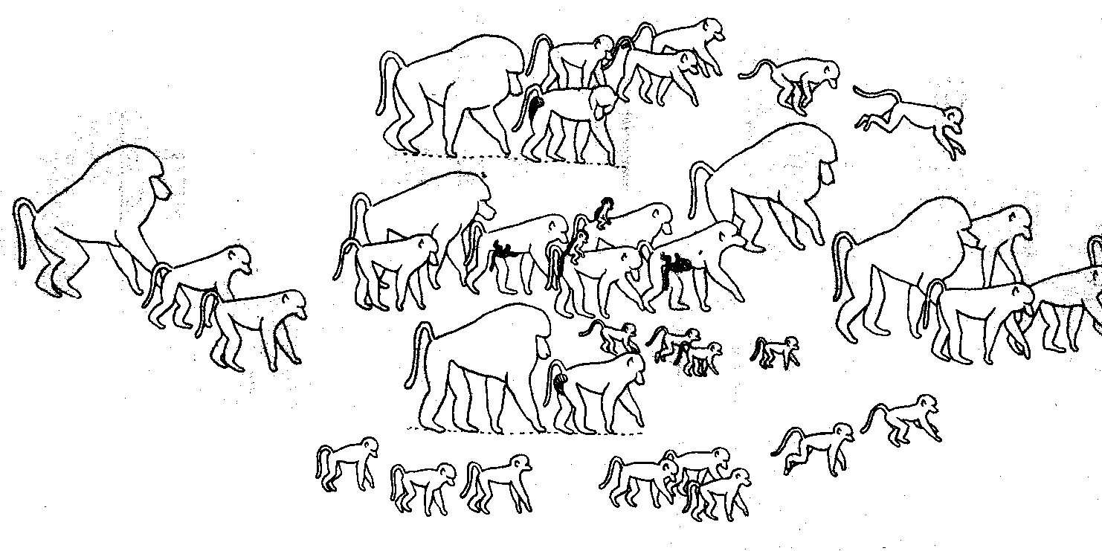
p. 136
Old World Monkeys: Baboon troop
DeVore (ed.), Primate Behavior, 1965) p. 70

Slide 49
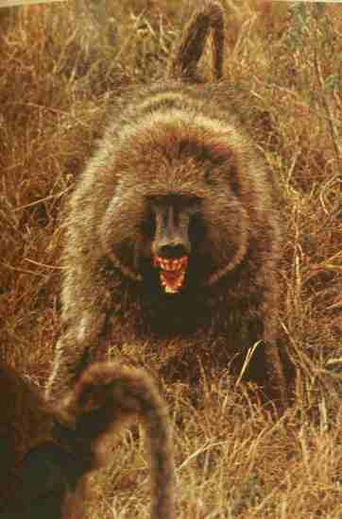
p. 136
Old World Monkey: Baboon
The Primates, Time-Life (1974) p. 119

Slide 50
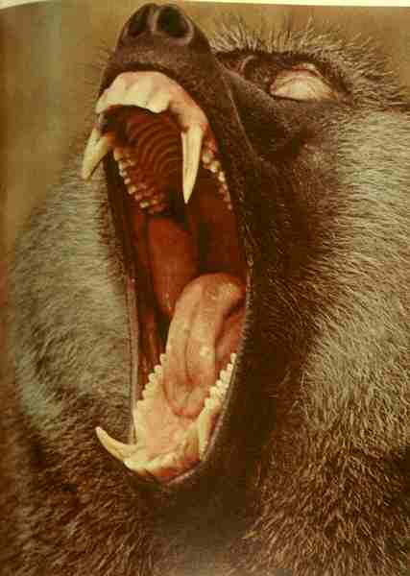
p. 136
Old World Monkey: Baboon
The Primates, Time-Life (1974) p. 117

Slide 51
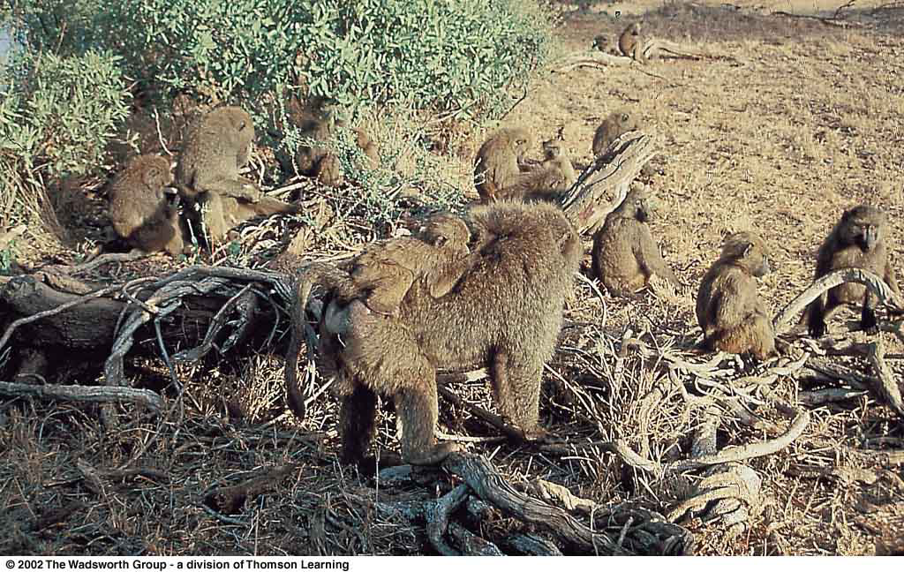
p. 136
Old World Monkeys: Group of savanna baboons
Understanding Physical Anthropology and Archaeology, 9th ed., p. 156

Slide 52
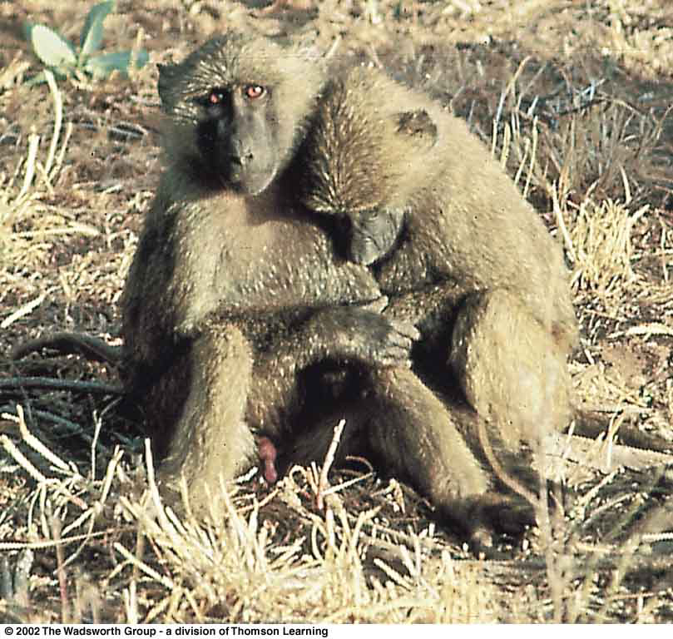
p. 136
Old World Monkey: Adolescent savanna baboons
Understanding Physical Anthropology and Archaeology, 9th ed., p. 149

Slide 53
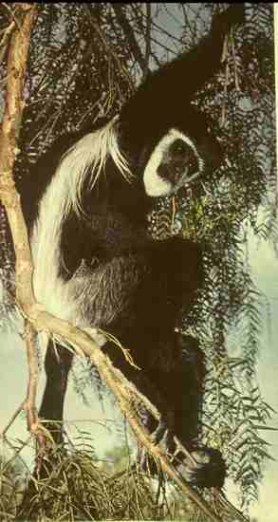
p. 136
Old World Monkey: Black and White Colobus
The Primates, Time-Life (1974) p. 54

Slide 54
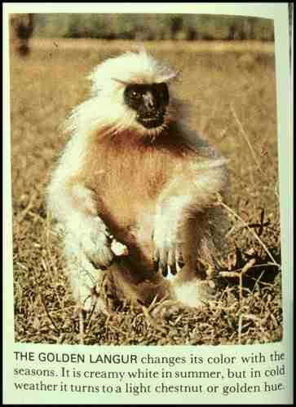
p. 136
Old World Monkey: Golden Langur
The Primates, Time-Life (1974) p. 54

Slide 55
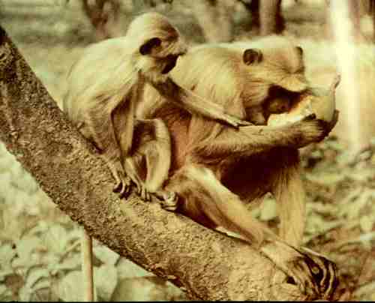
p. 136
Old World Monkeys: Langurs
The Primates, Time-Life (1974) p. 100

Slide 56
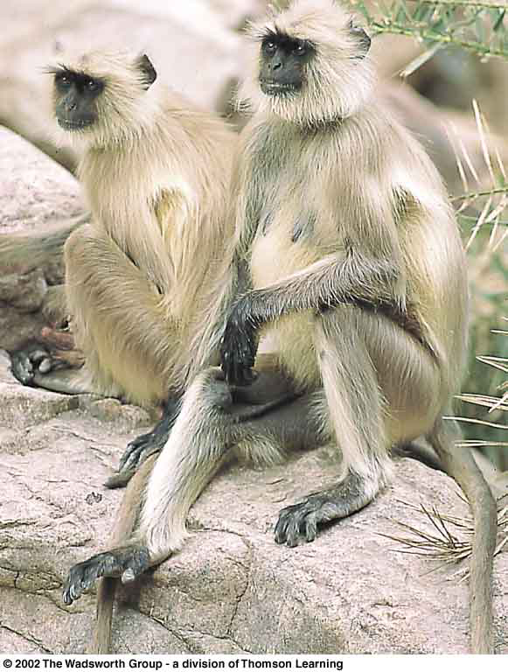
p. 136
Old World Monkeys: Hanuman langurs
Understanding Physical Anthropology and Archaeology, 9th ed., p. 153

Slide 59
Next:
Apes
Primate taxonomic classification
Understanding Humans, 10th ed., p. 129

