Slide 1

A Note on
Anthropology in Europe
or
Anthropology of Europe?
… Some Trends
After Susan Parman, Europe in the Anthropological Imagination, pp. 11 - 14
  ©Timothy G. Roufs 2009-2024

Slide 2
in the 1970s anthropologists became caught up in a surge of interest in world systems, processes that could be described independent of particular “culture areas”
Susan Parman, Europe in the Anthropological Imagination, pp. 14 - 16

Slide 3
in the 1970s anthropologists became caught up in a surge of interest in world systems, processes that could be described independent of particular “culture areas”
Susan Parman, Europe in the Anthropological Imagination, pp. 14 - 16

Slide 4
      urbanism
      transnationalism
      gender issues
      migration
Susan Parman, Europe in the Anthropological Imagination, pp. 14 - 16

Slide 5
these were universal processes, and anthropology was conceived of as a universal science of humankind
  not just of the exotic, non-Western, savage “Other”
Susan Parman, Europe in the Anthropological Imagination, pp. 14 - 16

Slide 6
these were universal processes, and anthropology was conceived of as a universal science of humankind
  not just of the exotic, non-Western, savage “Other”
Susan Parman, Europe in the Anthropological Imagination, pp. 14 - 16

Slide 7
as Caroline B. Brettell notes, urban anthropology began to appear as a distinct subdiscipline in the early 1970s, as indicated by the appearance of a new journal in 1972, and the publication of edited collections
Susan Parman, Europe in the Anthropological Imagination, pp. 14 - 16

Slide 8
as Caroline B. Brettell notes, urban anthropology began to appear as a distinct subdiscipline in the early 1970s, as indicated by the appearance of a new journal in 1972, and the publication of edited collections
Susan Parman, Europe in the Anthropological Imagination, pp. 14 - 16

Slide 9
another topic of interest was
migration
Susan Parman, Europe in the Anthropological Imagination, pp. 14 - 16

Slide 10
William A. Douglass argues that despite the appearance of the isolated peasant community as the typical focus of early Europeanist anthropology, the theme of migration was a constant thread ...
Susan Parman, Europe in the Anthropological Imagination, pp. 14 - 16

Slide 11
William A. Douglass argues that despite the appearance of the isolated peasant community as the typical focus of early Europeanist anthropology, the theme of migration was a constant thread …
Susan Parman, Europe in the Anthropological Imagination, pp. 14 - 16

Slide 12


Douglass extracts comments from ...
  Arensberg’s Irish Countryman
    the earliest example of anglophone Europeanist anthropology
  Pitt-Rivers’s People of the Sierra
    “anglophone Europeanist anthropology’s quintessential and most influential little community study”
Susan Parman, Europe in the Anthropological Imagination, pp. 14 - 16

Slide 13
Caroline Brettell notes that the 1970s also saw the beginning not only of urban anthropology but also of gender studies
    e.g., Rosaldo and Lamphere 1974
Susan Parman, Europe in the Anthropological Imagination, pp. 14 - 16

Slide 14
Caroline Brettell notes that the 1970s also saw the beginning not only of urban anthropology but also of gender studies
    e.g., Rosaldo and Lamphere 1974
Susan Parman, Europe in the Anthropological Imagination, pp. 14 - 16

Slide 15
today issues of gender in Europe vary from honor and shame in the Mediterranean to ...
    general issues of the status of women
    their power
    their role in migration
    the construction of gender identity
    the poetics of genders
Susan Parman, Europe in the Anthropological Imagination, pp. 14 - 16

Slide 16
thus from one point of view, one could argue that during the 1970s the anthropological study of Europe (or any culture area, for that matter) was irrelevant in “the anthropological imagination”
Susan Parman, Europe in the Anthropological Imagination, pp. 14 - 16

Slide 17
processes were universal
where they took place was of interest only in providing additional evidence about the nature of the processes themselves
Susan Parman, Europe in the Anthropological Imagination, pp. 14 - 16

Slide 18
processes were universal
where they took place was of interest only in providing additional evidence about the nature of the processes themselves
Susan Parman, Europe in the Anthropological Imagination, pp. 14 - 16

Slide 19
on the other hand, going to Europe was essential in “the anthropological imagination” because it validated the universality of anthropological models
  thus separating it from its image as a discipline relevant only to the study of the exotic, the “primitive,” and the non-West
Susan Parman, Europe in the Anthropological Imagination, pp. 14 - 16

Slide 20
on the other hand, going to Europe was essential in the “anthropological imagination” because it validated the universality of anthropological models
  thus separating it from its image as a discipline relevant only to the study of the exotic, the “primitive,” and the non-West
Susan Parman, Europe in the Anthropological Imagination, pp. 14 - 16

Slide 21
in choosing to go to Europe, Susanna Hoffman, producer of the film Kypseli, was testing the question of universality of anthropological models
Susan Parman, Europe in the Anthropological Imagination, pp. 14 - 16

Slide 22
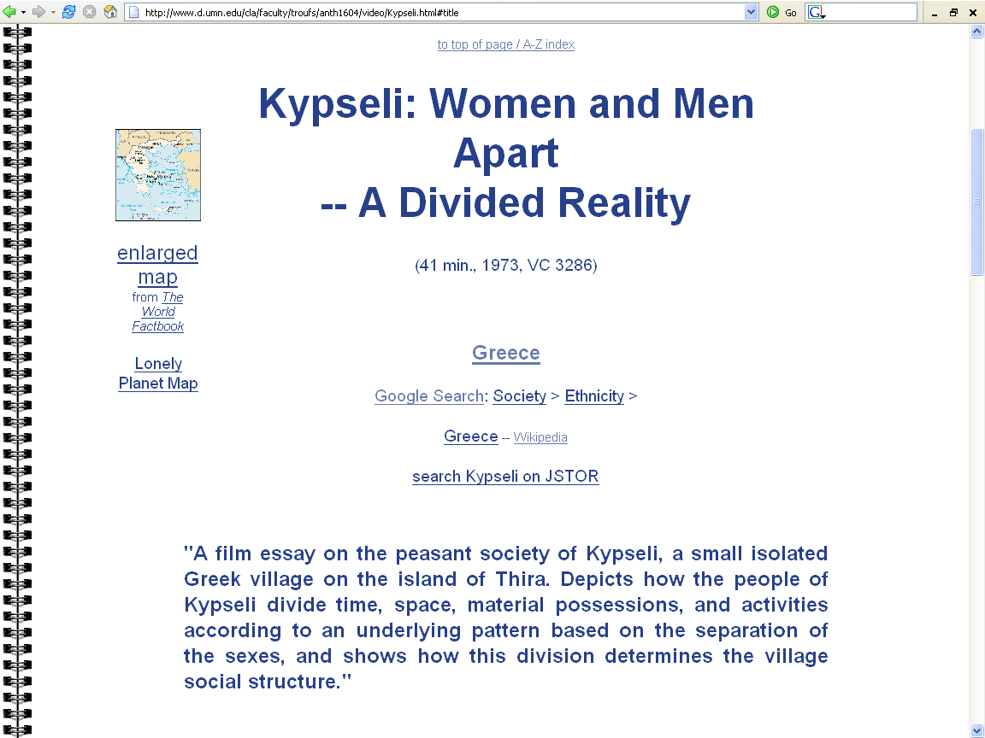

Slide 23
the “point of anthropology,” she said, was “to roll like a juggernaut across all landscapes toward the goal of describing the cross-cultural process of humankind”
Susan Parman, Europe in the Anthropological Imagination, pp. 14 - 16

Slide 24
according to Mark T. Shutes, this same motivation lay behind George Peter Murdock attempting to add more European material to the Human Relations Area Files, so as to expand the scope of ethnographic examples
Susan Parman, Europe in the Anthropological Imagination, pp. 14 - 16

Slide 25
according to Mark T. Shutes, this same motivation lay behind George Peter Murdock attempting to add more European material to the Human Relations Area Files, so as to expand the scope of ethnographic examples
Susan Parman, Europe in the Anthropological Imagination, pp. 14 - 16

Slide 26
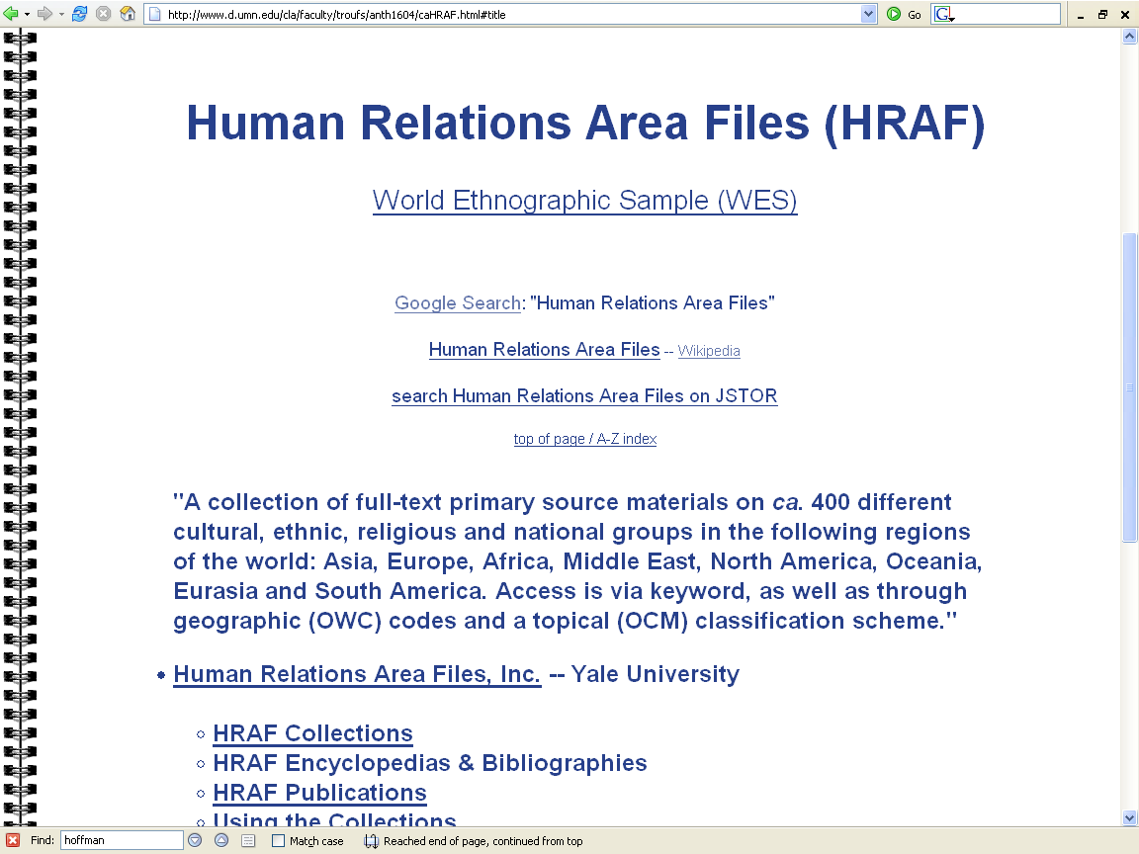

Slide 27
one can argue that studying Europe was a byproduct of the expanding interest of anthropologists in all cultures, including those of the West
Susan Parman, Europe in the Anthropological Imagination, pp. 14 - 16

Slide 28
as David I. Kertzer notes, “Studying peoples in the ‘west’ ... promises a way to recapture the generalizing aspirations of our discipline”
Susan Parman, Europe in the Anthropological Imagination, pp. 14 - 16

Slide 29
but it is also important to point out that the very fact of studying Europe made it easier to ask certain kinds of questions …
Susan Parman, Europe in the Anthropological Imagination, pp. 14 - 16

Slide 30
for example, given assumptions about Westerners, it may be easier to pose research problems emphasizing decision-making individuals …
Susan Parman, Europe in the Anthropological Imagination, pp. 14 - 16

Slide 31
for example, given assumptions about Westerners, it may be easier to pose research problems emphasizing decision-making individuals ...
Susan Parman, Europe in the Anthropological Imagination, pp. 14 - 16

Slide 32
it is also possible that new areas of interest can be more easily explored in Europe
  because Europe was not recognized as an acceptable, fully authentic, legitimate place for an anthropologist to do anthropological fieldwork …
Susan Parman, Europe in the Anthropological Imagination, pp. 14 - 16

Slide 33
therefore, if an anthropologist works in Europe, it is more likely that s/he would borrow from other disciplines
Susan Parman, Europe in the Anthropological Imagination, pp. 14 - 16

Slide 34
through their work on Europe, anthropologists have become more interdisciplinary, drawing on …
      history (Brettell, Rogers; Kertzer ...)
      political economy (Brettell, Kertzer)
      political science (Wilson)
      demography (Douglass)
Susan Parman, Europe in the Anthropological Imagination, pp. 14 - 16

Slide 35
“Orientalizing the occident, or exoticizing the familiar,” has been represented in a negative light in Parman ...
Susan Parman, Europe in the Anthropological Imagination, pp. 14 - 16

Slide 36
… many of the authors make a good case for anthropology to move out of the exotic margins and into the familiar centers of power, complexity, and hugeness
  to use Rogers’s example, to ‘move from Vasilika to Versailles’
Susan Parman, Europe in the Anthropological Imagination, pp. 14 - 16

Slide 37
... many of the authors make a good case for anthropology to move out of the exotic margins and into the familiar centers of power, complexity, and hugeness
  to use Rogers’s example, to ‘move from Vasilika to Versailles’
Susan Parman, Europe in the Anthropological Imagination, pp. 14 - 16

Slide 38
... many of the authors make a good case for anthropology to move out of the exotic margins and into the familiar centers of power, complexity, and hugeness
  to use Rogers’s example, to ‘move from Vasilika to Versailles’
Susan Parman, Europe in the Anthropological Imagination, pp. 14 - 16

Slide 39
Susan Parman, however, suggests that “wherever we pitch our tents (in small island peasant communities or in the back offices of high-powered Eurocrats), we should do our best to preserve the sense of the strange in the heart of the familiar — to disorient (not to Orient)” ...
Susan Parman, Europe in the Anthropological Imagination, pp. 14 - 16

Slide 40
Susan Parman, however, suggests that “wherever we pitch our tents (in small island peasant communities or in the back offices of high-powered Eurocrats), we should do our best to preserve the sense of the strange in the heart of the familiar — to disorient (not to Orient)” …
Susan Parman, Europe in the Anthropological Imagination, pp. 14 - 16

Slide 41
“This is not to argue with Kertzer, Davis, or Herzfeld (who were attacking the tendency, born of colonial power differentials, to create boundaries of essential otherness between Us and Them, Occident and Orient) ...”
Susan Parman, Europe in the Anthropological Imagination, pp. 14 - 16

Slide 42
“In the process of making the familiar strange, by engaging Europe in the calculus of a universalizing cultural critique, Anthropologists have the potential to turn the paradigmatic House of the Other into a common Global Home”
Susan Parman, Europe in the Anthropological Imagination, pp. 14 - 16

Slide 43
“The ability of anthropologists to …
  apply a cross-cultural perspective
  turn the familiar on edge
  develop a sense of distance from and cultural critique of what we take for granted
… is what will make or break a
successful anthropology of Europe”
Susan Parman, Europe in the Anthropological Imagination, pp. 14 - 16

Slide 44
“The ability of anthropologists to …
  apply a cross-cultural perspective
  turn the familiar on edge
  develop a sense of distance from and cultural critique of what we take for granted
… is what will make or break a
successful anthropology of Europe”
Susan Parman, Europe in the Anthropological Imagination, pp. 14 - 16

Slide 45
“... by studying Europe, anthropologists are in a position to dissolve the binary opposition of
“Us” / “Other”
with which anthropology has been engaged as part of its cultural heritage”
Susan Parman, Europe in the Anthropological Imagination, pp. 14 - 16

Slide 46
Anthropology in Europe
or
Anthropology of Europe?
… Some Trends
… Noted
After Susan Parman, Europe in the Anthropological Imagination, pp. 11 - 14
  ©Timothy G. Roufs 2009-2024

