Slide 1
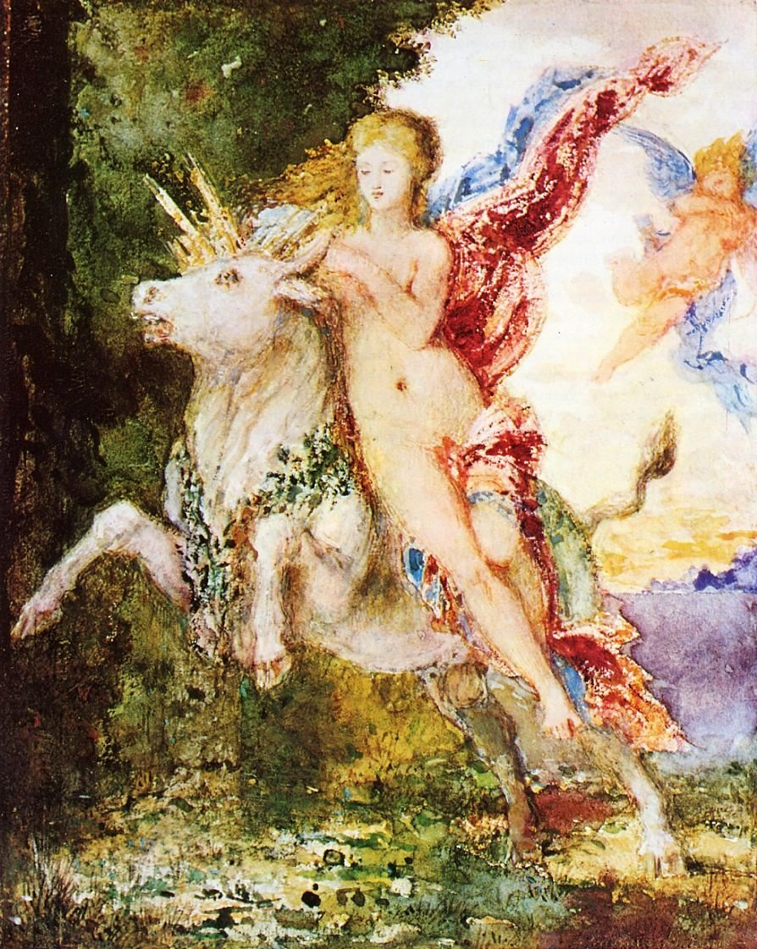
And, once again . . .
Welcome to
Peoples and Cultures
of Europe
Use your up/down arrow keys and/or
your space bar to advance the slides
Europa and the Bull Gustave Moreau,
c.1869
University of Minnesota Duluth
Tim Roufs’ © 2009-2015
http://www.d.umn.edu/cla/faculty/troufs/anth3635/

Slide 2
And, once again . . .
Welcome to
Peoples and Cultures
of Europe
Europa and the Bull Gustave Moreau,
c.1869
University of Minnesota Duluth
Tim Roufs’ © 2009-2015
http://www.d.umn.edu/cla/faculty/troufs/anth3635/

Slide 3
And, once again . . .
Welcome to
Peoples and Cultures
of Europe
This will be a great course . . .
you will see . . .
Europa and the Bull Gustave Moreau,
c.1869
University of Minnesota Duluth
Tim Roufs’ © 2009-2015
http://www.d.umn.edu/cla/faculty/troufs/anth3635/

Slide 4
One item you will see often (and often repeated) is that American Anthropology traditionally has a four-fold approach to the study of humans and closely related species.
These four fields include . . .

Slide 5
One item you will see often (and often repeated) is that American Anthropology traditionally has a four-fold approach to the study of humans and closely related species.
These four fields include . . .

Slide 6
American Anthropology
cultural / social
Physical / biological
archaeology
linguistics

Slide 9
First thing . . .
(if you are not already in Moodle)
go to your
course management site
and check it out . . .

Slide 10
How do you find
in the first place?

Slide 11
Further instructions follow,
but if you want,
and your browser permits,
clicking on the URL that follows
in the next slide
will take you to your Moodle home . . .
(your browser may require that you double-click)
There is another link at the end of this program

Slide 12
https://moodle.umn.edu/
(your browser may require that you double-click)
If your browser does not allow you to click on the above URL just enter it in your browser window . . .
Continue on here for further instructions . . .
There is another link at the end of this program

Slide 13
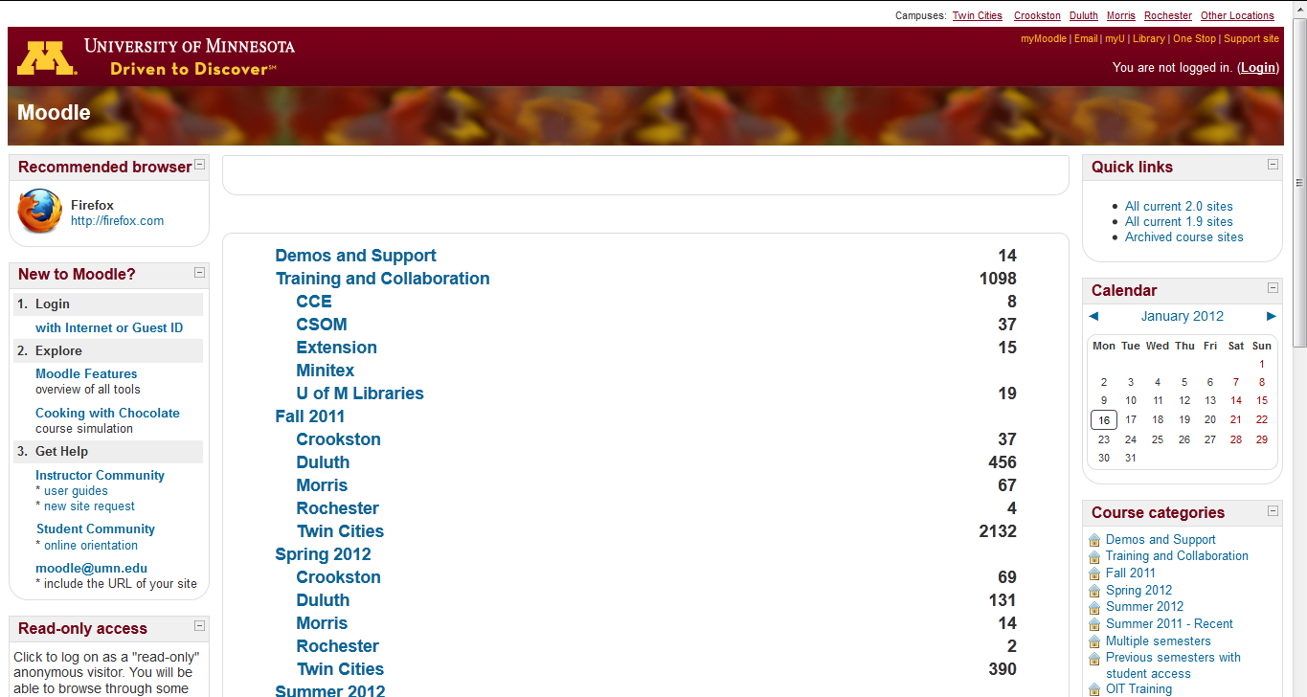
Your Moodle screen will look something like this . . .
Be sure to log in

Slide 14
Your Moodle screen will look something like this . . .
Be sure to log in

Slide 15
Your log-in page will look something like the following . . .
Log in using your “x.500” information . . .
(that’s the log-in information you use for your e-mail)
https://moodle.umn.edu/

Slide 16
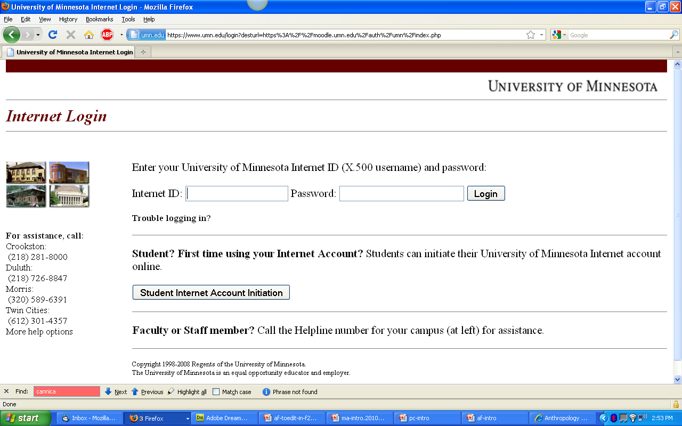
Log in using your “x.500” information . . .

Slide 17
Your Moodle screen
will look
something like the following . . .

Slide 18
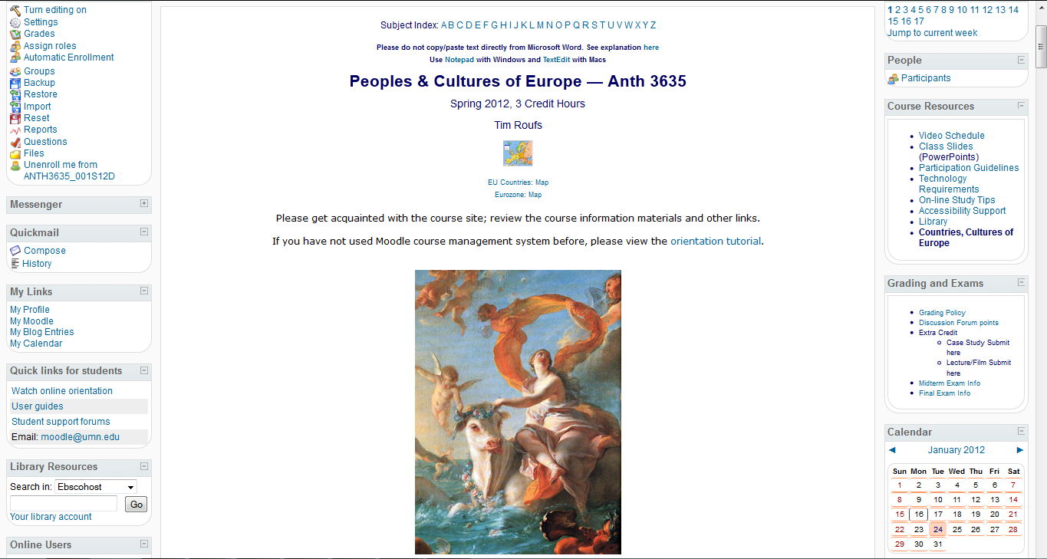
Your Moodle screen will look something like this . . .

Slide 19
Your Moodle screen will look something like this . . .
scroll down

Slide 20
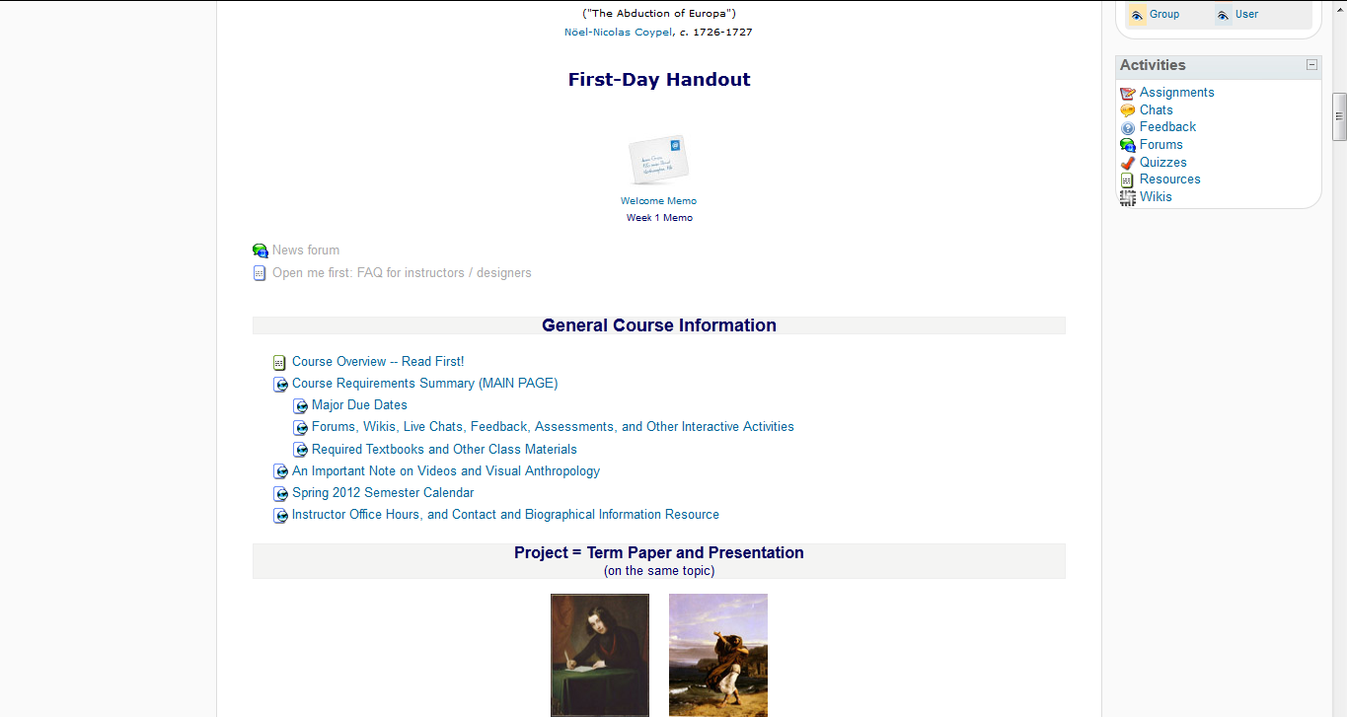
“Block 1” contains the basic information on the course . . .
“Block 1”

Slide 21
“Block 1” contains the basic information on the course . . .
“Block 1”
scroll down

Slide 22
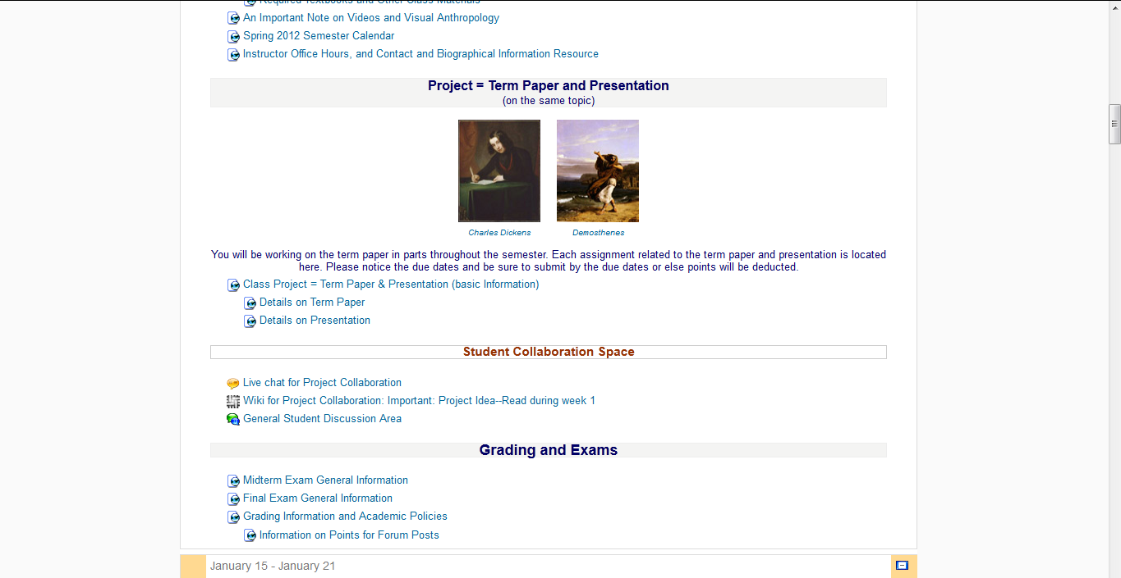
“Block 1” contains the basic information on the course . . .
“Block 1” continued

Slide 23
And the listing for Week 1
will look something like this . . .

Slide 24
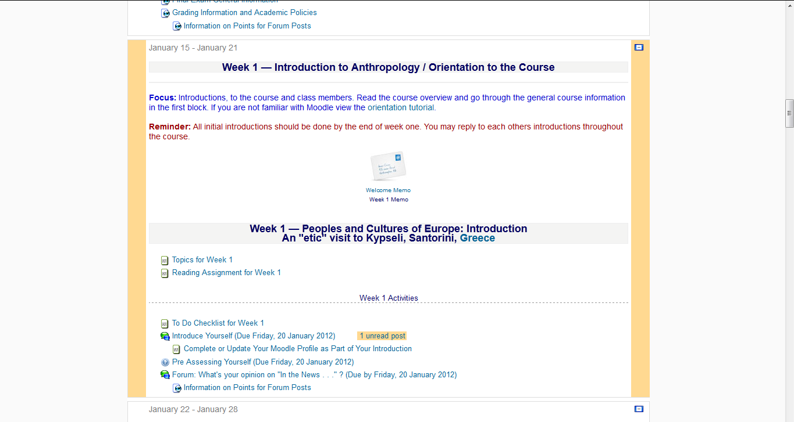
The listing for Week 1 will look something like this . . .

Slide 26
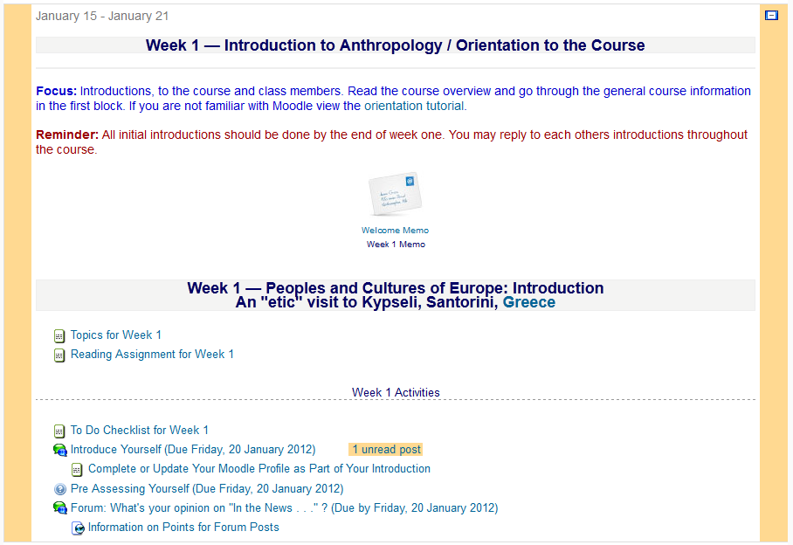

Slide 27
There are usually two main parts to the listing of a week . . .

Slide 28
1. Presentations . . .
(Topics and Reading Assignments)

Slide 29
and 2. Activities . . .

Slide 30
The first week . . .
introduce yourself
and, just for the fun of it, have a look around at the rest of the materials

Slide 31
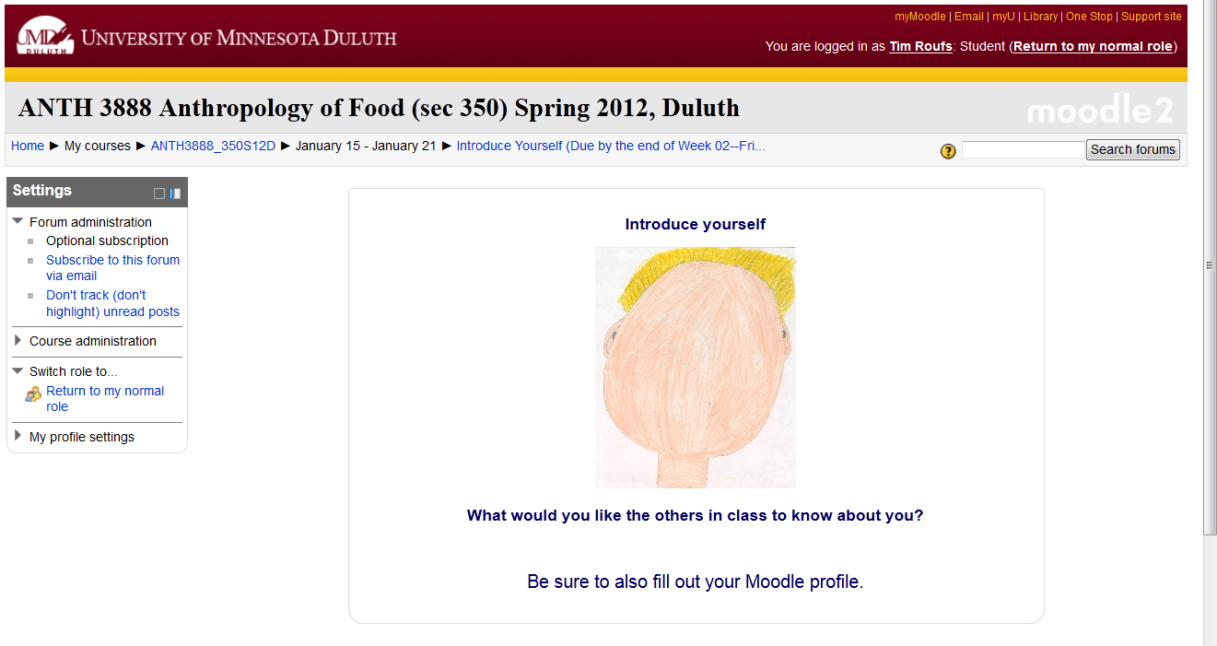
And the Introduction Page will look something like this . . .

Slide 32
The first week . . .
introduce yourself
and, just for the fun of it, have a look around at the rest of the materials
be sure to Update Your Moodle Profile as part of your introduction

Slide 33
The first week . . .
introduce yourself
and, just for the fun of it, have a look around at the rest of the materials

Slide 34
Week 2 . . .
do the Pre-Assessment
join in on the Forum Discussion
and, just for the fun of it, have a look around at the rest of the materials

Slide 35
The “Pre Assessment” Materials will look something like the following . . .

Slide 36
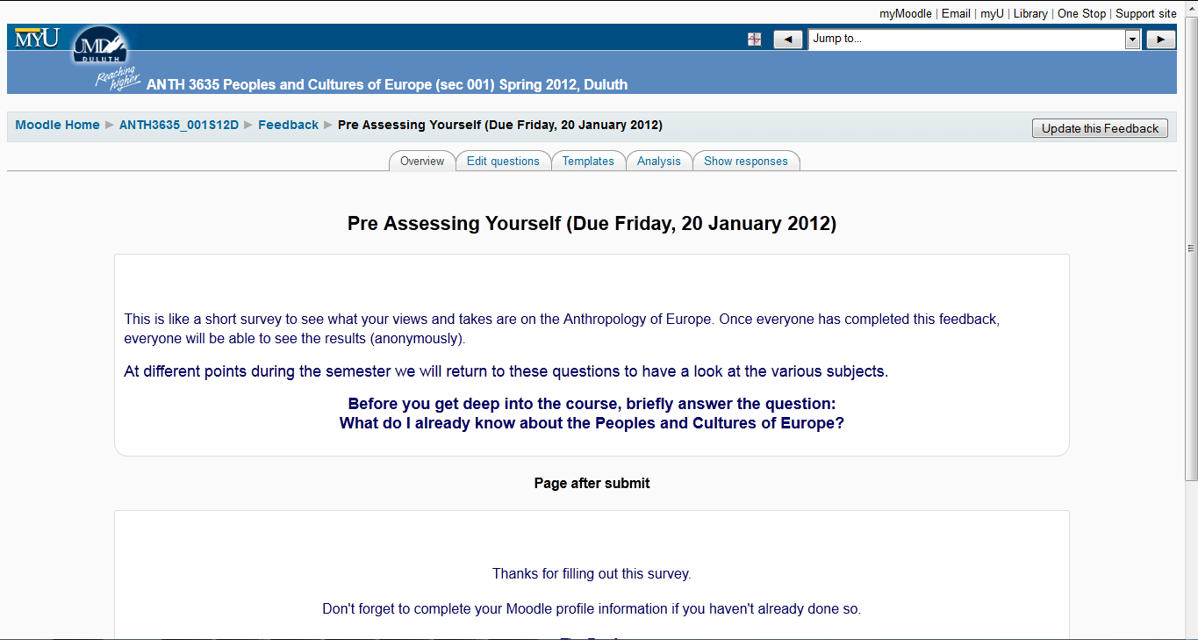
And the “Pre Assessment” Materials will look something like this . . .

Slide 37
The first week . . .
introduce yourself
do the Pre-Assessment
join in on the Forum Discussion
and, just for the fun of it, have a look around at the rest of the materials

Slide 38
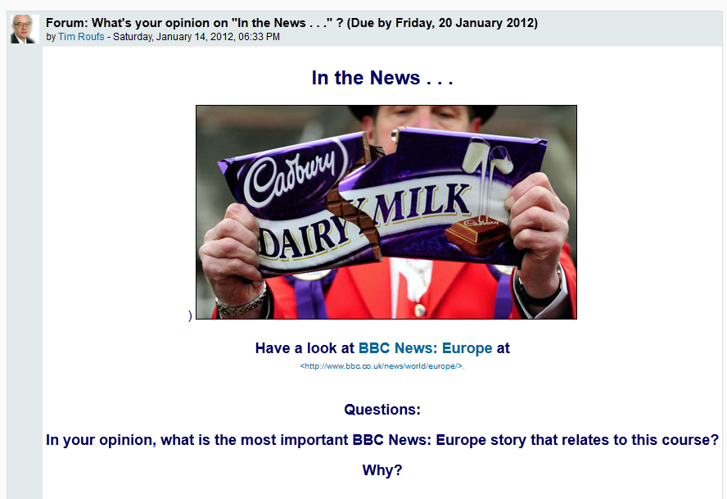
And the first Forum Materials will look something like this . . .

Slide 39
The first week . . .
introduce yourself
do the Pre-Assessment
join in on the Forum Discussion
and, just for the fun of it, have a look around at the rest of the materials

Slide 40
The listing for Week 1 will look something like this . . .

Slide 41
You may also access your Moodle folder via the Main UMD WebPage . . .
www.d.umn.edu

Slide 42
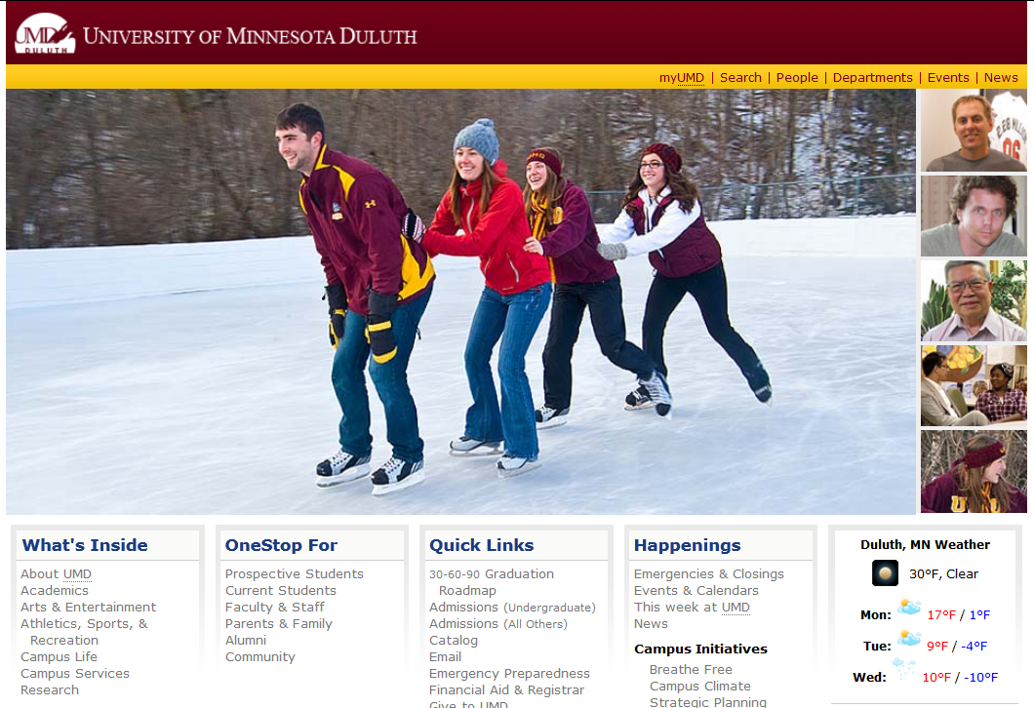
Main UMD WebPage . . .
(this image changes)
www.d.umn.edu

Slide 43
click on “OneStop For Current Students” . . .
(not the image that will appear)
www.d.umn.edu

Slide 44
Main UMD WebPage . . .
(this image changes)
Main UMD WebPage . . .
(this image changes)
www.d.umn.edu

Slide 45
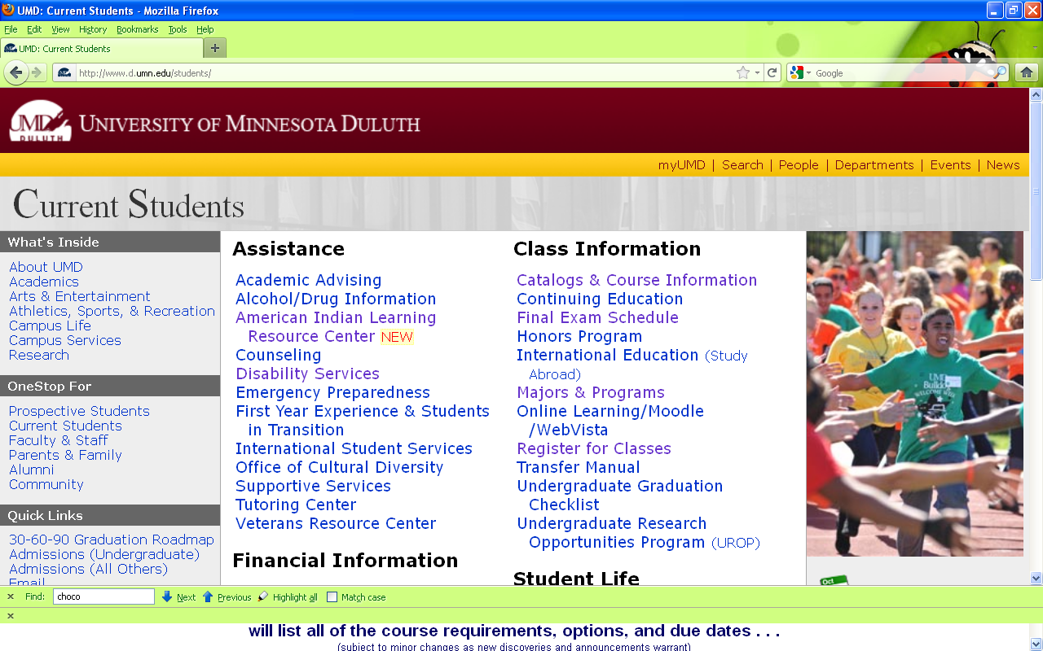
scroll down
http://www.d.umn.edu/students/

Slide 46
click on “Technology Resources for Students” . . .
http://www.d.umn.edu/itss/students/

Slide 47
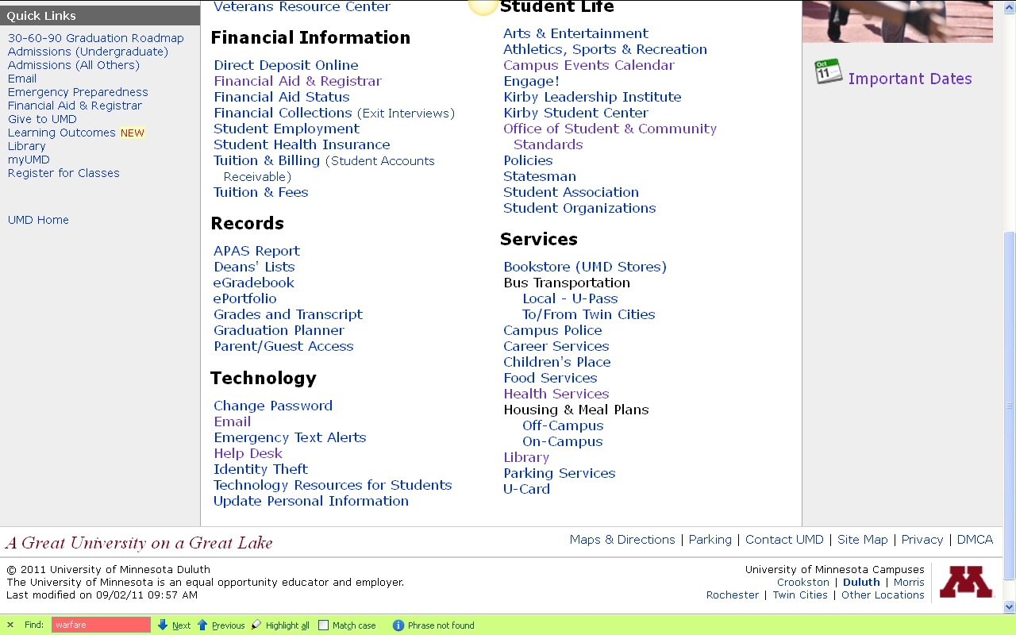
click on “Technology Resources for Students” . . .
click on “Technology Resources for Students” . . .
http://www.d.umn.edu/itss/students/

Slide 48
click on “Technology Resources for Students” . . .
http://www.d.umn.edu/itss/students/

Slide 49
then click on “Moodle Support” . . .
http://www.d.umn.edu/itss/students/

Slide 50
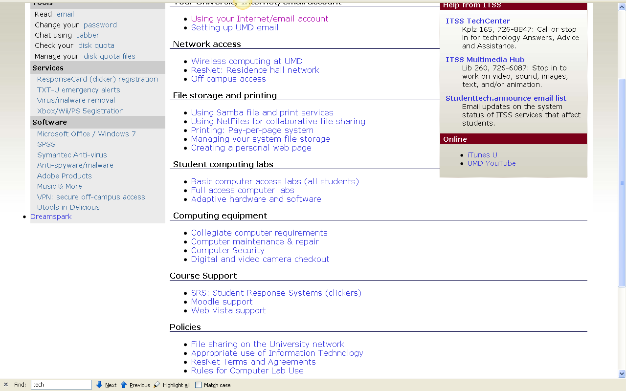
click on “Moodle Support” . . .
http://www.d.umn.edu/itss/students/

Slide 51
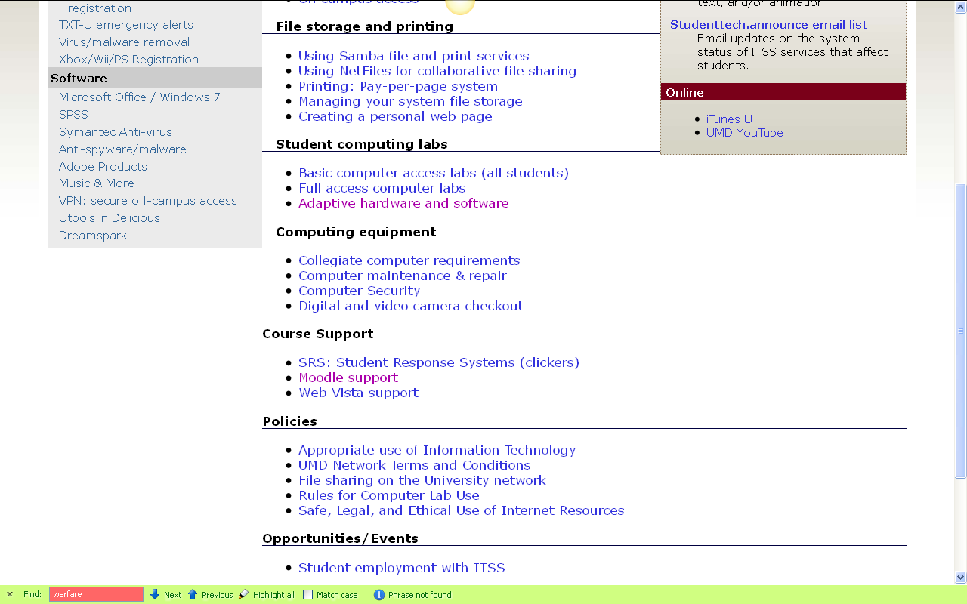
click on “Moodle Support” . . .
http://www.d.umn.edu/itss/students/

Slide 52
Your log-in page will look something like the following . . .
Log in using your “x.500” information . . .
(that’s the log-in information you use for your e-mail)
https://moodle.umn.edu/

Slide 53
Log in using your “x.500” information . . .

Slide 54
Your Moodle “home” will look something like the following . . .
https://moodle.umn.edu/

Slide 55
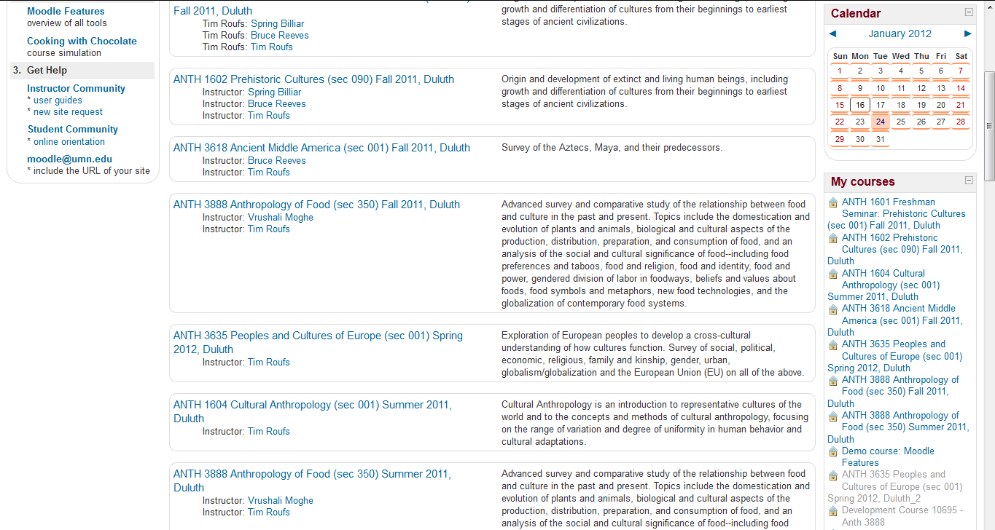
Your Moodle “home” will look something like this . . .
https://moodle.umn.edu/

Slide 56
Select Peoples and Cultures of Europe . . .
https://moodle.umn.edu/

Slide 57
Your Moodle “home” will look something like this . . .
https://moodle.umn.edu/

Slide 58
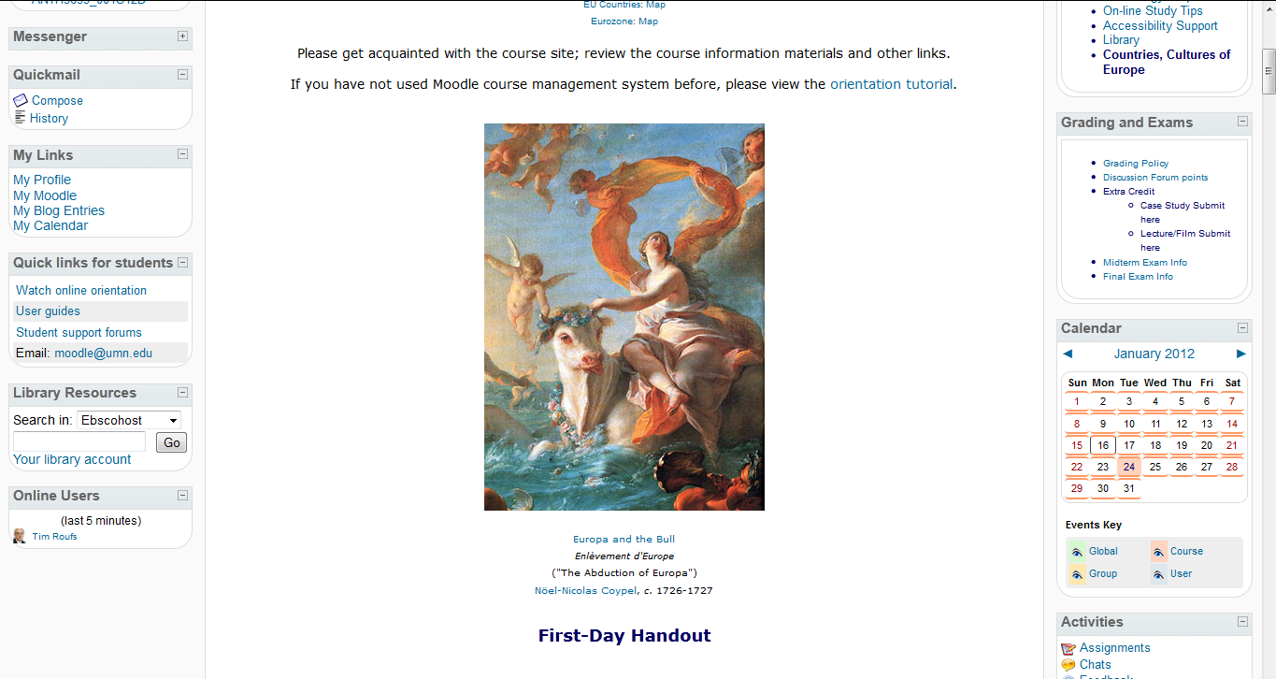
The “First-Day” Handout information below Europa . . .
https://moodle.umn.edu/

Slide 59
Select Prehistoric Cultures . . .
The “First-Day” Handout information contains the basic information . . .
It look something like the following . . .
https://moodle.umn.edu/

Slide 60
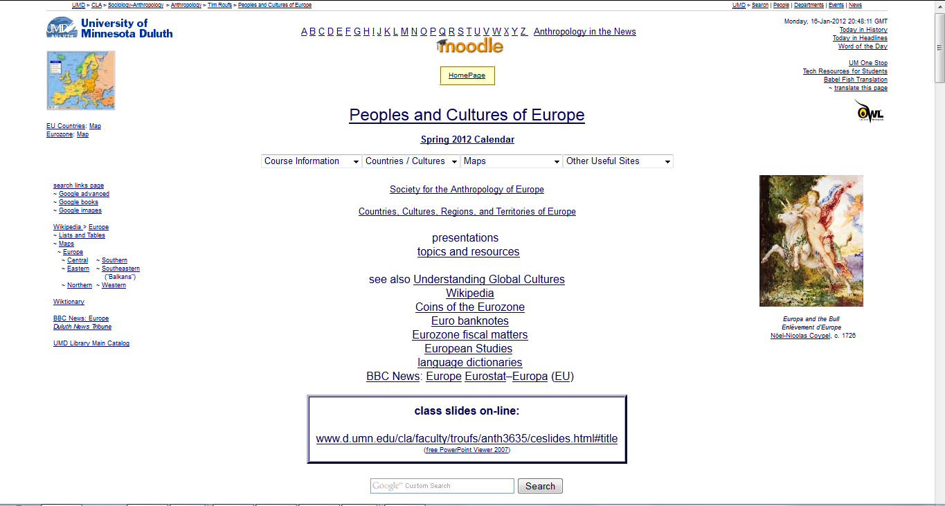
http://www.d.umn.edu/cla/faculty/troufs/anth3635/cehandout_first-day.html

Slide 61
scroll down
http://www.d.umn.edu/cla/faculty/troufs/anth3635/cehandout_first-day.html

Slide 62
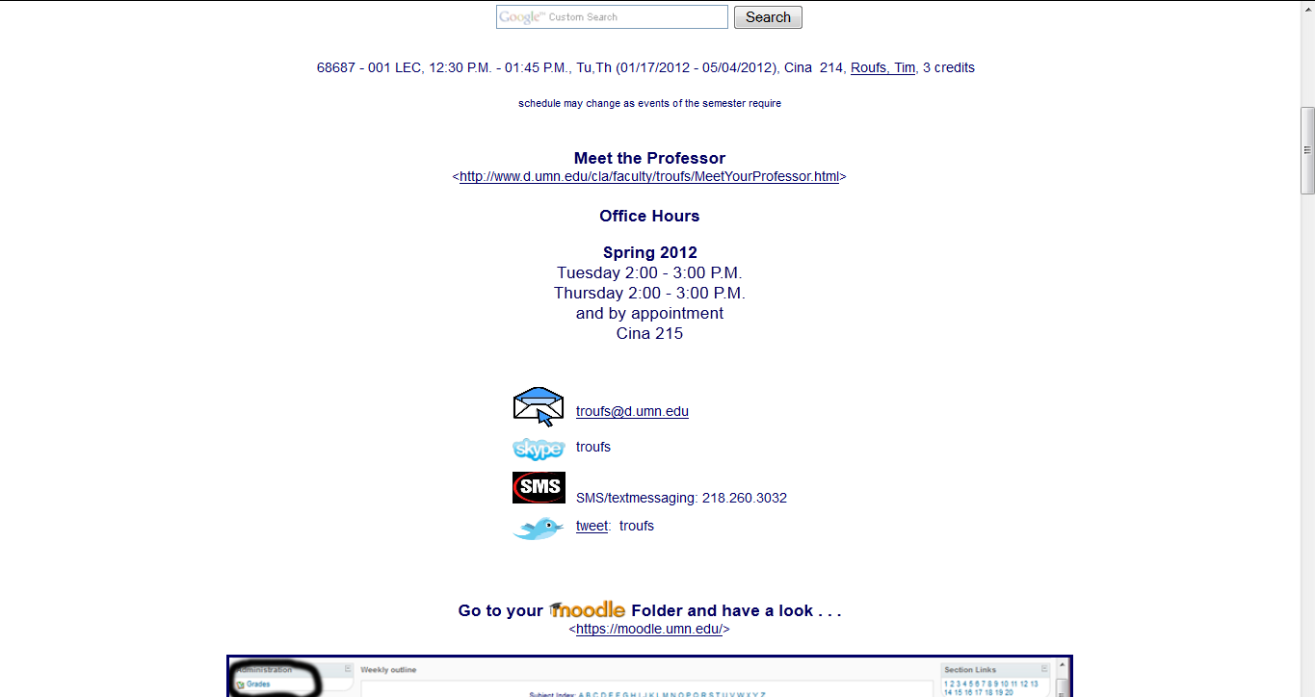
Basic Contact Information
http://www.d.umn.edu/cla/faculty/troufs/anth3635/cehandout_first-day.html

Slide 63
Basic Contact Information
scroll down
http://www.d.umn.edu/cla/faculty/troufs/anth3635/cehandout_first-day.html

Slide 64
Moodle “Block 1”

Slide 65
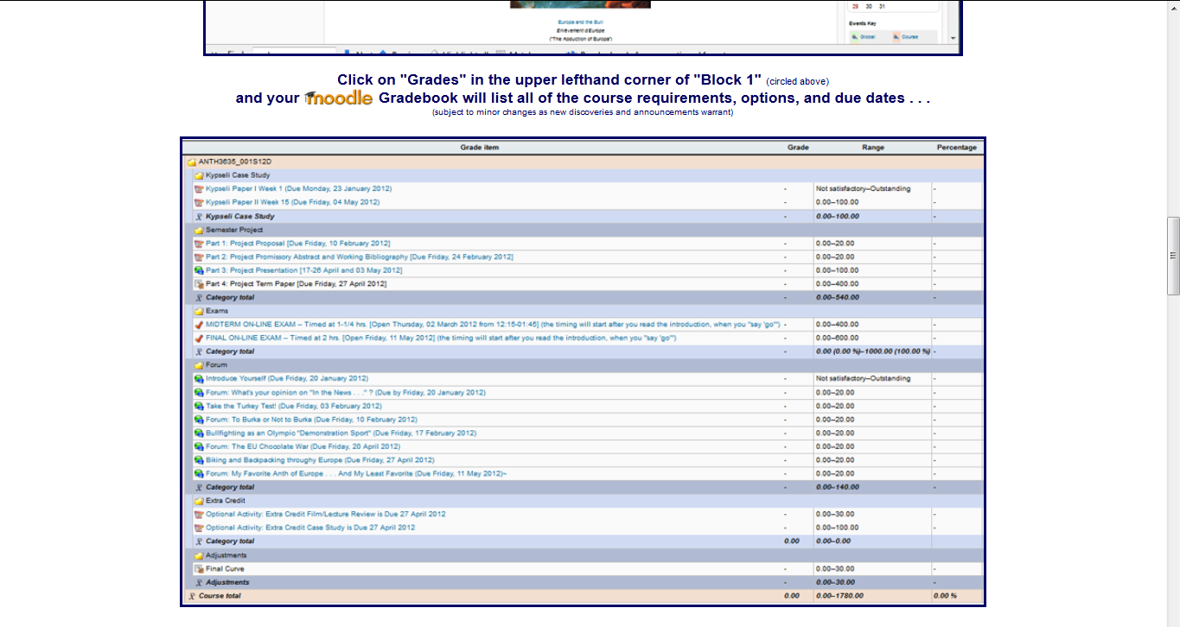
Moodle Grader

Slide 66
Basic Text Information
http://www.d.umn.edu/cla/faculty/troufs/anth3635/cehandout_first-day.html

Slide 67
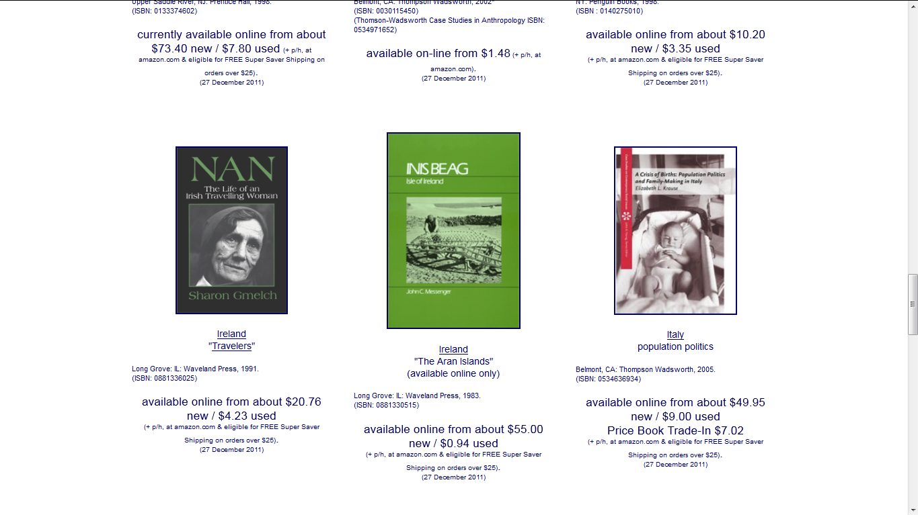
Basic Text Information
http://www.d.umn.edu/cla/faculty/troufs/anth3635/cehandout_first-day.html

Slide 68
Basic Text Information
including information on purchasing texts . . .
http://www.d.umn.edu/cla/faculty/troufs/anth3635/cehandout_first-day.html

Slide 69
Text:

Slide 70
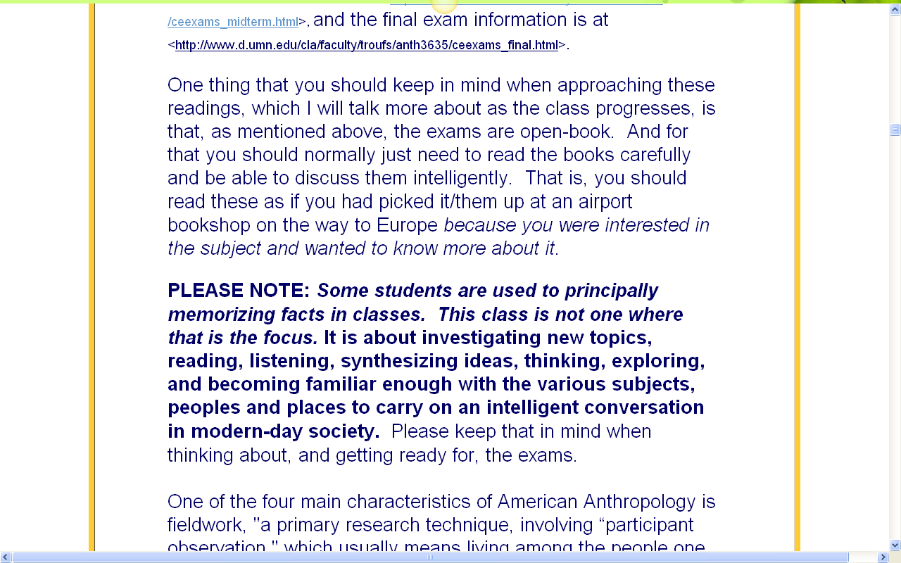
Text:

Slide 71
“Block 1” contains the basic information on the course . . .
Moodle “Block 1”

Slide 72
“Block 1” contains the basic information on the course . . .
Moodle “Block 1”

Slide 73
“Block 1” contains the basic information on the course . . .
Moodle “Block 1”

Slide 74
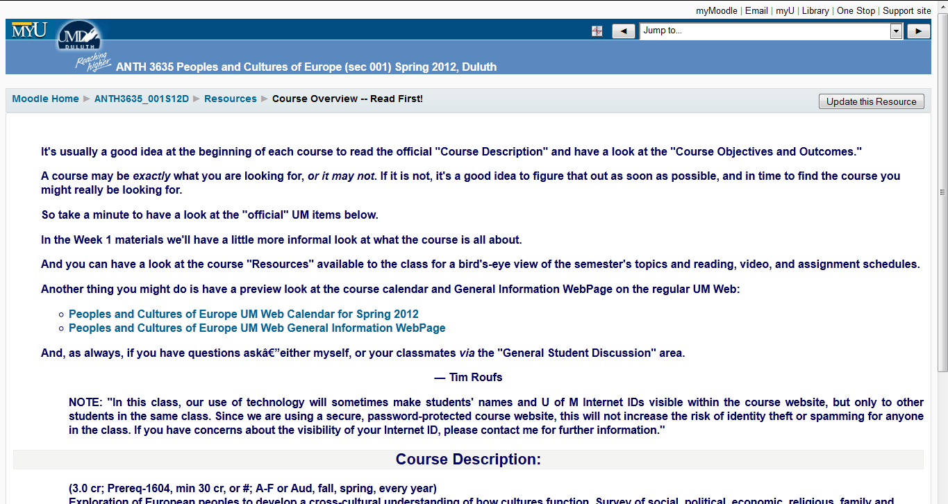

Slide 75
Governing Procedures
http://www.d.umn.edu/cla/faculty/troufs/anth3635/cehandout_first-day.html

Slide 76
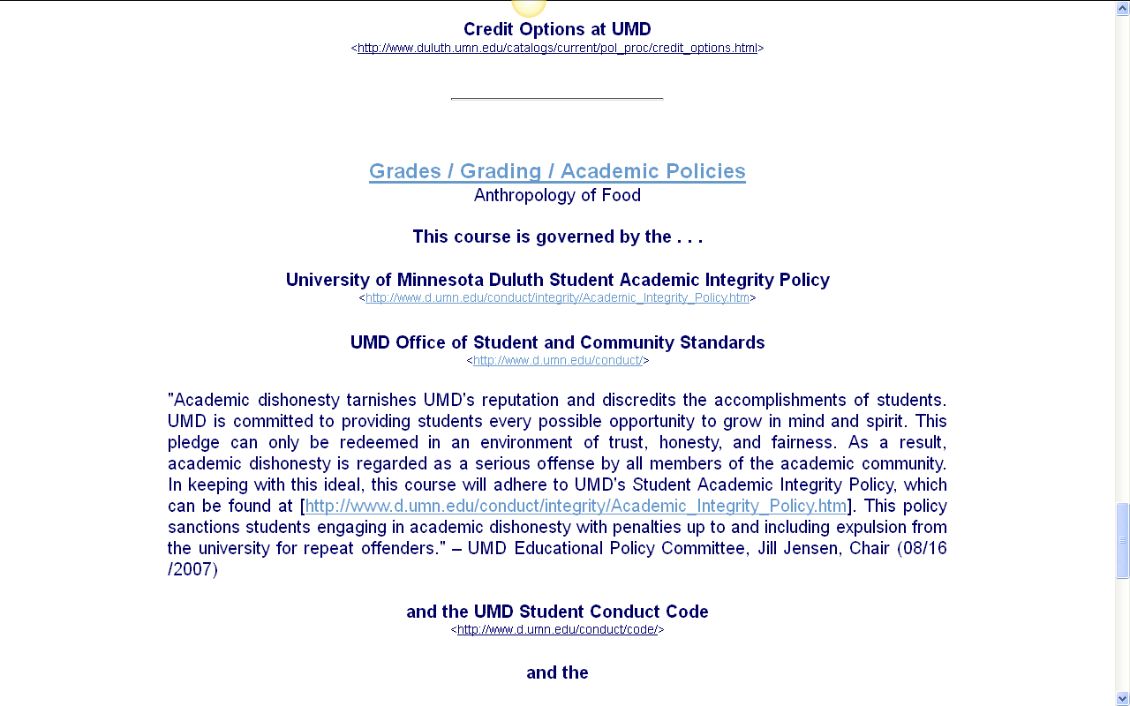
Governing Procedures
http://www.d.umn.edu/cla/faculty/troufs/anth3635/cehandout_first-day.html

Slide 77
Governing Procedures
http://www.d.umn.edu/cla/faculty/troufs/anth3635/cehandout_first-day.html

Slide 78
Governing Procedures
Governing Procedures
note on Extra Credit Papers
http://www.d.umn.edu/cla/faculty/troufs/anth3635/cehandout_first-day.html

Slide 79
Special Facilities
Information
http://www.d.umn.edu/cla/faculty/troufs/anth3635/cehandout_first-day.html

Slide 80
Moodle “Block 1”

Slide 81
Moodle “Block 1”
requirements, due dates, and grades

Slide 82
Moodle “Block 1”
requirements, due dates, and grades

Slide 83
Moodle “Block 1”
requirements, due dates, and grades

Slide 84
Moodle “Block 1”
requirements, due dates, and grades

Slide 85
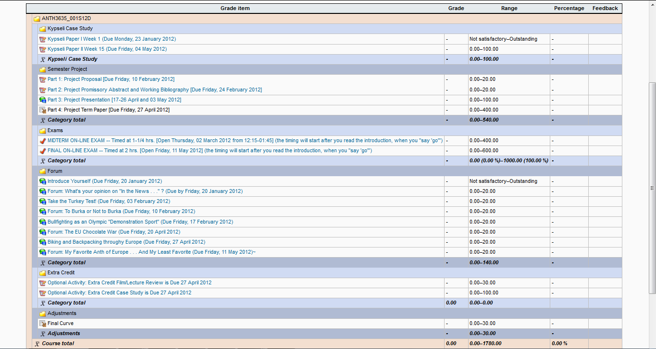
Your Gradebook
will look something like this

Slide 86
Your Gradebook
will look something like this
it lists course requirements, due dates, options, and grades . . .

Slide 87
Back to the main
Moodle page

Slide 88
“Block 1” contains the basic information on the course . . .

Slide 89
“Block 1” contains the basic information on the course . . .

Slide 90
“Block 1” contains the basic information on the course . . .

Slide 91
“Block 1” contains the basic information on the course . . .
“Major Due Dates” is a handy site

Slide 92
“Block 1” contains the basic information on the course . . .

Slide 94
“Block 1” contains the basic information on the course . . .

Slide 95
“Block 1” contains the basic information on the course . . .

Slide 96
“Block 1” contains the basic information on the course . . .

Slide 97
“Block 1” contains the basic information on the course . . .

Slide 98
Back to the main
Moodle page
REM

Slide 99
Reading Assignments

Slide 100
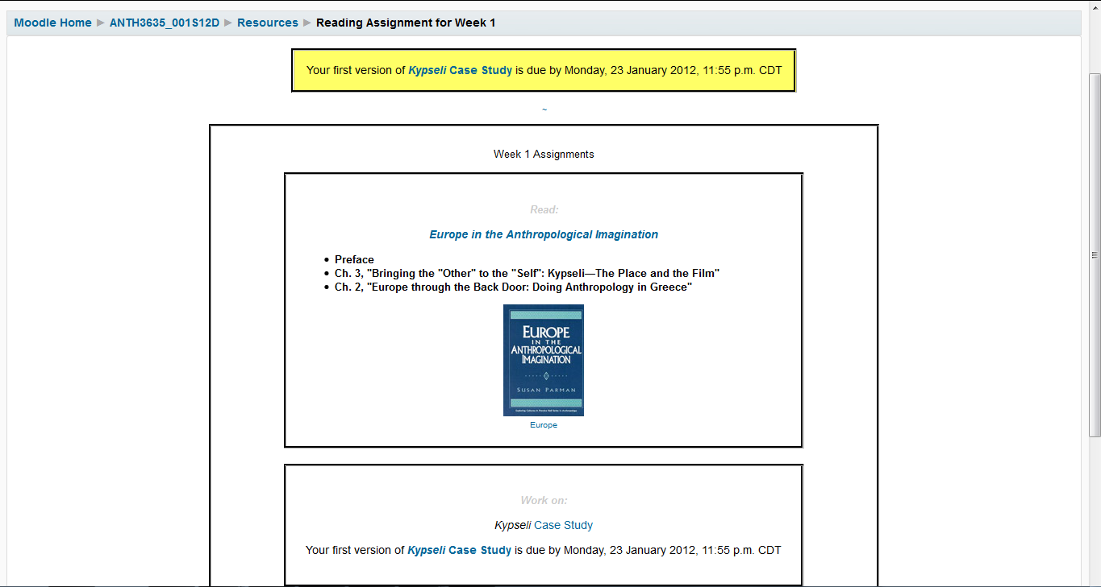
Reading Assignments for Week 1

Slide 101
REM: Don’t‘ forget the Activities . . .

Slide 102
And, if you haven’t already done so,
have a look at the
Orientation Materials

Slide 103
Your Moodle screen will look something like this . . .

Slide 104
Your Moodle screen will look something like this . . .

Slide 105
Your Moodle screen will look something like this . . .

Slide 106
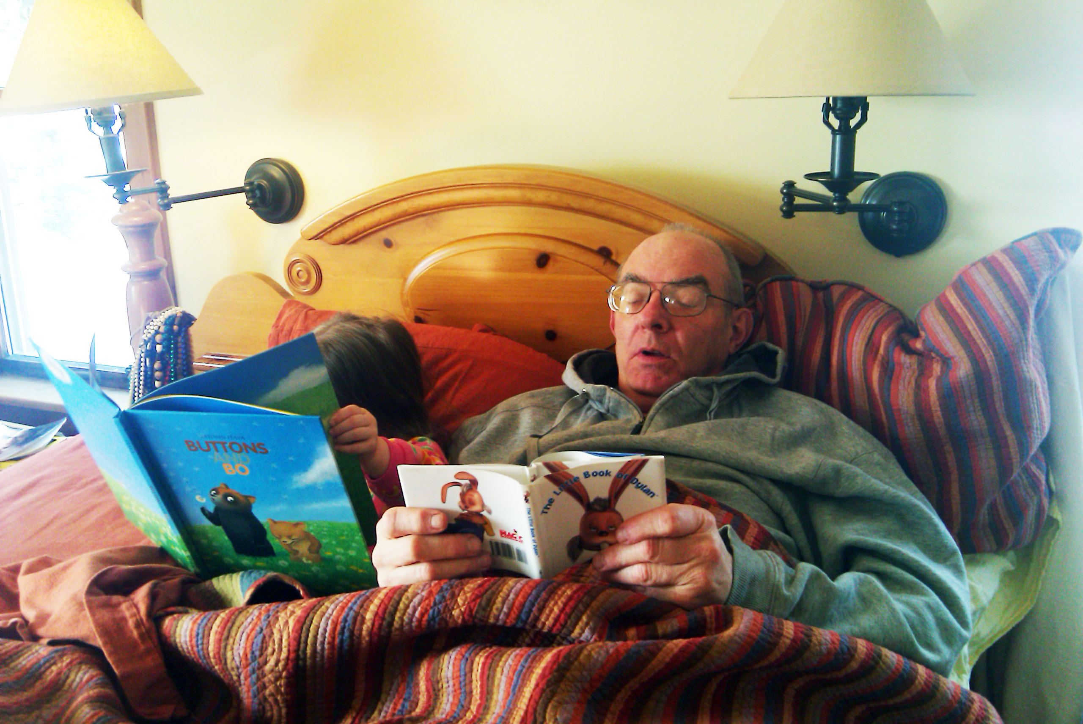
And, for the fun of it,
have a look at the
“Meet Your Professor” Materials

Slide 107
Why?

Slide 108
Research shows that people who know a little about their teachers . . .

Slide 109
Research shows that people who know a little about their teachers . . .
Learn more . . .

Slide 110
Research shows that people who know a little about their teachers . . .
Learn more . . .
Remember it better . . .

Slide 111
Research shows that people who know a little about their teachers . . .
Learn more . . .
Remember it better . . .
Have more fun learning . . .

Slide 112
one more piece
of useful information . . .

Slide 113
At the very top of “Block 1” you will see an alphabet. Clicking on a letter will bring you to a page that indexes course WebPages for virtually all of the scheduled topics and items in the course.

Slide 115
This information is very useful

Slide 116
How useful?

Slide 117
in the last three years there have been 292,000+ page visits to the
Anthropology of Europe course page . . .

Slide 118
in the last three years there have been 292,000+ page visits to the
Anthropology of Europe course page . . .

Slide 119
to access a topic simply click on a letter to go to an index page . . .

Slide 120
to access a topic simply click on a letter to go to an index page . . .

Slide 121
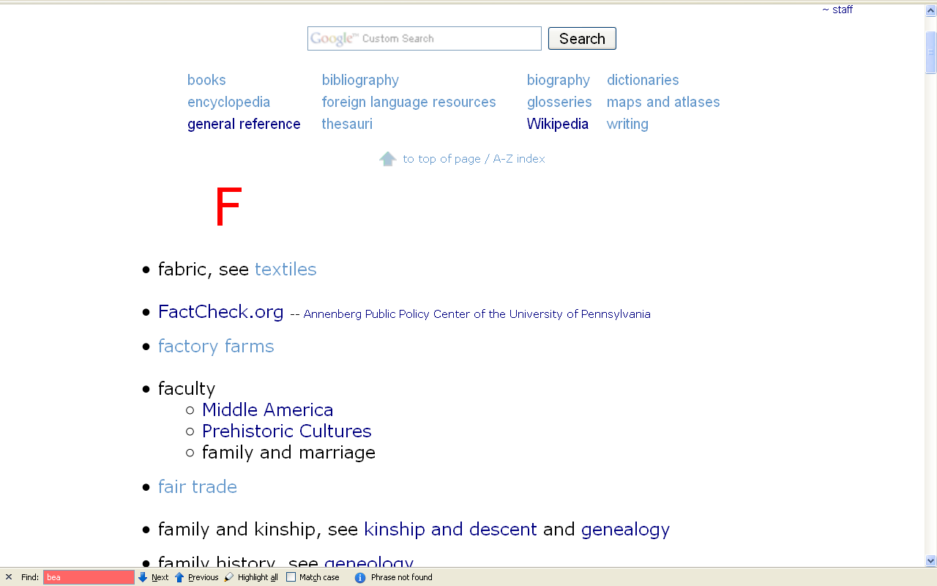
and from the index page click on the item you want . . .

Slide 122
scroll down for more items

Slide 123
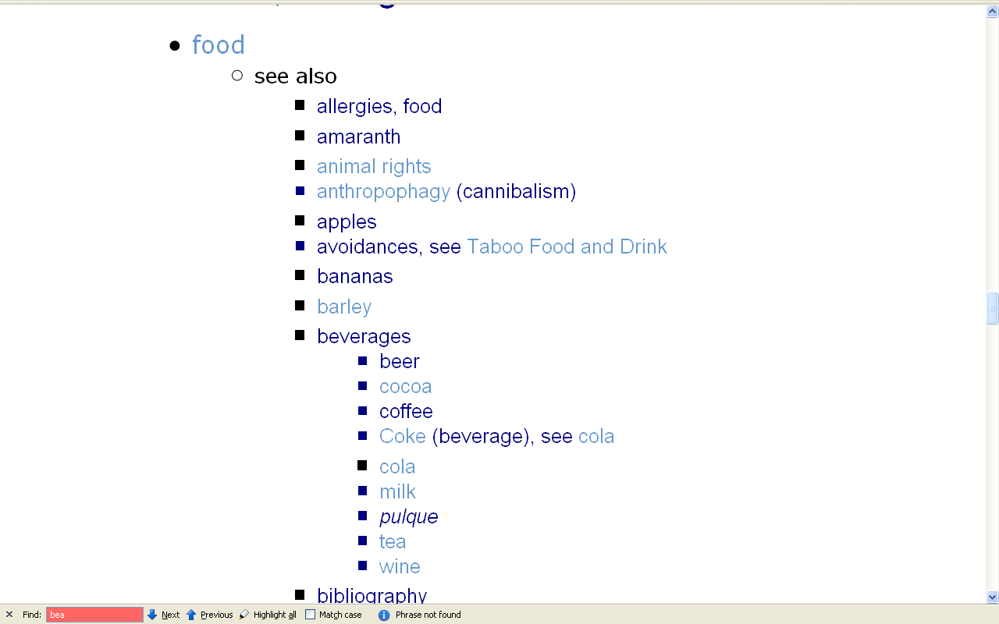
scroll down

Slide 124
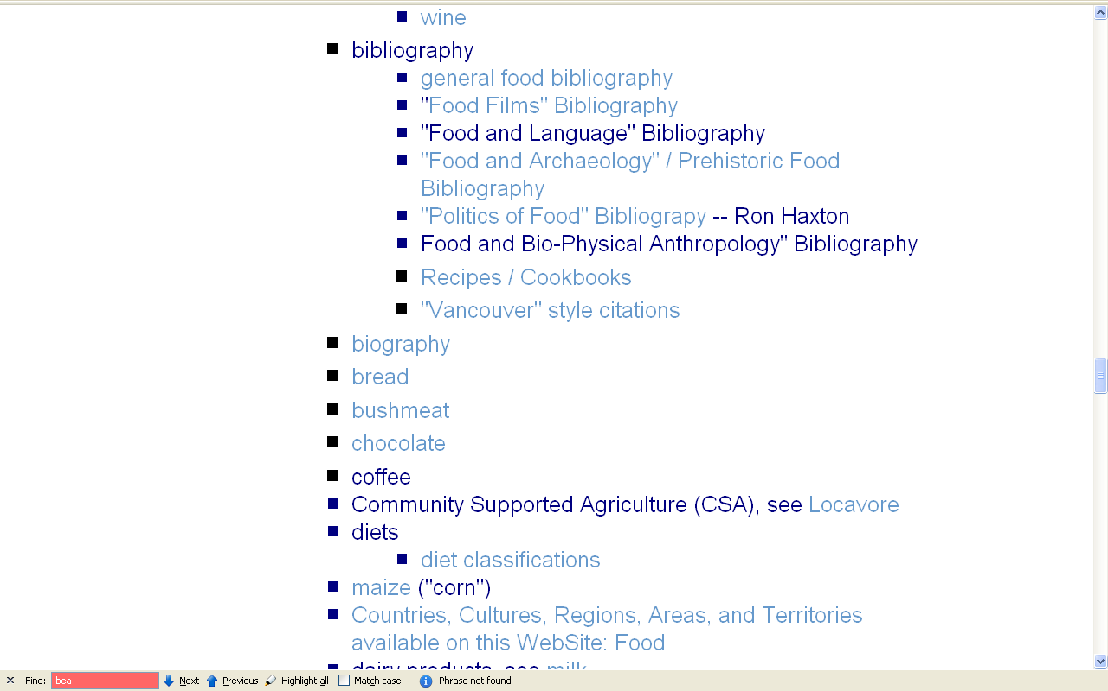
click on item . . . and . . .

Slide 125
voilà

Slide 126
Next Time . . .

Slide 128
Laptops
Welcome
(in fact, they’re encouraged)

Slide 129
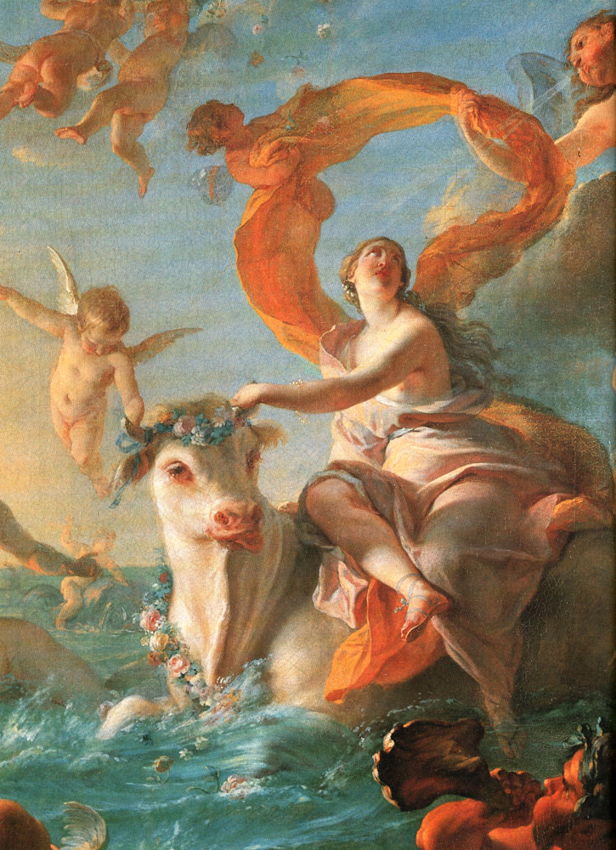
And, once again . . .
Once Again . . .
Welcome to
Peoples and Cultures
of Europe
Enjoy your stay!
Enlèvement d'Europe
Nöel-Nicolas Coypel
1726-1727
University of Minnesota Duluth
Tim Roufs’ © 2009-2015
http://www.d.umn.edu/cla/faculty/troufs/anth3635/

