Slide 1

Other
Important
Terms
re Psychological Anthropology
University of Minnesota Duluth
University of Minnesota Duluth
Tim Roufs
© 2010-2016

Slide 2
. . . and one or more of these term clarifications
might prove interesting, and even helpful with your class project

Slide 3


Slide 4
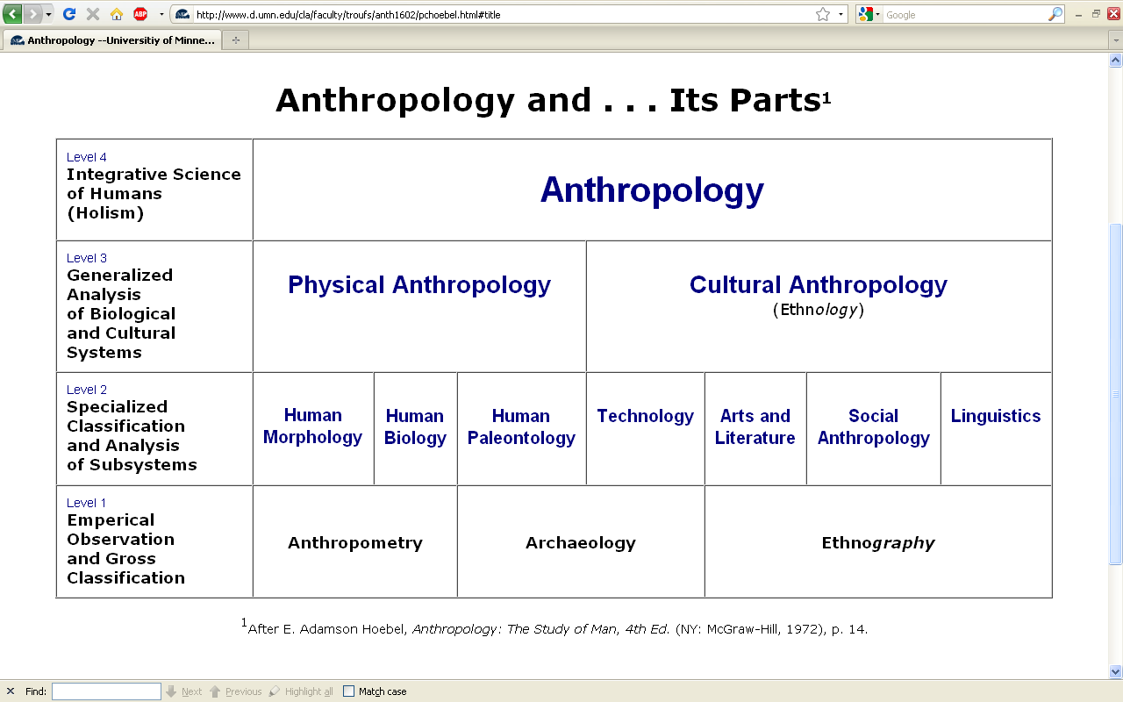
This is the same chart as in the
“Main Characteristics of Anthropology”
material

Slide 5
difficult terms

Slide 6
ethnography
  scientific description of cultures
  (“a portrait of a people”)

Slide 7
ethno – graphy
  graph from the Greek, meaning something “written” or “drawn”

Slide 8
ethno – graphy
  ethnography looks at “who,” “what,” “where” and “when”

Slide 9
ethnology
  comparative study of cultures

Slide 10
ethn – ology
  comparative study of cultures

Slide 11
ethn – ology
  ethnology looks at “why” and “how”

Slide 12
ethnology
  comparative study of cultures

Slide 13
ethnology
  comparative study of cultures
Take out the n and that yields an entirely different word . . .

Slide 14
ethology
  comparative study of cultures
  scientific study of the social behavior of animals, especially in their natural environments

Slide 15
primatology
  scientific study of the social behavior of primates, especially (non-human primates) apes and monkeys

Slide 16
primatology
  scientific study of the social behavior of primates, especially (non-human primates) apes and monkeys
We’ll see this in
Ch. 2, “Diet and Human Evolution”

Slide 17
“primatologist”
  usually refers to one who studies the behavior and social lives of chimpanzees, gorillas, orangutans, monkeys, etc.
      e.g., Jane Goodall, Diane Fossy
      Birute Galdikas-Brindamour

Slide 18
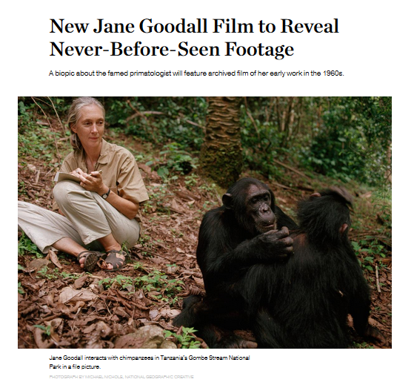
The new film (2016) will premiere
on the National Geographic Channel
in 171 countries and 44 languages.
(21 January 2016)
Jane Goodall is the most famous primatologist of all time – including human primates

Slide 19
“primates” include
    prosimians (“pre-monkeys”)
    monkeys
    apes
    and also humans

Slide 20
include
“primates”
    prosimians (“pre-monkeys”)
    monkeys
    apes
    and also humans

Slide 21
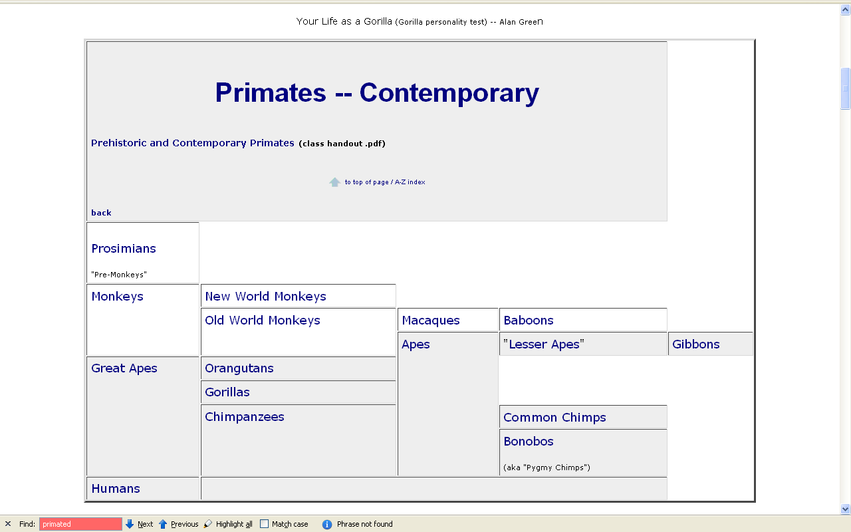
www.d.umn.edu/cla/faculty/troufs/anth1602/pcprim.html

Slide 22
“non-human primates” are
  prosimians (“pre-monkeys”)
  monkeys
  apes

Slide 23
“non-human primates”
www.d.umn.edu/cla/faculty/troufs/anth1602/pcprim.html

Slide 24
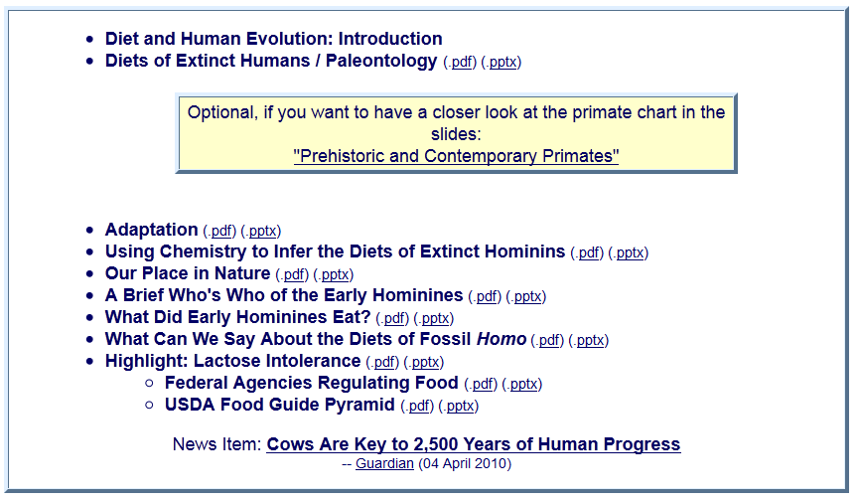
With regard to non-human primates, note one major relatively recent change

Slide 25
“hominins” is now generally used rather than “hominids”

Slide 26
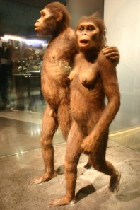
This reflects a relatively recent change in the classification of the Great Apes and many new prehistoric forms like “Lucy” . . . through the newest discovery, Homo naledi
“hominins” is now generally used rather than “hominids”

Slide 27
other important terms include . . .

Slide 28
ethnocentrism
  judging other cultures by the standards of one’s own culture rather than by the standards of that particular culture

Slide 29
two fundamental concepts in anthropology are . . .
ethnocentrism
  judging other cultures by the standards of one’s own culture rather than by the standards of that particular culture
cultural relativism

Slide 30
ethnocentrism
  is the mindset of judging other cultures by the standards of one’s own culture rather than by the standards of that particular culture

Slide 31
cultural relativism
  refers to the perspective that each culture must be understood in terms of the values and ideas of that culture and should not be judged by the standards of another

Slide 32
in recent times two types of cultural relativism have emerged . . .
cultural relativism
  absolute cultural relativism
  critical cultural relativism

Slide 33
the term as originally proposed came to be referred to as . . .
in recent times two types of cultural relativism have emerged . . .
cultural relativism
  absolute cultural relativism
  critical cultural relativism

Slide 34
absolute cultural relativism
  the perspective that says a person from one culture should not question the rightness or wrongness of behavior or ideas in other cultures because that would be ethnocentric

Slide 35
absolute cultural relativism
  was quickly criticized as unacceptable as, taken literally, [absolute] cultural relativism suggested we should accept anything and everything that was thought to be OK by the people under consideration

Slide 36
absolute cultural relativism
  critics quickly pointed to Hitler and the World War II Holocaust and (rightfully) said that no one should accept behaviors that resulted in The [WW II] Holocaust; that such behavior was unacceptable under any circumstances

Slide 37
absolute cultural relativism
  and the critics added enough other examples so that the original concept of cultural relativism was modified and resulted in today’s concept of
  critical cultural relativism

Slide 38
critical cultural relativism
  offers an alternative view that poses questions about cultural practices and ideas in terms of who accepts them and why, and who they might be harming or helping

Slide 39
critical cultural relativism . . .
answered many of the early critics
But—even accepting the modified concept—it is oftentimes not easy to figure out what “. . . in terms of who accepts them and why, and who they might be harming or helping” means

Slide 40
critical cultural relativism . . .
Let’s look at a few examples of where
“it is oftentimes not easy to figure out what ‘. . . in terms of who accepts them and why, and who they might be harming or helping’ means” . . .

Slide 41
absolute cultural relativism
  How about?
  Doctor Assisted Suicide
  arranged “underage” marriage
  female genital mutilations
  withholding of medical treatment of children for religious reasons
  polygyny
  marriage of first cousins . . .

Slide 42

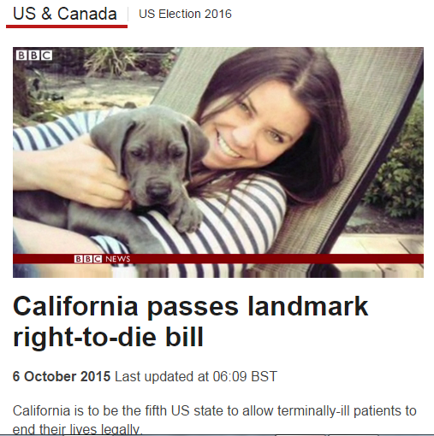
http://www.bbc.com/news/world-us-canada-34451379

Slide 43
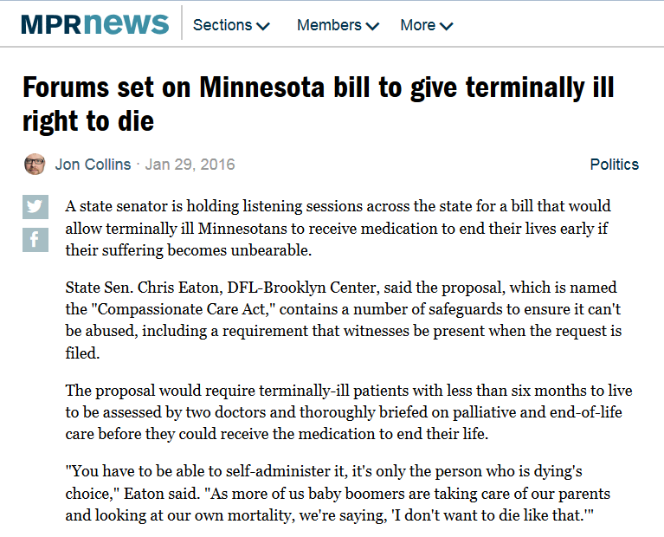
http://www.mprnews.org/story/2016/01/29/minnesota-right-to-die-bill-forums-set

Slide 44
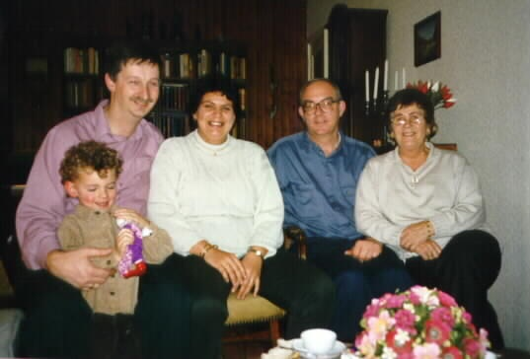
in many places doctor assisted suicide is legal, perfectly acceptable to many if not most, of the members of a culture

Slide 45
is that OK?

Slide 46
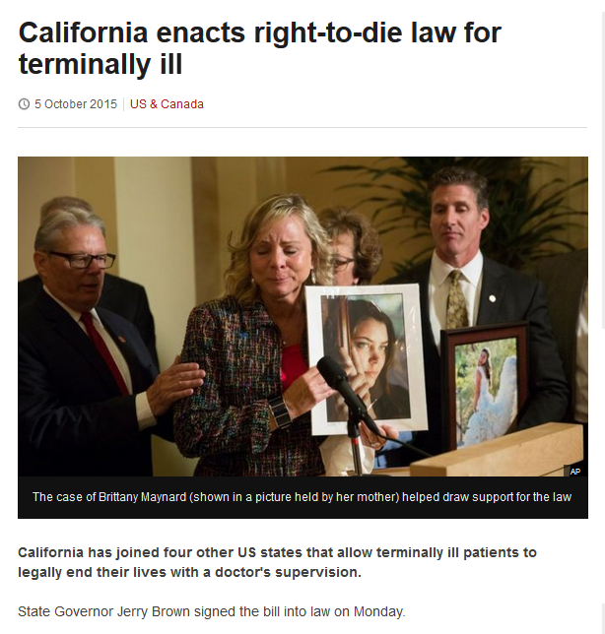
http://www.bbc.com/news/world-us-canada-34450058?ocid=global_bbccom_email_06102015_top+news+stories

Slide 47
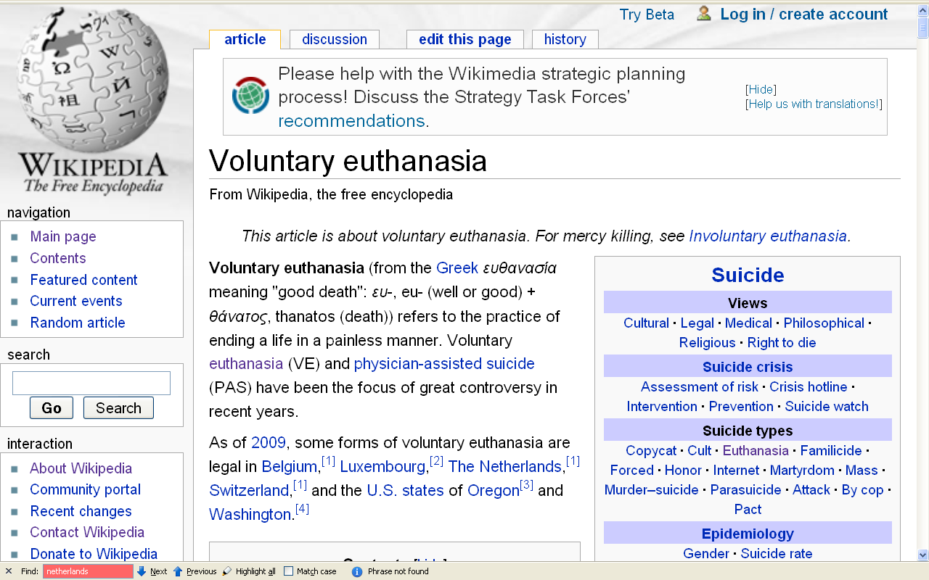
people living in the states of Oregon and Washington, and the countries of Belgium, Luxembourg, The Netherlands and Switzerland think so (for e.g.)
\ http://en.wikipedia.org/wiki/Voluntary_euthanasia

Slide 48
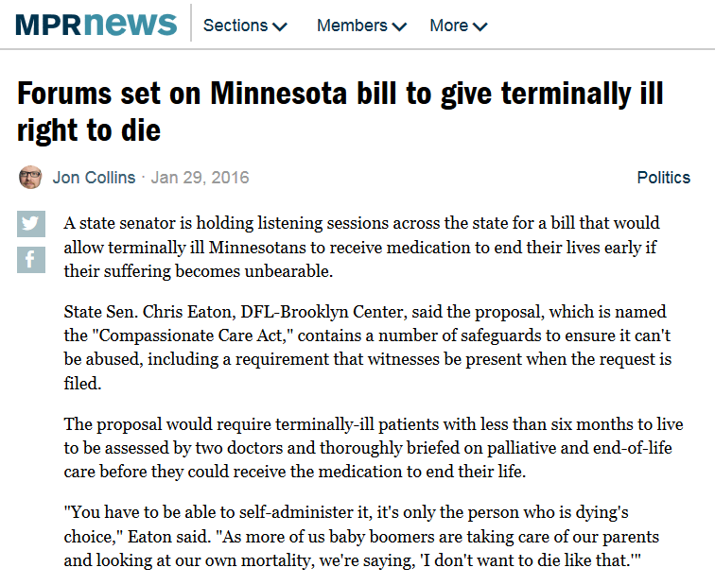
http://www.mprnews.org/story/2016/01/29/minnesota-right-to-die-bill-forums-set

Slide 49
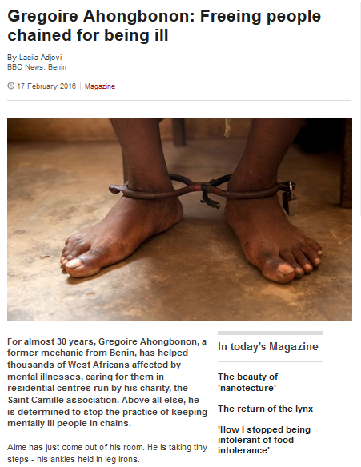
http://www.bbc.com/news/magazine-35586177?ns_mchannel=email&ns_source=inxmail_newsletter&ns_campaign=news_magazine_170216

Slide 50
absolute cultural relativism
  How about?
  Doctor Assisted Suicide
  arranged “underage” marriage
  female genital mutilations
  withholding of medical treatment of children for religious reasons
  polygyny
  marriage of first cousins . . .

Slide 51
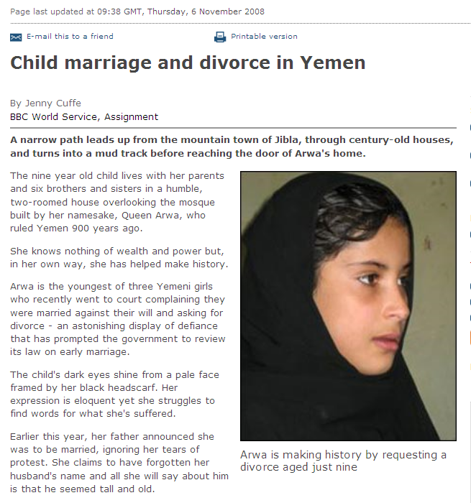
a 9-year-old requests a divorce in Yemen
http://news.bbc.co.uk/2/hi/middle_east/7711554.stm
Notes:
51

Slide 52
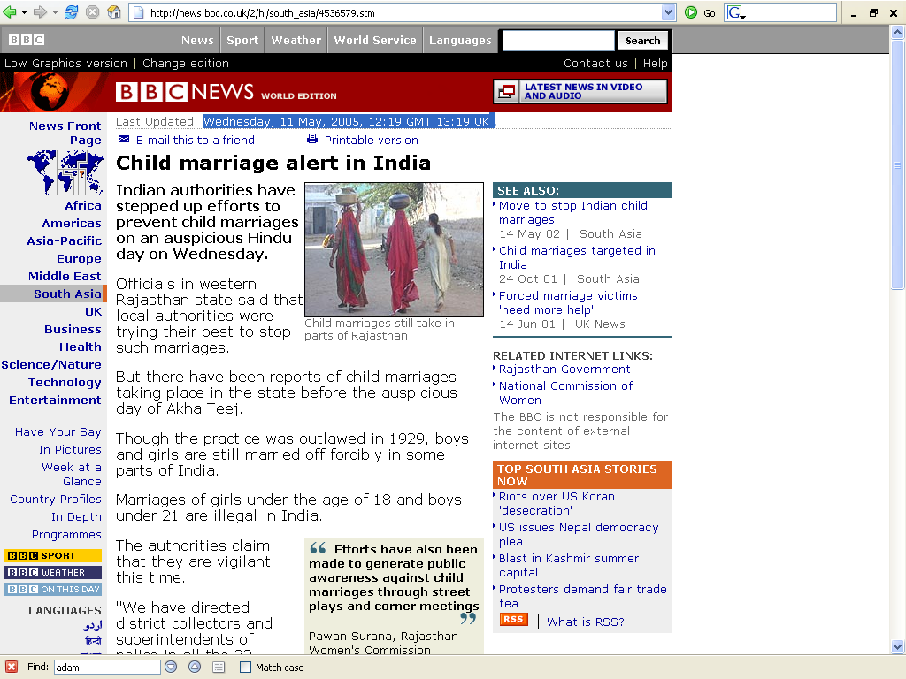
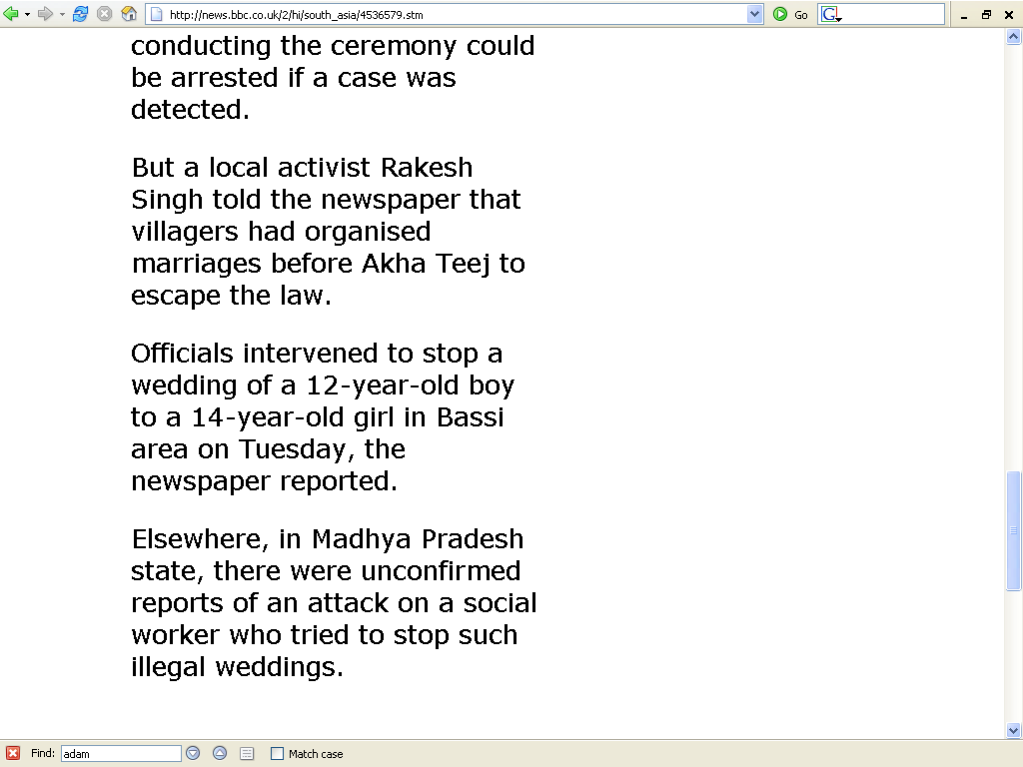
http://news.bbc.co.uk/2/hi/south_asia/4536579.stm

Slide 53
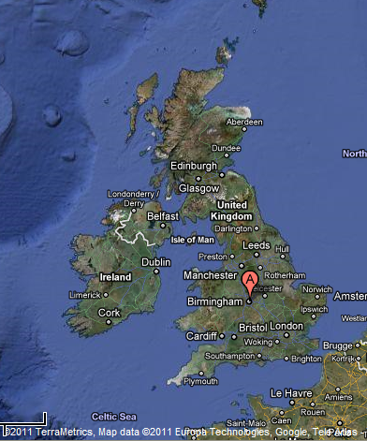
Birmingham, England
1985 Asian Teen HelpLine
received 1,400 calls / month

Slide 54
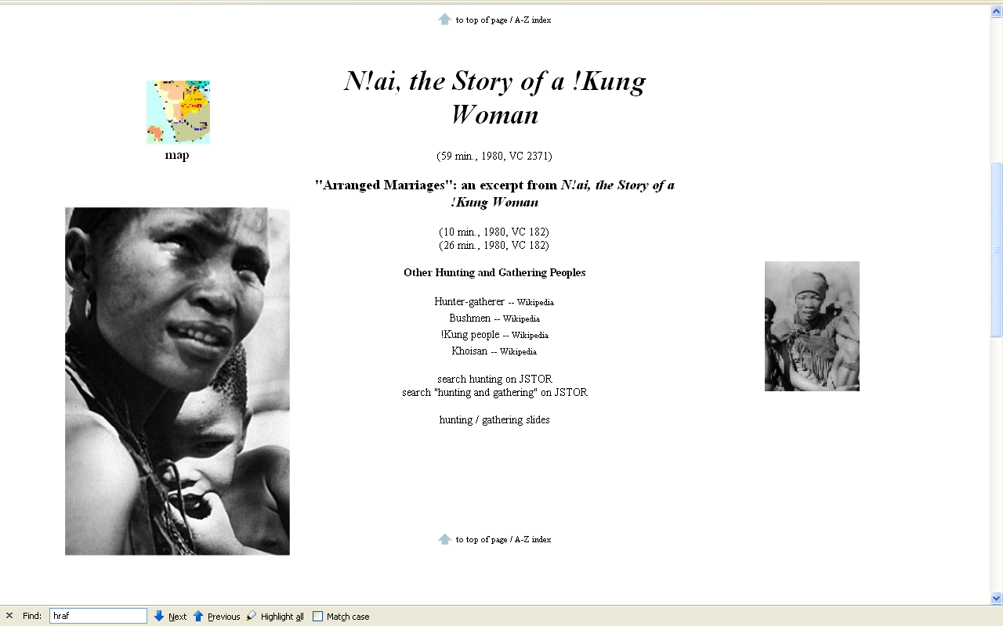
N!ai, one of the little girls in the film The Hunters,
was married to Gunda at the age of 8

Slide 55
absolute cultural relativism
  How about?
  Doctor Assisted Suicide
  arranged “underage” marriage
  female genital mutilations
  withholding of medical treatment of children for religious reasons
  polygyny
  marriage of first cousins . . .

Slide 56
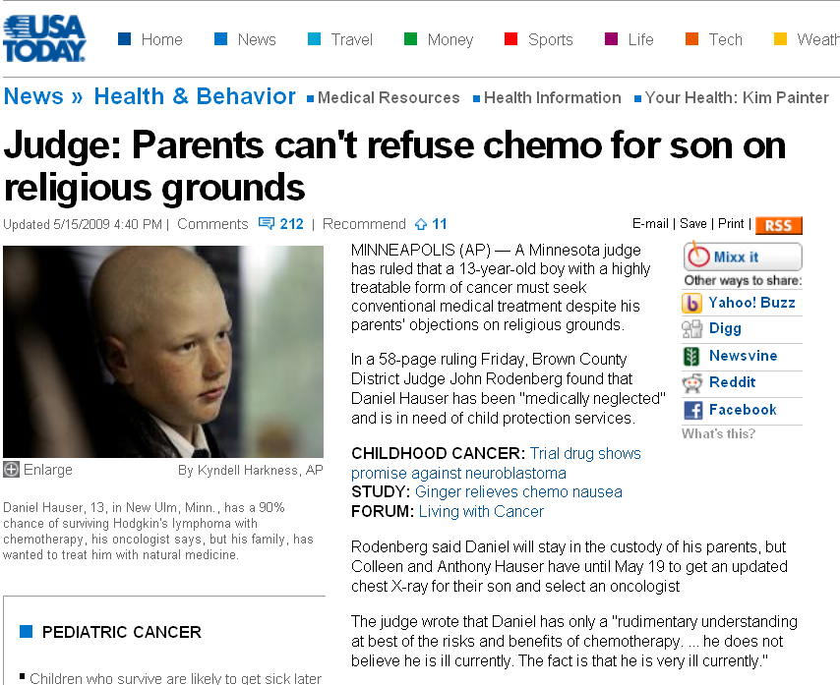
this is in Minnesota, not Africa
www.usatoday.com/news/health/2009-05-15-forced-chemotherapy_N.htm

Slide 57
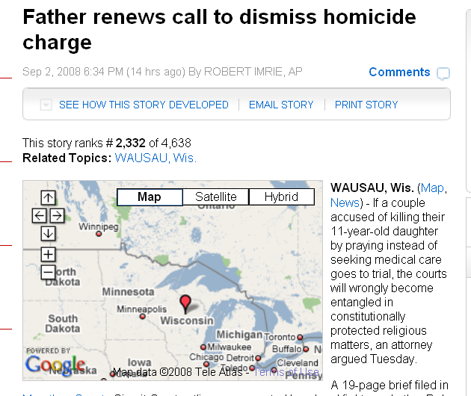
this is in Wisconsin, not Minnesota
www.examiner.com/a-1567034~Father_renews_call_to_dismiss_homicide_charge.html

Slide 58
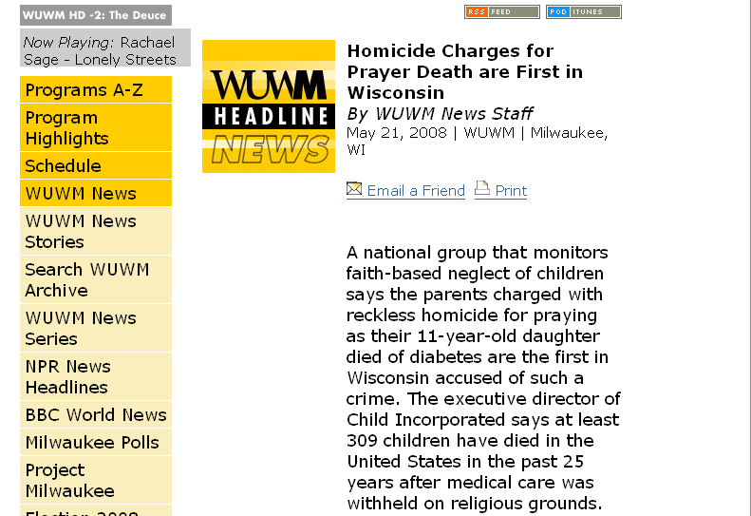
www.wuwm.com/programs/news/view_news.php?articleid=2242

Slide 59
absolute cultural relativism
  How about?
  Doctor Assisted Suicide
  arranged “underage” marriage
  female genital mutilations
  withholding of medical treatment of children for religious reasons
  polygyny
  marriage of first cousins . . .

Slide 60

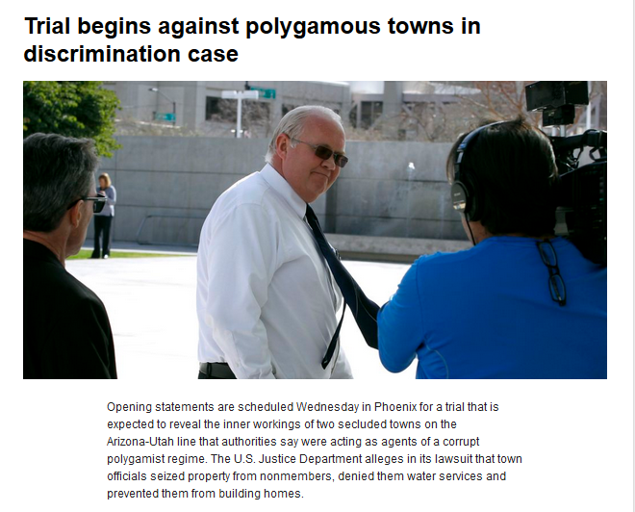
  20 January 2016
https://www.yahoo.com/digest/20160120/trial-begins-polygamous-towns-discrimination-case-01399592

Slide 61
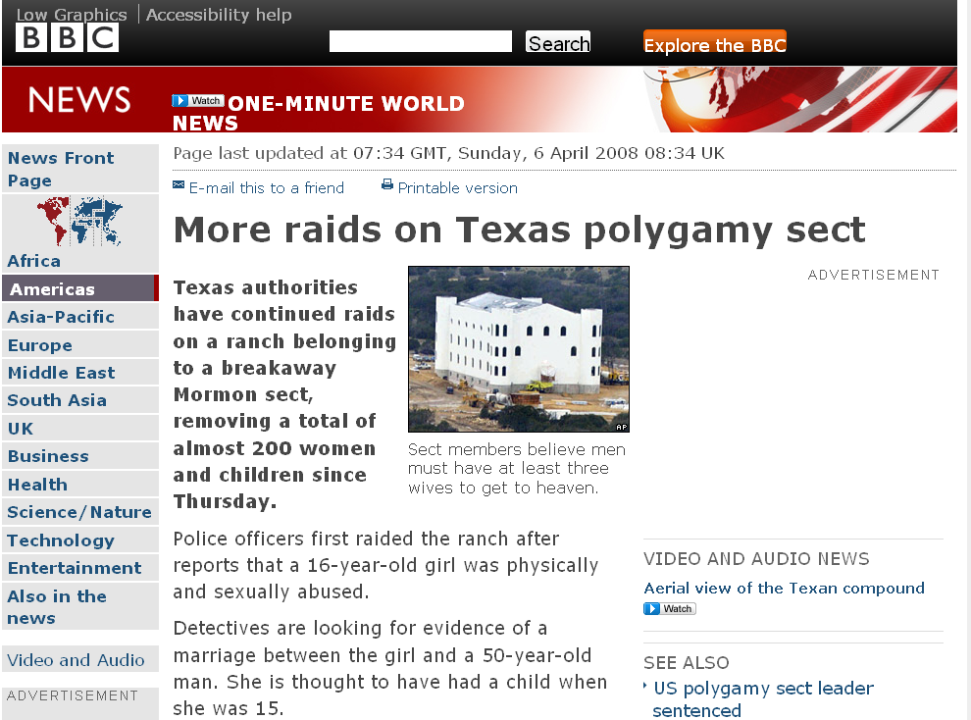
http://news.bbc.co.uk/2/hi/americas/7333004.stm

Slide 62
absolute cultural relativism
  How about the
  State of Texas authorities feeding food with preservatives to the Mormon children when they had them in custody?
  Doctor Assisted Suicide
  arranged “underage” marriage
  female genital mutilations
  withholding of medical treatment of children for religious reasons
  polygyny . . .

Slide 63
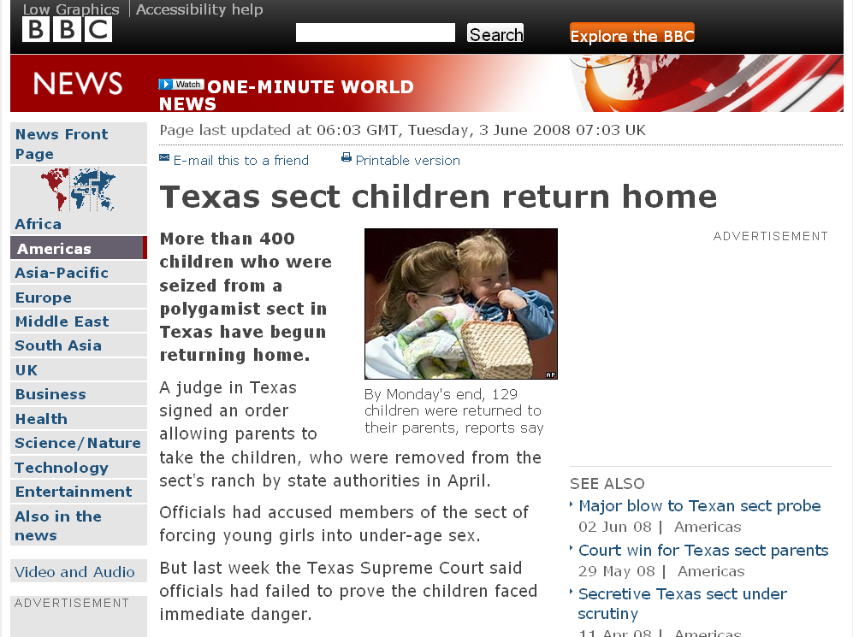
one of the complaints of the Mormons of Texas in court was that the State of Texas
was poisoning their children
with their [State provided] food
(with all it’s additives, sugars,
fats . . .)
http://news.bbc.co.uk/2/hi/americas/7431848.stm

Slide 64

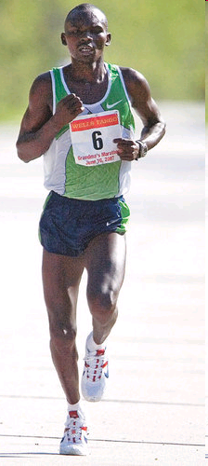
Grandma's Marathon: Remembering a fallen champion
Kevin Pates Duluth News Tribune
Published Sunday, June 15, 2008
There will be a moment of silence before the start of Saturday’s 32nd Grandma’s Marathon.
Standing on North Shore Drive, just south of Two Harbors, Stephen Muturi will gather his thoughts and emotions before the day’s task of running 26.2 miles.
He’ll remember close friend and countryman Wesly Ngetich, last year’s champion, who was killed Jan. 21 at Emarti village in Kenya’s Trans Mara district. Ngetich was caught in the middle of an incident that turned violent. He was 31 and had two wives and three children, ages 8, 6 and 1. “Wesly was a peacemaker. . . .”
www.duluthnewstribune.com/articles/index.cfm?id=68557
Notes:
64

Slide 65
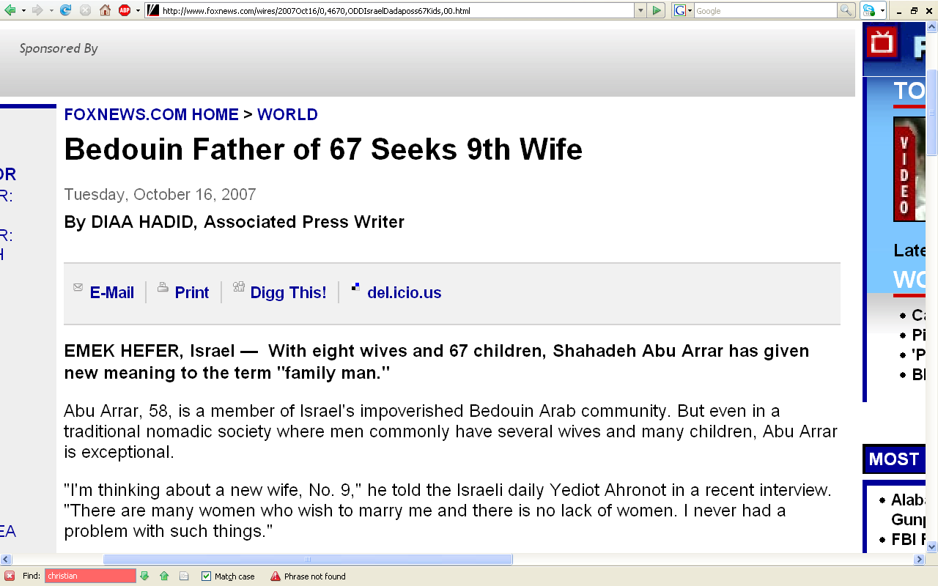
http://www.foxnews.com/wires/2007Oct16/0,4670,ODDIsraelDadaposs67Kids,00.html

Slide 66
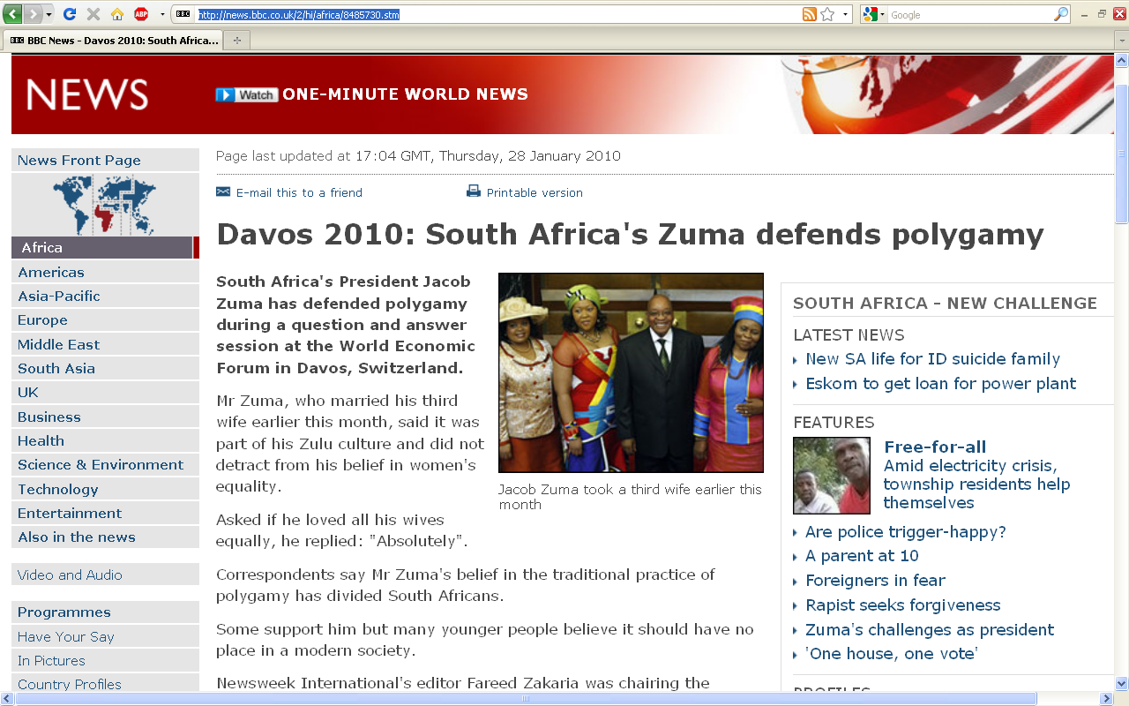
http://news.bbc.co.uk/2/hi/africa/8485730.stm
Notes:
66

Slide 67
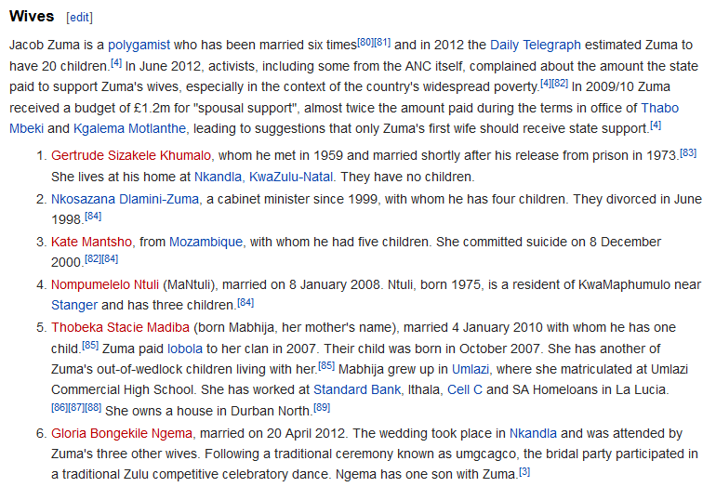
  How does the White House hadle official protocol at a state dinner when the President / Prime Minister of the other country has three or more wives?

Slide 68
  How does the White House handle official protocol at a state dinner when the President / Prime Minister of the other country has three or more wives?

Slide 69
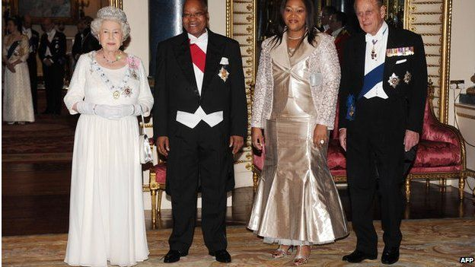
President Zuma attended a banquet at Buckingham Palace in 2010 with one of his wives, Tobeka Madiba Zuma
BBCNews

Slide 70
absolute cultural relativism
  How about?
  Doctor Assisted Suicide
  arranged “underage” marriage
  female genital mutilations
  withholding of medical treatment of children for religious reasons
  polygyny
  marriage of first cousins . . .

Slide 71
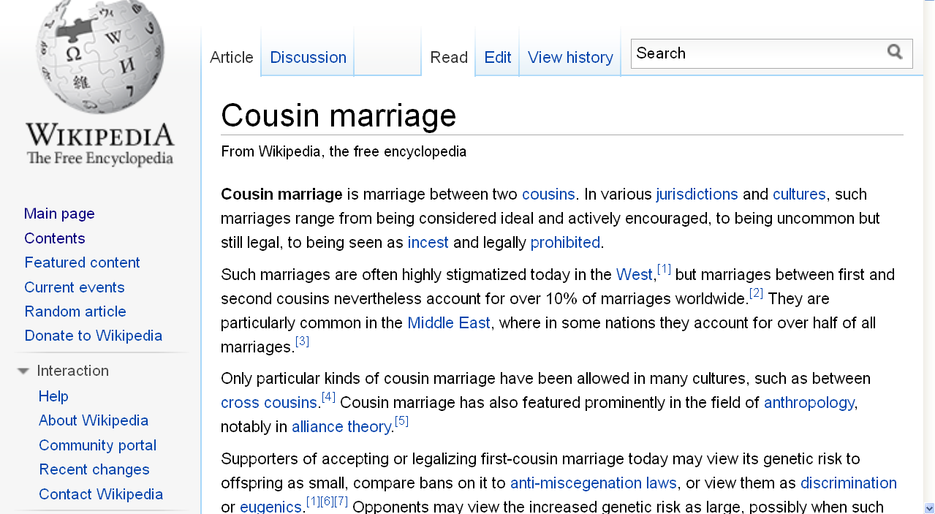
http://en.wikipedia.org/wiki/Cousin_marriage
Notes:
71

Slide 72
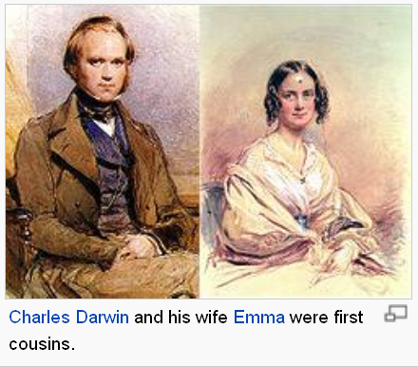
http://en.wikipedia.org/wiki/Cousin_marriage
Notes:
72

Slide 73
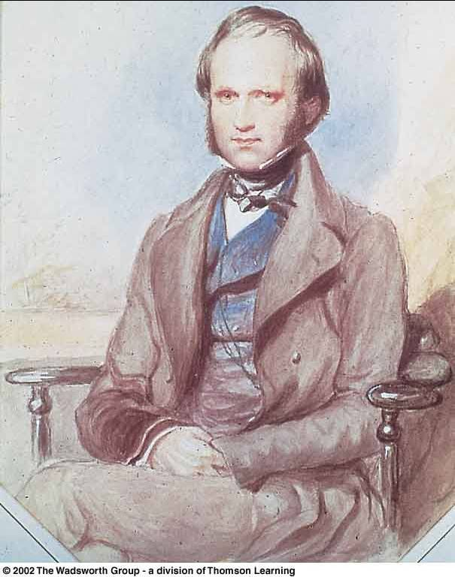
In 1839 Charles Darwin married his first cousin, Emma Wedgwood
Daughter of the younger Josiah Wedgwood, son of the Josiah Wedgwood who founded the pottery works
Darwin's mother Susannah was the sister of his wife’s father

Slide 74
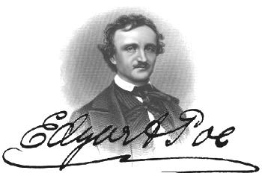
In 1835 Edgar Allan Poe married his widowed aunt’s daughter, Virginia Eliza Clemm
Virginia was 13 years old

Slide 75
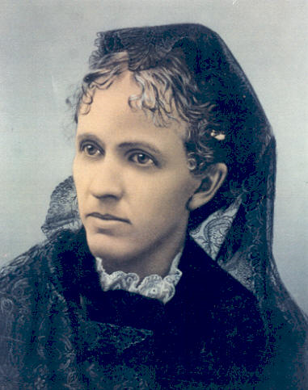
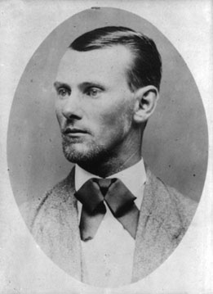
Jesse James married his first cousin
Zerelda "Zee" Mimms, named for his own mother
Zerelda "Zee" Mimms
“cousin of Jesse James and commonly accepted by historians as his wife”

Slide 76
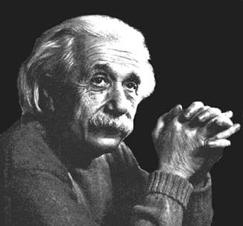
In 1919 Einstein married
his second cousin, his second wife,
Elsa Lowenthal

Slide 77
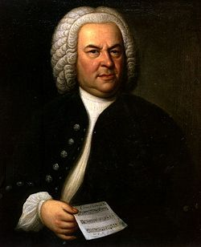
Johann Sebastian Bach
(1685-1750)
married his second cousin
Maria Barbara Bach
(1685-1750)
the daughter of Johann Michael Bach
http://news.bbc.co.uk/2/hi/americas/6057004.stm

Slide 78
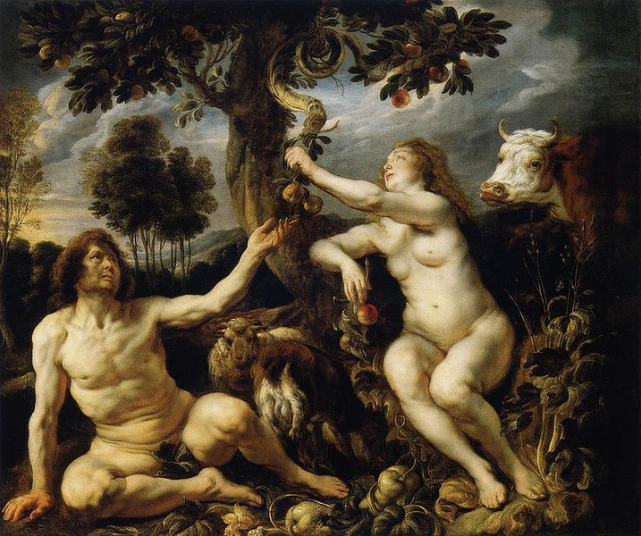
Adam and Eve’s Grandchildren
http://commons.wikimedia.org/wiki/File:Jordaens_Fall_of_man.jpg

Slide 79
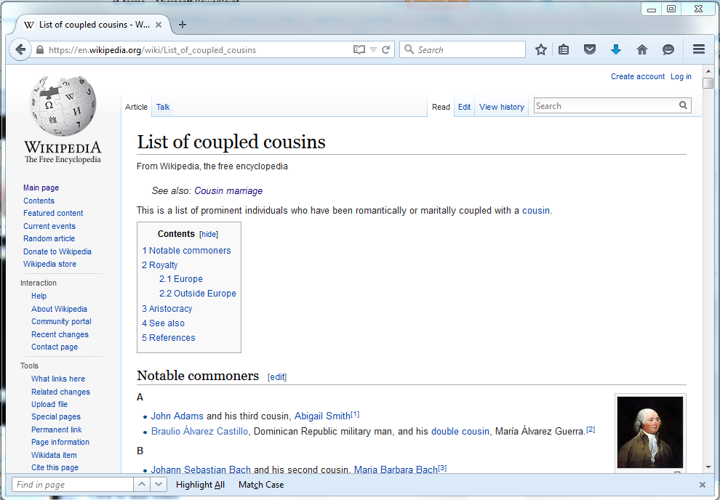
https://en.wikipedia.org/wiki/List_of_coupled_cousins
Notes:
79

Slide 80
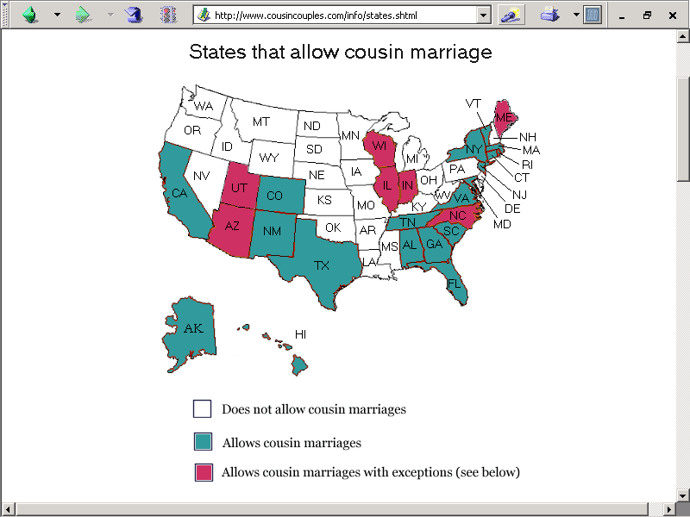
http://www.cousincouples.com/info/states.shtml

Slide 81
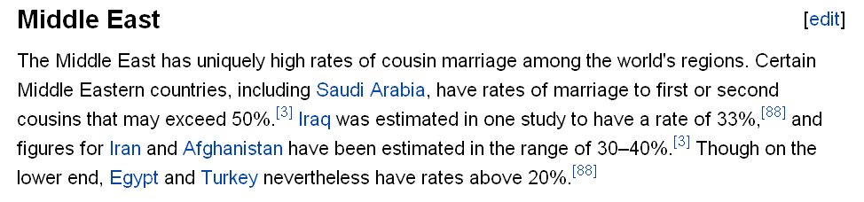
http://en.wikipedia.org/wiki/Cousin_marriage
Notes:
81

Slide 82
usually children of brothers marry
FA-BR-DA
http://en.wikipedia.org/wiki/Cousin_marriage
Notes:
82

Slide 83

Harvard University Press , 2011
Notes:
83

Slide 84
absolute cultural relativism
  How about . . .

Slide 85
absolute cultural relativism
  “freak shows” ?

Slide 86
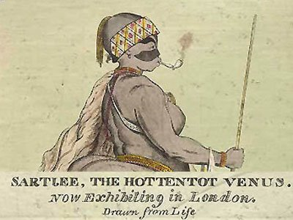
Saartjie Baartman
1789 - 1815

Slide 87
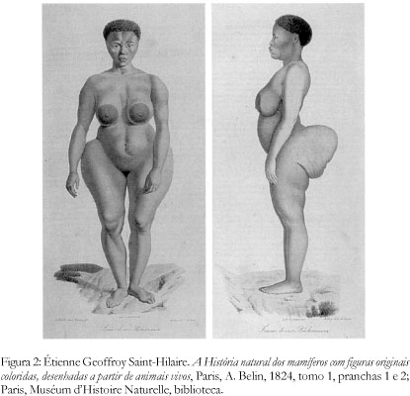
Saartjie Baartman
1789 - 1815

Slide 88
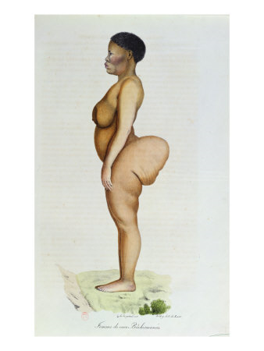
Saartjie Baartman
1789 - 1815

Slide 89
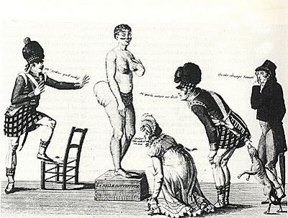
Saartjie Baartman
1789 - 1815

Slide 90
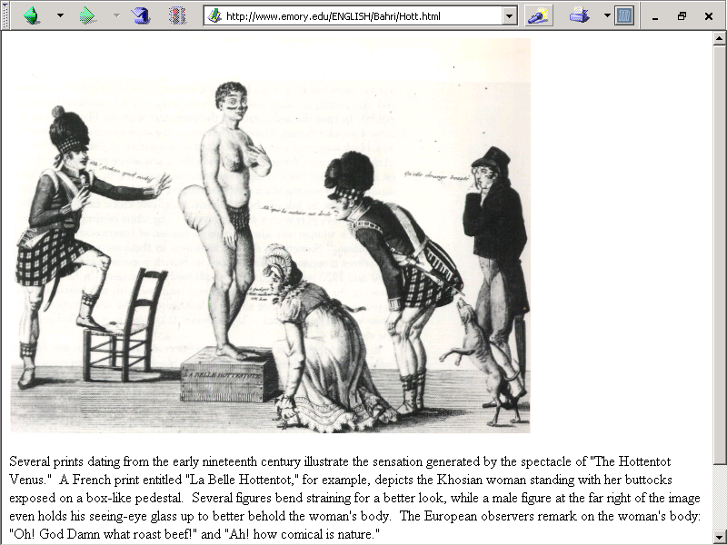
Saarjite Baartman,
“The Hottentot Venus,”
was brought to Europe from Cape Town, South Africa, in 1810, and was exhibited naked in a cage at Piccadilly, England.
www.emory.edu/ENGLISH/Bahri/Hott.html

Slide 91
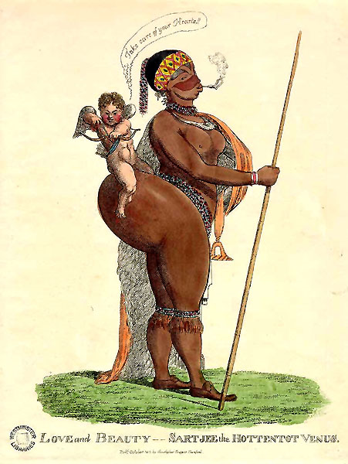
http://en.wikipedia.org/wiki/Saartjie_Baartman

Slide 92
She died on 29 December 1815
Her skeleton, preserved genitals and brain were placed
on display in Paris' Musée de l'Homme until 1974.
Her remains were repatriated to her homeland, the Gamtoos Valley, on 6 May 2002 and she was
finally laid to rest on 9 August 2002
on Vergaderingskop, a hill in the town of Hankey
over 200 years after her birth.
Saartjie Baartman
1789 - 1815
http://en.wikipedia.org/wiki/Saartjie_Baartman

Slide 93
She died on 29 December 1815
Her skeleton, preserved genitals and brain were placed
on display in Paris' Musée de l'Homme until 1974.
Her remains were repatriated to her homeland, the Gamtoos Valley, on 6 May 2002 and she was
finally laid to rest on 9 August 2002
on Vergaderingskop, a hill in the town of Hankey
over 200 years after her birth.
Saartjie Baartman
1789 - 1815
http://en.wikipedia.org/wiki/Saartjie_Baartman

Slide 94
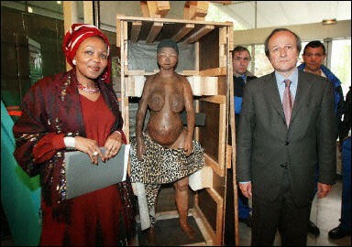
6 May 2002
Saartjie Baartman
1789 - 1815

Slide 95
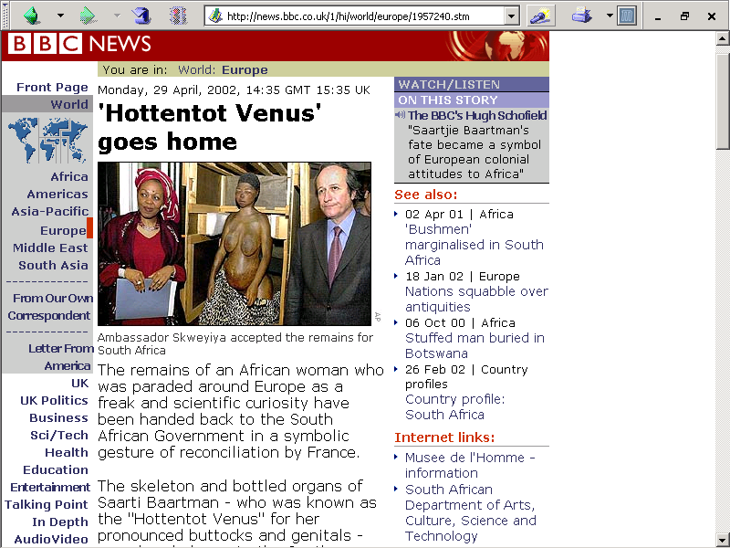
6 May 2002
http://news.bbc.co.uk/1/hi/world/europe/1957240.stm

Slide 96
6 May 2002
http://www.judyshopsthemall.com/2009/08/bodies-the-exhibition-walks-into-controversial-debut-at-mall-of-america/

Slide 97
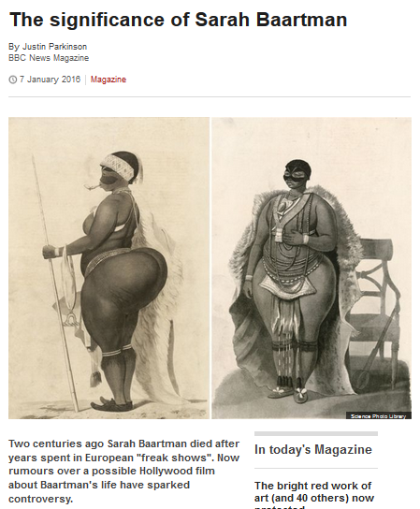
Saartjie Baartman
1789 - 1815

Slide 98
August 2009
http://www.judyshopsthemall.com/2009/08/bodies-the-exhibition-walks-into-controversial-debut-at-mall-of-america/

Slide 99
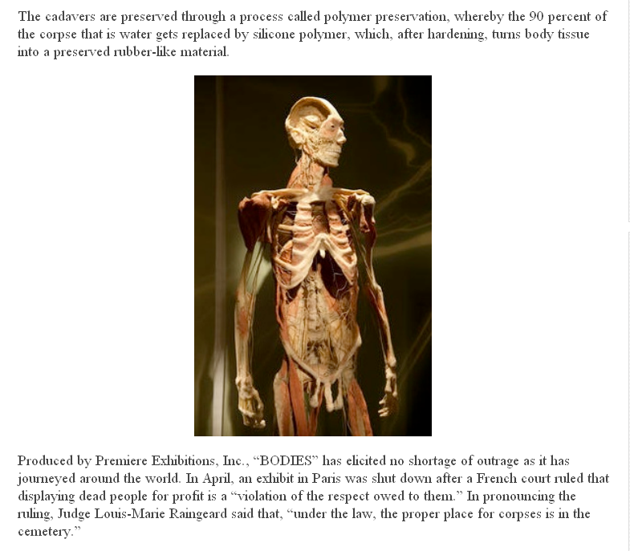
BODIES Exhibit
in Paris
an at
The Mall of America
August 2009
http://www.judyshopsthemall.com/2009/08/bodies-the-exhibition-walks-into-controversial-debut-at-mall-of-america/

Slide 100

http://news.bbc.co.uk/2/hi/uk_news/scotland/edinburgh_and_east/7492386.stm
Notes:
100

Slide 101

“It all amounts to a 21st Century version of a circus freak show; no one is supposed to watch junk like that but everyone does.”
www.duluthsuperior.com/mld/duluthsuperior/news/editorial/15397954.htmhttp://www.duluthsuperior.com/mld/duluthsuperior/news/editorial/15397954.htm

Slide 102
absolute cultural relativism
  How about . . .

Slide 103
absolute cultural relativism
  How about ? . . .
  cannibalism

Slide 104


Slide 105

  Marvin Harris
  (of “cultural materialism” fame)
  writes about cannibalism
  from an anthropological view
Knopf 1991

Slide 106

  so does
  Felipe Fernández-Armesto
Simon & Schuster 2003

Slide 107


Slide 108


10 June 2015
http://www.theguardian.com/science/2015/jun/10/brains-helped-papua-new-guinea-tribe

Slide 109

http://english.pravda.ru/science/19/94/377/14863_cannibalism.html

Slide 110

http://dsc.discovery.com/news/2008/02/27/neanderthal-cannibalism.html
Notes:
110

Slide 111


  “survival
  cannibalism”

Slide 112

Stephen King
“Survivor Type”
1985
  “survival
  cannibalism”

Slide 113

  “gustatory
  cannibalism”

Slide 114
  “ritual cannibalism”

Slide 115

cultural relativism?
  stealing peoples’ land and property
  infant cranial deformation
  Aztec human heart sacrifice
  cannibalism
  selling and eating children
  eating insects
  eating dogs
  . . .
  “ritual cannibalism”
e.g., Aztecs must sacrifice and eat humans
in order to please the gods
in order that the gods allow
the sun to rise each day,
so that the world doesn’t end

Slide 116
absolute cultural relativism
  How about ? . . .

Slide 117
cultural relativism
  stealing peoples’ land and property
  infant cranial deformation
  Aztec human heart sacrifice
  cannibalism
  selling and eating children
  eating insects
  eating dogs
  . . .

Slide 118

or eating gorilla?
Spring
2003
http://www.gastronomica.org/gastro/pages/sample3.2.html

Slide 119

Spring
2003
How about baiting, then killing Cecil the Lion to hang his stuffed head on your wall?
http://www.bbc.com/news/uk-england-oxfordshire-33782249

Slide 120
Spring
2003
Cecil was a well-known tourist attraction in Zimbabwe and was shot by dentist Walter Palmer from Minnesota, USA.
http://www.bbc.com/news/uk-england-oxfordshire-33782249

Slide 121
absolute cultural relativism
  How about ? . . .

Slide 122

http://www.bbc.com/news/world-us-canada-35117311

Slide 123
rich kids who kill people not held responsible because they are rich kids suffering from “affluenza” ?
http://www.bbc.com/news/world-us-canada-35117311

Slide 124

How about the rich kid’s mother harboring a fugitive, and aiding and abetting (and even celebrating) his criminal behavior ?
http://www.bbc.com/news/world-us-canada-35192267

Slide 125
http://www.bbc.com/news/world-us-canada-35192267

Slide 126


or maybe his genes made him do it . . .
source

Slide 127
source

Slide 128
switching to
a much more pleasant subject . . .

Slide 129
Glossary
critical cultural relativism
  What is “normal” / “abnormal” ?

Slide 130

Notes:
130

Slide 131

Notes:
131

Slide 132

http://www.nytimes.com/2010/02/10/health/10psych.html?th&emc=th
Notes:
¹³²

Slide 133

http://www.nytimes.com/2010/02/10/health/10psych.html?th&emc=th
Notes:
¹³³

Slide 134
always remember
that
people live in
multiple cultural worlds

Slide 135
multiple cultural worlds include
class
race
ethnicity
gender
age
institutions

Slide 136
multiple cultural worlds include
class
race
ethnicity
gender
age
institutions
we’ll take a close look at these in
Weeks 9-10 . . .

Slide 137
Other
Important
Terms . . .
more to come later . . .
University of Minnesota Duluth
re Psychological Anthropology
University of Minnesota Duluth
Tim Roufs

