Slide 1
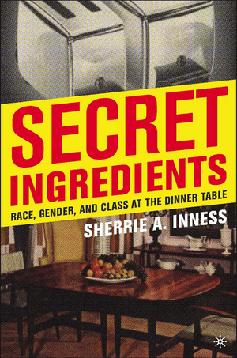
Use your up / down arrow keys and / or
your space bar to advance the slides
Sherrie A. Inness, Secret Ingredients, Palgrave Macmillan, 2006
Tim Roufs
© 2010-2024

Slide 2
Sherrie A. Inness, Secret Ingredients, Palgrave Macmillan, 2006
Tim Roufs
© 2010-2024

Slide 3
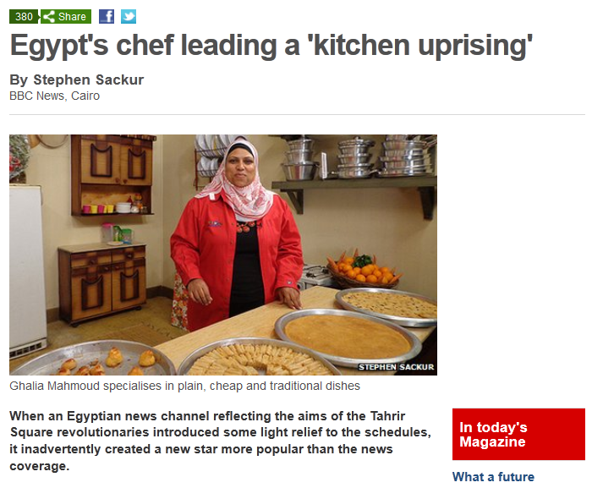
28 April 2012
July 19, 2009
http://www.bbc.co.uk/news/magazine-17843985
Notes:
3

Slide 4
          Sherrie A. Inness
          is a well-known writer focusing on . . .

Slide 5
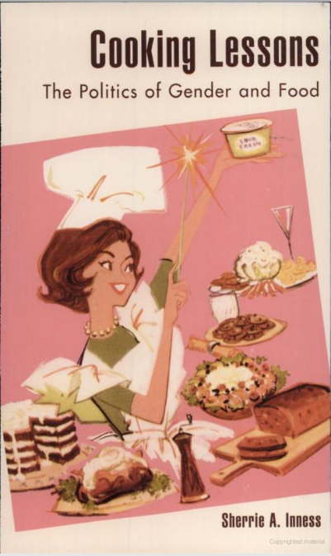
Sherrie A. Inness, Cooking Lessons: The Politics of Gender and Food
Rowman & Littlefield Publishers 2001

Slide 6
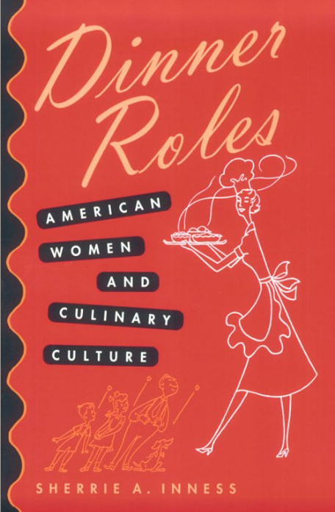
Sherrie A. Inness, Dinner Roles: American Women and Culinary Culture
University of Iowa Press 2001

Slide 7
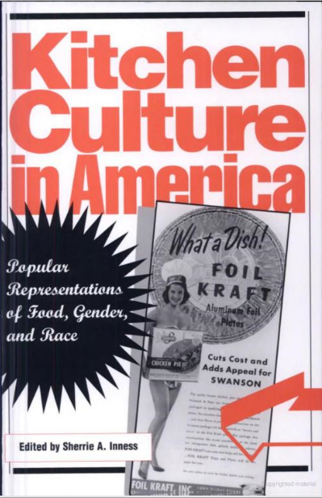
Sherrie A. Inness, Kitchen Culture in America: Popular Representations of Food, Gender, and Race
University of Pennsylvania Press 2000

Slide 8
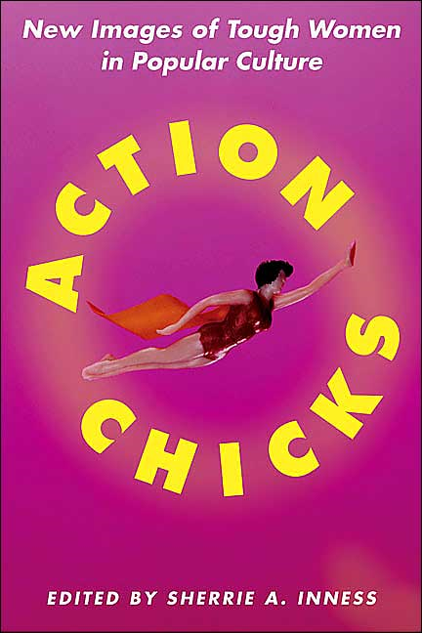
Sherrie A. Inness, Action Chicks
St. Martin's Press 2004

Slide 9
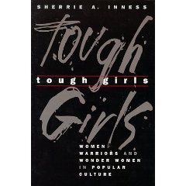
Sherrie A. Inness, Tough Girls: Women Warriors and Wonder Women in Popular Culture
University of Pennsylvania Press 1998

Slide 10
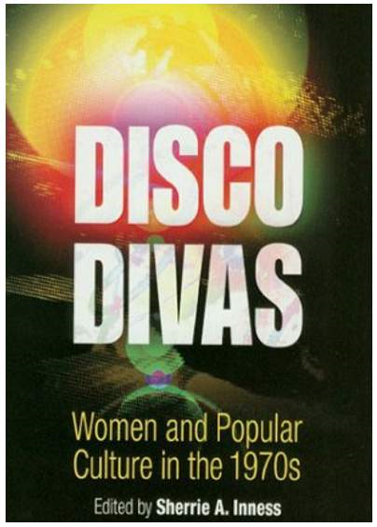
Sherrie A. Inness, Disco Divas: Women, Gender, and Popular Culture in the 1970s
University of Pennsylvania Press 2003

Slide 11
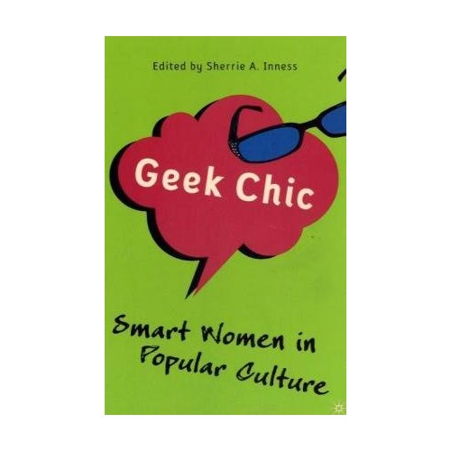
Sherrie A. Inness, Geek Chic: Smart Women in Popular Culture
Palgrave Macmillan 2007

Slide 12
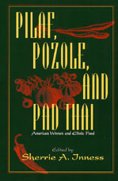
Essays on the significance of ethnic food in contemporary American culture
Sherrie A. Inness (Ed.), Pilaf, Pozole, and Pad Thai: American Women and Ethnic Food
University of Massachusetts Press, 2001

Slide 13
and . . .
Sherrie A. Inness, Secret Ingredients, Palgrave Macmillan, 2006, p. 169

Slide 14
In the 8 chapters of Secret Ingredients Inness explores
a number of themes . . .
Sherrie A. Inness, Secret Ingredients, Palgrave Macmillan, 2006, p. 169

Slide 15
  Inness suggests
  that cooking literature
  has been a space for nondominant voices to be heard that might be silenced in other genres
Sherrie A. Inness, Secret Ingredients, Palgrave Macmillan, 2006, p. 169

Slide 16
  Secret Ingredients examines how women from many backgrounds have used cooking literature to question society’s expectations about gender roles and other issues
Sherrie A. Inness, Secret Ingredients, Palgrave Macmillan, 2006, p. 169

Slide 17
  Secret Ingredients examines how women from many backgrounds have used cooking literature to question society’s expectations about gender roles and other issues
Sherrie A. Inness, Secret Ingredients, Palgrave Macmillan, 2006, p. 169

Slide 18
  “Women have used cooking literature to voice their protests
  against a society where they are not always heard.”
Sherrie A. Inness, Secret Ingredients, Palgrave Macmillan, 2006, p. 169

Slide 19
  “Because cooking literature is an ‘acceptable’ female genre,
  it has, since its beginnings,
  allowed women to write about their concerns.”
Sherrie A. Inness, Secret Ingredients, Palgrave Macmillan, 2006, p. 169

Slide 20
  “In recent decades, women have gained greater social freedom and are able to express themselves in a broader variety of genres
  but cooking literature still provides a significant arena for their issues.”
Sherrie A. Inness, Secret Ingredients, Palgrave Macmillan, 2006, p. 14

Slide 21
  “This modern literature not only provides a place for discussing contemporary food issues but it also creates a place for women to debate other social issues.”
Sherrie A. Inness, Secret Ingredients, Palgrave Macmillan, 2006, p. 14

Slide 22
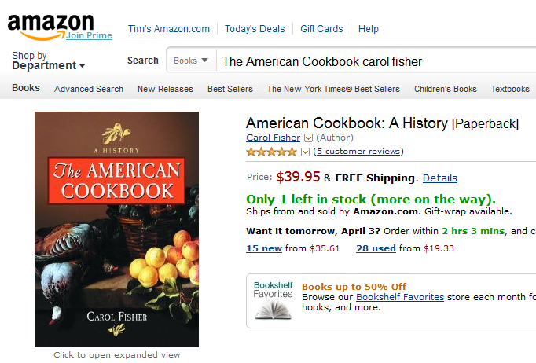

Slide 23
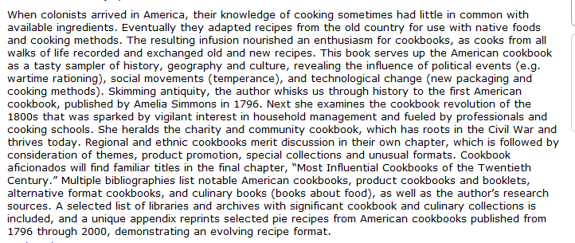

Slide 25
  “Cooking literature is a genre where nonwhite and working-class voices can be heard.”
  “It is vital to hear these voice because cooking culture’s celebrities tend to share elite backgrounds.”
Sherrie A. Inness, Secret Ingredients, Palgrave Macmillan, 2006, p. 169

Slide 26
  “Secret Ingredients focus on
  books written by middle-class white women and works written by women from different class and race backgrounds,
  who demonstrate that cooking culture is more varied and complex than revealed solely by [Julia] Child, [Martha] Stewart, and their ilk.”
Sherrie A. Inness, Secret Ingredients, Palgrave Macmillan, 2006, p. 169

Slide 27
  “Voices other than those of mainstream white authors deserve to be heard so that we can understand how women from various races, ethnicities, and economic backgrounds construct different narratives about their lives.”
Sherrie A. Inness, Secret Ingredients, Palgrave Macmillan, 2006, p. 169

Slide 28
  Secret Ingredients “. . . also encourages readers to pay more critical attention to cooking culture in general, whether it be books, television shows, internet sites, or magazine articles.”
Sherrie A. Inness, Secret Ingredients, Palgrave Macmillan, 2006, p. 169

Slide 29
  “Although our society is replete with culinary information, we rarely stop to analyze what messages are being distributed along with how to prepare a casserole*”
  [*that’s “hot dish” to Minnesotans].”
Sherrie A. Inness, Secret Ingredients, Palgrave Macmillan, 2006, p. 169

Slide 30
  “Culinary culture not only conveys recipes, but it is also equally intent on passing on implicit and explicit messages to people, confirming or challenging our roles in society.”
Sherrie A. Inness, Secret Ingredients, Palgrave Macmillan, 2006, p. 169

Slide 31
  “Culinary culture not only conveys recipes, but it is also equally intent on passing on implicit and explicit messages to people, confirming or challenging our roles in society.”
Sherrie A. Inness, Secret Ingredients, Palgrave Macmillan, 2006, p. 169

Slide 32
  “If we wish to understand our American lives, one useful place to turn is the vast culinary universe and its varied messages.”
Sherrie A. Inness, Secret Ingredients, Palgrave Macmillan, 2006, p. 169

Slide 33
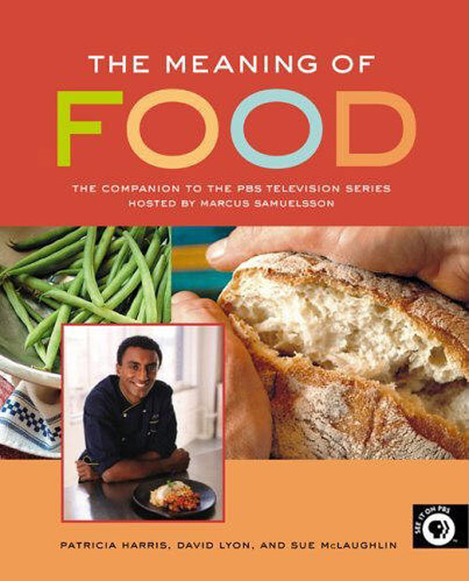
  Italian Wedding
  Bengali Fertility Feast
  Preparing Last Meals
  Makah Whaling
  Burger Nation
  Texas Czech Kolaches
  Geechee Rice . . .

Slide 34
Geechee Rice
(Gullah)
Vertamae Grosvenor, Vibration Cooking or The Travel Notes of a Geechee Girl
Ballantine, 1992

Slide 35
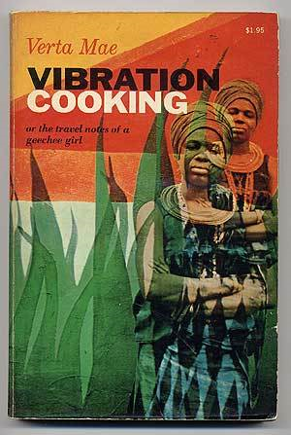
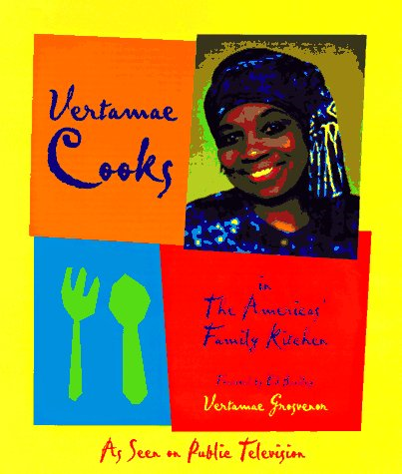
Geechee Rice
(Gullah)
Vertamae Grosvenor, Vibration Cooking or The Travel Notes of a Geechee Girl
Ballantine, 1992

Slide 36
  Food and food culture is an “omnipresent part of our individual lives. Food and its messages are everywhere. . . .”
  This cooking universe “shapes our perceptions of American society and the world and not only as those perceptions relate to food . . .”
Sherrie A. Inness, Secret Ingredients, Palgrave Macmillan, 2006, p. 169

Slide 37
  Food and food culture is an “omnipresent part of our individual lives. Food and its messages are everywhere. . . .”
  This cooking universe “shapes our perceptions of American society and the world and not only as those perceptions relate to food . . .”
Sherrie A. Inness, Secret Ingredients, Palgrave Macmillan, 2006, p. 169

Slide 38
  “. . . studying culinary culture offers insight into our individual lives”
Sherrie A. Inness, Secret Ingredients, Palgrave Macmillan, 2006, p. 169

Slide 39
  “. . . studying culinary culture offers insight into our individual lives”
  and, one might add,
  into the lives of the
  people and cultures
  of the rest of the world. . . .
Sherrie A. Inness, Secret Ingredients, Palgrave Macmillan, 2006, p. 169

Slide 40
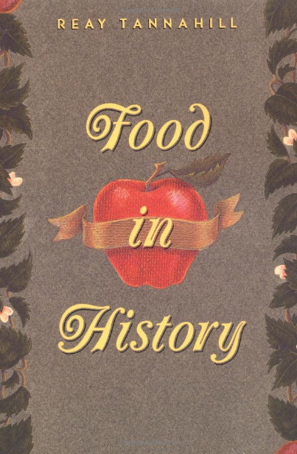
Reay Tannahill also spends considerable time discussing historical trends
through an analysis of “cookery books”
of various eras. This is an excellent work.
Three Rivers Press (Revised edition 1995)

Slide 41
in 8 Chapters . . .
Sherrie A. Inness, Secret Ingredients, Palgrave Macmillan, 2006, p. 169

Slide 42
  Ch. 1 "34,000,000,000 Work-Hours" Saved: Convenience Foods and Mom's Home Cooking”
  Ch. 2 "Unnatural, Unclean, and Filthy": Chinese-American Cooking Literature Confronting Racism in the 1950s”
  Ch. 3 "All Those Leftovers Are Hard on the Family Morale": Rebellion in Peg Bracken's I Hate to Cook Book”
  Ch. 4 "Boredom Is Quite Out of the Picture": Women's Natural Foods Cookbooks and Social Change”
  Ch. 5 "More American than Apple Pie": Modern African- American Cookbooks Fighting White Stereotypes”
  Ch. 6 "You Can't Get Trashier": White Trash Cookbooks and Social Class”
  Ch. 7 "Dining on Grass and Shrubs": Making Vegan Food Sexy”
  Ch. 8 “Thin Is Not In: Two Fat Ladies and Gender Stereotypes on the Food Network”
Sherrie A. Inness, Secret Ingredients, Palgrave Macmillan, 2006, p. 169

Slide 43
  Ch. 1 "34,000,000,000 Work-Hours" Saved: Convenience Foods and Mom's Home Cooking”
  Ch. 2 "Unnatural, Unclean, and Filthy": Chinese-American Cooking Literature Confronting Racism in the 1950s”
  Ch. 3 "All Those Leftovers Are Hard on the Family Morale": Rebellion in Peg Bracken's I Hate to Cook Book”
  Ch. 4 "Boredom Is Quite Out of the Picture": Women's Natural Foods Cookbooks and Social Change”
  Ch. 5 "More American than Apple Pie": Modern African- American Cookbooks Fighting White Stereotypes”
  Ch. 6 "You Can't Get Trashier": White Trash Cookbooks and Social Class”
  Ch. 7 "Dining on Grass and Shrubs": Making Vegan Food Sexy”
  Ch. 8 “Thin Is Not In: Two Fat Ladies and Gender Stereotypes on the Food Network”
  Ch. 1 “34,000,000,000 Work-Hours" Saved: Convenience Foods and Mom's Home Cooking”
Sherrie A. Inness, Secret Ingredients, Palgrave Macmillan, 2006, p. 169

Slide 44
  Ch. 1 "34,000,000,000 Work-Hours" Saved: Convenience Foods and Mom's Home Cooking”
  Ch. 2 "Unnatural, Unclean, and Filthy": Chinese-American Cooking Literature Confronting Racism in the 1950s”
  Ch. 3 "All Those Leftovers Are Hard on the Family Morale": Rebellion in Peg Bracken's I Hate to Cook Book”
  Ch. 4 "Boredom Is Quite Out of the Picture": Women's Natural Foods Cookbooks and Social Change”
  Ch. 5 "More American than Apple Pie": Modern African- American Cookbooks Fighting White Stereotypes”
  Ch. 6 "You Can't Get Trashier": White Trash Cookbooks and Social Class”
  Ch. 7 "Dining on Grass and Shrubs": Making Vegan Food Sexy”
  Ch. 8 “Thin Is Not In: Two Fat Ladies and Gender Stereotypes on the Food Network”
  Ch. 1 focuses on convenience food literature, which conveyed “a radical message that women should rethink how they cook”
Sherrie A. Inness, Secret Ingredients, Palgrave Macmillan, 2006, p. 169

Slide 45
  Ch. 1 "34,000,000,000 Work-Hours" Saved: Convenience Foods and Mom's Home Cooking”
  Ch. 2 "Unnatural, Unclean, and Filthy": Chinese-American Cooking Literature Confronting Racism in the 1950s”
  Ch. 3 "All Those Leftovers Are Hard on the Family Morale": Rebellion in Peg Bracken's I Hate to Cook Book”
  Ch. 4 "Boredom Is Quite Out of the Picture": Women's Natural Foods Cookbooks and Social Change”
  Ch. 5 "More American than Apple Pie": Modern African- American Cookbooks Fighting White Stereotypes”
  Ch. 6 "You Can't Get Trashier": White Trash Cookbooks and Social Class”
  Ch. 7 "Dining on Grass and Shrubs": Making Vegan Food Sexy”
  Ch. 8 “Thin Is Not In: Two Fat Ladies and Gender Stereotypes on the Food Network”
  “Cooking literature that portrayed convenience foods played a positive part in freeing women from countless hours of kitchen work.”
Sherrie A. Inness, Secret Ingredients, Palgrave Macmillan, 2006, p. 169

Slide 46
  Ch. 1 "34,000,000,000 Work-Hours" Saved: Convenience Foods and Mom's Home Cooking”
  Ch. 2 "Unnatural, Unclean, and Filthy": Chinese-American Cooking Literature Confronting Racism in the 1950s”
  Ch. 3 "All Those Leftovers Are Hard on the Family Morale": Rebellion in Peg Bracken's I Hate to Cook Book”
  Ch. 4 "Boredom Is Quite Out of the Picture": Women's Natural Foods Cookbooks and Social Change”
  Ch. 5 "More American than Apple Pie": Modern African- American Cookbooks Fighting White Stereotypes”
  Ch. 6 "You Can't Get Trashier": White Trash Cookbooks and Social Class”
  Ch. 7 "Dining on Grass and Shrubs": Making Vegan Food Sexy”
  Ch. 8 “Thin Is Not In: Two Fat Ladies and Gender Stereotypes on the Food Network”
  “Women were given a potentially liberating message: it was acceptable to take kitchen shortcuts and not cook ‘just like grandmother did.’”
Sherrie A. Inness, Secret Ingredients, Palgrave Macmillan, 2006, p. 169

Slide 47
  Ch. 1 "34,000,000,000 Work-Hours" Saved: Convenience Foods and Mom's Home Cooking”
  Ch. 2 "Unnatural, Unclean, and Filthy": Chinese-American Cooking Literature Confronting Racism in the 1950s”
  Ch. 3 "All Those Leftovers Are Hard on the Family Morale": Rebellion in Peg Bracken's I Hate to Cook Book”
  Ch. 4 "Boredom Is Quite Out of the Picture": Women's Natural Foods Cookbooks and Social Change”
  Ch. 5 "More American than Apple Pie": Modern African- American Cookbooks Fighting White Stereotypes”
  Ch. 6 "You Can't Get Trashier": White Trash Cookbooks and Social Class”
  Ch. 7 "Dining on Grass and Shrubs": Making Vegan Food Sexy”
  Ch. 8 “Thin Is Not In: Two Fat Ladies and Gender Stereotypes on the Food Network”
  “As well, cookbooks informed housewives that it was acceptable and even desirable to have a personal life aside from familial obligations and household chores.”
Sherrie A. Inness, Secret Ingredients, Palgrave Macmillan, 2006, p. 169

Slide 48
  Ch. 1 "34,000,000,000 Work-Hours" Saved: Convenience Foods and Mom's Home Cooking”
  Ch. 2 "Unnatural, Unclean, and Filthy": Chinese-American Cooking Literature Confronting Racism in the 1950s”
  Ch. 3 "All Those Leftovers Are Hard on the Family Morale": Rebellion in Peg Bracken's I Hate to Cook Book”
  Ch. 4 "Boredom Is Quite Out of the Picture": Women's Natural Foods Cookbooks and Social Change”
  Ch. 5 "More American than Apple Pie": Modern African- American Cookbooks Fighting White Stereotypes”
  Ch. 6 "You Can't Get Trashier": White Trash Cookbooks and Social Class”
  Ch. 7 "Dining on Grass and Shrubs": Making Vegan Food Sexy”
  Ch. 8 “Thin Is Not In: Two Fat Ladies and Gender Stereotypes on the Food Network”
  “Such a radical shift stemmed,
  at least partially, from popular cooking literature that lauded convenience foods as something every modern woman should adopt.”
Sherrie A. Inness, Secret Ingredients, Palgrave Macmillan, 2006, p. 169

Slide 49
  Ch. 1 "34,000,000,000 Work-Hours" Saved: Convenience Foods and Mom's Home Cooking”
  Ch. 2 "Unnatural, Unclean, and Filthy": Chinese-American Cooking Literature Confronting Racism in the 1950s”
  Ch. 3 "All Those Leftovers Are Hard on the Family Morale": Rebellion in Peg Bracken's I Hate to Cook Book”
  Ch. 4 "Boredom Is Quite Out of the Picture": Women's Natural Foods Cookbooks and Social Change”
  Ch. 5 "More American than Apple Pie": Modern African- American Cookbooks Fighting White Stereotypes”
  Ch. 6 "You Can't Get Trashier": White Trash Cookbooks and Social Class”
  Ch. 7 "Dining on Grass and Shrubs": Making Vegan Food Sexy”
  Ch. 8 “Thin Is Not In: Two Fat Ladies and Gender Stereotypes on the Food Network”
Sherrie A. Inness, Secret Ingredients, Palgrave Macmillan, 2006, p. 169

Slide 50
  Ch. 1 "34,000,000,000 Work-Hours" Saved: Convenience Foods and Mom's Home Cooking”
  Ch. 2 "Unnatural, Unclean, and Filthy": Chinese-American Cooking Literature Confronting Racism in the 1950s”
  Ch. 3 "All Those Leftovers Are Hard on the Family Morale": Rebellion in Peg Bracken's I Hate to Cook Book”
  Ch. 4 "Boredom Is Quite Out of the Picture": Women's Natural Foods Cookbooks and Social Change”
  Ch. 5 "More American than Apple Pie": Modern African- American Cookbooks Fighting White Stereotypes”
  Ch. 6 "You Can't Get Trashier": White Trash Cookbooks and Social Class”
  Ch. 7 "Dining on Grass and Shrubs": Making Vegan Food Sexy”
  Ch. 8 “Thin Is Not In: Two Fat Ladies and Gender Stereotypes on the Food Network”
  Ch. 2 “Unnatural, Unclean, and Filthy": Chinese-American Cooking Literature Confronting Racism in the 1950s”
Sherrie A. Inness, Secret Ingredients, Palgrave Macmillan, 2006, p. 169

Slide 51
  Ch. 1 "34,000,000,000 Work-Hours" Saved: Convenience Foods and Mom's Home Cooking”
  Ch. 2 "Unnatural, Unclean, and Filthy": Chinese-American Cooking Literature Confronting Racism in the 1950s”
  Ch. 3 "All Those Leftovers Are Hard on the Family Morale": Rebellion in Peg Bracken's I Hate to Cook Book”
  Ch. 4 "Boredom Is Quite Out of the Picture": Women's Natural Foods Cookbooks and Social Change”
  Ch. 5 "More American than Apple Pie": Modern African- American Cookbooks Fighting White Stereotypes”
  Ch. 6 "You Can't Get Trashier": White Trash Cookbooks and Social Class”
  Ch. 7 "Dining on Grass and Shrubs": Making Vegan Food Sexy”
  Ch. 8 “Thin Is Not In: Two Fat Ladies and Gender Stereotypes on the Food Network”
  Ch. 2 focuses on “how
  Chinese-American women used cooking literature in the 1950s as a podium to speak against racism”
Sherrie A. Inness, Secret Ingredients, Palgrave Macmillan, 2006, p. 169

Slide 52
  Ch. 1 "34,000,000,000 Work-Hours" Saved: Convenience Foods and Mom's Home Cooking”
  Ch. 2 "Unnatural, Unclean, and Filthy": Chinese-American Cooking Literature Confronting Racism in the 1950s”
  Ch. 3 "All Those Leftovers Are Hard on the Family Morale": Rebellion in Peg Bracken's I Hate to Cook Book”
  Ch. 4 "Boredom Is Quite Out of the Picture": Women's Natural Foods Cookbooks and Social Change”
  Ch. 5 "More American than Apple Pie": Modern African- American Cookbooks Fighting White Stereotypes”
  Ch. 6 "You Can't Get Trashier": White Trash Cookbooks and Social Class”
  Ch. 7 "Dining on Grass and Shrubs": Making Vegan Food Sexy”
  Ch. 8 “Thin Is Not In: Two Fat Ladies and Gender Stereotypes on the Food Network”
  Chinese cooking literature “promulgated the idea that
  the Chinese were not as alien as many white Americans assumed”
Sherrie A. Inness, Secret Ingredients, Palgrave Macmillan, 2006, p. 169

Slide 53
  Ch. 1 "34,000,000,000 Work-Hours" Saved: Convenience Foods and Mom's Home Cooking”
  Ch. 2 "Unnatural, Unclean, and Filthy": Chinese-American Cooking Literature Confronting Racism in the 1950s”
  Ch. 3 "All Those Leftovers Are Hard on the Family Morale": Rebellion in Peg Bracken's I Hate to Cook Book”
  Ch. 4 "Boredom Is Quite Out of the Picture": Women's Natural Foods Cookbooks and Social Change”
  Ch. 5 "More American than Apple Pie": Modern African- American Cookbooks Fighting White Stereotypes”
  Ch. 6 "You Can't Get Trashier": White Trash Cookbooks and Social Class”
  Ch. 7 "Dining on Grass and Shrubs": Making Vegan Food Sexy”
  Ch. 8 “Thin Is Not In: Two Fat Ladies and Gender Stereotypes on the Food Network”
  “Cooking literature
  helped to make Chinese people,
  as well as Chinese food
  more culturally intelligible to a predominantly white society”
Sherrie A. Inness, Secret Ingredients, Palgrave Macmillan, 2006, p. 169

Slide 54
  Ch. 1 "34,000,000,000 Work-Hours" Saved: Convenience Foods and Mom's Home Cooking”
  Ch. 2 "Unnatural, Unclean, and Filthy": Chinese-American Cooking Literature Confronting Racism in the 1950s”
  Ch. 3 "All Those Leftovers Are Hard on the Family Morale": Rebellion in Peg Bracken's I Hate to Cook Book”
  Ch. 4 "Boredom Is Quite Out of the Picture": Women's Natural Foods Cookbooks and Social Change”
  Ch. 5 "More American than Apple Pie": Modern African- American Cookbooks Fighting White Stereotypes”
  Ch. 6 "You Can't Get Trashier": White Trash Cookbooks and Social Class”
  Ch. 7 "Dining on Grass and Shrubs": Making Vegan Food Sexy”
  Ch. 8 “Thin Is Not In: Two Fat Ladies and Gender Stereotypes on the Food Network”
  “. . . Chinese cookbooks taught lessons about acceptance which was vital in the decade after World War II, when a dominant discourse pigeonholed Asians as barbaric and alien, and the Red scare only intensified such xenophobia”
Sherrie A. Inness, Secret Ingredients, Palgrave Macmillan, 2006, p. 169

Slide 55
  Ch. 1 "34,000,000,000 Work-Hours" Saved: Convenience Foods and Mom's Home Cooking”
  Ch. 2 "Unnatural, Unclean, and Filthy": Chinese-American Cooking Literature Confronting Racism in the 1950s”
  Ch. 3 "All Those Leftovers Are Hard on the Family Morale": Rebellion in Peg Bracken's I Hate to Cook Book”
  Ch. 4 "Boredom Is Quite Out of the Picture": Women's Natural Foods Cookbooks and Social Change”
  Ch. 5 "More American than Apple Pie": Modern African- American Cookbooks Fighting White Stereotypes”
  Ch. 6 "You Can't Get Trashier": White Trash Cookbooks and Social Class”
  Ch. 7 "Dining on Grass and Shrubs": Making Vegan Food Sexy”
  Ch. 8 “Thin Is Not In: Two Fat Ladies and Gender Stereotypes on the Food Network”
  Inness is not interested in how Chinese-American men use cooking literature as a podium to speak against racism
  even notable male social science cookbook authors . . .
Sherrie A. Inness, Secret Ingredients, Palgrave Macmillan, 2006, p. 169

Slide 56
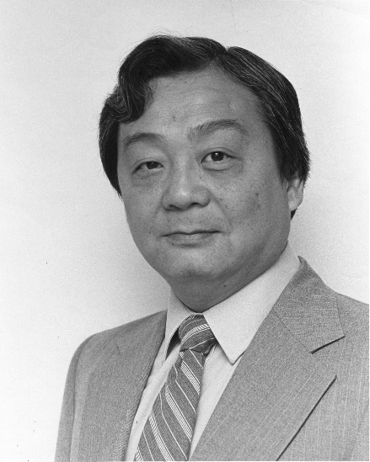
such as the internationally distinguished sociologist
William T. Liu, Ph.D.
at the University of Notre Dame

Slide 57
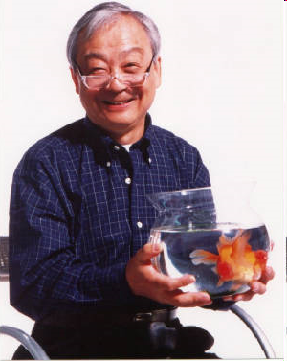
William T. Liu, Ph.D.
Professor Emeritus
1930 - 2008

Slide 58
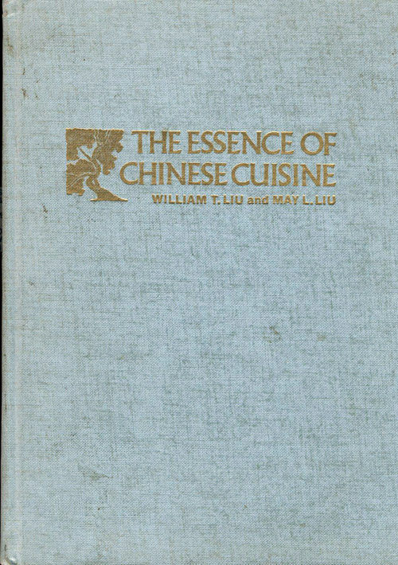
The Essence of Chinese Cuisine.
1970. William T Liu and May L. Liu.
Nashville/London: Aurora.

Slide 59
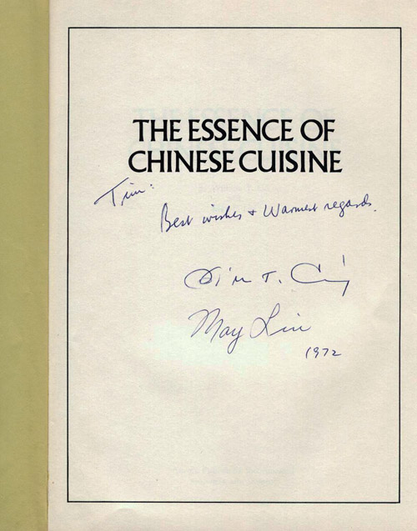
The Essence of Chinese Cuisine.
1970. William T Liu and May L. Liu.
Nashville/London: Aurora.

Slide 60
  Ch. 1 "34,000,000,000 Work-Hours" Saved: Convenience Foods and Mom's Home Cooking”
  Ch. 2 "Unnatural, Unclean, and Filthy": Chinese-American Cooking Literature Confronting Racism in the 1950s”
  Ch. 3 "All Those Leftovers Are Hard on the Family Morale": Rebellion in Peg Bracken's I Hate to Cook Book”
  Ch. 4 "Boredom Is Quite Out of the Picture": Women's Natural Foods Cookbooks and Social Change”
  Ch. 5 "More American than Apple Pie": Modern African- American Cookbooks Fighting White Stereotypes”
  Ch. 6 "You Can't Get Trashier": White Trash Cookbooks and Social Class”
  Ch. 7 "Dining on Grass and Shrubs": Making Vegan Food Sexy”
  Ch. 8 “Thin Is Not In: Two Fat Ladies and Gender Stereotypes on the Food Network”
Sherrie A. Inness, Secret Ingredients, Palgrave Macmillan, 2006, p. 169

Slide 61
  Ch. 1 "34,000,000,000 Work-Hours" Saved: Convenience Foods and Mom's Home Cooking”
  Ch. 2 "Unnatural, Unclean, and Filthy": Chinese-American Cooking Literature Confronting Racism in the 1950s”
  Ch. 3 "All Those Leftovers Are Hard on the Family Morale": Rebellion in Peg Bracken's I Hate to Cook Book”
  Ch. 4 "Boredom Is Quite Out of the Picture": Women's Natural Foods Cookbooks and Social Change”
  Ch. 5 "More American than Apple Pie": Modern African- American Cookbooks Fighting White Stereotypes”
  Ch. 6 "You Can't Get Trashier": White Trash Cookbooks and Social Class”
  Ch. 7 "Dining on Grass and Shrubs": Making Vegan Food Sexy”
  Ch. 8 “Thin Is Not In: Two Fat Ladies and Gender Stereotypes on the Food Network”
  Ch. 3 “All Those Leftovers Are Hard on the Family Morale": Rebellion in Peg Bracken's I Hate to Cook Book”
Sherrie A. Inness, Secret Ingredients, Palgrave Macmillan, 2006, p. 169

Slide 62
  Ch. 1 "34,000,000,000 Work-Hours" Saved: Convenience Foods and Mom's Home Cooking”
  Ch. 2 "Unnatural, Unclean, and Filthy": Chinese-American Cooking Literature Confronting Racism in the 1950s”
  Ch. 3 "All Those Leftovers Are Hard on the Family Morale": Rebellion in Peg Bracken's I Hate to Cook Book”
  Ch. 4 "Boredom Is Quite Out of the Picture": Women's Natural Foods Cookbooks and Social Change”
  Ch. 5 "More American than Apple Pie": Modern African- American Cookbooks Fighting White Stereotypes”
  Ch. 6 "You Can't Get Trashier": White Trash Cookbooks and Social Class”
  Ch. 7 "Dining on Grass and Shrubs": Making Vegan Food Sexy”
  Ch. 8 “Thin Is Not In: Two Fat Ladies and Gender Stereotypes on the Food Network”
  Ch. 3 “. . . discusses another cooking stereotype: women should love
  to cook”
Sherrie A. Inness, Secret Ingredients, Palgrave Macmillan, 2006, p. 169

Slide 63
  Ch. 1 "34,000,000,000 Work-Hours" Saved: Convenience Foods and Mom's Home Cooking”
  Ch. 2 "Unnatural, Unclean, and Filthy": Chinese-American Cooking Literature Confronting Racism in the 1950s”
  Ch. 3 "All Those Leftovers Are Hard on the Family Morale": Rebellion in Peg Bracken's I Hate to Cook Book”
  Ch. 4 "Boredom Is Quite Out of the Picture": Women's Natural Foods Cookbooks and Social Change”
  Ch. 5 "More American than Apple Pie": Modern African- American Cookbooks Fighting White Stereotypes”
  Ch. 6 "You Can't Get Trashier": White Trash Cookbooks and Social Class”
  Ch. 7 "Dining on Grass and Shrubs": Making Vegan Food Sexy”
  Ch. 8 “Thin Is Not In: Two Fat Ladies and Gender Stereotypes on the Food Network”
  . . . focuses on Peg Bracken’s
  best-selling cookbook,
  and its sequel,
  Peg Bracken’s Appendix to The I Hate to Cook Book (1966)
Sherrie A. Inness, Secret Ingredients, Palgrave Macmillan, 2006, p. 169

Slide 64
  Ch. 1 "34,000,000,000 Work-Hours" Saved: Convenience Foods and Mom's Home Cooking”
  Ch. 2 "Unnatural, Unclean, and Filthy": Chinese-American Cooking Literature Confronting Racism in the 1950s”
  Ch. 3 "All Those Leftovers Are Hard on the Family Morale": Rebellion in Peg Bracken's I Hate to Cook Book”
  Ch. 4 "Boredom Is Quite Out of the Picture": Women's Natural Foods Cookbooks and Social Change”
  Ch. 5 "More American than Apple Pie": Modern African- American Cookbooks Fighting White Stereotypes”
  Ch. 6 "You Can't Get Trashier": White Trash Cookbooks and Social Class”
  Ch. 7 "Dining on Grass and Shrubs": Making Vegan Food Sexy”
  Ch. 8 “Thin Is Not In: Two Fat Ladies and Gender Stereotypes on the Food Network”
  . . . focuses on Peg Bracken’s
  best-selling cookbook, and its sequel, Peg Bracken’s Appendix to The I Hate to Cook Book (1966)
  . . . along with her popular housekeeping book,
  The I Hate to Housekeep Book (1958)
Sherrie A. Inness, Secret Ingredients, Palgrave Macmillan, 2006, p. 169

Slide 65
  Ch. 1 "34,000,000,000 Work-Hours" Saved: Convenience Foods and Mom's Home Cooking”
  Ch. 2 "Unnatural, Unclean, and Filthy": Chinese-American Cooking Literature Confronting Racism in the 1950s”
  Ch. 3 "All Those Leftovers Are Hard on the Family Morale": Rebellion in Peg Bracken's I Hate to Cook Book”
  Ch. 4 "Boredom Is Quite Out of the Picture": Women's Natural Foods Cookbooks and Social Change”
  Ch. 5 "More American than Apple Pie": Modern African- American Cookbooks Fighting White Stereotypes”
  Ch. 6 "You Can't Get Trashier": White Trash Cookbooks and Social Class”
  Ch. 7 "Dining on Grass and Shrubs": Making Vegan Food Sexy”
  Ch. 8 “Thin Is Not In: Two Fat Ladies and Gender Stereotypes on the Food Network”
  Ch. 3 explores the connections between Bracken’s work and
  Betty Friedan’s
  The Feminine Mystique (1963),
  showing how each indicated women’s general sense of restlessness and dissatisfaction
Sherrie A. Inness, Secret Ingredients, Palgrave Macmillan, 2006, p. 169

Slide 66
  Ch. 1 "34,000,000,000 Work-Hours" Saved: Convenience Foods and Mom's Home Cooking”
  Ch. 2 "Unnatural, Unclean, and Filthy": Chinese-American Cooking Literature Confronting Racism in the 1950s”
  Ch. 3 "All Those Leftovers Are Hard on the Family Morale": Rebellion in Peg Bracken's I Hate to Cook Book”
  Ch. 4 "Boredom Is Quite Out of the Picture": Women's Natural Foods Cookbooks and Social Change”
  Ch. 5 "More American than Apple Pie": Modern African- American Cookbooks Fighting White Stereotypes”
  Ch. 6 "You Can't Get Trashier": White Trash Cookbooks and Social Class”
  Ch. 7 "Dining on Grass and Shrubs": Making Vegan Food Sexy”
  Ch. 8 “Thin Is Not In: Two Fat Ladies and Gender Stereotypes on the Food Network”
  Ch. 3 notes that “although
  the popular media portrayed the 1950s housekeepers
  as constantly cheerful, making yet another dinner for their families or tackling another load of laundry for their families,
  many women felt confined, stifled, and trapped by the expectations that they should perform the bulk of domestic work.”
Sherrie A. Inness, Secret Ingredients, Palgrave Macmillan, 2006, p. 169

Slide 67
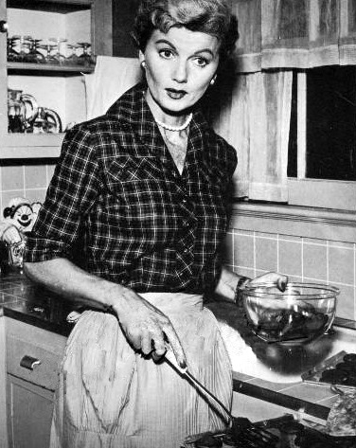
June Cleaver, in Leave it to Beaver

Slide 68
I just love to cook,
wash and iron clothes,
and scrub
the kitchen floor
June Cleaver, in Leave it to Beaver

Slide 69
  Ch. 1 "34,000,000,000 Work-Hours" Saved: Convenience Foods and Mom's Home Cooking”
  Ch. 2 "Unnatural, Unclean, and Filthy": Chinese-American Cooking Literature Confronting Racism in the 1950s”
  Ch. 3 "All Those Leftovers Are Hard on the Family Morale": Rebellion in Peg Bracken's I Hate to Cook Book”
  Ch. 4 "Boredom Is Quite Out of the Picture": Women's Natural Foods Cookbooks and Social Change”
  Ch. 5 "More American than Apple Pie": Modern African- American Cookbooks Fighting White Stereotypes”
  Ch. 6 "You Can't Get Trashier": White Trash Cookbooks and Social Class”
  Ch. 7 "Dining on Grass and Shrubs": Making Vegan Food Sexy”
  Ch. 8 “Thin Is Not In: Two Fat Ladies and Gender Stereotypes on the Food Network”
  “[Bracken] articulated what many housewives knew:
  cooking, cleaning, and other domestic chores were dull and laborious . . .”
Sherrie A. Inness, Secret Ingredients, Palgrave Macmillan, 2006, p. 169

Slide 70
  Ch. 1 "34,000,000,000 Work-Hours" Saved: Convenience Foods and Mom's Home Cooking”
  Ch. 2 "Unnatural, Unclean, and Filthy": Chinese-American Cooking Literature Confronting Racism in the 1950s”
  Ch. 3 "All Those Leftovers Are Hard on the Family Morale": Rebellion in Peg Bracken's I Hate to Cook Book”
  Ch. 4 "Boredom Is Quite Out of the Picture": Women's Natural Foods Cookbooks and Social Change”
  Ch. 5 "More American than Apple Pie": Modern African- American Cookbooks Fighting White Stereotypes”
  Ch. 6 "You Can't Get Trashier": White Trash Cookbooks and Social Class”
  Ch. 7 "Dining on Grass and Shrubs": Making Vegan Food Sexy”
  Ch. 8 “Thin Is Not In: Two Fat Ladies and Gender Stereotypes on the Food Network”
Sherrie A. Inness, Secret Ingredients, Palgrave Macmillan, 2006, p. 169

Slide 71
  Ch. 1 "34,000,000,000 Work-Hours" Saved: Convenience Foods and Mom's Home Cooking”
  Ch. 2 "Unnatural, Unclean, and Filthy": Chinese-American Cooking Literature Confronting Racism in the 1950s”
  Ch. 3 "All Those Leftovers Are Hard on the Family Morale": Rebellion in Peg Bracken's I Hate to Cook Book”
  Ch. 4 "Boredom Is Quite Out of the Picture": Women's Natural Foods Cookbooks and Social Change”
  Ch. 5 "More American than Apple Pie": Modern African- American Cookbooks Fighting White Stereotypes”
  Ch. 6 "You Can't Get Trashier": White Trash Cookbooks and Social Class”
  Ch. 7 "Dining on Grass and Shrubs": Making Vegan Food Sexy”
  Ch. 8 “Thin Is Not In: Two Fat Ladies and Gender Stereotypes on the Food Network”
  Ch. 4 “Boredom Is Quite Out of the Picture": Women's Natural Foods Cookbooks and Social Change”
Sherrie A. Inness, Secret Ingredients, Palgrave Macmillan, 2006, p. 169

Slide 72
  Ch. 1 "34,000,000,000 Work-Hours" Saved: Convenience Foods and Mom's Home Cooking”
  Ch. 2 "Unnatural, Unclean, and Filthy": Chinese-American Cooking Literature Confronting Racism in the 1950s”
  Ch. 3 "All Those Leftovers Are Hard on the Family Morale": Rebellion in Peg Bracken's I Hate to Cook Book”
  Ch. 4 "Boredom Is Quite Out of the Picture": Women's Natural Foods Cookbooks and Social Change”
  Ch. 5 "More American than Apple Pie": Modern African- American Cookbooks Fighting White Stereotypes”
  Ch. 6 "You Can't Get Trashier": White Trash Cookbooks and Social Class”
  Ch. 7 "Dining on Grass and Shrubs": Making Vegan Food Sexy”
  Ch. 8 “Thin Is Not In: Two Fat Ladies and Gender Stereotypes on the Food Network”
  Ch. 4 focuses on
  how natural foods cooking literature
  spread the ideology
  of using natural foods for
  a simpler and healthier lifestyle
Sherrie A. Inness, Secret Ingredients, Palgrave Macmillan, 2006, p. 169

Slide 73
  Ch. 1 "34,000,000,000 Work-Hours" Saved: Convenience Foods and Mom's Home Cooking”
  Ch. 2 "Unnatural, Unclean, and Filthy": Chinese-American Cooking Literature Confronting Racism in the 1950s”
  Ch. 3 "All Those Leftovers Are Hard on the Family Morale": Rebellion in Peg Bracken's I Hate to Cook Book”
  Ch. 4 "Boredom Is Quite Out of the Picture": Women's Natural Foods Cookbooks and Social Change”
  Ch. 5 "More American than Apple Pie": Modern African- American Cookbooks Fighting White Stereotypes”
  Ch. 6 "You Can't Get Trashier": White Trash Cookbooks and Social Class”
  Ch. 7 "Dining on Grass and Shrubs": Making Vegan Food Sexy”
  Ch. 8 “Thin Is Not In: Two Fat Ladies and Gender Stereotypes on the Food Network”
  “Along with passing down recipes
  . . . natural food cooking literature
  shared a political agenda about the necessity of changing mainstream Americans’ consumer-driven
  mind-set and making them think about how their actions impacted people around the world environmentally and otherwise.”
Sherrie A. Inness, Secret Ingredients, Palgrave Macmillan, 2006, p. 169

Slide 74
  Ch. 1 "34,000,000,000 Work-Hours" Saved: Convenience Foods and Mom's Home Cooking”
  Ch. 2 "Unnatural, Unclean, and Filthy": Chinese-American Cooking Literature Confronting Racism in the 1950s”
  Ch. 3 "All Those Leftovers Are Hard on the Family Morale": Rebellion in Peg Bracken's I Hate to Cook Book”
  Ch. 4 "Boredom Is Quite Out of the Picture": Women's Natural Foods Cookbooks and Social Change”
  Ch. 5 "More American than Apple Pie": Modern African- American Cookbooks Fighting White Stereotypes”
  Ch. 6 "You Can't Get Trashier": White Trash Cookbooks and Social Class”
  Ch. 7 "Dining on Grass and Shrubs": Making Vegan Food Sexy”
  Ch. 8 “Thin Is Not In: Two Fat Ladies and Gender Stereotypes on the Food Network”
  “Natural cooking literature sustained a movement that made a lasting impact on not just the American diet but also on the American cultural fabric . . .”
Sherrie A. Inness, Secret Ingredients, Palgrave Macmillan, 2006, p. 169

Slide 75
  Ch. 4 “Boredom Is Quite Out of the Picture": Women's Natural Foods Cookbooks and Social Change”
  Ch. 1 "34,000,000,000 Work-Hours" Saved: Convenience Foods and Mom's Home Cooking”
  Ch. 2 "Unnatural, Unclean, and Filthy": Chinese-American Cooking Literature Confronting Racism in the 1950s”
  Ch. 3 "All Those Leftovers Are Hard on the Family Morale": Rebellion in Peg Bracken's I Hate to Cook Book”
  Ch. 4 "Boredom Is Quite Out of the Picture": Women's Natural Foods Cookbooks and Social Change”
  Ch. 5 "More American than Apple Pie": Modern African- American Cookbooks Fighting White Stereotypes”
  Ch. 6 "You Can't Get Trashier": White Trash Cookbooks and Social Class”
  Ch. 7 "Dining on Grass and Shrubs": Making Vegan Food Sexy”
  Ch. 8 “Thin Is Not In: Two Fat Ladies and Gender Stereotypes on the Food Network”
  “Natural foods cookbooks showed how marginalized
  groups, such as women and natural foods activists, could use cooking literature to instigate and influence broad social change”
Sherrie A. Inness, Secret Ingredients, Palgrave Macmillan, 2006, p. 169

Slide 76
  Ch. 1 "34,000,000,000 Work-Hours" Saved: Convenience Foods and Mom's Home Cooking”
  Ch. 2 "Unnatural, Unclean, and Filthy": Chinese-American Cooking Literature Confronting Racism in the 1950s”
  Ch. 3 "All Those Leftovers Are Hard on the Family Morale": Rebellion in Peg Bracken's I Hate to Cook Book”
  Ch. 4 "Boredom Is Quite Out of the Picture": Women's Natural Foods Cookbooks and Social Change”
  Ch. 5 "More American than Apple Pie": Modern African- American Cookbooks Fighting White Stereotypes”
  Ch. 6 "You Can't Get Trashier": White Trash Cookbooks and Social Class”
  Ch. 7 "Dining on Grass and Shrubs": Making Vegan Food Sexy”
  Ch. 8 “Thin Is Not In: Two Fat Ladies and Gender Stereotypes on the Food Network”
Sherrie A. Inness, Secret Ingredients, Palgrave Macmillan, 2006, p. 169

Slide 77
  Ch. 1 "34,000,000,000 Work-Hours" Saved: Convenience Foods and Mom's Home Cooking”
  Ch. 2 "Unnatural, Unclean, and Filthy": Chinese-American Cooking Literature Confronting Racism in the 1950s”
  Ch. 3 "All Those Leftovers Are Hard on the Family Morale": Rebellion in Peg Bracken's I Hate to Cook Book”
  Ch. 4 "Boredom Is Quite Out of the Picture": Women's Natural Foods Cookbooks and Social Change”
  Ch. 5 "More American than Apple Pie": Modern African- American Cookbooks Fighting White Stereotypes”
  Ch. 6 "You Can't Get Trashier": White Trash Cookbooks and Social Class”
  Ch. 7 "Dining on Grass and Shrubs": Making Vegan Food Sexy”
  Ch. 8 “Thin Is Not In: Two Fat Ladies and Gender Stereotypes on the Food Network”
  Ch. 5 “More American than Apple Pie": Modern African-American Cookbooks Fighting White Stereotypes”
Sherrie A. Inness, Secret Ingredients, Palgrave Macmillan, 2006, p. 169

Slide 78
  Ch. 1 "34,000,000,000 Work-Hours" Saved: Convenience Foods and Mom's Home Cooking”
  Ch. 2 "Unnatural, Unclean, and Filthy": Chinese-American Cooking Literature Confronting Racism in the 1950s”
  Ch. 3 "All Those Leftovers Are Hard on the Family Morale": Rebellion in Peg Bracken's I Hate to Cook Book”
  Ch. 4 "Boredom Is Quite Out of the Picture": Women's Natural Foods Cookbooks and Social Change”
  Ch. 5 "More American than Apple Pie": Modern African- American Cookbooks Fighting White Stereotypes”
  Ch. 6 "You Can't Get Trashier": White Trash Cookbooks and Social Class”
  Ch. 7 "Dining on Grass and Shrubs": Making Vegan Food Sexy”
  Ch. 8 “Thin Is Not In: Two Fat Ladies and Gender Stereotypes on the Food Network”
  Along with Ch. 2, this chapter focuses on how different racial and ethnic groups use cooking literature to agitate for social change, providing a venue for questioning and subverting the dominant social order’s value system
Sherrie A. Inness, Secret Ingredients, Palgrave Macmillan, 2006, p. 169

Slide 79
  Ch. 1 "34,000,000,000 Work-Hours" Saved: Convenience Foods and Mom's Home Cooking”
  Ch. 2 "Unnatural, Unclean, and Filthy": Chinese-American Cooking Literature Confronting Racism in the 1950s”
  Ch. 3 "All Those Leftovers Are Hard on the Family Morale": Rebellion in Peg Bracken's I Hate to Cook Book”
  Ch. 4 "Boredom Is Quite Out of the Picture": Women's Natural Foods Cookbooks and Social Change”
  Ch. 5 "More American than Apple Pie": Modern African- American Cookbooks Fighting White Stereotypes”
  Ch. 6 "You Can't Get Trashier": White Trash Cookbooks and Social Class”
  Ch. 7 "Dining on Grass and Shrubs": Making Vegan Food Sexy”
  Ch. 8 “Thin Is Not In: Two Fat Ladies and Gender Stereotypes on the Food Network”
  The main theme continues:
  Cooking literature
  has been a space for non-dominant voices to be heard that might be silenced in other genres
Sherrie A. Inness, Secret Ingredients, Palgrave Macmillan, 2006, p. 169

Slide 80
  Ch. 5 “More American than Apple Pie": Modern African-American Cookbooks Fighting White Stereotypes”
  Ch. 1 "34,000,000,000 Work-Hours" Saved: Convenience Foods and Mom's Home Cooking”
  Ch. 2 "Unnatural, Unclean, and Filthy": Chinese-American Cooking Literature Confronting Racism in the 1950s”
  Ch. 3 "All Those Leftovers Are Hard on the Family Morale": Rebellion in Peg Bracken's I Hate to Cook Book”
  Ch. 4 "Boredom Is Quite Out of the Picture": Women's Natural Foods Cookbooks and Social Change”
  Ch. 5 "More American than Apple Pie": Modern African- American Cookbooks Fighting White Stereotypes”
  Ch. 6 "You Can't Get Trashier": White Trash Cookbooks and Social Class”
  Ch. 7 "Dining on Grass and Shrubs": Making Vegan Food Sexy”
  Ch. 8 “Thin Is Not In: Two Fat Ladies and Gender Stereotypes on the Food Network”
  “[Ch. 5] . . . analyzes African American women’s cookbooks from the 1980s and the 1990s. . . .
Sherrie A. Inness, Secret Ingredients, Palgrave Macmillan, 2006, p. 169

Slide 81
  Ch. 1 "34,000,000,000 Work-Hours" Saved: Convenience Foods and Mom's Home Cooking”
  Ch. 2 "Unnatural, Unclean, and Filthy": Chinese-American Cooking Literature Confronting Racism in the 1950s”
  Ch. 3 "All Those Leftovers Are Hard on the Family Morale": Rebellion in Peg Bracken's I Hate to Cook Book”
  Ch. 4 "Boredom Is Quite Out of the Picture": Women's Natural Foods Cookbooks and Social Change”
  Ch. 5 "More American than Apple Pie": Modern African- American Cookbooks Fighting White Stereotypes”
  Ch. 6 "You Can't Get Trashier": White Trash Cookbooks and Social Class”
  Ch. 7 "Dining on Grass and Shrubs": Making Vegan Food Sexy”
  Ch. 8 “Thin Is Not In: Two Fat Ladies and Gender Stereotypes on the Food Network”
  “Like the 1950s Chinese cookbooks, these works shared with their readers cultural and historical traditions that the white mainstream rarely addressed.”
Sherrie A. Inness, Secret Ingredients, Palgrave Macmillan, 2006, p. 169

Slide 82
  Ch. 1 "34,000,000,000 Work-Hours" Saved: Convenience Foods and Mom's Home Cooking”
  Ch. 2 "Unnatural, Unclean, and Filthy": Chinese-American Cooking Literature Confronting Racism in the 1950s”
  Ch. 3 "All Those Leftovers Are Hard on the Family Morale": Rebellion in Peg Bracken's I Hate to Cook Book”
  Ch. 4 "Boredom Is Quite Out of the Picture": Women's Natural Foods Cookbooks and Social Change”
  Ch. 5 "More American than Apple Pie": Modern African- American Cookbooks Fighting White Stereotypes”
  Ch. 6 "You Can't Get Trashier": White Trash Cookbooks and Social Class”
  Ch. 7 "Dining on Grass and Shrubs": Making Vegan Food Sexy”
  Ch. 8 “Thin Is Not In: Two Fat Ladies and Gender Stereotypes on the Food Network”
  “Black cookbooks rebelled against a white society that wished to forget about the past, especially slavery.”
Sherrie A. Inness, Secret Ingredients, Palgrave Macmillan, 2006, p. 169

Slide 83
  Ch. 5 “More American than Apple Pie": Modern African-American Cookbooks Fighting White Stereotypes”
  Ch. 1 "34,000,000,000 Work-Hours" Saved: Convenience Foods and Mom's Home Cooking”
  Ch. 2 "Unnatural, Unclean, and Filthy": Chinese-American Cooking Literature Confronting Racism in the 1950s”
  Ch. 3 "All Those Leftovers Are Hard on the Family Morale": Rebellion in Peg Bracken's I Hate to Cook Book”
  Ch. 4 "Boredom Is Quite Out of the Picture": Women's Natural Foods Cookbooks and Social Change”
  Ch. 5 "More American than Apple Pie": Modern African- American Cookbooks Fighting White Stereotypes”
  Ch. 6 "You Can't Get Trashier": White Trash Cookbooks and Social Class”
  Ch. 7 "Dining on Grass and Shrubs": Making Vegan Food Sexy”
  Ch. 8 “Thin Is Not In: Two Fat Ladies and Gender Stereotypes on the Food Network”
  “Along with discussing black history and culture, cookbooks shared and expanded on the long-standing tradition of women’s cooking as central to African-American communities.”
Sherrie A. Inness, Secret Ingredients, Palgrave Macmillan, 2006, p. 169

Slide 84
  Ch. 1 "34,000,000,000 Work-Hours" Saved: Convenience Foods and Mom's Home Cooking”
  Ch. 2 "Unnatural, Unclean, and Filthy": Chinese-American Cooking Literature Confronting Racism in the 1950s”
  Ch. 3 "All Those Leftovers Are Hard on the Family Morale": Rebellion in Peg Bracken's I Hate to Cook Book”
  Ch. 4 "Boredom Is Quite Out of the Picture": Women's Natural Foods Cookbooks and Social Change”
  Ch. 5 "More American than Apple Pie": Modern African- American Cookbooks Fighting White Stereotypes”
  Ch. 6 "You Can't Get Trashier": White Trash Cookbooks and Social Class”
  Ch. 7 "Dining on Grass and Shrubs": Making Vegan Food Sexy”
  Ch. 8 “Thin Is Not In: Two Fat Ladies and Gender Stereotypes on the Food Network”
  “At the same time,
  these cookbooks challenged white stereotypes of black women as being the ‘perfect’ cooks, who wished for nothing more than to serve whites.”
Sherrie A. Inness, Secret Ingredients, Palgrave Macmillan, 2006, p. 169

Slide 85
some examples of early imagery . . .

Slide 86
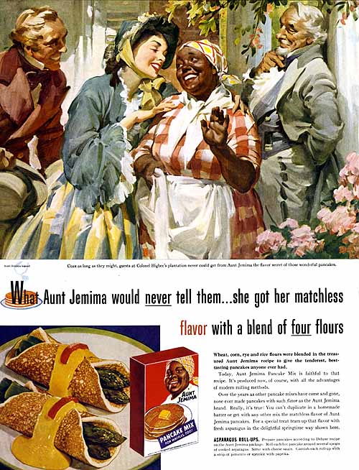
http://othejoys.blogspot.com/2006/10/politics-of-breakfast.html

Slide 87
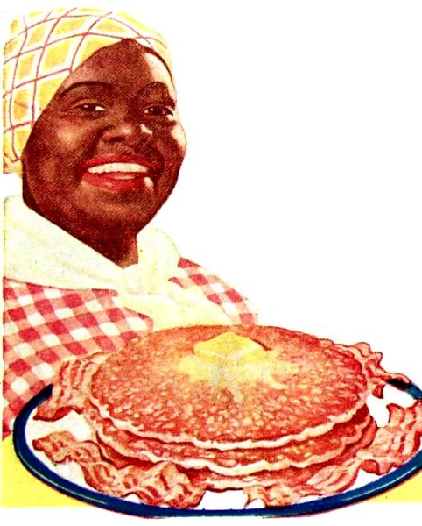
Nancy Green, the original Aunt Jemima
http://munchcast.com/

Slide 88
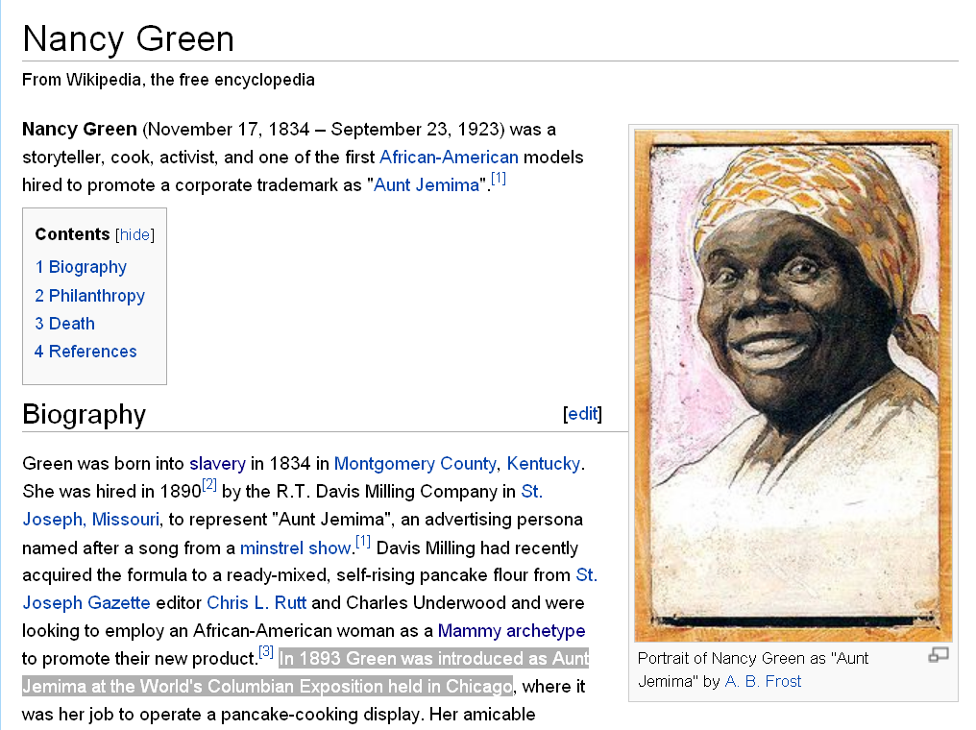
Nancy Green, the original Aunt Jemima.
In 1893 Green was introduced as Aunt Jemima at the World's Columbian Exposition held in Chicago
http://en.wikipedia.org/wiki/Nancy_Green

Slide 89
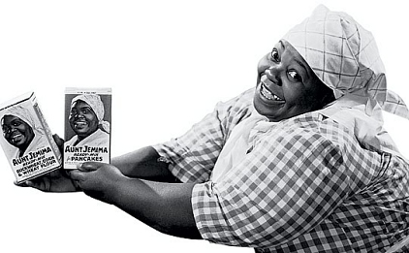
Nancy Green, the original Aunt Jemima
http://munchcast.com/

Slide 90
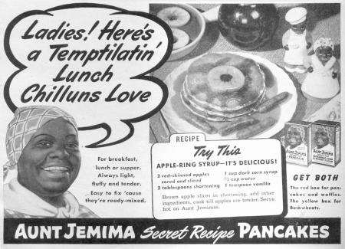
www.shyzer.ca/?p=31

Slide 91
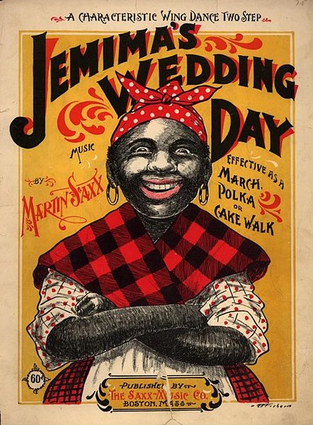
"Jemima" character on 1899 cakewalk sheet music cover
Wikipedia

Slide 92
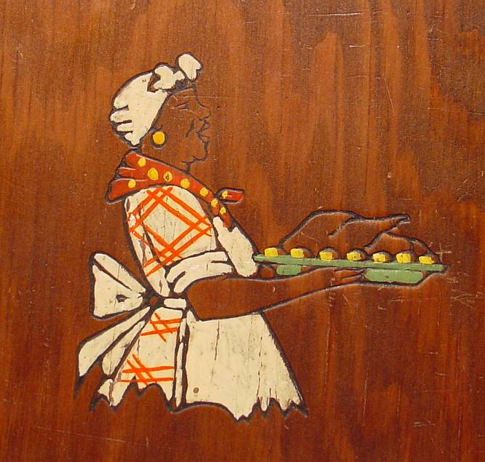
1939 BLACK MAMMY COOKBOOK Southern Cook Recipe Cooking
This item SOLD on 1/17/2009 for $202.50
image source

Slide 93
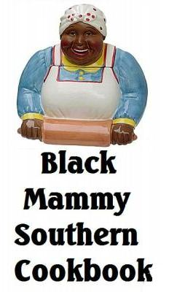
BLACK MAMMY AUNT JEMIMA OLD DIXIE SOUTHERN COOKBOOK
image source

Slide 94
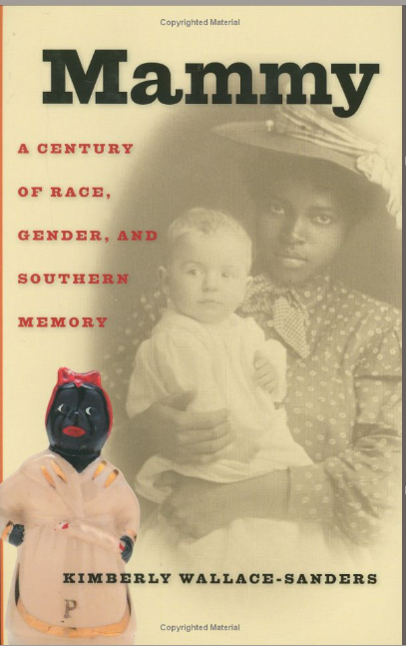

Slide 95
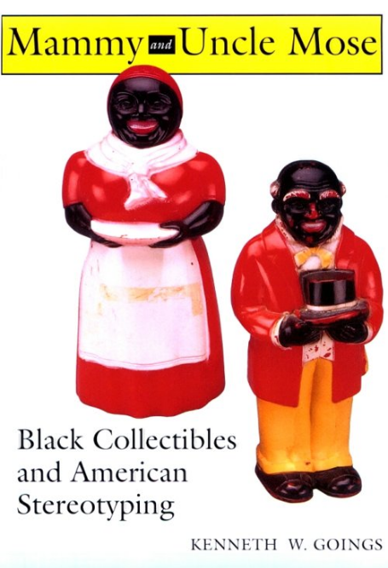

Slide 96
On 24 August 2021
there were 4 “Aunt Jemima” items for sale on eBay
On 28 March 2018
there were 999 “Aunt Jemima” items for sale on eBay
On 8 November 2017
there were 1,012 “Aunt Jemima” items for sale on eBay
On 29 March 2011
there were 1,084 “Aunt Jemima” items for sale on eBay
On 30 October 2010
there were 1,130 “Aunt Jemima” items for sale on eBay

Slide 97
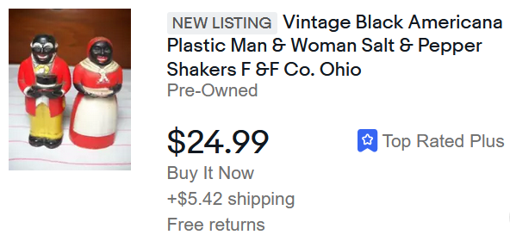
E-bay
24 August 2021

Slide 98
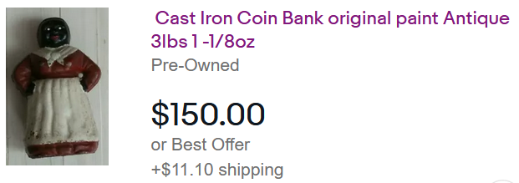
E-bay
24 August 2021

Slide 99
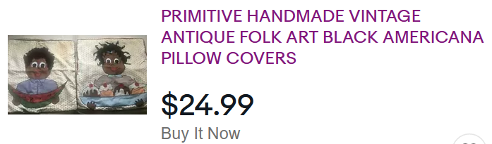
E-bay
24 August 2021

Slide 100
The modern-day “Aunt Jemima” ? . . .

Slide 101
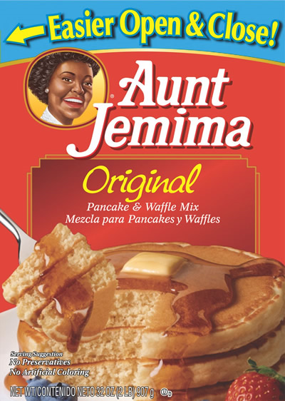
2008-
www.fda.gov/oc/po/firmrecalls/photos/quakeroats03_08.html

Slide 102
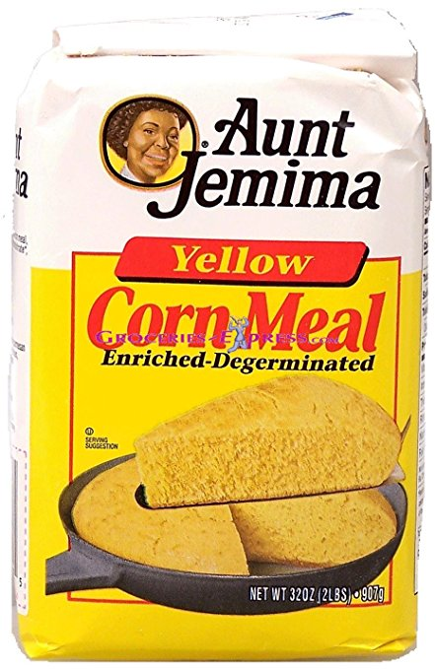
2018-
http://www.auntjemima.com/

Slide 103
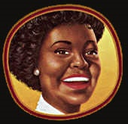
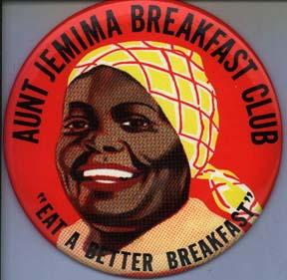

2018-
2008-
www.fda.gov/oc/po/firmrecalls/photos/quakeroats03_08.html

Slide 104
The future “Aunt Jemima” ? . . .

Slide 105
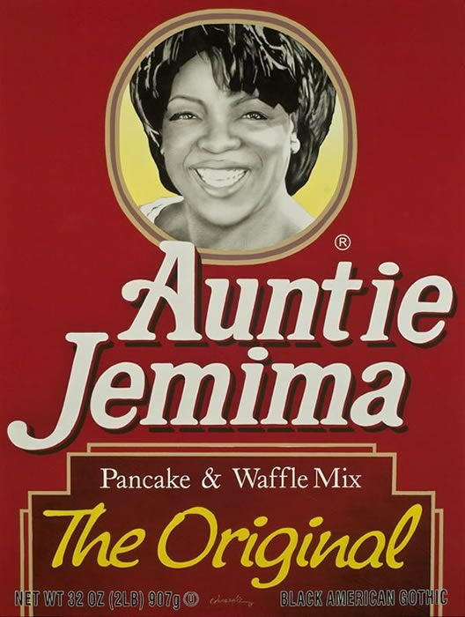
COLIN QUASHIE/BLACK AMERICAN GOTHIC AUNT JEMIMA
OPRAH WINFREY
image source

Slide 106
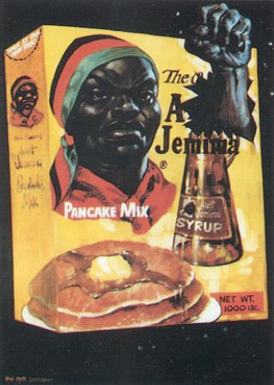
"No More!, 1967. Painting by Jon Onye Lockard"
http://othejoys.blogspot.com/2006/10/politics-of-breakfast.html

Slide 107
  Ch. 1 "34,000,000,000 Work-Hours" Saved: Convenience Foods and Mom's Home Cooking”
  Ch. 2 "Unnatural, Unclean, and Filthy": Chinese-American Cooking Literature Confronting Racism in the 1950s”
  Ch. 3 "All Those Leftovers Are Hard on the Family Morale": Rebellion in Peg Bracken's I Hate to Cook Book”
  Ch. 4 "Boredom Is Quite Out of the Picture": Women's Natural Foods Cookbooks and Social Change”
  Ch. 5 "More American than Apple Pie": Modern African- American Cookbooks Fighting White Stereotypes”
  Ch. 6 "You Can't Get Trashier": White Trash Cookbooks and Social Class”
  Ch. 7 "Dining on Grass and Shrubs": Making Vegan Food Sexy”
  Ch. 8 “Thin Is Not In: Two Fat Ladies and Gender Stereotypes on the Food Network”
  “This Aunt Jemima image has disturbing racist implications, helping to justify a white cultural fantasy where blacks enjoy their subordinate roles.”
Sherrie A. Inness, Secret Ingredients, Palgrave Macmillan, 2006, p. 169

Slide 108
  Ch. 1 "34,000,000,000 Work-Hours" Saved: Convenience Foods and Mom's Home Cooking”
  Ch. 2 "Unnatural, Unclean, and Filthy": Chinese-American Cooking Literature Confronting Racism in the 1950s”
  Ch. 3 "All Those Leftovers Are Hard on the Family Morale": Rebellion in Peg Bracken's I Hate to Cook Book”
  Ch. 4 "Boredom Is Quite Out of the Picture": Women's Natural Foods Cookbooks and Social Change”
  Ch. 5 "More American than Apple Pie": Modern African- American Cookbooks Fighting White Stereotypes”
  Ch. 6 "You Can't Get Trashier": White Trash Cookbooks and Social Class”
  Ch. 7 "Dining on Grass and Shrubs": Making Vegan Food Sexy”
  Ch. 8 “Thin Is Not In: Two Fat Ladies and Gender Stereotypes on the Food Network”
  “Black cookbooks refuted the fantasy [of Blacks enjoying their subordinate roles]
  demonstrating that blacks were forced by their low socioeconomic position to work for whites.”
Sherrie A. Inness, Secret Ingredients, Palgrave Macmillan, 2006, p. 169

Slide 109
  Ch. 1 "34,000,000,000 Work-Hours" Saved: Convenience Foods and Mom's Home Cooking”
  Ch. 2 "Unnatural, Unclean, and Filthy": Chinese-American Cooking Literature Confronting Racism in the 1950s”
  Ch. 3 "All Those Leftovers Are Hard on the Family Morale": Rebellion in Peg Bracken's I Hate to Cook Book”
  Ch. 4 "Boredom Is Quite Out of the Picture": Women's Natural Foods Cookbooks and Social Change”
  Ch. 5 "More American than Apple Pie": Modern African- American Cookbooks Fighting White Stereotypes”
  Ch. 6 "You Can't Get Trashier": White Trash Cookbooks and Social Class”
  Ch. 7 "Dining on Grass and Shrubs": Making Vegan Food Sexy”
  Ch. 8 “Thin Is Not In: Two Fat Ladies and Gender Stereotypes on the Food Network”
  “In many ways,
  authors used their books to rewrite mainstream stereotypes about African Americans and their traditional foods.”
Sherrie A. Inness, Secret Ingredients, Palgrave Macmillan, 2006, p. 169

Slide 110
if you’re interested in this topic have a look at a modern version of a Black woman’s cookbook . . .

Slide 111
it’s quite a fascinating work . . .

Slide 112
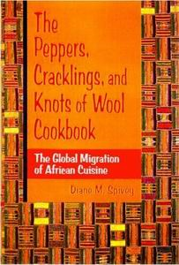
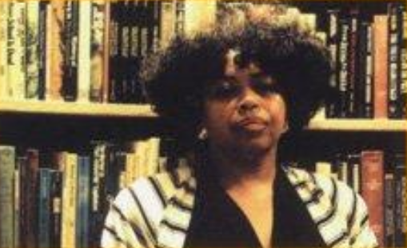
Diane M. Spivey. The Peppers, Cracklings, and Knots of Wool Cookbook: The Global Migration of African Cuisine.
Albany, NY: State University of New York Press, 1999

Slide 113
  Ch. 1 "34,000,000,000 Work-Hours" Saved: Convenience Foods and Mom's Home Cooking”
  Ch. 2 "Unnatural, Unclean, and Filthy": Chinese-American Cooking Literature Confronting Racism in the 1950s”
  Ch. 3 "All Those Leftovers Are Hard on the Family Morale": Rebellion in Peg Bracken's I Hate to Cook Book”
  Ch. 4 "Boredom Is Quite Out of the Picture": Women's Natural Foods Cookbooks and Social Change”
  Ch. 5 "More American than Apple Pie": Modern African- American Cookbooks Fighting White Stereotypes”
  Ch. 6 "You Can't Get Trashier": White Trash Cookbooks and Social Class”
  Ch. 7 "Dining on Grass and Shrubs": Making Vegan Food Sexy”
  Ch. 8 “Thin Is Not In: Two Fat Ladies and Gender Stereotypes on the Food Network”
Sherrie A. Inness, Secret Ingredients, Palgrave Macmillan, 2006, p. 169

Slide 114
  Ch. 1 "34,000,000,000 Work-Hours" Saved: Convenience Foods and Mom's Home Cooking”
  Ch. 2 "Unnatural, Unclean, and Filthy": Chinese-American Cooking Literature Confronting Racism in the 1950s”
  Ch. 3 "All Those Leftovers Are Hard on the Family Morale": Rebellion in Peg Bracken's I Hate to Cook Book”
  Ch. 4 "Boredom Is Quite Out of the Picture": Women's Natural Foods Cookbooks and Social Change”
  Ch. 5 "More American than Apple Pie": Modern African- American Cookbooks Fighting White Stereotypes”
  Ch. 6 "You Can't Get Trashier": White Trash Cookbooks and Social Class”
  Ch. 7 "Dining on Grass and Shrubs": Making Vegan Food Sexy”
  Ch. 8 “Thin Is Not In: Two Fat Ladies and Gender Stereotypes on the Food Network”
  Ch. 6 “You Can't Get Trashier": White Trash Cookbooks and Social Class”
Sherrie A. Inness, Secret Ingredients, Palgrave Macmillan, 2006, p. 169

Slide 115
  Ch. 1 "34,000,000,000 Work-Hours" Saved: Convenience Foods and Mom's Home Cooking”
  Ch. 2 "Unnatural, Unclean, and Filthy": Chinese-American Cooking Literature Confronting Racism in the 1950s”
  Ch. 3 "All Those Leftovers Are Hard on the Family Morale": Rebellion in Peg Bracken's I Hate to Cook Book”
  Ch. 4 "Boredom Is Quite Out of the Picture": Women's Natural Foods Cookbooks and Social Change”
  Ch. 5 "More American than Apple Pie": Modern African- American Cookbooks Fighting White Stereotypes”
  Ch. 6 "You Can't Get Trashier": White Trash Cookbooks and Social Class”
  Ch. 7 "Dining on Grass and Shrubs": Making Vegan Food Sexy”
  Ch. 8 “Thin Is Not In: Two Fat Ladies and Gender Stereotypes on the Food Network”
  Ch. 6 focuses on how “white trash” use cooking literature to agitate for social change, also providing a venue for questioning and subverting the dominant social order’s value system
Sherrie A. Inness, Secret Ingredients, Palgrave Macmillan, 2006, p. 169

Slide 116
  Ch. 1 "34,000,000,000 Work-Hours" Saved: Convenience Foods and Mom's Home Cooking”
  Ch. 2 "Unnatural, Unclean, and Filthy": Chinese-American Cooking Literature Confronting Racism in the 1950s”
  Ch. 3 "All Those Leftovers Are Hard on the Family Morale": Rebellion in Peg Bracken's I Hate to Cook Book”
  Ch. 4 "Boredom Is Quite Out of the Picture": Women's Natural Foods Cookbooks and Social Change”
  Ch. 5 "More American than Apple Pie": Modern African- American Cookbooks Fighting White Stereotypes”
  Ch. 6 "You Can't Get Trashier": White Trash Cookbooks and Social Class”
  Ch. 7 "Dining on Grass and Shrubs": Making Vegan Food Sexy”
  Ch. 8 “Thin Is Not In: Two Fat Ladies and Gender Stereotypes on the Food Network”
  Chapter 6
  explores issues of race, ethnicity, gender, and social class by analyzing white trash cooking literature . . .
Sherrie A. Inness, Secret Ingredients, Palgrave Macmillan, 2006, p. 169

Slide 117
  Ch. 1 "34,000,000,000 Work-Hours" Saved: Convenience Foods and Mom's Home Cooking”
  Ch. 2 "Unnatural, Unclean, and Filthy": Chinese-American Cooking Literature Confronting Racism in the 1950s”
  Ch. 3 "All Those Leftovers Are Hard on the Family Morale": Rebellion in Peg Bracken's I Hate to Cook Book”
  Ch. 4 "Boredom Is Quite Out of the Picture": Women's Natural Foods Cookbooks and Social Change”
  Ch. 5 "More American than Apple Pie": Modern African- American Cookbooks Fighting White Stereotypes”
  Ch. 6 "You Can't Get Trashier": White Trash Cookbooks and Social Class”
  Ch. 7 "Dining on Grass and Shrubs": Making Vegan Food Sexy”
  Ch. 8 “Thin Is Not In: Two Fat Ladies and Gender Stereotypes on the Food Network”
  Chapter 6
  explores issues of race, ethnicity, gender, and social class by analyzing white trash cooking literature . . .
  works like . . .
Sherrie A. Inness, Secret Ingredients, Palgrave Macmillan, 2006, p. 169

Slide 118
  Ch. 1 "34,000,000,000 Work-Hours" Saved: Convenience Foods and Mom's Home Cooking”
  Ch. 2 "Unnatural, Unclean, and Filthy": Chinese-American Cooking Literature Confronting Racism in the 1950s”
  Ch. 3 "All Those Leftovers Are Hard on the Family Morale": Rebellion in Peg Bracken's I Hate to Cook Book”
  Ch. 4 "Boredom Is Quite Out of the Picture": Women's Natural Foods Cookbooks and Social Change”
  Ch. 5 "More American than Apple Pie": Modern African- American Cookbooks Fighting White Stereotypes”
  Ch. 6 "You Can't Get Trashier": White Trash Cookbooks and Social Class”
  Ch. 7 "Dining on Grass and Shrubs": Making Vegan Food Sexy”
  Ch. 8 “Thin Is Not In: Two Fat Ladies and Gender Stereotypes on the Food Network”
  White Trash Cooking
  (1986)
  Ernest Matthew Mickler
  Ruby Ann’s Down Home Trailer Park Cookbook
  (2002)
  Ruby Ann Boxcar
Sherrie A. Inness, Secret Ingredients, Palgrave Macmillan, 2006, p. 169

Slide 119
  Ch. 1 "34,000,000,000 Work-Hours" Saved: Convenience Foods and Mom's Home Cooking”
  Ch. 2 "Unnatural, Unclean, and Filthy": Chinese-American Cooking Literature Confronting Racism in the 1950s”
  Ch. 3 "All Those Leftovers Are Hard on the Family Morale": Rebellion in Peg Bracken's I Hate to Cook Book”
  Ch. 4 "Boredom Is Quite Out of the Picture": Women's Natural Foods Cookbooks and Social Change”
  Ch. 5 "More American than Apple Pie": Modern African- American Cookbooks Fighting White Stereotypes”
  Ch. 6 "You Can't Get Trashier": White Trash Cookbooks and Social Class”
  Ch. 7 "Dining on Grass and Shrubs": Making Vegan Food Sexy”
  Ch. 8 “Thin Is Not In: Two Fat Ladies and Gender Stereotypes on the Food Network”
  White trash cookbook authors “. . . use humor to convey lessons about social class differences in the
  United States, including the social inequity that is an integral part of many American lives, especially those labeled ‘white trash.’”
Sherrie A. Inness, Secret Ingredients, Palgrave Macmillan, 2006, p. 169

Slide 120
  Ch. 1 "34,000,000,000 Work-Hours" Saved: Convenience Foods and Mom's Home Cooking”
  Ch. 2 "Unnatural, Unclean, and Filthy": Chinese-American Cooking Literature Confronting Racism in the 1950s”
  Ch. 3 "All Those Leftovers Are Hard on the Family Morale": Rebellion in Peg Bracken's I Hate to Cook Book”
  Ch. 4 "Boredom Is Quite Out of the Picture": Women's Natural Foods Cookbooks and Social Change”
  Ch. 5 "More American than Apple Pie": Modern African- American Cookbooks Fighting White Stereotypes”
  Ch. 6 "You Can't Get Trashier": White Trash Cookbooks and Social Class”
  Ch. 7 "Dining on Grass and Shrubs": Making Vegan Food Sexy”
  Ch. 8 “Thin Is Not In: Two Fat Ladies and Gender Stereotypes on the Food Network”
  Ch. 6 “You Can't Get Trashier": White Trash Cookbooks and Social Class”
  “Mickler and Boxcar, as well as other self-identified white trash writers, use their works to give a voice to America’s [white] underclass.”
Sherrie A. Inness, Secret Ingredients, Palgrave Macmillan, 2006, p. 169

Slide 121
  Ch. 1 "34,000,000,000 Work-Hours" Saved: Convenience Foods and Mom's Home Cooking”
  Ch. 2 "Unnatural, Unclean, and Filthy": Chinese-American Cooking Literature Confronting Racism in the 1950s”
  Ch. 3 "All Those Leftovers Are Hard on the Family Morale": Rebellion in Peg Bracken's I Hate to Cook Book”
  Ch. 4 "Boredom Is Quite Out of the Picture": Women's Natural Foods Cookbooks and Social Change”
  Ch. 5 "More American than Apple Pie": Modern African- American Cookbooks Fighting White Stereotypes”
  Ch. 6 "You Can't Get Trashier": White Trash Cookbooks and Social Class”
  Ch. 7 "Dining on Grass and Shrubs": Making Vegan Food Sexy”
  Ch. 8 “Thin Is Not In: Two Fat Ladies and Gender Stereotypes on the Food Network”
  “During the two decades when many upper- and middle-class whites rode the stock market and the technology boom to great wealth, white trash cooking literature reminded people that not all whites were wealthy, that some lived in poverty.”
Sherrie A. Inness, Secret Ingredients, Palgrave Macmillan, 2006, p. 169

Slide 122
  Ch. 1 "34,000,000,000 Work-Hours" Saved: Convenience Foods and Mom's Home Cooking”
  Ch. 2 "Unnatural, Unclean, and Filthy": Chinese-American Cooking Literature Confronting Racism in the 1950s”
  Ch. 3 "All Those Leftovers Are Hard on the Family Morale": Rebellion in Peg Bracken's I Hate to Cook Book”
  Ch. 4 "Boredom Is Quite Out of the Picture": Women's Natural Foods Cookbooks and Social Change”
  Ch. 5 "More American than Apple Pie": Modern African- American Cookbooks Fighting White Stereotypes”
  Ch. 6 "You Can't Get Trashier": White Trash Cookbooks and Social Class”
  Ch. 7 "Dining on Grass and Shrubs": Making Vegan Food Sexy”
  Ch. 8 “Thin Is Not In: Two Fat Ladies and Gender Stereotypes on the Food Network”
  “. . . the white trash writers also
  show that poor whites have always existed in the United States, shattering the illusion that all whites ‘naturally’ are able to share in the American dream.”
Sherrie A. Inness, Secret Ingredients, Palgrave Macmillan, 2006, p. 169

Slide 123
  Ch. 1 "34,000,000,000 Work-Hours" Saved: Convenience Foods and Mom's Home Cooking”
  Ch. 2 "Unnatural, Unclean, and Filthy": Chinese-American Cooking Literature Confronting Racism in the 1950s”
  Ch. 3 "All Those Leftovers Are Hard on the Family Morale": Rebellion in Peg Bracken's I Hate to Cook Book”
  Ch. 4 "Boredom Is Quite Out of the Picture": Women's Natural Foods Cookbooks and Social Change”
  Ch. 5 "More American than Apple Pie": Modern African- American Cookbooks Fighting White Stereotypes”
  Ch. 6 "You Can't Get Trashier": White Trash Cookbooks and Social Class”
  Ch. 7 "Dining on Grass and Shrubs": Making Vegan Food Sexy”
  Ch. 8 “Thin Is Not In: Two Fat Ladies and Gender Stereotypes on the Food Network”
Sherrie A. Inness, Secret Ingredients, Palgrave Macmillan, 2006, p. 169

Slide 124
  Ch. 1 "34,000,000,000 Work-Hours" Saved: Convenience Foods and Mom's Home Cooking”
  Ch. 2 "Unnatural, Unclean, and Filthy": Chinese-American Cooking Literature Confronting Racism in the 1950s”
  Ch. 3 "All Those Leftovers Are Hard on the Family Morale": Rebellion in Peg Bracken's I Hate to Cook Book”
  Ch. 4 "Boredom Is Quite Out of the Picture": Women's Natural Foods Cookbooks and Social Change”
  Ch. 5 "More American than Apple Pie": Modern African- American Cookbooks Fighting White Stereotypes”
  Ch. 6 "You Can't Get Trashier": White Trash Cookbooks and Social Class”
  Ch. 7 "Dining on Grass and Shrubs": Making Vegan Food Sexy”
  Ch. 8 “Thin Is Not In: Two Fat Ladies and Gender Stereotypes on the Food Network”
  Ch. 7 “Dining on Grass and Shrubs": Making Vegan Food Sexy”
Sherrie A. Inness, Secret Ingredients, Palgrave Macmillan, 2006, p. 169

Slide 125
  Ch. 1 "34,000,000,000 Work-Hours" Saved: Convenience Foods and Mom's Home Cooking”
  Ch. 2 "Unnatural, Unclean, and Filthy": Chinese-American Cooking Literature Confronting Racism in the 1950s”
  Ch. 3 "All Those Leftovers Are Hard on the Family Morale": Rebellion in Peg Bracken's I Hate to Cook Book”
  Ch. 4 "Boredom Is Quite Out of the Picture": Women's Natural Foods Cookbooks and Social Change”
  Ch. 5 "More American than Apple Pie": Modern African- American Cookbooks Fighting White Stereotypes”
  Ch. 6 "You Can't Get Trashier": White Trash Cookbooks and Social Class”
  Ch. 7 "Dining on Grass and Shrubs": Making Vegan Food Sexy”
  Ch. 8 “Thin Is Not In: Two Fat Ladies and Gender Stereotypes on the Food Network”
  Ch. 7 focuses on
  another disenfranchised group:
  Vegans
Sherrie A. Inness, Secret Ingredients, Palgrave Macmillan, 2006, p. 169

Slide 126
  Ch. 1 "34,000,000,000 Work-Hours" Saved: Convenience Foods and Mom's Home Cooking”
  Ch. 2 "Unnatural, Unclean, and Filthy": Chinese-American Cooking Literature Confronting Racism in the 1950s”
  Ch. 3 "All Those Leftovers Are Hard on the Family Morale": Rebellion in Peg Bracken's I Hate to Cook Book”
  Ch. 4 "Boredom Is Quite Out of the Picture": Women's Natural Foods Cookbooks and Social Change”
  Ch. 5 "More American than Apple Pie": Modern African- American Cookbooks Fighting White Stereotypes”
  Ch. 6 "You Can't Get Trashier": White Trash Cookbooks and Social Class”
  Ch. 7 "Dining on Grass and Shrubs": Making Vegan Food Sexy”
  Ch. 8 “Thin Is Not In: Two Fat Ladies and Gender Stereotypes on the Food Network”
  in recent decades,
  vegan foods have not always had the most flattering press . . .
Sherrie A. Inness, Secret Ingredients, Palgrave Macmillan, 2006, p. 169

Slide 127
  Ch. 1 "34,000,000,000 Work-Hours" Saved: Convenience Foods and Mom's Home Cooking”
  Ch. 2 "Unnatural, Unclean, and Filthy": Chinese-American Cooking Literature Confronting Racism in the 1950s”
  Ch. 3 "All Those Leftovers Are Hard on the Family Morale": Rebellion in Peg Bracken's I Hate to Cook Book”
  Ch. 4 "Boredom Is Quite Out of the Picture": Women's Natural Foods Cookbooks and Social Change”
  Ch. 5 "More American than Apple Pie": Modern African- American Cookbooks Fighting White Stereotypes”
  Ch. 6 "You Can't Get Trashier": White Trash Cookbooks and Social Class”
  Ch. 7 "Dining on Grass and Shrubs": Making Vegan Food Sexy”
  Ch. 8 “Thin Is Not In: Two Fat Ladies and Gender Stereotypes on the Food Network”
  “[Vegans] have commonly
  been depicted as
  appealing only to zealots who do not care if what they eat is unpalatable or nearly inedible;
  vegan foods have been associated with a radical fringe move concerned about animal rights than culinary pleasure.”
Sherrie A. Inness, Secret Ingredients, Palgrave Macmillan, 2006, p. 169

Slide 128
  Ch. 1 "34,000,000,000 Work-Hours" Saved: Convenience Foods and Mom's Home Cooking”
  Ch. 2 "Unnatural, Unclean, and Filthy": Chinese-American Cooking Literature Confronting Racism in the 1950s”
  Ch. 3 "All Those Leftovers Are Hard on the Family Morale": Rebellion in Peg Bracken's I Hate to Cook Book”
  Ch. 4 "Boredom Is Quite Out of the Picture": Women's Natural Foods Cookbooks and Social Change”
  Ch. 5 "More American than Apple Pie": Modern African- American Cookbooks Fighting White Stereotypes”
  Ch. 6 "You Can't Get Trashier": White Trash Cookbooks and Social Class”
  Ch. 7 "Dining on Grass and Shrubs": Making Vegan Food Sexy”
  Ch. 8 “Thin Is Not In: Two Fat Ladies and Gender Stereotypes on the Food Network”
  “[Vegans] have commonly
  been depicted as
  appealing only to zealots who do not care if what they eat is unpalatable or nearly inedible;
  vegan foods have been associated with a radical fringe move concerned about animal rights than culinary pleasure.”
Sherrie A. Inness, Secret Ingredients, Palgrave Macmillan, 2006, p. 169

Slide 129
  Ch. 1 "34,000,000,000 Work-Hours" Saved: Convenience Foods and Mom's Home Cooking”
  Ch. 2 "Unnatural, Unclean, and Filthy": Chinese-American Cooking Literature Confronting Racism in the 1950s”
  Ch. 3 "All Those Leftovers Are Hard on the Family Morale": Rebellion in Peg Bracken's I Hate to Cook Book”
  Ch. 4 "Boredom Is Quite Out of the Picture": Women's Natural Foods Cookbooks and Social Change”
  Ch. 5 "More American than Apple Pie": Modern African- American Cookbooks Fighting White Stereotypes”
  Ch. 6 "You Can't Get Trashier": White Trash Cookbooks and Social Class”
  Ch. 7 "Dining on Grass and Shrubs": Making Vegan Food Sexy”
  Ch. 8 “Thin Is Not In: Two Fat Ladies and Gender Stereotypes on the Food Network”
  “Many Americans do not even know what vegan foods and philosophies are,
  since the media has not popularized veganism as much as vegetarianism.”
Sherrie A. Inness, Secret Ingredients, Palgrave Macmillan, 2006, p. 169

Slide 130
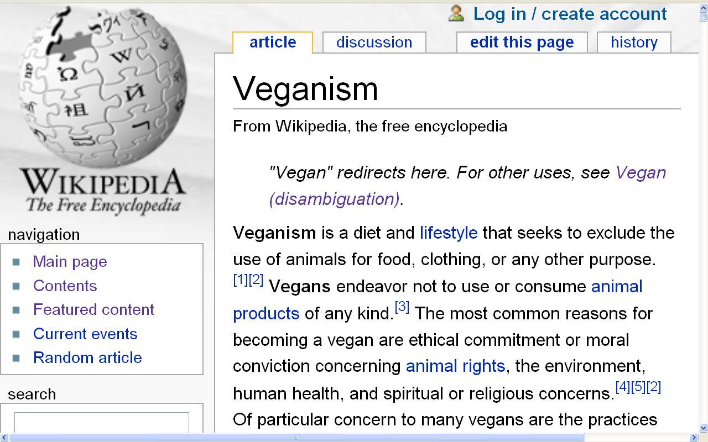
Wikipedia

Slide 131
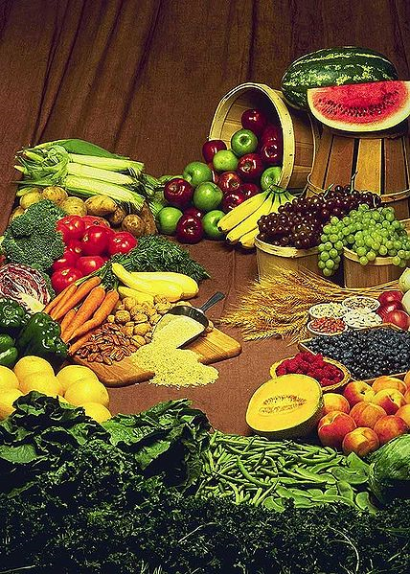
Various fruits, vegetables, nuts, and grains; some basic ingredients of a vegan diet.
Wikipedia

Slide 132
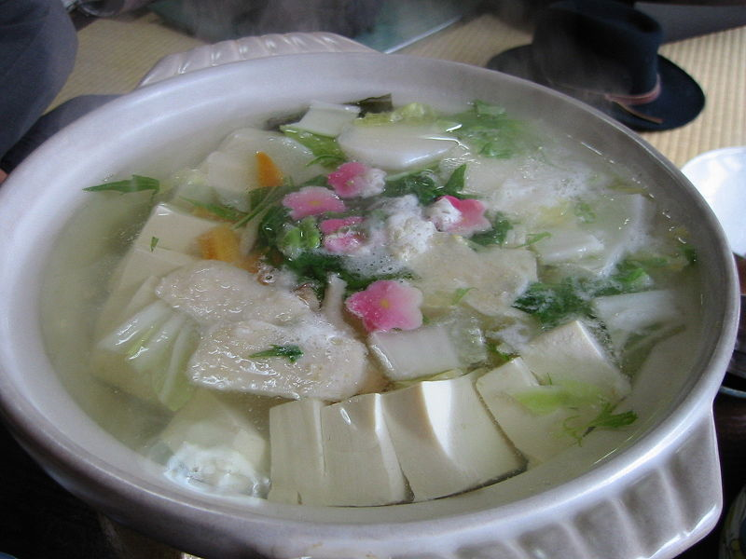
Sample of vegan Buddhist cuisine
from a Zen temple in Japan
Wikipedia

Slide 133
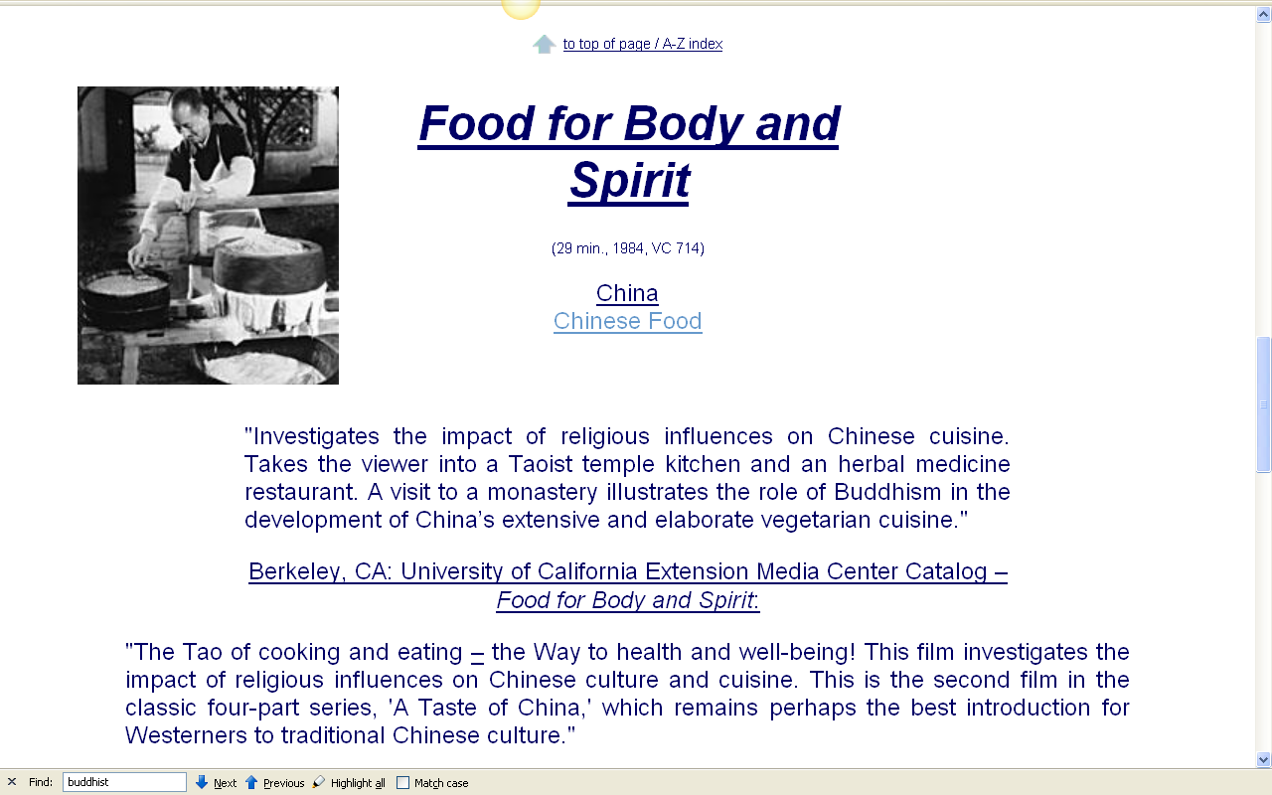
  Cf., food in a Buddhist monastery Week 6

Slide 134
  Ch. 1 "34,000,000,000 Work-Hours" Saved: Convenience Foods and Mom's Home Cooking”
  Ch. 2 "Unnatural, Unclean, and Filthy": Chinese-American Cooking Literature Confronting Racism in the 1950s”
  Ch. 3 "All Those Leftovers Are Hard on the Family Morale": Rebellion in Peg Bracken's I Hate to Cook Book”
  Ch. 4 "Boredom Is Quite Out of the Picture": Women's Natural Foods Cookbooks and Social Change”
  Ch. 5 "More American than Apple Pie": Modern African- American Cookbooks Fighting White Stereotypes”
  Ch. 6 "You Can't Get Trashier": White Trash Cookbooks and Social Class”
  Ch. 7 "Dining on Grass and Shrubs": Making Vegan Food Sexy”
  Ch. 8 “Thin Is Not In: Two Fat Ladies and Gender Stereotypes on the Food Network”
  “Contemporary vegans are thus faced with a dual dilemma of addressing the popular media’s negative images and making vegan ideas more visible to the mainstream. To address these issues, vegans have turned to cooking literature.”
Sherrie A. Inness, Secret Ingredients, Palgrave Macmillan, 2006, p. 169

Slide 135
  Ch. 1 "34,000,000,000 Work-Hours" Saved: Convenience Foods and Mom's Home Cooking”
  Ch. 2 "Unnatural, Unclean, and Filthy": Chinese-American Cooking Literature Confronting Racism in the 1950s”
  Ch. 3 "All Those Leftovers Are Hard on the Family Morale": Rebellion in Peg Bracken's I Hate to Cook Book”
  Ch. 4 "Boredom Is Quite Out of the Picture": Women's Natural Foods Cookbooks and Social Change”
  Ch. 5 "More American than Apple Pie": Modern African- American Cookbooks Fighting White Stereotypes”
  Ch. 6 "You Can't Get Trashier": White Trash Cookbooks and Social Class”
  Ch. 7 "Dining on Grass and Shrubs": Making Vegan Food Sexy”
  Ch. 8 “Thin Is Not In: Two Fat Ladies and Gender Stereotypes on the Food Network”
  “In earlier years, vegan cookbooks were more utilitarian than anything, but this has changed in the last few decades as a number of women
  (and some men) have published cookbooks that depict vegan cooking as ‘sexy’ and chic, making their audience rethink its ideas about veganism.”
Sherrie A. Inness, Secret Ingredients, Palgrave Macmillan, 2006, p. 169

Slide 136
  Ch. 1 "34,000,000,000 Work-Hours" Saved: Convenience Foods and Mom's Home Cooking”
  Ch. 2 "Unnatural, Unclean, and Filthy": Chinese-American Cooking Literature Confronting Racism in the 1950s”
  Ch. 3 "All Those Leftovers Are Hard on the Family Morale": Rebellion in Peg Bracken's I Hate to Cook Book”
  Ch. 4 "Boredom Is Quite Out of the Picture": Women's Natural Foods Cookbooks and Social Change”
  Ch. 5 "More American than Apple Pie": Modern African- American Cookbooks Fighting White Stereotypes”
  Ch. 6 "You Can't Get Trashier": White Trash Cookbooks and Social Class”
  Ch. 7 "Dining on Grass and Shrubs": Making Vegan Food Sexy”
  Ch. 8 “Thin Is Not In: Two Fat Ladies and Gender Stereotypes on the Food Network”
  Everyday Vegan: 300 Recipes for Healthful Eating
  (2002)
  Jeani-Rose Atchinson
Sherrie A. Inness, Secret Ingredients, Palgrave Macmillan, 2006, p. 169

Slide 137
  Ch. 1 "34,000,000,000 Work-Hours" Saved: Convenience Foods and Mom's Home Cooking”
  Ch. 2 "Unnatural, Unclean, and Filthy": Chinese-American Cooking Literature Confronting Racism in the 1950s”
  Ch. 3 "All Those Leftovers Are Hard on the Family Morale": Rebellion in Peg Bracken's I Hate to Cook Book”
  Ch. 4 "Boredom Is Quite Out of the Picture": Women's Natural Foods Cookbooks and Social Change”
  Ch. 5 "More American than Apple Pie": Modern African- American Cookbooks Fighting White Stereotypes”
  Ch. 6 "You Can't Get Trashier": White Trash Cookbooks and Social Class”
  Ch. 7 "Dining on Grass and Shrubs": Making Vegan Food Sexy”
  Ch. 8 “Thin Is Not In: Two Fat Ladies and Gender Stereotypes on the Food Network”
  The Voluptuous Vegan: More than 200 Sinfully Delicious Recipes for Meatless, Eggless and Dairy-Free Meals
  (2000)
  Myra Kornfeld
Sherrie A. Inness, Secret Ingredients, Palgrave Macmillan, 2006, p. 169

Slide 138
  Ch. 1 "34,000,000,000 Work-Hours" Saved: Convenience Foods and Mom's Home Cooking”
  Ch. 2 "Unnatural, Unclean, and Filthy": Chinese-American Cooking Literature Confronting Racism in the 1950s”
  Ch. 3 "All Those Leftovers Are Hard on the Family Morale": Rebellion in Peg Bracken's I Hate to Cook Book”
  Ch. 4 "Boredom Is Quite Out of the Picture": Women's Natural Foods Cookbooks and Social Change”
  Ch. 5 "More American than Apple Pie": Modern African- American Cookbooks Fighting White Stereotypes”
  Ch. 6 "You Can't Get Trashier": White Trash Cookbooks and Social Class”
  Ch. 7 "Dining on Grass and Shrubs": Making Vegan Food Sexy”
  Ch. 8 “Thin Is Not In: Two Fat Ladies and Gender Stereotypes on the Food Network”
  Vegan Planet: 400 Irresistible Recipes with Fantastic Flavors from Home and around the World
  (2003)
  Robin Robertson
Sherrie A. Inness, Secret Ingredients, Palgrave Macmillan, 2006, p. 169

Slide 139
  Ch. 1 "34,000,000,000 Work-Hours" Saved: Convenience Foods and Mom's Home Cooking”
  Ch. 2 "Unnatural, Unclean, and Filthy": Chinese-American Cooking Literature Confronting Racism in the 1950s”
  Ch. 3 "All Those Leftovers Are Hard on the Family Morale": Rebellion in Peg Bracken's I Hate to Cook Book”
  Ch. 4 "Boredom Is Quite Out of the Picture": Women's Natural Foods Cookbooks and Social Change”
  Ch. 5 "More American than Apple Pie": Modern African- American Cookbooks Fighting White Stereotypes”
  Ch. 6 "You Can't Get Trashier": White Trash Cookbooks and Social Class”
  Ch. 7 "Dining on Grass and Shrubs": Making Vegan Food Sexy”
  Ch. 8 “Thin Is Not In: Two Fat Ladies and Gender Stereotypes on the Food Network”
  “By showing vegan cooking to be hip and trendy, as exciting as nonvegan cooking, these books are attracting a large audience that might never even have heard about veganism.”
Sherrie A. Inness, Secret Ingredients, Palgrave Macmillan, 2006, p. 169

Slide 140
  Ch. 1 "34,000,000,000 Work-Hours" Saved: Convenience Foods and Mom's Home Cooking”
  Ch. 2 "Unnatural, Unclean, and Filthy": Chinese-American Cooking Literature Confronting Racism in the 1950s”
  Ch. 3 "All Those Leftovers Are Hard on the Family Morale": Rebellion in Peg Bracken's I Hate to Cook Book”
  Ch. 4 "Boredom Is Quite Out of the Picture": Women's Natural Foods Cookbooks and Social Change”
  Ch. 5 "More American than Apple Pie": Modern African- American Cookbooks Fighting White Stereotypes”
  Ch. 6 "You Can't Get Trashier": White Trash Cookbooks and Social Class”
  Ch. 7 "Dining on Grass and Shrubs": Making Vegan Food Sexy”
  Ch. 8 “Thin Is Not In: Two Fat Ladies and Gender Stereotypes on the Food Network”
  Contemporary vegan cookbooks,
  as did natural foods cookbooks,
  are affecting the way their readers view the world
Sherrie A. Inness, Secret Ingredients, Palgrave Macmillan, 2006, p. 169

Slide 141
  Ch. 1 "34,000,000,000 Work-Hours" Saved: Convenience Foods and Mom's Home Cooking”
  Ch. 2 "Unnatural, Unclean, and Filthy": Chinese-American Cooking Literature Confronting Racism in the 1950s”
  Ch. 3 "All Those Leftovers Are Hard on the Family Morale": Rebellion in Peg Bracken's I Hate to Cook Book”
  Ch. 4 "Boredom Is Quite Out of the Picture": Women's Natural Foods Cookbooks and Social Change”
  Ch. 5 "More American than Apple Pie": Modern African- American Cookbooks Fighting White Stereotypes”
  Ch. 6 "You Can't Get Trashier": White Trash Cookbooks and Social Class”
  Ch. 7 "Dining on Grass and Shrubs": Making Vegan Food Sexy”
  Ch. 8 “Thin Is Not In: Two Fat Ladies and Gender Stereotypes on the Food Network”
  “Vegan cookbooks
  wish to influence people to adopt a more ethically involved stance toward not just cooking but how they impact the globe in other ways.”
Sherrie A. Inness, Secret Ingredients, Palgrave Macmillan, 2006, p. 169

Slide 142
  Ch. 1 "34,000,000,000 Work-Hours" Saved: Convenience Foods and Mom's Home Cooking”
  Ch. 2 "Unnatural, Unclean, and Filthy": Chinese-American Cooking Literature Confronting Racism in the 1950s”
  Ch. 3 "All Those Leftovers Are Hard on the Family Morale": Rebellion in Peg Bracken's I Hate to Cook Book”
  Ch. 4 "Boredom Is Quite Out of the Picture": Women's Natural Foods Cookbooks and Social Change”
  Ch. 5 "More American than Apple Pie": Modern African- American Cookbooks Fighting White Stereotypes”
  Ch. 6 "You Can't Get Trashier": White Trash Cookbooks and Social Class”
  Ch. 7 "Dining on Grass and Shrubs": Making Vegan Food Sexy”
  Ch. 8 “Thin Is Not In: Two Fat Ladies and Gender Stereotypes on the Food Network”
Sherrie A. Inness, Secret Ingredients, Palgrave Macmillan, 2006, p. 169

Slide 143
  Ch. 1 "34,000,000,000 Work-Hours" Saved: Convenience Foods and Mom's Home Cooking”
  Ch. 2 "Unnatural, Unclean, and Filthy": Chinese-American Cooking Literature Confronting Racism in the 1950s”
  Ch. 3 "All Those Leftovers Are Hard on the Family Morale": Rebellion in Peg Bracken's I Hate to Cook Book”
  Ch. 4 "Boredom Is Quite Out of the Picture": Women's Natural Foods Cookbooks and Social Change”
  Ch. 5 "More American than Apple Pie": Modern African- American Cookbooks Fighting White Stereotypes”
  Ch. 6 "You Can't Get Trashier": White Trash Cookbooks and Social Class”
  Ch. 7 "Dining on Grass and Shrubs": Making Vegan Food Sexy”
  Ch. 8 “Thin Is Not In: Two Fat Ladies and Gender Stereotypes on the Food Network”
  Ch. 8 “Thin Is Not In: Two Fat Ladies
  and Gender Stereotypes
  on the Food Network”
Sherrie A. Inness, Secret Ingredients, Palgrave Macmillan, 2006, p. 169

Slide 144
  Ch. 1 "34,000,000,000 Work-Hours" Saved: Convenience Foods and Mom's Home Cooking”
  Ch. 2 "Unnatural, Unclean, and Filthy": Chinese-American Cooking Literature Confronting Racism in the 1950s”
  Ch. 3 "All Those Leftovers Are Hard on the Family Morale": Rebellion in Peg Bracken's I Hate to Cook Book”
  Ch. 4 "Boredom Is Quite Out of the Picture": Women's Natural Foods Cookbooks and Social Change”
  Ch. 5 "More American than Apple Pie": Modern African- American Cookbooks Fighting White Stereotypes”
  Ch. 6 "You Can't Get Trashier": White Trash Cookbooks and Social Class”
  Ch. 7 "Dining on Grass and Shrubs": Making Vegan Food Sexy”
  Ch. 8 “Thin Is Not In: Two Fat Ladies and Gender Stereotypes on the Food Network”
  The final chapter of Secret Ingredients turns from cookbooks
  to cooking shows
Sherrie A. Inness, Secret Ingredients, Palgrave Macmillan, 2006, p. 169

Slide 145
  Ch. 1 "34,000,000,000 Work-Hours" Saved: Convenience Foods and Mom's Home Cooking”
  Ch. 2 "Unnatural, Unclean, and Filthy": Chinese-American Cooking Literature Confronting Racism in the 1950s”
  Ch. 3 "All Those Leftovers Are Hard on the Family Morale": Rebellion in Peg Bracken's I Hate to Cook Book”
  Ch. 4 "Boredom Is Quite Out of the Picture": Women's Natural Foods Cookbooks and Social Change”
  Ch. 5 "More American than Apple Pie": Modern African- American Cookbooks Fighting White Stereotypes”
  Ch. 6 "You Can't Get Trashier": White Trash Cookbooks and Social Class”
  Ch. 7 "Dining on Grass and Shrubs": Making Vegan Food Sexy”
  Ch. 8 “Thin Is Not In: Two Fat Ladies and Gender Stereotypes on the Food Network”
  “Increasingly, if one wishes to understand the changing nature of cooking literature and cooking culture in general, it is necessary to focus on television, where the Food Network’s popularity has created a new venue for the culinary arts.”
Sherrie A. Inness, Secret Ingredients, Palgrave Macmillan, 2006, p. 169

Slide 146
  Ch. 1 "34,000,000,000 Work-Hours" Saved: Convenience Foods and Mom's Home Cooking”
  Ch. 2 "Unnatural, Unclean, and Filthy": Chinese-American Cooking Literature Confronting Racism in the 1950s”
  Ch. 3 "All Those Leftovers Are Hard on the Family Morale": Rebellion in Peg Bracken's I Hate to Cook Book”
  Ch. 4 "Boredom Is Quite Out of the Picture": Women's Natural Foods Cookbooks and Social Change”
  Ch. 5 "More American than Apple Pie": Modern African- American Cookbooks Fighting White Stereotypes”
  Ch. 6 "You Can't Get Trashier": White Trash Cookbooks and Social Class”
  Ch. 7 "Dining on Grass and Shrubs": Making Vegan Food Sexy”
  Ch. 8 “Thin Is Not In: Two Fat Ladies and Gender Stereotypes on the Food Network”
  “Although popular televised cooking shows, including Julia Child’s The French Chef, existed in previous decades, they never had the societal influence of a television network that features nothing but food shows twenty-four hours a day.”
Sherrie A. Inness, Secret Ingredients, Palgrave Macmillan, 2006, p. 169

Slide 147
  Ch. 1 "34,000,000,000 Work-Hours" Saved: Convenience Foods and Mom's Home Cooking”
  Ch. 2 "Unnatural, Unclean, and Filthy": Chinese-American Cooking Literature Confronting Racism in the 1950s”
  Ch. 3 "All Those Leftovers Are Hard on the Family Morale": Rebellion in Peg Bracken's I Hate to Cook Book”
  Ch. 4 "Boredom Is Quite Out of the Picture": Women's Natural Foods Cookbooks and Social Change”
  Ch. 5 "More American than Apple Pie": Modern African- American Cookbooks Fighting White Stereotypes”
  Ch. 6 "You Can't Get Trashier": White Trash Cookbooks and Social Class”
  Ch. 7 "Dining on Grass and Shrubs": Making Vegan Food Sexy”
  Ch. 8 Thin Is Not In: Two Fat Ladies and Gender Stereotypes on the Food Network”
  Ch. 8 “Thin Is Not In: Two Fat Ladies
  and Gender Stereotypes
  on the Food Network”
  Christina Deyo
  Bobby Flay
  Emeril Legasse
  Rachel Ray
  Roccco DiSpirito
  Wolfgang Puck . . .
Sherrie A. Inness, Secret Ingredients, Palgrave Macmillan, 2006, p. 169

Slide 148
  Ch. 1 "34,000,000,000 Work-Hours" Saved: Convenience Foods and Mom's Home Cooking”
  Ch. 2 "Unnatural, Unclean, and Filthy": Chinese-American Cooking Literature Confronting Racism in the 1950s”
  Ch. 3 "All Those Leftovers Are Hard on the Family Morale": Rebellion in Peg Bracken's I Hate to Cook Book”
  Ch. 4 "Boredom Is Quite Out of the Picture": Women's Natural Foods Cookbooks and Social Change”
  Ch. 5 "More American than Apple Pie": Modern African- American Cookbooks Fighting White Stereotypes”
  Ch. 6 "You Can't Get Trashier": White Trash Cookbooks and Social Class”
  Ch. 7 "Dining on Grass and Shrubs": Making Vegan Food Sexy”
  Ch. 8 “Thin Is Not In: Two Fat Ladies and Gender Stereotypes on the Food Network”
  “Some of these celebrities and their shows seem well known primarily for their sleek, sophisticated gloss,
  but not all are equally glossy.”
Sherrie A. Inness, Secret Ingredients, Palgrave Macmillan, 2006, p. 169

Slide 149
  Ch. 1 "34,000,000,000 Work-Hours" Saved: Convenience Foods and Mom's Home Cooking”
  Ch. 2 "Unnatural, Unclean, and Filthy": Chinese-American Cooking Literature Confronting Racism in the 1950s”
  Ch. 3 "All Those Leftovers Are Hard on the Family Morale": Rebellion in Peg Bracken's I Hate to Cook Book”
  Ch. 4 "Boredom Is Quite Out of the Picture": Women's Natural Foods Cookbooks and Social Change”
  Ch. 5 "More American than Apple Pie": Modern African- American Cookbooks Fighting White Stereotypes”
  Ch. 6 "You Can't Get Trashier": White Trash Cookbooks and Social Class”
  Ch. 7 "Dining on Grass and Shrubs": Making Vegan Food Sexy”
  Ch. 8 “Thin Is Not In: Two Fat Ladies and Gender Stereotypes on the Food Network”
  Enter . . .
  The Two Fat Ladies
Sherrie A. Inness, Secret Ingredients, Palgrave Macmillan, 2006, p. 169

Slide 150
  Ch. 1 "34,000,000,000 Work-Hours" Saved: Convenience
  Foods and Mom's Home Cooking”
  Ch. 2 "Unnatural, Unclean, and Filthy": Chinese-American Cooking Literature Confronting Racism in the 1950s”
  Ch. 3 "All Those Leftovers Are Hard on the Family Morale": Rebellion in Peg Bracken's I Hate to Cook Book”
  Ch. 4 "Boredom Is Quite Out of the Picture": Women's
  Natural Foods Cookbooks and Social Change”
  Ch. 5 "More American than Apple Pie": Modern African- American Cookbooks Fighting White Stereotypes”
  Ch. 6 "You Can't Get Trashier": White Trash Cookbooks and
  Social Class”
  Ch. 7 "Dining on Grass and Shrubs": Making Vegan Food Sexy”
  Ch. 8 “Thin Is Not In: Two Fat Ladies
  and Gender Stereotypes on the Food Network”
Sherrie A. Inness, Secret Ingredients, Palgrave Macmillan, 2006, p. 169

Slide 151
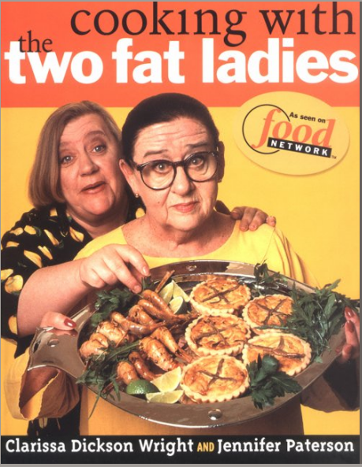
Cooking With the Two Fat Ladies, Clarkson Potter, 1998

Slide 152
Clarissa
Dickson
Wright
Jennifer
Patterson
Cooking With the Two Fat Ladies, Clarkson Potter, 1998

Slide 153
        “Stars of the late 1990s hit television series Two Fat Ladies, Jennifer Patterson and Clarissa Dickson Wright, broke a major social taboo by being fat.”
          this was a first for food television to depict fat women positively
          Why is this unusual?
            . . . cooking is an industry where fat or heavy set men have been embraced . . .
Sherrie A. Inness, Secret Ingredients, Palgrave Macmillan, 2006, p. 169

Slide 154
        “[The Two Fat] women did not try to conceal their fatness but, instead, reveled in it. . . .”
        “Rebelling against a culture
        that assumes women have to be thin
        in order to star in the media,
        the Fat Ladies delighted in their fatness.”
Sherrie A. Inness, Secret Ingredients, Palgrave Macmillan, 2006, p. 169

Slide 155
        “In addition, the Ladies challenged the stereotype that it is taboo on television to be
        middle aged or older.”
          Jennifer Patterson was in her 60s
          Clarissa Dickson Wright was in her 50s
Sherrie A. Inness, Secret Ingredients, Palgrave Macmillan, 2006, p. 170

Slide 156
        “The Ladies, however,
        accomplished more
        than just suggesting that it was acceptable for women, including media stars, to be fat and older.”
        “In their TV show and cookbooks,
        the Ladies spoke out about a number of important social issues related to food and the people who provide it. . . .”
Sherrie A. Inness, Secret Ingredients, Palgrave Macmillan, 2006, p. 170

Slide 157
        “Despite its nontraditional female stars, Two Fat Ladies was a great success when if first aired.”
          they developed a cult following among those who have an innate fondness for British eccentrics. . . .”
            they “made the Food Network worth watching”
            the program was a hit in other countries, including Australia and Canada
Sherrie A. Inness, Secret Ingredients, Palgrave Macmillan, 2006, p. 175

Slide 158
        “When the Ladies visited Australia,
        they were treated like a ‘mixture
        of the Queen Mother and the Beatles.’”
Sherrie A. Inness, Secret Ingredients, Palgrave Macmillan, 2006, p. 175

Slide 159
        “What explains the women’s appeal
        around the globe?”
Sherrie A. Inness, Secret Ingredients, Palgrave Macmillan, 2006, p. 175

Slide 160
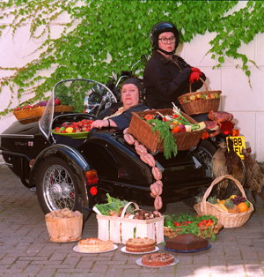
Jennifer
Patterson
Clarissa
Dickson
Wright
Two Fat Ladies

Slide 161
were they
Two Visionaries?
Two Fat Ladies

Slide 162
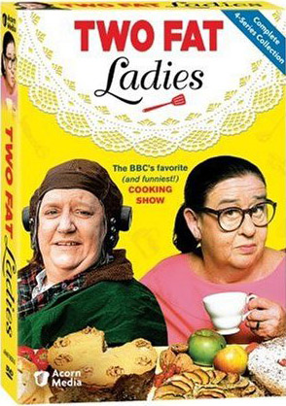

Slide 163
Sherrie A. Inness, Secret Ingredients, Palgrave Macmillan, 2006
Tim Roufs
© 2010-2024

