Slide 1

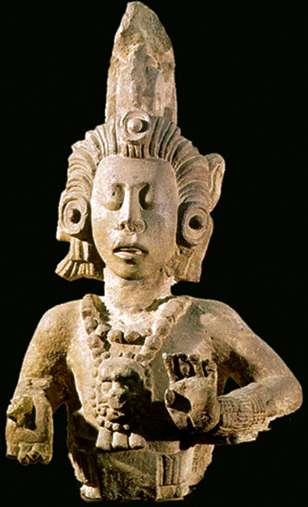
Tehuacán
Puebla,
Mexico
Anthropology of Food
University of Minnesota Duluth
Tim Roufs
©2010-2024
Maize God
Notes:
1

Slide 2
Chapter 3: “Food in Historical Perspective: Dietary Revolutions”
“Food in Historical Perspective:
Dietary Revolutions”
  The Agricultural Revolution of the Neolithic Era
    Development of Agriculture in the Tehuacán Valley
    Nutritional Consequences of the Agricultural Revolution: A Comparison of Foragers and Agriculturalists
    Social and Political Consequences of the Agricultural Revolution
  The Search for Spices
  The Industrial Revolution
  Early Technology
  The Scientific Revolution
  Modern-Day Adaptations
  Summary
  Highlight: Vegetarian Diets: Then and Now

Slide 3
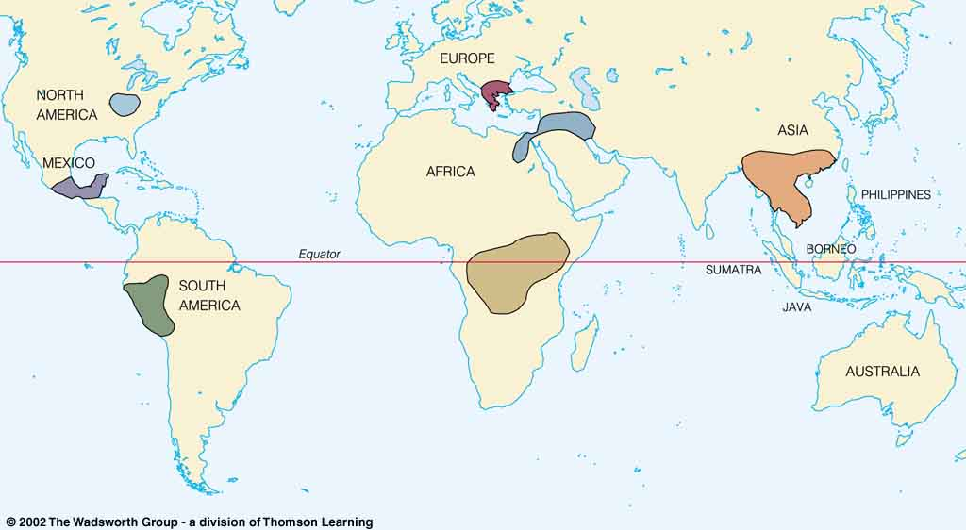
Origin of Domestication for Selected Plants
lettuce, grape, olive
6,500-5,000 ybp
gourd
5,000 ybp
maize
4,500 ybp
rice
7,000 ybp
wheat
10,500 ybp
millet
4,000 ybp
Maize (corn) became the major staple crop of the
New World and made possible the development
of several major ancient civilizations in
Mesoamerica and parts of North America
manioc
4,200 ybp
Understanding Physical Anthropology and Archaeology, 8th Ed., p. 417

Slide 4
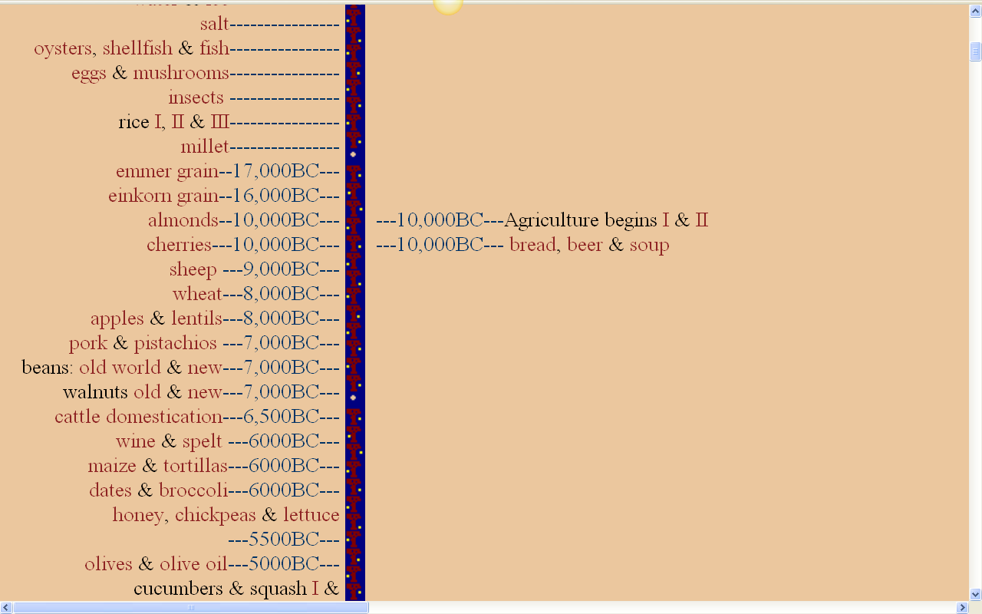
The food timeline
http://www.foodtimeline.org/

Slide 5
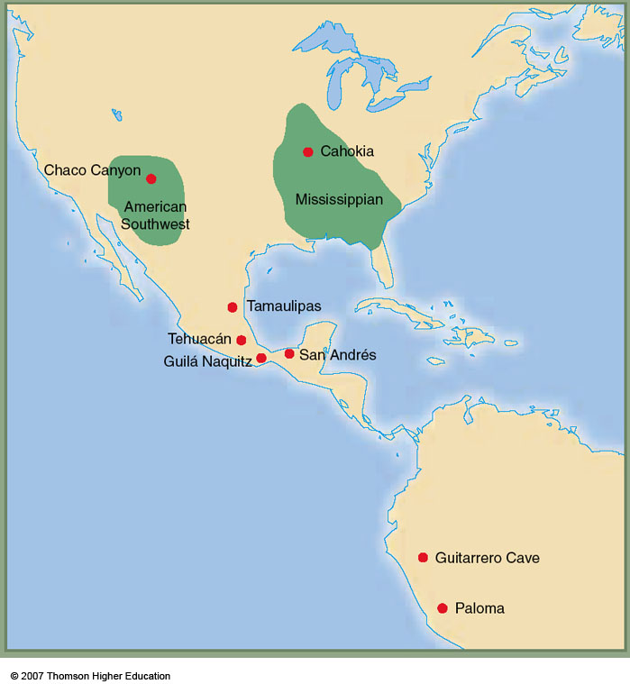
maize
4,500 ybp
The Tehuacán Valley, Puebla, Mexico,
is one of the most important sites in the world for tracing the development and diffusion of agriculture.
The Tehuacán Valley (or perhaps just a little west of it) is the center of the domestication of maize (corn), which became the major staple crop of the New World.
Tehuacán is a featured site in The Cultural Feast., pp. 49 ff.
Early farming in the Americas

Slide 6
Tehuacán
Valley
maize
4,500 ybp
Early farming in the Americas
Understanding Physical Anthropology and Archaeology, 9th Ed., p. 358
Early farming in the Americas

Slide 7
examples:
Tehuacán, Puebla, Mexico
pre-Columbian Kentucky
the changes toward dependence on agriculture was not always swift
in the short term, it was not always healthful
The Cultural Feast, 2nd Ed., p. 49

Slide 8
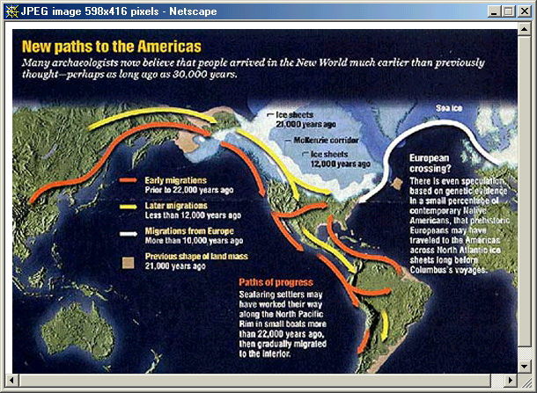
how humans first arrive in America is controversial, but it seems clear that there were at least three migrations, the “traditional” one of big-game “Clovis” hunters across the Bering Strait, and two others coming down both the Atlantic and Pacific coasts. . . .

Slide 9
the people coming via the “traditional” route were big-game hunters, and the other peoples were foragers making use of the “fisheries” along each coast

Slide 10
some of these peoples are known as “Pre-Clovis”

Slide 11
the term “fisheries” includes turtles, snails, clams, lobsters, crawfish, and, of course, fish

Slide 12
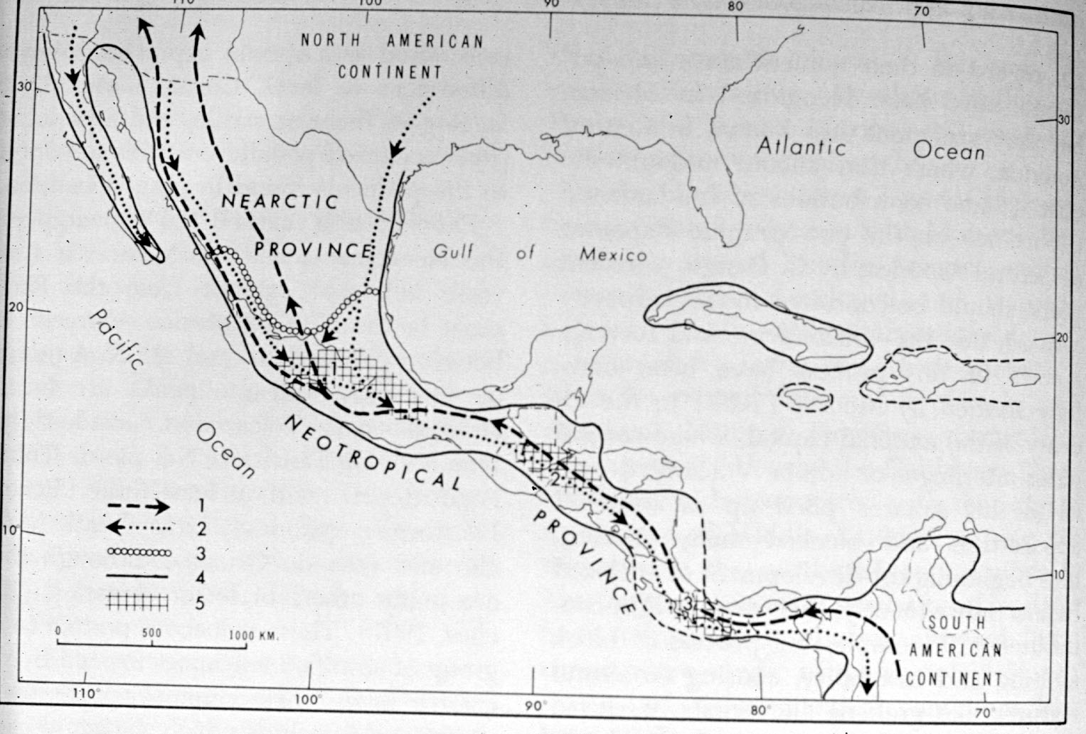
big-game hunters, were probably following the migration routes of their prey animals . . .
Miocene-Pliocene Routes of Animal Migrations

Slide 13
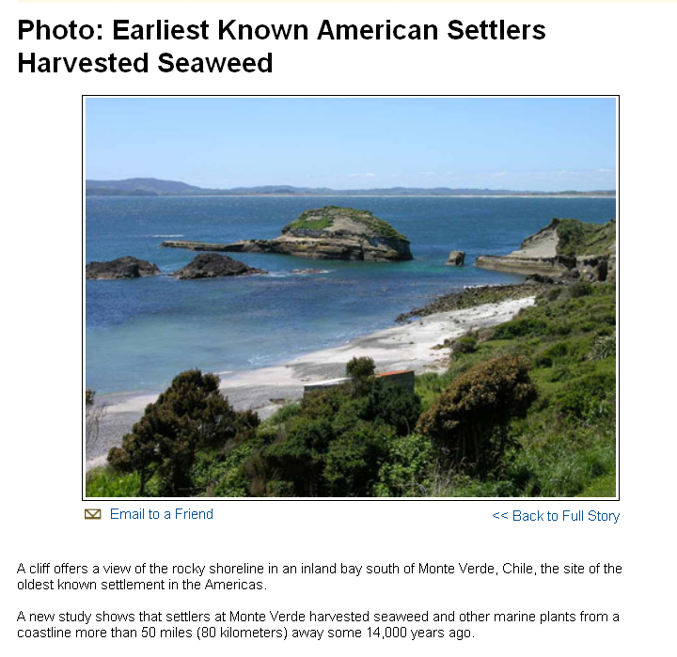
and the coastal peoples, in addition to utilizing the “fisheries” also ate the bountiful plants available, among them seaweed . . .
http://news.nationalgeographic.com/news/bigphotos/15550150.html
Notes:
13

Slide 14
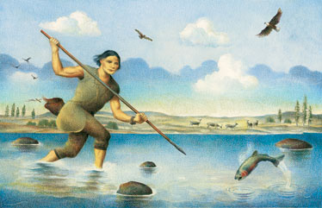

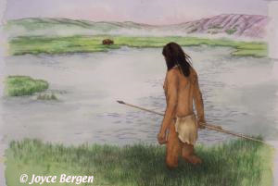
“Kennewick Man”
8,400 ybp
although the “hunters” also utilized “fisheries” when available . . .
http://www.time.com/time/magazine/article/0,9171,1169905,00.html

Slide 15
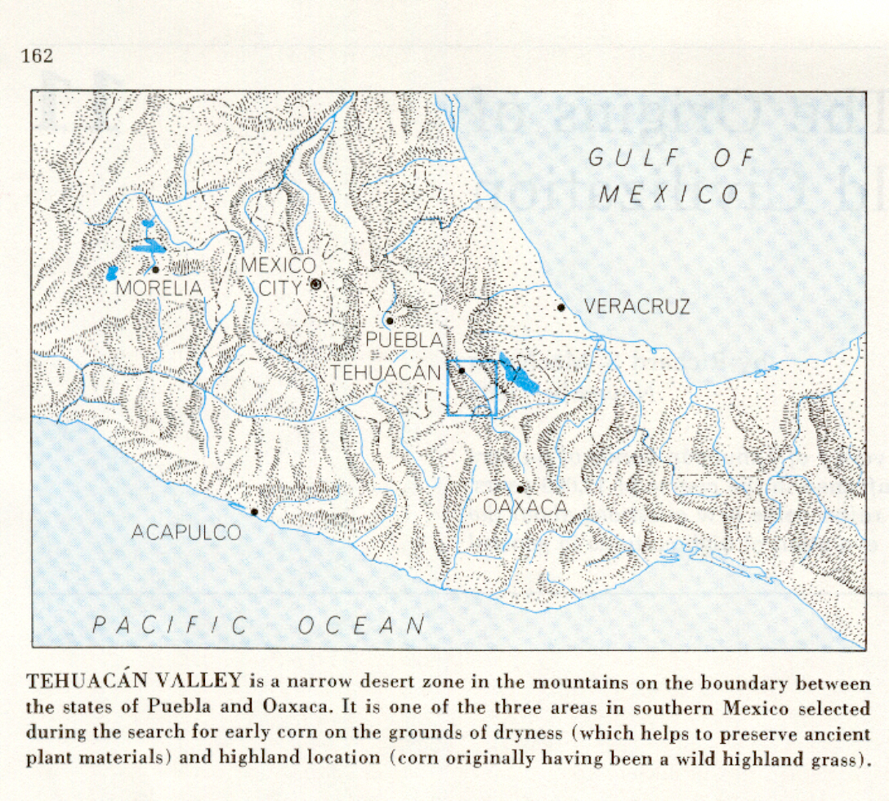
just a few people (probably about 12-24) first arrived
in the Tehuacán Valley
about 11,000 – 10,000 B.C. . . .
at the very beginning they may have hunted the legendary mastodon . . .
Richard S. Mac Neish, Scientific American, 1964
Understanding Physical Anthropology and Archaeology (8th ed), p. 417.

Slide 16
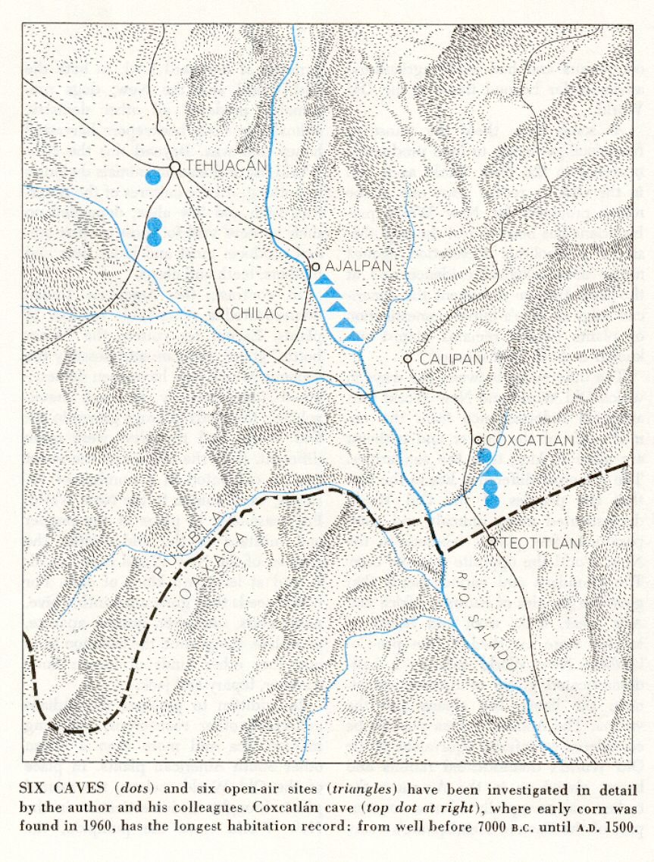
details of the Tehuacán Valley

Slide 17
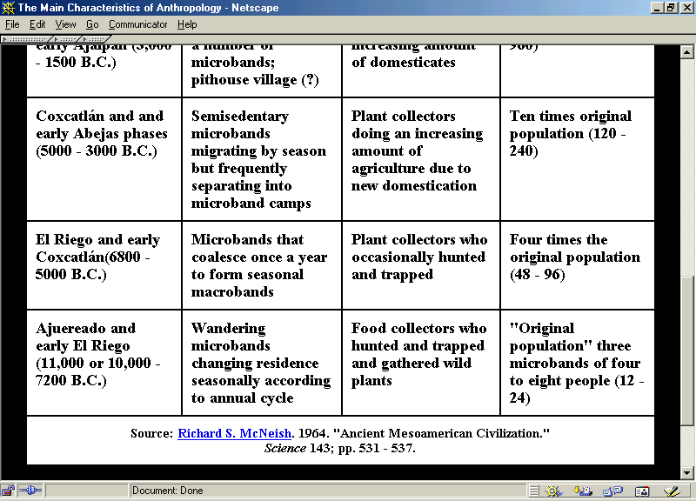

Slide 18
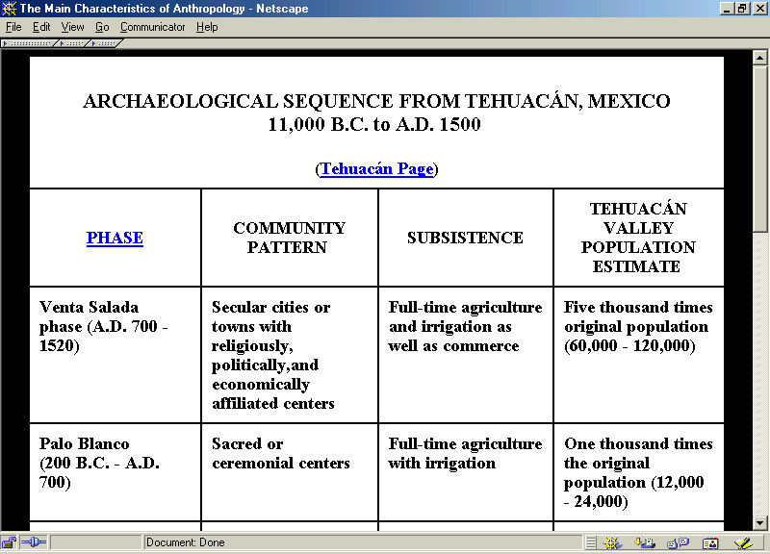
2010
and people have been in the Tehuacán Valley ever since . . .

Slide 19
People first arrived in the Tehuacán valley
about 11,000 – 10,000 B.C. . . .
at the very beginning they may have hunted the legendary mastodon . . .
Richard S. Mac Neish, Scientific American, 1964
Understanding Physical Anthropology and Archaeology (8th ed), p. 417.

Slide 20
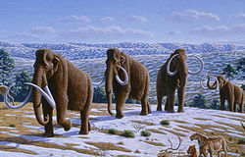

Slide 21
  but mastodon become extinct
  about 11,000 ybp

Slide 22
  perhaps as a result of overhunting or the human impact on the environment as a result of burning
  but they become extinct
  at about 11,000 ybp

Slide 23
  at 10,000 ybp people obtained all of their food from hunting and gathering

Slide 25
  but seed collection and smaller game became more important in the diets as time went on

Slide 26
  and the transition from foraging to domestication of plants and animals began

Slide 27
  the first evidence for cultivated plants in this region comes ca. 7,000 ybp

Slide 29
  the diets still contained a large proportion of wild plants, but meat consumption had dropped considerably
  the first evidence for cultivated plants in this region comes ca. 7,000 ybp

Slide 30
  over the next 5,000 years the Tehuacán inhabitants relied more and more heavily on cultivated crops

Slide 31
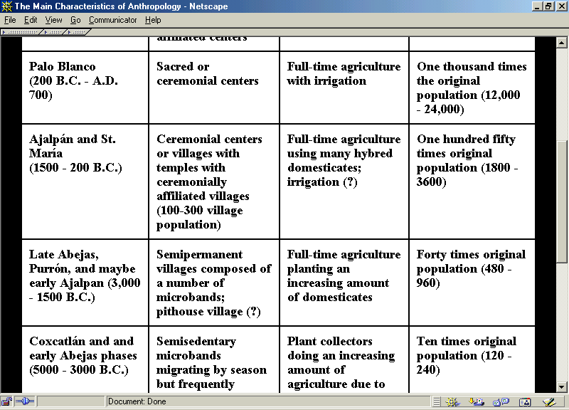

Slide 35
  by about the time of Christ domesticated plants made up almost their entire diet
  animals contributed only a small portion to the nutrient intake

Slide 37
  over time the Mexican diet became even more narrowly focused, and
  corn
  beans
  squash
  became the core
2009

Slide 38
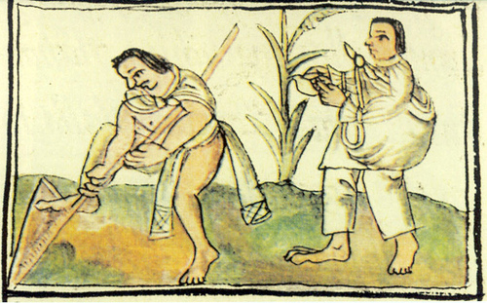
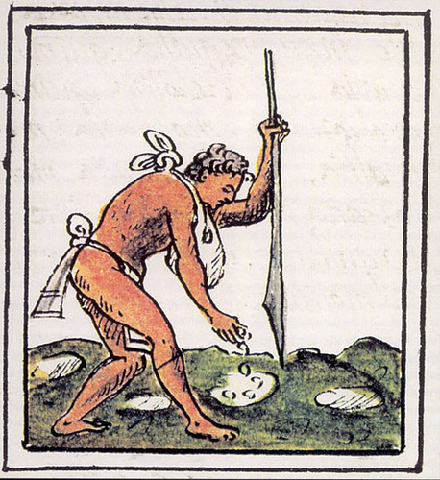
Aztecs sowing
late 16th century
Florentine Codex

Slide 39
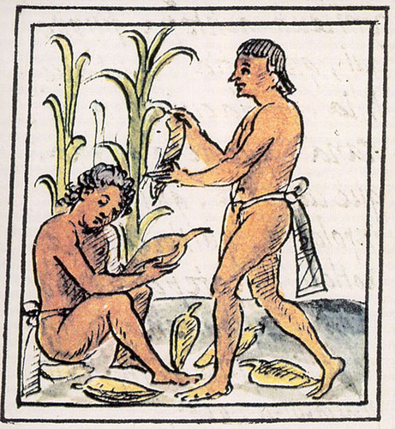
Aztecs harvesting maize
Florentine Codex
late 16th century

Slide 40
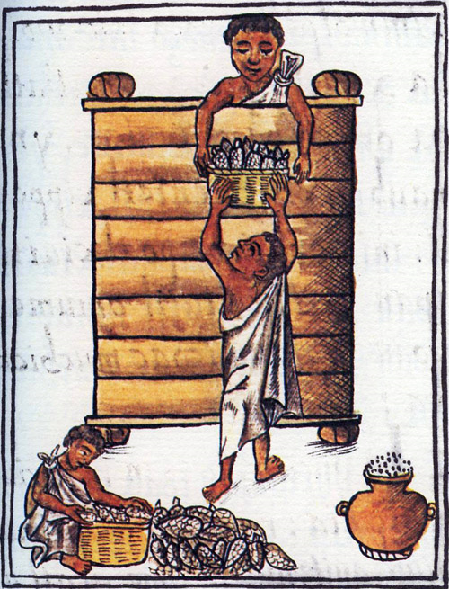
Aztecs storing maize
Florentine Codex,
late 16th century

Slide 41
  and
  corn
  beans
  squash
  remain the core
  of Mexican diets to this day
2010

Slide 42
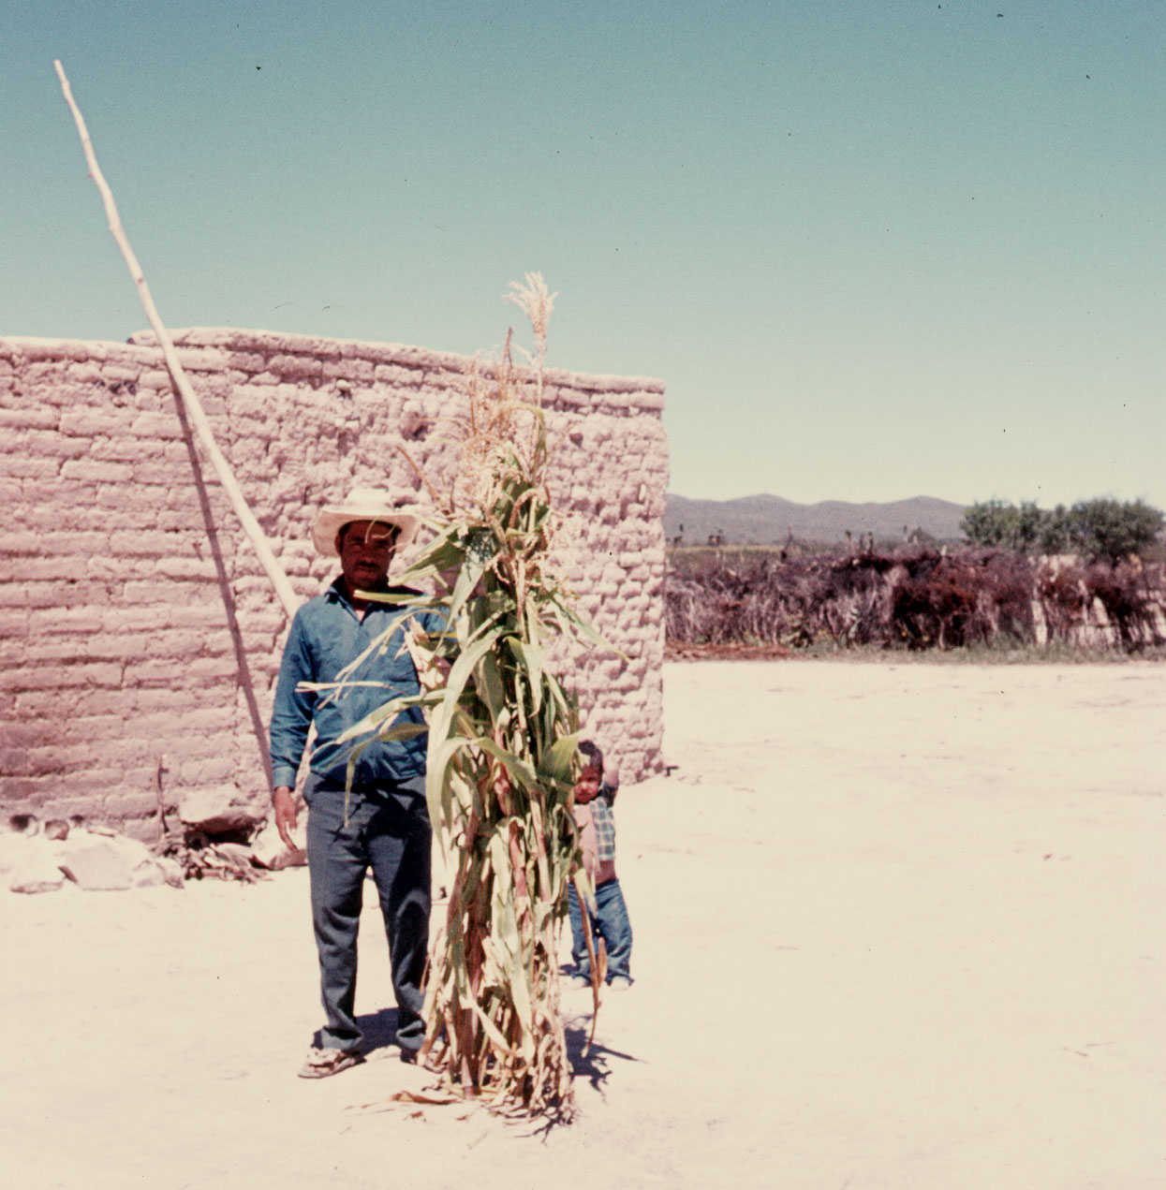
Compound of the 9 Brothers, near Matawala, San Luis Potosi, Mexico

Slide 43
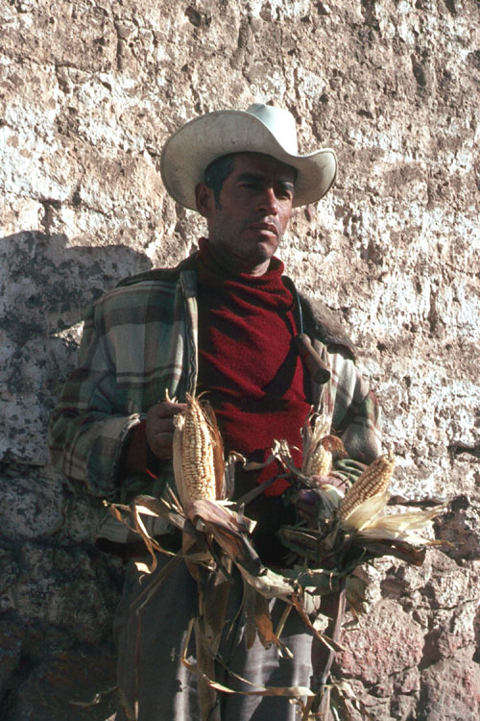
Valley of Apan, Hidalgo, Mexico

Slide 44
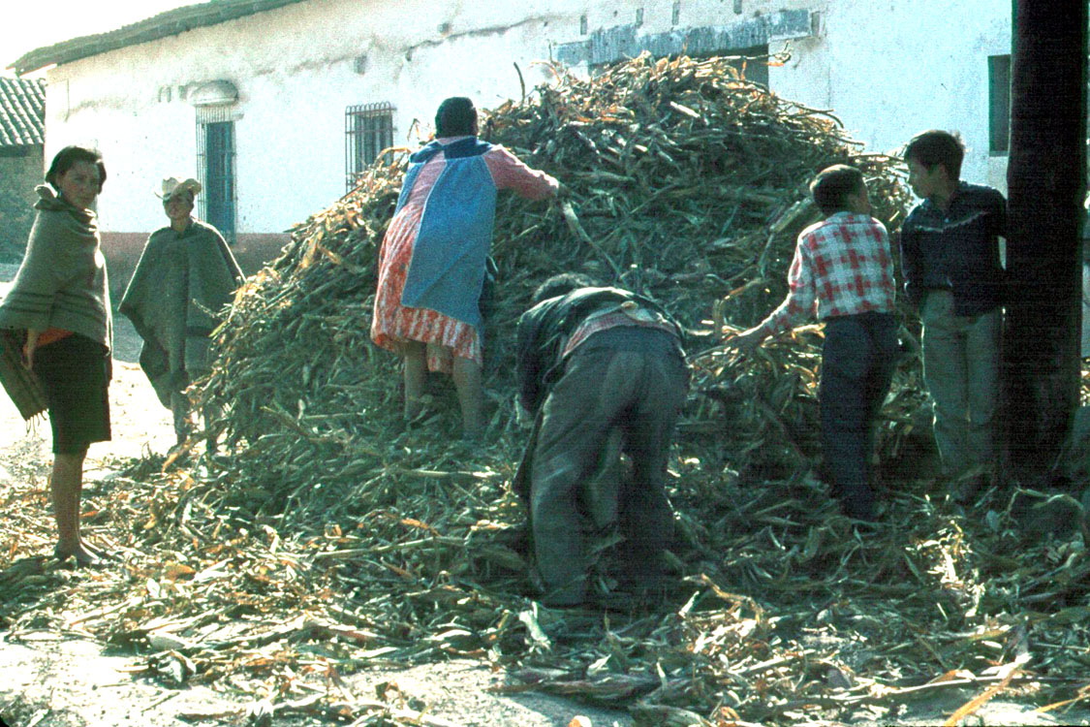
Valley of Apan, Hidalgo, Mexico

Slide 45
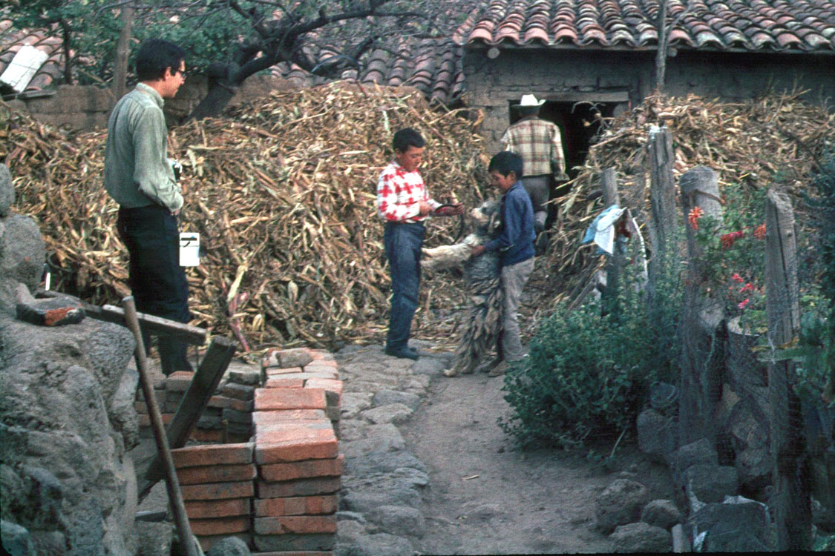
Valley of Apan, Hidalgo, Mexico

Slide 46
  the Tehuacán sequence is one of the best in the world to show, how over thousands of years, there was a slow transition during which they changed from a foraging to an agricultural existence
2009

Slide 47
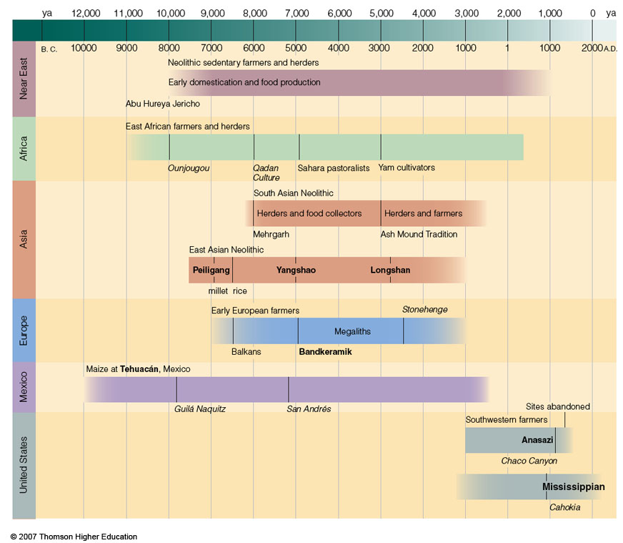
Timeline for Ch.16 "Food Production”
Understanding Physical Anthropology and Archaeology, 9th Ed., p. 333

Slide 48
  “the gradual way in which the production of food developed may have been due, in part, to the nutritional risks inherent in an agricultural way of life”
  (The Cultural Feast, 2nd Ed., p. 51)
2009

Slide 49
the story of maize in Middle America goes back
80,000 years . . .
Richard S. Mac Neish, Scientific American, 1964
Understanding Physical Anthropology and Archaeology (8th ed), p. 417.

Slide 50
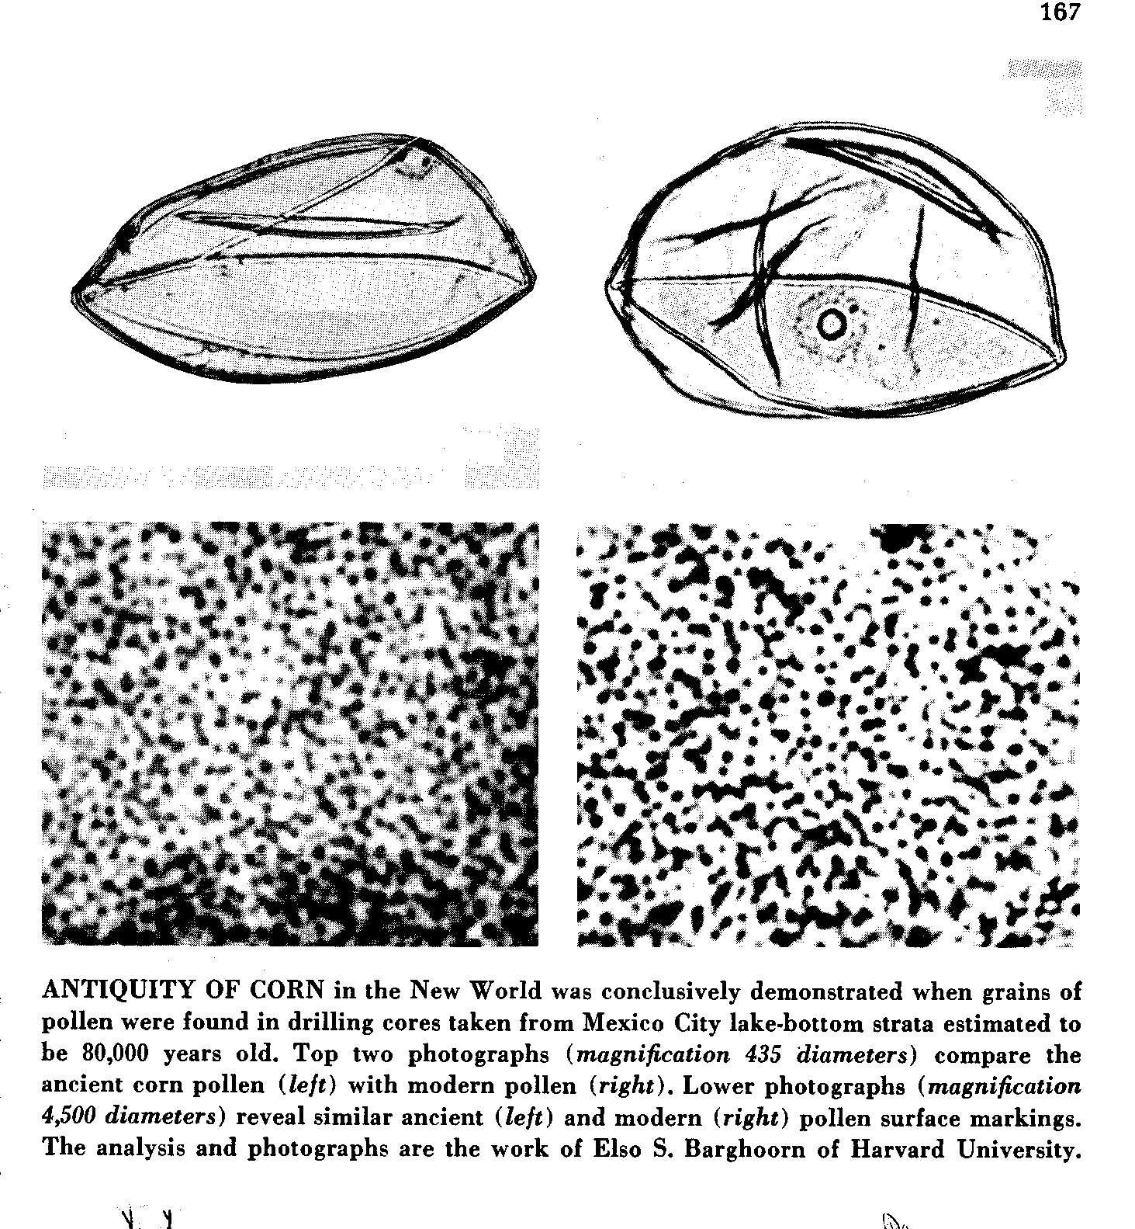
Pollen
microscopic
male gametes
produced by
flowering
plants.
starting with the fossil pollen of wild corn from Lake Texcoco (Mexico City area)
some of which has been dated to 80,000 ybp . . .
Richard S. Mac Neish, Scientific American, 1964

Slide 51
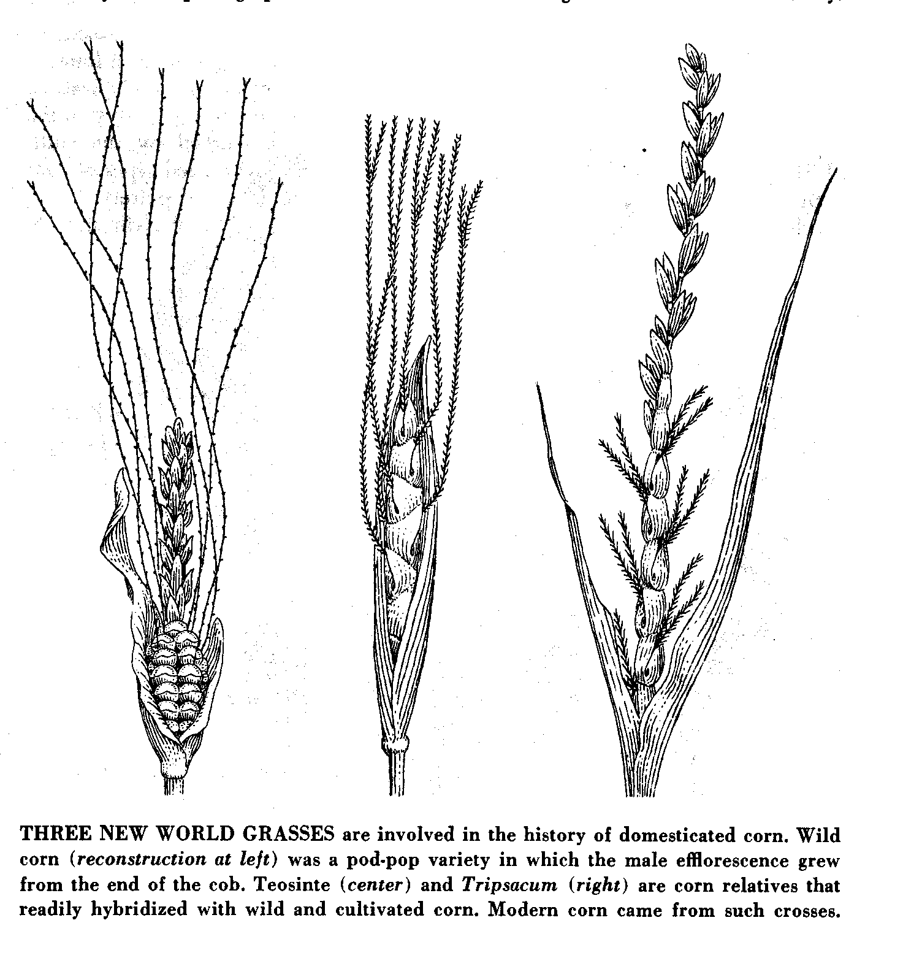
Wild corn
Teosinte
Tripsacum
wild
pod-pop
variety
wild corn is of the “pod” variety . . .
i.e., the “kernels” grew individually at the end of the “cob” . . .
Richard S. Mac Neish, Scientific American, 1964

Slide 52
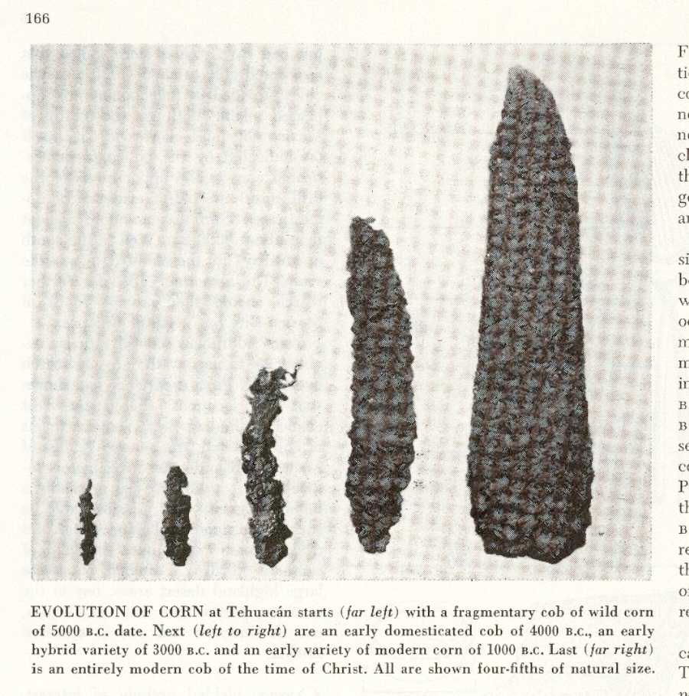
A.D. 0
1,000 B.C.
3,000 B.C.
5,000 B.C.
4,000 B.C.
and over 5,000 years the type of corn we know gradually emerged . . .
Richard S. Mac Neish, Scientific American, 1964

Slide 53
A.D. 0
1,000 B.C.
this process of change can be tracked by what is known as
seriation
of the fossil pollen
3,000 B.C.
5,000 B.C.
4,000 B.C.
Richard S. Mac Neish, Scientific American, 1964

Slide 54
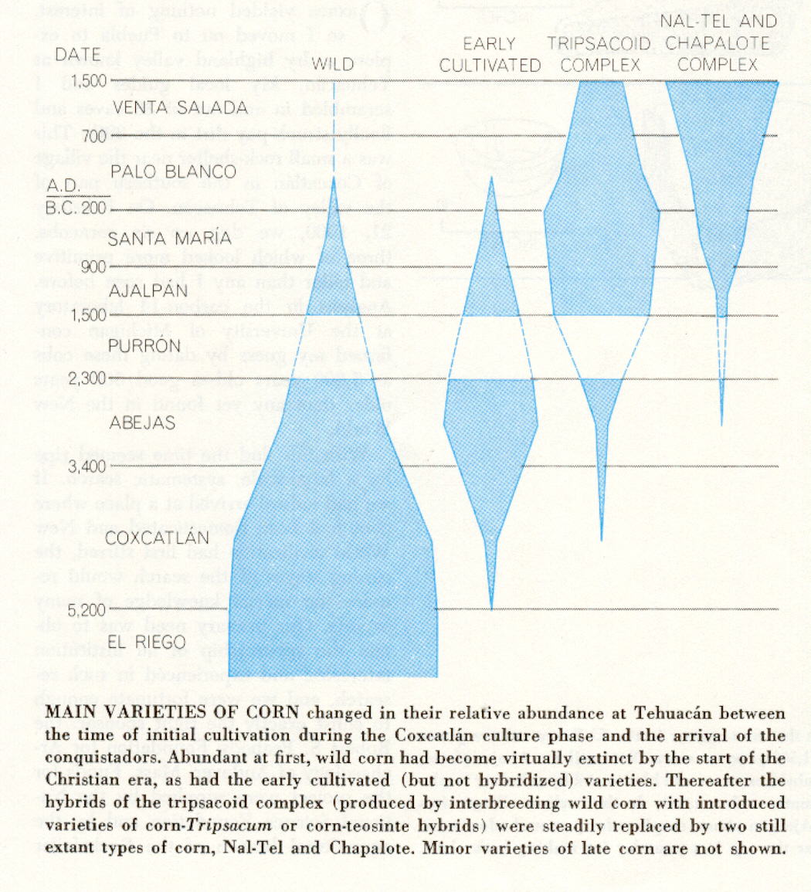
= 100%
= 100%
in the chart that follows
four strains of maize are represented:
“wild”
“early cultivated”
“Tripsacoid complex”
“Nal-tel and Chapalote complex”
= 100%
“seriation”
Richard S. Mac Neish, Scientific American, 1964

Slide 55
= 100%
= 100%
with seriation
the total combined width of the figures
equals 100%
so if you add up the shaded part of the four strains across one time period, the total should be 100%
If it does not equal 100% that means a new
(or sometimes an older) strain is not pictured on the seriation graph
(for e.g. at the top in the “Venta Salada” phase)
= 100%
“seriation”
Richard S. Mac Neish, Scientific American, 1964

Slide 56
= 100%
with seriation
the total combined width of the figures
equals 100%
so if you add up the shaded part of the four strains across one time period, the total should be 100%
If it does not equal 100% that means a new
(or sometimes an older) strain is not pictured
on the seriation graph
(for e.g. at the top in the “Venta Salada” phase)
= 100%
“seriation”
Richard S. Mac Neish, Scientific American, 1964

Slide 57
= 100%
= 100%
“seriation”
Richard S. Mac Neish, Scientific American, 1964

Slide 58
= 100%
= 100%
and sometimes you can see other interesting things on a seriation graph . . .
notice, for example, how the wild strain of maize never fully disappears from use . . .
= 100%
“seriation”
Richard S. Mac Neish, Scientific American, 1964

Slide 59
notice for example how the wild strain of maize never fully disappears from use . . .
that most likely represents a continuing use by some people of the wild version of maize, probably for medical or ritual purposes . . .
Richard S. Mac Neish, Scientific American, 1964

Slide 60
and sometimes you can see other interesting things on a seriation graph . . .
notice, for example, that the
“Agricultural Revolution” in Mesoamerica
took 5000 years . . .
= 100%
“seriation”
Richard S. Mac Neish, Scientific American, 1964

Slide 61
Richard S. Mac Neish, Scientific American, 1964

Slide 62
along with food production
came new technologies . . .
and these can easily be compared with seriation graphs . . .
Richard S. Mac Neish, Scientific American, 1964

Slide 63
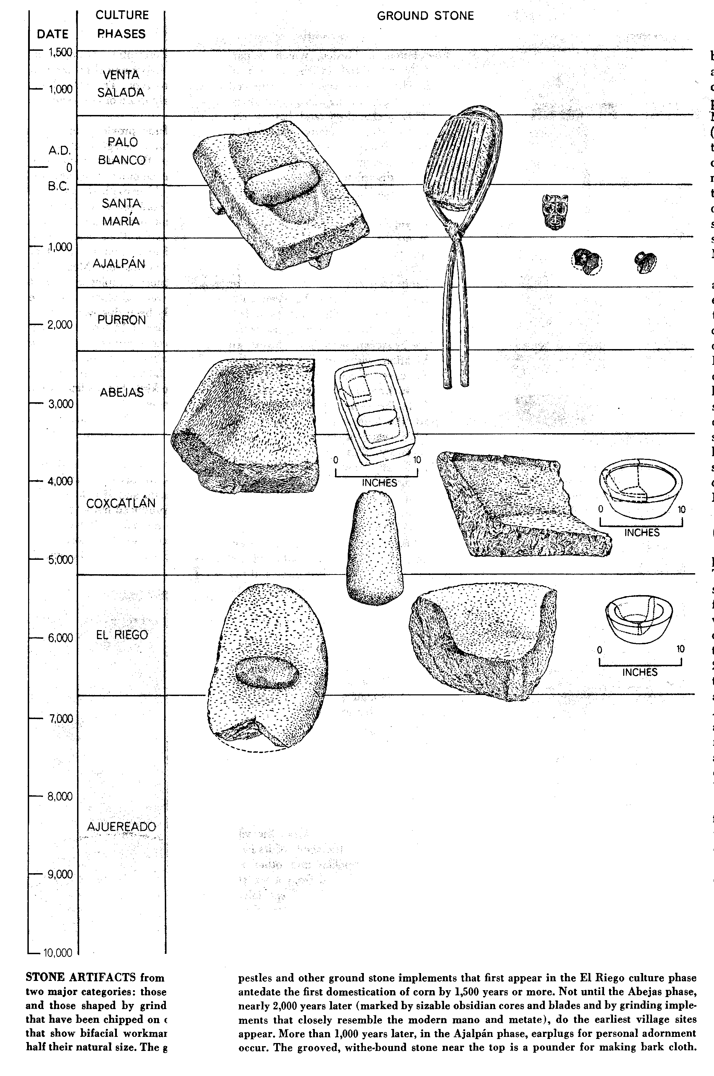
Richard S. Mac Neish, Scientific American, 1964

Slide 64
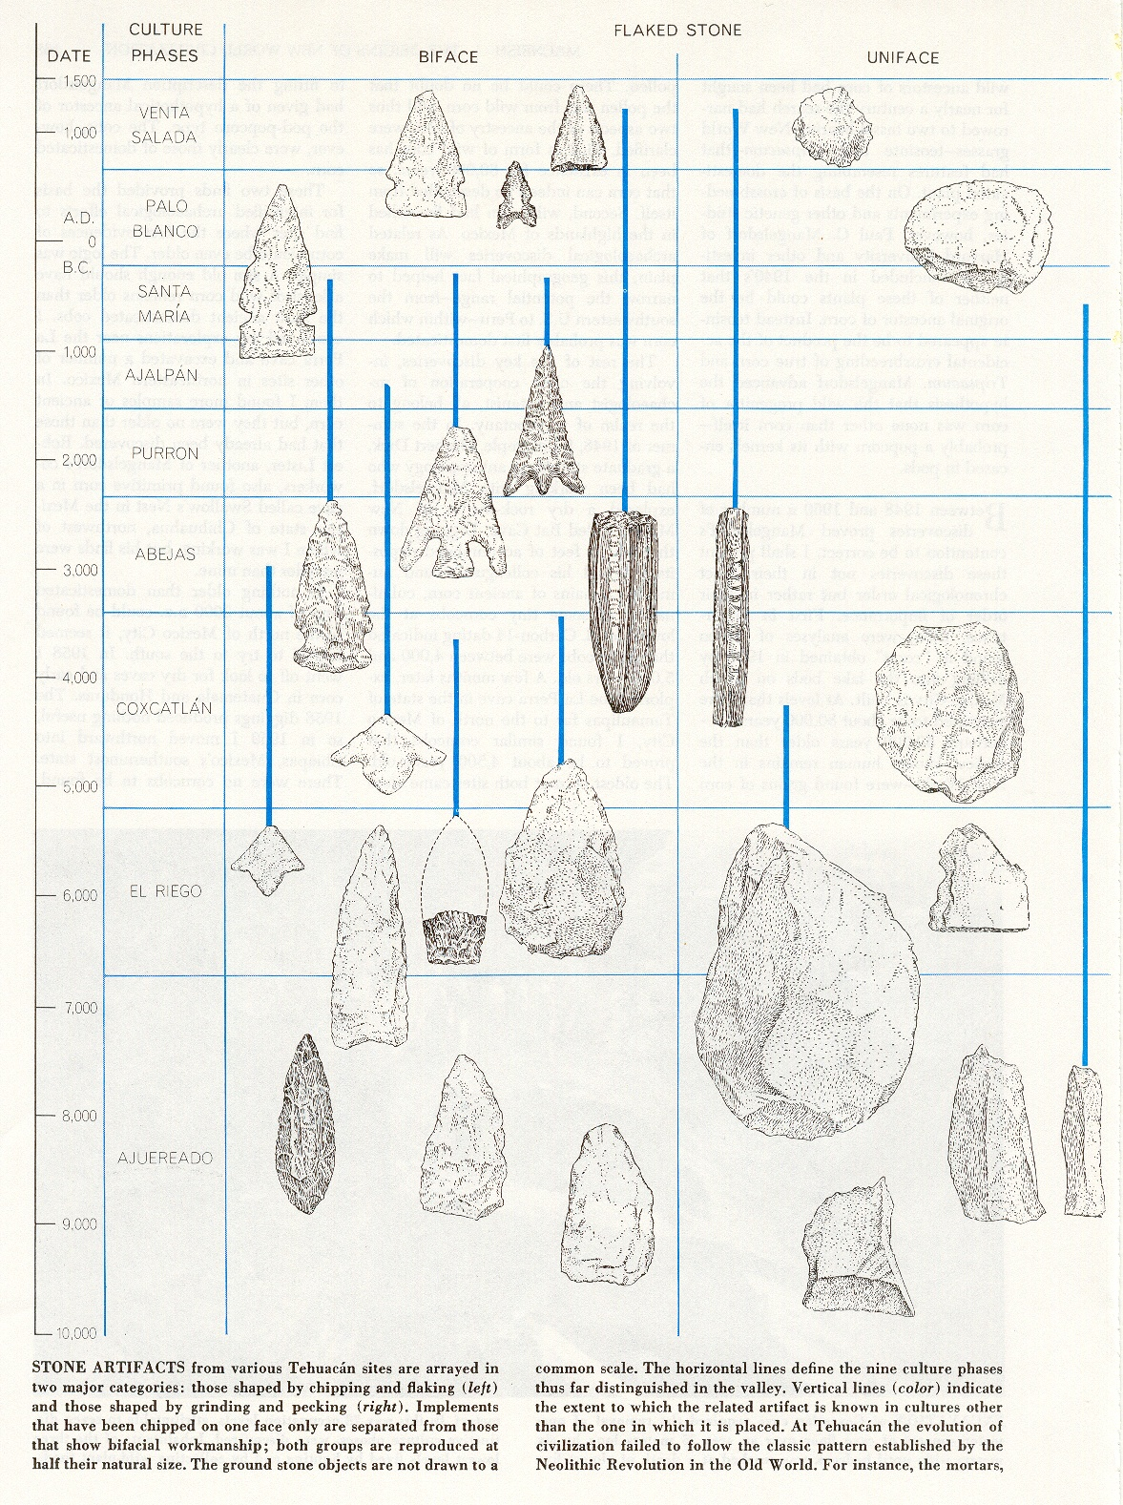
Richard S. Mac Neish, Scientific American, 1964

Slide 65
Richard S. Mac Neish, Scientific American, 1964

Slide 66
Richard S. Mac Neish, Scientific American, 1964

Slide 67
Richard S. Mac Neish, Scientific American, 1964

Slide 68
seriation graphs of other plants (and animals) would show a similarly slow transformation of a hunting/gathering/foraging society to a society which was primarily dependent on domesticated plants and animals
(but only where domestication occurred — there were pockets where this transformation didn’t occur, lasting up until the latter part of the 20th century).
Richard S. Mac Neish, Scientific American, 1964

Slide 69
this process was so slow that the people themselves were probably not very much aware that they were part of
an “agricultural revolution” . . .
Richard S. Mac Neish, Scientific American, 1964

Slide 70
seriation graphs in other parts of the world and with other crops would basically show a similar transition . . .
Richard S. Mac Neish, Scientific American, 1964

Slide 71
Origin of Domestication for Selected Plants
lettuce, grape, olive
6,500-5,000 ybp
gourd
5,000 ybp
rice
7,000 ybp
wheat
10,500 ybp
maize
4,500 ybp
millet
4,000 ybp
manioc
4,200 ybp
see the “Domestication” slide set for an overall view of domestication in these area
Understanding Physical Anthropology and Archaeology, 8th Ed., p. 417

Slide 72
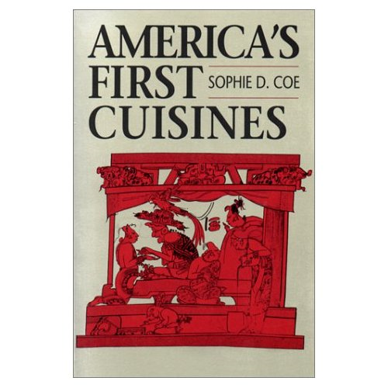
nixtamalization
with maize, there is another feature that is particularly interesting (and necessary)
to look at . . .
Cf., The Cultural Feast, 2nd Ed., p. 152
America’s First Cuisines, Ch. 2
Notes:
72

Slide 73
Development of Agriculture in the Tehuacán Valley
diets of hunters and gatherers include a wide variety of plants and animals and, therefore, tend to be nutritionally well-balanced
agriculturalists typically rely on
a limited number of cultivated crops
The Cultural Feast, 2nd Ed., p. 51

Slide 74
Development of Agriculture in the Tehuacán Valley
if the crops do not contain a balance of nutrients necessary for survival, as is often the case,
wild foods must often be used as supplements
The Cultural Feast, 2nd Ed., p. 51

Slide 75
Development of Agriculture in the Tehuacán Valley
in Mexico, full dependence on agriculture had to wait until
a group of foods were domesticated that could sustain human populations
as adequately as the more traditional diet obtained through foraging
The Cultural Feast, 2nd Ed., p. 51

Slide 76
Development of Agriculture in the Tehuacán Valley
not until
corn, beans, and squash
were combined did agriculture
adequately meet the
protein
energy
and vitamin needs
of humans
The Cultural Feast, 2nd Ed., p. 51

Slide 77
Development of Agriculture in the Tehuacán Valley
not until
corn, beans, and squash
were combined did agriculture
adequately meet the
protein
energy
and vitamin needs of humans
with
pulque and chilis
provide a “perfect” diet
The Cultural Feast, 2nd Ed., p. 51

Slide 78
Development of Agriculture in the Tehuacán Valley
not until
corn, beans, and squash
were combined did agriculture
adequately meet the
protein
energy
and vitamin needs of humans
with
pulque and chilis
provide a “perfect” diet
. . . is a very important ancient Mesoamerican drink made from the fermented sap
of the maguey cactus . . .

Slide 79
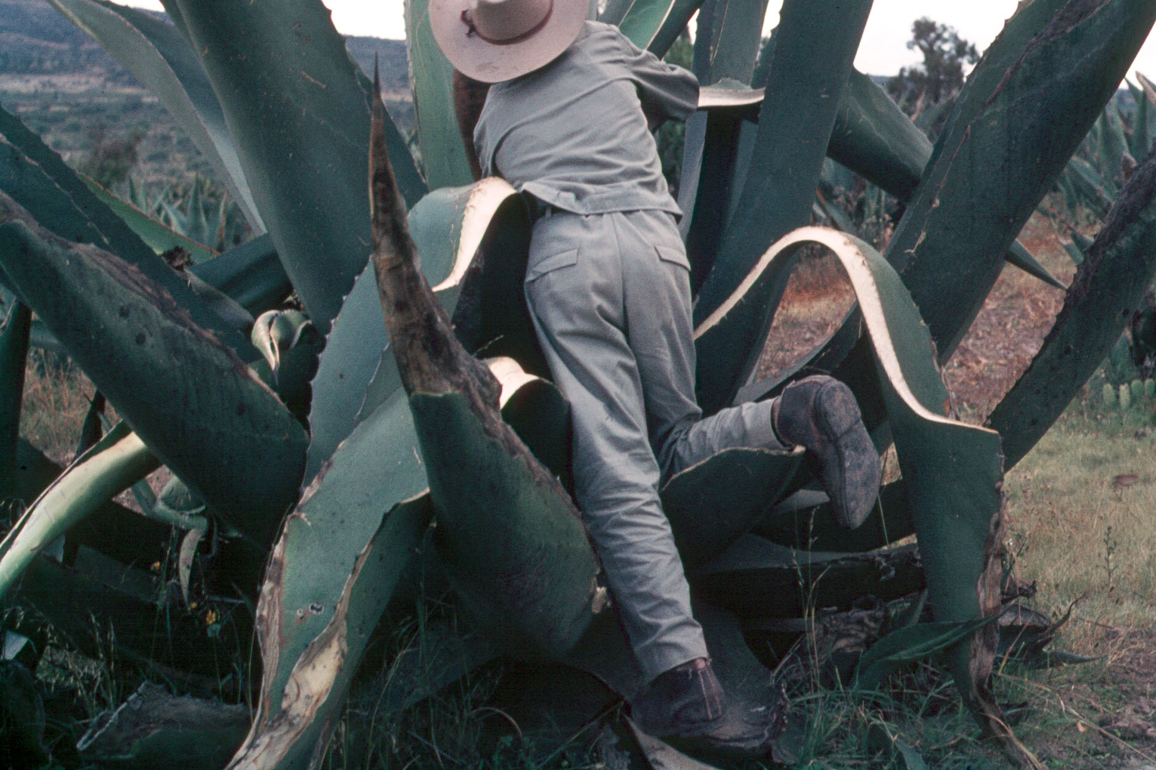
the
maguey
cactus
is also known as
“agave”
(Cf., The Cultural Feast, 2nd Ed., p.50)
and the
“century plant”
because it take such a long time (10-12 years)
to reach maturity (for pulque)
Los Cides, Hidalgo, Mexico

Slide 80
the person collecting the sap is known as a
tlachiquero
(Soltero Dorantz is pictured here)
Los Cides, Hidalgo, Mexico

Slide 81
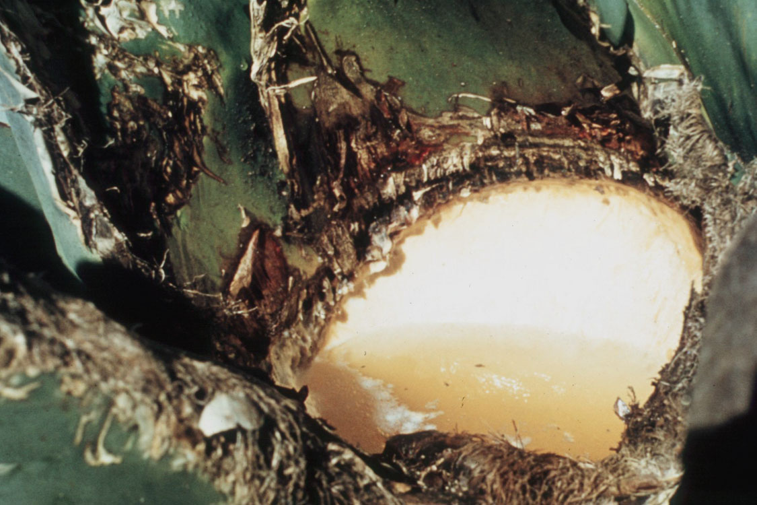
the sap itself is called
agua miel

Slide 82
the sap will be fermented into
an alcoholic drink called
pulque

Slide 83
because of all of the larvae
and small gusanos
in the agua miel
pulque coincidently
provides a substantial
amount of animal protein . . .

Slide 84
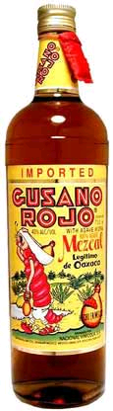
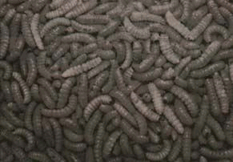
you’re probably familiar with
gusanos
in the mexcal
from Oaxaca
(this is a marketing “gimmick”)
but in the interest of full disclosure I must
admit that I’m an official member of the gusano “club”
Gusanos de maguey

Slide 85
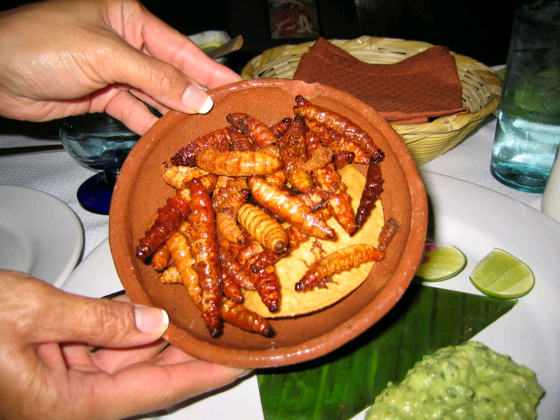
the gusanos in the meszcal
are a marketing feature
but the natives in the
Central Highlands
(the center of pulque production)
love gusanos . . .
Gusanos de maguey

Slide 86
in fact, my friends have armed guards at their farm to
prevent theft of their gusanos,
which they say, of course, are
“the very best in the entire Republic”
. . .
Gusanos de maguey

Slide 87
gusanos are eaten raw or fried . . .
if you try them raw, I recommend quite a bit of salsa verde on them . . .
or, alternately, you might want to think about having some tequilla or quite a bit of Bohamia beer with them
(in moderation, of course) . . .
Gusanos de maguey

Slide 88

as another aside,
mescal is not tequila . . .

Slide 89
as another aside,
mescal is not tequila . . .
“Tequila” is a
protected geographical status
food/beverage product
from around the city of Tequila . . .

Slide 90

countries and regions sometimes have
“Protected Geographical Status”
(for historic and cultural reasons)
which prevents others from legally using the protected designation in their marketing of a similar product . . .
http://en.wikipedia.org/wiki/Protected_designation_of_origin

Slide 91
“Cheddar” cheese
for e.g.,
legally must now come from
the Cheddar Cave region of England . . .
“Burgundy” wine
must legally come from
the Burgundy region of France . . .
http://en.wikipedia.org/wiki/Protected_designation_of_origin

Slide 92
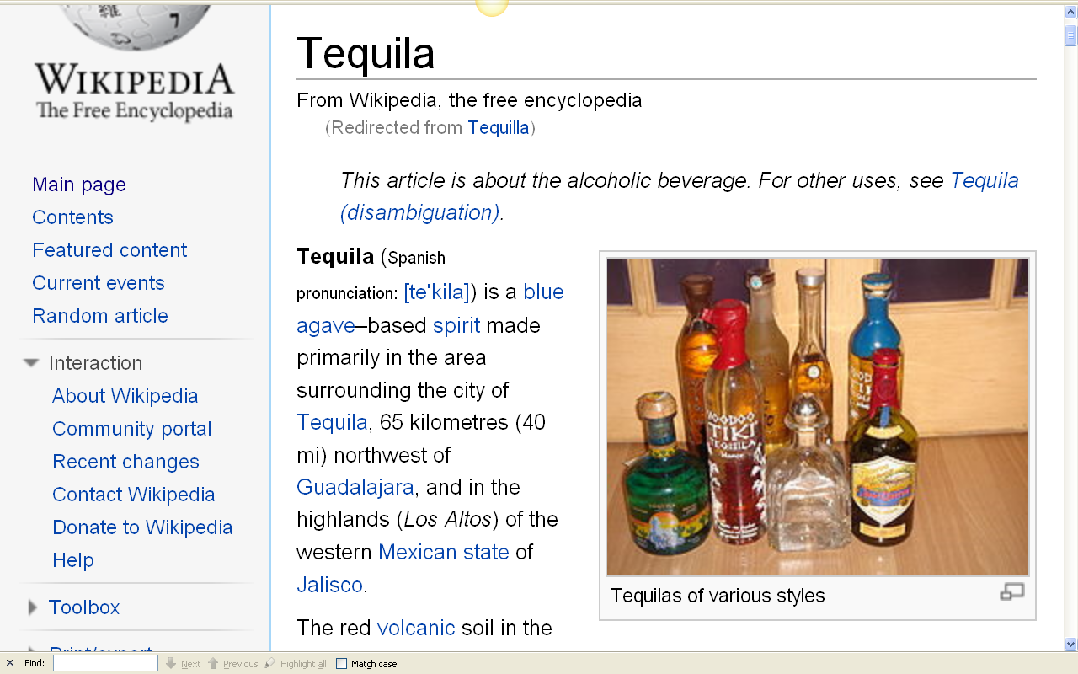
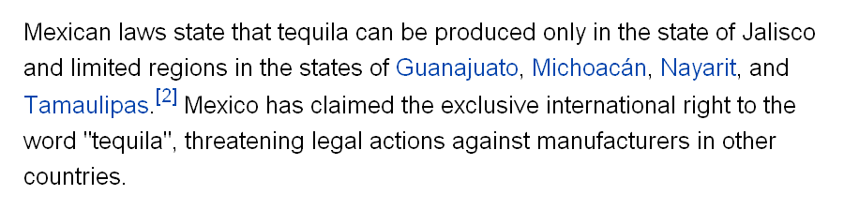
http://en.wikipedia.org/wiki/Tequilla

Slide 93
as another aside,
mescal is not tequila . . .
tequila is a
protected geographical status
food/beverage product
from around the city of Tequila . . .
Tequila is made from blue-agave,
a different type of agave than is used in the production of pulque . . .

Slide 94
as another aside,
mescal is not tequila . . .
tequila is a
protected geographical status
food/beverage product
from around the city of Tequila . . .
Tequila is made from blue-agave, a different type of agave than is used in the production of pulque . . .
and tequila is distilled . . .
and not simply fermented . . .
giving it a 35-55% alcohol content,
rather the than 2-8% pulque has

Slide 95
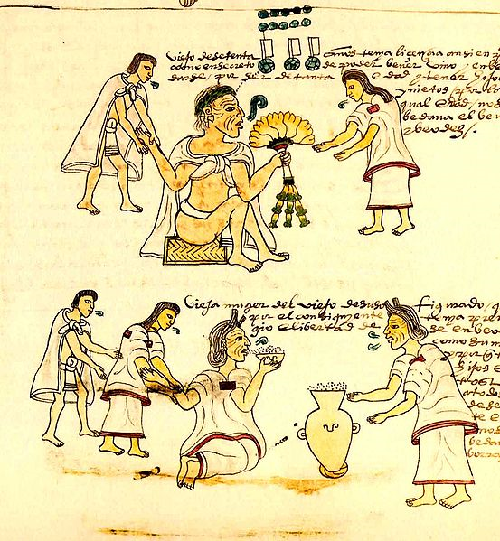
pulque played a huge role in pre-conquest and conquest Mexico, but in recent years pulque consumption has declined, largely to the increasing popularity of beer . . .
An elderly Aztec woman drinking pulque
Codex Mendoza
mid 16th century

Slide 96
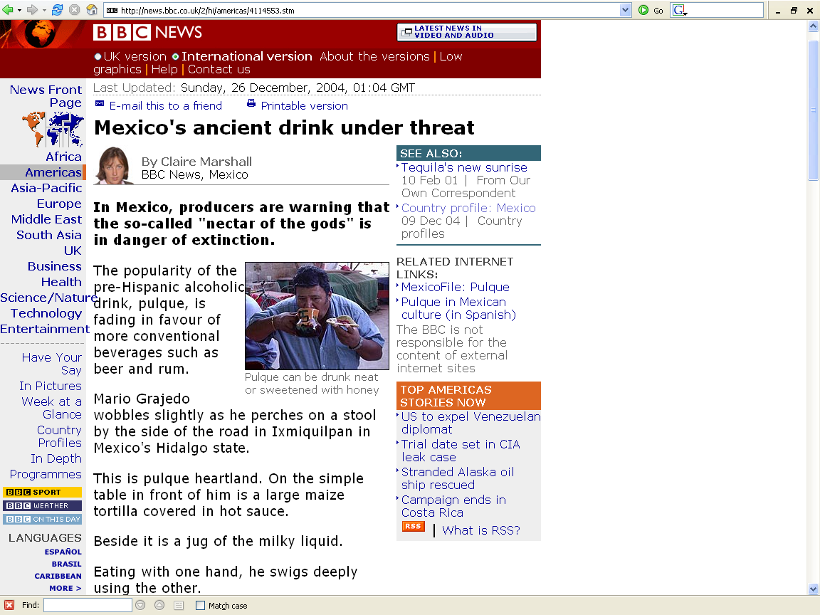
http://news.bbc.co.uk/2/hi/americas/4114553.stm

Slide 97
nixtamalization
back to maize and . . .
America’s First Cuisines, Ch. 2
Notes:
97

Slide 98
nixtamalization
is the process that starts with soaking the ripe maize grains and then cooking them with lime or wood ashes
America’s First Cuisines, Ch. 2
Notes:
98

Slide 99
nixtamalization
allows the transparent skin on the grain to be removed
(the pericarp)
making the grain easier to grind
America’s First Cuisines, Ch. 2
Notes:
99

Slide 100
nixtamalization
enhances the protein value of the maize for human beings
America’s First Cuisines, Ch. 2
Notes:
100

Slide 101
nixtamalization
“So superior is nixtamalized maize to the unprocessed kind that it is tempting to see the rise of Mesoamerican civilization as a consequence of this invention. . . .”
America’s First Cuisines, p. 14
Notes:
101

Slide 102
Development of Agriculture in the Tehuacán Valley
  but corn alone does not provide sufficient protein to sustain life
    it is deficient in lysine and tryptophan
      amino acids that must be present to make up the complete protein essential in human diets
The Cultural Feast, 2nd Ed., p. 51

Slide 103
Development of Agriculture in the Tehuacán Valley
  but when corn is combined with beans they provide a high-quality protein mixture capable of supporting human populations
    beans are a good source of lysine and tryptophan
The Cultural Feast, 2nd Ed., p. 51

Slide 104
Development of Agriculture in the Tehuacán Valley
  squash seeds
  also make a good
  protein supplement
  to a corn diet
The Cultural Feast, 2nd Ed., p. 51

Slide 105
Development of Agriculture in the Tehuacán Valley
  proteins
  see FOCUS 3.1
  “A Protein Primer”
  The Cultural Feast, 2nd ed., p. 52

Slide 106
Development of Agriculture in the Tehuacán Valley
  proteins
  see FOCUS 3.1
  “A Protein Primer”
  The Cultural Feast, 2nd Ed., p. 52

Slide 107
Development of Agriculture in the Tehuacán Valley
  proteins
  the word protein comes from the Greek word πρώτειος (proteios) "primary"
  first described and named by the Swedish chemist Jöns Jakob Berzelius in 1838
  the central role of proteins in living organisms was not fully appreciated until 1926, when James B. Sumner showed that the enzyme urease was a protein
  the first protein to be sequenced was insulin
Wikipedia

Slide 108
Development of Agriculture in the Tehuacán Valley
  proteins
  “. . . organic compounds made of amino acids arranged in a linear chain and joined together by peptide bonds between the carboxyl and amino groups of adjacent amino acid residues”
  the sequence of amino acids in a protein is defined by the sequence of a gene, which is encoded in the genetic code
Wikipedia

Slide 109
Development of Agriculture in the Tehuacán Valley
  amino acids are the building blocks of protein
    human tissue contains 22 different amino acids
      13 can be made by the body
      9 of the 22 must be obtained from foods
        these are “essential amino acids” (EAAs)
The Cultural Feast, 2nd Ed., p. 52

Slide 110
Development of Agriculture in the Tehuacán Valley
  proteins
  “. . . are essential parts of organisms and participate in every process within cells”
  “Many proteins are enzymes that catalyze biochemical reactions and are vital to metabolism.“
Wikipedia

Slide 111
Development of Agriculture in the Tehuacán Valley
  proteins
  “. . . also have structural or mechanical functions,
  such as actin and myosin in muscle and the proteins in the cytoskeleton, which form a system of scaffolding that maintains cell shape.”
Wikipedia

Slide 112
Development of Agriculture in the Tehuacán Valley
  proteins
  “Other proteins are important in cell signaling,
  immune responses,
  cell adhesion,
  and the cell cycle.”
Wikipedia

Slide 113
Development of Agriculture in the Tehuacán Valley
  proteins
  “. . . necessary in animals' diets, since animals cannot synthesize all the amino acids they need
  and must obtain essential amino acids from food.”
  “Through the process of digestion, animals break down ingested protein into free amino acids that are then used in metabolism.”
Wikipedia

Slide 114
Development of Agriculture in the Tehuacán Valley
  protein is found in a variety of foods
    meat
    fish
    dairy products
    eggs
    beans
    grains
    nuts
    vegetables
The Cultural Feast, 2nd Ed., p. 52

Slide 115
Development of Agriculture in the Tehuacán Valley
  amino acids are the building blocks of protein
    human tissue contains 22 different amino acids
      13 can be made by the body
      9 of the 22 must be obtained from foods
        these are “essential amino acids” (EAAs)
The Cultural Feast, 2nd Ed., p. 52

Slide 116
Development of Agriculture in the Tehuacán Valley
  amino acids are the building blocks of protein
    human tissue contains 22 different amino acids
      13 can be made by the body
      9 of the 22 must be obtained from foods
        these are “essential amino acids” (EAAs)
The Cultural Feast, 2nd Ed., p. 52

Slide 117
Development of Agriculture in the Tehuacán Valley
  “all proteins are not created equal”
  animal foods contain all 9 EEAs
    are easily utilized by the body
The Cultural Feast, 2nd Ed., p. 52

Slide 118
Development of Agriculture in the Tehuacán Valley
  “all proteins are not created equal”
  most plant foods contain limited amounts of one or two amino acids
    for this reason single-item diets, such as those made up almost solely of corn or yams, can lead to protein deficiency
The Cultural Feast, 2nd Ed., p. 52

Slide 119
Development of Agriculture in the Tehuacán Valley
  “all proteins are not created equal”
  but if a diet contains several different plant foods, protein deficiency does not occur
    some plant foods have generous amounts of amino acids that others are lacking
The Cultural Feast, 2nd Ed., p. 52

Slide 120
Development of Agriculture in the Tehuacán Valley
  protein complementation
  if plant foods are combined, the strengths of one can complement the weaknesses of another
  and together they make a high-quality protein
The Cultural Feast, 2nd Ed., pp. 51-52

Slide 121
Development of Agriculture in the Tehuacán Valley
  protein complementation
  as long as the protein from plant sources is reasonably varied and there are enough calories, plant sources of protein can provide adequate protein
The Cultural Feast, 2nd Ed., pp. 51-52

Slide 122
Development of Agriculture in the Tehuacán Valley
  protein complementation
  in addition to plant foods complementing one another, the body also has a reserve of amino acids that can be used to complement dietary proteins
The Cultural Feast, 2nd Ed., pp. 51-52

Slide 123
Development of Agriculture in the Tehuacán Valley
  the reserve of amino acids
  comes from
    enzymes secreted into the intestine to digest proteins
    intestinal cells sloughed off into the intestine
    a pool of free amino acids in the intracellular spaces of the skeletal muscle
The Cultural Feast, 2nd Ed., pp. 51-52

Slide 124
Development of Agriculture in the Tehuacán Valley
  plant food can be divided into three broad groups based on EEAs’ strengths and weaknesses
    whole grains
      wheat, rye, barley, rice, corn, etc.
    legumes, nuts and seeds
      legumes = beans, peas
    vegetables
The Cultural Feast, 2nd Ed., pp. 51-52

Slide 125
Development of Agriculture in the Tehuacán Valley
  vegetables and legumes generally compensate for the EEAs underrepresented in the grain group
    whole grains
      wheat, rye, barley, rice, corn, etc.
    legumes, nuts and seeds
      legumes = beans, peas
    vegetables
The Cultural Feast, 2nd Ed., pp. 51-52

Slide 126
Development of Agriculture in the Tehuacán Valley
  even within groups, the proteins often complement each other to some extent, because all foods have a slightly different collection of amino acids
    whole grains
      wheat, rye, barley, rice, corn, etc.
    e.g., legumes, nuts and seeds
      legumes = beans, peas
    vegetables
The Cultural Feast, 2nd Ed., pp. 51-52

Slide 127
Development of Agriculture in the Tehuacán Valley
  dairy products, eggs, and meats can improve the protein efficiency of any of the groups
    whole grains
      wheat, rye, barley, rice, corn, etc.
    legumes, nuts and seeds
      legumes = beans, peas
    vegetables
The Cultural Feast, 2nd Ed., pp. 51-52

Slide 128
Development of Agriculture in the Tehuacán Valley
  before scientists discovered the need for essential amino acids, complementary protein combinations evolved spontaneously as the basis of many cuisines
    Chinese
        soy products and rice
    African
        sorghum / millet and cowpeas
    India
        lentil curry and rice
    Italy
        pasta and beans (pasta e fagioli)
    Southern U.S.A.
        soup beans and corn bread
The Cultural Feast, 2nd Ed., p. 52

Slide 129
Development of Agriculture in the Tehuacán Valley
. . . back to
early agriculture in the Americas
The Cultural Feast, 2nd Ed., p. 51

Slide 130
Development of Agriculture in the Tehuacán Valley
not until
corn, beans, and squash
were combined did agriculture
adequately meet the
protein
energy
and vitamin needs of humans
with
pulque and chilis
provide a “perfect” diet
The Cultural Feast, 2nd Ed., p. 51

Slide 131
Development of Agriculture in the Tehuacán Valley
as mentioned above,
in Mexico, full dependence on agriculture had to wait until
a group of foods were domesticated that could sustain human populations . . .
maize alone would not do it . . .
The Cultural Feast, 2nd Ed., p. 51

Slide 132
Development of Agriculture in the Tehuacán Valley
but with
corn, beans, and squash combined,
agriculture
more than adequately met the
protein
energy
and vitamin needs of the people
and allowed sufficient surplus for the development of
several major Ancient Civilizations
The Cultural Feast, 2nd Ed., p. 51

Slide 133
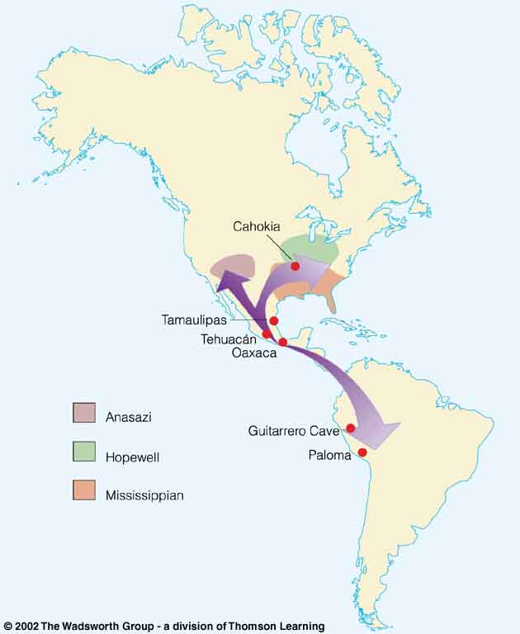
and the maize, beans, squash, chili “complex” spread throughout much of North and northern South America . . .

Slide 134
diffusion
  is the spread of something from one group to another through contact
  or exchange
Early farming
in the Americas,
showing the diffusion
of maize agriculture
(purple)
Understanding Physical Anthropology and Archaeology, cf. 9th Ed., p. 358

Slide 135
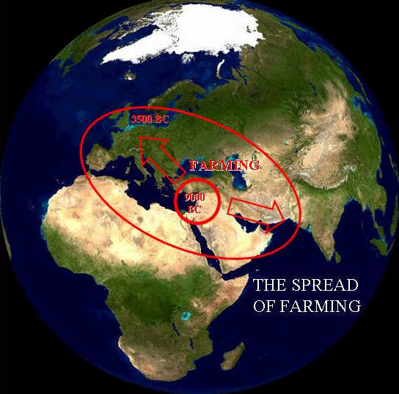
diffusion
occurred from all of the centers
of agricultural domestication
“A dialectical model of Neolithic Origins”
www.archatlas.dept.shef.ac.uk/OriginsFarming/Farming.php

Slide 136
  the Pueblos
  benefited from
  the diffusion of
  agriculture from
  the Mesoamerican area

Slide 137
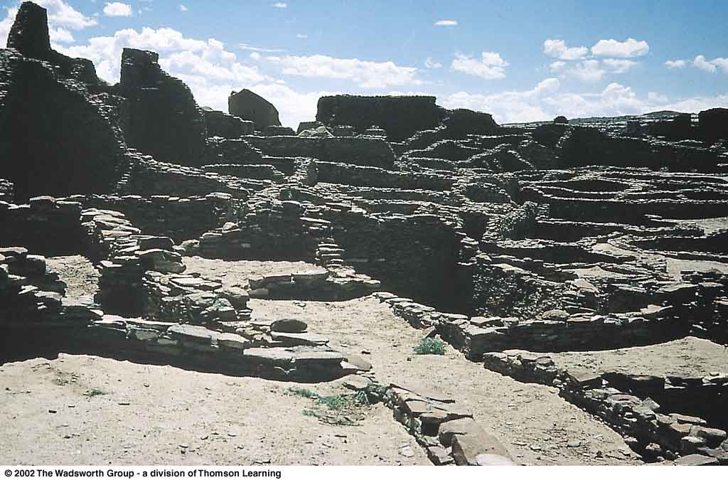
Pueblos
  Spanish term for "town" referring to multiroom residence structures built by village farmers in
  the American Southwest
Pueblo Bonito,
Chaco Canyon,
New Mexico
Understanding Physical Anthropology and Archaeology, 9th Ed., p. 360

Slide 138
Chaco Canyon
New Mexico
Early farming in the Americas
Understanding Physical Anthropology and Archaeology, 9th Ed., p. 358

Slide 139
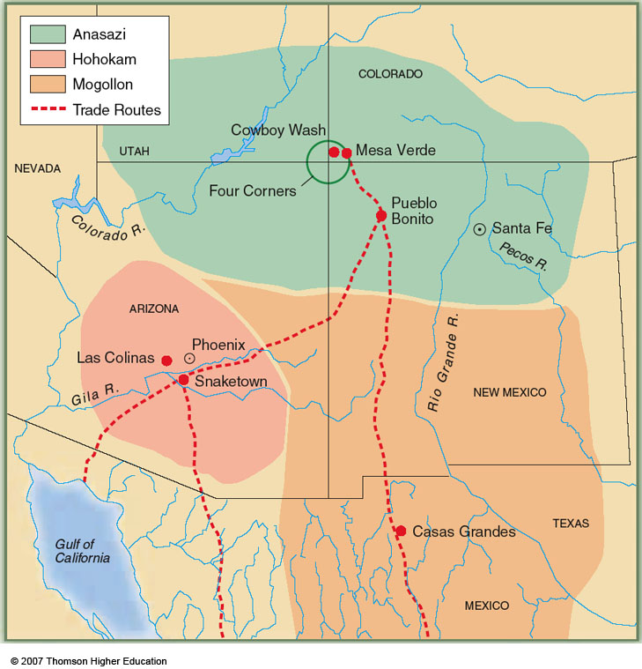
Pueblo Bonito
New Mexico
Village farming cultures of the American Southwest, showing trade routes (red)
Understanding Physical Anthropology and Archaeology, 9th Ed., p. 359

Slide 140
Other Early Farmers in the Americas included . . .
  Hopewell
  Mississippian

Slide 141
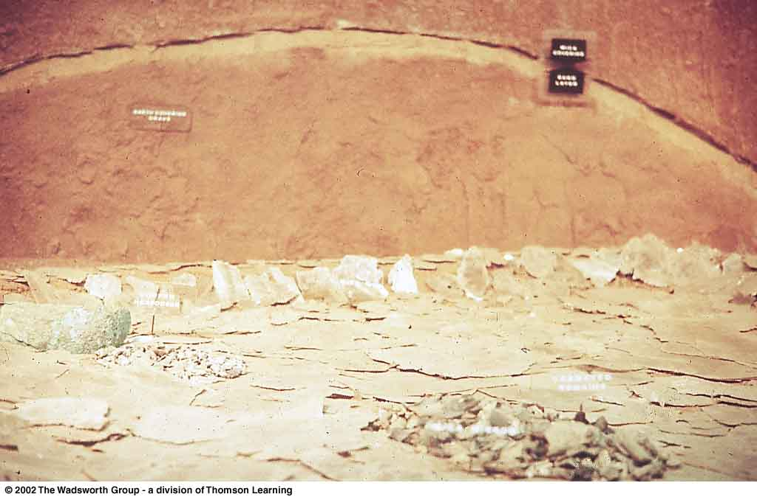
Hopewell
a culture centered in southern Ohio between 2,100 and 1,700 ybp but influencing a much wider region through trade and the spread of a cult centered on burial ritualism
Understanding Physical Anthropology and Archaeology, 9th Ed., p. 362

Slide 142
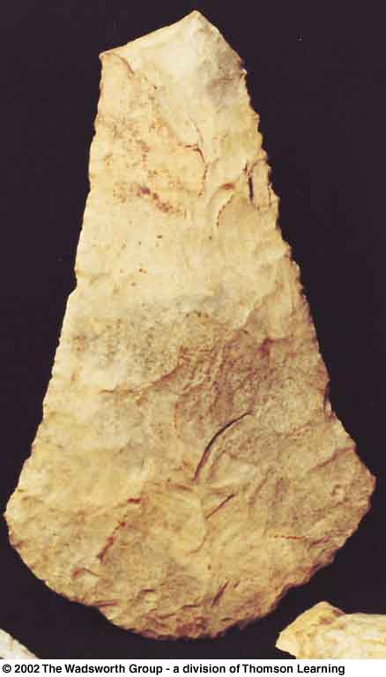
Mississippian
  flint hoe blade
  used by Mississippian farmers
Understanding Physical Anthropology and Archaeology, 9th Ed., p. 363

Slide 143
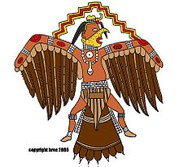
Mississippian
one of the best known Mississippian sites is the city of Cahokia near Collinsville, Illinois
Cahokia was the largest pre-Columbian city in North America . . .
Early farming in the Americas
Understanding Physical Anthropology and Archaeology, 9th Ed., p. 358

Slide 144
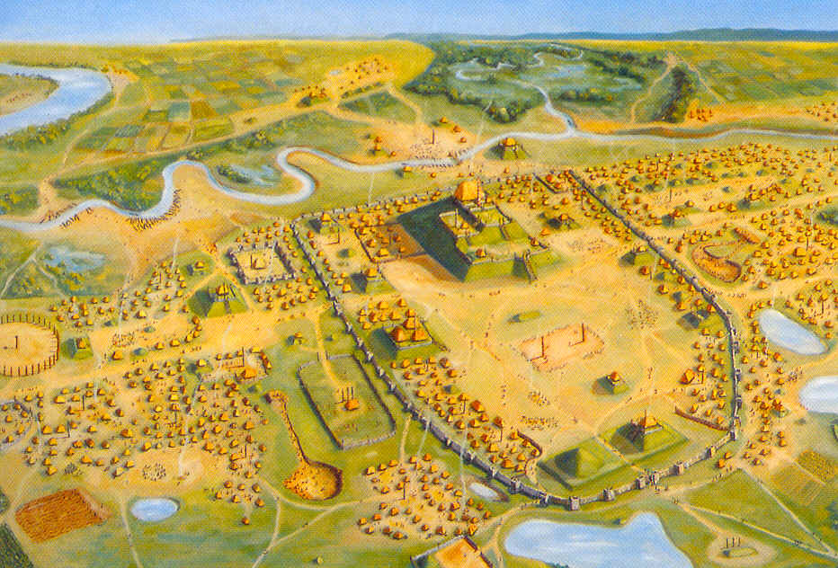
“In the 12th century [Cahokia] was as large as London!”
“It was the largest city in America until Philadelphia outgrew it in 1800! 1800! “
http://www.meredith.edu/nativeam/cahokia.htm
Cahokia
William R. Iseminger
Cahokia Mounds State Historic Site
Collinsville, Illinois

Slide 145
Cahokia
William R. Iseminger
Cahokia Mounds State Historic Site
Collinsville, Illinois

Slide 146
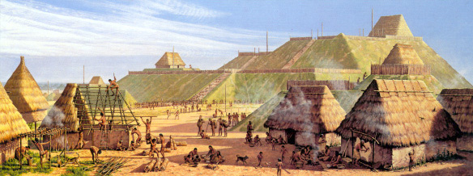
"Community Life“ at Cahokia
Michael Hampshire
Cahokia Mounds State Historic Site
Collinsville, Illinois

Slide 147
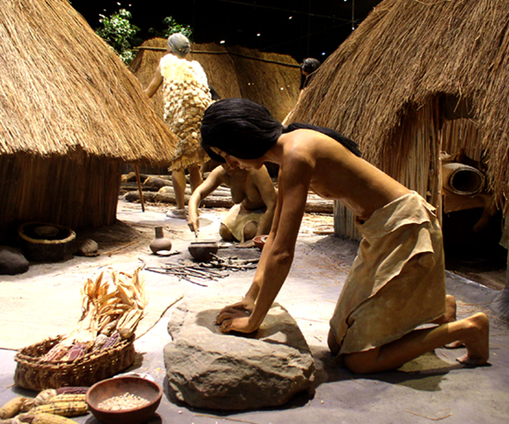
Woman Grinding Maize
Cahokia Mounds State Historic Site
Collinsville, Illinois

Slide 148

Cahokia,
Illinois
A.D. 600 – 1400
2,200 acres
pop. 8,000 - 40,000
http://en.wikipedia.org/wiki/Cahokia
Cahokia Mounds State Historic Site
Collinsville, Illinois

Slide 149
Cahokia,
Illinois
a final note:
compared to hunting/gathering/foraging
agriculture is not particularly healthy . . .
Cahokia Mounds State Historic Site
Collinsville, Illinois

Slide 150
Cahokia,
Illinois
in fact, some argue, a life based on agriculture can be downright UNhealthy . . .
Cahokia Mounds State Historic Site
Collinsville, Illinois

Slide 151
but compared to hunting/gathering/foraging
agriculture is not particularly healthy . . .
in fact, some argue, it can be downright Unhealthy . . .
let’s go to over to some of Cahokia’s neighbors, in prehistoric Kentucky,
and have a comparative look at the relative merits of hunting vs. agriculture
in the “Nutritional Consequences: Foraging and Agriculturalists” slide set
Cahokia,
Illinois

Slide 152
Cahokia,
Illinois
Cahokia Mounds State Historic Site
Collinsville, Illinois

Slide 153
have a look at the
“Nutritional Consequences:
Foraging and Agriculturalists”
slide set
Hardin
Village,
Kentucky
Indian
Knoll,
Kentucky
Cahokia Mounds State Historic Site
Collinsville, Illinois

Slide 154
Tehuacán
Puebla,
Mexico
Anthropology of Food
University of Minnesota Duluth
Tim Roufs
©2010-2024
Maize God
Notes:
154

