Slide 1
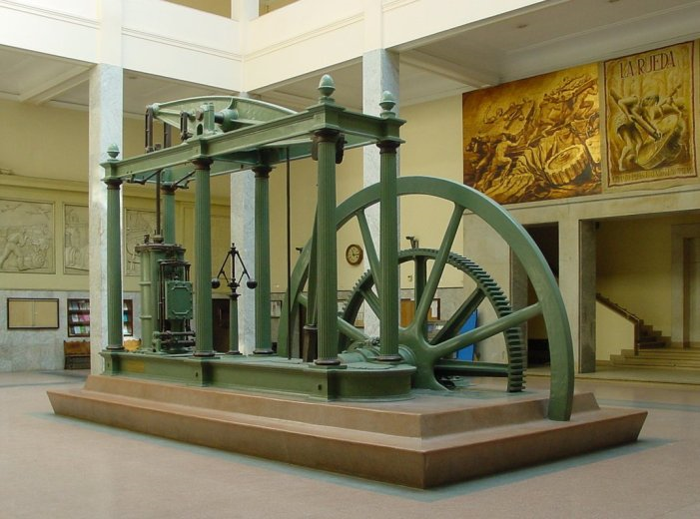
Food in Historical Perspective:
The Industrial Revolution
Anthropology of Food
University of Minnesota Duluth
Tim Roufs
©2010-2024
http://en.wikipedia.org/wiki/Industrial_revolution

Slide 2
Food in Historical Perspective: Dietary Revolutions
Food in Historical Perspective:
Dietary Revolutions
Industrial
Revolution
factories
industrial cities
18th and 19th
centuries
nutritional status changed for the worse
initially
as people moved from farms to overcrowded cities

Slide 3
Food in Historical Perspective: Dietary Revolutions
Food in Historical Perspective:
Dietary Revolutions
Industrial
Revolution
factories
industrial cities
18th and 19th
centuries
nutritional status changed for the worse
initially
as people moved from farms to overcrowded cities

Slide 4
REM
Simon & Schuster 2003

Slide 5
REM Eight Food “Revolutions”
Invention of Cooking
Discovery that Food is More Than Sustenance
The “Herding Revolution”
Snail Farming
Use of Food as a Means and Index of Social Differentiation
Long-Range Exchange of Culture
Ecological Revolution of last 500 years
Industrial Revolution of the 19th and 20th Centuries
Simon & Schuster 2003

Slide 6
Food in Historical Perspective: Dietary Revolutions
Food in Historical Perspective:
Dietary Revolutions
The Agricultural Revolution
The Search for Spices
The Industrial Revolution
Transportation, Refrigeration, and Canning
The Scientific Revolution
Modern-Day Adaptations
Summary
Highlight: Vegetarian Diets: Then and Now

Slide 7
The Industrial Revolution
“The industrial revolution . . .
was only possible as a result of agricultural change”
not since the Neolithic agricultural revolution had people so drastically change how they relate to the world around them
The Cultural Feast, 2nd Ed., p. 60

Slide 8
The Industrial Revolution
“The industrial revolution . . .
was only possible as a result of agricultural change”
not since the Neolithic agricultural revolution had people so drastically change how they relate to the world around them
see “The Neolithic “Agricultural” Revolution slide set for details
The Cultural Feast, 2nd Ed., p. 60

Slide 9
The Industrial Revolution
“The industrial revolution . . .
was only possible as a result of agricultural change”
brought farms and villages into existence
gave birth to factories
The Cultural Feast, 2nd Ed., p. 60

Slide 10
The Industrial Revolution
“The industrial revolution . . .
was only possible as a result of agricultural change”
created densely populated industrialized cities
dramatically changed the dietary patterns in the new urban centers
The Cultural Feast, 2nd Ed., p. 60

Slide 11
The Industrial Revolution
“The industrial revolution . . .
was only possible as a result of agricultural change”
in the late 18th century England began to experience rapid acceleration in manufacturing
The Cultural Feast, 2nd Ed., p. 60

Slide 12
The Industrial Revolution
“The industrial revolution . . .
was only possible as a result of agricultural change”
in the late 18th century England began to experience rapid acceleration in manufacturing
Britain gave birth to “The Industrial Revolution” . . .
The Cultural Feast, 2nd Ed., p. 60

Slide 13
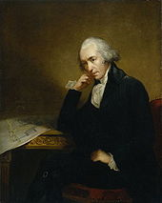
James Watt improved the Newcomen steam engine, and that invention powered the First Industrial Revolution . . .
http://en.wikipedia.org/wiki/Industrial_revolution

Slide 14
a Watt steam engine
http://en.wikipedia.org/wiki/Industrial_revolution

Slide 15
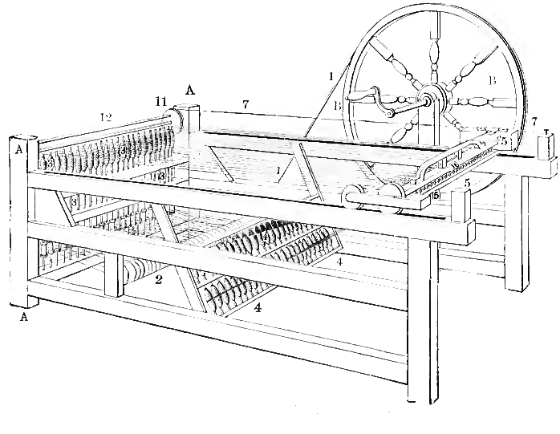
steam power was harnessed to run newly-invented machinery,
and The Industrial Revolution was set in motion
“in Great Britain and the world” . . .
http://en.wikipedia.org/wiki/Industrial_revolution

Slide 16
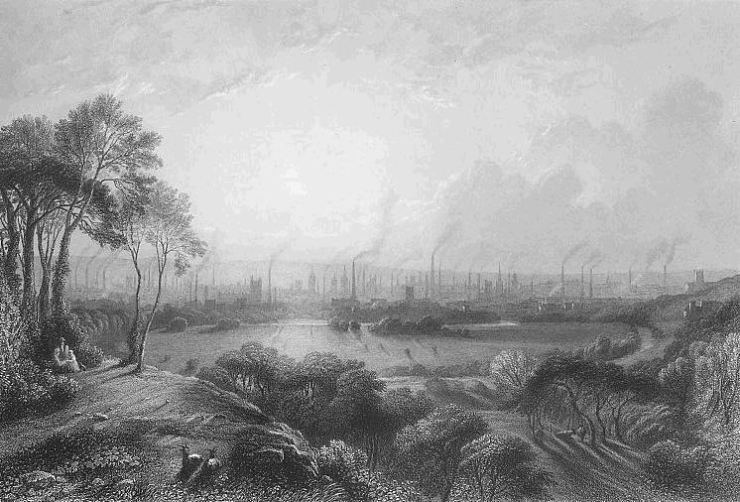
mills sprang up, and quickly changed life forever, bringing with them new demands for provisioning the workers . . .
Manchester, from Kersal Moor
Edward Goodall (1795-1870)
http://en.wikipedia.org/wiki/Industrial_revolution

Slide 17
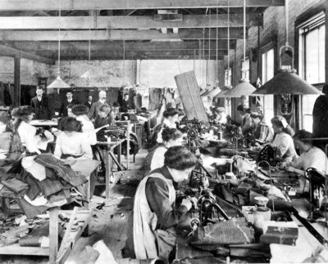
feeding factory workers was different than farmers feeding themselves . . .
diets changed radically . . .
and even the concept of time itself changed . . .
hours were long . . .
and dreary . . .
http://en.wikipedia.org/wiki/Sweat_shops http://en.wikipedia.org/wiki/Porter_Ale

Slide 18
with the mills came “sweatshops” . . .
Manchester, from Kersal Moor
Edward Goodall (1795-1870)
http://en.wikipedia.org/wiki/Industrial_revolution

Slide 19
“While many workplaces through history have been crowded, dangerous, low-paying, and without job security, the concept of a sweatshop has its origins between 1830 and 1850 as a specific type of workshop in which a certain type of middleman, the sweater, directed others in garment making (the process of producing clothing), under arduous conditions. The terms sweater for the middleman and sweating system for the process of subcontracting piecework were used in early critiques. . . .”

Slide 20
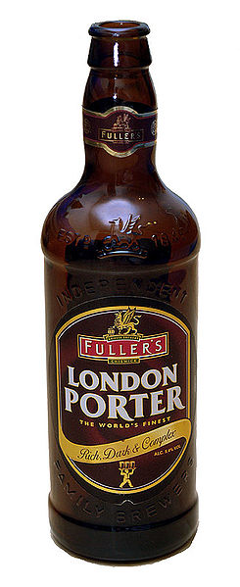
hours were long . . .
and dreary . . .
http://en.wikipedia.org/wiki/Sweat_shops http://en.wikipedia.org/wiki/Porter_Ale

Slide 21
and, in Birmingham, England, for e.g.,
people began to “supplement” their food intake with porter ale — a type of beer developed in 18th century London, and favored by the “street and river porters of London”, and the factory workers throughout Britain, when they could afford it
it was high in alcohol by modern standards (6.6% in the 1770s) . . .
http://en.wikipedia.org/wiki/Sweat_shops http://en.wikipedia.org/wiki/Porter_Ale

Slide 22
food and beverage production also became industrialized . . .
and a merchant class grew up around the new industries . . .
John Cadbury (1801-1889), a Quaker,
began vending tea, coffee and, later, chocolate in Birmingham, England, in 1824. He thought that if factory workers were given a popular alternative to high-alcohol porter beer — like a chocolate drink — that would be an improvement in their lives.
http://en.wikipedia.org/wiki/Cadbury_UK http://en.wikipedia.org/wiki/Sweat_shops http://en.wikipedia.org/wiki/Porter_Ale

Slide 23
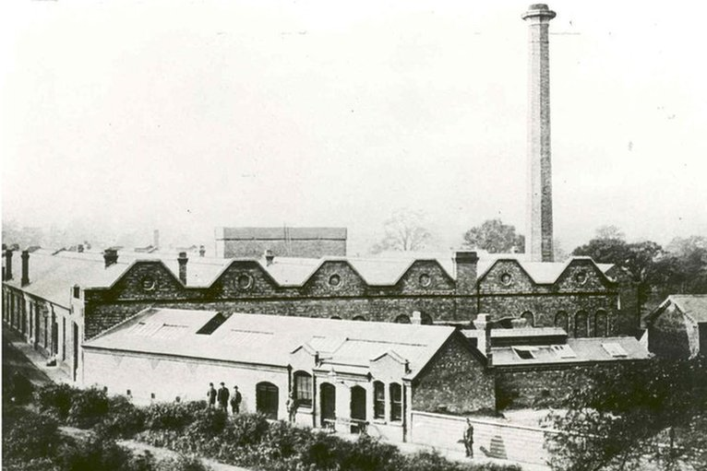
John Cadbury's sons, Richard and George, opened a major chocolate factory in the Birmingham suburb of Bournville,
four miles south of the city
http://news.bbc.co.uk/2/hi/uk_news/england/west_midlands/8467428.stm

Slide 24
John Cadbury's sons, Richard and George, opened a major chocolate factory in the Birmingham suburb of Bournville
four miles south of the city
http://news.bbc.co.uk/2/hi/uk_news/england/west_midlands/8467428.stm

Slide 25
John Cadbury's sons, Richard and George, opened a major chocolate factory in the Birmingham suburb of Bournville
four miles south of the city
you recognize the name of the little village if you’re a Cadbury chocolate fan
http://news.bbc.co.uk/2/hi/uk_news/england/west_midlands/8467428.stm

Slide 27
not all factories and businesses were sweatshops and the like
— some businesses,
like what came to be the food giant Cadbury
were founded on a business philosophy
aimed at taking care of the worker,
and sharing the fruits of
The Industrial Revolution
with them . . .
http://news.bbc.co.uk/2/hi/uk_news/england/west_midlands/8467428.stm

Slide 28
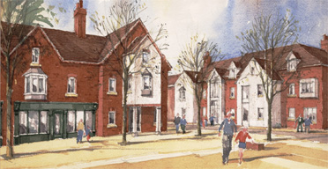
Bournville itself was created as a “Model Village” town in 1879 amongst “. . . a few scattered farmsteads and cottages, linked by winding country lanes, as the Brothers Cadbury moved their expanding business”
http://en.wikipedia.org/wiki/Bournville

Slide 29
“Loyal and hard-working workers were treated with great respect and relatively high wages and good working conditions; Cadbury also pioneered pension schemes, joint works committees and a full staff medical service. . . . The Cadburys were particularly concerned with the health and fitness of their workforce, incorporating park and recreation areas into the Bournville village plans and encouraging swimming, walking and indeed all forms of outdoor sports.”
http://en.wikipedia.org/wiki/Bournville

Slide 30
The Cadbury company continued this commitment to its workers for 185 years, right up until the company was acquired by Kraft foods in February 2010
http://en.wikipedia.org/wiki/Bournville

Slide 31
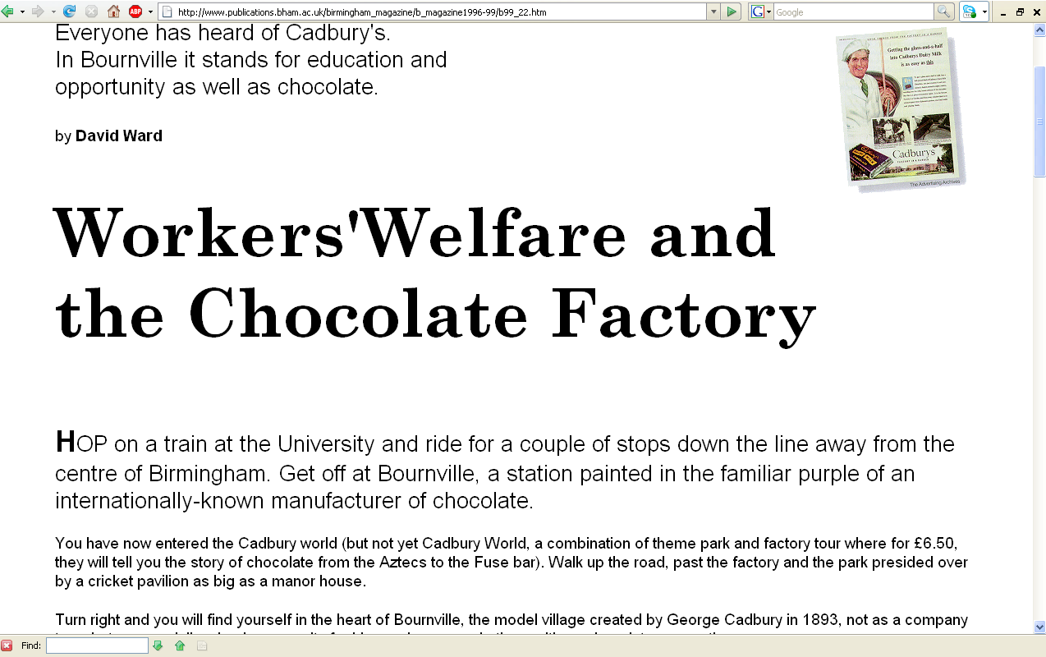
http://www.publications.bham.ac.uk/birmingham_magazine/b_magazine1996-99/b99_22.htm

Slide 32
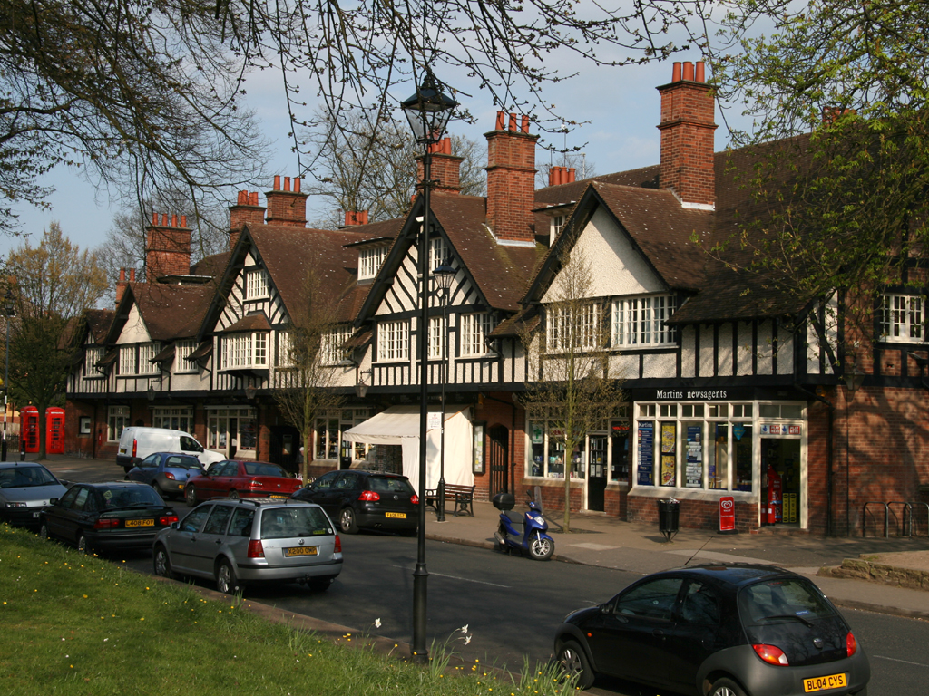
Bournville Shops around the Green
http://en.wikipedia.org/wiki/Bournville

Slide 33
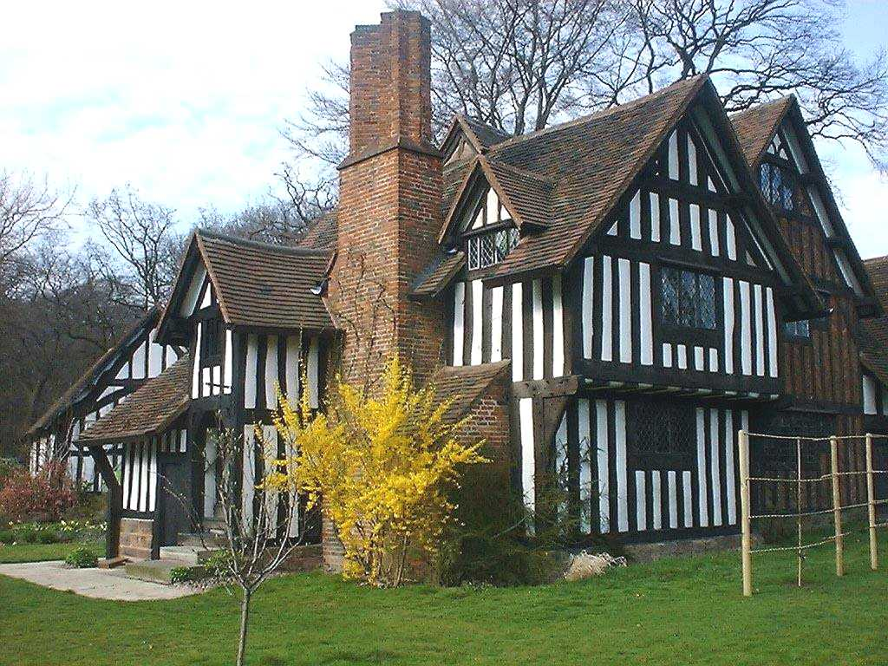
Selly Manor House
http://www.virtualbrum.co.uk/heritage/page6.htm

Slide 34
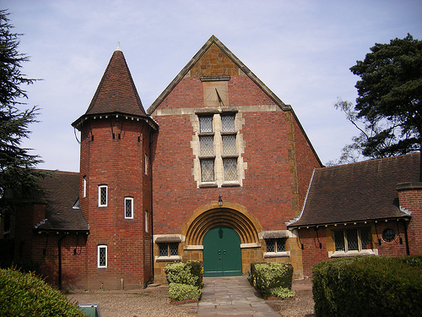
The Quaker Meeting House
Selly Manor Museum and Bournville Village Trust

Slide 35
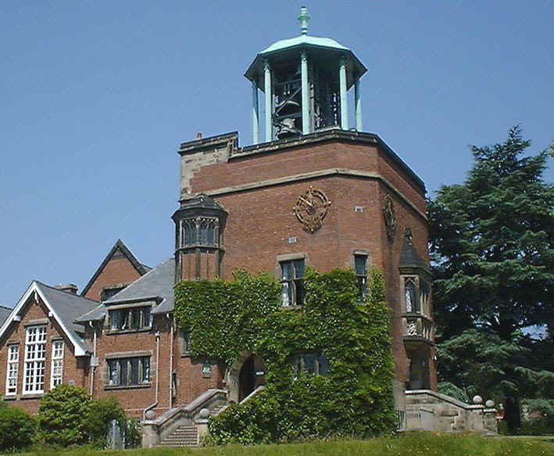
Bournville Carillon
Bournville Junior School
http://www.virtualbrum.co.uk/heritage/page6.htm

Slide 36
this is the school my son Anthony attended when we lived in England in 1984-1985
Bournville Carillon
Bournville Junior School
http://www.virtualbrum.co.uk/heritage/page6.htm

Slide 37
but not all factories and business were concerned about their workers,
as the Cadburys were . . .
and the pace of cultural change was heretofore unseen . . . in virtually every facet of life . . . and none of it could have happened without a major change in food production . . .
http://en.wikipedia.org/wiki/Industrial_revolution

Slide 38
The Industrial Revolution
“what is so striking about the industrial age was
the speed of change”
there was landslide of innovation
some technological
some social
some political
The Cultural Feast, 2nd Ed., p. 61

Slide 39
The Industrial Revolution
“what is so striking about the industrial age was
the speed of change”
there was landslide of innovation
some technological
some social
some political
The Cultural Feast, 2nd Ed., p. 61

Slide 40
The Industrial Revolution
“The industrial revolution could not have been launched without changes in food production that made it possible to feed a large urban population”
The Cultural Feast, 2nd Ed., p. 61

Slide 41
Food in Historical Perspective: Dietary Revolutions
Food in Historical Perspective:
Dietary Revolutions
The Agricultural Revolution of the Neolithic Era
The Search for Spices
The Industrial Revolution
Transportation, Refrigeration, and Canning
The Scientific Revolution
Modern-Day Adaptations
Summary
Highlight: Vegetarian Diets: Then and Now
Agricultural Change in England, Seventeenth and Eighteenth Centuries
Food and the Industrial Revolution
The Emergence of National Cuisines
The Cultural Feast, 2nd Ed., p. 61

Slide 42
Agricultural Change in England, Seventeenth and Eighteenth Centuries
“In Britain, the industrial revolution was closely related to the changes made in farming and livestock breeding practices . . .”
beginning as early as 1500
“but taking hold during the 18th century”
large landowners sought to make farming more efficient and productive
The Cultural Feast, 2nd Ed., p. 61

Slide 43
Agricultural Change in England, Seventeenth and Eighteenth Centuries
“In Britain, the industrial revolution was closely related to the changes made in farming and livestock breeding practices . . .”
throughout the Middle Ages various arrangements of commonly owned lands, open fields, and semicollective methods of farming prevailed
although plots of land were owned individually, a single farmer’s land was in small strips scattered across the village lands
land was worked and decisions were made communally
everyone’s animals had grazing access to uncultivated areas
The Cultural Feast, 2nd Ed., p. 61

Slide 44
Agricultural Change in England, Seventeenth and Eighteenth Centuries
“In Britain, the industrial revolution was closely related to the changes made in farming and livestock breeding practices . . .”
the picture began to change as early as the 16th century
some large landholders advocated enclosures
The Cultural Feast, 2nd Ed., p. 61

Slide 45
Agricultural Change in England, Seventeenth and Eighteenth Centuries
“In Britain, the industrial revolution was closely related to the changes made in farming and livestock breeding practices . . .”
large landowners consolidated and fenced their holdings
usually with hedges
originally used to increase the profitability of raising sheep
by the 18th century the enclosure was often done to increase the efficiency of producing crops
The Cultural Feast, 2nd Ed., p. 61

Slide 46
30 August 2010
and in one way or another they’re still arguing
over those hedgerows
http://www.bbc.co.uk/news/uk-11129571

Slide 47
30 August 2010
Phoebe Weston
@phoeb0
2 Feb 2021
and in one way or another they’re still arguing
over those hedgerows
http://www.bbc.co.uk/news/uk-11129571

Slide 48
Agricultural Change in England, Seventeenth and Eighteenth Centuries
“In Britain, the industrial revolution was closely related to the changes made in farming and livestock breeding practices . . .”
Once a large landholder has his property “enclosed,” he was free to strive to maximize profits on his holdings
planted new fodder crops like turnips and clover
attempted to improve the breeding of livestock
used new methods of crop rotation
introduced new machinery
The Cultural Feast, 2nd Ed., p. 61

Slide 49
Agricultural Change in England, Seventeenth and Eighteenth Centuries
“In Britain, the industrial revolution was closely related to the changes made in farming and livestock breeding practices . . .”
the “enclosure movement” not only
led to vast increases in agricultural production, it also displaced a great number of agricultural laborers
1516 Thomas More, in Utopia, lamented the disruption of rural life due to enclosures to raise sheep
The Cultural Feast, 2nd Ed., p. 61

Slide 50
Agricultural Change in England, Seventeenth and Eighteenth Centuries
as time went on the number of displaced agricultural workers increased
these people often sought work in the rising manufacturing cities
this influx of people provided much of the labor necessary for the industrial revolution to gain momentum
The Cultural Feast, 2nd Ed., p. 61

Slide 51
Agricultural Change in England, Seventeenth and Eighteenth Centuries
as time went on the number of displaced agricultural workers increased
these people often sought work in the rising manufacturing cities
this influx of people provided much of the labor necessary for the industrial revolution to gain momentum
The Cultural Feast, 2nd Ed., p. 61

Slide 52
Food in Historical Perspective: Dietary Revolutions
Food in Historical Perspective:
Dietary Revolutions
The Agricultural Revolution of the Neolithic Era
The Search for Spices
The Industrial Revolution
Transportation, Refrigeration, and Canning
The Scientific Revolution
Modern-Day Adaptations
Summary
Highlight: Vegetarian Diets: Then and Now
Agricultural Change in England, Seventeenth and Eighteenth Centuries
Food and the Industrial Revolution
The Emergence of National Cuisines
The Cultural Feast, 2nd Ed., pp. 62-63

Slide 53
Food and the Industrial Revolution
the shifts in livelihoods and locations were dramatic . . .
The Cultural Feast, 2nd Ed., p. 62

Slide 54
Food and the Industrial Revolution
the shifts in livelihoods and locations were dramatic . . .
1500 England: 80% worked in agriculture (est.)
most produced only enough food to support their household
1850 England: only 20% worked in agriculture (est.)
largely to produce food for the marketplace
The Cultural Feast, 2nd Ed., p. 62

Slide 55
Food and the Industrial Revolution
in the United Sates
1790: 5% lived in cities (first census)
1920: 51% lived in cities
2000: 80% lived in cities
currently “only about 1.5% of Americans are full-time farmers”
The Cultural Feast, 2nd Ed., p. 62

Slide 56
Food and the Industrial Revolution
the shifts in livelihoods and locations were dramatic
The Cultural Feast, 2nd Ed., p. 62

Slide 57
Food and the Industrial Revolution
the shifts in livelihoods and locations were dramatic
working conditions were deplorable in the initial decades of the industrial revolution
bad housing
poor sanitation
dehumanizing working conditions
limited cooking facilities
contaminated water supplies
by industrial pollution and human
and animal waste material
The Cultural Feast, 2nd Ed., p. 62

Slide 58
Food and the Industrial Revolution
the shifts in livelihoods and locations were dramatic
a typical foods for the British working class
tea
boiled potatoes
occasional bits of bacon
bread
cheese
gruel / porridge
The Cultural Feast, 2nd Ed., p. 62

Slide 59
Food and the Industrial Revolution
the shifts in livelihoods and locations were dramatic
1840s London working-class district:
bread was the only solid food given to children in 17 out of 21 meals in a week
vitamin deficiencies were widespread

Slide 60
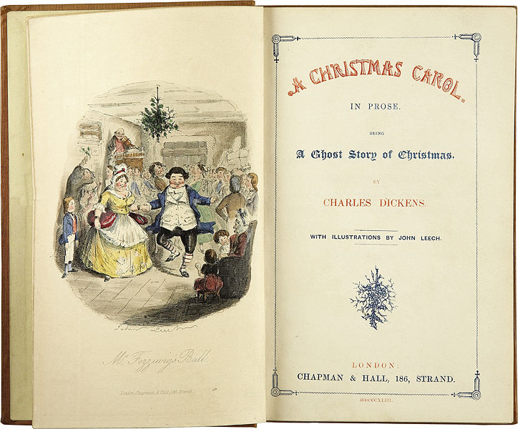
you’ve seen this in Charles Dickens’ writings . . .
1843
Wikisource

Slide 61
1843
Wikisource

Slide 62
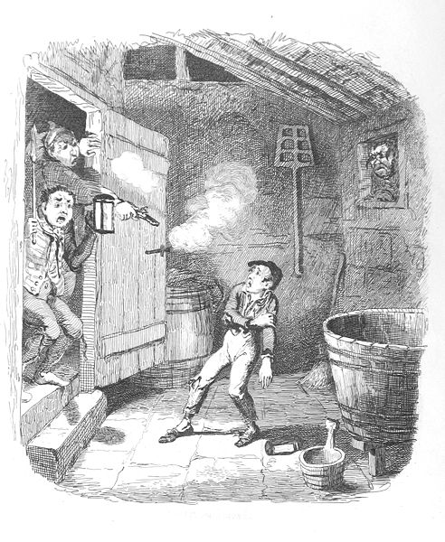
Oliver Twist; or, the Parish Boy's Progress
1838
Wikisource

Slide 63
Food, Glorious food!
Is it worth the waiting for? If we live 'til eighty four All we ever get is gru...el! Ev'ry day we say our prayer -- Will they change the bill of fare? Still we get the same old gru...el! There is not a crust, not a crumb can we find, Can we beg, can we borrow, or cadge, But there's nothing to stop us from getting a thrill When we all close our eyes and imag...ine
Food, glorious food! Hot sausage and mustard! While we're in the mood -- Cold jelly and custard! . . .
Oliver Twist; or, the Parish Boy's Progress
1838
Wikisource

Slide 64
Food, Glorious food!
And research shows that within a household food was not distributed equally, with the father,
“the breadwinner”
getting a disproportionate amount of the food available, leading to nutritional problems with the wife and children . . .
Oliver Twist; or, the Parish Boy's Progress
1838
Wikisource

Slide 65
Food and the Industrial Revolution
the shifts in livelihoods and locations were dramatic
The Cultural Feast, 2nd Ed., p. 62

Slide 66
Food and the Industrial Revolution
the shifts in livelihoods and locations were dramatic
1840s British military:
60% of rural recruits were “deemed fit for service”
only 10% from urban areas made the grade
The Cultural Feast, 2nd Ed., p. 62

Slide 67
Food and the Industrial Revolution
industrialization influenced . . .
what people ate
when and where they ate it
agrarian Europeans traditionally ate 2 meals / day
large meal at noon after a strenuous morning in the fields
a lighter meal at the end of the workday in the late afternoon
The Cultural Feast, 2nd Ed., p. 62

Slide 68
Food and the Industrial Revolution
industrialization influenced . . .
Industrial workers worked 10 – 12 hours / day
ate a large breakfast to provide enough energy for the first half of the day
lunch was shorter, less caloric, and eaten at the factory so that the worker could get back to machines as soon as possible
after a long day at the factory, workers went home and consumed a third meal
The Cultural Feast, 2nd Ed., p. 62

Slide 69
Food and the Industrial Revolution
While the working class struggled in the first part of the 19th century, the middle class of industrial England increased in number and influence
factory owners
bankers
merchants
shippers
lawyers
clergymen
The Cultural Feast, 2nd Ed., p. 62

Slide 70
Food and the Industrial Revolution
members of this more affluent class had access to a much wider variety of food and a better-quality diet . . .
more meat
butter
cheese
finer bread
occasional fruits and vegetables
The Cultural Feast, 2nd Ed., pp. 62-63

Slide 71
Food and the Industrial Revolution
members of this more affluent class had access to a much wider variety of food and a better-quality diet . . .
more meat
butter
cheese
finer bread
occasional fruits and vegetables
The Cultural Feast, 2nd Ed., pp. 62-63

Slide 72
Food and the Industrial Revolution
members of this more affluent class had access to a much wider variety of food and a better-quality diet . . .
more meat
butter
cheese
finer bread
occasional fruits and vegetables
. . . was a big deal before the Industrial Revolution.
Peasants even paid their rent in butter.
Years earlier, butter was a big item in Martin Luther’s Protestant Revolution . . .
The Cultural Feast, 2nd Ed., pp. 62-63

Slide 73
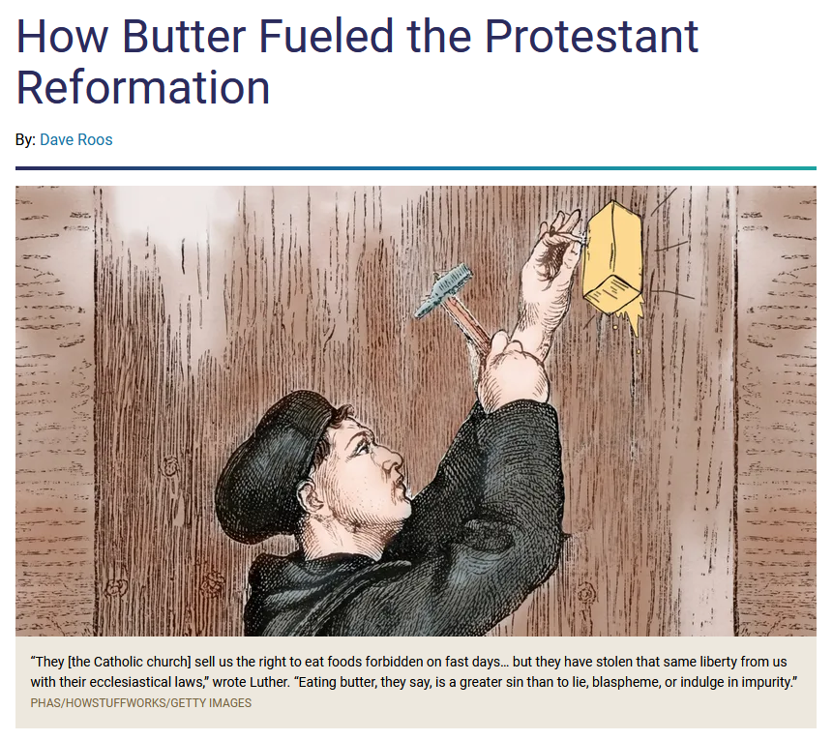
https://history.howstuffworks.com/historical-events/butter-fueled-protestant-reformation.htm

Slide 74
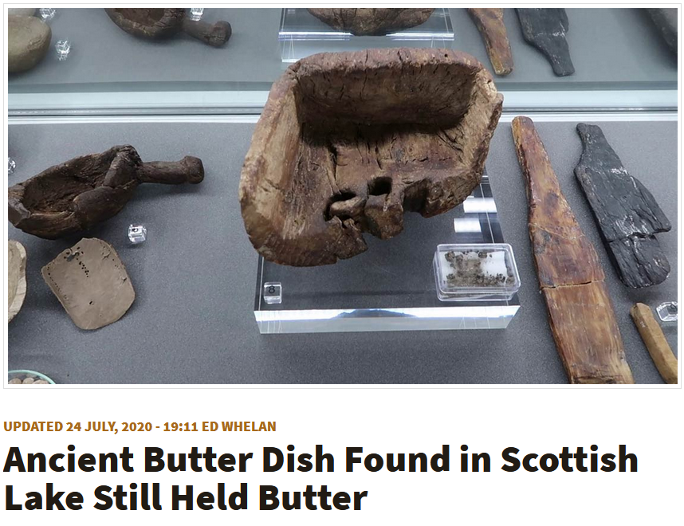
2000-year-old-butter was found in Scotland in 2020
https://www.ancient-origins.net/news-history-archaeology/ancient-butter-dish-0014024

Slide 75
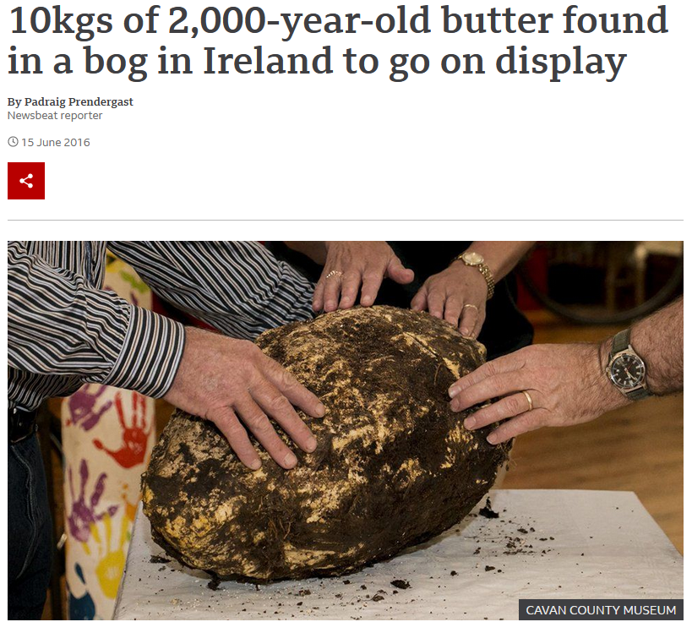
2000-year-old-butter was found earlier in Ireland . . .
https://www.bbc.com/news/newsbeat-36539065

Slide 76
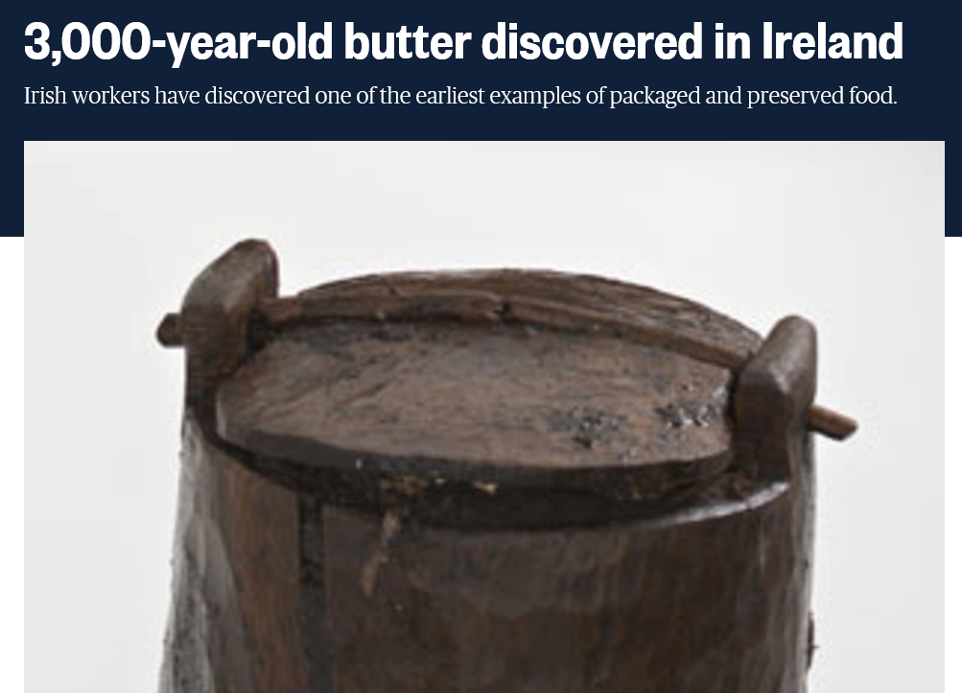
77 lbs. of 3000-year-old-butter was found in Ireland in 2009 . . .
https://www.nbcnews.com/id/wbna32630695

Slide 77
Food and the Industrial Revolution
industrialization eventually influenced lots of things . . .
The Cultural Feast, 2nd Ed., p. 63

Slide 78
Food and the Industrial Revolution
industrialization eventually influenced lots of things . . .
. . . and . . . we begin to see . . .
The Cultural Feast, 2nd Ed., p. 63

Slide 79
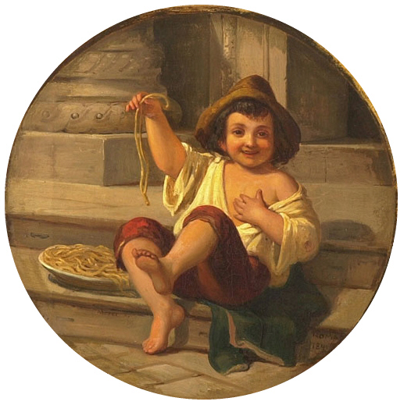
Spaghetti essender Junge, Roma Moser 1808
http://commons.wikimedia.org/wiki/File:Moser_Spaghetti_essender_Junge.jpg

Slide 80
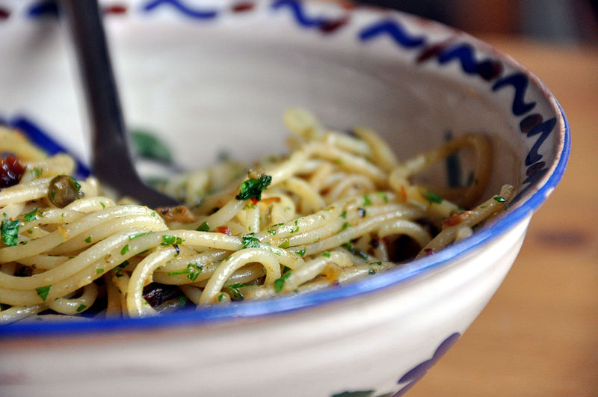
http://commons.wikimedia.org/wiki/File:Flickr_-_cyclonebill_-_Spaghetti_med_ansjoser,_chili,_hvidl%C3%B8g,_kapers_og_persille.jpg

Slide 81
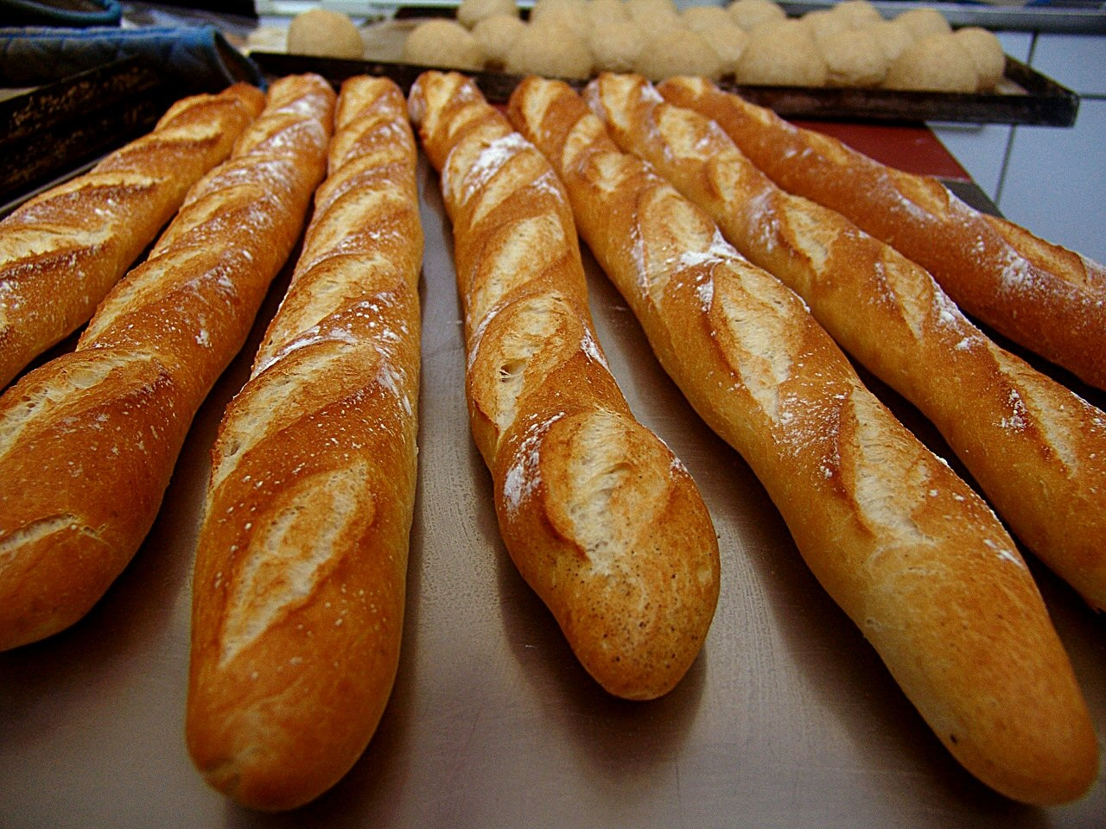
http://boulangeriesacrepaye.com/id69.html

Slide 82
http://en.wikipedia.org/wiki/French_wine

Slide 83
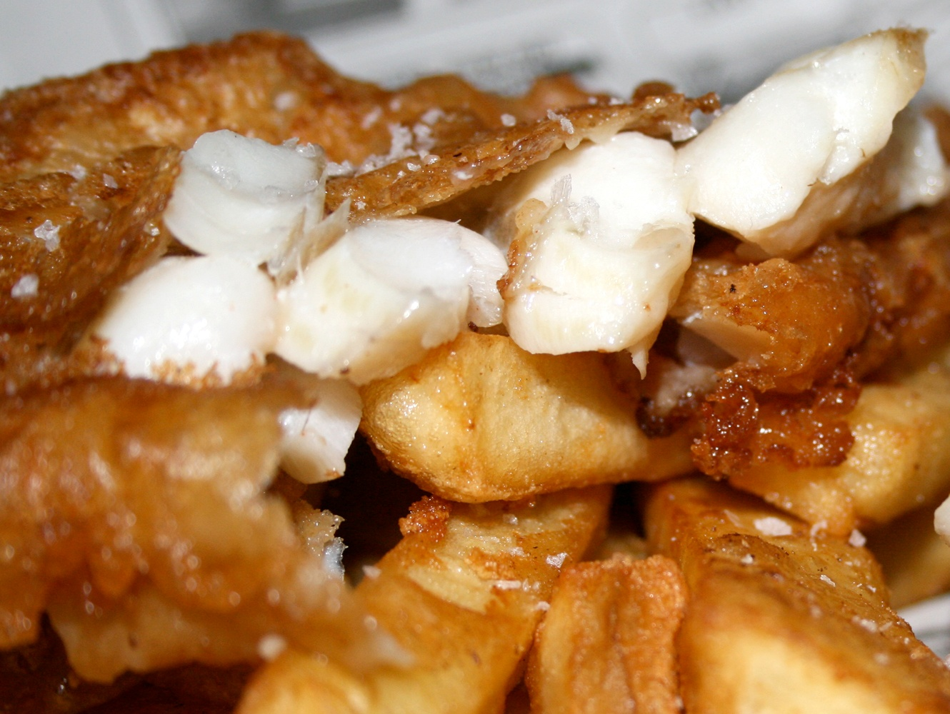
http://tomdowson.wordpress.com/2008/09/30/jackson-pollock-and-chips/

Slide 84
http://www.wil92.com/post/51210_hog_dog_hot_dog_this_4th_of_july

Slide 85
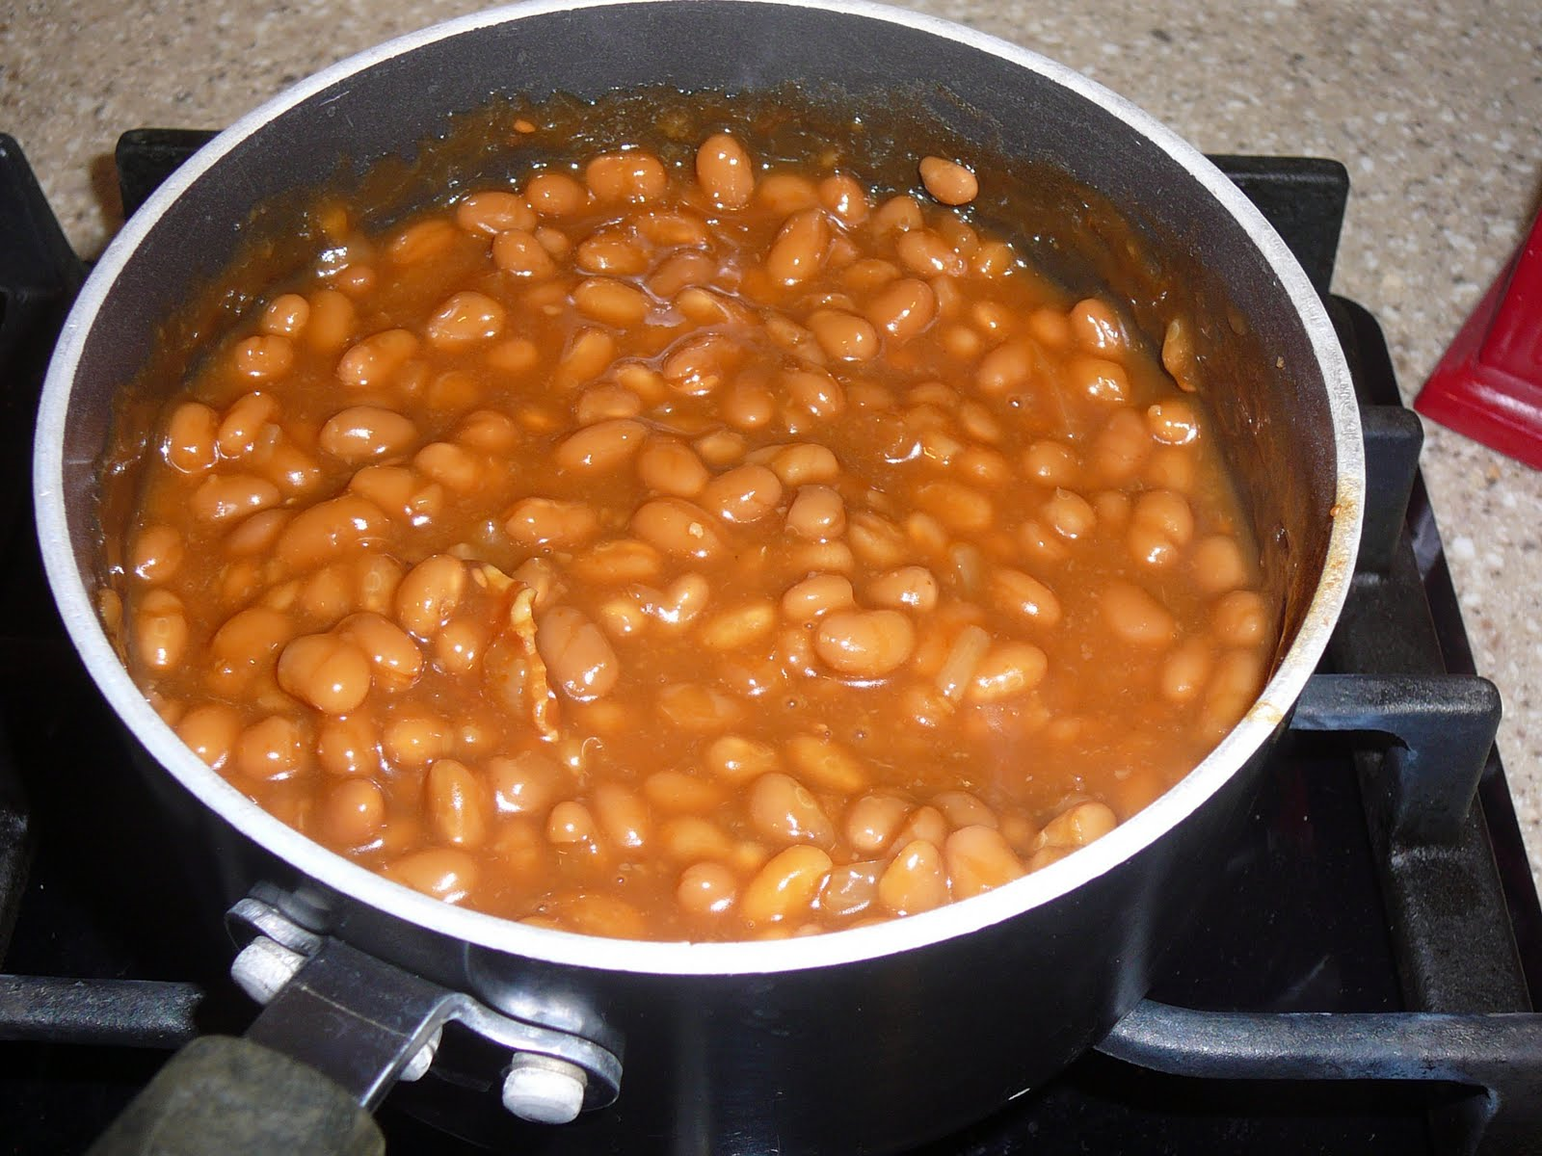
http://cookingmommies.blogspot.com/

Slide 86
http://www.countryliving.com/magazine/made-in-america-0707

Slide 87
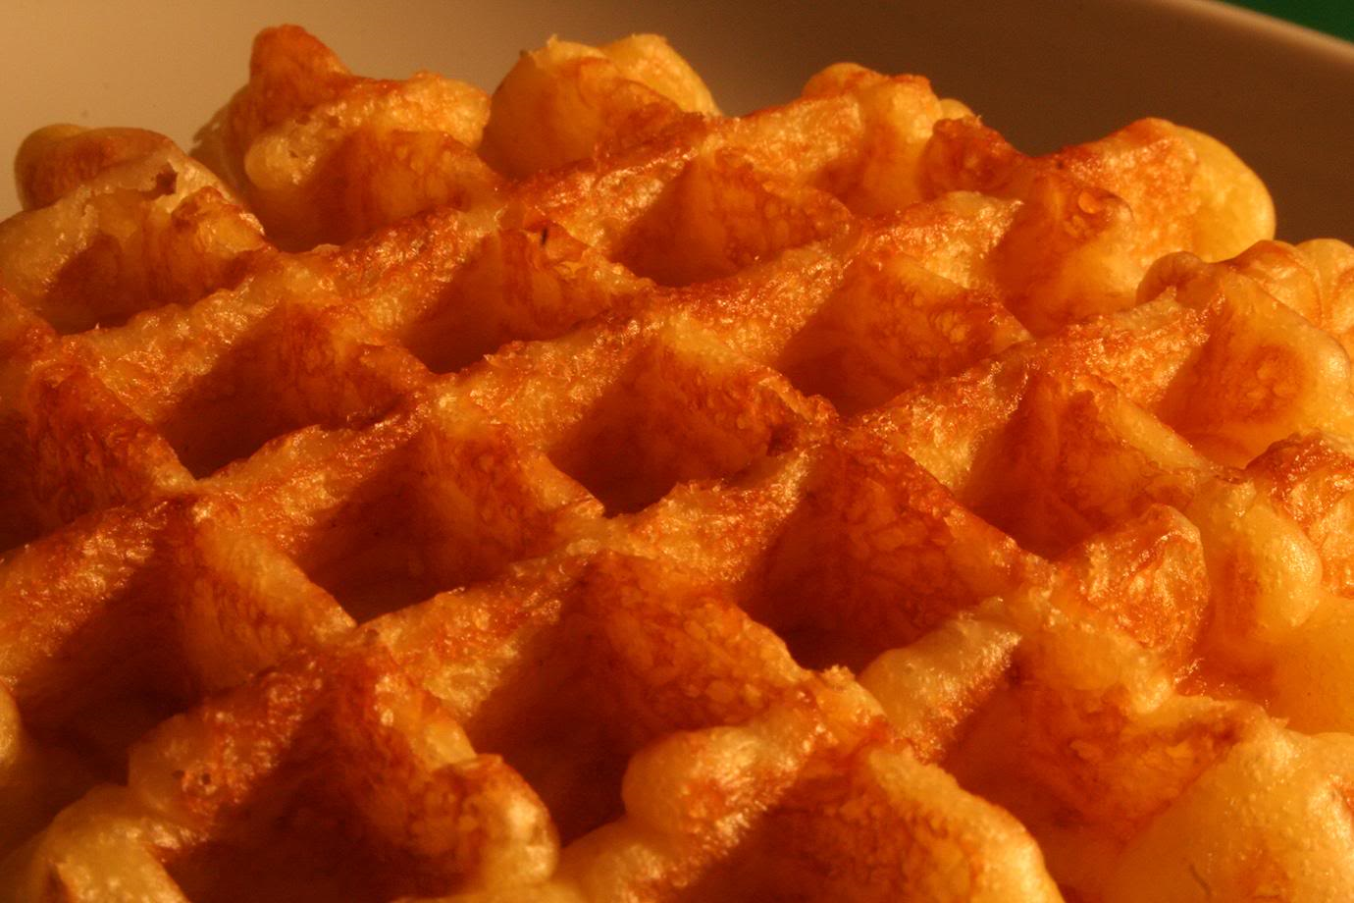
http://home-and-garden.webshots.com/photo/2769409050063439164ILcwlu

Slide 88
Food in Historical Perspective: Dietary Revolutions
Food in Historical Perspective:
Dietary Revolutions
The Agricultural Revolution of the Neolithic Era
The Search for Spices
The Industrial Revolution
Transportation, Refrigeration, and Canning
The Scientific Revolution
Modern-Day Adaptations
Summary
Highlight: Vegetarian Diets: Then and Now
Agricultural Change in England, Seventeenth and Eighteenth Centuries
Food and the Industrial Revolution
The Emergence of National Cuisines
The Cultural Feast, 2nd Ed., p. 63

Slide 89
The Emergence of National Cuisines
as people migrated into cities during the late 18th century
regional cuisines developed based on popular cooking styles of the major urban centers
mass production of foods and advertising elevated some of these urban food styles into national cuisines
The Cultural Feast, 2nd Ed., p. 63

Slide 90
The Emergence of National Cuisines
Italian cuisine
from pasta of Milan, Turin and Rome
The Cultural Feast, 2nd Ed., p. 63

Slide 91
The Emergence of National Cuisines
French cuisine
from Parisian bread, butter-based cooking
and red wine became a national French cuisine
The Cultural Feast, 2nd Ed., p. 63

Slide 92
The Emergence of National Cuisines
French cuisine
but the “French” way of cooking largely came from Italy in 1533 with Catherine de' Medici when she married Henry II of France

Slide 93
The Emergence of National Cuisines
English cuisine
fish-and-chips emerged
The Cultural Feast, 2nd Ed., p. 63

Slide 94
The Emergence of National Cuisines
American “cuisine”
hot dogs
canned beans
white bread
The Cultural Feast, 2nd Ed., p. 63

Slide 95
The Emergence of National Cuisines
by the end of the 19th century
most major countries
had their own
national cuisines
foods that immediately struck visitors as characteristic
The Cultural Feast, 2nd Ed., p. 63

Slide 96
The Emergence of National Cuisines
by the end of the 19th century
most major countries
had their own
national cuisines
the association of certain dishes with nationalities reflected the emergence of the nation-state in the political life of the Western world in the 19th century
The Cultural Feast, 2nd Ed., p. 63

Slide 97
Food and the Industrial Revolution
by 1850 it was becoming clear that the ever-increasing number of urban laborers needed to be supplied with more abundant, cheaper food
if not, they would be unable to continue to provide the labor needed for the new industrialized economy
the situation was first recognized in England, but was soon noted in other European countries and the United States as well
The Cultural Feast, 2nd Ed., p. 63

Slide 98
Food and the Industrial Revolution
technological advancements . . .
made food cheaper . . .
expanded the variety of foods available . .
kept foods fresh longer . . .
The Cultural Feast, 2nd Ed., p. 63

Slide 99
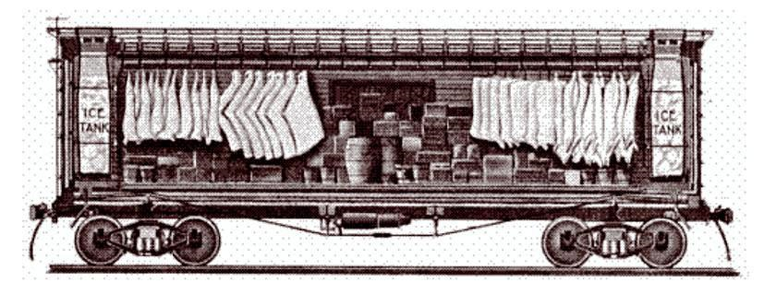
we’ll have a closer look at these technological advancements in . . .
Refrigerated Freight Car ca. 1870
Vicksburg Historical Society
http://en.wikipedia.org/wiki/Refrigerator_car

Slide 100
Food in Historical Perspective:
Early Technologies —
Transportation
Refrigeration
Canning
Refrigerated Freight Car ca. 1870
Vicksburg Historical Society
http://en.wikipedia.org/wiki/Refrigerator_car

Slide 101
Food in Historical Perspective:
The Industrial Revolution
Anthropology of Food
University of Minnesota Duluth
Tim Roufs
©2010-2024
http://en.wikipedia.org/wiki/Industrial_revolution

