Slide 1
Food in Historical Perspective: Dietary Revolutions
Food in Historical Perspective:
Dietary Revolutions
  the Agricultural Revolution of the Neolithic Era
  the Search for Spices
  the Industrial Revolution
  Early Technology
    Domestication
    Transportation
    Refrigeration
    Canning
  the Scientific Revolution
  Modern-Day Adaptations
  Summary
  Highlight: Vegetarian Diets: then and Now

Slide 2
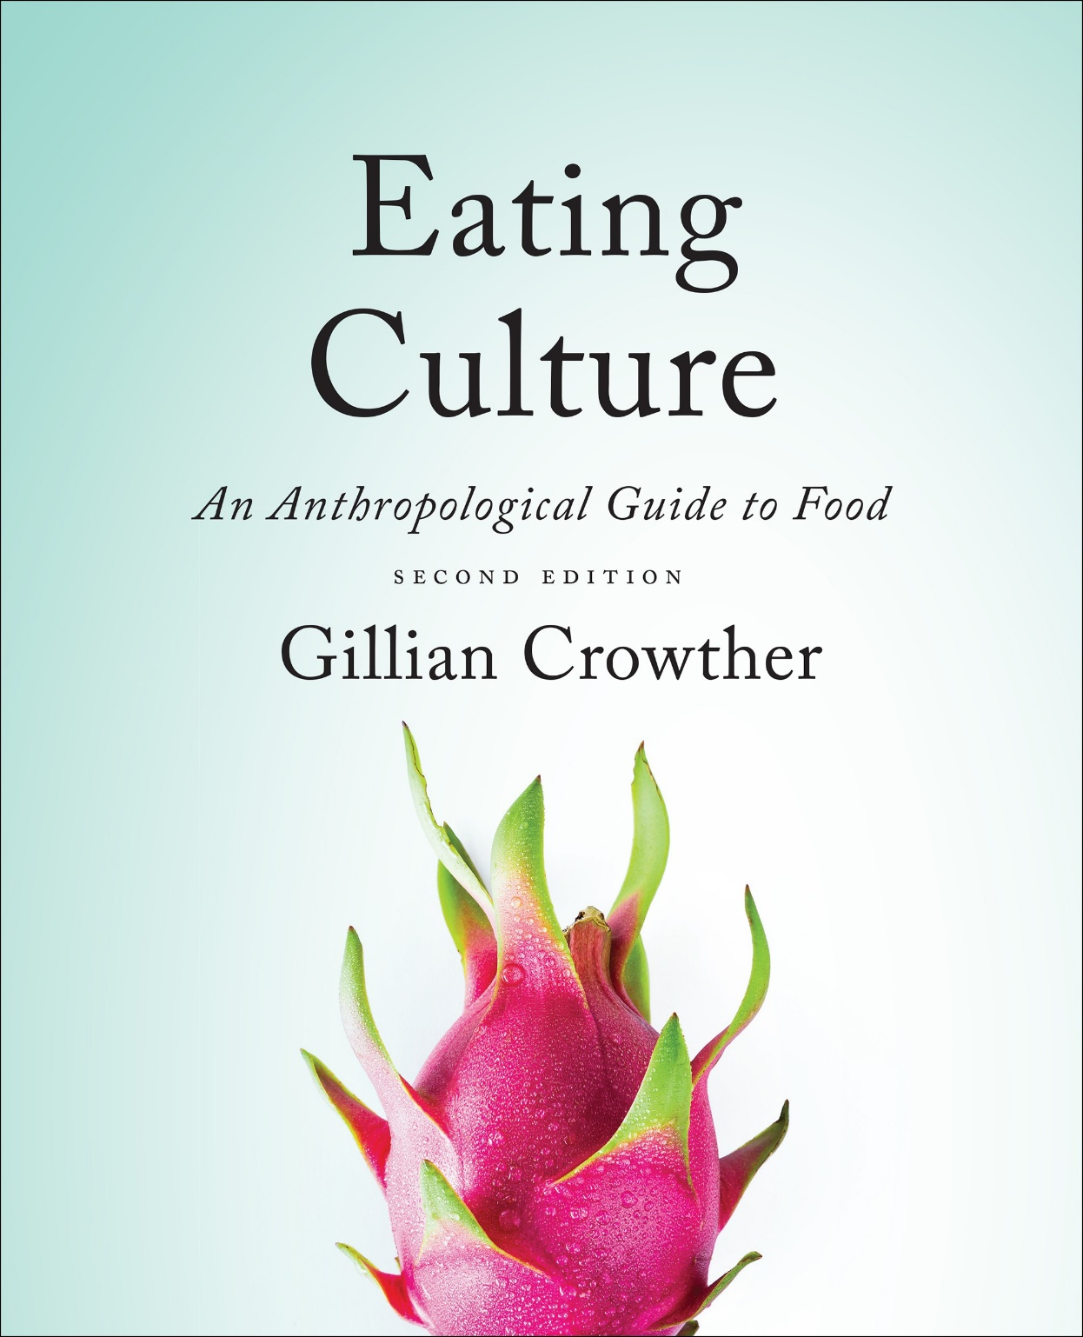
Dietary Revolutions:
the Neolithic Revolution
use your up/down arrow keys and/or
your space bar to advance the slides
Tim Roufs
© 2010-2024

Slide 3
Dietary Revolutions:
the Neolithic Revolution
Tim Roufs
© 2010-2024

Slide 4
Tim Roufs
© 2010-2024
www.d.umn.edu/cla/faculty/troufs/anthfood/aftexts.html#title

Slide 5
Food in Historical Perspective: Dietary Revolutions
Food in Historical Perspective:
Dietary Revolutions
  the Agricultural Revolution of the Neolithic Era
  the Search for Spices
  the Industrial Revolution
  Early Technology
    Domestication
    Transportation
    Refrigeration
    Canning
  the Scientific Revolution
  Modern-Day Adaptations
  Summary
  Highlight: Vegetarian Diets: then and Now

Slide 6
Food in Historical Perspective: Dietary Revolutions
Food in Historical Perspective:
Dietary Revolutions
  the Agricultural Revolution
  the Search for Spices
  the Industrial Revolution
  Early Technology
    Domestication
    Transportation
    Refrigeration
    Canning
  the Scientific Revolution
  Modern-Day Adaptations
  Summary
  Highlight: Vegetarian Diets: then and Now

Slide 7
Food in Historical Perspective: Dietary Revolutions
Food in Historical Perspective:
Dietary Revolutions
  foraging
  wild foods
  in the
  wilderness
  foraging
  wildly, foods
  in the
  supermarket
  localvores
  globalvores

Slide 8
Food in Historical Perspective: Dietary Revolutions
Food in Historical Perspective:
Dietary Revolutions
  food
  collection
  food
  production
  ca., 12,000 ybp
  people ate
  a wide variety
  of foraged foods
  people eat
  a small number
  of domesticated plants and animals

Slide 9
Food in Historical Perspective: Dietary Revolutions
Food in Historical Perspective:
Dietary Revolutions
  food
  collection
  food
  production
  ca., 12,000 ybp
  life expectancy
  lengthened
  population increased

Slide 10
Food in Historical Perspective: Dietary Revolutions
Food in Historical Perspective:
Dietary Revolutions
  the Agricultural Revolution of the Neolithic Era
  the Search for Spices
  the Industrial Revolution
  Transportation, Refrigeration, and Canning
  the Scientific Revolution
  Modern-Day Adaptations
  Summary
  Highlight: Vegetarian Diets: then and Now

Slide 11
currently
less than 1% of Americans are full-time farmers
the U.S. Census

Slide 12
“… the domestication of plants and animals is one of the major cultural revolutions humans have undergone in order to adapt to their physical and social environments.”
the Cultural Feast, 2nd Ed., p. 48

Slide 13
“the agricultural revolution of the Neolithic era laid the groundwork for the subsequent industrial and scientific revolutions.”
it increased food production
fostered a global network of food distribution
reshaped many aspects of modern life
the Cultural Feast, 2nd Ed., p. 48

Slide 14
About 12,000 years ago
(ca. 10,000 B.C.)
a dramatic change
in the way humans acquired their food began to unfold
the Cultural Feast, 2nd Ed., p. 48

Slide 15
people gradually shifted
from food collection
(foraging)
to food production
the Cultural Feast, 2nd Ed., p. 48

Slide 16
“Although the transition
took thousands of years
(it was more of an evolutionary
than a revolutionary process),
we consider this a major cultural revolution because of its important long-term impact on how humans interact with their environment”
the Cultural Feast, 2nd Ed., p. 48

Slide 17
before the advent of agriculture . . .
people lived in small groups
moved from place to place in search of food
populations were small
humans needed to exploit a relatively large territory
the Cultural Feast, 2nd Ed., p. 48

Slide 18
“… in a few areas of the New and Old Worlds, foraging groups living on riverbanks and in coastal areas with access to ample shellfish and plant foods were able to develop sedentary lifestyles”
the Cultural Feast, 2nd Ed., p. 48

Slide 19

Simon & Schuster 2003

Slide 20
Eight Food “Revolutions”
Invention of Cooking
Discovery that Food is More than Sustenance
the “Herding Revolution”
Snail Farming
Use of Food as a Means and Index of Social Differentiation
Long-Range Exchange of Culture
Ecological Revolution of last 500 years
Industrial Revolution of the 19th and 20th Centuries
Simon & Schuster 2003

Slide 21
Eight Food “Revolutions”
Invention of Cooking
Discovery that Food is More than Sustenance
the “Herding Revolution”
Snail Farming
Use of Food as a Means and Index of Social Differentiation
Long-Range Exchange of Culture
Ecological Revolution of last 500 years
Industrial Revolution of the 19th and 20th Centuries
Simon & Schuster 2003

Slide 22
Food in Historical Perspective: Dietary Revolutions
nomadism
moving from place to place daily, weekly, or seasonally
the Cultural Feast, 2nd Ed., p. 48

Slide 23
Food in Historical Perspective: Dietary Revolutions
nomadism
allowed human groups to include a wide range of foods in their diets without depleting any one resource
the Cultural Feast, 2nd Ed., pp. 48-49

Slide 24
“As people began to domesticate plants and animals, and actively manage the production of their food supply the food supply became more stable and abundant . . .
but it also became less diverse
this allowed humans to settle in village
the Cultural Feast, 2nd Ed., p. 49

Slide 25
settling in villages . . .
resulted in a
rise in population density
and an overall increase in the total human population
had significant effects on many other aspects of human life
provides the foundation for the development of civilization
the Cultural Feast, 2nd Ed., p. 49

Slide 26
neolithic
revolution
the Cultural Feast, 2nd Ed., p. 48

Slide 27
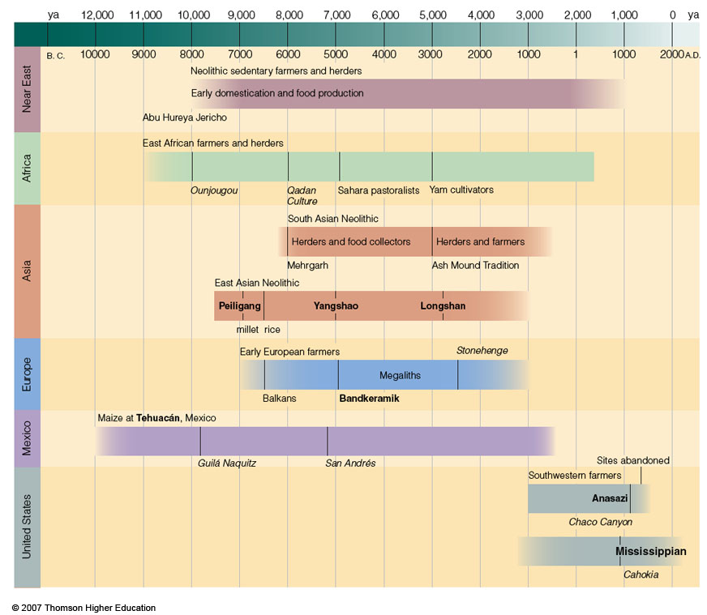
“Neolithic Revolution”
V. Gordon Childe's term for the far-reaching
  consequences of food production
Time line for Ch.16 "Food Production”
Understanding Physical Anthropology and Archaeology, 9th Ed., p. 333

Slide 28
Ten Classic Characteristics
of
Early Civilization
After V. Gordon Childe
Man Makes Himself (Rev. Ed).
NY: New American Library, 1951
What Happened in History.
Baltimore: Pelican Books, 1957

Slide 29
Ten Classic Characteristics
of
Early Civilization
After V. Gordon Childe
Man Makes Himself (Rev. Ed).
NY: New American Library, 1951
What Happened in History.
Baltimore: Pelican Books, 1957

Slide 30
Food in Historical Perspective: Dietary Revolutions
agricultural revolution
the growing of plants
(agriculture)
and the management of domesticated animals
(animal husbandry)
the Cultural Feast, 2nd Ed., p. 49

Slide 31
Food in Historical Perspective: Dietary Revolutions
agricultural revolution
the adoption of food production
the critical factor was domestication
the Cultural Feast, 2nd Ed., p. 49

Slide 32
Food in Historical Perspective: Dietary Revolutions
domestication
control over plant and animal reproduction
genetic transformation of wild species into domesticated species through selective breeding
the Cultural Feast, 2nd Ed., pp. 48-49

Slide 33
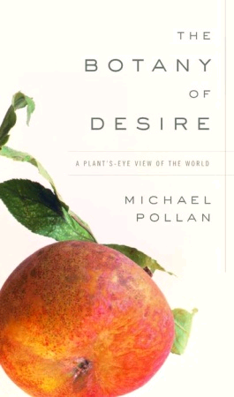
www.randomhouse.com/catalog/display.pperl?isbn=9781588360083

Slide 34
Simon & Schuster 2003

Slide 35
Eight Food “Revolutions”
Invention of Cooking
Discovery that Food is More than Sustenance
the “Herding Revolution”
Snail Farming
Use of Food as a Means and Index of Social Differentiation
Long-Range Exchange of Culture
Ecological Revolution of last 500 years
Industrial Revolution of the 19th and 20th Centuries
Simon & Schuster 2003

Slide 36
Eight Food “Revolutions”
Invention of Cooking
Discovery that Food is More than Sustenance
the “Herding Revolution”
Snail Farming
Use of Food as a Means and Index of Social Differentiation
Long-Range Exchange of Culture
Ecological Revolution of last 500 years
Industrial Revolution of the 19th and 20th Centuries
Simon & Schuster 2003

Slide 37
agriculture
  the propagation and exploitation of domesticated plants and/or animals by humans

Slide 38
agriculture
  a cultural activity

Slide 39
agriculture
  a cultural activity
  a cultural activity associated with planting, herding, and processing domesticated species

Slide 40
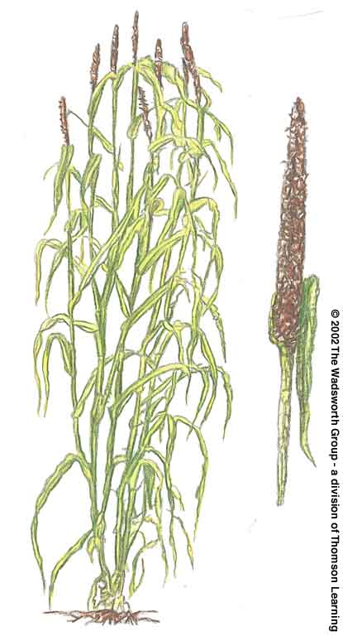
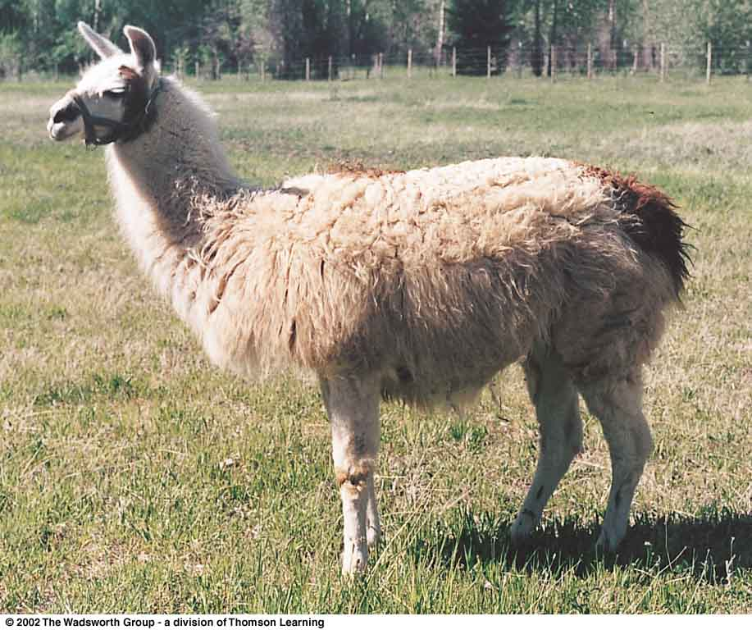
domestication
  a state of interdependence between humans and selected plant or animal species
pearl millet
South American llama
Understanding Physical Anthropology and Archaeology, 8th Ed., pp. 421, 9th Ed., 347

Slide 41
domestication
  an evolutionary process that requires genetic transformation of a wild species

Slide 42
Domestication: Dogs
  dogs were the first domesticated animals
  first role was to help with hunting
  as other animals were domesticated, dogs were used to herd, as working dogs
  and possibly they acted as camp watch dogs . . .

Slide 43
Domestication: Dogs
  and “garbage disposals”
  and as food
    Dakota
    Aztecs
    China
    formerly Germany
    some parts of India
    and elsewhere
  the burial of a puppy with a Natufian who died 10,000 y.a. suggests dogs earned the role of pet very early

Slide 44
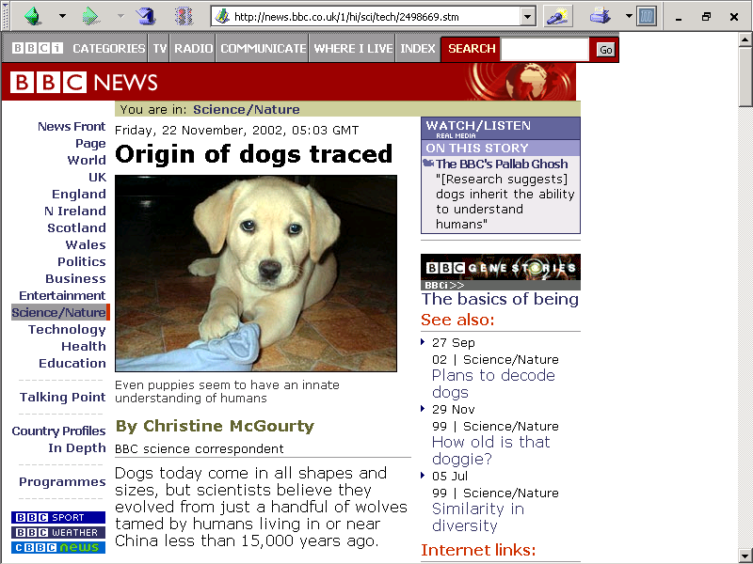
22 November 2002
http://news.bbc.co.uk/1/hi/sci/tech/2498669.stm

Slide 45

http://www.duluthnewstribune.com/event/obituary/id/123538/

Slide 46

http://www.duluthnewstribune.com/event/obituary/id/123538/

Slide 47
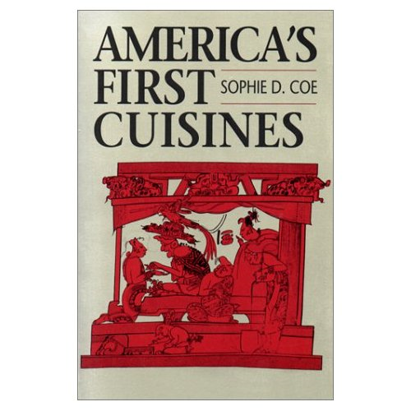

Texquiquiac Dog
Notes:
47

Slide 48
as favorable plant traits developed, foragers would collect more of the plants with the favorable traits
  this stimulated genetic changes in the plants and eventually
  produced a cultigen

Slide 49
cultigen
  a plant that is wholly dependent on humans
  a domesticate

Slide 50
cultivars
  wild plants fostered by human efforts to make them more productive
  wild plants fostered by human efforts to make them more productive

Slide 51
  as selection and isolation from other plants continued, plants became dependent on humans to disperse seeds

Slide 52
Other Important Terms . . .

Slide 53
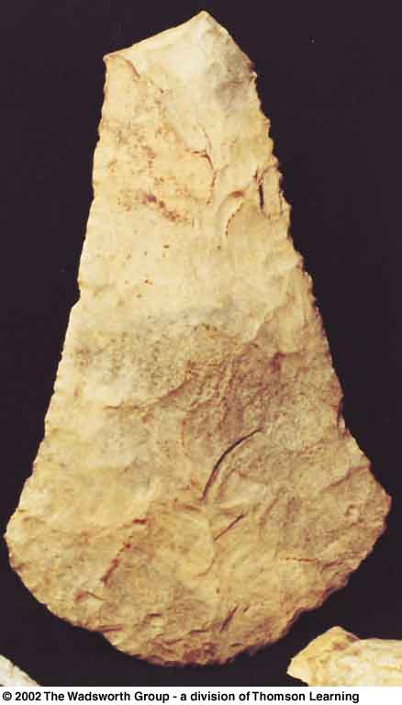
horticulture
  farming method in which only hand tools are used
  typical of most early
  Neolithic societies
Mississippian flint hoe blade, p. 363

Slide 54
symbiosis
  mutually advantageous association of two different organisms
  also known as “mutualism”

Slide 55
neolithic
revolution
end
the Cultural Feast, 2nd Ed., p. 48

Slide 56
Food in Historical Perspective: Dietary Revolutions
domestication
how?
why?
where?
the Cultural Feast, 2nd Ed., pp. 48-49

Slide 57
Functionalists
  domestication emerged in response to a pressing need
Systems Approach
  there is no single factor that propels domestication -- there are many factors

Slide 58
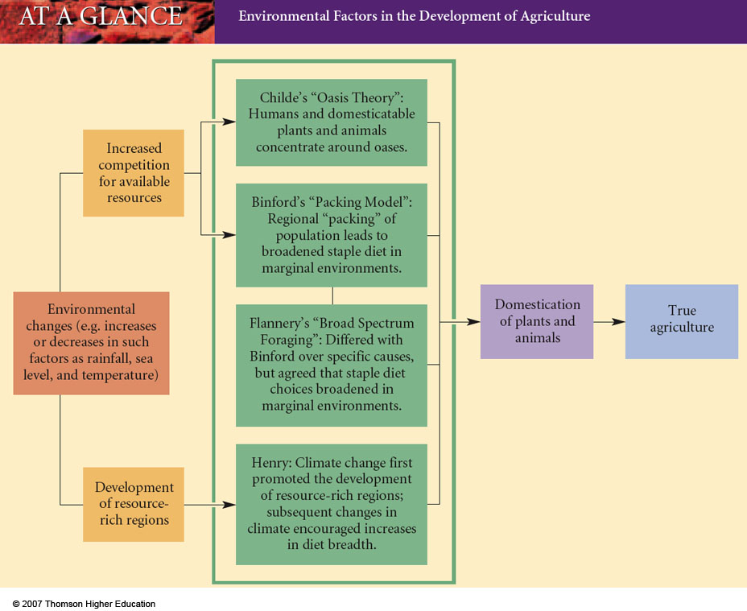
Environmental Factors in the Development of Agriculture
Understanding Physical Anthropology and Archaeology, 9th Ed., p. 338

Slide 59
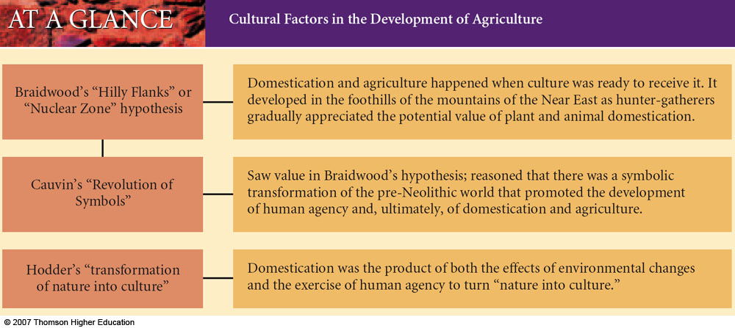
Cultural Factors in the Development of Agriculture
Understanding Physical Anthropology and Archaeology, 9th Ed., p. 340

Slide 60
“. . . contemporary foragers
(see Ch. 5)
manage the plants and animals in the environments in which they live, though not to the extent farmers and herders do.”
the Cultural Feast, 2nd Ed., p. 49

Slide 61
Ch. 4 “the Edible Earth:
Managing Plant Life for Food”
Simon & Schuster 2003

Slide 62
“… it is though that
women were responsible for much of the development of agriculture”
they probably did much of the gathering of plants and capturing of small animals
were probably more attuned to the plants in the environment
tend to stay closer to the home base than men
were in a position to observe the growth of plants from seeds
were a in a position to care for captured animals
the Cultural Feast, 2nd Ed., p. 49

Slide 63
“… people switched very slowly from harvesting wild species to planting selected varieties.”
at first, the cultivated varieties served only as supplements to the wild plants and animals they consumed
through time, people grew increasingly dependent on cultivated plants and animals
eventually agriculture produced the vast majority of foods eaten
the Cultural Feast, 2nd Ed., p. 49

Slide 64
TEHUACAN
add slides here
from ma
the Cultural Feast, 2nd Ed., p. 48

Slide 65
Archaeological Evidence for Domestication

Slide 66
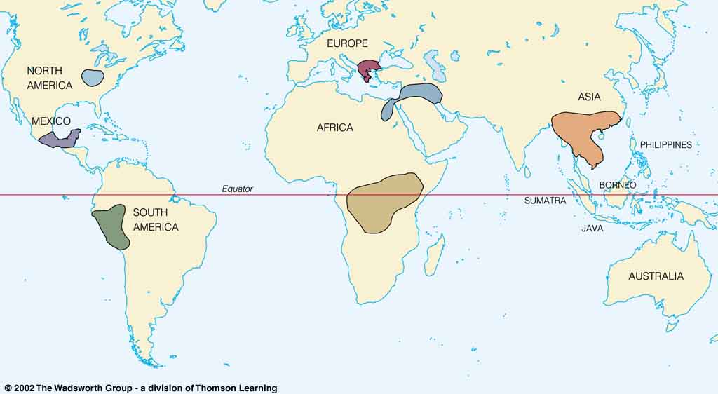
Origin of Domestication for Selected Plants
wheat
10,500 ybp
rice
7,000 ybp
maize
4,500 ybp
millet
4,000 ybp
manioc
4,200 ybp
Understanding Physical Anthropology and Archaeology, 8th Ed., p. 417

Slide 67
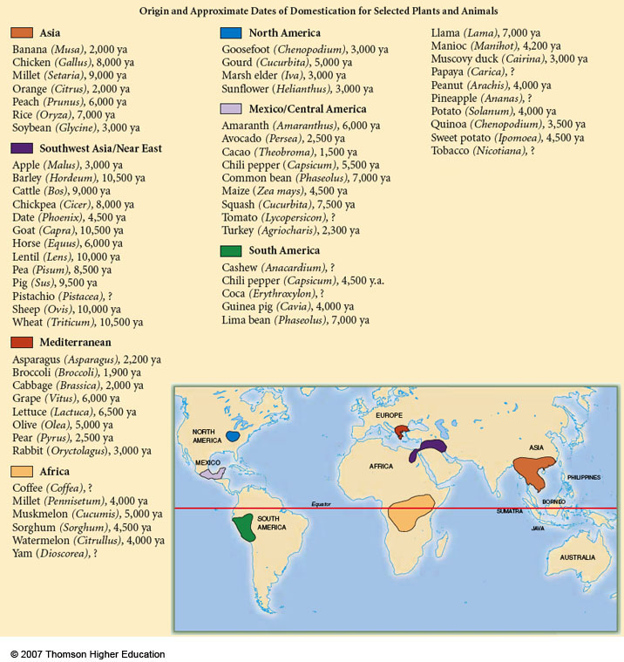
Origin and Approximate Dates of Domestication for Selected Plants and Animals
Understanding Physical Anthropology and Archaeology, 9th Ed., p. 417

Slide 68
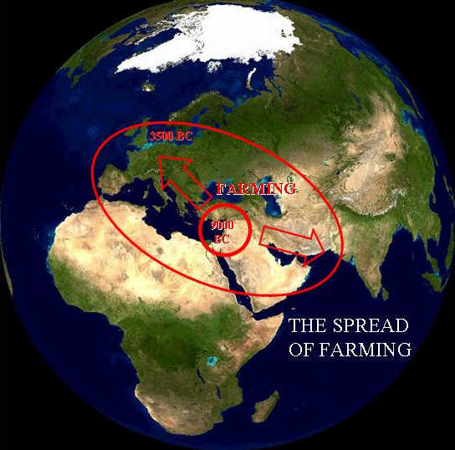
diffusion
“A dialectical model of Neolithic Origins”
www.archatlas.dept.shef.ac.uk/OriginsFarming/Farming.php

Slide 69
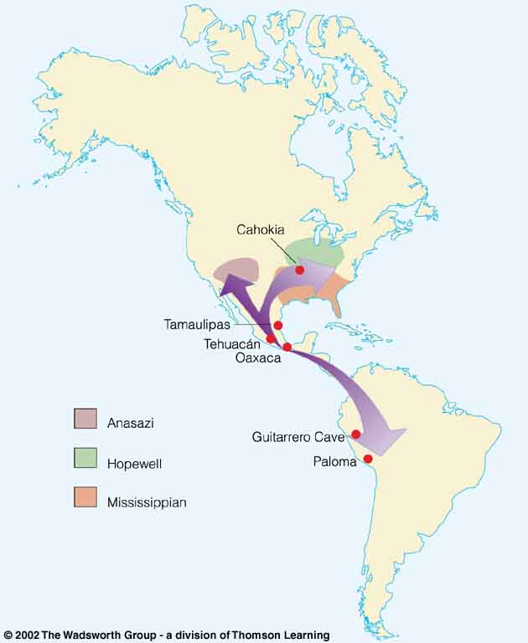
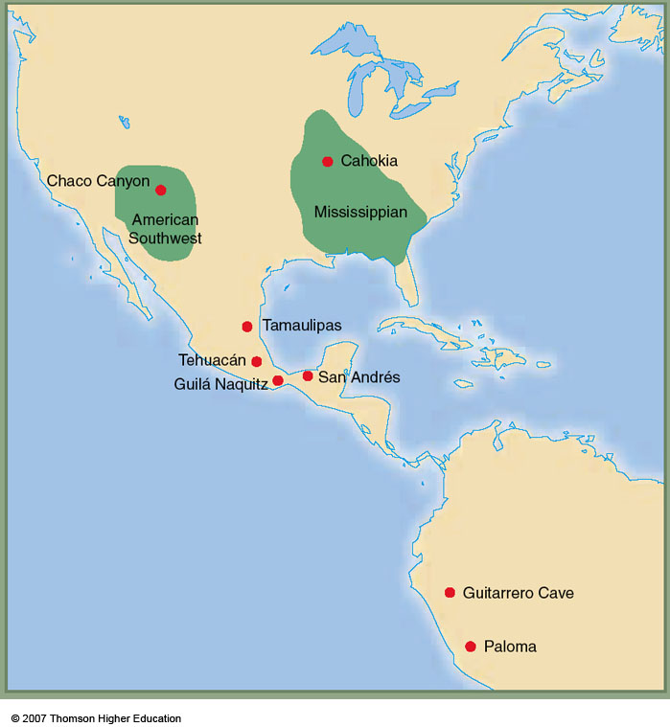
diffusion
  the spread of something from one group to another through contact
  or exchange
Early farming
in the Americas,
showing the spread
of maize agriculture
(purple)
Tehuacán Valley
Understanding Physical Anthropology and Archaeology, cf. 9th Ed., p. 358

Slide 70
Food in Historical Perspective: Dietary Revolutions
Food in Historical Perspective:
Dietary Revolutions
  the Agricultural Revolution of the Neolithic Era
  the Search for Spices
  the Industrial Revolution
  Transportation, Refrigeration, and Canning
  the Scientific Revolution
  Modern-Day Adaptations
  Summary
  Highlight: Vegetarian Diets: then and Now
  Development of Agriculture in the Tehuacán Valley
  Nutritional Consequences of the Agricultural Revolution: A Comparison of Foragers and Agriculturalists
  Social and Political Consequences of the Agricultural Revolution

Slide 71
examples:
Tehuacán, Puebla, Mexico
pre-Columbian Kentucky
the changes toward dependence on agriculture was not always swift
in the short term, it was not always healthful
the Cultural Feast, 2nd Ed., p. 49

Slide 72
examples:
Tehuacán, Puebla, Mexico
pre-Columbian Kentucky
the changes toward dependence on agriculture was not always swift
in the short term, it was not always healthful
the Cultural Feast, 2nd Ed., p. 49

Slide 73
examples:
Tehuacán, Puebla, Mexico
pre-Columbian Kentucky
the changes toward dependence on agriculture was not always swift
in the short term, it was not always healthful
the Cultural Feast, 2nd Ed., p. 49

Slide 74
Tehuacán, Puebla, Mexico
America’s First Cuisines, Ch. 2
Notes:
74

Slide 75
Tehuacán
Valley,
Puebla,
Mexico
maize
4,500 ybp
Early farming in the Americas
Understanding Physical Anthropology and Archaeology, 9th Ed., p. 358

Slide 76
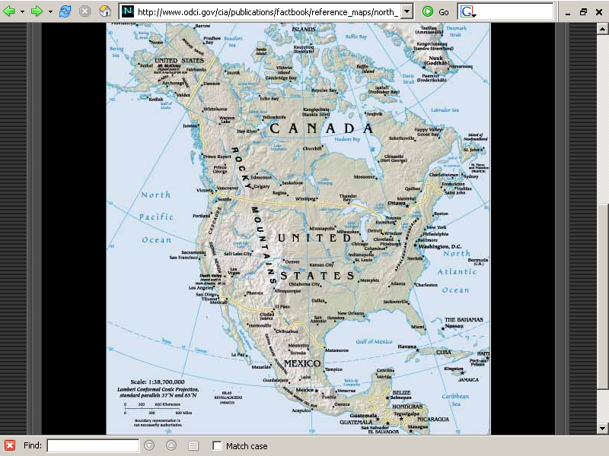
Bering Strait
56-mile-wide portion of the North Pacific Ocean
that separates Asia from North America
Cultural Feast 2nd Ed., p. 50
www.odci.gov/cia/publications/factbook/reference_maps/north_america.html

Slide 77
www.odci.gov/cia/publications/factbook/reference_maps/north_america.html

Slide 78
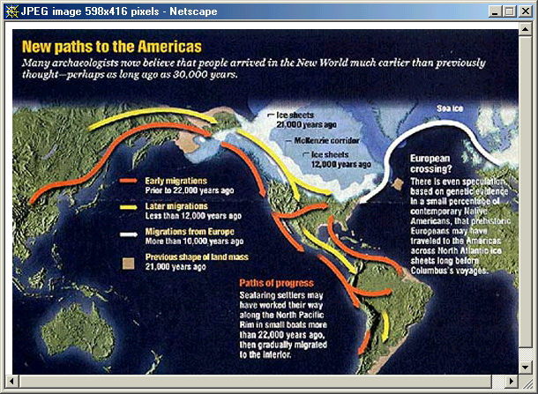

Slide 79
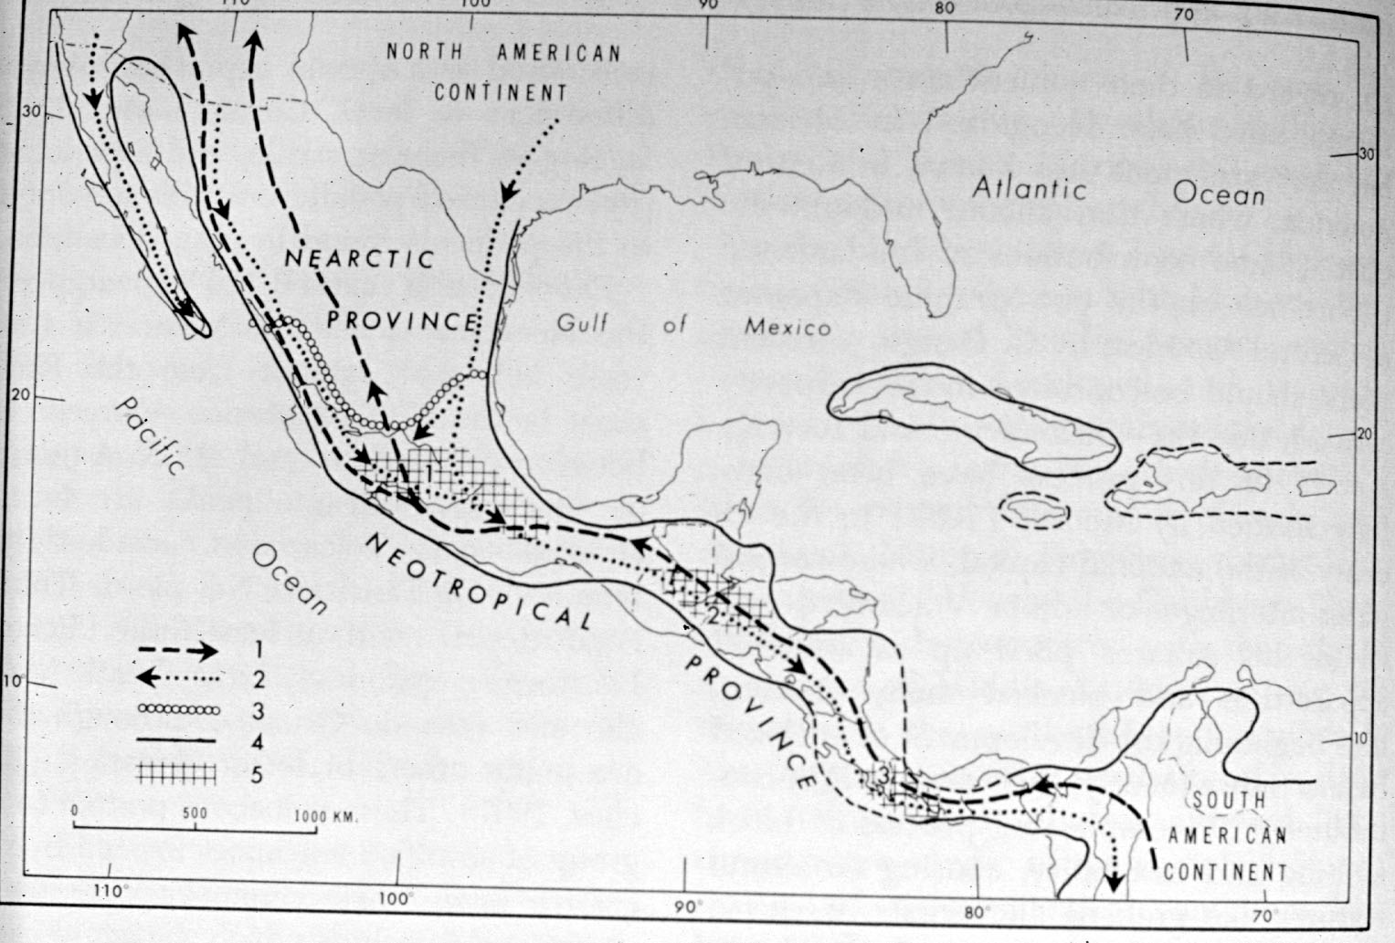
Miocene-Pliocene Routes of Animal Migrations

Slide 80
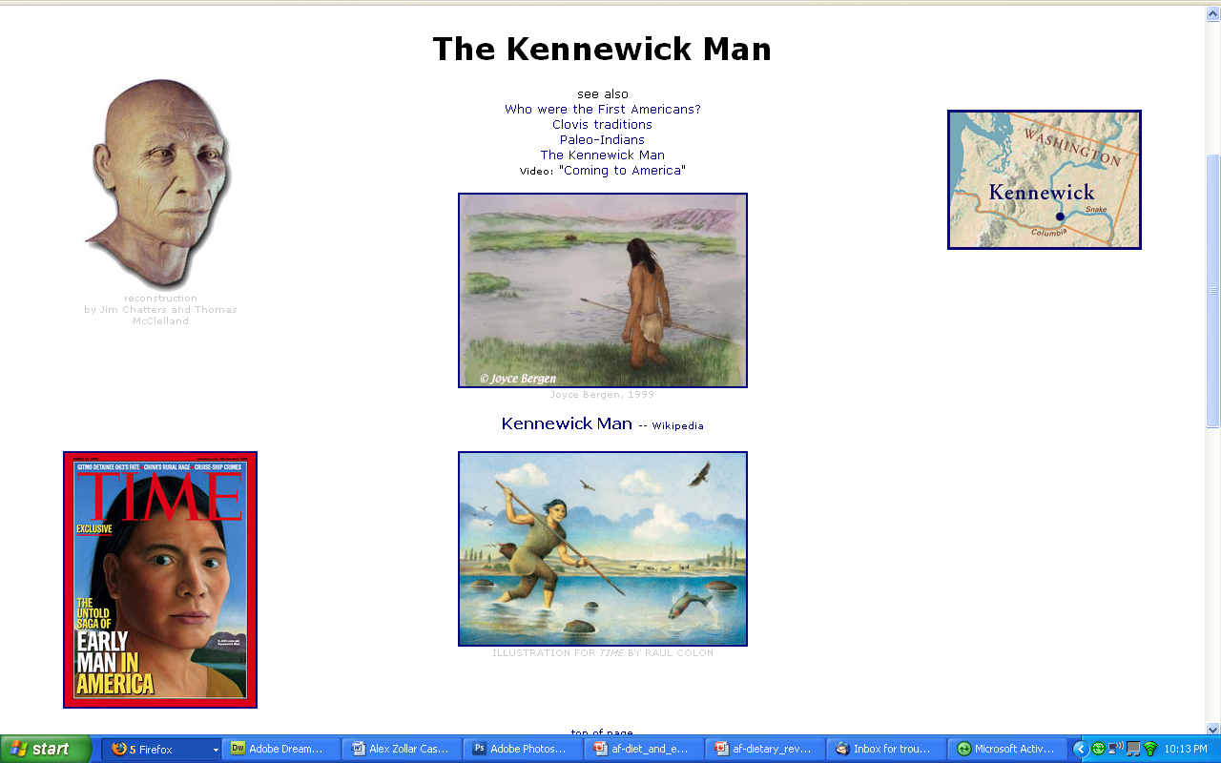
8,400 ybp
www.d.umn.edu/cla/faculty/troufs/anth1602/pckennewick.html#title

Slide 81
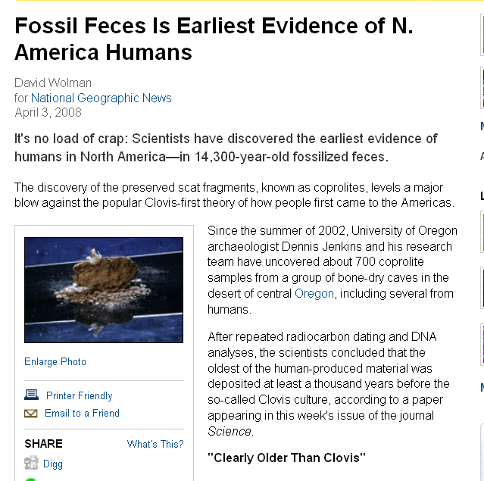
http://news.nationalgeographic.com/news/2008/04/080403-first-americans.html
Notes:
81

Slide 82
http://news.nationalgeographic.com/news/2008/04/080403-first-americans.html
Notes:
82

Slide 83
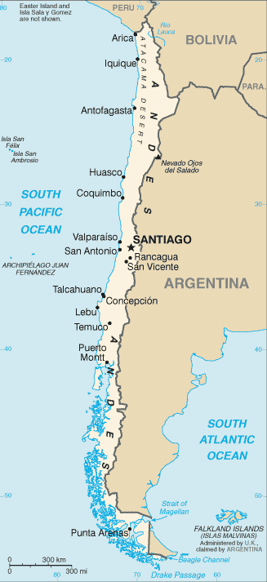

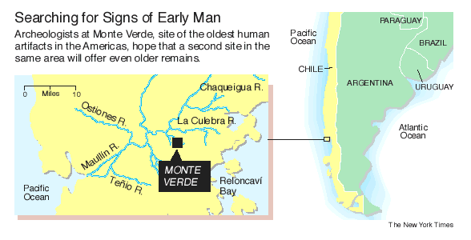
www.unl.edu/rhames/monte_verde/monte_verde_map.gif
www.learnnc.org/lp/media/uploads/2008/02/monte_verde_chile.jpg
Notes:
83

Slide 84
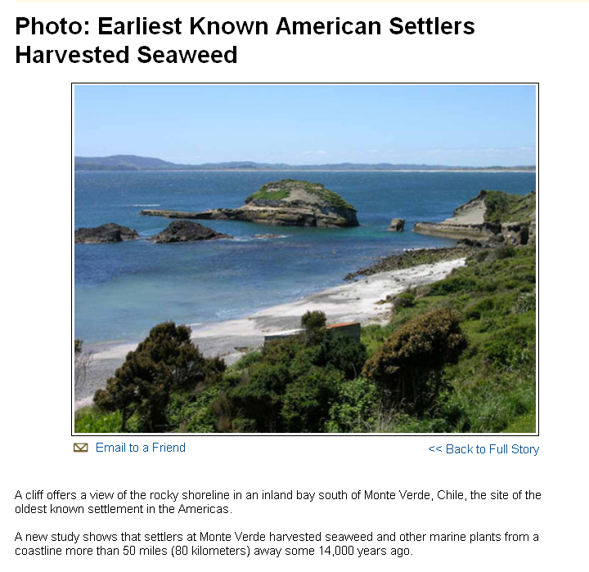
http://news.nationalgeographic.com/news/bigphotos/15550150.html
Notes:
84

Slide 85
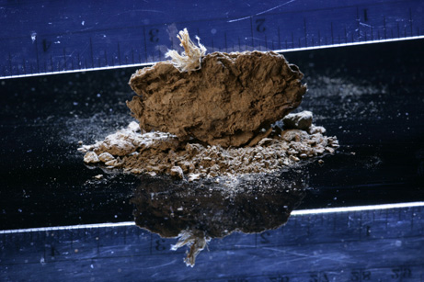
this coprolite, or fossilized chunk of feces, was found in Oregon's Paisley 5 Mile Point Caves.
Scientists have dated the remains to 14,300 years ago—the oldest evidence yet found of humans in North America.
http://news.nationalgeographic.com/news/bigphotos/96254452.html
Notes:
85

Slide 86
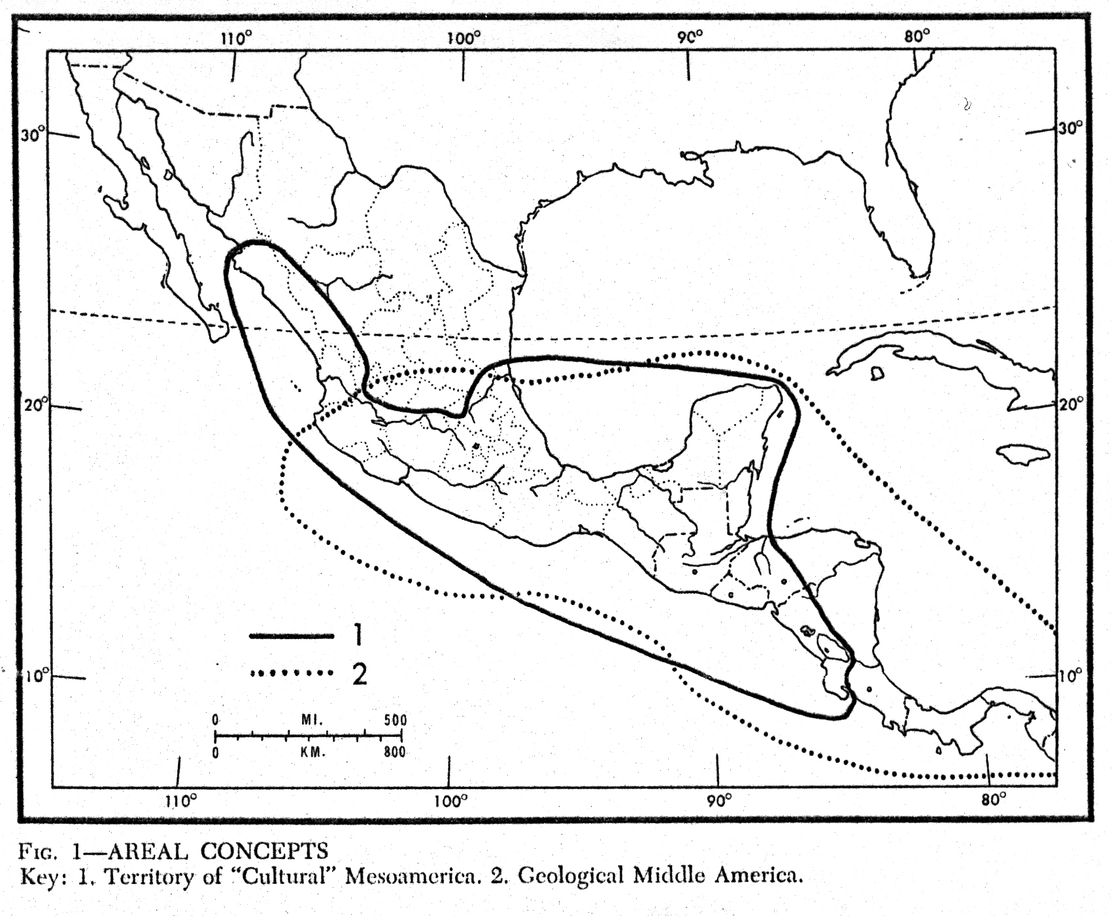
“Middle America”
(geological)
“Mesoamerica”
(cultural)

Slide 87
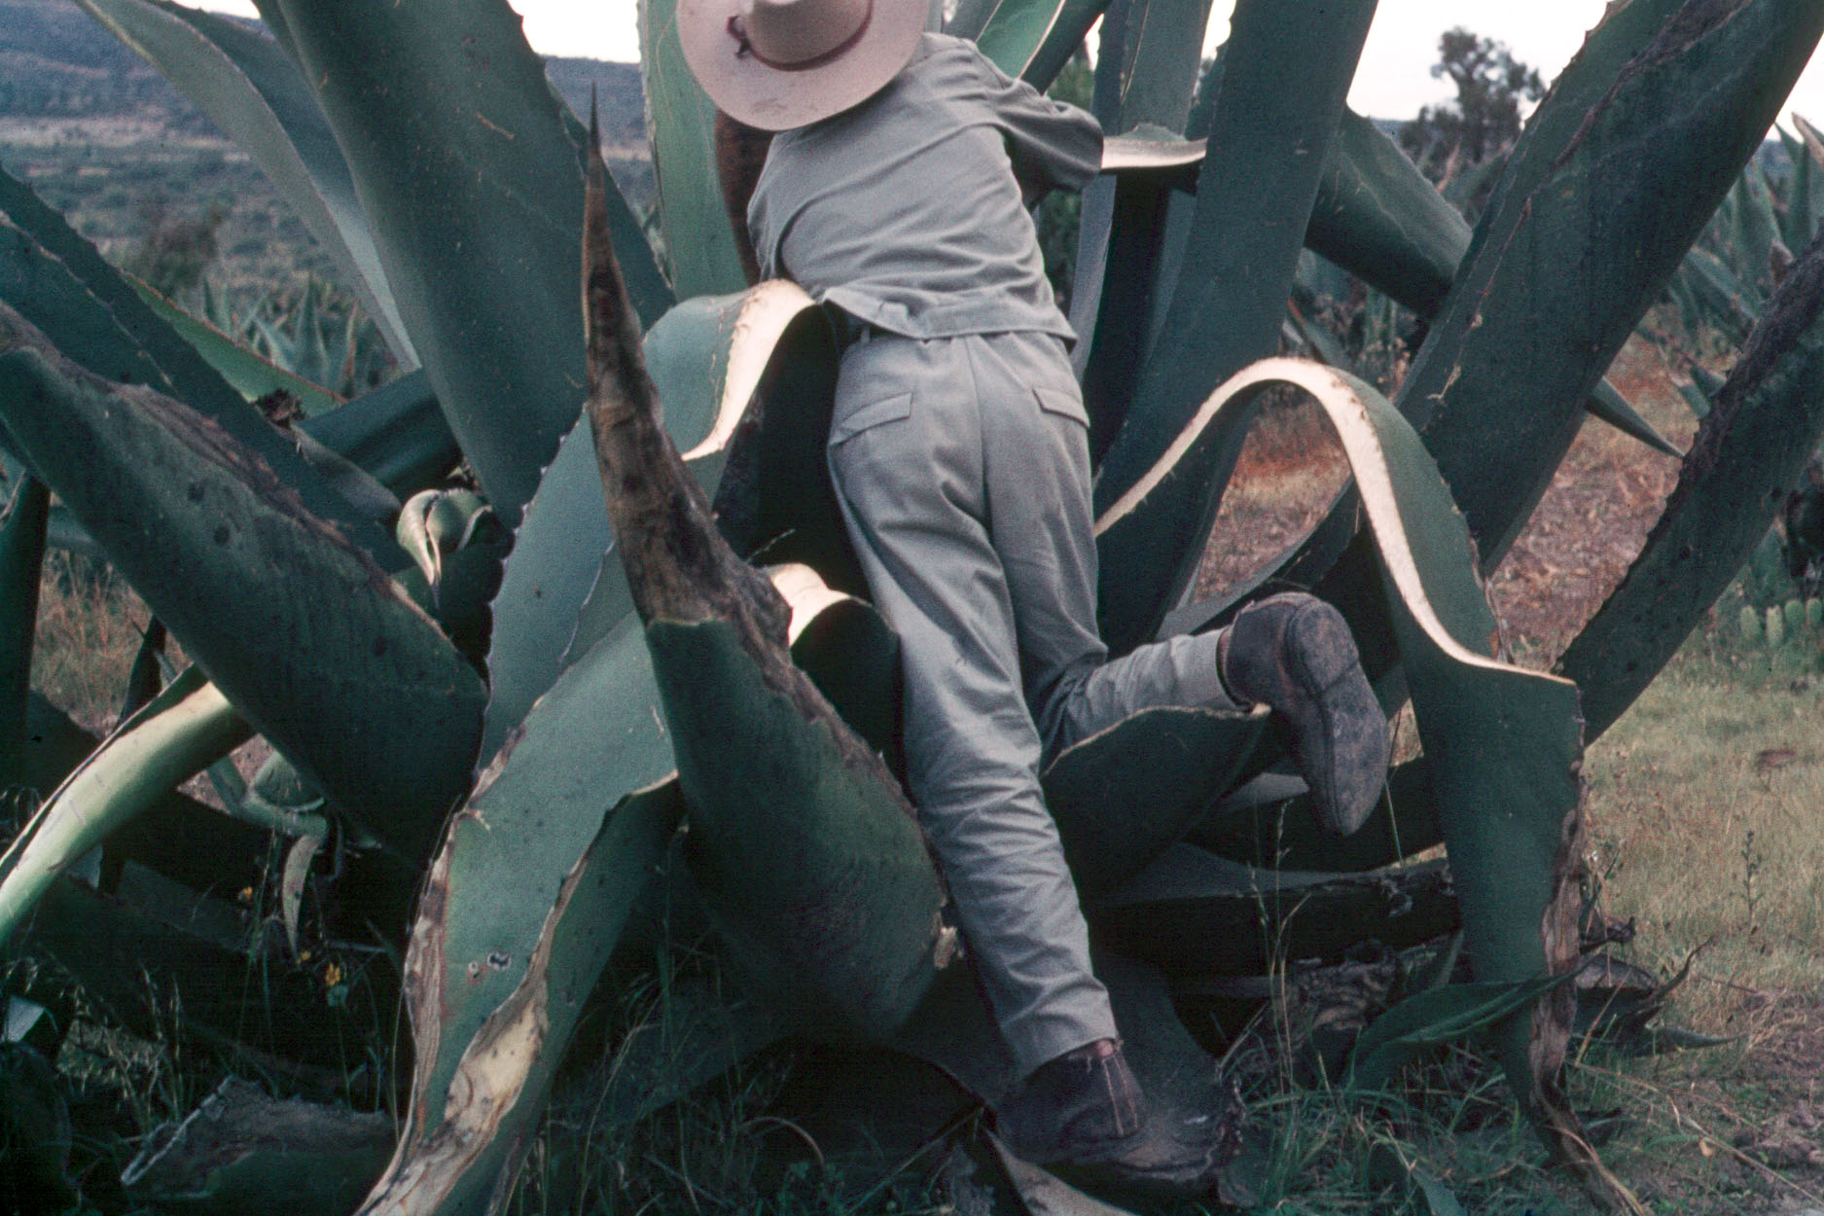
maguey
cactus
aka
“agave”
(the Cultural Feast, 2nd Ed., p.50)
and
“century plant”
tlachiquero
(Soltero Dorantz)
Los Cides, Hidalgo, Mexico

Slide 88
Ch. 5
“Aztec Ingredients”
Notes:
88

Slide 89
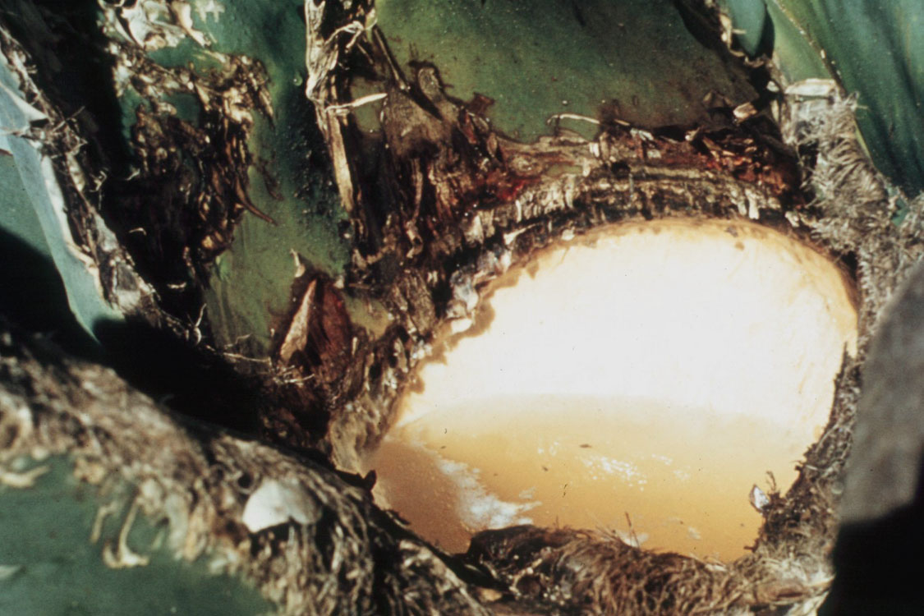
agua miel
will be fermented into
pulque

Slide 90
pulque
America’s First Cuisines, Ch. 4
Notes:
90

Slide 91
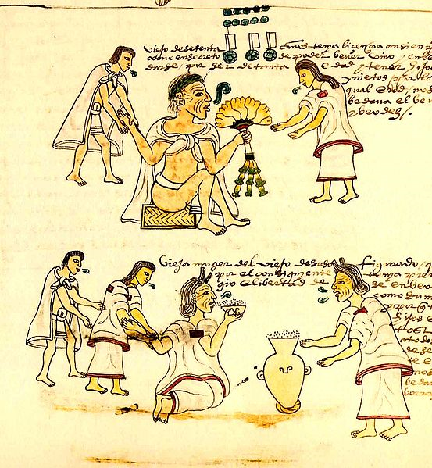
An elderly Aztec woman drinking pulque
Codex Mendoza
mid 16th century

Slide 92

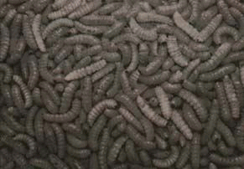
gusanos
Gusanos de maguey

Slide 93
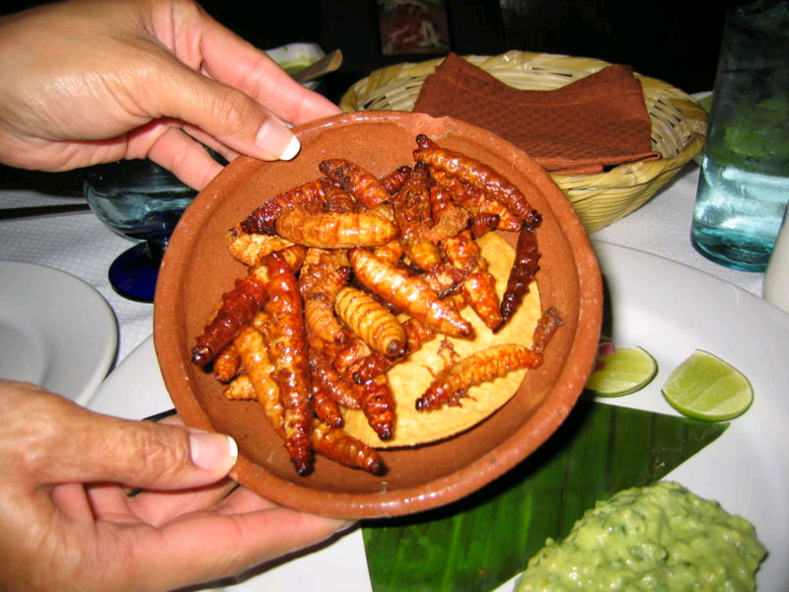
more
gusanos
Gusanos de maguey

Slide 94
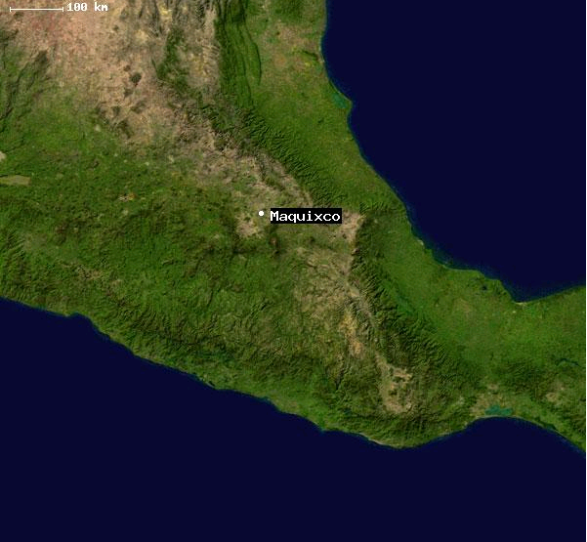
Maquixco
Santa Maria Maquixco, Mexico, Mexico
is situated in Temascalapa, Mexico, Mexico, its geographical coordinates are 19° 47' 0" North,
98° 50' 0" West and its original nameis Santa María Maquixco.

Slide 95
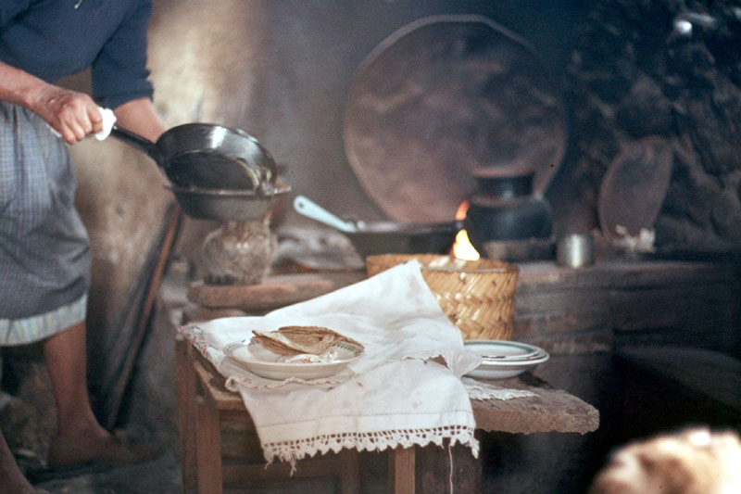
Tinacaleros, Los Cides, Hidalgo, Mexico

Slide 96
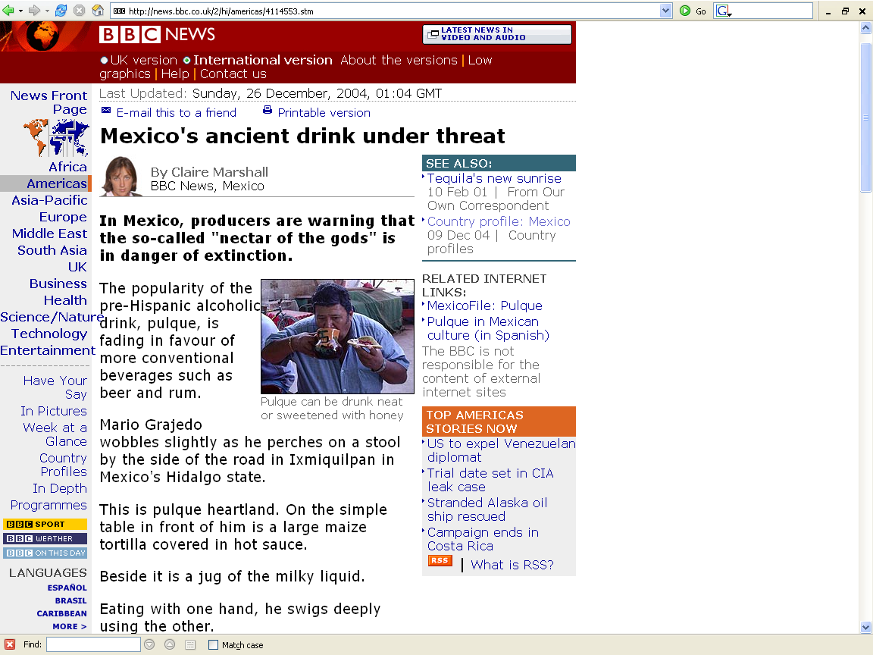
http://news.bbc.co.uk/2/hi/americas/4114553.stm

Slide 97
cactus
America’s First Cuisines, Ch. 4
Notes:
97

Slide 98
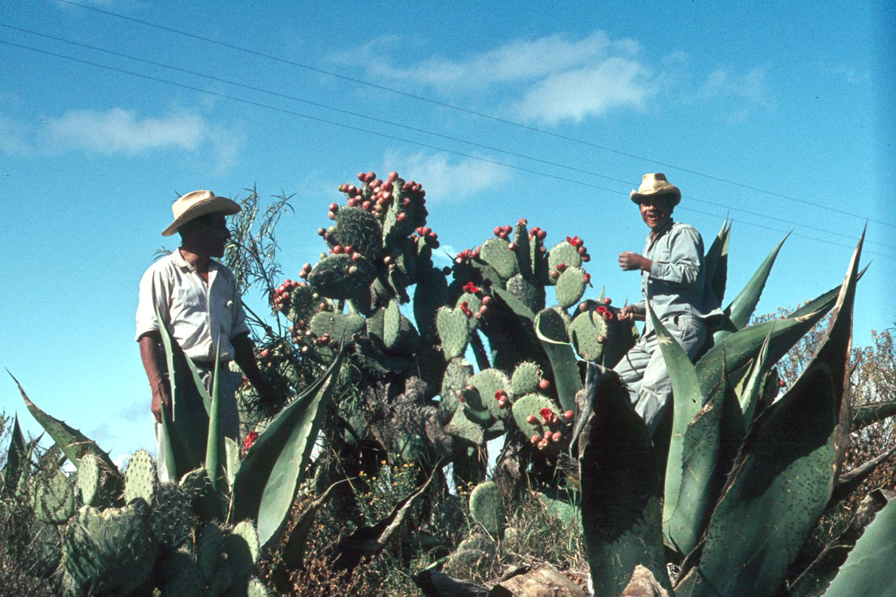
harvesting tunas

Slide 99
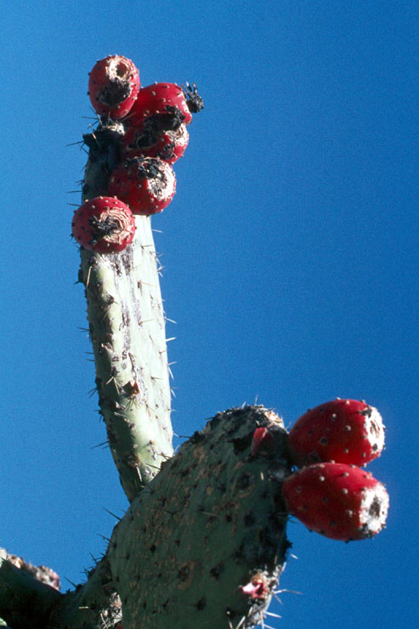
tunas
Nopale Cactus and Tunas, Hidalgo, Mexico

Slide 100
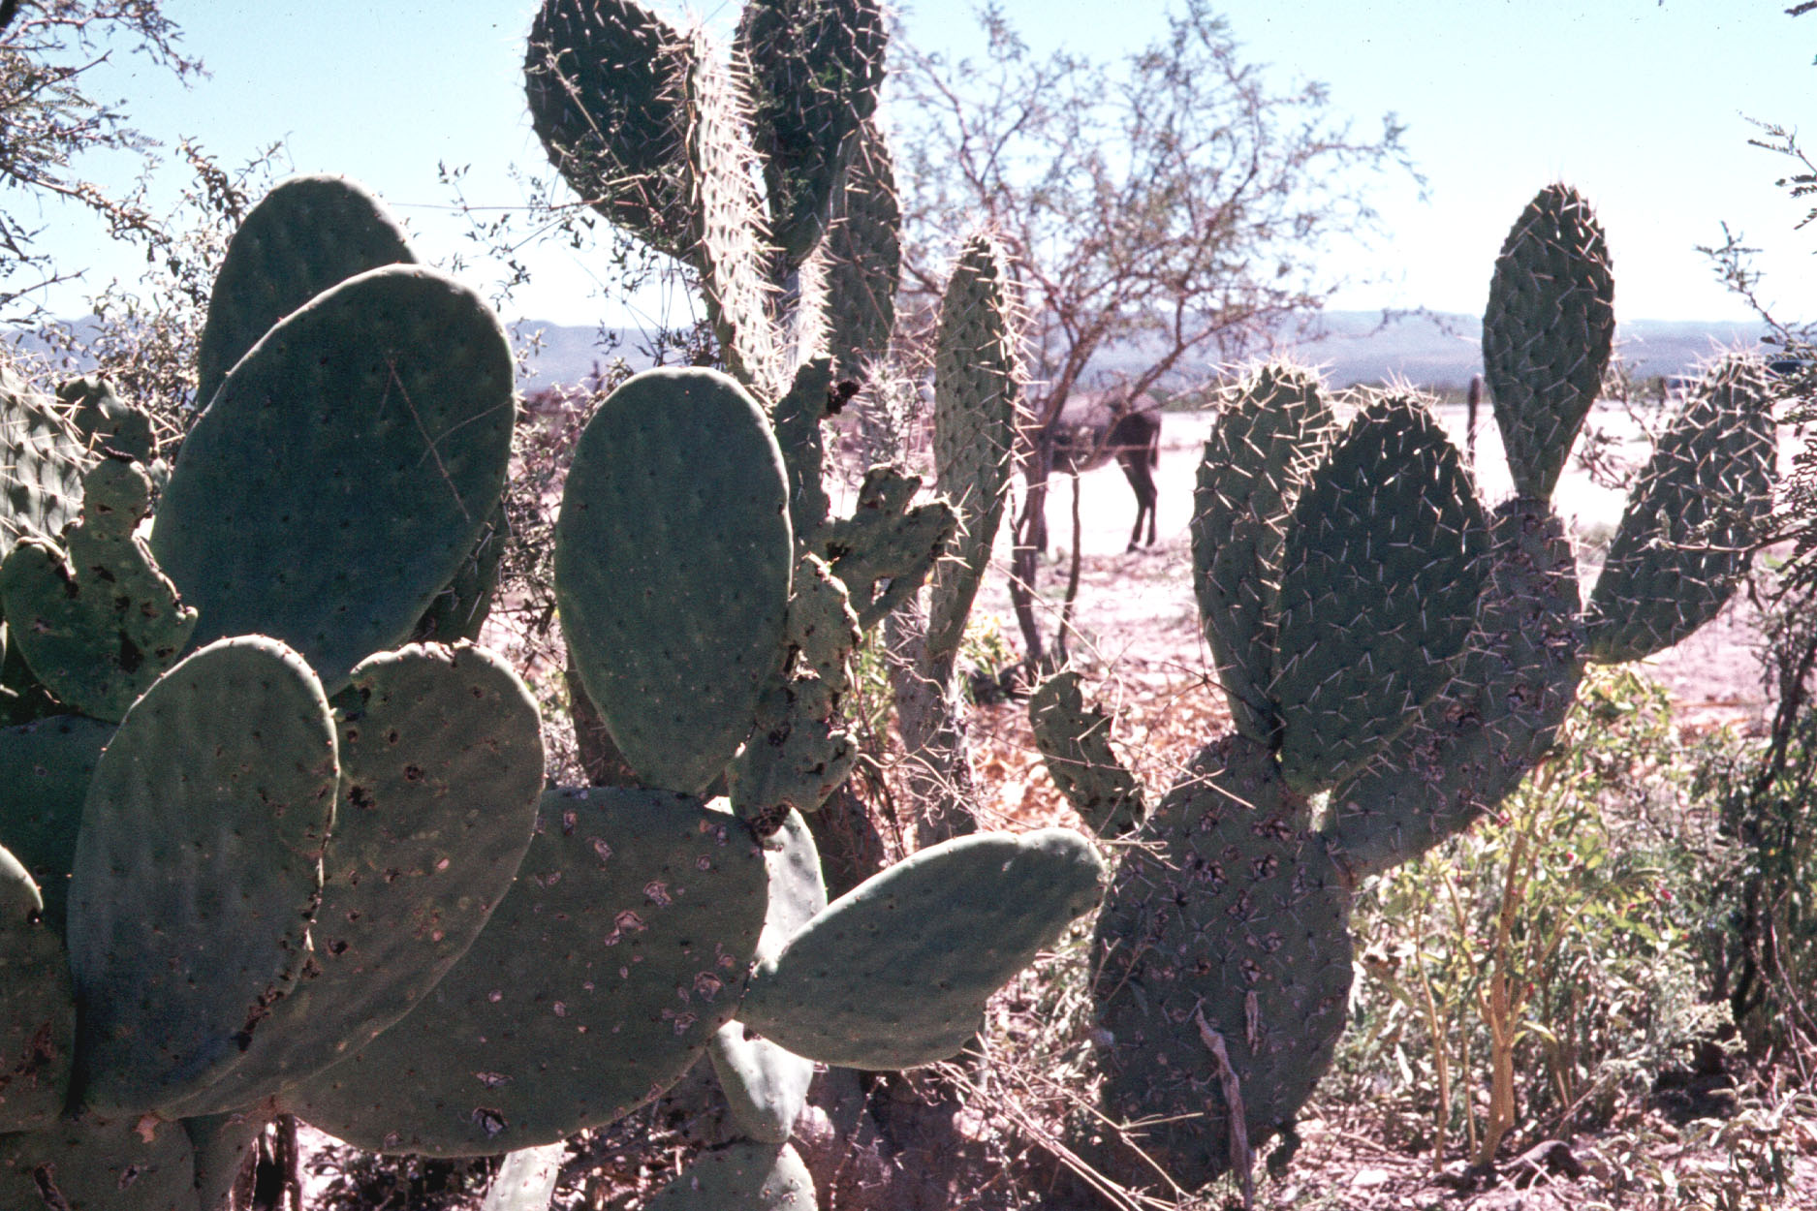
nopales
from the Nahuatl
word nōpalli for the pads,
or nostle (nōchtli)
for the fruit
nopales
“prickly pear” cactus
Compound of the 9 Brothers, near Matawala, San Luis Potosi, Mexico

Slide 101
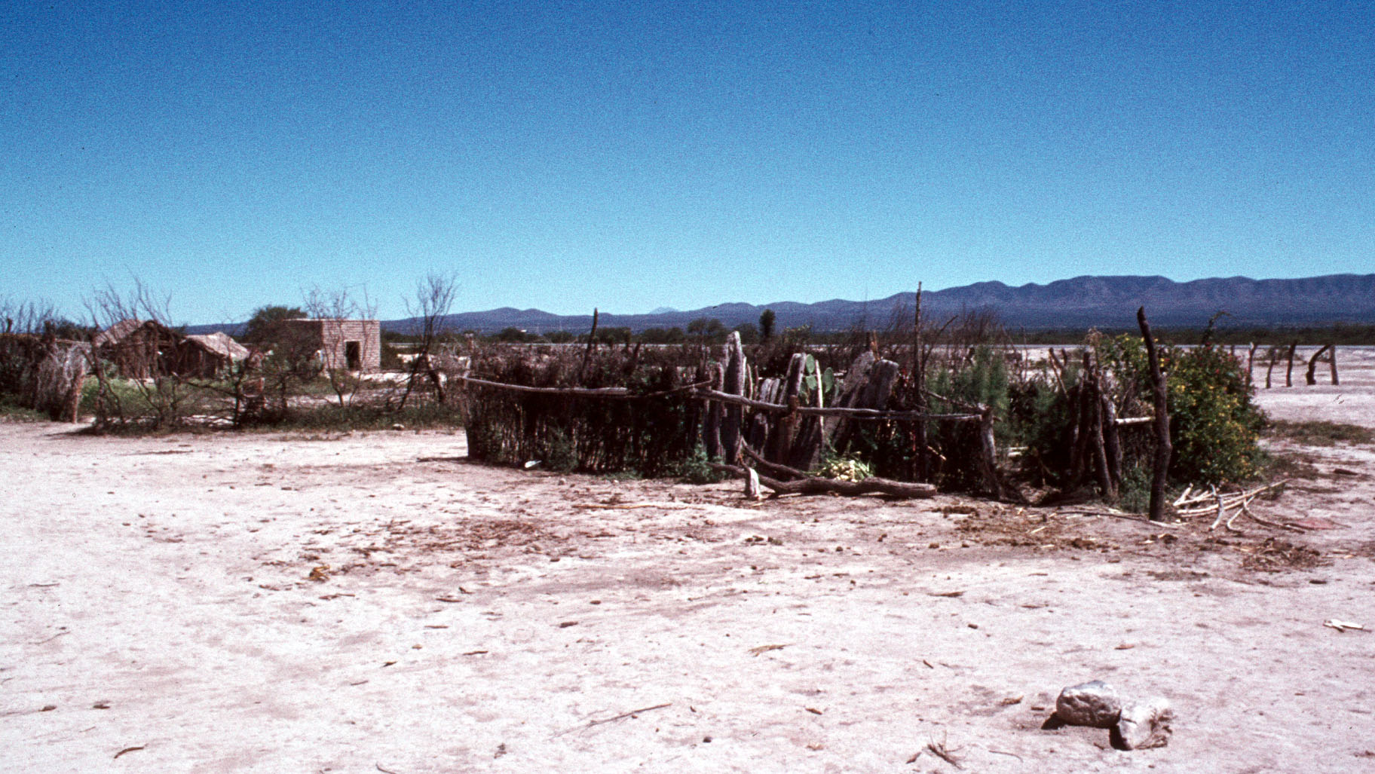
Compound of the 9 Brothers, near Matawala, San Luis Potosi, Mexico

Slide 102
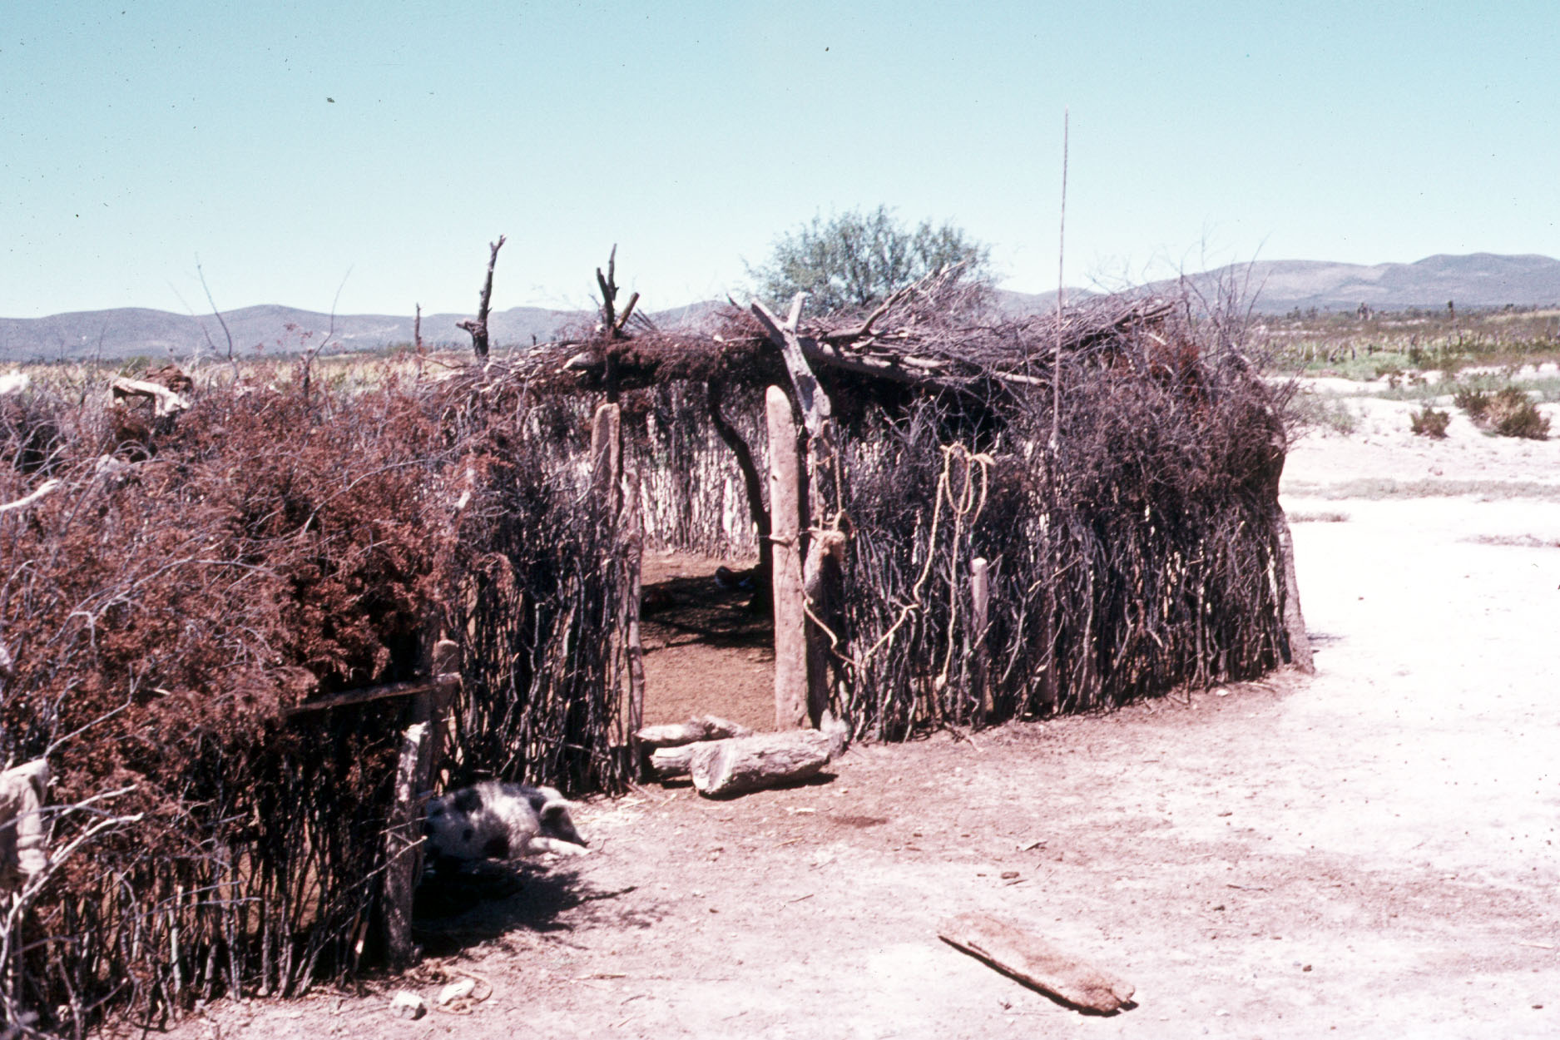
Compound of the 9 Brothers, near Matawala, San Luis Potosi, Mexico

Slide 103
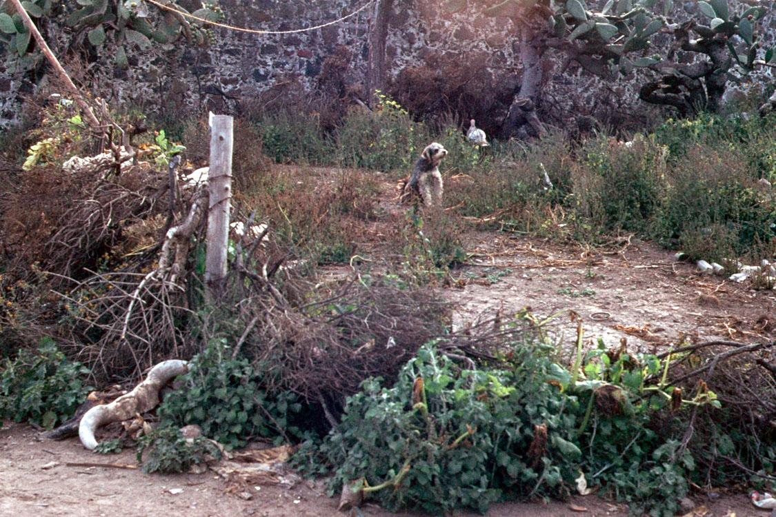

Slide 104
maize
America’s First Cuisines, Ch. 4
Notes:
104

Slide 105
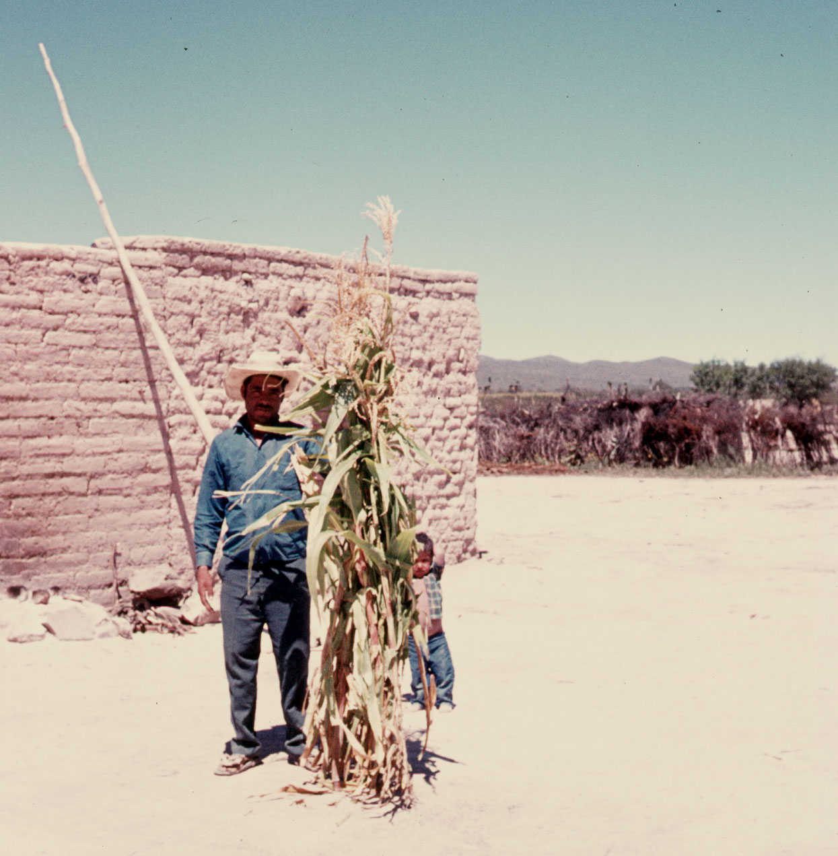
Compound of the 9 Brothers, near Matawala, San Luis Potosi, Mexico

Slide 106
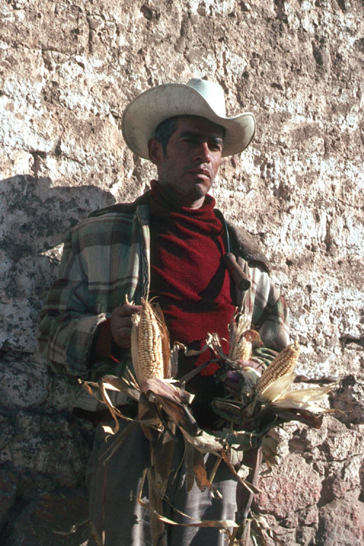

Slide 107
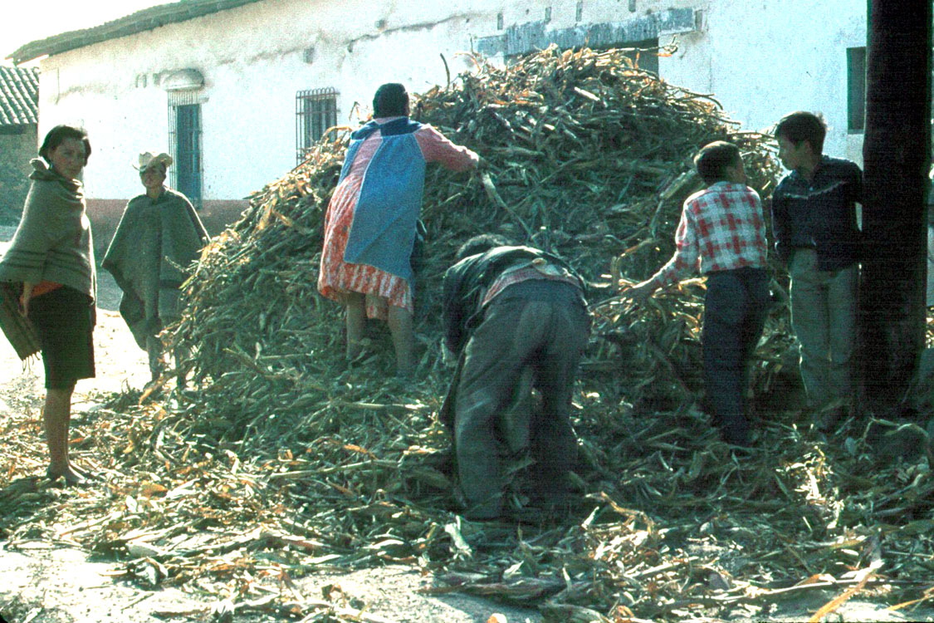

Slide 108
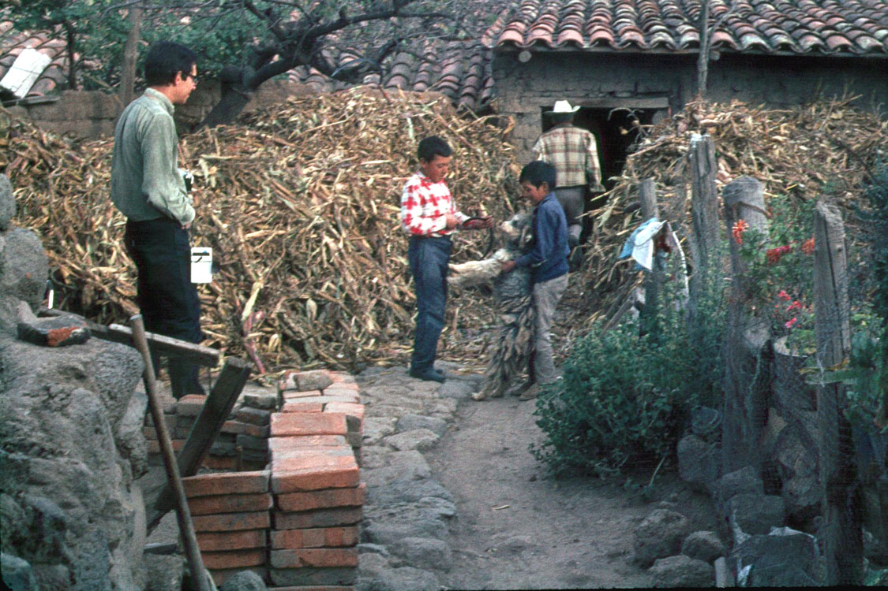

Slide 109
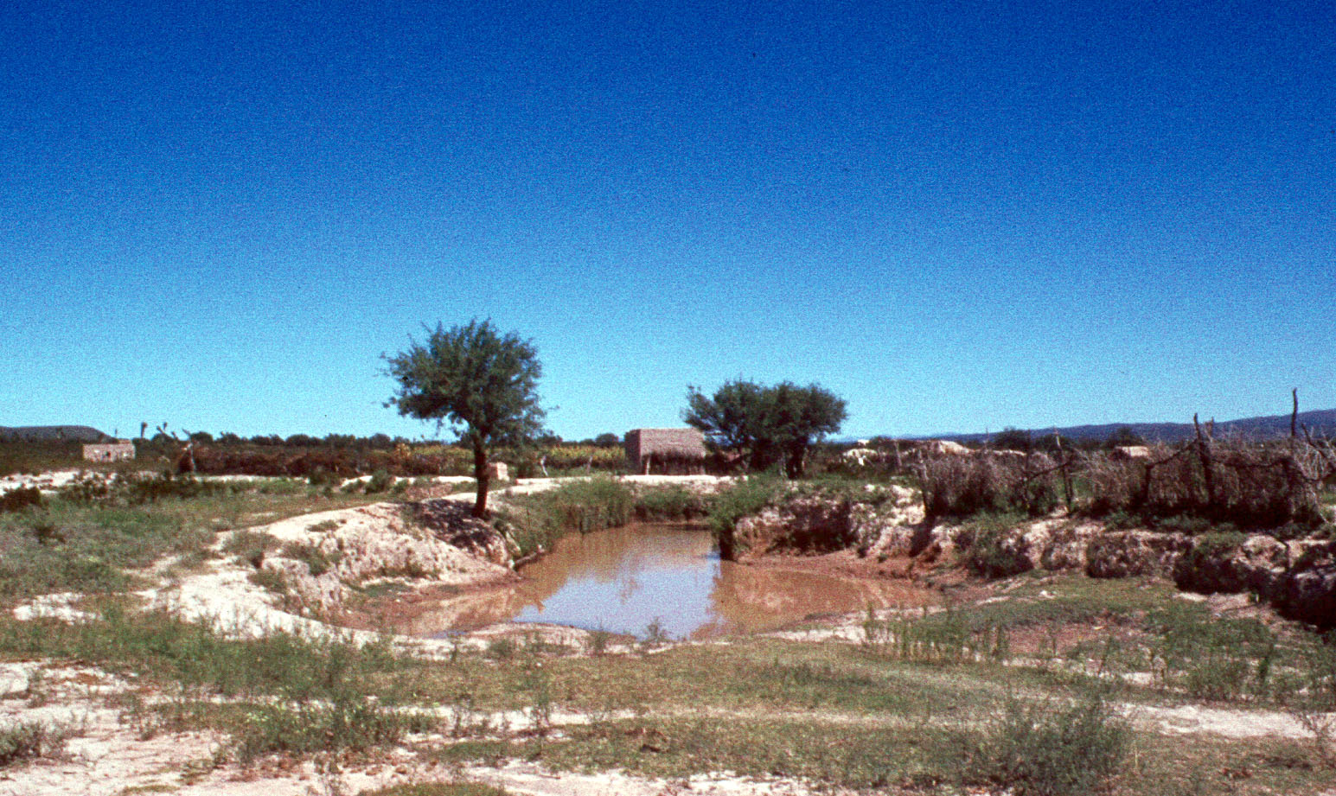
Compound of the 9 Brothers, near Matawala, San Luis Potosi, Mexico

Slide 110
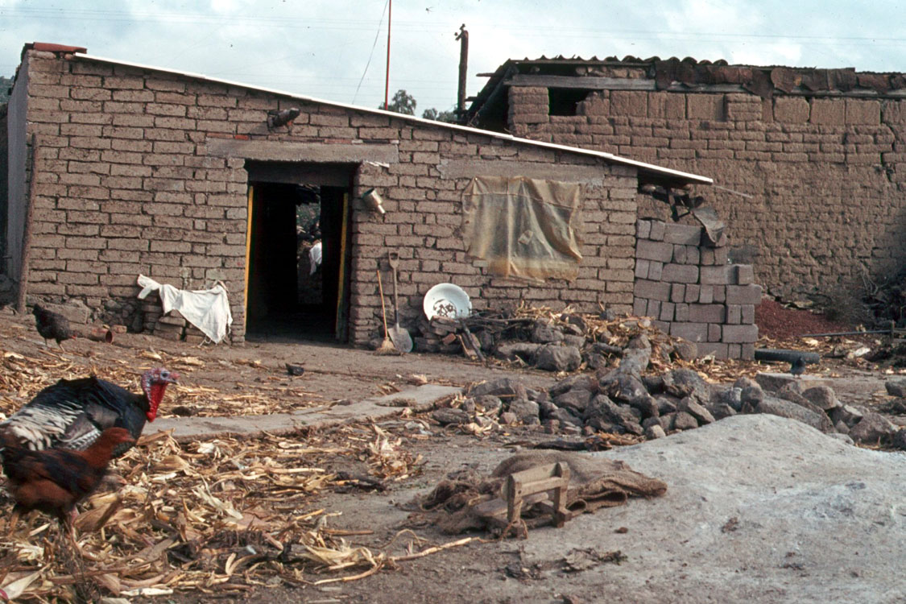

Slide 111
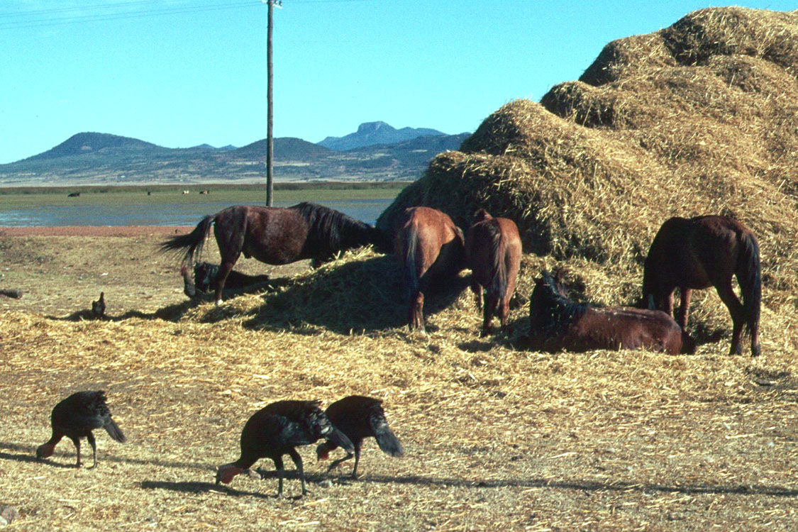

Slide 112
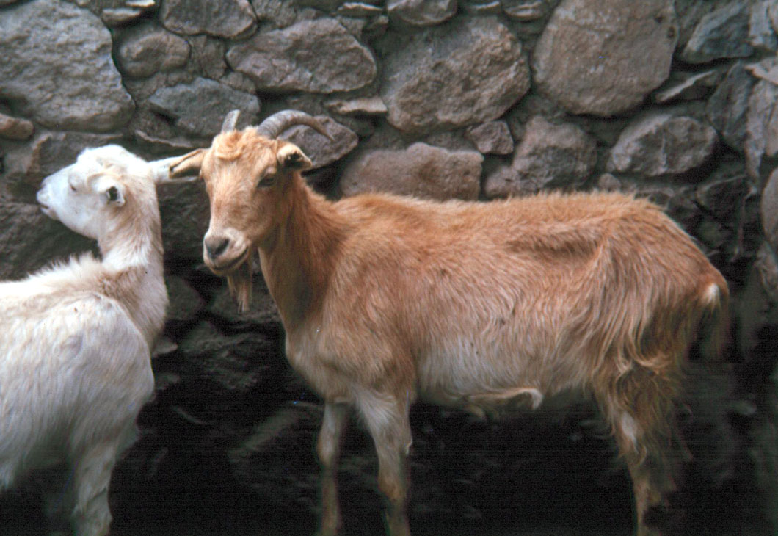
Tinacaleros, Los Cides, Hidalgo, Mexico

Slide 113
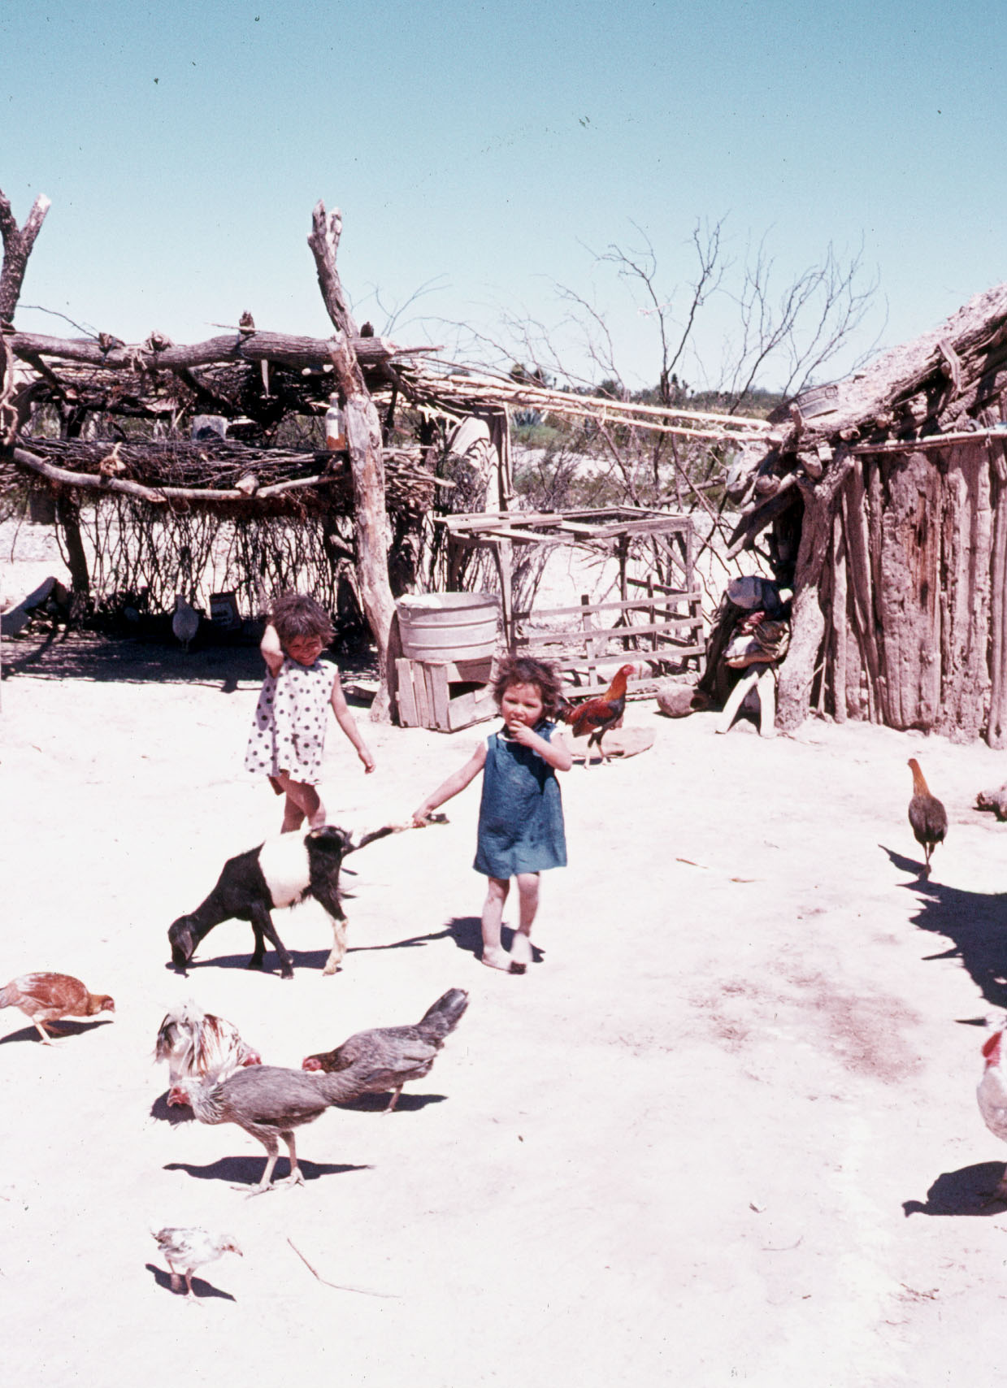
Compound of the 9 Brothers, near Matawala, San Luis Potosi, Mexico

Slide 114
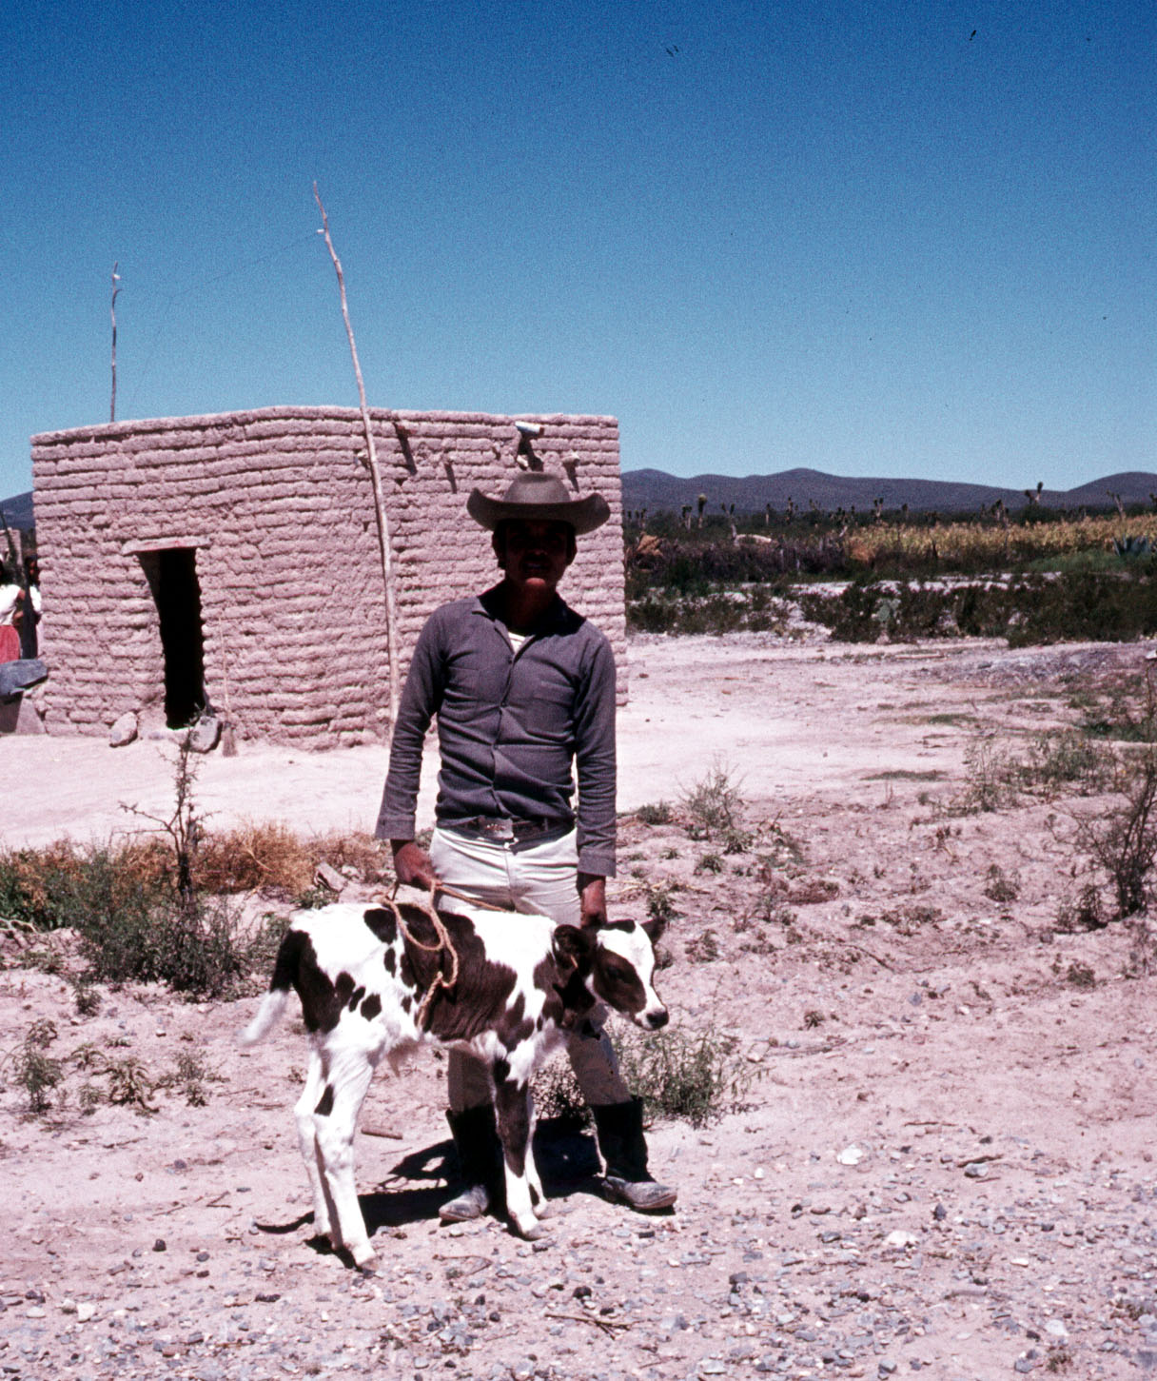
Compound of the 9 Brothers, near Matawala, San Luis Potosi, Mexico

Slide 115
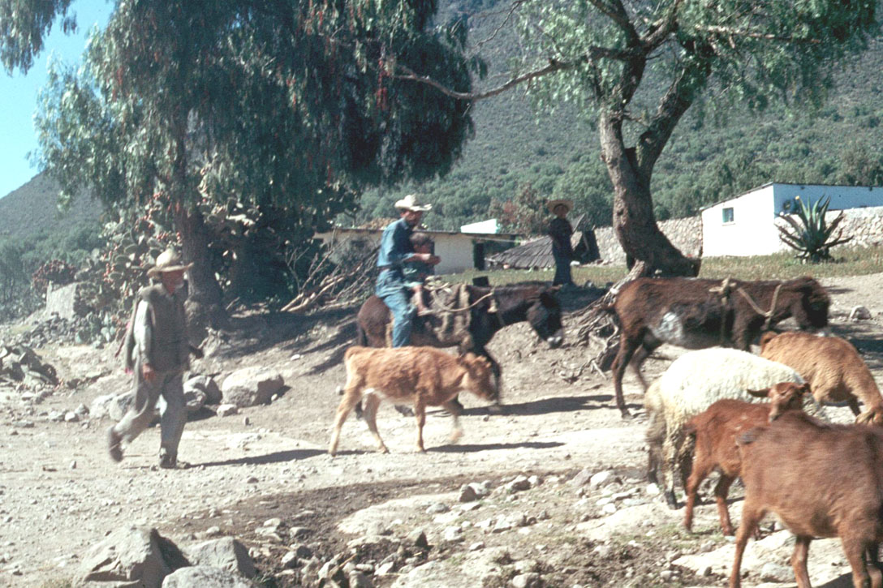
Tlachiqueros, Los Cides, Hidalgo, Mexico

Slide 116


Slide 117


Slide 118


Slide 119


Slide 120


Slide 121

Aztecs fishing
Florentine Codex
late 16th century

Slide 122


Slide 123

Compound of the 9 Brothers, near Matawala, San Luis Potosi, Mexico

Slide 124
back to
Tehuacán, Puebla
America’s First Cuisines, Ch. 2
Notes:
124

Slide 125

Important Mexican and South American Sites and Regions
Understanding Physical Anthropology and Archaeology, 9th Ed., p. 357

Slide 126
Time line for Ch.16 "Food Production”
Understanding Physical Anthropology and Archaeology, 9th Ed., p. 333

Slide 127


Richard S. Mac Neish, Scientific American, 1964.
Understanding Physical Anthropology and Archaeology (8th ed), p. 417.

Slide 128


Aztecs sowing
Florentine Codex
late 16th century

Slide 129

Aztecs harvesting maize
Florentine Codex
late 16th century

Slide 130

Pollen
microscopic
male gametes
produced by
flowering
plants.
Richard S. Mac Neish, Scientific American, 1964

Slide 131


Slide 132

Wild corn
Teosinte
Tripsacum
wild
pod-pop
variety
Richard S. Mac Neish, Scientific American, 1964

Slide 133

A.D. 0
1,000 B.C.
3,000 B.C.
5,000 B.C.
4,000 B.C.
Richard S. Mac Neish, Scientific American, 1964

Slide 134

= 100%
= 100%
= 100%
“seriation”
Richard S. Mac Neish, Scientific American, 1964

Slide 135
Richard S. Mac Neish, Scientific American, 1964

Slide 136
Food in Historical Perspective: Dietary Revolutions
Food in Historical Perspective:
Dietary Revolutions
  the Agricultural Revolution of the Neolithic Era
  the Search for Spices
  the Industrial Revolution
  Transportation, Refrigeration, and Canning
  the Scientific Revolution
  Modern-Day Adaptations
  Summary
  Highlight: Vegetarian Diets: then and Now

Slide 137
consequences of
“Neolithic”
(food production)
activities
  new settlement patterns
  new technologies
  profound biocultural effects

Slide 138

Richard S. Mac Neish, Scientific American, 1964

Slide 139

Richard S. Mac Neish, Scientific American, 1964

Slide 140
Richard S. Mac Neish, Scientific American, 1964

Slide 141
consequences of
“Neolithic”
(food production)
activities
  new settlement patterns
  new technologies
  profound biocultural effects

Slide 142



2009

Slide 143

  perhaps as a result of overhunting or the human impact on the environment as a result of burning
  become extinct
  about 11,000 ybp

Slide 144
  10,000 ybp people obtained all of their food from hunting and gathering

Slide 145
  seed collection and smaller game became more important in the diets

Slide 146
  and the transition from foraging to domestication of plants and animals began

Slide 147
  the diets still contained a large proportion of wild plants, but meat consumption had dropped considerably
  the first evidence for cultivated plants in this region comes ca. 7,000 ybp

Slide 148
  over the next 5,000 years the Tehuacán inhabitants relied more and more heavily on cultivated crops

Slide 149


Slide 150
  by about the time of Christ domesticated plants made up almost their entire diet
  animals contributed only a small portion to the nutrient intake

Slide 151
  over time the Mexican diet became even more narrowly focused
  corn
  beans
  squash
  became the core
2009

Slide 152
  the Tehuacán sequence is one of the best in the world to show, how over thousands of years, there was a slow transition during which they changed from a foraging to an agricultural existence
2009

Slide 153
  “the gradual way in which the production of food developed may have been due, in part, to the nutritional risks inherent in an agricultural way of life”
  (p. 51)
2009

Slide 154
Development of Agriculture in the Tehuacán Valley
diets of hunters and gatherers include a wide variety of plants and animals and, therefore, tend to be nutritionally well-balanced
agriculturalists typically rely on
a limited number of cultivated crops
the Cultural Feast, 2nd Ed., p. 51

Slide 155
Development of Agriculture in the Tehuacán Valley
if the crops do not contain a balance of nutrients necessary for survival, as is often the case,
wild foods must often be used as supplements
the Cultural Feast, 2nd Ed., p. 51

Slide 156
Development of Agriculture in the Tehuacán Valley
in Mexico, full dependence on agriculture had to wait until
a group of foods were domesticated that could sustain human populations
as adequately as the more traditional diet obtained through foraging
the Cultural Feast, 2nd Ed., p. 51

Slide 157
Development of Agriculture in the Tehuacán Valley
not until
corn, beans, and squash
were combined did agriculture
adequately meet the
protein
energy
and vitamin needs
of humans
the Cultural Feast, 2nd Ed., p. 51

Slide 158
Development of Agriculture in the Tehuacán Valley
not until
corn, beans, and squash
were combined did agriculture
adequately meet the
protein
energy
and vitamin needs of humans
with
pulque and chilis
provide a “perfect” diet
the Cultural Feast, 2nd Ed., p. 51

Slide 159
and then there’s
nixtamalization
America’s First Cuisines, Ch. 2
Notes:
159

Slide 160
nixtamalization
the process that starts with soaking the ripe maize grains and then cooking them with lime or wood ashes
America’s First Cuisines, Ch. 2
Notes:
160

Slide 161
nixtamalization
allows the transparent skin on the grain to be removed
(the pericarp)
making the grain easier to grind
America’s First Cuisines, Ch. 2
Notes:
161

Slide 162
nixtamalization
enhances the protein value of the maize for human beings
America’s First Cuisines, Ch. 2
Notes:
162

Slide 163
nixtamalization
“So superior is nixtamalized maize to the unprocessed kind that it is tempting to see the rise of Mesoamerican civilization as a consequence of this invention. . . .”
America’s First Cuisines, p. 14
Notes:
163

Slide 164
Development of Agriculture in the Tehuacán Valley
  but corn alone does not provide sufficient protein to sustain life
    it is deficient in lysine and tryptophan
      amino acids that must be present to make up the complete protein
      essential in human diets
the Cultural Feast, 2nd Ed., p. 51

Slide 165
Development of Agriculture in the Tehuacán Valley
  but when corn is combined with beans they provide a high-quality protein mixture capable of supporting human populations
    beans are a good source of lysine and tryptophan
the Cultural Feast, 2nd Ed., p. 51

Slide 166
Development of Agriculture in the Tehuacán Valley
  squash seeds
  also make a good
  protein supplement
  to a corn diet
the Cultural Feast, 2nd Ed., p. 51

Slide 167
Development of Agriculture in the Tehuacán Valley
  proteins
  see FOCUS 3.1
  “A Protein Primer”
  the Cultural Feast, 2nd Ed., p. 52

Slide 168
Development of Agriculture in the Tehuacán Valley
  proteins
  see FOCUS 3.1
  “A Protein Primer”
  the Cultural Feast, 2nd Ed., p. 52

Slide 169
Development of Agriculture in the Tehuacán Valley
  proteins
  the word protein comes from the Greek word πρώτειος (proteios) "primary"
  first described and named by the Swedish chemist Jöns Jakob Berzelius in 1838
  the central role of proteins in living organisms was not fully appreciated until 1926, when James B. Sumner showed that the enzyme urease was a protein
  the first protein to be sequenced was insulin
Wikipedia

Slide 170
Development of Agriculture in the Tehuacán Valley
  proteins
  “… organic compounds made of amino acids arranged in a linear chain and joined together by peptide bonds between the carboxyl and amino groups of adjacent amino acid residues”
  the sequence of amino acids in a protein is defined by the sequence of a gene, which is encoded in the genetic code
Wikipedia

Slide 171
Development of Agriculture in the Tehuacán Valley
  amino acids are the building blocks of protein
    human tissue contains 22 different amino acids
      13 can be made by the body
      9 of the 22 must be obtained from foods
        these are “essential amino acids” (EAAs)
the Cultural Feast, 2nd Ed., p. 52

Slide 172
Development of Agriculture in the Tehuacán Valley
  proteins
  “. . . are essential parts of organisms and participate in every process within cells”
  “Many proteins are enzymes that catalyze biochemical reactions and are vital to metabolism.“
Wikipedia

Slide 173
Development of Agriculture in the Tehuacán Valley
  proteins
  “… also have structural or mechanical functions,
  such as actin and myosin in muscle and the proteins in the cytoskeleton, which form a system of scaffolding that maintains cell shape.”
Wikipedia

Slide 174
Development of Agriculture in the Tehuacán Valley
  proteins
  “Other proteins are important in cell signaling,
  immune responses,
  cell adhesion,
  and the cell cycle.”
Wikipedia

Slide 175
Development of Agriculture in the Tehuacán Valley
  proteins
  “… necessary in animals' diets, since animals cannot synthesize all the amino acids they need
  and must obtain essential amino acids from food.”
  “through the process of digestion, animals break down ingested protein into free amino acids that are then used in metabolism.”
Wikipedia

Slide 176
Development of Agriculture in the Tehuacán Valley
  protein is found in a variety of foods
    meat
    fish
    dairy products
    eggs
    beans
    grains
    nuts
    vegetables
the Cultural Feast, 2nd Ed., p. 52

Slide 177
Development of Agriculture in the Tehuacán Valley
  amino acids are the building blocks of protein
    human tissue contains 22 different amino acids
      13 can be made by the body
      9 of the 22 must be obtained from foods
        these are “essential amino acids” (EAAs)
the Cultural Feast, 2nd Ed., p. 52

Slide 178
Development of Agriculture in the Tehuacán Valley
  amino acids are the building blocks of protein
    human tissue contains 22 different amino acids
      13 can be made by the body
      9 of the 22 must be obtained from foods
        these are “essential amino acids” (EAAs)
the Cultural Feast, 2nd Ed., p. 52

Slide 179
Development of Agriculture in the Tehuacán Valley
  “all proteins are not created equal”
  animal foods contain all 9 EEAs
    are easily utilized by the body
the Cultural Feast, 2nd Ed., p. 52

Slide 180
Development of Agriculture in the Tehuacán Valley
  “all proteins are not created equal”
  most plant foods contain limited amounts of one or two amino acids
    for this reason single-item diets, such as those made up almost solely of corn or yams, can lead to protein deficiency
the Cultural Feast, 2nd Ed., p. 52

Slide 181
Development of Agriculture in the Tehuacán Valley
  “all proteins are not created equal”
  but if a diet contains several different plant foods, protein deficiency does not occur
    some plant foods have generous amounts of amino acids that others are lacking
the Cultural Feast, 2nd Ed., p. 52

Slide 182
Development of Agriculture in the Tehuacán Valley
  protein complementation
  if plant foods are combined, the strengths of one can complement the weaknesses of another
  and together they make a high-quality protein
the Cultural Feast, 2nd Ed., pp. 51-52

Slide 183
Development of Agriculture in the Tehuacán Valley
  protein complementation
  as long as the protein from plant sources is reasonably varied and there are enough calories, plant sources of protein can provide adequate protein
the Cultural Feast, 2nd Ed., pp. 51-52

Slide 184
Development of Agriculture in the Tehuacán Valley
  protein complementation
  in addition to plant foods complementing one another, the body also has a reserve of amino acids that can be used to complement dietary proteins
the Cultural Feast, 2nd Ed., pp. 51-52

Slide 185
Development of Agriculture in the Tehuacán Valley
  the reserve of amino acids
  comes from
    enzymes secreted into the intestine to digest proteins
    intestinal cells sloughed off into the intestine
    a pool of free amino acids in the intracellular spaces of the skeletal muscle
the Cultural Feast, 2nd Ed., pp. 51-52

Slide 186
Development of Agriculture in the Tehuacán Valley
  plant food can be divided into three broad groups based on EEAs’ strengths and weaknesses
    whole grains
      wheat, rye, barley, rice, corn, etc.
    legumes, nuts and seeds
      legumes = beans, peas
    vegetables
the Cultural Feast, 2nd Ed., pp. 51-52

Slide 187
Development of Agriculture in the Tehuacán Valley
  vegetables and legumes generally compensate for the EEAs underrepresented in the grain group
    whole grains
      wheat, rye, barley, rice, corn, etc.
    legumes, nuts and seeds
      legumes = beans, peas
    vegetables
the Cultural Feast, 2nd Ed., pp. 51-52

Slide 188
Development of Agriculture in the Tehuacán Valley
  even within groups, the proteins often complement each other to some extent, because all foods have a slightly different collection of amino acids
    whole grains
      wheat, rye, barley, rice, corn, etc.
    e.g., legumes, nuts and seeds
      legumes = beans, peas
    vegetables
the Cultural Feast, 2nd Ed., pp. 51-52

Slide 189
Development of Agriculture in the Tehuacán Valley
  dairy products, eggs, and meats can improve the protein efficiency of any of the groups
    whole grains
      wheat, rye, barley, rice, corn, etc.
    legumes, nuts and seeds
      legumes = beans, peas
    vegetables
the Cultural Feast, 2nd Ed., pp. 51-52

Slide 190
Development of Agriculture in the Tehuacán Valley
  before scientists discovered the need for essential amino acids, complementary protein combinations evolved spontaneously as the basis of many cuisines
    Chinese
        soy products and rice
    African
        sorghum / millet and cowpeas
    India
        lentil curry and rice
    Italy
        pasta and beans (pasta e fagioli)
    Southern U.S.A.
        soup beans and corn bread
the Cultural Feast, 2nd Ed., p. 52

Slide 191
Development of Agriculture in the Tehuacán Valley
. . . back to
early agriculture in the Americas
the Cultural Feast, 2nd Ed., p. 51

Slide 192
diffusion
  the spread of something from one group to another through contact
  or exchange
Early farming
in the Americas,
showing the spread
of maize agriculture
(purple)
Understanding Physical Anthropology and Archaeology, cf. 9th Ed., p. 358

Slide 193
Early Farmers in the Americas
  the Pueblos
  benefited from
  the diffusion of
  agriculture from
  the Mesoamerican area

Slide 194
Tehuacán
Valley,
Puebla,
Mexico
maize
4,500 ybp
Early farming in the Americas
Understanding Physical Anthropology and Archaeology, 9th Ed., p. 358

Slide 195
Chaco Canyon,
New Mexico
Early farming in the Americas
Understanding Physical Anthropology and Archaeology, 9th Ed., p. 358

Slide 196

Village farming cultures of the American Southwest, showing trade routes (red)
Understanding Physical Anthropology and Archaeology, 9th Ed., p. 359

Slide 197

Pueblos
  Spanish term for "town" referring to multiroom residence structures built by village farmers in the American Southwest
Pueblo Bonito,
Chaco Canyon,
New Mexico
Understanding Physical Anthropology and Archaeology, 9th Ed., p. 360

Slide 198
Other Early Farmers in the Americas
  Hopewell
  Mississippian

Slide 199

Hopewell
a culture centered in southern Ohio between 2,100 and 1,700 ybp but influencing a much wider region through trade and the spread of a cult centered on burial ritualism
Understanding Physical Anthropology and Archaeology, 9th Ed., p. 362

Slide 200
Mississippian
Early farming in the Americas
Understanding Physical Anthropology and Archaeology, 9th Ed., p. 358

Slide 201

Cajokia,
Illinois
Cahokia Mounds State Historic Site
Collinsville, Illinois

Slide 202
Mississippian
  flint hoe blade
  used by Mississippian farmers
Understanding Physical Anthropology and Archaeology, 9th Ed., see p. 363

Slide 203

Mississippian
a southeastern United States mound-building culture that flourished from 1,100 to 500 y.a.
Monks Mound, Cahokia, East St. Louis, Illinois
the largest prehistoric city north of Mexico
Understanding Physical Anthropology and Archaeology, 9th Ed., see p. 363

Slide 204

Mississippian
one of the best known Mississippian sites is the city of Cahokia near Collinsville, Illinois
Cahokia was the largest pre-Columbian city in North America . . .
Early farming in the Americas
Understanding Physical Anthropology and Archaeology, 9th Ed., p. 358

Slide 205

“In the 12th century [Cahokia] was as large as London!”
“It was the largest city in America until Philadelphia outgrew it in 1800! 1800! “
http://www.meredith.edu/nativeam/cahokia.htm
Cahokia
William R. Iseminger
Cahokia Mounds State Historic Site
Collinsville, Illinois

Slide 206
Cahokia
William R. Iseminger
Cahokia Mounds State Historic Site
Collinsville, Illinois

Slide 207

By Meilan Solly
smithsonianmag.com
April 16, 2021
https://www.smithsonianmag.com/smart-news/why-did-cahokia-one-largest-pre-hispanic-cities-north-america-collapse-180977528/

Slide 208

"Community Life" by Michael Hampshire
Courtesy of Cahokia Mounds State Historic Site
Collinsville, Illinois

Slide 209

Woman Grinding Maize
Cahokia Mounds State Historic Site
Collinsville, Illinois

Slide 210
Cajokia,
Illinois
Cahokia Mounds State Historic Site
Collinsville, Illinois

Slide 211
KENTUCKY
the Cultural Feast, 2nd Ed., p. 48

Slide 212
Hardin
Village,
Kentucky
Indian
Knoll,
Kentucky
Cahokia Mounds State Historic Site
Collinsville, Illinois

Slide 213
examples:
Tehuacán, Puebla, Mexico
pre-Columbian Kentucky
the changes toward dependence on agriculture was not always swift
in the short term, it was not always healthful
the Cultural Feast, 2nd Ed., p. 49

Slide 214
examples:
Tehuacán, Puebla, Mexico
pre-Columbian Kentucky
the changes toward dependence on agriculture was not always swift
in the short term, it was not always healthful
the Cultural Feast, 2nd Ed., p. 49

Slide 215
Food in Historical Perspective: Dietary Revolutions
Food in Historical Perspective:
Dietary Revolutions
  the Agricultural Revolution of the Neolithic Era
  the Search for Spices
  the Industrial Revolution
  Transportation, Refrigeration, and Canning
  the Scientific Revolution
  Modern-Day Adaptations
  Summary
  Highlight: Vegetarian Diets: then and Now
  Development of Agriculture in the Tehuacán Valley
  Nutritional Consequences of the Agricultural Revolution: A Comparison of Foragers and Agriculturalists
  Social and Political Consequences of the Agricultural Revolution

Slide 216
with
hunters and gatherers
times of food scarcity certainly exist but
famine is a relatively infrequent occurrence
and chronic malnutrition is even rarer
the Cultural Feast, 2nd Ed., p. 54

Slide 217
with the advent of agriculture,
the picture changes …
dependence on a small number of cultivated crops or domesticated animals increases the risk
of widespread famine
the Cultural Feast, 2nd Ed., p. 54

Slide 218
with the advent of agriculture,
the picture changes …
a less diversified diet makes it far harder to achieve an adequate balance of essential nutrients
  especially protein and certain vitamins
the Cultural Feast, 2nd Ed., p. 54

Slide 219
with the advent of agriculture,
the picture changes …
vitamin deficiency diseases are especially problematic in grain-dependent communities
the Cultural Feast, 2nd Ed., p. 54

Slide 220
Claire Cassidy
(1980)
the Cultural Feast, 2nd Ed., p. 54

Slide 221

http://www.healthinsightstoday.com/articles/v1i2/cassidy_p1.html

Slide 222
Claire Cassidy
(1980)
assessed the nutritional impact of the introduction of agriculture on pre-Columbian Native Americans
examined skeletal remains of two precontact villages in Kentucky
the Cultural Feast, 2nd Ed., p. 54

Slide 223

Hardin Village
www.metmuseum.org/toah/hd/knol/hd_knol.htm

Slide 224
Claire Cassidy (Ed.)
(1980)
Nutrition and Health in
Agriculturalists and
Hunters and Gatherers
NY: Redgrave
the Cultural Feast, 2nd Ed., p. 54

Slide 225
Indian Knoll
Hardin Village
foragers
agriculturalists
ca. 5,000 ybp
ca. 1,000 ybp
had very different diets
the Cultural Feast, 2nd Ed., p. 54

Slide 226
Indian Knoll
Hardin Village
foragers
agriculturalists
ca. 5,000 ybp
ca. 1,000 ybp
people ate large quantities of
river mussels and snails
and deer, small mammals, wild turkeys, box turtles, fish, and occasionally dog
the Cultural Feast, 2nd Ed., p. 54

Slide 227
Indian Knoll
Hardin Village
foragers
agriculturalists
ca. 5,000 ybp
ca. 1,000 ybp
similar sites suggest they also ate hickory nuts, walnuts, acorns, elderberries, persimmons,
sunflower seeds,
and other wild berries
the Cultural Feast, 2nd Ed., p. 54

Slide 228
Hardin Village
Indian Knoll
foragers
agriculturalists
ca. 5,000 ybp
ca. 1,000 ybp
people relied primarily on
cultivated corn, beans, and squash
supplemented with deer, eel, small mammals, wild turkeys, box turtles, and wild plants
the Cultural Feast, 2nd Ed., p. 54

Slide 229
Claire Cassidy
(1980)
compared 296 skeletons from
Hardin Village and 285 skeletons from Indian Knoll in Kentucky
data on health was derived from careful analysis of the bones and teeth …
the Cultural Feast, 2nd Ed., p. 54

Slide 230
Indian Knoll
Hardin Village
foragers
agriculturalists
ca. 5,000 ybp
ca. 1,000 ybp
life expectancies for both sexes at all ages were lower at Hardin Village
the Cultural Feast, 2nd Ed., p. 54

Slide 231
Indian Knoll
Hardin Village
foragers
agriculturalists
ca. 5,000 ybp
ca. 1,000 ybp
infant mortality was higher at Hardin Village
the Cultural Feast, 2nd Ed., p. 54

Slide 232
Indian Knoll
Hardin Village
foragers
agriculturalists
ca. 5,000 ybp
ca. 1,000 ybp
iron-deficiency anemia of sufficient duration to cause bone changes was absent at Indian Knoll
but was present at Hardin Village
  50% of cases occurred in children under 5
the Cultural Feast, 2nd Ed., p. 54

Slide 233
Indian Knoll
Hardin Village
foragers
agriculturalists
ca. 5,000 ybp
ca. 1,000 ybp
growth arrest episodes at Indian Knoll were periodic and more often of short duration and were possibly due to food shortages in late winter
those at Hardin Village occurred randomly and were more often of long duration, probably indicative of disease as a causative agent
the Cultural Feast, 2nd Ed., p. 54

Slide 234
Indian Knoll
Hardin Village
foragers
agriculturalists
ca. 5,000 ybp
ca. 1,000 ybp
more children suffered infections at Hardin Village
the Cultural Feast, 2nd Ed., p. 55

Slide 235
Indian Knoll
Hardin Village
foragers
agriculturalists
ca. 5,000 ybp
ca. 1,000 ybp
the syndrome of
periosteal inflammation
was more common at Hardin Village
  a swelling of the outermost layer of the bone
the Cultural Feast, 2nd Ed., p. 55

Slide 236
Indian Knoll
Hardin Village
foragers
agriculturalists
ca. 5,000 ybp
ca. 1,000 ybp
tooth decay was rampant at Hardin Village and led to early abscessing and tooth loss
decay was unusual at Indian Knoll and abscessing occurred later in life because of severe wear to the teeth
the Cultural Feast, 2nd Ed., p. 55

Slide 237
Indian Knoll
Hardin Village
foragers
agriculturalists
ca. 5,000 ybp
ca. 1,000 ybp
the differences in tooth wear rate and carries rate are very likely attributable to dietary differences between the two groups
the Cultural Feast, 2nd Ed., p. 55

Slide 238


Indian Knoll
Hardin Village
foragers
foragers
agriculturalists
ca. 5,000 ybp
ca. 1,000 ybp
better life expectancies
lower infant mortality
no iron-deficiency anemia
growth arrests periodic and short
fewer infections
less bone inflammation
less tooth decay and abscessing
the Cultural Feast, 2nd Ed., p. 55

Slide 239
Indian Knoll
Hardin Village
foragers
agriculturalists
ca. 5,000 ybp
ca. 1,000 ybp
Cassidy concluded that the
agricultural Hardin Villagers were less healthy
in Cassidy’s opinion most of the health conditions were related to dietary factors
  especially the lack of animal protein in the agriculturalists’ diet
the Cultural Feast, 2nd Ed., p. 55

Slide 240
Indian Knoll
Hardin Village
foragers
agriculturalists
ca. 5,000 ybp
ca. 1,000 ybp
A.H. Goodman and G.J. Armelagos (2000) draw similar conclusions from the remains at Dickson’s Mounds in Illinois
“Disease and Death at Dr. Dickson’s Mounds” in A.H. Goodman, D.L. Dufour, & G.H. Pelto (Eds.), Nutritional Anthropology: Biocultural Perspectives on Food and Nutrition. Mountain View, CA: Mayfield.
the Cultural Feast, 2nd Ed., p. 55

Slide 241
Dickson Mounds,
Illinois
Hardin
Village,
Kentucky
Indian
Knoll,
Kentucky
Cahokia Mounds State Historic Site
Collinsville, Illinois

Slide 242
Ch. 4 “the Edible Earth:
Managing Plant Life for Food”
raises the question
“Why did they bother?”
Simon & Schuster 2003

Slide 243
END
KENTUCKY
the Cultural Feast, 2nd Ed., p. 48

Slide 244
Ch. 16 Food Production: A Biocultural Revolution
Biocultural Consequences of Food Production

Slide 245
consequences of
“Neolithic”
(food production)
activities
  new settlement patterns
  new technologies
  profound biocultural effects

Slide 246
  Social and Political Consequences
  of the Agricultural Revolution
  population growth
  establishment of large, sedentary villages
    opportunity for increased social interaction
    but with added health risks
the Cultural Feast, 2nd Ed., p. 55

Slide 247
Indian Knoll
Hardin Village
foragers
agriculturalists
ca. 5,000 ybp
ca. 1,000 ybp
despite a higher incidence of malnutrition and disease in the agricultural population, domestication of plants and animals was associated with population growth
the Cultural Feast, 2nd Ed., p. 55

Slide 248
Indian Knoll
Hardin Village
foragers
agriculturalists
ca. 5,000 ybp
ca. 1,000 ybp
“Hardin Village, like millions [sic.] of agricultural communities, increased significantly, growing from 100 to 300 people over a 150-year period.”
the Cultural Feast, 2nd Ed., p. 55

Slide 249
Biocultural Consequences: Population
around the world
population size
and density
increased
with the agricultural revolution

Slide 250

Biocultural Consequences: Population
World population growth
Understanding Physical Anthropology and Archaeology, 9th Ed., p. 365

Slide 251
Biocultural Consequences: Population
demographic increase
  pertaining to the size or rate of increase of human populations

Slide 252
Biocultural Consequences: Population
carrying capacity
  population the environment
  can sustain

Slide 253
Indian Knoll
Hardin Village
foragers
agriculturalists
ca. 5,000 ybp
ca. 1,000 ybp
“thus, although overall health was poorer,
food production allowed a much larger population to live together than the previous way of life could sustain.”
the Cultural Feast, 2nd Ed., p. 55

Slide 254
Biocultural Consequences: Population
people clustered into villages
women had more children
even early settlements quickly reached considerable size

Slide 255

Monks Mound, Cahokia, Illinois
ca. A.D. 800-1000
www.d.umn.edu/cla/faculty/troufs/anth1602/pcmississippian.html#title

Slide 256
  Social and Political Consequences
  of the Agricultural Revolution
  population growth
  establishment of large, sedentary villages
    opportunity for increased social interaction
    but with added health risks
the Cultural Feast, 2nd Ed., p. 55

Slide 258
  Social and Political Consequences
  of the Agricultural Revolution
  population growth
  establishment of large, sedentary villages
    opportunity for increased social interaction
    but with added health risks
the Cultural Feast, 2nd Ed., p. 55

Slide 259
Biocultural Consequences: Diet and Health
early food producers faced health risks due to close proximity to domesticated animals
  dogs carry rabies
  horses carry tetanus
  pigs and poultry carry influenza
  AIDs was derived from chimpanzees

Slide 260
Biocultural Consequences: Population
around the world
population size
and density
increased
with the agricultural revolution

Slide 261
other parts of the
world
the Cultural Feast, 2nd Ed., p. 48

Slide 262
Agricultural Societies
of
Near East
Asia
Europe

Slide 263
Agricultural Societies
of
Near East
Asia
Europe

Slide 264
Origin of Domestication for Selected Plants
wheat
10,500 ybp
rice
7,000 ybp
maize
4,500 ybp
although in India
millet was actually important first
millet
4,000 ybp
manioc
4,200 ybp
Understanding Physical Anthropology and Archaeology, 8th Ed., p. 417

Slide 265
Origin and Approximate Dates of Domestication for Selected Plants and Animals
Understanding Physical Anthropology and Archaeology, 9th Ed., p. 417

Slide 266
Near Eastern Farmers
  Jericho, Palestine
  Çatalhöyük, Anatolia, Turkey
  Jarmo, Iraq
  Ali Kosh, Iran

Slide 267

Early Neolithic sites of the Fertile Crescent
Understanding Physical Anthropology and Archaeology, 9th Ed., p. 349

Slide 268
early Neolithic community in Palestine
Early Neolithic sites of the Fertile Crescent
Understanding Physical Anthropology and Archaeology, 9th Ed., p. 349

Slide 269
Time line for Ch.16 "Food Production”
Understanding Physical Anthropology and Archaeology, 9th Ed., p. 333

Slide 270

Lorenzo Ghiberti's 15th Century visualization of the attack
on the walls of Jericho
www.howardbloom.net/jericho.htm

Slide 271

Map of Jericho in 14th century Farhi Bible
http://en.wikipedia.org/wiki/Jericho

Slide 272

Dwelling foundations unearthed at Tell es-Sultan in
Jericho
http://en.wikipedia.org/wiki/Jericho

Slide 273

Jericho
http://faculty.smu.edu/dbinder/jericho.html

Slide 274

Jericho
http://ancientneareast.tripod.com/Jericho_Tell_Sultan.html

Slide 275
early Neolithic community in southern Anatolia, Turkey
Early Neolithic sites of the Fertile Crescent
Understanding Physical Anthropology and Archaeology, 9th Ed., p. 349

Slide 276
Time line for Ch.16 "Food Production”
Understanding Physical Anthropology and Archaeology, 9th Ed., p. 333

Slide 277

Çatalhöyük, Anatolia, or Turkey
Shane, Orrin C. III, and Mine Küçuk.
"the World's First City."
Archaeology 51.2 (1998): 43-47.

Slide 278

Çatalhöyük, Anatolia, or Turkey
http://www.ccny.cuny.edu/architecture/archprog/slide-232/pages/001%20Catal%20Huyuk.htm

Slide 279

Wild bull horns on pillars in Building 77
Çatalhöyük
www.catalhoyuk.com/

Slide 280

Mural of an aurochs, a deer, and humans from
Çatalhöyük sixth millennium B.C.
http://en.wikipedia.org/wiki/%C3%87atalh%C3%B6y%C3%BCk /

Slide 281


www.si.edu/mci/english/research/past_projects/obsidian_trade.html

Slide 282

Uruk trade network
www.freebuck.com/articles/elliott/00elliottfoundations.htm

Slide 283

www.telesterion.com/catal2.htm

Slide 284
www.si.edu/scmre/learning/obsidian_trade.htm

Slide 285
early Neolithic community in northern Iraq
the oldest known farming community in the world
ca. 7000 B.C.
Early Neolithic sites of the Fertile Crescent
Understanding Physical Anthropology and Archaeology, 9th Ed., p. 349
Understanding Physical Anthropology and Archaeology, 9th Ed., p. 349

Slide 286

Jarmo, Iraq

Slide 287
Ali Kosh
  early site in the Fertile Crescent

Slide 288
early site in the Fertile Crescent
Early Neolithic sites of the Fertile Crescent
Understanding Physical Anthropology and Archaeology, 9th Ed., p. 349

Slide 289

= 100%
= 100%
= 100%
“seriation”
= 100%
Pottery types from Deh Luran, Iran.
Hole, Flannery and Neely, “Prehistory and Human Ecology
Of the Deh Luran Plain: An Early Village Sequence from
Khuzistan, Iran.” Ann Arbor: 1969, fig. 69.

Slide 290
Egypt
the Cultural Feast, 2nd Ed., p. 48

Slide 291
Near Eastern Farmers
  Jericho, Palestine
  Çatalhöyük, Anatolia, Turkey
  Jarmo, Iraq
  Ali Kosh, Iran
  Ancient Egypt

Slide 292

Egypt
Understanding Physical Anthropology and Archaeology, 9th Ed., p.378

Slide 293

Understanding Physical Anthropology and Archaeology, 9th Ed., p. 449

Slide 294
Egypt
the Old Kingdom times marked the beginning of Nile valley civilization
(4,575 - 4,150 ybp)
the merger of Nile valley societies under one king created the world's first nation state

Slide 295

Hieroglyphics
  the picture-writing of ancient Egypt
Royal Egyptian Hunting marsh birds from a papyrus boat
Understanding Physical Anthropology and Archaeology, 9th Ed., p 463

Slide 296

Decorated predynastic pottery jar,
Nile valley,
Egypt
Understanding Physical Anthropology and Archaeology, 9th Ed., p. 461

Slide 297

amber
  fossil pine pitch or resin,
  long valued for jewelry or offerings
amber lotus
Amber jewelry has been found in Egypt from as far back as
2,600 B.C.
www.aeraweb.org/artifacts.asp

Slide 298
Eight Food “Revolutions”
Invention of Cooking
Discovery that Food is More than Sustenance
the “Herding Revolution”
Snail Farming
Use of Food as a Means and Index of Social Differentiation
Long-Range Exchange of Culture
Ecological Revolution of last 500 years
Industrial Revolution of the 19th and 20th Centuries
Simon & Schuster 2003

Slide 299
what archaeologists can learn from dead plants
    (Archaeobotany)
Add other image here
From 9th p. 343
carbonized grain of
domesticated barley
from the Nile valley.
Understanding Physical Anthropology and Archaeology, 8th Ed., p. 419

Slide 300

what archaeologists can learn from dead plants
    (Archaeobotany)
carbonized grain of
domesticated barley
from the Nile valley.
Understanding Physical Anthropology and Archaeology, 8th Ed., p. 419

Slide 301
Asia
the Cultural Feast, 2nd Ed., p. 48

Slide 302
Agricultural Societies
of
Near East
Asia
Europe

Slide 303
Considering Civilization
Why Did Civilizations Form?
Cities and Civilizations
Ancient Civilizations of the Old World
  Near Eastern Farmers
  Mesopotamia
  Egypt
  the Indus Valley
  Northern China
  the Mediterranean Realm
    Malta
    Minoan and Mycenaean civilizations

Slide 304
Origin of Domestication for Selected Plants
wheat
10,500 ybp
rice
7,000 ybp
maize
4,500 ybp
REM
in India
millet was actually important first
millet
4,000 ybp
manioc
4,200 ybp
Understanding Physical Anthropology and Archaeology, 8th Ed., p. 417

Slide 305
Origin and Approximate Dates of Domestication for Selected Plants and Animals
Understanding Physical Anthropology and Archaeology, 9th Ed., p. 417

Slide 306

  One of the earliest Neolithic settlements of southern Asia, Pakistan
  includes one of the earliest examples of dentistry
Early Farming in Asia
Understanding Physical Anthropology and Archaeology, 9th Ed., p. 352

Slide 307
Agricultural Societies
of
Near East
Asia
Europe

Slide 308
Origin of Domestication for Selected Plants
wheat
10,500 ybp
rice
7,000 ybp
maize
4,500 ybp
millet
4,000 ybp
manioc
4,200 ybp
Understanding Physical Anthropology and Archaeology, 8th Ed., p. 417

Slide 309
Origin and Approximate Dates of Domestication for Selected Plants and Animals
Understanding Physical Anthropology and Archaeology, 9th Ed., p. 417

Slide 310

European farmers
Early Neolithic Sites of Europe
Understanding Physical Anthropology and Archaeology, 9th Ed., p. 354

Slide 311
Time line for Ch.16 "Food Production”
Understanding Physical Anthropology and Archaeology, 9th Ed., p. 333

Slide 312


megaliths
  monumental structures made of very large stones, characteristic of western Europe during the early Neolithic
^{Stonehenge, England.}
Understanding Physical Anthropology and Archaeology, 8th Ed., p. 429

Slide 313
European farmers
Early Neolithic Sites of Europe
Understanding Physical Anthropology and Archaeology, 9th Ed., p. 354

Slide 314

Carnac, France
http://pages.infinit.net/celte/chateau.html

Slide 315
consequences of
“Neolithic”
(food production)
activities
  new settlement patterns
  new technologies
  profound biocultural effects

Slide 316
social and political consequences
the Cultural Feast, 2nd Ed., p. 48

Slide 317
Food in Historical Perspective: Dietary Revolutions
Food in Historical Perspective:
Dietary Revolutions
  the Agricultural Revolution of the Neolithic Era
  the Search for Spices
  the Industrial Revolution
  Transportation, Refrigeration, and Canning
  the Scientific Revolution
  Modern-Day Adaptations
  Summary
  Highlight: Vegetarian Diets: then and Now
  Development of Agriculture in the Tehuacán Valley
  Nutritional Consequences of the Agricultural Revolution: A Comparison of Foragers and Agriculturalists
  Social and Political Consequences of the Agricultural Revolution

Slide 318
consequences:
new foods…
the Cultural Feast, 2nd Ed., p. 48

Slide 319
  Social and Political Consequences
  of the Agricultural Revolution
  surplus food
    fostered trade with people in other ecological zones
    allowed access to previously unknown commodities
    for the first time in history not everyone had to be involved in food-getting activities
the Cultural Feast, 2nd Ed., p. 55

Slide 320
  Social and Political Consequences
  of the Agricultural Revolution
  surplus food
    fostered trade with people in other ecological zones
    allowed access to previously unknown commodities
    for the first time in history not everyone had to be involved in food-getting activities
the Cultural Feast, 2nd Ed., p. 55

Slide 321
maize
manioc
potatoes, sweet potatoes, yams
beans
peanuts
squash
pineapples
avocados
tomatoes
chocolate
vanilla
chile
America’s First Cuisines, Chs. 2 and 3
Notes:
321

Slide 322

Pochteca
Florentine Codex
late 16th century
Notes:
322

Slide 323

Maya trade
Bonampak
Notes:
323

Slide 324
barter and exchange flourished
new social order distinguished landowners and tenant farmers

Slide 325
consequences:
trade
the Cultural Feast, 2nd Ed., p. 48

Slide 326
  Social and Political Consequences
  of the Agricultural Revolution
  some people also succeeded in trade and the acquisition of surplus wealth
    giving rise in many places to an
    affluent and powerful merchant class
the Cultural Feast, 2nd Ed., p. 55

Slide 327
consequences:
specialization
the Cultural Feast, 2nd Ed., p. 48

Slide 328
  Social and Political Consequences
  of the Agricultural Revolution
  surplus food
    fostered trade with people in other ecological zones
    allowed access to previously unknown commodities
    for the first time in history not everyone had to be involved in food-getting activities
the Cultural Feast, 2nd Ed., p. 55

Slide 329
non-farmers
could engage in
specialized crafts

Slide 330
  Social and Political Consequences
  of the Agricultural Revolution
  people began to master
    basket making
    ceramics
    bronze and metal casting
    brick making
    masonry
    other skills
the Cultural Feast, 2nd Ed., p. 55

Slide 331

Day's Place, Frozen Sap, Lake Mille Lacs
Minnesota Historical Society

Slide 332

Woman and Blueberries
Patrick DesJarlait (1912-1972)
Minnesota Historical Society

Slide 333

economic system allows individuals
to devote full time to occupations
like …
basket making
Prehistoric basketry techniques
(Jean Connor)

Slide 334
  Social and Political Consequences
  of the Agricultural Revolution
  people began to master
    basket making
    ceramics
    bronze and metal casting
    brick making
    masonry
    other skills
the Cultural Feast, 2nd Ed., p. 55

Slide 335
Biocultural Consequences: Technology
basket and skin containers were replaced with ceramic vessels
  baskets were likely lined with clay, and eventually fired
  fire pits likely naturally were fired as part of the cooking process

Slide 336
Biocultural Consequences: Technology
pottery made it easier to prepare and boil grains into digestible foods

Slide 337

Reay Tannahill,
(NY: three Rivers Press, 1988)

Slide 338

Comal
Notes:
338

Slide 339

Codex Mendoza, folio 60r
Notes:
339

Slide 340

the three hearthstones supporting the comal(li)
Codex Mendoza, folio 60r
Notes:
340

Slide 341
Biocultural Consequences: Technology
pottery made it easier to prepare and boil grains into digestible foods
  prehistoric people at the Fish Lake Dam site just north of Duluth may have invented pottery
  in order to parch wild rice

Slide 342

"Rice Gatherers“
Seth Eastman, 1867)
Minnesota Historical Society

Slide 343

Woman parching rice
Minnesota Historical Society

Slide 344

economic system allows individuals
to devote full time to occupations
like …
pottery making
Classic Maya cylindrical jar
with bird motif and glyphs,
9th p. 411

Slide 345

prehistoric decorated pottery vessel from Arizona
Understanding Physical Anthropology and Archaeology, 9th Ed., p. 365

Slide 346
Time line for Ch.16 "Food Production”
Understanding Physical Anthropology and Archaeology, 9th Ed., p. 333

Slide 347
Chaco Canyon,
New Mexico
1150 – 750 ybp
Early farming in the Americas
Understanding Physical Anthropology and Archaeology, 9th Ed., p. 358

Slide 348

bandkeramic
  Add image here from p. 355
Understanding Physical Anthropology and Archaeology, 8th Ed., p. 427

Slide 349
bandkeramic
  “lined pottery," referring to a Neolithic ceramic ware widely encountered in central Europe and to the culture that produced it
Understanding Physical Anthropology and Archaeology, 8th Ed., p. 427

Slide 350
early Neolithic community in Palestine
Early Neolithic sites of the Fertile Crescent
Understanding Physical Anthropology and Archaeology, 9th Ed., p. 349

Slide 351
= 100%
= 100%
= 100%
“seriation”
= 100%
Pottery types from Deh Luran, Iran.
Hole, Flannery and Neely, “Prehistory and Human Ecology
Of the Deh Luran Plain: An Early Village Sequence from
Khuzistan, Iran.” Ann Arbor: 1969, fig. 69.
Notes:
351

Slide 352
= 100%
“seriation”
Pottery types from Deh Luran, Iran.
Hole, Flannery and Neely, “Prehistory and Human Ecology
Of the Deh Luran Plain: An Early Village Sequence from
Khuzistan, Iran.” Ann Arbor: 1969, fig. 69.

Slide 353
Time line for Ch.16 "Food Production”
Understanding Physical Anthropology and Archaeology, 9th Ed., p. 333

Slide 354

Important European Sites and Regions
Understanding Physical Anthropology and Archaeology, 9th Ed., p. 355

Slide 355
  Social and Political Consequences
  of the Agricultural Revolution
  people began to master
    ceramics
    bronze and metal casting
    brick making
    masonry
    other skills
the Cultural Feast, 2nd Ed., p. 55

Slide 356


Copper Age
"Ötzi“ “the Iceman”
Wikipedia

Slide 357

Bronze Age
  period of early Old World civilizations associated with the widespread use of metal tools after 5,500 y.a.
Cast bronze ritual
vessel of the Shang
dynasty, China
Understanding Physical Anthropology and Archaeology, 9th Ed., p 468

Slide 358

economic system allows individuals
to devote full time to occupations
like …
metalworking
Inca gold

Slide 359

economic system allows individuals
to devote full time to occupations
like …
metalworking
Inca gold ceremonial mask

Slide 360

Mycenaean Bronze Age axe,
or winged palstave
Understanding Physical Anthropology and Archaeology, 8th Ed., p. 473

Slide 361
consequences:
increased social
interaction
the Cultural Feast, 2nd Ed., p. 48

Slide 362
  Social and Political Consequences
  of the Agricultural Revolution
  population growth
  establishment of large, sedentary villages
    opportunity for increased social interaction
    but with added health risks
the Cultural Feast, 2nd Ed., p. 55

Slide 363
consequences:
food storage for times of shortage
the Cultural Feast, 2nd Ed., p. 48

Slide 364
  Social and Political Consequences
  of the Agricultural Revolution
  surplus food
    food surplus could be used in times of shortages
the Cultural Feast, 2nd Ed., p. 55

Slide 365

Joseph interprets the dream of the Pharaoh
Peter von Cornelius
http://en.wikipedia.org/wiki/Joseph_(Hebrew_Bible)

Slide 366

Seven Years of Plenty, Seven Years of Famine
www.mycatholictradition.com/saints-of-old-joseph2.html

Slide 367

Aztecs storing maize
Florentine Codex
late 16th century

Slide 368
consequences:
surplus taxed…
monumental arch
the Cultural Feast, 2nd Ed., p. 48

Slide 369
  Social and Political Consequences
  of the Agricultural Revolution
  surplus food
    excess production served as capital that fostered new socioeconomic transactions
the Cultural Feast, 2nd Ed., p. 55

Slide 370


Ten Classic Characteristics of Early Civilization
Social means of collecting “surplus” production
Small Sumerian clay table is a 4,000-year-old tax receipt
with cuneiform impressions on both sides
Understanding Physical Anthropology and Archaeology, 9th Ed. , p. 389

Slide 371
consequences
the Cultural Feast, 2nd Ed., p. 48

Slide 372
  Social and Political Consequences
  of the Agricultural Revolution
  as population increased
    competition for limited resources occurred
      water
      land
      other basic resources
the Cultural Feast, 2nd Ed., p. 55

Slide 373
  Social and Political Consequences
  of the Agricultural Revolution
  political/religious/military hierarchies took over the tasks of …
    organizing production
    maintaining order in an increasingly complex society
    defending the community
the Cultural Feast, 2nd Ed., pp. 55-56

Slide 374
  Social and Political Consequences
  of the Agricultural Revolution
  political/religious/military hierarchies control over various tasks …
    led to the rise of states and empires
the Cultural Feast, 2nd Ed., pp. 55-56

Slide 375
  Social and Political Consequences
  of the Agricultural Revolution
  states and empires began to have …
    specialized laborers
    private property
    class systems
    organized governments
the Cultural Feast, 2nd Ed., p. 56

Slide 376
  Social and Political Consequences
  of the Agricultural Revolution
  people became divided for the first time into …
    priests, warriors, and artisans groups
    rich and poor
    upper and lower classes
    rulers and ruled
the Cultural Feast, 2nd Ed., p. 56

Slide 377

Ten Classic Characteristics of Early Civilization
A privileged ruling class of religious, political, and military leaders organizes and directs the entire system
Hieroglyphic inscription of a royal Egyptian hunting marsh birds from a papyrus boat,
9th Ed. p. 393.
King Tut

Slide 378

Montezuma’s Dinner:
An Essay on the Tribal
Society of the North American Indians
Lewis Henry Morgan
NY: Heritage Press
1876
Mocezuma II

Slide 379

Aztecs stone altar dedicated to corn
Museum of Anthropology

Slide 380
Tutankhamen, “King Tut”
  Egyptian pharaoh of the New Kingdom period, who died at age 19 in 1323 B.C.

Slide 381

16 February 1923
www.ctv.ca/servlet/ArticleNews/story/CTVNews/20071104/king_tut_071104/20071104?hub=CTVNewsAt11
Notes:
381

Slide 382

30 September 2002
http://news.bbc.co.uk/2/hi/science/nature/2288952.stm
Notes:
382

Slide 383

By Isis Davis-Marks
smithsonianmag.com
March 29, 2021
source
Notes:
383

Slide 384

4 November 2007
http://news.bbc.co.uk/2/hi/science/nature/7077423.stm
Notes:
384

Slide 385

4 November 2007
http://news.bbc.co.uk/2/hi/science/nature/7077423.stm
Notes:
385

Slide 386

Panel from the back
of the golden throne
of King Tut
www.bbc.co.uk/history/ancient/egyptians/tutankhamun_gallery_02.shtml
Notes:
386

Slide 387
  Social and Political Consequences
  of the Agricultural Revolution
  with social stratification heterogeneous diets appeared …
    not everyone who lived in the same area ate similar foods
    food patterns of a region varied considerably among people of different rank or status
the Cultural Feast, 2nd Ed., p. 56

Slide 388
  Social and Political Consequences
  of the Agricultural Revolution
  by the end of the 15th century …
    agriculture had brought cities and complex political systems to most parts of the world
    trade networks linked many parts of the world
    the age of exploration was about to begin
the Cultural Feast, 2nd Ed., p. 56

Slide 389
Austin: University of Texax Press, 1994

Slide 390
  Social and Political Consequences
  of the Agricultural Revolution
  … and food played a critical role
  in the political developments
  of this era …
the Cultural Feast, 2nd Ed., p. 56

Slide 391
Food in Historical Perspective: Dietary Revolutions
Food in Historical Perspective:
Dietary Revolutions
  the Agricultural Revolution of the Neolithic Era
  the Search for Spices
  the Industrial Revolution
  Early Technology
    Transportation
    Refrigeration
    Canning
  the Scientific Revolution
  Modern-Day Adaptations
  Summary
  Highlight: Vegetarian Diets: then and Now

Slide 392
Food in Historical Perspective: Dietary Revolutions
Food in Historical Perspective:
Dietary Revolutions
  the Agricultural Revolution of the Neolithic Era
  the Search for Spices
  the Industrial Revolution
  Early Technology
    Transportation
    Refrigeration
    Canning
  the Scientific Revolution
  Modern-Day Adaptations
  Summary
  Highlight: Vegetarian Diets: then and Now
  changed
  the history of the world forever

Slide 393
Food in Historical Perspective: Dietary Revolutions
Food in Historical Perspective:
Dietary Revolutions
  the Agricultural Revolution of the Neolithic Era
  the Search for Spices
  the Industrial Revolution
  Early Technology
    Transportation
    Refrigeration
    Canning
  the Scientific Revolution
  Modern-Day Adaptations
  Summary
  Highlight: Vegetarian Diets: then and Now

Slide 394
Food in Historical Perspective: Dietary Revolutions
Food in Historical Perspective:
Dietary Revolutions
  the Agricultural Revolution of the Neolithic Era
  the Search for Spices
  the Industrial Revolution
  Transportation, Refrigeration, and Canning
  the Scientific Revolution
  Modern-Day Adaptations
  Summary
  Highlight: Vegetarian Diets: then and Now
  Summary

Slide 395
Food in Historical Perspective: Dietary Revolutions
Food in Historical Perspective:
Dietary Revolutions
  foraging
  wild foods
  in the
  wilderness
  foraging
  wildly, foods
  in the
  supermarket
  localvores
  globalvores

Slide 396
Food in Historical Perspective: Dietary Revolutions
Food in Historical Perspective:
Dietary Revolutions
  the Agricultural Revolution
  the Search for Spices
  the Industrial Revolution
  Transportation, Refrigeration, and Canning
  the Scientific Revolution
  Modern-Day Adaptations
  Summary
  Highlight: Vegetarian Diets: then and Now

Slide 397
About 12,000 years ago
(ca. 10,000 B.C.)
a dramatic change
in the way humans acquired their food began to unfold
the Cultural Feast, 2nd Ed., p. 48

Slide 398
Food in Historical Perspective: Dietary Revolutions
Food in Historical Perspective:
Dietary Revolutions
  food
  collection
  food
  production
  ca., 12,000 ybp
  people ate
  a wide variety
  of foraged foods
  people eat
  a small number
  of domesticated plants and animals

Slide 399
Food in Historical Perspective: Dietary Revolutions
nomadism
allowed human groups to include a wide range of foods in their diets without depleting any one resource
the Cultural Feast, 2nd Ed., pp. 48-49

Slide 400
Development of Agriculture in the Tehuacán Valley
diets of hunters and gatherers include a wide variety of plants and animals and, therefore, tend to be nutritionally well-balanced
agriculturalists typically rely on
a limited number of cultivated crops
the Cultural Feast, 2nd Ed., p. 51

Slide 401
Food in Historical Perspective: Dietary Revolutions
Food in Historical Perspective:
Dietary Revolutions
  food
  collection
  food
  production
  ca., 12,000 ybp
  life expectancy
  lengthened
  population increased

Slide 402
settling in villages …
resulted in a
rise in population density
and an overall increase in the total human population
had significant effects on many other aspects of human life
provides the foundation for the development of civilization
the Cultural Feast, 2nd Ed., p. 49

Slide 403
Food in Historical Perspective: Dietary Revolutions
Food in Historical Perspective:
Dietary Revolutions
  European
  exploration
  new
  lands
  15th century
  search
  for spices
  exchange of food between regions
  diversified diets
  globalization
  of food

Slide 404
Food in Historical Perspective: Dietary Revolutions
Food in Historical Perspective:
Dietary Revolutions
  Industrial
  Revolution
  factories
  industrial cities
  18th and 19th
  centuries
  nutritional status changed for the worse
  initially
  as people moved from farms to overcrowded cities

Slide 405
Food in Historical Perspective: Dietary Revolutions
Food in Historical Perspective:
Dietary Revolutions
  the Agricultural Revolution of the Neolithic Era
  the Search for Spices
  the Industrial Revolution
  Transportation, Refrigeration, and Canning
  the Scientific Revolution
  Modern-Day Adaptations
  Summary
  Highlight: Vegetarian Diets: then and Now
  the Exchange of Food Between the Old and New Worlds

Slide 406
  the Exchange of Food Between the Old and New Worlds
“…the movement of foods across Asia and Europe and then across the Atlantic Ocean (in both directions) reminds us that the process of globalization with respect to food is not a new one.”
humans have had a globalized food system for a long time
the Cultural Feast, 2nd Ed., p. 60

Slide 407
Food in Historical Perspective: Dietary Revolutions
Food in Historical Perspective:
Dietary Revolutions
  Industrial
  Revolution
  factories
  industrial cities
  18th and 19th
  centuries
  nutritional status changed for the worse
  initially
  as people moved from farms to overcrowded cities

Slide 408
  the Industrial Revolution
“the industrial revolution …
was only possible as a result of agricultural change.”
brought farms and villages into existence
gave birth to factories and industrial cities
the Cultural Feast, 2nd Ed., p. 60

Slide 409
  the Industrial Revolution
“the industrial revolution …
was only possible as a result of agricultural change.”
created densely populated industrialized cities
dramatically changed the dietary patterns in the new urban centers
the Cultural Feast, 2nd Ed., p. 60

Slide 410
  Food and the Industrial Revolution
  the shifts in livelihoods and locations were dramatic
  the nutritional status changed for the worse initially as people moved from farms to overcrowded cities
the Cultural Feast, 2nd Ed., p. 62

Slide 411
Food in Historical Perspective: Dietary Revolutions
Food in Historical Perspective:
Dietary Revolutions
  Transportation
  Refrigeration
  Canning
  … gradually improved diets by …
      making food cheaper
      expanding the variety of foods available
      keeping foods fresh longer
  the Agricultural Revolution of the Neolithic Era
  the Search for Spices
  the Industrial Revolution
  Transportation, Refrigeration, and Canning
  the Scientific Revolution
  Modern-Day Adaptations
  Summary
  Highlight: Vegetarian Diets: then and Now

Slide 412
Food in Historical Perspective: Dietary Revolutions
Food in Historical Perspective:
Dietary Revolutions
  the Agricultural Revolution of the Neolithic Era
  the Search for Spices
  the Industrial Revolution
  Transportation, Refrigeration, and Canning
  the Scientific Revolution
  Modern-Day Adaptations
  Summary
  Highlight: Vegetarian Diets: then and Now
  “the scientific revolution ultimately led to our current level of knowledge about human nutrition and enabled us to exert an unprecedented control over food supply, health, and physical well-being.”

Slide 413
Food in Historical Perspective: Dietary Revolutions
Food in Historical Perspective:
Dietary Revolutions
  current level
  knowledge
  of nutrition
  Scientific
  Revolution
  19th and 20th
  centuries
  enables unprecedented
  control over
  food supply, health, physical well being

Slide 414
Food in Historical Perspective: Dietary Revolutions
Food in Historical Perspective:
Dietary Revolutions
  current level
  knowledge
  of nutrition
  Scientific
  Revolution
  19th and 20th
  centuries
  good effects:
  pasteurization … increased food safety
  good effects

Slide 415
Food in Historical Perspective: Dietary Revolutions
Food in Historical Perspective:
Dietary Revolutions
  current level
  knowledge
  of nutrition
  Scientific
  Revolution
  19th and 20th
  centuries
  negative effects:
  milling of grains led to widespread
  vitamin deficiencies in some parts of the world …
  bad effects

Slide 416

  Food Preservation
    pasteurization
      1860s Louis Pasteur lays the groundwork of the science of microbiology
          figured out that microorganisms caused the spoiling of
          wine, beer and milk
          and that heating and
          re-cooling the liquids
          preserves freshness
  increased the safety of food
the Cultural Feast, 2nd Ed., p. 68

Slide 417
  Unforeseen Drawbacks of Food Processing
    white bread …
      from 1840 on nutrients, especially Vitamin B, were removed with iron roller milling
      the old mills removed the bran, but not the germ, from the wheat kernel
      the new iron roller mills removed both germ and bran
  milling of grains led to widespread vitamin deficiencies in some parts of the world
the Cultural Feast, 2nd Ed., p. 66

Slide 418
  Unforeseen Drawbacks of Food Processing
    rice …
      new milling techniques also removed most of the essential B vitamins
      as people switched to polished rice, beriberi swept through the population
        Vitamin B-1 deficiency disease that affects the nerves, heart and digestive tract
  milling of grains led to widespread vitamin deficiencies in some parts of the world
the Cultural Feast, 2nd Ed., p. 66

Slide 419
Food in Historical Perspective: Dietary Revolutions
  paved the way to a new understanding of food and its effects on health
Food in Historical Perspective:
Dietary Revolutions
  the Agricultural Revolution of the Neolithic Era
  the Search for Spices
  the Industrial Revolution
  Transportation, Refrigeration, and Canning
  the Scientific Revolution
  Modern-Day Adaptations
  Summary
  Highlight: Vegetarian Diets: then and Now
  Adulteration of Food
  Food Preservation
  the Discovery of Vitamins
  Complicating Factors Associated with Modern Food Technology

Slide 420
Food in Historical Perspective: Dietary Revolutions
Food in Historical Perspective:
Dietary Revolutions
  new understanding of food and its effects on health
  discovery
  of
  vitamins
  19th and 20th
  centuries

Slide 421
Dietary Revolutions:
the Neolithic Revolution
Tim Roufs
© 2010-2024

