Slide 1
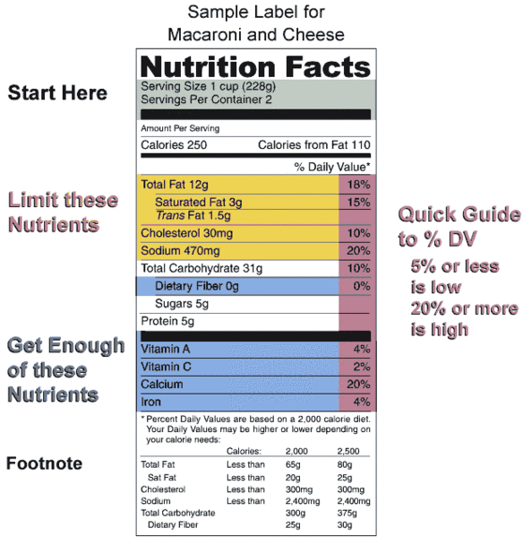
Food in Historical Perspective:
Dietary Revolutions —
The Scientific Revolution
Anthropology of Food
University of Minnesota Duluth
Tim Roufs
©2010-2024
http://en.wikipedia.org/wiki/Nutrition

Slide 2
Food in Historical Perspective: Dietary Revolutions
Food in Historical Perspective:
Dietary Revolutions
  The Agricultural Revolution
  The Search for Spices
  The Industrial Revolution
  Transportation, Refrigeration, and Canning
  The Scientific Revolution
  Modern-Day Adaptations
  Summary
  Highlight: Vegetarian Diets: Then and Now

Slide 3

REM Eight Food “Revolutions”
Invention of Cooking
Discovery that Food is More Than Sustenance
The “Herding Revolution”
Snail Farming
Use of Food as a Means and Index of Social Differentiation
Long-Range Exchange of Culture
Ecological Revolution of last 500 years
Industrial Revolution of the 19th and 20th Centuries
“The Scientific Revolution”
is part of . . .
Simon & Schuster 2003

Slide 4
Food in Historical Perspective: Dietary Revolutions
Food in Historical Perspective:
Dietary Revolutions
  current level
  knowledge
  of nutrition
  Scientific
  Revolution
  19th and 20th
  centuries
  enables unprecedented
  control over
  food supply, health, physical well being

Slide 5
Food in Historical Perspective: Dietary Revolutions
Food in Historical Perspective:
Dietary Revolutions
  current level
  knowledge
  of nutrition
  Scientific
  Revolution
  19th and 20th
  centuries
  enables unprecedented
  control over
  food supply, health, physical well being

Slide 6
Food in Historical Perspective: Dietary Revolutions
Food in Historical Perspective:
Dietary Revolutions
  current level
  knowledge
  of nutrition
  Scientific
  Revolution
  19th and 20th
  centuries
  good effects:
  pasteurization . . . increased food safety

Slide 7
Food in Historical Perspective: Dietary Revolutions
Food in Historical Perspective:
Dietary Revolutions
  current level
  knowledge
  of nutrition
  Scientific
  Revolution
  19th and 20th
  centuries
  negative effects:
  milling of grains led to widespread
  vitamin deficiencies in some parts of the world . . .

Slide 8
Food in Historical Perspective: Dietary Revolutions
Food in Historical Perspective:
Dietary Revolutions
  new understanding of food and its effects on health
  discovery
  of
  vitamins
  19th and 20th
  centuries

Slide 9
Food in Historical Perspective: Dietary Revolutions
Food in Historical Perspective:
Dietary Revolutions
  The Agricultural Revolution of the Neolithic Era
  The Search for Spices
  The Industrial Revolution
  Transportation, Refrigeration, and Canning
  The Scientific Revolution
  Modern-Day Adaptations
  Summary
  Highlight: Vegetarian Diets: Then and Now
  “The scientific revolution ultimately led to our current level of knowledge about human nutrition and enabled us to exert an unprecedented control over food supply, health, and physical well-being”
The Cultural Feast, 2nd Ed., p. 67

Slide 10
Food in Historical Perspective: Dietary Revolutions
Food in Historical Perspective:
Dietary Revolutions
  The Agricultural Revolution of the Neolithic Era
  The Search for Spices
  The Industrial Revolution
  Transportation, Refrigeration, and Canning
  The Scientific Revolution
  Modern-Day Adaptations
  Summary
  Highlight: Vegetarian Diets: Then and Now
          Kepler
          Galileo
          Newton
          Bacon
The Cultural Feast, 2nd Ed., p. 67

Slide 11
Food in Historical Perspective: Dietary Revolutions
Food in Historical Perspective:
Dietary Revolutions
  The Agricultural Revolution of the Neolithic Era
  The Search for Spices
  The Industrial Revolution
  Transportation, Refrigeration, and Canning
  The Scientific Revolution
  Modern-Day Adaptations
  Summary
  Highlight: Vegetarian Diets: Then and Now
          Kepler
          Galileo
          Newton
          Bacon
were among those who changed the way most people view the world, and our place in it . . .
The Cultural Feast, 2nd Ed., p. 67

Slide 12
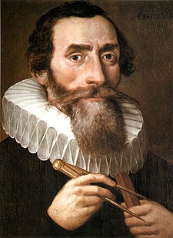
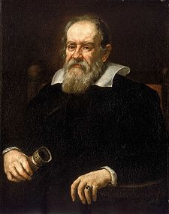


Food in Historical Perspective: Dietary Revolutions
Food in Historical Perspective:
Dietary Revolutions
  The Agricultural Revolution of the Neolithic Era
  The Search for Spices
  The Industrial Revolution
  Transportation, Refrigeration, and Canning
  The Scientific Revolution
  Modern-Day Adaptations
  Summary
  Highlight: Vegetarian Diets: Then and Now
          Kepler
          Galileo
          Newton
          Bacon

Slide 13
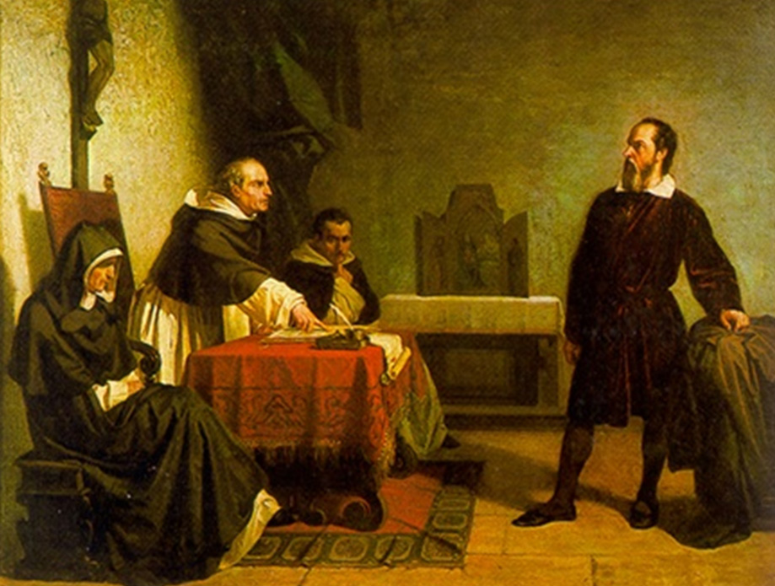
and that was not an easy thing to do . . .
Galileo facing the Roman Inquisition
Cristiano Banti
http://blogs.physicstoday.org/newspicks/2009/12/church-celebrates-galileo-anni.html

Slide 14
Galileo facing the Roman Inquisition
Cristiano Banti
http://blogs.physicstoday.org/newspicks/2009/12/church-celebrates-galileo-anni.html

Slide 15
Food in Historical Perspective: Dietary Revolutions
Food in Historical Perspective:
Dietary Revolutions
  The Agricultural Revolution of the Neolithic Era
  The Search for Spices
  The Industrial Revolution
  Transportation, Refrigeration, and Canning
  The Scientific Revolution
  Modern-Day Adaptations
  Summary
  Highlight: Vegetarian Diets: Then and Now
  they rejected the notion that nature was mysterious and capricious
  they believed the world was governed by “natural laws” that are intelligible to humans
The Cultural Feast, 2nd Ed., p. 67

Slide 16
Food in Historical Perspective: Dietary Revolutions
Food in Historical Perspective:
Dietary Revolutions
  The Agricultural Revolution of the Neolithic Era
  The Search for Spices
  The Industrial Revolution
  Transportation, Refrigeration, and Canning
  The Scientific Revolution
  Modern-Day Adaptations
  Summary
  Highlight: Vegetarian Diets: Then and Now
      and they fostered a sense that
      humans would one day
      control nature
The Cultural Feast, 2nd Ed., p. 67

Slide 17
Food in Historical Perspective: Dietary Revolutions
Food in Historical Perspective:
Dietary Revolutions
  The Agricultural Revolution of the Neolithic Era
  The Search for Spices
  The Industrial Revolution
  Transportation, Refrigeration, and Canning
  The Scientific Revolution
  Modern-Day Adaptations
  Summary
  Highlight: Vegetarian Diets: Then and Now
  Adulteration of Food
  Food Preservation
  The Discovery of Vitamins
  Complicating Factors Associated with Modern Food Technology
The Cultural Feast, 2nd Ed., p. 67

Slide 18
Food in Historical Perspective: Dietary Revolutions
Food in Historical Perspective:
Dietary Revolutions
  The Agricultural Revolution of the Neolithic Era
  The Search for Spices
  The Industrial Revolution
  Transportation, Refrigeration, and Canning
  The Scientific Revolution
  Modern-Day Adaptations
  Summary
  Highlight: Vegetarian Diets: Then and Now
  Adulteration of Food
  Food Preservation
  The Discovery of Vitamins
  Complicating Factors Associated with Modern Food Technology
The Cultural Feast, 2nd Ed., p. 67

Slide 19
  Unforeseen Drawbacks of Food Processing
    “One of the first substantial impacts of science on food came when chemists brought popular foods into their laboratories and found, much to the manufacturers’ chagrin, that
    many foods
    contained questionable ingredients”
      1820 British scientist Frederick Accum, published “A Treatise on Adulteration of Food and Culinary Poisons”
      30 years later an “Analytical and Sanitation Commission” report finally prompted Parliament to pass the first British Food and Drug Act
The Cultural Feast, 2nd Ed., p. 67

Slide 20
  Unforeseen Drawbacks of Food Processing
    “In the United States, the government was even slower to follow up on scientific findings”
      1900 Dr. Harvey Wiley, chief of the Bureau of Chemistry of the United States Department of Agriculture (USDA) demonstrates that some food additives were dangerous to health
        food manufacturers tried to have him removed from office
The Cultural Feast, 2nd Ed., pp. 67-68

Slide 21
  Unforeseen Drawbacks of Food Processing
    “In the United States, the government was even slower to follow up on scientific findings”
      1900 Dr. Harvey Wiley, chief of the Bureau of Chemistry of the United States Department of Agriculture (USDA) demonstrates that some food additives were dangerous to health
        food manufacturers tried to have him removed from office
and REM:
USDA
is the
United States Department of Agriculture
not Health
The Cultural Feast, 2nd Ed., pp. 67-68

Slide 22

and REM:
EPA
is not the
Department of Health, Education and Welfare
www.guardian.co.uk/world/2008/jul/11/usa.epa

Slide 23
www.guardian.co.uk/world/2008/jul/11/usa.epa

Slide 24
www.guardian.co.uk/world/2008/jul/11/usa.epa

Slide 25
www.guardian.co.uk/world/2008/jul/11/usa.epa

Slide 26
  Unforeseen Drawbacks of Food Processing
    “In the United States, the government was even slower to follow up on scientific findings”
      1906 Upton Sinclair publishes The Jungle
        a major work that described Chicago’s meat-packing plants as filthy, rat-infested buildings where spoiled meat was chemically treated and handled by tubercular workers
The Cultural Feast, 2nd Ed., pp. 67-68

Slide 27

1906

Slide 28
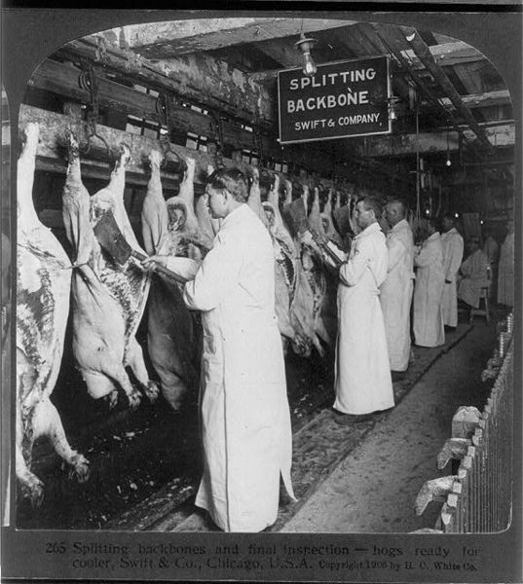
Chicago meat inspectors in early 1906
http://en.wikipedia.org/wiki/The_Jungle

Slide 29
and many issues remain today . . .
Chicago meat inspectors in early 1906
http://en.wikipedia.org/wiki/The_Jungle

Slide 30

and many issues remain today . . .
we’ll have a look at some of these towards the end of the term . . .
Robert Kenner
2009

Slide 31

and many issues remain today . . .
we’ll have a look at some of these towards the end of the term . . .
Timothy Pachirat
2013

Slide 32
  Unforeseen Drawbacks of Food Processing
    “In the United States, the government was even slower to follow up on scientific findings”
      1906 Upton Sinclair publishes The Jungle
        described Chicago’s meat-packing plants as filthy, rat-infested buildings where spoiled meat was chemically treated and handled by tubercular workers
      1906 U.S. Congress passes the Pure Food and Drug Act
        designed to prevent the “manufacture, sale, or transportation of adulterated, misbranded, poisonous or deleterious foods, drugs, medicines and liquors”
The Cultural Feast, 2nd Ed., pp. 67-68

Slide 33
  Unforeseen Drawbacks of Food Processing
    “In the United States, the government was even slower to follow up on scientific findings”
      1906 Upton Sinclair publishes The Jungle
        described Chicago’s meat-packing plants as filthy, rat-infested buildings where spoiled meat was chemically treated and handled by tubercular workers
      1906 U.S. Congress passes the Pure Food and Drug Act
        designed to prevent the “manufacture, sale, or transportation of adulterated, misbranded, poisonous or deleterious foods, drugs, medicines and liquors”
      1820 British scientist Frederick Accum,
      published “A Treatise on Adulteration of Food and Culinary Poisons”
The Cultural Feast, 2nd Ed., pp. 67-68

Slide 34
Food in Historical Perspective: Dietary Revolutions
Food in Historical Perspective:
Dietary Revolutions
  The Agricultural Revolution of the Neolithic Era
  The Search for Spices
  The Industrial Revolution
  Transportation, Refrigeration, and Canning
  The Scientific Revolution
  Modern-Day Adaptations
  Summary
  Highlight: Vegetarian Diets: Then and Now
  Adulteration of Food
  Food Preservation
  The Discovery of Vitamins
  Complicating Factors Associated with Modern Food Technology

Slide 35
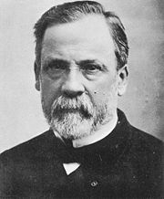
  Food Preservation
    pasteurization
      1860s Louis Pasteur lays the groundwork of the science of microbiology
          figured out that microorganisms caused the spoiling of
          wine, beer and milk
          and that heating and
          re-cooling the liquids
          preserves freshness
The Cultural Feast, 2nd Ed., p. 68

Slide 36
  Food Preservation
    pasteurization
      1860s Louis Pasteur lays the groundwork of the science of microbiology
          figured out that microorganisms caused the spoiling of
          wine, beer and milk
          and that heating and
          re-cooling the liquids
          preserves freshness
you know about that . . .
The Cultural Feast, 2nd Ed., p. 68

Slide 37
Food in Historical Perspective: Dietary Revolutions
Food in Historical Perspective:
Dietary Revolutions
  The Agricultural Revolution of the Neolithic Era
  The Search for Spices
  The Industrial Revolution
  Transportation, Refrigeration, and Canning
  The Scientific Revolution
  Modern-Day Adaptations
  Summary
  Highlight: Vegetarian Diets: Then and Now
  Adulteration of Food
  Food Preservation
  The Discovery of Vitamins
  Complicating Factors Associated with Modern Food Technology
The Cultural Feast, 2nd Ed., p. 68

Slide 38
  The Discovery of Vitamins
    it had long been known that relatively small amounts of certain foods had positive effects on health
      e.g., since the mid 18th century people have known that seamen could avoid getting scurvy by having access to citrus products
http://en.wikipedia.org/wiki/Vitamins
The Cultural Feast, 2nd Ed., p. 68

Slide 39
  The Discovery of Vitamins
      “limey” – American and Canadian slang
      for the British,
      originally for a British sailor
        the British surgeon James Lind noticed that the cabbage-eating Dutch had fewer problems with scurvy and by conducting the first-ever clinical trial developed the theory that citrus fruits prevented scurvy
http://en.wikipedia.org/wiki/Vitamins
The Cultural Feast, 2nd Ed., p. 68

Slide 40
  The Discovery of Vitamins
    “By the mid-19th century, through the work of European chemists, the foundation of modern nutrition science was laid when it became possible to classify foods as . . .
        carbohydrate
        protein
        fat
        . . . based on their percentages of
        carbon, hydrogen, and nitrogen,
        and when it was recognized that all three classes of foods were needed in the human diet”
The Cultural Feast, 2nd Ed., p. 69

Slide 41
  The Discovery of Vitamins
    soon the importance of minerals
    also became apparent . . .
The Cultural Feast, 2nd Ed., p. 69

Slide 42
  The Discovery of Vitamins
    . . . but an understanding of a fundamental component of a healthful diet . . .
    vitamins
    was missing . . .
The Cultural Feast, 2nd Ed., p. 69

Slide 43
  The Discovery of Vitamins
    vitamins
      1886 the Dutch scientist Dr. Christiaan Eijkman observes that the
      hens fed on a diet of polished rice developed an inability to walk
      and exhibited other symptoms
      similar to beriberi
          beriberi had been causing a number
          of deaths in the Dutch East Indies (Indonesia)
The Cultural Feast, 2nd Ed., p. 69

Slide 44
  The Discovery of Vitamins
    vitamins
      1886 Eijkman further observes that the
      hens recovered promptly
      when fed rice bran
          this information was soon applied to humans, and hundreds of beriberi patients at the Buitenzorg hospital walked out fully recovered
The Cultural Feast, 2nd Ed., p. 69

Slide 45
  The Discovery of Vitamins
    vitamins
      1901 Eijkman finally identifies the importance of the rice germ within the bran
          but did not isolate what it was it the germ that had the healing effect
          but his work led others to seek a new category of food components so essential to health and survival
The Cultural Feast, 2nd Ed., p. 69

Slide 46
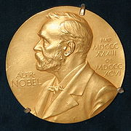
  The Discovery of Vitamins
    vitamins
      1901 Eijkman finally identifies the importance of the rice germ within the bran
          but did not isolate what it was it the germ that had the healing effect
          but his work led others to seek a new category of food components so essential to health and survival
The Cultural Feast, 2nd Ed., p. 69

Slide 47
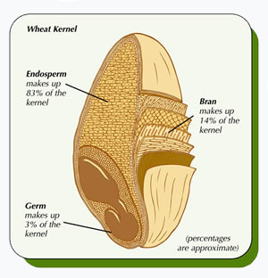
www.grainsessential.ca/english/grains/healthyLifestyle.html
The Cultural Feast, 2nd Ed., p. 69

Slide 48
www.grainsessential.ca/english/grains/healthyLifestyle.html
The Cultural Feast, 2nd Ed., p. 69

Slide 49
  The Discovery of Vitamins
    vitamins
      American biochemists isolated what would become known as vitamin A
      over the next few decades biochemists isolated and chemically identified the various vitamins we know today
The Cultural Feast, 2nd Ed., p. 69

Slide 50
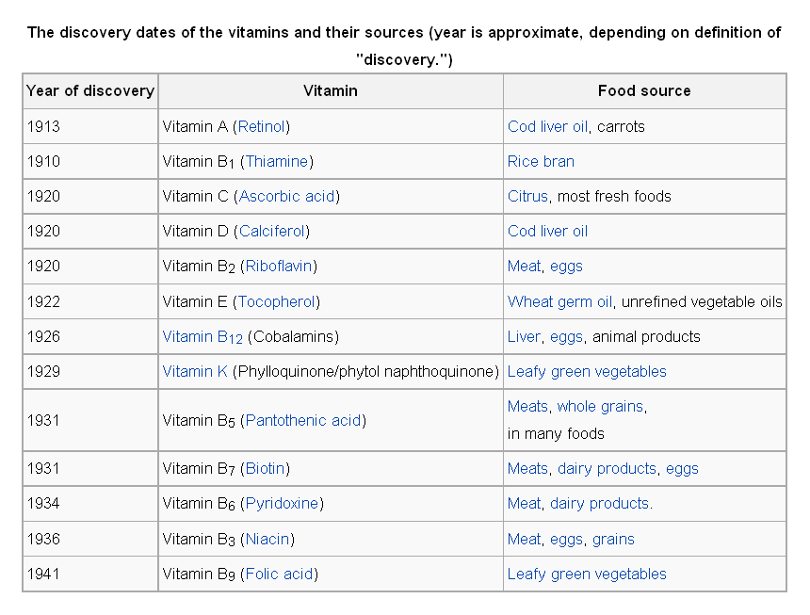
http://en.wikipedia.org/wiki/Vitamins#List_of_vitamins

Slide 51
  The Discovery of Vitamins
    vitamins
      once scientists synthesized these food components, they could be added to milk, breakfast cereals, and breads in hopes of diminishing vitamin deficiencies
The Cultural Feast, 2nd Ed., p. 69

Slide 52
  The Discovery of Vitamins
    vitamins
      the first half of the 20th century is referred to a
      the “golden age of nutrition”
      when vitamins were isolated
      and linked to deficiency diseases
The Cultural Feast, 2nd Ed., p. 69

Slide 53
  The Discovery of Vitamins
    current research . . .
The Cultural Feast, 2nd Ed., p. 70

Slide 54
  The Discovery of Vitamins
    phytochemicals
    (phytonutrients)
      biologically active compound
      found in plants . . .
      non-essential nutrients,
      but scientifically confirmed as being important to human health . . .
The Cultural Feast, 2nd Ed., p. 70

Slide 55
  The Discovery of Vitamins
    phytochemicals
    (phytonutrients)
      biologically active compound
      found in plants . . .
      are not “nutrients”, but are scientifically confirmed as being important to human health . . .
The Cultural Feast, 2nd Ed., p. 70

Slide 56
  The Discovery of Vitamins
    phytochemicals
    (phytonutrients)
      their absence is not related to an acute deficiency disease and they provide no calories . . .
      but they may be key players in maintaining optimal health . . .
The Cultural Feast, 2nd Ed., p. 70

Slide 57
  The Discovery of Vitamins
    phytochemicals
    (phytonutrients)
      “. . . may help slow the aging process and reduce the risk of many diseases, including cancer, heart disease, stroke, high blood pressure, cataract, osteoporosis, birth defects, and urinary tract infections”
The Cultural Feast, 2nd Ed., p. 70

Slide 58
  The Discovery of Vitamins
    phytochemicals
    (phytonutrients)
      “. . . may have opened an exciting era in nutrition research that has been termed the ‘second golden age of nutrition’”
The Cultural Feast, 2nd Ed., p. 70

Slide 59
Food in Historical Perspective: Dietary Revolutions
Food in Historical Perspective:
Dietary Revolutions
  The Agricultural Revolution of the Neolithic Era
  The Search for Spices
  The Industrial Revolution
  Transportation, Refrigeration, and Canning
  The Scientific Revolution
  Modern-Day Adaptations
  Summary
  Highlight: Vegetarian Diets: Then and Now
  Adulteration of Food
  Food Preservation
  The Discovery of Vitamins
  Complicating Factors Associated
  with Modern Food Technology
The Cultural Feast, 2nd Ed., p. 70

Slide 60
  Complicating Factors Associated
  with Modern Food Technology
        “. . . the intertwining
        agricultural, industrial,
        and scientific revolutions
        have created a global system that makes possible the most abundant, reliable food supply
        ever known to humankind”
      chemical fertilizers
      pesticides
      globalization
The Cultural Feast, 2nd Ed., p. 70

Slide 61
  Complicating Factors Associated
  with Modern Food Technology
        “. . . the intertwining
        agricultural, industrial,
        and scientific revolutions
        have created a global system that makes possible the most abundant, reliable food supply
        ever known to humankind”
      chemical fertilizers
      pesticides
      globalization
but there are “complicating factors”
associated with modern food technology . . .
The Cultural Feast, 2nd Ed., p. 70

Slide 62
  Complicating Factors Associated
  with Modern Food Technology
some of these “complicating factors” involve . . .
      chemical fertilizers
      pesticides
      globalization
The Cultural Feast, 2nd Ed., p. 70

Slide 63
  Complicating Factors Associated
  with Modern Food Technology
      chemical fertilizers
      pesticides
      globalization
we look more closely into the complicating factors
in the second half of the term. They include things like . . .
The Cultural Feast, 2nd Ed., p. 70

Slide 64
  Complicating Factors Associated
  with Modern Food Technology
      chemical fertilizers
        may be harmful to the humans who ingest the final product
        may be harmful to birds, fish and other animals whose habitats are affected by the chemicals
The Cultural Feast, 2nd Ed., p. 71

Slide 65
  Complicating Factors Associated
  with Modern Food Technology
      chemical fertilizers
      pesticides
      globalization
      involves the
        influence of multinational corporations that dominate world markets
        and we’ll have a look at that issue also
The Cultural Feast, 2nd Ed., p. 71

Slide 66
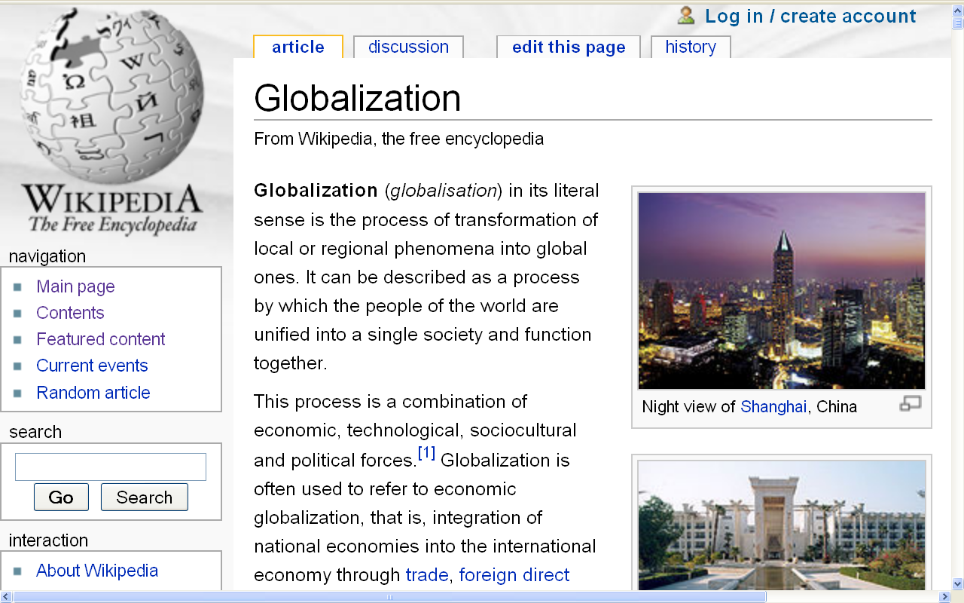
http://en.wikipedia.org/wiki/Globalization

Slide 67
  Complicating Factors Associated
  with Modern Food Technology
including issues dealing with . . .
        influence of multinational corporations that dominate world markets
          lopsided growth of wealth
          growth of political power
The Cultural Feast, 2nd Ed., p. 71

Slide 68
      chemical fertilizers
      pesticides
      globalization
“locavorism” is relatively new. . .
        vs. locavorism
The Cultural Feast, 2nd Ed., p. 70

Slide 69
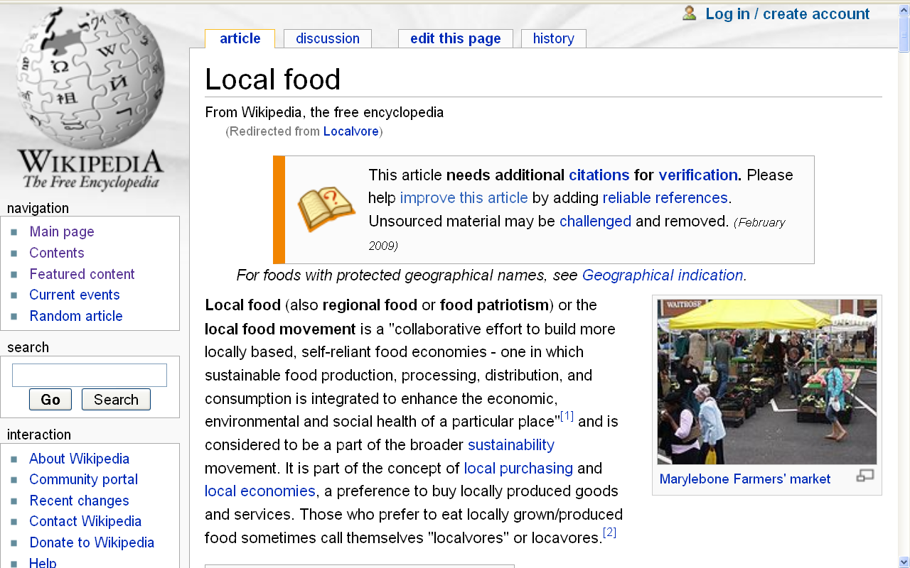
locavore
2007 New Oxford American Dictionary Word of the Year
http://en.wikipedia.org/wiki/Frankenfoods

Slide 70
  Complicating Factors Associated
  with Modern Food Technology
a number of other things also become “complicating factors”. . .
      farm machinery
        causes devastating erosion of topsoil resources
The Cultural Feast, 2nd Ed., p. 71

Slide 71
Biocultural Consequences: Environment
soil erosion due to plowing, terracing, clear-cutting of forests, and animal grazing
ntensive agriculture depleted soil nutrients
many areas remain unproductive thousands of years later

Slide 72

https://www.bbc.com/news/science-environment-56566377

Slide 73
Biocultural Consequences: Environment
soil erosion due to plowing, terracing, clear-cutting of forests, and animal grazing
intensive agriculture depleted soil nutrients
many areas remain unproductive thousands of years later

Slide 74
Biocultural Consequences: Environment
in the Tigris-Euphrates valley, salts carried by irrigation waters slowly poisoned fields
in North Africa, herders allowed animals to overgraze the Sahara grasslands, furthering the development of the world's largest desert

Slide 75
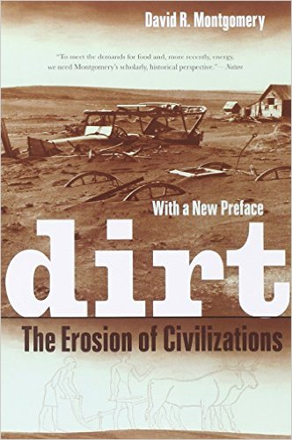
Mesopotamia
China
North America
South America
Europe
Asia
Africa
Pacific Islands
Berkeley: University of California, 2012
http://www.amazon.com/Empires-Food-Feast-Famine-Civilizations/dp/1582437939/ref=sr_1_1?ie=UTF8&qid=1452654498&sr=8-1&keywords=empires+of+food

Slide 76
  Complicating Factors Associated
  with Modern Food Technology
      synthesized growth hormones
        raises questions
The Cultural Feast, 2nd Ed., p. 70

Slide 77
  Complicating Factors Associated
  with Modern Food Technology
      use of radiation to increase the shelf life of fruits and vegetables
        raises questions
The Cultural Feast, 2nd Ed., p. 70

Slide 78
  Complicating Factors Associated
  with Modern Food Technology
      genetic modification (GM)
        the insertion of genes from one plant into another plant in an effort to increase yield, resistance, and nutrition
The Cultural Feast, 2nd Ed., p. 70

Slide 79
  Complicating Factors Associated
  with Modern Food Technology
      genetic modification (GM)
        has drawn fire because of the
        potential health and environmental risks
          including new food products causing allergic reactions in some people
The Cultural Feast, 2nd Ed., p. 70

Slide 80

www.bbc.co.uk/topics/gm_food

Slide 81
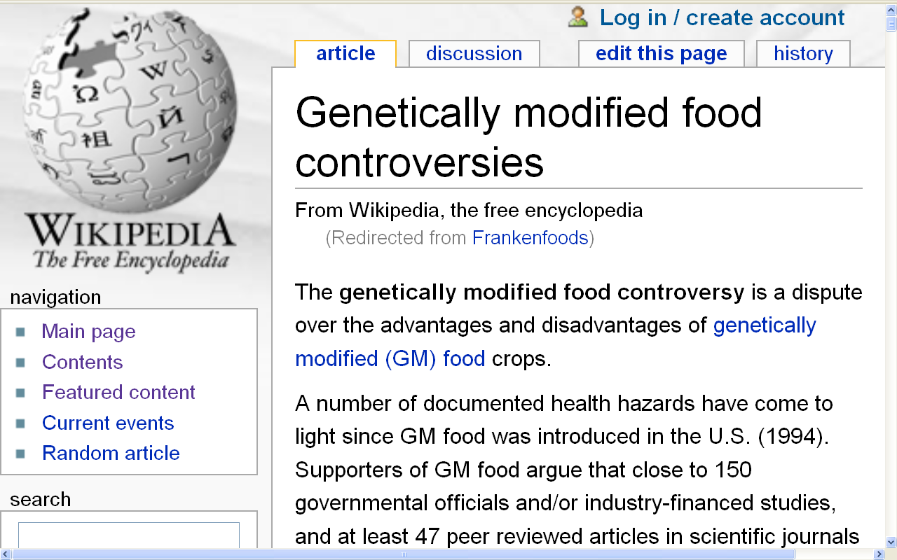
http://en.wikipedia.org/wiki/Frankenfoods

Slide 82
  Complicating Factors Associated
  with Modern Food Technology
      genetic modification (GM)
        see Highlight 6, pp. 179-189
        Frankenfoods?
        or
        The solution to world hunger?
The Cultural Feast, 2nd Ed., p. 70

Slide 83
  Complicating Factors Associated
  with Modern Food Technology
        health problems associated with the abundance and convenience of food in industrialized countries
          increased intake of refined carbohydrates, salt, cholesterol and saturated fats
          decrease in consumption of dietary fiber
          decrease in physical exertion
The Cultural Feast, 2nd Ed., p. 70

Slide 84
  Complicating Factors Associated
  with Modern Food Technology
        health problems associated with the abundance and convenience of food in industrialized countries
          increased cardiovascular disease
          increased diabetes
          other physical problems
            obesity
            anorexia
            bulimia
The Cultural Feast, 2nd Ed., p. 71

Slide 85
towards the end of the term our plate will be full . . .
thanks — ironically— to . . .
  Complicating Factors Associated
  with Modern Food Technology
        “. . . the intertwining
        agricultural, industrial,
        and scientific revolutions
        have created a global system that makes possible the most abundant, reliable food supply
        ever known to humankind”
      chemical fertilizers
      pesticides
      globalization
The Cultural Feast, 2nd Ed., p. 70

Slide 86
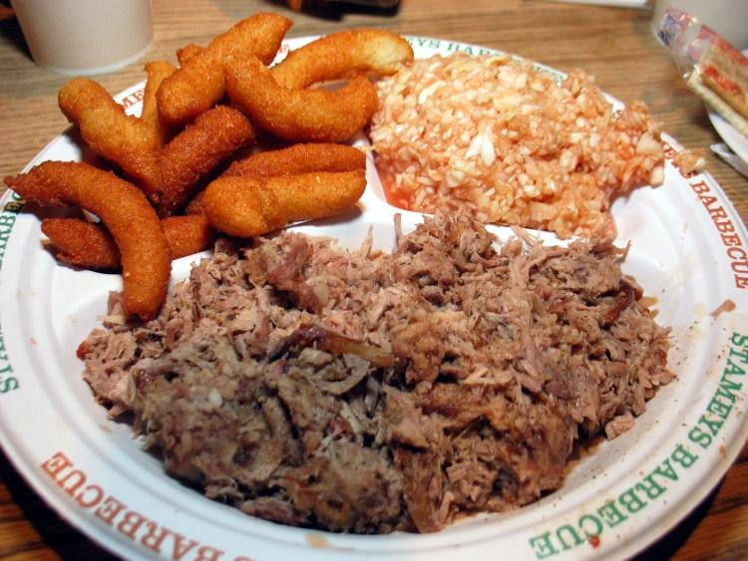
http://www.d.umn.edu/cla/faculty/troufs/anthfood/afroadfood.html#title

Slide 87
Food in Historical Perspective:
Dietary Revolutions —
The Scientific Revolution
Anthropology of Food
University of Minnesota Duluth
Tim Roufs
©2010-2024
http://en.wikipedia.org/wiki/Nutrition

