Slide 1
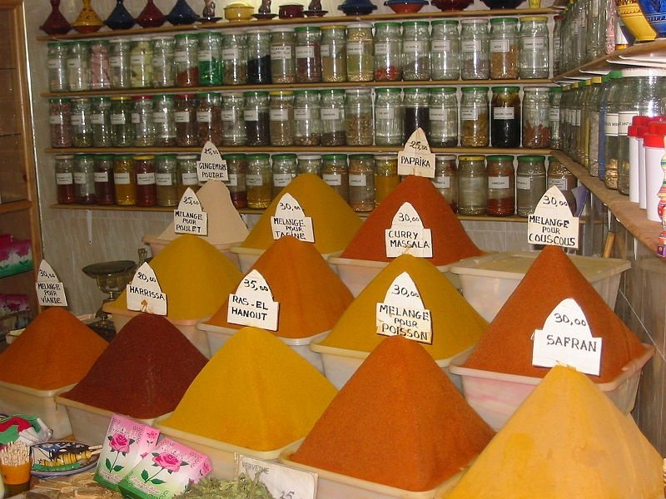
Food in Historical Perspective:
The Search for Spices
Anthropology of Food
University of Minnesota Duluth
Tim Roufs
©2010-2024

Slide 2
Food in Historical Perspective:
Dietary Revolutions
  The Agricultural Revolution of the Neolithic Era
  The Search for Spices
  The Industrial Revolution
  Transportation, Refrigeration, and Canning
  The Scientific Revolution
  Modern-Day Adaptations
  Summary
  Highlight: Vegetarian Diets: Then and Now

Slide 3
Food in Historical Perspective:
Dietary Revolutions
  The Agricultural Revolution of the Neolithic Era
  The Search for Spices
  The Industrial Revolution
  Transportation, Refrigeration, and Canning
  The Scientific Revolution
  Modern-Day Adaptations
  Summary
  Highlight: Vegetarian Diets: Then and Now

Slide 4
Food in Historical Perspective:
Dietary Revolutions
  The Agricultural Revolution of the Neolithic Era
  The Search for Spices
  The Industrial Revolution
  Transportation, Refrigeration, and Canning
  The Scientific Revolution
  Modern-Day Adaptations
  Summary
  Highlight: Vegetarian Diets: Then and Now
  changed
  the history of the world forever . . .
  in ways few things have

Slide 5
Food in Historical Perspective:
Dietary Revolutions
  The Agricultural Revolution of the Neolithic Era
  The Search for Spices
  The Industrial Revolution
  Transportation, Refrigeration, and Canning
  The Scientific Revolution
  Modern-Day Adaptations
  Summary
  Highlight: Vegetarian Diets: Then and Now
  changed
  the history of the world forever . . .
  in ways few things ever have

Slide 6
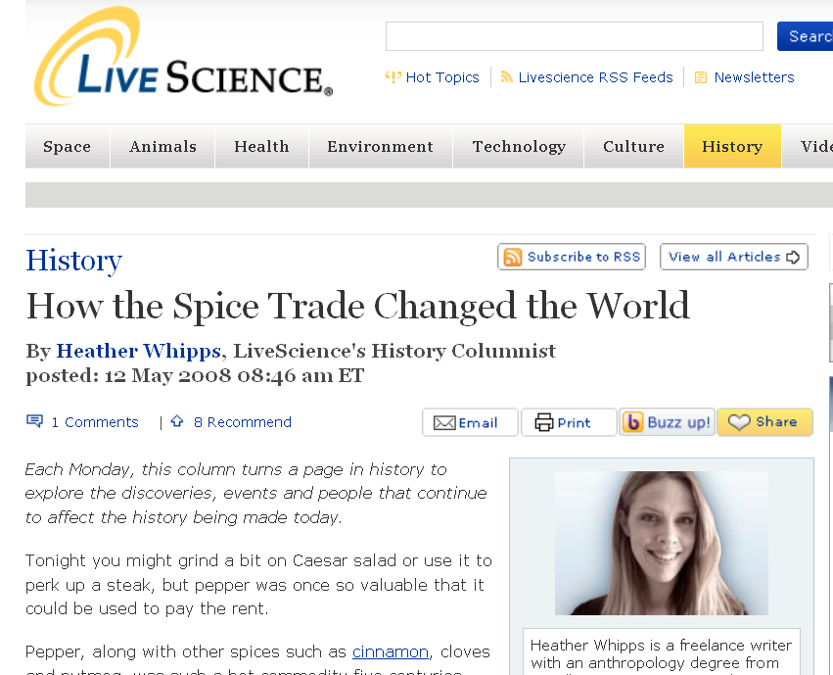
and that huge change is universally recognized
www.livescience.com/history/080512-hs-spicetrade.html

Slide 7
Food in Historical Perspective:
Dietary Revolutions
  European
  exploration
  new
  lands
  15th century
  search
  for spices
  exchange of food between regions
  diversified diets
  globalization
  of food

Slide 8
Food in Historical Perspective:
Dietary Revolutions
  European
  exploration
  new
  lands
  15th century
  search
  for spices
  exchange of food between regions
  diversified diets
  globalization
  of food

Slide 9

. . . is “an incredibly well narrated history of the Spice Wars — the quest for a regular trade route to the West Indies”
Nathaniel's Nutmeg: Or, the True and Incredible Adventures of the Spice Trader who Changed the Course of History
Giles Milton
Farrar, Straus and Giroux, 1999

Slide 10
. . . is “an incredibly well narrated history of the Spice Wars — the quest for a regular trade route to the West Indies”
this is one of the most interesting and important
history of food books written in decades . . .
(personal opinion)
Nathaniel's Nutmeg: Or, the True and Incredible Adventures of the Spice Trader who Changed the Course of History
Giles Milton
Farrar, Straus and Giroux, 1999

Slide 11
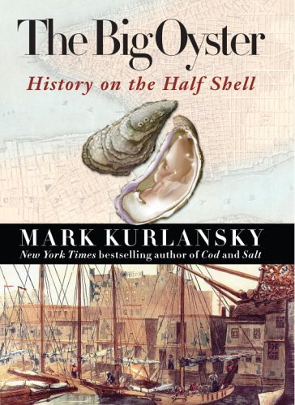
and Nathaniel’s Nutmeg should be read in conjunction with The Big Oyster
as they chronicle related events brought together more or less by historical accident . . .
events which changed the world forever . . .
(fact, not personal opinion)
Random House 2007

Slide 12
and if you’re still looking for a paper topic,
and love New York, or history, or food, or adventure, or even just oysters, a comparison of
The Big Oyster and Nathaniel’s Nutmeg
would make a very interesting project
Random House 2007

Slide 13
  back to The Search for Spices
  in the 15th century . . .
    spices were so highly valued in Europe that the quest for them stimulated the exploration of new land
        bringing nations into cut-throat (literally) competition
The Cultural Feast, 2nd Ed., p. 56

Slide 14
  The Search for Spices
  in the 15th century . . .
    spices were so highly valued in Europe that the quest for them stimulated the exploration of new land
        bringing nations into cut-throat (literally) competition
The Cultural Feast, 2nd Ed., p. 56

Slide 15
  The Search for Spices
  Why the passion for spices?
    spices preserved foods
    spices disguised the flavor of partially spoiled food
    spicing food became a “mania” . . .
The Cultural Feast, 2nd Ed., p. 57

Slide 16
  The Search for Spices
  Stu Sivertson’s
  grandfather
  on a sailing ship mired in
  “the doldrums”
  off of the coast of Africa used spices to . . .
  Why the passion for spices?
    spices preserved foods
    spices disguised the flavor of partially spoiled food
    spicing food became a “mania” . . .
The Cultural Feast, 2nd Ed., p. 57

Slide 17
  The Search for Spices
  Why the passion for spices?
    spices preserved foods
    spices disguised the flavor of partially spoiled food?
    spicing food became a “mania” . . .
  BUT is this a food myth? . . .
The Cultural Feast, 2nd Ed., p. 57

Slide 18
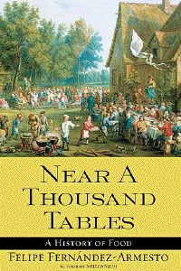
Eight Food “Revolutions”
  Yes, says Fernández-Armesto . . .
Simon & Schuster 2003

Slide 19
Eight Food “Revolutions”
“The idea that the demand for spices was the result of the need to digest tainted meat and fish is one of the great myths of the history of food. It is an offshoot of the myth of the progress — the assumption that people in earlier times were less competent, or less intelligent, or less capable of providing for their needs than we are today.”
p. 155
Simon & Schuster 2003

Slide 20
Eight Food “Revolutions”
“It is more likely that fresh foods in the Middle Ages were fresher than today, because [they were] locally produced, and that preserved foods were just as well preserved in their different ways — by salting, pickling, desiccating and conserving — than ours are in the age of canning, refrigeration and freeze-drying. . . .”
p. 155
Simon & Schuster 2003

Slide 21
Eight Food “Revolutions”
“. . . freeze-drying . . .
a technique, by the way, [which] was known in antiquity and developed to a high degree by Andean potato growers in what we think of as the Middle Ages”
p. 155
Simon & Schuster 2003

Slide 22
Eight Food “Revolutions”
“Both fresh and preserved foods were probably healthier in those days because they were not grown with chemical fertilizers. In any event, the role of spices in cooking was determined by culture.
Spice-rich cuisine was expensive and, therefore, socially differentiating. . . .”
p. 155
Simon & Schuster 2003

Slide 23
Eight Food “Revolutions”
“For those who could afford it, this made it an ineluctable luxury. It was liked because it was a defining characteristic of the era’s model haute cuisine, imitated from the Arabs”
p. 155
Simon & Schuster 2003

Slide 24
Eight Food “Revolutions”
“For those who could afford it, this made it an ineluctable luxury. It was liked because it was a defining characteristic of the era’s model haute cuisine, imitated from the Arabs”
which they learned about in part as a result of the Crusades . . .
p. 155
Simon & Schuster 2003

Slide 25
  The Search for Spices
  Why the passion for spices?
    Crusaders discovered spices in western Asia . . .
          cinnamon
          pepper
          ginger
          nutmeg
          mace
          others
The Cultural Feast, 2nd Ed., p. 57

Slide 26
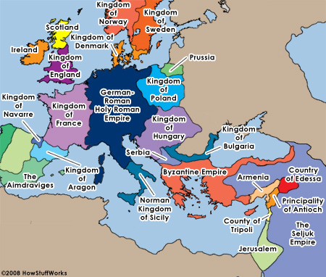
the world at the time of the Crusades
http://history.howstuffworks.com/middle-ages/crusades1.htm

Slide 27
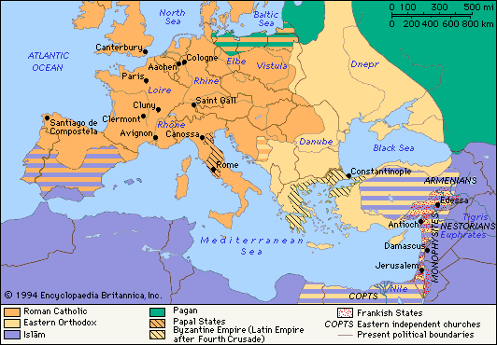
the world at the time of the Crusades by major religions
www.student.britannica.com

Slide 28
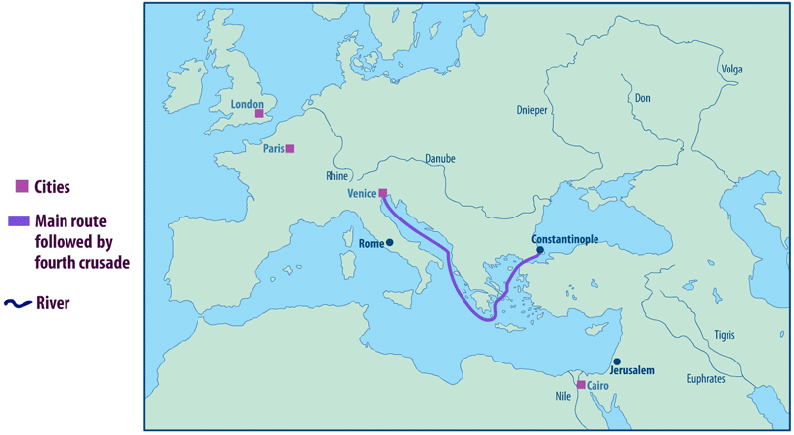
Venice was a staging area for the Crusades
(for e.g., Fourth Crusade 1202–1204)
and became a major player
in the importation of spices to Europe
Cf., The Cultural Feast, 2nd Ed., p. 57
http://en.wikipedia.org/wiki/Age_of_Discovery

Slide 29
  The Search for Spices
  Why the passion for spices?
    the spices that the Crusaders discovered in western Asia included . . .
          cinnamon
          pepper
          ginger
          nutmeg
          mace
          and others
The Cultural Feast, 2nd Ed., p. 57

Slide 30
  The Search for Spices
  Why the passion for spices?
    spices preserved foods
    spices disguised the flavor of partially spoiled food
    and spicing food became a “mania”
The Cultural Feast, 2nd Ed., p. 57

Slide 31
  The Search for Spices
  Why the passion for spices?
    spicing food became a “mania” . . .
        culinary fashion of the late medieval period called for a great variety of spices used in precise combinations
          recipes even detailed the proper moment to add spices
The Cultural Feast, 2nd Ed., p. 57

Slide 32
  The Search for Spices
  Why the passion for spices?
    some spices were believed to have curative properties
        and many of the spices, including sugar, were used as medicine
The Cultural Feast, 2nd Ed., p. 57

Slide 33
  The Search for Spices
  Why the passion for spices?
    some spices were also used to make incense for religious ceremonies
The Cultural Feast, 2nd Ed., p. 57

Slide 34
  The Search for Spices
  Why the passion for spices?
    some spices were believed to improve sexual functioning
      the search for aphrodisiacs underlies
      the history of many foods
The Cultural Feast, 2nd Ed., p. 57

Slide 35
  The Search for Spices
  Why the passion for spices?
    many of the most desirable spices could not be produced in Europe
      in part, that may be one of the reasons they were “desirable”
The Cultural Feast, 2nd Ed., p. 57

Slide 36
  The Search for Spices
  Why the passion for spices?
    but the origins of these commodities that the Crusaders discovered were places far to the east . . .
                China
                India
                East Indies
The Cultural Feast, 2nd Ed., p. 57

Slide 37
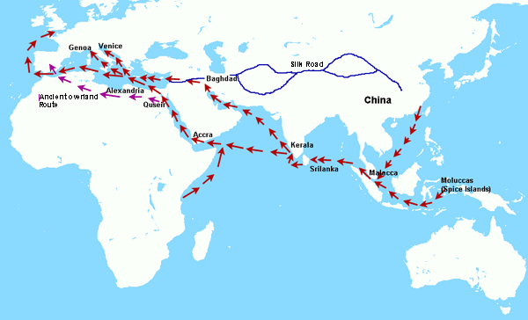
“This map of the ancient trade routes shows the position of the fabled Spice-Islands (Moluccas) . . .“
“Only there can cloves, nutmeg and mace be found.
Other prized spices were: pepper, ginger and cinnamon.“
http://www.iro.umontreal.ca/~vaucher/Genealogy/Documents/Asia/EuropeanExploration.html

Slide 38
  The Search for Spices
  Why the passion for spices?
    the fact that the origins of these commodities that the Crusaders
    discovered were places far to the east . . .
                China
                India
                East Indies
The Cultural Feast, 2nd Ed., p. 57

Slide 39
  The Search for Spices
  Why the passion for spices?
          the fact that the origins of these commodities that the Crusaders
          discovered were places far to the east . . .
              made spices
              extremely expensive
                pepper, for e.g., became “black gold”
The Cultural Feast, 2nd Ed., p. 57

Slide 40
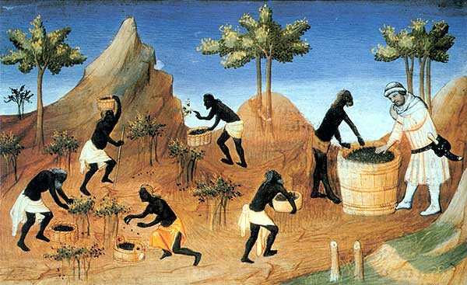
"The Mullus" Harvesting pepper
Illustration from a French edition of The Travels of Marco Polo
date unknown
Paris, Biblioteque Nationale

Slide 41
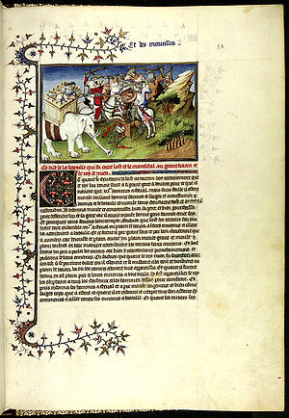
  The Search for Spices
  Marco Polo
  also helped stimulate the demand for exotic spices
  The Travels of Marco Polo
  Il Milione
  1271 - 1295
The Cultural Feast, 2nd Ed., p. 57

Slide 42
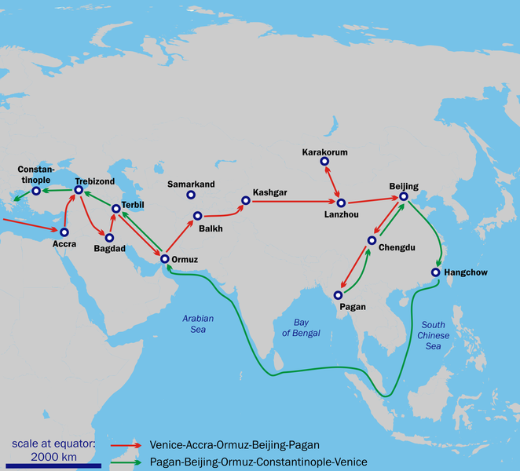
Marco Polo's Travels, 1271 — 1295
24 years and almost 15,000 miles
(24,140 km)
http://en.wikipedia.org/wiki/Marco_polo

Slide 43
  The Search for Spices
  but spice traders could not use Marco Polo’s overland route
    because there were many geographic barriers
    and because of the growing strength of the Ottoman Turks
      who were “unfriendly to Europeans”
The Cultural Feast, 2nd Ed., p. 57

Slide 44
  The Search for Spices
  Muslim traders dominated
  the spice trade
    bringing the goods across the Indian Ocean to as far away as the Mediterranean
    from there Venetian merchants had a monopoly for distribution in Europe
The Cultural Feast, 2nd Ed., p. 57

Slide 45
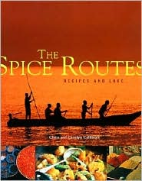
for more details see this excellent book
Chris and Carolyn Caldicott
Soma Books 2001

Slide 46
  The Search for Spices
  “by the late 15th century
  some European monarchs
  were willing
  to finance sailing expeditions
  from Europe to Asia
  in hopes of
  cutting out the costly middleman”
The Cultural Feast, 2nd Ed., p. 57

Slide 47
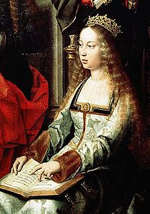
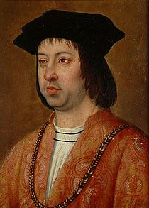
for e.g., the best-known financial backers who partially financed
the expeditions of Christopher Columbus included . . .
Isabella I of Castile
1451 – 1504
Ferdinand II
King of Aragon, Sicily,
Naples, and Valencia
1452 – 1516
http://en.wikipedia.org/wiki/Spice_trade

Slide 48
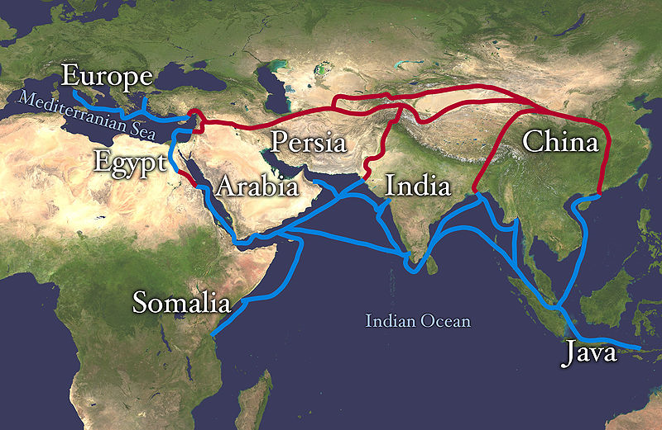
“The economically important Silk Road (red) and spice trade routes
(blue) blocked by the Ottoman Empire ca. 1453 with the fall of the Byzantine Empire, spurring exploration motivated initially by the finding of a sea route around Africa and triggering the Age of Discovery”
http://en.wikipedia.org/wiki/Spice_trade

Slide 49
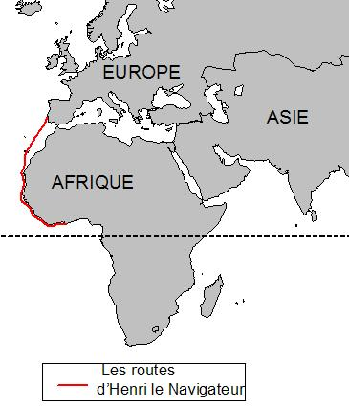
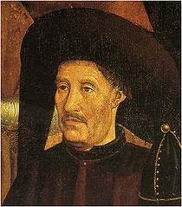
  The Search for Spices
    Prince Henry the Navigator (1394 – 1460)
      explored west African coast, ca. 1415-
    Bartholomew Dias (1451 – 1500)
      1488 reached the Cape of Good Hope
    Vasco da Gama (ca. 1460/1469 – 1524)
      1498 sailed from Portugal to India
    Christopher Columbus (1451 – 1506)
      1492 got lost on his way to India
The Cultural Feast, 2nd Ed., p. 57

Slide 50
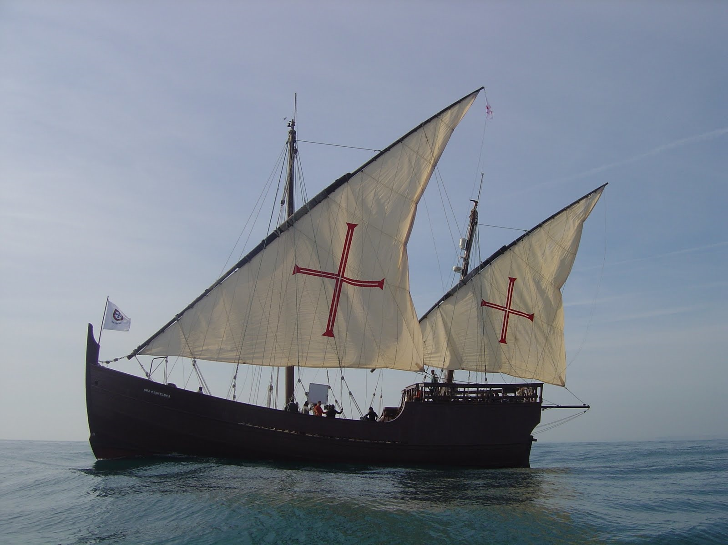
under Prince Henry “. . . a new and much lighter ship was developed, the caravel, which could sail further and faster . . .” than the slow, heavy ships of the Mediterranean
Portuguese “replica of caravel ship (Boa Esperança ) introduced in mid-15th century for oceanic exploration”
http://en.wikipedia.org/wiki/Age_of_Discovery
http://en.wikipedia.org/wiki/Prince_Henry_the_Navigator#Vila_do_Infante.2C_patron_of_Portuguese_exploration

Slide 51
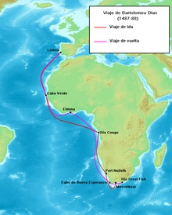
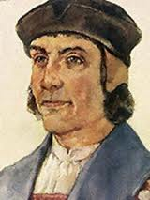
  The Search for Spices
    Prince Henry the Navigator (1394 – 1460)
      explored west African coast, ca. 1415-
    Bartholomew Dias (1451 – 1500)
      1488 reached the Cape of Good Hope
    Vasco da Gama (ca. 1460/1469 – 1524)
      1498 sailed from Portugal to India
    Christopher Columbus (1451 – 1506)
      1492 got lost on his way to India
The Cultural Feast, 2nd Ed., p. 57

Slide 52
Eight Food “Revolutions”
“It is quite misleading — though depressingly common — to suppose that the voyage to the Cape of Bartolomeu Dias in 1487-88 inspired the breakthrough. On the contrary, though Dias did find that the coast began to trend northward beyond the Cape he had, if anything, contributed to the dampening of expectations. He had found a Cape of Storms and an entrance to the Indian Ocean guarded by ferocious currents. . . . No known voyages followed up Dias’s efforts for nine years.”
pp. 157-158
Simon & Schuster 2003

Slide 53
  The Search for Spices
    Prince Henry the Navigator (1394 – 1460)
      explored west African coast, ca. 1415-
    Bartholomew Dias (1451 – 1500)
      1488 reached the Cape of Good Hope
    Vasco da Gama (ca. 1460/1469 – 1524)
      1498 sailed from Portugal to India
    Christopher Columbus (1451 – 1506)
      1492 got lost on his way to India
The Cultural Feast, 2nd Ed., p. 57

Slide 54
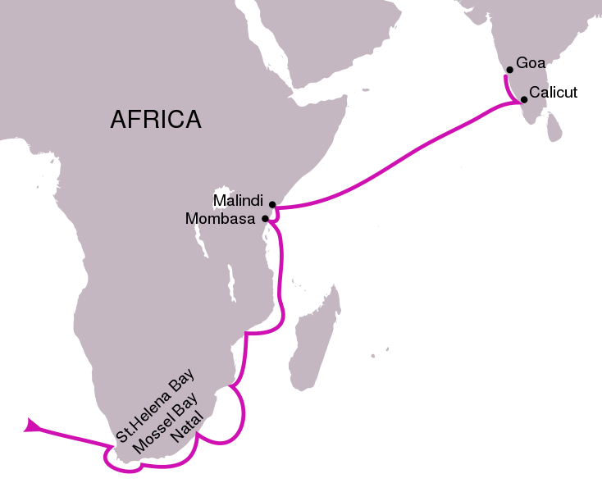
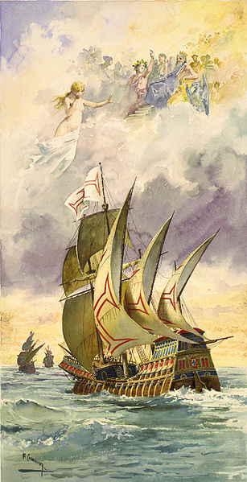
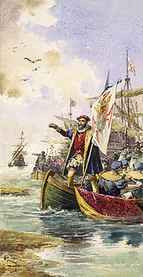
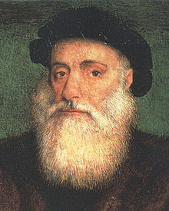
the route followed in
Vasco da Gama's first voyage
(1497–1499)
http://en.wikipedia.org/wiki/Vasco_da_Gama

Slide 55
  The Search for Spices
    with a direct route
    to the East established
    the Portuguese were in a position
    to displace the Turks and Italians
    (Venetians)
    in the lucrative spice trade
The Cultural Feast, 2nd Ed., p. 57

Slide 56
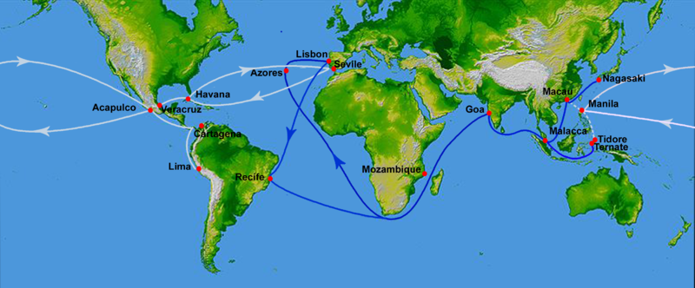
“Portuguese . . . trade routes (blue)
since Vasco da Gama’s 1498 travel
and its rival . . . Spanish treasure fleets (white)
established in 1568”
http://en.wikipedia.org/wiki/Spice_trade

Slide 57
  The Search for Spices
    but within 25 years
    of Vasco da Gama's voyage
    other European nations
    were dissatisfied with the Portuguese domination of the trade
    as they had been earlier with the Turks and Italians
The Cultural Feast, 2nd Ed., p. 57

Slide 58
  The Search for Spices
    gradually the Dutch and then others began to make inroads
    into the spice trade
    this set the stage for
    international competition
    and increasing European dominance
    of “ever-larger portions of Asia”
The Cultural Feast, 2nd Ed., pp. 57-58

Slide 59
Nathaniel’s Nutmeg is a must-read book for this time period
“An incredibly well narrated history of the Spice Wars — the quest for a regular trade route to the West Indies”
Giles Milton
Farrar, Straus and Giroux, 1999

Slide 60
and Nathaniel’s Nutmeg should be read in conjunction with The Big Oyster
Random House 2007

Slide 61
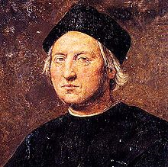
  The Search for Spices
    Prince Henry the Navigator (1394 – 1460)
      explored west African coast, ca. 1415-
    Bartholomew Dias (1451 – 1500)
      1488 reached the Cape of Good Hope
    Vasco da Gama (ca. 1460/1469 – 1524)
      1498 sailed from Portugal to India
    Christopher Columbus (1451 – 1506)
      1492 got lost on his way to India
The Cultural Feast, 2nd Ed., p. 57

Slide 62
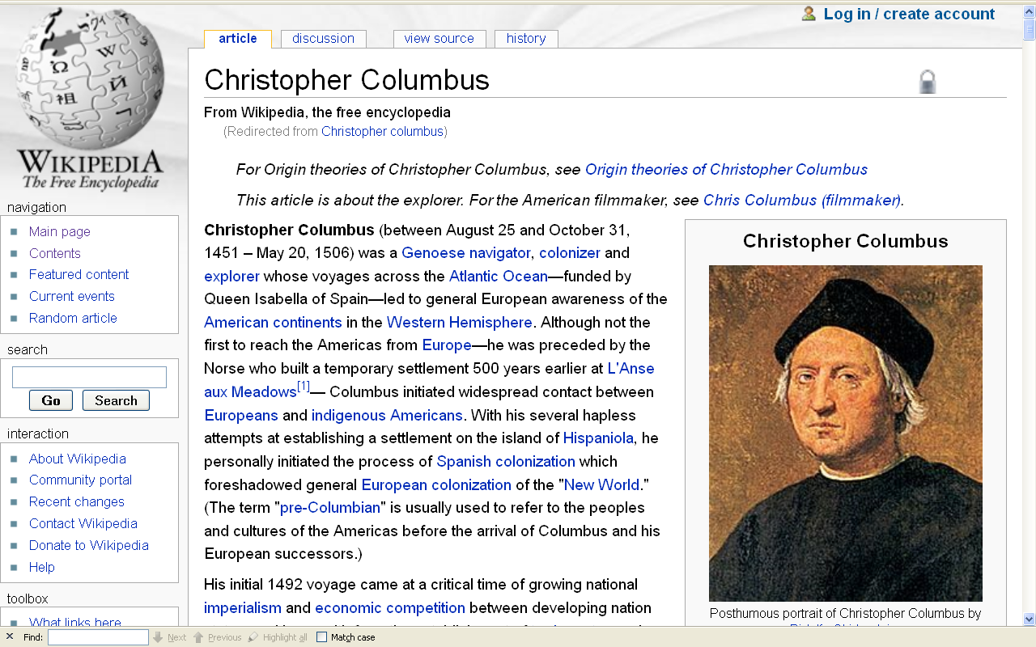
http://en.wikipedia.org/wiki/Christopher_columbus

Slide 63
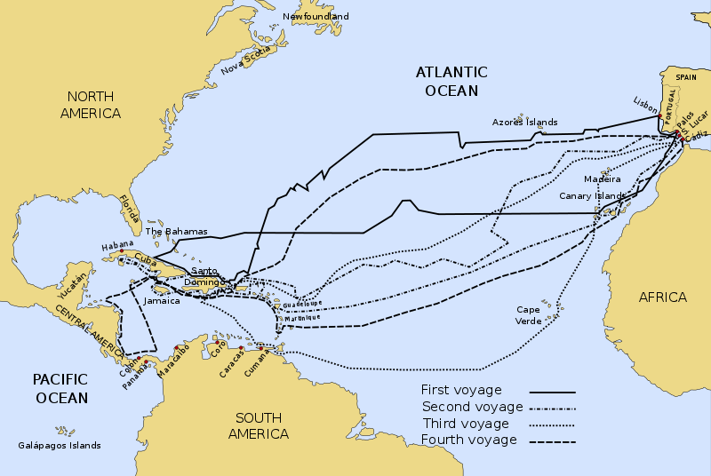
Christopher Columbus was looking for an alternate sea route around Africa when he came upon an island he named “San Salvador”
The four voyages of Christopher Columbus 1492–1503
http://en.wikipedia.org/wiki/Age_of_Discovery

Slide 64
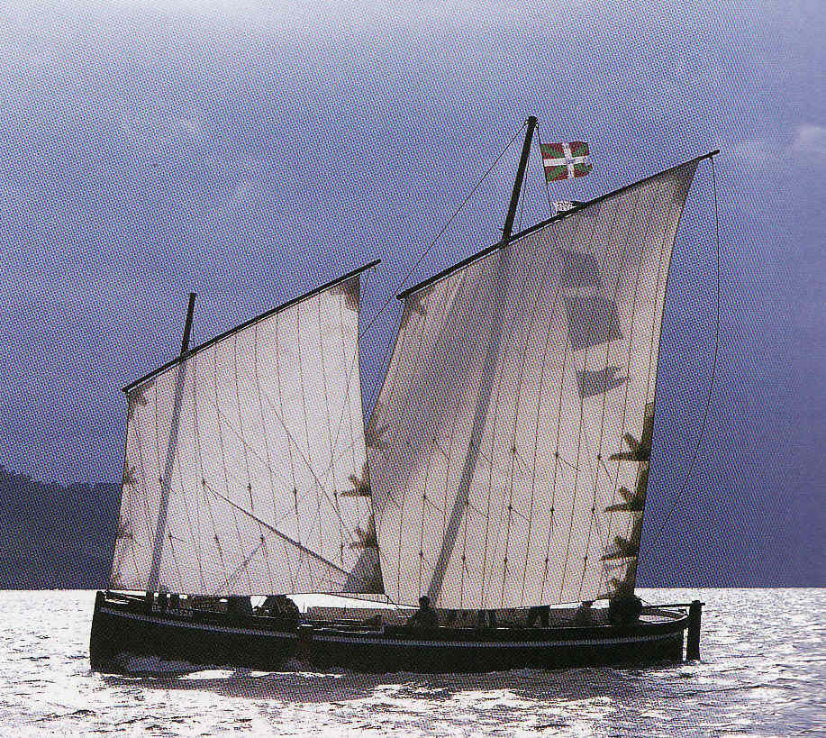
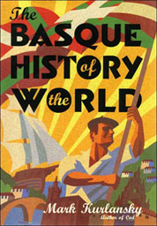
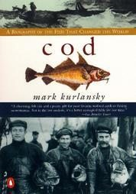
of course Basque and Scandinavian fishermen had likely been fishing off the coast of North America for 500 years before Columbus “discovered” America in 1492,
probably from 986 A.D. or so onward . . .
The four voyages of Christopher Columbus 1492–1503
http://dutch-speeljacht.blogspot.com/

Slide 65
of course Basque and Scandinavian fishermen had likely been fishing off the coast of North America for 500 years before Columbus “discovered” America in 1492,
probably from 986 A.D. or so onward . . .
but like most successful fishermen
they didn’t talk much about it . . .
The four voyages of Christopher Columbus 1492–1503
http://dutch-speeljacht.blogspot.com/

Slide 66
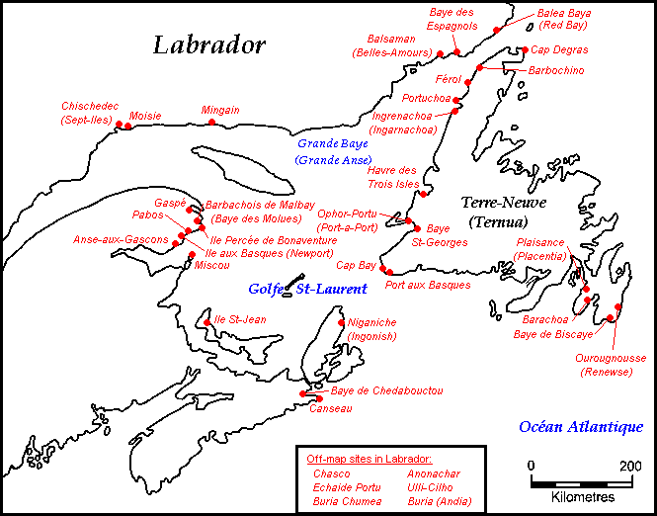
The four voyages of Christopher Columbus 1492–1503
Basque fishing sites in Canada in the 16th and 17th centuries
http://en.wikipedia.org/wiki/File:Basques_Newfoundland.gif

Slide 67
  The Exchange of Food Between the Old and New Worlds
“. . . The movement of foods across Asia and Europe and then across the Atlantic Ocean (in both directions) reminds us that the process of globalization with respect to food is not a new one”
humans have had a globalized food system for a long time
The Cultural Feast, 2nd Ed., p. 60

Slide 68
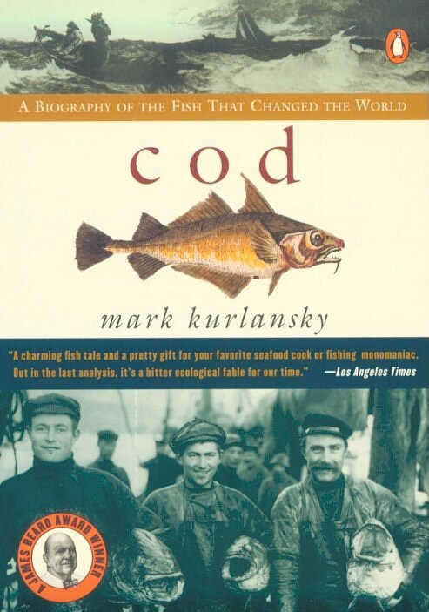
Penguin, 2003

Slide 69
Simon & Schuster 2003

Slide 70
REM Eight Food “Revolutions”
Invention of Cooking
Discovery that Food is More Than Sustenance
The “Herding Revolution”
Snail Farming
Use of Food as a Means and Index of Social Differentiation
Long-Range Exchange of Culture
Ecological Revolution of last 500 years
Industrial Revolution of the 19th and 20th Centuries
Simon & Schuster 2003

Slide 71
REM Eight Food “Revolutions”
Invention of Cooking
Discovery that Food is More Than Sustenance
The “Herding Revolution”
Snail Farming
Use of Food as a Means and Index of Social Differentiation
Long-Range Exchange of Culture
Ecological Revolution of last 500 years
Industrial Revolution of the 19th and 20th Centuries
Simon & Schuster 2003

Slide 72
Food in Historical Perspective: Dietary Revolutions
Food in Historical Perspective:
Dietary Revolutions
  The Agricultural Revolution of the Neolithic Era
  The Search for Spices
  The Industrial Revolution
  Transportation, Refrigeration, and Canning
  The Scientific Revolution
  Modern-Day Adaptations
  Summary
  Highlight: Vegetarian Diets: Then and Now
  The Exchange of Food Between the Old and New Worlds

Slide 73
  The Exchange of Food Between the Old and New Worlds
  “Although the New World produced few of the spices
  that helped spur the overseas voyages of exploration,
  it did contribute many new foods
  to the Old World diet”
The Cultural Feast, 2nd Ed., p. 58

Slide 74
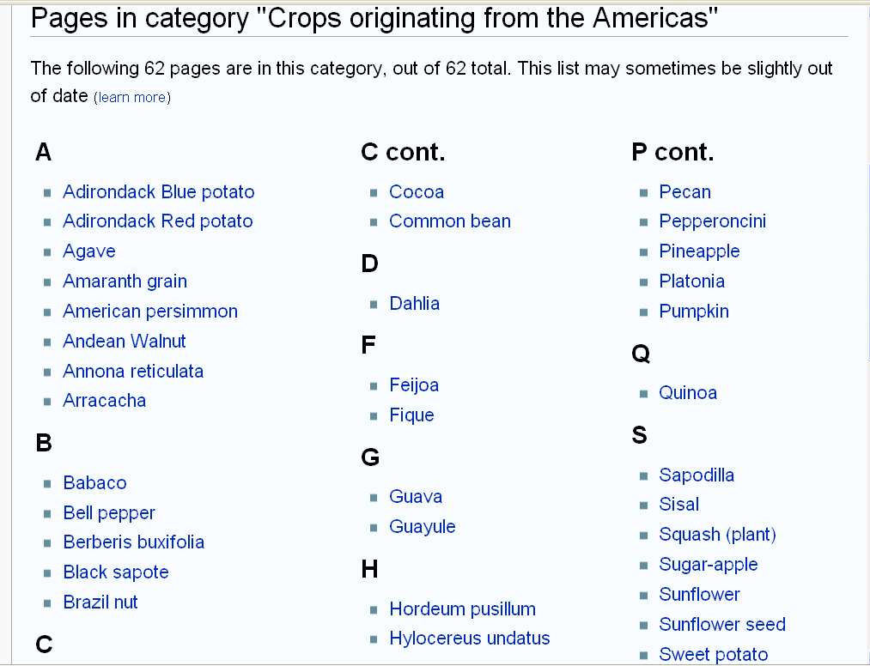
Crops originating from the Americas
http://en.wikipedia.org/wiki/Category:Crops_originating_from_the_Americas

Slide 75
  The Exchange of Food Between the Old and New Worlds
  The European explorers and settlers rejected many of the
  American Indian foods . . .
    foods sometimes weren’t exportable
    wouldn’t grow well in alien soil
    conflicted with Europeans’ cultural sensibilities
The Cultural Feast, 2nd Ed., p. 58

Slide 76
  The Exchange of Food Between the Old and New Worlds
  Spanish Conquistadors . . .
    rejected Indians’ crawling delicacies
      ants
      spiders
      gusanos (“grub worms”)
      newts
      iguanas
      aphids
The Cultural Feast, 2nd Ed., p. 58

Slide 77
  The Exchange of Food Between the Old and New Worlds
  Spanish conquistadors . . .
    rejected Indians’ crawling delicacies
      ants
      spiders
      gusanos (“grub worms”)
      newts
      iguanas
      aphids
The Cultural Feast, 2nd Ed., p. 58

Slide 78
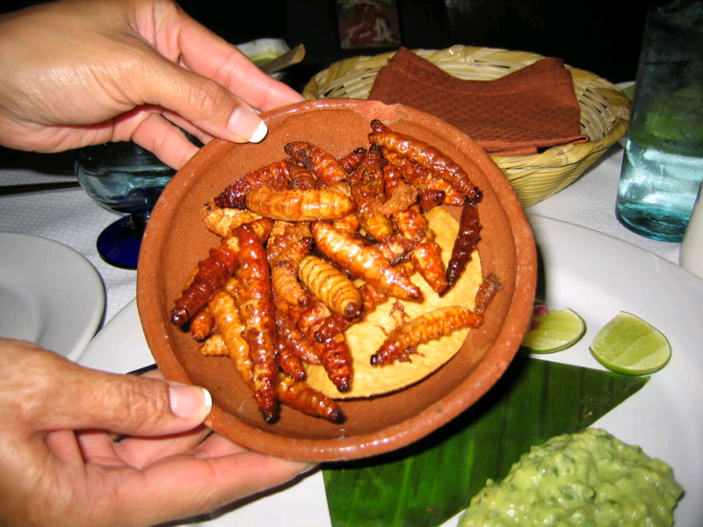
gusanos
Gusanos de maguey

Slide 79
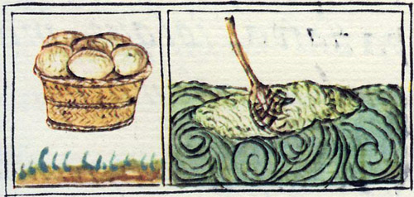
Aztec harvest of insect eggs and the tortillas from which they were made
Florentine Codex
late 16th century

Slide 80
  The Exchange of Food Between the Old and New Worlds
  American Indians seemed to be more accepting of European food practices . . .
    European prepared meats
    vegetables
    “. . . even ship’s biscuit[s]
    (a hard, tasteless affair)”
The Cultural Feast, 2nd Ed., p. 58

Slide 81
  The Exchange of Food Between the Old and New Worlds
  the story of European settlers colonizing the Americas . . . illustrates how the diets of different cultures are affected by contact with each other . . .
    exchange of foodstuffs altered dietary patterns radically
    and, eventually, world economic patterns
The Cultural Feast, 2nd Ed., p. 58

Slide 82
  The Exchange of Food Between the Old and New Worlds
  “In the early 1600s English colonists settled the eastern coast of the present-day United States, bringing with them the gastronomic tastes of the British Isles”
    but why did some of the new arrivals starve in “the land of plenty?”
The Cultural Feast, 2nd Ed., pp. 58-59

Slide 83
  The Exchange of Food Between the Old and New Worlds
  “First, the colonists did not have much experience making their way in the wilderness”
    in the first permanent English colony, Jamestown, VA, most of the colonists were hoping to get rich quick via precious metals
    they were poorly prepared for the hard work and endurance required of them in the New World
The Cultural Feast, 2nd Ed., p. 59

Slide 84
  The Exchange of Food Between the Old and New Worlds
  “First, the colonists did not have much experience making their way in the wilderness”
    poor timing
      the Pilgrims arrived in December
The Cultural Feast, 2nd Ed., p. 59

Slide 85
  The Exchange of Food Between the Old and New Worlds
  “The colonists’ survival was jeopardized by their reluctance to accept new foods available in America”
    settlers relied on shipments sent from England rather than collecting fish and other foods that were locally abundant
      but when shipments failed the colonists began to adopt some of the staples in the native Indian diet
The Cultural Feast, 2nd Ed., p. 59

Slide 86
  The Exchange of Food Between the Old and New Worlds
  “The colonists’ survival was jeopardized by their reluctance to accept new foods available in America”
    Jamestown settlers considered the Indians’ corn to be an inferior type of wheat and called it “savage trash”
      that Indian corn now is part 20-25% of all foods available in U.S. supermarkets
      and it powers modern Americans’ automobiles
The Cultural Feast, 2nd Ed., p. 59

Slide 87
  The Exchange of Food Between the Old and New Worlds
  “. . . people are much more likely to accept new foods if they
  are similar in some way to the foods they already eat”
    beans were accepted
    squash was adopted
      it looked a little bit like some European foods
The Cultural Feast, 2nd Ed., p. 59

Slide 88
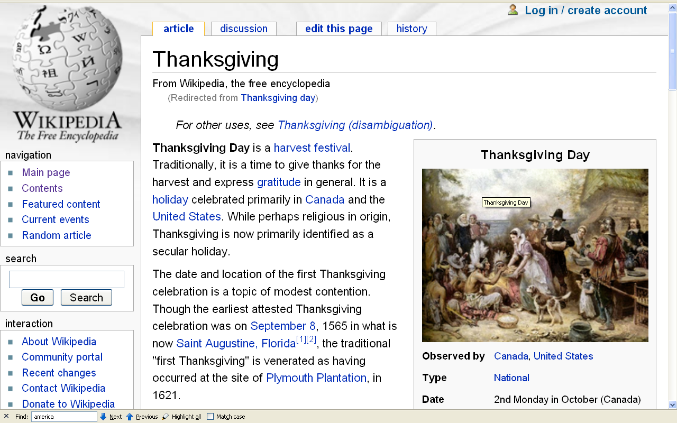
http://en.wikipedia.org/wiki/Thanksgiving

Slide 89
you know the story . . .
Plymouth Colony
autumn 1621
about 90 Native Americans “shared a bountiful meal with the Pilgrims . . .”
“. . . Pilgrims were grateful for the end of a difficult year, a successful harvest, and the Indians; help in learning how to secure food in the new land . . .”
The Cultural Feast, 2nd Ed., p. 59
http://en.wikipedia.org/wiki/Thanksgiving

Slide 90
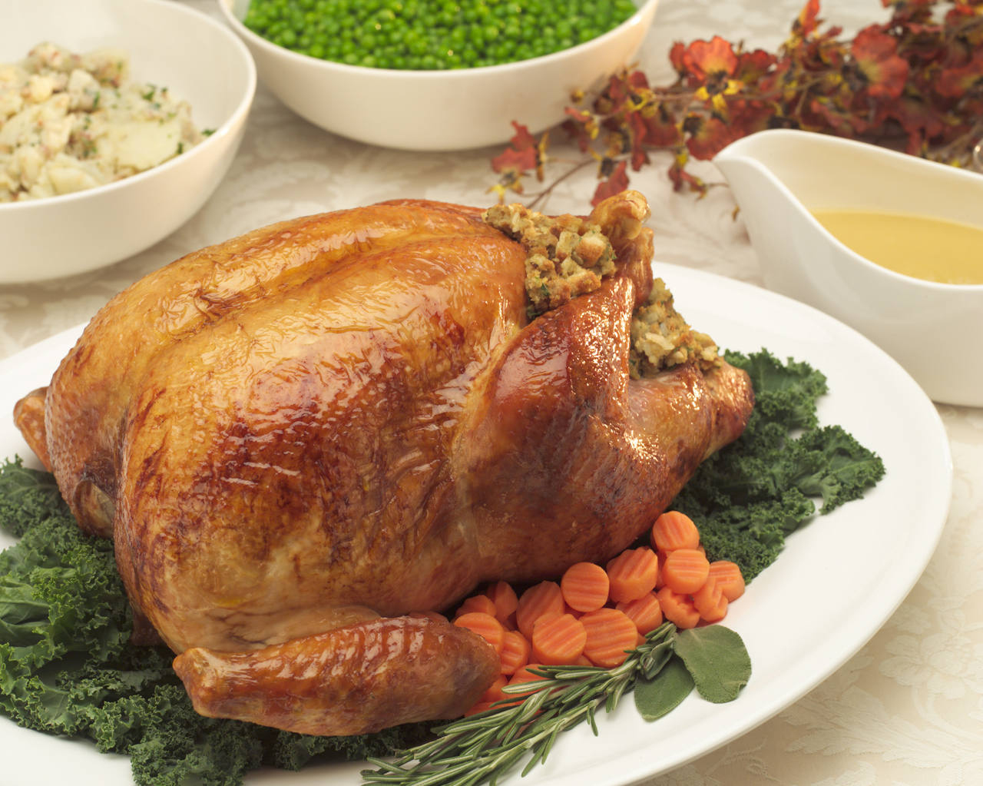

Slide 91
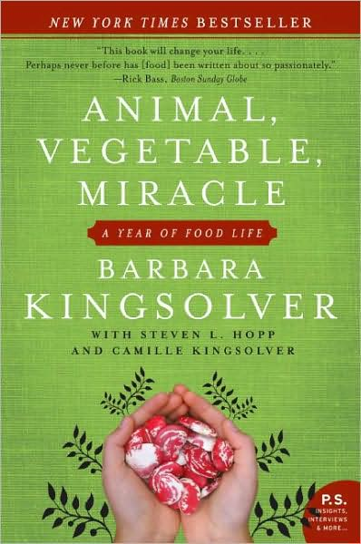
for a modern take on turkeys, have a look at
Animal, Vegetable, Miracle
HarperCollins, 2008

Slide 92
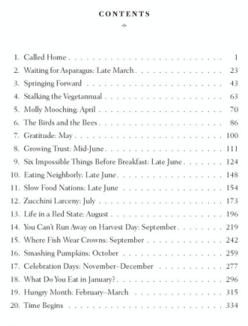
HarperCollins, 2008

Slide 93
The Plymouth Colony Menu
(probably included)
turkey
corn
squash
pumpkin
    but stewed in cinnamon of Asian origin
and from the Old World
  carrots
  onions
  cabbage
The Cultural Feast, 2nd Ed., p. 59

Slide 94
colonist also worked hard to develop “their beloved European foods”
apples
peaches
apricots
pears
a variety of vegetables
a variety of beans
  and the natives were “quite receptive
  to these unfamiliar foods” . . .
  especially the ones that resembled their own
The Cultural Feast, 2nd Ed., p. 59

Slide 95
colonist also worked hard to develop “their beloved European foods”
apples
peaches
apricots
pears
a variety of vegetables
a variety of beans
  and the natives were “quite receptive
  to these unfamiliar foods” . . .
  especially
  the ones that resembled their own
The Cultural Feast, 2nd Ed., p. 59

Slide 96
“The introduction of domestic animals by the Europeans was also accepted and added to the Indians’ predominantly vegetable-based diet”
the pig was most readily adopted into the native food system
cows came to Florida about 1550
    providing access to milk and beef
sheep became popular among some tribes (like the Navajo) . . .
The Cultural Feast, 2nd Ed., p. 60

Slide 97
  The Exchange of Food Between the Old and New Worlds
“The most significant American crops introduced to the Europeans were . . .”
the potato
  which originated in South America
corn
    the British used the word “corn” as a generic term for grain
    when corn was imported to England, it was referred to as “maize”, or “Indian corn”
    corn became important as animal food
    in many places
The Cultural Feast, 2nd Ed., p. 60

Slide 98
  The Exchange of Food Between the Old and New Worlds
“The most significant American crops introduced to the Europeans were . . .”
the potato
corn
    the British used the word “corn” as a generic term for grain
    when corn was imported to England, it was referred to as maize, or “Indian corn”
    corn became important as animal food in many places
    corn and potatoes
    helped lay the foundation for
    the industrial revolution
we’ll see more on this in the slide set
“The Industrial Revolution”
The Cultural Feast, 2nd Ed., p. 60

Slide 99
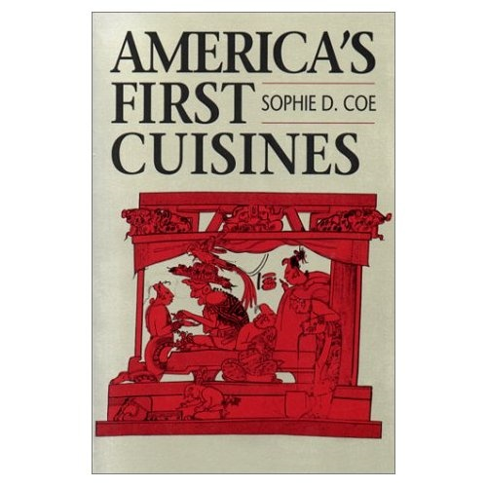
the best work on pre-Columbian food
(from an anthropological point of view)
is
America’s First Cuisines
Austin: University of Texax Press, 1994

Slide 100
  The Exchange of Food Between the Old and New Worlds
among “the most significant American crops introduced to the Europeans . . .” was
chocolate
  which originated in South America

Slide 101
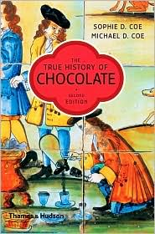
there are several excellent works on chocolate;
this is one of them
Thames & Hudson, 2007

Slide 102

a closing observation from Everyone Eats . . .
New York University Press 2005

Slide 103
another consequence of our primate heritage and enlarged brain is that
we are blessed and cursed with an insensate craving
for sweets and fats
we seem especially fond
of sweet-sour foods
  in nature, ripe fruits and berries
we love animal fats
and vegetable fats equally
  nuts, seeds, oily fruits
Everyone Eats pp. 33-34

Slide 104
these are high-calorie, easily digestible foods that are most easily found in a rich patch following a burn
Everyone Eats pp. 33-34

Slide 105
“so the human tendency to crave certain foods is biologically grounded” for . . .
salty foods
fatty foods
sweet foods
Everyone Eats pp. 33-34

Slide 106
“so the human tendency to crave certain foods is biologically grounded” for . . .
salty foods
fatty foods
sweet foods
Everyone Eats pp. 33-34

Slide 107
  The Exchange of Food Between the Old and New Worlds
“the most significant American crops introduced to the Europeans” included . . .”
sugar (one of those things we biologically crave)
  which originated in India
    during the Gupta dynasty, around A.D. 350
  became important in the exchange of food between the New and Old World later on
The Cultural Feast, 2nd Ed., p. 60

Slide 108
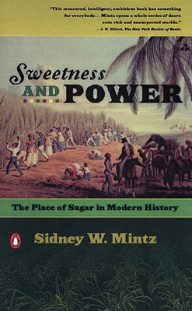
this is the definitive work on sugar
(from an anthropological point of view)
when Mark Kurlansky was asked if he was thinking about writing a book on sugar he responded, “No. It has already been written [by Mintz].”
Penguin 1986

Slide 109
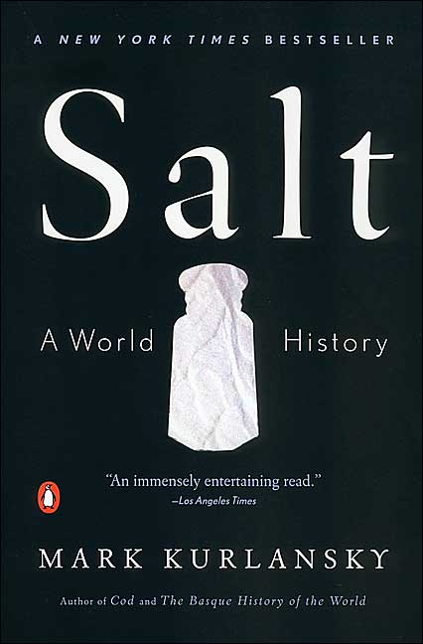
salt is also one of those things we crave . . .
(and this is the definitive work on salt)
Penguin, 2003

Slide 110
salt and sugar played major roles
in early food preservation . . .
along with dehydrating, pickling, and freezing . . .
it was up to Napoleon, looking to feed his troops, to come up with preserving food by means of canning . . .

Slide 111
salt and sugar played major roles
in early food preservation . . .
along with dehydrating, pickling, and freezing . . .
it was up to Napoleon, looking to feed his troops, to come up with preserving food by means of canning . . .
and that brings us to the slide sets dealing with . . .
The Industrial Revolution
and
Early Technology: Transportation, Refrigeration, Canning

Slide 112
have a look

Slide 113
Food in Historical Perspective:
The Search for Spices
Anthropology of Food
University of Minnesota Duluth
Tim Roufs
©2010-2024

