Slide 1

Food in Historical Perspective:
Dietary Revolutions —
Modern-Day Adaptations
Anthropology of Food
University of Minnesota Duluth
Tim Roufs
©2010-2024

Slide 2
Food in Historical Perspective: Dietary Revolutions
Food in Historical Perspective:
Dietary Revolutions
  The Agricultural Revolution of the Neolithic Era
  The Search for Spices
  The Industrial Revolution
  Transportation, Refrigeration, and Canning
  The Scientific Revolution
  Modern-Day Adaptations
  Summary
  Highlight: Vegetarian Diets: Then and Now

Slide 3
  Modern-Day Adaptations
        in the last 40 years science and technology have produced a food supply containing a large menu of chemical compounds never before ingested by humans
          we know little of these chemicals’ effects on liver function, nerve tissues, the immunological system, fetal development, or biochemical genetics
The Cultural Feast, 2nd Ed., p. 71

Slide 4
  Modern-Day Adaptations
        The questions we must ask ourselves
        today are . . .
          “How are we adapting to these new environmental stresses?”
The Cultural Feast, 2nd Ed., p. 71

Slide 5
  Modern-Day Adaptations
        The questions we must ask ourselves
        today are . . .
          “How are we adapting to these new environmental stresses?”
          “What will these adaptations bring for life tomorrow?”
The Cultural Feast, 2nd Ed., p. 71

Slide 6

Euronews
11 August 2021
https://www.euronews.com/green/2021/08/11/the-countries-that-could-go-extinct-due-to-climate-change-may-surprise-you

Slide 7
  Modern-Day Adaptations
        The questions we must ask ourselves
        today are . . .
          “How are we adapting to these new environmental stresses?”
          “What will these adaptations bring for life tomorrow?”
this is one of the main questions Spencer Wells
(of National Geographic fame)
addresses in his important — book Pandora’s Seed
(Random House 2010)
The Cultural Feast, 2nd Ed., p. 71

Slide 8
Random House 2010

Slide 9
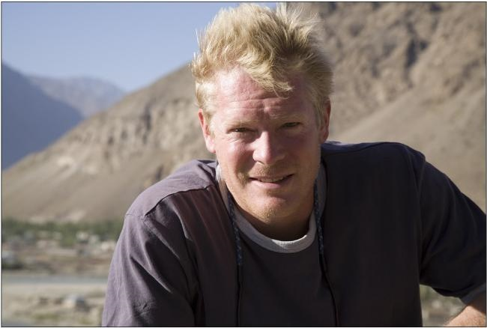
Random House 2010

Slide 10
Spencer Wells talks about
“transgenerational power”
which is a concept dealing with “. . . the idea that, with the increase in our power over the world around us brought about through the development of agriculture, we gained the power to affect events many generations down the line”
Note the concept. This is an increasingly important topic of discussion . . .
Random House 2010

Slide 11
Biocultural Consequences: Diversity
humans still rely on the seeds of a few grasses, several root crops and a few domesticated fowl and mammals
agricultural scientists are attempting to reestablish some genetic diversity through the introduction of "wild" strains

Slide 12
Biocultural Consequences: Diversity
and many people are preserving seeds and heritage foods to try to maintain genetic diversity so that current varieties of plants will be available to future generations . . .
for example . . .

Slide 13
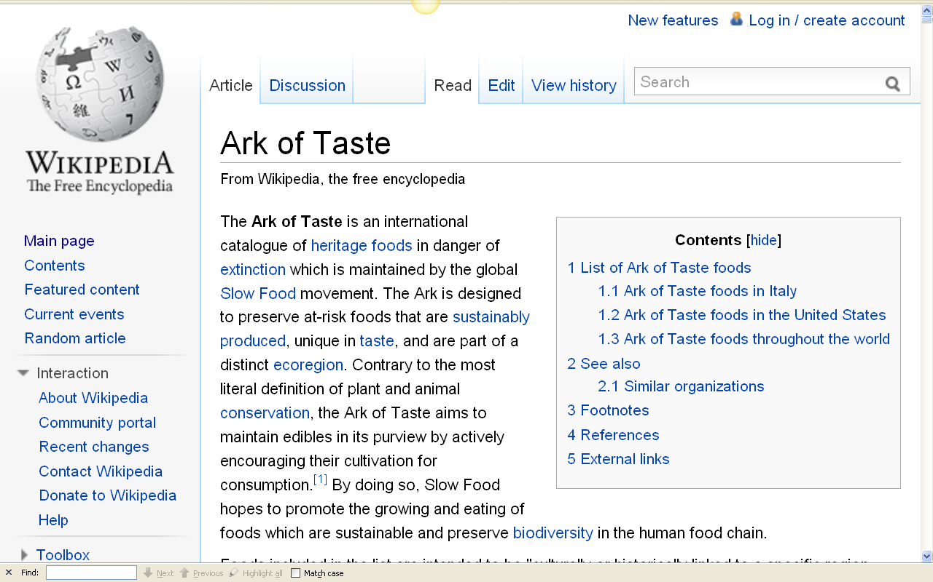
http://en.wikipedia.org/wiki/Ark_of_Taste

Slide 14
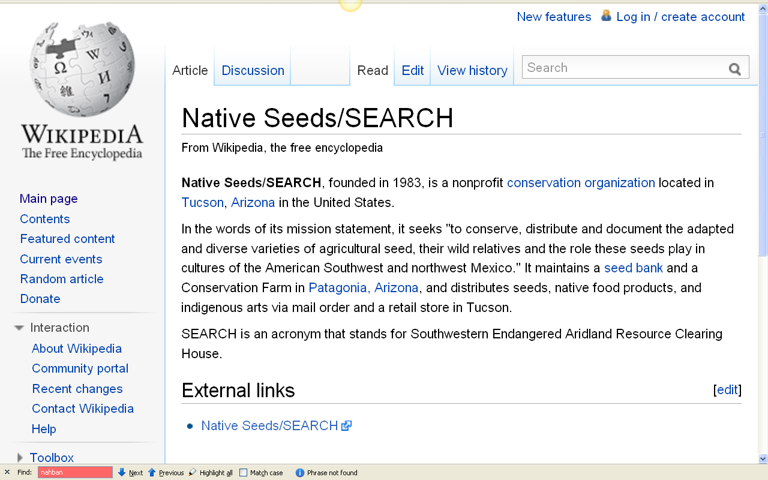
http://en.wikipedia.org/wiki/Native_Seeds/SEARCH

Slide 15

http://en.wikipedia.org/wiki/Native_Seeds/SEARCH

Slide 16

http://www.nativeseeds.org/

Slide 17
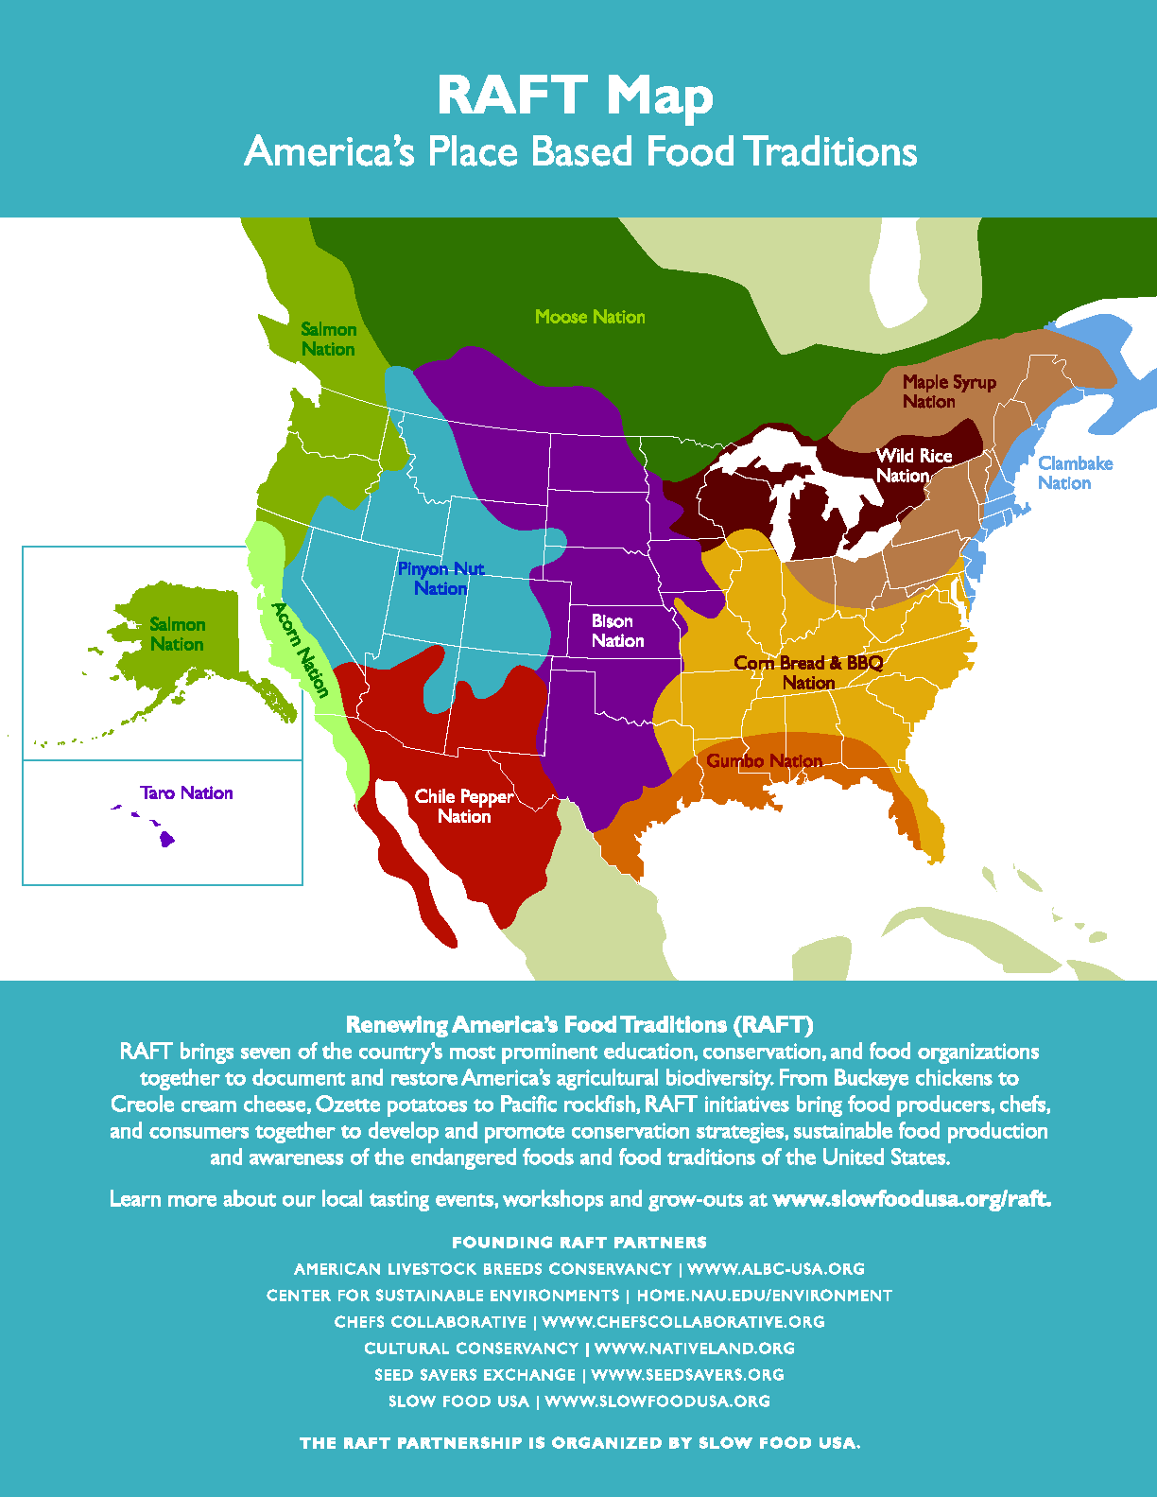

Slide 18
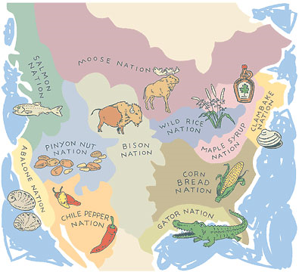

Slide 19
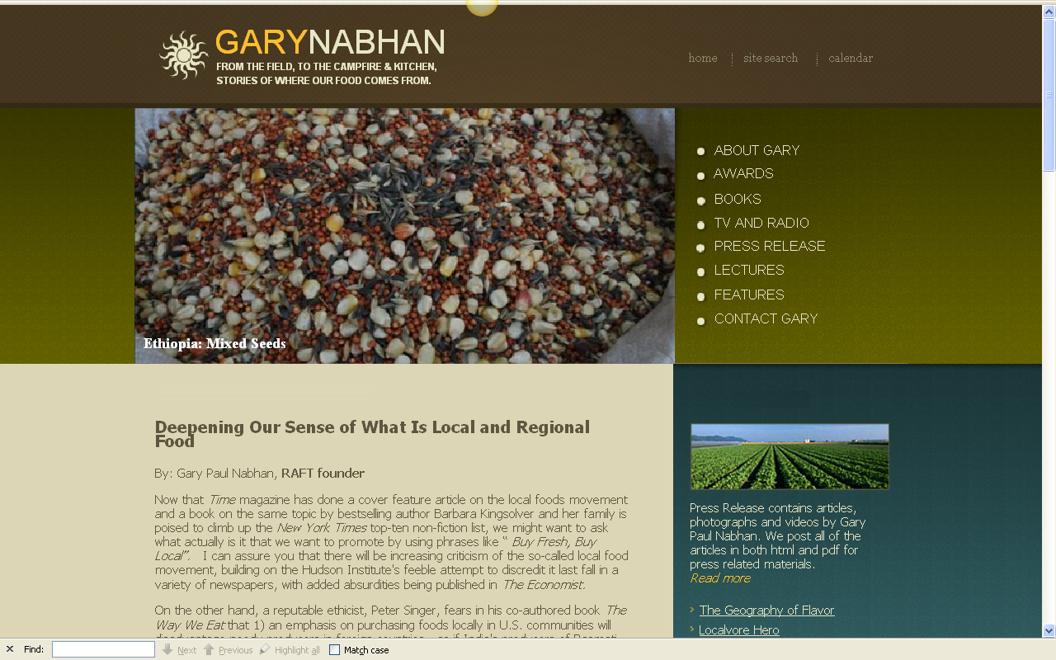

instrumental in these efforts is Gary Paul Nabhan,
a major contemporary award-winning writer of the Anthropology of Food . . .
http://www.garynabhan.com/press/gpn000016.html

Slide 20

http://www.garynabhan.com/about.html

Slide 21
Gary Paul Nabhan is a main person in these efforts, and one of the leading contemporary authors in the area of Anthropology of Food . . . an author whose works are worth reading . . .
If you do not yet have a term project, check out his works . . .
You might find something interesting . . .
on saving seeds . . .
on preserving heirloom plants . . .
on locavorism, especially focusing on American Indian foods . . .
on why some people like hot sauce . . .
on why cultural groups respond differently to drinking alcohol . . .
on lactose intolerance . . .
and on a whole host of interesting topics related to
The Anthropology of Food
http://www.garynabhan.com/about.html

Slide 22

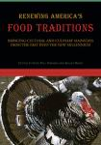


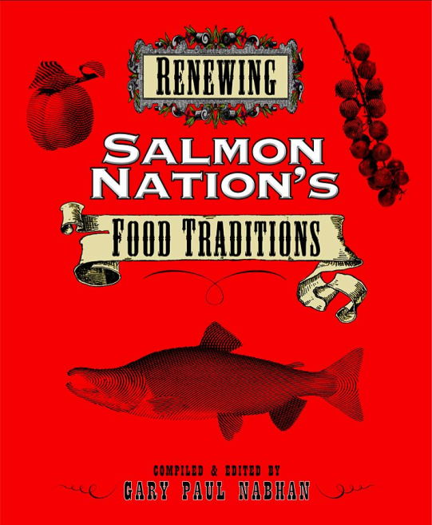


have a look at these if you need project ideas . . .

Slide 23
  Modern-Day Adaptations
        there is no doubt that we are responding
        to dietary change on all three levels . . .
          genetically
          physiologically
          behaviorally
The Cultural Feast, 2nd Ed., p. 71

Slide 24
  Modern-Day Adaptations
        there is no doubt that we are responding
        to dietary change on all three levels . . .
          genetically
          physiologically
          behaviorally
The Cultural Feast, 2nd Ed., p. 71

Slide 25
  Modern-Day Adaptations
        there is no doubt that we are responding
        to dietary change on all three levels . . .
          genetically
          physiologically
          behaviorally
  this is evidenced in different rates of fertility, morbidity, and mortality found among people in industrialized and nonindustrialized nations
The Cultural Feast, 2nd Ed., p. 71

Slide 26
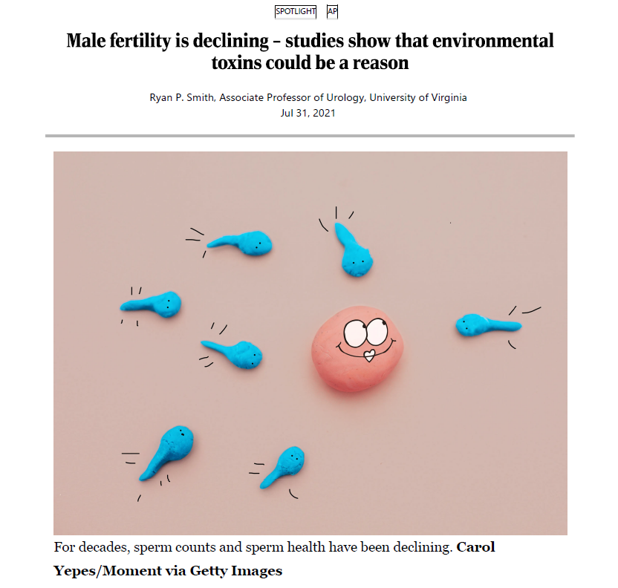
Madison.com
Ryan P. Smith
Jul 31, 2021
https://madison.com/lifestyles/health-med-fit/male-fertility-is-declining-studies-show-that-environmental-toxins-could-be-a-reason/article_08cf078a-7482-57ac-a7a8-462a9c04d394.html

Slide 27


Sophie McBain
Jul 30, 2021
https://www.afr.com/life-and-luxury/arts-and-culture/how-a-declining-birth-rate-will-reshape-the-world-20210715-p58a2g

Slide 28
  Modern-Day Adaptations
        there is no doubt that we are responding
        to dietary change on all three levels . . .
          genetically
          physiologically
          behaviorally
  humankind is still undergoing biological evolution
The Cultural Feast, 2nd Ed., p. 71

Slide 29
  Modern-Day Adaptations
        there is no doubt that we are responding
        to dietary change on all three levels . . .
          genetically
          physiologically
          behaviorally
The Cultural Feast, 2nd Ed., p. 71

Slide 30
  Modern-Day Adaptations
        there is no doubt that we are responding
        to dietary change on all three levels . . .
          genetically
          physiologically
          behaviorally
  low infant mortality and increased longevity in industrial societies attests to our physiological adaptability
The Cultural Feast, 2nd Ed., p. 71

Slide 31
  Modern-Day Adaptations
        there is no doubt that we are responding
        to dietary change on all three levels . . .
          genetically
          physiologically
          behaviorally
  but recent warnings about the sustainability of agricultural methods, the potential carcinogenic effects of food additives, and the ever-growing number of occupational and environmental hazards remind us that our physiological adaptability also has limits . . .
The Cultural Feast, 2nd Ed., p. 71

Slide 32
  Modern-Day Adaptations
        there is no doubt that we are responding
        to dietary change on all three levels . . .
          genetically
          physiologically
          behaviorally
  . . . and the limits are being exceeded by our modern, industrialized way of life
The Cultural Feast, 2nd Ed., p. 71

Slide 33
  Modern-Day Adaptations
        there is no doubt that we are responding
        to dietary change on all three levels . . .
          genetically
          physiologically
          behaviorally
The Cultural Feast, 2nd Ed., p. 71

Slide 34
  Modern-Day Adaptations
        there is no doubt that we are responding
        to dietary change on all three levels . . .
          genetically
          physiologically
          behaviorally
  we are trying numerous adaptive strategies . . .
The Cultural Feast, 2nd Ed., p. 71

Slide 35
  Modern-Day Adaptations
        there is no doubt that we are responding
        to dietary change on all three levels . . .
          genetically
          physiologically
          behaviorally
  in the U.S.A., for e.g., many chemicals are restricted by government agencies
    cyclamates
    DDT
    Red Dye No. 2
    the soil fumigant EDB
    dioxin
The Cultural Feast, 2nd Ed., p. 71

Slide 36
  Modern-Day Adaptations
        there is no doubt that we are responding
        to dietary change on all three levels . . .
          genetically
          physiologically
          behaviorally
  increasingly large numbers are making changes in personal consumption patterns
    switching to organically and locally grown vegetables
    passing up most of the highly processed convenience food
    espousing vegetarian, vegan, and other diets
    joining the Slow Food movement
    exploring non-traditional (for them) foods . . .
The Cultural Feast, 2nd Ed., p. 71

Slide 37
  Modern-Day Adaptations
        there is no doubt that we are responding
        to dietary change on all three levels . . .
          genetically
          physiologically
          behaviorally
  “. . . culture offers us the most rapid and flexible way to adapt to an ever-changing environment”
    insects or worms anyone?
The Cultural Feast, 2nd Ed., p. 71

Slide 38
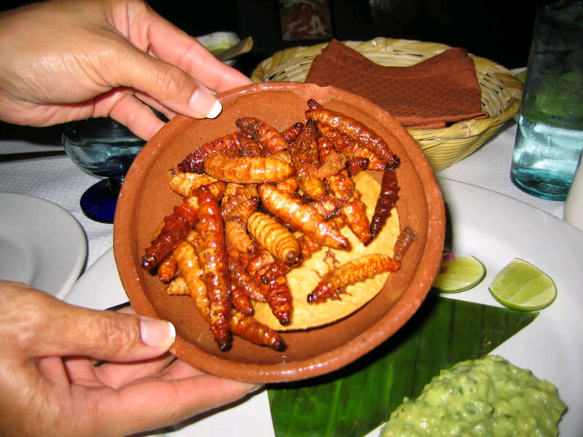
more
gusanos?
Gusanos de maguey

Slide 39
Food in Historical Perspective:
Dietary Revolutions —
Modern-Day Adaptations
Anthropology of Food
University of Minnesota Duluth
Tim Roufs
©2010-2024

