Slide 1
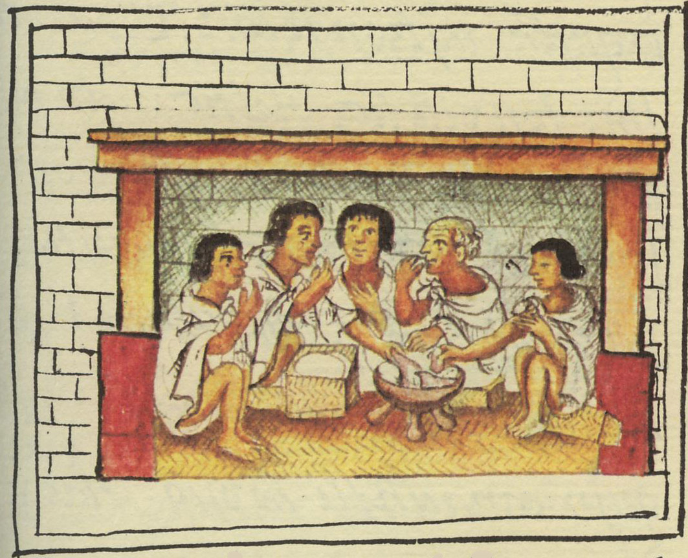
Social and Political Consequences
of the Agricultural Revolution
Aztec men sharing a meal.
Florentine Codex, late 16th century
Anthropology of Food
University of Minnesota Duluth
Tim Roufs
©2010-2024

Slide 2

this is a major work on the social, political, and nutritional consequences of “The Agricultural Revolution” . . .
and it’s a very good read
NY: Random House, 2010

Slide 3
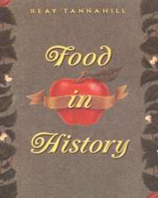
and Reay Tannahill’s work is also excellent . . .
Reay Tannahill,
(NY: Three Rivers Press, 1988)

Slide 4
Food in Historical Perspective: Dietary Revolutions
Food in Historical Perspective:
Dietary Revolutions
  The Agricultural Revolution of the Neolithic Era
  The Search for Spices
  The Industrial Revolution
  Transportation, Refrigeration, and Canning
  The Scientific Revolution
  Modern-Day Adaptations
  Summary
  Highlight: Vegetarian Diets: Then and Now
  Development of Agriculture in the Tehuacán Valley
  Nutritional Consequences of the Agricultural Revolution: A Comparison of Foragers and Agriculturalists
  Social and Political Consequences of the Agricultural Revolution

Slide 5
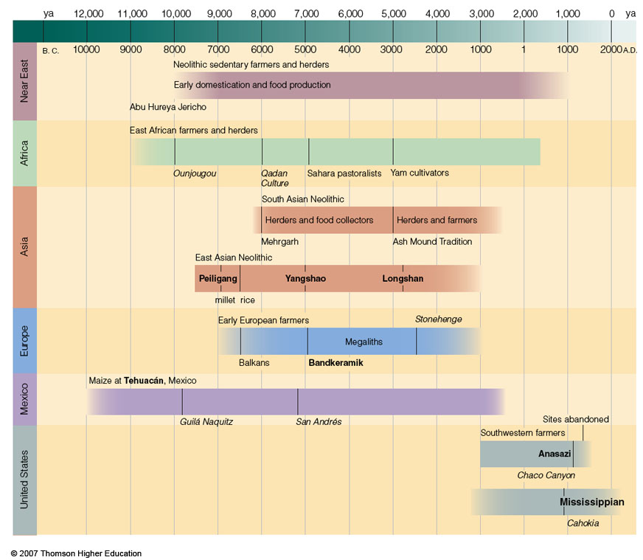
the far-reaching consequences of
food production
began with the
“Neolithic Revolution”
aka outside of the Near East as the
“Agricultural Revolution”
Timeline for Ch.16 "Food Production”
Understanding Physical Anthropology and Archaeology, 9th Ed., p. 333

Slide 6
  as a result of the Agricultural Revolution people began to have and see . . .
    surplus food
    trade and trade networks
    specialization of production
    specialized laborers
    increased social interaction
    food storage for times of shortage
    surplus is “taxed”
    monumental architecture
    competition for limited resources
    private property
    class systems
    organized governments (political / religious / military hierarchies)
    and the list goes on . . .

Slide 7
  as a result of the Agricultural Revolution
  people began to have and see . . .
    surplus food promotes cultural change
    trade and trade networks
    specialization of production
    specialized laborers
    increased social interaction
    food storage for times of shortage
    surplus is “taxed”
    monumental architecture
    competition for limited resources
    private property
    class systems
    organized governments (political / religious / military hierarchies)
    and the list goes on . . .

Slide 8
  Social and Political Consequences
  of the Agricultural Revolution
  surplus food
    fostered trade with people in other ecological zones
    allowed access to previously unknown commodities
    for the first time in history not everyone had to be involved in food-getting activities
The Cultural Feast, 2nd Ed., p. 55

Slide 9
  Social and Political Consequences
  of the Agricultural Revolution
  surplus food
    fostered trade with people in other ecological zones
    allowed access to previously unknown commodities
    for the first time in history not everyone had to be involved in food-getting activities
The Cultural Feast, 2nd Ed., p. 55

Slide 10
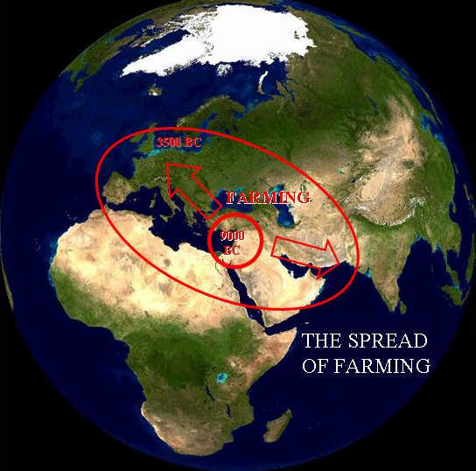
diffusion
occurred from all of the centers
of agricultural domestication
“A dialectical model of Neolithic Origins”
www.archatlas.dept.shef.ac.uk/OriginsFarming/Farming.php

Slide 11
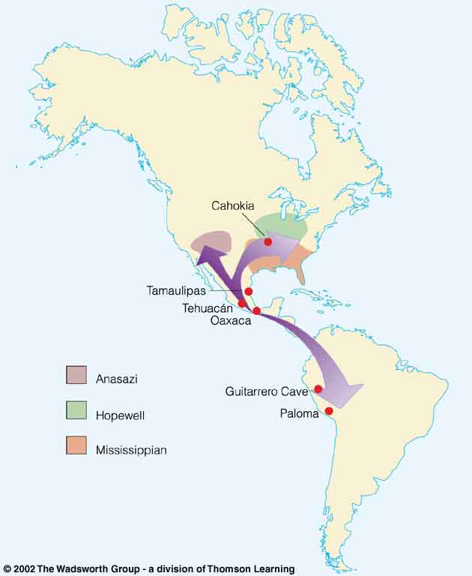
and the maize, beans, squash, chili “complex” spread throughout much of North and northern South America . . .

Slide 12
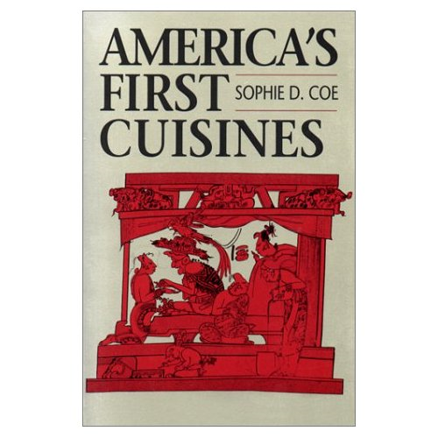
maize
manioc
potatoes, sweet potatoes, yams
beans
peanuts
squash
pineapples
avocados
tomatoes
chocolate
vanilla
chili
in prehistoric America, for e.g., various regions began to have new foods from other regions, and after contact with Europeans their foods were even more widely traded (throughout most of the world), and, in come cases, becoming central to the cuisines of other cultures . . .
America’s First Cuisines, Chs. 2 and 3
Notes:
12

Slide 13
maize
manioc
potatoes, sweet potatoes, yams
beans
peanuts
squash
pineapples
avocados
tomatoes
chocolate
vanilla
chili
in prehistoric America, for e.g., various regions began to have new foods from other regions, and after contact with Europeans their foods were even more widely traded (throughout most of the world), and, in come cases, becoming central to the cuisines of other cultures . . .
it’s difficult, for e.g., to even imagine Italian food without tomatoes
America’s First Cuisines, Chs. 2 and 3
Notes:
13

Slide 14
barter and exchange flourished
new social order distinguished landowners and tenant farmers

Slide 15
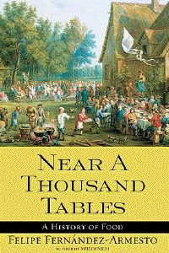
Eight Food “Revolutions”
Invention of Cooking
Discovery that Food is More Than Sustenance
The “Herding Revolution”
Snail Farming
Use of Food as a Means and Index of Social Differentiation
Long-Range Exchange of Culture
Ecological Revolution of last 500 years
Industrial Revolution of the 19th and 20th Centuries
Simon & Schuster 2003

Slide 16
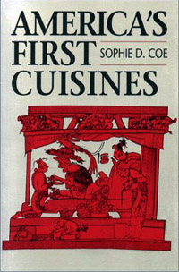
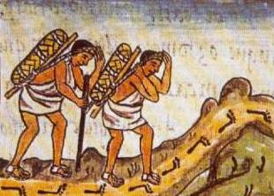
Aztec Pochteca, for e.g., travelled far and wide
(professional long-distance traveling merchants)
Florentine Codex
late 16th century
Notes:
16

Slide 17
  as a result of the Agricultural Revolution
  people began to have and see . . .
    surplus food
    trade and trade networks developed
    specialization of production
    specialized laborers
    increased social interaction
    food storage for times of shortage
    surplus is “taxed”
    monumental architecture
    competition for limited resources
    private property
    class systems
    organized governments (political / religious / military hierarchies)
    and the list goes on . . .

Slide 18
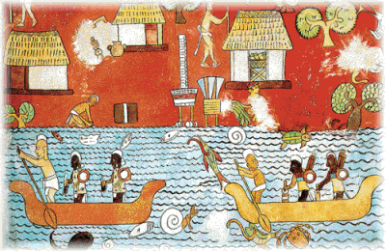
Maya trade
Bonampak
Notes:
18

Slide 19
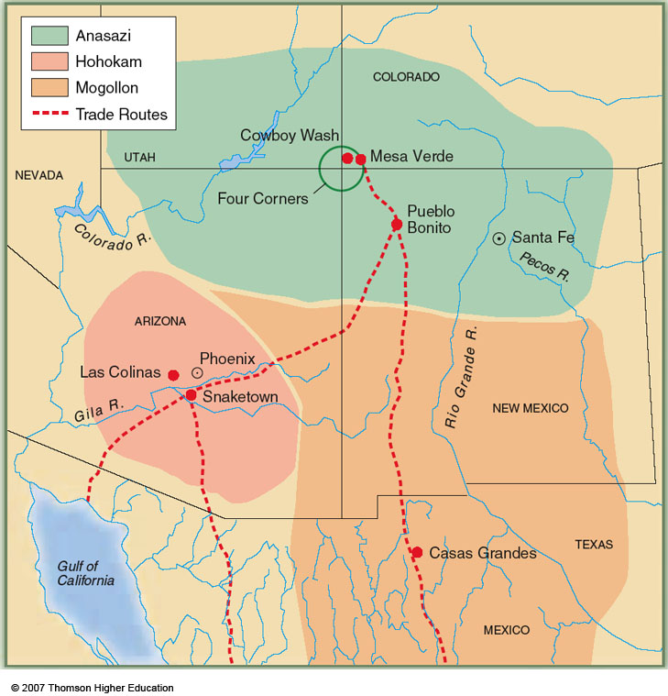
Pueblo Bonito
New Mexico
Village farming cultures of the American Southwest, showing trade routes (red)
Understanding Physical Anthropology and Archaeology, 9th Ed., p. 359

Slide 20
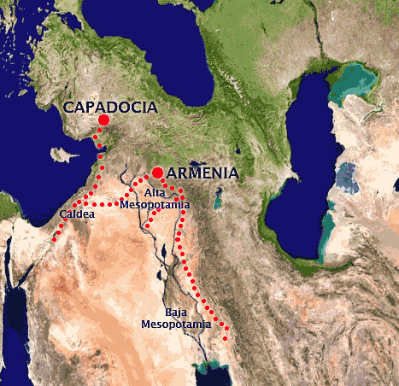
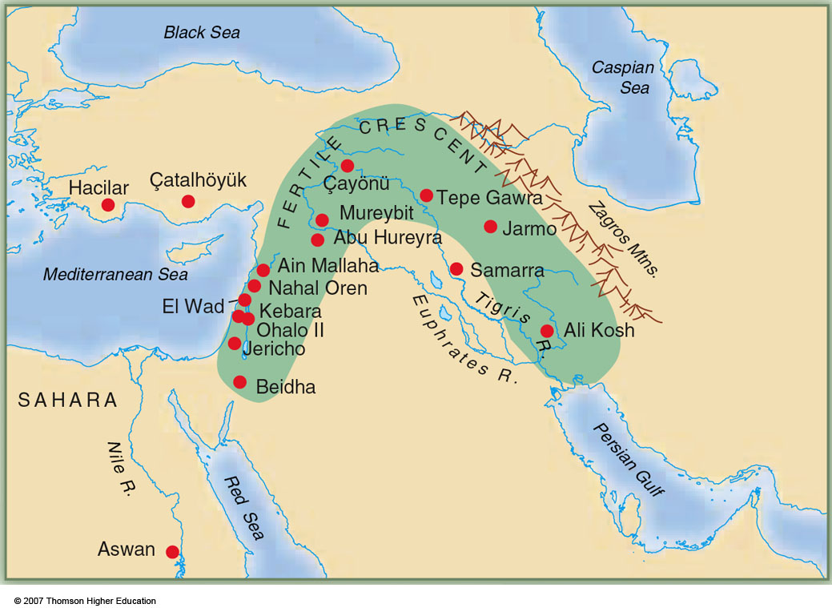
Obsidian trade
4th millennium B.C.
http://commons.wikimedia.org/wiki/File:Obsidian_trade_%28IV_millenium_BC%29.png

Slide 21
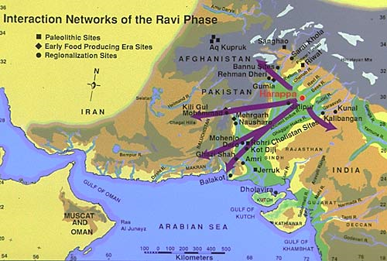
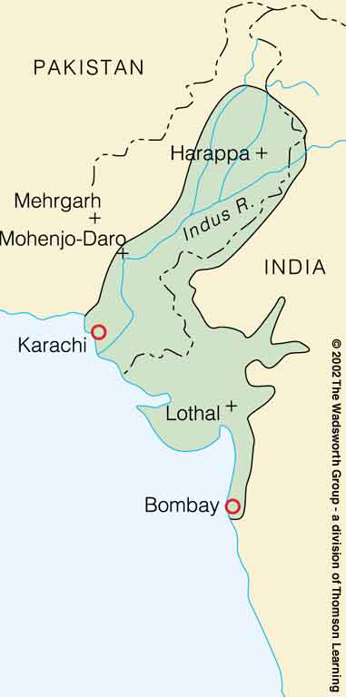
http://www.pakistanpatriot.com/?tag=moenjodaro

Slide 22
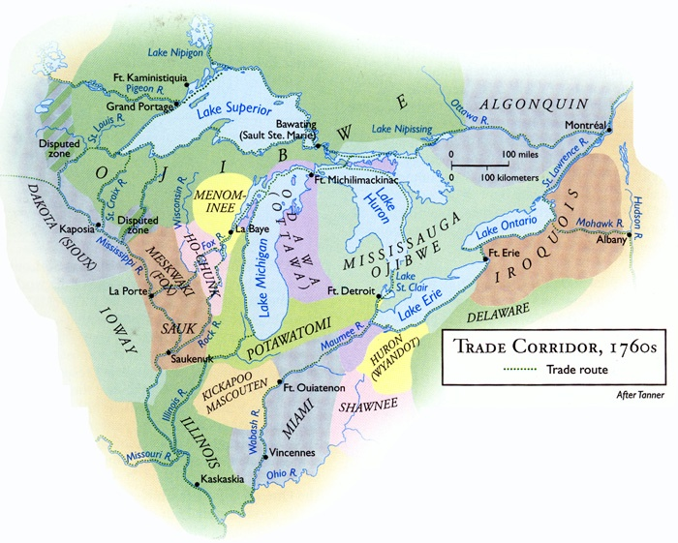
http://www.geo.msu.edu/geogmich/ojibwe.html

Slide 23
  Social and Political Consequences
  of the Agricultural Revolution
  some people also succeeded in trade and the acquisition of surplus wealth
    giving rise in many places to an
    affluent and powerful merchant class
The Cultural Feast, 2nd Ed., p. 55

Slide 24
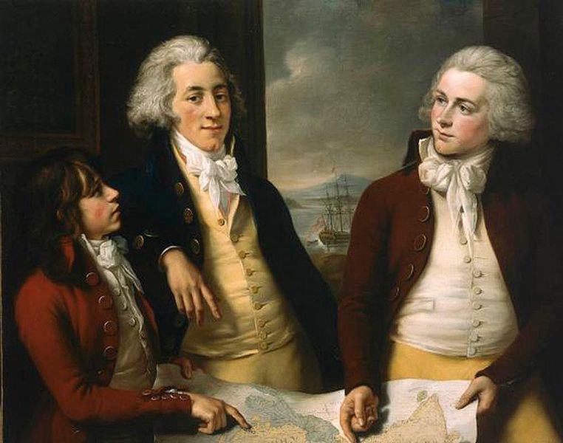
A group portrait of three sons of William Money (1738–96), an early director of the East India Company. Left to right: Robert (1775–1803), William (1769–1834), and James (1772–1833)
(1788–92)
[▼]John Francis Rigaud (1742–1810)
http://ocw.mit.edu/ans7870/21f/21f.027/rise_fall_canton_04/gallery_people/pages/cwPT_1788-92_nmm_BHC2866.htm

Slide 25
barter and exchange flourished
new social order distinguished landowners and tenant farmers . . .

Slide 26
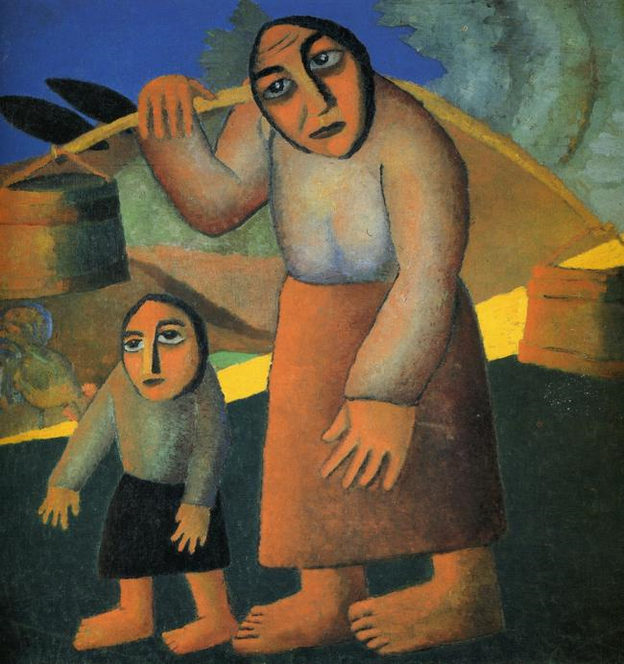
"Peasant Woman with Buckets and Child"
(1912)
Kazimir Malevich (1878-1935)
http://max.mmlc.northwestern.edu/~mdenner/Drama/visualarts/avant-garde/peasant_women14.html

Slide 27
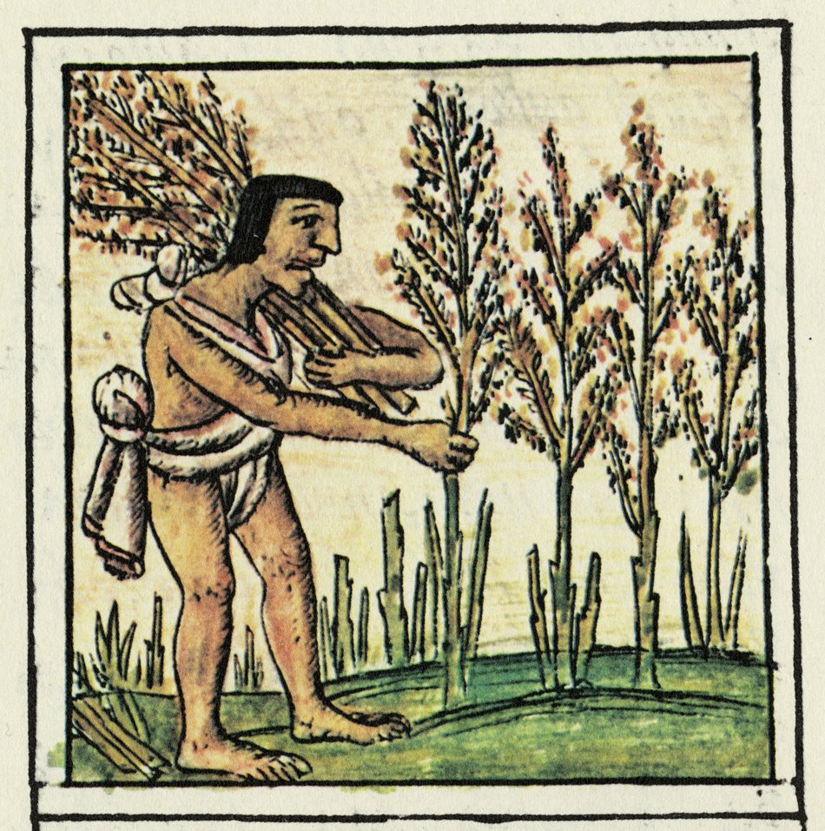
“Farmer Codex: In the Aztec world, the majority of people were farmers such as this man, harvesting his crop.”
Florentine Codex, Vol. 4, Folia 73L
http://museumanthropology.blogspot.com/2008/07/aztec-world-exhibition-at-field-museum.html

Slide 28
barter and exchange flourished
new social order distinguished landowners and tenant farmers . . . and eventually masters were distinguished from servants and slaves . . .

Slide 29
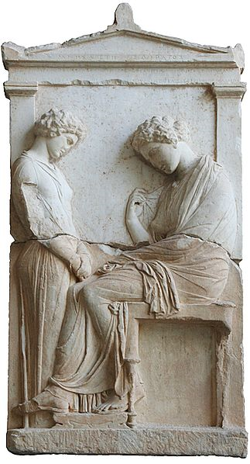
Funerary stele of Mnesarete a young servant (left) is facing her dead mistress
Attica
circa 380 B.C.
(Glyptothek, Munich, Germany)
http://museumanthropology.blogspot.com/2008/07/aztec-world-exhibition-at-field-museum.html

Slide 30
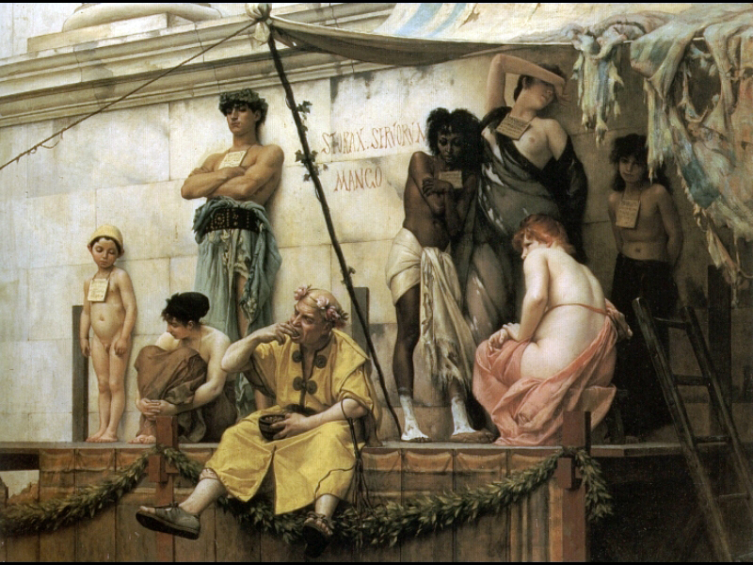
Le marché aux esclaves
(The Slave Market)
before 1882
Gustave Clarence Rodolphe Boulanger (1824-1888)
http://commons.wikimedia.org/wiki/File:Boulanger_Gustave_Clarence_Rudolphe_The_Slave_Market.jpg

Slide 31
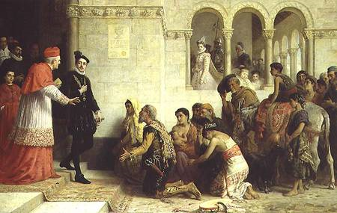
I supplicanti. Espulsione dei Gitanos dalla Spagna
1872
Edwin Longsden Long
http://commons.wikimedia.org/wiki/File:Supplicants_expulsion_gypsies_hi.jpg

Slide 32
  Social and Political Consequences
  of the Agricultural Revolution
  surplus food
    fostered trade with people in other ecological zones
    allowed access to previously unknown commodities
    for the first time in history not everyone had to be involved in food-getting activities
The Cultural Feast, 2nd Ed., p. 55

Slide 33
  as a result of the Agricultural Revolution
  people began to have and see . . .
    surplus food
    trade and trade networks
    specialization of production and
    specialized laborers appeared
    increased social interaction
    food storage for times of shortage
    surplus is “taxed”
    monumental architecture
    competition for limited resources
    private property
    class systems
    organized governments (political / religious / military hierarchies)
    and the list goes on . . .

Slide 34
non-farmers
could engage in
specialized gathering activities . . .

Slide 35
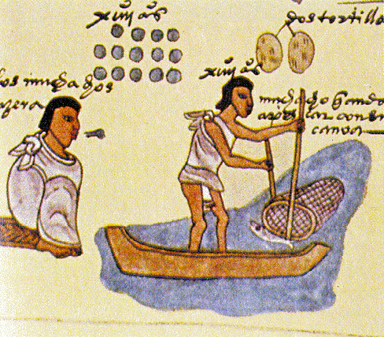
Aztecs Fishing
Florentine Codex
late 16th century

Slide 36
non-farmers
could even
specialize in gathering just one thing . . .

Slide 37


Slide 38
and non-farmers
could engage in
specialized crafts . . .

Slide 39
  Social and Political Consequences
  of the Agricultural Revolution
  people began to master crafts like . . .
    basket making
    ceramics
    bronze and metal casting
    brick making
    masonry
    other skills
The Cultural Feast, 2nd Ed., p. 55

Slide 40
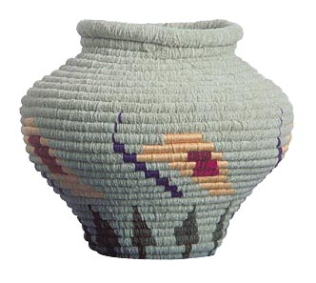
economic system allows individuals
to devote full time to occupations
like . . .
basket making
Prehistoric basketry techniques
(Jean Connor)

Slide 41
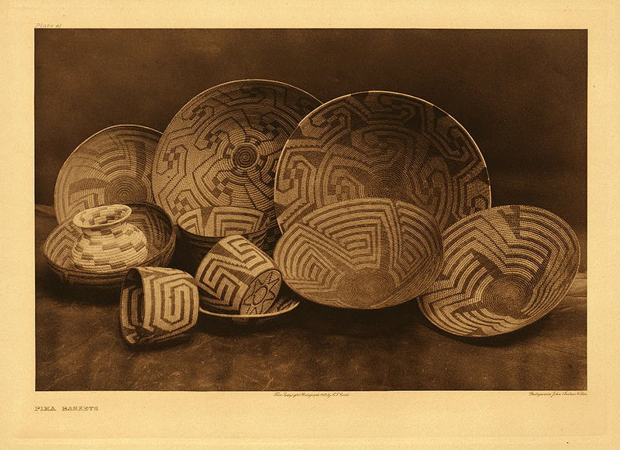
Pima baskets, photographed around 1907 by Edward S. Curtis
http://en.wikipedia.org/wiki/File:Pima_baskets.jpg

Slide 42
  Social and Political Consequences
  of the Agricultural Revolution
  people began to master crafts like . . .
    basket making
    ceramics
    bronze and metal casting
    brick making
    masonry
    other skills
The Cultural Feast, 2nd Ed., p. 55

Slide 43
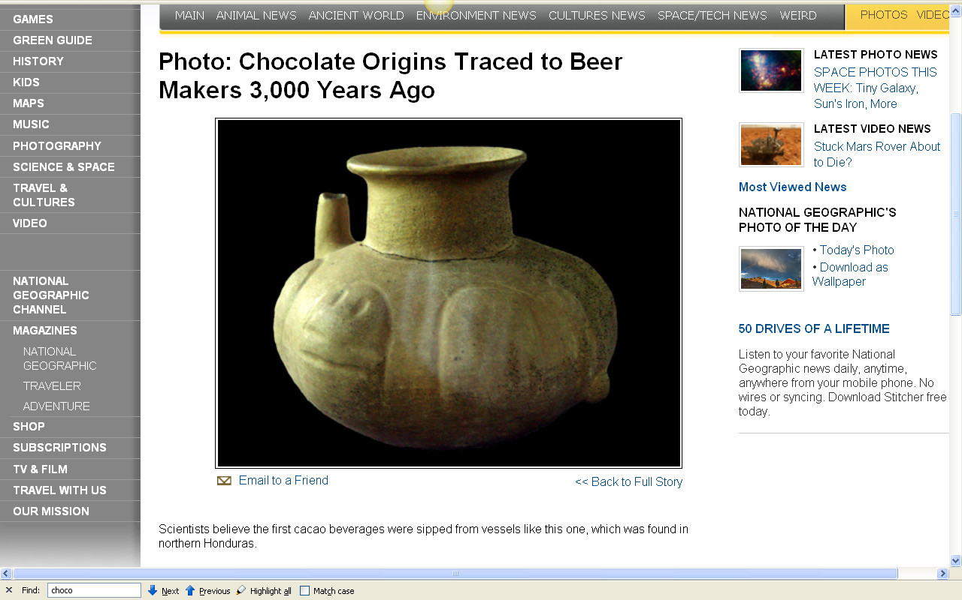
you can see the importance of pottery and pottery analysis in the “Chocolate” Forum
you saw the importance of pottery and pottery analysis in the “Chocolate” Forum
http://news.nationalgeographic.com/news/bigphotos/10056647.html

Slide 44
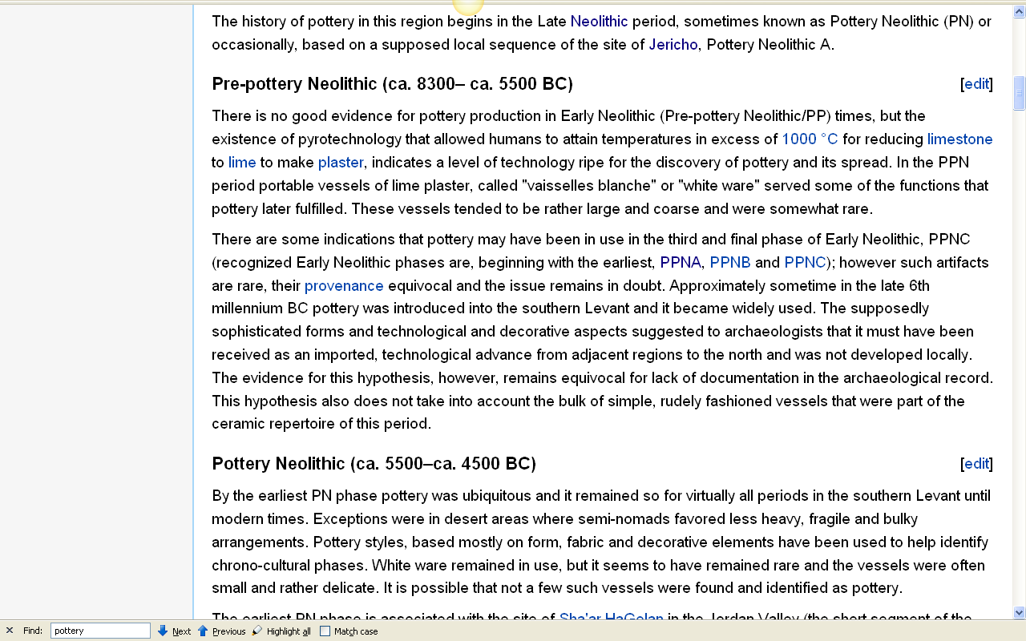
the “Pre-pottery” and “Pottery” stages
in fact define the Neolithic,
with pottery developing
by about 5500 B.C. . . .
http://en.wikipedia.org/wiki/History_of_pottery_in_the_Southern_Levant#Pre-pottery_Neolithic_.28ca._8300.E2.80.93_ca._5500_BC.29

Slide 45
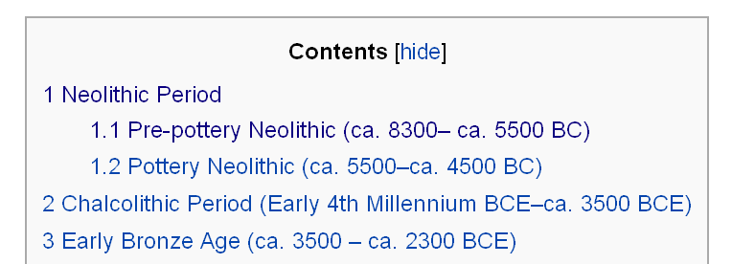
pottery in the Neolithic develops by about 5500 B.C. . . .
http://en.wikipedia.org/wiki/History_of_pottery_in_the_Southern_Levant#Pre-pottery_Neolithic_.28ca._8300.E2.80.93_ca._5500_BC.29

Slide 46
Biocultural Consequences: Technology
basket and skin containers were replaced with ceramic vessels
  baskets were likely lined with clay, and eventually fired
  fire pits likely naturally were fired as part of the cooking process

Slide 47
Biocultural Consequences: Technology
pottery made it easier to prepare and boil grains into digestible foods

Slide 48
Biocultural Consequences: Technology
pottery made it easier to prepare and boil grains into digestible foods
and in Europe, for e.g., up until relatively recent times grains — a primary food since the Neolithic Revolution — were probably eaten as a form of porridge or gruel by everyone except the upper class . . .

Slide 49
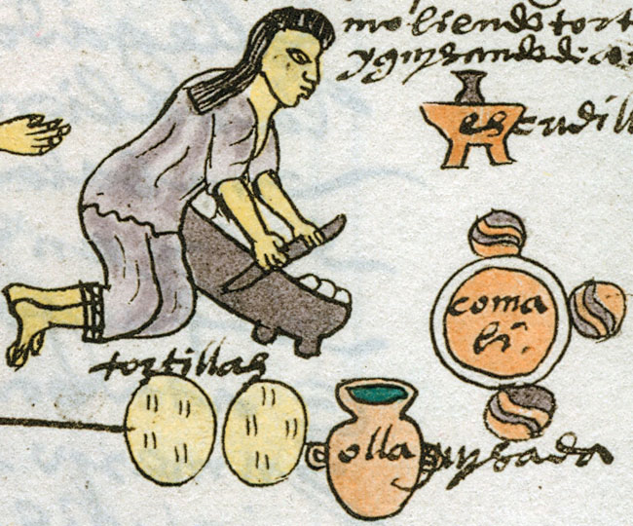
pottery appears in the 16th century Spanish manuscripts . . .
Aztec woman preparing tortillas — pottery jar . . .
Codex Mendoza, folio 60r
Notes:
49

Slide 50
pottery appears in the 16th century Spanish manuscripts . . .
Aztec woman preparing tortillas — comal(li) . .
Codex Mendoza, folio 60r

Slide 51
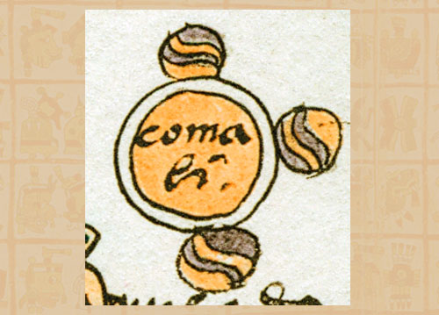
The three hearthstones support the traditional ceramic comal(li)
Codex Mendoza, folio 60r
Notes:
51

Slide 52
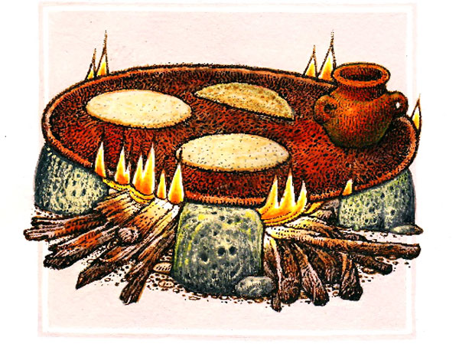
the comal is a flat pre-Conquest pottery griddle . . .
the likes of which are still used in Mesoamerica today . . .
Notes:
52

Slide 53
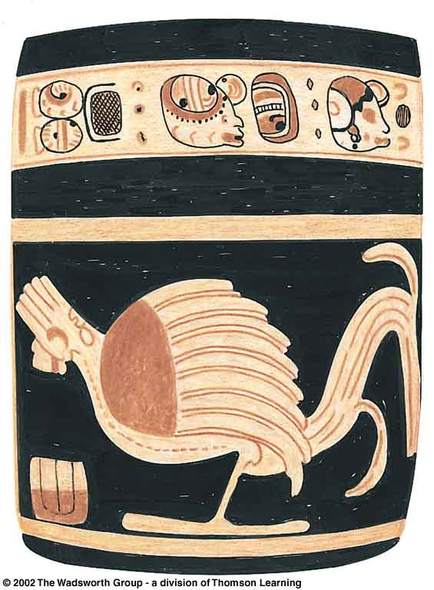
economic system allows individuals
to devote full time to occupations like . . .
pottery making
Classic Maya cylindrical jar
with bird motif and glyphs,
Understanding Physical Anthropology and Archaeology, 9th Ed., p. 411

Slide 54
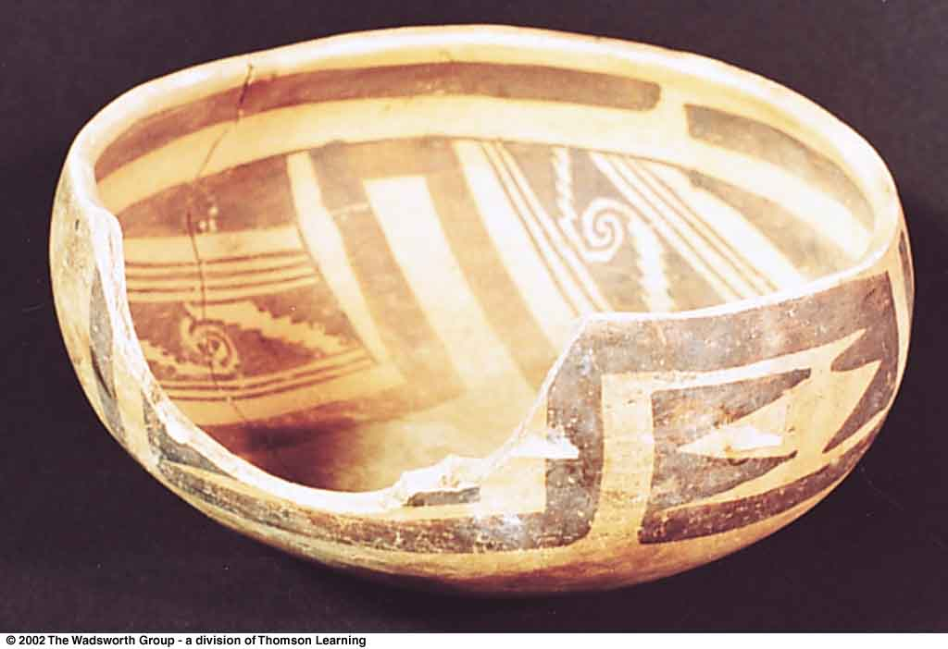
prehistoric decorated pottery vessel from Arizona
Understanding Physical Anthropology and Archaeology, 9th Ed., p. 365

Slide 55
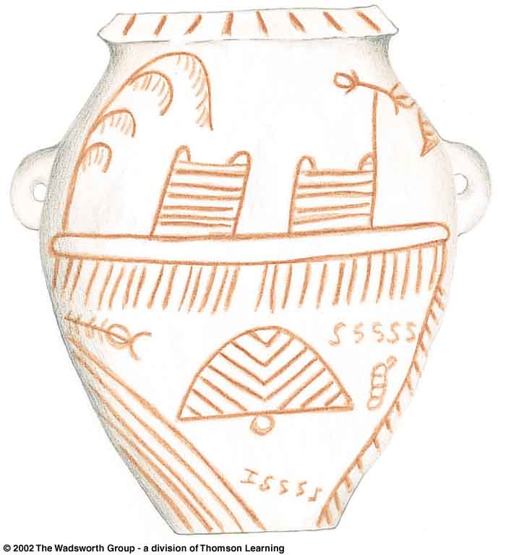
Decorated predynastic pottery jar,
Nile valley, Egypt
Understanding Physical Anthropology and Archaeology, 9th Ed., p. 461

Slide 56
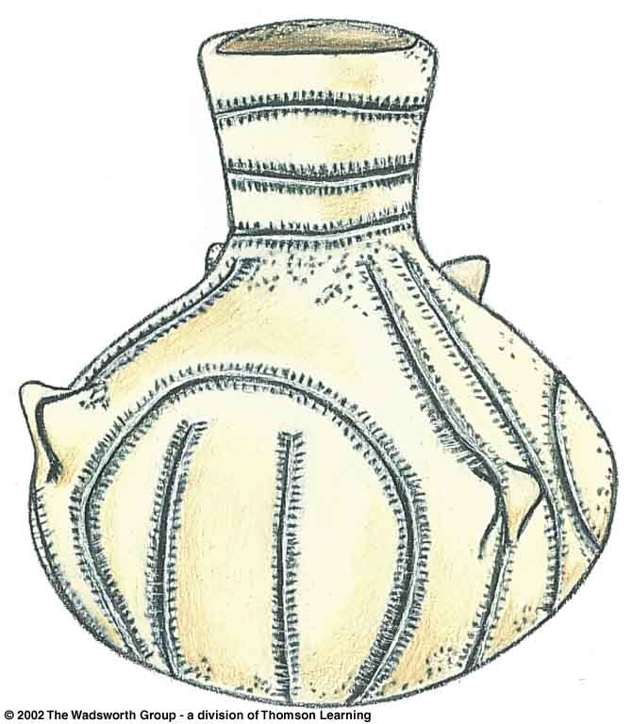
bandkeramic
  “lined pottery," referring to a Neolithic ceramic ware widely encountered in central Europe and to the culture that produced it
Understanding Physical Anthropology and Archaeology, 8th Ed., p. 427

Slide 57
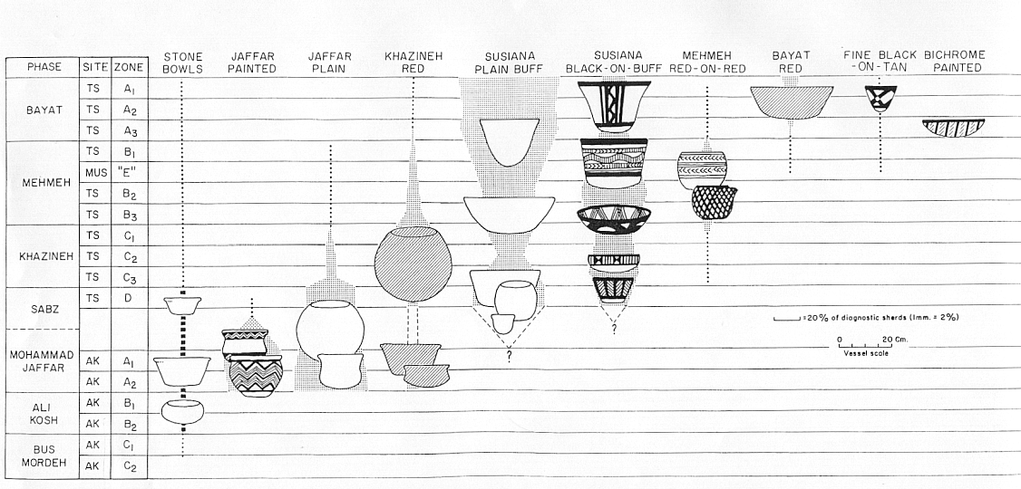
“seriation”
a “seriation graph” shows the evolution of pottery types from Deh Luran, Iran
Hole, Flannery and Neely, “Prehistory and Human Ecology
Of the Deh Luran Plain: An Early Village Sequence from
Khuzistan, Iran.” Ann Arbor: 1969, fig. 69

Slide 58
  Social and Political Consequences
  of the Agricultural Revolution
  people began to master crafts like . . .
    ceramics
    bronze and metal casting appear
    brick making
    masonry
    other skills
The Cultural Feast, 2nd Ed., p. 55

Slide 59
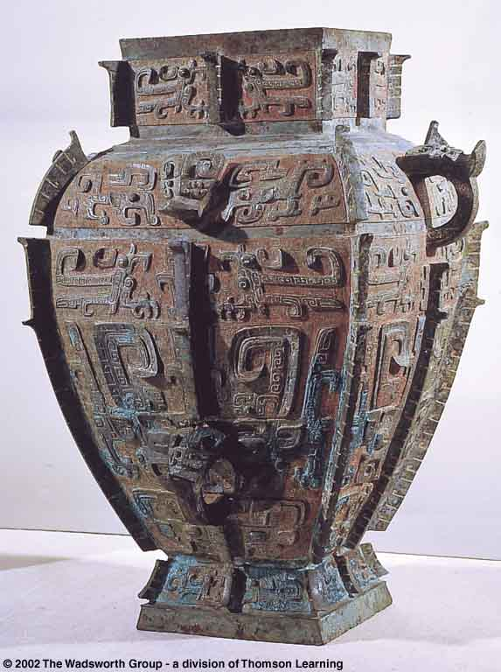
Bronze Age
  period of early Old World civilizations associated with the widespread use of metal tools after 5,500 ybp
Cast bronze ritual
vessel of the Shang
dynasty, China
Understanding Physical Anthropology and Archaeology, 9th Ed., p 468

Slide 60
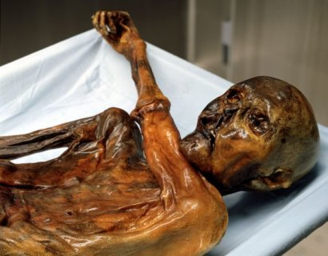
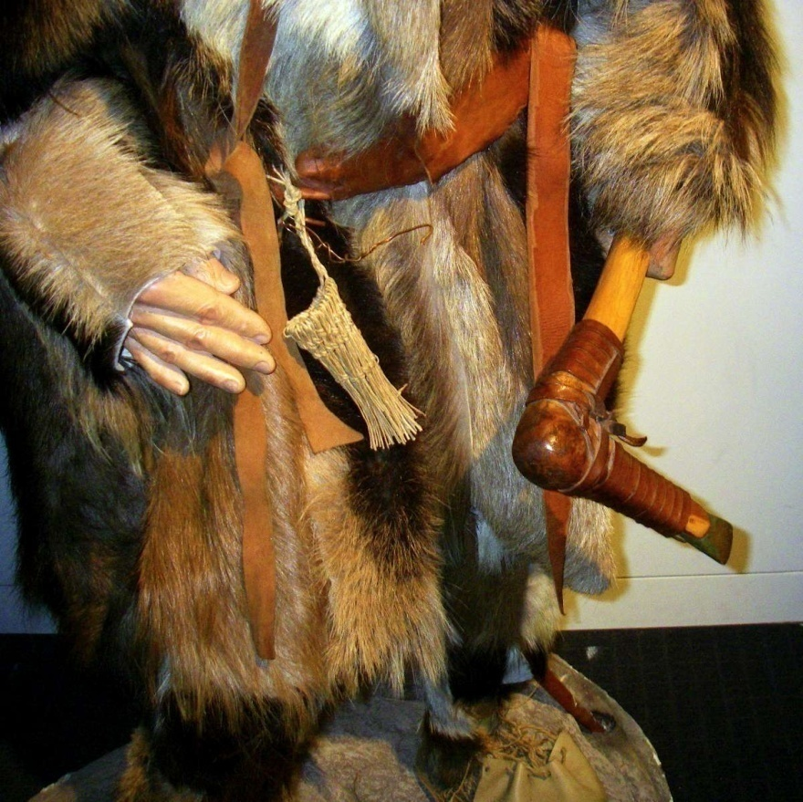
Copper Age
"Ötzi“ “The Iceman”
about 5,300 ybp
Wikipedia

Slide 61
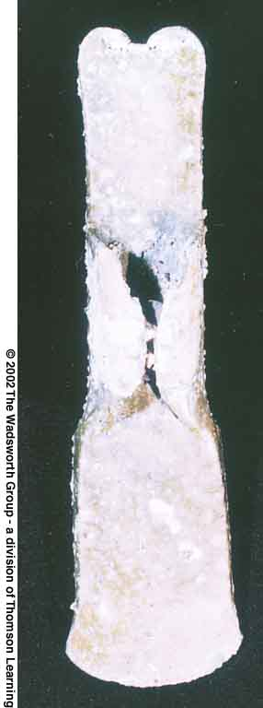
Mycenaean Bronze Age axe,
or winged palstave
Understanding Physical Anthropology and Archaeology, 8th Ed., p. 473

Slide 62
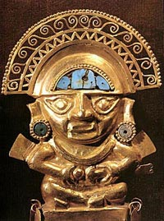
economic system allows individuals
to devote full time to occupations like . . .
metalworking
Inca gold

Slide 63
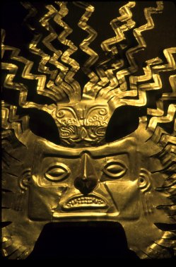
and these objects become an important part of the developing trading networks
Inca gold artifact in the Central Bank Museum, Quito, Ecuador
© D. Donne Bryant

Slide 64
  as a result of the Agricultural Revolution
  people began to have and see . . .
    surplus food
    trade and trade networks
    specialization of production
    specialized laborers
    increased social interaction develops
    food storage for times of shortage
    surplus is “taxed”
    monumental architecture
    competition for limited resources
    private property
    class systems
    organized governments (political / religious / military hierarchies)
    and the list goes on . . .

Slide 65
  Social and Political Consequences
  of the Agricultural Revolution
  population growth
  the establishment of large, sedentary villages provides . . .
    the opportunity for increased social interaction
    but with added health risks
The Cultural Feast, 2nd Ed., p. 55

Slide 66
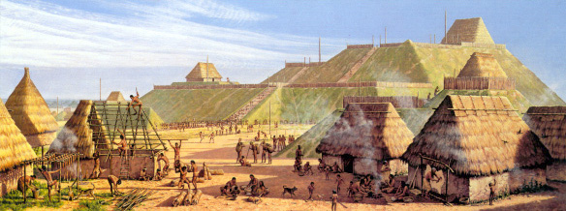
"Community Life“ at Cahokia
Michael Hampshire
Cahokia Mounds State Historic Site
Collinsville, Illinois

Slide 67
  as a result of the Agricultural Revolution
  people began to have and see . . .
    surplus food
    trade and trade networks
    specialization of production
    specialized laborers
    increased social interaction
    food storage for times of shortage appears
    surplus is “taxed”
    monumental architecture
    competition for limited resources
    private property
    class systems
    organized governments (political / religious / military hierarchies)
    and the list goes on . . .

Slide 68
  Social and Political Consequences
  of the Agricultural Revolution
  surplus food
    food surplus could be used in times of shortages
The Cultural Feast, 2nd Ed., p. 55

Slide 69
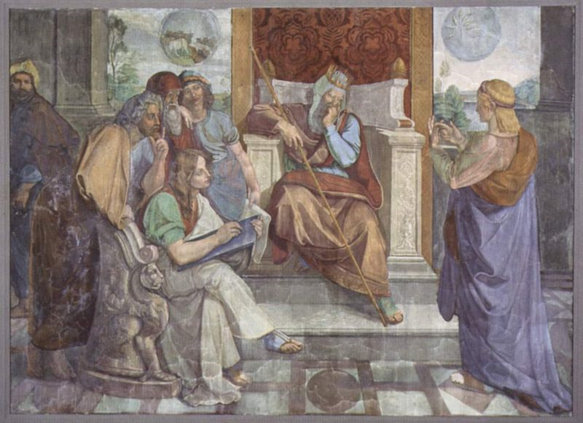
some of these are very well known
Joseph interprets the dream of the Pharaoh
Painting by Peter von Cornelius
http://en.wikipedia.org/wiki/Joseph_(Hebrew_Bible)

Slide 70
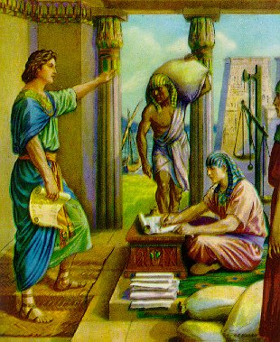
Seven Years of Plenty, Seven Years of Famine
www.mycatholictradition.com/saints-of-old-joseph2.html

Slide 71
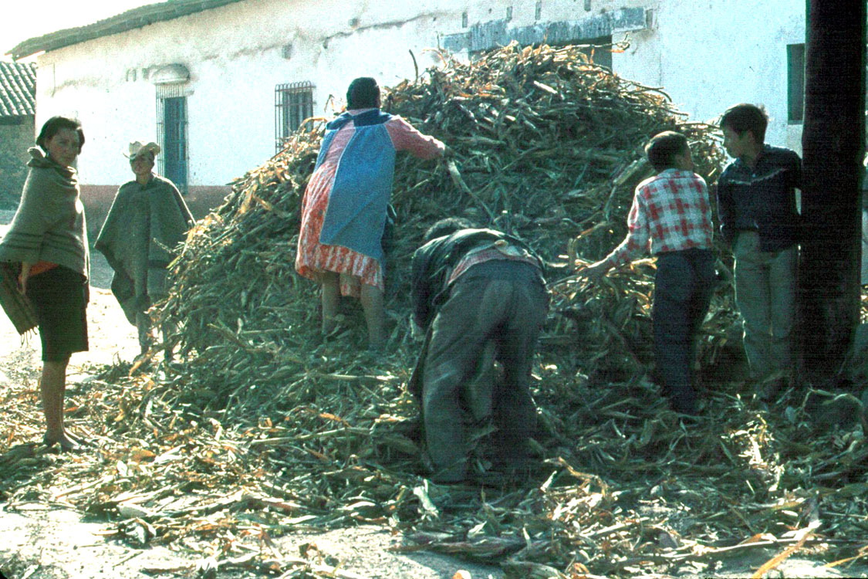
and some have been going on “forever,”
like the storing the annual maize crop
Hidalgo, Mexico

Slide 72
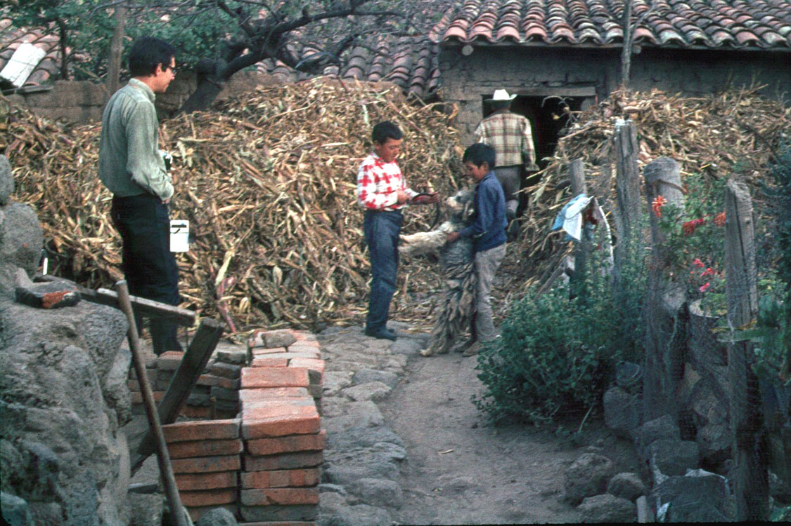
and some have been going on “forever,”
like the storing the annual maize crop
(in the backyard)
Hidalgo, Mexico

Slide 73
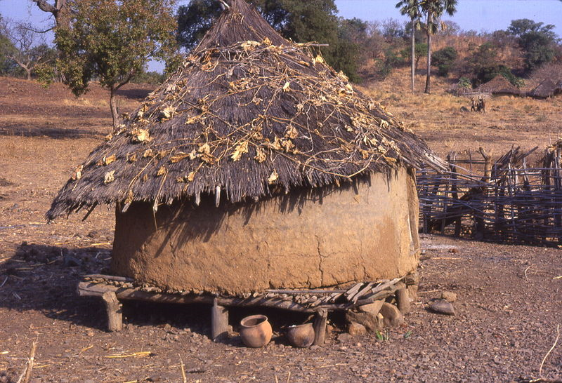
Grain storage structure and clay pots, southeast Sénégal
(west Africa)

Slide 74
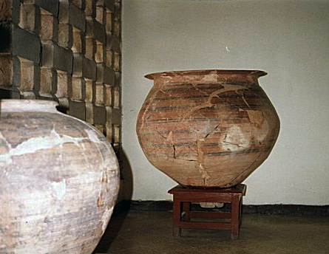
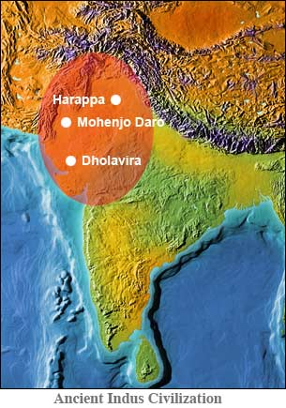
Large Grain Storage Jar
(Mohen-jo-daro, India)
http://homepage.ntlworld.com/myjamro/sindh/sindh_history/mohen-jo-daro_civil_engineering_wonder.htm

Slide 75

http://fanaticcook.blogspot.com/2009/07/prehistoric-granaries-humans-have-been.html

Slide 76

http://fanaticcook.blogspot.com/2009/07/prehistoric-granaries-humans-have-been.html

Slide 77
http://fanaticcook.blogspot.com/2009/07/prehistoric-granaries-humans-have-been.html

Slide 78

www.freebuck.com/articles/elliott/00elliottfoundations.htm

Slide 79

Aztecs Storing Maize
Florentine Codex
late 16th century

Slide 80
  as a result of the Agricultural Revolution
  people began to have and see . . .
    surplus food
    trade and trade networks
    specialization of production
    specialized laborers
    increased social interaction
    food storage for times of shortage
    surplus is “taxed”
    monumental architecture
    competition for limited resources
    private property
    class systems
    organized governments (political / religious / military hierarchies)
    and the list goes on . . .

Slide 81
  Social and Political Consequences
  of the Agricultural Revolution
  surplus food
    and “collecting” the tax and keeping track of crop exchanges led to
    early forms and eventual development of writing . . .
The Cultural Feast, 2nd Ed., p. 55

Slide 82


Ten Classic Characteristics of Early Civilization
Social means of collecting “surplus” production
Small Sumerian clay table is a 4,000-year-old tax receipt
with cuneiform impressions on both sides
Understanding Physical Anthropology and Archaeology, 9th Ed., p. 389

Slide 83

“Roman writing tablet from the Vindolanda Roman fort of Hadrian's Wall, in Northumberland (1st — 2nd century A.D.) requesting money to buy 5,000 measures of cereal used for brewing beer”
Department of Prehistory and Europe, British Museum
http://en.wikipedia.org/wiki/Accounting#Token_accounting_in_ancient_Mesopotamia

Slide 84
  Social and Political Consequences
  of the Agricultural Revolution
  surplus food
    excess production served as capital that fostered new socioeconomic transactions
    — including barter
The Cultural Feast, 2nd Ed., p. 55

Slide 85

http://indopraba.blogspot.com/2009/05/back-to-barter-economy.html

Slide 86

"The Barter“
Kibuuka
http://www.kibuuka-prints.com/print14.html

Slide 87
“This work immortalizes a local village market set in rural Uganda. Evoking a tradition that predates the notion of monetary wealth, goods in abundance are exchanged for those more scarce. These interactions reinforce complex social bonds while they reaffirm one's relationship to the local community and its shared resources.”
"The Barter“
Kibuuka
http://www.kibuuka-prints.com/print14.html

Slide 88

An 1874 newspaper illustration from Harper's Weekly, showing a man engaging in barter: offering chickens in exchange for his yearly newspaper subscription
http://en.wikipedia.org/wiki/Barter

Slide 89
  as a result of the Agricultural Revolution
  people began to have and see . . .
    surplus food
    trade and trade networks
    specialization of production
    specialized laborers
    increased social interaction
    food storage for times of shortage
    surplus is “taxed”
    monumental architecture
    competition for limited resources developed
    private property
    class systems
    organized governments (political / religious / military hierarchies)
    and the list goes on . . .

Slide 90
  Social and Political Consequences
  of the Agricultural Revolution
  as population increased
    competition for limited resources occurred . . . for . . .
      water
      land
      other basic resources
The Cultural Feast, 2nd Ed., p. 55

Slide 91
  Social and Political Consequences
  of the Agricultural Revolution
  as population increased
    competition for limited resources occurred . . . for . . .
      water
      land
      other basic resources
The Cultural Feast, 2nd Ed., p. 55

Slide 92

NY: Bloomsbury ( 2009)
http://en.wikipedia.org/wiki/Barter

Slide 93
  Social and Political Consequences
  of the Agricultural Revolution
  as population increased
    competition for limited resources occurred . . . for . . .
      water
      land
      other basic resources
The Cultural Feast, 2nd Ed., p. 55

Slide 94

http://news.bbc.co.uk/2/hi/americas/8600353.stm

Slide 95
  Social and Political Consequences
  of the Agricultural Revolution
  as population increased
    competition for limited resources occurred . . . for . . .
      water
      land
      other basic resources
The Cultural Feast, 2nd Ed., p. 55

Slide 96

http://news.bbc.co.uk/panorama/hi/front_page/newsid_8523000/8523999.stm

Slide 97
  Social and Political Consequences
  of the Agricultural Revolution
  political / religious / military hierarchies took over the tasks of . . .
    organizing production
    maintaining order in an increasingly complex society
    defending the community
The Cultural Feast, 2nd Ed., pp. 55-56

Slide 98
  Social and Political Consequences
  of the Agricultural Revolution
  political / religious / military hierarchies took over the tasks of . . .
    and this led to the rise of states and empires . . .
The Cultural Feast, 2nd Ed., pp. 55-56

Slide 99
  Social and Political Consequences
  of the Agricultural Revolution
  political / religious / military hierarchies took over the tasks of . . .
    and this led to the rise of states and empires . . .
James A. Michener says there were about 75 major civilizations in the “history” of the world
(with a typical rise-fall cycle of 200 – 400 years,
with the “fall” often related to food production and distribution)
The Cultural Feast, 2nd Ed., pp. 55-56

Slide 100
  Social and Political Consequences
  of the Agricultural Revolution
  states and empires began to have . . .
    specialized laborers
    private property
    class systems
    organized governments
The Cultural Feast, 2nd Ed., p. 56

Slide 101
  Social and Political Consequences
  of the Agricultural Revolution
  states and empires began to have . . .
    specialized laborers
    private property
    class systems
    organized governments
The Cultural Feast, 2nd Ed., p. 56

Slide 102
  as a result of the Agricultural Revolution
  people began to have and see . . .
    surplus food
    trade and trade networks
    specialization of production
    specialized laborers
    increased social interaction
    food storage for times of shortage
    surplus is “taxed”
    monumental architecture
    competition for limited resources
    private property
    class systems develop
    organized governments (political / religious / military hierarchies)
    and the list goes on . . .

Slide 103
  Social and Political Consequences
  of the Agricultural Revolution
  people became divided for the first time into . . .
    priests, warriors, and artisans groups
    rich and poor
    upper and lower classes
    rulers and ruled
    master and slave
The Cultural Feast, 2nd Ed., p. 56

Slide 104
REM Eight Food “Revolutions”
Invention of Cooking
Discovery that Food is More Than Sustenance
The “Herding Revolution”
Snail Farming
Use of Food as a Means and Index of Social Differentiation
Long-Range Exchange of Culture
Ecological Revolution of last 500 years
Industrial Revolution of the 19th and 20th Centuries
Simon & Schuster 2003

Slide 105


Ten Classic Characteristics of Early Civilization
A privileged ruling class of religious, political, and military leaders organizes and directs the entire system
Hieroglyphic inscription of a royal Egyptian hunting marsh birds from a papyrus boat
9th Ed. p. 393
King Tut

Slide 106

King “Tut”
www.ctv.ca/servlet/ArticleNews/story/CTVNews/20071104/king_tut_071104/20071104?hub=CTVNewsAt11
Notes:
106

Slide 107

Mocezuma II

Slide 108
a classic in the Anth of Food is . . .
“Montezuma’s Dinner:
An Essay on the Tribal
Society of the North American Indians”
Lewis Henry Morgan
NY: Heritage Press
1876
Mocezuma II

Slide 109

Aztecs stone altar dedicated to corn
Museum of Anthropology

Slide 110
  Social and Political Consequences
  of the Agricultural Revolution
  with social stratification heterogeneous diets appeared . . .
    not everyone who lived in the same area ate similar foods

Slide 111
  Social and Political Consequences
  of the Agricultural Revolution
  with social stratification heterogeneous diets appeared . . .
    not everyone who lived in the same area ate similar foods
    food patterns of a region varied considerably among people of different rank or status

Slide 112
  Social and Political Consequences
  of the Agricultural Revolution
  by the end of the 15th century . . .
    agriculture had brought cities and complex political systems to most parts of the world
    trade networks linked many parts of the world
    the age of exploration was about to begin
The Cultural Feast, 2nd Ed., p. 56

Slide 113
  Social and Political Consequences
  of the Agricultural Revolution
  . . . and food played a critical role
  in the political developments
  of almost every era from then until present-day . . .
The Cultural Feast, 2nd Ed., p. 56

Slide 114
  Social and Political Consequences
  of the Agricultural Revolution
have a look at
“The Search for Spices”
and
“The Scientific Revolution”
and
“Modern-Day Adaptations”
slide sets . . .
but first, speaking of modern-day . . .
  by the end of the 15th century . . .
    agriculture had brought cities and complex political systems to most parts of the world
    trade networks linked many parts of the world
    the age of exploration was about to begin
The Cultural Feast, 2nd Ed., p. 56

Slide 115
  Social and Political Consequences
  of the Agricultural Revolution
  . . . of course . . .
  the agricultural revolution also played a critical role in the development of modern-day era specialty foods that changed America (and Americans) . . .
The Cultural Feast, 2nd Ed., p. 56

Slide 116

http://www.inklingmagazine.com/inkycircus/C26/26/P10/

Slide 117

http://www.lisagriffis.com/2008/11/treat-your-holiday-plate-like-it-was-a-tv-dinner-tray/

Slide 118

http://pro.corbis.com/search/Enlargement.aspx?CID=isg&mediauid=858D8FC4-F6ED-4BA6-A022-765FABA76518

Slide 119

http://www.esquire.com/the-side/feature/worlds-worst-eating-contests-070108

Slide 120


Slide 121
  Social and Political Consequences
  of the Agricultural Revolution
  . . . and, of course, the agricultural revolution ultimately played a critical role in the development of modern-day era specialty foods that changed America
  (and Americans)
  including
  in Minnesota and Wisconsin . . .
Cf., The Cultural Feast, 2nd Ed., p. 56

Slide 122

http://www.hormel.com/

Slide 123

http://www.impactlab.net/2009/08/10/top-10-foods-on-a-stick/

Slide 124
In case you didn’t recognize it, this is Spam on a stick . . .
http://www.impactlab.net/2009/08/10/top-10-foods-on-a-stick/

Slide 125

not to be confused with the “Toronto Potato” on a stick . . .
http://www.impactlab.net/2009/08/10/top-10-foods-on-a-stick/

Slide 126
and finally, most cultural behaviors associated with food (including drink) can trace their roots all the way back to the Agricultural Revolution of Neolithic times . . .
and some, maybe even all the way back before that,
to “cave man” days . . .

Slide 127

http://ccounty.wordpress.com/category/educational/

Slide 128
Social and Political Consequences
of the Agricultural Revolution
Aztec men sharing a meal.
Florentine Codex, late 16th century
Anthropology of Food
University of Minnesota Duluth
Tim Roufs
©2010-2024

