Slide 1
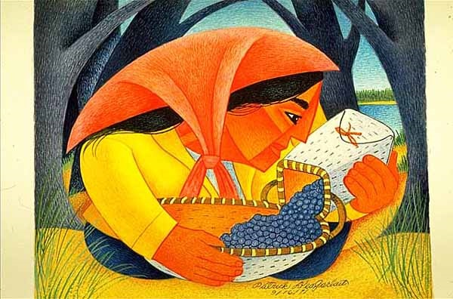
Start deck in “Slide Show” mode,
and use your up/down arrow keys and/or
your space bar to advance the slides
University of Minnesota Duluth
Tim Roufs
© 2010-2024

Slide 2
REM
indicates that the materials
are a REMinder
and are thus being repeated . . .
REMinder

Slide 3
ANTH 3888
Anthropology of Food
Main
Characteristics of
Anthropology
University of Minnesota Duluth
Tim Roufs
© 2010-2024

Slide 4
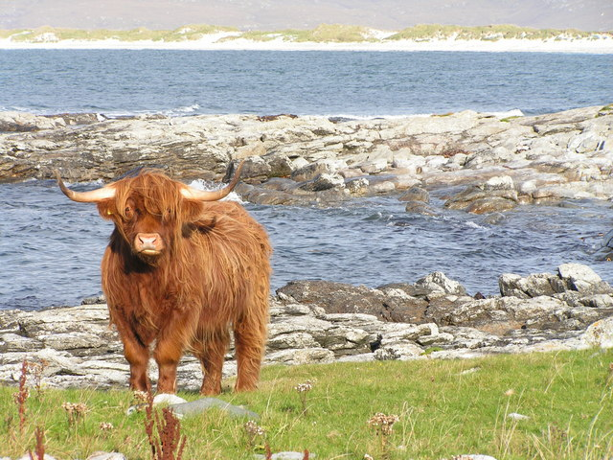
ANTH 3888
Anthropology of Food
Comparative Method
as a
Major Approach
University of Minnesota Duluth
Tim Roufs
© 2010-2024
http://en.wikipedia.org/wiki/Highland_cattle

Slide 5
American
Main Characteristics of˄Anthropology
1. the four fields of general anthropology
culture as a primary concept
comparative method as major approach
holism as a primary theoretical goal
fieldwork as a primary research technique

Slide 6
American
Main Characteristics of˄Anthropology
1. the four fields of general anthropology
culture as a primary concept
comparative method as major approach
holism as a primary theoretical goal
fieldwork as a primary research technique

Slide 7
Compare . . .
Main Characteristics
comparative method
as a major approach to the study of human behavior
the comparative method compares things (what else would a “comparative” method do?)

Slide 8
Compare . . .
Main Characteristics
comparative method
One form of comparative method was pioneered by Fred Eggan
(University of Chicago)
“Social anthropology and
the method of controlled comparison”
American Anthropologist, 56:743-61 (1954)

Slide 9
Compare . . .
Main Characteristics
comparative method
One form of comparative method was pioneered by Fred Eggan
(University of Chicago)
“Social anthropology and
the method of controlled comparison”
American Anthropologist, 56:743-61 (1954)

Slide 10
Compare . . .
Main Characteristics
the comparative method compares things for e.g. . . .
In a similar manner Evan D. Fraser and Andrew Rimas compare
Feast, Famine, and the Rise and Fall of Civilizations
around the world. . .

Slide 11
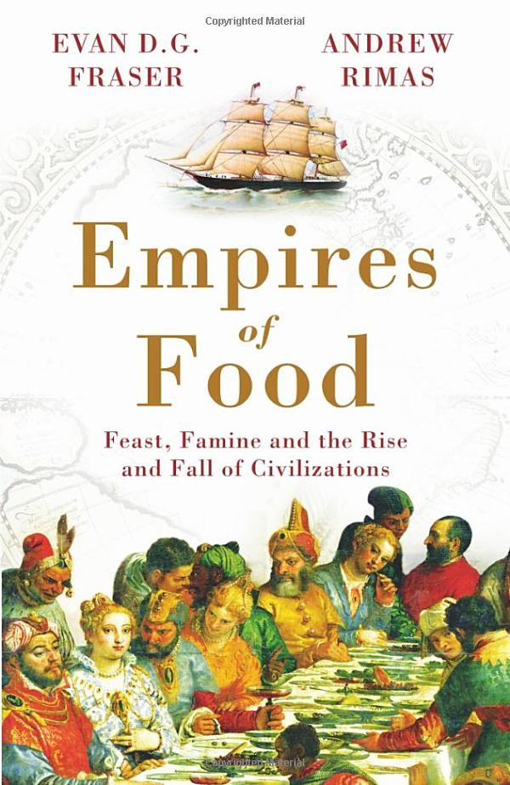
Mesopotamia
China
North America
South America
Europe
Asia
Africa
Pacific Islands
Berkeley: Counterpoint, 2012:
http://www.amazon.com/Empires-Food-Feast-Famine-Civilizations/dp/1582437939/ref=sr_1_1?ie=UTF8&qid=1452654498&sr=8-1&keywords=empires+of+food

Slide 12
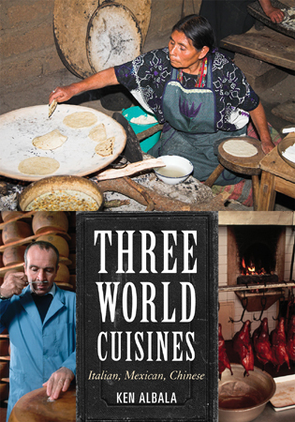
Italian
Mexican
Chinese
comparing cultures and cuisines

Slide 13
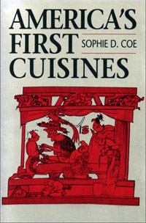
Aztec
Maya
Inca
Sophie D. Coe America's First Cuisines Austin: University of Texax Press, 1994.
comparing cultures and cuisines
www.d.umn.edu/cla/faculty/troufs/anthfood/aftexts.html#title

Slide 14
Aztec
Maya
Inca
Sophie D. Coe America's First Cuisines Austin: University of Texax Press, 1994.
comparing cultures and cuisines
www.d.umn.edu/cla/faculty/troufs/anthfood/aftexts.html#title

Slide 15
Text
comparing . . .
Omnivore’s Dilemma: A Natural History of Four Meals. NY: Penguin, 2013.
www.d.umn.edu/cla/faculty/troufs/anthfood/aftexts.html#title

Slide 16
Comparing food transformation by . . .
Fire (Roasting)
Water (Boiling)
Air (Baking)
Earth (Fermenting)
comparing . . .
Cooked: A Natural History of Transformation. NY: Penguin, 2013.
www.d.umn.edu/cla/faculty/troufs/anthfood/aftexts.html#title

Slide 17
Comparing food transformation by . . .
Soil
Land
Sea
Seed
Third Plate: Field Notes on the Future of Food
NY: Penguin, 2014.
http://www.amazon.com/Third-Plate-Field-Notes-Future/dp/0143127152/ref=sr_1_1?ie=UTF8&qid=1452655502&sr=8-1&keywords=the+third+plate

Slide 18
comparing films in class

Slide 19
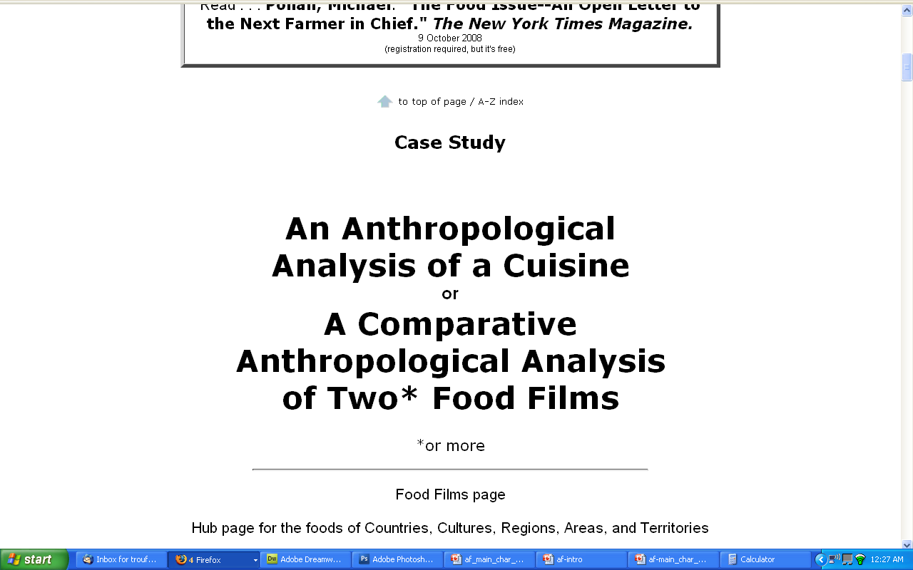
comparing cultures represented in two
“food flicks”
Extra Credit

Slide 20
Penguin Avery, 2009

Slide 21
The Popkin, 1950s
“typical multigenerational American family”
and 3 children
Superior, WI, U.S.A.
The “Jones, ” 2006
and 2 children
Suburban Cleveland, U.S.A.
Cesar and Ana Garcia
and 4 children
Immigrant Mexicans from Chiapas Mexico
Suburban Los Angeles
Rahul Desai and His Wife
and 4 children
Uttar Pradesh, Northern India
Gopal and Noopur Patel
and 3 children
Uttar Pradesh, Northern India
studied how lifestyle changes over the long term have affected the body composition of
Americans
80,000+ and 20,000
Chinese
22,000+
200+ communities
Russians
11,000+
300+ communities
Brazilians
Filipinos
Penguin Avery, 2009

Slide 22
The Popkin, 1950s
“typical multigenerational American family”
and 3 children
Superior, WI, U.S.A.
The “Jones, ” 2006
and 2 children
Suburban Cleveland, U.S.A.
Cesar and Ana Garcia
and 4 children
Immigrant Mexicans from Chiapas Mexico
Suburban Los Angeles
Rahul Desai and His Wife
and 4 children
Uttar Pradesh, Northern India
Gopal and Noopur Patel
and 3 children
Uttar Pradesh, Northern India
studied how lifestyle changes over the long term have affected the body composition of
Americans
80,000+ and 20,000
Chinese
22,000+
200+ communities
Russians
11,000+
300+ communities
Brazilians
Filipinos
including Superior, WI
(his home town)
Penguin Avery, 2009

Slide 23
comparing beer, wine, spirits,
coffee, tea, Coca-Cola

Slide 24
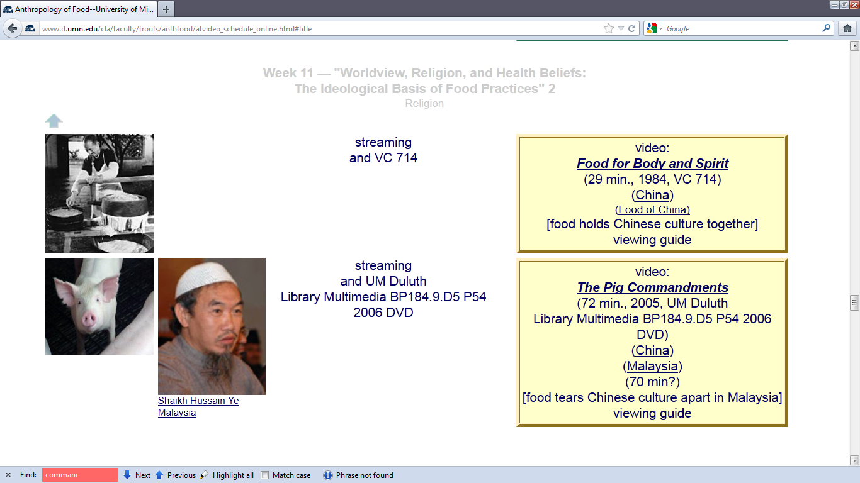
Videos
a controlled comparison of—
Chinese : Buddhism : Food
in China and Malaysia

Slide 25
Compare . . .
Main Characteristics
and items like “culture bound syndromes” are compared with similar phenomena that are thought to be “universal” . . . .

Slide 26
Main Characteristics
comparative method
often, for e.g.,
folks compare things regionally in an attempt
to understand process

Slide 27
Compare . . .
Main Characteristics
comparative method
Other methods . . .
process
essentially refers to
how things change
or
how things came to be
the way they are now
compare things regionally
in an attempt to understand process

Slide 28
Compare . . .
Main Characteristics
comparative method
Other methods . . .
process
essentially refers to
how things change
or
how things came to be
the way they are now
compare things regionally
in an attempt to understand process

Slide 29
Compare . . .
Main Characteristics
the comparative method compares things for e.g. . . .
David Montgomery compares what happens when great civilizations around the world ignore problems they are having with top soil . . .
Spoiler: All failed

Slide 30
Compare . . .
Main Characteristics
the comparative method compares things for e.g. . .
David Montgomery compares what happens when great civilizations around the world ignore problems they are having with top soil . . .
Spoiler: All failed

Slide 31
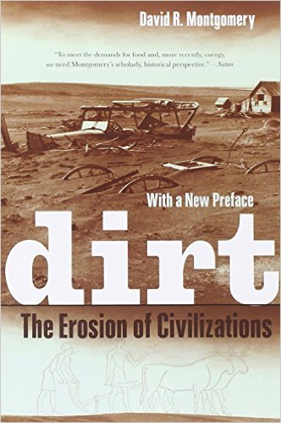
Mesopotamia
China
North America
South America
Europe
Asia
Africa
Pacific Islands
Berkeley: University of California, 2012
http://www.amazon.com/Empires-Food-Feast-Famine-Civilizations/dp/1582437939/ref=sr_1_1?ie=UTF8&qid=1452654498&sr=8-1&keywords=empires+of+food

Slide 32
Compare . . .
Main Characteristics
the comparative method compares things for e.g. . . .
David Montgomery compares what happens when great civilizations around the world ignore problems they are having with top soil . . .
Spoiler: All failed

Slide 33
Compare . . .
Main Characteristics
the comparative method compares things, for e.g., process of domestication / civilization
maize – Mexico
wheat – Turkey
rice – China
manioc – Brazil
millet – Africa

Slide 34
Compare . . .
Main Characteristics
the comparative method compares things, for e.g., process of domestication / civilization
maize – Mexico
wheat – Turkey
rice – China
manioc – Brazil
millet – Africa

Slide 35
Compare . . .
Main Characteristics
the comparative method compares things, for e.g., process of domestication / civilization
maize – Mexico
wheat – Turkey
rice – China
manioc – Brazil
millet – Africa

Slide 36
Compare . . .
Main Characteristics
the comparative method compares things, for e.g., process of domestication / civilization
maize – Mexico
wheat – Turkey
rice – China
manioc – Brazil
millet – Africa

Slide 37
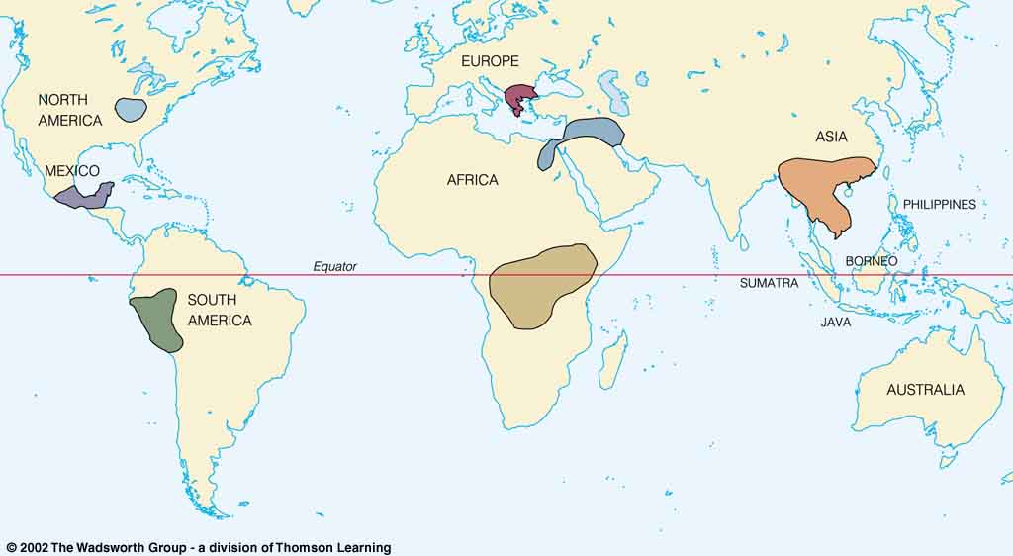
Origin of Domestication for Selected Plants
Compare . . .
wheat
10,500 ybp
maize
4,200 ybp
rice
7,000 ybp
manioc
4,200 ybp
millet
4,000 ybp
Understanding Physical Anthropology and Archaeology, 9th Ed., p. 342.

Slide 38
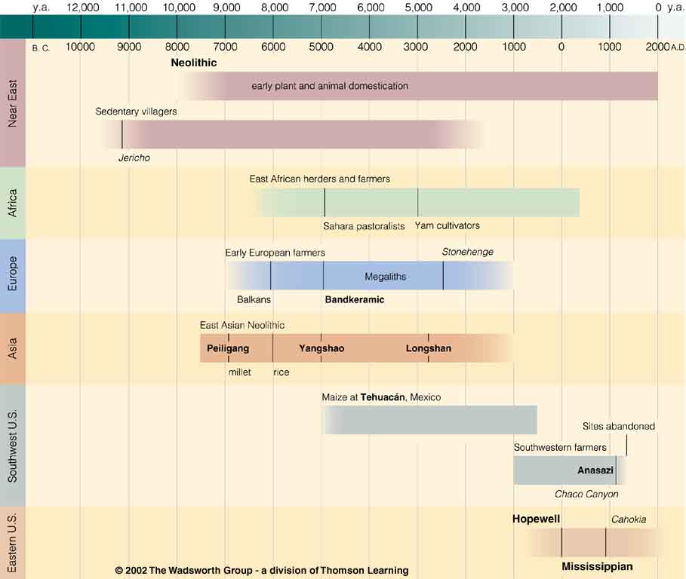
Neolithic
Time line for Ch. 14 Food Production
Understanding Physical Anthropology and Archaeology, 9th Ed., p. 333.

Slide 39
Chapter 14
Understanding Physical Anthropology and Archaeology, 9th Ed.
“Food Production”
A Biocultural Revolution
Neolithic
Time line for Ch. 14 Food Production
Understanding Physical Anthropology and Archaeology, 9th Ed., p. 333.

Slide 40
Neolithic
Tehuacán
Time line for Ch. 14 Food Production
Understanding Physical Anthropology and Archaeology, 9th Ed., p. 333.

Slide 41
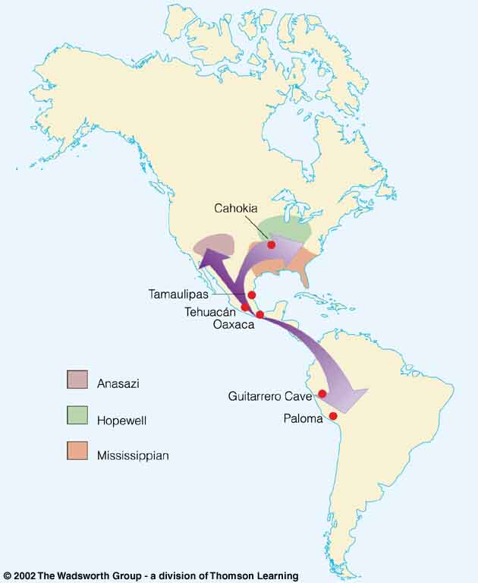
Compare . . .
Tehuacán Valley, Puebla, Mexico
maize
4,200 ybp
Understanding Physical Anthropology and Archaeology, 8th Ed., p. 432.

Slide 42
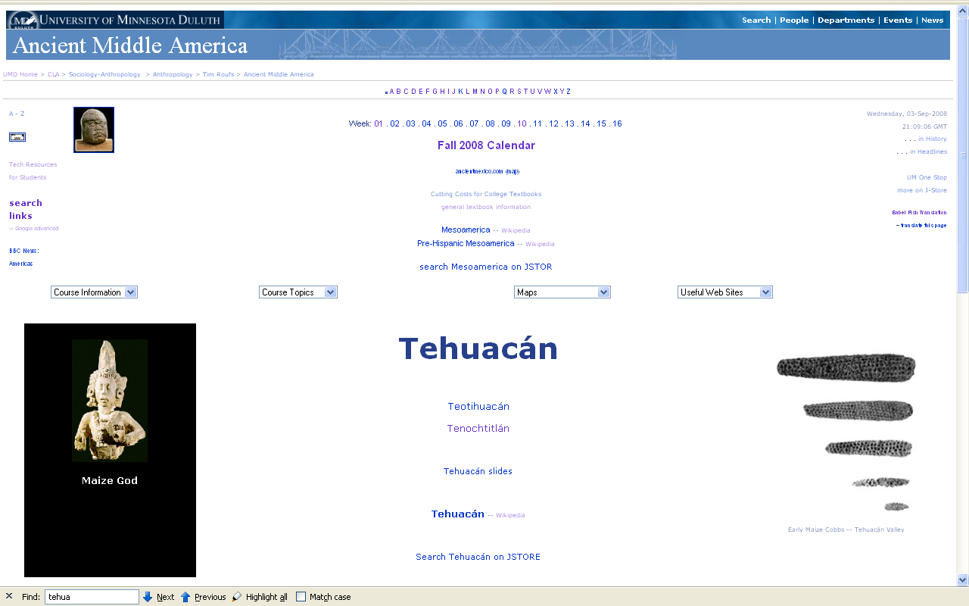
www.d.umn.edu/cla/faculty/troufs/anth3618/matehuac.html#title

Slide 43
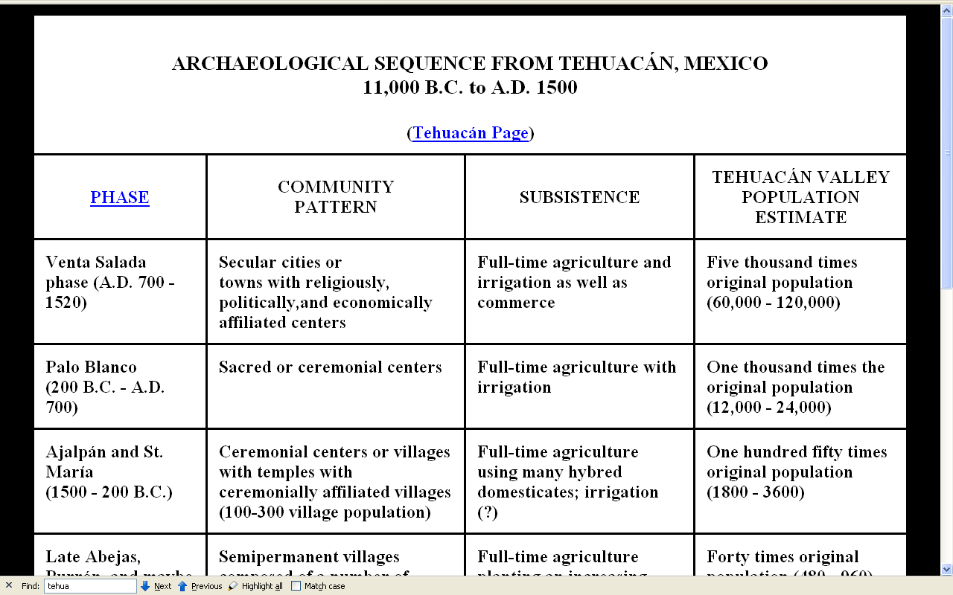
www.d.umn.edu/cla/faculty/troufs/anth3618/matehuac.html#title

Slide 44
Neolithic
Time line for Ch. 14 Food Production.
Understanding Physical Anthropology and Archaeology, 9th Ed., p. 333.

Slide 45
The Neolithic Revolution
=
The Agriculture Revolution

Slide 46
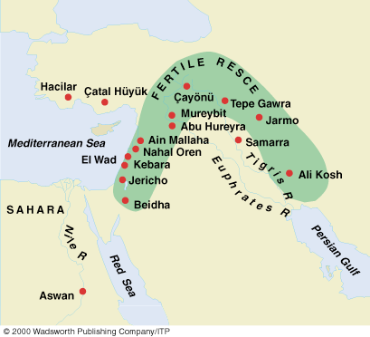
Compare . . .
Early Neolithic sites
Understanding Physical Anthropology and Archaeology, 9th Ed., p. 349.

Slide 47
Neolithic
Time line for Ch. 14 Food Production
Understanding Physical Anthropology and Archaeology, 9th Ed., p. 333.

Slide 49
Main Characteristics in a Nutshell

Slide 50
American
Main Characteristics of˄Anthropology
1. the four fields of general anthropology
culture as a primary concept
comparative method as major approach
holism as a primary theoretical goal
fieldwork as a primary research technique

Slide 51
The End
Comparative Method
as a
Major Approach
University of Minnesota Duluth
Tim Roufs
© 2010-2024
http://en.wikipedia.org/wiki/Highland_cattle

