Slide 1
Ancient Middle America
Aztec Tenochtitlán
University of Minnesota Duluth
Tim Roufs’ ©2009-2019

Slide 2
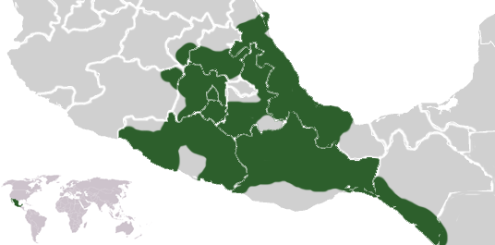
Aztec, Tenochtitlán
http://en.wikipedia.org/wiki/Aztecs

Slide 3
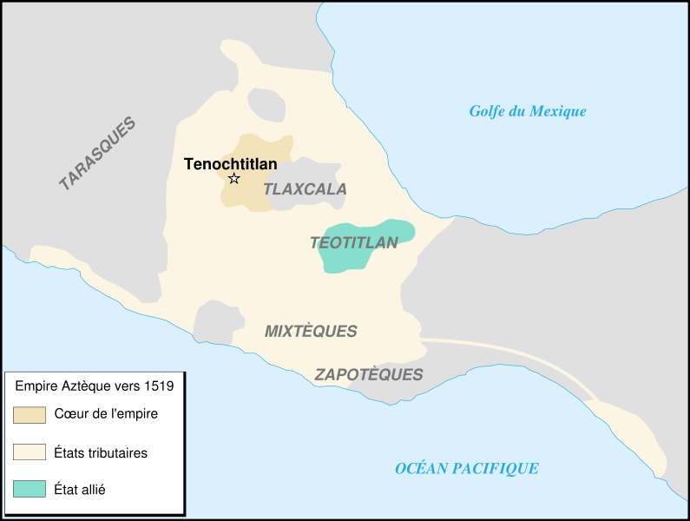
Aztec, Tenochtitlán
http://en.wikipedia.org/wiki/Aztecs

Slide 4
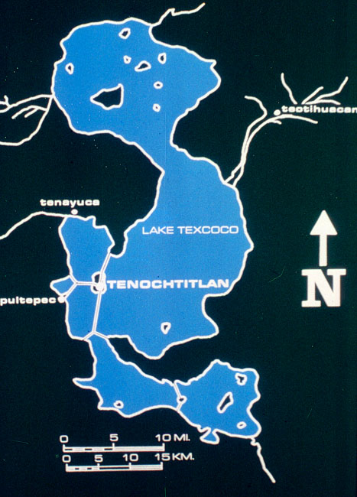
Aztec, Tenochtitlán

Slide 5
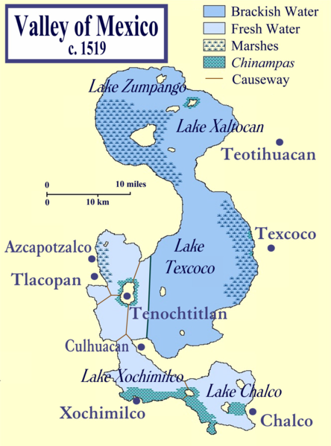
Aztec, Tenochtitlán
http://en.wikipedia.org/wiki/Aztecs

Slide 6
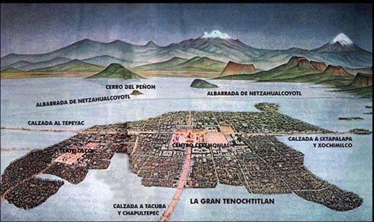
Aztec, Tenochtitlán
http://en.wikipedia.org/wiki/Aztecs

Slide 7
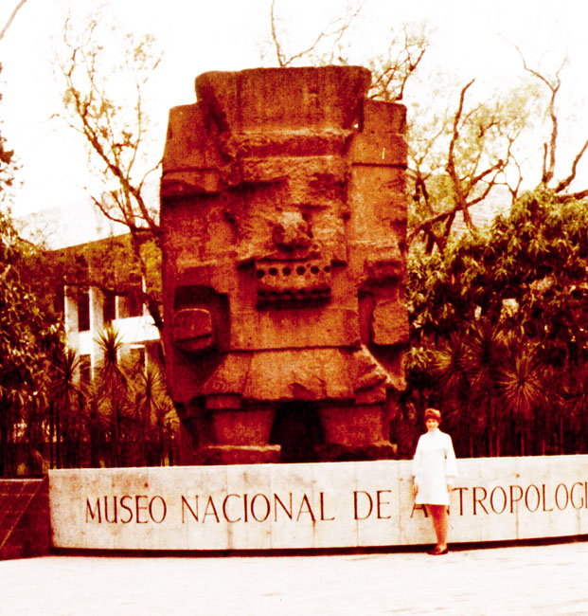
Aztec, Tenochtitlán

Slide 8
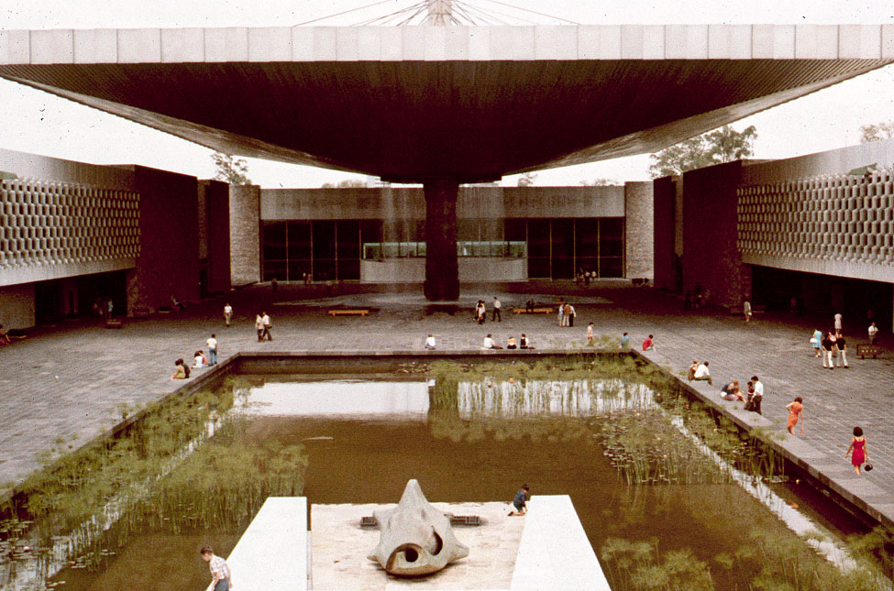
Aztec, Tenochtitlán

Slide 9
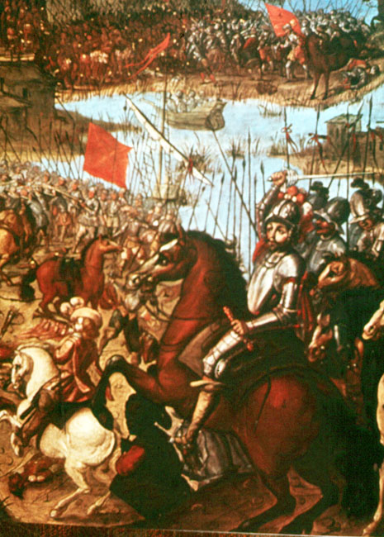
Aztec, Tenochtitlán

Slide 10
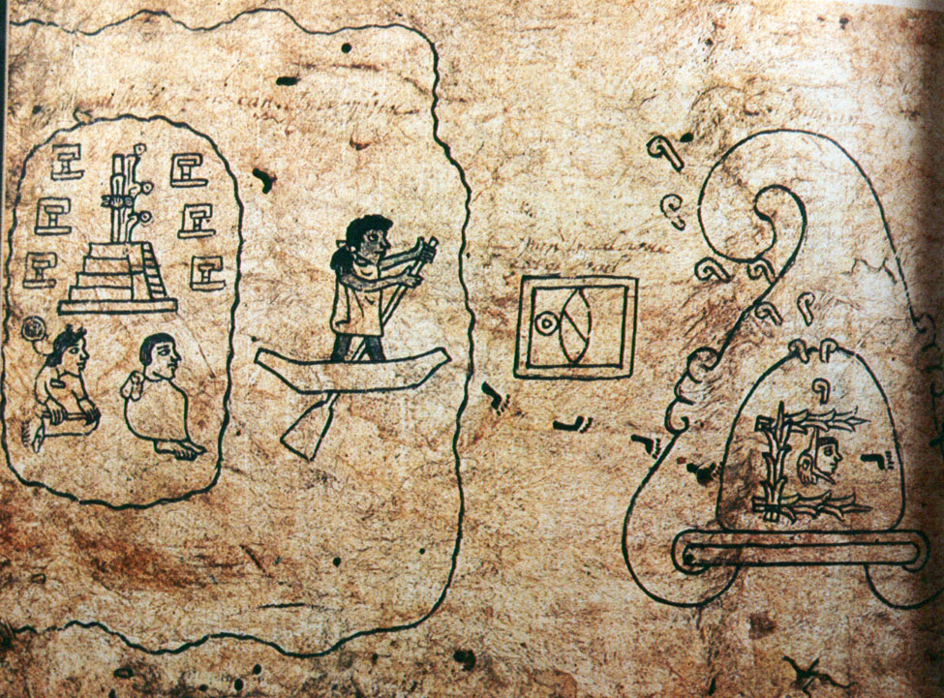
Aztec, Tenochtitlán

Slide 11
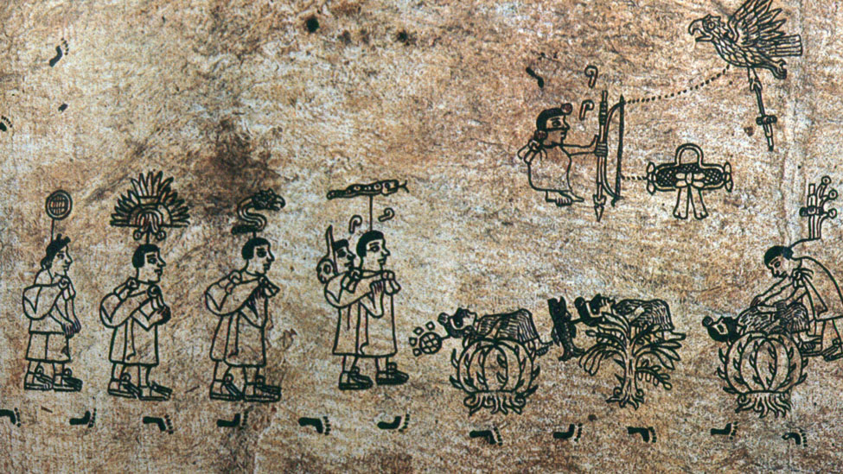
Aztec, Tenochtitlán

Slide 12
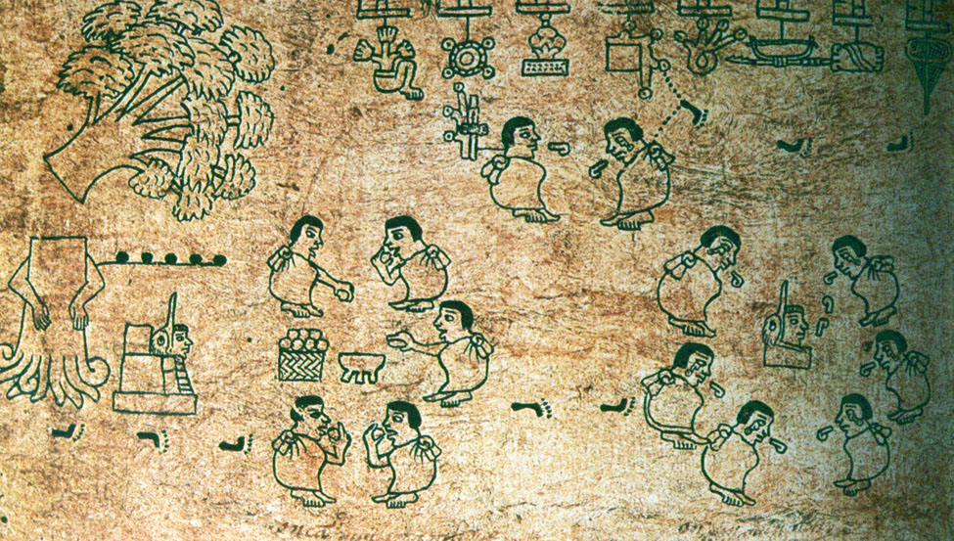
Aztec, Tenochtitlán

Slide 13
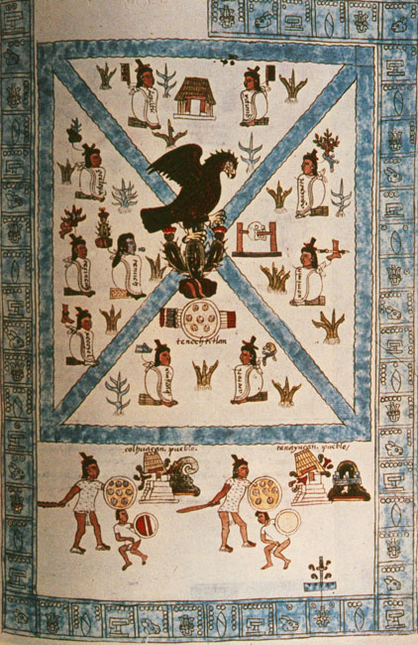
Aztec, Tenochtitlán

Slide 14
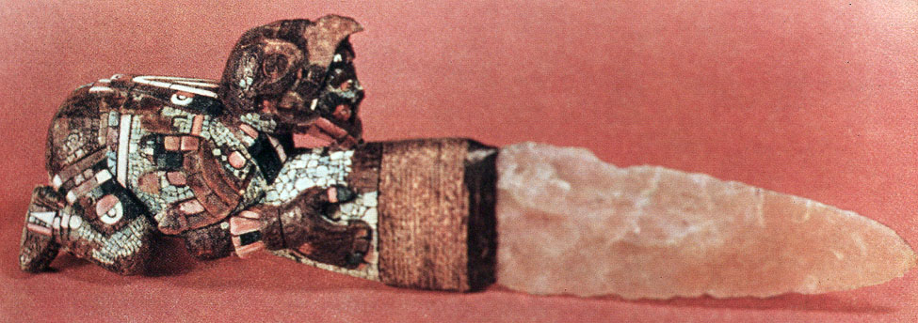
Aztec, Tenochtitlán

Slide 15
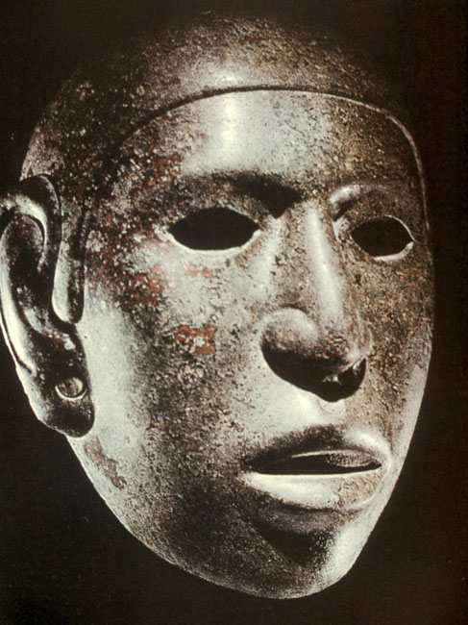
Aztec, Tenochtitlán

Slide 16
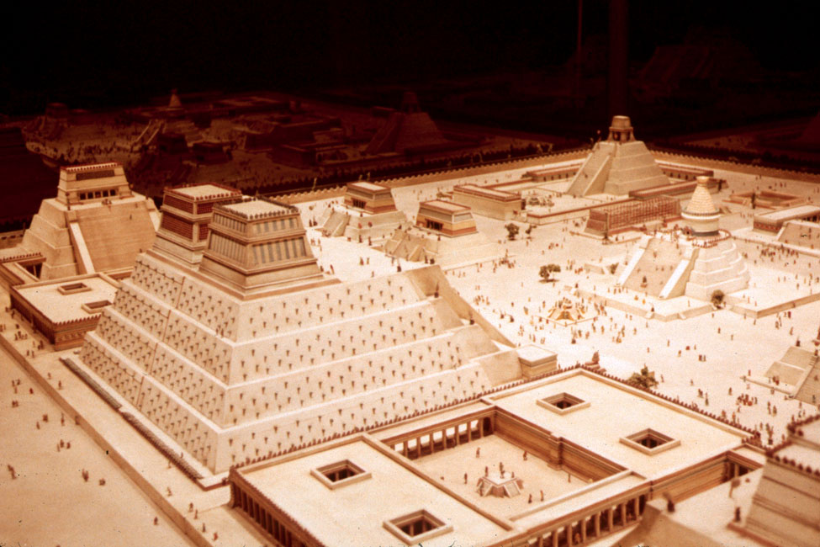
Aztec, Tenochtitlán

Slide 17
Aztec, Tenochtitlán

Slide 18
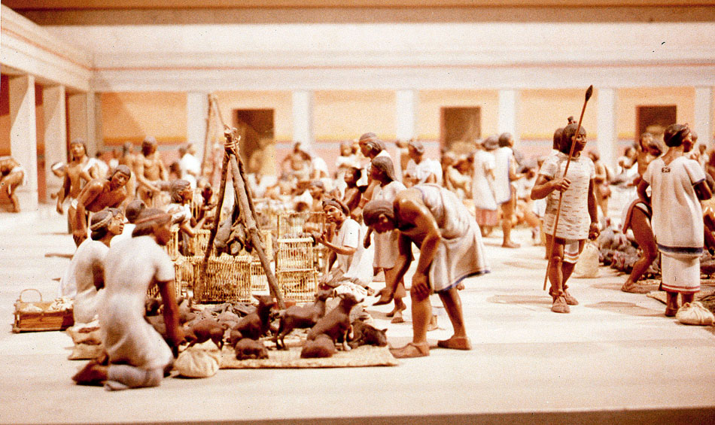
Aztec, Tenochtitlán

Slide 19
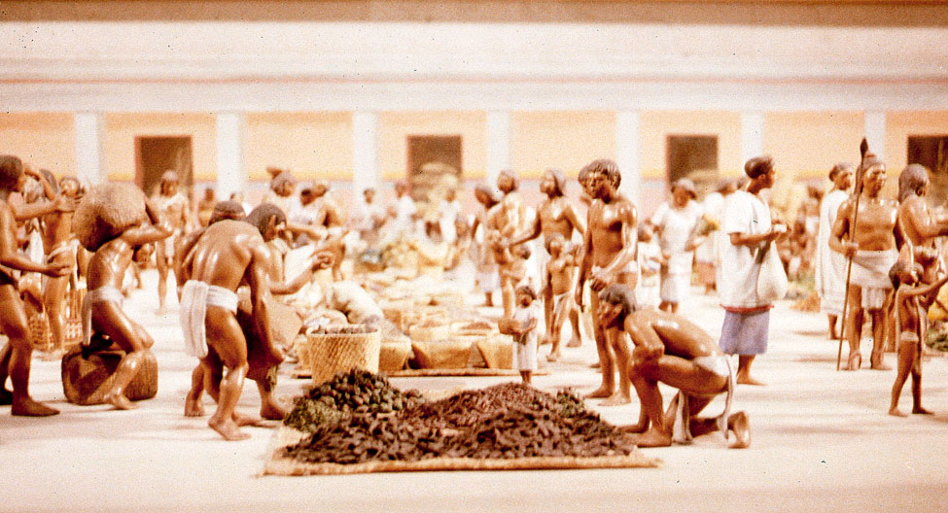
Aztec, Tenochtitlán

Slide 20
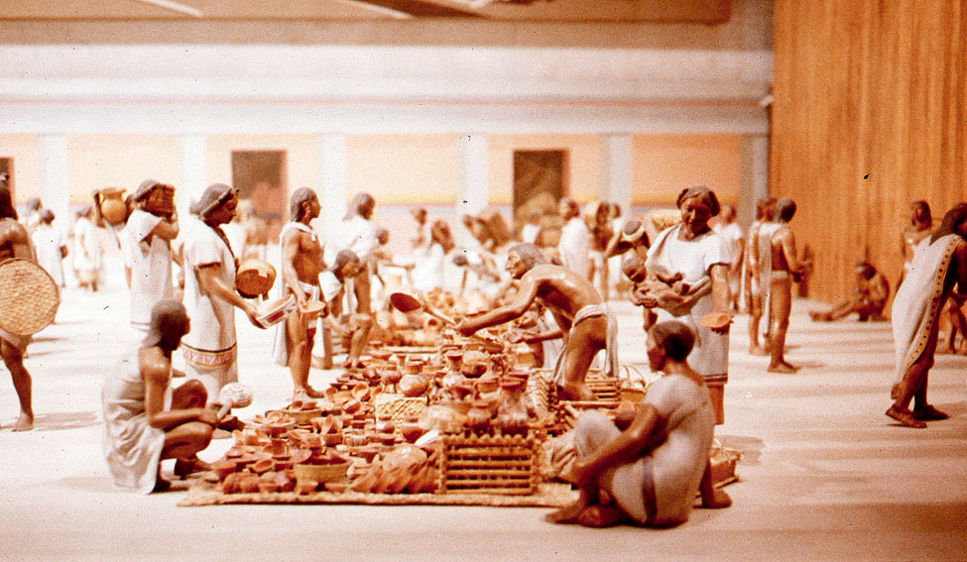
Aztec, Tenochtitlán

Slide 21
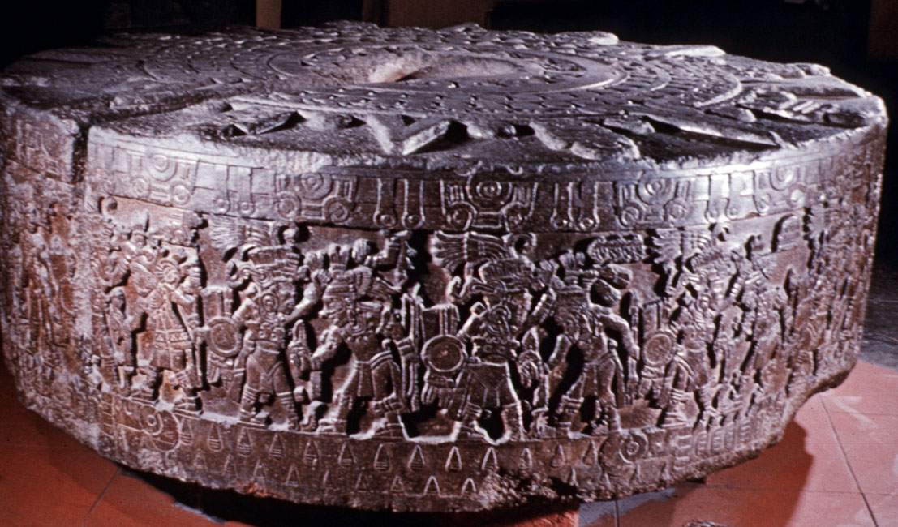
Aztec, Tenochtitlán

Slide 22
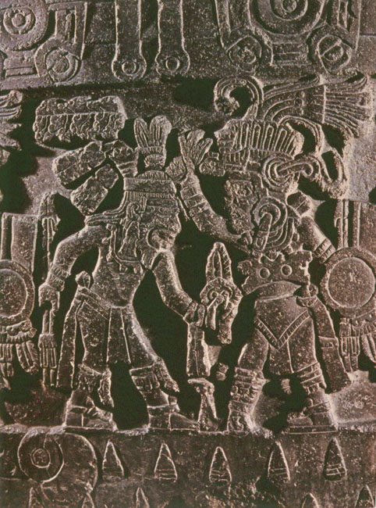
Aztec, Tenochtitlán

Slide 23
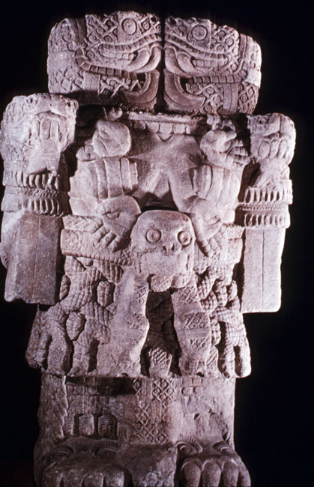
Aztec, Tenochtitlán

Slide 24
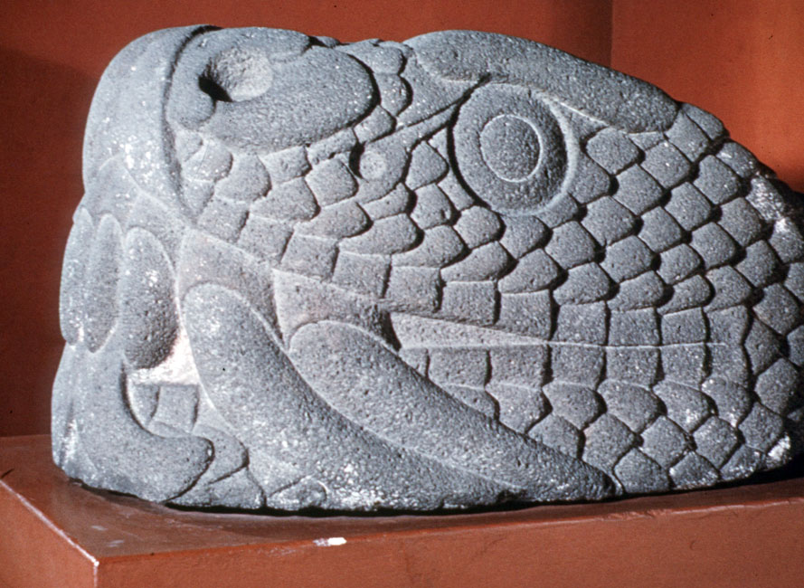
Aztec, Tenochtitlán

Slide 25
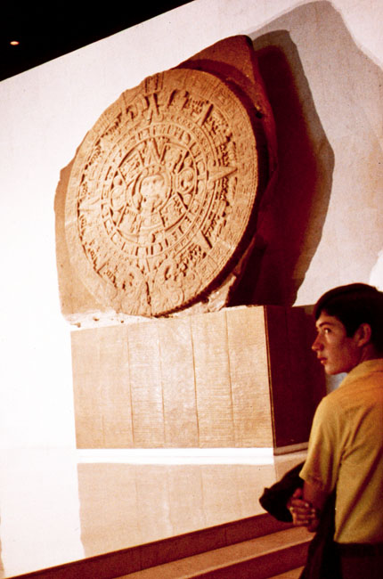
Aztec, Tenochtitlán

Slide 26
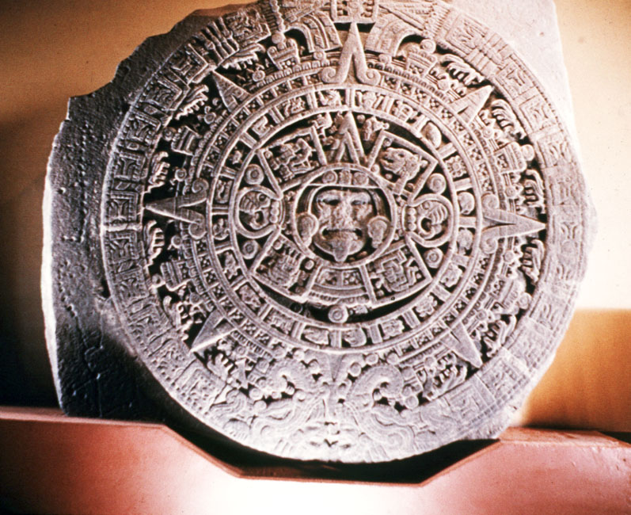
Aztec, Tenochtitlán

Slide 27
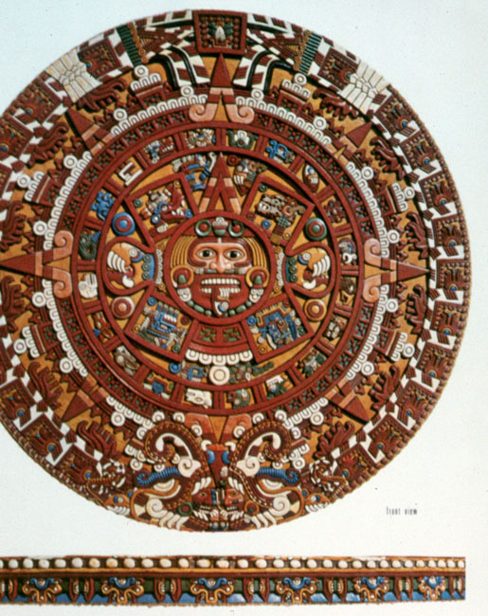
Aztec, Tenochtitlán

Slide 28
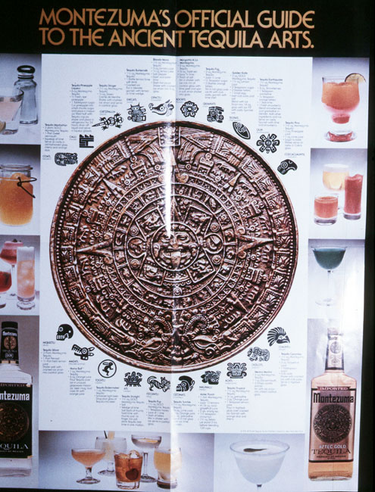
Aztec, Tenochtitlán

Slide 29
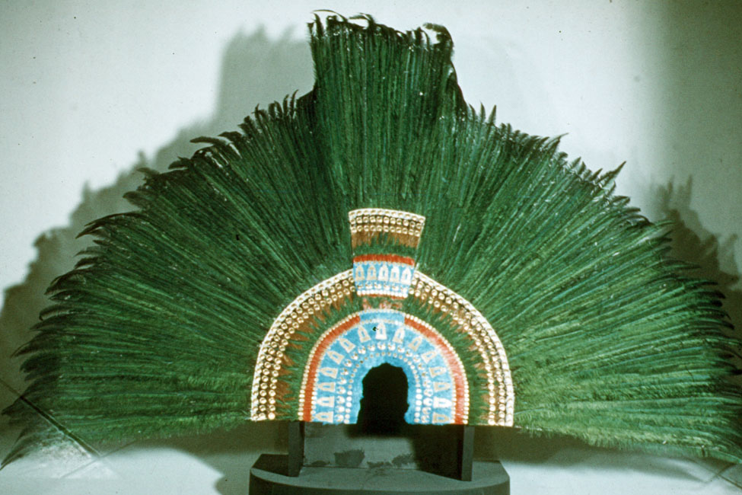
Aztec, Tenochtitlán

Slide 30
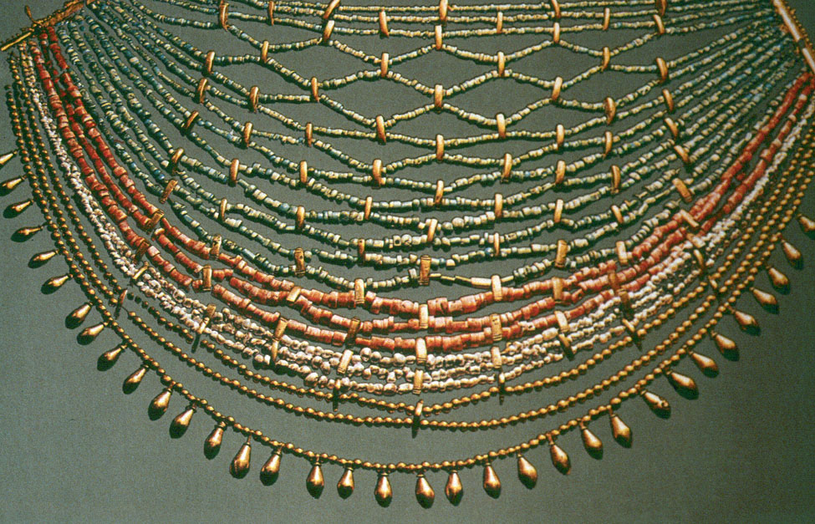
Aztec, Tenochtitlán

Slide 31
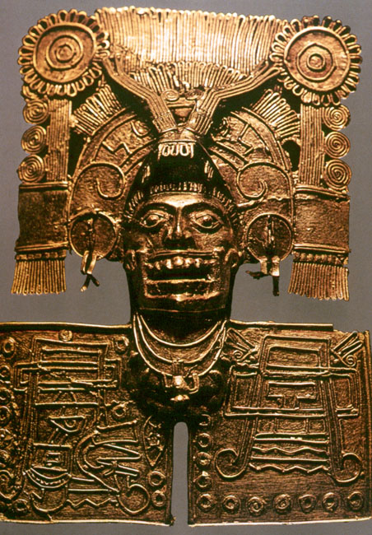
Aztec, Tenochtitlán

Slide 32
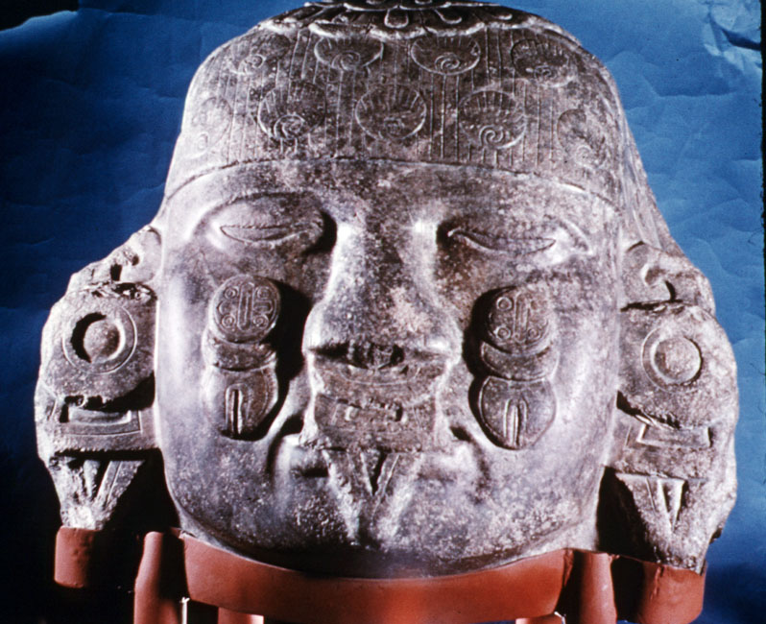
Aztec, Tenochtitlán

Slide 33
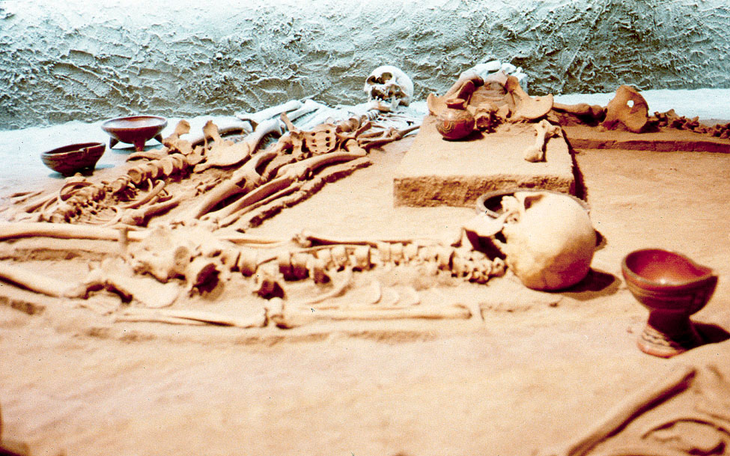
Aztec, Tenochtitlán

Slide 34
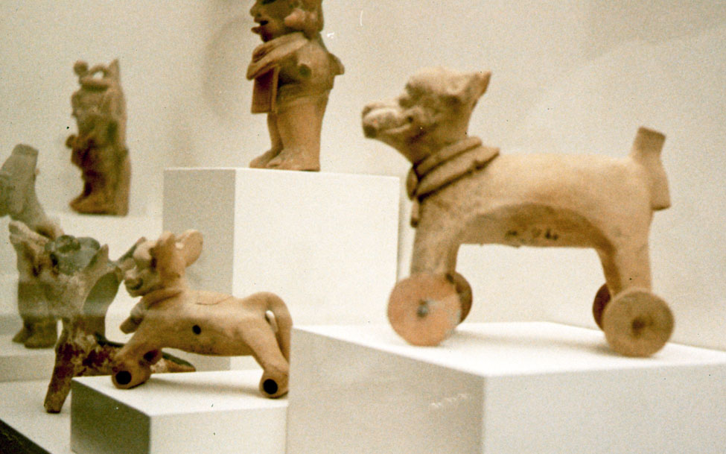
Aztec, Tenochtitlán

Slide 35
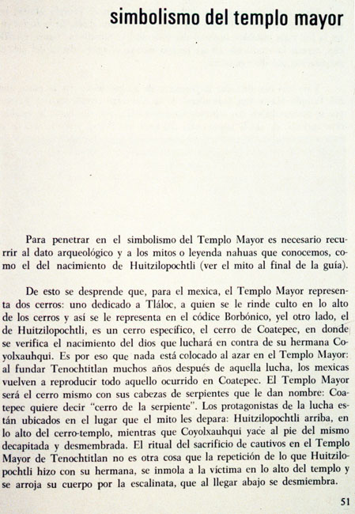
Aztec, Tenochtitlán

Slide 36
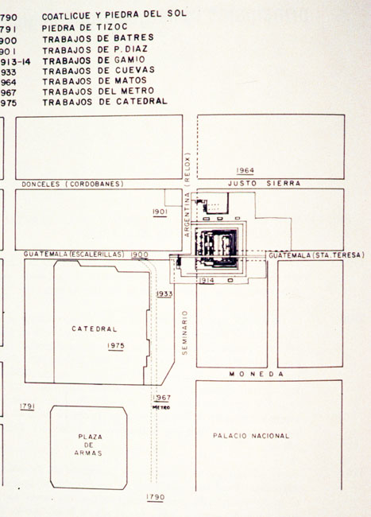
Aztec, Tenochtitlán

Slide 37
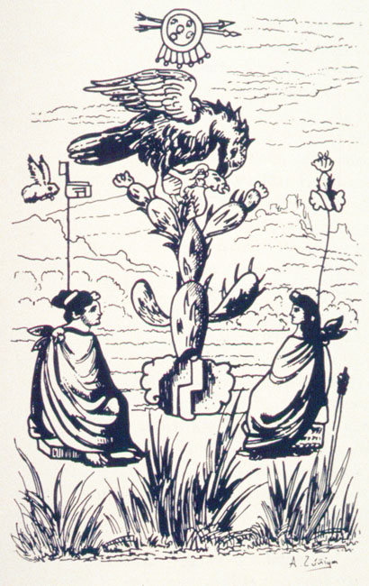
Aztec, Tenochtitlán

Slide 38
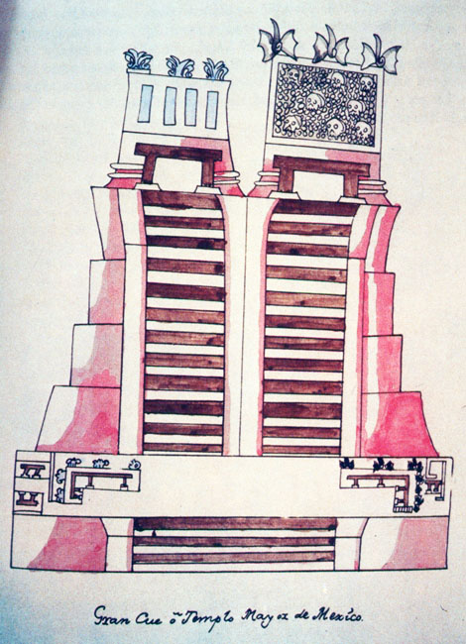
Aztec, Tenochtitlán

Slide 39
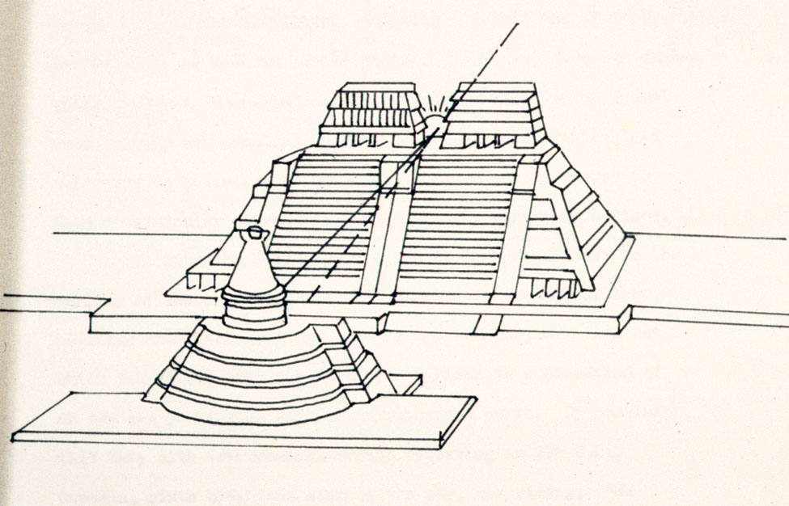
Aztec, Tenochtitlán

Slide 40
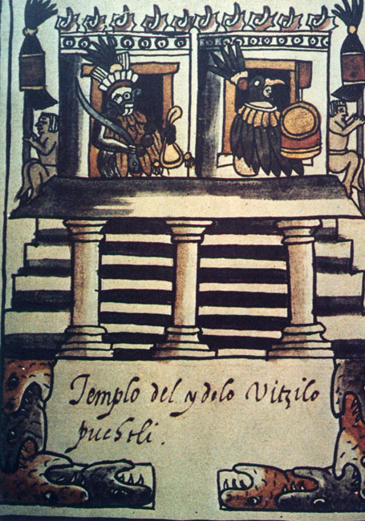
Aztec, Tenochtitlán

Slide 41
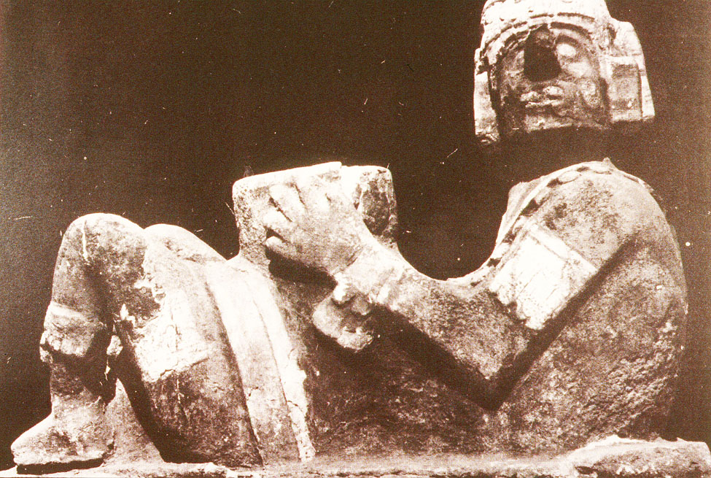
Aztec, Tenochtitlán

Slide 42
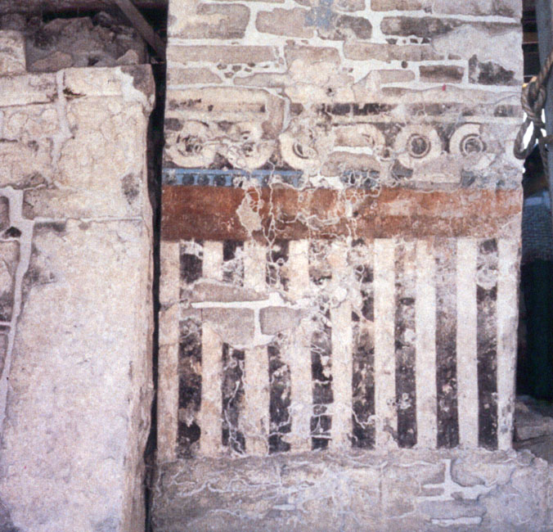
Aztec, Tenochtitlán

Slide 43
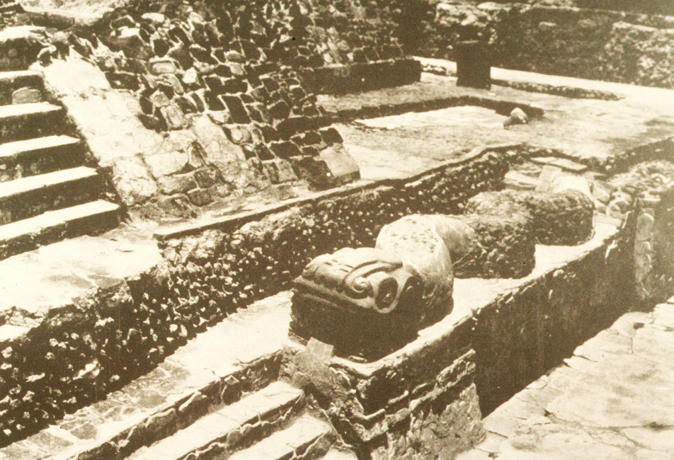
Aztec, Tenochtitlán

Slide 44
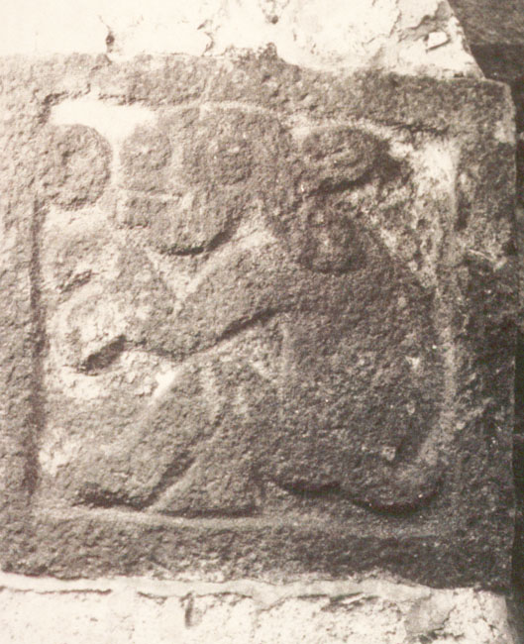
Aztec, Tenochtitlán

Slide 45
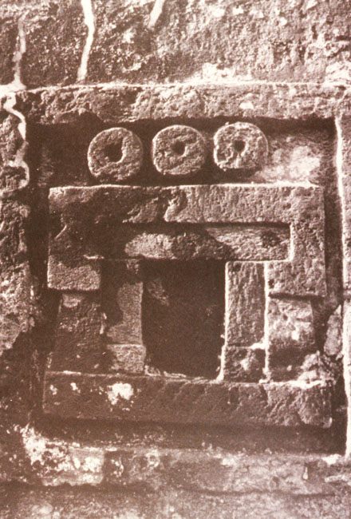
Aztec, Tenochtitlán

Slide 46
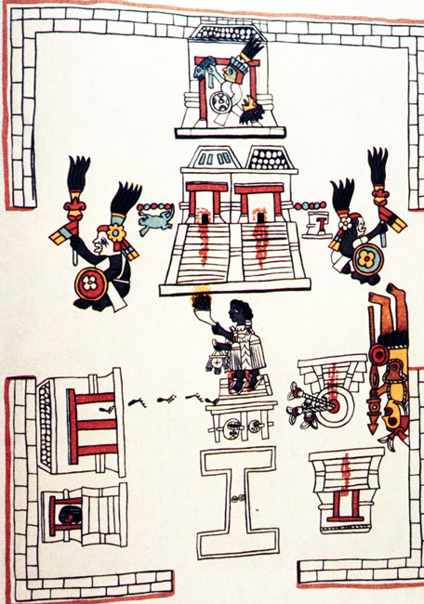
Aztec, Tenochtitlán

Slide 47
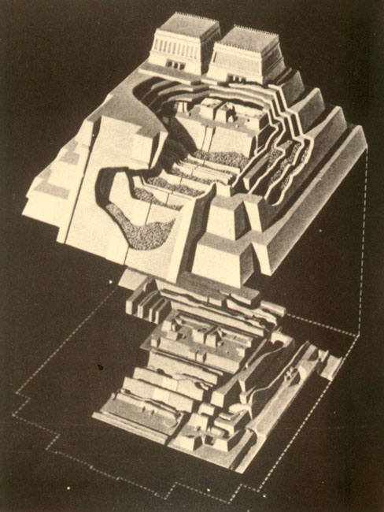
Aztec, Tenochtitlán

Slide 48
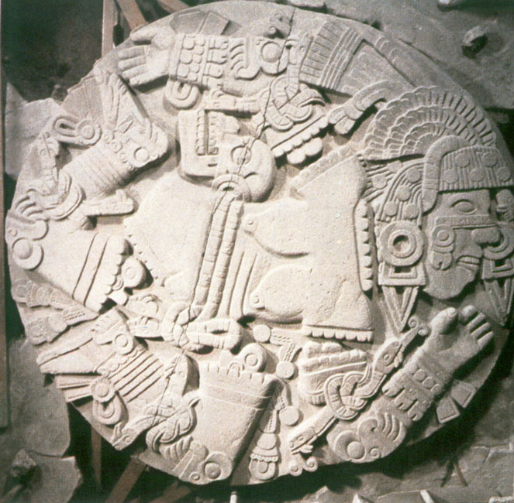
Aztec, Tenochtitlán

Slide 49
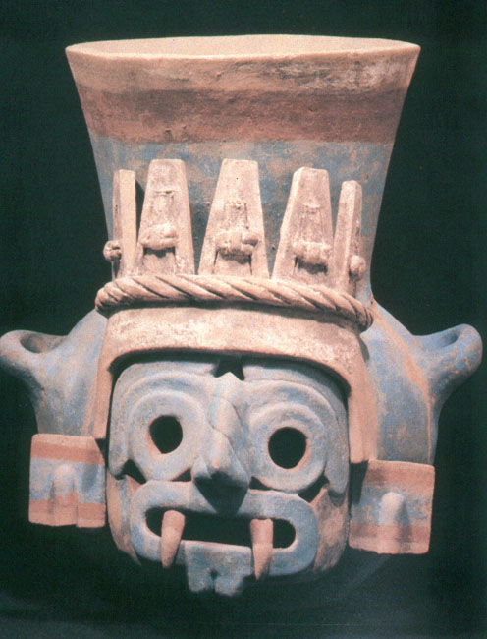
Aztec, Tenochtitlán

Slide 50
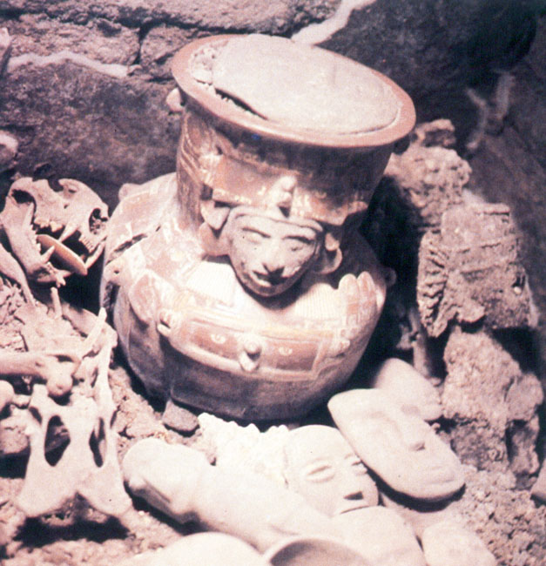
Aztec, Tenochtitlán

Slide 51
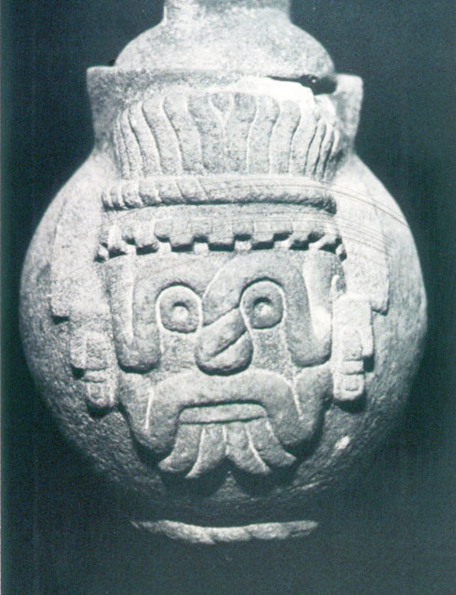
Aztec, Tenochtitlán

Slide 52
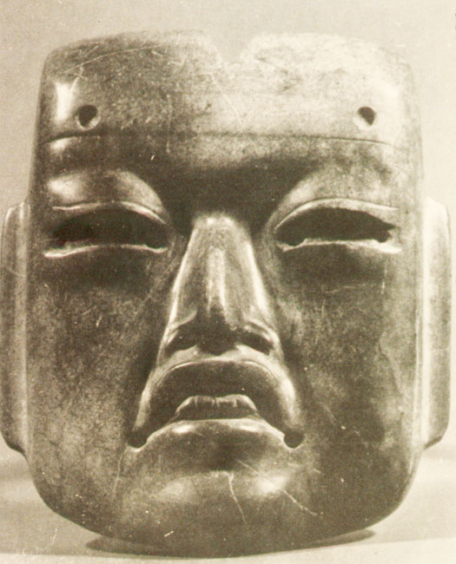
Aztec, Tenochtitlán

Slide 53
Aztec, Tenochtitlán

Slide 54
Aztec, Tenochtitlán

Slide 55
Aztec, Tenochtitlán

Slide 56
Aztec, Tenochtitlán

Slide 57
Aztec, Tenochtitlán

Slide 58
Aztec, Tenochtitlán

Slide 59
Aztec, Tenochtitlán

Slide 60
Aztec, Tenochtitlán

Slide 61
Aztec, Tenochtitlán

Slide 62
Aztec, Tenochtitlán

Slide 63
Aztec, Tenochtitlán

Slide 64
Aztec, Tenochtitlán

Slide 65
Aztec, Tenochtitlán

Slide 66
Aztec, Tenochtitlán

Slide 67
Aztec, Tenochtitlán

Slide 68
Aztec, Tenochtitlán

Slide 69
Aztec, Tenochtitlán

Slide 70
Aztec, Tenochtitlán

Slide 71
Aztec, Tenochtitlán

Slide 72
Aztec, Tenochtitlán

Slide 73
Aztec, Tenochtitlán

Slide 74
Aztec, Tenochtitlán

Slide 75
Aztec, Tenochtitlán

Slide 76
Aztec, Tenochtitlán

Slide 77
Aztec, Tenochtitlán

Slide 78
Aztec, Tenochtitlán

Slide 79
Aztec, Tenochtitlán

Slide 80
Aztec, Tenochtitlán

Slide 81
Aztec, Tenochtitlán

Slide 82
Aztec, Tenochtitlán

Slide 83
Aztec, Tenochtitlán

Slide 84
Aztec, Tenochtitlán

Slide 85
Aztec, Tenochtitlán

Slide 86
Aztec, Tenochtitlán

Slide 87
Aztec, Tenochtitlán

Slide 88
Aztec, Tenochtitlán

Slide 89
Aztec, Tenochtitlán

Slide 90
Aztec, Tenochtitlán

Slide 91
Aztec, Tenochtitlán

Slide 92
Aztec, Tenochtitlán

Slide 93
Aztec, Tenochtitlán

Slide 94
Aztec, Tenochtitlán

Slide 95
Aztec, Tenochtitlán

Slide 96
Aztec, Tenochtitlán

Slide 97
Aztec, Tenochtitlán

Slide 98
Aztec, Tenochtitlán

Slide 99
Aztec, Tenochtitlán

Slide 100
Aztec, Tenochtitlán

Slide 101
Aztec, Tenochtitlán

Slide 102
Aztec, Tenochtitlán

Slide 103
Aztec, Tenochtitlán

Slide 104
Aztec, Tenochtitlán

Slide 105
Aztec, Tenochtitlán

Slide 106
Aztec, Tenochtitlán

Slide 107
Aztec, Tenochtitlán
http://en.wikipedia.org/wiki/Aztecs

Slide 108
Jaguar Warrior from the Codex Magliabechiano
http://en.wikipedia.org/wiki/Aztecs

Slide 109
Aztec, Tenochtitlán
http://en.wikipedia.org/wiki/Aztecs

Slide 110
Aztec, Tenochtitlán
http://en.wikipedia.org/wiki/Aztecs

Slide 111
Human sacrifice as shown in the Codex Magliabechiano
http://en.wikipedia.org/wiki/Aztecs

Slide 112
Elder Aztecs being given intoxicants, Codex Mendoza
http://en.wikipedia.org/wiki/Aztecs

Slide 113
Ornament featuring a turquoise mosaic on a carved wooden base,
with red and white shells used for the mouths
http://en.wikipedia.org/wiki/Aztecs

Slide 114
Turquoise mask. Mixtec-Aztec. 1400-1521
http://en.wikipedia.org/wiki/Aztecs

Slide 115
Tlaloc, Codex Rios
http://en.wikipedia.org/wiki/Aztecs

Slide 116
Levels of military achievement, Codex Mendoza
http://en.wikipedia.org/wiki/Aztecs

Slide 117
Warrior progresses through the ranks, Codex Mendoza
http://en.wikipedia.org/wiki/Aztecs

Slide 118
Aztec warriors, Florentine Codex, 16th Century
Each warrior is brandishing a maquahuitl
http://en.wikipedia.org/wiki/Aztecs

Slide 119
Man holding a cacao bean, Aztec
http://en.wikipedia.org/wiki/Aztecs

Slide 120
Aztec men sharing a meal. Florentine Codex, Late 16th century
http://en.wikipedia.org/wiki/Aztecs

Slide 121
Aztec feast. Illustration from the Florentine Codex, Late 16th century
http://en.wikipedia.org/wiki/Aztecs

Slide 122
Aztec feast. Illustration from the Florentine Codex, Late 16th century
http://en.wikipedia.org/wiki/Aztecs

Slide 123
Aztec feast. Illustration from the Florentine Codex, Late 16th century
http://en.wikipedia.org/wiki/Aztecs

Slide 124
Aztec feast. Illustration from the Florentine Codex, Late 16th century
http://en.wikipedia.org/wiki/Aztecs

Slide 125
Aztec feast. Illustration from the Florentine Codex, Late 16th century
http://en.wikipedia.org/wiki/Aztecs

Slide 126
Aztec woman blowing on maize before putting it into the cooking pot
so it will not fear the fire, Florentine Codex, Late 16th century
http://en.wikipedia.org/wiki/Aztecs

Slide 127
Huehueteotl , Aztec
http://en.wikipedia.org/wiki/Aztecs

Slide 128
Codex Mendoza, mid-16th century, Aztec
http://en.wikipedia.org/wiki/Aztecs

Slide 129
Codex Mendoza, mid-16th century, Aztec
http://en.wikipedia.org/wiki/Aztecs

Slide 130
Codex Mendoza, mid-16th century, Aztec
http://en.wikipedia.org/wiki/Aztecs

Slide 131
Codex Tudela , 16th century, Aztec
http://en.wikipedia.org/wiki/Aztecs

Slide 132
Mixcoatl, Aztec
http://en.wikipedia.org/wiki/Aztecs

Slide 133
Macuilxochitl, Aztec
http://en.wikipedia.org/wiki/Aztecs

Slide 134
Tlahuizcalpantecutli, Aztec
http://en.wikipedia.org/wiki/Aztecs

Slide 135
Ehecatl , Aztec
http://en.wikipedia.org/wiki/Aztecs

Slide 136
Tzompantli, Aztec
http://en.wikipedia.org/wiki/Aztecs

Slide 137
Xipe Totec, Aztec
http://en.wikipedia.org/wiki/Aztecs

Slide 138
Quetzalcoatl , Codex Telleriano-Remensis, 16th century, Aztec
http://en.wikipedia.org/wiki/Aztecs

Slide 139
Aztec “Calendar”
http://en.wikipedia.org/wiki/Aztecs

Slide 140
Libellus de Medicinalibus Indorum Herbis,
an Aztec herbal composed in 1552 by Martín de la Cruz
http://en.wikipedia.org/wiki/Aztecs

Slide 141
Codex Mendoza, a mid-16th century, Aztec
http://en.wikipedia.org/wiki/Aztecs

Slide 142
The Mexica depart from Aztlán, Codex Boturini, 16th Century, Aztec
http://en.wikipedia.org/wiki/Aztecs

Slide 143
The board game Patolli, Codex Florentine, 1569, Aztec
http://en.wikipedia.org/wiki/Aztecs

Slide 144
Tlahuizcalpantecuhtli, Aztec
http://en.wikipedia.org/wiki/Aztecs

Slide 145
Tlaloc, Codex Rios, Aztec
http://en.wikipedia.org/wiki/Aztecs

Slide 146
Codex Mendoza, a mid-16th century, Aztec
http://en.wikipedia.org/wiki/Aztecs

Slide 147
Codex Mendoza, a mid-16th century, Aztec
http://en.wikipedia.org/wiki/Aztecs

Slide 148
Codex Mendoza, a mid-16th century, Aztec
http://en.wikipedia.org/wiki/Aztecs

Slide 149
Codex Mendoza, a mid-16th century, Aztec
http://en.wikipedia.org/wiki/Aztecs

Slide 150
Codex Mendoza, a mid-16th century, Aztec
http://en.wikipedia.org/wiki/Aztecs

Slide 151
Codex Mendoza, a mid-16th century, Aztec
http://en.wikipedia.org/wiki/Aztecs

Slide 152
Codex Mendoza, a mid-16th century, Aztec
http://en.wikipedia.org/wiki/Aztecs

Slide 153
The 13th trecena of the Aztec sacred calendar (tonalpohualli)
Codex Borbonicus, Aztec
http://en.wikipedia.org/wiki/Aztecs

Slide 154
Tzompantli , Codex Durana, 16th century, Aztec
http://en.wikipedia.org/wiki/Aztecs

Slide 155
Sun Stone “Calendar” , Aztec
http://en.wikipedia.org/wiki/Aztecs

Slide 156
Sceau aztèque
http://en.wikipedia.org/wiki/Aztecs

Slide 157
Idoles, Aztec
http://en.wikipedia.org/wiki/Aztecs

Slide 158
Idole, Aztec
http://en.wikipedia.org/wiki/Aztecs

Slide 159
Aztec pottery, Temple Mayor Museum, Mexico City
http://en.wikipedia.org/wiki/Aztecs

Slide 160
Aztec pot, Temple Mayor Museum, Mexico City
http://en.wikipedia.org/wiki/Aztecs

Slide 161
"One Flower" ceremony, Florentine Codex, Late 16th Century, Aztec
The two drums are the teponaztli (foreground) and the huehuetl (background).
http://en.wikipedia.org/wiki/Aztecs

Slide 162
Man threshing amaranth, Florentine Codex, Late 16th century, Aztec
http://en.wikipedia.org/wiki/Aztecs

Slide 163
Check other slides at
http://www.d.umn.edu/cla/faculty/troufs/anth3618/maaztec_feasts.html#title
And
http://www.d.umn.edu/cla/faculty/troufs/anth3618/maaztec.html#title
http://en.wikipedia.org/wiki/Aztecs

Slide 164
Ancient Middle America
Aztec Tenochtitlán
University of Minnesota Duluth
Tim Roufs’ ©2009-2019

