Slide 1
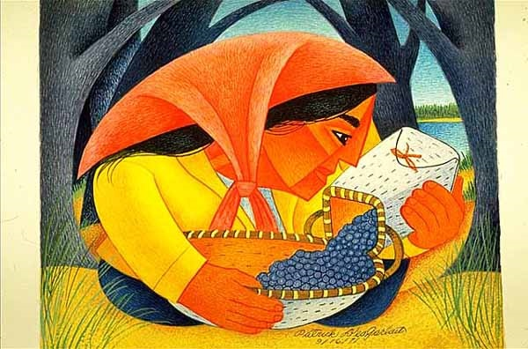
Start deck in “Slide Show” mode,
and use your up/down arrow keys and/or
your space bar to advance the slides
University of Minnesota Duluth
Tim Roufs
© 2010-2024

Slide 2
REM
indicates that the materials
are a REMinder
and are thus being repeated . . .
REMinder

Slide 3
ANTH 3888
Anthropology of Food
Main
Characteristics of
Anthropology
University of Minnesota Duluth
Tim Roufs
© 2010-2024

Slide 4
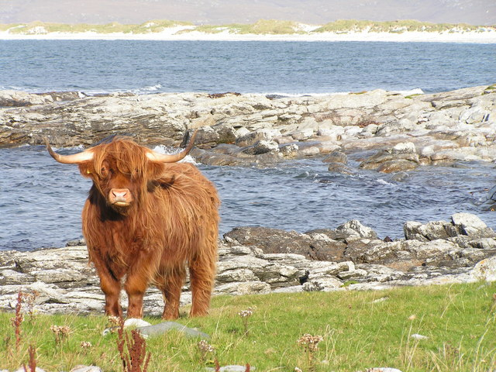
ANTH 3888
Anthropology of Food
Fieldwork
as a
Primary Research
Technique
University of Minnesota Duluth
Tim Roufs
© 2010-2024
http://en.wikipedia.org/wiki/Highland_cattle

Slide 5
American
Main Characteristics of˄Anthropology
1. the four fields of general anthropology
culture as a primary concept
comparative method as major approach
holism as a primary theoretical goal
fieldwork as a primary research technique

Slide 6
And finally,
we have the last
main characteristic of American Anthropology . . .

Slide 7
American
Main Characteristics of˄Anthropology
1. the four fields of general anthropology
culture as a primary concept
comparative method as major approach
holism as a primary theoretical goal
fieldwork as a primary research technique

Slide 8
Most of all (generally)
Anthropologists
LOVE . . .

Slide 9
Main Characteristics of Anthropology
1. the four fields of general anthropology
culture as a primary concept
comparative method as major approach
holism as a primary theoretical goal
fieldwork as a primary research technique -- involving “participant observation”

Slide 10
Note two terms in the
“Main Characteristics
of Anthropology”
listing . . .

Slide 11
Main Characteristics
1. culture as a primary concept
2. comparative method as major approach to the study of human behavior
3. holism or the study of "humankind" as a whole, as a primary theoretical goal
4. fieldwork as a primary research technique, involving “participant observation”

Slide 12
Main Characteristics
1. culture as a primary concept
2. comparative method as major approach to the study of human behavior
3. holism or the study of "humankind" as a whole, as a primary theoretical goal
4. fieldwork as a primary research technique, involving “participant observation”
what’s the difference?

Slide 13
Main Characteristics
1. culture as a primary concept
2. comparative method as major approach to the study of human behavior
3. holism or the study of "humankind" as a whole, as a primary theoretical goal
4. fieldwork as a primary research technique, involving “participant observation” = how you get information
= tool

Slide 14
Main Characteristics
1. culture as a primary concept
2. comparative method as major approach to the study of human behavior
3. holism or the study of "humankind" as a whole, as a primary theoretical goal
4. fieldwork as a primary research technique, involving “participant observation” = how you get information
data gathering technique —
participant observation
(fieldwork)
= tool

Slide 15
Main Characteristics
Anthropologists use other tools . . . like questionnaires, interview schedules, psychological tests, documentary filming . . . but “participant observation” is a characteristic technique use by anthropologists, especially cultural anthropologists (ethnologists)
1. culture as a primary concept
2. comparative method as major approach to the study of human behavior
3. holism or the study of "humankind" as a whole, as a primary theoretical goal
4. fieldwork as a primary research technique, involving “participant observation” = how you get information
= tool

Slide 16
Main Characteristics
Anthropologists use other tools . . . like questionnaires, interview schedules, psychological tests, documentary filming . . . but “participant observation” is a characteristic technique use by anthropologists, especially cultural anthropologists (ethnologists)
1. culture as a primary concept
2. comparative method as major approach to the study of human behavior
3. holism or the study of "humankind" as a whole, as a primary theoretical goal
4. fieldwork as a primary research technique, involving “participant observation” = how you get information
NOTE:
= tool

Slide 17
Main Characteristics
1. culture as a primary concept
2. comparative method as major approach to the study of human behavior
3. holism or the study of "humankind" as a whole, as a primary theoretical goal
4. fieldwork as a primary research technique, involving “participant observation” = how you get information
= tool

Slide 18
Main Characteristics
1. culture as a primary concept
2. comparative method as major approach to the study of human behavior
3. holism or the study of "humankind" as a whole, as a primary theoretical goal
4. fieldwork as a primary research technique, involving “participant observation” = how you get information
= approach
= how you use information
= tool

Slide 19
Main Characteristics of Anthropology
1. the four fields of general anthropology
culture as a primary concept
comparative method as major approach
holism as a primary theoretical goal
fieldwork as a primary research technique -- involving “participant observation”

Slide 20
Main Characteristics
1. culture as a primary concept
2. comparative method as major approach to the study of human behavior
3. holism or the study of "humankind" as a whole, as a primary theoretical goal
4. fieldwork as a primary research technique, involving “participant observation” = how you get information
= tool

Slide 21
Main Characteristics
1. culture as a primary concept
2. comparative method as major approach to the study of human behavior
3. holism or the study of "humankind" as a whole, as a primary theoretical goal
4. fieldwork as a primary research technique, involving “participant observation” = how you get information
other tools include
things like . . .
= tool

Slide 22
Main Characteristics
“24-hour diet survey”
diet records
(self-reported, diary)
“food frequency questionnaire” (recorded retrospectively)
1. culture as a primary concept
2. comparative method as major approach to the study of human behavior
3. holism or the study of "humankind" as a whole, as a primary theoretical goal
4. fieldwork as a primary research technique, involving “participant observation” = how you get information
= tool
after Marion Nestle, Food Politics, Rev. Ed., 2007, pp. 401-405

Slide 23
Main Characteristics
“24-hour diet survey”
diet records
(self-reported, diary)
“food frequency questionnaire” (recorded retrospectively)
1. culture as a primary concept
2. comparative method as major approach to the study of human behavior
3. holism or the study of "humankind" as a whole, as a primary theoretical goal
4. fieldwork as a primary research technique, involving “participant observation” = how you get information
= tool
after Marion Nestle, Food Politics, Rev. Ed., 2007, pp. 401-405

Slide 24
We’ll be doing a “24-hour diet survey” Week 3 as one of our activities . . .

Slide 25
Main Characteristics
1. culture as a primary concept
2. comparative method as major approach to the study of human behavior
3. holism or the study of "humankind" as a whole, as a primary theoretical goal
4. fieldwork as a primary research technique, involving “participant observation” = how you get information
and in food studies there are lots of other tools and approaches . . .
= tool

Slide 26
studies of laboratory animals
biochemical research
(“test tube”)
epidemiological research (populations)
clinical studies of humans
(medical)
after Marion Nestle, Food Politics, Rev. Ed., 2007, pp. 401-405

Slide 27
Anthropologists often like to use a research “technique” based on
“unobtrusive measures” . . .
(either in the field or elsewhere)

Slide 28
“unobtrusive measures”
analysis of data on availability of commodities in the food supply
food supply data analysis
(U.S.A. production + imported)
(foods available for consumption)
(unknown: home garden production, hunting/fishing/foraging, amount of food wasted . . .)
food composition analysis . . .
after Marion Nestle, Food Politics, Rev. Ed., 2007, pp. 401-405

Slide 29
But most of all (generally)
Anthropologists
LOVE . . .

Slide 30
Main Characteristics of Anthropology
1. the four fields of general anthropology
culture as a primary concept
comparative method as major approach
holism as a primary theoretical goal
fieldwork as a primary research technique -- involving “participant observation”

Slide 31
And of all of the subfields of Anthropology, fieldwork in the area of the Anthropology of Food is one of the very best . . .

Slide 32
Unfortunately, in this class we cannot travel to places far and wide in person, so we’ll do the next best thing and go there
via videos and slides.
In class we’ll see . . .

Slide 33
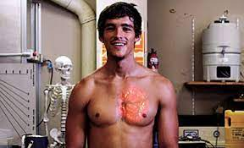
Damon Gameau, in That Sugar Film

Slide 34
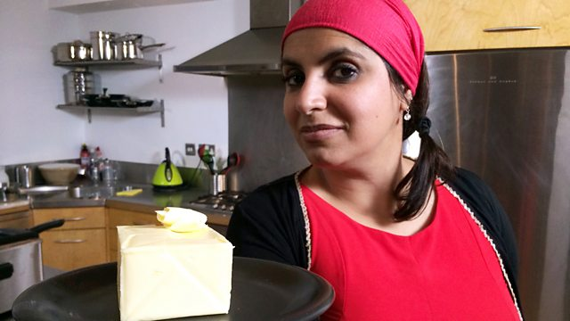
The Truth about Fat

Slide 35
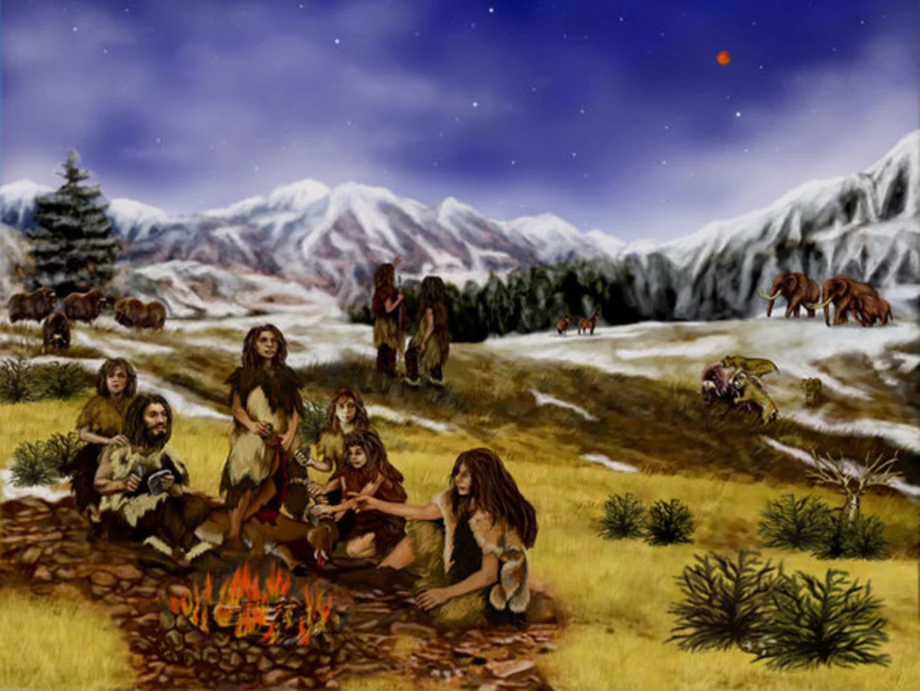
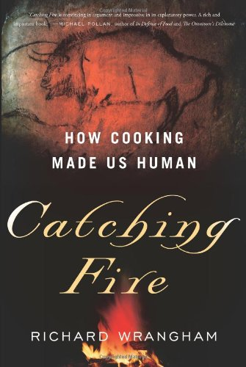
Did Cooking Make Us Human?

Slide 36
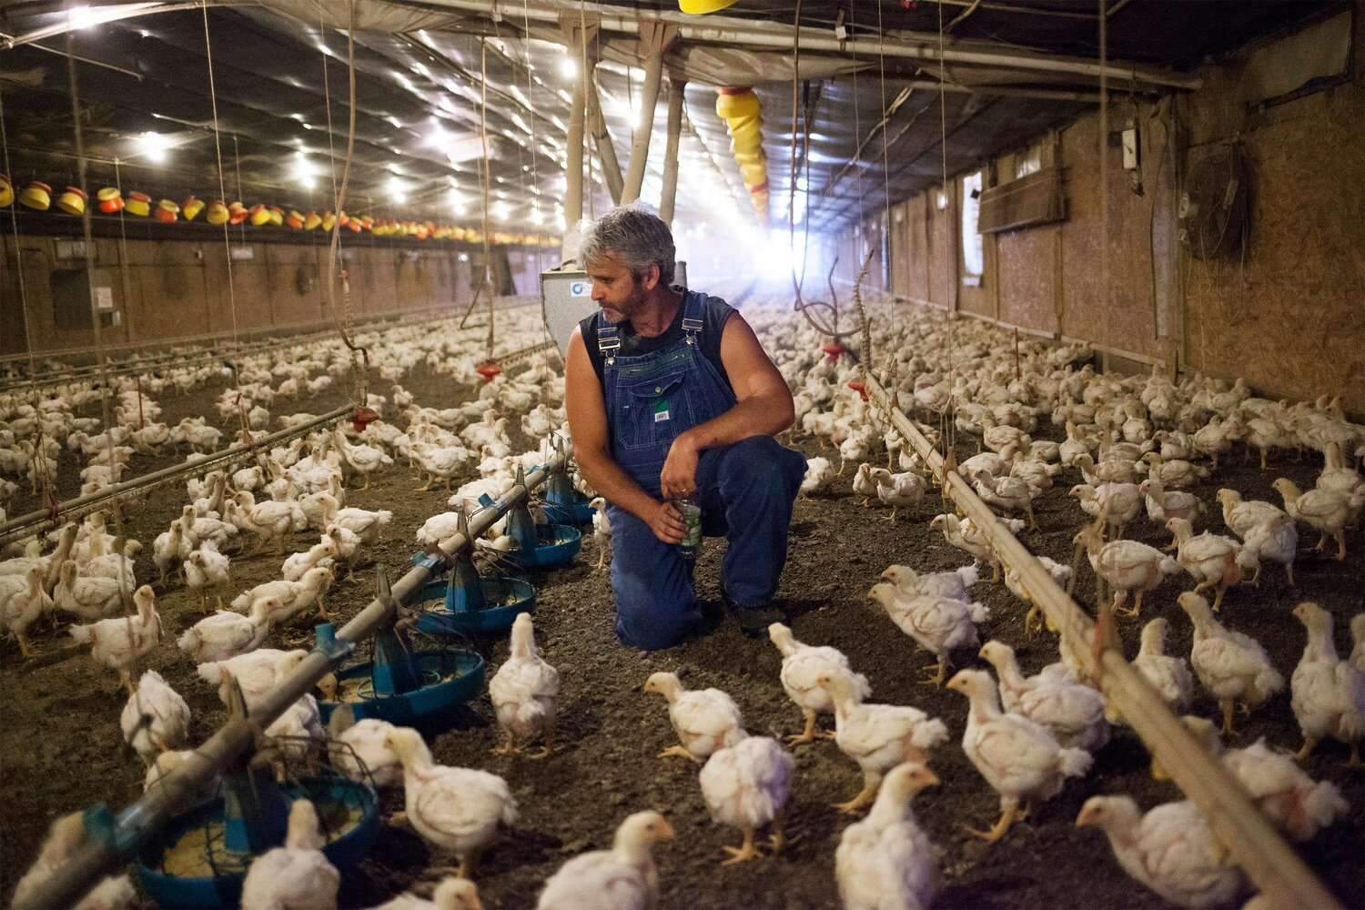
We’ll meet people like Craig Watts, Contract Farmer
Fairmont, North Carolina

Slide 37
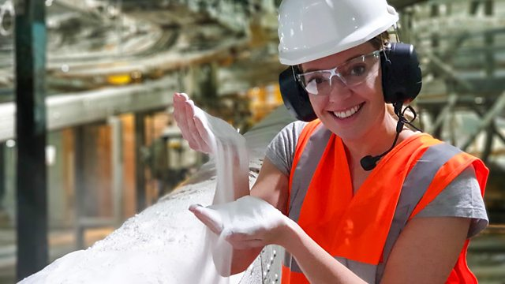
“Soup” Factory Worker in
Wigan, England

Slide 38
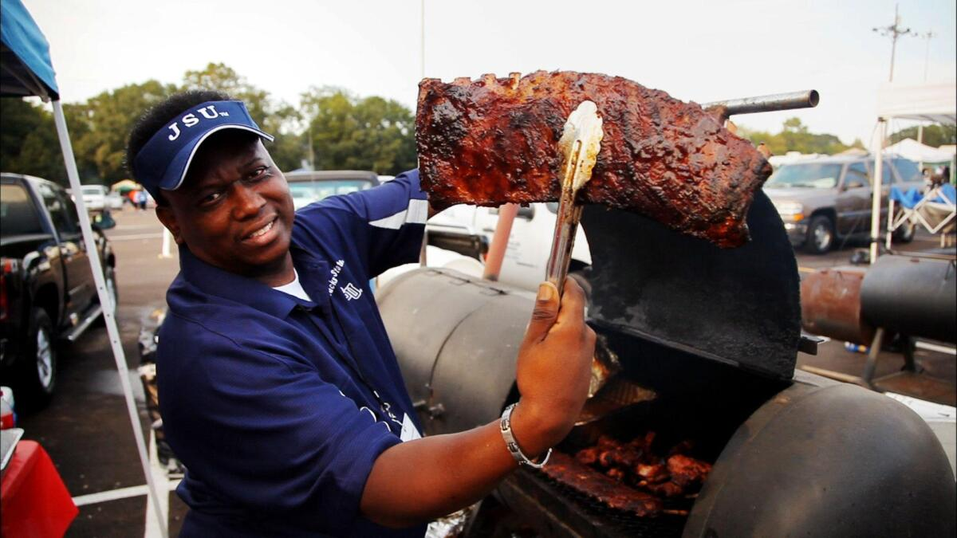
Soul Food Junkies
https://www.d.umn.edu/cla/faculty/troufs/anthfood/video/Soul_Food_Junkies.html#title

Slide 39
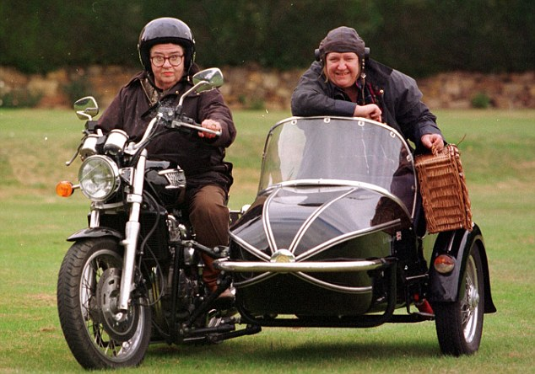
The Two Fat Ladies
United Kingdom

Slide 40
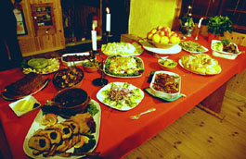
We’ll analyze the Danish Christmas Luncheon
Wikipedia

Slide 41
And have a look at the Singapore Hawker Centers
https://asianinspirations.com.au/experiences/hawker-heaven-5-hawker-centres-to-visit-in-singapore/

Slide 42
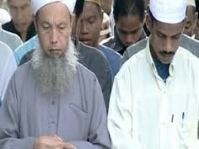
. . . and visit China and Malaysia . . .

Slide 43
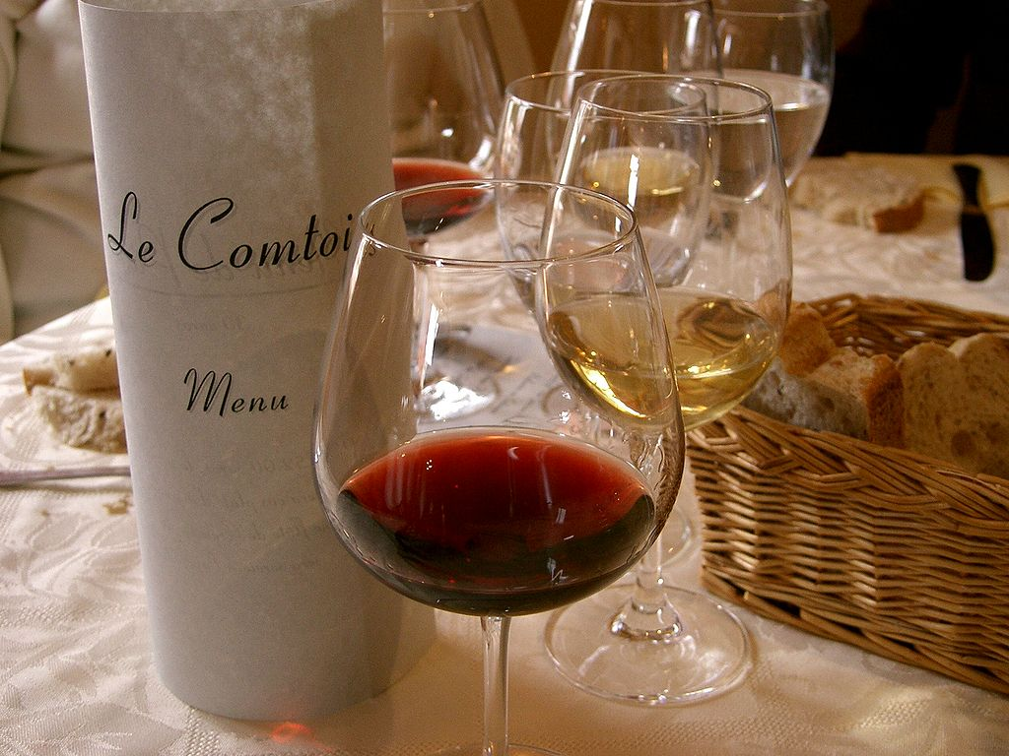
. . . savor French Wine
Wikipedia

Slide 44
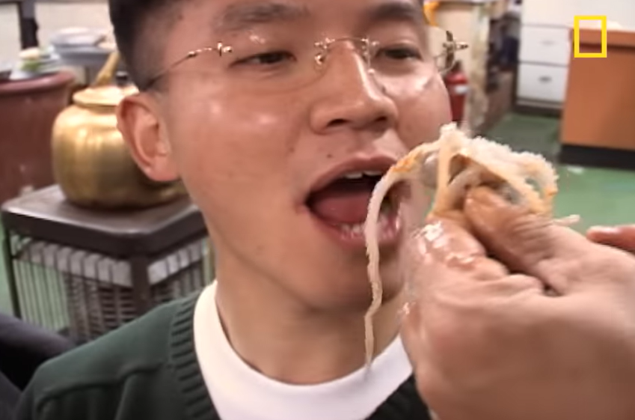
Watch folks “Eating Live Octopus”
https://youtu.be/JYDkzqCfJzg

Slide 45
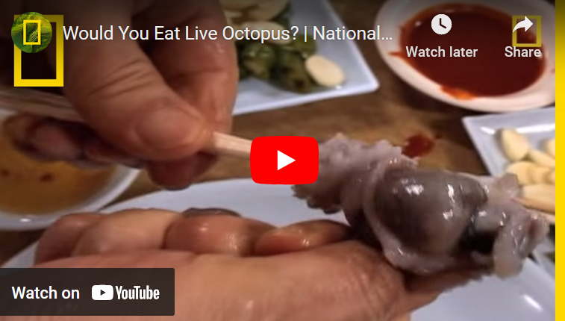
Watch folks “Eating Live Octopus”
https://youtu.be/JYDkzqCfJzg

Slide 46
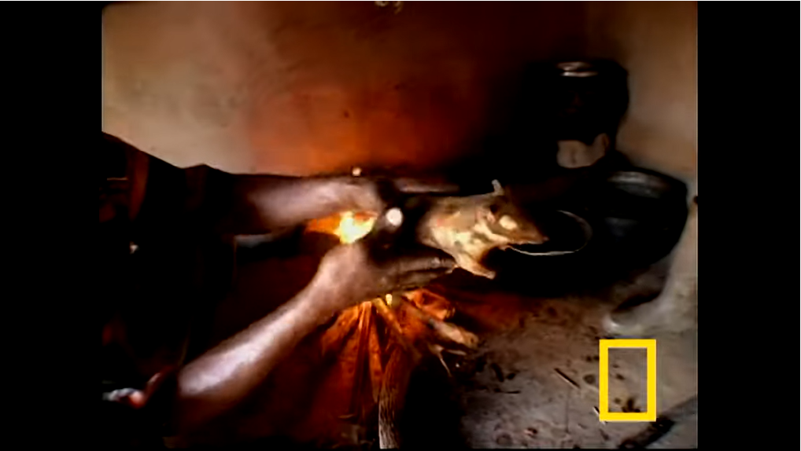
. . . and rats . . .
https://youtu.be/KvCjKh1h29Y

Slide 47
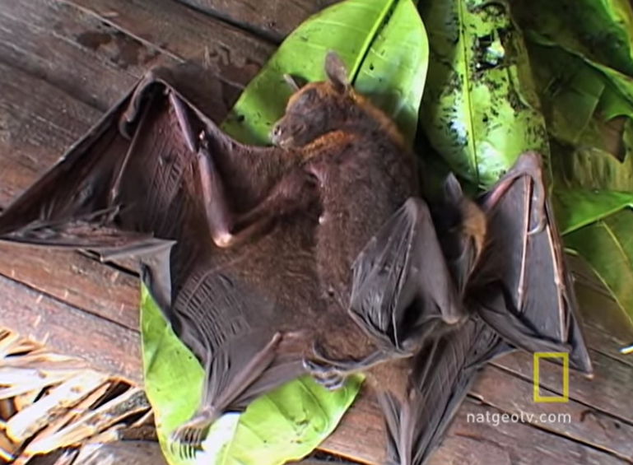
. . . and bats . . .
https://youtu.be/g3mMn2NtRig

Slide 48
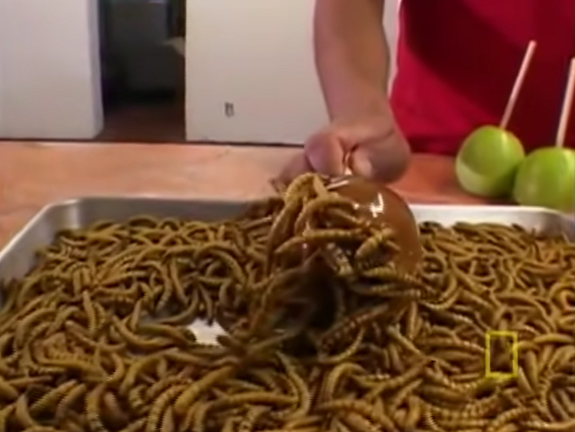
. . . and “insects” . . .
https://youtu.be/3f7I_HAm4d8

Slide 49
And as I mentioned earlier and in the “An Important Note on Videos and Visual Anthropology,” we would LOVE to take you along with us around the world, but the next best thing we can do is bring the world to you in the form of films and videos.
And we’ll do a lot of that.

Slide 50
So films and videos make up a very large part of this class . . .
In the best of all possible worlds, we would head off to the countries and cultures and meet and talk with the people.
That is simply not practical for this class
(but one can always sign up for one or more study abroad experiences).

Slide 51
So films and videos make up a very large part of this class . . .
In the best of all possible worlds, we would head off to the countries and cultures and meet and talk with the people.
That is simply not practical for this class
(but one can always sign up for one or more study abroad experiences).

Slide 52
So films and videos make up a very large part of this class . . .
In the best of all possible worlds, we would head off to the countries and cultures and meet and talk with the people.
That is simply not practical for this class
(but one can always sign up for one or more study abroad experiences).

Slide 53
So we’ll go
around the world
via videos
and slides

Slide 54
And what does
Leonardo DiCaprio think of this collection?

Slide 56
REM
Main Characteristics in a Nutshell

Slide 57
Main Characteristics of Anthropology
1. the four fields of general anthropology
culture as a primary concept
comparative method as major approach
holism as a primary theoretical goal
fieldwork as a primary research technique -- involving “participant observation”

Slide 58
The End
Fieldwork
as a
Primary Research
Technique
University of Minnesota Duluth
Tim Roufs
© 2010-2024
http://en.wikipedia.org/wiki/Highland_cattle

