Slide 1
Welcome Back
Today: Good Stuff from Chapters 11-14
Thursday: Drugs

Slide 2
Explaining the Violence Drop
▪ “Usual Suspects”
  ▪ Police tactics
  ▪ Increase in prison populations
  ▪ Economic conditions
  ▪ Changes in demographics
  ▪ Cultural shift
  ▪ Role of illicit drugs

Slide 3
Property Crimes
Burglary
Arson
Larceny-Theft
Motor Vehicle Theft

Slide 4
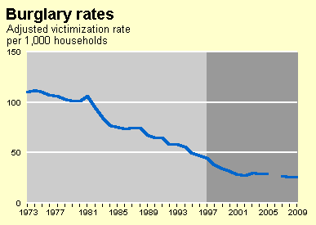

Slide 5
Burglary
Unlawful entry into building/dwelling
Intent to commit a crime (usually theft)
  AKA, “Breaking and Entering” or B&E
Nature and Extent
  Residential burglary has been on the decline since we’ve had the NCVS (stable over past decade)
    26/1,000 or 2.6% of households
  61% of B&E’s involve forceful entry
  Arrestees as male (84%), white (67%)
  Low income, rental hosing more prone to burglary

Slide 6
Research on Burglars/Burglary
Professional vs. Amateur
  Some truth to media stereotype of professional burglars
    Network of fences, information, etc.
    Learning process (older friends, family members, street associates)
  Amateur = opportunity x need

Slide 7
Theories & Burglary
Rational Choice Theory
  Especially for “criminal event”
  Target selection, evading law enforcement, etc.
Other theories predict criminal involvement (why burglary and not a job?)
  Social learning
  Low self-control
  Pretty much all theories

Slide 8
Burglary vs. Robbery
Robbery = use or threat of force
  Upside = steal cash to use immediately
Burglary
  Need “fence” or some way to sell stolen items
  Newer trend = Craig's list, ebay, etc.
  May be more “planned” (sometimes)

Slide 9
Response to Burglary
Very low clearance rate (10-15%)
  That includes multiple crimes from single offender
Situational Crime prevention
  Shrubbery maintenance , burglar alarms, dog, sign that says you have dog or alarm, good locks, timer lights

Slide 10
Arson
Willful or malicious burning or attempting to burn, with or without intent to defraud, a dwelling house public building…
  Not in NCVS
  UCR → 63,000 arsons reported to police in 2008
    Almost half of those arrested were juveniles
    84% males, 76% white
    Low (18%) clearance rates
  Fire starters/pyromaniacs vs. “hired torch”

Slide 11
Larceny-Theft
The completed or attempted theft of property or cash without personal contact
  Shoplifting, purse snatching, theft of motor vehicle parts…
  Not burglary (no breaking in) or robbery (no use or threat of force)
  Types
    Grand Larceny (> than x$) vs. Petit

Slide 12
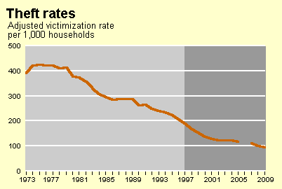

Slide 13
Nature/Extent of Larceny-Theft
NCVS vs. UCR
  NCVS only personal (not business) so estimates differ
Most common form of property crime
  67% of all property crime known to police
  Heavily underreported (34% reported)
  Average value of reported theft about $1,000

Slide 14
Explaining/Controlling Theft
With some exceptions, not a lot the CJS can do (low clearance)
  Exceptions = stings, data-driven surveillance
Lots of advances in target hardening and guardianship in private sphere
  Credit cards? Theft by check? Shoplifting?
  “Loss Prevention” units in stores
Great variation in motivation for theft
  Support drug habit, thrill, hedonism, professional…

Slide 15
Motor Vehicle Theft
Theft or attempted theft of car, RV, boat, etc.
  Cincinnati attempted theft of canoe
High reporting to police
Highest recovery rate of all stolen property
Typology
  Joyriders, professionals /profit, use , fraud
    Fence for autos = “chop shop”
  What type of car is most likely to be stolen?
    Raw Numbers = old sedans (e.g., Honda Civic, Accord)
    Highest proportion??

Slide 16
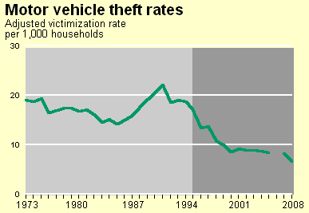

Slide 17
Public Order Offenses
“Blue Laws”
Prostitution
Gambling
Drug use / sale
Public intoxication / urination / defecation
Disorderly conduct
Panhandling
Fornication, adultery, sodomy, bestiality

Slide 18
Fodder for much discussion…
Conflict perspective & labeling theory
  Consensus over laws + enforcement
Use of the criminal justice system (especially police)
  Discrimination based on race, place, and class
  Discretion increases as crime seriousness decreases

Slide 19
The “enforcement” camps
Morality / Harm perspective
  Harmful or morally reprehensive behaviors should be illegal
    Moral entrepreneurs + conflict theory
    May or may not be based on empirical facts
Law and Order Perspective
  Broken windows /order maintenance , routine activities, and social disorganization
    Tolerating the little stuff” breeds crime and interferes with neighborhood collective efficacy

Slide 20
The “back up the truck, chuck” view
Reasons to be skeptical about enforcement
  Restricting goods/services drives up profit
    Organized crime thrives on black markets
    Driving up the cost of products leads to users engaging in crime to get money for product/service
  Takes enforcement time/resources away from more serious forms of crime
  Problems related to police enforcement
    Police corruption
    Police violation of procedural law
    Race/class/place discrimination (high discretion)
Relates also to the “Libertarian” Ideology

Slide 21
The case of Alcohol
How did prohibition come about?
  Moral entrepreneurs (moral perspective)
    Temperance Movement, “Abstinence Societies”
    Ethnic/religious conflict (Upper/middle class vs. working class; protestant vs. others)
    18th Amendment (1920) and Volstead Act
Why was prohibition repealed?
  Harm of substance versus harm of prohibiting
    Unintended consequences outweighed positive effects

Slide 22
Prostitution
Estimates of “use” rates vary widely
  3% (GSS) to 20% (Janus²)
Difficult to estimate number of active prostitutes
  Underrepresented on any “lists” to be sampled
  Estimates from 50,000 to 4.2 million
  FBI data on arrests reflects policy/policing

Slide 23
Prostitute Hierarchy
Crack Prostitutes
  Trade sex for drugs and/or cash
Street-walkers
  Classic media version
  Overrepresented in research and arrests
Call girls / brothels / massage parlors
  Better working conditions (choice of clients, hours, etc)
Critics: categories not exclusive, more similar (risk of violence, etc.) than different

Slide 24
Prostitution
Morality view
  Prostitutes as victims, coerced into prostitution
    High rates of sexual abuse, drug abuse, etc
    Coercion and patriarchy
Law and Order view
  Public prostitution creates fear/disorder, prostitutes and “johns” as targets for other crimes
Back up The Truck view
  Sex sales similar to alcohol/drugs/gambling
“Streetwalkers” vs. “Call-girls” controversy
  Moralists = not very different (path into, daily life as prostitute)
  Skeptics = many streetwalking problems as result of illegality

Slide 25
Gambling
Trend toward legalization
  Riverboats, Native American casinos, race tracks, “racinos”
Moralists
  Problem gamblers, affects family/friends, etc. People commit crime to get gambling money or hide debt
Law and Order
  Controlled by organized crime, invites other sort of criminals
BUTT
  Most people who gamble are not problem gamblers, use heavy taxation for public good
  Or in the case of MN, to house the sporting “bad”

Slide 26
Should we strictly enforce public order laws?
Broken Windows review
  Little stuff (public disorder) breeds serous crime
    Sends message that nobody cares
    Creates perception of neighborhood being unsafe
    Reduces collective efficacy
  Examples = Times Square, squeegee men, pan handling, use of “foot patrols”
  Downside of “order maintenance” policing?
Middle ground between zero tolerance and no enforcement?
  Kennedy’s focused deterrence
  “De-penalization” (prostitution, marijuana possession)

Slide 27
Cyber-Crime
Crime that occurs over the internet using a computer
  Cyber markets
  Fraud
  Development of criminal communities

Slide 28
Cyber-Markets
Piracy
  Software, Music, Movies, Television Broadcasts, Books…
    Requires minimal skill, but does entail some risks (viruses, lawsuits, etc.)
    Estimates vary, but roughly 1/3 of Americans report pirating
    Higher estimates among youth, especially COLLEGE KIDS!
      UMD STUDENTS = 62% pirated in past year, 20% did so “frequently”
    Music and video piracy appears to be declining…why?
Beyond pirating—use of legitimate (eBay, Craig's list) and illegitimate sites to engage in crime
  Sell stolen goods, trade in illicit drugs/sex

Slide 29
Cyber pornography market
Defining “pornography” has always been problematic
Other major issues
  Access by Minors
  Unwanted solicitation
  Child pornography
Federal legislation has had limited success…
  Communications Decency act of 1996
  Child Online Protection Act (COPA) of 1998
  Children’s Internet Protection Act (CIPA) of 2000

Slide 30
Cyber Fraud
Traditional Fraud Scams
  A friend from Nigeria wished to transfer a million dollars into your account
Phishing and Pharming scams
  Your Ebay account has been compromised!
Hacking
Major concern with many of these techniques is identity theft
  Use your information to take out loans, get credit cards, etc.

Slide 31
Identity Theft
The unlawful use of another person’s identifying information
  Use of name, DOB, social security number, credit card number…to commit fraud or other crimes
  Internet and information age has made this much easier

Slide 32
Combating Identity Theft
State Legislation
  “Freeze laws” – stops access to credit reports
  Laws to redact fraudulent transactions from credit reports
  Disclosure laws—if your info has been compromised
New emphasis on information privacy
Risk minimization
  Guard SS# and other private info, look at credit reports, shred sensitive paper, don’t open suspicious email…

Slide 33
Cybercrime Communities
Anonymity of cyberspace
  Deviant Subcultures have arena to share information and engage in crime
    Child Pornography
    Drug Distribution

