Slide 1
ANOVA
Conceptual Review
Conceptual Formula, Sig Testing
Calculating in SPSS

Slide 2
ANOVA as extension of t-test
T-test = difference between two means
Univariate/1 sample
Population mean compared to sample mean
Bivariate/2 sample
Compare sample means across two categories (males vs. female, old vs. young, white vs. nonwhite).
ANOVA
Compare sample means across three or more categories
Can no longer calculate a simple “difference between means”

Slide 3
The Logic of ANOVA
Instead of difference between means, analyze “variance”
Variance = sum of squared deviations from mean
appropriate df
Between group variance
Measure of how group means vary around “grand mean.” Larger mean differences produce larger values
Within group variance
Measure of how cases vary around their group mean. Considered “error” or “unexplained” variance, because it cannot be accounted for by the IV.

Slide 4
The F Ratio
F = Mean square between = Explained variance
Mean square within Unexplained variance
Mean squared = variance = Sum of Squares
df
df for between = (number of groups – 1)
Or, K-1
df for within = (N – number of groups)
Or, N - K

Slide 5
Use ANOVA when…
IV = nominal/ordinal with more than 2 categories
DV = interval ratio
Example
Instructor Iggy believes that the custody level of a prison is related to the number of prison infractions that an inmate accumulates in a year
NULL? µ_{min}= µ_{med} = µ_{max}
NOTE: NO DIRECTIONALITY HERE!!

Slide 6
Random sample of three prisons N = 15 (5 for each prison).
minimum medium maximum
X_{min} (x_{min} - x_{min} )² X_{med} (x_{med} - x_{med} )² X_{max} (x_{max} - x_{max} )²
1 1 4 2.56 8 .04
2 0 6 .16 10 3.24
3 1 7 1.96 7 1.44
2 0 5 .36 9 .64
2 0 6 .16 7 1.44
________________________________________________________________
Σ 10 2 28 5.2 41 6.8
_________________________________________________________________
x_{min}=2.0 x_{med}=5.6 x_{max}=8.2
Grand mean = 5.267

Slide 7
Conceptual Plot of the 3 groups
GRAND MEAN = 5.27
Based on all cases from all groups
1 2 3 4 5 6 7 8 9
BLUE: Minimum security (mean = 2)
GREEN: Medium security (mean = 5.2)
RED: Maximum security (mean = 6.8)

Slide 8
Types of Variation (SS)
Within group variation (error variation)
Add the variation from within each group together
SS_{minimim} + SS_{meduim} + SS_{maximum}
2 + 5.2 + 6.8 = 14
Between group variation (explained variation)
(grand mean - x_{min})² * N_{min} + (grand mean - x_{med})² * N_{med} +
(grand mean - x_{max})² * N_{max}
= [(5.27-2)²5] + [(5.27-5.6)² 5] + [(5.27-8.2)² 5]
53.6 + .56 + 43 = 97.16

Slide 9
Variation → Variance
Variation = sum of squared deviations (SS)
Variance = mean sum of squares (mean square)
Divide SS by appropriate degrees of freedom
SS within/N-K = within mean squared
SS between/K-1 = between mean squared
K means the number of groups
Prison Example
Within variance = 14/(15-3) = 1.17
Between variance = 97.16/(3-1) = 48.58

Slide 10
Variance → F ratio
F = Between variance / Within Variance
Prison Example
F_{obtained} = 48.58/1.17 = 41.5
With an alpha of .05, F_{critical} (2, 12) = 3.88
Reject the NULL hypothesis that the mean number of infractions across the different types of prison are equal (That prison type and number of infractions are unrelated)

Slide 11
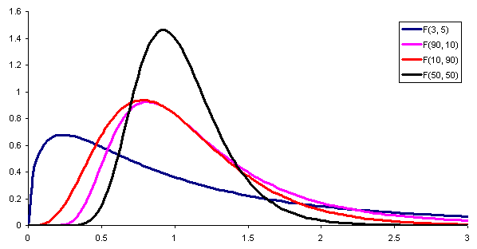
Like “t,” the sampling distribution for “F” depends on sample size (or df)

Slide 12
SPSS Output (Descriptives)
Number of infractions
 | N | Mean | Std. Deviation | Std. Error | 95% Confidence Interval for Mean |  | Minimum | Maximum
 |  |  |  |  | Lower Bound | Upper Bound
minimum security | 5 | 2.0000 | .70711 | .31623 | 1.1220 | 2.8780 | 1.00 | 3.00
medium security | 5 | 5.6000 | 1.14018 | .50990 | 4.1843 | 7.0157 | 4.00 | 7.00
maximum security | 5 | 8.2000 | 1.30384 | .58310 | 6.5811 | 9.8189 | 7.00 | 10.00
Total | 15 | 5.2667 | 2.81493 | .72681 | 3.7078 | 6.8255 | 1.00 | 10.00

Slide 13
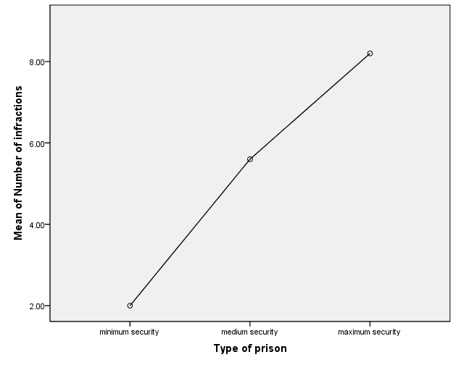
SPSS Output (Means plot)

Slide 14
SPSS OUTPUT (ANOVA)
ANOVA
Number of infractions
 | Sum of Squares | df | Mean Square | F | Sig.
Between Groups | 96.933 | 2 | 48.467 | 41.543 | .000
Within Groups | 14.000 | 12 | 1.167
Total | 110.933 | 14
From SPSS, p or “sig” = .000004

Slide 15
The F test is Exploratory
Null rejected → means are not equal in population
Next step is to conduct a series of t-test like comparisons
Compares each pair of means to find differences. What is the story in the data?
These are called “Post-hoc” tests
USE LSD ☺
If you FAIL to reject the null for the F-test, STOP THERE

Slide 16
PRISON EXAMPLE (BECAUSE OUR F WAS SIGNIFICANT AND WE REJECTED NULL)
Number of infractions LSD
(I) Type of prison | (J) Type of prison | Mean Difference (I-J) | Std. Error | Sig. | 95% Confidence Interval
 |  |  |  |  | Lower Bound | Upper Bound
1.00 minimum security | 2.00 medium security | -3.60000* ^{(1st)} | .68313 | .000 | -5.0884 | -2.1116
 | 3.00 maximum security | -6.20000* ^{(2nd)} | .68313 | .000 | -7.6884 | -4.7116
2.00 medium security | 1.00 minimum security | 3.60000* | .68313 | .000 | 2.1116 | 5.0884
 | 3.00 maximum security | -2.60000* ^{(3rd)} | .68313 | .003 | -4.0884 | -1.1116
3.00 maximum security | 1.00 minimum security | 6.20000* | .68313 | .000 | 4.7116 | 7.6884
 | 2.00 medium security | 2.60000* | .68313 | .003 | 1.1116 | 4.0884
*. The mean difference is significant at the 0.05 level.

Slide 17
ANOVA in SPSS
STEPS TO GET THE CORRECT OUTPUT…
ANALYZE → COMPARE MEANS → ONE-WAY ANOVA
INSERT…
INDEPENDENT VARIABLE (Nominal, >3 Categories) IN BOX LABELED “FACTOR:”
DEPENDENT VARIABLE (Interval/Ratio) IN THE BOX LABELED “DEPENDENT LIST:”
CLICK ON “POST HOC” AND CHOOSE “LSD”
CLICK ON “OPTIONS” AND CHOOSE “DESCRIPTIVE” AND MEANS PLOT

Slide 18
What you need to know for homework and exams
Difference between group variance and within group variance
Degrees of freedom → go from sum of squares to variance
Calculate F-ratio given either sum of squares or variance
How to calculate F in SPSS and how to interpret SPSS output

Slide 19
SPSS Group Exercise
Test whether fundamentalism (“fund”) is related to any of the following using the GSS data and an alpha of .05
1. Family size (“sibs”).
2. Number of science credits taken (“colscinm”)
3. Number of days were activity was limited due to health (“hlthdays”)
Write out null hypothesis
Write out the F-value, and the interpretation of “p”
Where appropriate, also interpret the LSD tests (which means are different from which)

