Slide 1

Keith Erickson
October 23, 2014
ECE 1001

Slide 2
Presentation Goals
Company Background
Business Operations
Software & Systems Engineering
Future Growth Plans
Parting Thoughts

Slide 3


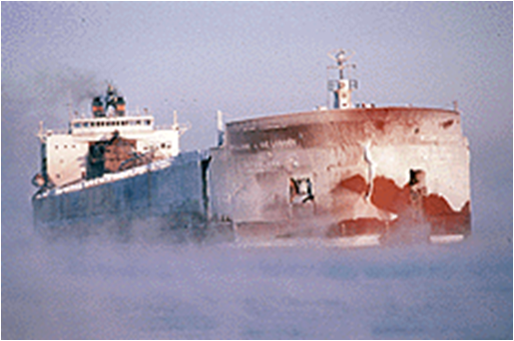

Locations
Duluth, MN
Grand Rapids, MN

Slide 4
Saturn Systems History
Founded in 1990 in Duluth, Minnesota
Origins in device control and integration
Since 2000, primary focus has shifted to enterprise application development, though device control is still important
25% Growth Annually Since 2006
Recognized as one of the Inc. 5000 Fastest Growing Companies the past four years in a row (2011 – 2014)

Slide 5
Rural Outsourcing
U.S. alternative to Off-Shoring
Saturn Systems Model
  Central U.S. Location
  High Skill Niche (degreed engineers)
  Minnesota/Duluth
    Lower overhead costs
    Attractive, high standard of living
    Well educated state
  Lower Employee Turnover

Slide 6
Competencies/Skills
Software Lifecycle Agile Process Focus
Experts at Working Over Distance
Technology Expertise
  Microsoft – C#, ASP.NET, SQL Server, C++
  Java Technologies
  Linux, Apache, MySQL, PHP (LAMP)
  IOS, Android Mobile

Slide 7
Staff Profile
Management Team
  MSEE, ECE, CS, Math, Accounting degrees
Duluth Technical Staff
  CS, ECE, related 4 year degrees
  Project Managers, Technical Leads, Senior Software Engineers, Software Engineers, Programmers, QA Testers
Telecommuters
  Saturn employees, working from their homes in outstate areas
Grand Rapids office
  Currently 6 software developers
Contractors
  Business Analysts, Engineers and Programmers

Slide 8

Duluth View

Slide 9
Business Activities
Operations & Scheduling
Marketing & Business Development
Recruiting
Financial (budgeting, taxes, accounting, forecasting)

Slide 10
Technical Activities
Writing Proposals and Estimates
Writing Functional Specifications
System Architecture & Design
Software Development
  Device control & protocols, web applications, desktop applications, database design and programming
Unit (developmental) testing
System-wide (beta) testing
Deployment and integration
Ongoing support and maintenance

Slide 11
Process & Communications
Project Portal for internal and customer communications (Basecamp, Jira)
  Internal Project Checklist
  Issue Tracking
  Milestones
  Published documents
Time Entry system for internal operations and customer invoices (BillQuick)

Slide 12
Revenue Generation
Project Based Contracts
  Time & Materials
  Starts with an Idea….Ends with an Application
Staff Augmentation
  We plug into client’s existing Development Teams
Timekeeping procedures
  We record all worked time in 15 minute increments, charge time to customer or Saturn administrative categories.
  We invoice customer for all ‘billable’ time, including activity comments.

Slide 13
Business Costs
Personnel
  Direct Labor (billable staff)
  Benefits (Health, Dental, Vacation, Perks)
  Management and administrative
  Non-billable (i.e. “bench”) time
  Cultural activities
Sales & Marketing
  Billboards, Public Radio, Google Adwords
Recruiting
  CareerBuilder, newspapers, recruiters.
Infrastructure
  Computers, hardware, network systems
  Office furniture
  Rent
Taxes

Slide 14
Marketing / Sales
Multiple Marketing Channels – New Customers
  Minnesota Public Radio
  Freeway Billboards
  Organic Search
  Google Adwords
  Tradeshows
  Referrals
Existing Customers
  Familiarity with Quality Products, Processes
Match Saturn Capabilities with Customer Needs

Slide 15
Development Process
Agile/Waterfall/Mixed
  Adapted to Customer Needs & Preferences
Staff Augmentation or Full Project Team
  Architecture & Design
  Coding
  Quality Assurance
  Deployment
  Support

Slide 16
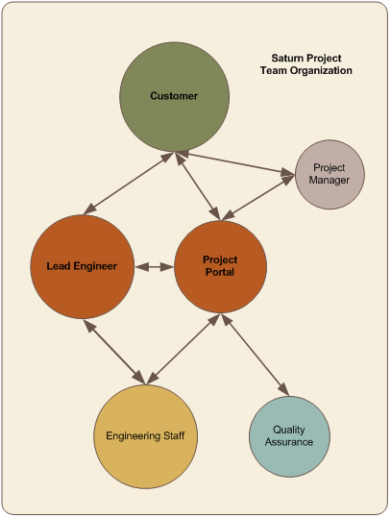
Development Process
Lead Engineer
Centric Approach
Cloud Based
Project Portal
Consistent Project
Process

Slide 17
Traditional Software Engineering
Define project scope & requirements.
Document system design, interfaces, test strategy.
Development and unit testing.
Beta deliverables and client testing.
System QA testing and integration.
Training & ongoing support.

Slide 18
Software Development Process/Lifecycle
Agile Focused Approach
Marketing/Sales
Contracts
Agile Project Plan
Scoping/Specific Requirements
Staffing
Development / QA
Deployment
Testing
Maintenance

Slide 19
Quality Assurance
Developer Independent Testing
  Black/White Box Functional Testing
Documentation
  Formal Test Plans
  Test Case Creation Tools
  Formal Test Results

Slide 20
Agile Methodology
Individuals and interactions - team interactions like co-location and mentoring are key.
Working software – builds confidence and provides a baseline for discussion.
Customer collaboration – requirements cannot be fully collected at the beginning of the software development cycle, therefore continuous customer or stakeholder involvement is very important.
Responding to change – quick responses to change and continuous refinement.

Slide 21
Development
Co-Location of Teams
Mentoring of less experienced engineers
Deployment of Sprint
  Test Servers / Environment
QA Test Sprint
  Internal QA
  Client QA
Rework (if necessary)
Adjust Agile Project Plan if Necessary
Tackle Next Sprint

Slide 22
The Future View
Companies Will Continue to Invest in Software Technologies to increase profit and gain competitive advantage
We Expect Continued Rapid Growth
  Expand Marketing Budgets and Channels
  Expand and Refine Recruiting Channels

Slide 23
What This Means For You
Very Bright Employment Outlook
  Companies will continue to invest in hardware and software technologies to reduce costs and increase profits
  Reduction in Overhead employees
Engineers Will be Scarce and Coveted
  Very Challenging Degrees
  Many high school grads are not prepared for the challenge
Offshore Competition has equalized

Slide 24
Parting Thoughts
Commitment to Your Degree Program
  Study First. Study Hard.
  Those with the best record get the best jobs
Work For Companies Where You are the Product
  Revenue Employee vs. Overhead
  Tech and Engineering Companies
Don’t be Afraid to Take Risks
  Move to Another Region if necessary

Slide 25

Questions?

