Slide 1
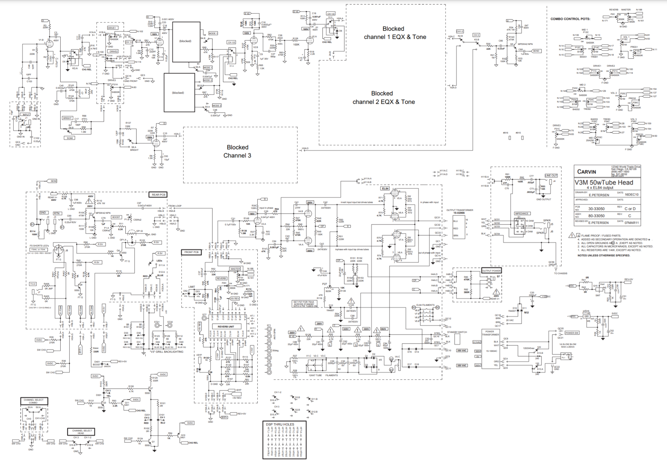
CARVIN V3M AMPLIFIER
Rob Neiburg

Slide 2
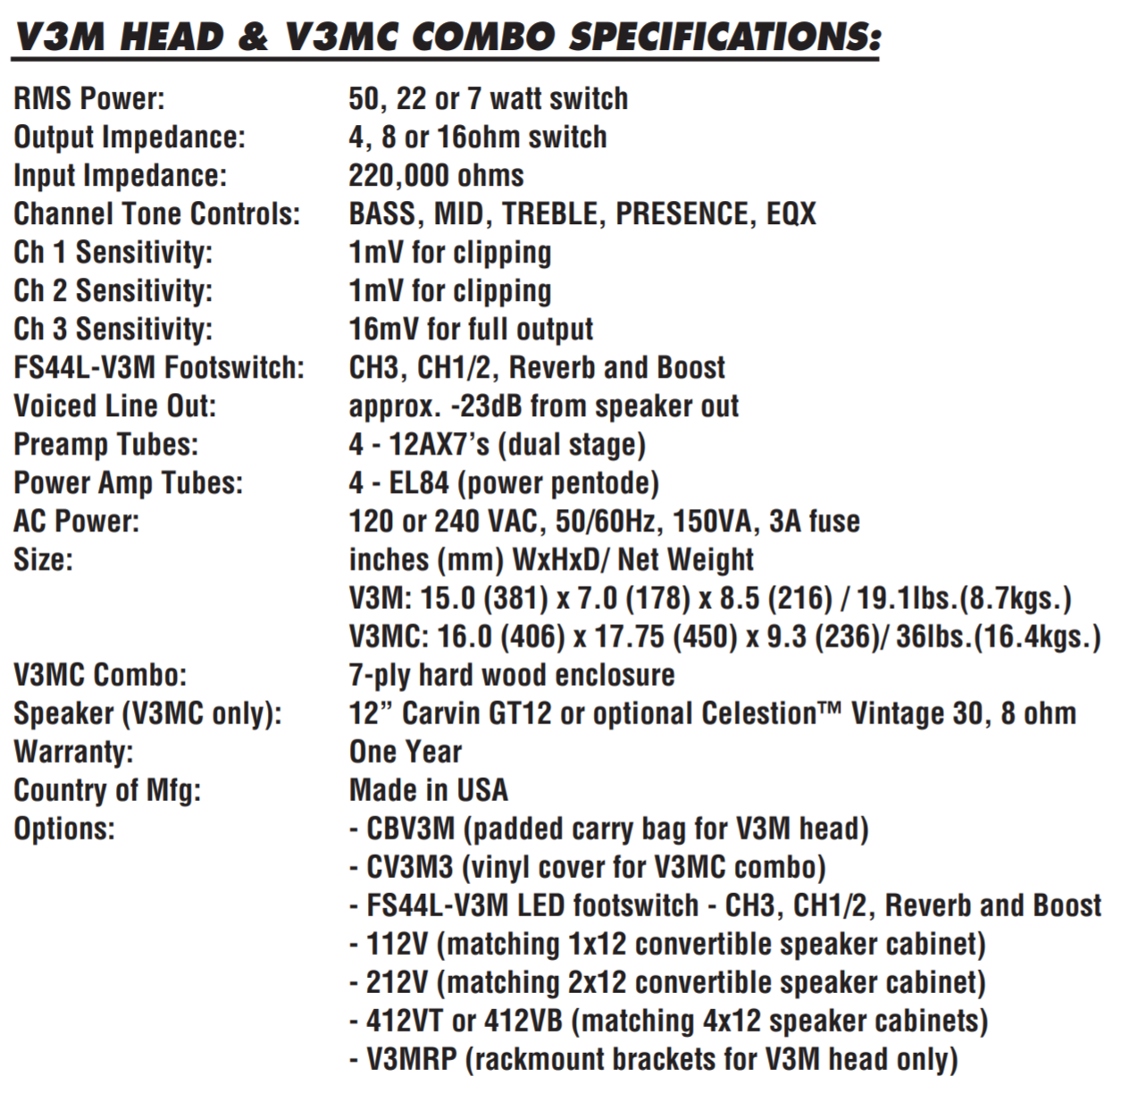
Specification Overview
50 Watts, switchable to 22 Watts or 7 Watts
4 12AX7 preamp tubes
4 EL84 power amp tubes
3 channels
Class AB
Notes:
Class AB amp is a combination of class A and class B.

Slide 3
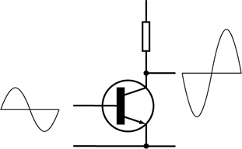
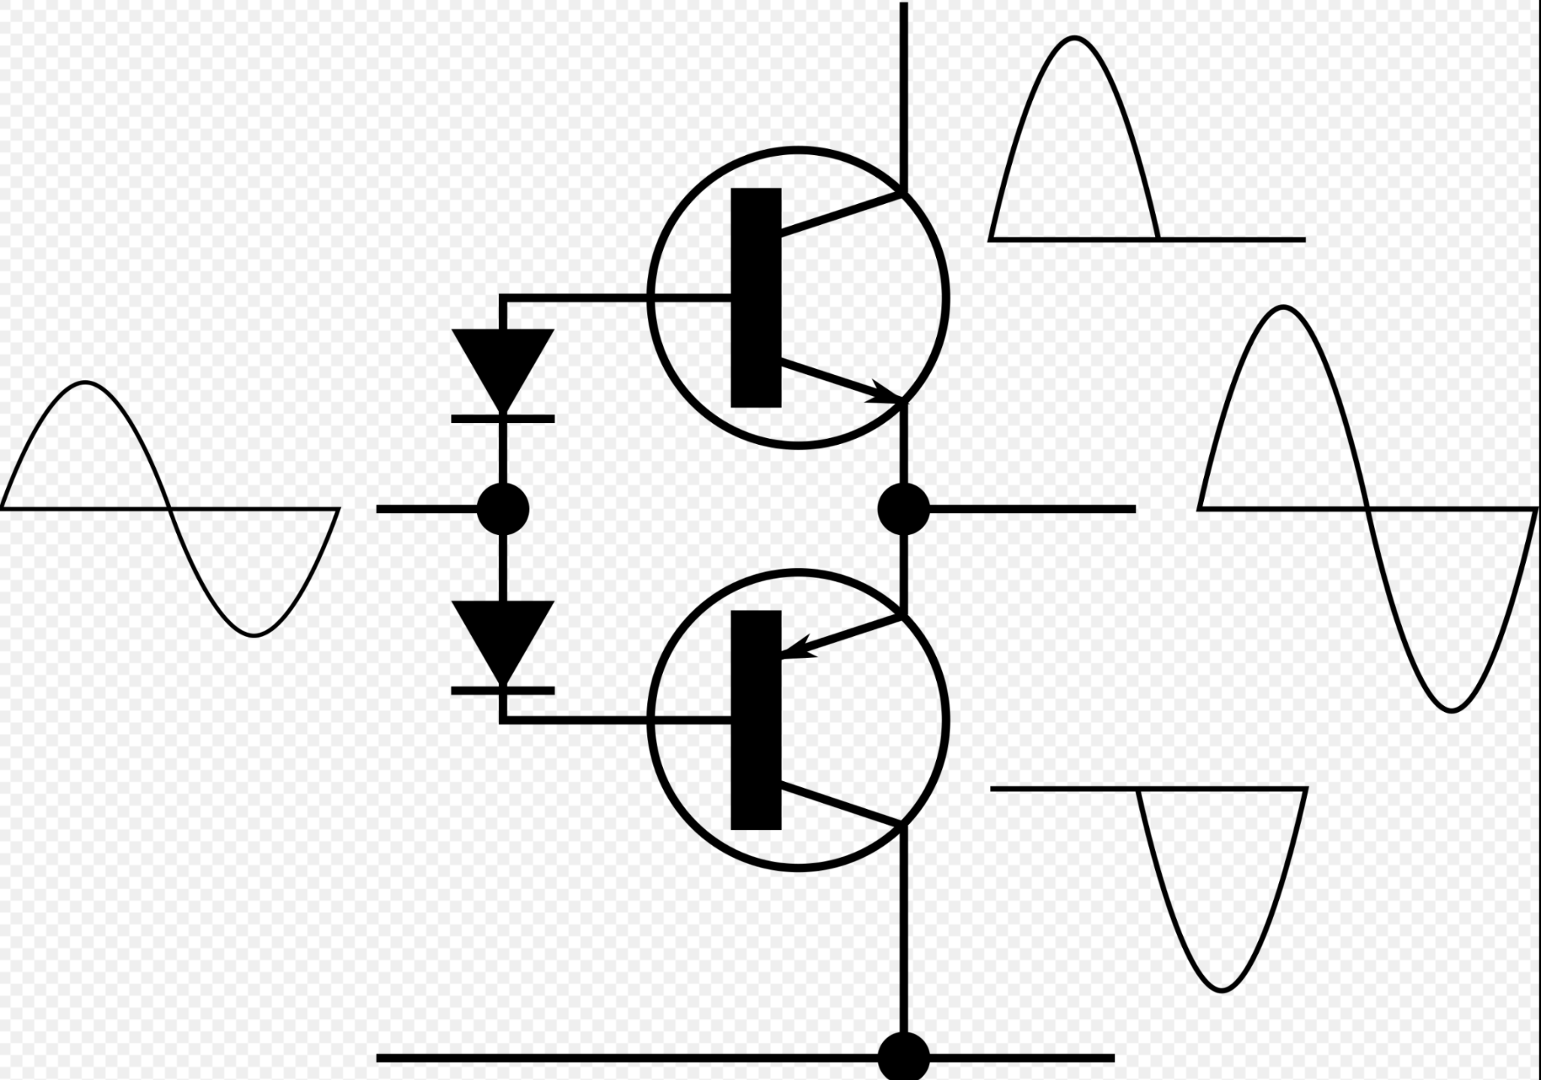
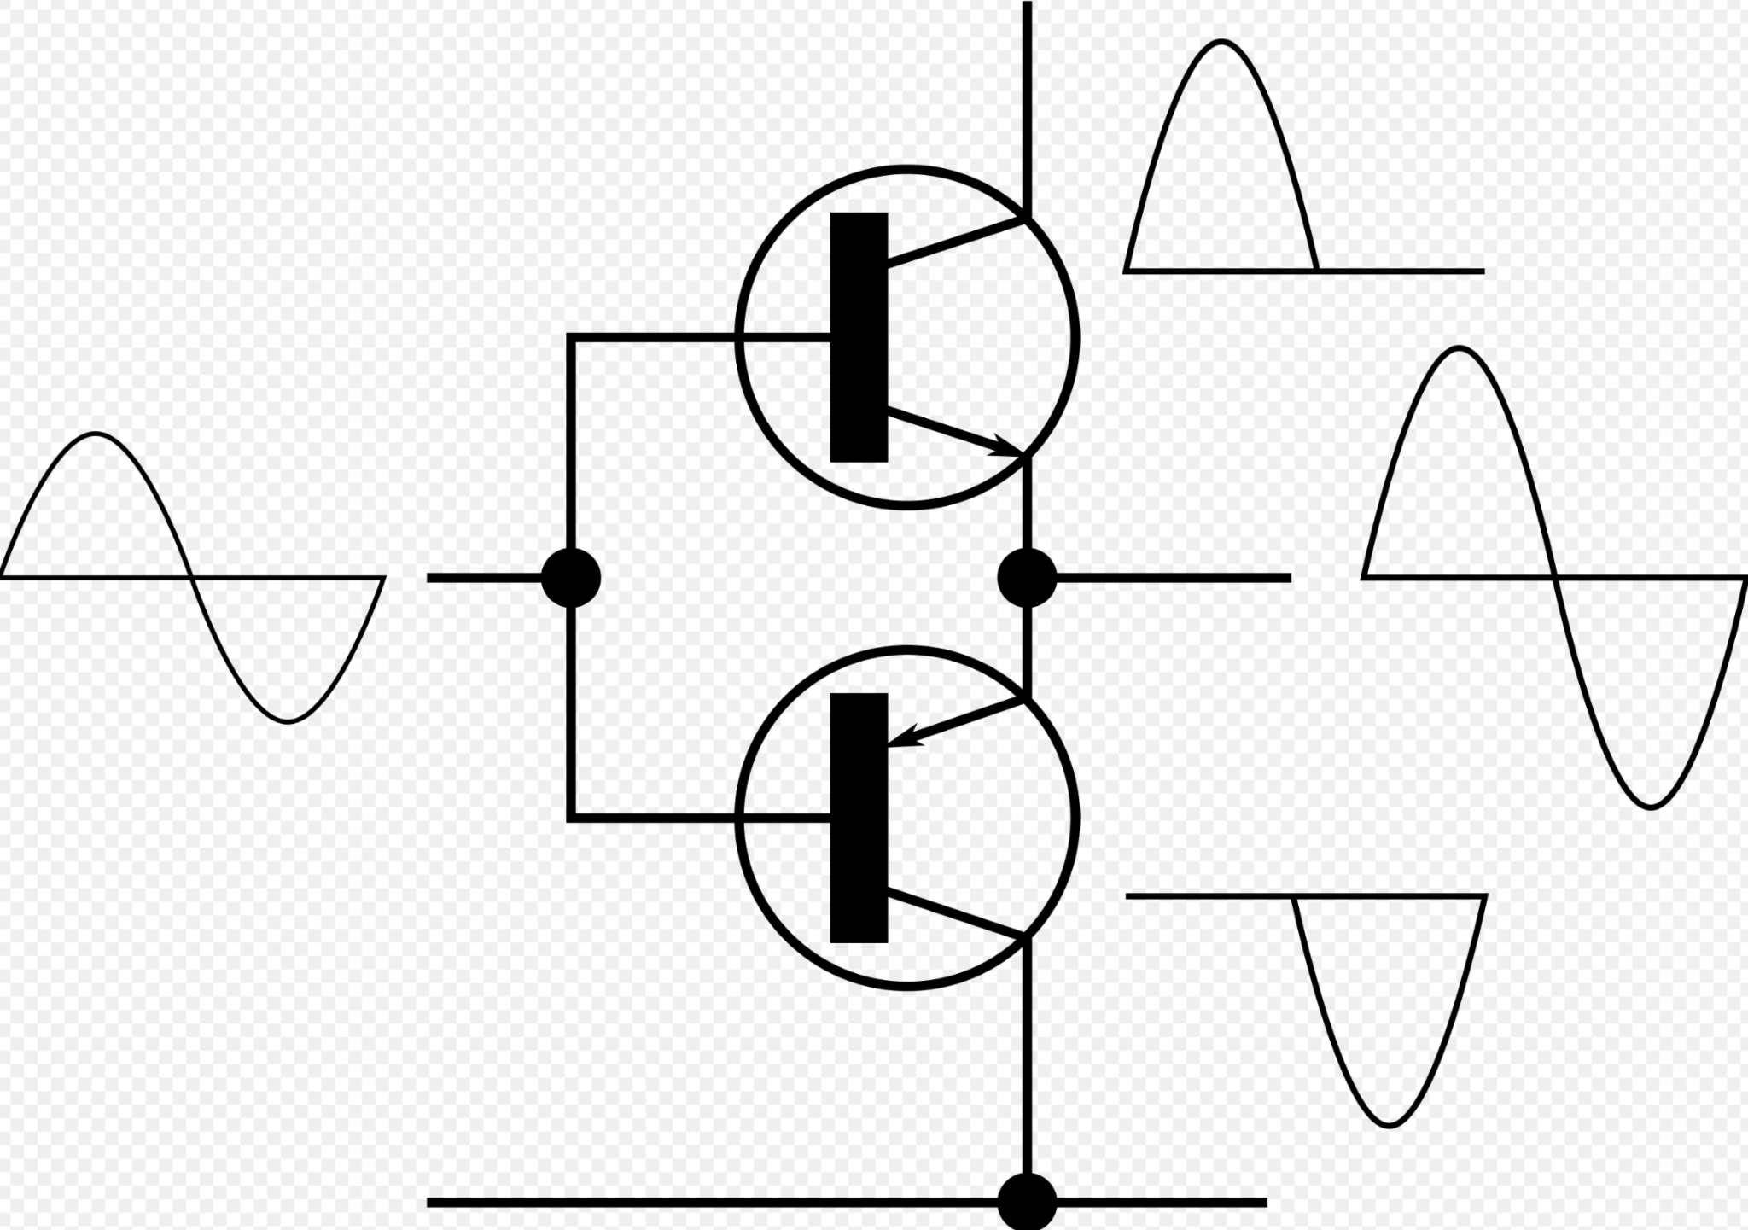
Class A, Class B, and Class AB amplifiers
Notes:
Class A: Amplifies the full input signal.
Class B: Each device only amplifies half of the signal, so two devices are used to amplify the full signal. This configuration is called a push pull configuration. Class B offers a higher efficiency than class A.
Class AB: Operates like class A in lower gain application functions as a class A and in higher gain applications it functions as a call B. Class AB is slightly less efficient than class B, but more efficient than class A. Typically less distortion than class B.

Slide 4
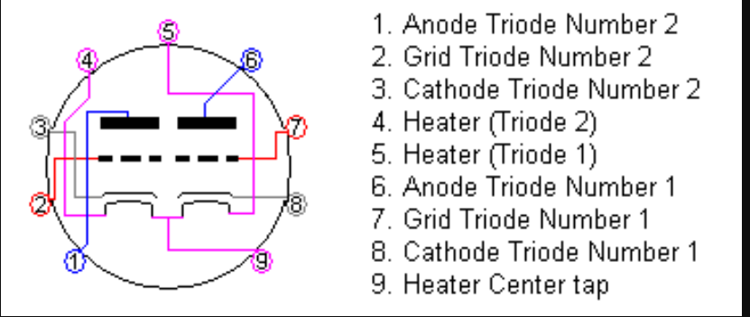
Vacuum Tubes
12AX7
Very commonly used the preamp in guitar amps.
Dual Triode
6.3 Volts to power the heater
Cathode, Grid, Anode, Heater
Notes:
The simplest vacuum tube, the diode, invented in 1904 by John Ambrose Fleming, contains only a heated electron-emitting cathode and an anode. Electrons can only flow in one direction through the device—from the cathode to the anode. Adding one or more control grids within the tube allows the current between the cathode and anode to be controlled by the voltage on the grids.
This tube uses one grid, hence the name triode. The 12 represents the heater voltage, but because there is a center tap on the heater, it can operate in either 6.3V or 12.6V

Slide 5
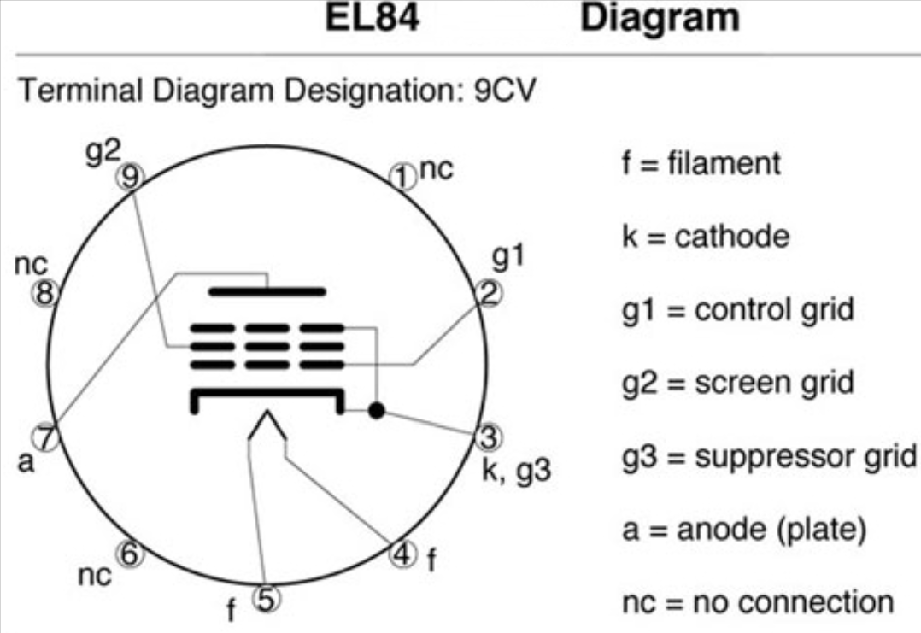
Vacuum Tubes
EL84
Very common in power amps of lower wattage guitar amps, typically under 50W
Power Pentode
6.3 Volts to power the heater

Slide 6
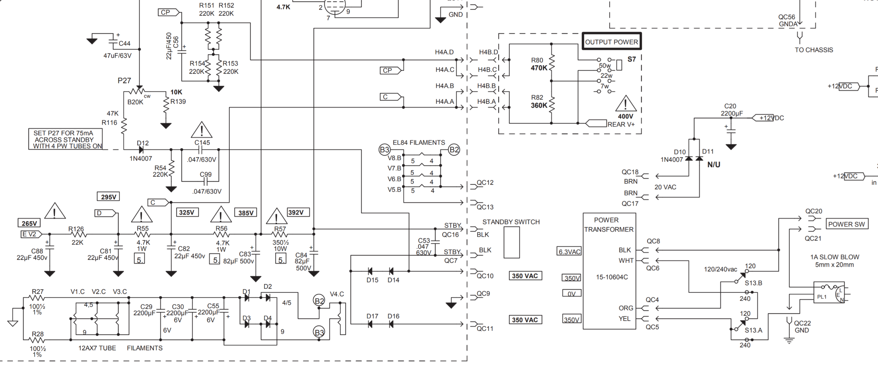
Input and Output Power

Slide 7
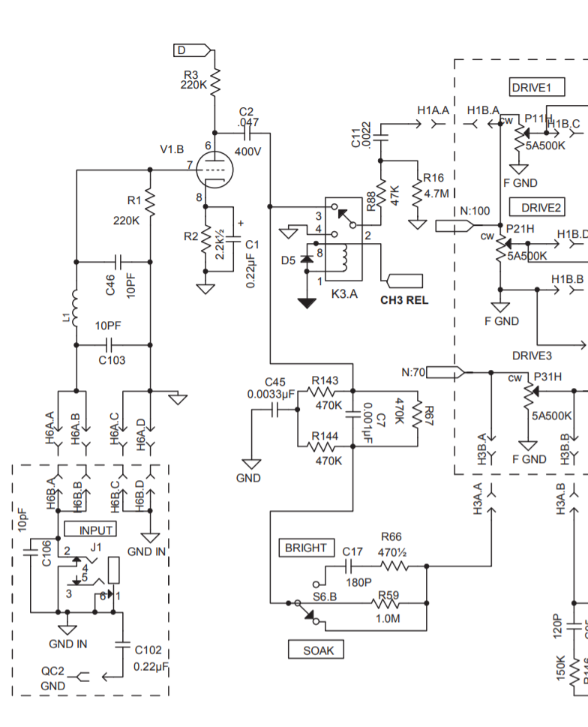
Signal Input and Channel Selector

Slide 8
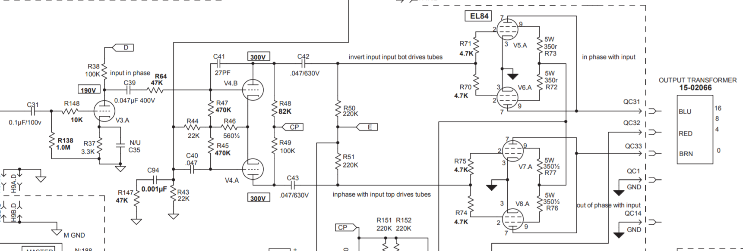
Power Amp

