Slide 1
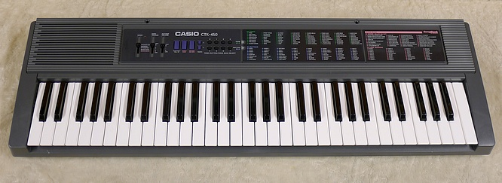
Casio CTK-450 Electronic Keyboard
Chris Silman

Slide 2
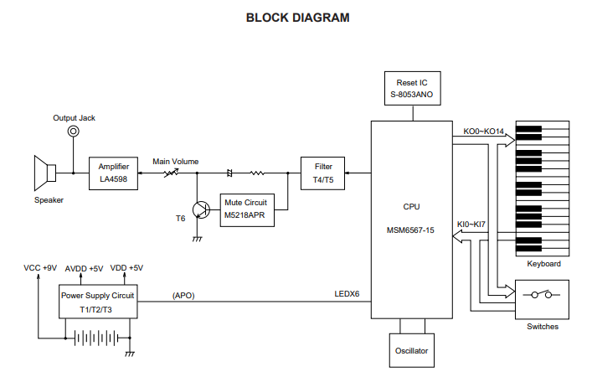
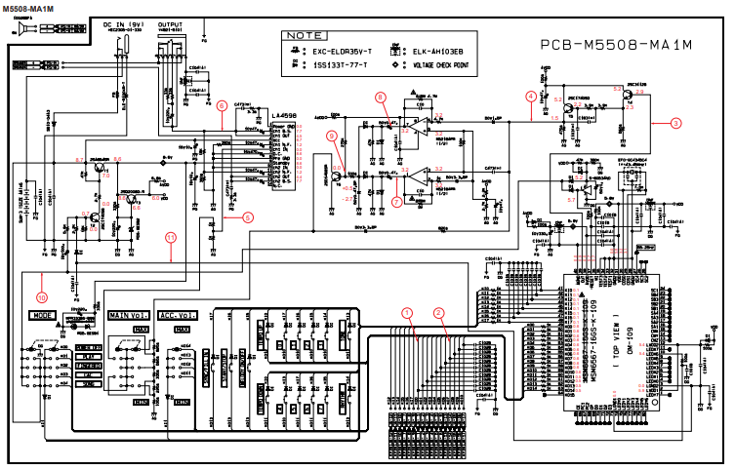
Here on the left is a simple block diagram showing each key part that contributes to our keyboard.
On the right is a technical representation of each component with circuit diagrams shown. As per the suggestion of Dr. Burns, we’ll step through each component from the power supply all the way to the amplifier at the end.

Slide 3
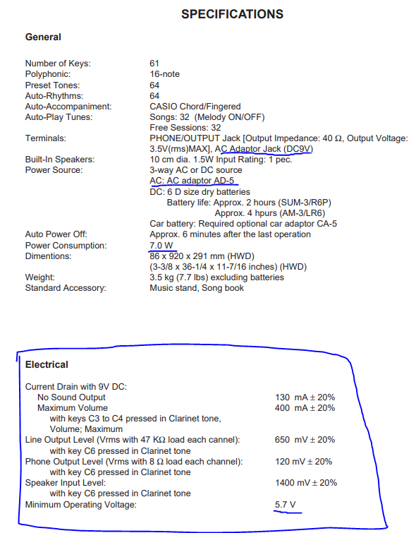
Specifications
Requires an AC adaptor/DC power source that will provide 9V.
Requires 7.0 watts of power.
Electrical specifications show current drain depending on what actions are being performed.

Slide 4
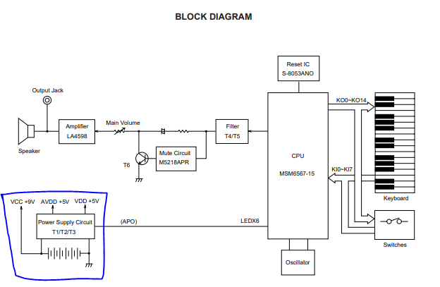
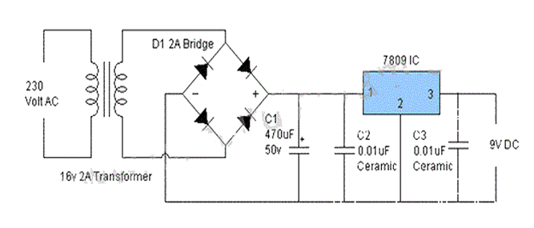
Power Supply
The power supply circuit generates three voltages:
VDD (+6.0V) for the CPU and Reset IC.
AVDD (+6.0V) for Analog Circuit. (A stands for analog)
VCC1 (+8.6V) for pilot lamp and power amplifier.
While I couldn’t find the exact circuit diagram for the AC/DC adaptor, I believe that this would closely resemble the one that would be used.
Notes:
- It uses a full-wave rectifier to remove negative portion of our AC signal and produce a fully positive signal from two out of phase waves.
- Contains a transformer to step down our AC voltage and capacitors for ripple voltage.

Slide 5
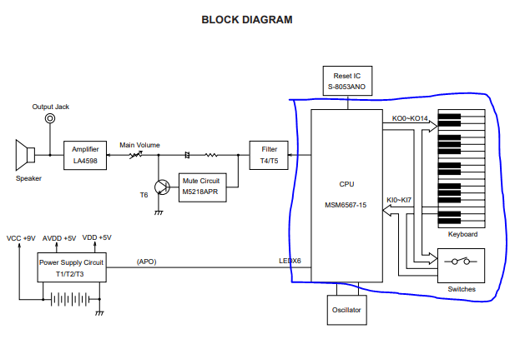
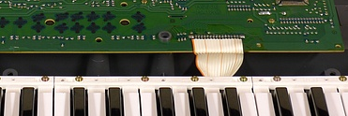
CPU and Keys
On the right are shown all the pin specifications for our CPU.
I couldn’t find an exact circuit diagram, however, as seen in the picture above a bunch of wires are connected to a PCB under the piano keys.
When a piano key is pressed, the CPU transforms that and produces a sound waveform. As you can see, it is not a smooth sinusoidal wave.

Slide 6
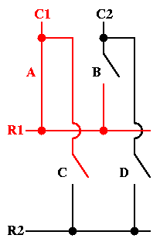
Why so few wires? How do we know what key?
Uses something known as a “keyboard matrix circuit”.
Essentially key switches are connected to a grid of wires.
By scanning the crossing point of a row and column. With 16 wires we have up to 64 combinations.
Notice how when a key is pressed, both a column and associated row have voltage passing.
This is all processed by a keyboard controller (essentially informs CPU when key is pressed.).

Slide 7
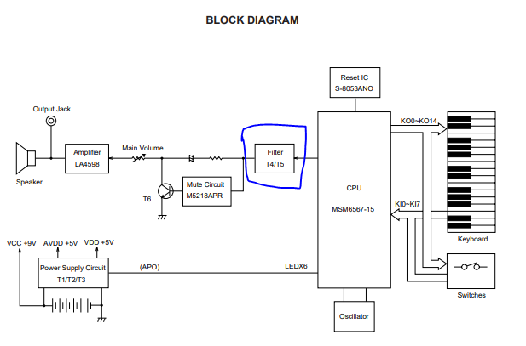
Filter Block
The sound signal from the CPU now enters our filter.
As seen before, the CPU produces a stepped waveform and not a smooth sinusoidal signal.
The purpose of the filter is to smooth out our waveform. Two BJTs can be see in the circuit diagram, T4 and T5.
AVDD can be seen here too, which was +5v coming from our power supply.

Slide 8
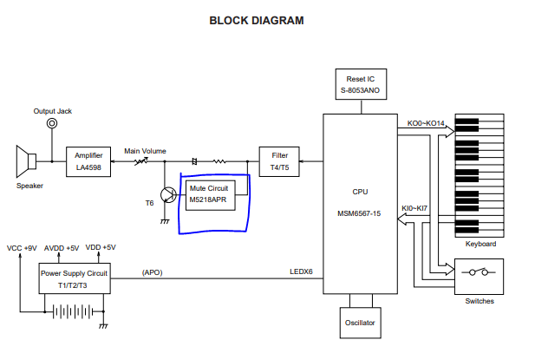
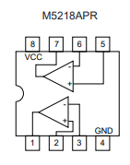
Mute Circuit
Shown to the left is a simple diagram of the mute IC
The purpose of the mute circuit is to remove noise from the sound signal before it fades away.
This circuit detects the amplitude of the decaying sound signal and amplifies it by 1000 times.
The transistor T6 flows that signal into ground when amplitude decays to almost zero.

Slide 9
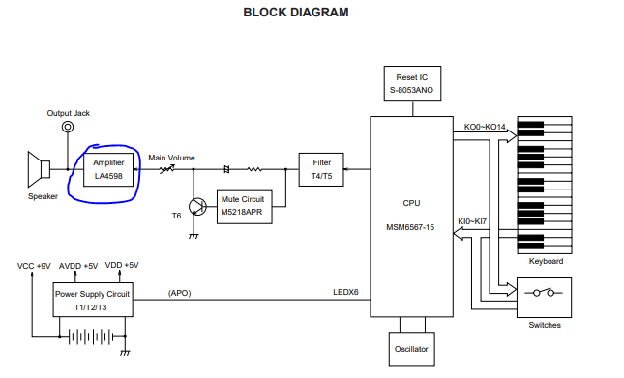
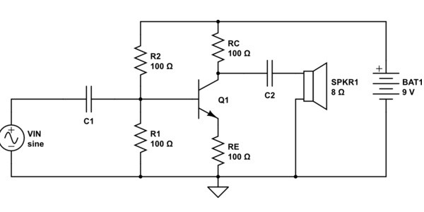
The Amplifier – it all lead to here!
Contains a two-channel power amplifier with stand-by switch, each channel having three op-amps with certain purposes.
The purpose of the stand-by switch is when it receives +9V it is on, and at 0V it is off.
Input Amp
Broken into negative feedback input or just normal input
Pre-drive Amplifier
Converts weak electrical signal into an output signal strong enough to be noise-tolerant and used for further processing.
Power Amplifier
I couldn’t find the circuit for the power amplifier, but I assume it would look somewhat similar to the image on the right. The transistor causes a certain amount of gain on our signal based on the resistor values (as seen in Lab 8!).

Slide 10
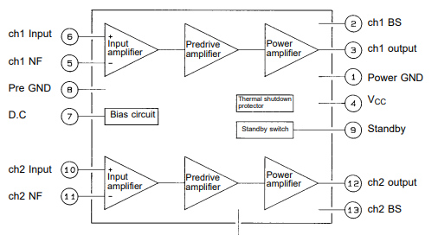
The Amplifier Info Cont.
Here is a breakdown of all the pins that connect to our LA4598 audio amplifier.

Slide 11
Sources
Casio CTK-450 Datasheet
https://www.manualslib.com/manual/700162/Casio-Ctk-450.html#manual
AC/DC Adaptor Circuit
https://circuits-diy.com/9v-power-supply-circuit-using-lm7809-voltage-regulator-ic/
Internal Pictures
https://www.deepsonic.ch/deep/htm/casio_ctk-450.php
LA4598 Datasheet
https://www.alldatasheet.com/datasheet-pdf/pdf/40126/SANYO/LA4598.html
Keyboard Matrix Circuit
https://en.wikipedia.org/wiki/Keyboard_matrix_circuit
Keyboard Controller
https://en.wikipedia.org/wiki/Keyboard_controller_(computing)

