Slide 1
Electronics I Extra Credit
Alex Jegers

Slide 2
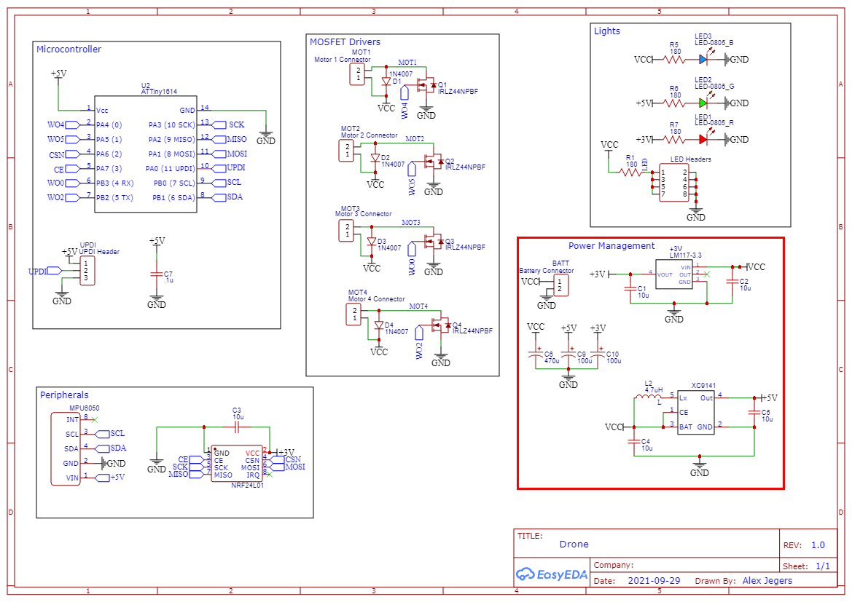
My Custom Drone Project - Overview
This is the full schematic of circuit board on the drone.
Will be focusing on the power management aspects.

Slide 3
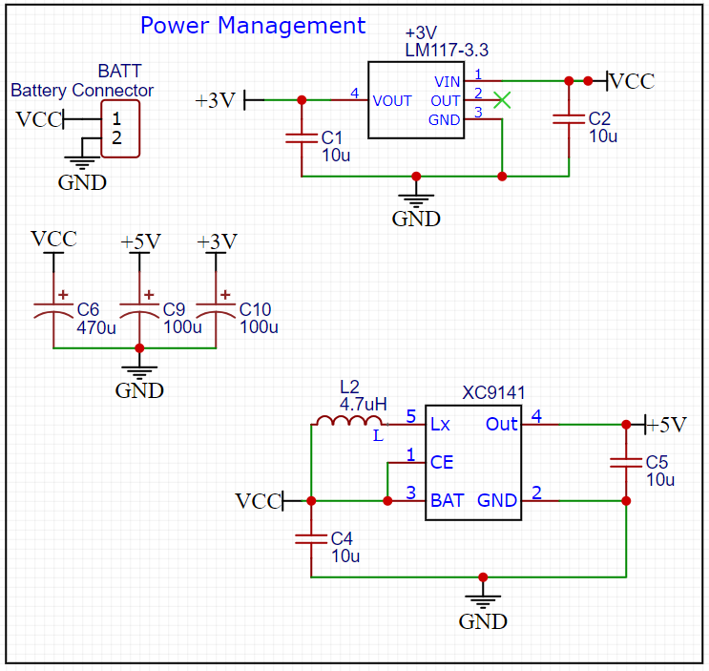
Power Management Details
Battery - Single cell LiPo (Lithium Polymer) 3.7V.
Directly powering the 4 brushed DC motors.
XC9141 - 5V output boost converter.
5V output needed for the microcontroller and gate of the MOSFETs that drive the motors.
LM1117 - 3.3V linear voltage regulator.
3.3v output used for radio transceiver and gyro/accelerometer.

Slide 4
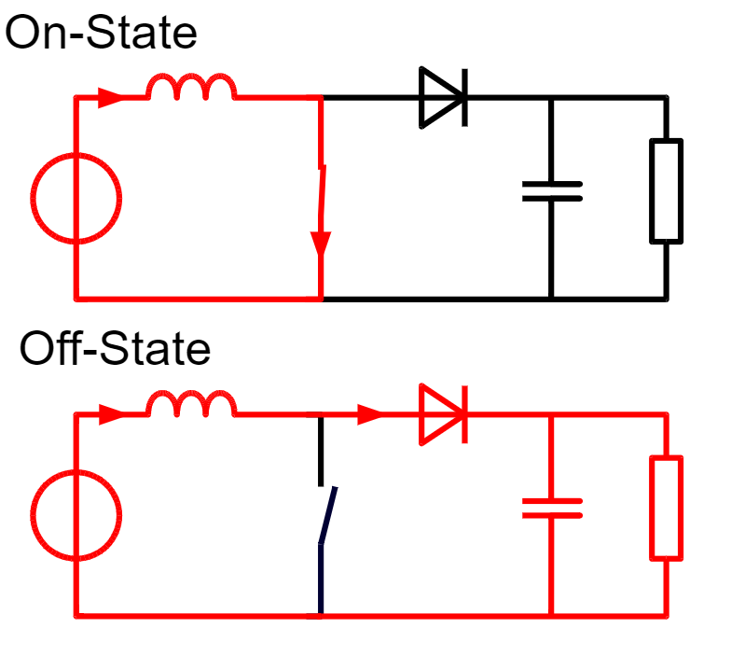
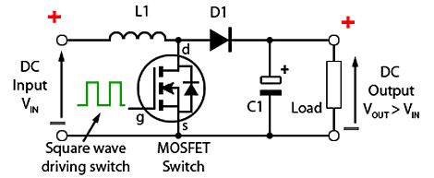
Boost Converter Basics - DC to DC Amplification
Comprised of 4 main components; inductor, diode, switch, and capacitor.
When in “on-mode” the inductor is charging and generating a magnetic field. When the switch is turned off, this magnetic field collapses and the polarity of the inductor is reversed sending current towards the load, which is the resistor in this case.
A capacitor is used across the load for smoothing like in rectifying circuits.
A MOSFET is used as the switch and driven by a square wave, or pulse width modulation (PWM) input, generally in the range of 100kHz to 1MHZ.
This simple of a setup only works when the input voltage and load are constant.

Slide 5
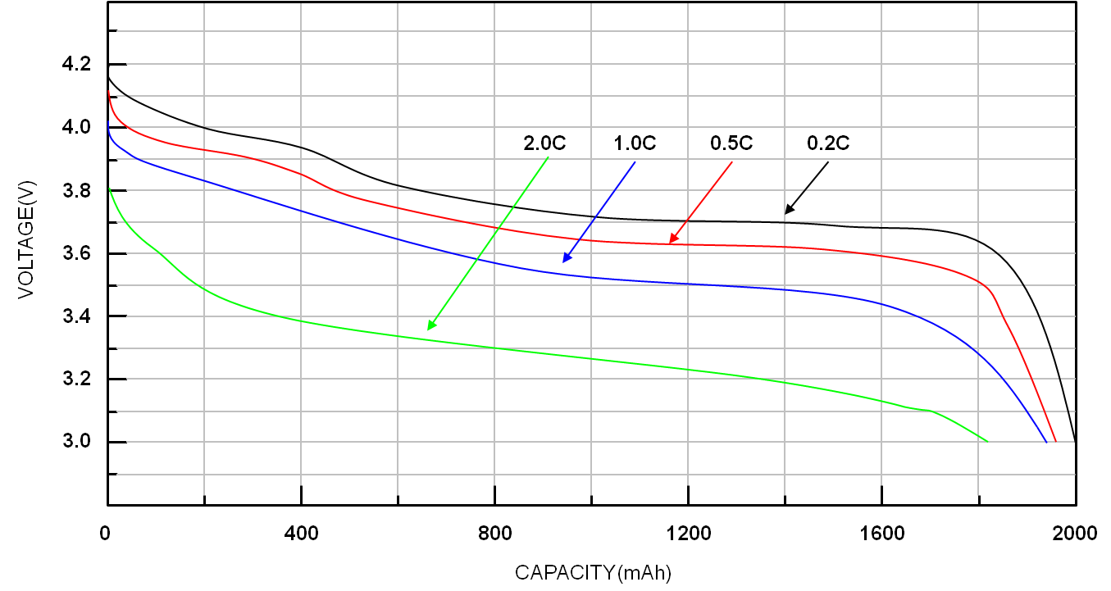
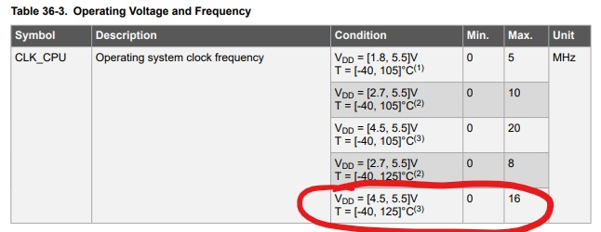
Boost Converter Voltage Source and Load
LiPo battery supplies anywhere from 4.2V at a full charge to 3.0V.
“x.xC” refers to the current draw (A) divided by the current capacity (Ah) of the battery.
ATTiny 1614 microcontroller requires minimum 4.5V to run the clock at 16MHz which necessary for the radio communication.
Also, cannot exceed 5.5V (ATTiny absolute maximum rating).

Slide 6
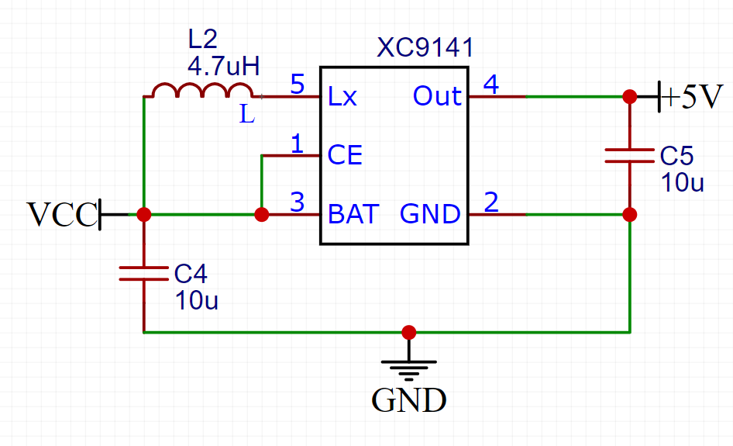
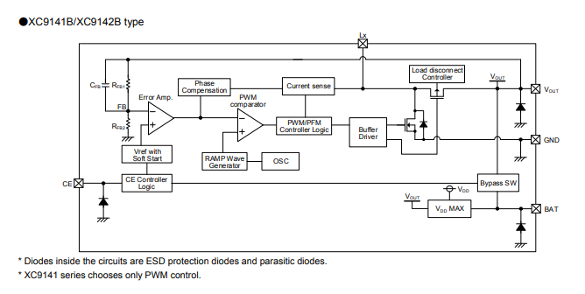
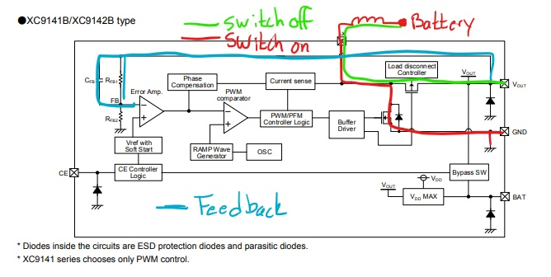
XC9141 Boost Converter
Uses feedback from the output voltage to adjust the duty cycle of the PWM driving the MOSFET.
Comes in a very small package size (SOT-25), cheap ($1.31), and uses few external components (two capacitors, one inductor).

Slide 7
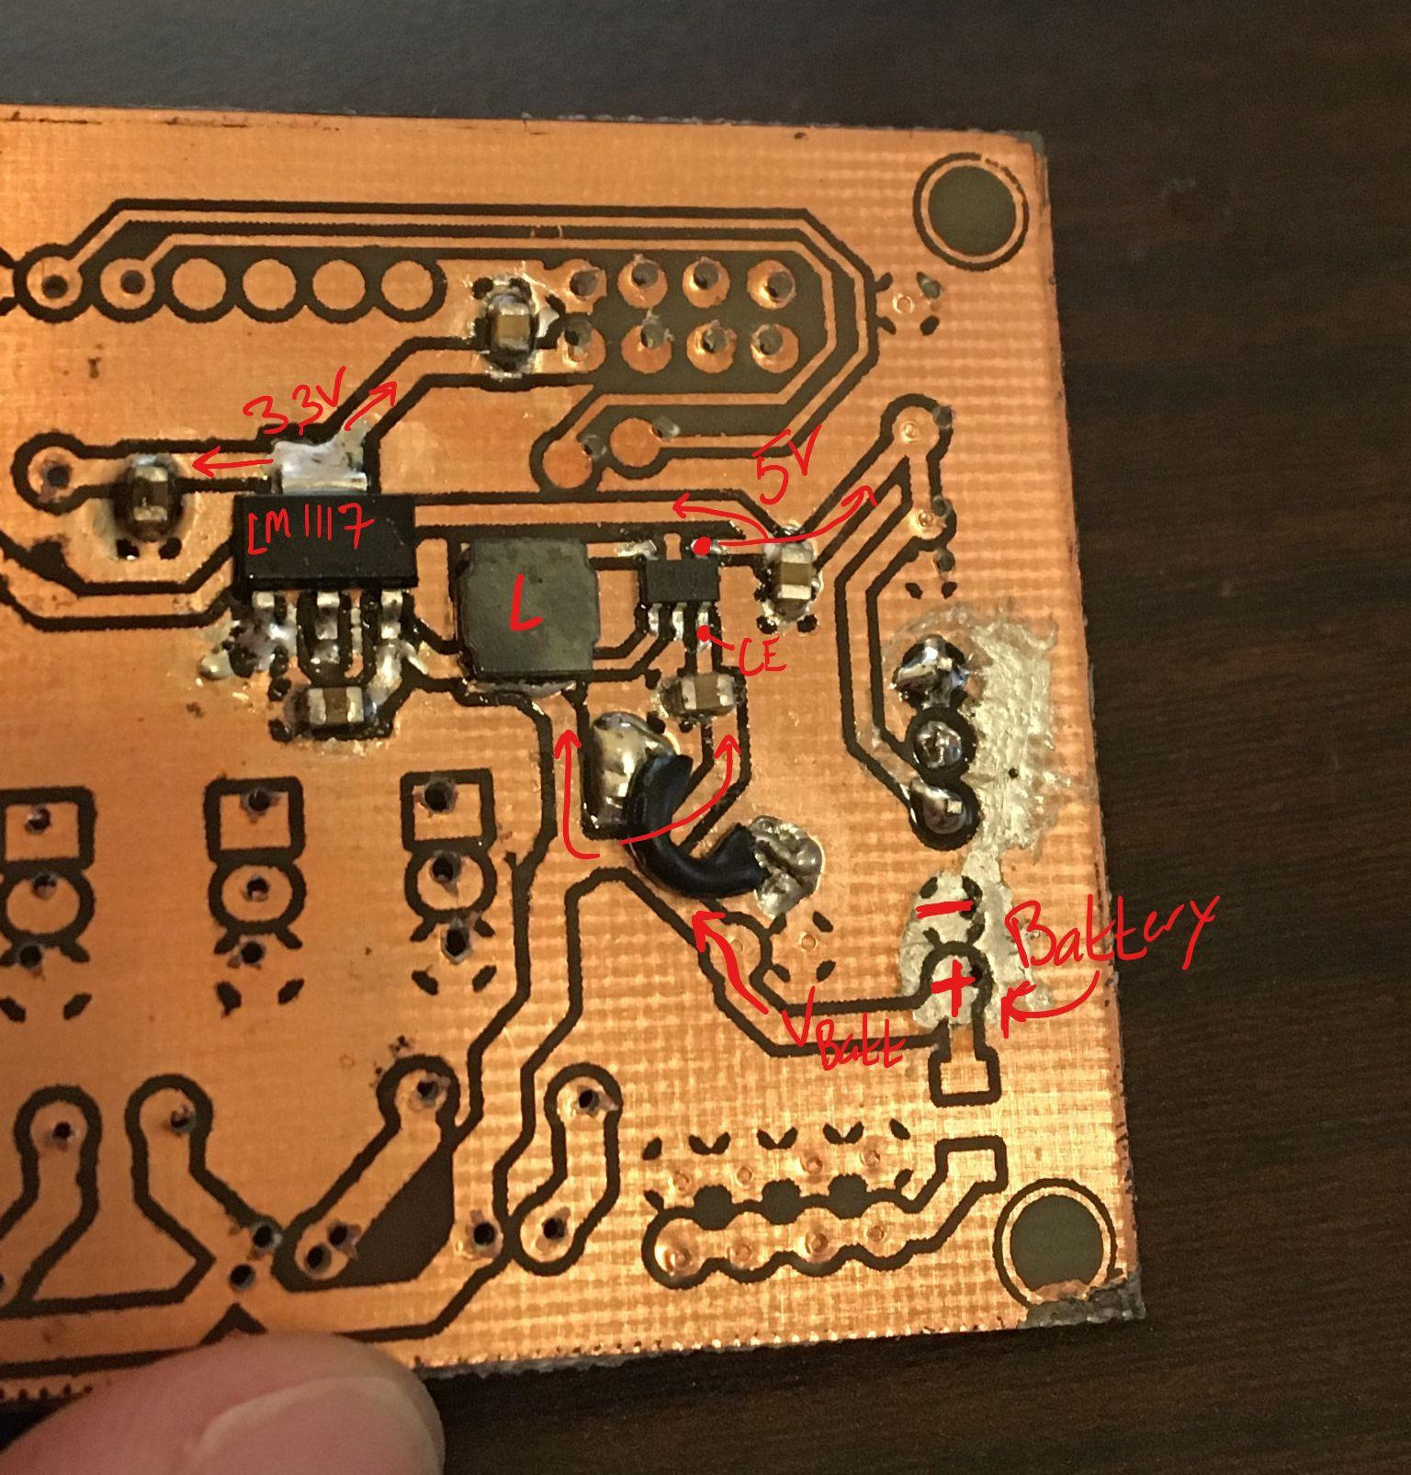
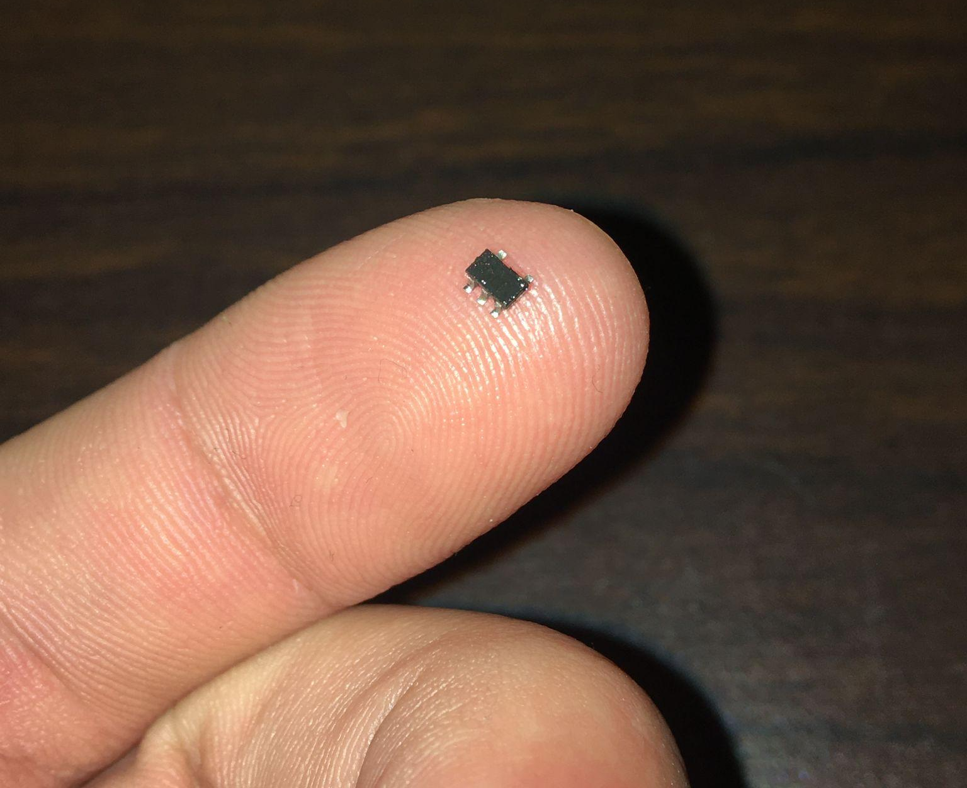
XC9141 Boost Converter

Slide 8
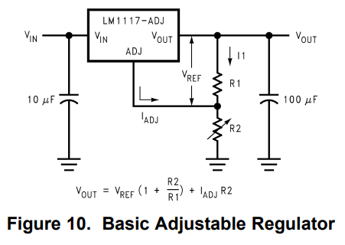
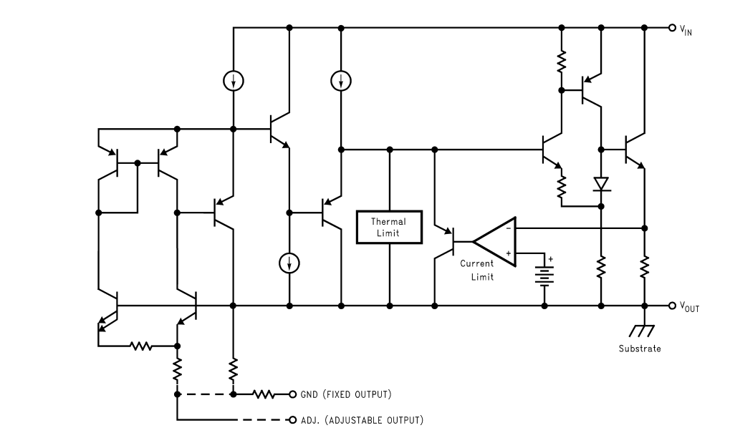
LM1117 - Linear Voltage Regulator
Comes in an adjustable version that uses two external resistors to set the output voltage. According to the data sheet, a reference voltage is applied across Vout and Vadj which causes a constant current to flow through R1. This current then goes through R2, setting the output voltage.
In fixed output devices, like mine (LM1117-3.3), these resistors are integrated in the device with the rest of the current sources/sinks/mirrors.

Slide 9
Thanks for listening

