Slide 1
Solar charger diagram analysis
Tanner Boge

Slide 2
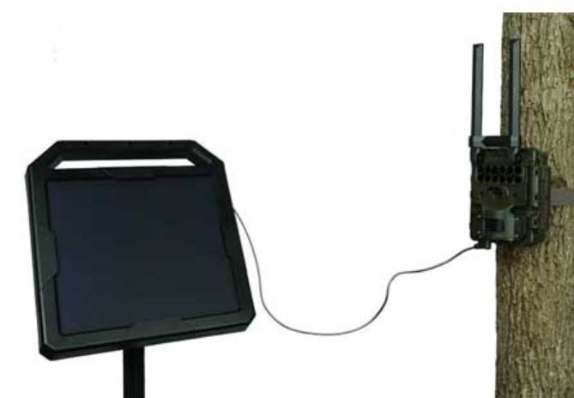
Purpose
Circuit is attached to small (10w) solar panel and 12v lead acid battery.
Allows indefinite battery life.
This paired with cellular technology can allow the user to set up IR cameras and receive the photos from an app on their phone.
Completely eliminates the need to change batteries and sd cards.

Slide 3
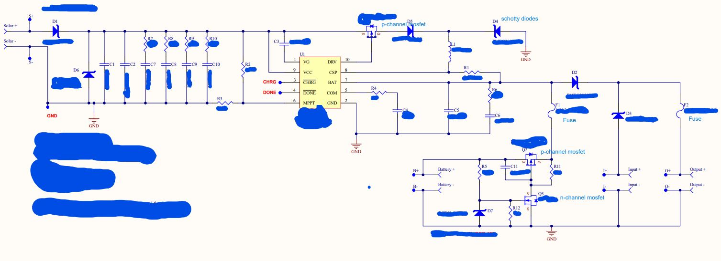
Solar Charger Diagram

Slide 4
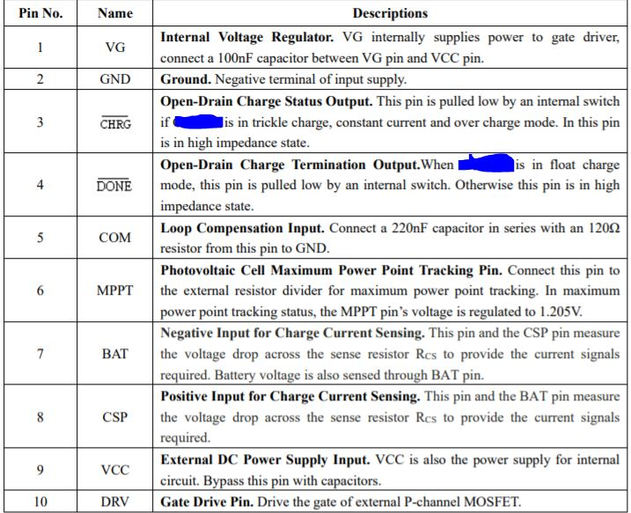
Chip used in circuit
Charges the battery usually by trickle charge but can be configured to constant current charge, float charge and over charge
Charges in cycles when vcc > UVLO(undervoltage lockout) and greater than batteries voltage.
When approaching overcharge the circuit will switch to float-charge/over-charge mode
automatically enter sleep mode when input voltage is lower than battery voltage.

Slide 5
Solar Charger Diagram
Circuitry surrounding Q2 and Q3 is intended to help with the case where the user installs the battery with reversed polarity.
When the battery is installed correctly:
- the Zener at D7 has significant Voltage across it (R5 limits the current through D7). This voltage across the gate of Q3 turns Q3 ON. Q3 being ON places the gate of Q2 at ground. By grounding Q2's gate, Q2 is ON and battery current can pass through Q2 to the load. Q2 being ON also allows charge current to pass to the battery. (when the p-ch MOSFET is ON, current can flow in both directions as long as the gate is negative relative to the source (Vgs).
When the battery polarity is reversed:
- D7 is forward biased, so the gate of Q3 has around .5V Vgs, keeping Q3 OFF
- with Q3 OFF, R11 keeps the gate and the source of Q2 at the same potential, so it is OFF.
- the body diode of the MOSFET (Q2) always allow current to flow from the drain to the Source, but the orientation of the MOSFET is chosen so that the reverse current flow is blocked by the MOSFET being OFF and its body diode being reversed biased.
Q2(the p-channel) and
Q3(the n-channel) enhancement MOSFETs

Slide 6
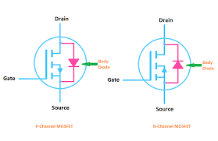
Zener Diode Across Mosfets
Zener diodes across the Mosfets are used to protect them from damage.
Allow one way current while Mosfet is off. Either from source to drain or drain to source
These are called body diodes

Slide 7
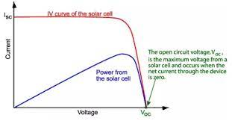
Solar Charger Diagram
I believe capacitors function to smooth out the input into MPPT on the chip. MPPT tracks the Maximum power point track. Basically maximizes the efficiency of the solar panel by comparing its output to the battery and calculating the power the panels can put out to charge the battery. Up to 30% more efficient pulse width modulation which does more of a trickle charge to voltage levels just above the batteries voltage.

Slide 8
Solar Charger Diagram
Q1(p-type enhancement mosfet)
Is controlled by DRV on the integrated circuit. Depending on the MPPT the circuit would allow current to flow source to drain by putting negative voltage on the gate.

Slide 10
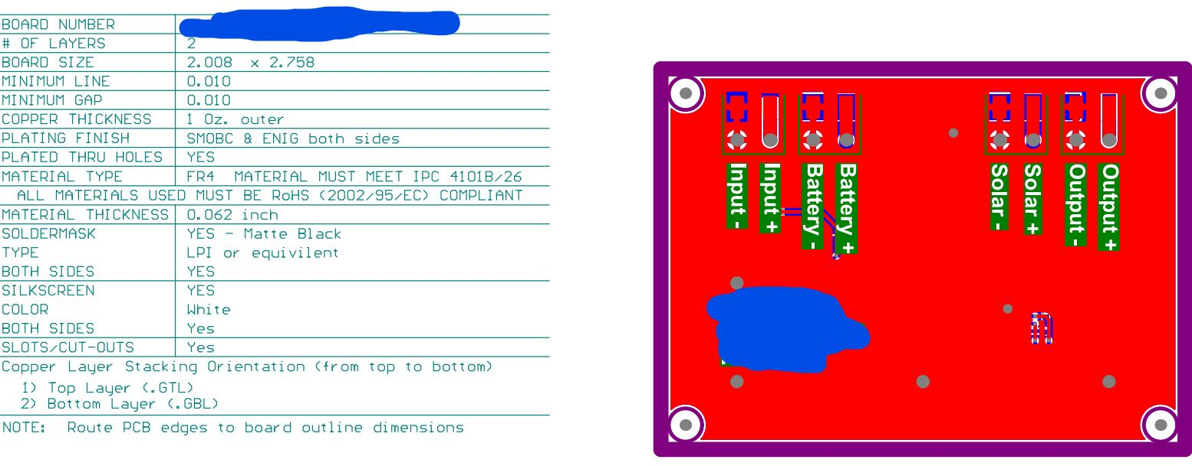
Chip Size

Slide 11
Results
Some photos captured from Reconyx game cameras I pulled of my phone. Saved hours not having to drive and hike in order to swap batteries and cards.

