Slide 1
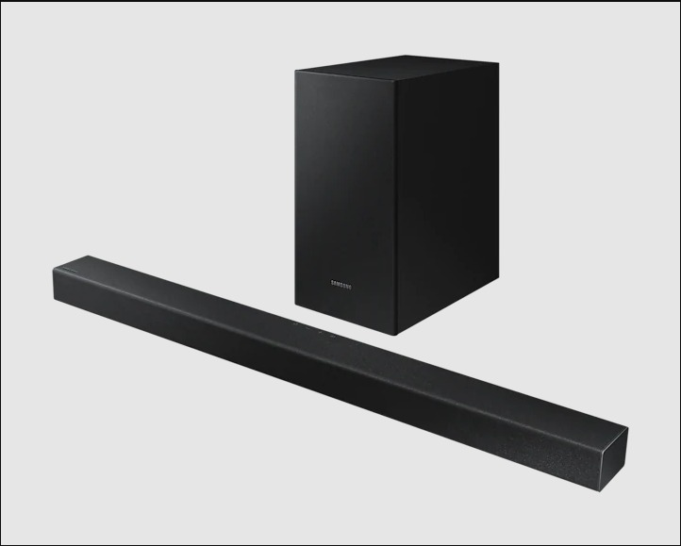
Samsung Soundbar HW-T450 Touger Vue

Slide 2
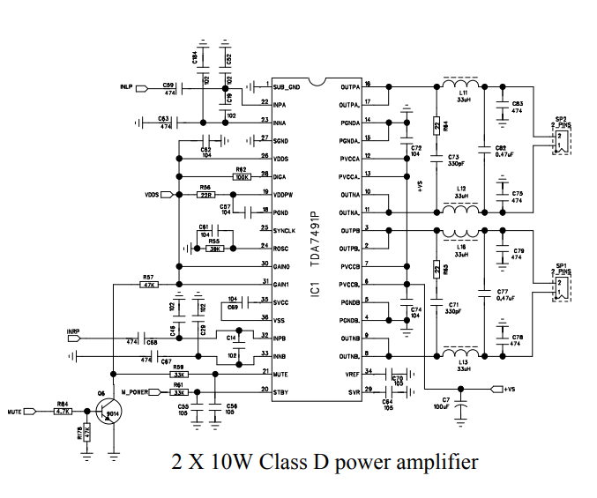
Circuit Diagram/ Class D power amplifiers
https://fccid.io/A2HRTS7220B/Schematics/Circuit-Diagram-1761394

Slide 3
Data Sheet
https://www.st.com/resource/en/datasheet/tda7491p.pdf

