Slide 1
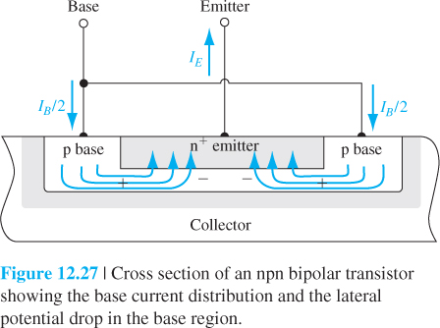
12 and 15 November
Review QUIZ 5
BJT Part 2

Slide 2
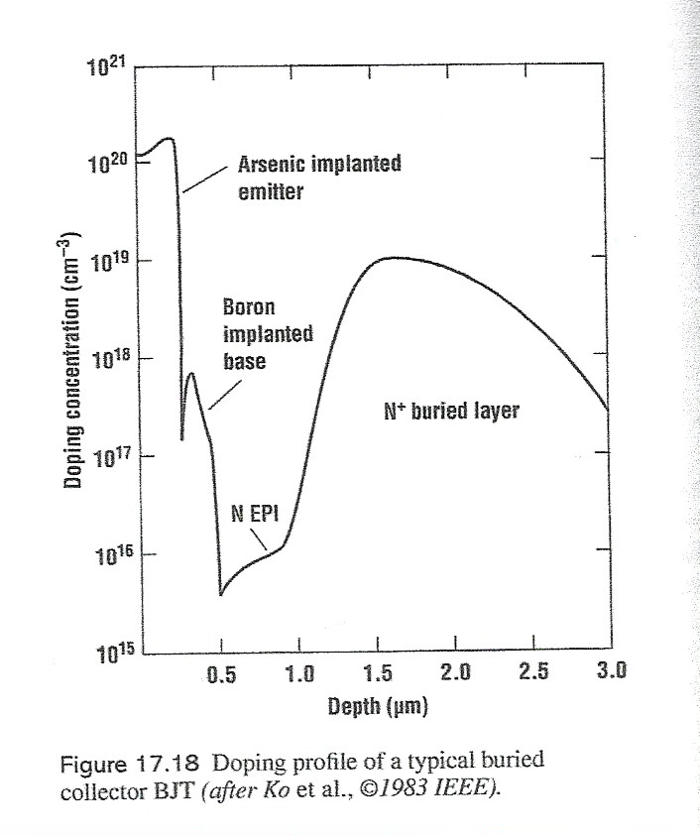
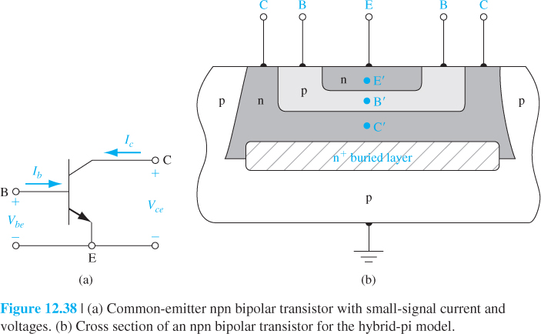

Slide 3
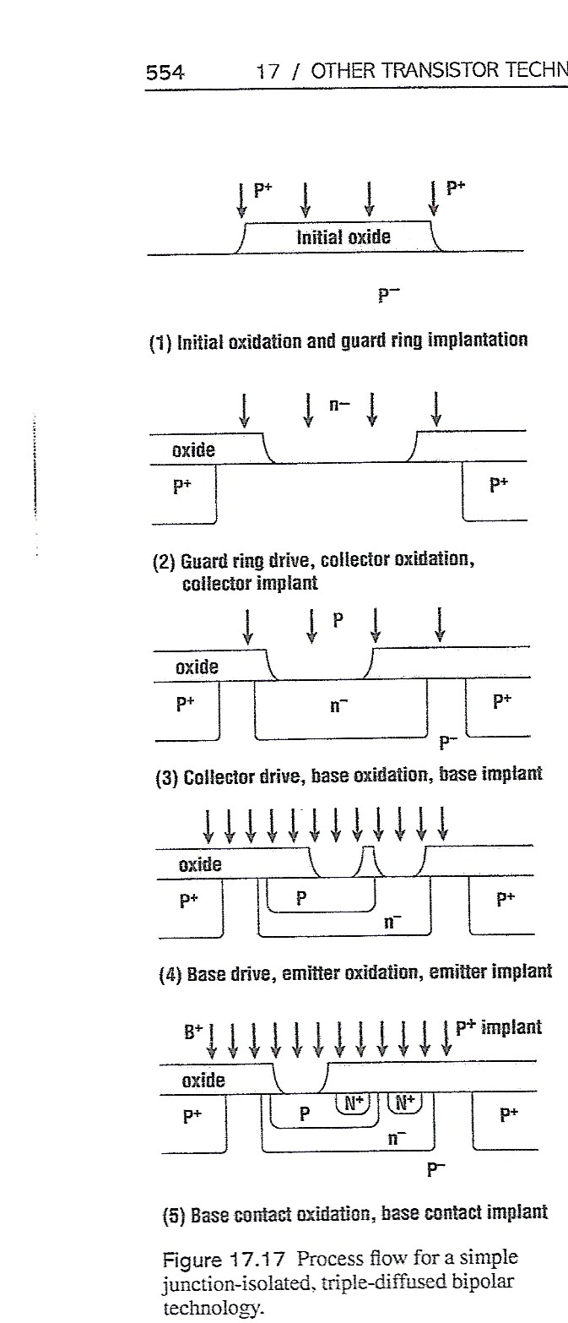
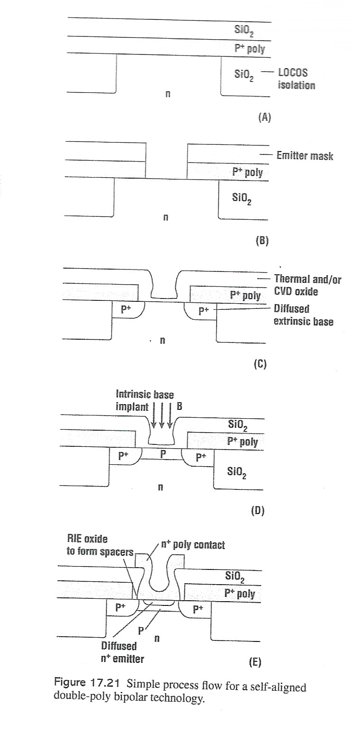

Slide 4
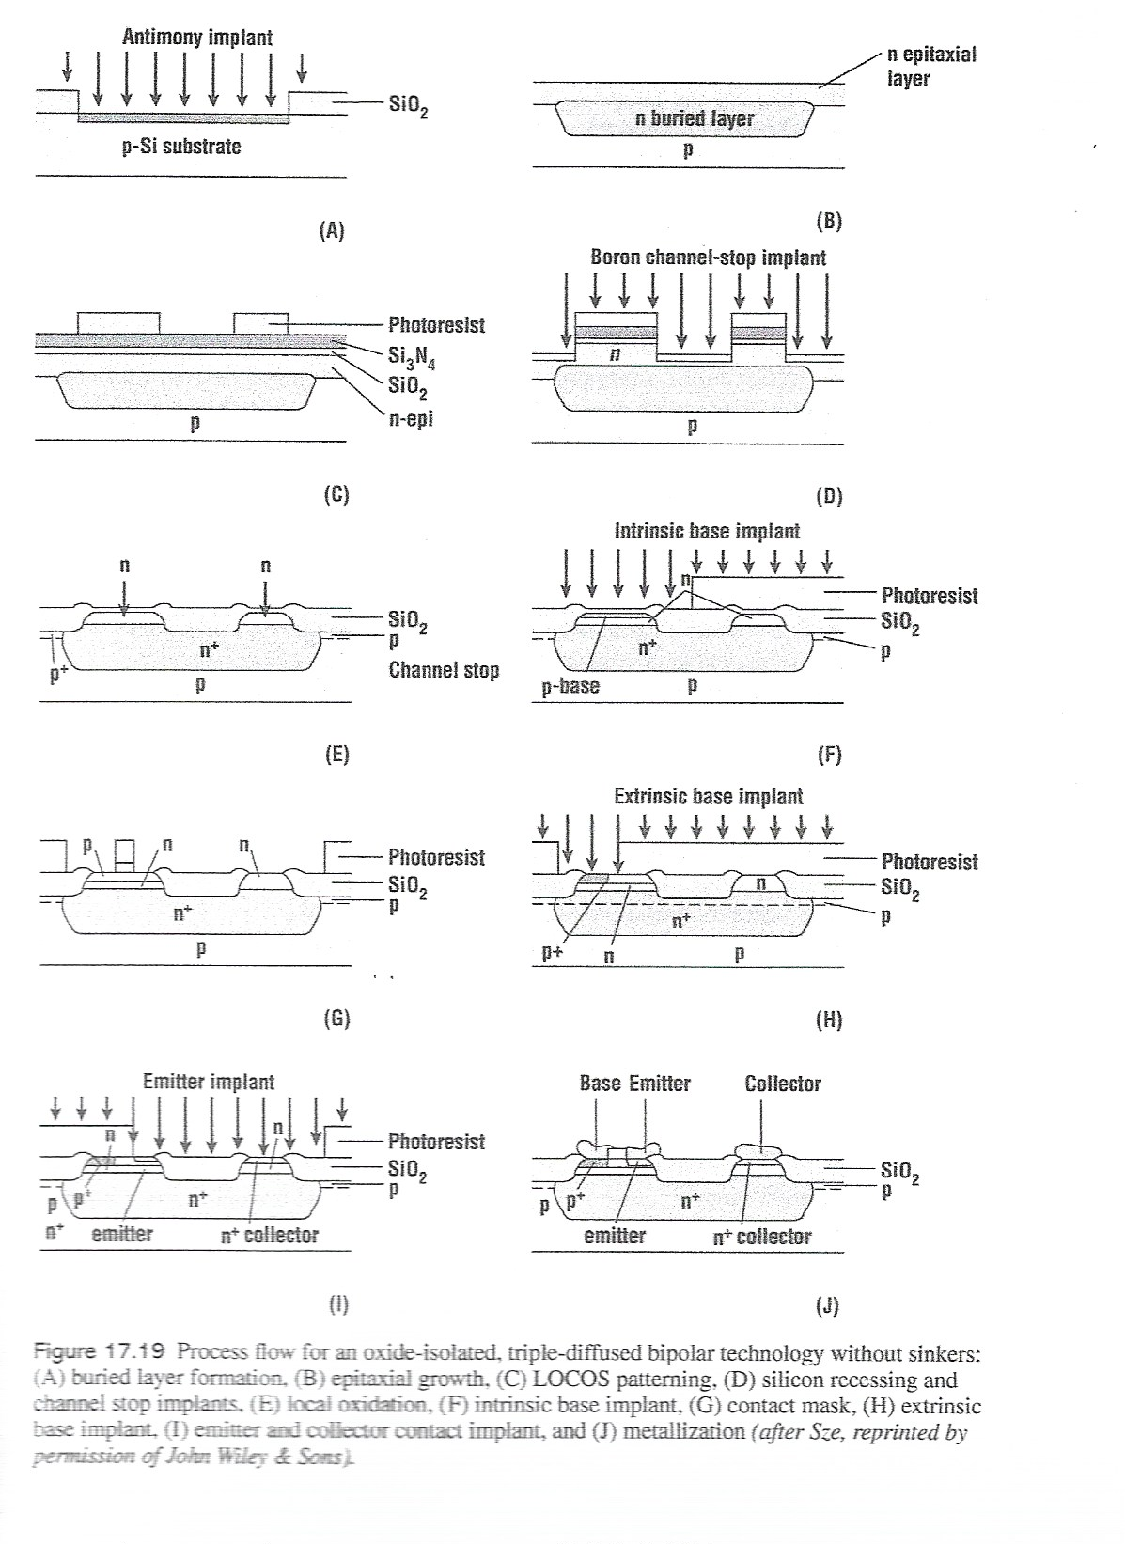

Slide 5
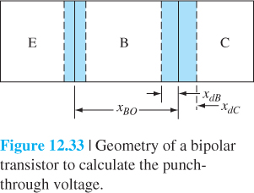
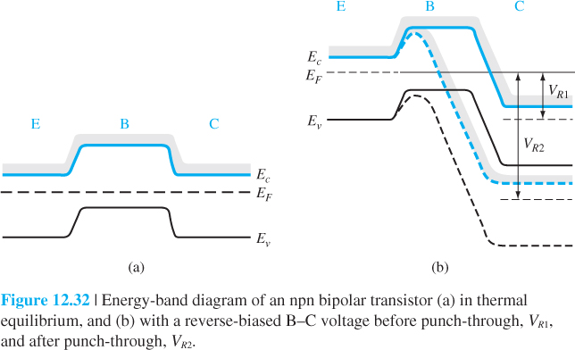

Slide 6
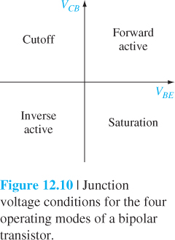

Slide 7
Operation modes of BJT
Mode | BE junction | BC junction | Currents
Active | Forward | Reverse | i_{c} = βi_{B}
Cutoff | Reverse | Reverse | i_{E}= i_{B}= i_{C}=0
Saturation | Forward | Forward | i_{c} < βi_{B}
Reverse active | Reverse | Forward | i_{c} = β_{R}i_{B}
Analysis:
Active mode: most useful bias mode when using a bipolar junction transistor as an amplifier
Cutoff mode: no electron injected to the base, all currents are zero. Used as “off” state in digital circuits or open switch
Saturation mode: used as “on” state in digital circuits or closed switch
Reverse active mode: emitter and collector regions switch roles. Seldom used.
7
Notes:
7

Slide 8
