Slide 1
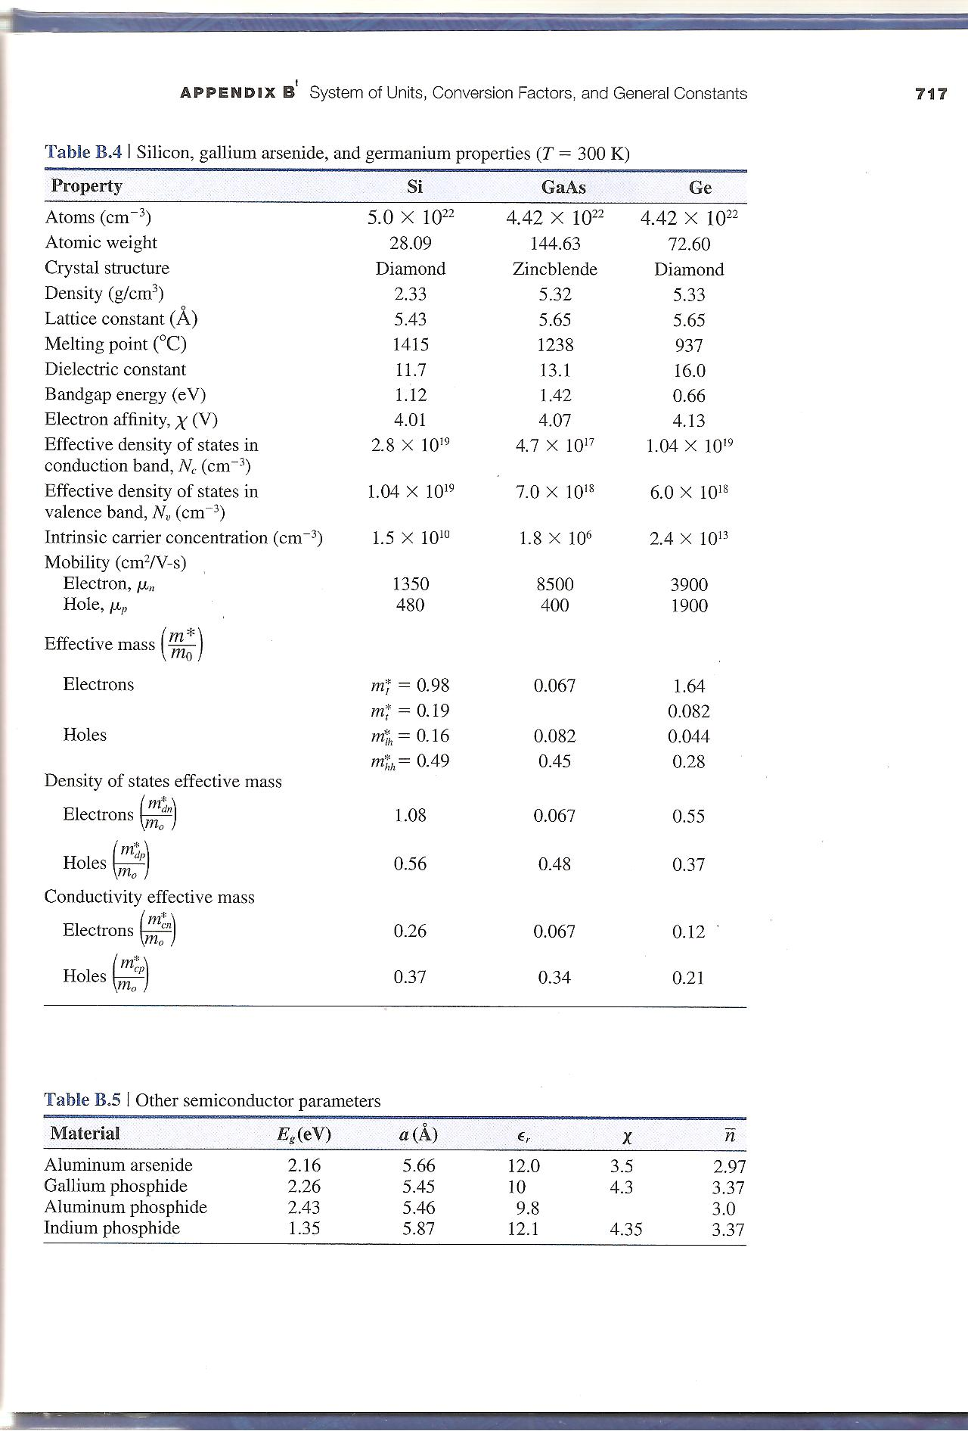
15 and 17 September 2021
Semiconductor Properties
Diffusion Equation Derivation
20 and 22 September
Diffusion Process
Chapter 3

Slide 2
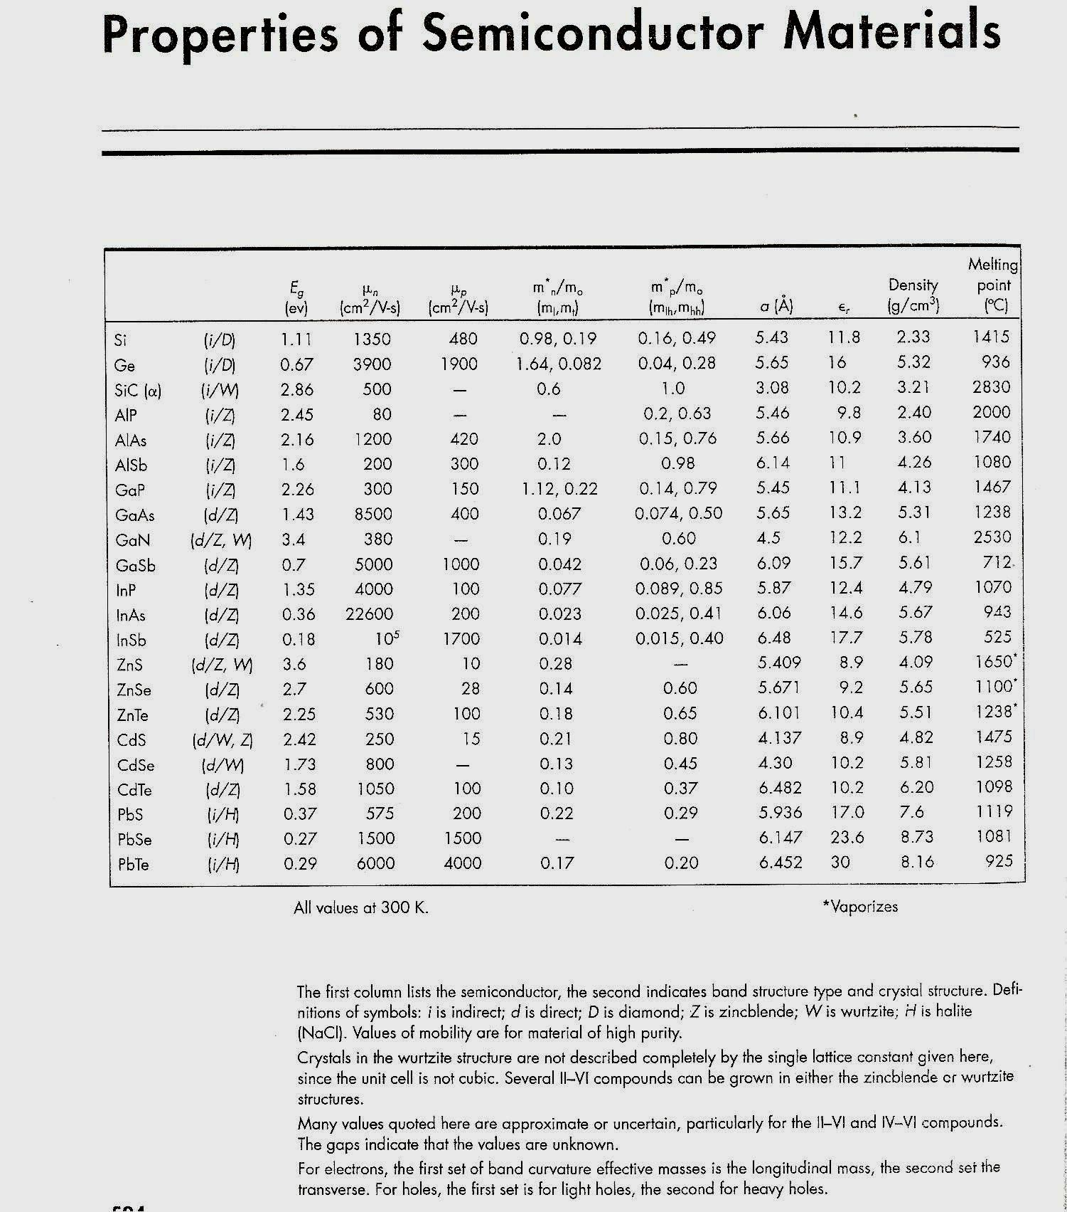

Slide 4
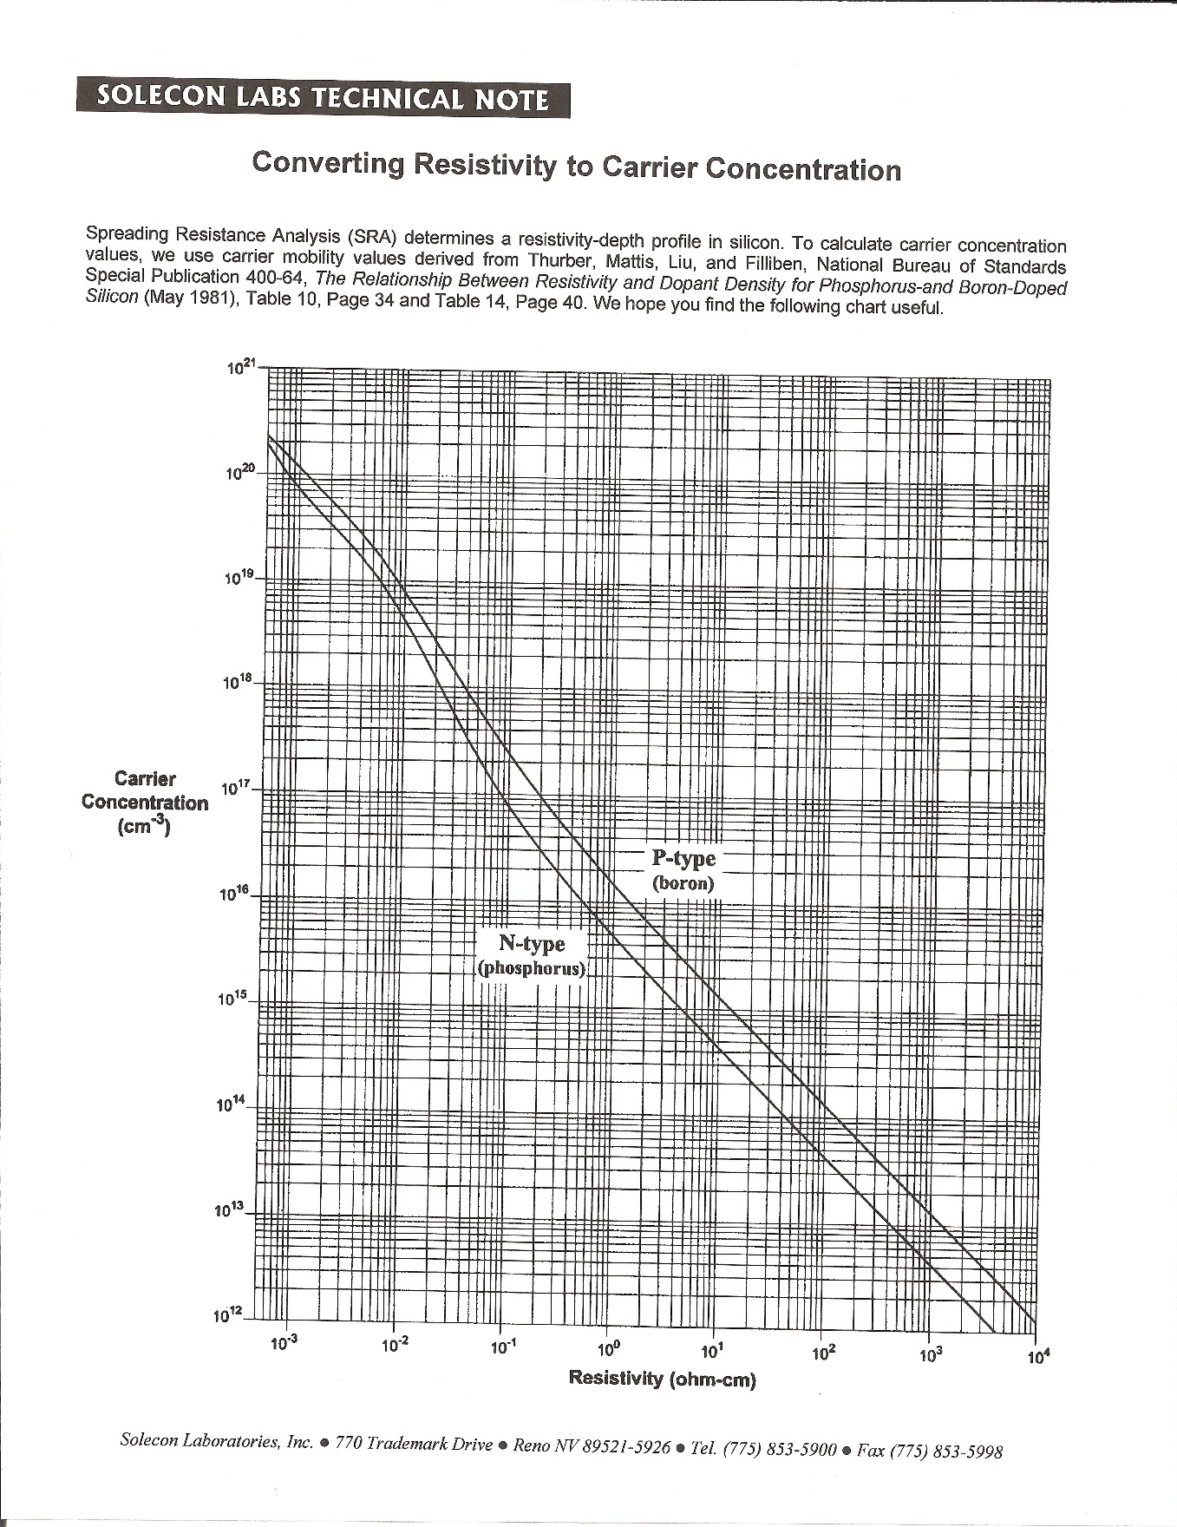

Slide 6
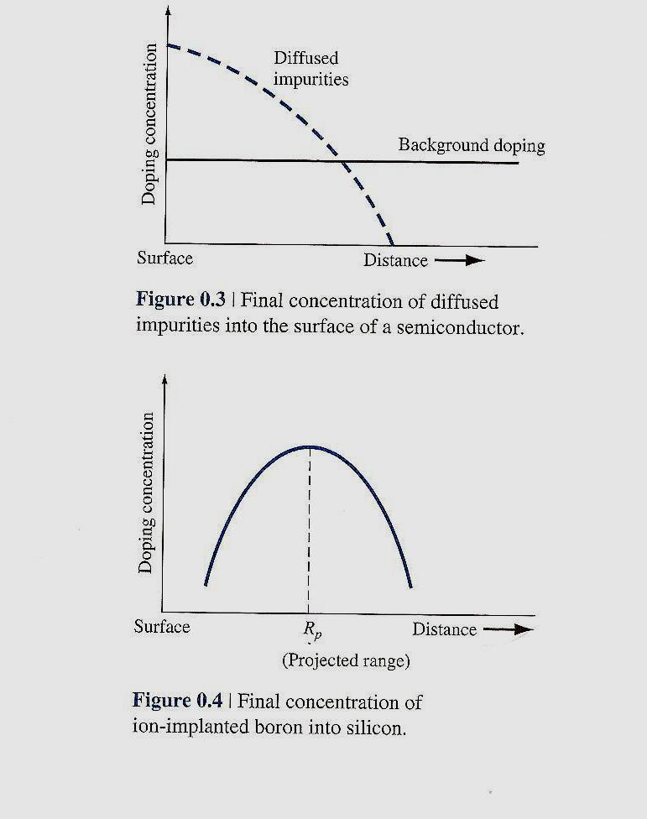

Slide 7
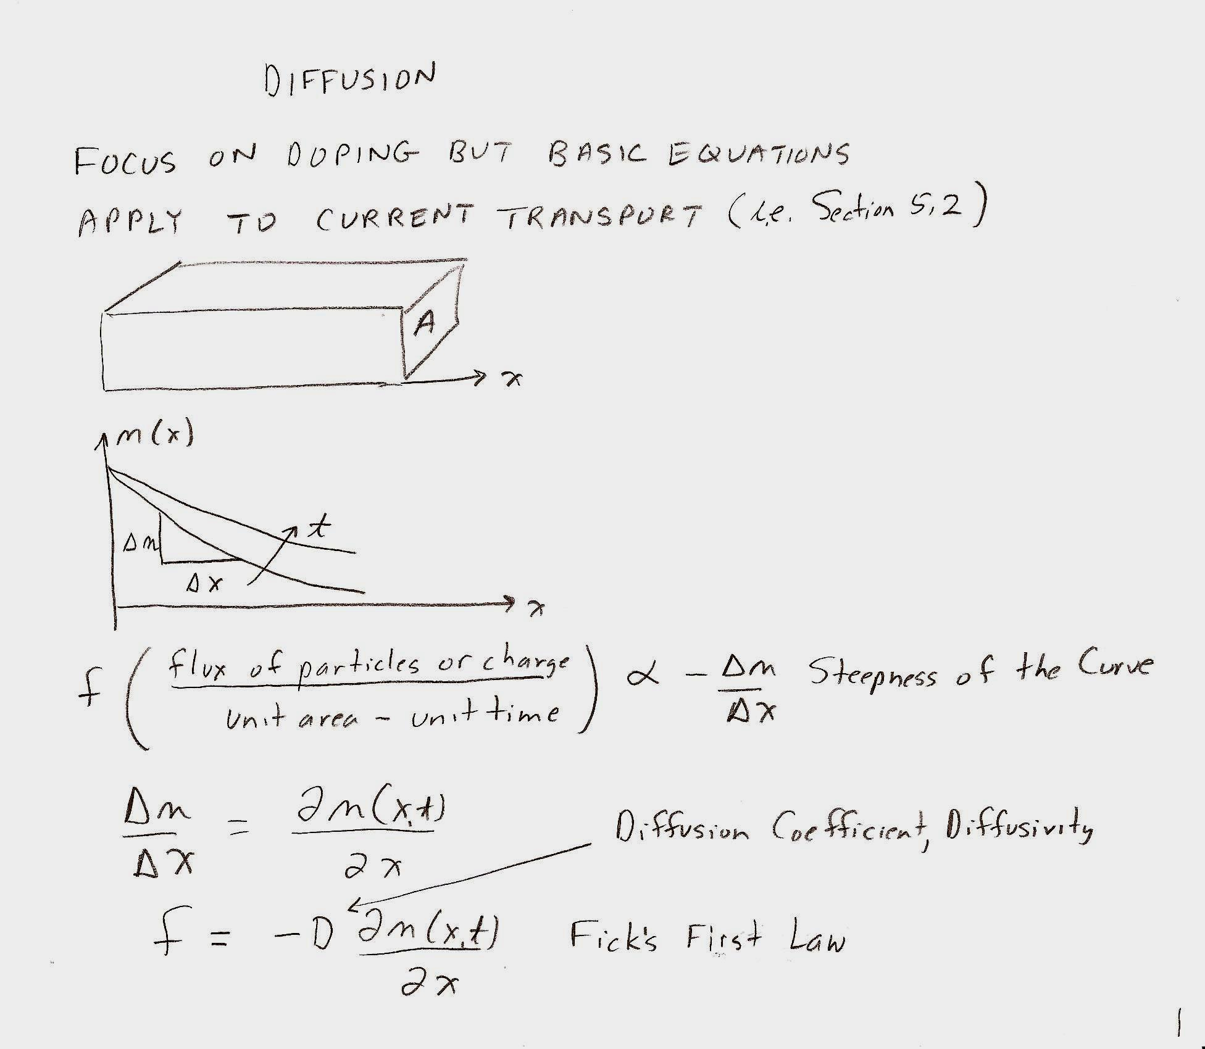
Doping Using Diffusion

Slide 11
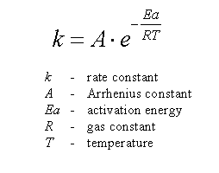

Slide 13
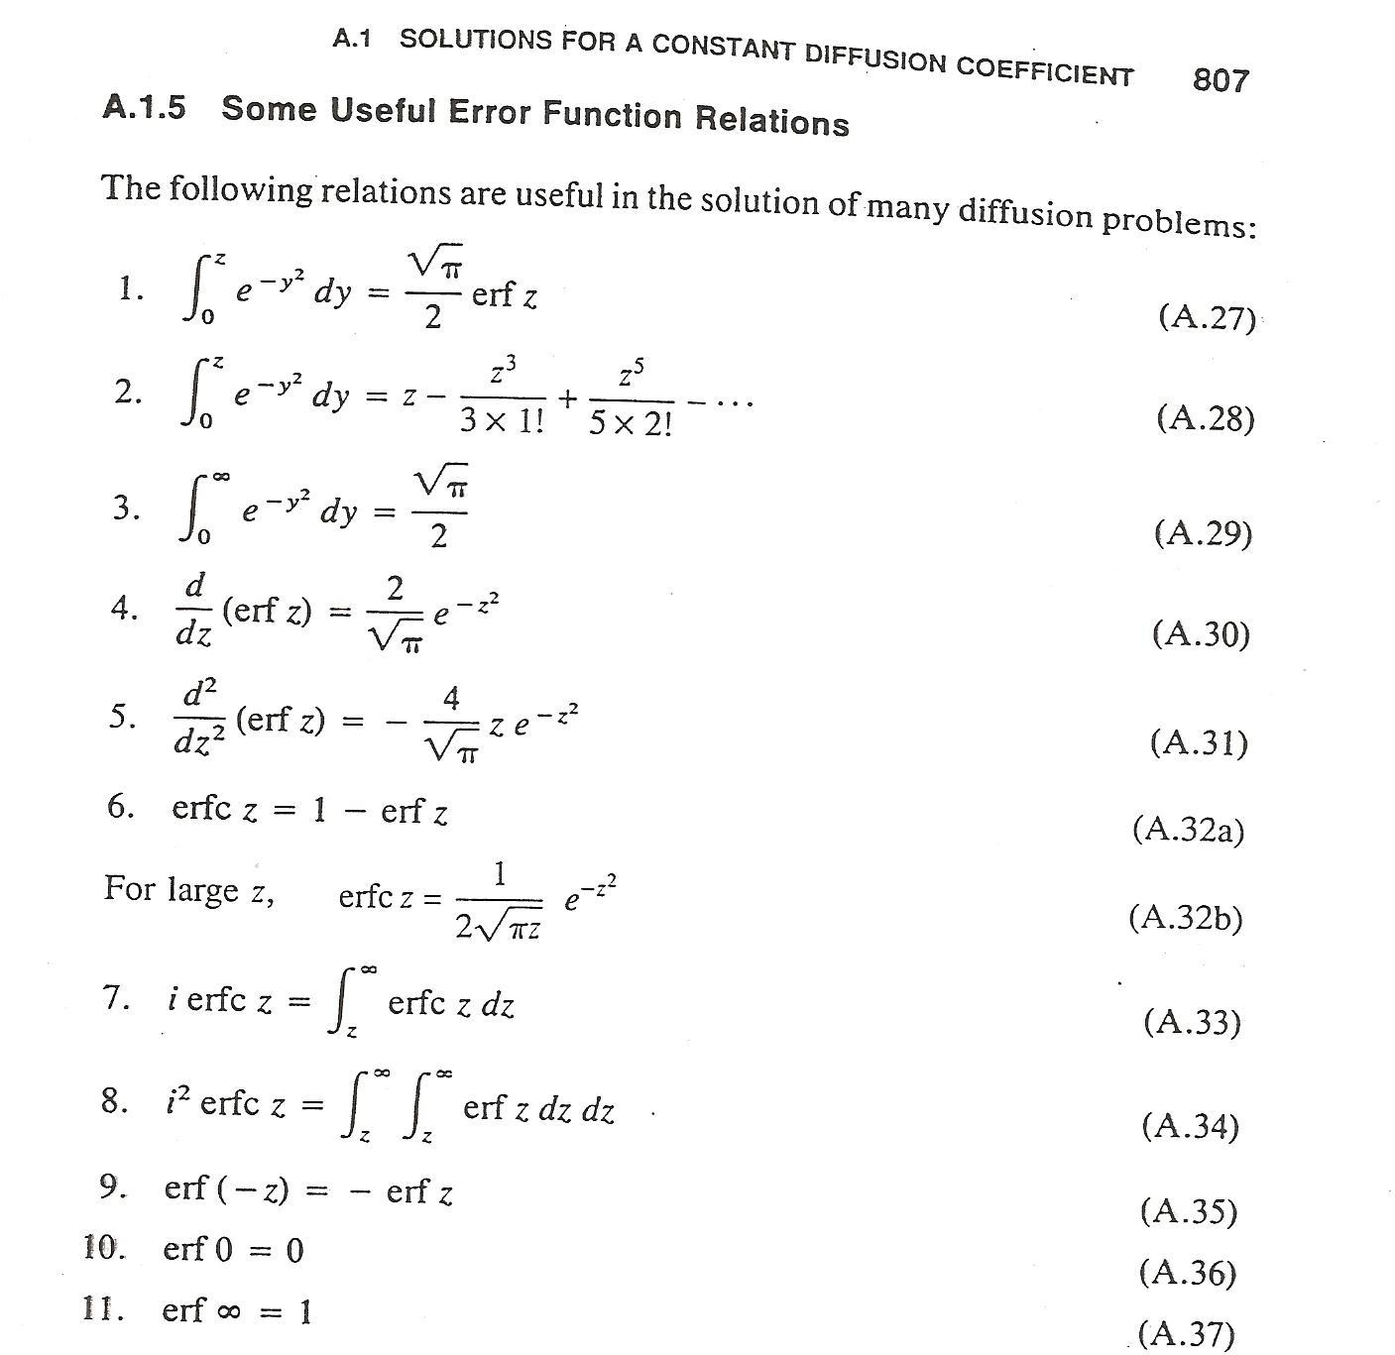

Slide 17
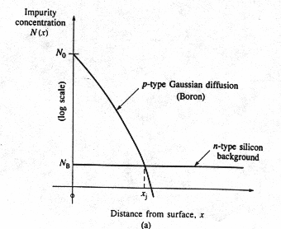
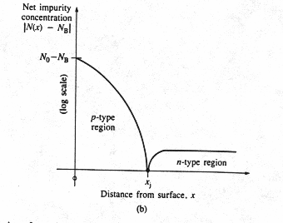
Junction Depth
In this example, Si substrate is n-type doped with the doping concentration N_{B}. the diffusion process is to create a p-well in the n-type wafer. N(x) is the p-type doping concentration.
x_{j} is the junction depth:
x< x_{j}, N(x)> N_{B,} p-type region;
x= x_{j}, N(x)= N_{B,} neutral;
x> x_{j}, N(x)< N_{B,} n-type region;

Slide 19
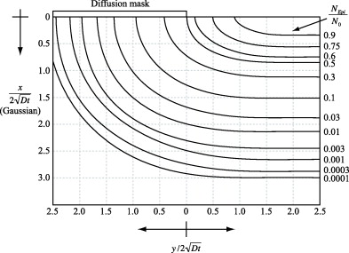
Lateral Diffusion
Simulation results of two-dimensional diffusion process.
During diffusion, impurities not only diffuse vertically, but also move laterally under the edge of any diffusion barrier.

Slide 22
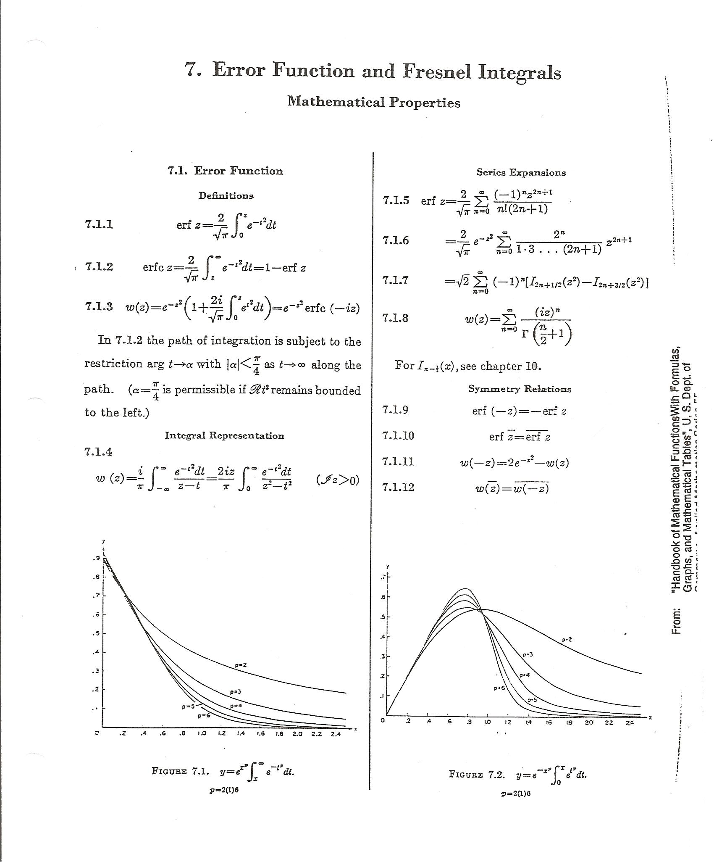

Slide 25
The Diffusion Coefficients for Typical Dopants
Diffusion coefficients depend exponentially on temperature:
Unit of D: cm²/sec
temperature independent term, which depends on the vibration frequency and geometry
the activation energy of the neutral vacancy
Diffusion coefficients of typical impurities in Si
Element | Type
Boron (B) | p | 10.5 | 3.69
Gallium | p | 3.60 | 3.51
Phosphorus | n | 10.5 | 3.69
Arsenic | n | 0.32 | 3.56

Slide 28
Overview of Doping Technologies
Technology criteria on doping:
Doping profile — precise control of doping concentration and region (depth and planar area)
Major doping Technologies:
High-temperature Diffusion
Ion implantation followed by diffusion and annealing
Dopants (impurities) for Si:
n-type dopant (donor): Phosphorus (P), Arsenic (As), Antimony (Sb)
p-type dopant (acceptor): Boron (B), Gallium (Ga), Indium (In)
Aluminum (Al) not used as a dopant

Slide 29
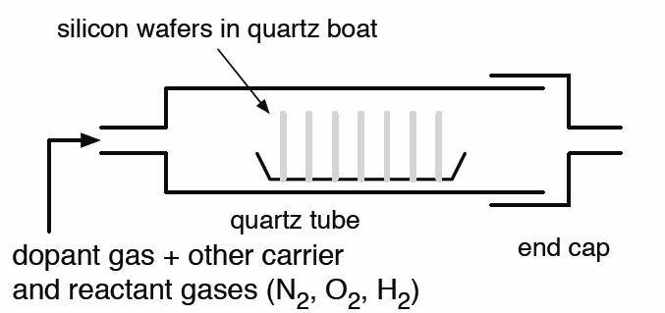
Diffusion with Gas Sources (Phosphorus)
2PH₃ + 4O₂ P₂O₅ +3H₂O
2P₂O₅ + 5Si 5SiO₂ +4P
The glass oxide layer is formed on the silicon surface.

Slide 30
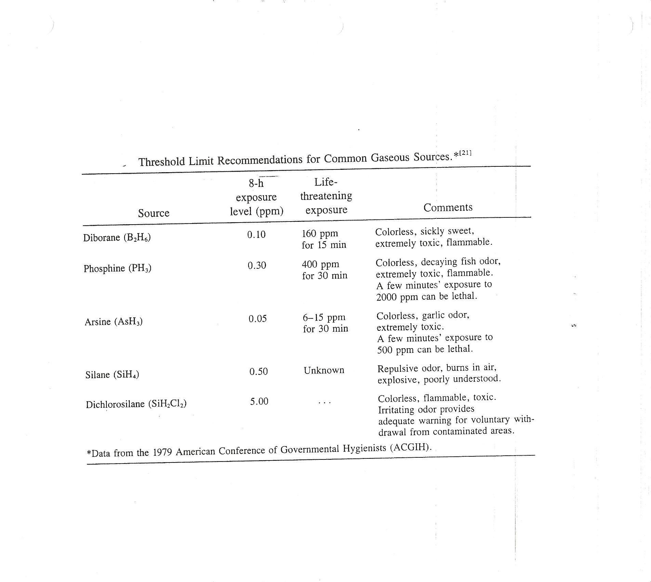

Slide 31
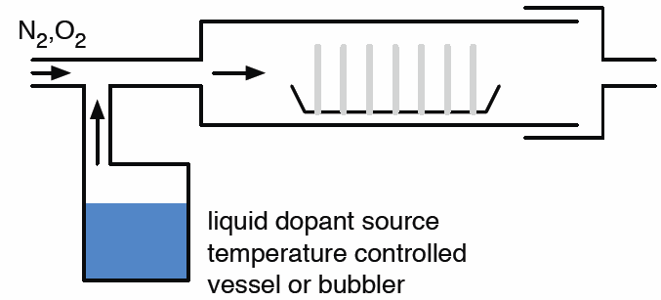
Diffusion with Liquid Sources (Phosphorus)
Reactions: 4POCl₃ + 3O₂ 2P₂O₅ + 6Cl₂
2P₂O₅ + 5Si 5SiO₂ +4P
The glass oxide layer is formed on the silicon surface.

Slide 32
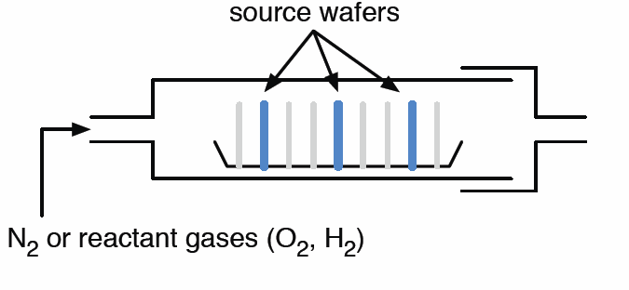
Diffusion with Solid Sources (Phosphorus)
Reactions:
2P₂O₅ + 5Si 5SiO₂ +4P
The glass oxide layer is formed on the silicon surface.

Slide 33
Reactions for Boron Diffusion
Boron Diffusion:
Gas source: 4B₂H₆ + 3O₂ 2B₂O₃ + 3H₂O
2B₂O₃+ 3Si 3SiO₂ +4B
Liquid source: 4BBr₃ + 3O₂ 2B₂O₃ + 6Br₂
2B₂O₃+ 3Si 3SiO₂ +4B
Solid source:
4BN + 3O₂ 2B₂O₃ + 2N₂
2B₂O₃+ 3Si 3SiO₂ +4B

Slide 34
Diffusion Procedure
What happens during diffusion:
Predeposition: deposition of a high concentration of the desired impurity on the silicon surface through windows etched in the protective barrier layer.
Drive in: At high temperatures (900 ~ 1200ºC), the impurity atoms move from the surface into the silicon crystal via the substitutional or interstitial mechanisms
Doping source
SiO₂ protective layer
Doped region
P
(a) N-well predeposition
Doping source removed
n-well
P
(b) N-well drive in

Slide 35
Mechanisms of Diffusion
Diffusion mechanisms:
Impurity atom
Si atom
No vacancy available
Interstitial diffusion
Vacancy available
Substitutional diffusion
The Substitutional diffusion proceeds at a relatively low rate because the supply of vacancies is limited, but this slow diffusion rate is actually an advantage because it permits good control of the diffusion process.
The interstitial diffusion mechanism does not require the presence of vacancies, so it proceeds more rapidly than substitutional diffusion. The rapid diffusion rate makes interstitial diffusion difficult to control.
Either of the two mechanisms may be dominant depending on process conditions.

Slide 38
Lateral Diffusion
Simulation results of two-dimensional diffusion process.
During diffusion, impurities not only diffuse vertically, but also move laterally under the edge of any diffusion barrier.

Slide 39
Junction Depth
In this example, Si substrate is n-type doped with the doping concentration N_{B}. the diffusion process is to create a p-well in the n-type wafer. N(x) is the p-type doping concentration.
x_{j} is the junction depth:
x< x_{j}, N(x)> N_{B,} p-type region;
x= x_{j}, N(x)= N_{B,} neutral;
x> x_{j}, N(x)< N_{B,} n-type region;

Slide 40
Junction-Depth Measurement
Test wafers are normally processed in parallel with the actual IC wafers. The test wafer provides a large area for experimental characterization of junction depth since no making is done on test wafers.
Alternatively, special test dice replace a few of the normal die sites on each wafer. These test dice provide an array of test structure for monitoring process and device characteristics during various phases of the process
Junction-depth measurement methods:
Grove-and-stain method
Sheet resistance measurement (four

Slide 41
Stanley G. Burns
UMD-ECE

Slide 42
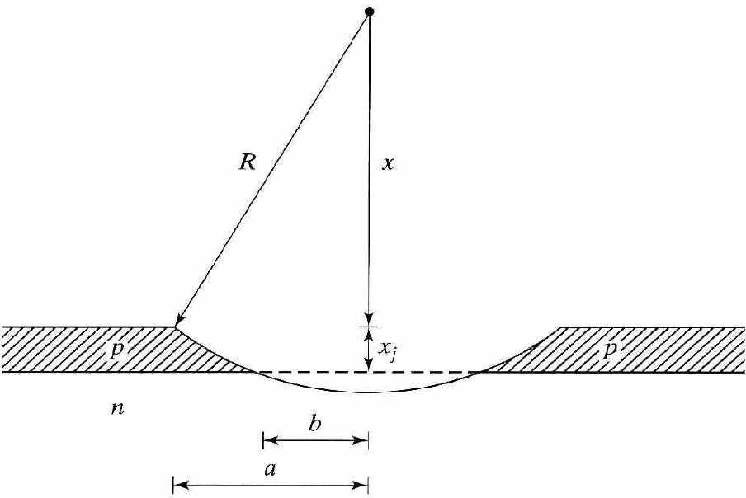
Grove-and-stain method
A cylindrical groove is mechanically ground into the surface of the wafer.
After grooving operation, the junction is delineated using a chemical etchant which stains the PN junction.
The distance a and b can be measured through a microscope. If radius R of the grinding tool is known. The junction depth is

Slide 43
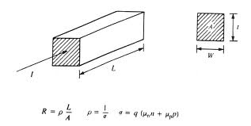
Sheet Resistance
In diffused layers, resistivity is strong function of depth. In circuit and device design, it is convenient to work with the sheet resistance, R_{s}
Sheet resistance of the layer of material,
Unit: ohms per square
The ratio (L/W) can be interpreted as the # of unit squares in the resistor.

Slide 44
Irwin’s Curve (1)
When conductivity varies with the depth of diffusion,
and
So
x_{j}: the junction depth
μ: the majority-carrier mobility
N(x): the net impurity concentration
The depletion region near the junction x_{j} is neglected.

Slide 45
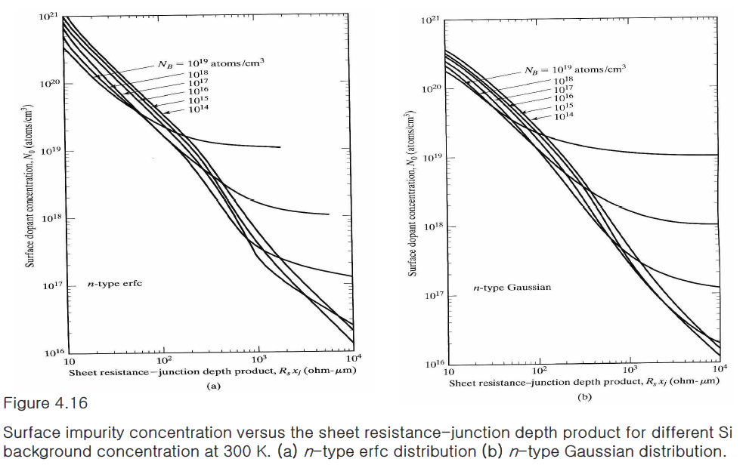
Irwin’s Curve (2)
For a given diffusion profile, sheet resistance is uniquely related to the surface concentration of the diffused layer N_{o} and the background concentration N_{B.}
Sheet resistance is an electrical quantity which depends on the majority-carrier concentration

Slide 46
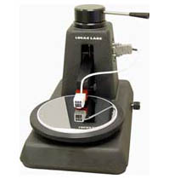
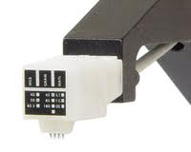
Four-Point Probe (1)
Four-point probe: a special instrument that is used to measure the bulk resistivity of starting wafers and the R_{s} of shallow diffused layers

Slide 47
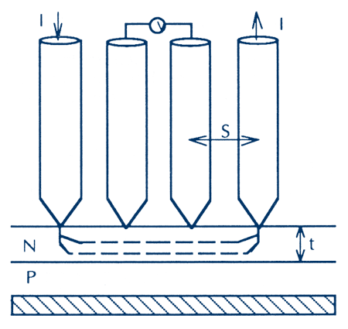
Principle of Four-Point Probe Measurement
A fixed current is injected into the wafer through the two outer probes, the resulting voltage is measured between the two inner probes.

Slide 48
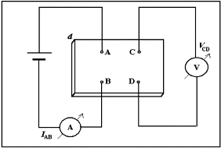
Van der Pauw’s Method
The sheet resistance of an arbitrary shaped sample of material may be measured by placing four contacts on the periphery of the sample.
A current is injected through one pair of the contacts, and the voltage is measured across another pair of contacts.

Slide 49
Concentration-Dependent Diffusion
When the dopant concentration gets higher than certain level, the diffusion becomes concentration-dependent
In this case, the Fick’s diffusion equation must account for the concentration-dependent diffusion coefficient
Fick’s first law of diffusion for 1D diffusion process:
D: diffusion coefficient (cm²/s)
N: impurity concentration (cm⁻³)

Slide 50
Diffusion in SiO₂
SiO₂ is frequently used as the mask for diffusion, ion implantation and insulating layer
Dopant atoms could also diffuse into SiO₂
Diffusion coefficients in SiO₂
Element | Type
Boron (B) | p | 3×10⁻⁴ | 3.53
Phosphorus (P) | n | 0.19 | 4.03
Diffusion coefficients in Si
Element | Type
Boron (B) | p | 10.5 | 3.69
Phosphorus (P) | n | 10.5 | 3.69

