Slide 1
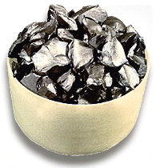
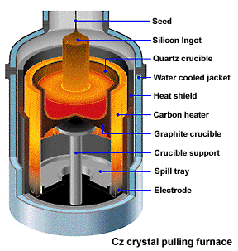
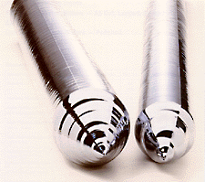
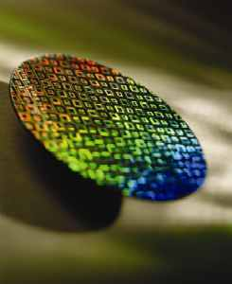
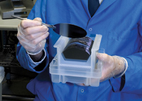
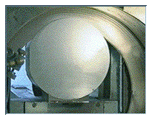
IC Fabrication Overview
Procedure of Silicon Wafer Production
Process Overview
3 and 8 September 2021
Raw material ― Polysilicon nuggets purified from sand
Up to you. Keep in touch.
Si crystal ingot
Up to you. Keep in touch.
Crystal pulling
A silicon wafer fabricated with microelectronic circuits
Final wafer product after polishing, cleaning and inspection
Slicing into Si wafers using a diamond saw
1
Notes:
(1) Raw material from sand and made into the polysilicon nuggests
(2) The polysilicon nuggets are placed into the quartz crucible. Quartz crucible, surrounded by graphite heater, 1600degree C. Metling it rotated. The melted nuggets can be pulled out slowly using a crystal seed. The crystal seed the shape is long thin needle. When it pull out and colled and formed the cylinder shpaed inget. The ingot is single crystal slicon.The diameter of the ingot is deciced by the temperature when melting and the rotating speed when it pulled out.
Pure crystal cylindar ingets.temparatue and rate decide the diameter

Slide 3
Stanley G. Burns
UMD-ECE

Slide 7
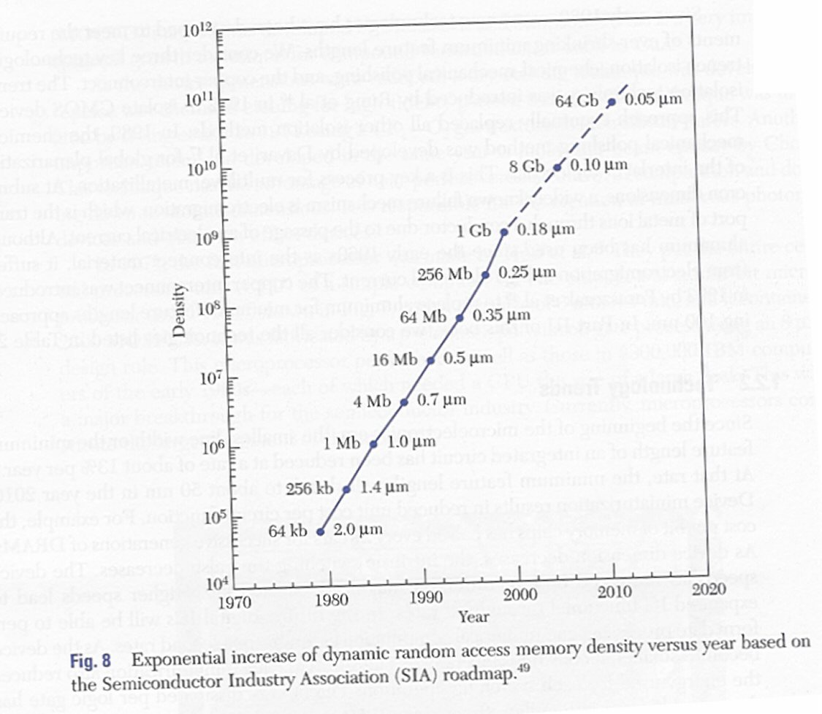
<$30
256 GB
14 nm Micron Memory, 7 nm Apple iPhone 12

Slide 8
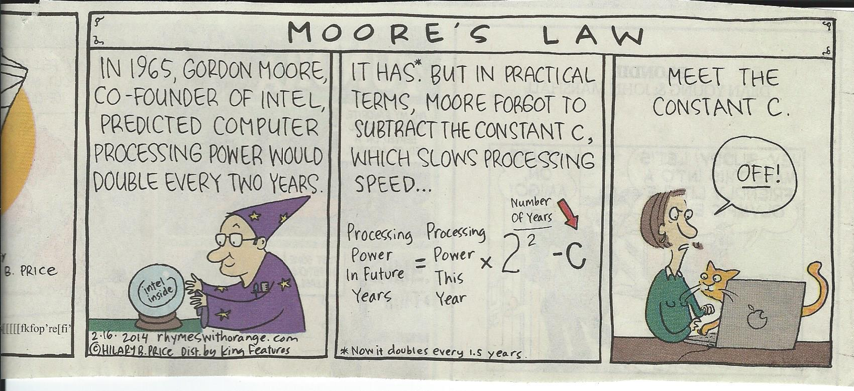
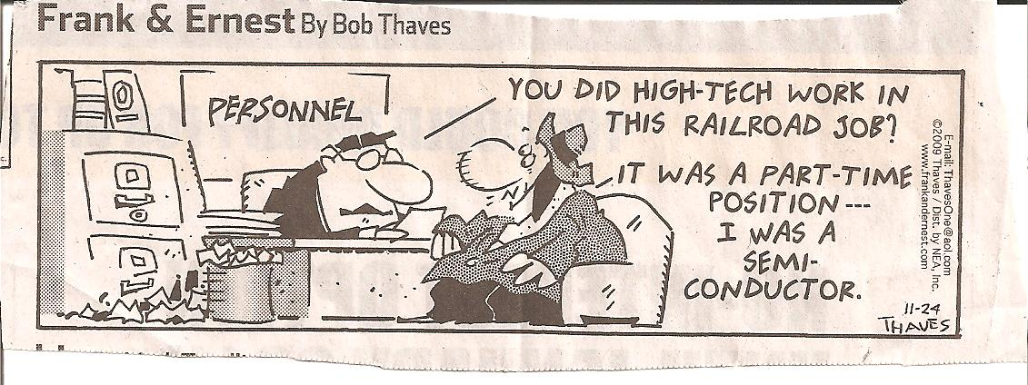

Slide 9
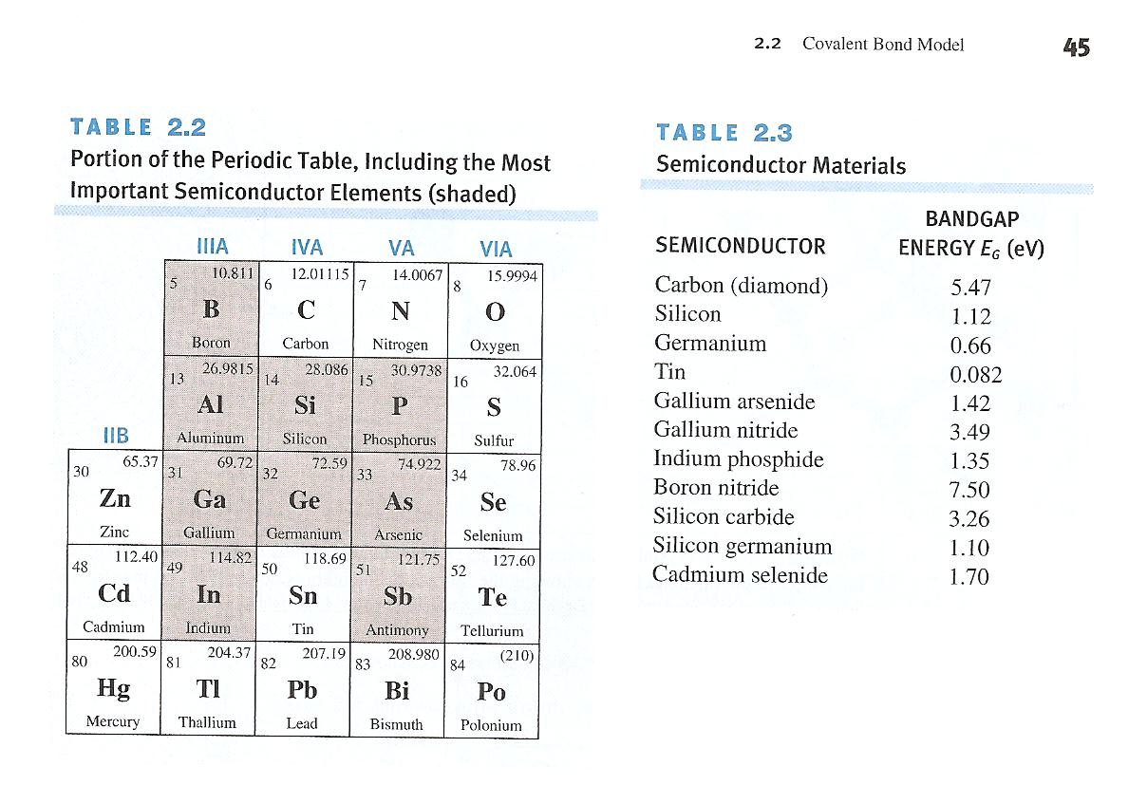

Slide 11
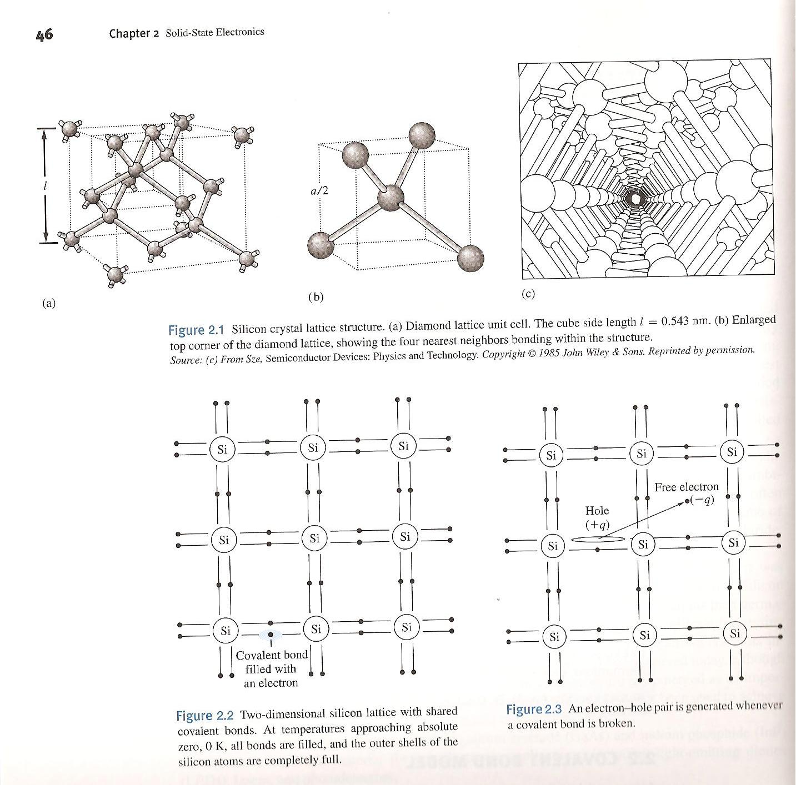
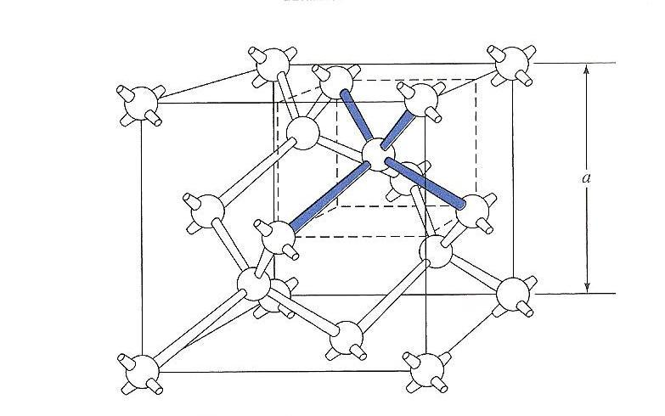

Slide 12
Extrinsic (Doped) Semiconductor Materials
An extrinsic semiconductor is a semiconductor that has been doped, that is, into which dopant atoms has been introduced, giving it different electrical properties than the intrinsic semiconductor.
Semiconductor doping is the process that changes an intrinsic semiconductor to an extrinsic semiconductor. During doping, impurity atoms are introduced to an intrinsic semiconductor.
N-type doping: doping pure silicon with group V elements such as phosphorus, extra valence electrons are added and become unbonded from individual atoms, which allows the compound to be electrically conductive. The n-type dopant is said to behave as an electron donor.
P-type doping: doping with group III elements, such as boron, which are missing the fourth valence electron and create "broken bonds", or holes, in the silicon lattice. The p-type dopant is an acceptor.
12
12
Notes:
12

Slide 13
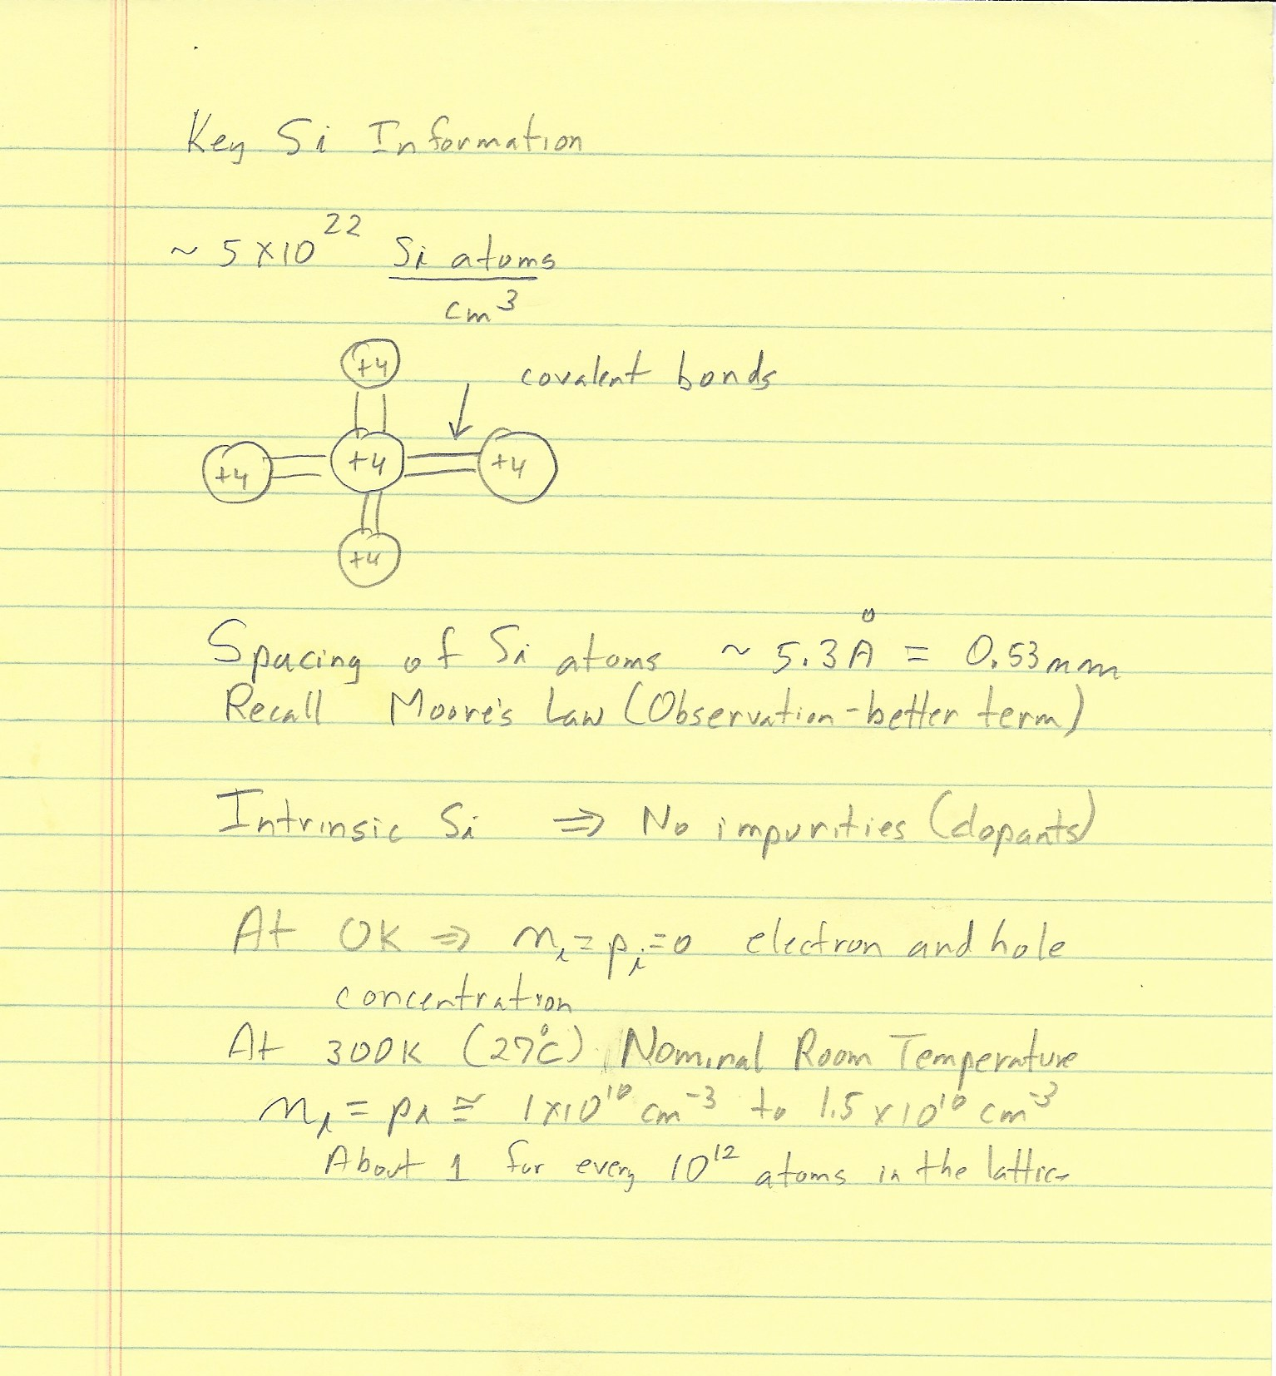

Slide 14
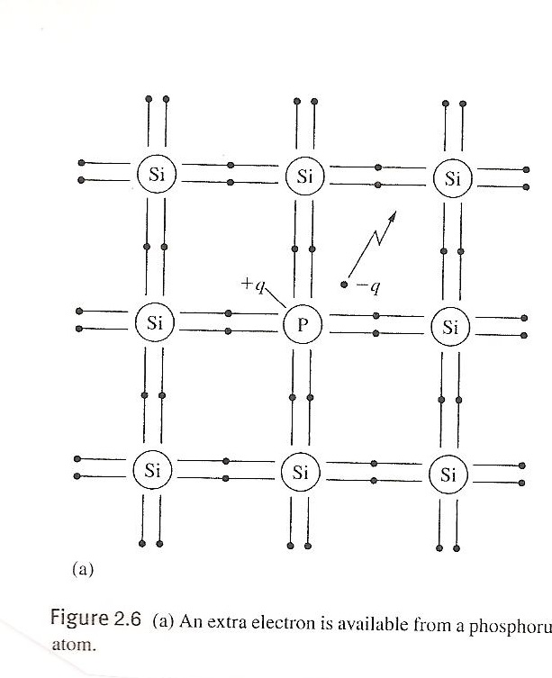
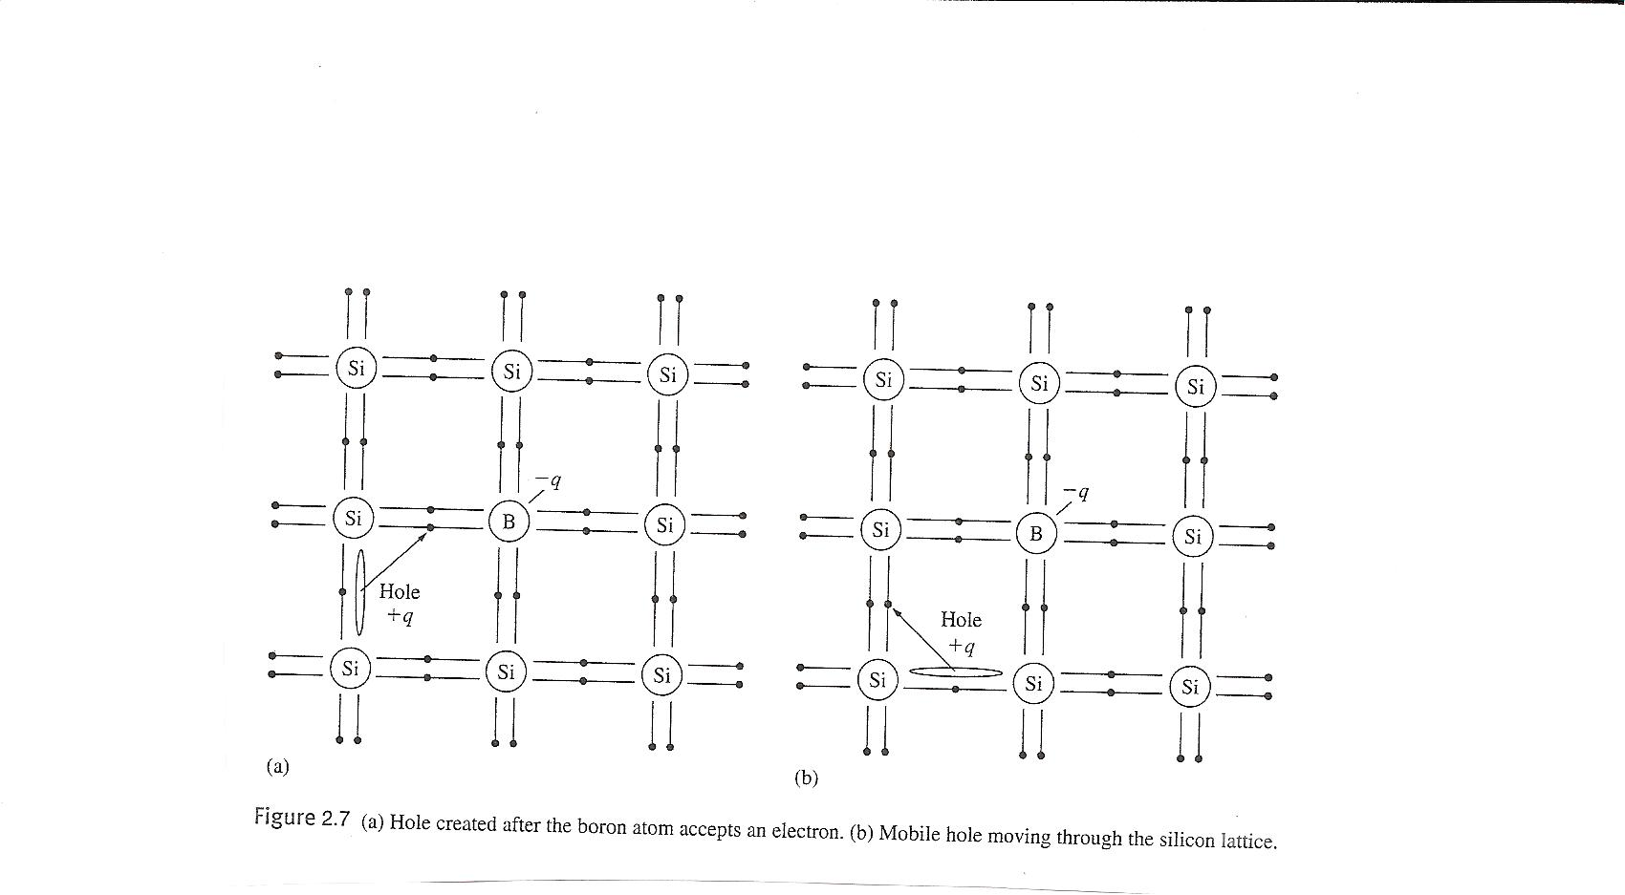

Slide 16
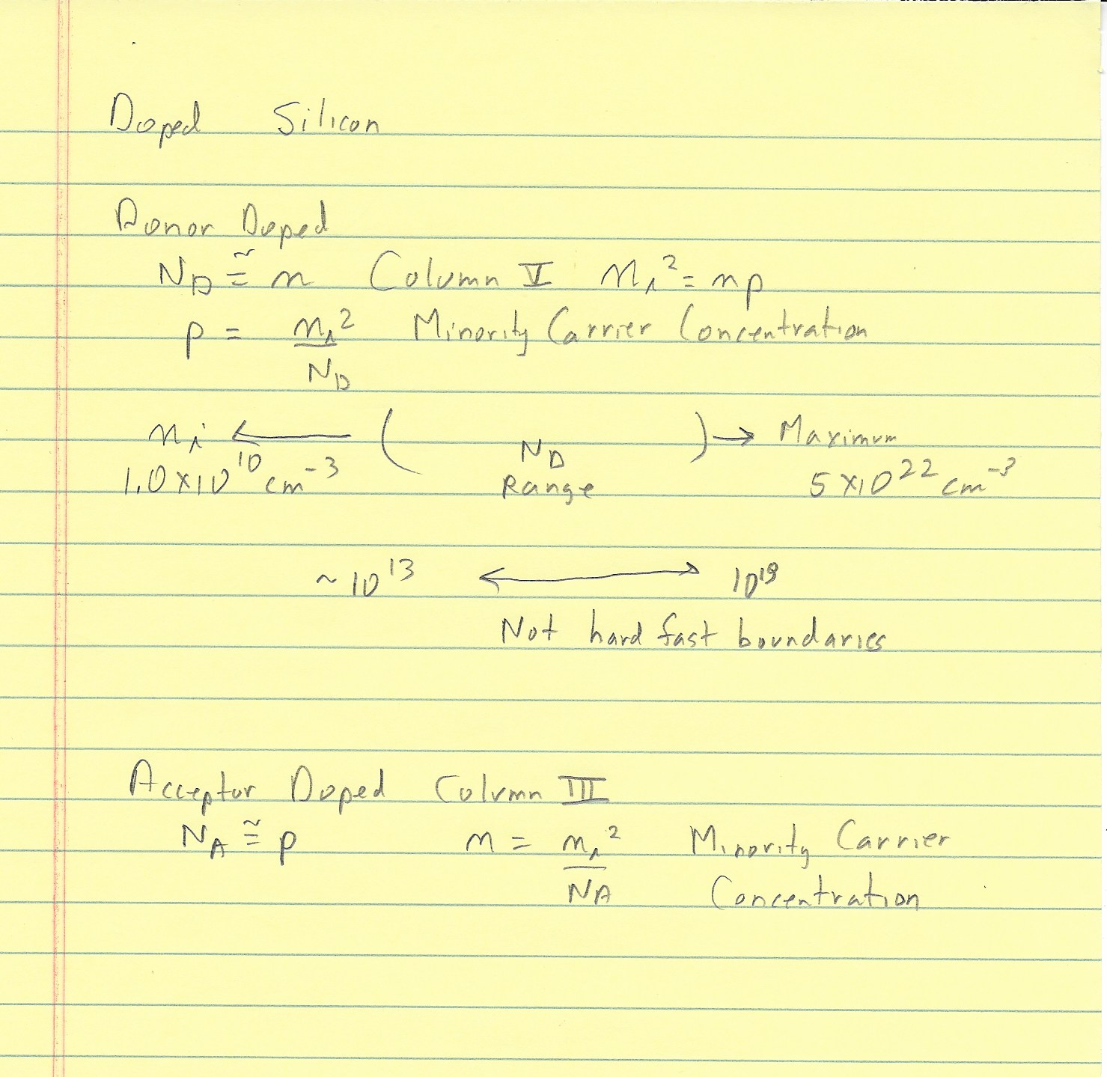

Slide 17
Semiconductor Doping Processes
Diffusion: doping was accomplished by exposing the Si wafer to a P, As, or B containing source and then driving it into the wafer at high temperature (by diffusion).
Ion Implantation: highly accelerated ions of the dopant material impinge on the semiconductor substrate, and penetrate further into the substrate.
Advantages of ion implantation:
Precise control of dosage and penetration depth
Low temperature process
Excellent lateral dose uniformity
Dopant gas
SiO₂
SiO₂
Si
Three steps:
Pre-deposition
Drive-in
Annealing
17
17
Notes:
17

Slide 18
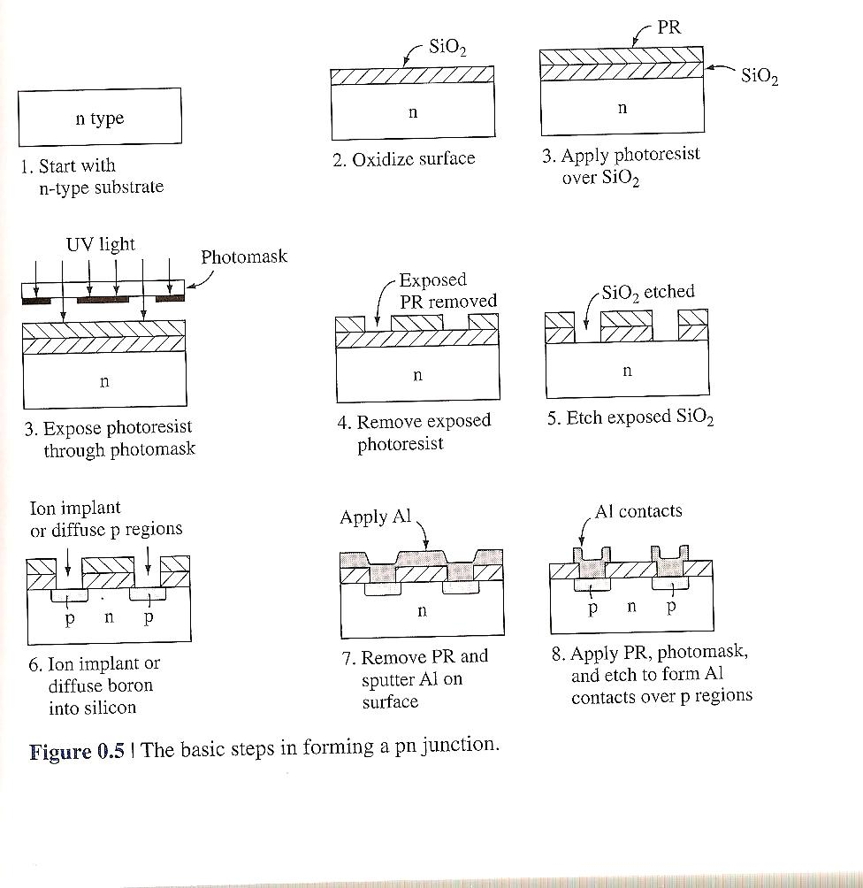

Slide 19
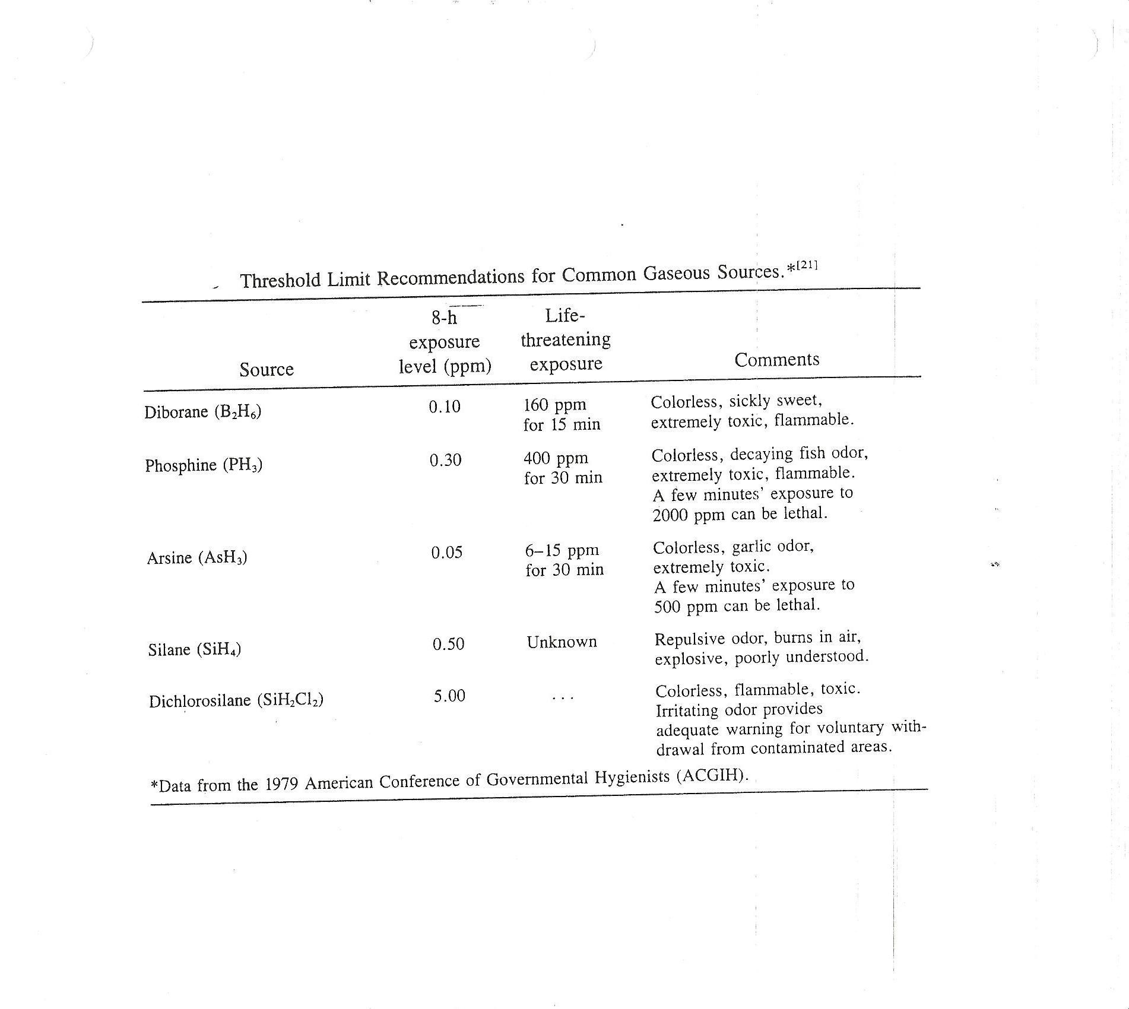

Slide 20
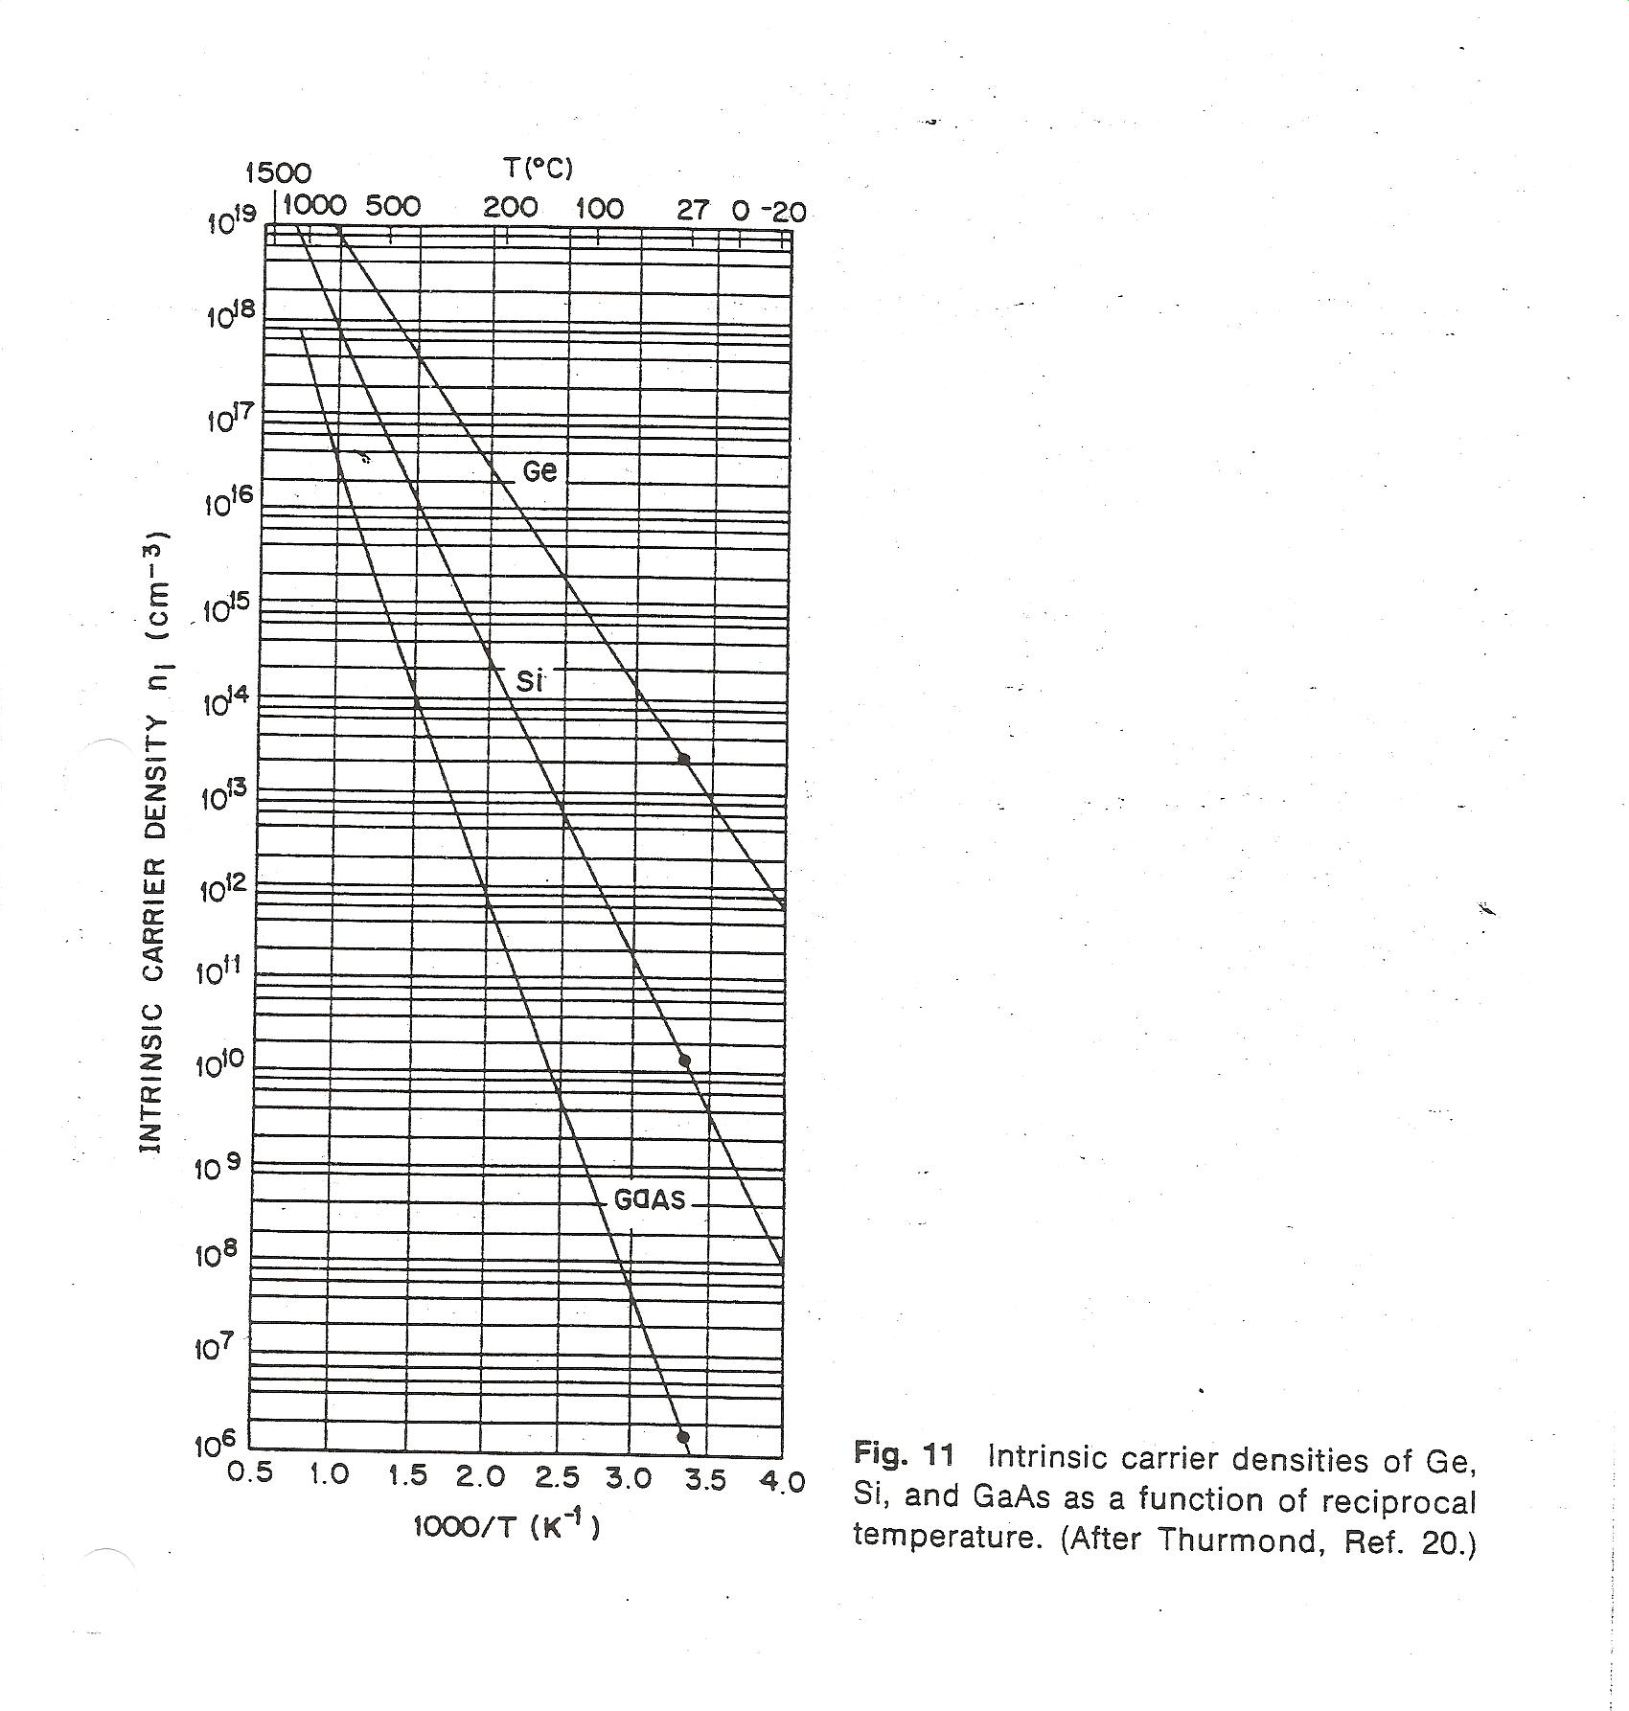
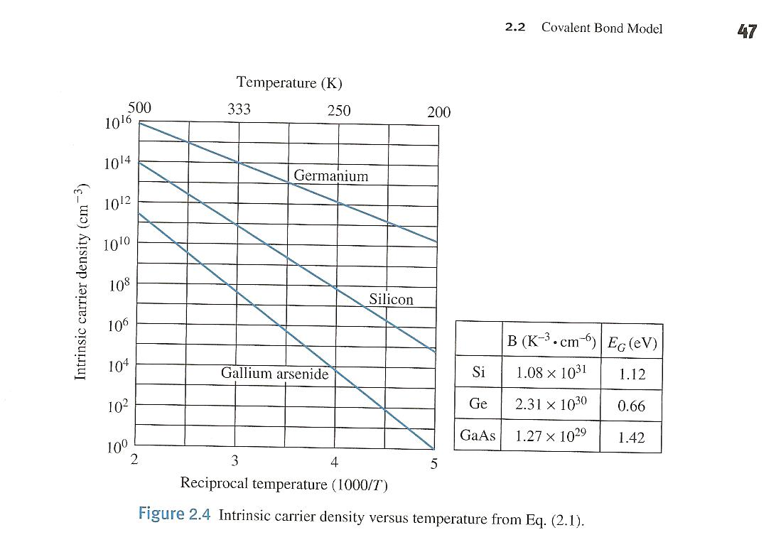

Slide 21
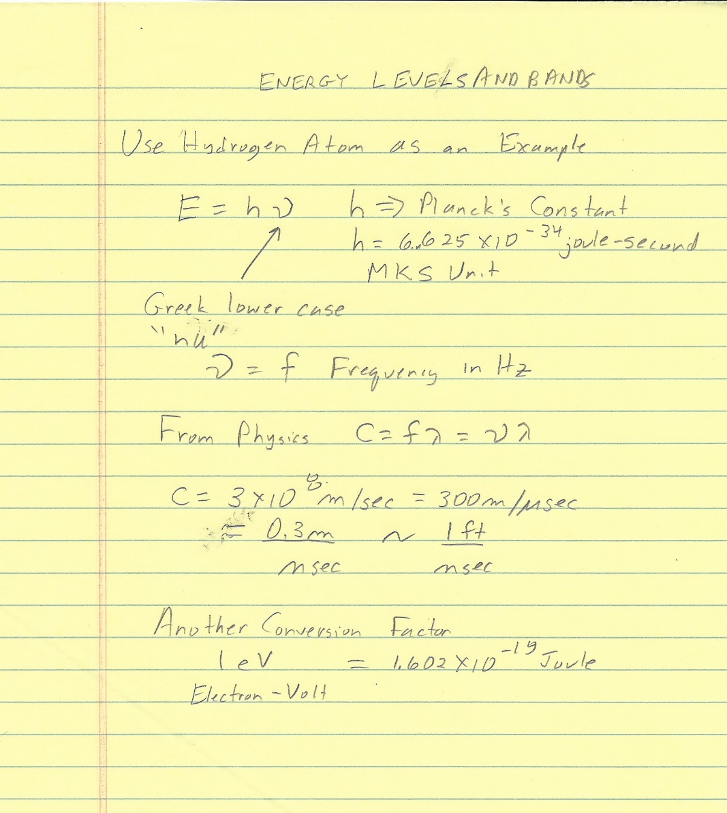
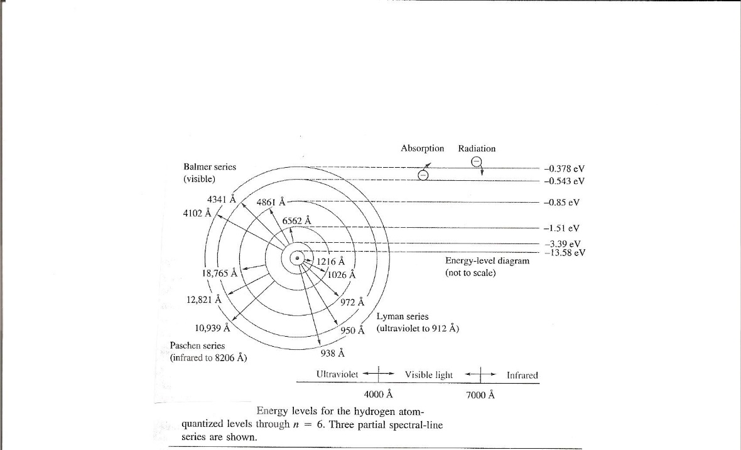

Slide 22
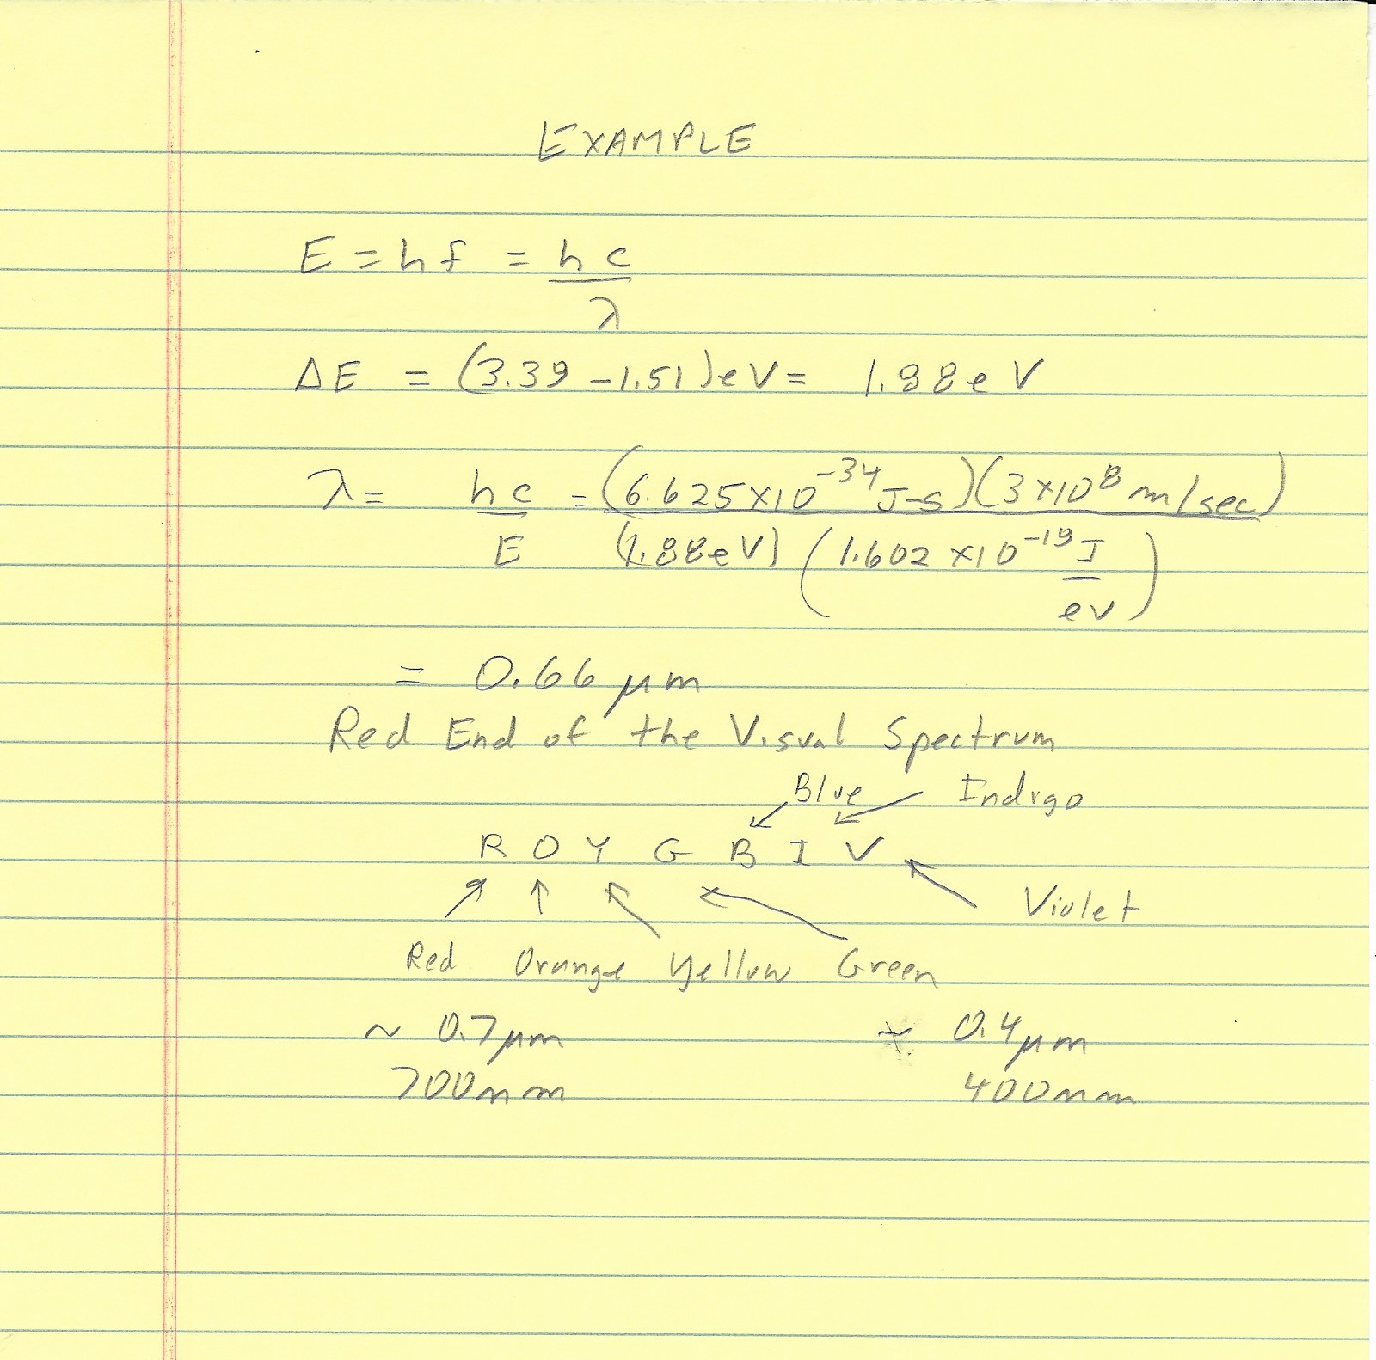
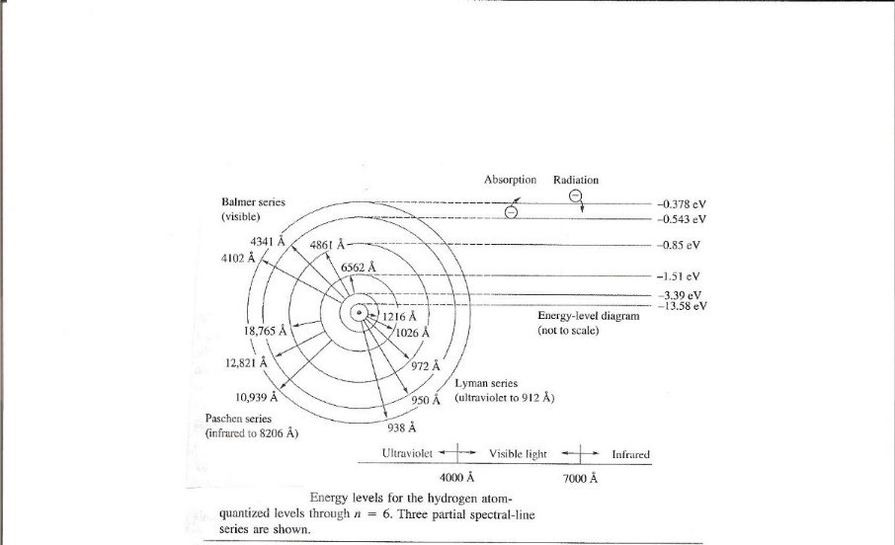

Slide 23
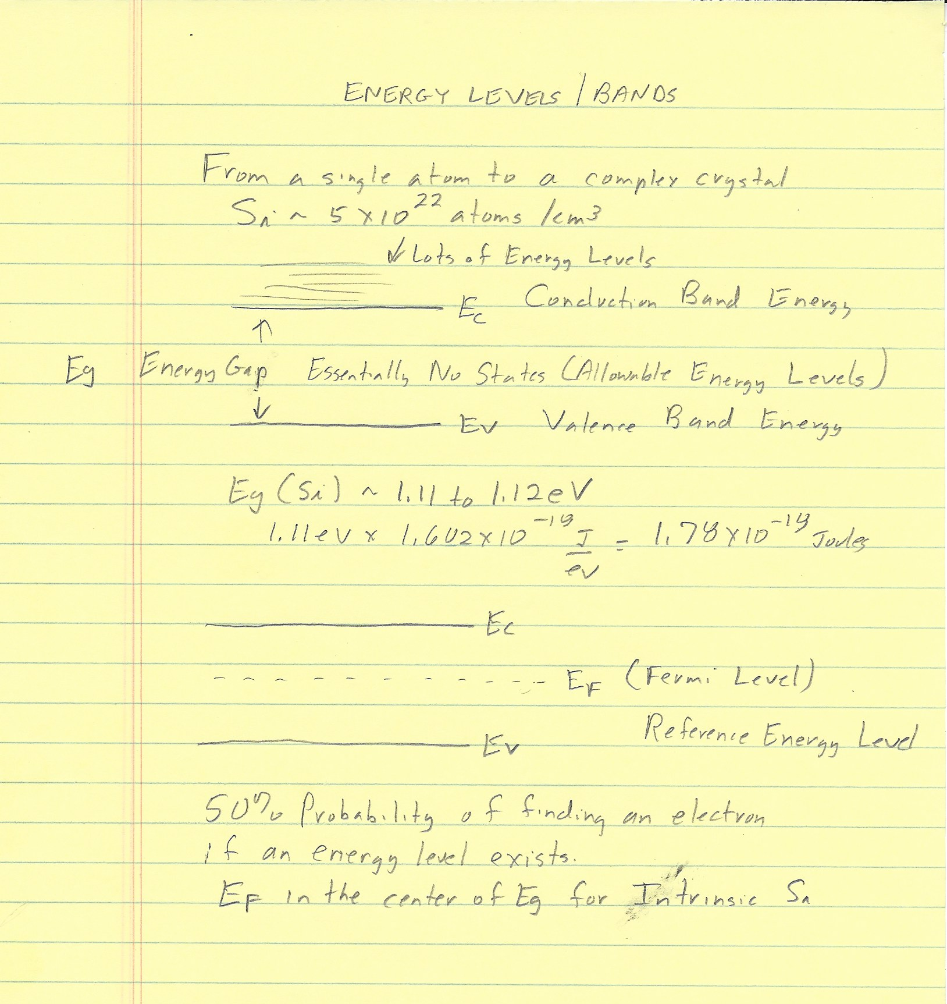

Slide 24
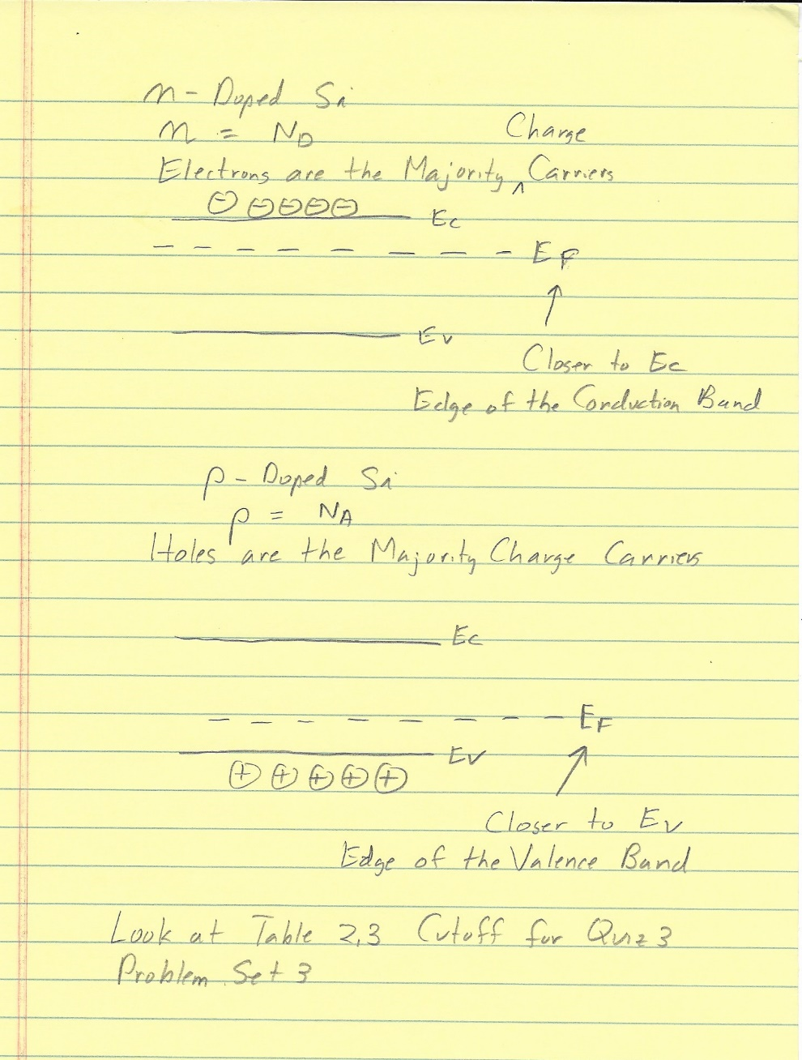

Slide 25
Direct and Indirect Bandgap Semiconductors
Direct bandgap
Indirect bandgap
E
E
E_{c}
E_{c}
Photon
Photon
E_{g}
E_{g}
E_{v}
E_{v}
k
k
Δk: phonon momentum
Easy to get momentum conservation, no phonon involved, good for optoelectronics (e.g., GaAs)
Difficult to get a phonon with right momentum, not good for optoelectronics (e.g., Si)
25
25

Slide 27
BASIC PROCESSING STEPS Design Then Repeated Application Of:
Oxidation and/or Nitridation
Photolithography
Wet Etching (Chemical)
Dry Etching (Plasma)
Ion Implantation and/or Diffusion
Evaporation
Sputtering
Plasma Assisted Deposition
Epitaxy
Many Processing Steps are at temperatures to 1200°C

