Slide 1
3D-IC DEVICES AND FABRICATION
Abstract: Key technologies of wafer level three-dimensional integrated circuits (3D IC) are reviewed. The direction of wafer stacking, wafer bonding methods, fabrication using through-Silicon via (TSV), Monolithic Inter-Tier vias (MIVs), CU bonding are described. The necessity or benefits of the 3-D IC as the new technology and industrial applications of using this technology are discussed.
BY LASHE OKUNADE 11/24/2021

Slide 2
OUTLINE
Evolution of Moore’s law
Definition of 3D devices
Benefits of 3D devices
Classification of 3D devices
Fabrication using TSVs
Fabrication using MIVs (Monolithic)
Challenge of the 3D IC
Industrial applications
The future: 3nm chips
Summary and conclusion
References
Questions

Slide 3
End of Moore’s law?
Moore’s law: number of transistors in an integrated circuit doubles every two years. Also linked to increased speed of the system.
Over the years, this law has been followed to the letter by integrating many transistors into the chip for better performance using the 2D layout. Now, the limit of miniaturization has been reached on the atomic level, thus the need for 3D configuration i.e exploiting the Z-axis.

Slide 4
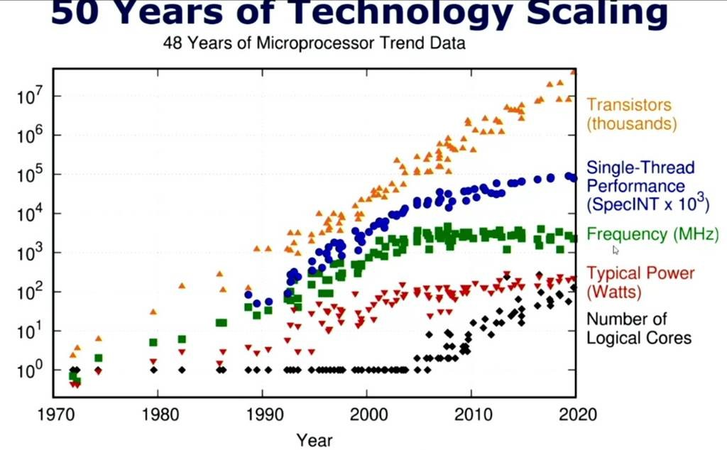
Link

Slide 5
DEFINITION OF 3D-IC DEVICES
3D IC devices are a conglomerate of vertically stacked multiple layers of active devices and are mostly connected by Through Silicon Vias (TSVs).
A 3D IC could be heterogenous i.e contains various circuits (active devices) e.g processor cores and memories, RF circuits, Logic circuits etc stacked vertically.
Ways of Integrating 3D IC devices:
1. Wafer to Wafer
2. Chip-to-Chip
3. Chip-to-wafer

Slide 6
WAFER TO WAFER
Electronic devices are built on two or more semi-conductor wafers
The following processes are then carried out: Alignment, Bonding and Dicing into 3D Ics.
The TSVs pass through the silicon substrate between active devices.

Slide 7
CHIP TO WAFER
Electronic components are built on two semi-conductor wafers.
Dice one wafer
The diced chips are then aligned and bonded onto die sitess of the other wafer
Thinning and TSV creation are also performed on or after the bonding process

Slide 8
CHIP TO CHIP
Electronic components are built on the multiple chips
Alignment and bonding
Thinning and TSVs are created on or after bonding
Advantage:
Each component die can be tested individually, so as not to ruin the entire stack
Binning can be done on each die to optimize the power being consumed and heat dissipation

Slide 9
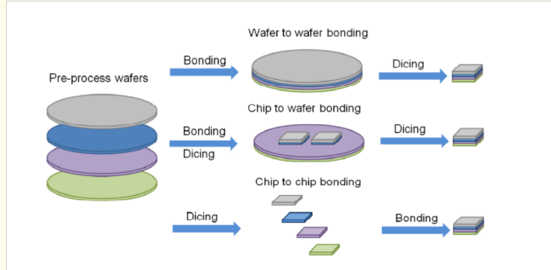
https://www.intechopen.com/media/chapter/39179/media/image3.png

Slide 10
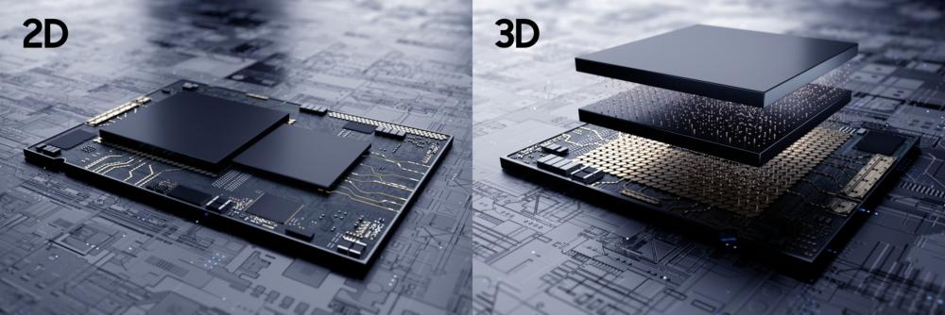
2D VS 3D
Samsung Announces Availability of its Silicon-Proven 3D IC Technology for High-Performance Applications – Samsung Global Newsroom

Slide 11
Integrity 3D-IC: Industry’s First Fully Integrated 3D-IC Platform – YouTube (play video)

Slide 12
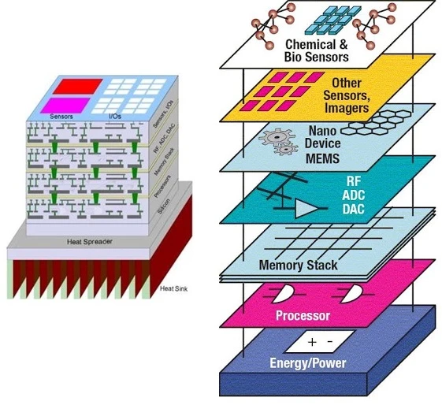
Three Dimensional Integrated Circuits (3D IC) Technology By Dr. Imran Khan – YouTube

Slide 13
BENEFITS OF THE 3D IC
1. Less noise
2. Power
3. Higher density
4. Higher performance (memory arrays=more bandwidth)
5. heterogenous integration

Slide 14
CLASSIFICATIONS OF 3D IC TECHNOLOGY
1. Wafer bonding methods:
a) Metal to Metal: Good thermal conductivity and adhesion. Cu most popularly used
b) Oxide to Oxide: Silicon oxide is used. Two steps are involved: room temperature contact between surfaces followed by High temperature annealing of about 1000 degrees Celsius to form strong covalent bonds. It has high stacking density
C) Polymer to Polymer: Similar to oxide to oxide. In addition to high stacking density, it also has better adhesive strength. Wafer may end up polluted due to decomposition of polymer at temperature less than 400 degrees Celsius.
2. Direction Stacking:
a) Face to face: Top and Bottom layers must be aligned and bonded face to face
b) Face to back: More complex but no need for symmetry

Slide 15
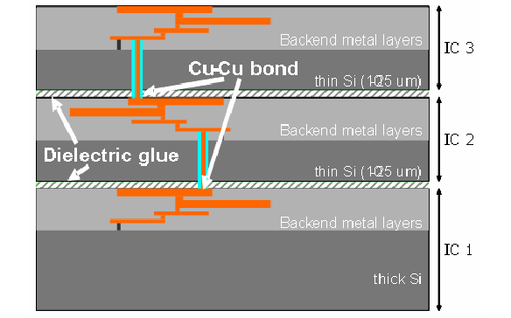
METAL TO METAL BONDING
Link

Slide 16
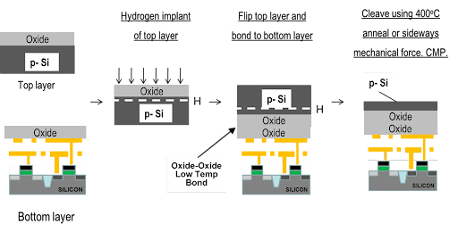
OXIDE TO OXIDE BONDING
Low Temperature Wafer Direct Bonding (monolithic3d.com)

Slide 17
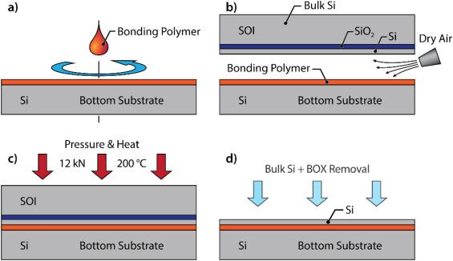
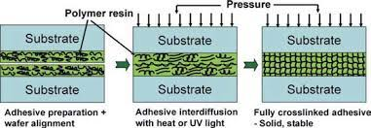
POLYMER TO POLYMER
Link

Slide 18
FACE TO FACE & FACE TO BACK BONDING
FACE TO FACE
FACE TO BACK
https://image.slidesharecdn.com/2db81fe2-f679-474f-b828-fc1b6c70ae62-150522133438-lva1-app6892/95/fpga-3d-5-638.jpg?cb=1432301787
Wafer-level three-dimensional integrated circuits (3D IC): Schemes and key technologies - ScienceDirect

Slide 19
MIT PROCESS OF FABRICATING 3D ICs USING TSVs
Fabrication of device layers on a SOI Si wafer
To stack device layers on top of one another, the SOI substrate has to be thinned by grinding and etching. Also, a handle wafer is attached to the SOI
Mechanical grind-back and chemical etching is used to remove the Si substrate which stops on the buried oxide of SOI
Create inter-vias by etching the oxide
PECVD oxide passivation is carried out and filling the vias with damascene
Cu interconnects are deposited on vias
Bonding of wafers
Remove wafer handle
Wafer-level three-dimensional integrated circuits (3D IC): Schemes and key technologies - ScienceDirect

Slide 20
THE MONOLITHIC 3D IC
Electronic components e.g transistors and their connections are built on a single silicon wafer, which is then diced into 3D Ics. Due to the usage of only one substrate, there is no need for alignment, bonding, thinning or TSVs. It mainly uses Monolithic Inter-Tier vias (MIVs).
In this fabrication, the tiers are fabricated sequentially instead of bonding pre-fabricated dies.
Advantages over the traditional 3D Ics:
1. The small size of the MIVs ultra-high integration density
2. The MIVs improve power performance

Slide 21
FABRICATION OF THE MONOLITHIC 3D IC
a. Fabrication of the bottom layer like 2D IC
b. Oxide is grown on an empty wafer and H ion is implanted below the substrate at a constant depth
c. The wafer is flipped and bonded to the top of the bottom layer
d. The silicon is then cut until it reaches the H ion line and then polished to give high quality silicon layer
e. The gates are formed on the top layer and MIVs of <100nm in diameter are created with contact masks
f. Metallization of both layers
(PDF) Power-Performance Study of Block-Level Monolithic 3D-ICs Considering Inter-Tier Performance Variations (researchgate.net)

Slide 22
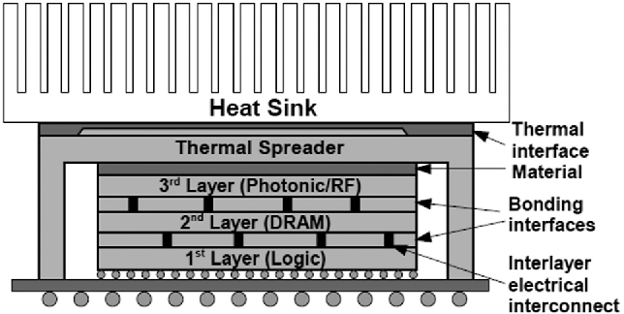
CHALLENGES OF THE 3D IC DEVICE
Heat dissipation: Due to the reduction in the surface area to volume ratio, power density is increased, leading to increased power density and causing heating in the chips. Therefore, a form of heat sink is always attached to the device.
picture reference

Slide 23
INDUSTRIAL APPLICATIONS
1. Imaging application: Three chip stacked rolling sensor
2. Micro-displays

Slide 24
THREE-CHIP STACKED ROLLING SENSOR
To eliminate image distortion, which is caused by time lag in the reading between the first and last bits, a capacitor in the pixel devices is added. The DRAM chip is in between the pixel and logic gates to temporarily store signals.
The pixel and DRAM chips are facing downward towards the logic chip.
TSVs are formed between the pixel and logic gates for interconnection of about 2-2.5 μm in diameter and 6.3 μm in pitch
The BackSide Illumination (BSI) pixel array chip is bonded face to back on top of the DRAM-logic-chip interconnect.
Silicon substrate thickness of about 3-5μm
Produces a frame rate of 30fps

Slide 25
MICRO DISPLAYS
PCB: transmits instructions and electric signal to the device
Silicon: serves as regulator for the liquid crystal
Reflective coating: reflects incoming light
Liquid crystal: controls the amount of light reaching the reflective coating and that is allowed back out
Alignment layer: keeps the liquid crystals aligned to direct the light accurately
Transparent electrode: completes the circuit with the silicon and liquid crystal
Glass cover: protects and seals the system
Exploring the Potential of LCoS Microdisplays (azom.com)

Slide 26
GOING BEYOND THE 5NM CHIPS: A PEEK AT THE FUTURE
3nm chips: the next step. R&D ongoing.
Extreme Ultraviolet Lithography is being proposed.
New deposition, etch and inspection technologies are being worked on.
Apple's 2022 Lineup Could Be Based on TSMC's Faster 3nm Node | Digital Trends
Making Chips At 3nm And Beyond (semiengineering.com)

Slide 27
SUMMARY AND CONCLUSION
The evolution of how the 3D IC device came into being was discussed in conjunction with Moore’s law and its applicability. The benefits were shared also the classification of the 3D device based on bonding and stacking directions were shown. Fabrication methods using TSVs and MIVs were shown. Also, the heating problem of the vertically stacked IC was shown alongside its many industrial applications.
A sneak peek was taken at the future: 3nm and beyond chips. Research is still ongoing and should be available in 2023.
In conclusion, 3D IC devices have overridden 2D IC devices with higher performance functionalities and industrial usage and will keep on being improved upon until a limit is reached.

Slide 28
REFERENCES
Three-dimensional integrated circuit - Wikipedia
(PDF) Three-dimensional integrated circuits (researchgate.net)
Wafer-level three-dimensional integrated circuits (3D IC): Schemes and key technologies – ScienceDirect
Three Dimensional Integrated Circuits (3D IC) Technology By Dr. Imran Khan - YouTube
Technology For Realizing 3D Integration By-Dipyaman Modak. - ppt download (slideplayer.com)
Advancement of Chip Stacking Architectures and Interconnect Technologies for Image Sensors | J. Electron. Packag. | ASME Digital Collection
Exploring the Potential of LCoS Microdisplays (azom.com)

Slide 29
QUESTIONS
What is your understanding of the 3D-IC device.
Why is there the need for transitioning into the 3D-IC device configuration and what are the benefits?
What is your projection of Moore’s law on this? Will it still continue to hold.
In conjunction with the heat sink, how else do you think this heat dissipation problem can be reduced.
As chips shrink to the 3nm range, what is the projected replacement for FinFETS

