Slide 1
6 October 2021 Optical Lithgraphy
Photoresist (PR)
Exposure and development
Mask
An example of fabrication process
1

Slide 2
Positive and Negative Photoresist
There are two types of photoresist: positive and negative.
For positive resists, the resist is exposed with UV light wherever the underlying material is to be removed. In these resists, exposure to the UV light changes the chemical structure of the resist so that it becomes more soluble in the developer. The exposed resist is then washed away by the developer solution, leaving windows of the bare underlying material. The mask, therefore, contains an exact copy of the pattern which is to remain on the wafer.
Negative resists behave in just the opposite manner. Exposure to the UV light causes the negative resist to become polymerized, and more difficult to dissolve. Therefore, the negative resist remains on the surface wherever it is exposed, and the developer solution removes only the unexposed portions. Masks used for negative photoresists, therefore, contain the inverse (or photographic "negative") of the pattern to be transferred.

Slide 3
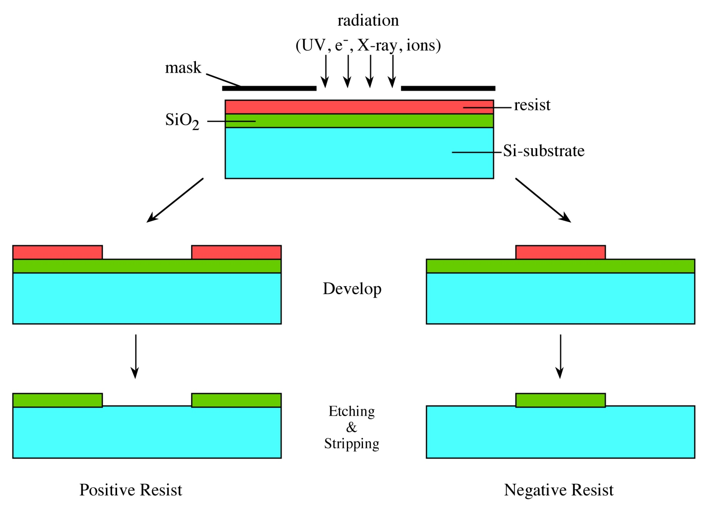
Exposure and Development

Slide 4
Mask
Original and now obsolete approach. A “mask” or "photomask" is a square glass plate with a patterned emulsion of metal film on one side. The mask is aligned with the wafer, so that the pattern can be transferred onto the wafer surface. Each mask after the first one must be aligned to the previous pattern with the help of designed “alignment mark” on the mask.
Contemporary is electronic raster scan or similar but the results are the same.
Once the mask has been accurately aligned with the pattern on the wafer's surface, the photoresist is exposed through the pattern on the mask with a high intensity ultraviolet light.
One of the most important steps in the photolithography process is mask alignment.

Slide 5
Photolithography Process (1)
(1) Wafer cleaning and dehydration baking
SiO₂
(2) Deposit barrier layer, e.g., SiO_{2;}
(3) Coat the photoresist (PR).
Before coating with the PR, the wafer is always coated with a pre-resist priming layer designed to enhance the adhesion properties of the wafer even further.
PR
(4) Soft bake at around 90ºC for 10~30 mins. This step is to: a) drive away the solvent from the spun-on resist; b) improve the adhesion of the resist to the wafer; and c) anneal the shear stresses introduced during the spin-coating

Slide 6
Photolithography Process (2)
UV-light
Mask
(5) Align mask and expose pattern under UV light
(6) Develop PR and hard bake the wafer at 120-180ºC for about 30 mins. Hard bake is to harden the PR and improve adhesion to the substrate.
(7) Etch SiO₂
(8) Remove PR

