Slide 1
1 and 4 October 2021
Ion Implantation
Ion implantation system description
Comparison between ion implantation and diffusion
Mathematical model for ion implantation
1

Slide 2
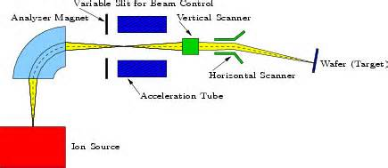

Slide 3
The Ion Implantation System

Slide 4
Major Components in the Ion Implantation System
Ion source: operates at high voltage (10s to 100s of keV) and produces a plasma containing the desired impurity (arsine, phosphine, etc. used in the source)
2. Analyzing magnet: bends the ion beam through a right angle to select the desired impurity ion
3. High-voltage accelerator: accelerator column adds energy to the beam (180 keV)
4. Scanning system: x- and y-axis deflection plates used to scan the beam across the wafer to give a uniform implantation
5. Target chamber: Si wafers serve as targets for the ion beam. Operated in vacuum conditions

Slide 5
Ion Implantation Process
During ion implantation, impurity atoms are ionized and accelerated toward the silicon substrate
These high-energy ions enter the crystal lattice and lose their energy by colliding with some silicon atoms before finally coming to rest at some depth displacing Si atoms
The average depth of depositing the impurity atoms can be controlled by adjusting the acceleration energy of ions
Heat treatment is used to anneal or repair the crystal lattice disturbances caused by the atomic collisions

Slide 6
Comparison between Diffusion and Ion Implantation
 | Advantage | Disadvantage
Diffusion | Cheaper Simple system Long diffusion depth | High-temperature process, need hard mask SiO₂ Dopants diffuse unevenly, and interact with each other altering the diffusion rate Isotropic dopant profile Cannot independently control the dopant concentration, junction depth
Ion Implantation | Low temperature process, PR mask is OK Precise control of doping profile and junction depth Less lateral distribution, also most anisotropic dopant profile | Expensive Complex system Low implantation depth cause damage to the lattice structure, so annealing treatment is needed after implantation

Slide 7
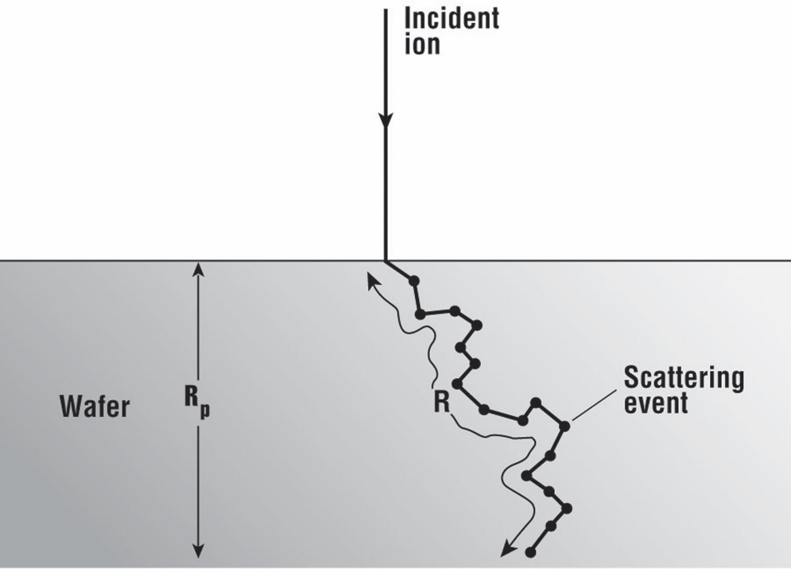
Projected Range of the Ions
Behavior of ions during implantation:
enter the surface of the wafer
collides with atoms in the lattice and interacts with electrons in the crystal
Each collision or interaction reduce the energy of the ion until it finally comes to rest within the target
Interaction with the crystal is a statistical process

Slide 12
The Dose from the Implanter
The dose Q (cm⁻²) from implanter:
I: the beam current, unit: A
A: the wafer area
T: the implantation time
n=1 for singly ionized ions, n=2 for doubly ionized ions
e Electronic charge, 1.602 x 10^-19 coulombs

Slide 15
Mathematical Model for Ion Implantation
Implanted impurity profile could be approximated by Gaussian distribution:
R_{p}: the projected range, which is average distance an ion travels before it stops
N_{p:} the peak concentration occurs at x=R_{p}
The spread (standard deviation) of the distribution, called straggle
Implanted dose can range from 10¹¹ ~10¹⁸ cm⁻²

