Slide 1
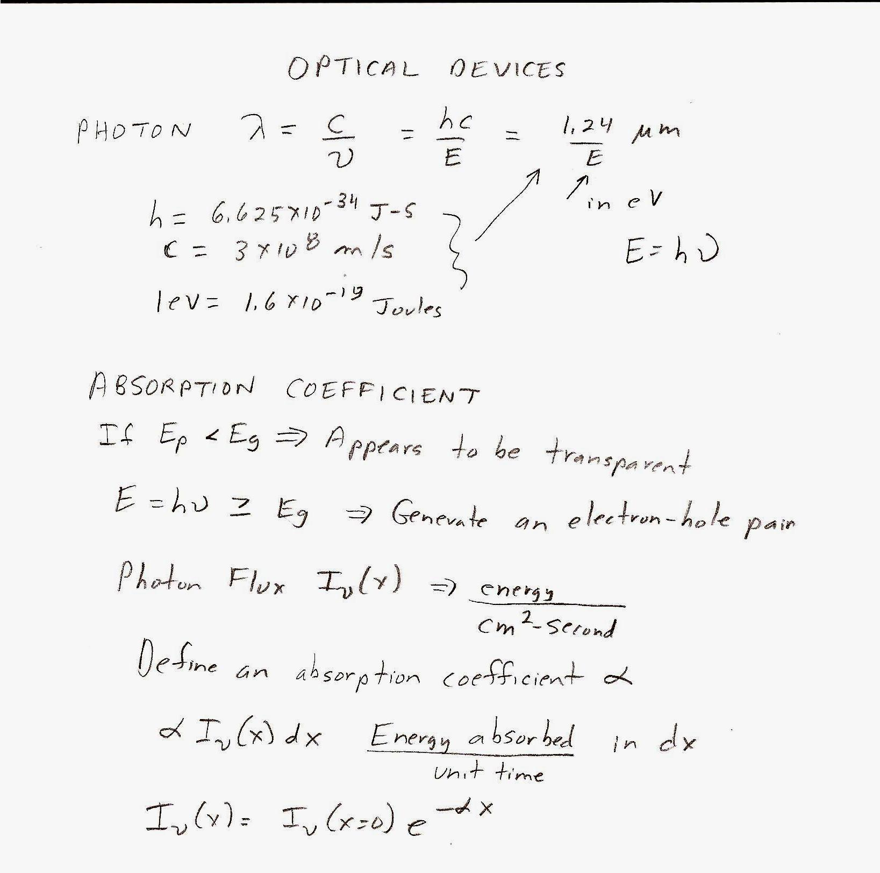
6 and 8 October
Photonics-PPT #1
Photovoltaics
PPT#2 Will Cover Lighting

Slide 2
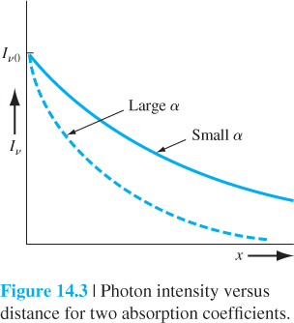
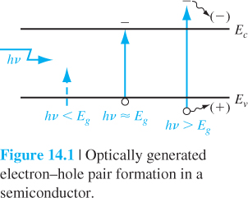
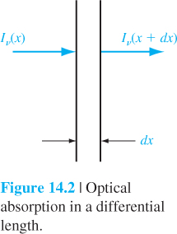

Slide 3
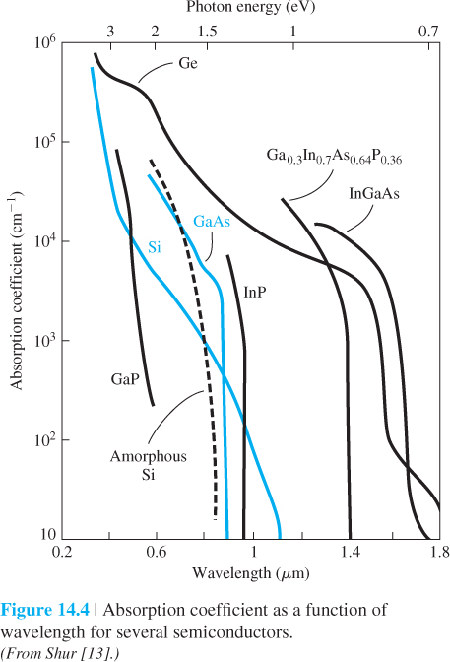
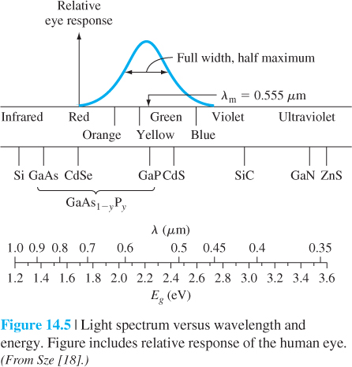

Slide 4
Sun
Part of the Spectrum
Wave Length (µm)
0.3
0.4
0.5
0.6
0.7
1.5
2.0
3.0
10.0
20.0
30.0
40.0
50.0
UV
VIS
NIR
MIR (3~30 µm)
(FIR)
Visible Spectrum From About 0.4 micrometers Blue) to 0.7 micrometers (Red)
UV-Ultraviolet
NIR-Near Infrared or Just IR
MIR and FIR Middle and Far Infrared

Slide 5
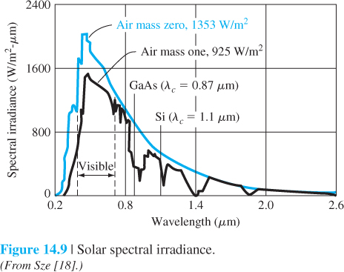

Slide 6
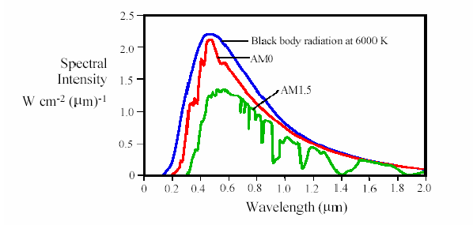
Solar Energy Spectrum
Solar radiation outside the earth’s surface:
1.35 kW/m², 6500 times larger than world’s energy demand
Spectrum of the solar energy
AM0: radiation above the earth’s atmosphere
AM1.5: radiation at the earth’s surface
Blackbody radiation: ideal radiation

Slide 8
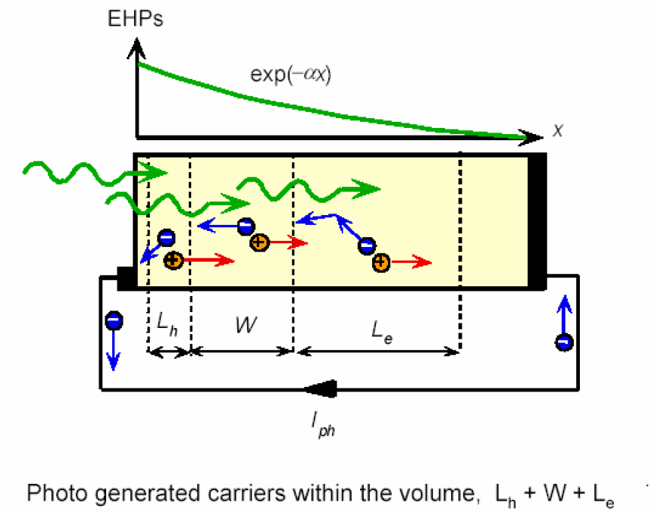
Operation Principle of Solar Cells

Slide 9
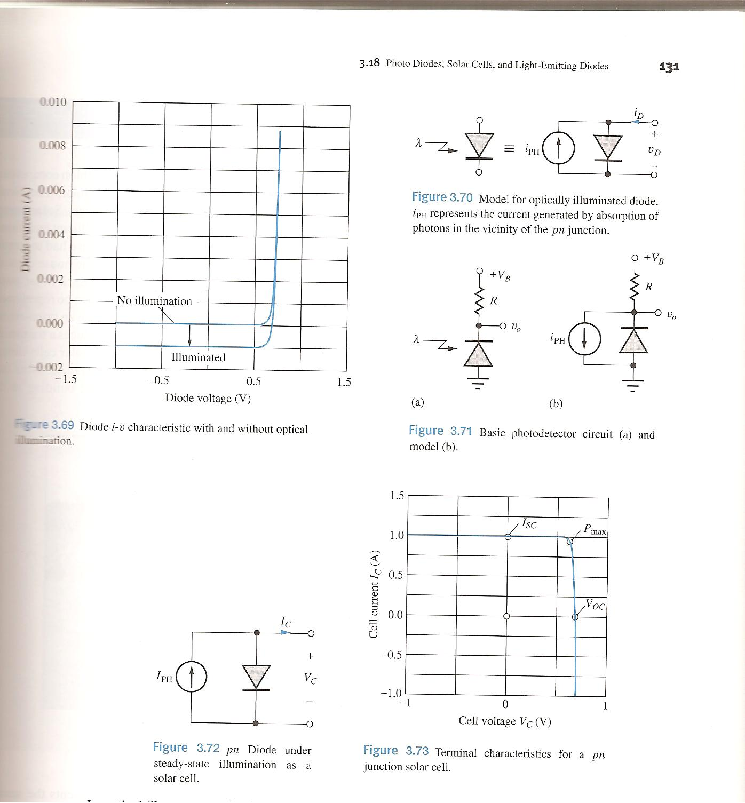
From EE 2212 Text

Slide 10
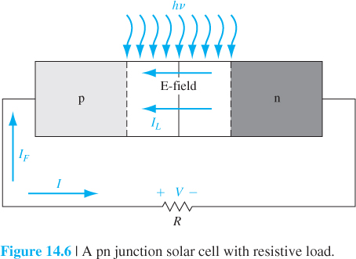
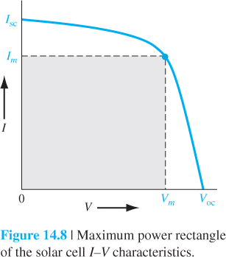
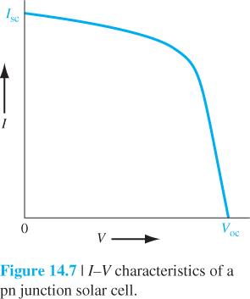

Slide 11
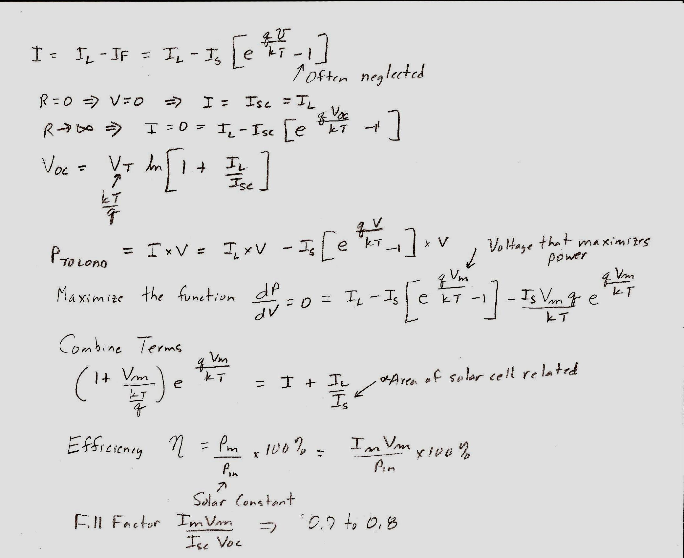

Slide 12
Summary of Loss Mechanisms of Semiconductor Solar cells
Loss
Optical loss
Electrical loss
Heat
hv >E_{G}
No absorption
hv <E_{G}
Reflection
Shadowing
Incomplete absorption
Ohmic
Recombination
Manufacture defects proving alternate current path
SC material
Contact material
Metal-SC
SC surface
SC body
Depletion region
12
12
12
Notes:
12

Slide 13
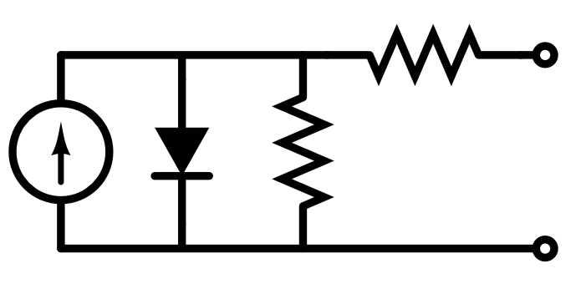
Circuit-Model for Ideal Solar Cell
R_{S}
R_{S}
R_{S}
I_{Dark}
I_{Dark}
I_{Dark}
I_{SC}
R_{SH}
Load
I_{SC}
R_{SH}
Load
R_{SH}
“Ideal” means that the resistive losses are ignored.
13
13
13
Notes:
13

Slide 14
Circuit-Model for Solar Cell with Resistive Losses
R_{S}
I_{Dark}
I_{SC}
R_{SH}
Load
R_{SH}: shunt resistance. It accounts for manufacture defects of the material. Low shunt resistance causes power loss by providing additional path for light-generated current.
R_{S}: series resistance. Series resistance in a solar cell has three causes: (1) the movement of current through the emitter (n-type, heavily doped) and base (p-type, moderately doped) of the solar cell; (2) the contact resistance between the metal contact and the silicon; (3) the resistance of the top and rear metal contacts.
14
14
14
Notes:
14

Slide 15
Design of High Efficiency Solar Cells
Techniques and design features adopted to produce the highest possible efficiencies include:
Very fine metal contact lines, typically less than 20 µm wide, to minimise shading losses;
Small area devices and good metal conductivities, to minimise resistive losses in the metal grid;
Use of elaborate metallization schemes, such as titanium/palladium/silver, that give very low contact resistances;
Good rear surface passivation, to reduce recombination;
Use of anti-reflection coatings, which can reduce surface reflection from 30% to well below 10%.
Use solar concentrator
15
15
15
Notes:
15

Slide 16
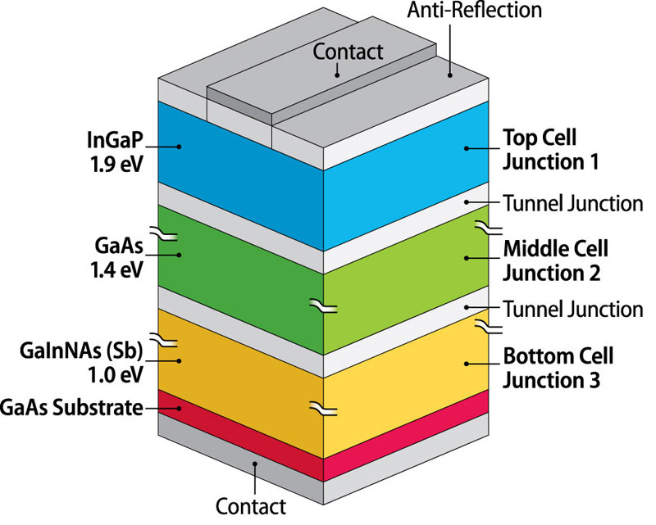
Multi-Junction Semiconductor Solar Cells
Feature: split the spectrum and use a solar cell with multiple sections. Each section is optimized to each section of the spectrum.
Eg₁
Eg₂
Eg₃
Bottom layer
Top layer
The top cell absorbs high energy photons.
Arrangement of layers based on bandgap.
The bottom cell absorbs low energy photons.
16

Slide 17
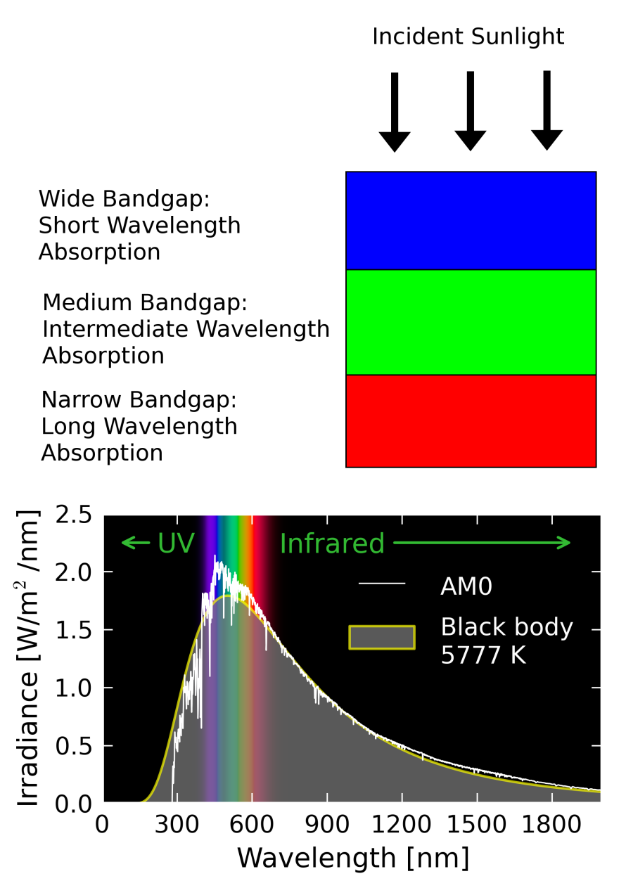
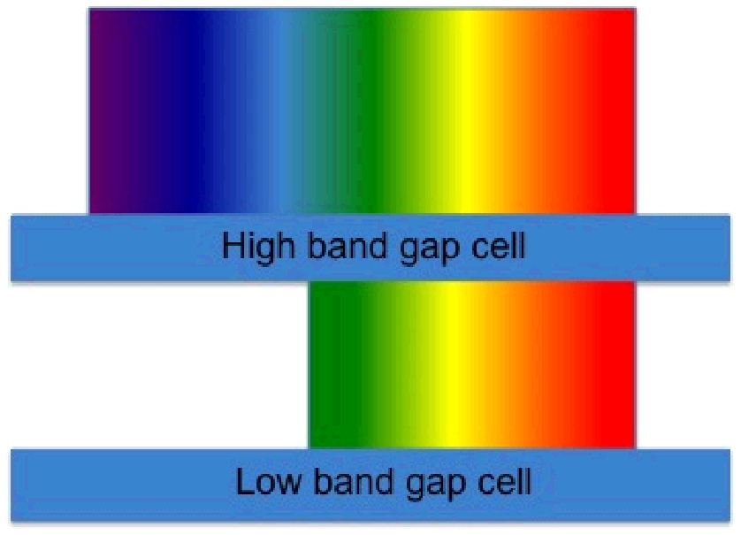
Absorption Spectrum of Multi-junction Cells
Two junction tandem solar cells
Highest efficiency achieved so far is 46%
17

Slide 18
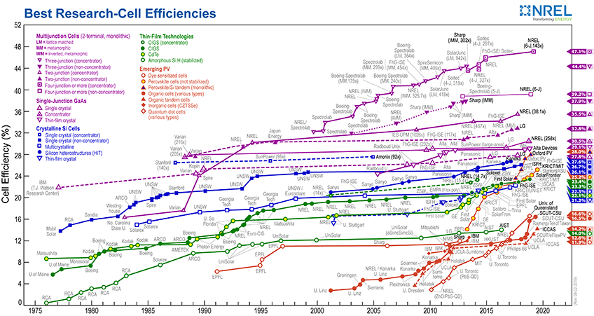
NREL’s Measurement of Best Solar Cell Efficiencies
18

Slide 19
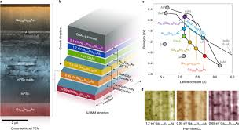
Work Record for Solar Cells Efficiency at 47.1% by NREL
Six-junction III-V solar cell
19

Slide 20

Multi-Junction Solar Cell Efficiency at 46%
20

Slide 21
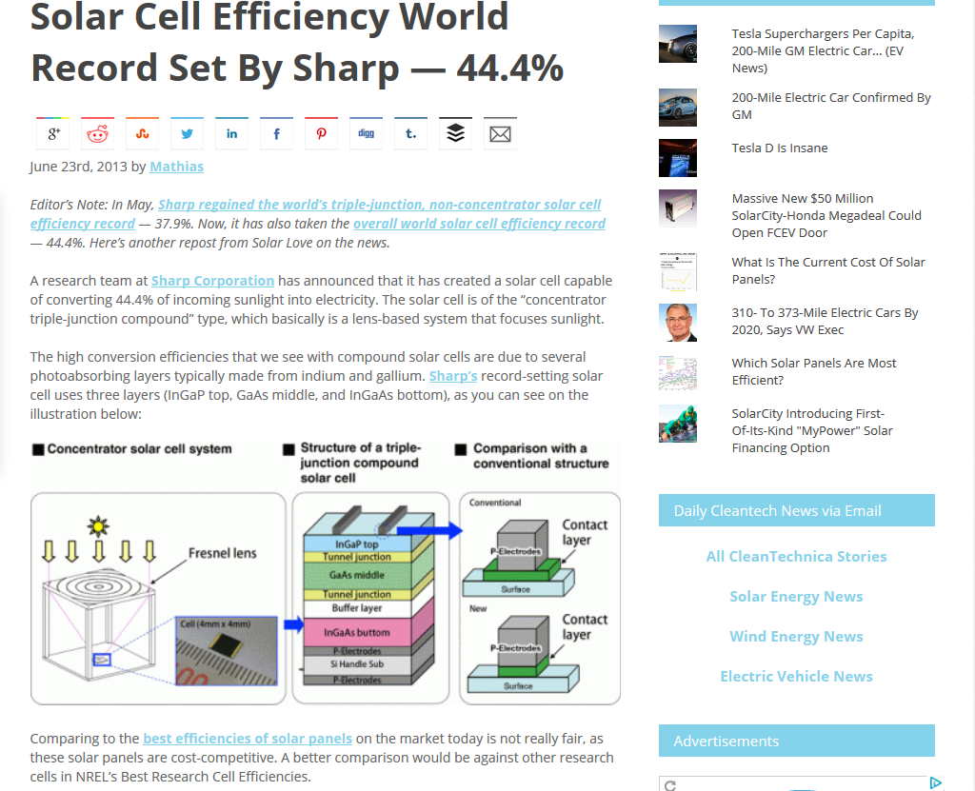
Solar Cell with 44.4% Efficiency by Sharp
III-V compound Semiconductors
Solar concentrator
Triple junction tandem solar cell
21

Slide 22
Multi-bandgap Solar Cells
Au grid bar
200 nm n⁺ GaAs
CB
30 nm n GaInP
E_{CI}
100 nm n GaAs
IB
UD GaAsP
InGaAs QDs
0.5 µm intrinsic region
UD GaAsP
h(ν₁+ ν ₂)
or hν₃
E_{IV}
InGaAs QDs
UD GaAsP
InGaAs QDs
UD GaAsP
VB
100 nm p GaAs
Band structure of QDSC
p⁺ GaAs (311)B substrate
Feature: additional photon absorption windows in the solar spectrum
Objective: investigate non-radiative transition mechanisms that could degrade the photovoltaic conversion efficiency;
Strategy: build QDSC model to including all possible transition mechanisms
Au contact
Lattice parameter
QD Solar Cell design
22
22

Slide 23
Plasmonic Solar Cells
H. A. Atwater and A. Polman, Nature Materials, Vol 9, March 2010

Slide 24
Dye-sensitized Solar Cells (DSSCs)
Electrolyte containing redox couple
Conducting glass plate for the photo-anode
SnO₂ layer
Dye-sensitized TiO₂ layer
Polymer sealant
Pt layer
Conducting glass plate for the cathode
Feature: easy and cheap fabrication, but low output power

Slide 25
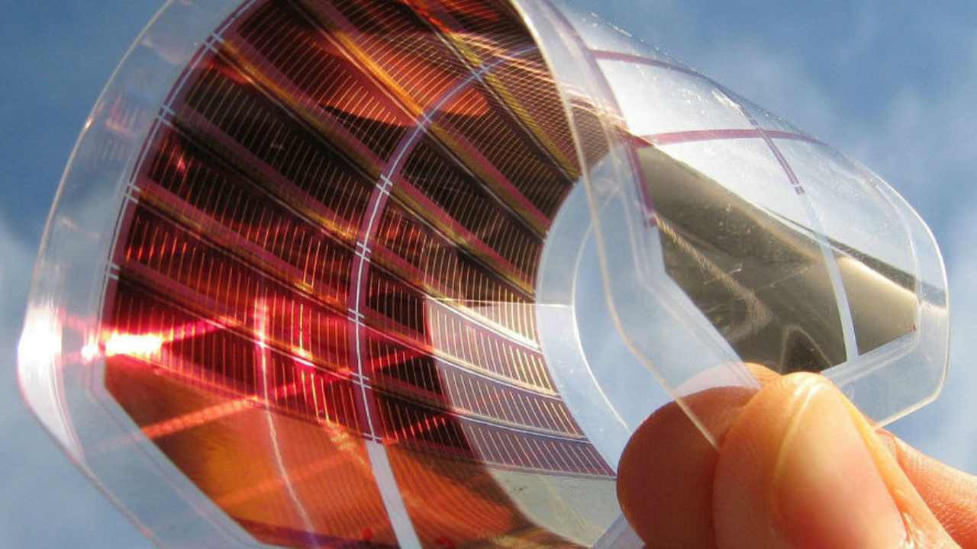
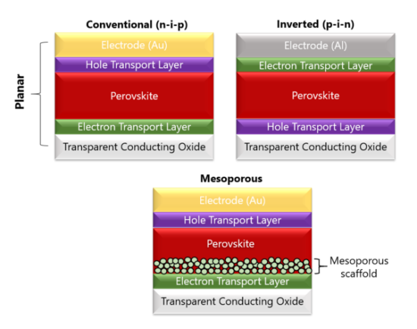
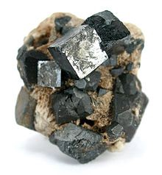
Perovskite Solar Cells
Features:
(1) Cheaper fabrication cost vs. efficiency achieved, flexible cell structure
(2) Weakness: poor long-term stability, and high heat loss
Source: www.medium.com

Slide 26
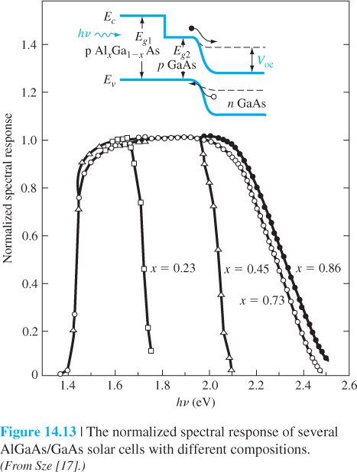

Slide 27
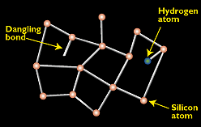
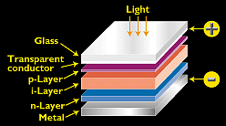
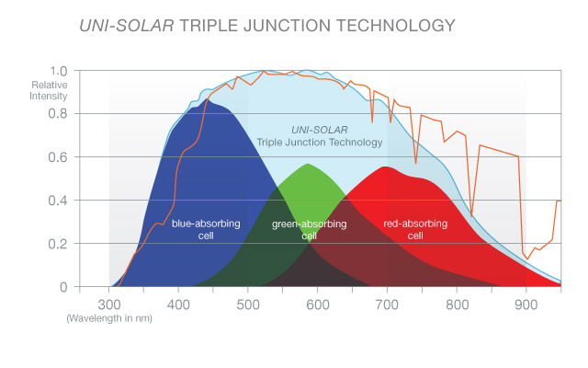
Amorphous silicon's random structural characteristics result in deviations like "dangling bonds." Dangling bonds provide places for electrons to recombine with holes, but this may be neutralized somewhat with hydrogen.
The typical amorphous silicon cell employs a p-i-n design, in which an intrinsic layer is sandwiched between a p layer and an n layer.
).
http://www.nrel.gov/index.html
http://www.powerfilmsolar.com/
http://www.powerfilmsolar.com/education/calculations/

Slide 28
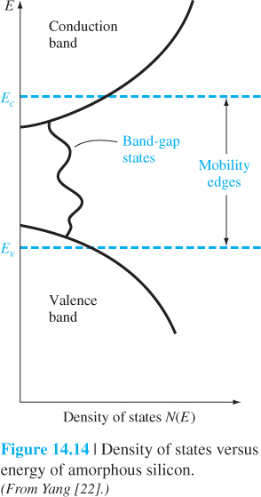

Slide 29

5.6 KW Photovoltaic Array
(Funding incorporated within the Malosky Stadium Renovation Budget)
CIP Grant Through Minnesota Power Provides Funding For Instrumentation and EE Students To Develop A WEB Presence)

Slide 31
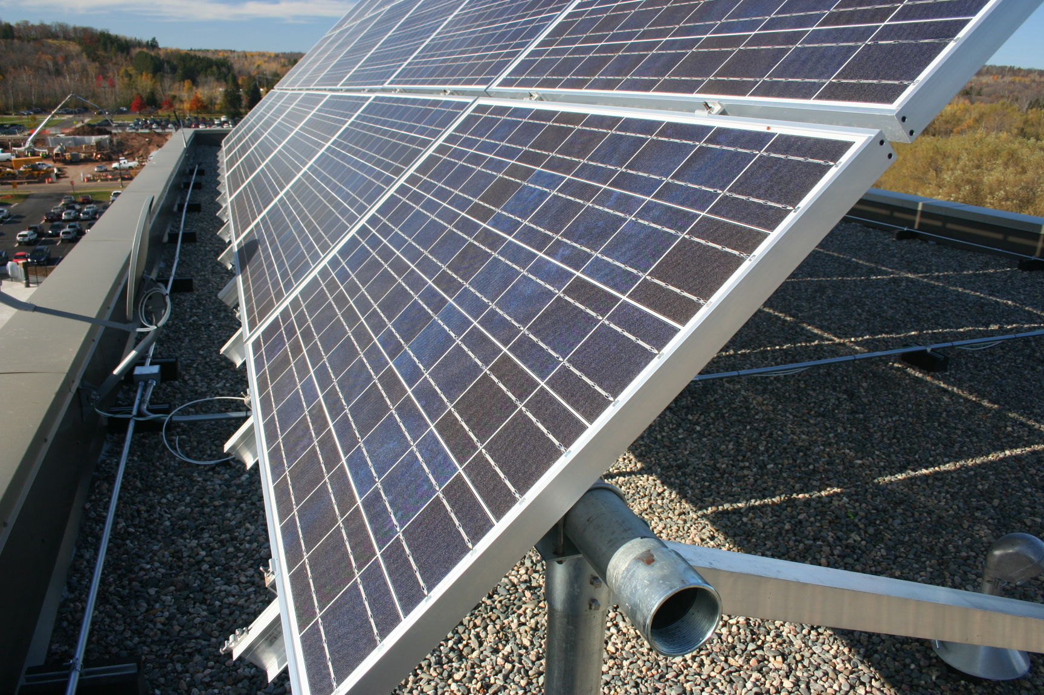

Slide 32
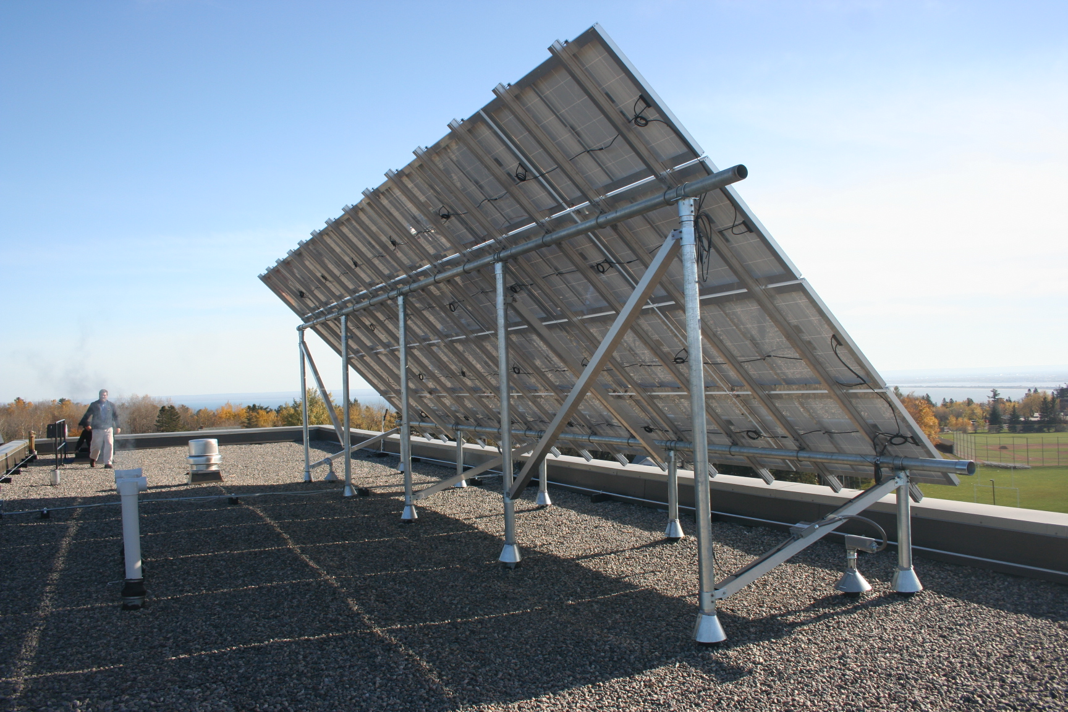

Slide 33
