Slide 1
Handling and Remediation of Toxic Materials in Device Fabrication, Chemistry and Environmental Issues
Abstract:
Thin film processes, largely including chemical vapor deposition (CVD), including atomic layer deposition (ALD), and photolithography use chemicals and form byproducts that have a negative potential impact on the environment and the individuals who are involved in the manufacturing and handling procedures. CVD processes alone represent a $14-$15 billion USD industry and so proper usage and disposal of these products play a significant role given this large-scale application [3]. As such, the proper handling of these materials, their chemical behavior, their potential impacts, and solutions to the issues they present will be covered in this presentation.
Lucas Eckardt Wednesday, December 8th 2021

Slide 2
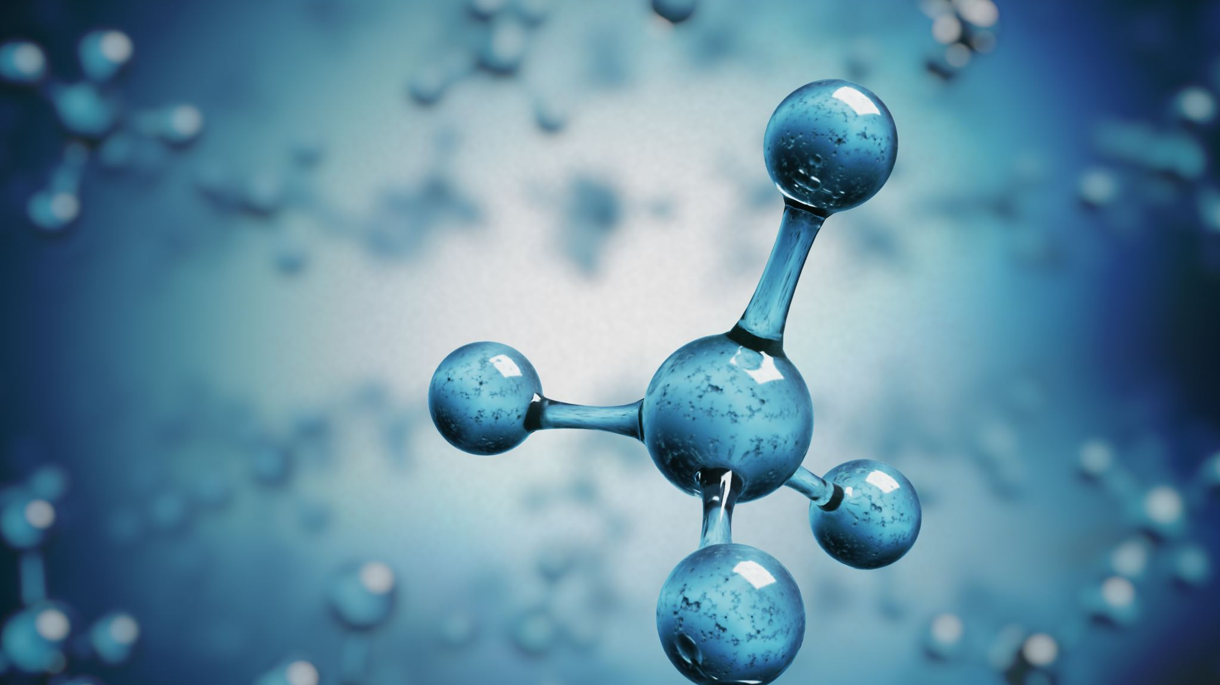
Outline
Overview and Issues
Case Study
Leading processes and chemicals that present a potential toxic significance
Common Chemicals
Chemistry
Potential Risk
Projection of future chemical usage in micro-electronics
Current Industry Standards
Additional Solutions
Summary
References
Key Take-Aways (Exam Prep)

Slide 3
Overview & issues
A major semiconductor company may use around 450+ chemical products
(greater than 1,100 Ingredients) [7]
Risks and special procedures related to so many toxic chemicals are expansive
Trade Secret Laws heavily restrict access to information
Each chemical may react with any other.
Immense possibilities create immensely difficult to analyze data and SOP’s
Each chemical requires a safety data sheet (SDS) as well as a standard operating procedure (SOP) for proper handling, storage, and disposal.
Many chemicals commonly used in the semi-conductor industry present a toxic risk, either directly or from a reaction with other chemicals, so all reactions must be strictly controlled.

Slide 4
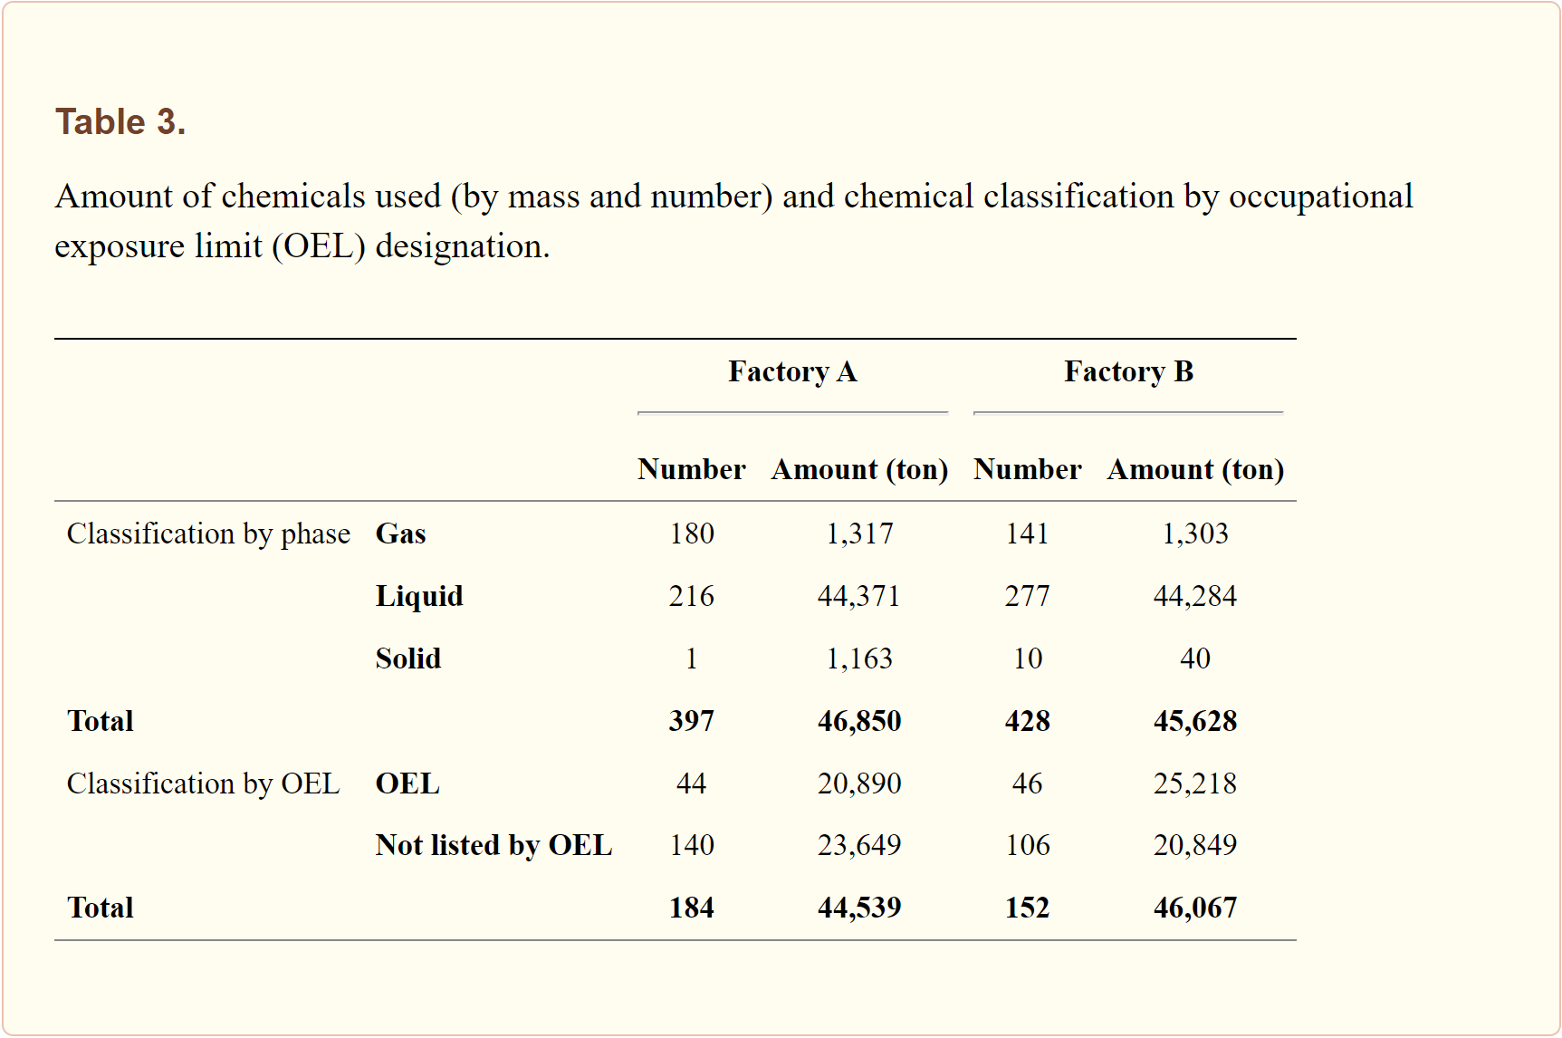
Case Study [7]
Factory A: 428 chemical products → ~11% (47 chemicals) are carcinogens (Not Including Trade Secrets)
345 ingredients and 186 products are classified as trade secrets, 7 and 45 have no information provided, respectively.
Factory B: 432 chemical products → ~6% (28 chemicals) are carcinogens (Not Including Trade Secrets)
363 ingredients and 168 products are classified as trade secrets, 9 and 41 have no information provided, respectively.
>97% (~109 chemical products) of those used in photolithography contain trade secret ingredients

Slide 5
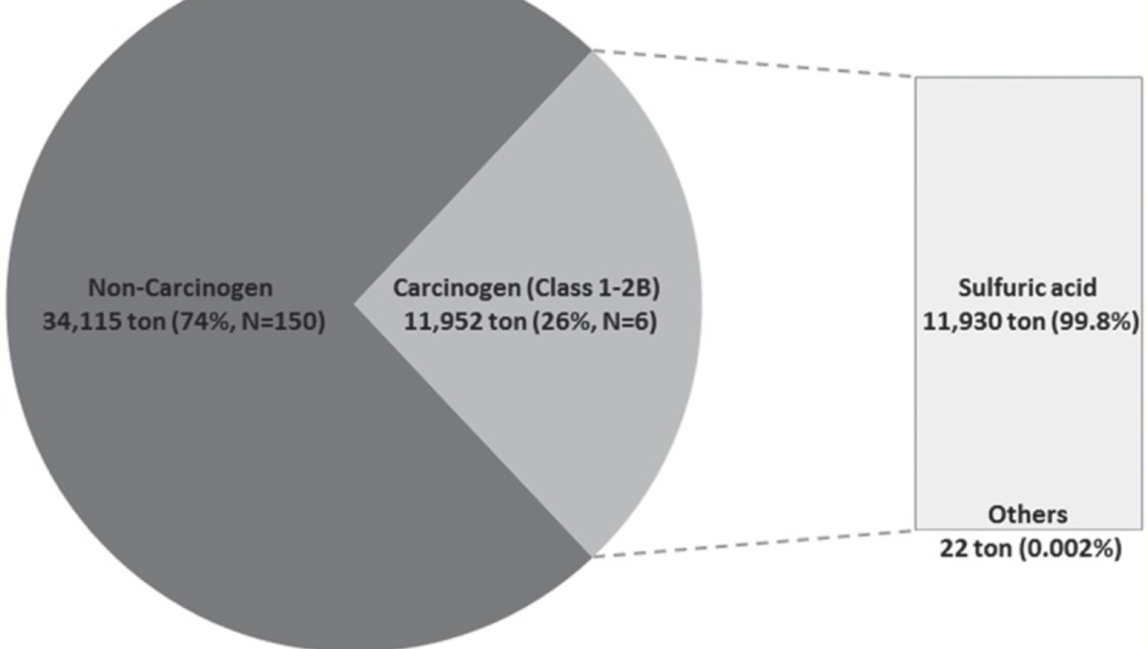
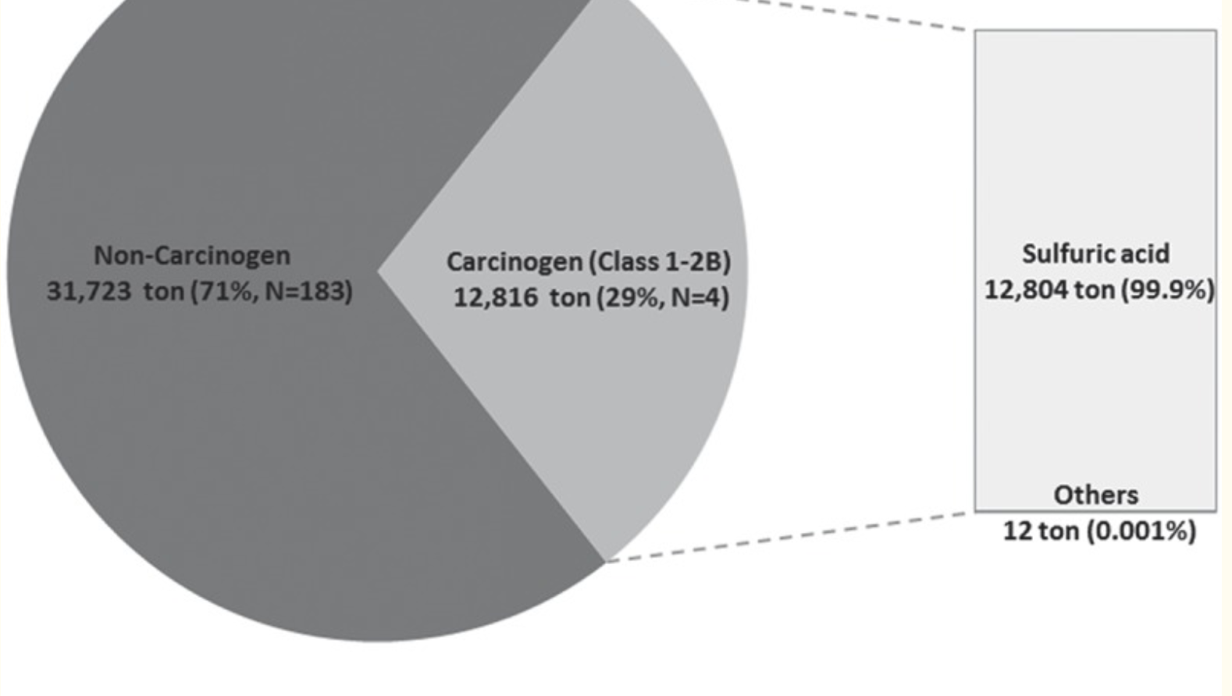
Case Study Cont. [7]
*Analysis Does Not Include Black Carbon Due to Lack of Information*
*Analysis Does Not Include Toxic Chemicals Not Classified as Carcinogens*

Slide 6
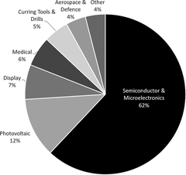
Toxic Chemicals & Greenhouse Gasses Used
Chemical Vapor Deposition (CVD) including Atomic Layer Deposition (ALD)
Trimethylgallium (Ga(CH₃)₃), Ammonia (NH₃), Carbon Dioxide (CO₂), chlorofluorocarbons (CFCs), hydrochlorofluorocarbons (HCFCs), hydrofluorocarbons (HFCs), perfluorocarbons (PFCs), Sulfur Hexafluoride (SF₆), & Nitrogen Trifluoride (NF₃) [3]
The use of CVD processes cross over many markets and industries besides microelectronics [3]
FIG. 1. CVD and ALD equipment market size and segmentation in 2020, $14–$15 billion USD annual revenue as estimated by TECHCET CA LLC. [2]

Slide 7
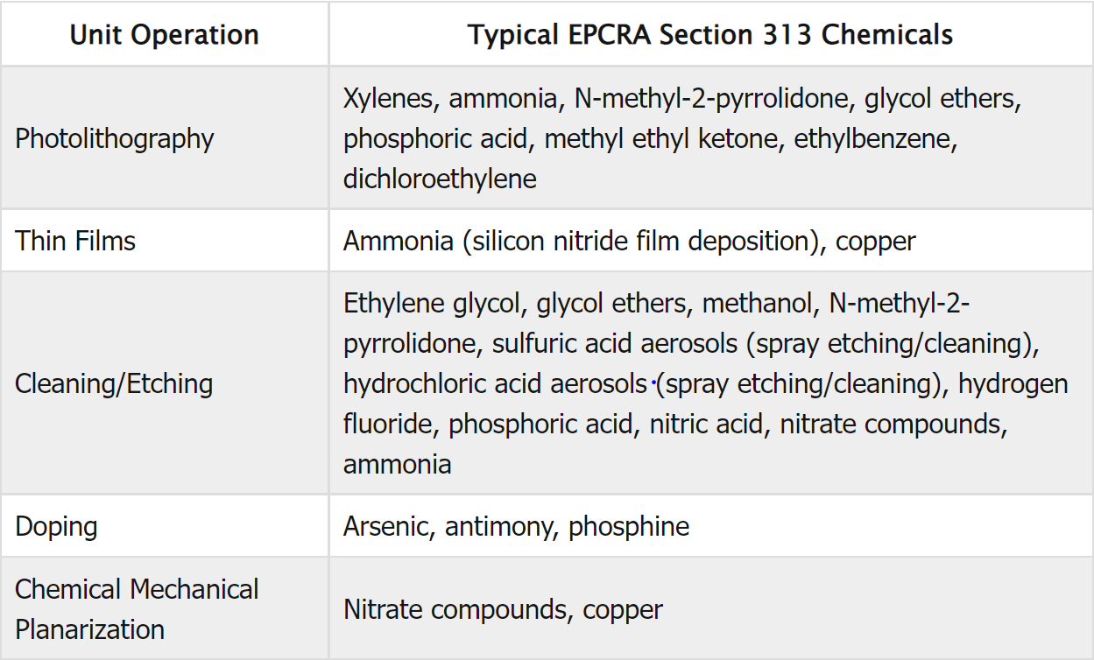
EPA’s Most Reported Toxic Chemicals in Semiconductor Manufacturing
“Table 2-2 EPCRA Section 313 Chemicals and Chemical Categories Commonly Encountered in Semiconductor Manufacturing” [2]

Slide 8
Reactions and Consequences
Al₂O₃ is commonly deposited via CVD using CO₂ to synthesize H₂O in the reaction chamber.
CO₂+H₂→H₂O+CO
Deposition chemistry for Al₂O₃ is controlled by the addition of CO, creating a tunable and responsive process.
Use of CO₂ and syntheses of CO in the same reaction. CO₂ and CO are both known for their affects on the environment and living organisms in higher densities.
Fluorocarbons are often produced as waste in CVD processes.
CFC’s and other fluorocarbons begin a reaction in the Earth’s atmosphere that results in the free chlorine causing the conversion of ozone molecules into oxygen, effectively “depleting” the ozone layer on some scale.

Slide 9
Chemical Risk
Trimethylgallium (Ga(CH3)3)
Causes burns, respiratory irritation and potential damage, sever eye damage, is poisonous.
Ammonia (NH3)
Potential skin and lung irritation, and eye damage.
Carbon Dioxide (CO2) and CO
Causes oxygen deprivation when in large enough densities and is harmful to environment as it traps heat.
Chlorofluorocarbons (CFCs), hydrochlorofluorocarbons (HCFCs), hydrofluorocarbons (HFCs), perfluorocarbons (PFCs), Sulfur Hexafluoride (SF6), & Nitrogen Trifluoride (NF3)
Known as green house gasses and cause conversion of ozone into another substance, causing ozone depletion.

Slide 10
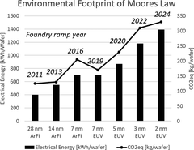
Moore’s Law and Chemical Usage
Chemical use expected to Sky-Rocket
“Energy consumption and greenhouse gas emissions per 300 mm wafer for CMOS fabrication—and the included CVD processing steps in particular—increase with a decreasing node size” [2]
FIG. 2. Electrical energy consumption and greenhouse gas emission in 300 mm logic wafer production for relevant technology nodes in production in 2021 and to be ramped up in the next five years. [1]

Slide 11
Current Industry Standards
Highly controlled environment (limit outside exposure or reactions)
Use of SOP’s and SDS’s
Automation often used for application of chemicals and thus human contact is further reduced.
PPE specific to the chemical being handled.
Reaction chambers that often allow efficient pumping of venting of excess or waste chemical
Liquid waste products purged, diluted and disposed through a third part contractor or held in proper long-term storage
Waste gas vented to environment when not regulated or under the set rate or production governed by epa
Waste gas often burned and released to atmosphere as low hazard gases and vapors.

Slide 12
Additional Solutions
Alternate chemicals for plasma enhanced chemical vapor deposition (PECVD)chamber cleans
This process emits the most significant portion of PFC’s for a typical device fabrication facility.
Using octafluorocyclobutane clean chemistries reduced clean gas consumption by 65% and PFC emission by 78% with no impact on deposited thin film properties or process function/repeatability. [5]
Electroless metallization reduces usage of toxic metals over electroplating
Potential Advanced Recycling procedures for “waste” chemicals

Slide 13
Summary/conclusion
The semiconductor industry uses a significant number and volume of chemicals daily. Many of these pose a risk if given direct contact or an environmental risk. Currently the semiconductor industry is a massive producer of carbon dioxide and green house gasses and as the raise for smaller components continues so will the annual growth in the use of chemical in the semiconductor industry. Currently companies are largely sheltered by trade secrets and from lack of information about their newer chemical and regulations for specific process are few and far in between. Proper procedures and handling are very vital in the semiconductor industry as well as plans for disposal.

Slide 14
References (1 of 2)
[1] A. D. Little, llc, “Nomination Background: Hexamethyldisilazane (CASRN: 999-97-3).” 10-Apr-1991.
[2] EPA, “Toxics Release Inventory (TRI) Guideme,” EPA. [Online]. Available: https://ordspub.epa.gov/ords/guideme_ext/f?p=guideme%3Agd%3A%3A%3A%3A%3Agd%3Asemicond. [Accessed: Nov-2021].
[3] H. Pedersen, S. T. Barry, and J. Sundqvist, “Green CVD—toward a sustainable philosophy for thin film deposition by chemical vapor deposition,” Journal of Vacuum Science &amp; Technology A, vol. 39, no. 5, Jul. 2021.
[4] J. A. Isaacs, A. Tanwani and M. L. Healy, "Environmental Assessment of SWNT Production," Proceedings of the 2006 IEEE International Symposium on Electronics and the Environment, 2006., 2006, pp. 38-41, doi: 10.1109/ISEE.2006.1650028.
[5] K. Avala, Li Liu, D. Brindza, G. Loh and S. A. Moiyadi, "Reduced PFC emissions and gas consumption using a c-C/sub 4/F/sub 8/-based PECVD chamber clean chemistry," in IEEE Transactions on Semiconductor Manufacturing, vol. 17, no. 4, pp. 504-509, Nov. 2004, doi: 10.1109/TSM.2004.835713.
[6] L. Mendicino, P. T. Brown, K. Reid, V. Vartanian and J. Van Gompel, "Abatement of emissions from advanced chemical vapor deposition processes," Twenty Fourth IEEE/CPMT International Electronics Manufacturing Technology Symposium (Cat. No.99CH36330), 1999, pp. 264-269, doi: 10.1109/IEMT.1999.804831.

Slide 15
References (2 of 2)
[7] S. Kim, C. Yoon, S. Ham, J. Park, O. Kwon, D. Park, S. Choi, S. Kim, K. Ha, and W. Kim, “Chemical use in the semiconductor manufacturing industry,” International Journal of Occupational and Environmental Health, vol. 24, no. 3-4, pp. 109–118, 2018.
[8] U. of New Mexico, “Photolithography Powerpoint.” Southwest Center for Microsystems Education and The Regents of the University of New Mexico, Albuquerque, 07-Oct-2012.
[9] W. Contributors, “Fluorochemical industry,” Wikipedia, 03-Sep-2021. [Online]. Available: https://en.wikipedia.org/wiki/Fluorochemical_industry.

Slide 16
Key Take-Aways (Possible Exam Topics)
What are 3 chemicals common in the CVD process that are regulated by the EPA? (see slides 6-7)
What form of photolithography uses few toxic chemicals? (see slide 12)
Describe the effect of node size in the microelectronics industry on chemical usage:
Ballpark, how many different chemical ingredients may a major semiconductor company use?
Why is the emission of various fluorocarbons considered a negative and how do they react in the atmosphere?

Slide 17
Questions?

