Slide 1
MEMS Fabrication and Applications
ABSTRACT:
Taking a brief look at MicroElectroMechanical Systems (MEMS), we will guide you through the fabrication stages and show you some applications that they are used for. MEMS can be very simple and not move at all to being immensely complex systems with lots of moving elements being controlled by the system. Starting off with some simple facts we will then show the stages of their fabrication. The basic process of manufacturing MEMS starts with deposition of thin films onto their respective material layers. Then the material is patterned by one of many forms of lithography. The final step in creating MEMS is etching the pattern so that the final product will be the desired shape. MEMS can be created at a relatively low cost because they can be produced in high volumes because of bulk fabrication. MEMS are used for microvalves for controlling gas and liquid, switches, sensors, actuators, and much more!
Brought to you by: Jack Link & Aaron Schiller
Date delivered on: Friday the third of May, 2013

Slide 2
Outline of our Presentation
A brief overview of MEMS
Fabrication
  Basic steps of fabrication
    Deposition
    Patterning
    Etching
  Types of Fabrication
Applications
  Sensors
  Actuators
  Switches

Slide 3
MEMS and What They Are
MEMS must be mechanically functional whether or not there are any moving parts
MEMS devices can be smaller than one um all the way up to several mm
Referred to as Microsystems Technology in Europe or Micromachines in Japan
Usually consist of a CPU IC that controls the MEMS which act as the eyes and arms of the system.
Physics of MEMS are not fully understood
Sources 9 and 5

Slide 4
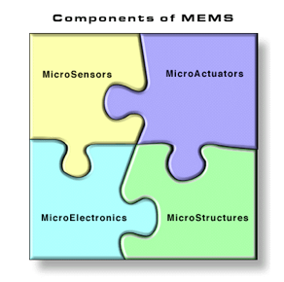
Source 9

Slide 5
Fabrication
Deposition
  Manufacturing MEMS starts with depositing a mask on top of a substrate
  Acts as a mechanical layer for the device to built on top of
  Acts as a "sacrificial layer" and is usually made of some sort of oxide
Patterning
  The deposition then has a pattern cut out into it to show where it need be etched
  Done by some form of lithography, most often photolithography
Sources 1, 5, and 4

Slide 6
Fabrication
Etching
  Wet etching is the most popular amongst MEMS creators because of its fast etch rate and selectivity
  Substrate is then dipped in a chemical that will dissolve the deposition but not the mask.
  Dry etching is much slower and not used as much
  Dry etching is usually done with either plasma or gas
Sources 1, 4, and 5

Slide 7
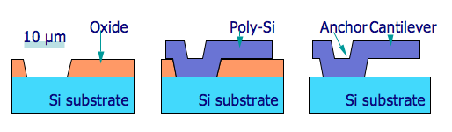
Start to Finish Picture of the Fabrication of MEMS
Source 1

Slide 8
Types of Fabrication
Surface manufacturing
  Adds deposit to substrate and deposit gets cut away
  Used to make MEMS and IC's on the same silicon wafer
  layer thickness of around 2 um
  comb structures and in-plane operation
Bulk manufacturing
  Oldest way to create MEMS
  Shaped the way the industry started to make sensors and accelerometers in the 80's and 90's
  better performance than surface
HAR (High Aspect Ratio) Silicon
  layer thickness of around 10-100um
  NOT used for IC's, only MEMS
  combines comb structures and in-plane operation of surface and good performance of bulk
Sources 1 & 5

Slide 9
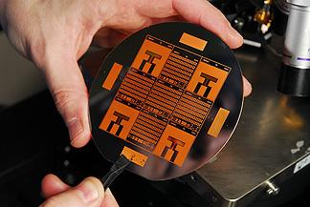
Source 3

Slide 10
Uses
Microvalves to control the flow of liquid and gaseous solutions
Optical switches which can change direction, size, and intensity of light beams for displays
Microactuators which help move large objects easily (e.g. flaps on an airplane)
Microsensors which can measure anything from temperature to pressure to radiation.
Transducers such as microsensors/actuators which convert energy from one form to another (e.g. depth finder on a boat)
Sources 2 and 5

Slide 11
Applications
Accelerometers
  In cars tell the airbag to deploy, seatbelts to lock, crash test dummies etc.
  Electronics
    In cell phones (e.g. screen rotation), video game controllers, HDD's
Medical
  Measures vitals such as blood pressure, respiration, pulse etc.
  Eye surgery, inhalers, dialysis, analysis of blood etc.
  DNA testing
Sources 2 and 5

Slide 12
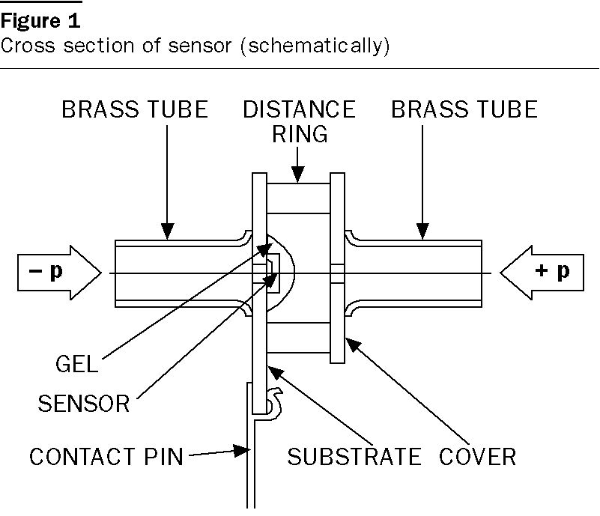
Source 8

Slide 13
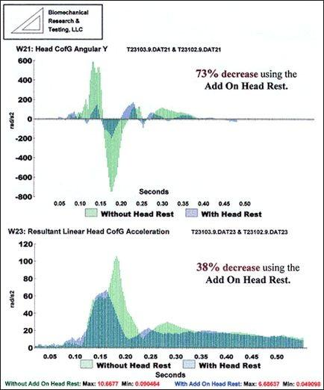
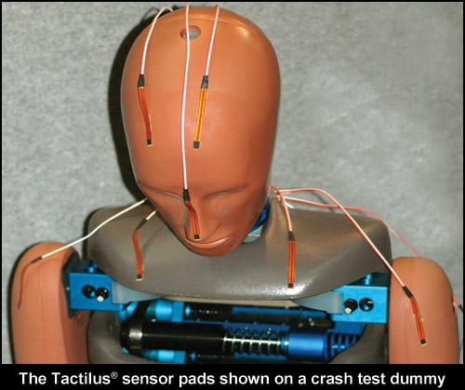
Above picture: 6
Right picture: 7

Slide 14
Summary/Conclusions
MEMS are very useful and can be applied in almost any situation. They are cheap and relatively easy to make and help a lot in everyday life.

Slide 15
Sources
1. https://www.mems-exchange.org/MEMS/fabrication.html\
2. https://www.mems-exchange.org/MEMS/applications.html
3. http://gtresearchnews.gatech.edu/newsrelease/mems-cad.htm
4. http://www-bsac.eecs.berkeley.edu/projects/ee245/Lectures/lecturepdfs/Lecture2.BulkMicromachining.pdf
5. http://en.wikipedia.org/wiki/Microelectromechanical_systems
6. http://www.addonheadrest.com/crashtests.html
7. http://www.sensorprod.com/dynamic/impact.php
8. http://www.emeraldinsight.com/journals.htm?articleid=878408&show=html
9. https://www.mems-exchange.org/MEMS/what-is.html

Slide 16
5 Key Concepts
MEMS are always mechanically functional and are usually made from Silicon and silicon dioxide.
Their sizes can range from under one micron to more than several mm.
The three basic steps to fabricating MEMS are deposition, patterning, and etching.
Chemical etching is the primary use of getting the deposition layer because it is easier, faster, and allows finer details
Their main uses are sensors, actuators, and switches

