Slide 1
Optoelectronics
By: Rob Toland and Nick Peterson
Abstract: Optoelectronics is the study and
application of electronic devices that source,
detect and control light. Optoelectronics can
be broken down into two sub-divisions; light
emission and light detection.

Slide 2
Light emitters:
•Incandescent lamps
•Light emitting diodes (LED) •Laser diodes •Vacuum fluorescent devices
•Plasma devices •Gas lasers •Electroluminescent devices
Light detectors:
•Photoconductors
•Solar cells (Photodiodes)

Slide 3
Incandescent lamps
Incandescent lamps are the most common type of light emitting electronic used around the house. The lamps rely on heating up a thin wire (usually tungsten) to white heat.
Low efficiency, most of the energy used is transferred to heat.
Due to low efficiency, are being replace with LEDs.

Slide 4
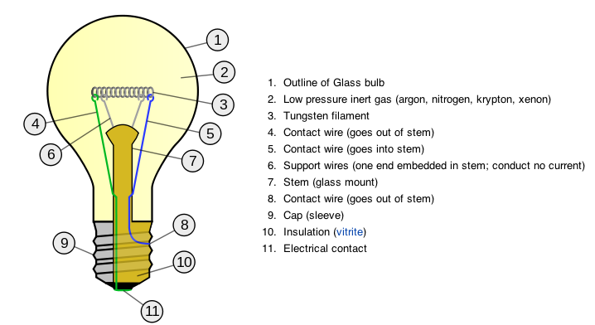

Slide 5
Light emitting diodes (LED)
The LED is a semiconductor device that emits infrared or visible light when charged with an electric current.
Used as indicator lamps, in automobiles as rear-window and brake lights, and on billboards and signs as alphanumeric displays or even full-color posters.
Infrared LEDs are used in autofocus cameras and television remote controls and also as light sources in fibre-optic telecommunication systems

Slide 6
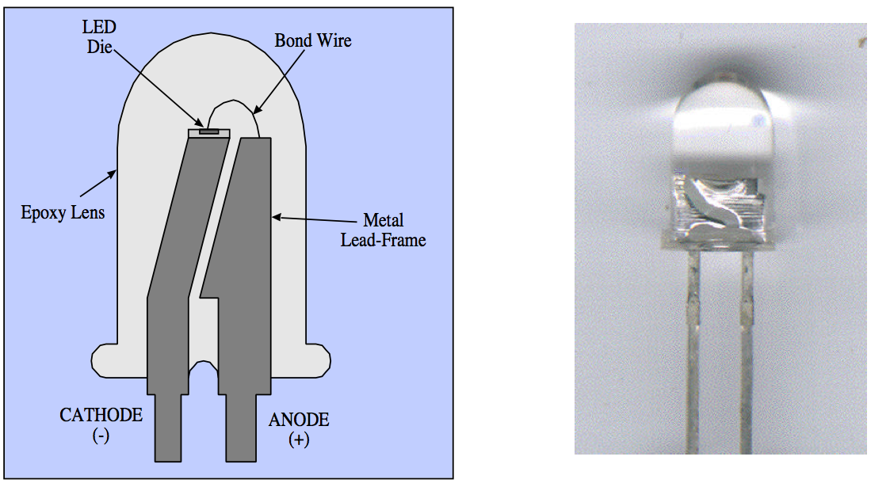

Slide 7
Vacuum fluorescent devices
Vacuum fluorescent devices are an older emissive display that utilizes vacuum tube technology
They are rugged, inexpensive, and easily configured.
Unlike LCDs, VFDs are able to function normally in cold, even sub-zero, temperatures, making them ideal for outdoor devices in cold climates.

Slide 8
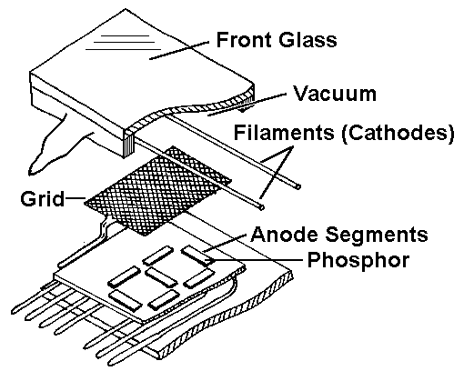
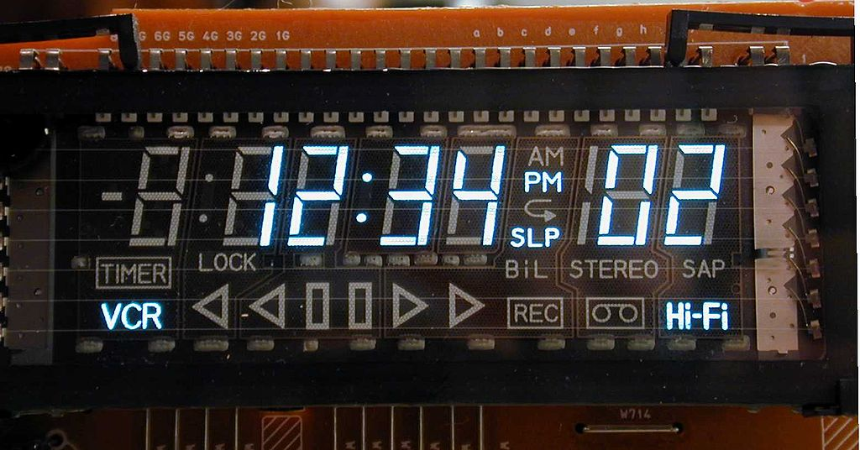

Slide 9
Plasma Devices
Plasma devices are used to excite a gas using an electrical charge to produce plasma.
Plasma is one of the four fundamental states of matter.
Typically used for visual effects.
The excitement of gasses produces very cool colors of light.

Slide 10
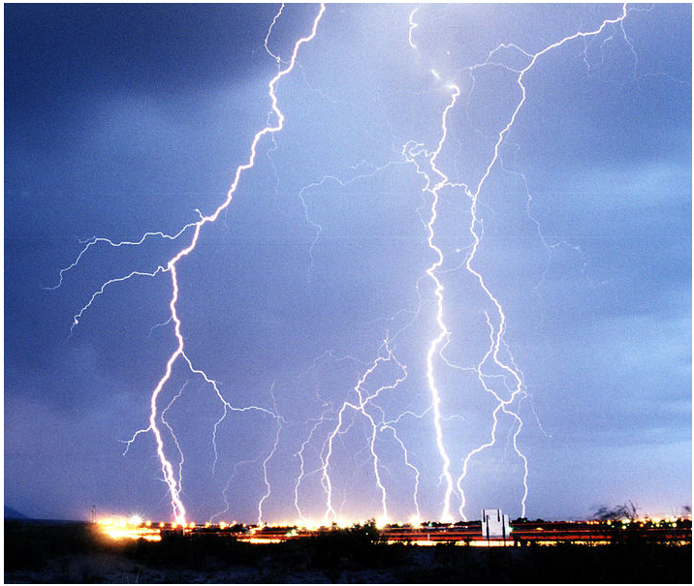
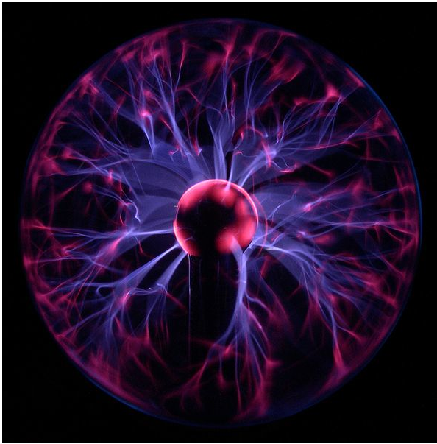
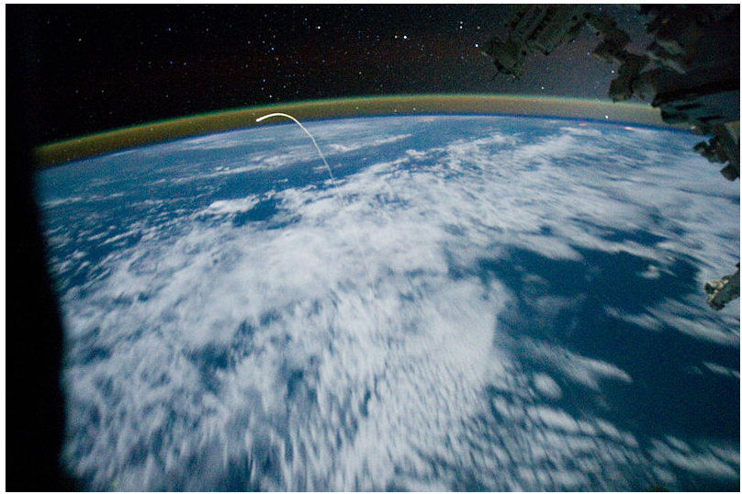

Slide 11
Electroluminescent devices
Electroluminescent devices are fabricated using either organic or inorganic electroluminescent materials.
The active materials are generally semiconductors of wide enough bandwidth to allow exit of the light.
Typically used for nightlights and backlighting of instrumentation.

Slide 12
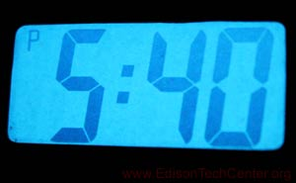
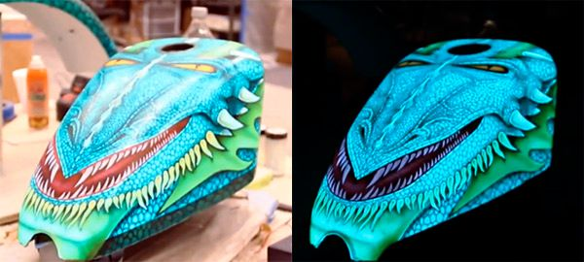

Slide 13
Laser diodes
A laser diode is a laser where the active medium is a semiconductor similar to that found in a LED
Laser diodes emits light either from its edge or its surface and creates a smaller beam than a LED
This makes it easier for use with the smaller core found in a single-mode optical fiber.

Slide 14
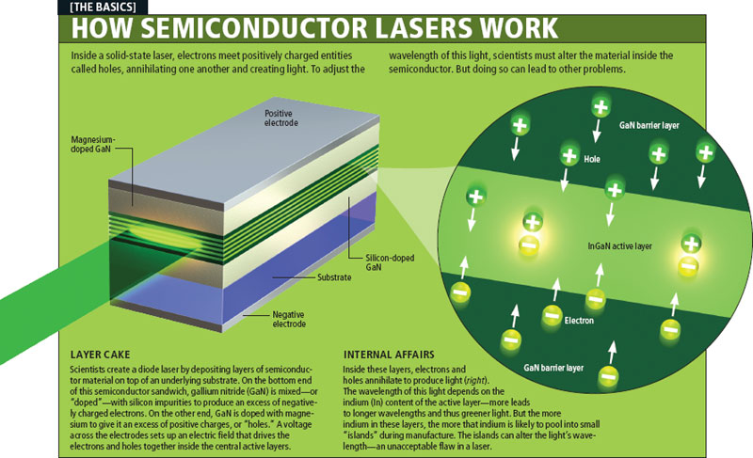

Slide 15
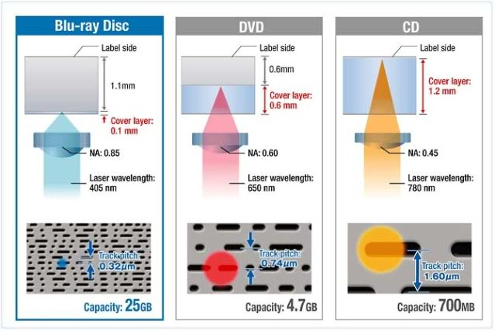

Slide 16
Gas Lasers
Gas lasers use the same type of mechanism as plasma devices.
An inert gas is excited to produce light.
That light is reflected off of mirrors to be focused into a beam.
Mainly used for laser etching and in making holograms.

Slide 17
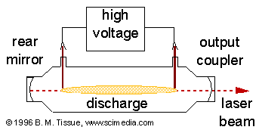
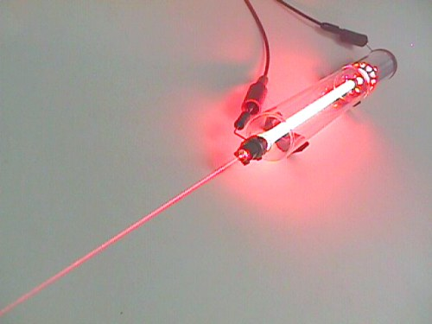

Slide 18
Gas vs Diode Lasers
Diode Lasers
Lower production and maintenance costs
Require about 20X less energy
Wider range and control of frequencies
Gas Lasers
Superior optical characteristics
large power scaling
Doesn’t require external optics

Slide 19
Photoconductor
Photoconductors are materials that react to light.
The higher the concentration of light, the more conductive the material becomes.
Primarily used in printing applications. (ie. Photocopy machines and laser printers)
First organic photoconductor was made in the1970 by IBM to avoid patents for dry printing.

Slide 20
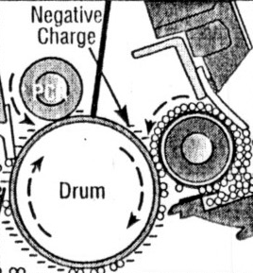

Slide 21
Solar cells (Photodiode)
Photovoltaic effect first observed by Alexandre-Edmond Becquerel in 1839, while the first photovoltaic cell was no produced until 1883 with an efficiency of about 1%.
The first feasible solar cell was produced in 1954 by Daryl Chapin with an efficiency of about 6% compared to the industry standard of about .5%.
In 1959 Vanguard 1 became the first satellite to be powered by solar cells, lengthening the operational time from a few weeks to about 7 years.
Current solar cell rang in efficiency from about 11% to 44%.

Slide 22
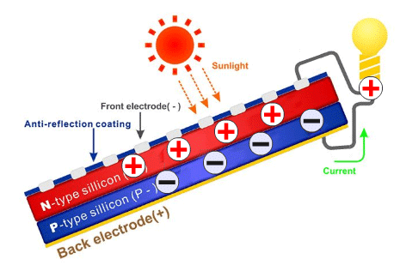

Slide 24
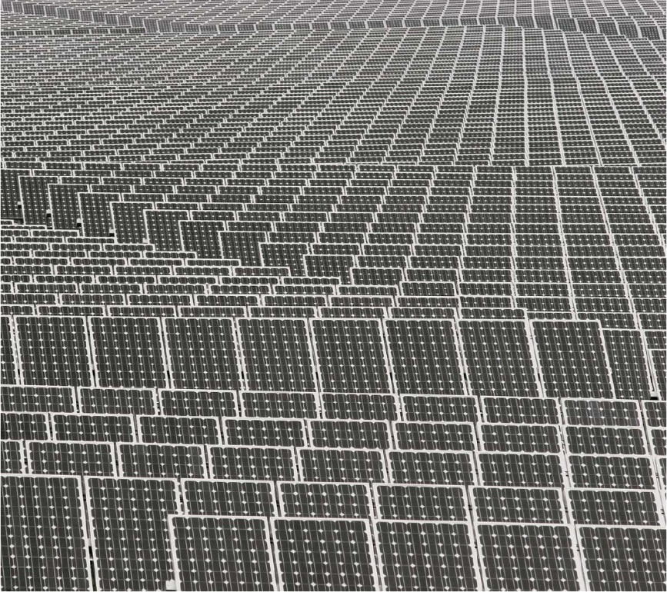
Current Solar Power
Largest solar array is in Arizona, the Agua Caliente Solar Project facility that will produce 397 MW, currently only 251MW, compared to an average coal plant that produces 375MW, or the Hoover dam that produces 2080 MW.
Cost of solar power has dropped from about $150 in 1970 to about $0.60 today
Agua Caliente Solar Project
contains nearly 21,00 solar
panels with an estimated price tag of 967 million dollars.

Slide 25
Summary
Optoelectronics is the study and application of electronic devices that source, detect and control light.
Optoelectronics can be broken down into two sub-divisions; light emission and light detection.
Light emission device usually consist of a substance being energized by a current to produce light.
Light detector device usually consist of a substance that is sensitive to the presence of light. Changing the conductivity or energizing a circuit.
Photoconductors, Phototransistors, and Integrated photodetectors have varied characteristics, but function the same way under the influence of light.

Slide 26
Sources
http://www.wikipedia.com
http://www.stanford.edu/class/ee122/Handouts/5-optoelectronics.pdf
http://www.burnhams.com/fiber_optics_glossary.html
http://www.olympusfluoview.com/theory/laserintro.html
http://www.nrel.gov/ncpv/
http://solarenergyfactsblog.com
http://www.thorlabs.com
http://www.cleanenergyactionproject.com/CleanEnergyActionProject/Home.html

Slide 27
Key Points
Diode lasers have a wider range and control of frequencies.
Gas lasers are more easily scaled with power output in terms of size.
One of the first viable uses for photovoltaic cells was in space.
Electroluminescent devices can be used on a wide range of surfaces and applications. Examples include nightlights, instrumentation, as well as visual effect.

