Slide 1
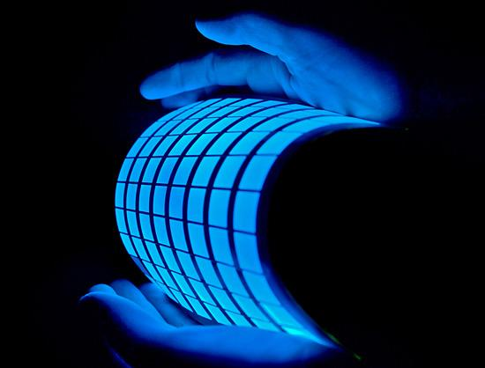
Organic Light-Emitting Diodes (OLEDs)
ECE 4611
By Sean Davey and Jacob Walker
Image Courtesy of Topper Choice http://topperchoice.com/working-principle-of-oled-organic-light-emitting-diode/

Slide 2
Abstract
In this presentation, we discuss OLED's. How they work, What they are made of, different strategies to manufacture them with layers thicknesses, and the many applications for them.

Slide 3
Outline
Explanation Of What OLEDs Are
Explanation Of How OLEDs Operate
Materials Used
Advantages
Disadvantages
Real World Examples Of Use

Slide 4
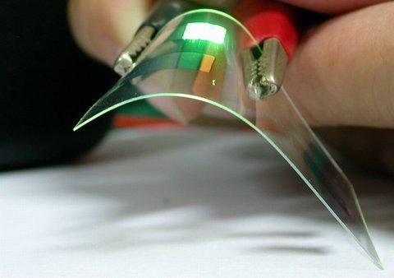
Explanation of what OLEDs are
An OLED (organic light-emitting diode) is a type of LED (light-emitting diode), where the emissive electroluminescent layer is a film of organic compound which emits
light in response to an electric current.
Image courtesy of Wikimedia Commons

Slide 5
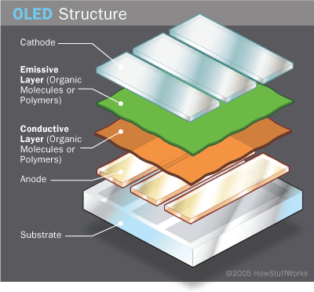
How OLEDs Operate
-Components
Substrate- support structure, sometimes flexible
Anode
Organic Material
  Emissive
  Conductive
Cathode

Slide 6
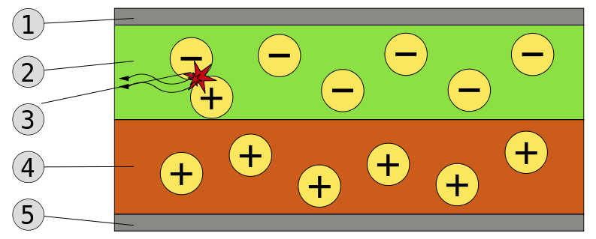
How OLEDs Operate
Cathode 2000A
Emissive Layer 800A
Photon Radiation
Conductive Layer 1200A
Anode 1500A
http://en.wikipedia.org/wiki/File:OLED_schematic.svg
Notes:
As current flows from Cathode to Anode the electrons move through the organic layers, removing electrons from the conductive layer and leaving holes in emissive layer. To balance the holes and electrons recombine in the emissive layer and the leftover energy is given off as light.
The wavelength of the light is determined by the emissive layer Indium Tin Oxide is mainly used as the transparent layer.
Average human hair is 200X the thickness of OLED layers
http://en.wikipedia.org/wiki/OLED#Material_technologies organic stuff
http://en.wikipedia.org/wiki/PEDOT:PSS conductive layer

Slide 7
OLED Manufacturing
There are two general types of OLEDs
  Those based on small molecules (Usually the term OLEDs are usually referred to these)
  Those made using polymers (PLED)
  There is also a newer type of OLEDs under development called phosphorescent organic light emitting diodes (PHOLED) which has efficiencies approaching 100%

Slide 8
OLED Manufacturing (cont.)
Vacuum Thermal Evaporation(VTE)
  Used with small molecule OLEDs
Organic Vapor Phase Deposition(OVPD)
  Used with polymer LEDs (PLED)
Inkjet Printing
  Also used with PLEDs

Slide 9
OLED Manufacturing (cont.)
Those based on small molecules are typically used with smaller structures and can be used to make well controlled, homogeneous films, and the construction of very complex multi-layer structures
Those made using polymers are used for larger area films. They are efficient and require a small amount of power

Slide 10
Materials Used
Small molecule production can be made of organometallic chelates, fluorescent and phosphorescent dyes and conjugated dendrimers. Many materials are used for their charge transport properties, triphenylamine and derivatives are often used as materials for hole transport layers. Fluorescent dyes can be chosen to obtain light emission at different wavelengths, and compounds such as perylene, rubrene and quinacridone derivatives are often used.
Typical polymers used in PLED displays include derivatives of poly(p-phenylene vinylene) and polyfluorene.

Slide 11
Advantages
Lighter
Flexible
Thinner
Brightness
Power Consumption and Efficiency
Easier to Produce in Large Sizes
170 Degree Viewing Area
Theoretically Cheaper to Make in the Future
Faster Response Time
Notes:
lightweight - OLED displays can be fabricated on flexible plastic substrates leading to the possibility of flexible organic light-emitting diodes being fabricated or other new applications such as roll-up displays embedded in fabrics or clothing. As the substrate used can be flexible such as PET,^{[55]} the displays may be produced inexpensively.
Wider viewing angles & improved brightness - OLEDs can enable a greater artificial contrast ratio (both dynamic range and static, measured in purely dark conditions) and viewing angle compared to LCDs because OLED pixels directly emit light. OLED pixel colours appear correct and unshifted, even as the viewing angle approaches 90° from normal.
Response time - OLEDs can also have a faster response time than standard LCD screens. Whereas LCD displays are capable of between 1 and 16 ms response time offering a refresh rate of 60 to 480 Hz, an OLED can theoretically have less than 0.01 ms response time, enabling up to 100,000 Hz refresh rate.. OLED's can also be run as a flicker display, similiar to a CRT, in order to eliminate the sample-and-hold effect which creates motion blur on OLED's
Cheaper in future - OLEDs can be printed onto any suitable substrate by an inkjet printer or even by screen printing,^{[54]} theoretically making them cheaper to produce than LCD or plasma displays. However, fabrication of the OLED substrate is more costly than that of a TFT LCD, until mass production methods lower cost through scalability. Roll-roll vapour-deposition methods for organic devices do allow mass production of thousands of devices per minute for minimal cost, although this technique also induces problems in that multi-layer devices can be challenging to make due to registration issues, lining up the different printed layers to the required degree of accuracy.

Slide 12
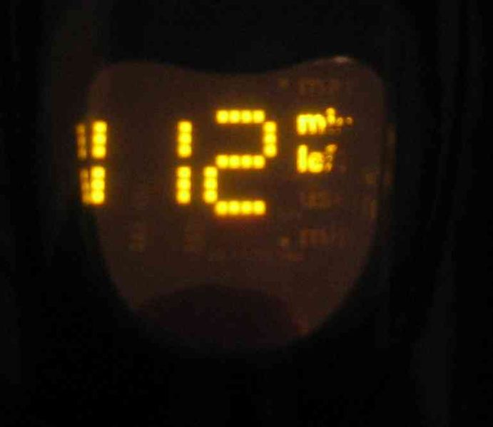
Disadvantages
Vulnerability to Fluids
Lifetime of Blue Organic Film
Cost of Manufacturing
Power Consumption (White Backgrounds)

Slide 13
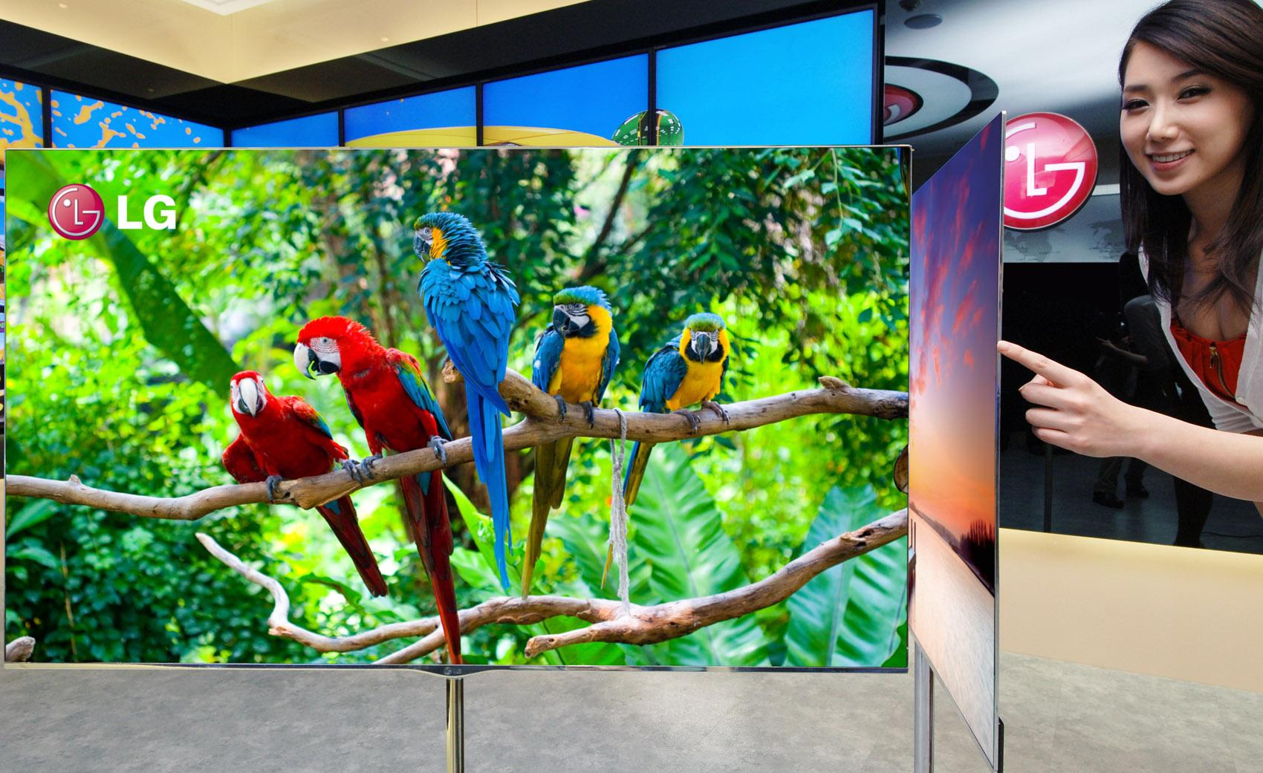
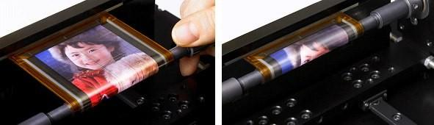
Commercial Uses
Portable Digital Media Players
Mobile Phones
Car Radios
Digital Cameras
High Definition TVs

Slide 14
Summary
OLED's use the reaction of electrons and holes to produce light, but unlike normal LED's these use organic material layers in the process. OLED's have many manufacturing challenges before they can become viable for consumer products. The advantages will be smaller brighter displays for modern devices which are very efficient.

Slide 15
References
http://topperchoice.com/working-principle-of-oled-organic-light-emitting-diode/
http://en.wikipedia.org/wiki/OLED#Material_technologies
http://electronics.howstuffworks.com/oled.htm
Bellmann, E.; Shaheen, S. E.; Thayumanavan, S.; Barlow, S.; Grubbs, R. H.; Marder, S. R.; Kippelen, B.; Peyghambarian, N. (1998). "New Triarylamine-Containing Polymers as Hole Transport Materials in Organic Light-Emitting Diodes: Effect of Polymer Structure and Cross-Linking on Device Characteristics". Chemistry of Materials 10 (6): 1668.

Slide 16
References (cont)
http://www.nbcnews.com/technology/gadgetbox/whats-difference-between-oled-tvs-led-tvs-715504
Sato, Y.; Ichinosawa, S.; Kanai, H. (1998). "Operation Characteristics and Degradation of Organic Electroluminescent Devices". IEEE Journal of Selected Topics in Quantum Electronics 4: 40.
http://www.lg.com/us/oled/index.jsp
http://www.emagin.com/oled-microdisplays/
http://www.ewh.ieee.org/soc/cpmt/presentations/cpmt0401a.pdf

Slide 17
Five Key Concepts
Four main components are the anode, cathode, emission, and conductive layers.
Unlike normal LED's, OLEDs use organic material layers in the process.
Photons are released when an electron and a hole are paired, giving off light.
The thickness of layers of an OLED are in the Angstrom range.
There are two general types of OLEDs. Those based on small molecules and those made using polymers

