Slide 1
Micro-Electro-Mechanical Systems (MEMS)
Abstract:
MEMS technology consists of microelectronic elements, actuators, sensors, and mechanical structures built onto a substrate, which is usually silicon. They are developed using microfabrication techniques: deposition, patterning, and etching. The most common forms of production for MEMS are bulk micromachining, surface micromachining, and HAR fabrication. The benefits on this small scale integration brings the technology to a vast number and variety of devices.
Presented by: Patrick Trueman and Matt Koloski
May 2, 2014

Slide 2
Introduction/Outline
- What Are MEMS?
- Components of MEMS
- Fabrication
- MEMS Operation
- Applications
- Summary
- 5 Key Concepts
- ?Questions?

Slide 3
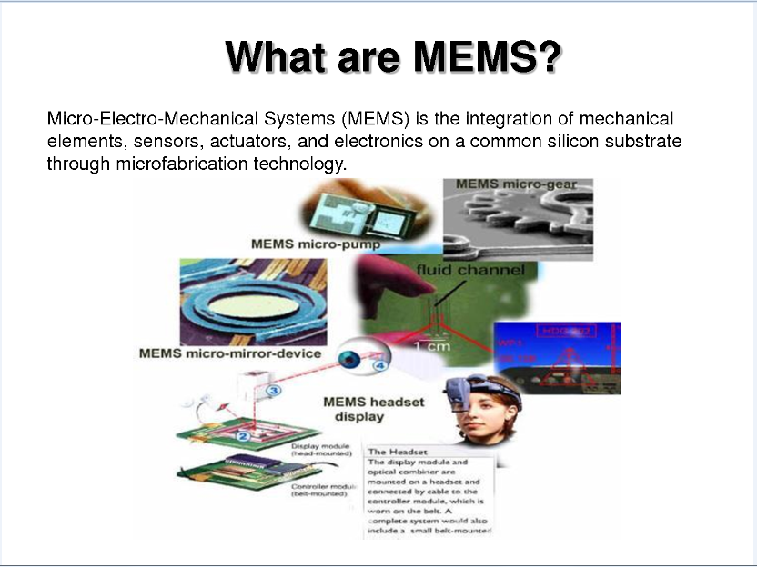


Slide 4
What are MEMS?
Made up of components between 1-100 micrometers in size
Devices vary from below one micron up to several mm
Functional elements of MEMS are miniaturized structures, sensors, actuators, and microelectronics
One main criterion of MEMS is that there are at least some elements that have mechanical functionality, whether or not they can move

Slide 5
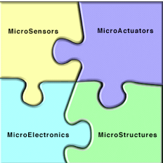

Components
Microelectronics:
“brain” that receives, processes, and makes decisions
data comes from microsensors
Microsensors:
constantly gather data from environment
pass data to microelectronics for processing
can monitor mechanical, thermal, biological, chemical optical, and magnetic readings
Microactuator:
acts as trigger to activate external device
microelectronics will tell microactuator to activate device
Microstructures:
extremely small structures built onto surface of chip
built right into silicon of MEMS

Slide 6
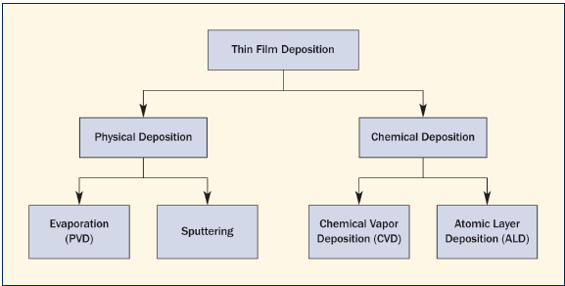
Fabrication Processes
Deposition:
deposit thin film of material (mask) anywhere between a few nm to 100 micrometers onto substrate
physical: material placed onto substrate, techniques include sputtering and evaporation
chemical: stream of source gas reacts on substrate to grow product, techniques include chemical vapor deposition and atomic layer deposition
substrates: silicon, glass, quartz
thin films:polysilicon, silicon
dioxide, silicon nitride, metals,
polymers

Slide 7
Patterning:
transfer of a pattern into a material after deposition in order to prepare for etching
techniques include some type of lithography, photolithography is common
Etching:
wet etching: dipping substrate into chemical solution that selectively removes material
process provides good selectivity, etching rate of target material higher that mask material
dry etching: material sputtered or dissolved from substrate with plasma or gas variations
choosing a method: desired shapes, etch depth and uniformity, surface roughness, process compatibility, safety, cost, availability, environmental impact

Slide 8
Fabrication Methods
Bulk Micromachining:
oldest micromachining technology
technique involves selective removal of substrate to produce mechanical components
accomplished by physical or chemical process with chemical being used more for MEMS production
chemical wet etching is popular because of high etch rate and selectivity
isotropic wet etching: etch rate not dependent on crystallographic orientation of substrate and etching moves at equal rates in all directions
anisotropic wet etching: etch rate is dependent on crystallographic orientation of substrate

Slide 9
Surface Micromachining:
process starts with deposition of thin-film that acts as a temporary mechanical layer (sacrificial layer)
device layers are constructed on top
deposition and patterning of structural layer
removal of temporary layer to allow movement of structural layer
benefits: variety of structure, sacrificial and etchant combinations, uses single-sided wafer processing
allows higher integration density and lower resultant per die cost compared to bulk micromachining
disadvantages: mechanical properties of most thin-films are usually unknown and reproducibility of their mechanical properties

Slide 10
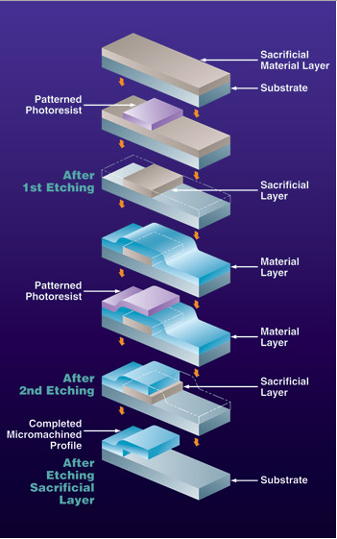
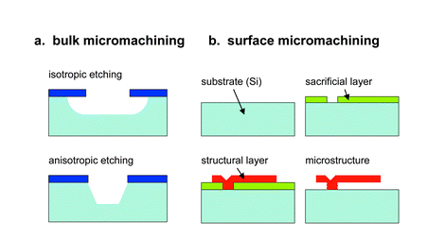

Slide 11
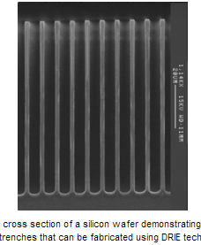
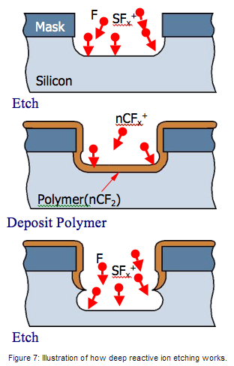
Wafer Bonding:
Method that involves joining two or more
wafers together to create a wafer stack
Three types of wafer bonding: direct bonding,
anodic bonding, and intermediate layer bonding
All require substrates that are flat, smooth,
and clean in order to be efficient and successful
High Aspect Ratio Fabrication (Silicon):
Deep reactive ion etching (DRIE)
Enables very high aspect ratio etches to be performed into silicon substrates
Sidewalls of the etched holes are nearly vertical
Depth of the etch can be hundreds or even thousands of microns into the silicon substrate.

Slide 12
Benefits/Tradeoffs
Much smaller area
Cheaper than alternatives
  In medical market, that means disposable
Can be integrated with electronics (system on one chip)
Speed:
  Lower thermal time constant
  Rapid response times(high frequency)
Power consumption:
  low actuation energy
  low heating power
Imperfect fabrication techniques
Difficult to design on micro scales

Slide 13
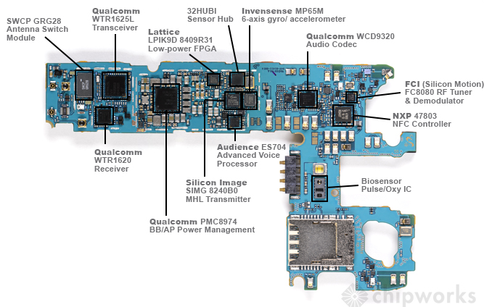
Where Are MEMS?
Smartphones, tablets, cameras, gaming devices, and many other electronics have MEMS technology inside of them
http://www.chipworks.com/en/technical-competitive-analysis/resources/blog/inside-the-samsung-galaxy-s5/

Slide 14
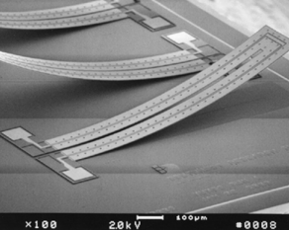
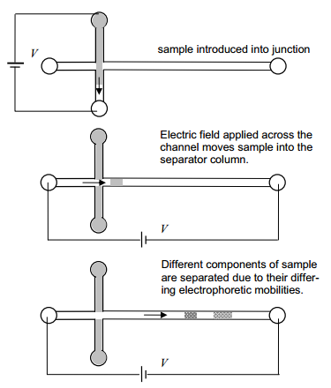
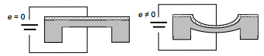
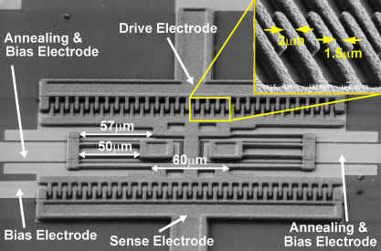
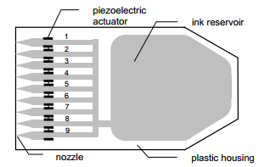
MEMS Operation
Sensors & Actuators
3 main types of transducers:
  Capacitive
  Piezoelectric
  Thermal
Additionally: Microfluidic

Slide 15
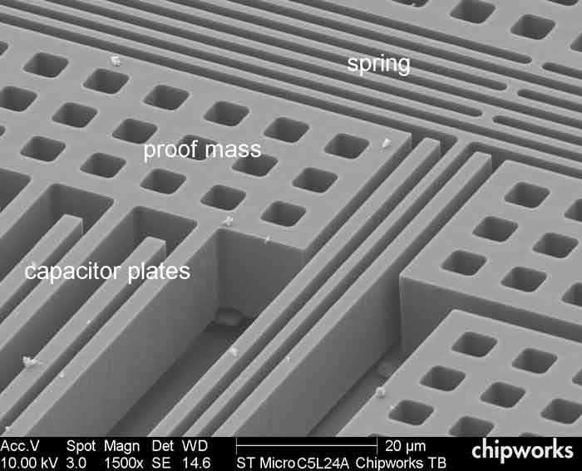
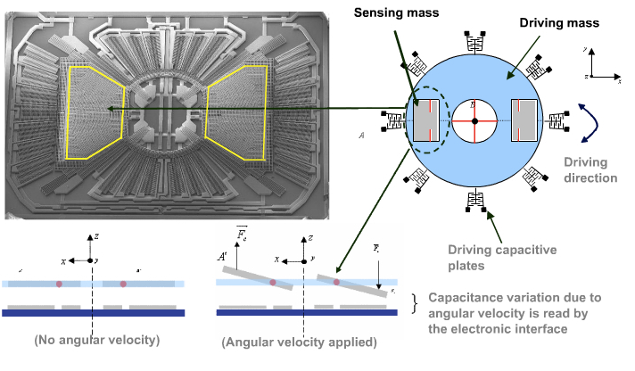
Inertial Sensors
MEMS Accelerometer
MEMS Gyroscope

Slide 16
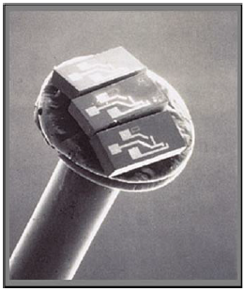
Biomedical Applications
Usually in the form of pressure sensors
  Intracranial pressure sensors
  Pacemaker applications
  Implanted coronary pressure measurements
  Intraocular pressure monitors
  Cerebrospinal fluid pressure sensors
  Endoscope pressure sensors
  Infusion pump sensors
Retinal prosthesis
Glucose monitoring & insulin delivery
MEMS tweezers & surgical tools
Cell, antibody, DNA, RNA enzyme measurement devices
Blood Pressure sensor on the head of a pin
Notes:
The precise dispensing of small amounts of liquids (amounts as
minute as a picoliter and flow rates of as low as a few
microliters per minute) found in needleless injectors,
nebulizers, insulin pumps, and drug delivery systems.
Sub-dermal glucose monitors that not only monitor one's
glucose levels, but also deliver the necessary amount of insulin.
The picture to the right of the MiniMed Paradigm 522 shows a
diabetic patient wearing a chemical sensor (C) that measures
the blood glucose and a transmitter (D) that sends the
measurement to the a computer in (A). (A) also contains a
micropump that delivers a precise amount of insulin
through the cannula (B) to the patient. This is a
continuous bioMEMS monitoring and drug delivery
system that has eliminated the traditional finger
pricks for blood samples that diabetics have to do
daily.
MEMS tweezers or miniature robot arms that move, rotate, cut and place molecules, sort cells
and proteins, and manipulate organelles and DNA inside a living cell.5
Miniature surgical tools that incorporate sensing and measuring devices.
Medical diagnostics (glucose monitoring, blood analysis, cells counts and numerous others).
Biosensing devices used to measure biomolecular information
(cells, antibodies, DNA, RNA enzymes)
Medical stents inserted into previously blocked arteries to open
and maintain a clear channel for blood flow (see Stent Delivery
Catheter to right). There devices are coated with a nanocoating
of a drug that is slowly released into the bloodstream over time.
This prevents a re-narrowing of the artery and future
procedures.
DNA microarrays used to test for genetic diseases, medicine
interaction, and other biological markers.
DNA duplication devices such as the Polymerase Chain
Reaction (PCR) system that takes a miniscule bit of DNA,
amplifies it and produces an exact duplication.

Slide 17
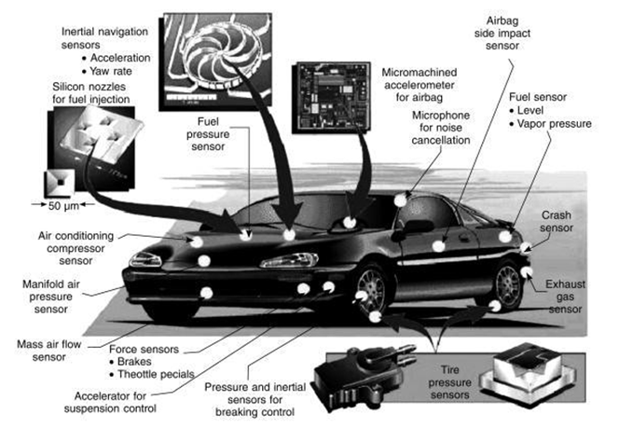
In the Car

Slide 18
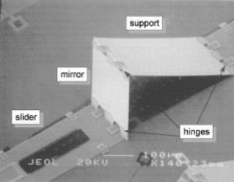
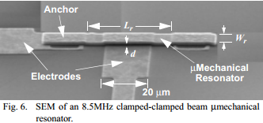
Additional Applications
Optical MEMS
  Ex: optical switches, digital micromirror devices (DMD), bistable mirrors, laser scanners, optical shutters, and dynamic micromirror displays
RF MEMS
  Smaller, cheaper, better way to manipulate RF signals
  Reliability is issue, but getting there

Slide 19
Summary/Conclusion
Micro-Electro-Mechanical Systems are 1-100 micrometer devices that convert electrical energy to mechanical energy and vice-versa. The three basic steps to MEMS fabrication are deposition, patterning, and etching. Due to their small size, they can exhibit certain characteristics that their macro equivalents can’t. MEMS produce benefits in speed, complexity, power consumption, device area, and system integration. These benefits make MEMS a great choice for devices in numerous fields.

Slide 20
References
"What Is MEMS Technology?" What Is MEMS Technology? N.p., n.d. Web. 28 Apr. 2014.
"Fabricating MEMS and Nanotechnology." Fabricating MEMS and Nanotechnology. N.p., n.d. Web. 28Apr. 2014.
D. J. Nagel and M. E. Zaghloul,“MEMS: Micro Technology, MegaImpact,” IEEE Circuits Devices Mag.,pp. 14-25, Mar. 2001.
K. W. Markus and K. J. Gabriel,“MEMS: The Systems Function Revolution,” IEEE Computer, pp. 25-31, Oct. 1990.
K. W. Markus, “Developing Infrastructure to Mass-Produce MEMS,” IEEE Comput. Sci. Eng., Mag., pp. 49-54, Jan. 1997.
M. E. Motamedi, "Merging Micro-optics with Micromechanics: Micro-Opto-Electro-Mechanical (MOEM) devices", Critical Reviews of Optical Science and Technology, V. CR49, SPIE Annual Meeting, Proceeding of Diffractive and Miniaturized Optics, page 302-328, July, 1993
http://seor.gmu.edu/student_project/syst101_00b/team07/components.html
https://www.mems-exchange.org/MEMS/fabrication.html
http://www-bsac.eecs.berkeley.edu/projects/ee245/Lectures/lecturepdfs/Lecture2.BulkMicromachining.pdf
Images
http://www.docstoc.com/docs/83516847/What-are-MEMS
http://seor.gmu.edu/student_project/syst101_00b/team07/images/MEMScomponents2.gif
http://www.empf.org/empfasis/2010/December10/images/fig3-1.gif
http://pubs.rsc.org/en/content/articlehtml/2003/AN/B208563C#sect274
http://www.photonics.com/images/Web/Articles/2008/11/1/thumbnail_35519.jpg
https://www.memsnet.org/mems/fabrication.html

Slide 21
5 Key Concepts
MEMS are made up of microelectronics, microactuators, microsensors, and microstructures.
The three basic steps to MEMS fabrication are: deposition, patterning, and etching.
Chemical wet etching is popular because of high etch rate and selectivity.
3 types of MEMS transducers are: capacitive, thermal, and piezoelectric.
The benefits of using MEMS: speed, power consumption, size, system integration(all on one chip).

