Slide 1
3-Dimensional IC Fabrication and Devices
Abstract:
3-D ICs are particularly suited for combinations of memory with other memory or logic devices. With the integration of Through Silicon Viasing (TSV) for chip to chip interconnects, microelectronics manufacturers are now implementing 3-Dimensional chip stacking to improve performance, bandwidth, power, weight, and storage.
Jacob Lee
4/15/2015

Slide 2
Outline & Intro
Fabrication
The Basics
Evolution from 2-D → 2.5-D → 3-D
Devices
Solid State Drives (SSD)
Field-Programmable Gate Array (FPGA) boards
Companies who have helped further 3-D IC Technology

Slide 3
Fabrication – The Basics
Integrated circuits, in their most basic form, are a combination of die mounted on a substrate
Each die has a function: memory, digital logic, analog/RF, etc.
On any given IC there can be one or many of each depending on the application

Slide 4
The Basics
Common IC substrates are:
  Laminates – printed circuit boards which contain anywhere from 5 to 25 tracks which are used to communicate between dies
  Ceramic, glass or metal substrates that are covered in a layer of dielectric material such as polyimide
  Semiconductor substrates – predominately silicon, with very fine tracks formed using opto-lithographic processes

Slide 5
Inside the 3-D IC
Silicon Interposers
    Placed between the die and the substrate
    Likely to have redistribution layers and TSVs to bring power, signal and ground connections through the interposer die to package connections
    Used to dissipate heat as well as other minor benefits
    Signals traveling over the interposer tend to be slowed when leaving so timing can be an issue
      To counter this, shields and ground plates have been inserted inside the interposer

Slide 6
Inside the 3-D IC
Bumps and Balls – used to connect the IC to the substrate
Micro bumps – connect die to die, smaller than the ones used for the substrate connections
Through-Silicon Viasing (TSVs) – used to make an electrical connection from the circuitry on top of the die to the substrate
  - Usually made out of copper or tungsten
Redistribution Layers – metallization on the top or bottom of the die
- Used to connect die to die

Slide 7
Benefits
Smaller Footprint - more functionality fits into a smaller space
Cost – Stacking reduces fabrication costs and each part can be produced by different companies based on their own expertise
Shorter Interconnect – Wire length is shorter, on average 10-15%, so faster devices
Design – Vertical dimension adds a higher order of connectivity and offers new design possibilities
Bandwidth – with larger number of vertical viasing between layers, this allows construction of wide bandwidth busses between functional blocks in different layers

Slide 8
Drawbacks
Cost – In the early stages, it will be expensive to commercialize 3-D ICs into mainstream consumer applications. Once it is determined where the cost comes from when building them, it will be known where it has the potential to be reduce
Heat – By stacking multiple dies on one another, there can be a considerable amount of heat that needs to be dissipated
Lack of Standards – There are few standards for TSV-based 3D IC design, so manufacturing and packaging can differ between companies
Yield – Each extra manufacturing step adds the chance for defects

Slide 9
Evolution of ICs
Integrated circuits started out being placed on a flat, 2 dimensional, substrate
As technology made things smaller, ICs started to change and expand in the Z direction
Here is a quick look at some of the changes going from 2-Dimensional ICs to 2.5-Dimensional ICs and finally to 3-Dimensional modern day ICs

Slide 10
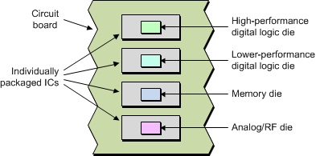
2-Dimensional ICs
One of the first designs of ICs had everything presented in discrete devices in their own chip packages
Each die could be produced by different companies depending on their expertise and/or capabilities
Disadvantages: Circuit boards would be much larger, heavier and would consume more power
  Also, performance lacked because of the distance between devices

Slide 11
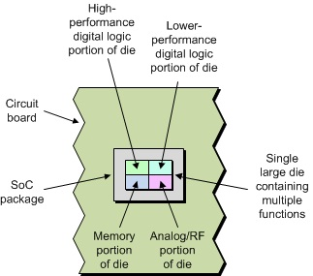
2-Dimensional ICs
System-on-Chip (SoC) devices
All functions implemented on a single die
Highest performance with the lowest power consumption, for the digital portions that is
Disadvantages:
  They are very complicated to build
    Have limited resources
    Time consuming

Slide 12
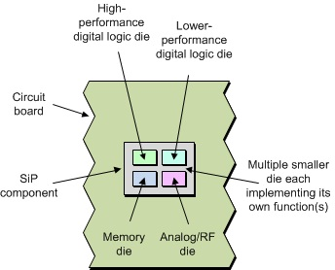
2-Dimensional ICs
System-in-Package (SiP) assemblies
Sort of like SoC, but each die is now separate and removable
Can be used with off-the-shelf parts which can be used to upgrade devices and assemblies as technology advances in the future
Possible to create a number of small SiPs and mount those onto a larger package, called package-in-package (PiP) or package-on-package (PoP) depending on orientation

Slide 13
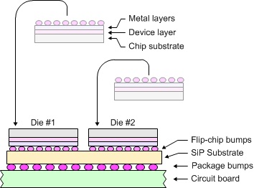
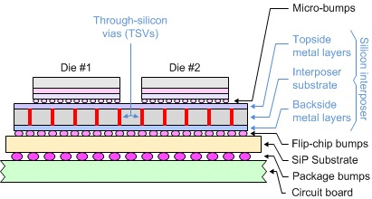
2.5-Dimensional ICs
Typical 2-Dimensional IC only showing two die, Cross-sectional
2.5-Dimensional IC Cross-section with Silicon Interposer added

Slide 14
2.5-Dimensional ICs
With the addition of the interposer, they have increased capacity and performance
One big downfall is that they are significantly more complicated and harder to produce when compared to it’s 2-D counterparts
Drawings are not really to scale, each die is approx. 200um thick and the interposer not much thicker than that.

Slide 15
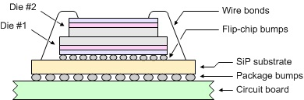
3-Dimensional ICs
Mounting two or more dice on top of each other
This design isn’t all that new, and there have been several variations of it over the years
Theoretically could stack 100, but the heat produced would melt the structure

Slide 16
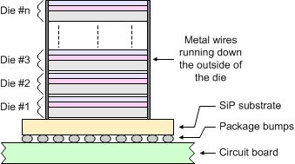
3-Dimensional ICs
Another design is to stack all the die that have the same function, such as memory chips, and run wires down the sides connecting them

Slide 17
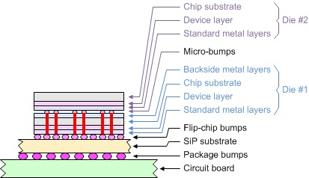
True 3-D IC/SiP
With the addition of TSVs, manufacturers now had the ability to go vertical. They were able to stack different die on top of each other but are still able to use them independently of each other
For example:
A memory die could also be attached to a logic die or any other feasible combination

Slide 18
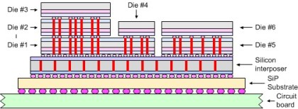
True 3-D IC/SiP
Here is another example showing how a 3-D IC could be set up with different size/usage dice

Slide 19
Devices
3-Dimension IC used in many forms of electronics
Especially in Solid State Drives (SSDs) and field-programmable gate array (FPGA) boards
Companies like SanDisk, Toshiba, Intel, Micron and Xilinx are some of the leading companies in consumer 3-D IC production

Slide 20
3-D NAND Flash Technology
Intel and Micron have been doing a lot in 3-D designs for SSDs and state that they will soon have the capability to produce 3.5 TB flash drives and 10 TB 2.5” SSDs
  They manufactured the first chips that use a floating gate cell design
  By stacking vertically in 32-layers they can achieve:
    256Gb multilevel cells (MLC) and 384Gb triple-level cells (TLC) die that will fit within standard packaging
  Up to 48GB of NAND per die, 3X that of current NAND TLC chips

Slide 21
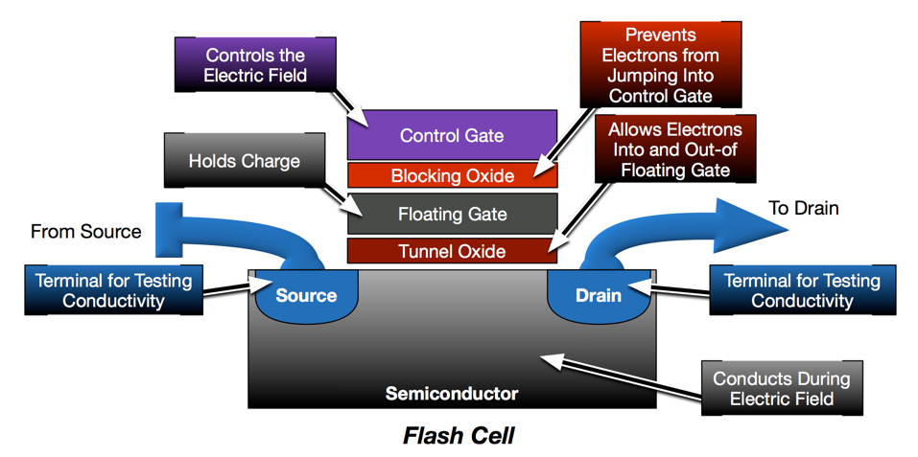
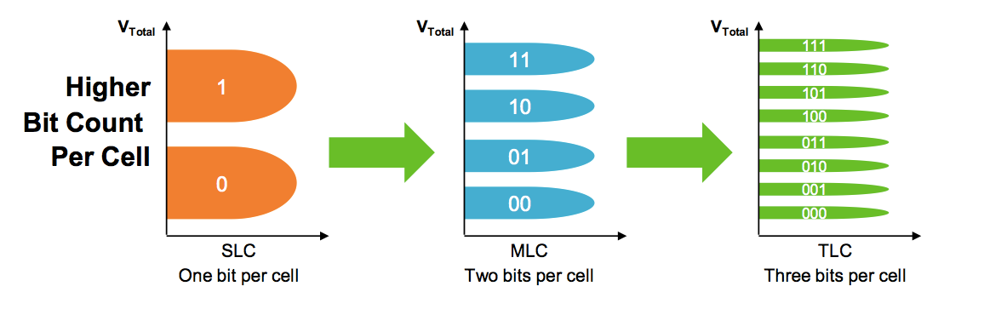
Floating Gate Cell design
Single-level cell, multi-level cell and triple-level cell

Slide 22
3-D NAND Flash Technology
Currently SanDisk and partner company, Toshiba, recently announced the development of a 48-layer 3-D NAND flash chips.
  Full production expected to take place in early 2016
Some benefits of 3-D NAND Flash Technology
  More storage capabilities
  Better performance
  Bigger energy savings
  Longer-lived SSDs

Slide 23
Xilinx UltrascaleTM 3D ICs/FPGAs
Xilinx is Delivering a Generation Ahead with All Programmable FPGAs, SoCs, 3-D ICs and Design Tools at 28nm and 20nm scale
They provide unprecedented levels of system integration, performance, and capability
Ideal for:
  Next-gen wired communications
  High-performance computing
  Medical image processing
  ASIC prototyping/emulation

Slide 24
Other Companies Involved in 3-D ICs
Many microelectronic manufacturers have had a hand in making 3 Dimensional Integrated Circuits technology what it is today
Some have developed specialized tools while others have conducted research and development on the many parts that are all put into each die and/or package
The next slide has a list of companies and the year that they started manufacturing their tech

Slide 25
Other Companies Involved in 3-D ICs
Tezzaron (2012)
Ziptronix (2012)
ZyCube (2010)
Vertical Circuits (2010)
FlipChip International (2010)
Amkor (2012)
3D Plus (2010)
ALLVIA (2011)
Austriamicrosystems (2010)
CMC Microsystems (2012)
CMP (2012)
Mosis (2012)
IMT (2010)
EPworks (2011)
CEA-Leti (2011)
Syagrus (2012)

Slide 26
Summary and Conclusions
3-D ICs are going to become an integral part of modern day and future technology
With everything getting smaller and faster, vertically stacking die have been proven to be one of the best ways to keep up with that demand
Many companies have had a hand in this technology and most of them say that we have only scratched the surface of what we are capable of doing with it

Slide 27
References
"2.5D-IC, 3D-IC, and 5.5D-IC – Stacked-die Integration." Tech Design Forum Techniques. N.p., n.d. Web. 07 Apr. 2015.
Hernandez, Pedro. "SanDisk, Toshiba, Intel and Micron Locked in 3D Flash Memory Race." SanDisk, Toshiba, Intel and Micron Locked in 3D Flash Memory Race. InfoStor, 27 Mar. 2015. Web. 09 Apr. 2015.
“Industry’s First 3D ICs." 3D IC. N.p., n.d. Web. 09 Apr. 2015.
Lau, John H. "Through-Silicon Hole Interposers for 3-D IC Integration." IEEE Xplore 1.1 (2011): n. pag. 2011. Web. 8 Apr. 2015.
Maxfield, Clive. "2D vs. 2.5D vs. 3D ICs 101 | EE Times." EETimes. N.p., 8 Apr. 2012. Web. 07 Apr. 2015.
"The 3D Community." Tezzaron. N.p., n.d. Web. 09 Apr. 2015.

Slide 28
List of 5 questions for final exam
What is one function of a die?
    Memory, logic or analog/RF
Benefits of 3-D ICs
    Smaller footprint, shorter interconnect , better bandwidth, etc
Drawbacks?
    Cost, heat, lack of standards and yield.
With the addition of _____ to the 2-D ICs, 3-D ICs were born.
    Through Silicon Vias (TSVs)
With 3-D NAND technology, what size flash drives and SSDs do Intel and Micron claim to be able to build?
    3.5 TB Flash drives and 10 TB 2.5” SSDs

