Slide 1
ADVANCED PHOTOVOLTAICS NEW MATERIALS AND APPROACHES ,GRID APPLICATIONS
Shanmukha Reddy
4th MAY 2015
Abstract
While a majority of current worlds electricity generated from fossil fuels like coal,oil and natural gas,these traditional energy sources face a number of challenges including rising prices,security concerns over dependency of imports from limited number of countries having significant supply of fossil fuels,growing environmental concerns over climate change.Whereas the solar energy is getting cheaper with time ,reduces dependency on fossil fuels, Environmental Advantage,Matching peak time output with peak time demand,Modularity and scalability,Flexible Locations and Government incentives.

Slide 2
OUTLINE
Introduction.
Need of Advanced Photovoltaics.
Types of Photovoltaics.
Multijunction solar cells.
Organic PV.
Hybrid PV.
Grid Integration.
Overview/Conclusions.
References.
Keypoints.

Slide 3
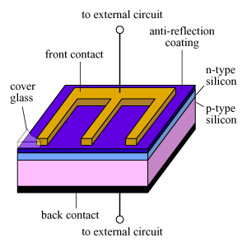
Introduction
It’s just not a contact of P and N type materials,
then it would form a Diode ,instead ohmic metal-semiconductor
contacts are made which are connected to external load so that
electrons are swept to n-side and holes to p-side.

Slide 4
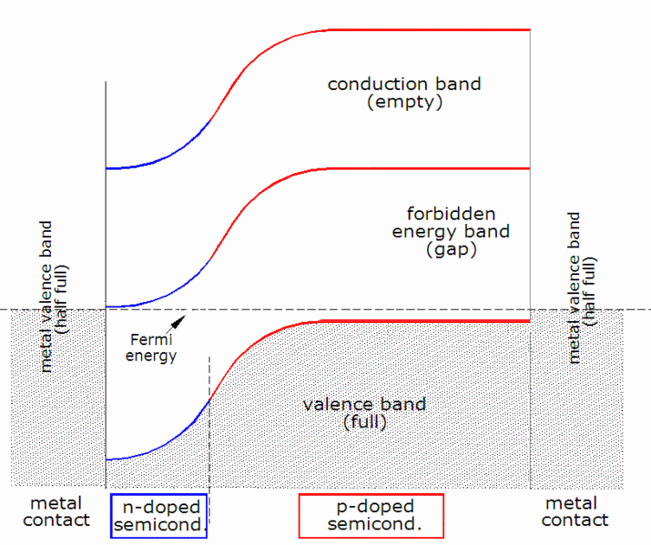
Introduction (Contd…)

Slide 5
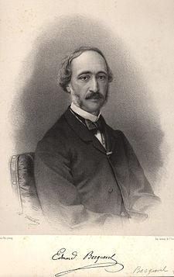
History
Experimentally first demonstrated by Edmond
Becquerel.
Albert Einstein explained the mechanism
(photoelectric effect) in 1905.
First public demonstration by Bell labs on
25th April 1954.
Solar cell gained prominence in 1958 when
when proposed as addition in satellite.

Slide 6
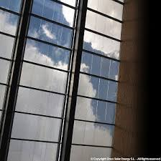
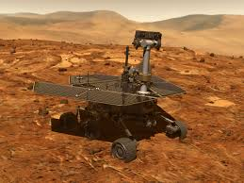
Need of Advanced Photovoltaics
There are many space missions which use PV modules for
power generation.
Efficient power generation for terrestrial use.
Manufacturing Non-toxic PV cells.
Manufacturing transparent and different coloured PV’s

Slide 7
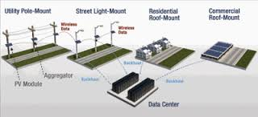
Need of Advanced PV(contd…)
To make the solar Energy much more cheaper.
To make the solar panel more compatible to integrate with the power Grid.
Long lasting without degradation in performance and low maintenance by making them more robust.

Slide 8
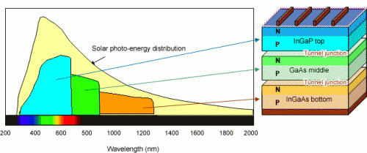
Multijunction Solar Cells
Today,s most common PV devices use single junction.
To increase the efficiency of solar cells.
Highest efficiency achieved until now for a solar cell is 37.7% for the trijunction cell shown below by sharp corporation of japan. About to use this in satellites.
Planning to increase the power output by using the focusing reflectors.

Slide 9
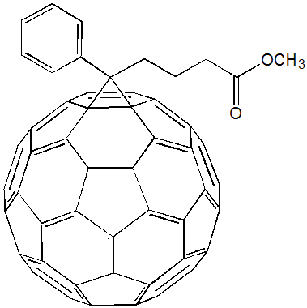
Organic Photovoltaics
Manufactured using organic (Non-metallic) materials which have semiconductor properties.
Semiconductivity occurs in these material for molecules ,short chain of molecules or long polymer chains unlike in semiconductor material atoms.
Small molecule semiconductors include Anthracene, Pentacene and Rubrene ,large molecules include Fullerenes and Fullerene derivatives.

Slide 10
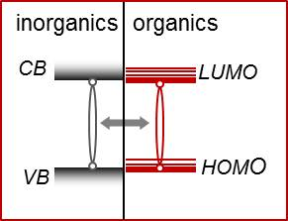
Organic PV(contd…)
When photon is absorbed then electron -hole pair is created which is bound together by exciton(Electrostatic interactions) confined to a molecule.
This Exciton is broken up by effective field of the PN junction.
These material have delocalized Pi bonding and Pi* antibonding orbitals for electrons and the delocalized Pi orbital is Highest occupied molecular orbital(HOMO).
Pi* orbital is the lowest unoccupied Molecular Orbital(LUMO).

Slide 11
Organic PV(contd…)
Advantages and Disadvantages of organic PV compared to inorganic:
Advantages: Disadvantages:
1. Less expensive to generate 1. Low efficiency.
than inorganic semiconductors.
2. Inexpensive Fabrication. 2.Susceptible to water and oxygen.
3. Low Annealing temperature 3.Still in initial stage of research.
is required .
4. Low annealing temperatures give
flexibility for substrate.
5. Intoxic and soluble in some solvents
so cheaper processing.

Slide 12
Hybrid PV
Has the advantages of both organic and inorganic solar cells.
Organic material acts as donor and inorganic material as acceptor.
Controlling the interface of both material can increase efficiency of cells.
3 different types of interfaces and structures of hybrid PV.
1. Mesoporous Films
- Has a porous inorganic material filled with organic surfactants.
- problem of random ordering and controlling nanoscale structure.
2. Ordered Lamellar films.
- It has large number of organic and inorganic layers alternately.
3. Films of ordered Nanostructures.
- It is nanostructures surrounded by organic material
-Reduces TIR and increases defect tolerance.

Slide 13
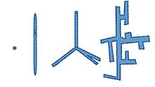
Types of Hybrid PV
Polymer-nanoparticle composite type:
- resembles polymer solar cells except nanoparticles replace fullerene acceptor.
-Many advantages over organic semiconductors
Fullerene synthesis need high temperature arc .
Organic material degrade performance with time .
Nanoparticles are more absorbent and has customizable bandgap.
Some materials can generate 2 excitons.

Slide 14
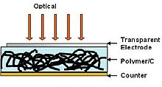
Types of Hybrid PV(contd…)
Carbon Nanotube(CNT) PV:
-can be used as both for exciton carrier transport medium and as photoactive layer
-Metallic CNT used for exciton carrier transport.
-Semiconductor CNT used for active layer(photon-electron conversion).
-High surface area and conductivity of CNT increase efficiency for transport.
-The bandgap of CNT inversely proportional to diameter of CNT.

Slide 15
Types of Hybrid PV(contd…)
Challenges for CNT:
-Degrades in oxygen rich environment and passivation layer reduces efficiency.
-Dispersion of CNT into polymer is a complex process.
-No capability to form PN junction due to difficulty of doping certain segments .
-Band bending is used using electrodes of different work functions.
-Oxidized CNT is less useful as PV material.

Slide 16
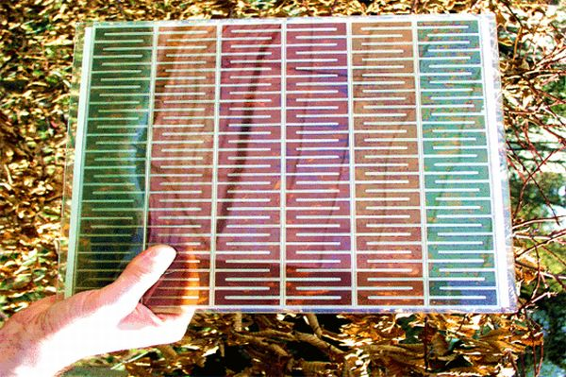
Types of Hybrid PV(contd…)
Dye sensitized PV:
- They are formed with inorganic material (TiO2) and any organic material.
-Dye adsorbed titania is used to increase absorption bandwidth of incident light.
-Low diffusion length so, variety of organic material are used with Titania.
-TiO2 acts as n-type material due to
donor like oxygen vacancies.
-Cheaper, cleaner alternative of SiO2,
and is available abundantly.

Slide 17
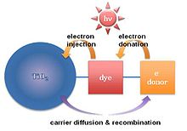
Types of Hybrid PV(contd…)
Two Fabrication schemes:
1.Dye sensitized Electrochemical cells(Gratzel cell):
-TiO2 Nanoparticles are synthesized in tens of nanometers and dye molecules are
attached to TiO2 surface which is enclosed by liquid electrolyte.
- Has a disadvantage of Short diffusivity ,multifunctional sensitizers are being
investigated to improve diffusivity.
- Has a significant efficiency of 10%.

Slide 18
Types of Hybrid PV(contd…)
2.Solid state Dye sensitized solar cell:
-Porous TiO2 containing pores of Diameter 2-50nm is filled with solid hole conducting
material(p-type semiconductor or Organic ).
-Liquid electrolyte in Gratzel cell replaced by solid conducting material so better
diffusivity.
- High conversion efficiency, with organic materials.
Disadvantages:
Disordered TiO2 layer
LUMO of dye should be higher than conduction band of TiO2.
P-type material crystallizes and destroys contact of dye and TiO2.

Slide 19
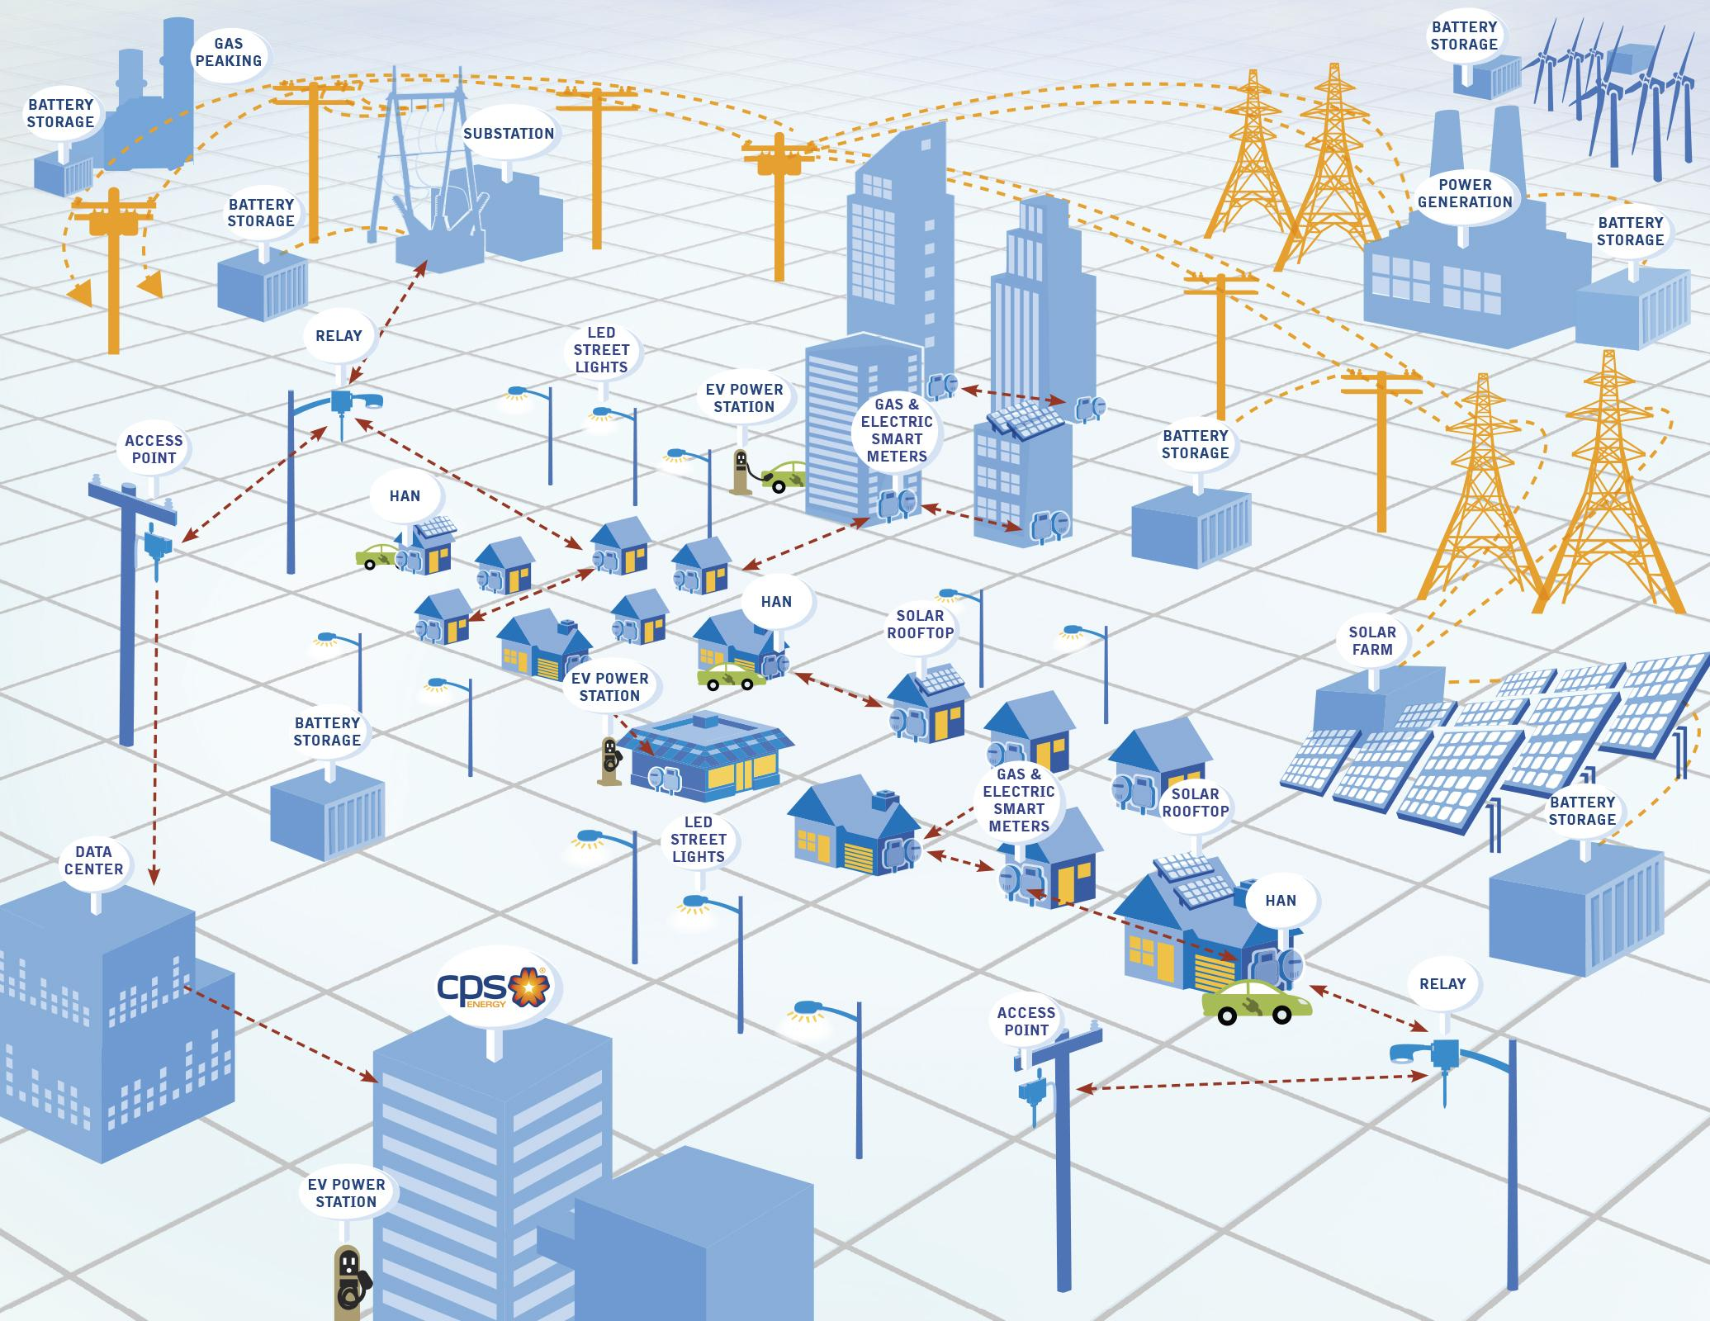
Grid Integration
The only way to integrate PV with Grid is to to grow and act like a power plant.
For integration Inverter technology ,Forecast and energy storage must evolve.
The power generated by solar PV is DC whereas the power generated by conventional methods is Alternating.

Slide 20
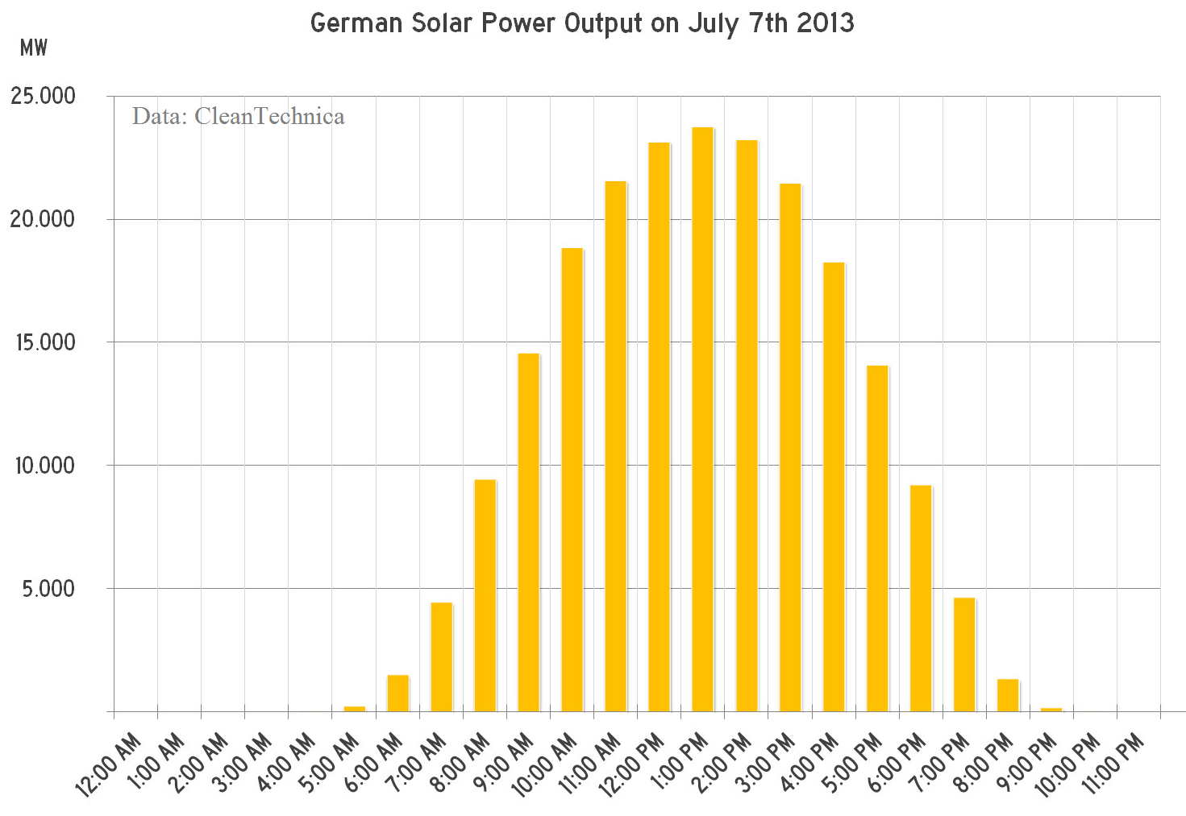
Case study of Grid Integration
Germany uses huge amount of solar power ,example graph of solar output when demand was less on a sunny day it generated 200 GWh, about 13% extra so exported.
Say if target is 25% of overall power power generation (130 TWh) and installed for
35-150 GW the consumption is variable
and now generation will also be variable.
Could give a huge over supply of 800 GW
and grid can hold only 200 GW.

Slide 21
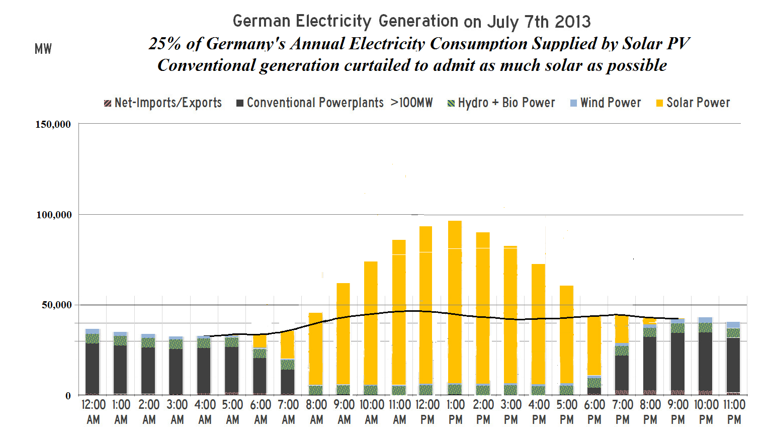
Case study (contd…)
The generation graph even if conventional generation is cut down the graph is
shown below, this might damage the grid heavily.

Slide 22
Overview and Conclusions
The popularity of solar energy is growing due to the increase in costs of conventional energy and reduction in cost of solar energy.
So the Research in this field is growing day by day.
Solar energy is of unlimited supply and more than what we need.
Presently more research is being done on improving the efficiency, making them non toxic, and flexible.
There are initiations for integrating Solar power farms to the Grid but many problems to solve if solar energy is enhanced.

Slide 23
References
http://phys.org/news/2012-12-solar-cell-world-highest-conversion.html
http://imr.osu.edu/research/centers/focus-areas/advanced-photovoltaics/
http://en.wikipedia.org/wiki/Organic_solar_cell
http://www.elp.com
http://euanmearns.com/large-scale-grid-integration-of-solar-power-many-problems-few-solutions/
http://commons.wikimedia.org/wiki/solar_cell
http://www.sigmaldrich.com
Images:
http://www.nwscc.edu/nsfdc/technology/Electronic%20Symbols%20.htm
http://www.engineering.com/ElectronicsDesign/ElectronicsDesignArticles/ArticleID/6123/Photovoltaic-Thermal-System-Achieves-86-Efficiency.aspx
http://imr.osu.edu/research/centers/focus-areas/advanced-photovoltaics/
http://euanmearns.com/large-scale-grid-integration-of-solar-power-many-problems-few-solutions/
http://www.newsroom.cpsenergy.com
http://www.ili.si.edu/digitalcollections/hst//scientificidentity/fullsize/SIL14-B2-07a.jpg

Slide 24
Keypoints
Need of Advancement in PV.
The major difference between a PN junction diode and a solar cell.
Highest efficiency achieved by a solar cell .
Need of organic and Hybrid photovoltaics.
Advantages and disadvantages of organic and hybrid PV over inorganic PV.
Challenges faced in integrating solar power with grid.

Slide 25
.
Questions!

