Slide 1
II-VI Semiconductor Materials, Devices, and Applications Lorelei Lewandowski 4/20/2015
There are 7 II-VI semiconductor materials. Because of their direct, wide band gap energy, they are becoming increasingly useful in optical applications. While some of them have been around for many years, research is still needed to determine the full potential of others. The “latest and greatest” technology in the near future will most likely owe much of its success to these materials.

Slide 2
Outline/Intro
List of II-VI Semiconductor Materials
General Common Properties
Common Usage of Each
Overview/Conclusion
References
Concept Check

Slide 3
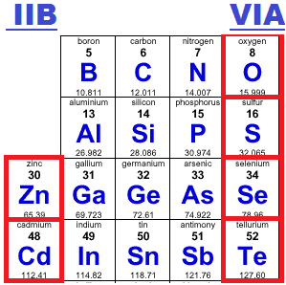
The 7 Materials
Zinc Oxide
Zinc Sulfide
Zinc Selenide
Zinc Telluride
Cadmium Sulfide
Cadmium Selenide
Cadmium Telluride

Slide 4
Process
The growth methods vary by material, but there are various types used with each one. The growth method used depends on the application that is needed.

Slide 5
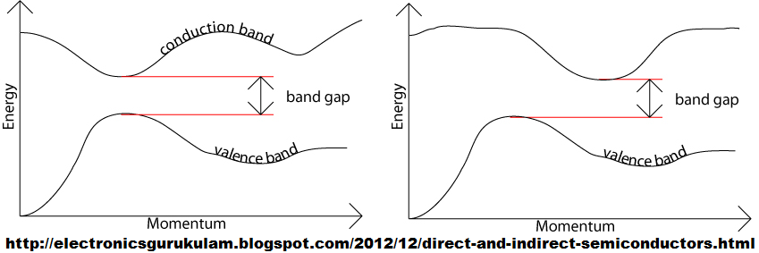
Direct band gaps
No change in momentum takes place, so light can be emitted in the form of a photon, which is necessary for optical devices.

Slide 6
Wide band gap
These 7 materials have band gaps ranging from 1.5eV to 3.54eV.
Perspective: Si has a band gap of 1.1eV and GaAs 1.4eV.
A wider band gap is one property that these materials have in common. Because of this, they have various common applications such as:
LEDs & LDs
Signal Processing

Slide 7
advantages
Higher Iconicity & Stronger Bonds = Higher Melting Temp
Less Energy Lost = More Efficient & Potential For Lower Cost
Higher Breakdown Voltage = High Power & Freq Applications
Higher Doping Concentration = Thinner Device Layers
Higher Electron Mobility = Faster Operation

Slide 8
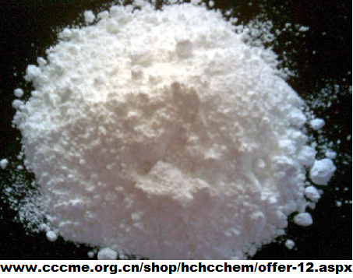
Zinc Oxide (ZnO)
3.3eV Band Gap Energy
Doping is n-type
Abundant & Non-Toxic
Strong Piezoelectric (converting mechanical energy into electrical energy) Effect
Used in Nanogenerators

Slide 9
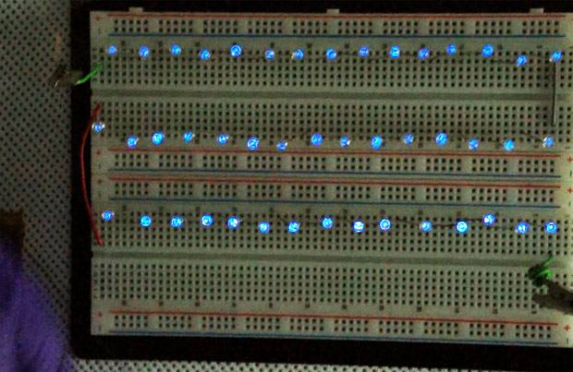
nanogenerators
Currently Being Researched
Many applications
Wind/Water
Human Body – Biomedical
KAIST in Korea in 2014: 130V
Issues
Power Supply
Low Output Current
Unknowns That May Affect Surface Charge Density

Slide 10
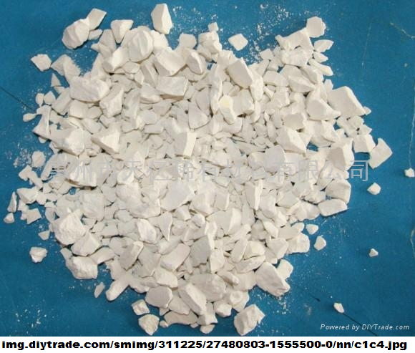
Zinc Sulfide (ZnS)
3.54eV Band Gap Energy
Doping is p-type or n-type
Used in Cathode Ray Tube
Detects Alpha Radiation (via Scintillation)
Scintillation was done in the early 1900s before the nucleus was discovered.

Slide 11
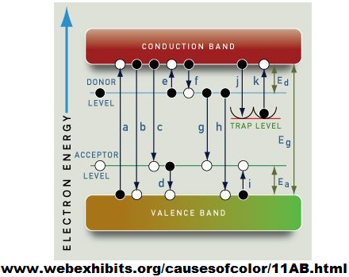
“Glow In The Dark”
Phosphorescence
Silver Added For Blue Glow
Manganese For Orange/Red Glow
Copper Usually Added
Common Green Glow
Glow Lasts Longer

Slide 12
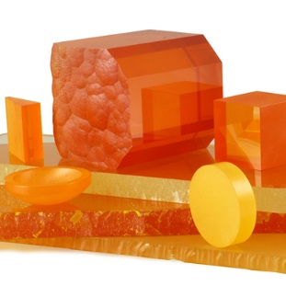
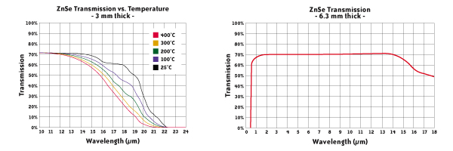
Zinc Selenide (ZnSe)
2.82 eV Band Gap Energy
Doping is n-type
Used As Lenses In High Power CO2 Lasers

Slide 13
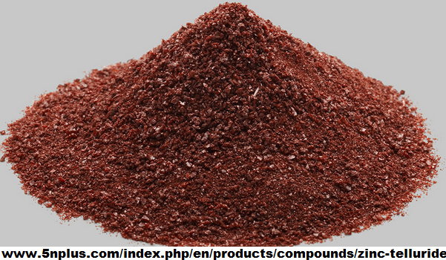
Zinc Telluride (ZnTe)
2.26 eV Band Gap Energy
Doping is p-type
Background Layer in Solar Cells
Tellerium is found in the Earth’s crust, but is very rare.
(About 1-5 Parts Per Billion)
THZ detection and generation

Slide 14
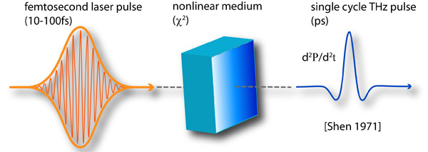
Thz signals
Used For:
Medical Imaging
Security
Spectroscopy

Slide 15
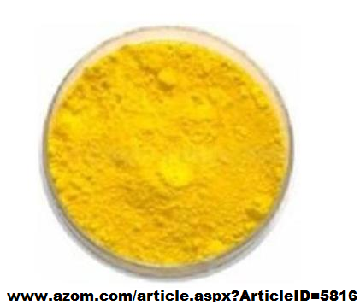
Cadmium Sulfide (CdS)
2.42 eV Band Gap Energy
Doping is n-type
Mainly Used As Pigment
Used in Photoresistors

Slide 16
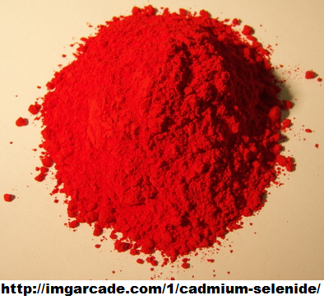
Cadmium Selenide (CdSe)
1.74 eV Band Gap Energy
Doping is n-type
Can Be Used as Layer in CdTe Solar Cells
Most Research Focused On Nanoparticles– Quantum Dots

Slide 17
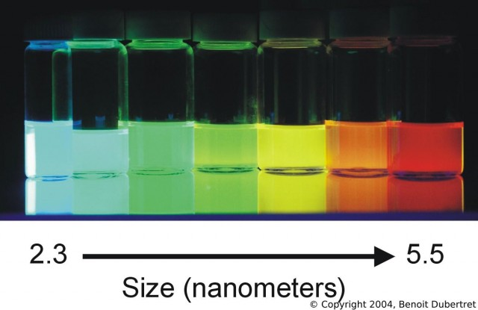
Quantum dots
Quantum dots, discovered in 1981, are nanoscale “dots” of semiconducting material.
They glow a specific color when hit with light.
Applications include LCD LED Tvs, photonics, medical diagnostics, biomedical imaging, etc.

Slide 18
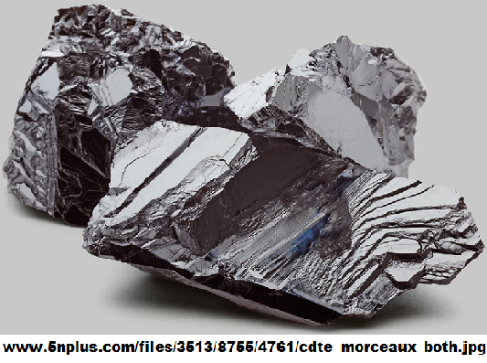
Cadmium Telluride (CdTe)
1.5 eV Band Gap Energy
Doping is p-type
Issues with Cadmium’s Toxicity
2nd most utilized solar cell in the world
CdTe solar panels are the only ones that have surpassed the cost efficiency of polycrystalline Silicon solar panels.
Just last month First Solar set the world record for thin film CdTe solar panel efficiency at 18.7%!
They believe they can achieve up to 23%.

Slide 19
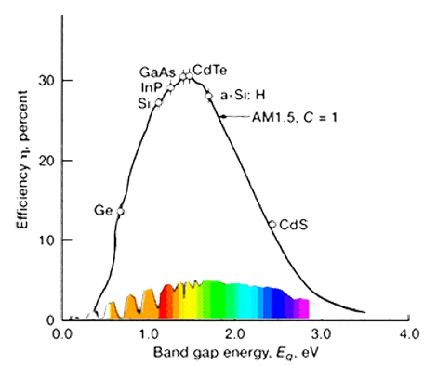
Solar power
CdTe is very close to GaAs in efficiency.
GaAs behavior is used to predict future CdTe efficiency trends.

Slide 20
SUMMARY & CONCLUSION
II-VI semiconductor materials are becoming increasingly important in the semiconductor industry. Nanogenerators have the potential to change the future of electronics while quantum dots and solar panels are integrating themselves into modern electronics. While it’s impossible to determine just how large of an effect these materials will have and how long-lived they will be, high power electronics and the medical industry are already benefiting from them.

Slide 21
REFERENCES
Academic Sources (Articles, Textbooks, IEEE Spectrum)
http://psec.uchicago.edu/library/microchannel_plates/zinc_oxide.pdf
https://books.google.com/books?id=qCebxPjdSBUC&pg=PA110&lpg=PA110&dq=radioactive+decay+zns&source=bl&ots=H2NiCPCG8P&sig=4JyD-vteNbBwENaQYiovVmpJl0s&hl=en&sa=X&ei=3rQwVfyPJ4yZsAWdkYC4Dw&ved=0CCYQ6AEwAg#v=onepage&q&f=false
http://scholar.lib.vt.edu/theses/available/etd-04262005-181042/unrestricted/Ch1Applications.pdf
http://link.springer.com/article/10.1007%2Fs00216-007-1661-9#page-1
http://spectrum.ieee.org/tech-talk/semiconductors/nanotechnology/energy-harvesting-nanogenerators-give-130-volts-at-the-touch-of-a-finger
Websites
http://www.azom.com/article.aspx?ArticleID=8415#5
http://www.firstsolar.com
http://mpsd-cmd.cfel.de/research-met-thz-optrect.html
http://www.iiviinfrared.com/Optical-Materials/znse.html

Slide 22
KEY CONCEPTS
Wide/Direct Band Gap – Importance in Photonics
What are nanogenerators?
What causes things to “glow in the dark”?
Quantum Dots Applications
Solar Panel Innovation by CdTe

