Slide 1
OLED Displays
By: Adam Weidling
Date: 5/1/15

Slide 2
Abstract
OLEDS are an emerging technology in todays electronic display industry. In this presentation the different types of OLED displays as well as their uses will be covered. OLEDS will also be compared to other relevant technologies in use today.

Slide 3
Goals and Objectives
Understand the different types of OLED displays and how they function.
Know the difference between PMOLED and AMOLED and their different applications.
Understand current OLED technology and future developments.

Slide 4
Brief Overview
What is an OLED?
- A light-emitting diode containing thin flexible sheets of organic electroluminescent material which can be used for visual displays.
How does an OLED work?
-Electrons are injected from the cathode.
-Holes are injected from the anode.
Transport and radiative recombination of electron hole pairs at the emissive polymer.

Slide 5
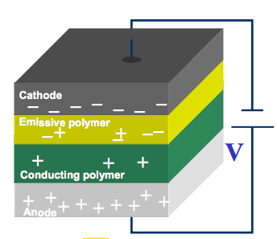

Slide 6
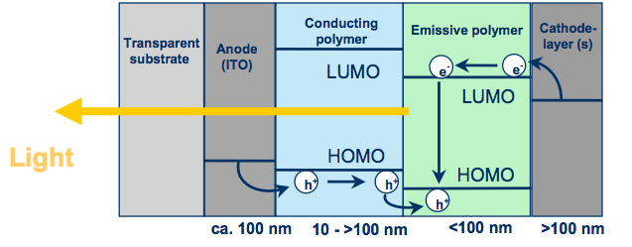
Energy Diagram

Slide 7
PMOLED
Passive matrix OLED (PMOLED)
- PMOLED display uses a fairly simple control scheme in which you control one row or line sequentially.
- PMOLED displays don’t make use of a storage capacitor so the pixels are actually off for a majority of the time.
-The lack of a storage capacitor requires that more voltage be used to make the display brighter.
Higher voltage causes for a shorter lifetime of the OLED.
The more lines you add the more voltage you have to use.

Slide 8
-PMOLED displays are restricted in resolution and size so as OLED display technology advances PMOLED will unlikely be used to create large displays.
Generally PMOLED displays there is a restriction on resolution and size. Usually up to 3” displays.
Used to display small character data or icons.

Slide 9
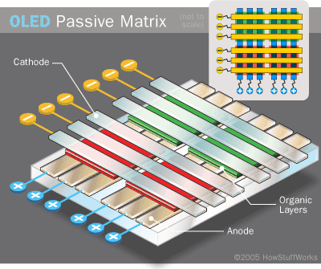

Slide 10
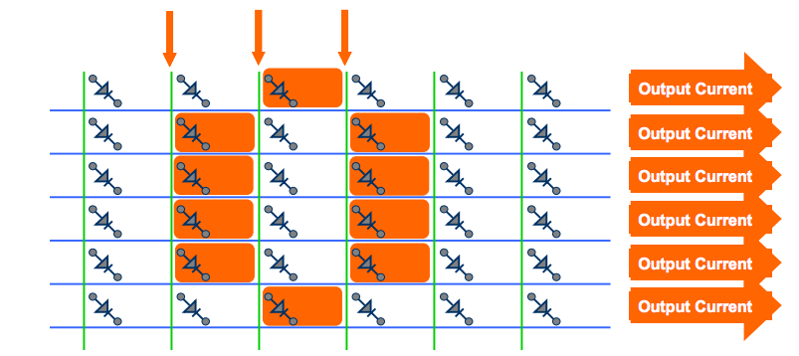
PMOLED Display

Slide 12
AMOLED
Active Matrix OLED (AMOLED)
- AMOLED displays require a thin film transistor backplane to switch each pixel on or off. This scheme allows for larger display sizes and higher resolution.
Currently low temperature polycrystalline silicon TFT backplanes are used.
The TFT controls the amount of current going to the pixel which dictates the brightness.
As information is sent to the transistor it will adjust the pixels.
OLED is operating continuously so it can avoid the need for high currents such as in the PMOLED array.
Storage capacitor used to maintain pixel state.

Slide 13
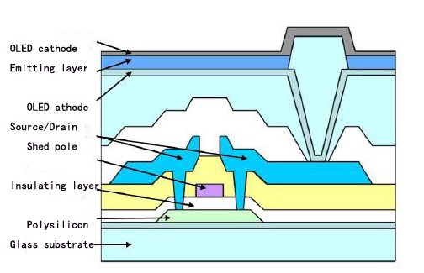
TFT

Slide 14
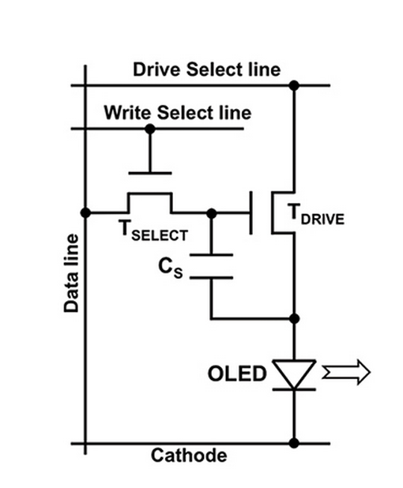
Simple Control Circuit

Slide 15
Backplane Technologies

Slide 16
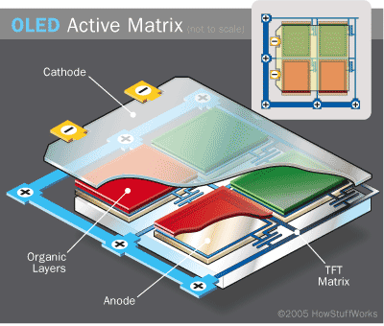

Slide 17
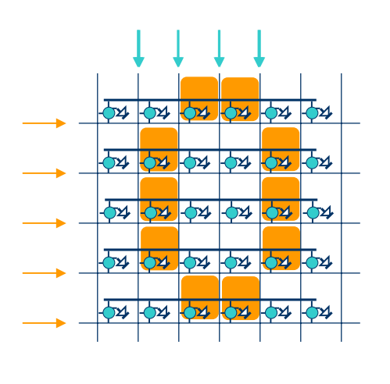
AMOLED Display

Slide 18
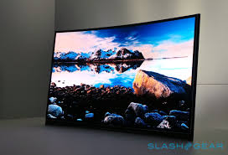
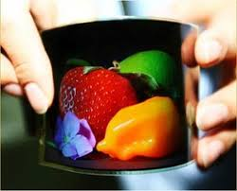

Slide 19
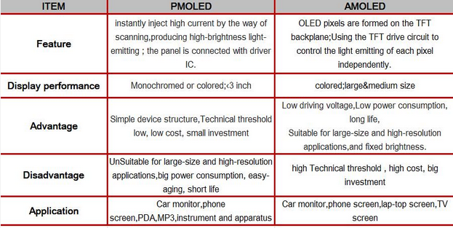
PMOLED Vs. AMOLED

Slide 20
Current Technology
Max Resolution 3840 x 2160 (4k) 16:9 aspect ratio
Annual operating cost of $27

Slide 21
1920 x 1080 16:9 Aspect ratio
Annual cost of $27

Slide 22
Pixel Architecture
LCD
AMOLED

Slide 23
LCD has same amount of red, blue, and green sub pixels.
All sub pixels are the same size
AMOLED pixels follow the red, green, blue, green pattern.
This results in half the number of red and blue sub pixels.
This layout also improves efficiency because the blue pixels use 10 times the energy of a green pixel to maintain the same brightness.
Same brightness is obtained with lower power consumption.
Blue and Red sub pixels burnout faster and pentile layout allows displays to last longer.

Slide 24
Resolution
8k displays are in the works!

Slide 25
4K resolution (UHD) Ultra High Definition
3840 x 2160 which is about 8 million pixels
4 times the resolution of a 1080p TV.
Future 8k displays
7680x4320 which is about 33 million pixels
Pixilation would be non existent to the human eye

Slide 26
Affordability
LG plans to quadrupling production at their M2 factory in hopes that with increased supply the cost of OLEDS will drop.
600 million dollar investment to make sure a larger array of sizes will be available to the public.
Projected revenue of 27 Billion by 2017

Slide 27
Why OLED?
Incredible image quality
No backlight necessary
Very thing and lightweight
Flexible
Numerous applications

Slide 28
OLED vs. LCD/LED
Advantages
Higher quality images. (deeper blacks, better contrast)
Faster refresh rate
Wider viewing angle
Vibrant colors
Simple structure
Disadvantages
Cost
Lifetime
Slightly higher annual operating cost

Slide 32
Quality LCD Vs. OLED

Slide 33
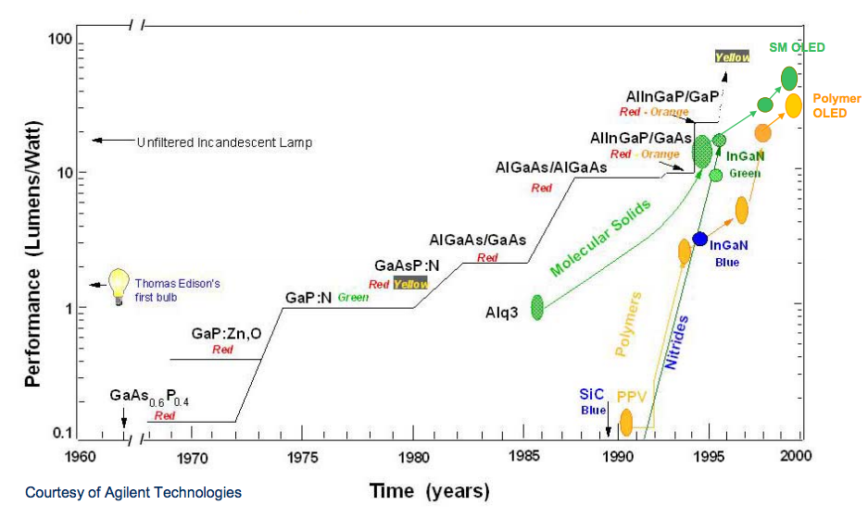
Other Technologies

Slide 34
Future OLED Displays
Future of OLED displays is virtually endless. The use of transparent OLEDS can factor into almost all aspects of life.
Future Samsung displays: transparent and bendable.
https://www.youtube.com/watch?v=NCZ5JDEv9_g

Slide 35
5 main concepts
PMOLED
AMOLED
TFT backplane technology
Why pentile pixel layout
What color OLED is most inefficient

Slide 36
Conclusion
OLED displays have drastically increased image quality and efficiency of power consumption. If OLED displays are able to overcome the hurdles such as lifetime and cost they will certainly be the future of the large display industry.

Slide 37
References
"OLED For Everyone? LG Explains How It's Making OLED TVs Affordable." Forbes. Forbes Magazine, n.d. Web. 27 Apr. 2015.
"4K vs. UHD: What’s the Difference? | ExtremeTech." ExtremeTech. N.p., n.d. Web. 28 Apr. 2015.
"OLEDs, 4K HD, and Smart TV: What’s the Best Near-term Bet for Better Television? | ExtremeTech." ExtremeTech. N.p., n.d. Web. 28 Apr. 2015.
Homer Antoniadis | Oled Product Development|, and Page:. Overview of OLED Display Technology (n.d.): n. pag. Web. 22 Apr. 2015.

Slide 38
"Display Technology Explained: A-Si, LTPS, Amorphous IGZO, and beyond." Android Authority Display Technology Explained ASi LTPS Amorphous IGZO and beyond Comments. N.p., 02 July 2014. Web. 28 Apr. 2015.
"Post Navigation." Dailywirelessorg. N.p., n.d. Web. 28 Apr. 2015.

