Slide 1
OLEDs – THEORY AND FABRICATION
Nick Robillard 5/1/15
ABSTRACT: Organic Light Emitting Diodes are quickly becoming the cutting edge in display technology. This presentation will give a brief history of OLEDs, the theory behind organic semiconductors, the physics behind OLEDs, and then go into different fabrication techniques. The apparent advantages and disadvantages of OLEDs will also be examined.

Slide 2
OUTLINE
History
Organic Semiconductors
Physics of OLEDs
Fabrication
Advantages/Disadvantages

Slide 3
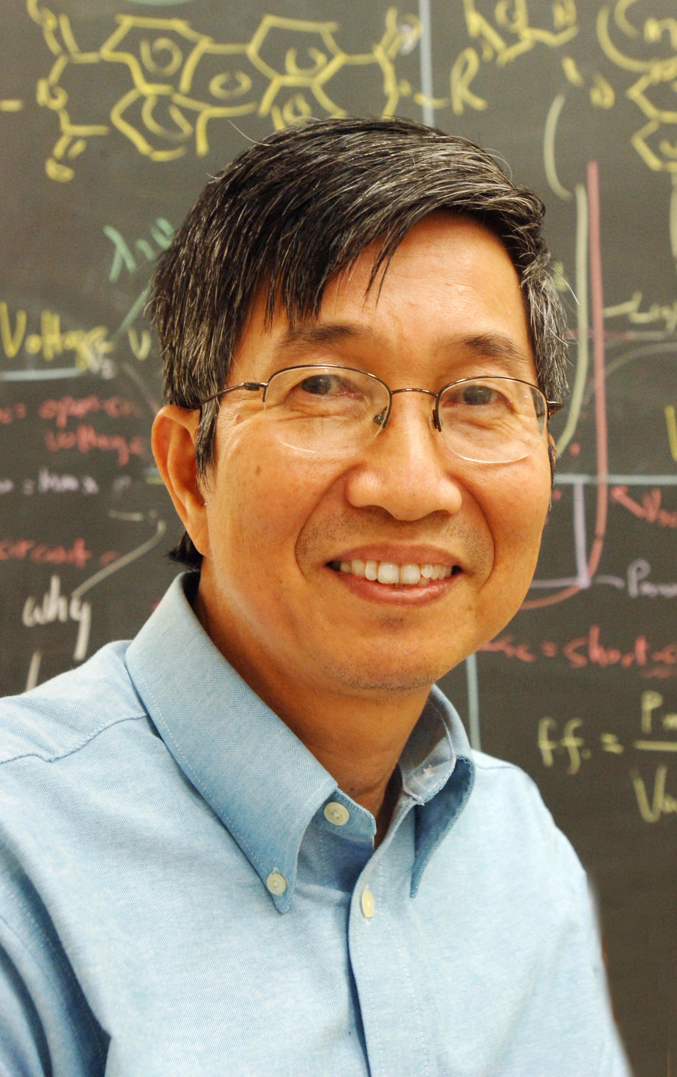
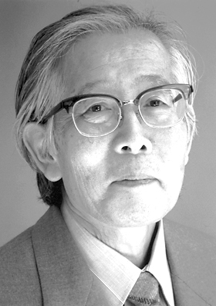
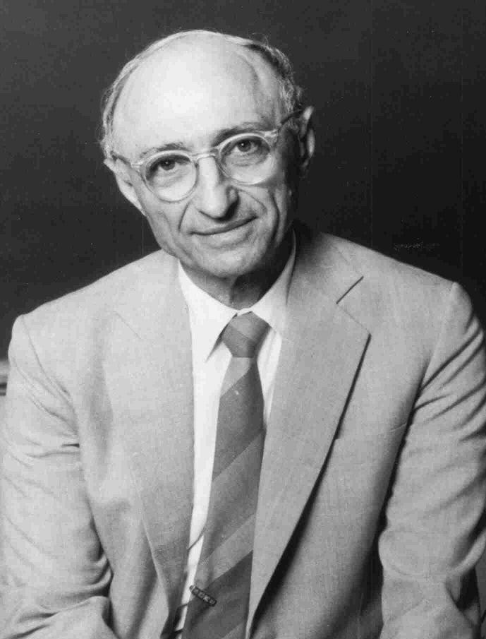
HISTORY OF OLEDs
1862 – Henry Letheby
1st partly conductive polymer: polyaniline
1950s – Andre Bernanose
1st observation of organic electroluminesce
1960 – Martin Pope
Developed ohmic dark-injecting electrode contacts for organic crystals
basis for charge injection in all modern OLED devices
1977 – Hideki Shirakawa
high conductivity in iodine-doped polyacetylene
Awarded Nobel Prize in Chemistry
1987 – Ching Tang & Steven Van Slyke
first organic diode device for Eastman Kodak
http://www.npg.org.uk/collections/search/portraitLarge/mw124586/Henry-Letheby?LinkID=mp87183&search=sas&sText=Letheby&OConly=true&role=sit&rNo=0

Slide 4
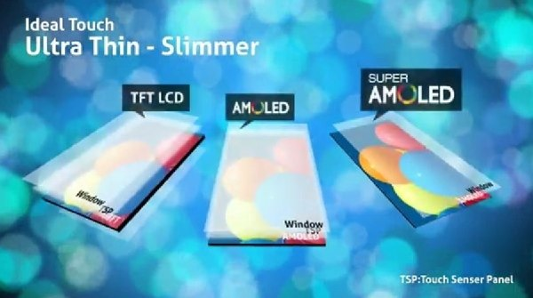
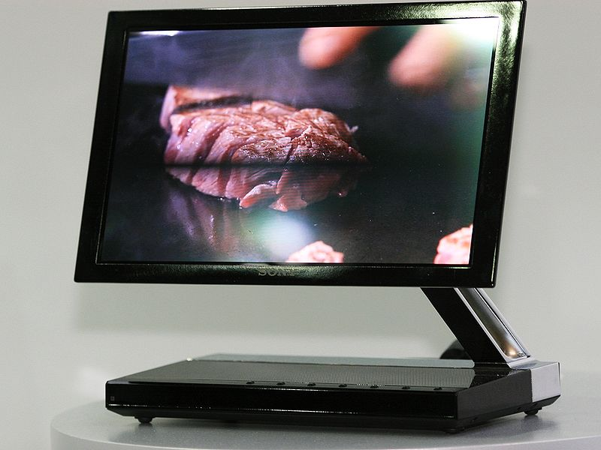
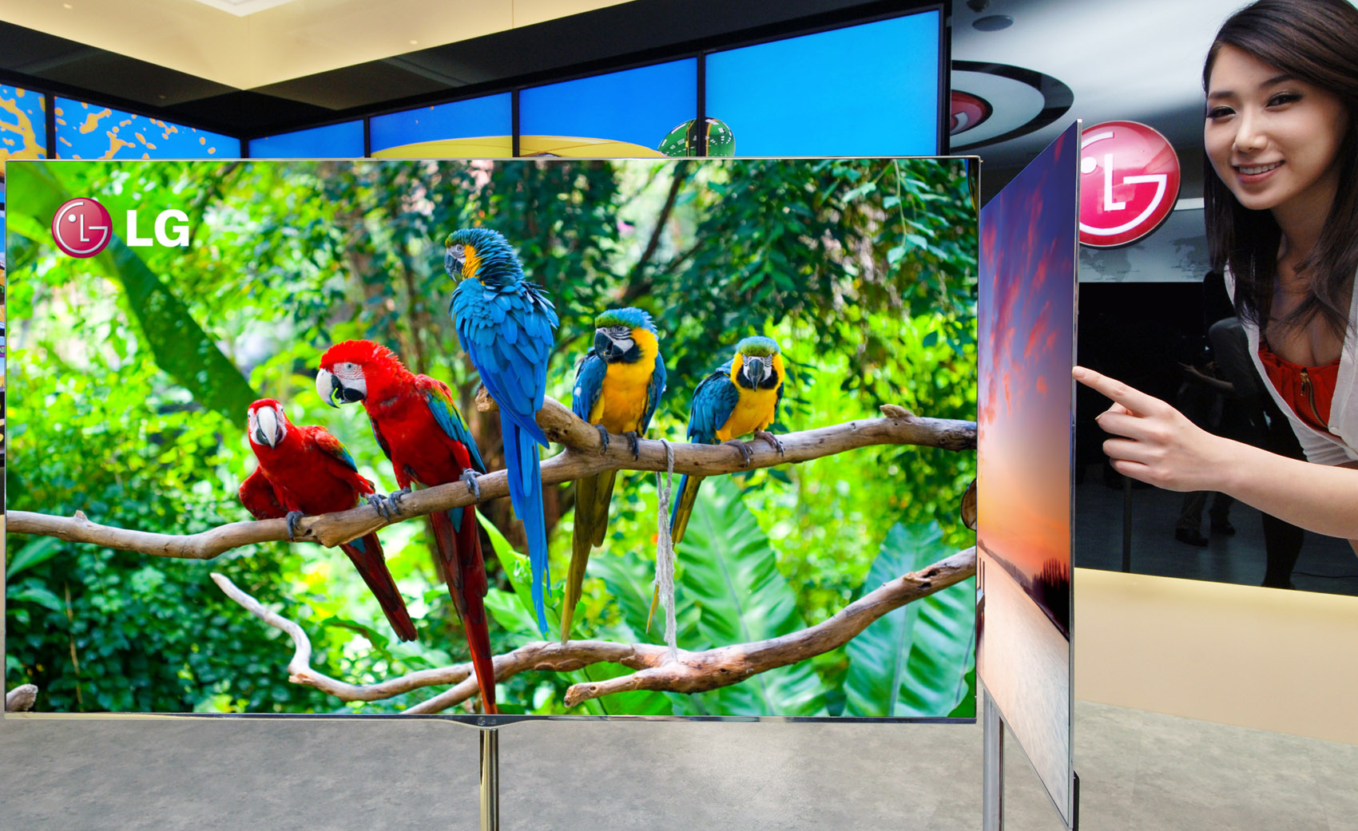
History of OLEDs(cont)
1990 – JH Burroughs
High efficiency green light emitting polymers
Sheets 100 nm thick
1998 – Kodak & Sanyo
Full-Color AMOLED
2007 – Sony
First OLED TV in Japan
2010 – Samsung
7 inch Super-AMOLED display
2012 – LG
55 in TV display

Slide 5
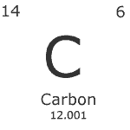
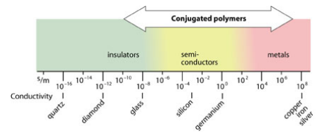
Organic Semiconductors
Carbon polymers
Plastic
Insulator?
Doping
Heeger, MacDiarmid, and Shirakawa
Oxidize a thin film of polyacetylene with iodine vapor
Increase conductivity a billion times
Much like doping of conventional semiconductors

Slide 6
ORGANIC SEMICONDUCTORS(cont.)
Conductive Polymer
Conjugate double bonds
Doping
Oxidation (P-doping)
Halogen gas
Ex.) [CH]_{n} + 3x/2 I₂ --> [CH]_{n}^{x+} + x I₃⁻
Reduction(n-doping)
Alkali metal
Ex.) [CH]_{n} + x Na --> [CH]_{n}^{x-} + x Na⁺
Polyacetylene
http://www.nobelprize.org/nobel_prizes/chemistry/laureates/2000/popular.html

Slide 7
π and σ Bonds

Slide 8
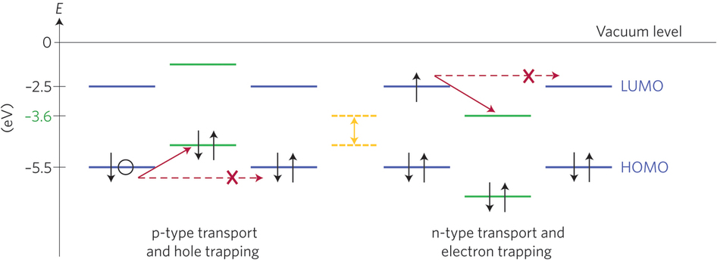
Organic Semiconductors(cont.)
Most organic materials are intrinsically p-type
Higher hole mobility than electron mobility
Opposite of non-organic semiconductors
Trap states
Electrons more susceptible to trapping
Impurities frequently have empty orbitals (that trap electrons) below -3eV
Filled orbitals (which trap holes) above -5eV are not as common
http://www.nature.com/nmat/journal/v11/n10/full/nmat3427.html?WT.ec_id=NMAT-201210

Slide 9
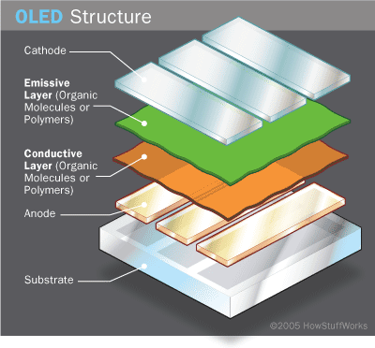
Physics of OLEDs
Cathode
Emissive layer
“N-type” polymer
Ex.) polyfluorene
Conducting layer
“P-type” polymer
Ex.) polyaniline
Anode
http://electronics.howstuffworks.com/oled1.htm

Slide 10
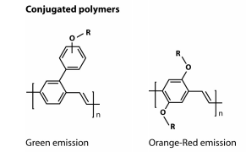
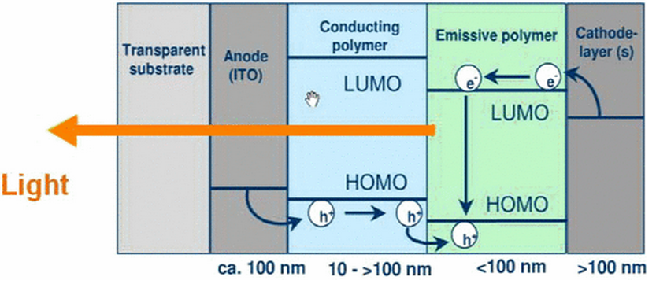
Physics of OLEDs(cont.)
Electrophosphorescence
Voltage applied across device
Electron-hole recombination
Energy released in the form of light
∆ E = E(LUMO) – E (HOMO) = h ν = h c / λ
Different emissive polymers emit different wavelengths of light
Displays will use several types of organic lights to make the different colors
http://ieeexplore.ieee.org/ielx5/6329165/6338451/6338465/html/img/6338465-fig-2-small.gif
http://www.nobelprize.org/nobel_prizes/chemistry/laureates/2000/advanced-chemistryprize2000.pdf

Slide 11
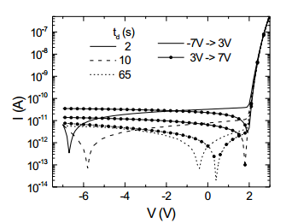
Physics of OLEDs(cont.)
Operating voltage: 2-10V
Very dynamic
Can emit all steps between 0% and 100% light, depending on the current
V-I Characteristic
Hysteresis for different sweep directions
Transient behavior likely from deep traps
http://ieeexplore.ieee.org/stamp/stamp.jsp?arnumber=1503740

Slide 12
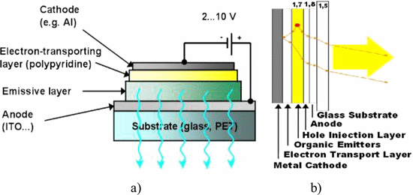
Fabrication of OLEDs
General layout
Three Types:
Vacuum Deposition/Vacuum Thermal Evaporation(VTE)
Organic Vapor Phase Deposition
Inkjet Printing
http://ieeexplore.ieee.org/xpls/icp.jsp?arnumber=6338465

Slide 13
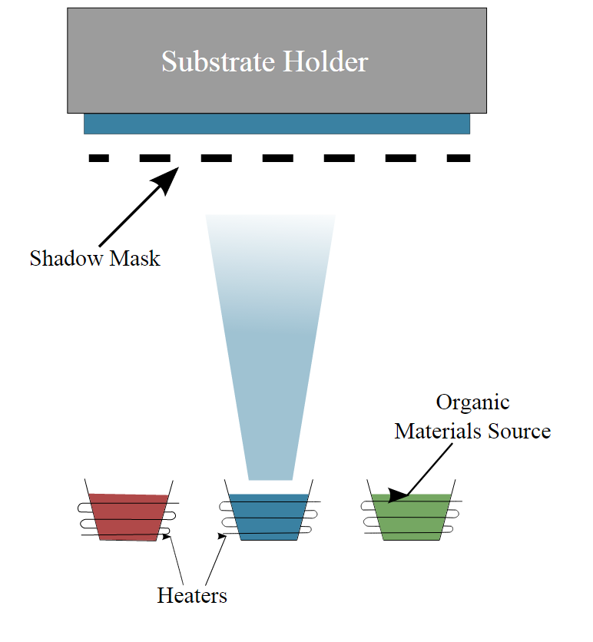
Vacuum Thermal Evaporation
Very low pressure (10⁻⁶ or 10⁻⁵ Torr)
Organic molecules heated until evaporation
Condense on a cooled substrate
Thickness of each layer can be precisely controlled
Disadvantages:
Evaporant condensed on cold walls can flake off, contaminating the system and substrate
Controlling uniformity and doping concentration over large areas are very difficult
Very expensive and inefficient

Slide 14
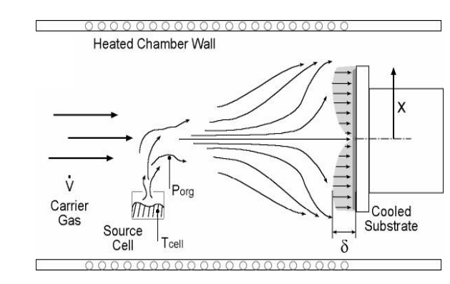
Organic Vapor Phase Deposition
Process:
Organic compound is thermally evaporated
Fed into a diluting, non-reactive gas stream(such as nitrogen)
Condenses onto a cooled substrate
Improves control over doping
Controlled by both temperature and carrier gas flow rate
Better for large-area substrates
http://www.princeton.edu/~benziger/OVPD.pdf

Slide 15
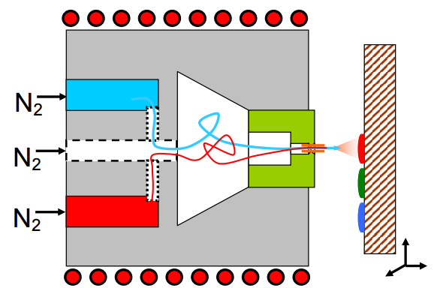
Inkjet Printing
Process:
Organic materials diluted into a liquid and sprayed onto substrates, just like a standard inkjet printer
State-of-the-art
Current Research Area
MIT spinout Kateeva
Many techniques are proprietary
Organic Vapor Jet Printing
Developed at Princeton
Uses vaporized organics instead of the liquid based jets of other inkjet printers
Drastically decreases manufacturing costs and paves the way for flexible and large-screen models
http://www.princeton.edu/~benziger/OVPD.pdf

Slide 16
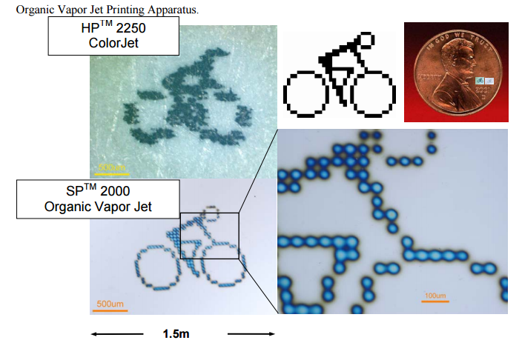

Slide 17
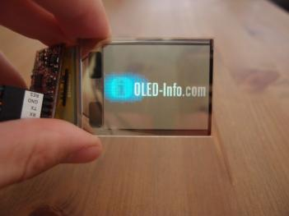
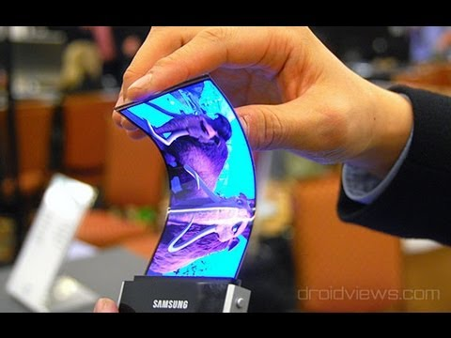
Advantages
Disadvantages
Relatively easy and cheap to produce
Drastically reduce power consumption of displays
Flexible, foldable, and transparent displays
Questionable lifespan
Blue OLEDs currently degrade significantly faster than red and green
Color balance
Water damage susceptibility
Expensive manufacturing
http://www.oled-info.com/files/4DS-transparent-PMOLED-img_assist-351x263.jpg
http://i.ytimg.com/vi/mLMWXBv5rY4/hqdefault.jpg

Slide 18
Summary
OLEDs are made of organic semiconductors
Discovered by accident by Hideki Shirakawa
Conjugated Bonds and Doping
Physics of Electrophosphorescence
Fabrication
Vacuum Thermal Deposition
Organic Vapor Phase Deposition
Inkjet Printing
Advantages/Disadvantages

Slide 19
References
http://newsoffice.mit.edu/2015/mass-produced-inkjet-printed-oled-displays-0212
http://www.princeton.edu/~benziger/OVPD.pdf
http://ieeexplore.ieee.org.libpdb.d.umn.edu:2048/stamp/stamp.jsp?tp=&arnumber=1511521
http://electronics.howstuffworks.com/oled7.htm
http://spectrum.ieee.org/tech-talk/semiconductors/materials/organic-glasses
http://spectrum.ieee.org/semiconductors/materials/organic-semiconductor-breakthrough-could-speed-flexible-circuits
http://www.nobelprize.org/nobel_prizes/chemistry/laureates/2000/popular.html

Slide 20
References(cont.)
http://www.nobelprize.org/nobel_prizes/chemistry/laureates/2000/advanced-chemistryprize2000.pdf
http://www.nature.com/nmat/journal/v11/n10/full/nmat3427.html
http://ieeexplore.ieee.org/stamp/stamp.jsp?arnumber=1503740
http://ieeexplore.ieee.org/xpls/icp.jsp?arnumber=973248
http://en.wikipedia.org/wiki/Organic_semiconductor
http://en.wikipedia.org/wiki/OLED

Slide 21
Questions/Comments?

