Slide 1
Advance LED and LASER Structures Including Quantum Well Structures
By Karin Larson 4/25/16
Abstract: This presentation introduces the difference between LED and LASER diodes, their four main structures, and basic emissions.

Slide 2
Outline
LED vs LASER
Homostructure
Single Heterostructure
Double Heterostructure
Quantum Wells
Edge and Surface Emissions

Slide 3
LED and LASER
Electroluminescence
Reliable and long lifespan due to small size
Mass produced at low cost
Release a photon by an electron moving from a high state to a lower one

Slide 4
LED
Light Emitting Diode
Mostly Monochromatic
Light from spontaneous emission
Significantly divergent
Incoherent light

Slide 5
LASER
Light Amplification by Stimulation of Emitted Radiation
Single wavelength
Light by stimulated emission
Little divergence
Coherent light

Slide 6
Homostructure
p-n homojuction
Both p and n are heavily doped
Excess carriers are spread by diffusion
Thickness of the active region is generally a few micrometers
Impractical for LASER diodes

Slide 7
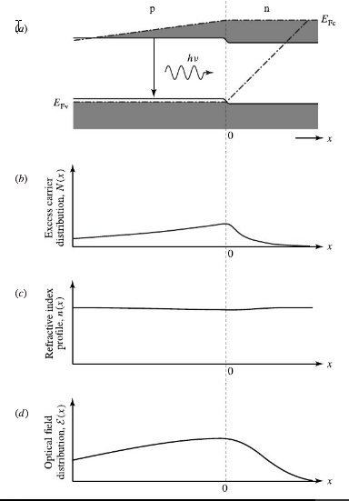
(Liu)

Slide 8
Single Heterostructure
Replace p region with a P-p heterojunction to restrict diffusion
Creates a P-p-n diode
Causes a defined active layer in p region

Slide 9
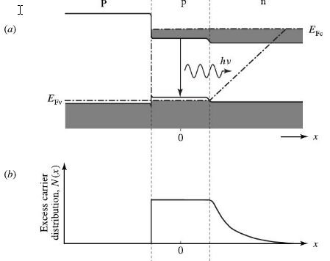
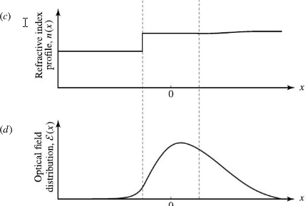
(Liu)

Slide 10
Double Heterostructure
Can be either P-p-N or P-n-N
There is now a heterojunction on each side of the active region
Better than single heterostructures
Active region 100-300nm
High efficiency and large optical gain
Less absorption loss

Slide 11
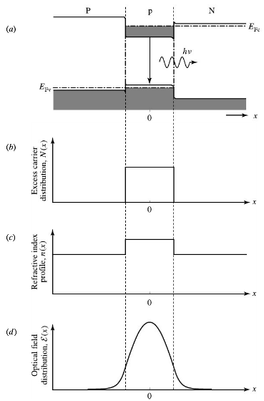
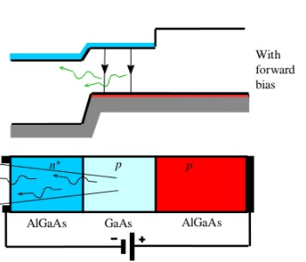
(Treharne)
(Liu)

Slide 12
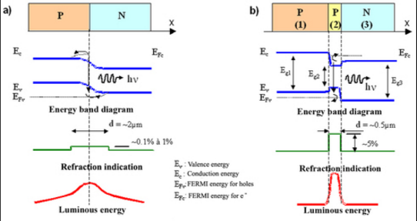
("Crédits Des Ressources.")

Slide 13
Quantum Well
Double heterostructure when the active region is much smaller
Splits conduction and valence bands into sub-bands
The required injection current density is required than of a DH
Much higher gain
Gain bandwidth is typically 20-40THz

Slide 14
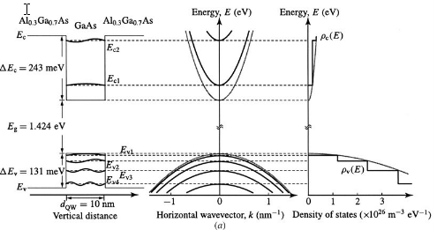
(Liu)

Slide 15
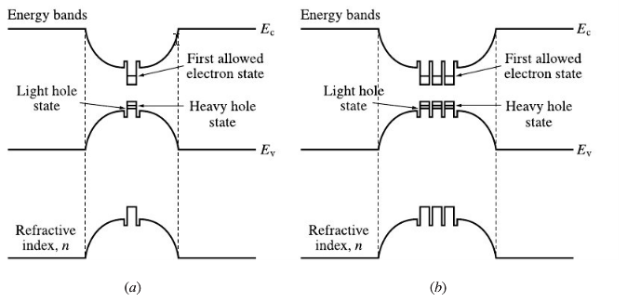
(Liu)

Slide 16
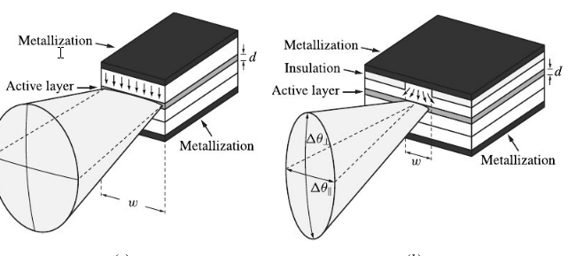
Edge Emission
Categorized by broad-area and stripe-geometry
(Liu)

Slide 17
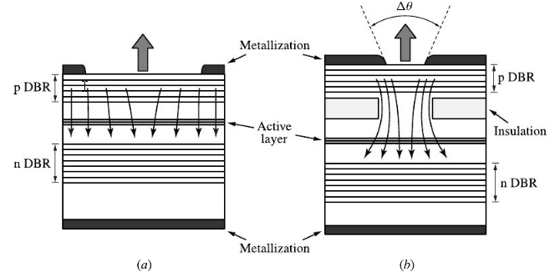
Surface Emission
Categorized into broad and small area
(Liu)

Slide 18
Conclusion
In general LEDs and LASER diodes have a lot of similarities with a few defining differences
Adding in heterojunctions leads to more control over the active region and refining the refractive index
Quantum wells are DH structures with a reduced active region and are much better
Light emissions can either be from the edge or the surface of the diode

Slide 19
References
"Crédits Des Ressources." Specific Applications of Sensors for Photonic and Imaging. N.p., n.d. Web. 20 Apr. 2016. <http://www.optique-ingenieur.org/en/courses/OPI_ang_M05_C04/co/OPI_ang_M05_C04_web_2.html>.
Farrell, Gerald. "Laser Structures." Optical Communications Systems: Semiconductor Laser Diodes (n.d.): n. pag. Laser Structures. Dublin Institute of Technology, 2002. Web. 20 Apr. 2016. <http://www.electronics.dit.ie/staff/gfarrell/LaserPhotodiodes/4Laserdiodestruct.pdf>.
Larsen, Adrien P. "LASER vs. LED: What’s the Difference?" Acupuncture Technology News. N.p., 11 Feb. 2014. Web. 20 Apr. 2016. <https://www.miridiatech.com/news/2014/02/laser-vs-led-whats-the-difference/>.
Liu, Jia-Ming. "Semiconductor Lasers and Light Emitting Diodes." Photonic Devices. Cambridge: Cambridge, 2005. N. pag. Knovel. Web. 20 Apr. 2016.
"Potential Well." Wikipedia. Wikimedia Foundation, n.d. Web. 20 Apr. 2016. <https://en.wikipedia.org/wiki/Potential_well>.
Treharne, Robert. "Lecture 5: Junctions." Lecture 5: Junctions. Slide Share, 6 Nov. 2014. Web. 20 Apr. 2016. <http://www.slideshare.net/RobertTreharne/lecture-5-junctions>.
"Quantum Well Laser." Wikipedia. Wikimedia Foundation, n.d. Web. 20 Apr. 2016. <https://en.wikipedia.org/wiki/Quantum_well_laser>.

Slide 20
5 Key Points
The main differences between LED and LASER diodes are emission, divergence and coherence
The 4 structures are homostructure, single and double heterostructures, and quantum wells
Quantum wells are DH’s with a smaller active region
Light emissions are either from the edge of the diode or the surface
In general LEDS have a broader emission configuration while LASER uses smaller

