Slide 1
Graphene theory, devices, and applications
Ee 4611
Calvin miner
April 15, 2016

Slide 2
Overview
What is Graphene?
Potential innovations
Issues with implementation

Slide 3
What is graphene?
http://www.extremetech.com/extreme/211437-extremetech-explains-what-is-graphene

Slide 4
What is graphene?
Graphene is a surface of carbon one atom thick.
It has the highest thermal and electrical conductivity of all known materials
Graphene was first produced with Scotch Tape
http://www.extremetech.com/extreme/211437-extremetech-explains-what-is-graphene

Slide 5
Potential Innovations
Bridges
Space Elevator
Transistors
Solar cells

Slide 6
http://www.sessions.edu/notes-on-design/materials-of-the-future-graphene
Extremely high-tensile strength and lightweight strands could build first practical space elevator

Slide 7
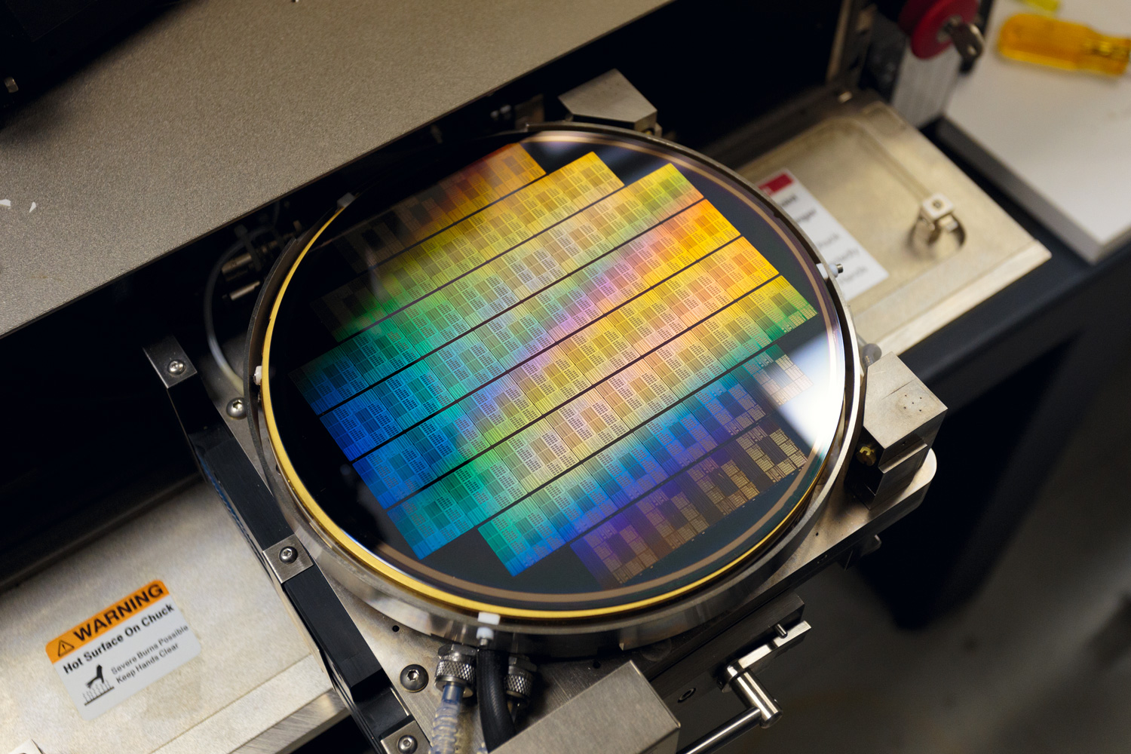
http://www.extremetech.com/extreme/211437-extremetech-explains-what-is-graphene
Graphene’s extremely low resistance would reduce transistor size

Slide 8
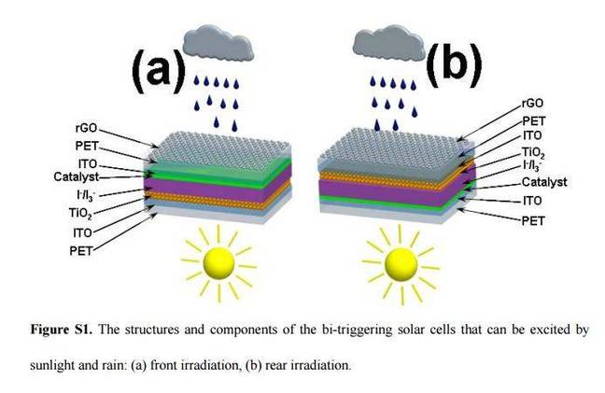
http://www.theregister.co.uk/2016/04/12/graphene_solar_panels_harvest_energy_from_rain/
Graphene’s extremely low resistance could improve solar cell efficiency and methods.

Slide 9
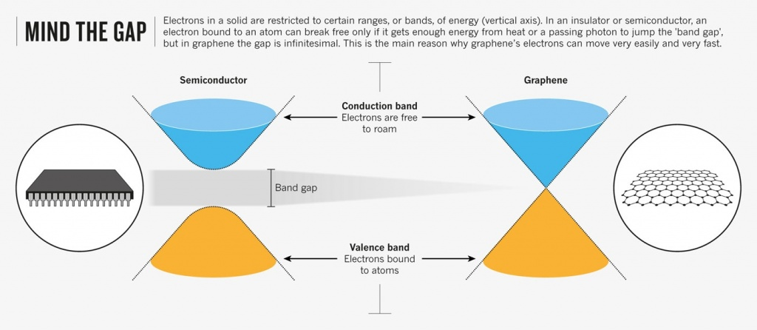
http://rebrn.com/re/how-is-graphene-both-a-good-conductor-of-electricity-and-a-semic-661039/
Band gap of zero
Six Dirac Points due to hexagonal atomic structure

Slide 10
http://spectrum.ieee.org/semiconductors/materials/graphene-makes-transistors-tunable
Tuning graphene’s band-gap 0-300 eV using perpendicular electric fields induced by offset second graphene layer

Slide 11
Issues with implementation
Band gap ratio between on and off states
Mass production of graphene sheets

Slide 12
conclusions
Despite significant obstacles, graphene remains tremendously promising.
Fixes are within reach
New potential uses for graphene continue to be found

Slide 13
Works Cited
F. Xia, D. B. Farmer, Y. Lin, and P. Avouris, “Graphene Field-Effect Transistors with High On/Off Current Ratio and Large Transport Band Gap at Room Temperature,” Nano Lett., vol. 10, no. 2, pp. 715–718, Feb. 2010.
“How is graphene both a good conductor of electricity and a semiconductor? | Rebrn.com,” Rerbn. [Online]. Available:http://rebrn.com/re/how-is-graphene-both-a-good-conductor-of-electricity-and-a-semic-661039/. [Accessed: 13-Apr-2016].
N. Savage, “Graphene Makes Transistors Tunable,” 08–31-2009. [Online]. Available:http://spectrum.ieee.org/semiconductors/materials/graphene-makes-transistors-tunable. [Accessed: 13-Apr-2016].
H. Shaffer, “Materials of the Future: Graphene,” Notes On Design, 08-Sep-2014. [Online]. Available: http://www.sessions.edu/notes-on-design/materials-of-the-future-graphene. [Accessed: 13-Apr-2016].
Patching, Research, Security, Vulnerabilities, Malware, crimeware ’breaches' every year Airbus boarded by 12 nation-state, R. funds breached as crims target brokers’ un-patched W. machines, and P. “mass damage” in A. Smb. crappy login hygiene really helps-hacker, “Graphene solar panels harvest energy from rain.” [Online]. Available:http://www.theregister.co.uk/2016/04/12/graphene_solar_panels_harvest_energy_from_rain/. [Accessed: 13-Apr-2016].
“Graphene, Meet Mainstream — NOVA Next | PBS,” NOVA Next, 19-Aug-2015. [Online]. Available:http://www.pbs.org/wgbh/nova/next/tech/graphene/. [Accessed: 13-Apr-2016].
G. T. on A. 5 and 2015 at 7:03 Am, “What is graphene?,”ExtremeTech. [Online]. Available:http://www.extremetech.com/extreme/211437-extremetech-explains-what-is-graphene. [Accessed: 13-Apr-2016].

Slide 14
Five key concepts
Structure of Graphene is a surface of carbon one atom thick
Graphene has highest electrical & thermal conductivity of all known materials
Major potential uses are high-tensile strands, solar cells, and semiconductors
Major impediments to implementation are insufficient band-gap ratio and mass production techniques
Most promising resolutions to these issues include using van Der Walls to mechanically manipulate graphene and perpendicular electrical fields to fine-tune band-gap.

