Slide 1
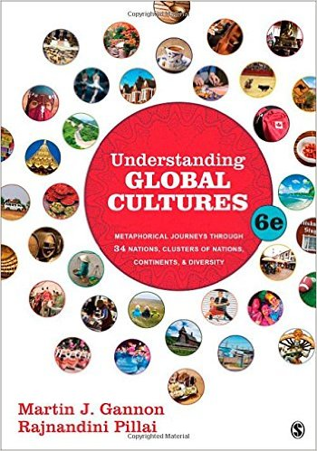
Use your up / down arrow keys and / or
your space bar to advance the slides
Three Major
Perennial
Debates
© 2010-2024 Timothy G. Roufs, University of Minnesota Duluth

Slide 2
Three Major
Perennial
Debates
© 2010-2024 Timothy G. Roufs, University of Minnesota Duluth

Slide 3
© 2010-2024 Timothy G. Roufs, University of Minnesota Duluth

Slide 4
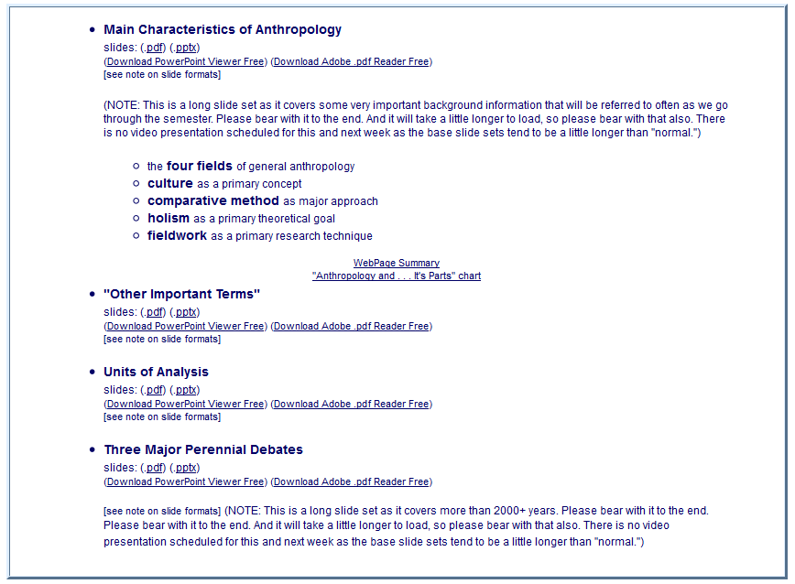
Remember these items from elsewhere in the course? . . .

Slide 5
Main Characteristics of Anthropology . . .

Slide 6
Units of Analysis . . .

Slide 7
the “Three Major Perennial Debates” information is towards the bottom . . .

Slide 8
they are important to pay attention to, especially when it comes to talking about theories and hypotheses . . .

Slide 9
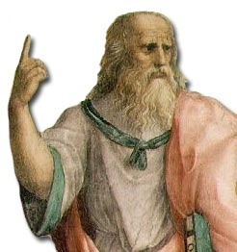
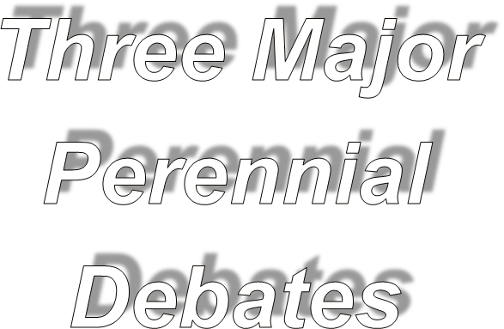
Global Cultures
Plato

Slide 10
Some debates going on today have been going on since at least the days of Socrates, Plato, and Aristotle
Plato

Slide 11
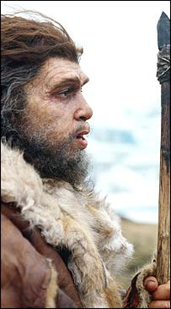
and probably even the Neandertals argued about the same sorts of things
Neandertal

Slide 12
so let’s have a look at the big three debates . . .
Neandertal

Slide 13
three major perennial debates
Biological Determinism vs. Cultural Constructionism (“nature” vs. “nurture”)
Ideationism vs. Cultural Materialism (ideas vs. things)
Individual Agency vs. Structuralism (“free will” vs. “power structures”)

Slide 14
three major perennial debates
Biological Determinism vs. Cultural Constructionism (“nature” vs. “nurture”)
Ideationism vs. Cultural Materialism (ideas vs. things)
Individual Agency vs. Structuralism (“free will” vs. “power structures”)

Slide 15
three major perennial debates
Biological Determinism vs. Cultural Constructionism (“nature” vs. “nurture”)
Ideationism vs. Cultural Materialism (ideas vs. things)
Individual Agency vs. Structuralism (“free will” vs. “power structures”)
this is the classical debate on whether something is so because it is
inherited or because it is learned . . .
you know the argument . . .
and it goes by different names . . .

Slide 16
three major perennial debates
Biological Determinism vs. Cultural Constructionism (“nature vs. nurture”) (“inherited vs. learned”)
(“nativism” vs. “empiricism”
(“biology” vs. “culture”)

Slide 17
three major perennial debates
Biological Determinism vs. Cultural Constructionism (“nature vs. nurture”) (“inherited vs. learned”)
(“nativism” vs. “empiricism”)
(“biology” vs. “culture”)

Slide 18
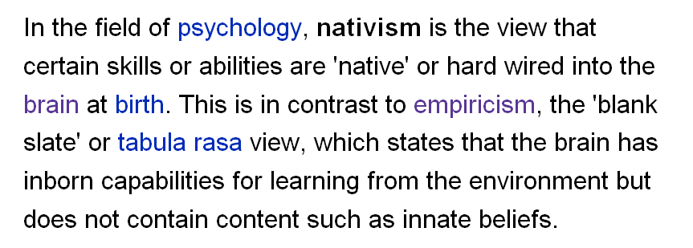
http://en.wikipedia.org/wiki/Psychological_nativism

Slide 19
http://en.wikipedia.org/wiki/Psychological_nativism

Slide 20
http://en.wikipedia.org/wiki/Psychological_nativism

Slide 21
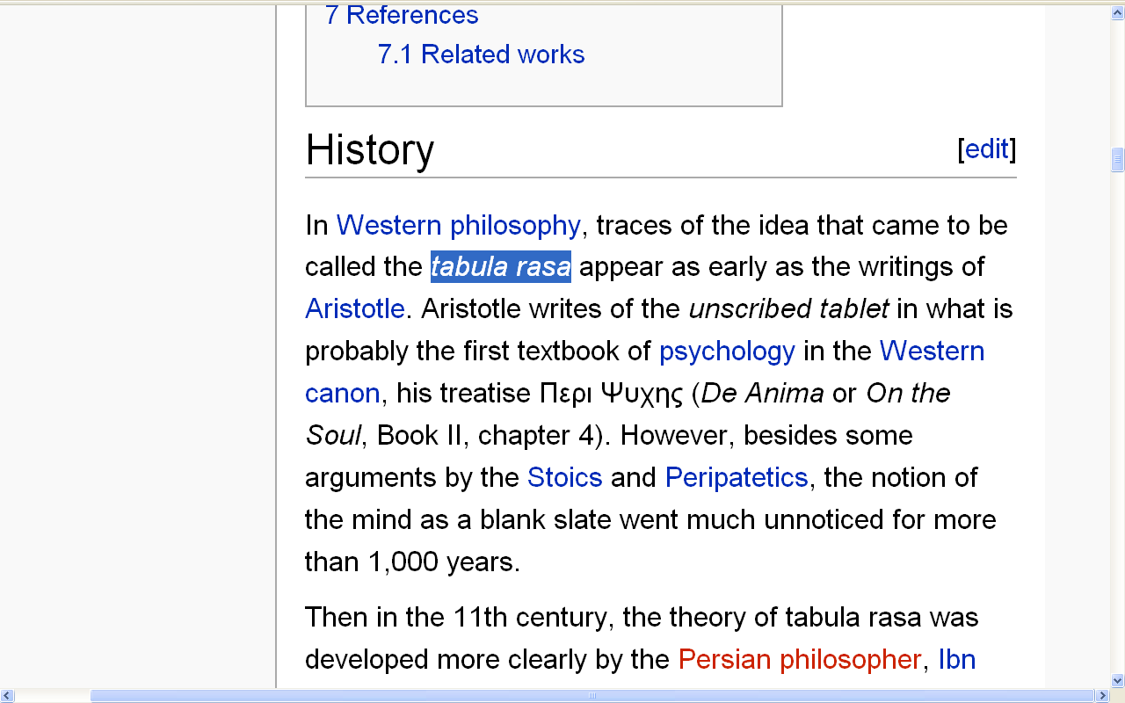
http://en.wikipedia.org/wiki/Tabula_rasa#History

Slide 22
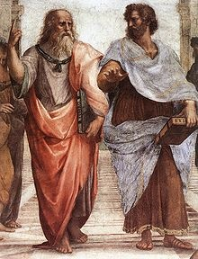
Aristotle
Plato
http://en.wikipedia.org/wiki/Tabula_rasa#History

Slide 23
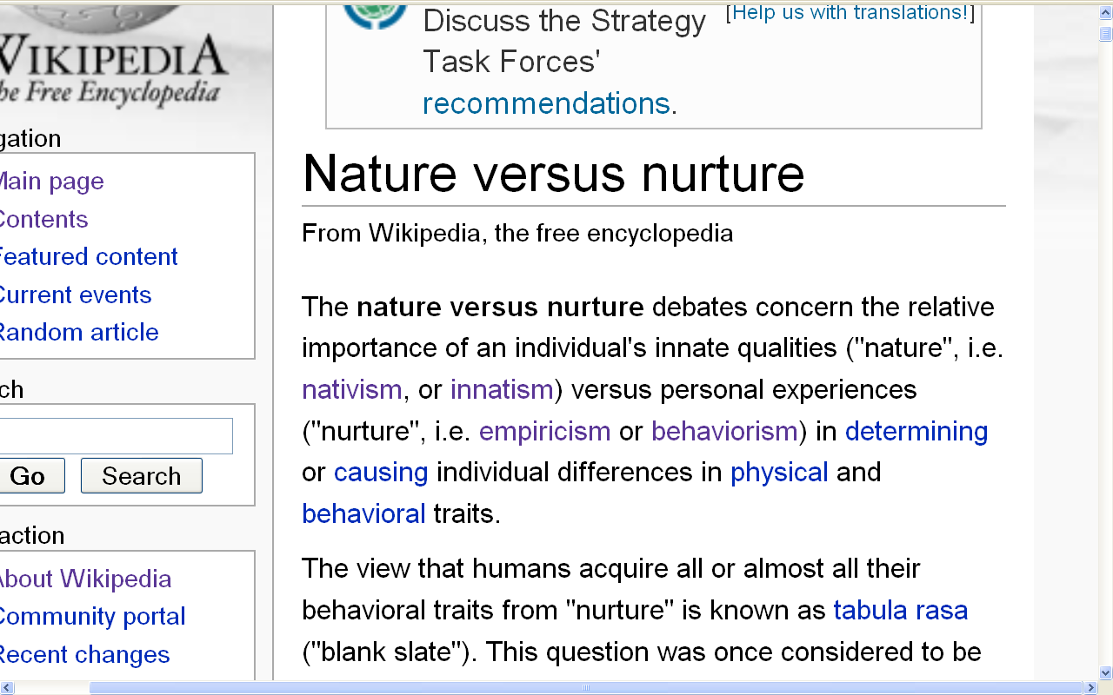
(“nature vs. nurture”)
(“inherited vs. learned”)
(“nativism” vs. “empiricism”)
(“biology” vs. “culture”)
http://en.wikipedia.org/wiki/Nature_versus_nurture

Slide 24
three major contemporary debates
NOTE: several of the following examples included food materials in an attempt to make the following points clearer by using situations and sources with which you may, at the current time, be a bit more familiar

Slide 25
something you will see often (and often repeated)
in American Anthropology
are discussions of the relationship between the physical and the cultural aspects of humans . . .
Some examples . . .

Slide 26
something you will see often (and often repeated)
in American Anthropology
are discussions of the relationship between the physical and the cultural aspects of humans . . .
Some examples . . .

Slide 27
three major perennial debates
Biological Determinism vs. Cultural Constructionism (“nature vs. nurture”) (“inherited vs. learned”)
(“nativism” vs. “empiricism”)
(“biology” vs. “culture”)

Slide 28
10 March 2023
Does Nature or Nurture Determine Musical Ability?
New study is the first to find brain structure in infants predicting musical aptitude
https://www.gse.harvard.edu/ideas/usable-knowledge/23/03/does-nature-or-nurture-determine-musical-ability

Slide 29
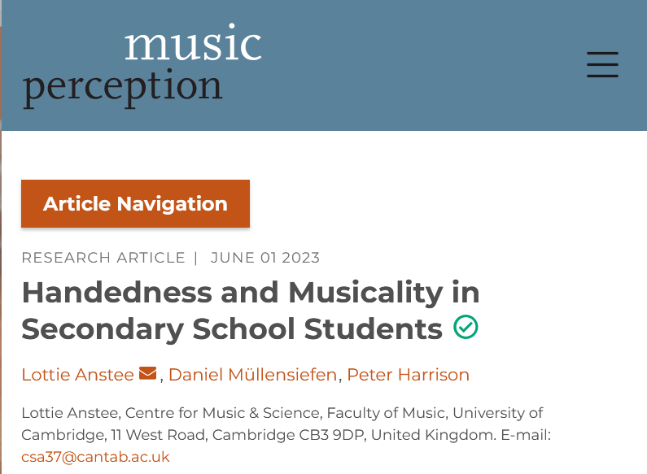
10 March 2023
1 June 2023
“78.9% of the left-handed children had musical talent”
https://online.ucpress.edu/mp/article/40/5/373/196692/Handedness-and-Musicality-in-Secondary-School
https://www.gse.harvard.edu/ideas/usable-knowledge/23/03/does-nature-or-nurture-determine-musical-ability

Slide 30
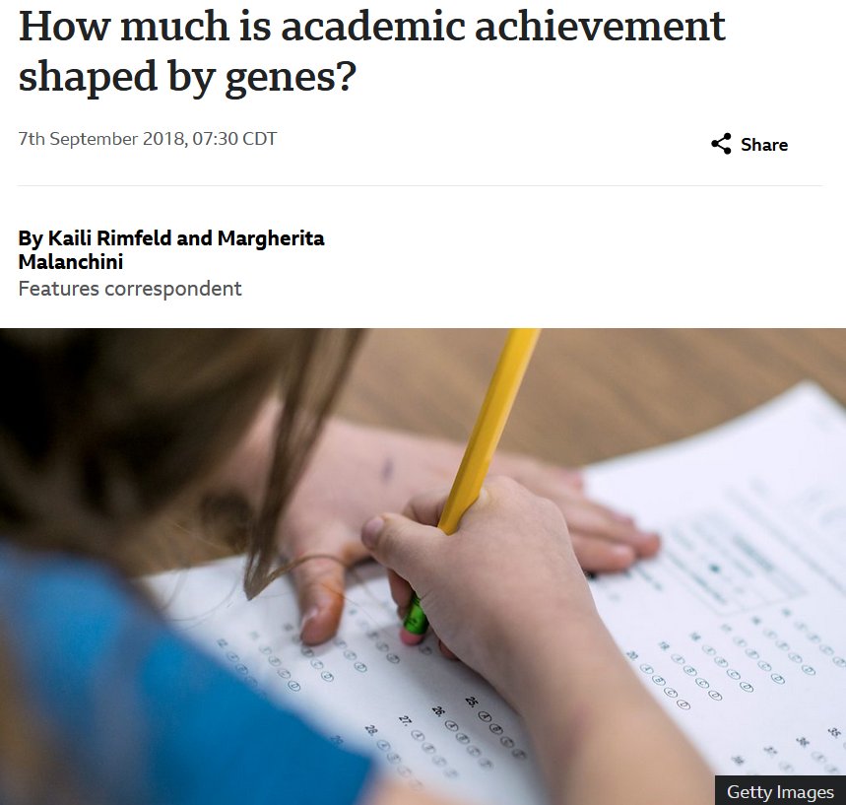
7 September 2018
https://www.bbc.com/future/article/20180905-how-genes-influence-achievement-and-success-in-school

Slide 31
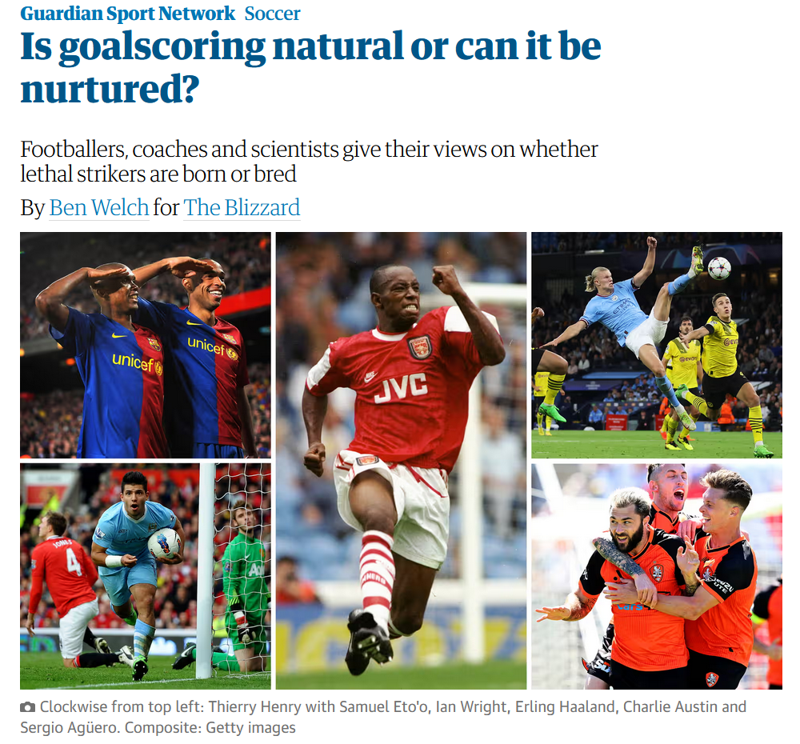
8 February 2023
https://www.theguardian.com/football/2023/feb/08/goalscorers-natural-nurtured-footballers-coaches-scientists-strikers

Slide 32
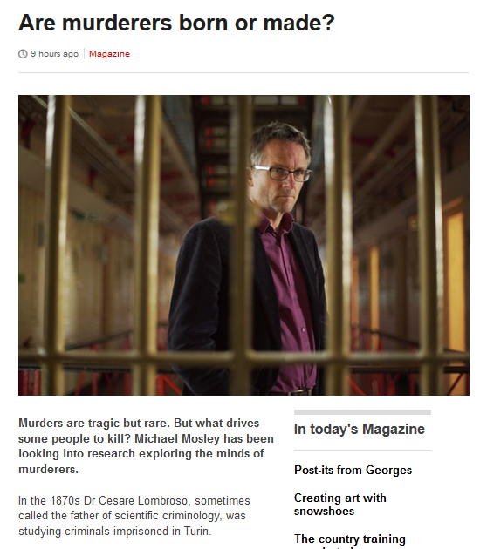
9 March 2015
http://m.bbc.com/news/magazine-31714853

Slide 33
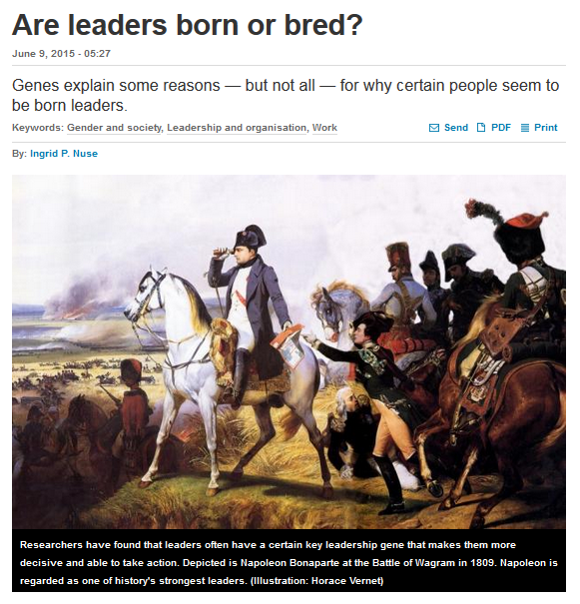
http://sciencenordic.com/are-leaders-born-or-bred
Notes:
³³

Slide 34
http://sciencenordic.com/are-leaders-born-or-bred
Notes:
³⁴

Slide 35
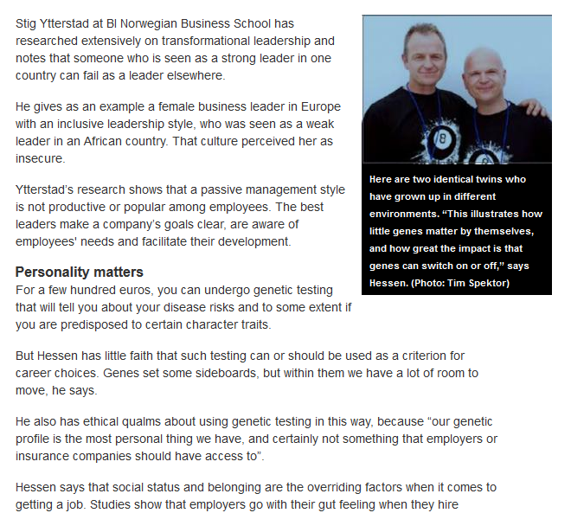
http://sciencenordic.com/are-leaders-born-or-bred
Notes:
³⁵

Slide 36
(“nature vs. nurture”)
(“inherited vs. learned”)
(“nativism” vs. “empiricism”)
(“biology” vs. “culture”)
http://en.wikipedia.org/wiki/Nature_versus_nurture

Slide 37
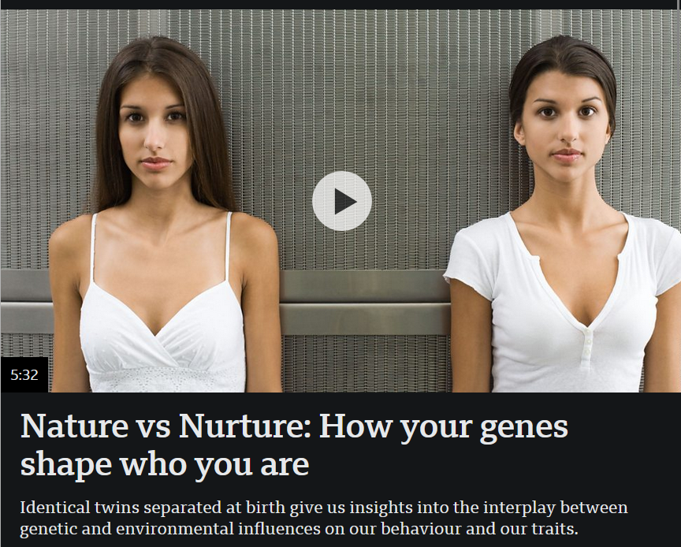
23 February 2023
https://www.bbc.com/reel/video/p0bn70nw/nature-vs-nurture-how-your-genes-shape-who-you-are?ocid=ww.social.link.email

Slide 38
11 December 2022
‘Like living mirrors’: what twins’ special bonds reveal about nature, nurture and genetics
https://www.theguardian.com/science/2022/dec/11/twins-special-bond-mystery-life?CMP=Share_iOSApp_Other

Slide 39
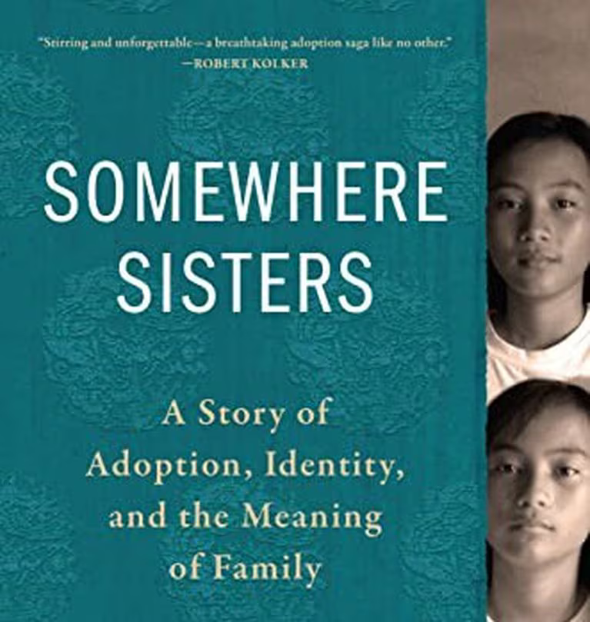
“Erika Hayasaki's book explores the ideas of nature and nurture through the story of two twins.”
Erika Hayasaki
Algonquin Books, 3 October 2023
https://www.opb.org/article/2023/09/29/erika-hayasaki-somewhere-sisters/

Slide 40
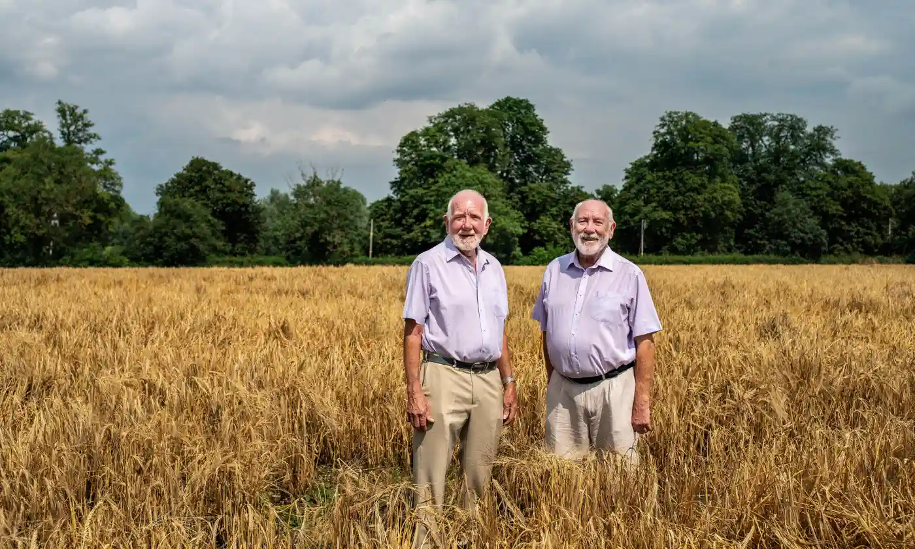
25 July 2023
What can doppelgangers tell us about nature v nurture? – podcast
source

Slide 41
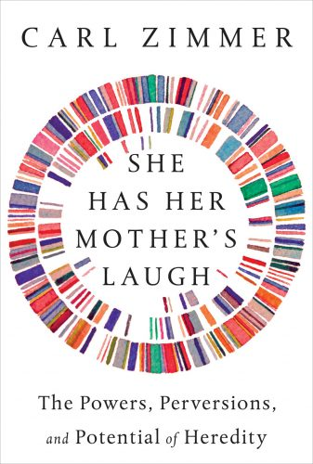
“New York Times columnist Carl Zimmer dives deep into the ways that we pass along our genetic inheritance.”
Dutton, 2018
https://carlzimmer.com/books/she-has-her-mothers-laugh/

Slide 42
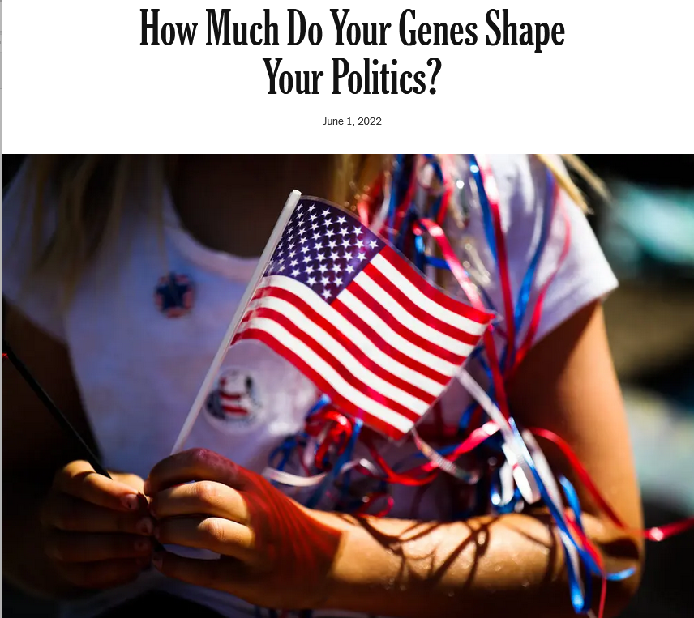
1 June 2022
https://www.nytimes.com/2022/06/01/opinion/politics-genetics-research.html?referringSource=articleShare
Notes:
42

Slide 43
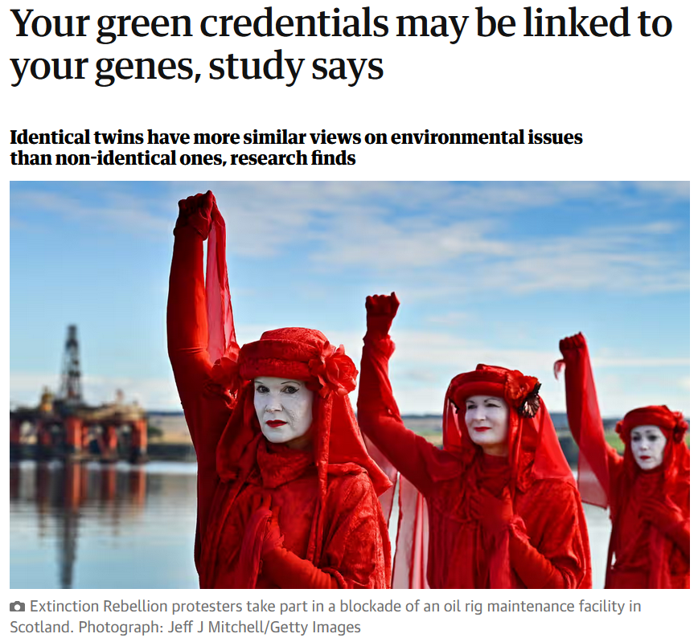
20 October 2021
https://www.theguardian.com/environment/2021/oct/20/your-green-credentials-may-be-linked-to-your-genes-scientists-say?CMP=Share_iOSApp_Other
Notes:
43

Slide 44
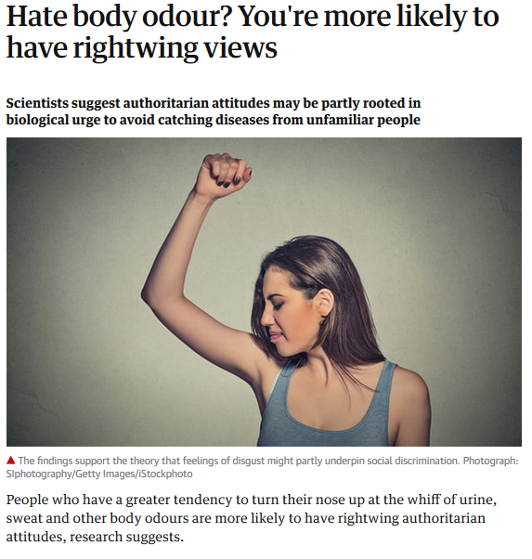
27 Feb 2018
https://www.theguardian.com/science/2018/feb/28/hate-body-odour-youre-more-likely-to-have-rightwing-views?CMP=Share_iOSApp_Other
Notes:
44

Slide 45
three major perennial debates
Biological Determinism vs. Cultural Constructionism (“nature” vs. “nurture”)
Ideationism vs. Cultural Materialism (ideas vs. things)
Another way to ask the question is,
“How much are we ‘hardwired’ for things?”

Slide 46
26 December 2023
https://imageio.forbes.com/specials-images/imageserve/653a89b7988194f3e38aa6ee/Human-Beings-are-Wired-for-Story-Here-s-Why/960x0.jpg?format=jpg&width=1440
Notes:
46

Slide 47
5 Feb 2021
https://blog.dropbox.com/topics/work-culture/our-minds-are-hardwired-to-wander--and-that-s-not-a-bad-thing
Notes:
47

Slide 48
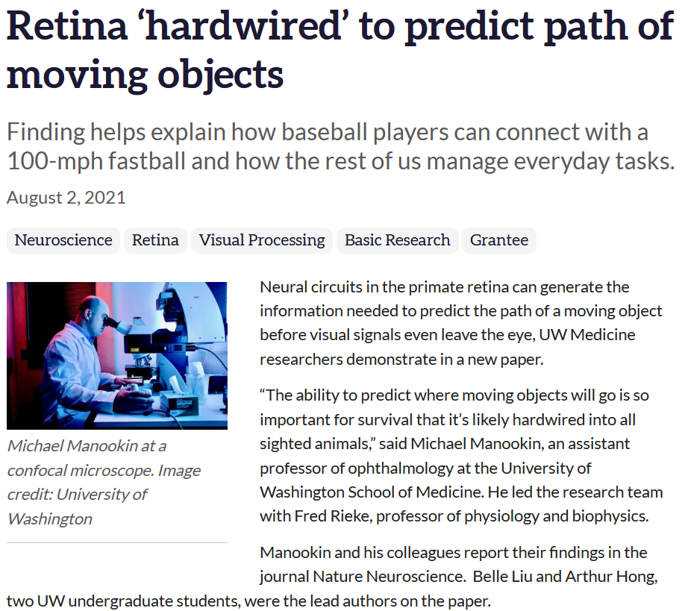
https://www.nei.nih.gov/about/news-and-events/news/retina-hardwired-predict-path-moving-objects
Notes:
48

Slide 49
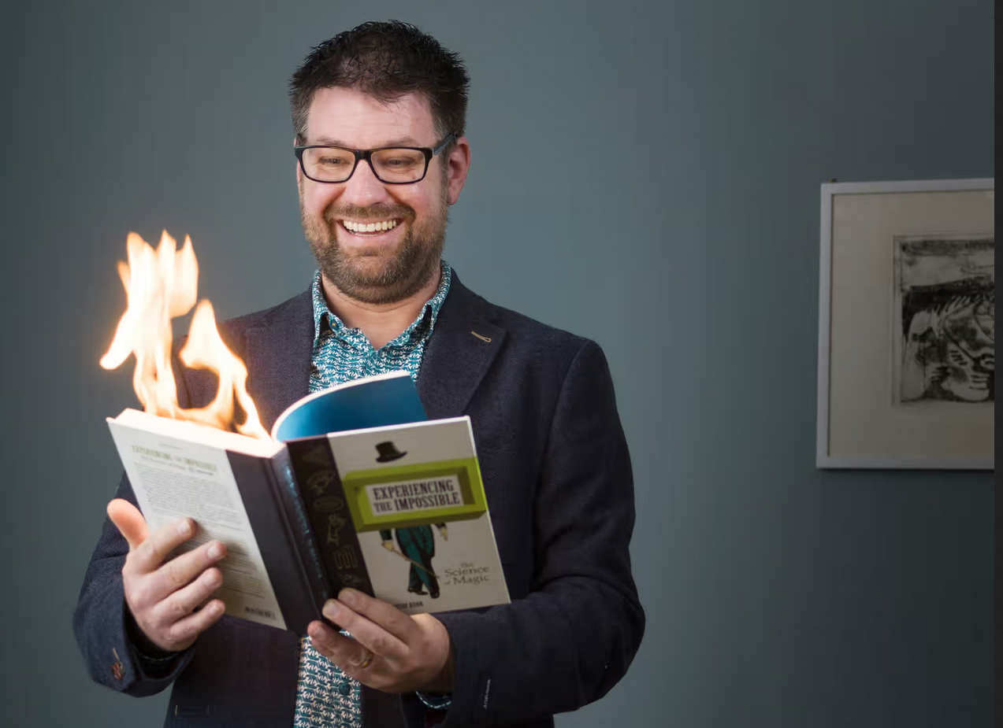
30 March 2019
And that’s one of the ways that “magic” tricks work.
Mind games:
what magic reveals about how our brains work
https://www.theguardian.com/lifeandstyle/2019/mar/30/mind-games-what-magic-reveals-about-how-our-brains-work
Notes:
49

Slide 50
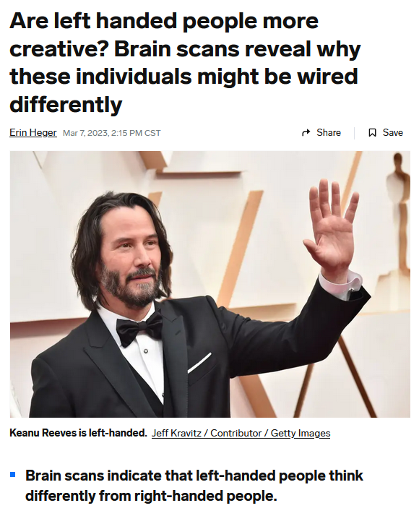
7 March 2023
https://www.businessinsider.com/are-left-handed-people-more-creative-2023-3

Slide 51
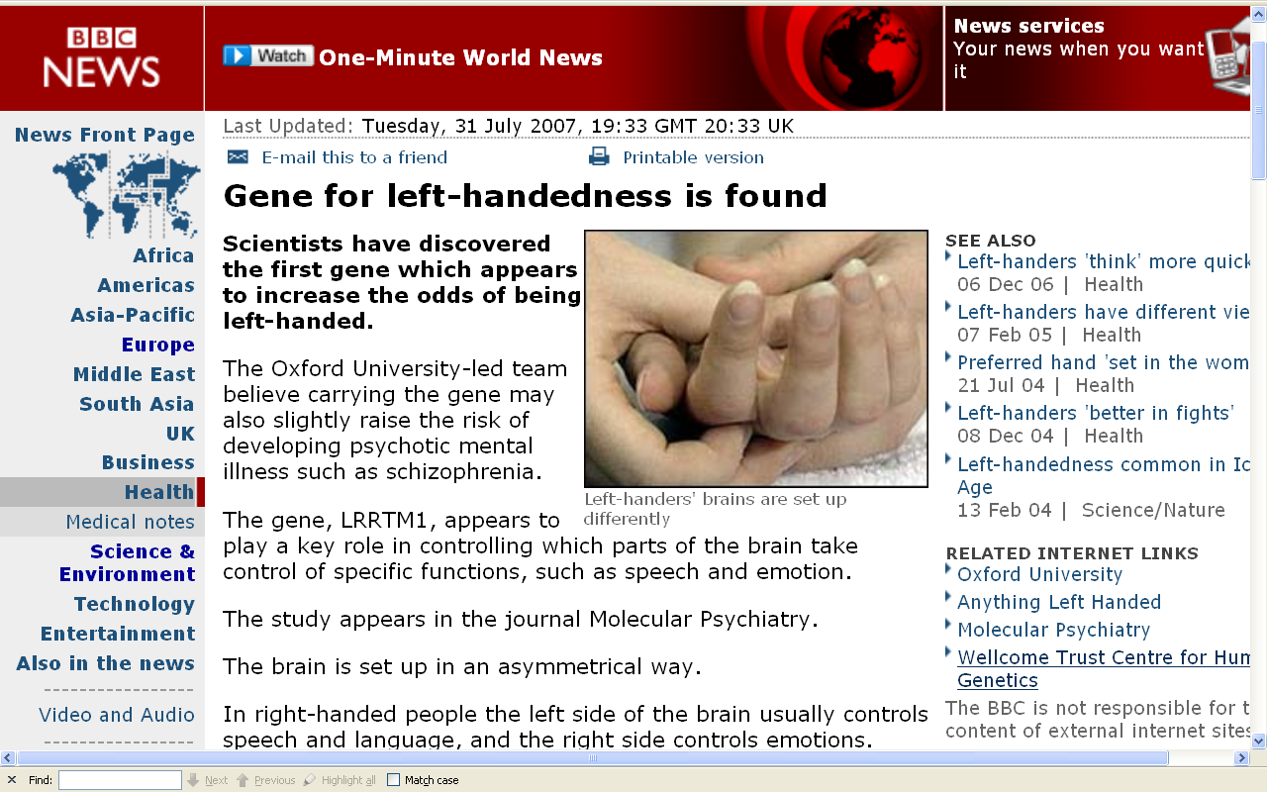
http://news.bbc.co.uk/2/hi/health/6923577.stm

Slide 52
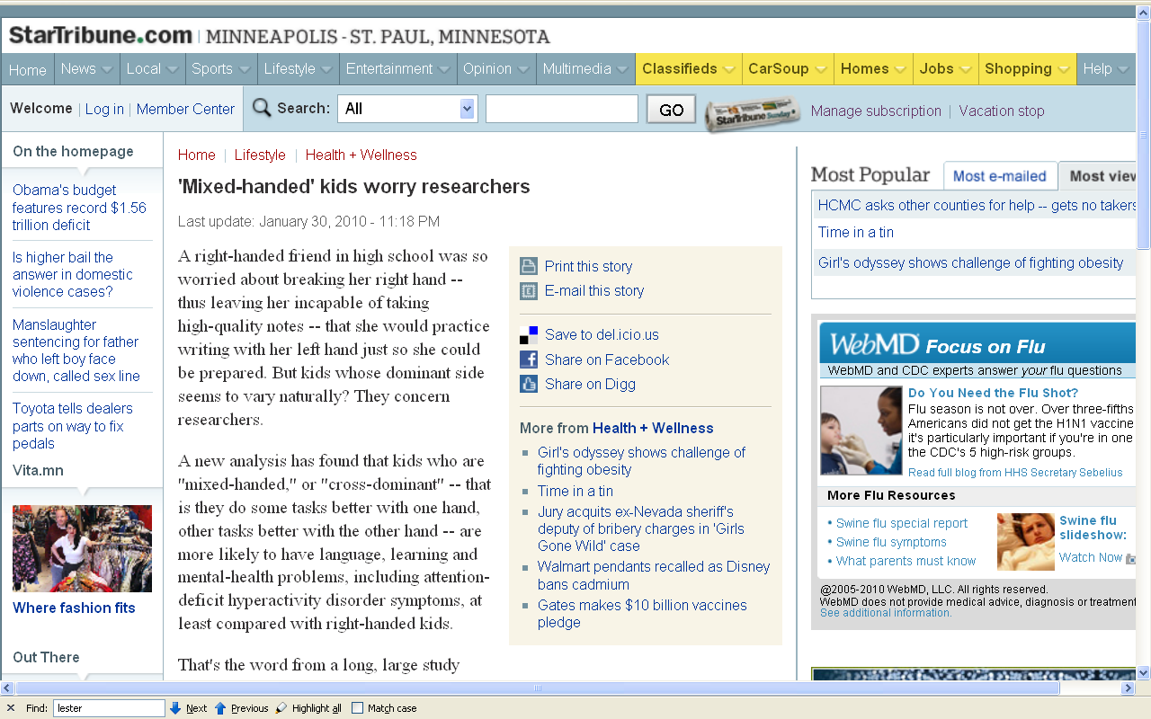
http://news.bbc.co.uk/2/hi/health/6923577.stm

Slide 53
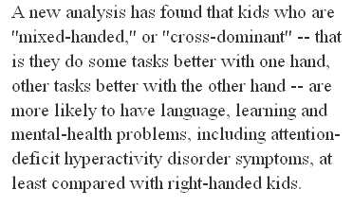
http://news.bbc.co.uk/2/hi/health/6923577.stm

Slide 54
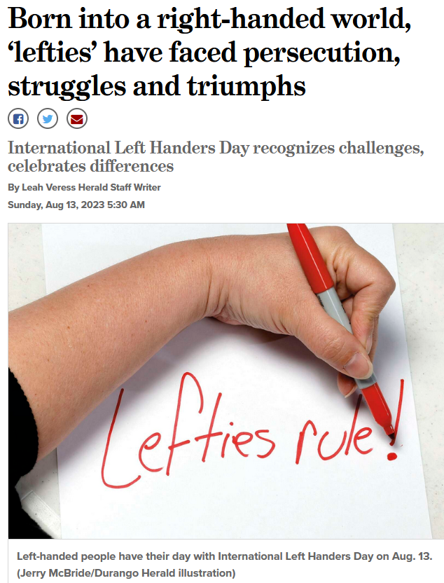
7 March 2023
https://www.durangoherald.com/articles/born-into-a-right-handed-world-lefties-have-faced-persecution-struggles-and-triumphs/

Slide 55
7 March 2023
“In the Catholic religion, the left hand was perceived as the devil’s hand, while the right was associated with God. It was this belief that prompted Catholic teachers to discipline their left-handed pupils.”
https://www.durangoherald.com/articles/born-into-a-right-handed-world-lefties-have-faced-persecution-struggles-and-triumphs/

Slide 56
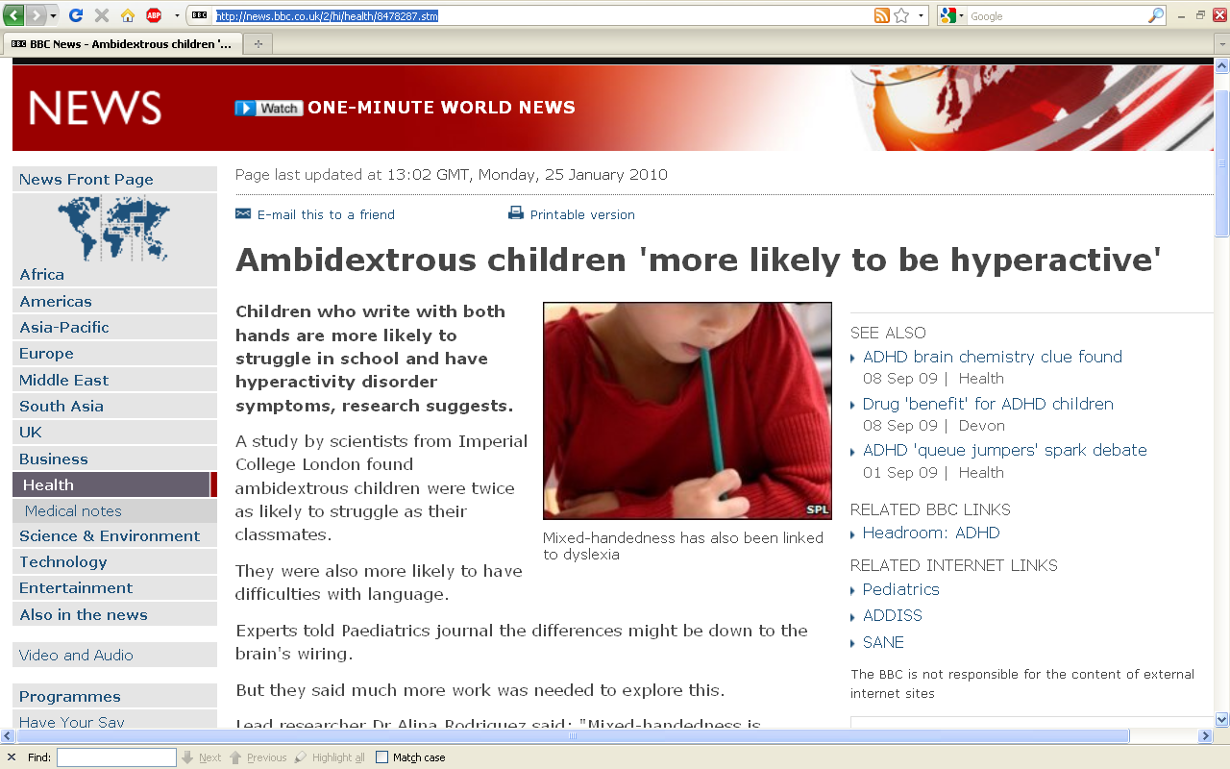
http://news.bbc.co.uk/2/hi/health/8478287.stm

Slide 57
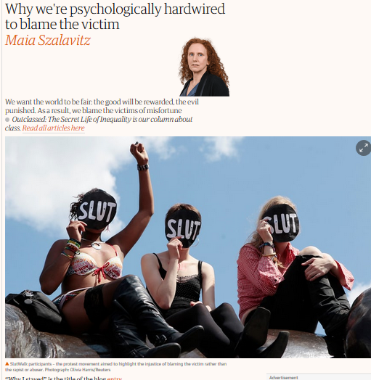
27 Feb 2018
https://www.theguardian.com/us-news/2018/feb/27/victim-blaming-science-behind-psychology-research?CMP=Share_iOSApp_Other
Notes:
57

Slide 58
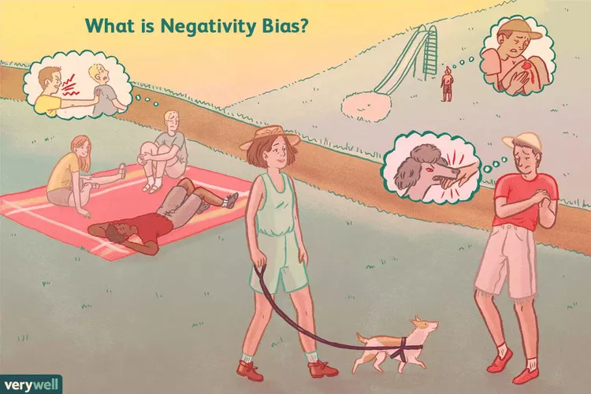
verywellmind
13 November 2023
Negative Bias: Why We're Hardwired for Negativity
https://www.verywellmind.com/negative-bias-4589618
Notes:
58

Slide 59
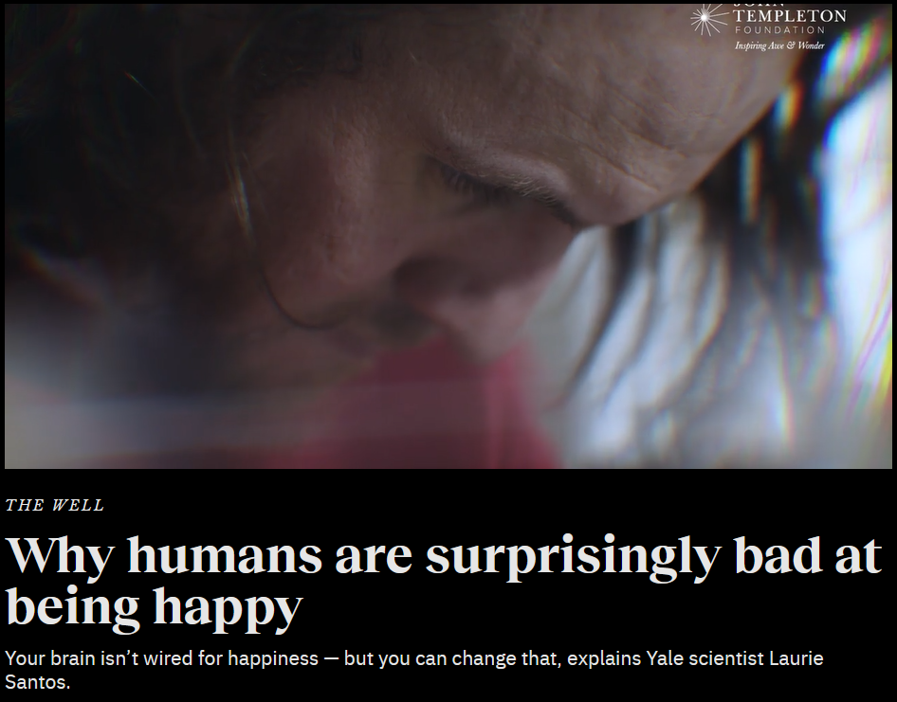
5 July 2023
https://bigthink.com/the-well/how-to-be-happy-415573/
Notes:
59

Slide 60
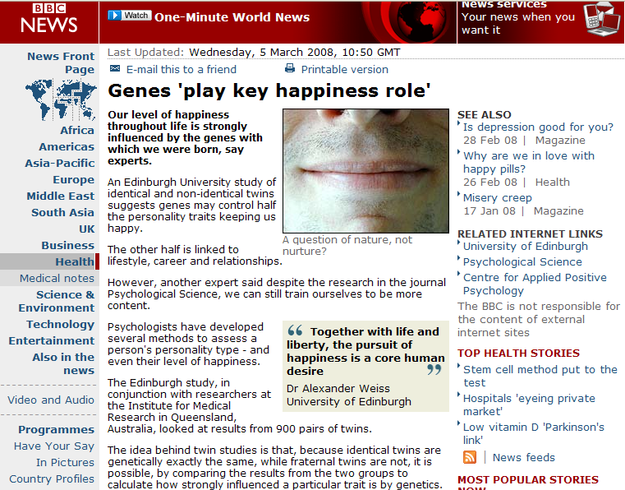
July 19, 2009
http://news.bbc.co.uk/2/hi/health/7278853.stm
Notes:
60

Slide 61
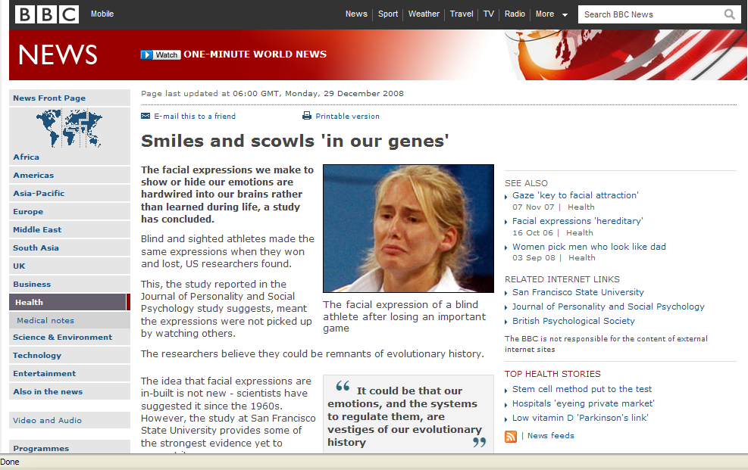
July 19, 2009
http://news.bbc.co.uk/2/hi/health/7798687.stm
Notes:
61

Slide 62
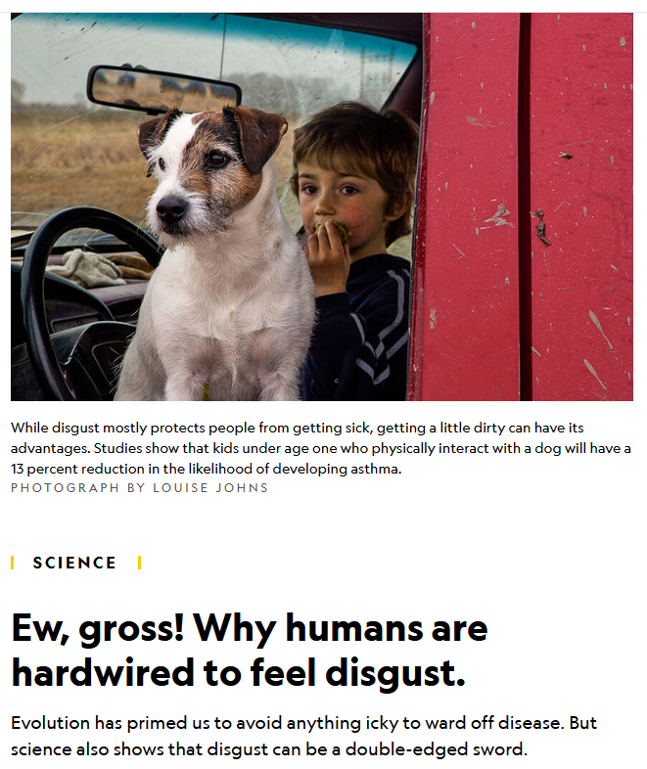
30 Mar 2021
https://www.nationalgeographic.com/science/article/gross-why-humans-are-hardwired-to-feel-disgust
Notes:
62

Slide 63
Another big question . . .
Notes:
63

Slide 64
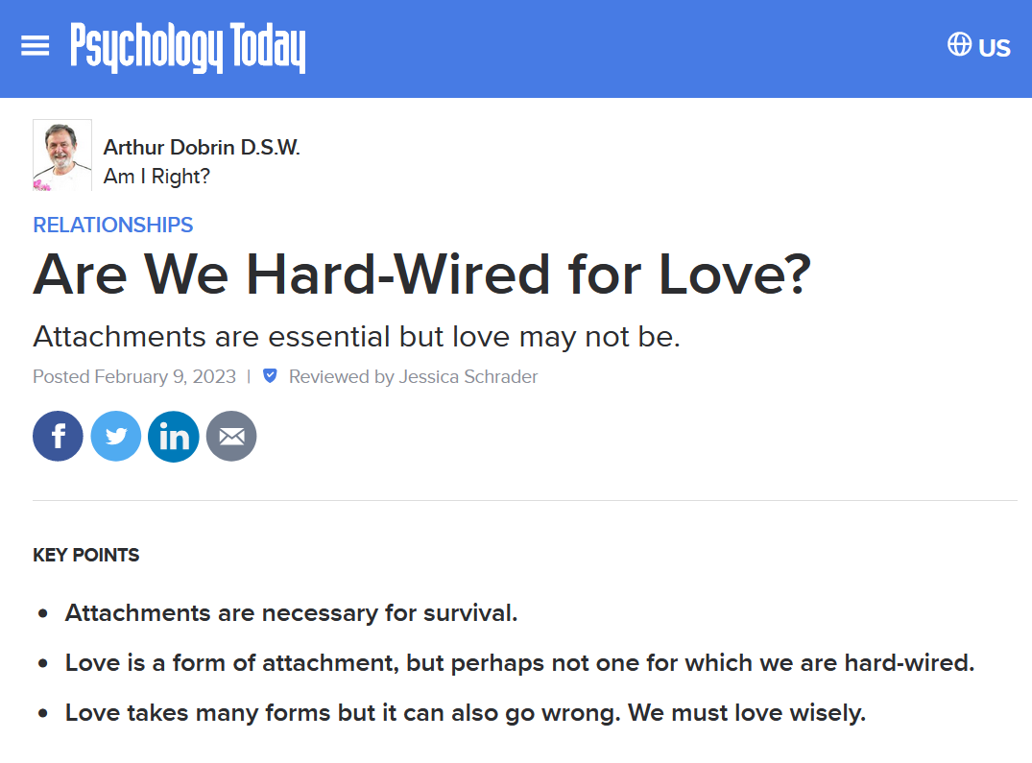
https://www.psychologytoday.com/us/blog/am-i-right/202210/are-we-hard-wired-for-love
Notes:
64

Slide 65
And how about other things?

Slide 66
11 March 2018
Genes have a role in empathy, study says
https://www.bbc.com/news/health-43343807
Notes:
66

Slide 67
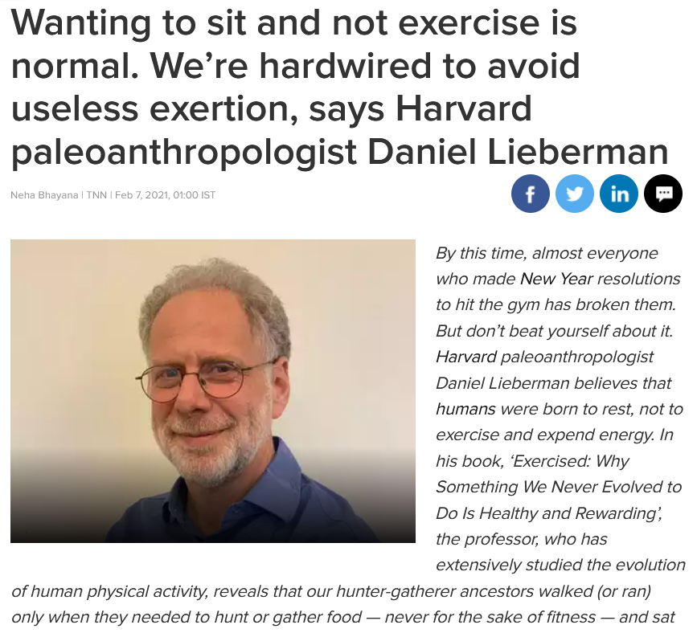
7 Feb 2021
https://timesofindia.indiatimes.com/home/sunday-times/wanting-to-sit-and-not-exercise-is-normal-were-hardwired-to-avoid-useless-exertion-says-harvard-paleoanthropologist-daniel-lieberman/articleshow/80726076.cms
Notes:
67

Slide 68
three major perennial debates
Biological Determinism vs. Cultural Constructionism (“nature” vs. “nurture”)
Ideationism vs. Cultural Materialism (ideas vs. things)
Individual Agency vs. Structuralism (“free will” vs. “power structures”)
Other bio-physical attributes are also important to look at

Slide 69
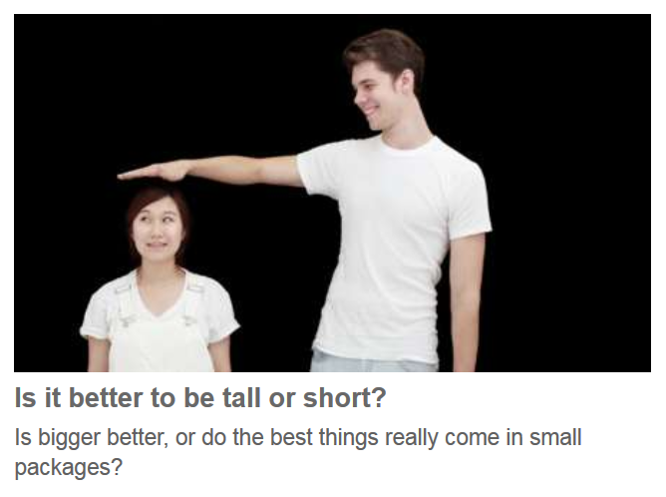
July 19, 2009
http://www.bbc.com/future/story/20150928-tall-vs-small-which-is-it-better-to-be
Notes:
69

Slide 70
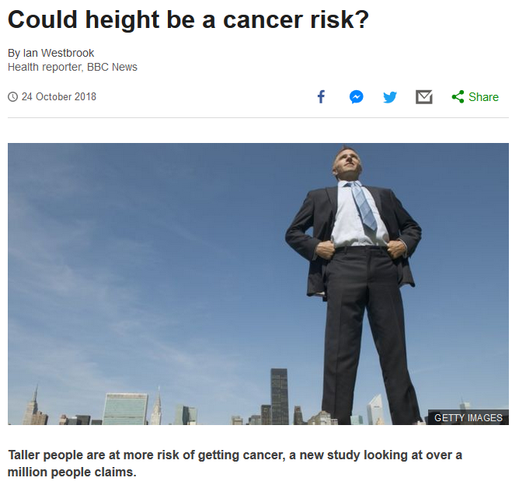
24 October 2018
https://www.bbc.com/news/health-45953442
Notes:
70

Slide 71
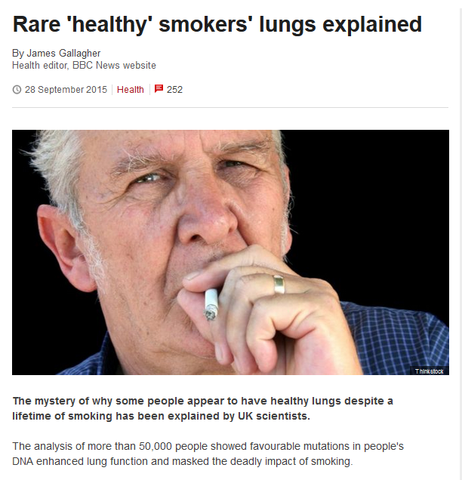
http://www.bbc.com/news/health-34360865
Notes:
71

Slide 72
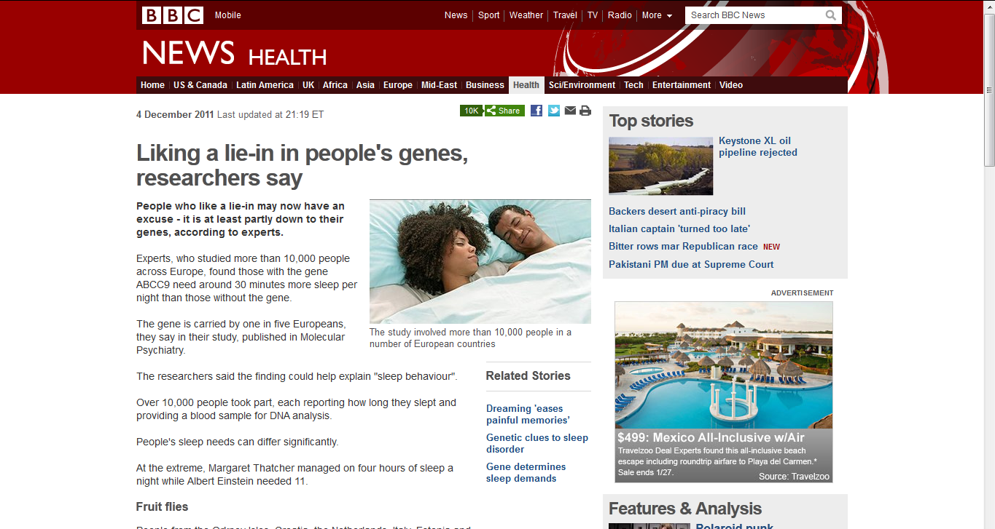
July 19, 2009
Notes:
72

Slide 73
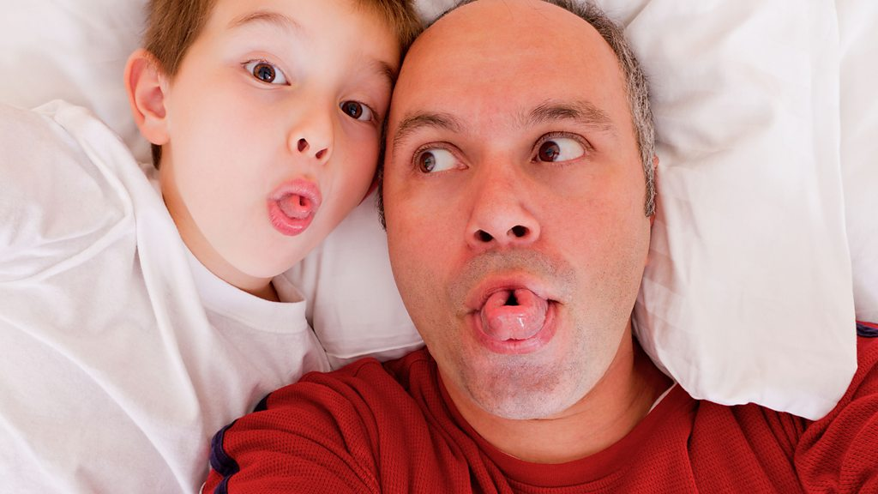
30 January 2018
Do you inherit the ability to roll your tongue?
https://www.bbc.com/future/article/20180130-do-you-inherit-the-ability-to-roll-your-tongue
Notes:
73

Slide 74
How about the brain . . .?
https://www.bbc.com/future/article/20180130-do-you-inherit-the-ability-to-roll-your-tongue
Notes:
74

Slide 75
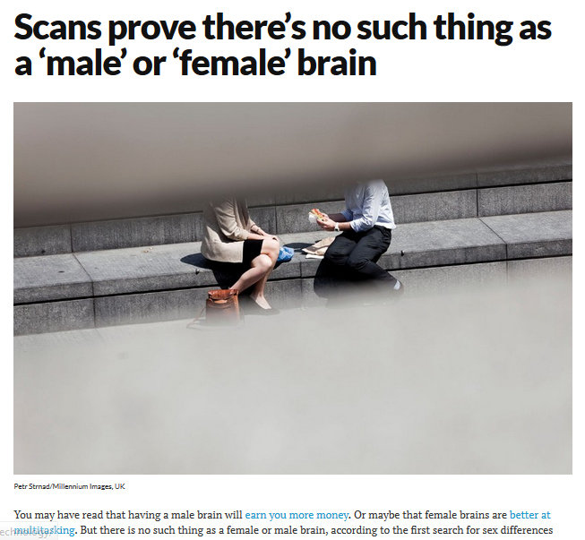
July 19, 2009
30 November 2015
https://www.newscientist.com/article/dn28582-scans-prove-theres-no-such-thing-as-a-male-or-female-brain/
Notes:
75

Slide 76
STRUCTURALLY SPEAKING . . .
But what about FUNCTIONALLY? . . .
July 19, 2009
30 November 2015
https://www.newscientist.com/article/dn28582-scans-prove-theres-no-such-thing-as-a-male-or-female-brain/
Notes:
76

Slide 77
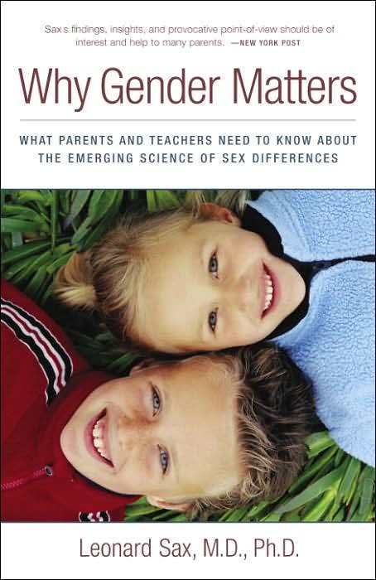
July 19, 2009
“nature vs. nurture”
Three Rivers Press, 2006
Notes:
77

Slide 78
July 19, 2009
“nature vs. nurture”
boys and girls learn differently
Three Rivers Press, 2006
Notes:
78

Slide 79
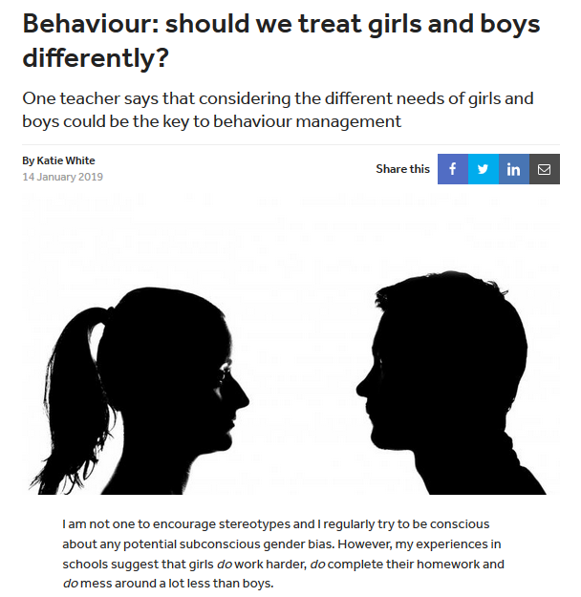
TES for Teaching
14 January 2019
link
Notes:
79

Slide 80
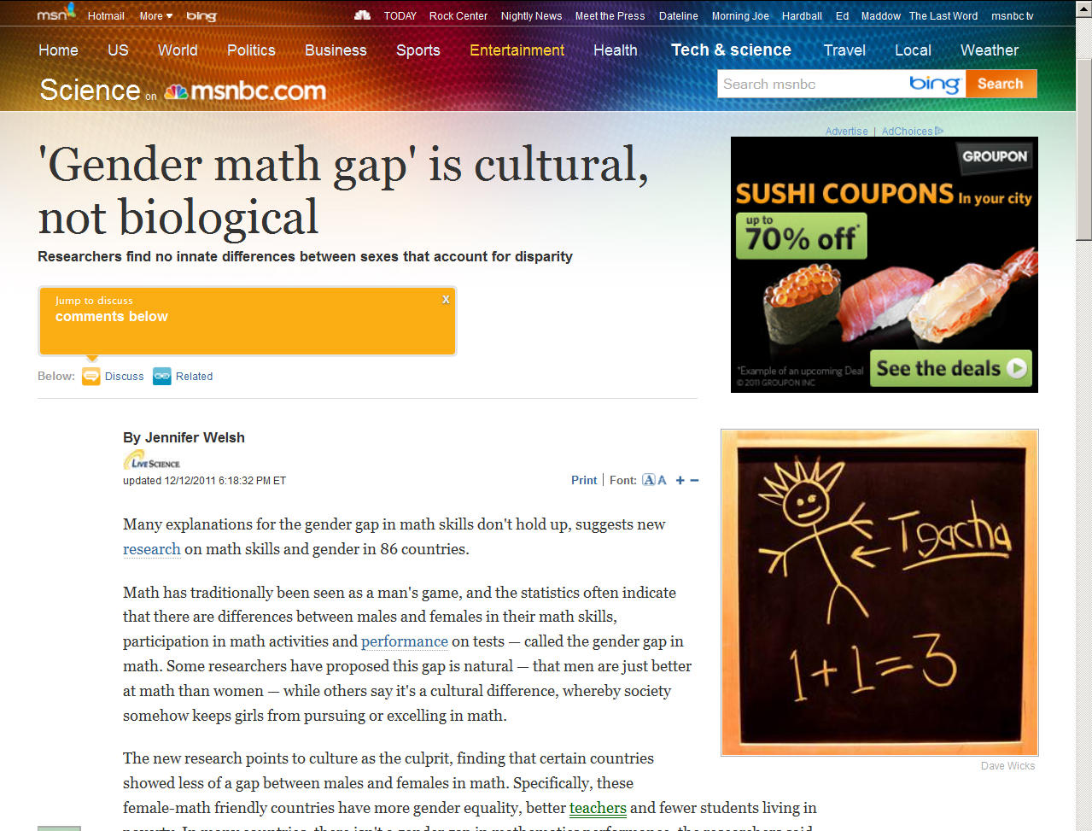
July 19, 2009
“nature vs. nurture”
Notes:
80

Slide 81
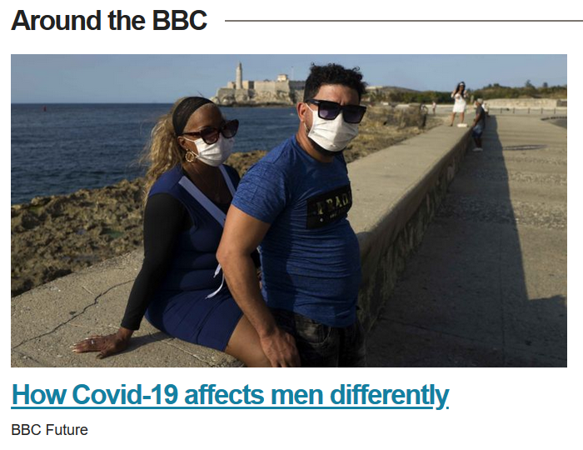
12 April 2020
https://www.bbc.com/future/article/20200409-why-covid-19-is-different-for-men-and-women

Slide 82
As of 12 April 2020 in the U.S.A. twice as many men had died of
Covid-19 as women.
At that time 69% of all deaths in Europe had been male. Similar patterns were been seen in China and elsewhere.
12 April 2020
https://www.bbc.com/future/article/20200409-why-covid-19-is-different-for-men-and-women

Slide 83
As of 12 April 2020 in the U.S.A. twice as many men had died of
Covid-19 as women.
At that time 69% of all deaths in Europe had been male. Similar patterns were been seen in China and elsewhere.
Why?
12 April 2020
https://www.bbc.com/future/article/20200409-why-covid-19-is-different-for-men-and-women

Slide 84
Is the reason biological?
12 April 2020
https://www.bbc.com/future/article/20200409-why-covid-19-is-different-for-men-and-women

Slide 85
Is the reason biological?
Or does it have something to do with “life style?” (culture)
12 April 2020
https://www.bbc.com/future/article/20200409-why-covid-19-is-different-for-men-and-women

Slide 86
Is the reason biological?
Or does it have something to do with “life style?” (culture)
Or is it a combination of
biology and culture?
12 April 2020
https://www.bbc.com/future/article/20200409-why-covid-19-is-different-for-men-and-women

Slide 87
Is it NATURE or NURTURE?
12 April 2020
https://www.bbc.com/future/article/20200409-why-covid-19-is-different-for-men-and-women

Slide 88
One theory is that women’s immune response to the virus is stronger, says Philip Goulder, professor of immunology at the University of Oxford. “The immune response throughout life to vaccines and infections is typically more aggressive and more effective in females compared to males,” he says.
12 April 2020
https://www.bbc.com/future/article/20200409-why-covid-19-is-different-for-men-and-women

Slide 89
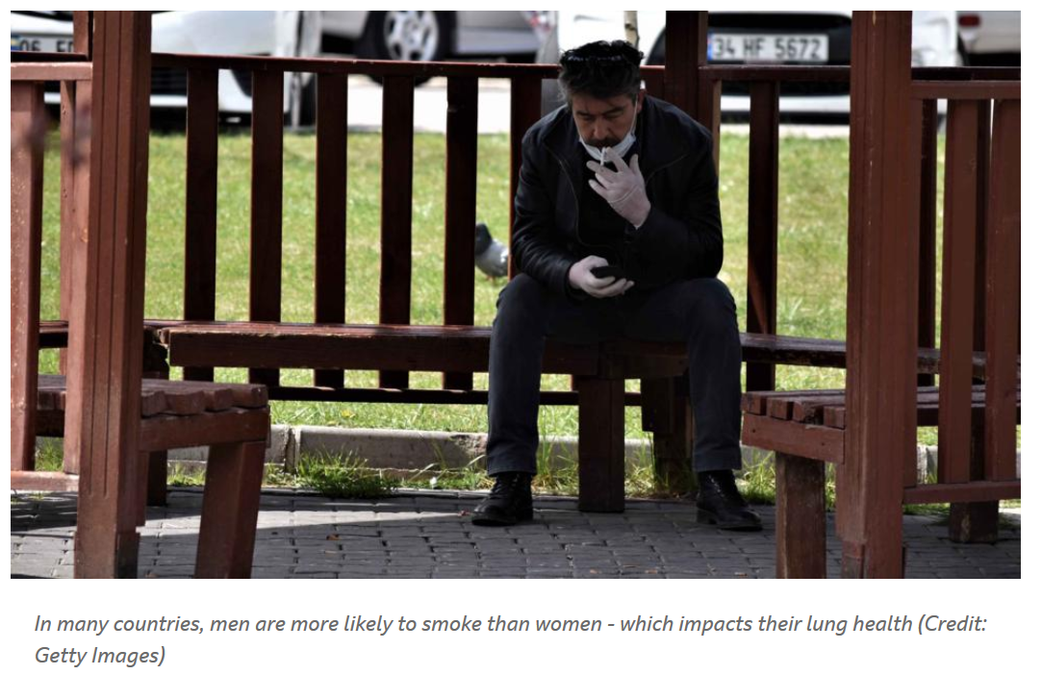
12 April 2020
https://www.bbc.com/future/article/20200409-why-covid-19-is-different-for-men-and-women

Slide 90
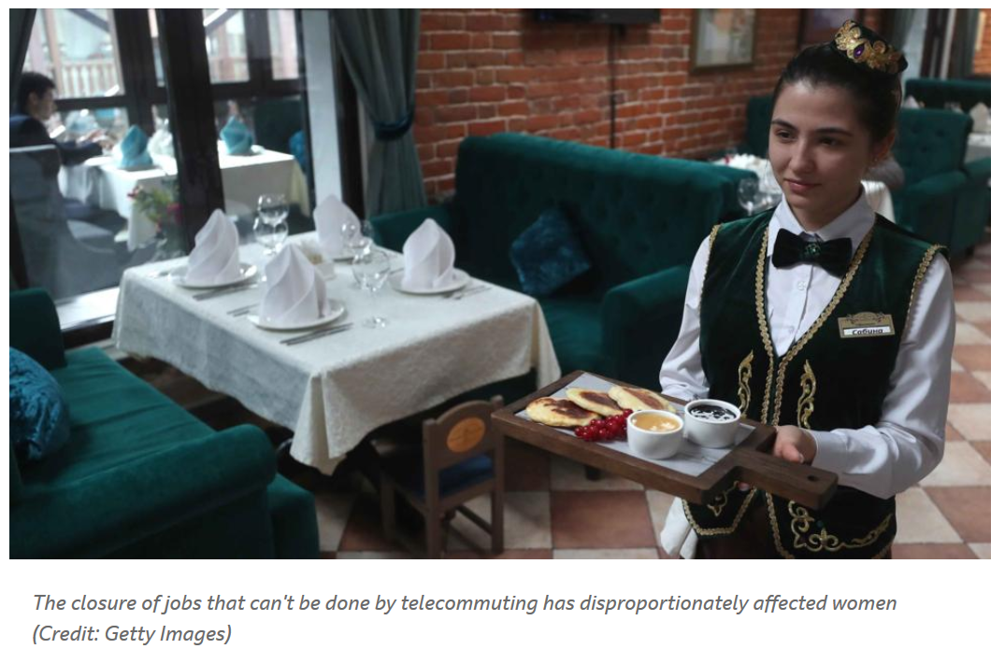
12 April 2020
https://www.bbc.com/future/article/20200409-why-covid-19-is-different-for-men-and-women

Slide 91
12 April 2020
https://www.bbc.com/future/article/20200409-why-covid-19-is-different-for-men-and-women

Slide 92
12 April 2020
https://www.bbc.com/future/article/20200409-why-covid-19-is-different-for-men-and-women

Slide 93
three major perennial debates
Biological Determinism vs. Cultural Constructionism (“nature” vs. “nurture”)
Ideationism vs. Cultural Materialism (ideas vs. things)
Individual Agency vs. Structuralism (“free will” vs. “power structures”)
Food related items . . .

Slide 94
“nature vs. nurture”
July 19, 2009
http://www.pbs.org/wgbh/nova/body/science-picky-eaters.html
Notes:
94

Slide 95
20 October 2021
“nature vs. nurture”
https://news.illinoisstate.edu/2021/04/social-media-effects-on-body-image-and-eating-disorders/

Slide 96
18 June 2018
July 19, 2009
But . . .
emotional eating is
'learned by children
not inherited'
https://www.bbc.com/news/health-44520122
Notes:
96

Slide 97
“nature vs. nurture”
http://www.forbes.com/lifestyle/health/feeds/hscout/2006/03/07/hscout531389.html

Slide 98
http://news.bbc.co.uk/2/hi/health/7120564.stm

Slide 99
24 January 2019
“nature vs. nurture”
https://www.theguardian.com/society/2019/jan/24/thinness-and-obesity-its-in-the-genes?CMP=Share_iOSApp_Other
Notes:
99

Slide 100
July 19, 2009
“nature vs. nurture”
http://news.bbc.co.uk/2/hi/health/7820042.stm
Notes:
100

Slide 101
“nature vs. nurture”
http://news.bbc.co.uk/2/hi/health/7837012.stm
Notes:
¹⁰¹

Slide 102
July 19, 2009
“nature vs. nurture”
http://www.bbc.co.uk/news/uk-scotland-edinburgh-east-fife-14852541
Notes:
102

Slide 103
July 19, 2009
“nature vs. nurture”
http://www.bbc.com/news/health-31372156
Notes:
103

Slide 104
July 19, 2009
“nature vs. nurture”
http://news.bbc.co.uk/2/hi/health/8394991.stm
Notes:
104

Slide 105
July 19, 2009
“nature vs. nurture”
“probiotics”
microorganisms believed to provide health benefits when consumed
http://news.bbc.co.uk/2/hi/health/8394991.stm
Notes:
105

Slide 106
July 19, 2009
“probiotics”
microorganisms believed to provide health benefits when consumed
are featured in Michael Pollan’s Cooked
NY: Penguin, 2014
Notes:
106

Slide 107
July 19, 2009
“probiotics”
are big these days in the BigFood Industries
http://www.nestle.com/nutrition-health-wellness/nutrition-basics/fact-sheets/probiotics
Notes:
107

Slide 108
July 19, 2009
“probiotics”
are big these days in the BigFood Industries
http://www.nutraingredients.com/Manufacturers/New-patented-probiotic-for-Nestle-formula
Notes:
108

Slide 109
three major perennial debates
Biological Determinism vs. Cultural Constructionism (“nature” vs. “nurture”)
Ideationism vs. Cultural Materialism (ideas vs. things)
Individual Agency vs. Structuralism (“free will” vs. “power structures”)
bio-physical attributes like genetics can also influence your food and drink preferences . . .

Slide 110
25 August 2016
July 19, 2009
https://www.theguardian.com/science/2016/aug/25/your-daily-coffee-habit-could-be-partly-genetic-new-study-suggests?CMP=Share_iOSApp_Other
Notes:
110

Slide 111
July 19, 2009
http://www.bbc.com/news/health-37549578
Notes:
111

Slide 112
July 19, 2009
http://www.bbc.com/news/health-37549578
Notes:
112

Slide 113
“nature vs. nurture”
http://news.sciencemag.org/health/2015/06/mayan-ancestry-may-help-explain-high-risk-diabetes-mexico
Notes:
¹¹³

Slide 114
http://news.sciencemag.org/health/2015/06/mayan-ancestry-may-help-explain-high-risk-diabetes-mexico
Notes:
¹¹⁴

Slide 115
“nature vs. nurture”
“nature vs. nurture”
July 19, 2009
https://www.nytimes.com/2019/04/18/health/genetics-weight-obesity.html
Notes:
115

Slide 116
three major perennial debates
Biological Determinism vs. Cultural Constructionism (“nature” vs. “nurture”)
Ideationism vs. Cultural Materialism (ideas vs. things)
Individual Agency vs. Structuralism (“free will” vs. “power structures”)
And gene-linked physical traits appear in a wide variety of items . . .

Slide 117
http://news.bbc.co.uk/2/hi/uk_news/scotland/edinburgh_and_east/8380341.stm

Slide 118
http://news.bbc.co.uk/2/hi/health/7954451.stm

Slide 119
www.washingtonpost.com/wp-dyn/content/article/2008/09/01/AR2008090102087.html

Slide 120
http://news.bbc.co.uk/2/hi/health/8130255.stm

Slide 121
http://www.bbc.co.uk/news/science-environment-12207954

Slide 122
http://www.bbc.co.uk/news/health-11727707

Slide 123
May 2013
July 19, 2009
“nature vs. nurture”
Notes:
123

Slide 124
three major perennial debates
Biological Determinism vs. Cultural Constructionism (“nature vs. nurture”) (“inherited vs. learned”)
(“nativism” vs. “empiricism”)
(“biology” vs. “culture”)

Slide 125
02 Jun 2014
July 19, 2009
“nature vs. nurture”
http://www.telegraph.co.uk/news/science/science-news/10868532/Why-having-blonde-genes-will-not-make-you-ditzy.html
Notes:
125

Slide 126
and, of course, the question of how they relate to one another in causing or influencing something is at the root of many of the arguments . . .

Slide 127
the “correct” answer,
of course, is . . .
(at least to most serious observers)
that they both contribute.
So the basic question is . . .

Slide 128
the “correct” answer,
of course, is . . .
(at least to most serious observers)
that they both contribute.
So the basic question is . . .

Slide 129
the “correct” answer,
of course, is . . .
(at least to most serious observers)
that they both contribute.
So the basic question is . . .

Slide 130
“nature vs. nurture”
July 19, 2009
http://www.npr.org/2016/07/15/485709299/how-do-nature-and-nurture-combine-to-make-us-who-we-are
Notes:
130

Slide 131
July 19, 2009
https://www.sciencedaily.com/releases/2016/05/160518130006.htm
http://news.nd.edu/news/67163-nature-vs-nuture-both-are-important-anthropologist-argues/
Notes:
131

Slide 132
July 19, 2009
Source
Notes:
132

Slide 133
the “correct” answer,
of course, is . . .
(at least to most serious observers)
that they both contribute.
So it’s . . .

Slide 134
three major perennial debates
Biological Determinism and Cultural Constructionism (“nature and nurture”) (“inherited and learned”)
(“nativism” and “empiricism”)
(“biology” and “culture”)

Slide 135
http://www3.interscience.wiley.com/journal/123232350/abstract

Slide 136
http://en.wikipedia.org/wiki/Nature_versus_nurture

Slide 137
“nature vs. nurture”
July 19, 2009
http://www.d.umn.edu/cla/faculty/troufs/anth4616/cpgender.html#title
Notes:
137

Slide 138
July 19, 2009
“nature vs. nurture”
http://www.d.umn.edu/cla/faculty/troufs/anth4616/cpgender.html#title
Notes:
138

Slide 139
July 19, 2009
“nature vs. nurture”
http://www.d.umn.edu/cla/faculty/troufs/anth4616/cpgender.html#title
Notes:
139

Slide 140
three major perennial debates
Biological Determinism vs. Cultural Constructionism (“nature” vs. “nurture”)
Ideationism vs. Cultural Materialism (ideas vs. things)
Individual Agency vs. Structuralism (“free will” vs. “power structures”)
What about Intersexuality . . .?

Slide 141
“nature vs. nurture”
July 19, 2009
http://www.d.umn.edu/cla/faculty/troufs/anth4616/cpgender.html#title
Notes:
141

Slide 142
“nature vs. nurture”
July 19, 2009
http://www.d.umn.edu/cla/faculty/troufs/anth4616/cpgender.html#title
Notes:
142

Slide 143
“nature vs. nurture”
Jani Farrell-Roberts “traveled from priestly rank in the Catholic Church to become a parent, an investigative journalist who has made much praised films for TV, been published in major papers and, to her amazement, even to being accepted by many as a priestess. . . .”
July 19, 2009
http://www.witch.plus.com/7days-synopis.html
http://www.d.umn.edu/cla/faculty/troufs/anth4616/cpgender.html#title
Notes:
143

Slide 144
“nature vs. nurture”
“The story she tells is both honest and intriguing. She tells of joining a strict religious order where women were not to be seen, then of escaping from patriarchy, of her explorations of male sexulity at a time she now sees as when she lived in drag, contrasting this with her later experiences of female sex. She weaves into this acount the wider story of what happened to hermaphrodites and women who were once honoured as priestesses or shamans through a Dark Age that lasted until much more recently than we care to think. It casts a fascinating and absolutely unique light on issues of male and female gender identity as well as of the clash betwen magic and religion, sex and purity. Finally she suggests ways to better balance the male and female aspects we all possess.”
July 19, 2009
http://www.witch.plus.com/7days-synopis.html
http://www.d.umn.edu/cla/faculty/troufs/anth4616/cpgender.html#title
Notes:
144

Slide 145
“nature vs. nurture”
July 19, 2009
http://www.d.umn.edu/cla/faculty/troufs/anth4616/cpgender.html#title
Notes:
145

Slide 146
“nature vs. nurture”
14 January 2019
https://www.bbc.com/news/av/health-46843612/intersex-surgeries-is-it-right-to-assign-sex-to-a-baby
Notes:
146

Slide 147
25 October 2018
https://www.nytimes.com/2018/10/25/opinion/sex-biology-binary.html
Notes:
147

Slide 148
22 May 2017
http://www.bbc.com/news/health-39979186
Notes:
148

Slide 149
4 May 2017
http://www.bbc.com/news/world-africa-39780214
Notes:
149

Slide 150
06 April 2017
https://aeon.co/essays/people-born-intersex-have-a-right-to-genital-integrity?utm_source=Aeon+Newsletter&utm_campaign=2641c6cfe7-EMAIL_CAMPAIGN_2017_04_07&utm_medium=email&utm_term=0_411a82e59d-2641c6cfe7-55451365
Notes:
150

Slide 151
July 19, 2009
http://www.bbc.com/news/magazine-34290981
Notes:
151

Slide 152
three major perennial debates
Biological Determinism vs. Cultural Constructionism (“nature” vs. “nurture”)
Ideationism vs. Cultural Materialism (ideas vs. things)
Individual Agency vs. Structuralism (“free will” vs. “power structures”)

Slide 153
three major perennial debates
Biological Determinism vs. Cultural Constructionism (“nature” vs. “nurture”)
Ideationism vs. Cultural Materialism (ideas vs. things)
Individual Agency vs. Structuralism (“free will” vs. “power structures”)

Slide 154
three major perennial debates
Ideationism vs. Cultural Materialism
(ideas vs. things)
2.

Slide 155
three major perennial debates
Biological Determinism vs. Cultural Constructionism
Ideationism vs. Cultural Materialism
Individual Agency vs. Structuralism (“free will” vs. “power structures”)
Relates to . . .
Peace
Justice
Security
Freedom
Honor
God’s will / Allah’s will . . .

Slide 156
three major perennial debates
Biological Determinism vs. Cultural Constructionism
Ideationism vs. Cultural Materialism
Individual Agency vs. Structuralism (“free will” vs. “power structures”)
Ideationism vs. Cultural Materialism
e.g., Aztecs must sacrifice and eat humans
in order to please the gods
in order that the gods allow
the sun to rise each day,
so that the world doesn’t end

Slide 157
Aztec human sacrifice as shown in the Codex Magliabechiano
http://en.wikipedia.org/wiki/Image:Mendoza_HumanSacrifice.jpg

Slide 158
three major contemporary debates
Ideationism vs. Cultural Materialism
Biological Determinism vs. Cultural Constructionism
Ideationism vs. Cultural Materialism
Individual Agency vs. Structuralism (“free will” vs. “power structures”)
e.g., Aztecs sacrificed and ate humans
in order to control population size
in order to preserve their property,
to terrorize their neighbors
so they will continue to provide
goods and services as tribute,
and because they tasted good

Slide 159
A tzompantli, or skull rack, as shown in the post-Conquest Ramirez Codex.
http://en.wikipedia.org/wiki/Image:Mendoza_HumanSacrifice.jpg

Slide 160
http://rawstory.com/news/afp/Bush_says_Iraq_war_about_al_Qaeda_07242007.html
Notes:
160

Slide 161
Peace
Justice
Security
Freedom
Honor
[God’s will / Allah’s will . . .]
http://rawstory.com/news/afp/Bush_says_Iraq_war_about_al_Qaeda_07242007.html
Notes:
161

Slide 162
Peace
Justice
Security
Freedom
Honor
[God’s will / Allah’s will . . .]
Ideationism vs. Cultural Materialism
http://rawstory.com/news/afp/Bush_says_Iraq_war_about_al_Qaeda_07242007.html
Notes:
162

Slide 163
God’s will / Allah’s will
is often a huge motivating force . . .

Slide 164
In the U.S.A. 2012 presidential election . . .

Slide 165
Tim Pawlenty
Minnesota
Rick Perry
Texas
Michele Bachmann
Minnesota
Five candidates were
called by God
to run for
President of the United States
In the 2012 Presidential election
Sarah Palin
Alaska
Notes:
165

Slide 166
Notes:
166

Slide 167
In the U.S.A. 2016 presidential election . . .

Slide 168
https://www.bbc.com/news/world-us-canada-47066659
Notes:
168

Slide 169
1 February 2019
source
Notes:
169

Slide 170
04/16/2019
Source
Notes:
170

Slide 171
3 October 2018
Notes:
171

Slide 172
And part of the divine plan was also for Jesus to take care of COVID . . .

Slide 173
https://www.theguardian.com/society/2018/feb/07/evangelical-flu-shot-pray-donald-trump-gloria-copeland?CMP=Share_iOSApp_Other
Notes:
173

Slide 174
7 Jul 2020
https://www.galvnews.com/opinion/letters_to_editor/article_425c89e8-86fc-5a4c-80a5-a67fd681ea75.html

Slide 175
31 August 2020
https://web.colby.edu/coronaguidance/2020/08/31/davis-jesus-is-vaccine-and-mask/

Slide 176
31 July 2021
https://www.youtube.com/watch?v=2Yoo0CLJ25A

Slide 177
In the U.S.A. 2020 presidential election . . .

Slide 178
[in Minnesota]
https://www.mprnews.org/story/2018/02/05/michele-bachmann-not-running-for-franken-senate-seat
Notes:
178

Slide 179
[But god will curse us if we do not listen to her in spite of the fact that she is not a senator.]
Notes:
179

Slide 180
02/28/2018
https://www.huffingtonpost.com/entry/oprah-one-thing-make-her-run-president_us_5a96abd0e4b07dffeb6e6502?ncid=APPLENEWS00001
Notes:
180

Slide 181
02/28/2018
https://www.huffingtonpost.com/entry/oprah-one-thing-make-her-run-president_us_5a96abd0e4b07dffeb6e6502?ncid=APPLENEWS00001
Notes:
181

Slide 182
In the U.S.A. 2024 presidential election . . .

Slide 183
05 April 2023
https://www2.cbn.com/news/us/2024-gop-presidential-candidates-fight-evangelical-vote-judeo-christian-nation

Slide 184
The role religion plays in today’s Republican Party?
1 September 2023
https://ny1.com/nyc/all-boroughs/news/2023/09/01/religion-2024-race-gop-candidates#

Slide 185
We’ll see . . .

Slide 186
According to Sarah Palin
God also declared war (for “our” side) . . .

Slide 187
http://news.aol.com/political-machine/2008/09/02/sarah-palin-iraq-war-gods-plan/
Notes:
187

Slide 188
Ideationism vs. Cultural Materialism
http://news.aol.com/political-machine/2008/09/02/sarah-palin-iraq-war-gods-plan/
Notes:
188

Slide 189
According to Sarah Palin
God supports gas and oil exploration and exploitation (at least for companies in Sarah Palin’s Alaska) . . .

Slide 190
Sarah Palin on building a new natural gas pipeline
in Alaska . . .
http://news.aol.com/political-machine/2008/09/02/sarah-palin-iraq-war-gods-plan/
Notes:
190

Slide 191
Sarah Palin on building a new natural gas pipeline
in Alaska . . .
Ideationism vs. Cultural Materialism
http://news.aol.com/political-machine/2008/09/02/sarah-palin-iraq-war-gods-plan/
Notes:
191

Slide 192
http://www.bbc.com/news/world-us-canada-34168737
Notes:
192

Slide 193
Ideationism vs. Cultural Materialism
http://www.bbc.com/news/world-us-canada-34168737
Notes:
193

Slide 194
Ideationism has been around “forever.”
take my Church, for e.g., The Holy Roman Catholic Church.
they [said they] “fought“ the Crusades ideationally (at least at first) . . .

Slide 195
The Siege of Antioch, from a medieval miniature painting, during the First Crusade.
http://en.wikipedia.org/wiki/Crusade
Notes:
195

Slide 196
Ideationism vs. Cultural Materialism
The Siege of Antioch, from a medieval miniature painting, during the First Crusade (1097-1098).
http://en.wikipedia.org/wiki/Crusade
Notes:
196

Slide 197
BUT . . .
(at least to most serious observers)

Slide 198
The so-called the “Fourth Crusade” attacked, captured, and pillaged the Byzantine city of Constantinople.
It basically had nothing to do with an ideational “Crusade”
The Siege of Constantinople, 1204.
https://en.wikipedia.org/wiki/Fourth_Crusade
Notes:
198

Slide 199
The so-called the “Fourth Crusade” attacked, captured, and pillaged the Byzantine city of Constantinople.
It basically had nothing to do with an ideational “Crusade”.
The Siege of Constantinople, 1204.
https://en.wikipedia.org/wiki/Fourth_Crusade
Notes:
199

Slide 200
The Siege of Constantinople, 1204.
https://en.wikipedia.org/wiki/Fourth_Crusade
Notes:
200

Slide 201
The so-called the “Fourth Crusade” attacked, captured, and pillaged the Byzantine city of Constantinople.
It basically had nothing to do with a “Crusade”.
The Siege of Constantinople, 1204.
https://en.wikipedia.org/wiki/Fourth_Crusade
Notes:
201

Slide 202
Ideationism vs. Cultural Materialism
It was pure . . .
The Siege of Constantinople, 1204.
https://en.wikipedia.org/wiki/Fourth_Crusade
Notes:
202

Slide 203
The Siege of Constantinople, 1204.
“The (so-called) Fourth Crusade”.
https://en.wikipedia.org/wiki/Fourth_Crusade
Notes:
203

Slide 204
Saint Joan of Arc Burned at the stake by an ecclesiastical court for leading the French Armey by divine guidance
During the Hundred Years’ War (1337 to 1453)
http://en.wikipedia.org/wiki/Joan_of_arc
Notes:
204

Slide 205
Ideationism vs. Cultural Materialism
Saint Joan of Arc Burned at the stake by an ecclesiastical court for leading the French Armey by divine guidance
During the Hundred Years’ War (1337 to 1453)
http://en.wikipedia.org/wiki/Joan_of_arc
Notes:
205

Slide 206
and Ideationism will probably be around “forever” . . .

Slide 207
19 February 2010
[Former Governor of Minnesota]
Ideationism vs. Cultural Materialism
http://thecaucus.blogs.nytimes.com/2010/02/19/pawlentys-principles-gods-in-charge/
Notes:
207

Slide 208
Faith Based
Kim Davis
http://www.bbc.com/news/world-us-canada-34145941
Notes:
208

Slide 209
to preserve the sanctity of marriage . . .
Faith Based
Kim Davis
http://www.bbc.com/news/world-us-canada-34145941
Notes:
209

Slide 210
Faith Based
Kim Davis
http://www.bbc.com/news/world-us-canada-34145941
Notes:
210

Slide 211
02 September 2015
Faith Based
https://www.salon.com/2015/09/02/kim_davis_four_marriages_the_ugly_self_righteousness_of_the_saved_that_fuels_her_marriage_license_refusal/
Notes:
211

Slide 212
But others say “no.”
They say the real reasons lay in materialism (not ideas) . . .

Slide 213
three major perennial debates
Biological Determinism vs. Cultural Constructionism
Ideationism vs. Cultural Materialism
Individual Agency vs. Structuralism (“free will” vs. “power structures”)

Slide 214
three major perennial debates
Biological Determinism vs. Cultural Constructionism
Ideationism vs. Cultural Materialism
Individual Agency vs. Structuralism (“free will” vs. “power structures”)
for e.g., . . .

Slide 215
www.abc.net.au/news/stories/2007/09/17/2034283.htm
Notes:
215

Slide 216
Ideationism vs. Cultural Materialism
www.abc.net.au/news/stories/2007/09/17/2034283.htm
Notes:
216

Slide 217
http://www.independent.co.uk/news/uk/politics/chilcot-report-john-prescott-says-tony-blair-led-uk-into-illegal-war-in-iraq-a7129106.html
Notes:
217

Slide 218
Where does the Afghan war fit in?
Ideationism vs. Cultural Materialism
President George W. Bush in the Oval Office in September 2001
https://newrepublic.com/article/163291/afghanistan-war-founded-lies-people-still-telling-them
Notes:
218

Slide 219
16 August 2021
https://www.forbes.com/sites/hanktucker/2021/08/16/the-war-in-afghanistan-cost-america-300-million-per-day-for-20-years-with-big-bills-yet-to-come/?sh=21b6c50e7f8d
Notes:
219

Slide 220
16 August 2021
https://www.motherjones.com/politics/2021/08/the-us-used-afghan-women-to-justify-its-war-now-its-leaving-them-behind/
https://www.motherjones.com/politics/2021/08/the-us-used-afghan-women-to-justify-its-war-now-its-leaving-them-behind/
Notes:
220

Slide 221
https://www.aljazeera.com/opinions/2021/8/21/white-women-washing-the-uss-civilising-mission-in-afghanistan
Notes:
221

Slide 222
?
Where does Putin’s war fit in?
Ideationism vs. Cultural Materialism
President George W. Bush in the Oval Office in September 2001
https://newrepublic.com/article/163291/afghanistan-war-founded-lies-people-still-telling-them
Notes:
222

Slide 223
?
Where does the Israel-Hamas war fit in?
Ideationism vs. Cultural Materialism
President George W. Bush in the Oval Office in September 2001
https://newrepublic.com/article/163291/afghanistan-war-founded-lies-people-still-telling-them
Notes:
223

Slide 224
?
Where would a potential 2024 expansion of the Israel-Hamas war fit in?
Ideationism vs. Cultural Materialism
President George W. Bush in the Oval Office in September 2001
https://newrepublic.com/article/163291/afghanistan-war-founded-lies-people-still-telling-them
Notes:
224

Slide 225
Well, what do you think? . . .
Where do our most recent wars fit in?
Ideationism vs. Cultural Materialism

Slide 226
“The Two Cultlures”
of C.P. Snow

Slide 227
In 1959 C.P. Snow pointed out a fundamental problem in these in continuing perennial debates, in a landmark lecture now known as
The Rede Lecture of 1959 . . .

Slide 228
Rede Lecture of 1959
Notes:
228

Slide 229
I think the best short discussion of this is in Marion Nestle’s Food Politics

Slide 230
University of California Press
2007

Slide 231
three major perennial debates
Biological Determinism vs. Cultural Constructionism
Ideationism vs. Cultural Materialism
Individual Agency vs. Structuralism (“free will” vs. “power structures”)
these debates are related in part to
“THE ‘TWO-CULTURE’ PROBLEM”
— C.P. Snow

Slide 232
Marion Nestle
Food Politics, Revsed Ed.
Ch. 10 “Science versus Supplements: ‘A Gulf of Mutual Incomprehension’”
“THE ‘TWO-CULTURE’ PROBLEM”
“belief-based” attitudes
vs.
“science-based” attitudes

Slide 233
Marion Nestle
Food Politics, Revsed Ed.
Ch. 10 “Science versus Supplements: ‘A Gulf of Mutual Incomprehension’”
“THE ‘TWO-CULTURE’ PROBLEM”
“belief-based” attitudes
vs.
“science-based” attitudes
University of California Press
2007

Slide 234
Marion Nestle
Food Politics, Revised Ed.
Ch. 10 “Science versus Supplements: ‘A Gulf of Mutual Incomprehension’”
“THE ‘TWO-CULTURE’ PROBLEM”
“belief-based” attitudes
vs.
“science-based” attitudes
Marion Nestle, Food Politics, Rev. Ed., 2007, pp. 230-233

Slide 235
This idea is based on C.P. Snow’s Classic Lecture . . .
C.P. Snow
“Two Cultures and the Scientific Revolution: The Rede Lecture.”
London, Cambridge University Press
1959

Slide 236
http://en.wikipedia.org/wiki/The_Two_Cultures
Notes:
236

Slide 237
Take, for e.g., a question raised by Nestle in Food Politics . . .

Slide 238
https://www.bbc.com/news/health-45992725

Slide 239
Are dietary supplements needed?
http://en.wikipedia.org/wiki/Multivitamin

Slide 240
https://www.grandviewresearch.com/industry-analysis/dietary-supplements-market

Slide 241
ca. $56,700,000,000
https://www.grandviewresearch.com/industry-analysis/dietary-supplements-market

Slide 242
9 February 2023
Global Supplement market was $151.9 Billion in 2021.
U.S.A. Markets for dietary supplements could grow to $56.7 Billion by 2024.
https://www.greatgreenwall.org/supplements/vitamin-and-supplement-industry-statistics/
Notes:
²⁴²

Slide 243
+
http://www.marketwatch.com/story/most-us-adults-dont-need-dietary-supplements-2016-01-08

Slide 244
29 June 2019
https://www.theguardian.com/science/2019/jun/29/save-your-money-no-evidence-brain-health-supplements-work-say-experts

Slide 245
Are dietary supplements needed?
A comparison of . . .
“belief-based” attitudes
vs.
“science-based” attitudes
(based on the criteria of)
Safety
Need
Efficacy
after Marion Nestle, Food Politics, Rev. Ed., 2007, pp. 232

Slide 246
Are dietary supplements needed?
A comparison of . . .
“belief-based” attitudes
vs.
“science-based” attitudes
(based on the criteria of)
Safety
Need
Efficacy
after Marion Nestle, Food Politics, Rev. Ed., 2007, pp. 232

Slide 247
Are dietary supplements needed?
“science-based” attitudes
Safety
Excessive doses of many nutrients are demonstrably toxic
High levels of single nutrients interfere with the functions of other nutrients
The safety of many herbal products is untested and, therefore, unknown
Herbal supplements vary in composition, potency, and quality
after Marion Nestle, Food Politics, Rev. Ed., 2007, pp. 232

Slide 248
These 7 Supplements Can Be Toxic If You Take Too Much
When it comes to certain nutrients, more isn’t better.
By
Barbie Cervoni, M.S., RD, CDN, CDE
Barbie Cervoni, M.S., RD, CDN, CDE
EatingWell's Editorial Guidelines
Updated on October 24, 2023
Reviewed by Dietitian
Emily Lachtrupp, M.S., RD
EatingWell
24 October 2023
https://www.eatingwell.com/article/8053927/these-supplements-can-be-toxic-if-you-take-too-much/

Slide 249
25 July 2021
https://www.theguardian.com/australia-news/2021/jul/26/dietary-supplements-causing-severe-liver-injuries-in-australians-with-some-requiring-transplants-study-shows?CMP=Share_iOSApp_Other

Slide 250
http://www.marketwatch.com/story/most-us-adults-dont-need-dietary-supplements-2016-01-08

Slide 251
http://news.sciencemag.org/health/2015/08/feature-revealing-hidden-dangers-dietary-supplements

Slide 252
http://www.mprnews.org/story/2010/03/09/new-aspirin-guidelines

Slide 253
http://www.mprnews.org/story/2010/03/09/new-aspirin-guidelines

Slide 254
http://www.mprnews.org/story/2010/03/09/new-aspirin-guidelines

Slide 255
Are dietary supplements needed?
“belief-based” attitudes
Safety
Supplements are safe within a broad range of intake; safety problems are rare
Herbal products have been used for thousands of years
Supplements cause less harm than many prescription drugs
after Marion Nestle, Food Politics, Rev. Ed., 2007, pp. 232

Slide 256
Are dietary supplements needed?
A comparison of . . .
“belief-based” attitudes
vs.
“science-based” attitudes
(based on the criteria of)
Safety
Need
Efficacy
after Marion Nestle, Food Politics, Rev. Ed., 2007, pp. 232

Slide 257
Are dietary supplements needed?
“science-based” attitudes
Need
Food is sufficient to meet nutritional needs
Foods provide nutrients and other valuable substances not present in supplements
People who take supplements are better educated and wealthier
they are healthier whether or not they take supplements
after Marion Nestle, Food Politics, Rev. Ed., 2007, pp. 232

Slide 258
29 June 2019
https://www.theguardian.com/society/2019/may/26/top-uk-scientist-urges-people-to-take-vitamin-d-supplements?CMP=Share_iOSApp_Other

Slide 259
http://www.latimes.com/opinion/op-ed/la-oe-price-vitamin-d-20160516-snap-story.html

Slide 260
Are dietary supplements needed?
“belief-based” attitudes
Need
Diets do not always follow dietary recommendations
Foods grown on depleted soils lack essential nutrients
Pollution and stressful living conditions increase nutrient requirements
Cooking destroys essential nutrients
after Marion Nestle, Food Politics, Rev. Ed., 2007, pp. 232

Slide 261
Are dietary supplements needed?
A comparison of . . .
“belief-based” attitudes
vs.
“science-based” attitudes
Re Need – “The Answer” . . .
(NOTE: This is an opinion not a recommendation. Consult a licensed medical practitioner for recommendations.)
after Marion Nestle, Food Politics, Rev. Ed., 2007, pp. 232

Slide 262
https://www.cuimc.columbia.edu/news/what-supplements-do-you-need-probably-none

Slide 263
Are dietary supplements needed?
A comparison of . . .
“belief-based” attitudes
vs.
“science-based” attitudes
(based on the criteria of)
Safety
Need
Efficacy
after Marion Nestle, Food Politics, Rev. Ed., 2007, pp. 232

Slide 264
Are dietary supplements needed?
“science-based” attitudes
Efficacy
Research demonstrates health benefits of diets and foods, not of single nutrients
Higher-than-recommended doses of few single nutrients improve health
Health claims for many supplements often address issues (such as “stress”) that are difficult to evaluate scientifically
The health benefits of most supplements are unproven
Many “benefits” of supplements can be explained as placebo or other self-healing effects
after Marion Nestle, Food Politics, Rev. Ed., 2007, pp. 232

Slide 265
http://www.healthline.com/health-news/americans-spend-billions-on-vitamins-and-herbs-that-dont-work-031915

Slide 266
Are dietary supplements needed?
“belief-based” attitudes
Efficacy
People who take supplements are healthier
People feel better when they take supplements
Studies demonstrate the health benefits of supplements
Benefits are sometimes greater at amounts higher than can be obtained from food
after Marion Nestle, Food Politics, Rev. Ed., 2007, pp. 232

Slide 267
DIETARY SUPPLEMENTS
“science-
based”
“faith-
based”
Safe No/ Yes
Unknown
Need No Yes
Efficacy No/ Yes
Unknown
Take No Yes
after Marion Nestle, Food Politics, Rev. Ed., 2007, pp. 232

Slide 268
In the end, Nestle essentially concludes that food supplements are basically a modern-day version of . . .

Slide 269
02varvara.wordpress.com
Notes:
²⁶⁹

Slide 270
http://georgespond.wordpress.com/
Notes:
²⁷⁰

Slide 271
http://www.reverbnation.com/data_public/artist/userfiles/97034/shine04.09.jpg
Notes:
²⁷¹

Slide 272
New Scientist
31 July 2023
https://www.newscientist.com/article/mg25934500-200-which-dietary-supplements-actually-work-and-which-should-you-take/
Notes:
²⁷²

Slide 273
Which dietary supplements actually work and which should you take?
(if any)

Slide 274
DIETARY SUPPLEMENTS
in the end, some people accomplish the same thing without food supplements
they either eat a healthy, balanced meal, or . . .

Slide 275
DIETARY SUPPLEMENTS
in the end, some people accomplish the same thing without food supplements
they either eat a healthy, balanced meal, or . . .
Notes:
²⁷⁵

Slide 276
DIETARY SUPPLEMENTS
in the end, some people accomplish the same thing without food supplements
they either eat a healthy, balanced meal, or . . .
Notes:
²⁷⁶

Slide 277
www.foxnews.com/story/0,2933,405765,00.html
Notes:
²⁷⁷

Slide 278
https://health.howstuffworks.com/wellness/food-nutrition/vitamin-supplements/supplement-industry-news.htm
Notes:
²⁷⁸

Slide 279
REM:
9 February 2023
Global Supplement market was $151.9 Billion in 2021.
U.S.A. Markets for dietary supplements could grow to $56.7 Billion by 2024.
https://www.greatgreenwall.org/supplements/vitamin-and-supplement-industry-statistics/
Notes:
²⁷⁹

Slide 280
DIETARY SUPPLEMENTS
Question:
What percentage of Americans
regularly take
dietary supplements?
after Marion Nestle, Food Politics, Rev. Ed., 2007, pp. 232

Slide 281
18 April 2023
https://www.cnn.com/2023/04/18/health/supplement-use-wellness/index.html

Slide 282
16 Jan 2019
https://www.prnewswire.com/news-releases/poll-finds-86-of-americans-take-vitamins-or-supplements-yet-only-21-have-a-confirmed-nutritional-deficiency-300779470.html

Slide 283
U.SA. 2023
4 February 2023
68% of existing supplement consumers think that their supplements don’t do anything.
https://www.greatgreenwall.org/supplements/vitamin-and-supplement-industry-statistics/
Notes:
²⁸³

Slide 284
U.SA. 2023
4 February 2023
Only 23% of people take a supplement because of advice from a doctor or other health care provider
https://www.greatgreenwall.org/supplements/vitamin-and-supplement-industry-statistics/
Notes:
²⁸⁴

Slide 285
DIETARY SUPPLEMENTS
And the really good question is:
Why do the science-based “people” take them?
after Marion Nestle, Food Politics, Rev. Ed., 2007, pp. 232

Slide 286
DIETARY SUPPLEMENTS
“science-
based”
“faith-
based”
Safe No/ Yes
Unknown
Need No Yes
Efficacy No/ Yes
Unknown
Take No Yes
Yes
after Marion Nestle, Food Politics, Rev. Ed., 2007, pp. 232

Slide 287
How does “The Two Cultures” problem relate to other things?
Like eating insects, for example.

Slide 288
How does “The Two Cultures” problem relate to other things?
Like eating insects, for example.

Slide 289
http://www.scientificamerican.com/article.cfm?id=7-insects-youll-be-eating-in-the-future
Notes:
²⁸⁹

Slide 290
Eating Insects
“science-
based”
“faith-
based”
Safe Yes Yes Unknown
Nutritious Yes! Yes
Will help Yes Yes
With World Hunger
Should eat Yes Maybe
Will Eat No No
BUT FOR NOW . . .
No

Slide 291
does
“science based” vs. “belief based” decision making make any difference in the “real” world?

Slide 292
yes, and especially if the adherents are members of things like Senate committees?

Slide 293
Ted Cruz, for e.g., is the ranking minority member of the U.S. Senate Committee on Commerce, Science, and Transportation
30 December 2023
https://www.senate.gov/general/committee_assignments/assignments.htm
after Marion Nestle, Food Politics, Rev. Ed., 2007, pp. 232

Slide 294
And about other things?
Like eating insects, for example.

Slide 295
Global Warming
“science-
based”
“faith-
based”
Real Yes No
Mostly now caused by Yes No
humans
Action needed Yes No
now

Slide 296
an excellent
review of the
problem
NY: Simon & Schuster, 2015.

Slide 297
Pope Francis issues new call for dramatic climate change measures
4 October 2023
Science Based
https://www.catholicnewsagency.com/news/255563/in-new-exhortation-pope-warns-of-climate-change-our-responses-have-not-been-adequate
Notes:
297

Slide 298
Science Based
http://www.bbc.com/news/world-us-canada-34341009
Notes:
298

Slide 299
Faith Based
http://www.bbc.com/news/science-environment-34342808
Notes:
299

Slide 300
Faith Based
http://www.bbc.com/news/science-environment-34342808
Notes:
300

Slide 301
Faith Based
http://www.bbc.com/news/science-environment-34342808
Notes:
301

Slide 302
Science Based
http://www.bbc.com/news/science-environment-34342808
Notes:
302

Slide 303
Science Based
http://www.bbc.com/news/world-us-canada-34337942
Notes:
303

Slide 304
Science Based
Faith Based
http://www.bbc.com/news/world-us-canada-34337942
Notes:
304

Slide 305
Science Based
source
Notes:
305

Slide 306
Tenzin Gyatso
The 14th Dalai Lama
Notes:
306

Slide 307
Tenzin Gyatso
The 14th Dalai Lama
Science Based
Notes:
307

Slide 308
Tenzin Gyatso
The 14th Dalai Lama
http://www.mprnews.org/story/2015/09/28/dalai-lama
Notes:
308

Slide 309
Science Based
Greta Thunberg
Swedish environmental activist
https://en.wikipedia.org/wiki/Greta_Thunberg
Notes:
309

Slide 310
Rafael Edward Cruz
American politician
“Belief” Based
http://www.nationofchange.org/2015/10/31/ted-cruz-climate-change-is-not-science-its-religion/
Notes:
310

Slide 311
And people will die, be put in harms way, and lose considerable property and money because of it . . .
And our security
will be threatened . . .

Slide 312
24 July 2016
http://www.pri.org/stories/2016-07-24/gop-leading-effort-block-military-planning-climate-change
Notes:
312

Slide 313
3 October 2016
http://www.nationalmemo.com/climate-change-significant-direct-threat-u-s-military-reports/
Notes:
313

Slide 314
And people will die, be put in harms way, and lose considerable property and money because of it . . .
And our health and security
will be threatened . . .

Slide 315
14 September 2016
https://www.theguardian.com/environment/2016/sep/14/military-experts-climate-change-significant-security-risk
Notes:
315

Slide 316
14 February 2013
https://www.theguardian.com/environment/2013/feb/14/funding-climate-change-denial-thinktanks-network
Notes:
316

Slide 317
www.dailypress.com/business/dp-biz_endangered_wheat_0528may28,0,3094328.story
Notes:
317

Slide 318
and there are lots of other issues at stake . . .
for example . . .

Slide 319
Death Penalty
“science-
based”
“faith-
based”
Failed Policy Yes No
Confidence
In the System No No
Support No Yes

Slide 320
according to Nestle, and others,
this is a really important work,
so make note of it . . .
C.P. Snow
“Two Cultures and the Scientific Revolution: The Rede Lecture”
London, Cambridge University Press
1959

Slide 321
and if you’re interested
in these kinds of questions
also have a look at . . .

Slide 322
“THE ‘TWO-CULTURE’ PROBLEM”
in a nutshell
“belief-based” attitudes
vs.
“science-based” attitudes

Slide 323
16 August 2021
https://bigthink.com/surprising-science/most-famous-popular-science-book

Slide 324
50th Anniversary Edition
(Fourth Edition)
(2012)
Science Based
https://www.amazon.com/Thomas-Kuhn-Scientific-Revolutions-Anniversary/dp/B019EWPINS/ref=sr_1_4?dchild=1&keywords=the+structure+of+scientific+revolutions&qid=1629944122&sr=8-4

Slide 325
three major perennial debates
Biological Determinism vs. Cultural Constructionism
Ideationism vs. Cultural Materialism
Individual Agency vs. Structuralism (“free will” vs. “power structures”)
this debate is related in part to
“THE ‘TWO-CULTURE’ PROBLEM”
— C.P. Snow

Slide 326
in anthropology in general, the guru of Cultural Materialism was . . .

Slide 327
Cultural Materialism
Marvin Harris.
The Rise of Anthropological Theory:
A History of Theories of Culture,
Updated Edition.
Lanham, MD: Altamira Press, 2000.
Notes:
327

Slide 328
http://en.wikipedia.org/wiki/Cultural_materialism_%28anthropology%29
Notes:
328

Slide 329
www.cultural-materialism.org/cultural-materialism/
Notes:
329

Slide 330
three major perennial debates
Biological Determinism vs. Cultural Constructionism (“nature” vs. “nurture”)
Ideationism vs. Cultural Materialism (ideas vs. things)
Individual Agency vs. Structuralism (“free will” vs. “power structures”)
. . . back to our
three major perennial debates . . .

Slide 331
three major perennial debates
Biological Determinism vs. Cultural Constructionism (“nature” vs. “nurture”)
Ideationism vs. Cultural Materialism (ideas vs. things)
Individual Agency vs. Structuralism (“free will” vs. “power structures”)

Slide 332
three major perennial debates
Biological Determinism vs. Cultural Constructionism (“nature” vs. “nurture”)
Ideationism vs. Cultural Materialism (ideas vs. things)
Individual Agency vs. Structuralism (“free will” vs. “power structures”)
. . . and finally . . .

Slide 333
three major perennial debates
Biological Determinism vs. Cultural Constructionism (“nature” vs. “nurture”)
Ideationism vs. Cultural Materialism (ideas vs. things)
Individual Agency vs. Structuralism (“free will” vs. “power structures”)

Slide 334
three major perennial debates
Biological Determinism vs. Cultural Constructionism (“nature” vs. “nurture”)
Ideationism vs. Cultural Materialism (ideas vs. things)
Individual Agency vs. Structuralism (“free will” vs. “power structures”)

Slide 335
“free will”?

Slide 336
July 19, 2009
“free will”?
Notes:
336

Slide 337
three major perennial debates
Biological Determinism vs. Cultural Constructionism (“nature” vs. “nurture”)
Ideationism vs. Cultural Materialism (ideas vs. things)
Individual Agency vs. Structuralism (“free will” vs. “power structures”)

Slide 338
www.wenatcheeworld.com/apps/pbcs.dll/article?AID=/20080122/FOOD/373497927/1030/rss1030
Notes:
338

Slide 339
www.wenatcheeworld.com/apps/pbcs.dll/article?AID=/20080122/FOOD/373497927/1030/rss1030
Notes:
339

Slide 340
(“free will” vs. “power structures”)
www.wenatcheeworld.com/apps/pbcs.dll/article?AID=/20080122/FOOD/373497927/1030/rss1030
Notes:
340

Slide 341
www.wenatcheeworld.com/apps/pbcs.dll/article?AID=/20080122/FOOD/373497927/1030/rss1030
Notes:
341

Slide 342
(“free will” vs. “power structures”)
www.wenatcheeworld.com/apps/pbcs.dll/article?AID=/20080122/FOOD/373497927/1030/rss1030
Notes:
342

Slide 343
July 19, 2009
http://news.bbc.co.uk/2/hi/health/8394991.stm
Notes:
343

Slide 344
July 19, 2009
August 2015
http://www.bbc.com/news/blogs-trending-33646878
Notes:
344

Slide 345
http://www.bbc.com/news/world-us-canada-35808627?ocid=global_bbccom_email_15032016_top+news+stories

Slide 346
3 December 2017
https://www.theguardian.com/lifeandstyle/2017/dec/03/how-neanderthal-are-you-and-can-you-blame-your-dna-personality-quiz?CMP=Share_iOSApp_Other
Notes:
346

Slide 347
http://www.science20.com/the_conversation/my_genes_made_me_do_it_the_problem_of_determinism_and_diminished_culpability-161174

Slide 348
https://www.theguardian.com/sport/2021/mar/12/oklahoma-high-school-basketball-racial-slur?CMP=Share_iOSApp_Other

Slide 349
http://www.nydailynews.com/news/politics/track-palin-sarah-palin-adult-son-arrested-alaska-article-1.2502319

Slide 350
sSource

Slide 351
“power structures”
“nature”
sSource

Slide 352
www.cafepress.com/metalstar.71120928
Notes:
352

Slide 353
(“free will” vs. “power structures”)
www.cafepress.com/metalstar.71120928
Notes:
353

Slide 354
and, speaking of the devil,
Christians have been trying
to get rid of the devil since . . .
Notes:
354

Slide 355
Christ chased “unclean spirits” out of a man and into a herd of swine 2,000 years ago . . .
http://news.bbc.co.uk/2/hi/uk_news/7999000.stm

Slide 356
St Benedict of Nursia exorcises the devil from man possessed in a fresco by Giovanni-Antonio Bazzi Credit: Rex
ca. 480-ca. 543
http://www.telegraph.co.uk/news/2016/09/26/leading-us-exorcists-explain-huge-increase-in-demand-for-the-rit/
Notes:
356

Slide 357
Saint Francis (1181/1182 –1226) exorcised demons in Arezzo Giotto
http://en.wikipedia.org/wiki/Exorcism
Notes:
357

Slide 358
Saint Francis Borgia (1510 –1572) performing an exorcism
Francisco Goya
http://en.wikipedia.org/wiki/Exorcism
Notes:
358

Slide 359
in more modern times possession by the devil, and interest in exorcism, was rekindled by the film . . .
Notes:
359

Slide 360
Notes:
360

Slide 361
26 December 2023
https://www.theguardian.com/film/2023/dec/26/rarely-does-a-film-cause-national-hysteria-the-exorcist-turns-50
Notes:
361

Slide 362
26 January 2018
https://www.nationalgeographic.com/video/shorts/1146962499790/
Notes:
362

Slide 363
Demons be gone:
meeting America’s new exorcists
21 April 2023
https://www.theguardian.com/world/2023/apr/20/spiritual-warfare-deliverance-demons-exorcism
Notes:
363

Slide 364
Exorcism can have a role to play
in therapy
20 November 2022
https://www.theguardian.com/society/2022/nov/20/exorcism-can-have-a-role-to-play-in-therapy
Notes:
364

Slide 365
9 July 2014
Pope Francis and the psychology of exorcism and possession
https://i.guim.co.uk/img/static/sys-images/Guardian/Pix/pictures/2014/7/8/1404839913778/9af22656-1ea2-456a-8af7-03b69a266a1a-2060x1236.jpeg?width=620&dpr=2&s=none
Notes:
365

Slide 366
20 March 2017
https://www.huffingtonpost.com/entry/pope-francis-priests-exorcism_us_58d0674de4b0be71dcf76a81?ncid=APPLENEWS00001&ec_carp=7124969481248896585
Notes:
366

Slide 367
17 August 2018
https://www.bbc.com/news/world-europe-43697573

Slide 368
17 August 2018
9 June 2022
https://www.theguardian.com/world/2022/jun/09/irish-exorcist-extra-help-people-oppressed-by-evil-spirits

Slide 369
26 September 2016
http://www.telegraph.co.uk/news/2016/09/26/leading-us-exorcists-explain-huge-increase-in-demand-for-the-rit/

Slide 370
In 2005 His Holiness Pope John Paul II increased efforts to train Roman Catholic priests in exorcism . . .
http://news.bbc.co.uk/1/hi/world/europe/4272689.stm

Slide 371
each diocese in the Church of England provides a priest to exorcise demons . . .
Canterbury Cathedral
https://en.wikipedia.org/wiki/Canterbury_Cathedral

Slide 372
http://news.bbc.co.uk/2/hi/uk_news/7999000.stm

Slide 373
and Pat Robertson (RIP 8 June 2023) – founder of the Christian Broadcasting Network
warned . . .
Notes:
373

Slide 374
RIP 8 June 2023
http://www.salon.com/2013/02/26/pat_robertson_there_could_be_demons_attached_to_your_thrift_store_finds/

Slide 375
25 May 2020
priests exorcising the coronavirus
Pope Francis “performs first exorcism”
https://www.bbc.com/news/av/world-asia-52779677/the-metro-manila-priests-fighting-coronavirus-with-the-cross

Slide 376
17 May 2020
Pope Francis “performs first exorcism”
https://www.theguardian.com/world/2020/may/17/priest-holy-water-squirt-gun-detroit?CMP=Share_iOSApp_Other

Slide 377
24 December 2019
Earlier, a crop-dusting plane in US sprinkled 100 gallons of holy water
Pope Francis “performs first exorcism”
Rev. Matthew Barzare and St. Anne Church parishioners,
Cow Island, Louisiana
https://www.bbc.com/news/world-us-canada-50870610

Slide 378
During the pandemic people questiones if one should wear a face mask in public to slow the spread
of COVID-19?

Slide 379
some have been killed in the argument
https://securitytoday.com/articles/2020/05/06/security-guard-killed-in-dispute-over-face-mask-policy-in-michigan.aspx

Slide 380
WEAR FACE MASK?
“science-
based”
“faith-
based”
Safe Yes Yes/No
Need Yes Yes/No
Efficacy Yes/ Yes/No
Unknown
Wear Yes Yes/No

Slide 381
15 May 2020
Pope Francis “performs first exorcism”
https://www.theguardian.com/world/2020/may/15/us-coronavirus-message-god-poll-results?CMP=Share_iOSApp_Other

Slide 382
Pope Francis “performs first exorcism”
https://www.ncronline.org/news/vatican/covid-19-not-gods-judgment-call-live-differently-pope-says

Slide 383
Pope Francis “performs first exorcism”
In Port-au-Prince, Haiti
Voodoo priests wear face masks to protect against the coronavirus
Photograph: Jeanty Junior Augustin/Reuters
https://www.theguardian.com/news/gallery/2020/may/11/voodoo-priests-and-cautious-commuters-mondays-best-photos?CMP=Share_iOSApp_Other

Slide 384
Advice from Baptist Church in South Florida
19 June 2020
Pope Francis “performs first exorcism”
https://baptisthealth.net/baptist-health-news/cdc-urges-wearing-of-cloth-face-coverings-to-slow-spread-of-covid-19/?cat=education

Slide 385
And Pope Francis . . .
Pope Francis “performs first exorcism”
https://www.thebostonpilot.com/article.asp?ID=187901

Slide 386
And Pope Francis . . .
Pope Francis “performs first exorcism”
https://www.thebostonpilot.com/article.asp?ID=187901

Slide 387
Pope Francis “performs first exorcism”
https://www.theguardian.com/world/2020/may/15/us-coronavirus-message-god-poll-results?CMP=Share_iOSApp_Other

Slide 388
20 June 2020
Pope Francis “performs first exorcism”
https://www.marketwatch.com/story/why-do-so-many-americans-refuse-to-wear-face-masks-it-may-have-nothing-to-do-with-politics-2020-06-16

Slide 389
What about babies and little children?
(and should they be vaccinated?)

Slide 390
20 June 2020
Pope Francis “performs first exorcism”
https://www.tmz.com/2020/06/20/woman-brings-newborn-three-week-old-baby-trump-tulsa-rally-covid/

Slide 391
Another general question that has always been around, but that has became acute during COVID times is . . .

Slide 392
What to do
with the bodies?

Slide 393
Should dead bodies be dissolved and flushed down the drain?
(one of the most ecological ways of dealing with the problem of what to do with them)

Slide 394
water cremation technology
https://www.cnet.com/features/the-misunderstood-funeral-tech-thats-illegal-in-30-states/

Slide 395
Or . . .?

Slide 396
https://www.aljazeera.com/programmes/newsfeed/2020/05/ghana-dancing-pallbearers-stay-home-dance-200519100012123.html

Slide 397
And, in general, speaking of the Devil . . .

Slide 398
even the Diocese of Duluth
has an exorcist . . .
although he’s not listed on the Diocesan web page . . .
http://www.dioceseduluth.org/index.php

Slide 399
http://www.dioceseduluth.org/index.php

Slide 400
the exorcist for the Diocese of Duluth was in attendance at the ordination of Bishop Sirba . . .
http://www.dioceseduluth.org/index.php

Slide 401
Bishop Sirba in turn went on to co-officiate at the installation of the religious order of nuns (sisters) founded by my cousin Claire . . .
http://www.dioceseduluth.org/index.php

Slide 402
http://www.minnesotamonthly.com/Lifestyle/People-Profiles/Meet-Mother-Mary-Clare-RoufsOne-of-the-Youngest-Nuns-in-America/

Slide 403
http://www.dioceseduluth.org/index.php

Slide 404
For my cousin Mother Claire (left) and me and the rest of the Roufs clan -- and for all other Roman Catholics -- belief in the existence of the devil is not an option, it is part of Roman Catholic Doctrine
06 May 2015
http://thecatholicspirit.com/featured/motherhood-in-the-sisterhood/

Slide 405
it’s Official Roman Catholic doctrine . . .
http://news.bbc.co.uk/2/hi/uk_news/7999000.stm

Slide 406
20 February 2019
https://www.theguardian.com/world/2019/feb/20/pope-francis-decries-critics-of-church-as-friends-of-the-devil?CMP=Share_iOSApp_Other

Slide 407
08 October 2018
https://thehill.com/blogs/blog-briefing-room/news/410401-pope-says-devil-trying-to-divide-attack-the-catholic-church

Slide 408
15 August 2019
06 May 2015
https://www.theguardian.com/film/2019/aug/15/hail-satan-are-satanists-now-the-good-guys-in-the-fight-against-the-evangelical-right?CMP=Share_iOSApp_Other

Slide 409
So . . . the debates continue . . .
Plato

Slide 410
the debates continue . . .
they’re . . . well . . .
they’re “perennial”
Plato

Slide 411
Three Major
Perennial
Debates
© 2010-2024 Timothy G. Roufs, University of Minnesota Duluth

