Slide 1
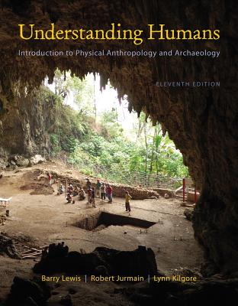
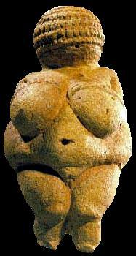
How to
Study for
Exams
Prehistoric Cultures University of Minnesota Duluth
Tim Roufs
© 2010-2013
http://www.d.umn.edu/cla/faculty/troufs/anth1602/

Slide 2
www.d.umn.edu/cla/faculty/troufs/anth1602/

Slide 3
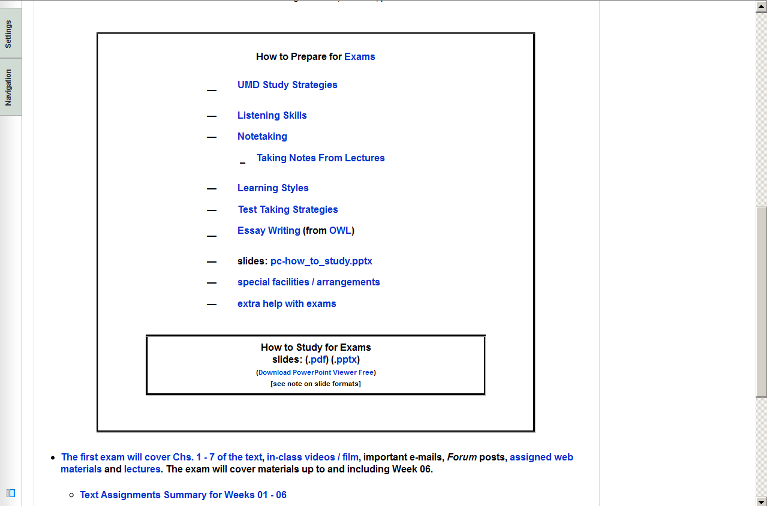

Slide 4
studying from the text

Slide 5
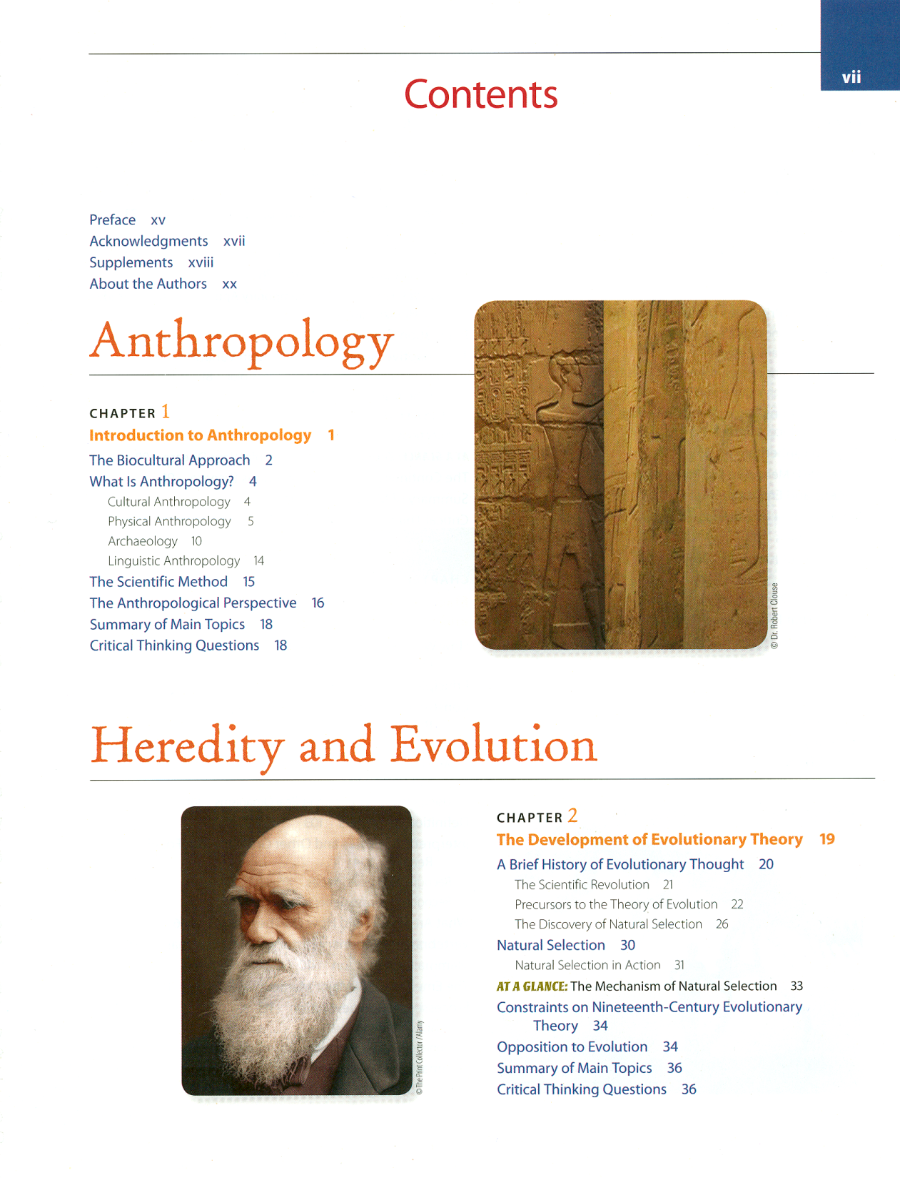
studying from the text

Slide 6
studying from the text

Slide 7
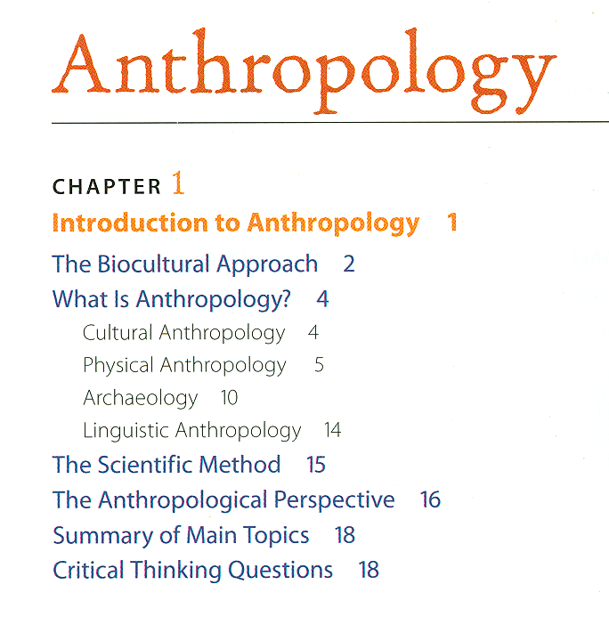
studying from the text

Slide 8
studying from the text
for items from the
“Contents”
1. What is it?
2. Why is it important?
3. When did it happen?

Slide 9
studying from the text
for items from the
“Contents”
1. What is it?
2. Why is it important?
3. When did it happen?

Slide 10
studying from the text
for items from the
“Contents”
1. What is it?
2. Why is it important?
3. When did it happen?

Slide 11
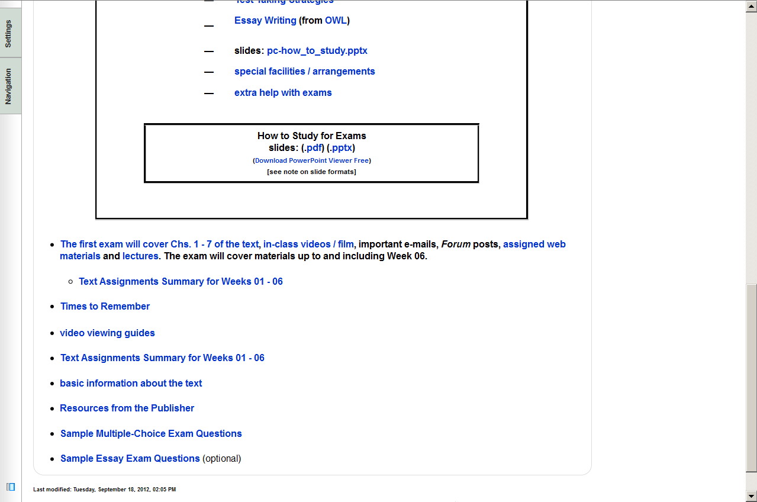
3. When did it happen?

Slide 12
read charts from the bottom up
http://www.d.umn.edu/cla/faculty/troufs/anth1602/pctimes.html

Slide 13
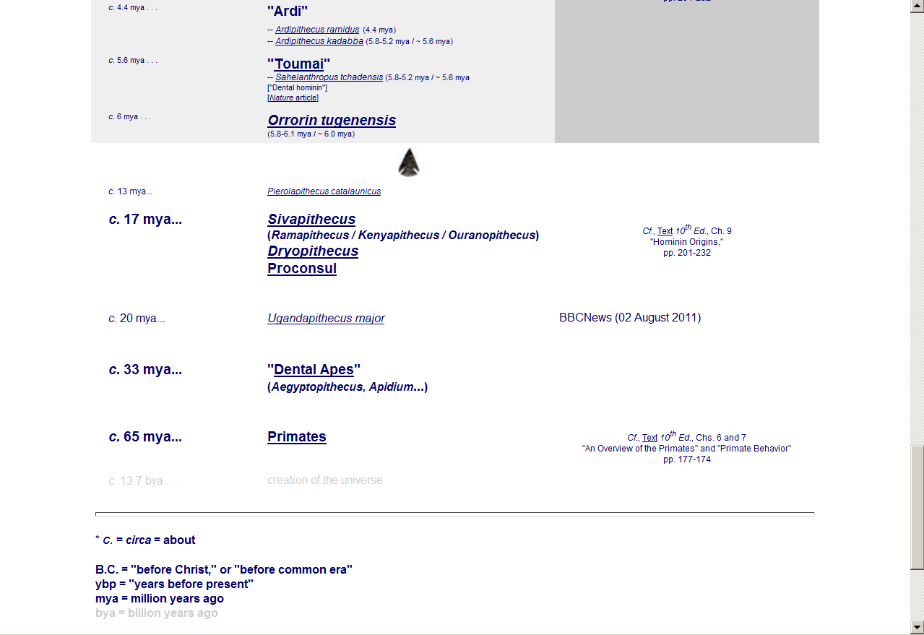
2.5 – 7
mya
http://www.d.umn.edu/cla/faculty/troufs/anth1602/pctimes.html

Slide 14
studying from the text
also keep track of
1. The first of things
2. The last of things
3. The best of things

Slide 15
studying from the text
also keep track of
1. The first of things
2. The last of things
3. The best of things

Slide 16
studying from the text
also keep track of
1. The first of things
2. The last of things
3. The best of things

Slide 17
studying from the text
REPEAT
keep track of
1. The first of things
2. The last of things
3. The best of things

Slide 18
studying from the text
pay attention
to the timelines in the text
See 11th ed., pp.
221
246
289
309
341
382
393

Slide 19
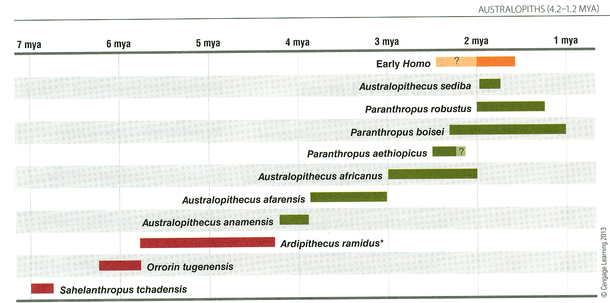
0
“gracile” Australopithecines
“gracile” Australopithecines
p. 221 Time line of early African Hominins

Slide 20
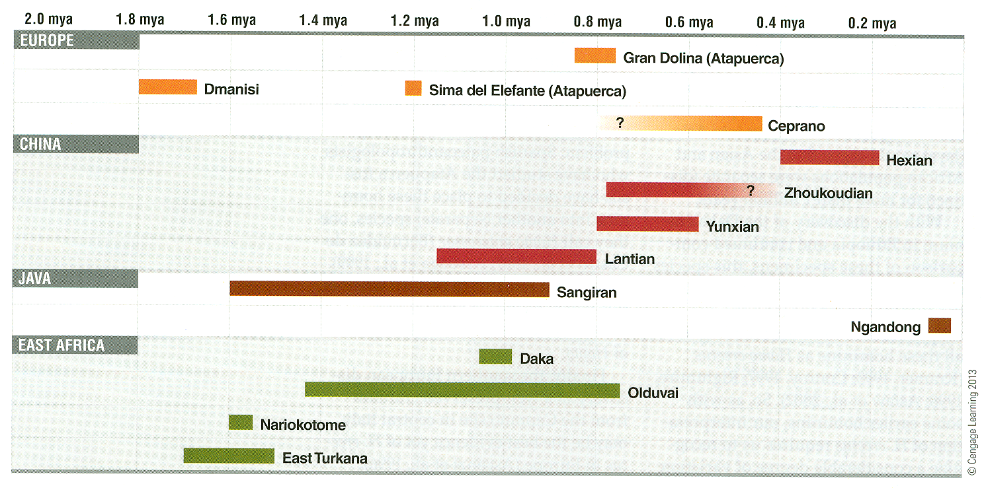
p. 256 Time line for Homo erectus and contemporaries

Slide 21
p. 256 Time line for Homo erectus and contemporaries

Slide 22
0
p. 256 Time line for Homo erectus and contemporaries

Slide 23
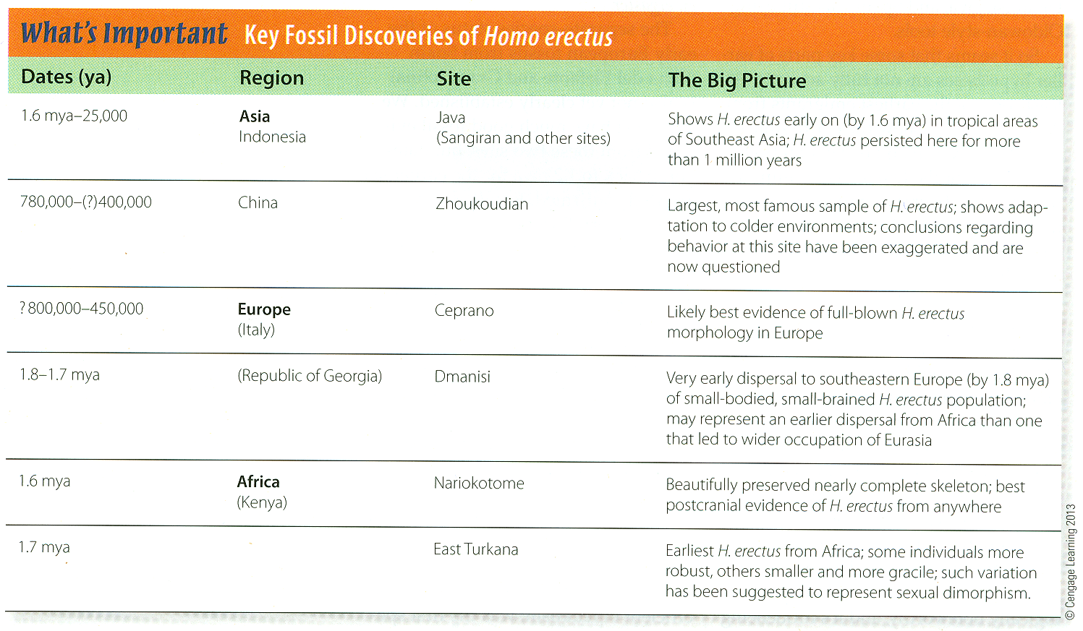
p. 250 Key Fossil Discoveries of Homo erectus

Slide 24
p. 278 Key Fossil Discoveries of Premodern Humans

Slide 25
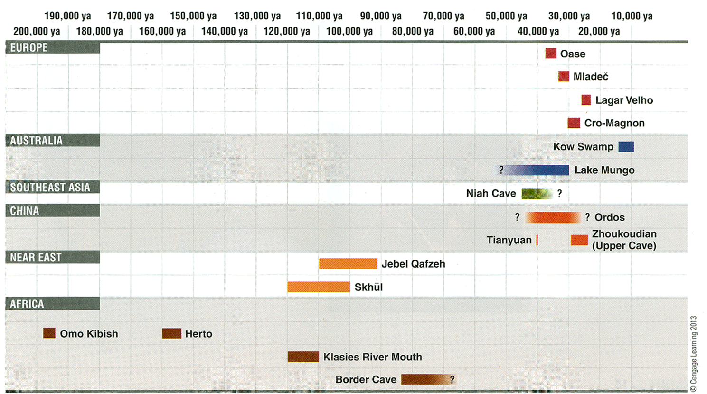
p. 289 Time line of Modern Homo sapiens discoveries

Slide 26
p. 289 Time line of Modern Homo sapiens discoveries.

Slide 27
0
p. 289 Time line of Modern Homo sapiens discoveries.

Slide 28
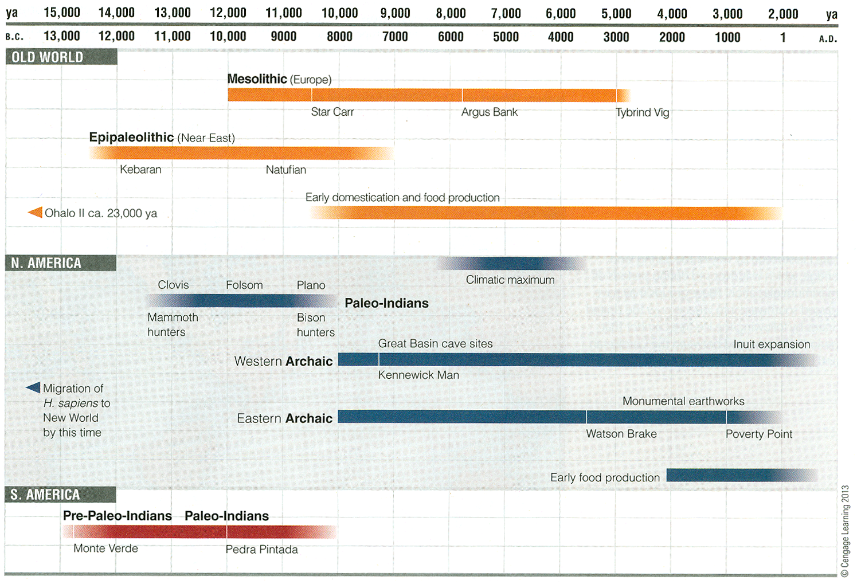
p. 309Time line of Early Holocene Hunters and Gatherers

Slide 29
p. 309Time line of Early Holocene Hunters and Gatherers

Slide 30
p. 309Time line of Early Holocene Hunters and Gatherers

Slide 31
transition from end of last
ice age to conditions
approximating the present
p. 309 Time line of Early Holocene Hunters and Gatherers

Slide 32
p. 309Time line of Early Holocene Hunters and Gatherers

Slide 33
p. 309Time line of Early Holocene Hunters and Gatherers

Slide 34
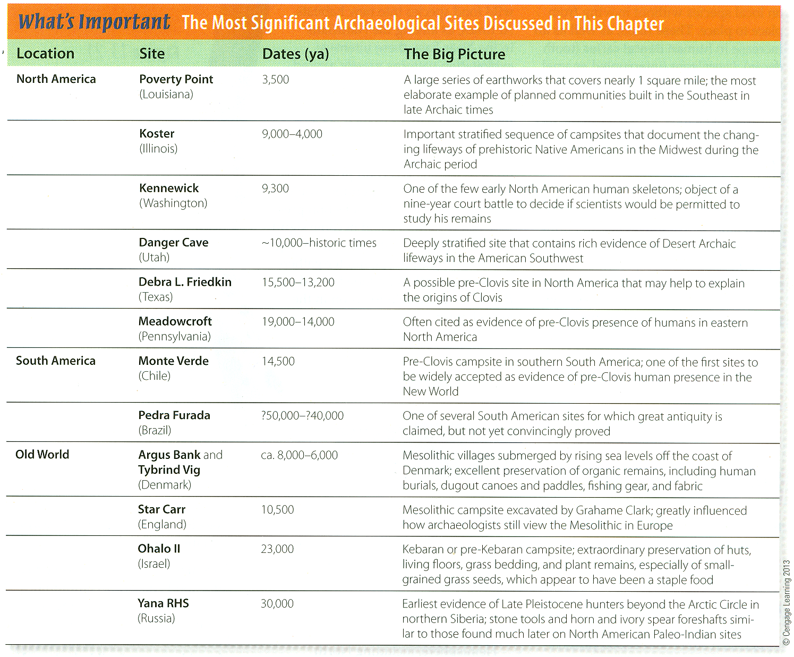
p. 338

Slide 35
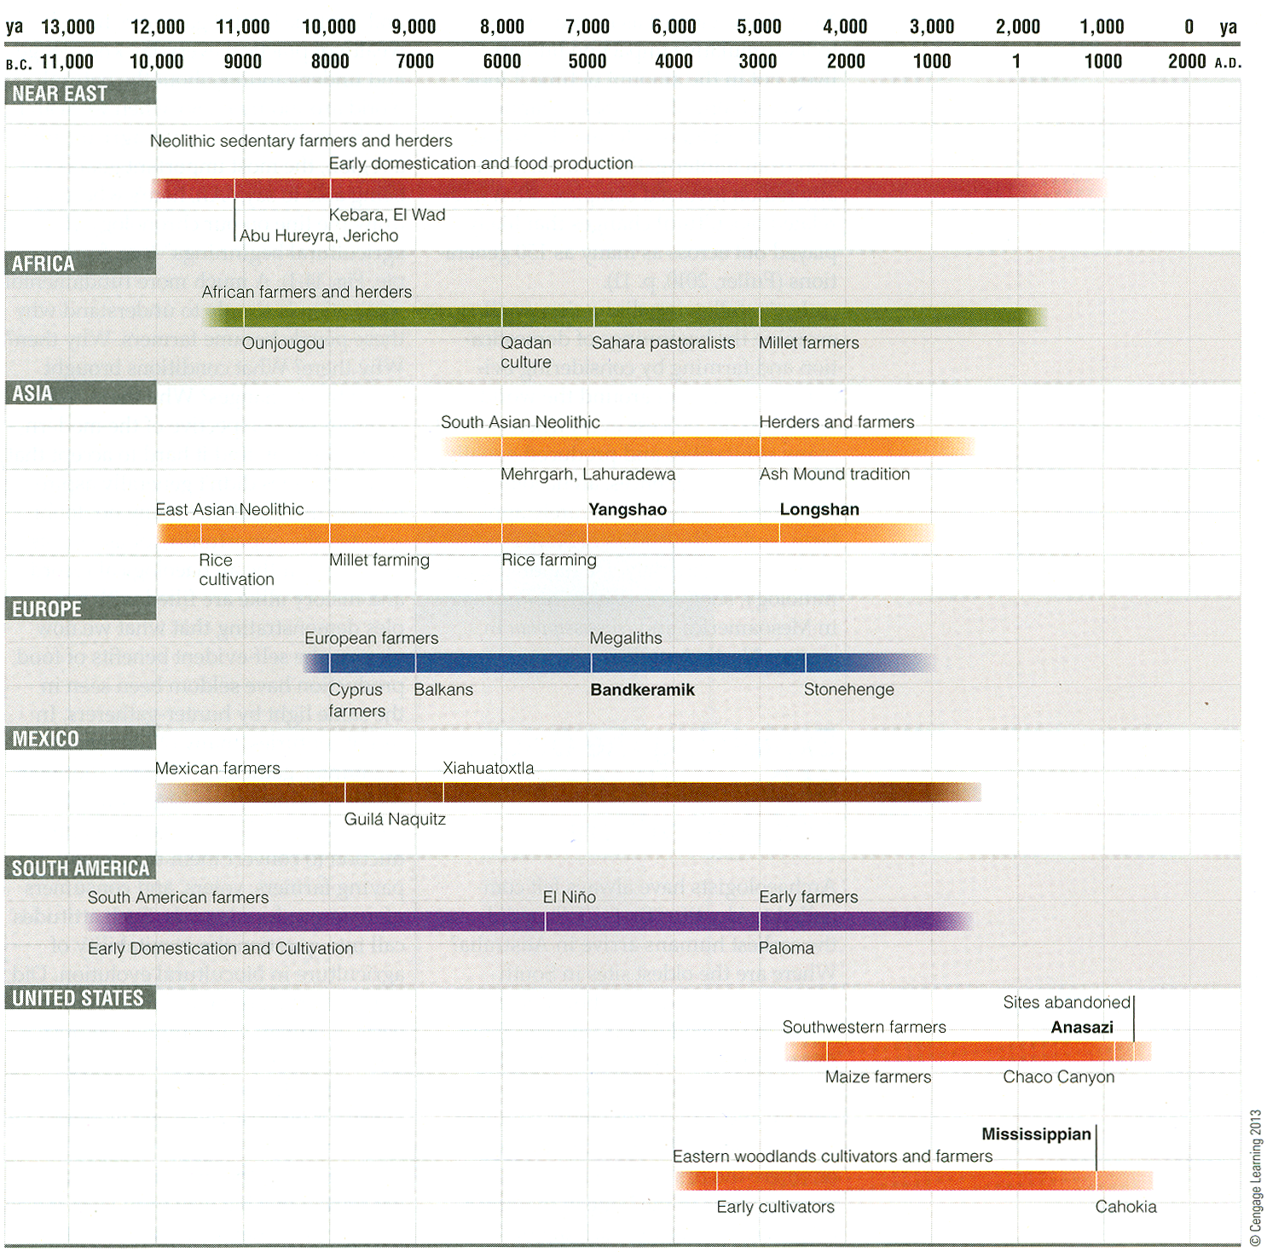
p. 341 Time line for Ch. 14 “Food Production”

Slide 36
p. 341 Time line for Ch. 14 “Food Production”

Slide 37
p. 341 Time line for Ch. 14 “Food Production”

Slide 38
transition from end of last
ice age to conditions
approximating the present
p. 341 Time line for Ch. 14 “Food Production”

Slide 39
p. 341 Time line for Ch. 14 “Food Production”

Slide 40
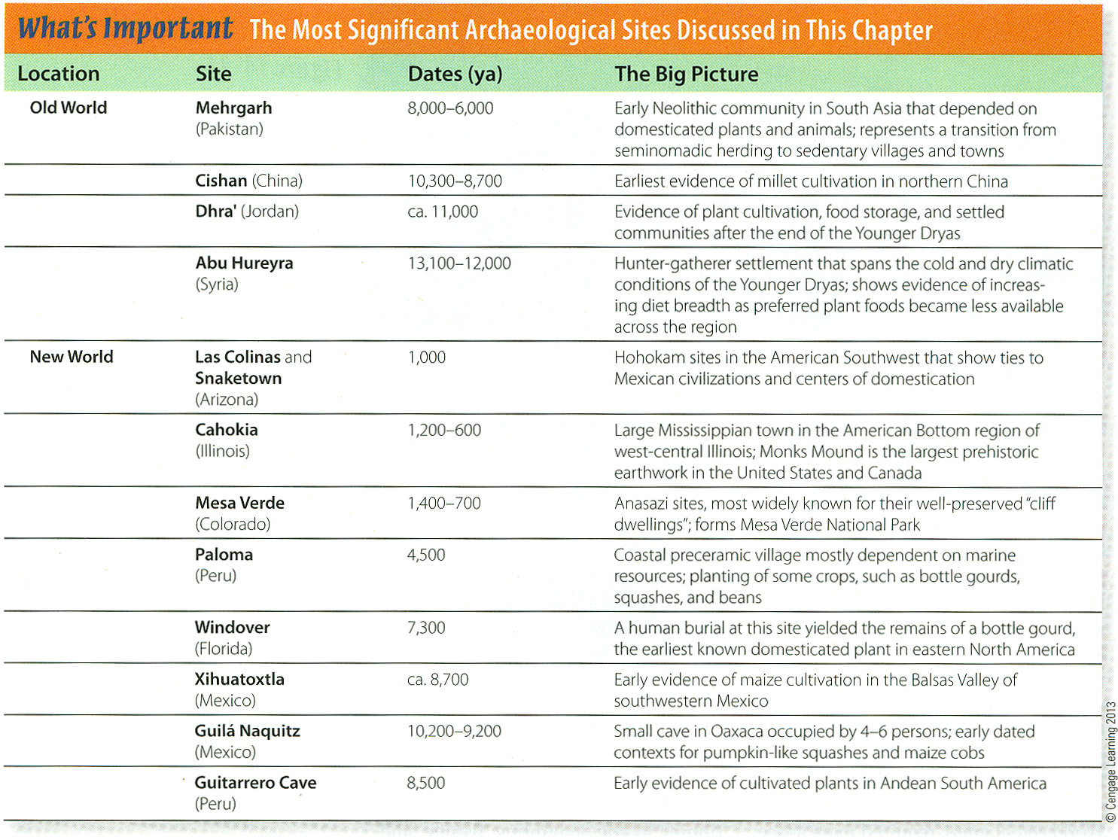
p. 372

Slide 41
p. 372

Slide 42
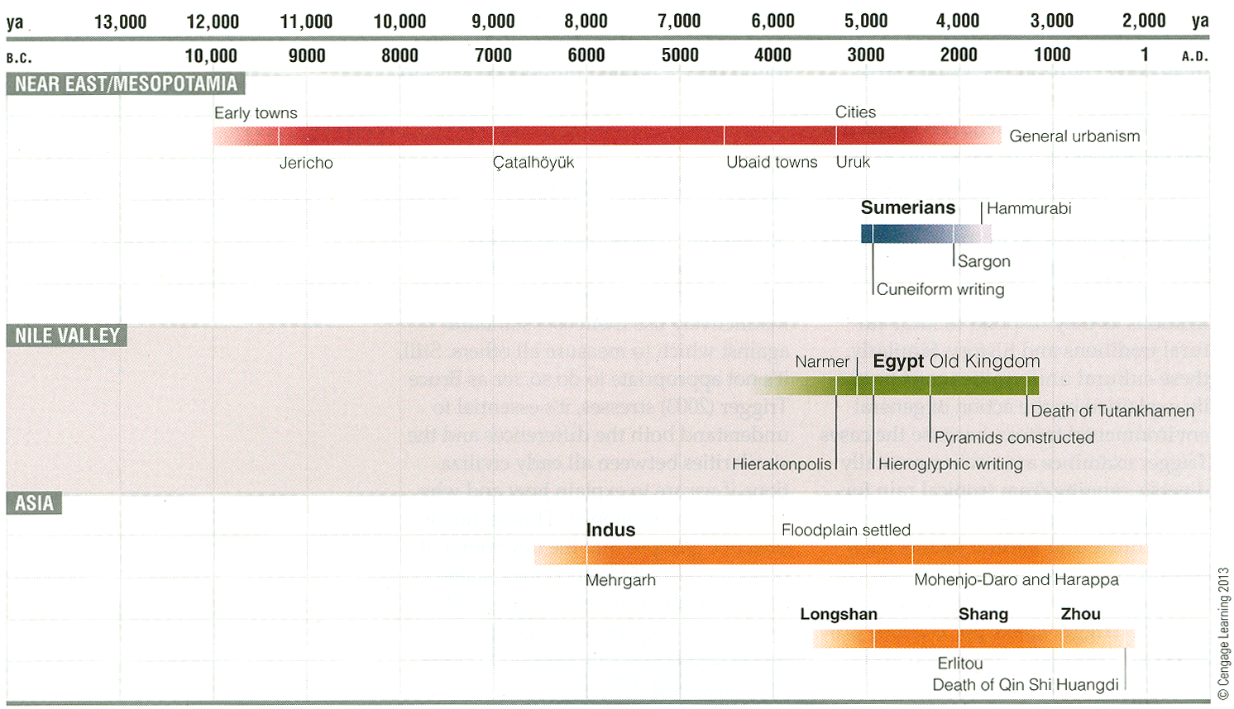
p. 382 Time line for Old World civilizations

Slide 43
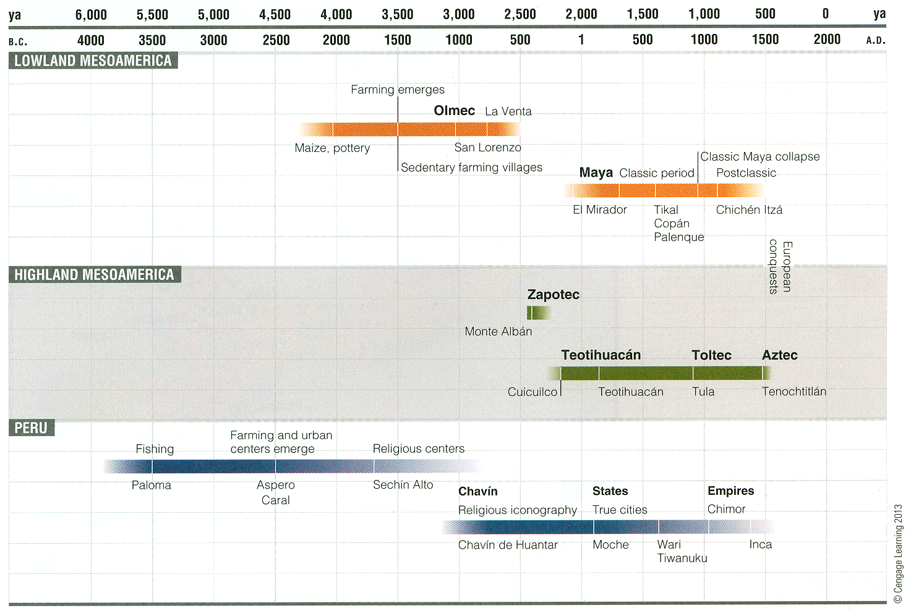
p. 393 Time line for New World civilizations

Slide 44
p. 393 Time line for New World civilizations

Slide 45
p. 393 Time line for New World civilizations

Slide 46
p. 393 Time line for New World civilizations

Slide 47
p. 393 Time line for New World civilizations

Slide 48
p. 393 Time line for New World civilizations

Slide 49
p. 393 Time line for New World civilizations

Slide 50
p. 393 Time line for New World civilizations

Slide 51
Mixtec
p. 393 Time line for New World civilizations

Slide 52
p. 393 Time line for New World civilizations

Slide 53
p. 393 Time line for New World civilizations

Slide 54
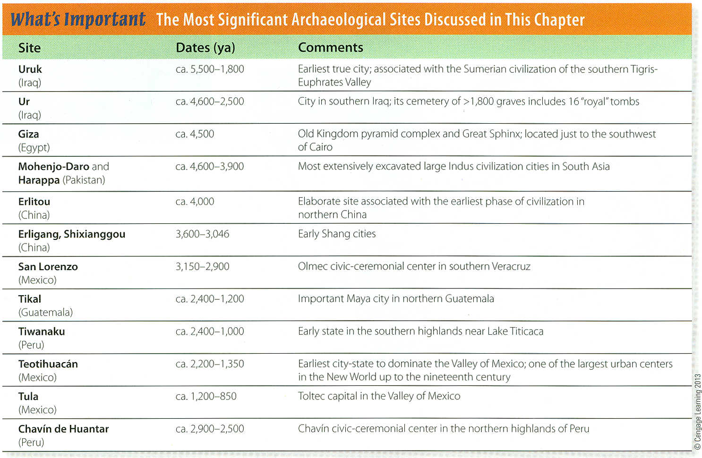
p. 406 The Most Significant Archaeological Site Discussed in Ch. 15, “The First Civilizations.”

Slide 55
studying from the text
for items from the
“Contents”
1. What is it?
2. Why is it important?
3. When did it happen?

Slide 56
studying from the text

Slide 57
studying from the text

Slide 58
studying from the text

Slide 59
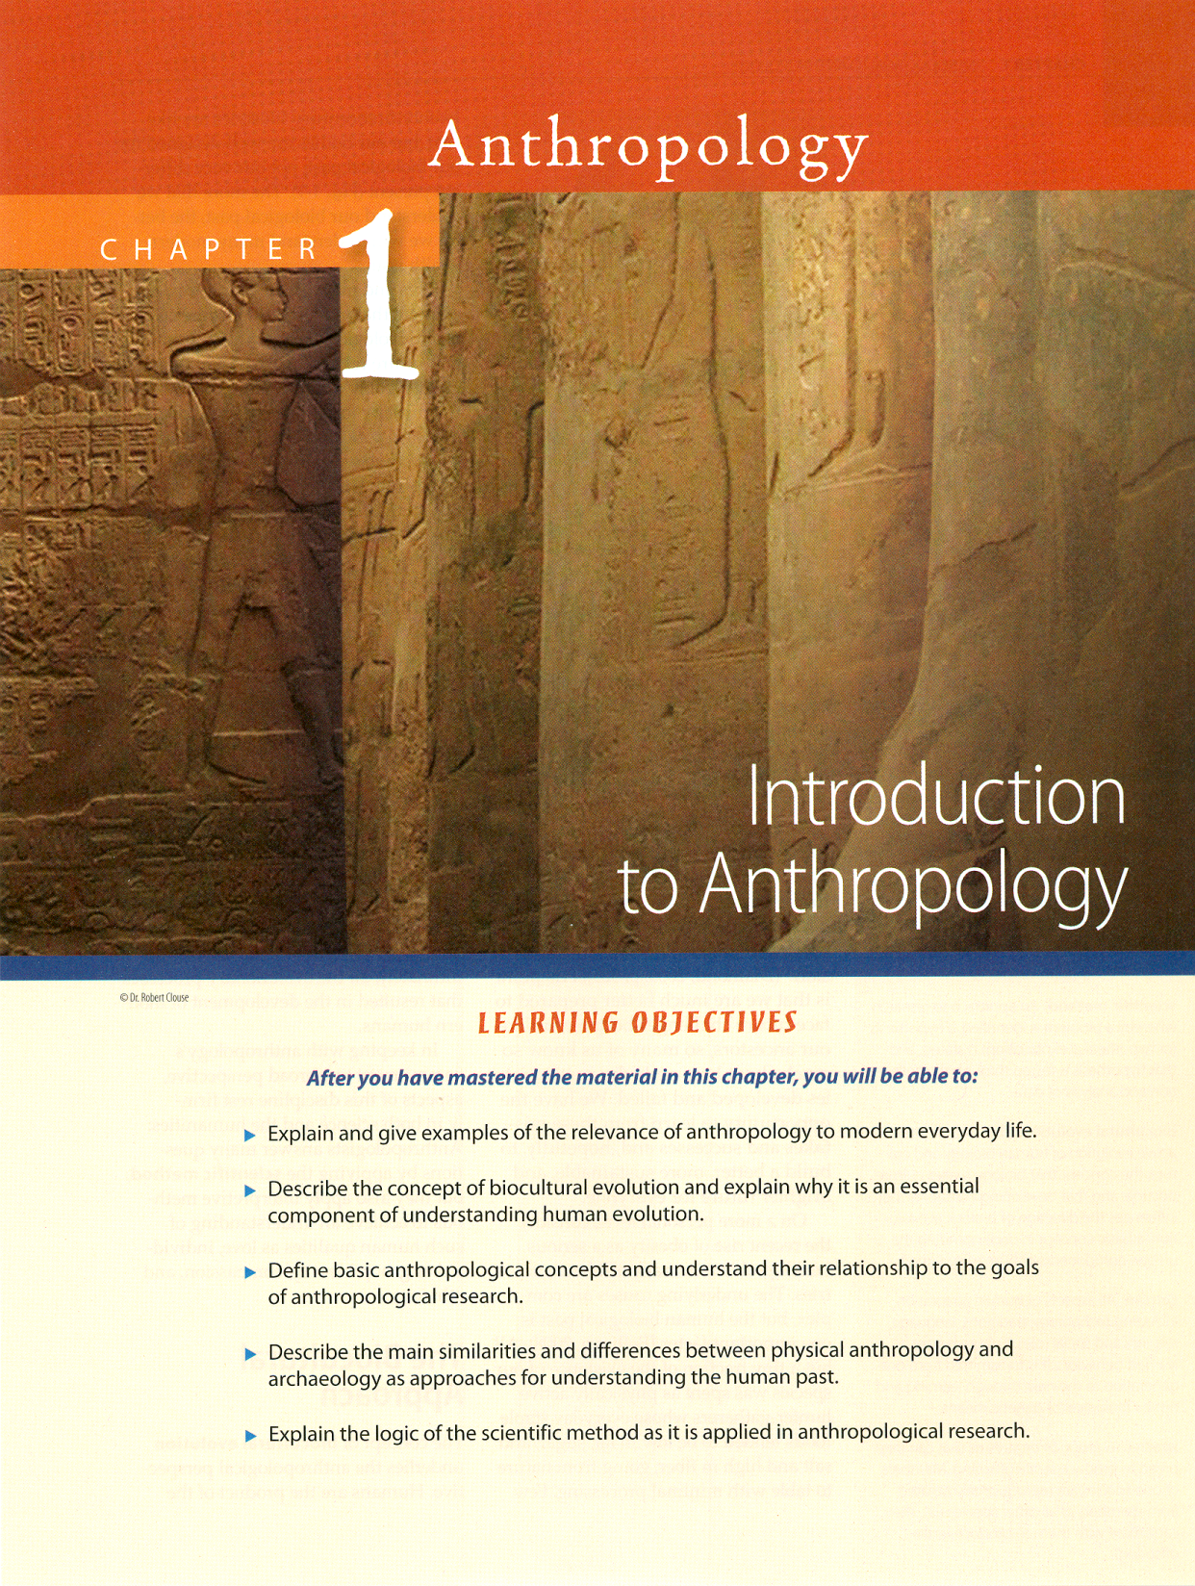
studying from the text

Slide 60
studying from the text

Slide 61
studying from the text

Slide 62
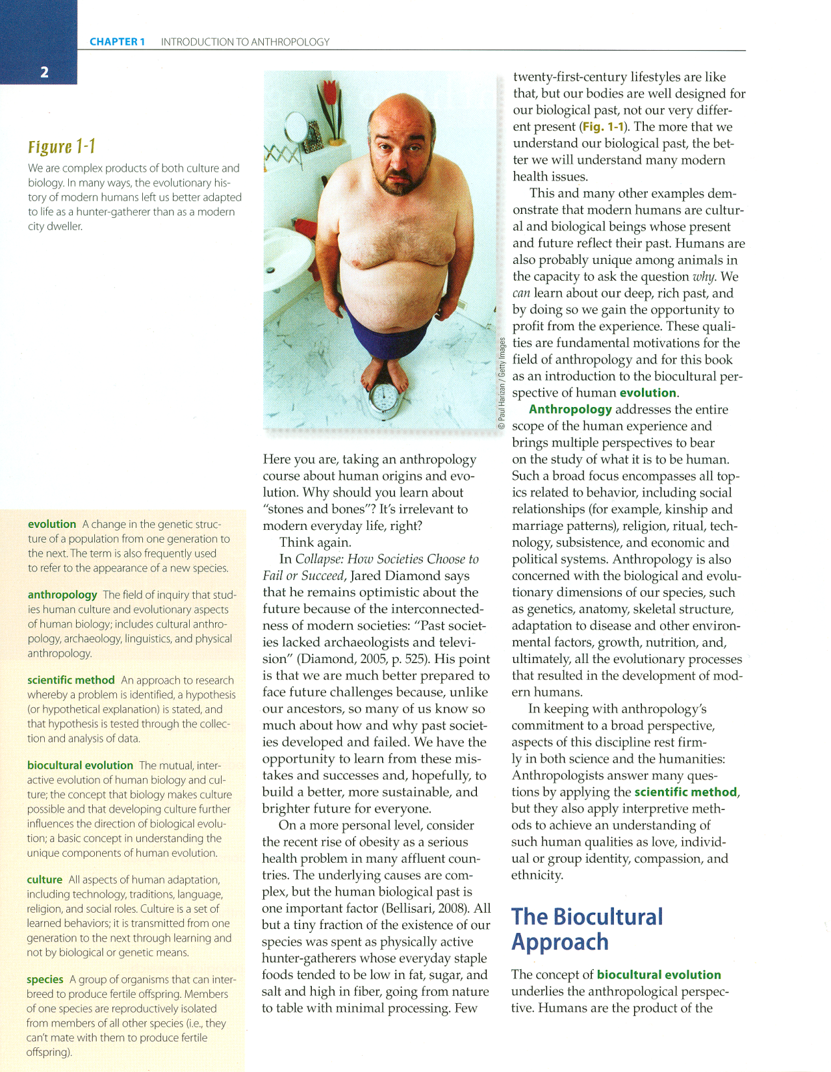
studying from the text
p. 2

Slide 63
studying from the text
p. 2

Slide 64
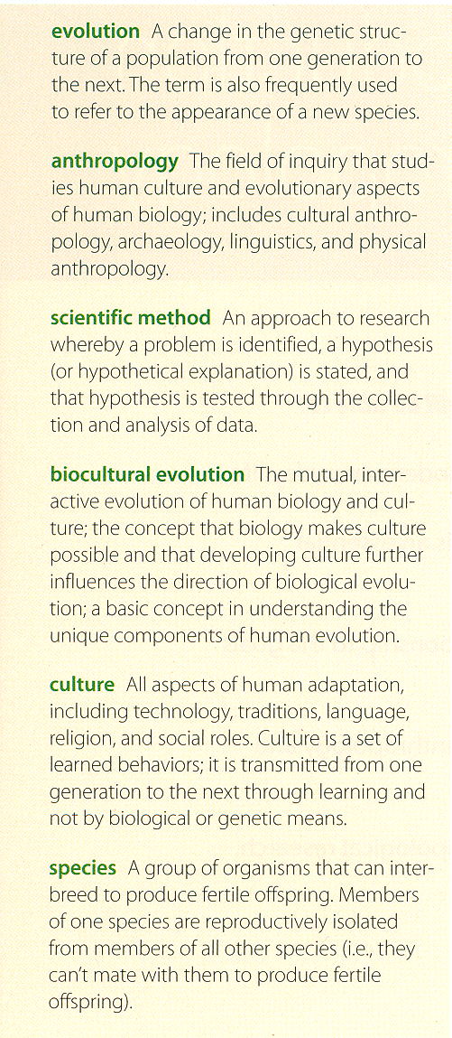
studying from the text
p. 2

Slide 65
studying from the text

Slide 66
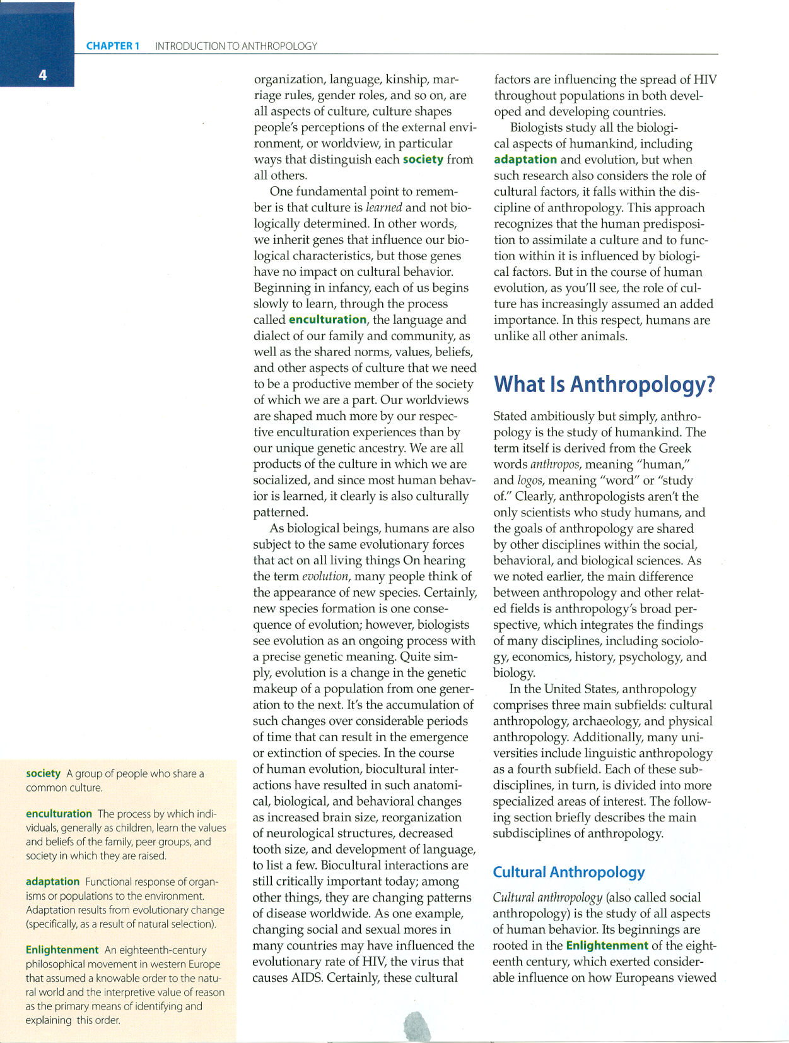
studying from the text

Slide 67
studying from the text

Slide 68
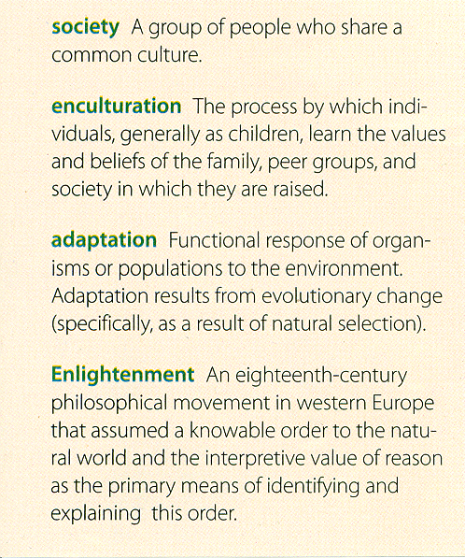
studying from the text

Slide 69
studying from the text
p. vii

Slide 70
studying from the text
continue on in a similar manner with the rest of the chapters
p. vii

Slide 71
continue on in a similar manner with the rest of the chapters
for each item ask . . .
1. What is it?
2. Why is it important?
3. When did it happen?

Slide 72
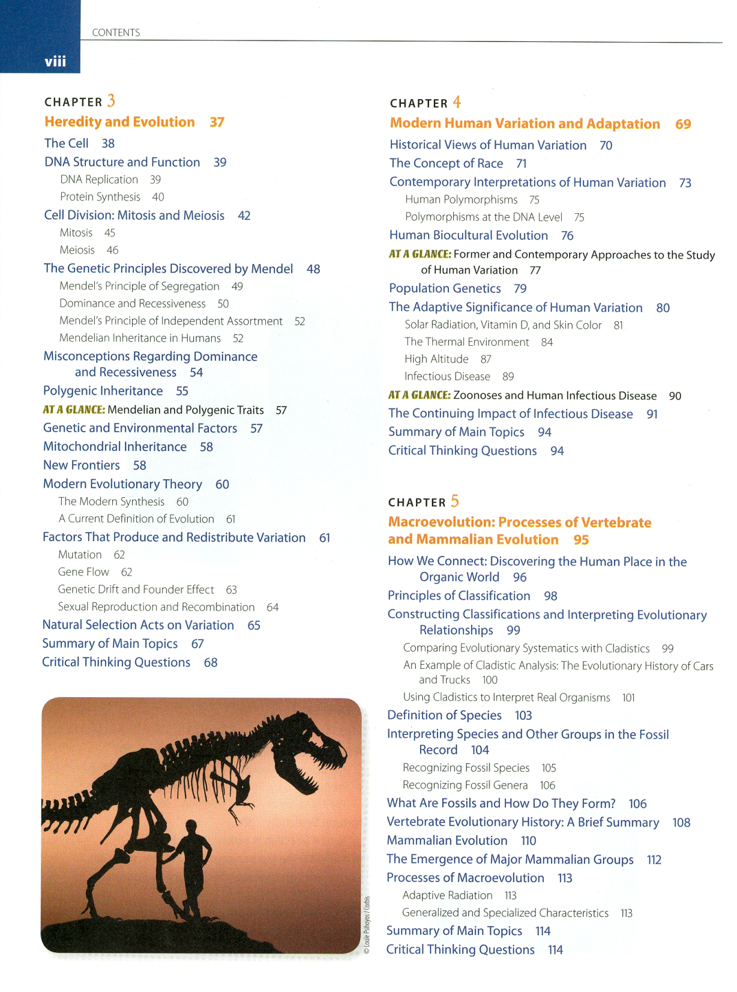
continue on in a similar manner with the rest of the chapters
p. viii

Slide 73
p. viii

Slide 74
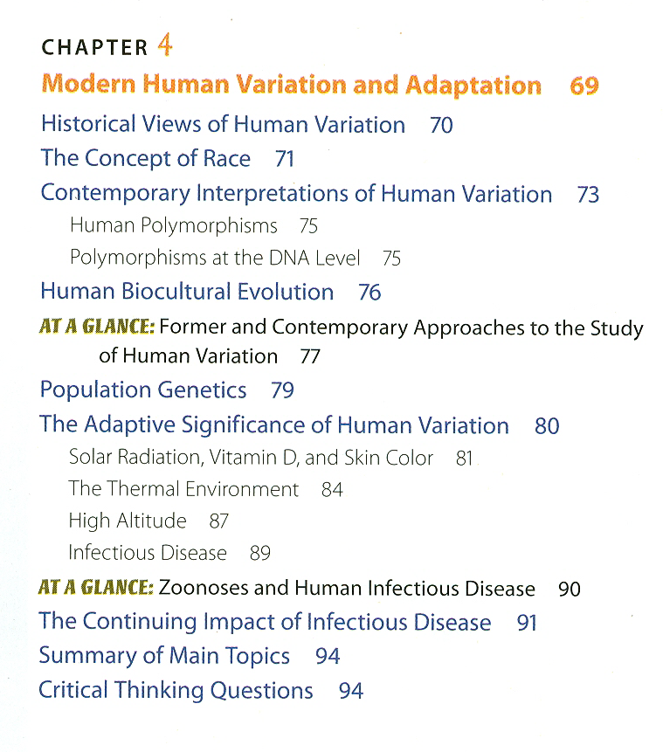
p. viii

Slide 75
this should be familiar from the film . . .
p. viii

Slide 77
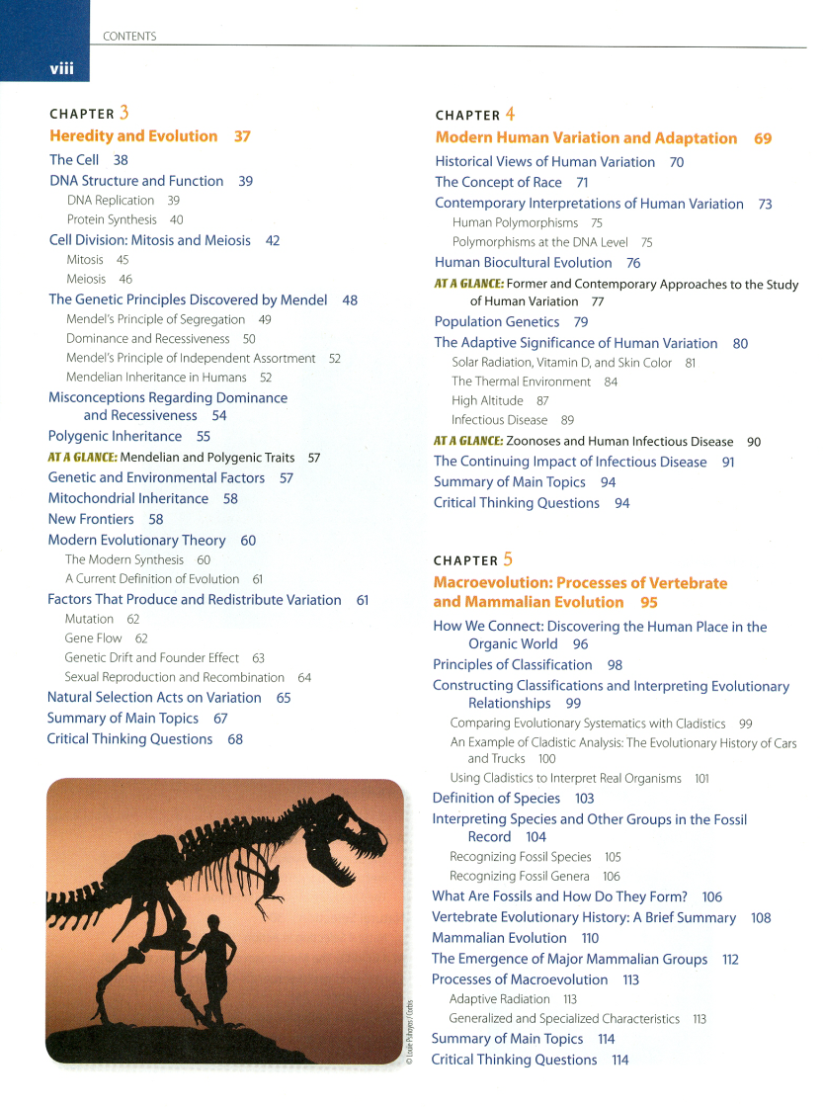
continue on in a similar manner with the rest of the chapters
for each item ask . . .
1. What is it?
2. Why is it important?
3. When did it happen?

Slide 78
continue on in a similar manner with the rest of the chapters
for each item ask . . .
1. What is it?
2. Why is it important?
3. When did it happen?
Quiz #1 will be
on Chs. 01-07
and other class materials

Slide 79
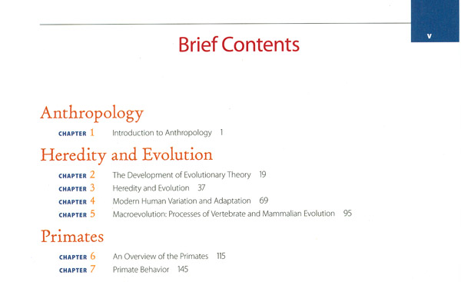

Slide 80
What about the names of people?
studying from the text

Slide 81
names of people
know the major figures from Bishop Ussher through the present
generally these are people whose pictures are in the text chapters, or who are discussed at some length in class

Slide 82
studying from the text
p. vii

Slide 83
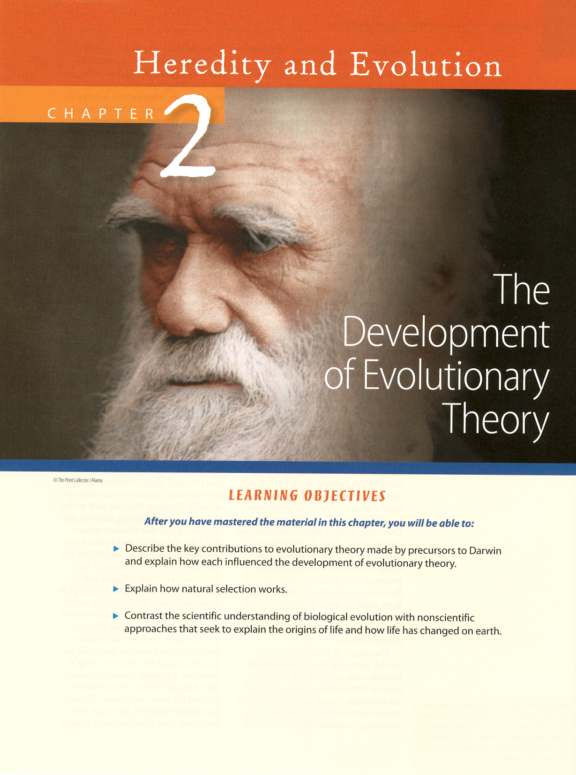
studying from the text
p. 19

Slide 84
studying from the text
p. viii

Slide 85
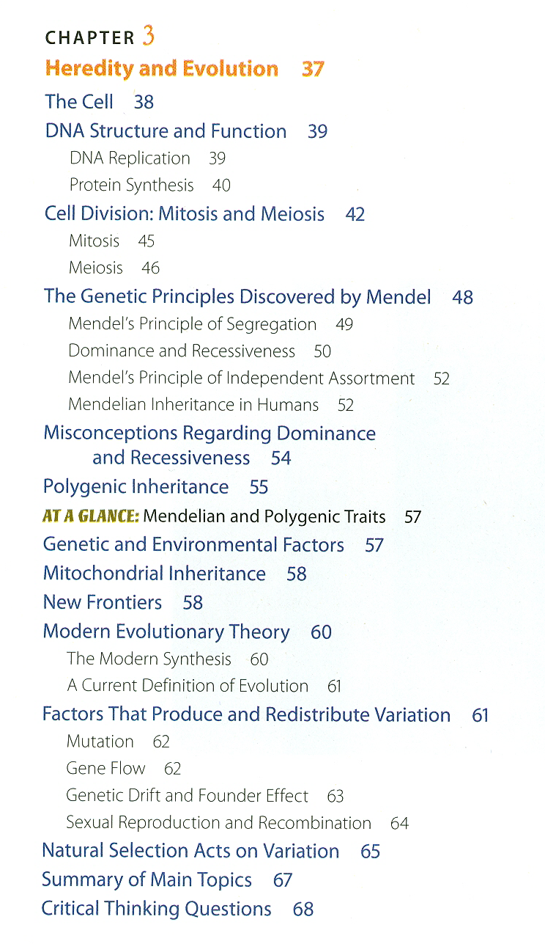
studying from the text
p. viii

Slide 86
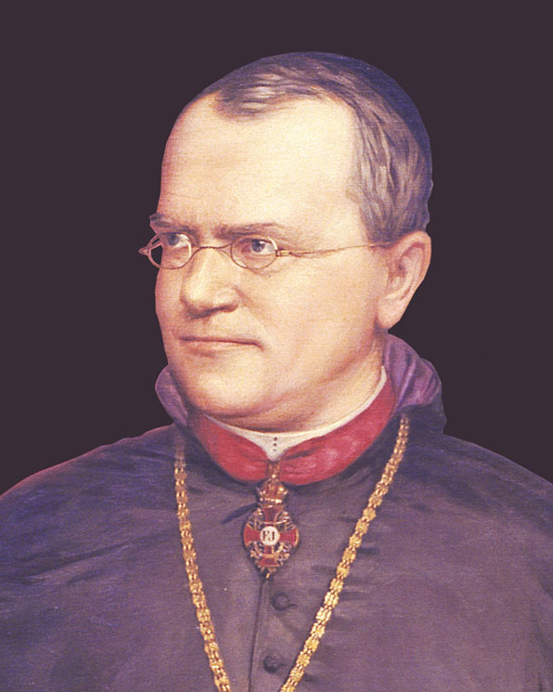
studying from the text
Know the people singled out in the Contents sections
p. viii

Slide 87
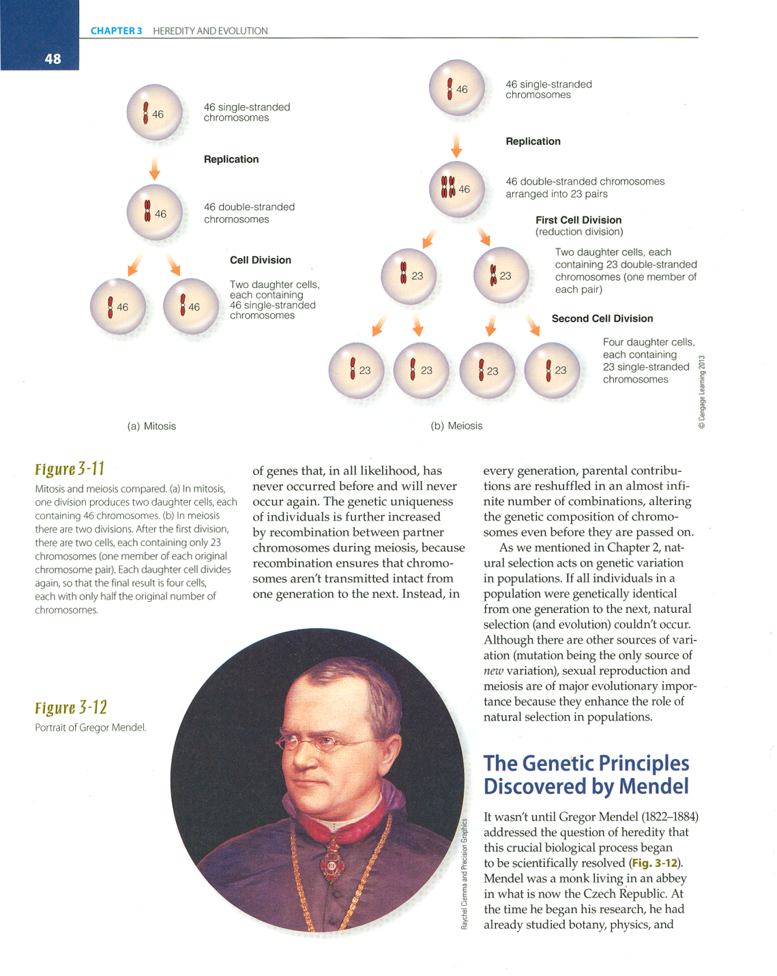
Know the people singled out in the Contents sections
11th Ed. p. 48

Slide 88
1
2
3

Slide 89
4

Slide 90
4

Slide 91
4

Slide 92
important people / works
Charles Darwin
(1809 - 1882)
Origin of Species 1859
Descent of Man 1871

Slide 93
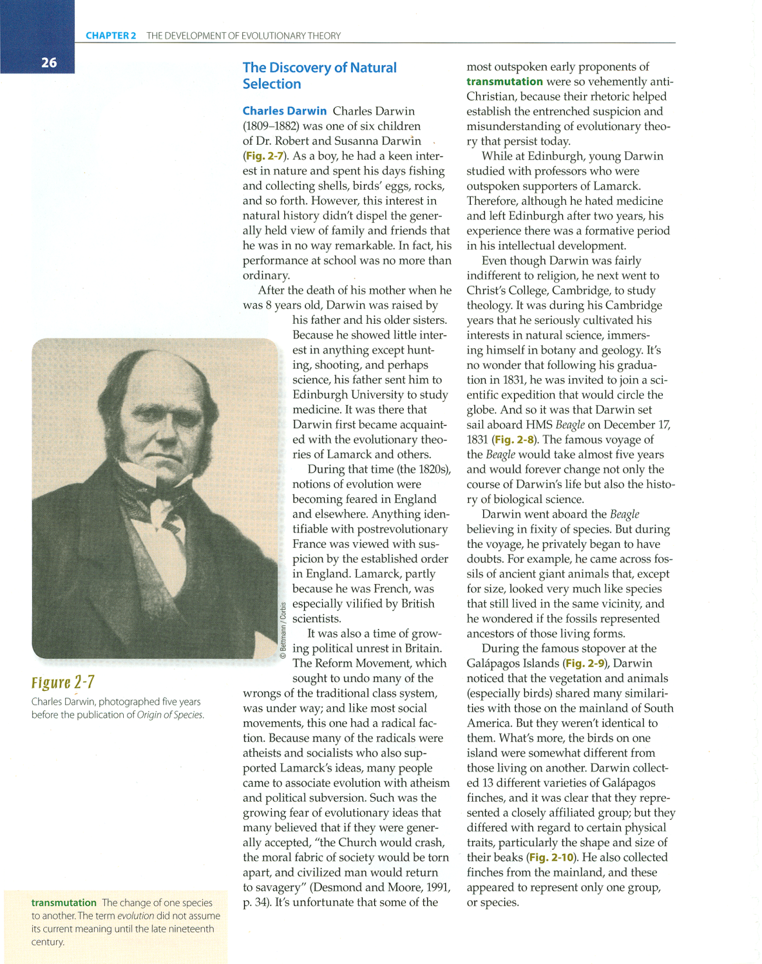
11th Ed. p. 26

Slide 94
2
3
1
11th Ed. p. 26

Slide 95
4

Slide 96
important people / works
4

Slide 97
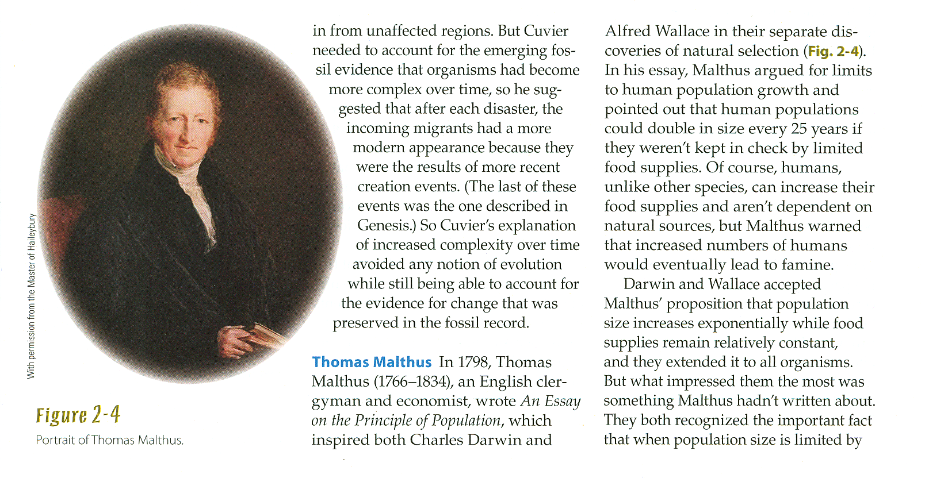
Thomas Malthus
11th Ed. p. 24

Slide 98
Thomas Malthus
Thomas Malthus
(1766-1834) “Essay on the Principle of Population”
1798
11th Ed. p. 24

Slide 99
important people / works

Slide 100
4

Slide 101
important people / works

Slide 102
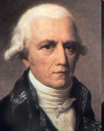
important people / works
Lamarck
Believed that species change was influenced by environmental change.
He is known
for his theory of the inheritance of acquired characteristics.
11th Ed. p. 23

Slide 103
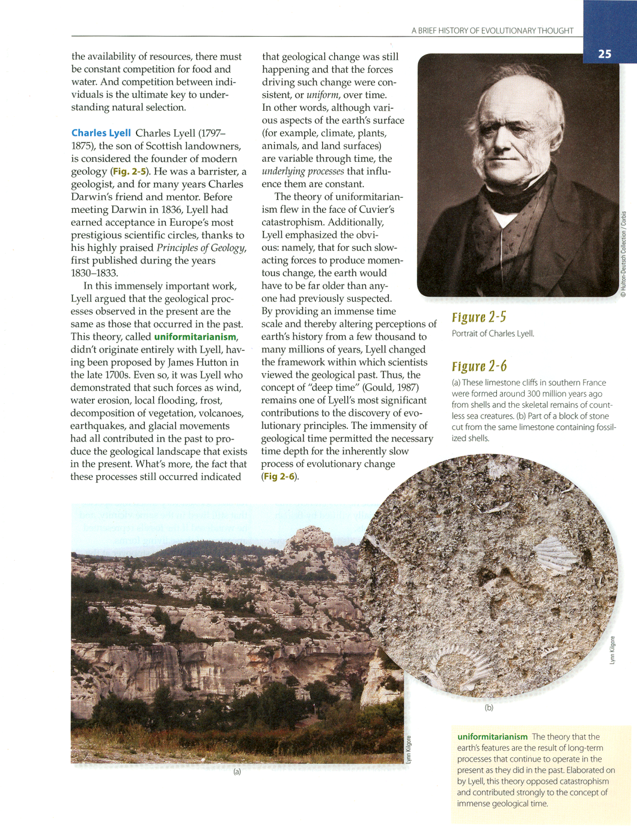
Lyell
The father of geology, stated that the theory of uniformitarianism in his Principles of Geology.
Charles Lyell
11th Ed. p. 25

Slide 104
important people / works

Slide 105
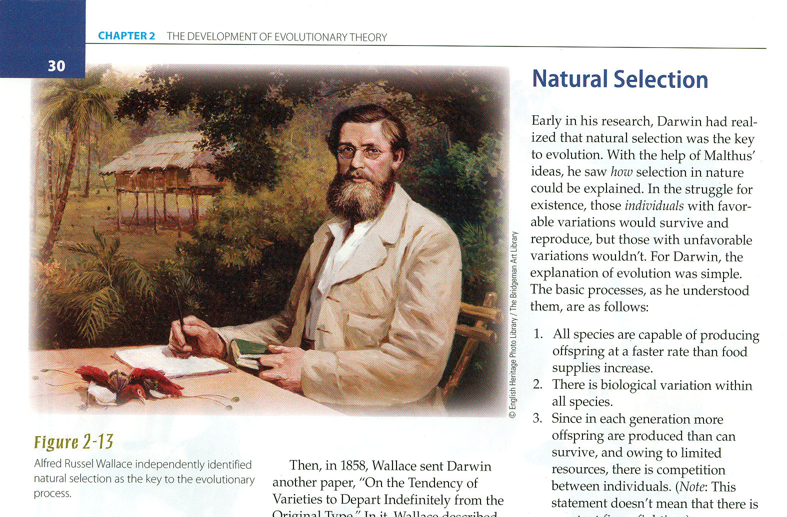
Alfred Russel Wallace
11th Ed. p. 30

Slide 106
Alfred Russel Wallace
independently
uncovered the key to the evolutionary process
11th Ed. p. 30

Slide 107
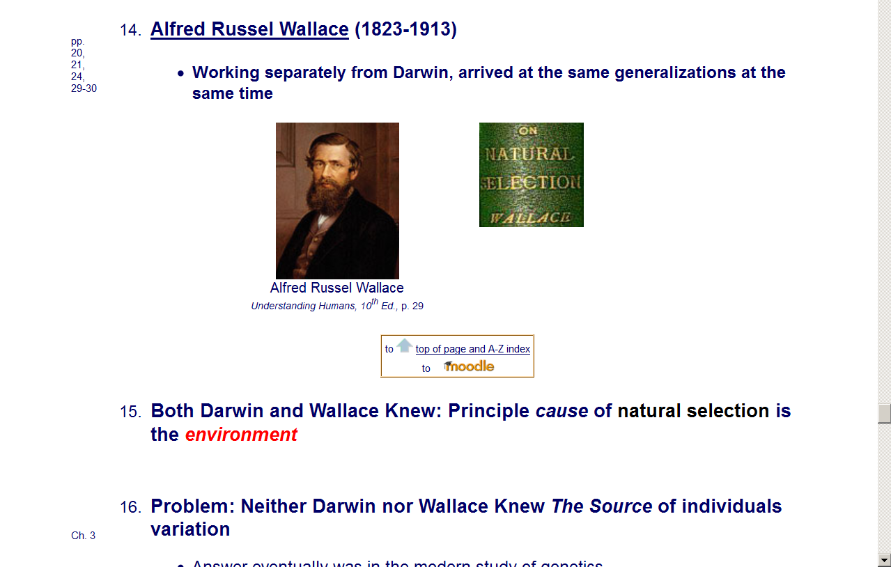
important people / works

Slide 108
studying from the text
REM:
pay special attention
to the definitions
in the margins of the text

Slide 109
studying from the text
p. 2

Slide 110
studying from the text

Slide 111
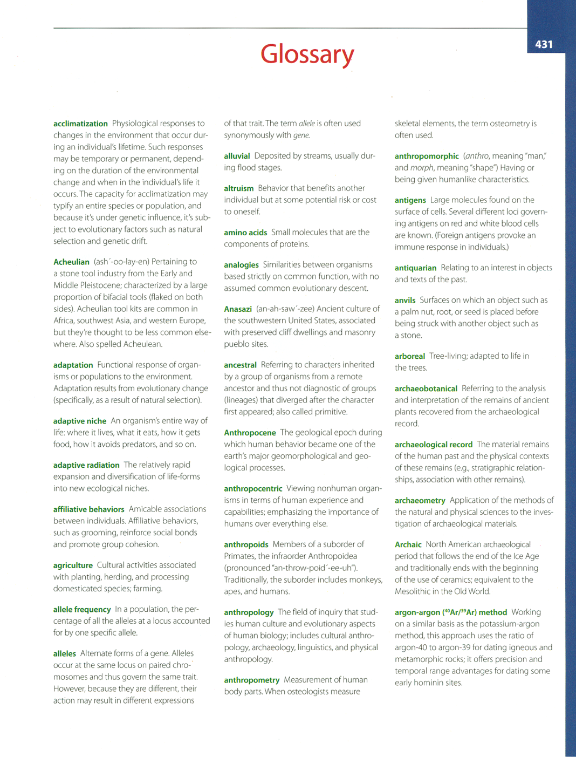
studying from the text
have a look
at
the Glossary items on pp. 431-444

Slide 112
glossary
. . . and other terms
introduced in class
biospecies
paleospecies

Slide 113
terms / concepts
from class handout
“History of Thought . . .”

Slide 114
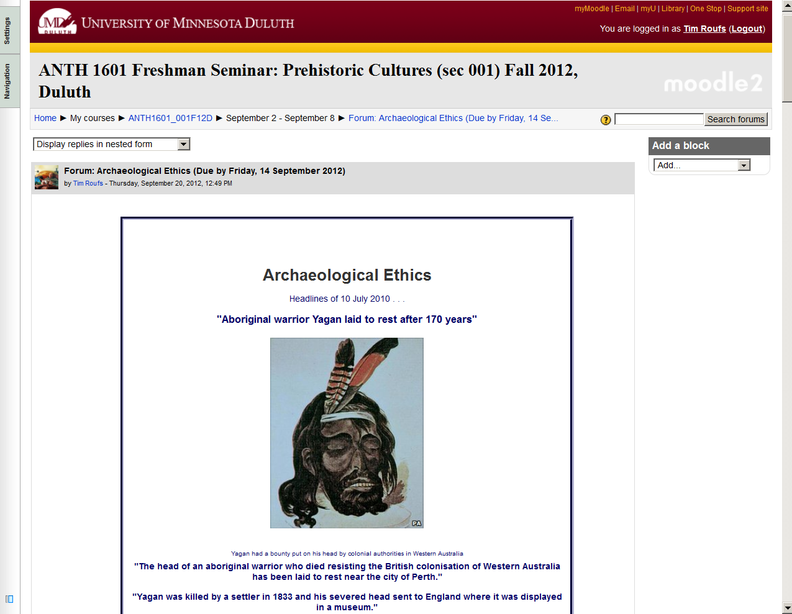

Slide 115
individual fossils
know major finds,
according to group type
early on that means the basic type of find
e.g., Australopithecus (“South African ape”)

Slide 116
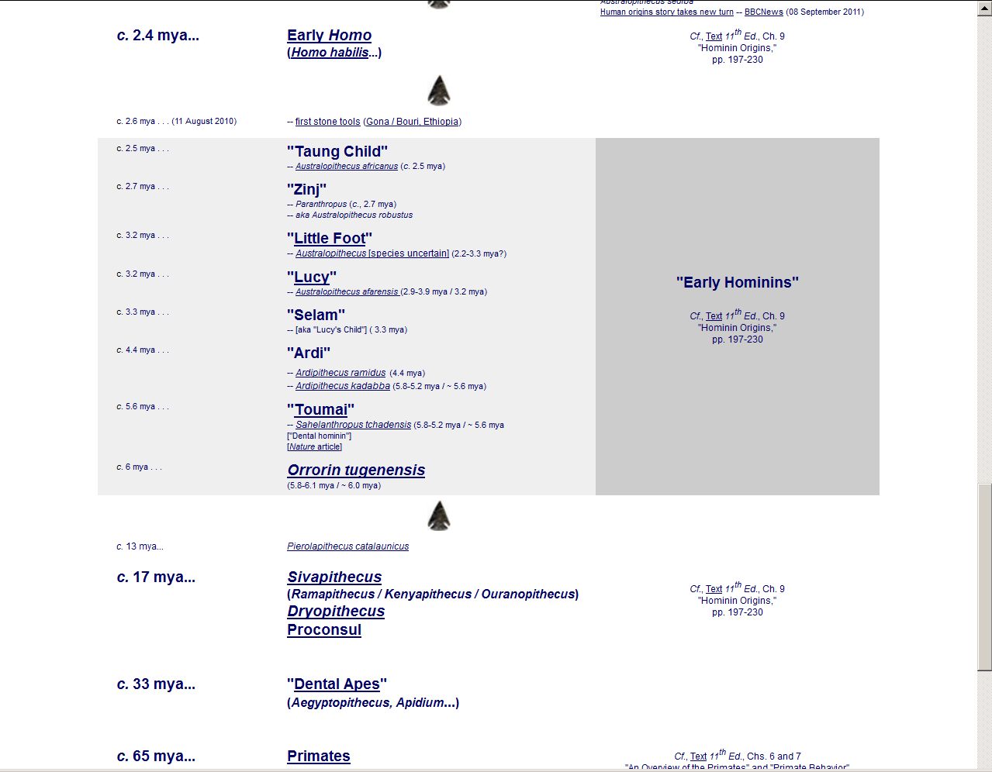
2.5 – 7
mya
http://www.d.umn.edu/cla/faculty/troufs/anth1602/pctimes.html

Slide 117
individual fossils
know major finds,
according to group type
early on that means the basic type of find
e.g., Australopithecus (“South African ape”)
later it means keeping track of the genus
e.g., “Australopithecus”

Slide 118
2.5 – 7
mya
Australopithecus
(“South African Ape”)
“robust”
“gracile”
http://www.d.umn.edu/cla/faculty/troufs/anth1602/pctimes.html

Slide 119
individual fossils
know major finds,
according to group type
early on that means the basic type of find
e.g., Australopithecus (“South African ape”)
later it means keeping track of the genus
e.g., “Early Homo”
toward the end (Chs. 10 - 16) that means keeping track of the species
e.g., Homo habilis, Homo erectus, Homo sapiens

Slide 120
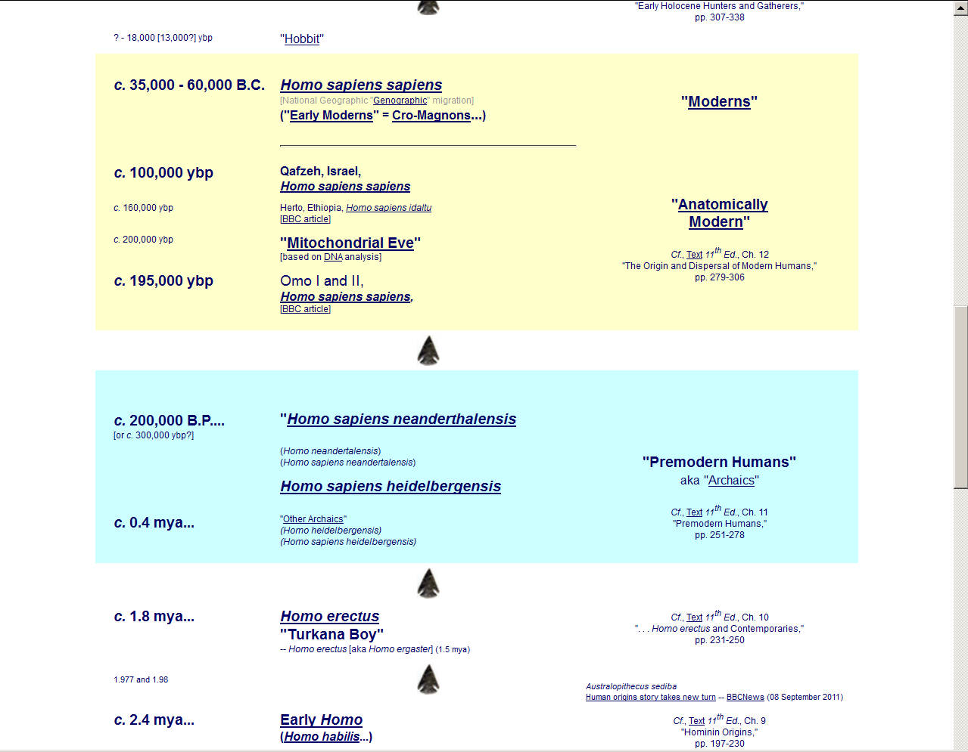

Slide 121
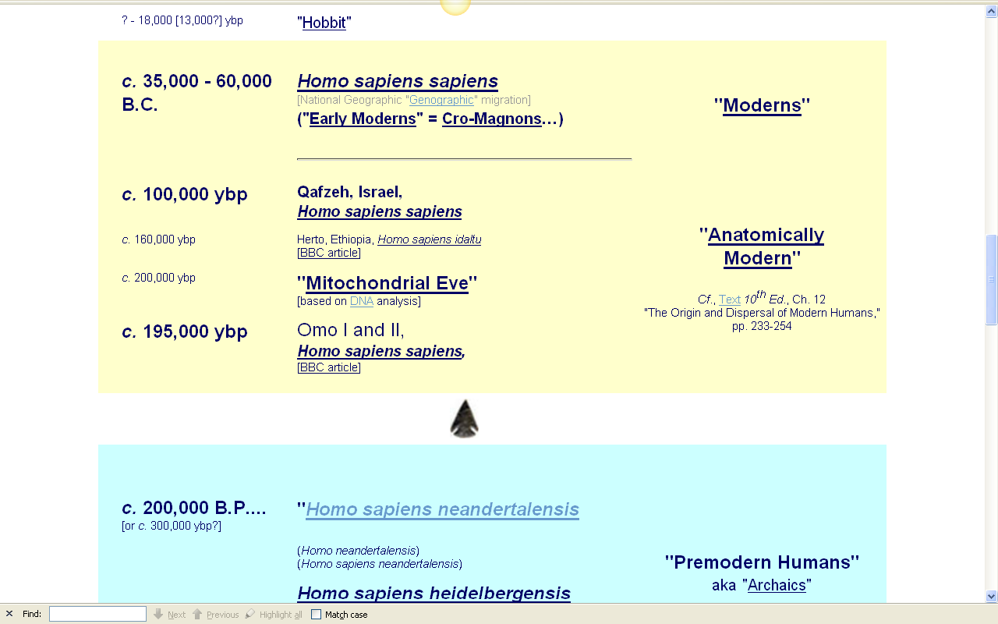
NG Genographic migration
www.d.umn.edu/cla/faculty/troufs/anth1602/pctimes.html#title

Slide 122
important individual fossils will be discussed in class

Slide 123
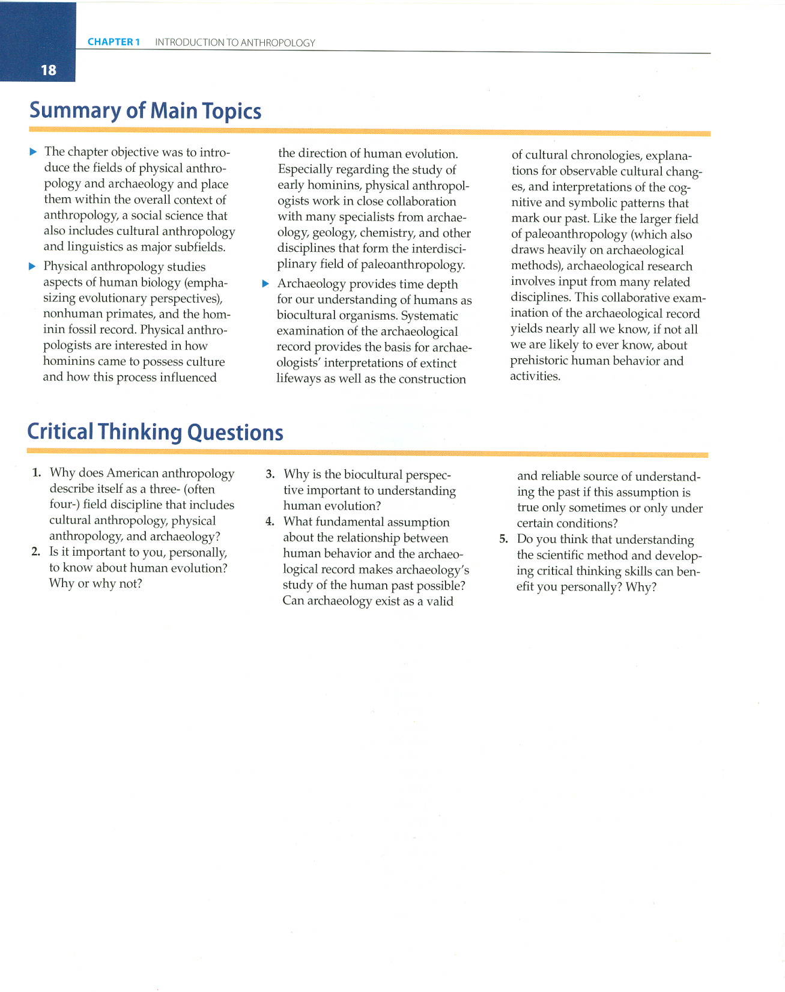
p. 18, Ch. 1, “Summary of Main Topics”

Slide 124
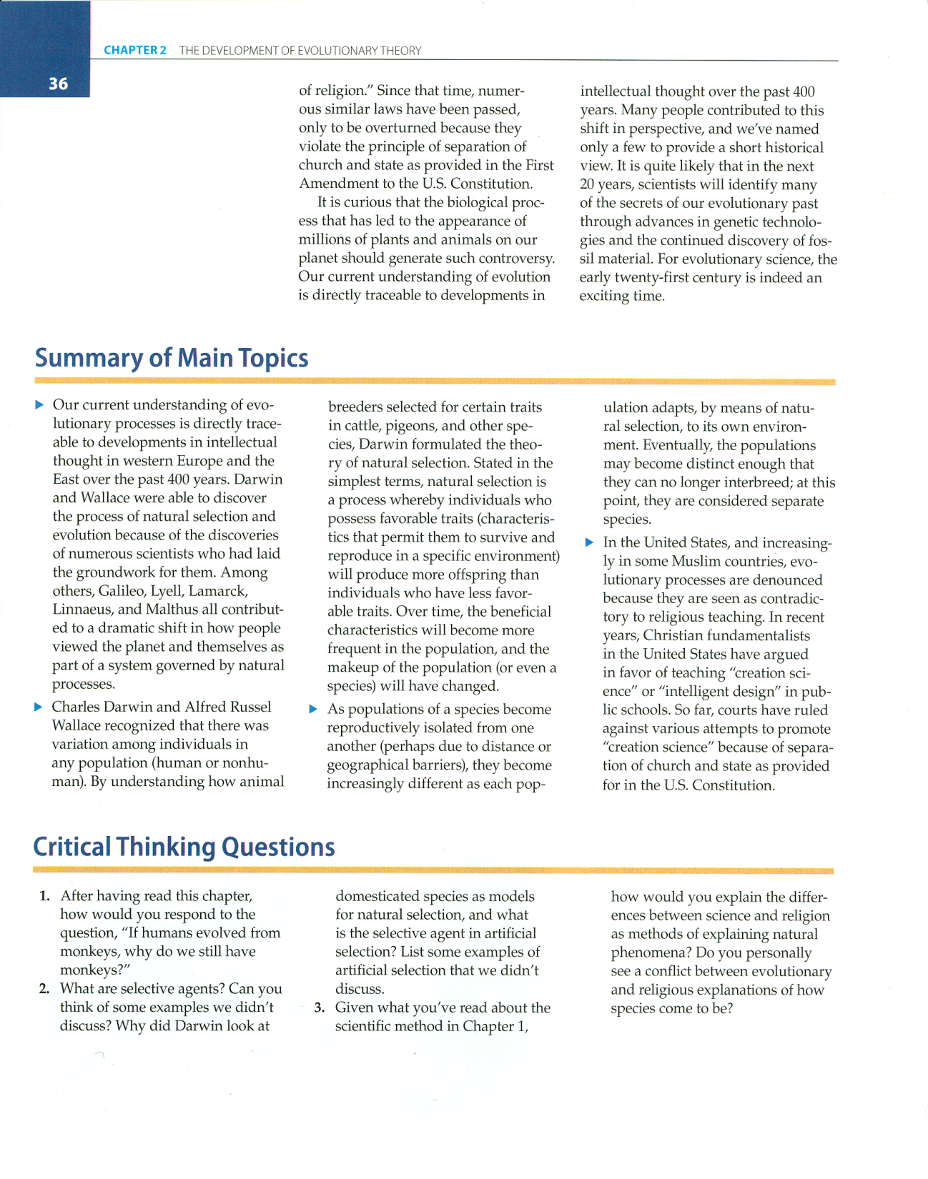
p. 36, Ch. 2, “Summary of Main Topics”

Slide 125
throughout the semester keep track of the major areas of change
bipedal walking
stereoscopic vision
grasping hand
brain development . . .

Slide 126
major areas of change
tool manufacture
hunting
art and ritual
agriculture
language and speech

Slide 127
major areas of change
other cultural adaptations
development of civilization
. . .

Slide 128
archaeological sites ?
names . . .
locations . . .
contents . . .

Slide 129
know major archaeological sites
Olduvai . . .
Laetoli . . .
Hadar . . .
Sterkfonein . . .
Afar . . .

Slide 130
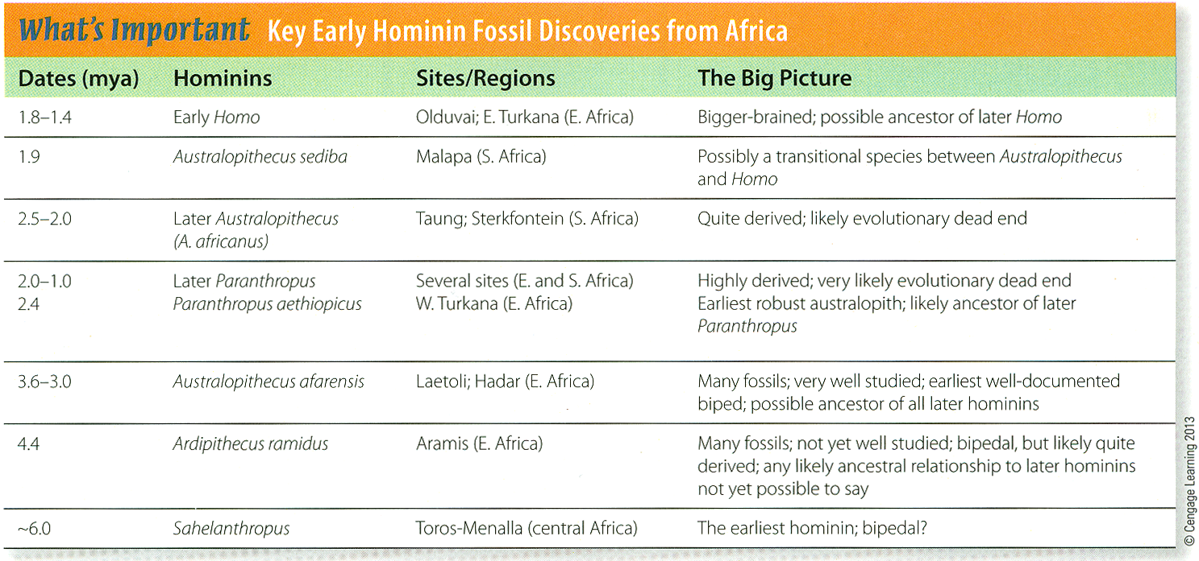
p. 229, Ch. 9, “What’s Important”

Slide 131
0
“gracile” Australopithecines
“gracile” Australopithecines
p. 221 Time line of early African Hominins

Slide 132
p. 250, Ch. 10, “What’s Important”

Slide 133
0
p. 256 Time line for Homo erectus and contemporaries

Slide 134
p. 278, Ch. 11, “What’s Important”

Slide 135
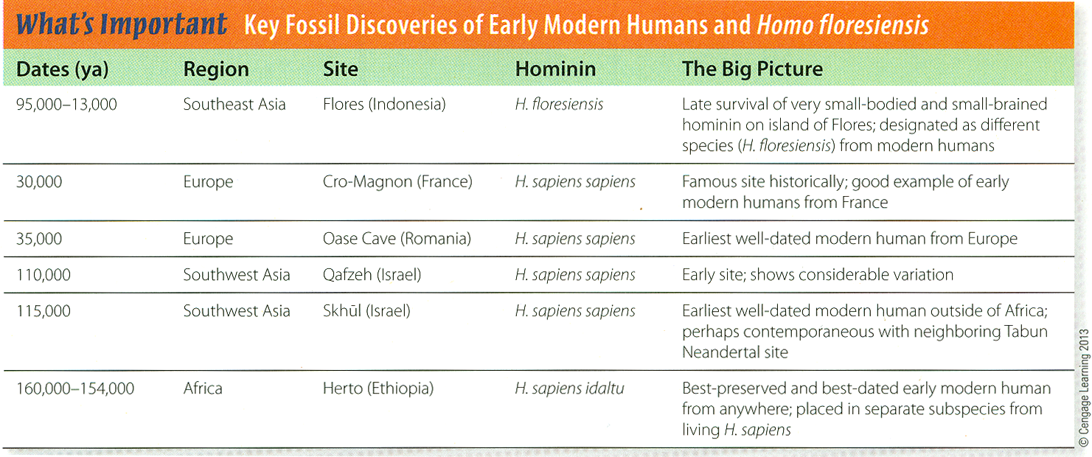
p. 305, Ch. 12, “What’s Important”

Slide 136
p. 289 Time line of Modern Homo sapiens discoveries

Slide 137
p. 338, Ch. 13, “What’s Important”

Slide 138
p. 309Time line of Early Holocene Hunters and Gatherers

Slide 139
p. 372, Ch. 14, “What’s Important”

Slide 140
p. 406, Ch. 15, “What’s Important”

Slide 141
p. 341 Time line for Ch. 14 “Food Production”

Slide 142
http://www.d.umn.edu/cla/faculty/troufs/anth1602/pcexams.html

Slide 143
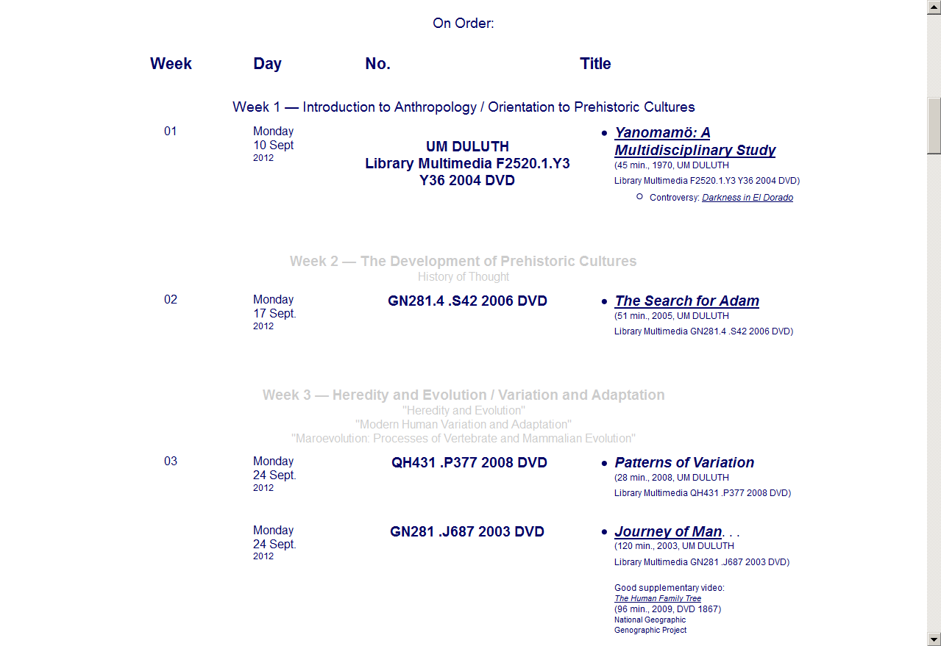
in-class videos and films
http://www.d.umn.edu/cla/faculty/troufs/anth1602/pcvideo_schedule.html

Slide 144
in-class videos and films
http://www.d.umn.edu/cla/faculty/troufs/anth1602/pcvideo_schedule.html

Slide 145
in-class videos and films
http://www.d.umn.edu/cla/faculty/troufs/anth1602/pcvideo_schedule.html

Slide 146
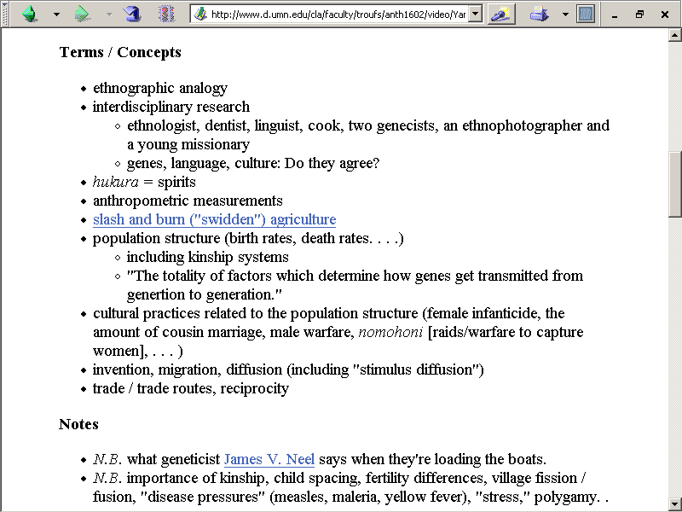
in-class videos and films
http://www.d.umn.edu/cla/faculty/troufs/anth1602/pcvideo_schedule.html

Slide 147
don’t forget
to have a look
at
the Glossary items on pp. 431- 443

Slide 148
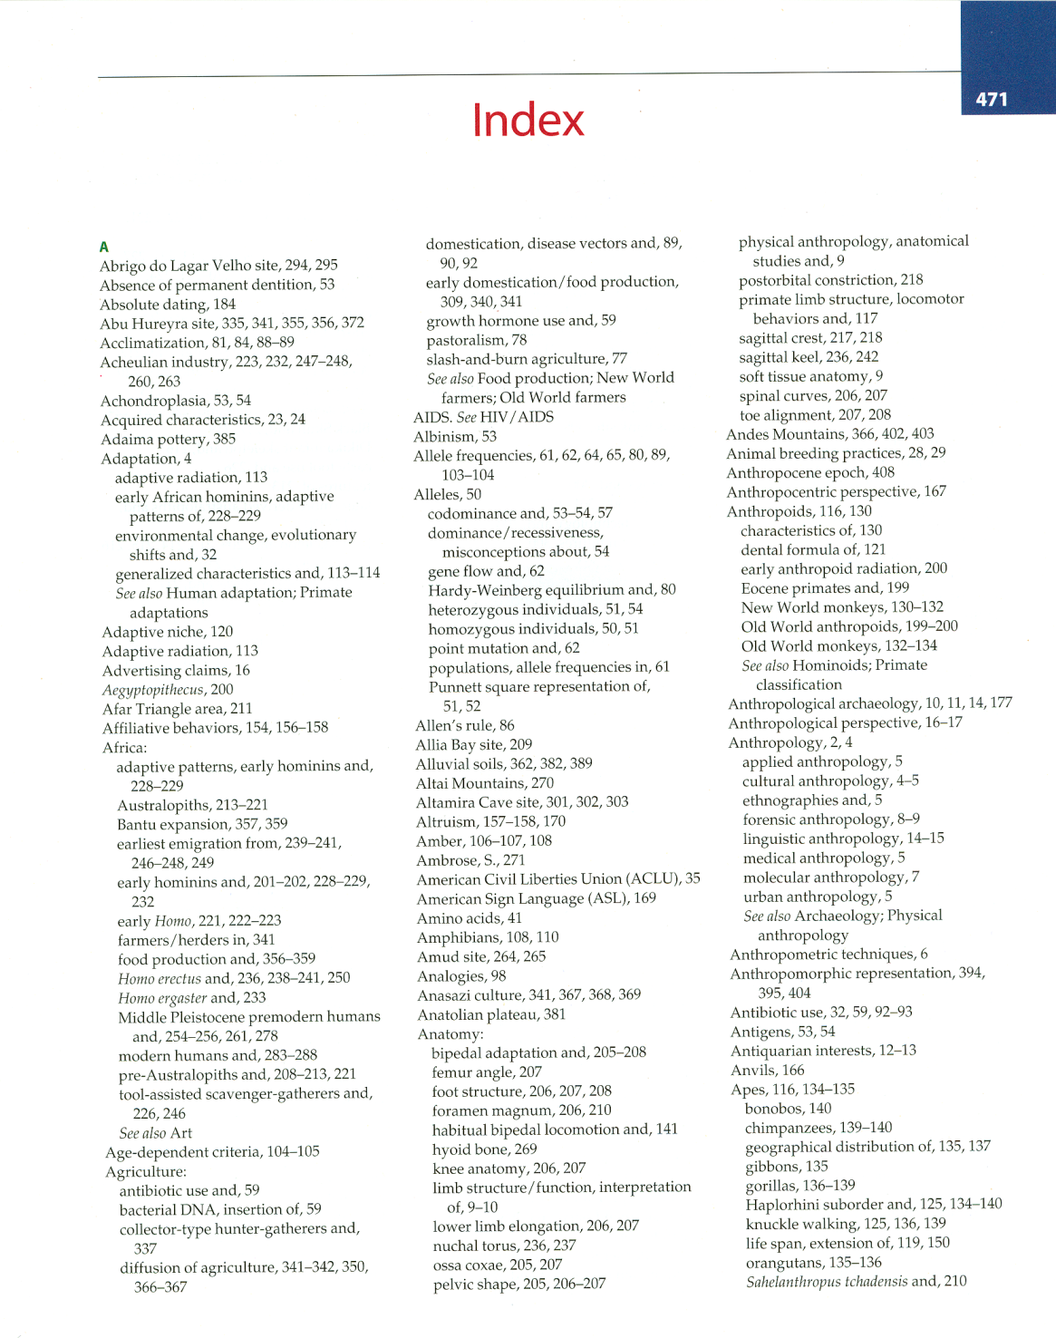
also
have a look at the Index,
pp. 471-492

Slide 149
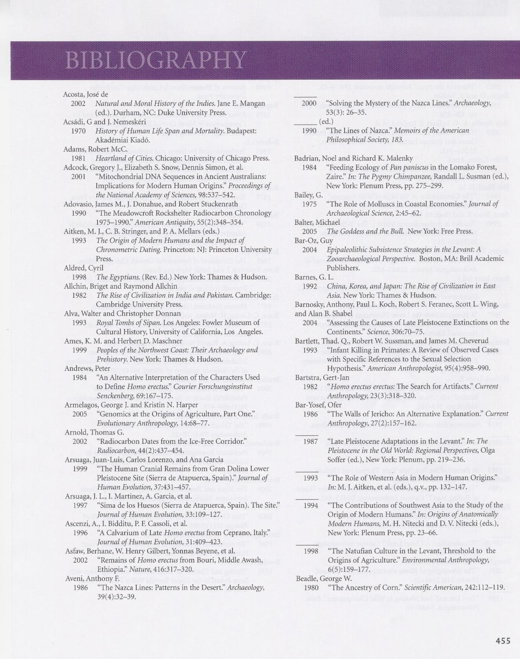
and
have a look at the Bibliography, pp. 451-472

