Slide 1
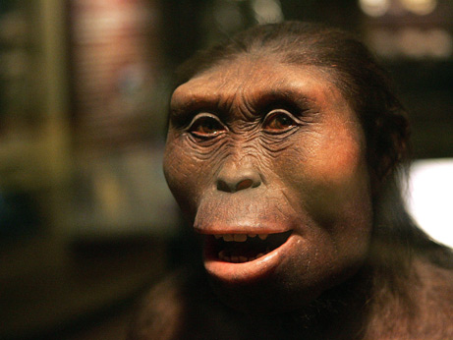
use your up/down arrow keys and/or
your space bar to advance the slides
Units
of
Analysis
Prehistoric Cultures
University of Minnesota Duluth
"Selam"
aka "Lucy's Baby”
Tim Roufs © 2010-2013
http://www.d.umn.edu/cla/faculty/troufs/anth3618/

Slide 2
Units
of
Analysis
Prehistoric Cultures
University of Minnesota Duluth
"Selam"
aka "Lucy's Baby”
Tim Roufs © 2010-2013
http://www.d.umn.edu/cla/faculty/troufs/anth3618/

Slide 3
when you are looking at anthropological works
— or social science works in general —
it is important to pay attention to what “units of analysis” are being considered
. . .

Slide 4
in the “Main Characteristics of Anthropology” review it is noted that one of the defining characteristics of Anthropology is that it tends to be comparative
. . .

Slide 5
in comparative works it is especially important to check to see that the units of analysis are comparable
. . .

Slide 6
and if you utilize a comparative approach in your project,
or in extra credit reports
— or in your exam questions —you need to be especially careful to compare like units
. . .

Slide 7
so lets have a look at
Units of Analysis

Slide 8
as mentioned in the “Orientation”
units of analysis may include:
one person
the family
the community
a region
a “culture area”
a culture / “subculture”
a nation
an item or action itself
a “cultural metaphor”

Slide 9
as mentioned in the “Orientation”
units of analysis may include:
one person
the family
the community
a region
a “culture area”
a culture / “subculture”
a nation
an item or action itself
a “cultural metaphor”

Slide 10
“units of analysis” may include:
one person
the family
the community
a region
a “culture area”
a culture / “subculture”
a nation
an item or action itself
a “cultural metaphor”
for e.g. . . .

Slide 12
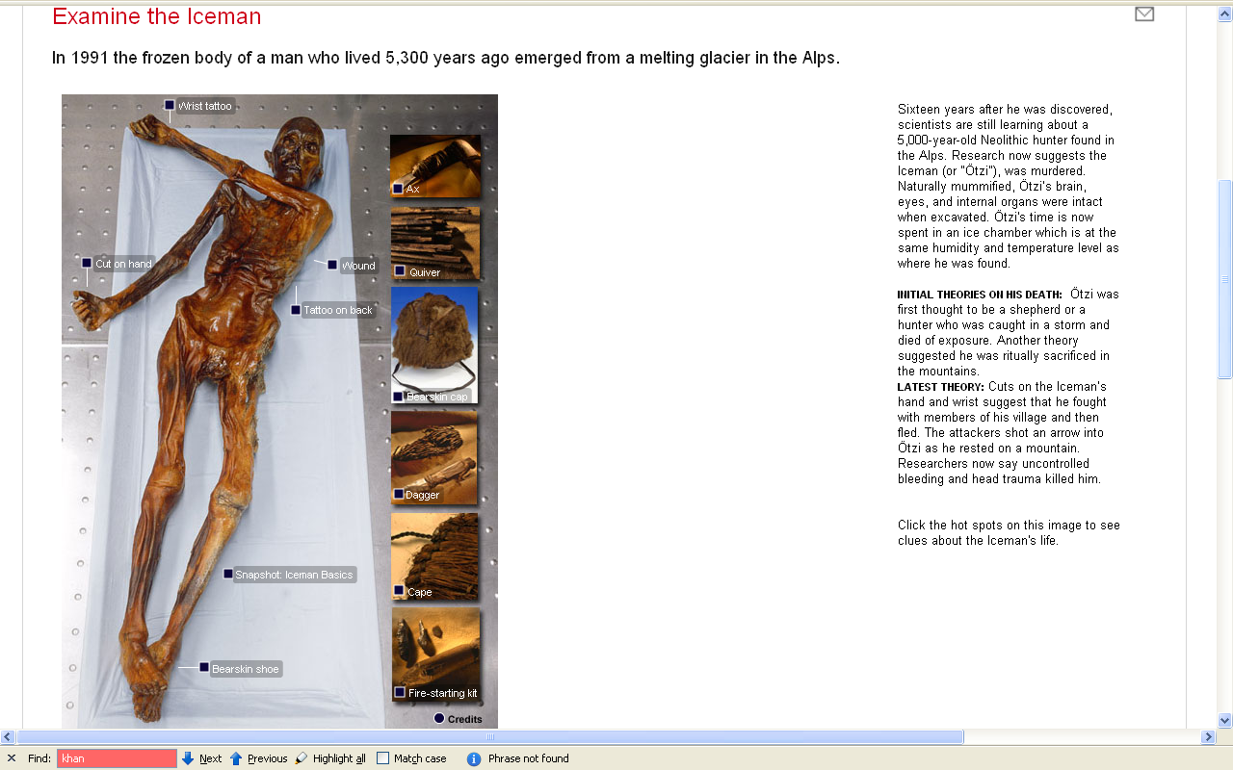

Slide 15
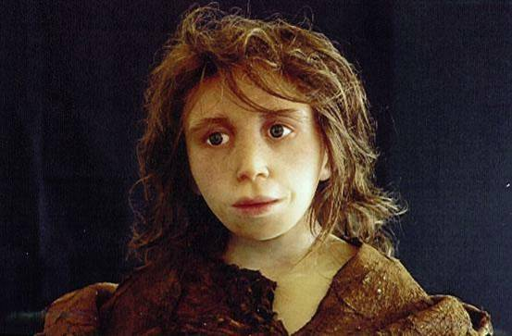
"Gibraltar I” Reconstruction of a ca. four-year-old Neandertal" PBS

Slide 17
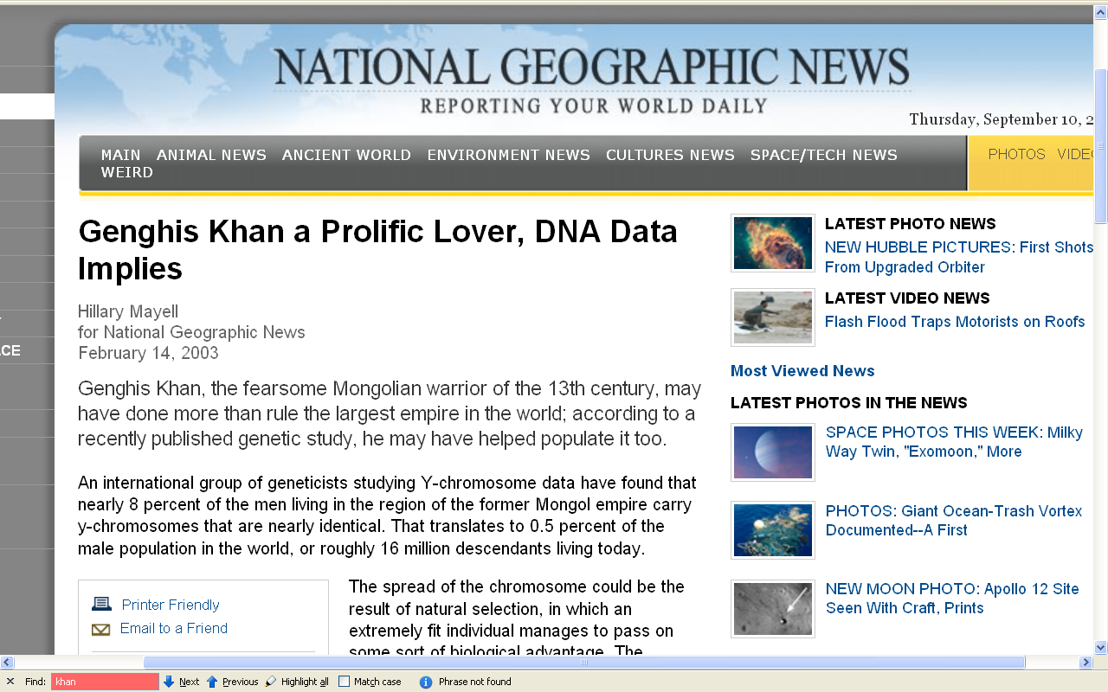

Slide 18
www.d.umn.edu/cla/faculty/troufs/anth4616/video/N!ai.html#title

Slide 19
Focusing on the individual as a unit of analysis was advocated in anthropology by early pioneers such as . . .
Oscar Lewis
Bronislaw Malinowski
Edward Sapir (“Sapir-Whorf” hypothesis)
Margaret Mead

Slide 20
as mentioned in the “Orientation”
units of analysis may include:
one person
the family
the community
a region
a “culture area”
a culture / “subculture”
a nation
an item or action itself
a “cultural metaphor”

Slide 21
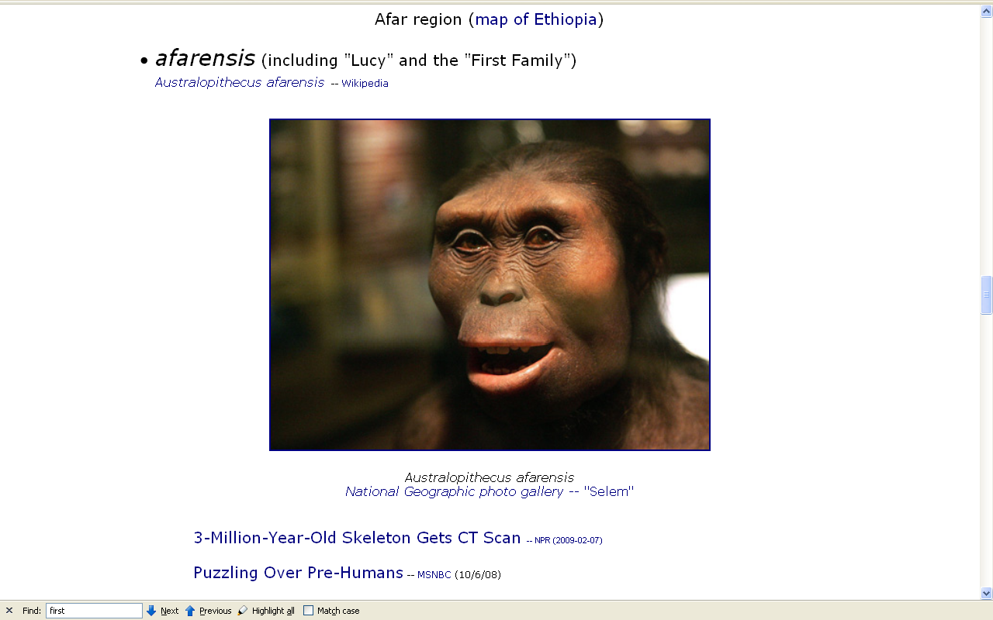
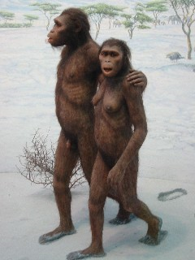
Lucy
and
“The First Family”
http://www.crystalinks.com/lucy.html

Slide 24
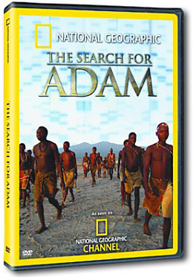

Slide 25
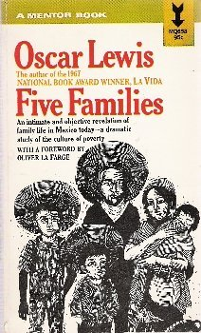
Oscar Lewis

Slide 26
as mentioned in the “Orientation”
units of analysis may include:
one person
the family
the community
a region
a “culture area”
a culture / “subculture”
a nation
an item or action itself
a “cultural metaphor”

Slide 27
as mentioned in the “Orientation”
units of analysis may include:
one person
the family
the community
a region
a “culture area”
a culture / “subculture”
a nation
an item or action itself
a “cultural metaphor”
in archaeology
the comparable unit
to the “community”
is the
“site”

Slide 28
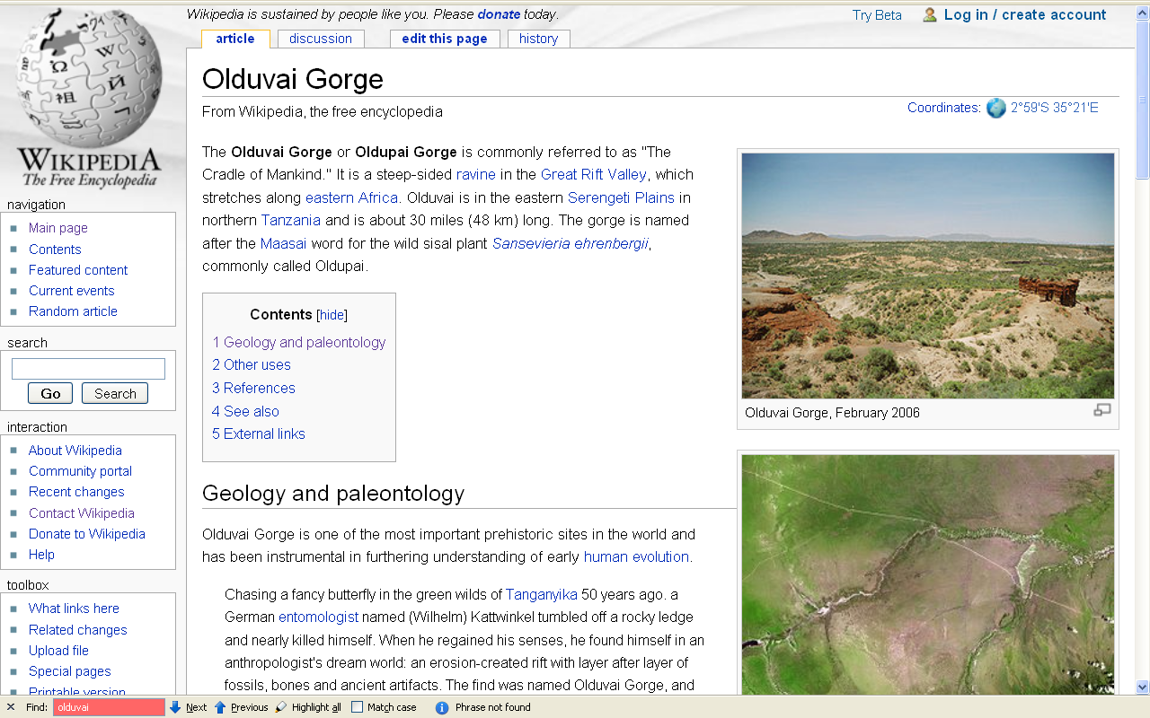
one of the best-known archaeological sites in the world

Slide 29
in some regions there are a lot of sites
there are more than
12,000
archaeological sites
in modern-day Mexico
alone
for e.g.

Slide 30
in some regions there are a lot of sites
there are more than
12,000
archaeological sites
in modern-day Mexico
alone
for e.g.

Slide 31
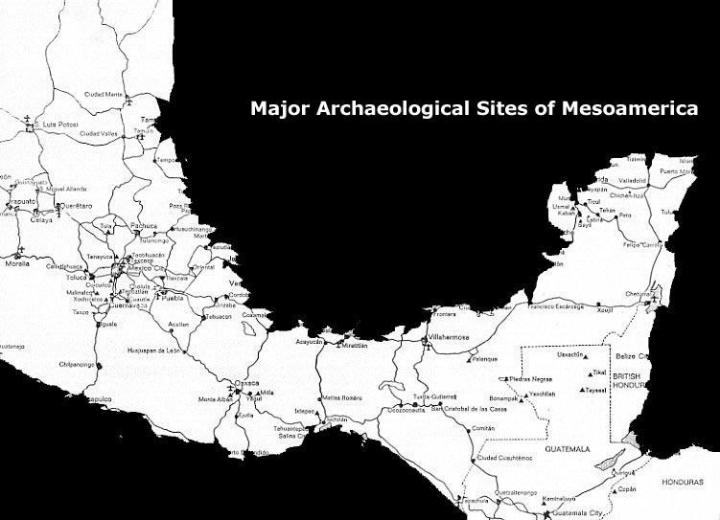

Slide 32
including some of the largest sites in the world
www.d.umn.edu/cla/faculty/troufs/anth3618/video/Teotihuacan.html#title

Slide 33
and some of those considered “most sacred”
www.d.umn.edu/cla/faculty/troufs/anth3618/video/Copan.html#title

Slide 34
as mentioned in the “Orientation”
units of analysis may include:
one person
the family
the community
a region
a “culture area”
a culture / “subculture”
a nation
an item or action itself
a “cultural metaphor”

Slide 35
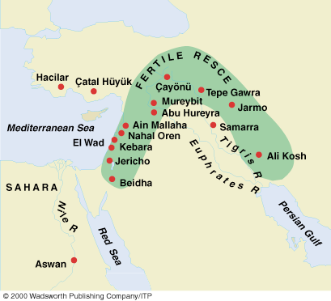
Early Neolithic sites
of the Fertile Crescent
Understanding Physical Anthropology and Archaeology, 10th Ed., p. 363

Slide 36
as mentioned in the “Orientation”
units of analysis may include:
one person
the family
the community
a region
a “culture area”
a culture / “subculture”
a nation
an item or action itself
a “cultural metaphor”
Valley of Mexico
Soconusco
El Bajío
Huasteca
Yucatán. . .

Slide 37
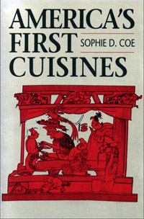
As mentioned in the “Orientation”
units of analysis may include:
one person
the family
the community
a region
a “culture area”
a culture / “subculture”
a nation
an item or action itself
a “cultural metaphor”
Valley of Mexico
Soconusco (Xoconusco)
El Bajío
Huasteca
Yucatán. . .

Slide 38
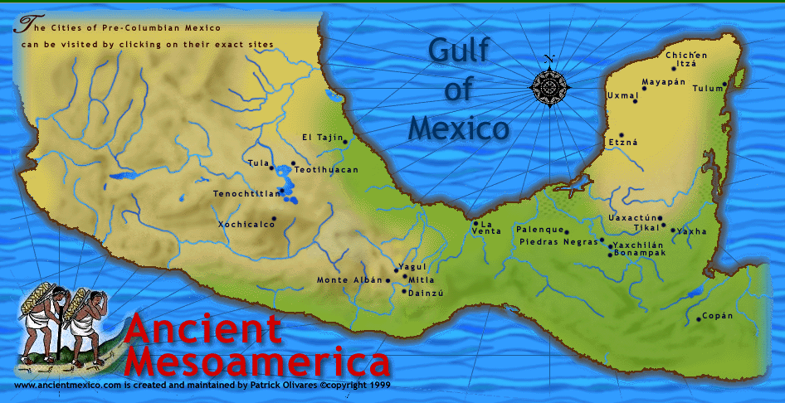
the Xoconusco region played a central role in chocolate, which played a key role in prehistoric and post-contact Mesoamerica
www.d.umn.edu/cla/faculty/troufs/anth3618/video/Copan.html#title

Slide 39
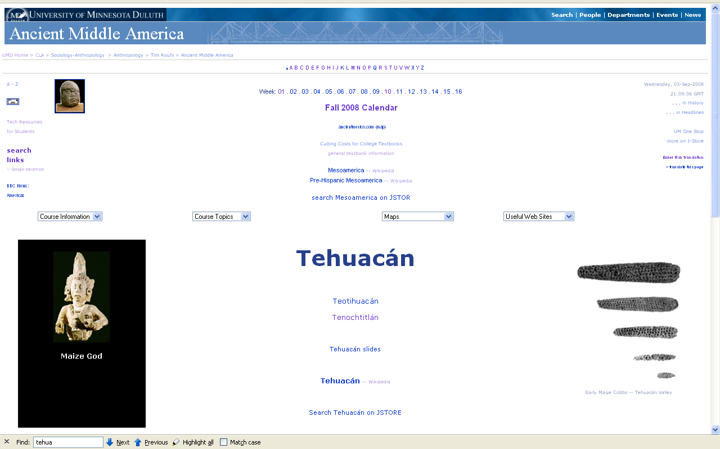
the Tehuacán region was one of the greatest centers of plant domestication in the world
www.d.umn.edu/cla/faculty/troufs/anth3618/matehuac.html#title

Slide 40
NOTE:
Tehuacán is different from Teotihuacán
the Tehuacán region was one of the greatest centers of plant domestication in the world
www.d.umn.edu/cla/faculty/troufs/anth3618/matehuac.html#title

Slide 41
and Tehuacán is one of the best places in the world to look at to understand
the “agricultural revolution”
www.d.umn.edu/cla/faculty/troufs/anth3618/video/Copan.html#title

Slide 42
and it’s likely where your bottled water came from if you purchased bottled water in Mexico
www.d.umn.edu/cla/faculty/troufs/anth3618/video/Copan.html#title

Slide 43
as mentioned, Tehuacán is it one of the best places in the world to look at to understand the “agricultural revolution”
www.d.umn.edu/cla/faculty/troufs/anth3618/video/Copan.html#title

Slide 44
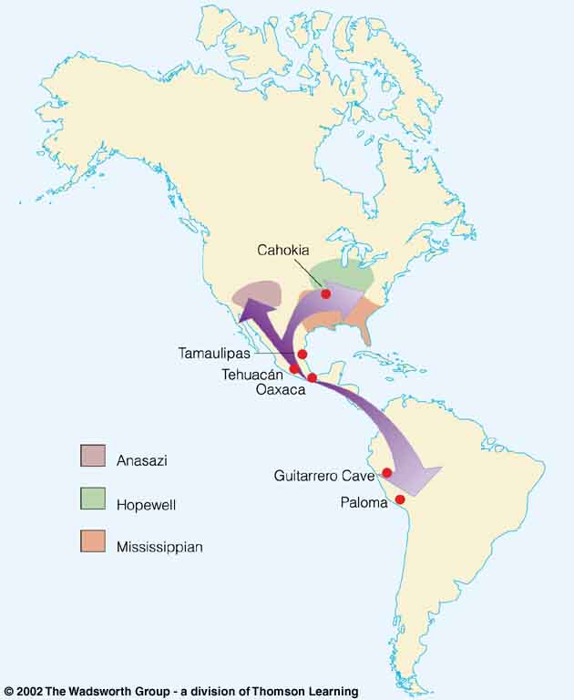
Tehuacán Valley, Puebla, Mexico
maize was domesticated here by at least
4,200 ybp
Understanding Physical Anthropology and Archaeology, 8th Ed., p. 432.

Slide 45
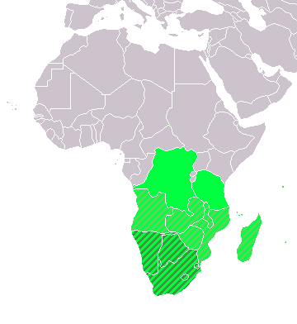
NOTE:
he nation of South Africa
is different from
the region of
South Africa
“South Africa”
is the region of
“southern Africa”
http://en.wikipedia.org/wiki/Southern_Africa

Slide 46
“South Africa”
is the region of
“southern Africa”
http://en.wikipedia.org/wiki/Southern_Africa

Slide 47
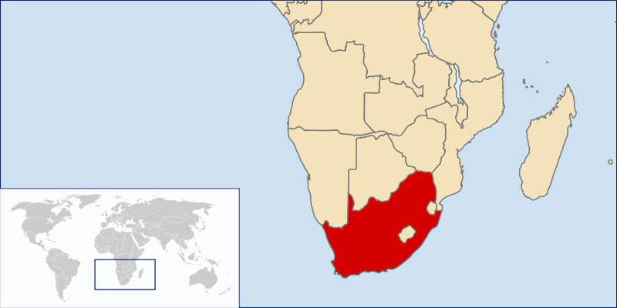
NOTE:
he nation of South Africa
is different from
the region of
South Africa
South Africa
is the nation of
South Africa
http://en.wikipedia.org/wiki/Southern_Africa

Slide 48
South Africa
is the nation of
South Africa
http://en.wikipedia.org/wiki/South_africa

Slide 49
as mentioned in the “Orientation”
units of analysis may include:
one person
the family
the community
a region
a “culture area”
a culture / “subculture”
a nation
an item or action itself
a “cultural metaphor”

Slide 50
some areas are “officially”
anthropological
“cultural areas” . . .

Slide 51
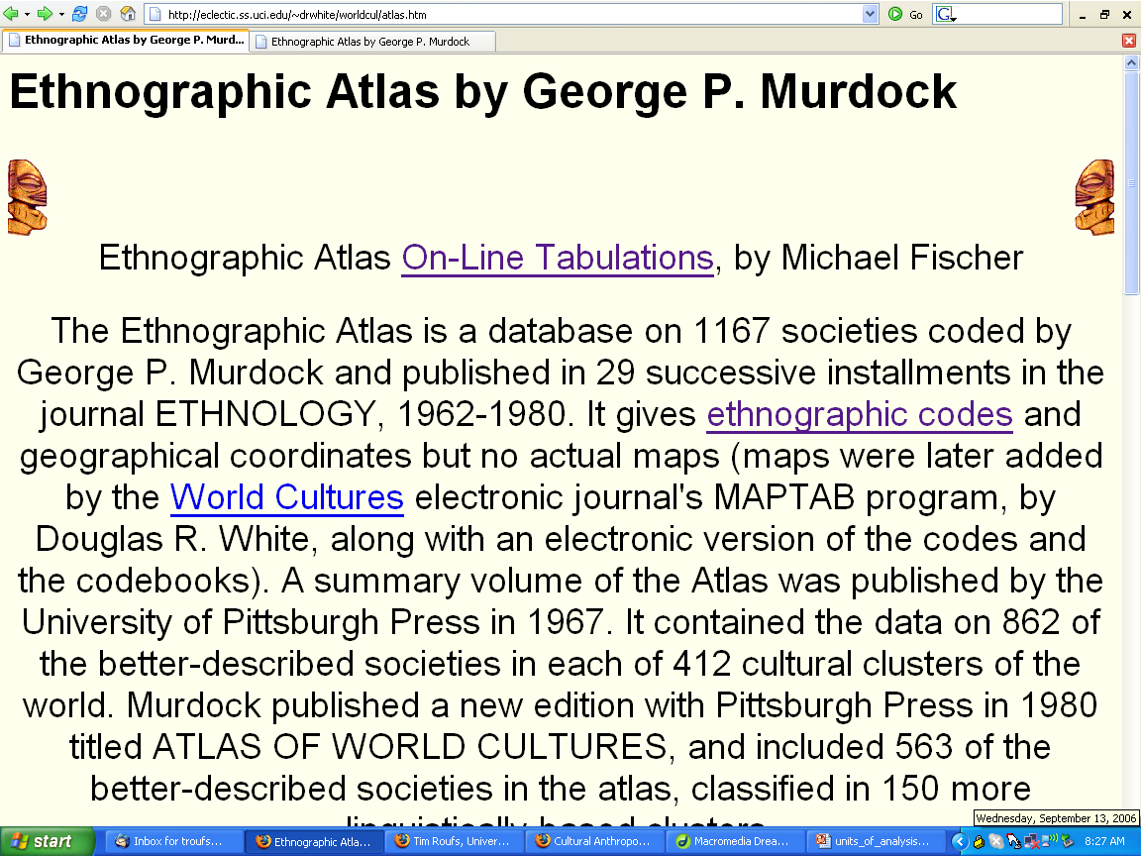
http://eclectic.ss.uci.edu/~drwhite/worldcul/atlas.htm

Slide 52
those “culture areas” were initially established by George P. Murdock and associates
and are commonly associated with
HRAF
(the Human Relations Area Files)
and its
World Ethnographic Atlas
http://eclectic.ss.uci.edu/~drwhite/worldcul/atlas.htm

Slide 53
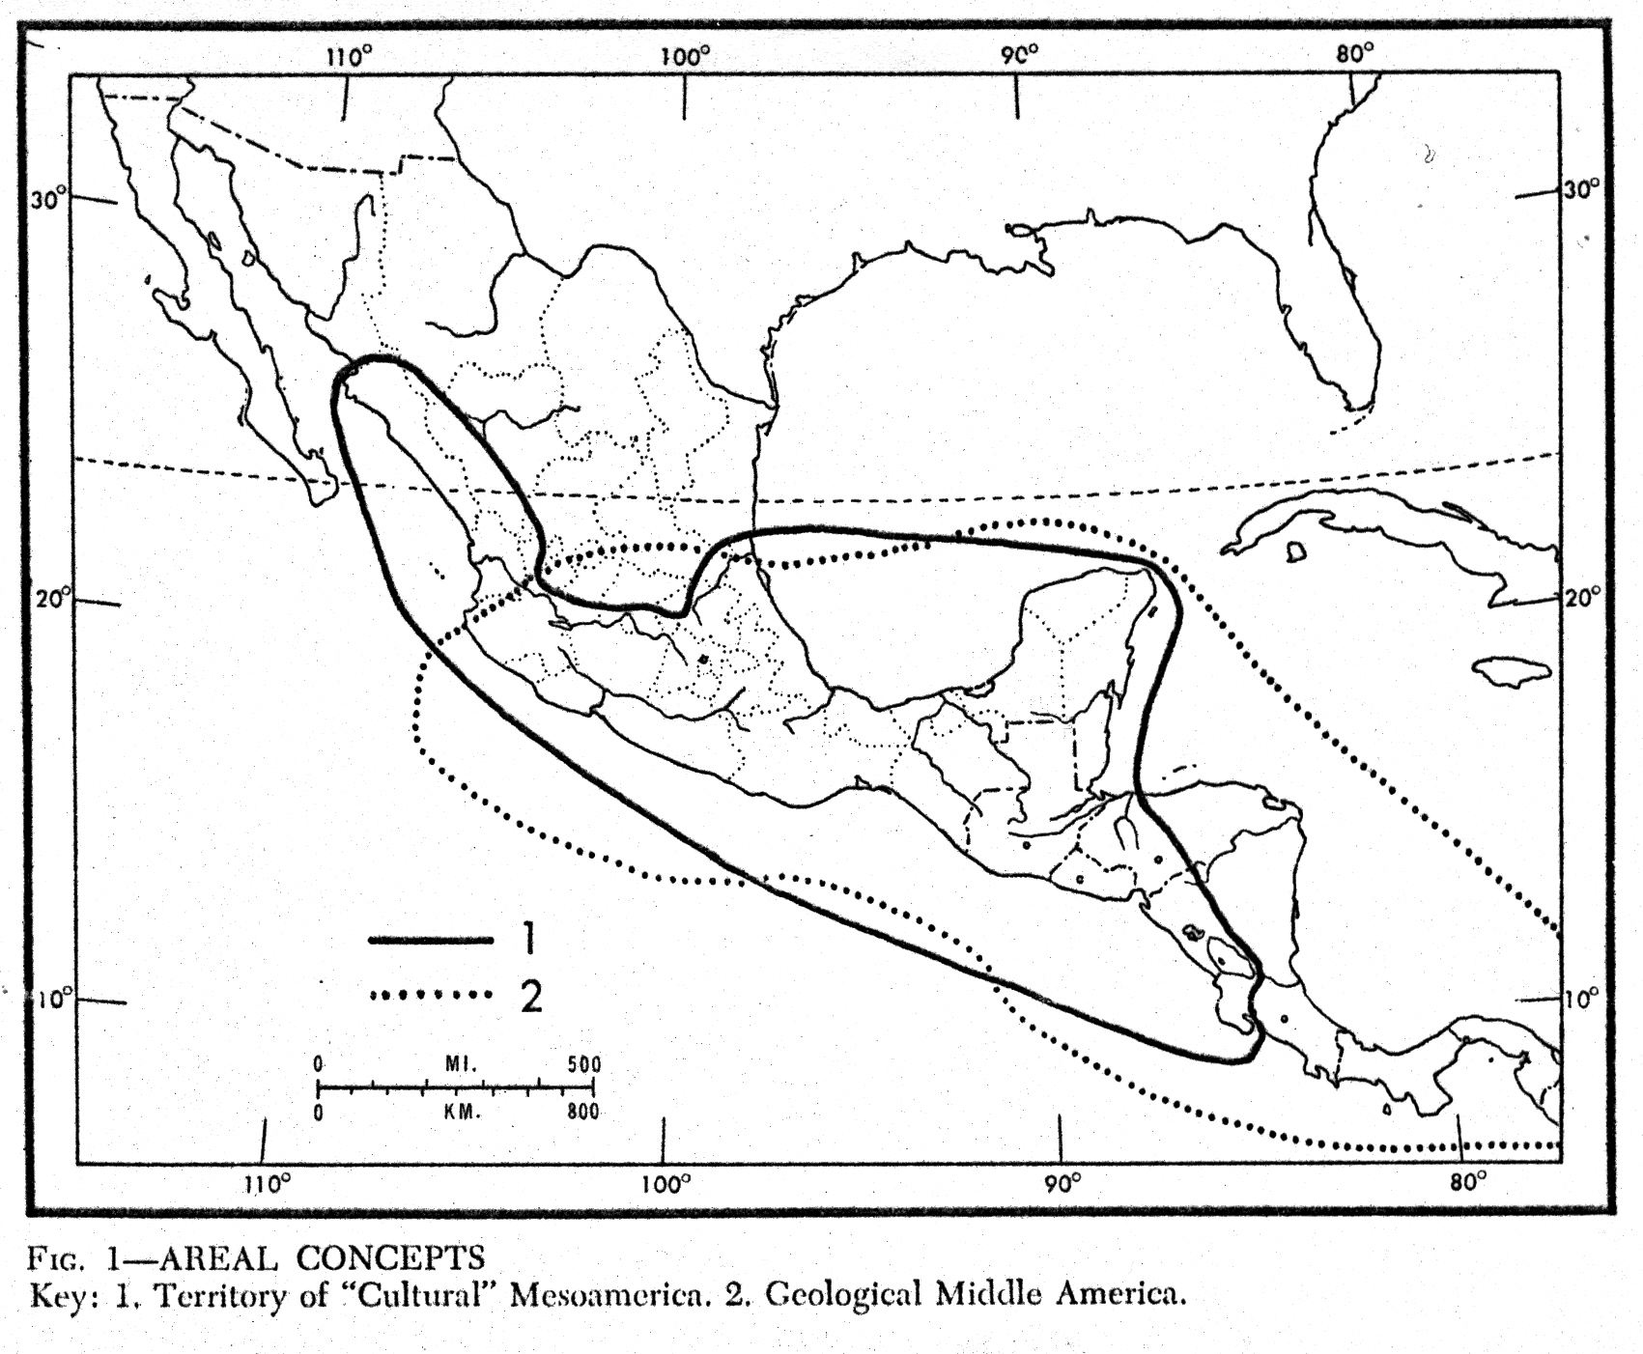
“Mesoamerica”
(“culture area)
“Middle America”
(geological area)

Slide 54
www.d.umn.edu/cla/faculty/troufs/anth3618/video/Copan.html#title

Slide 55
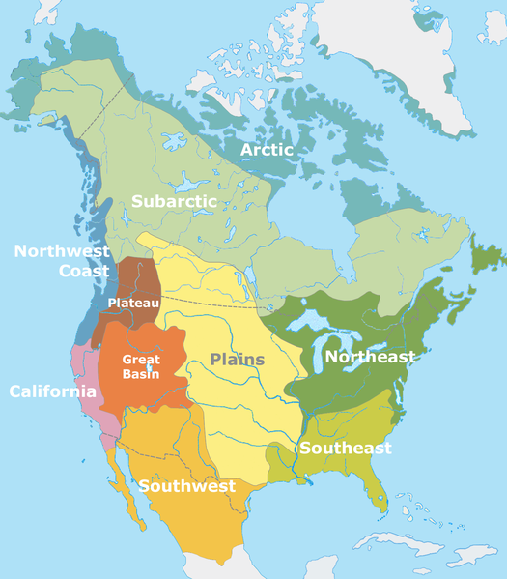
other North American “culture areas”
http://en.wikipedia.org/wiki/Culture_areas_of_North_America

Slide 56
some “areas” are not “officially”
anthropological
“cultural areas” . . .

Slide 57
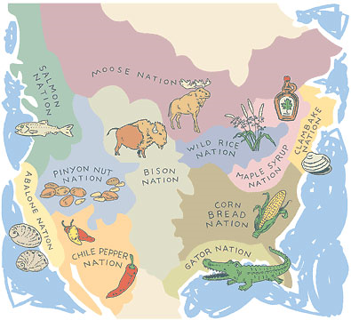
culture “areas” that are not “culture areas”
http://en.wikipedia.org/wiki/Culture_areas_of_North_America

Slide 58
it can get confusing
because, among other things,
some regions we consider cultural areas in daily life are also officially designated as “cultural areas” in modern Anthropology

Slide 59
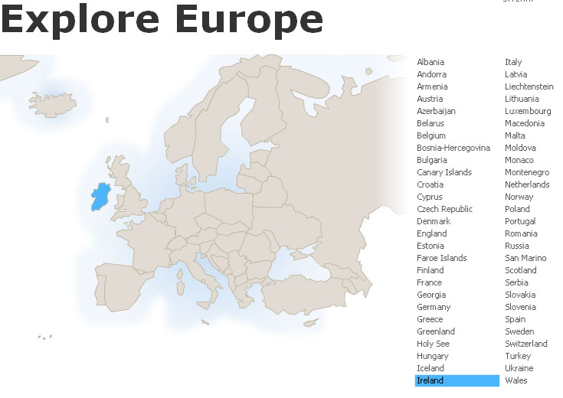
Europe, for e.g., is now officially an anthropological
“culture area”

Slide 60
as mentioned in the “Orientation”
units of analysis may include:
one person
the family
the community
a region
a “culture area”
a culture / “subculture”
a nation
an item or action itself
a “cultural metaphor”

Slide 61
as mentioned in the “Orientation”
units of analysis may include:
one person
the family
the community
a region
a “culture area”
a culture / “subculture”
a nation
an item or action itself
a “cultural metaphor”
cultures are major groups of individuals with common customs, traditions, history, and origin,
sharing a common language

Slide 62
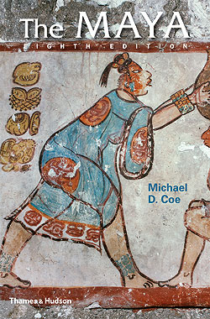
for e.g.,
www.d.umn.edu/cla/faculty/troufs/anth3618/matext.html#title

Slide 63
Aztec
Maya
Inca
Sophie D. Coe America's First Cuisines Austin: University of Texax Press, 1994.
www.d.umn.edu/cla/faculty/troufs/anthfood/aftexts.html#title

Slide 64
as mentioned in the “Orientation”
units of analysis may include:
one person
the family
the community
a region
a “culture area”
a culture / “subculture”
a nation
an item or action itself
a “cultural metaphor”
there are dozens in Mesoamerica
for e.g.
cultures are major groups of individuals with common customs, traditions, history, and origin,
sharing a common language

Slide 65
as mentioned in the “Orientation”
units of analysis may include:
one person
the family
the community
a region
a “culture area”
a culture / “subculture”
a nation
an item or action itself
a “cultural metaphor”
there are dozens in Mesoamerica
for e.g.
Maya
Chamula
Lancandon
Tzotzil
Tzeltal
Zoque
Yaqui
Otomi
Tarascan
Mixtec
Zapotec
Olmec
Toltec
Aztec
Teotihuacanos
Tarahumara . . .

Slide 66
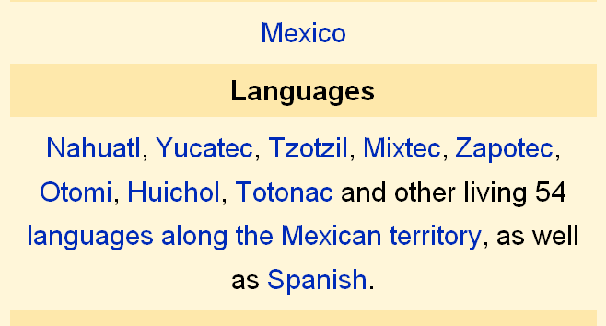
just in Mexico, for e.g., there are 63 languages spoken
—9 “major” languages,
and 54 languages of “microcultures”
http://en.wikipedia.org/wiki/Indigenous_peoples_of_Mexico#History_of_the_indigenous_peoples

Slide 67
www.d.umn.edu/cla/faculty/troufs/anth3618/matext.html#title

Slide 68
but Mexico, for e.g., is not a “culture”
it is a “nation”
www.d.umn.edu/cla/faculty/troufs/anth3618/matext.html#title

Slide 69
as mentioned in the “Orientation”
units of analysis may include:
one person
the family
the community
a region
a “culture area”
a culture / “subculture”
a nation
an item or action itself
a “cultural metaphor”

Slide 70
within “culture areas” there are most often
“subcultures”
these are also known as
“microcultures”
and occasionally as
“local cultures”

Slide 71
within “culture areas” there are most often
“subcultures”
these are also known as
“microcultures”
and occasionally as
“local cultures”

Slide 72
within “culture areas” there are most often
“subcultures”
these are also known as
“microcultures”
and occasionally as
“local cultures”

Slide 73
within “culture areas” there are most often
“subcultures”
these are also known as
“microcultures”
and occasionally as
“local cultures”

Slide 74
within “culture areas” there are most often
“subcultures”
these are also known as
“microcultures”
and occasionally as
“local cultures”
and often
there are lots of them

Slide 75
there are dozens in Mesoamerica
for e.g.
www.d.umn.edu/cla/faculty/troufs/anth3618/video/Copan.html#title

Slide 76
as mentioned in the “Orientation”
units of analysis may include:
one person
the family
the community
a region
a “culture area”
a culture / “subculture”
a nation
an item or action itself
a “cultural metaphor”
there are several “subcultures” in the Maya area alone
Maya
Chamula
Lancandon
Tzotzil
Tzeltal
Zoque
Olmec
Toltec
Aztec
Teotihuacanos
Tarahumara . . .
Yaqui
Otomi
Tarascan
Mixtec
Zapotec

Slide 77
Maya
Chamula
Lancandon
Tzotzil
Tzeltal
Zoque
www.d.umn.edu/cla/faculty/troufs/anth3618/video/Maya_Lords.html#title

Slide 78
www.d.umn.edu/cla/faculty/troufs/anth3618/video/Maya_Lords.html#title

Slide 79
as mentioned in the “Orientation”
units of analysis may include:
one person
the family
the community
a region
a “culture area”
a culture / “subculture”
a nation
an item or action itself
a “cultural metaphor”

Slide 80
REM NOTE:
he nation of South Africa
is different from
the region of
South Africa
South Africa
is the nation of
South Africa
http://en.wikipedia.org/wiki/Southern_Africa

Slide 81
REM NOTE:
he nation of South Africa
is different from
the region of
South Africa
“South Africa”
is the region of
“southern Africa”
http://en.wikipedia.org/wiki/Southern_Africa

Slide 82
REM: Mexico, for e.g., is not a “culture”
it is a “nation”
www.d.umn.edu/cla/faculty/troufs/anth3618/matext.html#title

Slide 83
as mentioned in the “Orientation”
units of analysis may include:
one person
the family
the community
a region
a “culture area”
a culture / “subculture”
a nation
an item or action itself
a “cultural metaphor”

Slide 84
as mentioned in the “Orientation”
units of analysis may include:
one person
the family
the community
a region
a “culture area”
a culture / “subculture”
a nation
an item or action itself
a “cultural metaphor”
including “processes”

Slide 85
as mentioned in the “Orientation”
units of analysis may include:
one person
the family
the community
a region
a “culture area”
a culture / “subculture”
a nation
an item or action itself
a “cultural metaphor”
and there’s almost no end
to these . . .

Slide 86
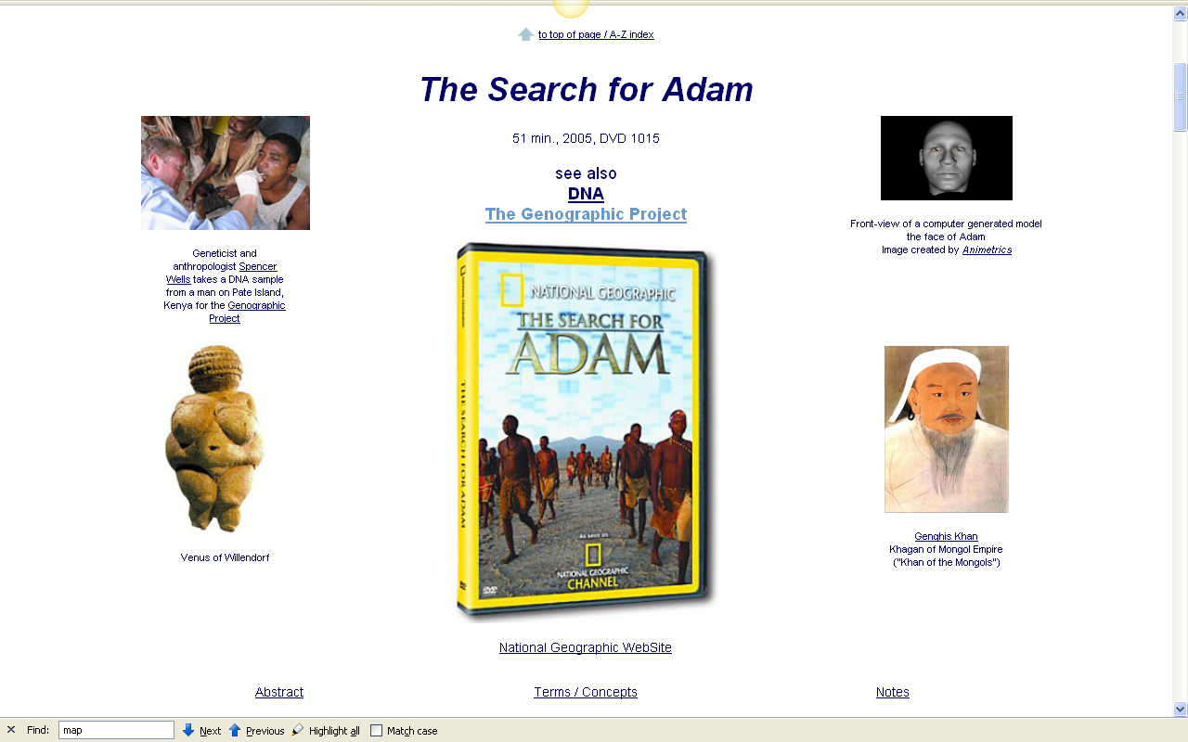
http://www.d.umn.edu/cla/faculty/troufs/anth1602/video/Search_for_Adam.html#title

Slide 87
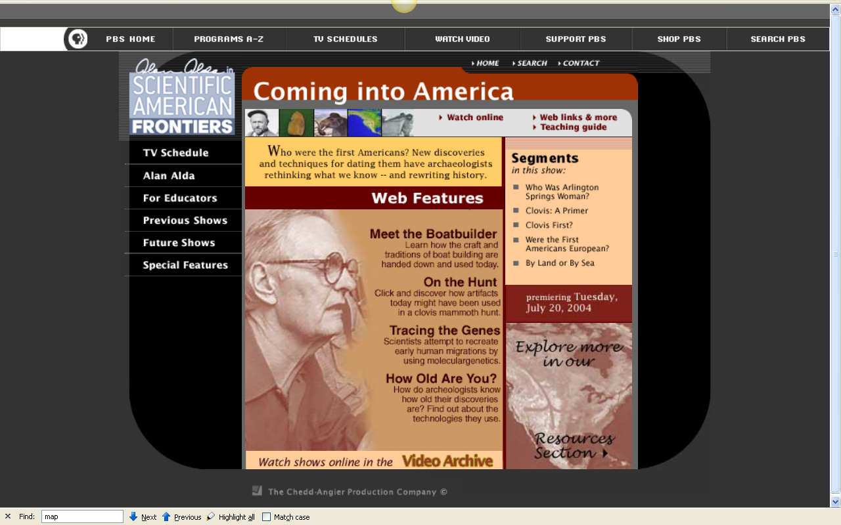
Who Were the First Americans?
http://www.pbs.org/saf/1406/index.html

Slide 88
http://www.d.umn.edu/cla/faculty/troufs/anth3618/video/Fallacy_of_Diffusionism.html#title

Slide 89
http://www.d.umn.edu/cla/faculty/troufs/anth1602/video/Last_Great_Ape.html#title

Slide 91
http://www.d.umn.edu/cla/faculty/troufs/anth1602/video/Blades.html#title

Slide 92
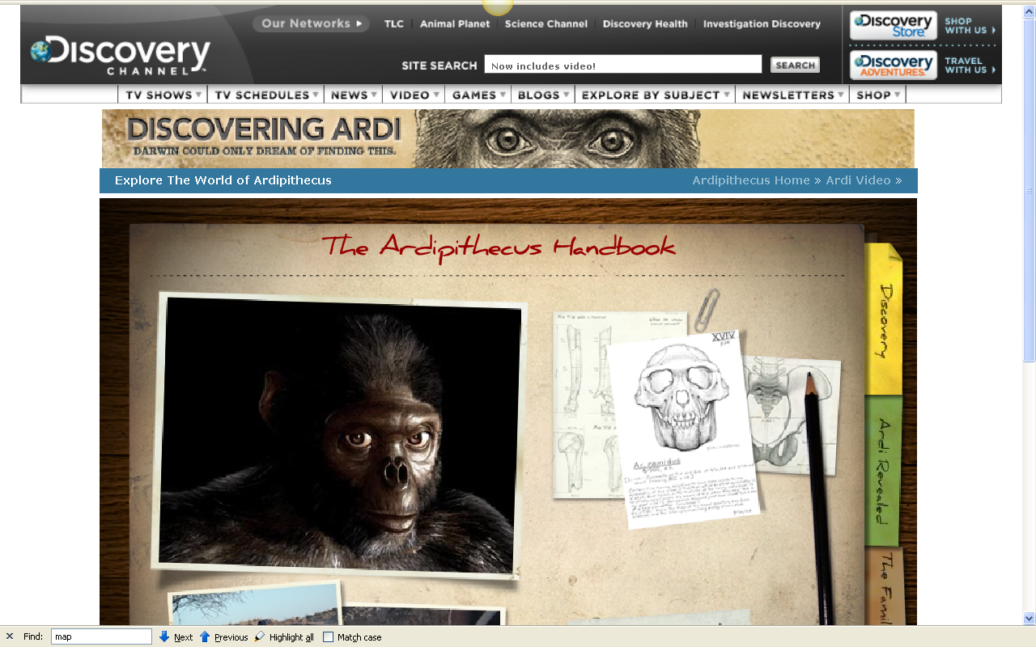
http://www.pbs.org/saf/1406/index.html

Slide 93
http://www.d.umn.edu/cla/faculty/troufs/anth1602/video/On_Trial.html#title

Slide 94
http://www.d.umn.edu/cla/faculty/troufs/anth1602/video/Ice_Man.html#title

Slide 95
www.d.umn.edu/cla/faculty/troufs/anth3618/video/Fall_Maya.html#title

Slide 96
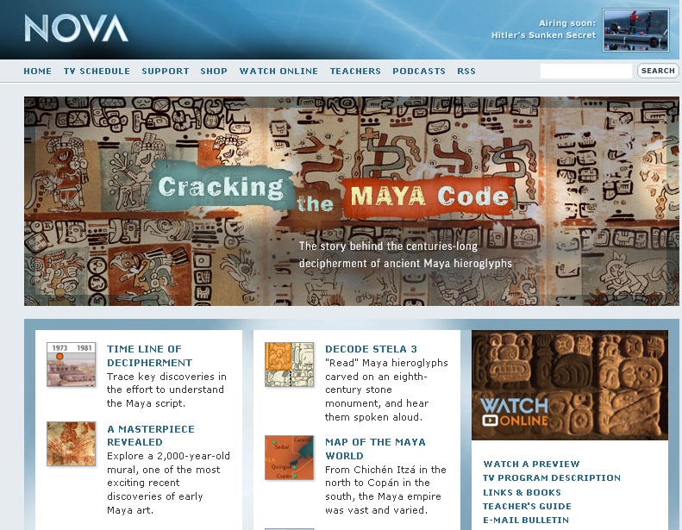
www.pbs.org/wgbh/nova/mayacode/

Slide 97
As mentioned in the “Orientation”
units of analysis may include:
one person
the family
the community
a region
a “culture area”
a culture / “subculture”
a nation
an item or action itself
a “cultural metaphor”

Slide 98
as mentioned in the “Orientation”
units of analysis may include:
one person
the family
the community
a region
a “culture area”
a culture / “subculture”
a nation
an item or action itself
a “cultural metaphor”
cultural metaphors use an item or event representative of a culture and analyze the culture with reference to that item or event

Slide 100
Carlos Fuentes
for e.g.,
looks at prehistoric and modern
Mexico and Spain
in terms of the imagery of
“The Virgin”
and
“The Bull”

Slide 101
and, of course, the
Units of Analysis
can be combined
(and quite often are)

Slide 102
www.d.umn.edu/cla/faculty/troufs/anth3618/video/Culture_and_Math.html#title

Slide 103
food
genes
cultural diversity
Island Press (2004)

Slide 104
in summary . . .

Slide 105
“units of analysis” may include:
one person
the family
the community
a region
a “culture area”
a culture / “subculture”
a nation
an item or action itself
a “cultural metaphor”

Slide 106
end of unit on
Units
of
Analysis
Prehistoric Cultures
University of Minnesota Duluth
"Selam"
aka "Lucy's Baby”
Tim Roufs © 2010-2013
http://www.d.umn.edu/cla/faculty/troufs/anth3618/

