Slide 1
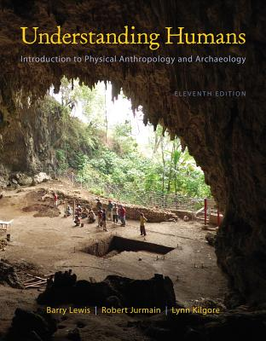
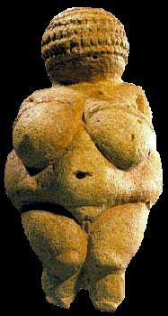
Class Slides Set 10A
Special Skills Used to Study Early Humans
. . . or how to make sense
out of
Ch. 8 of the text . . .
University of Minnesota Duluth
Tim Roufs
© 2010-2013
http://www.d.umn.edu/cla/faculty/troufs/anth1602/

Slide 2
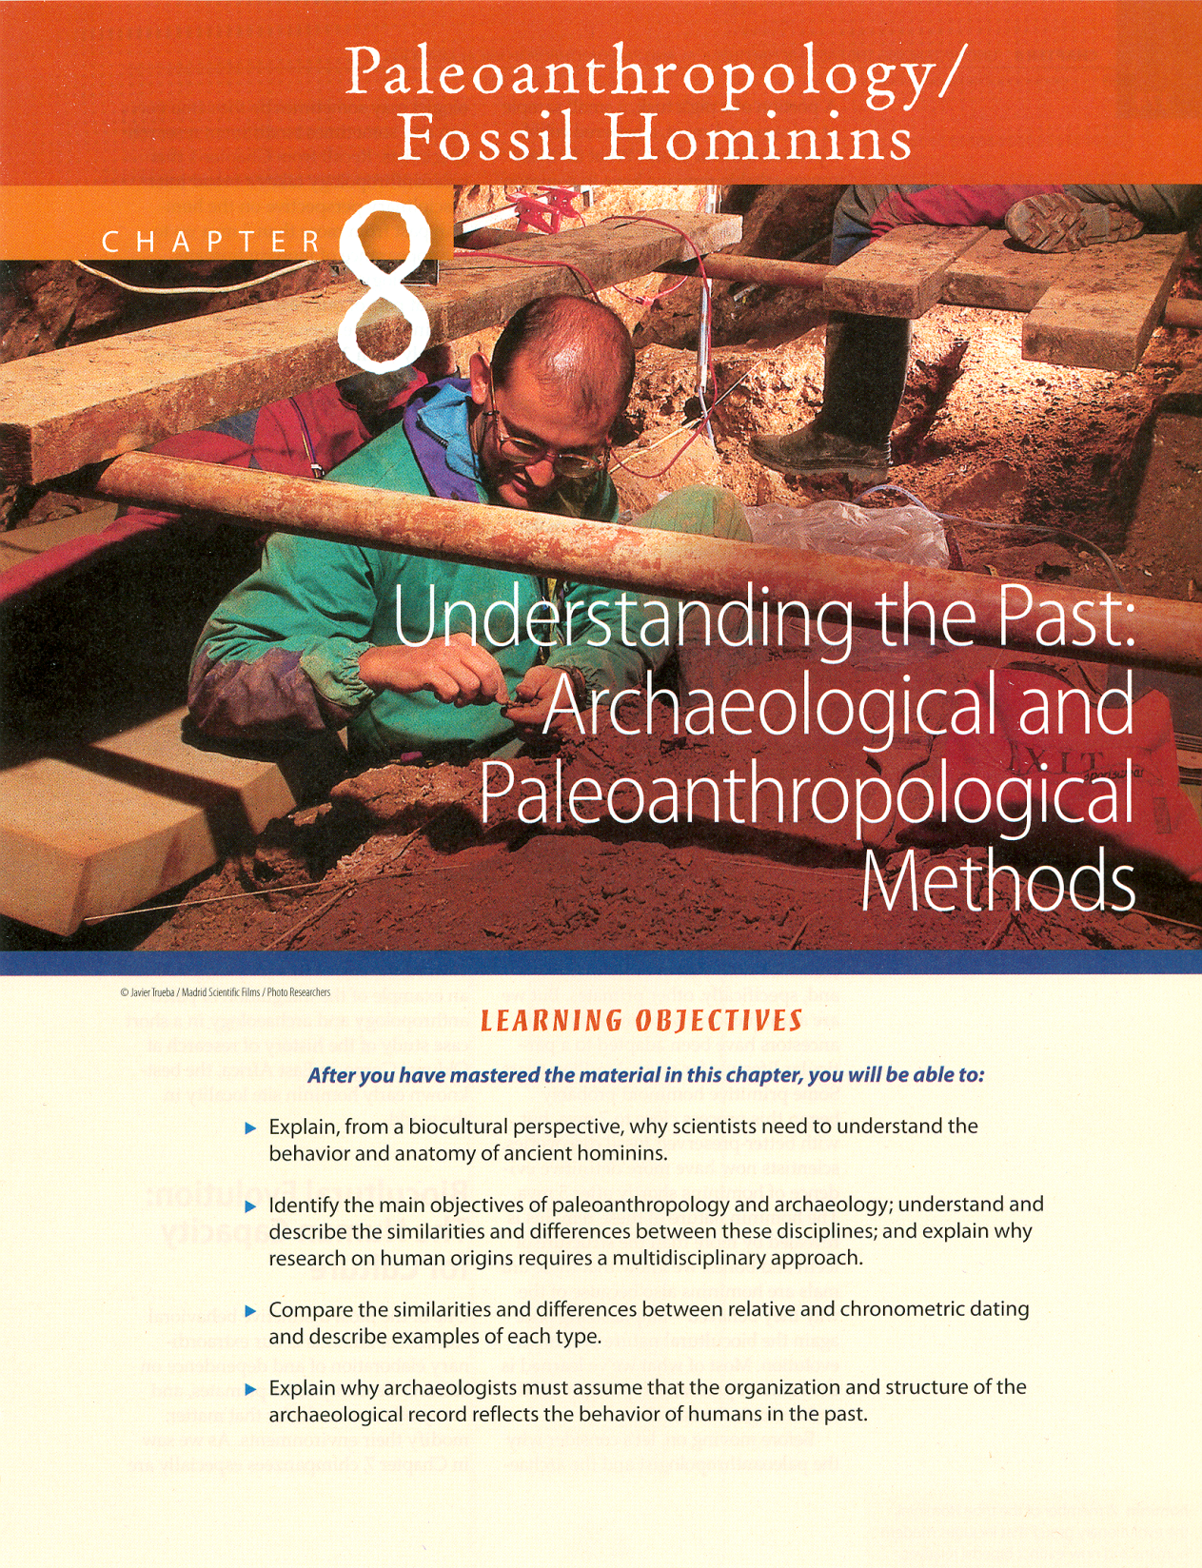
Other Methods
of
Analysis

Slide 3
other methods of analysis
microwear analysis
living floor analysis
phylogenetic analysis
  cladistics
seriation
ethnoarchaeology

Slide 4
other methods of analysis
microwear analysis
living floor analysis
phylogenetic analysis
  cladistics
seriation
ethnoarchaeology

Slide 5
microwear analysis
is the study of the polishes, striations, and other diagnostic microscopic changes on the edges of stone, teeth, and other materials

Slide 6
microwear analysis
is the study of the polishes, striations, and other diagnostic microscopic changes on the edges of stone, teeth, and other materials

Slide 7
striations
scratches or grooves
on the surface
of a tool, tooth, or bone

Slide 8
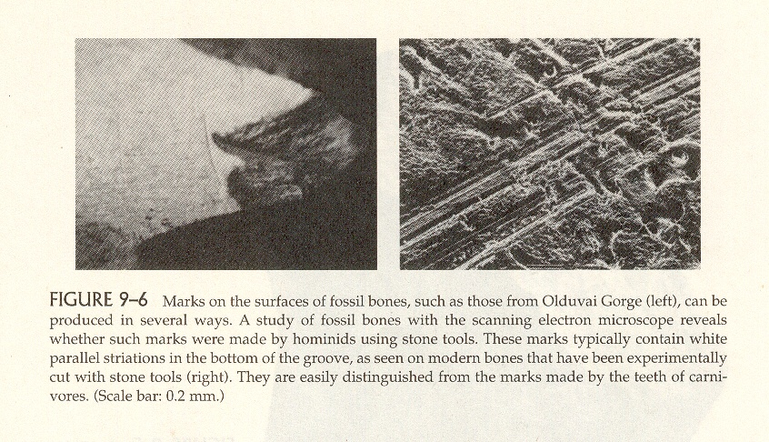
Marks on Olduvai fossil bones (left),
experimentally cut stone tools (right).
Humankind Emerging, 7th Ed., p. 278.

Slide 9
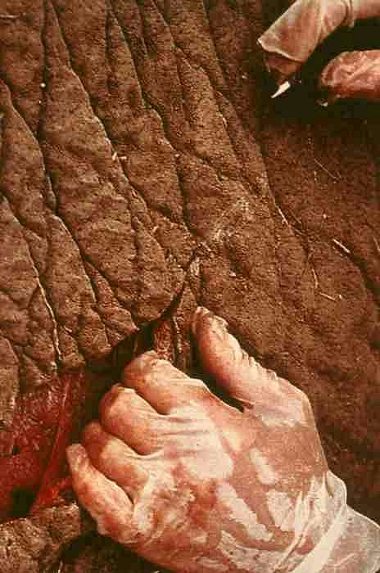
National Geographic, November 1985.

Slide 10
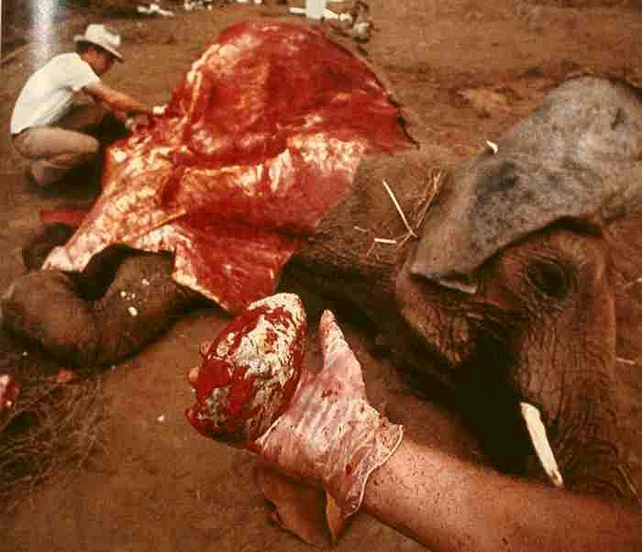
National Geographic, November 1985.

Slide 11
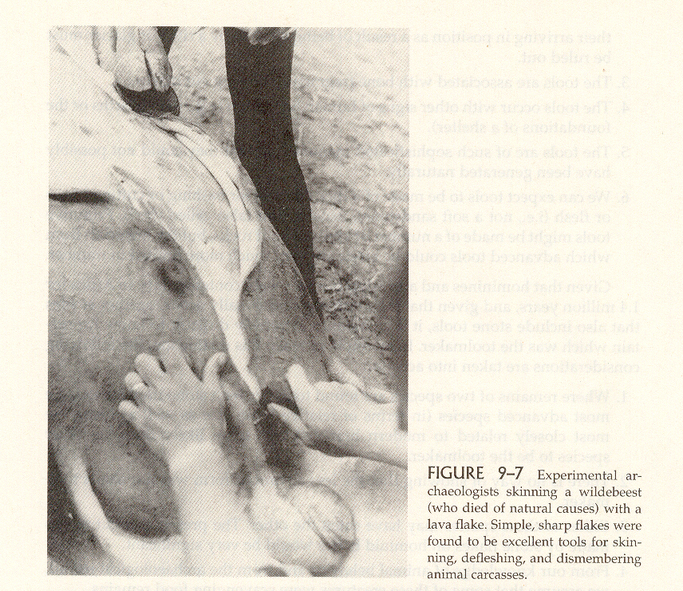
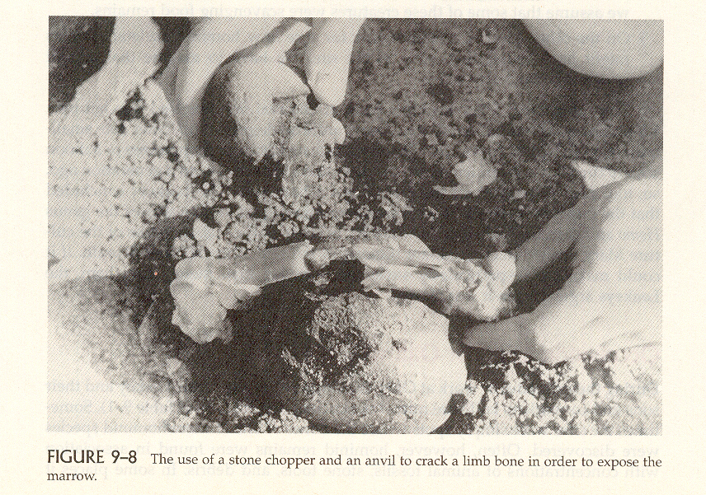
Experimental archaeology.
Humankind Emerging, 7th Ed., p. 279.

Slide 12
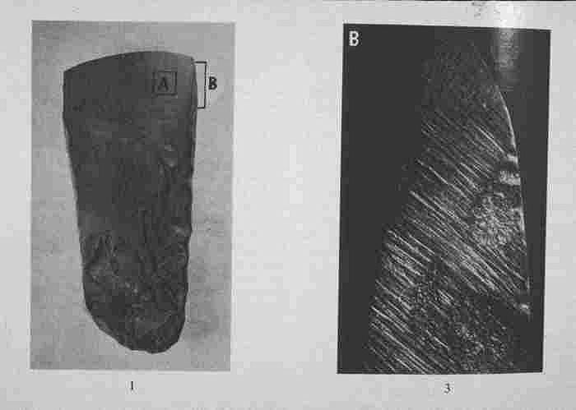

Slide 13
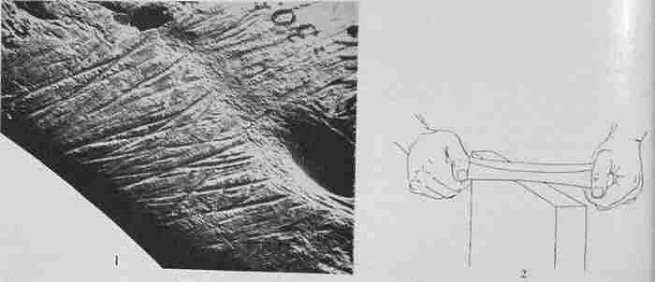

Slide 14
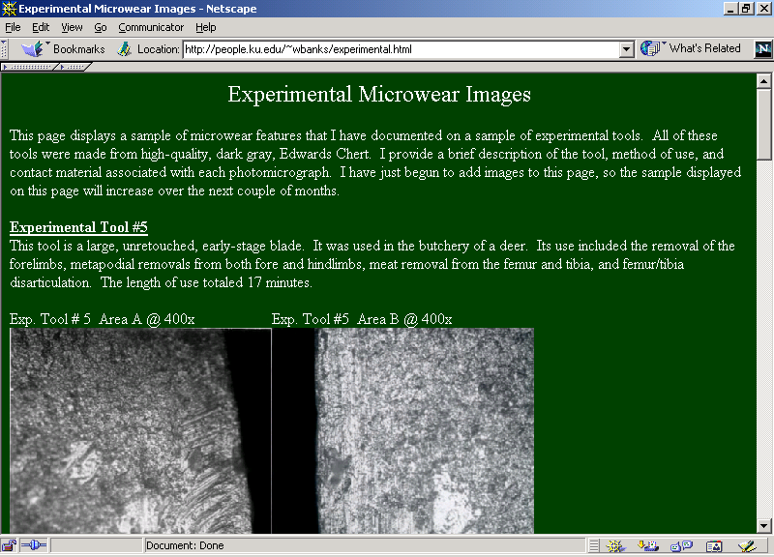
http://people.ku.edu/~wbanks/experimental.html

Slide 15
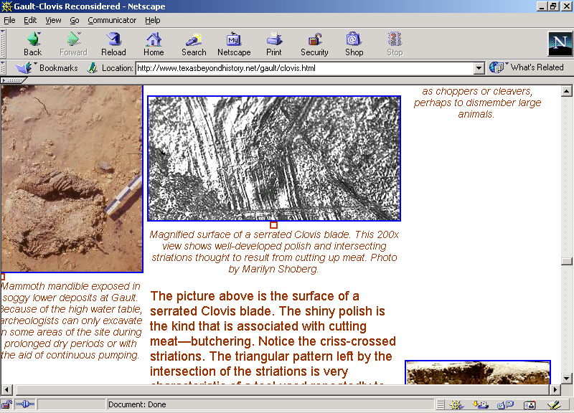
http://www.texasbeyondhistory.net/gault/clovis.html

Slide 16
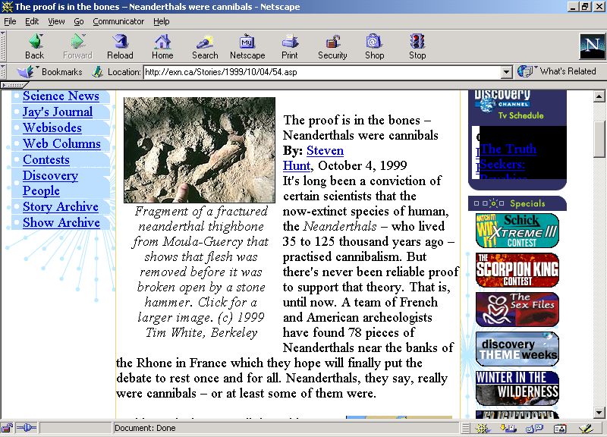
http://exn.ca/Stories/1999/10/04/54.asp

Slide 17
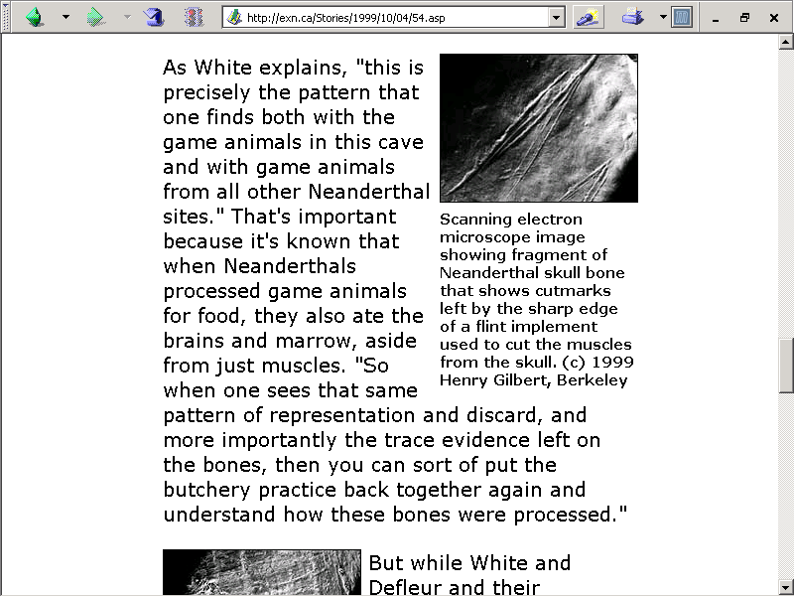
http://exn.ca/Stories/1999/10/04/54.asp

Slide 18
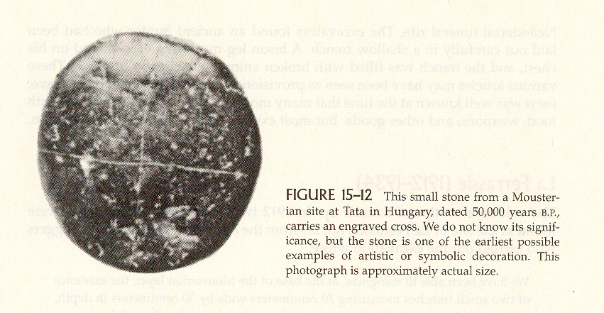
Incised stone from Tata, Hungary.
Humankind Emerging, 7th Ed., p. 443.

Slide 19
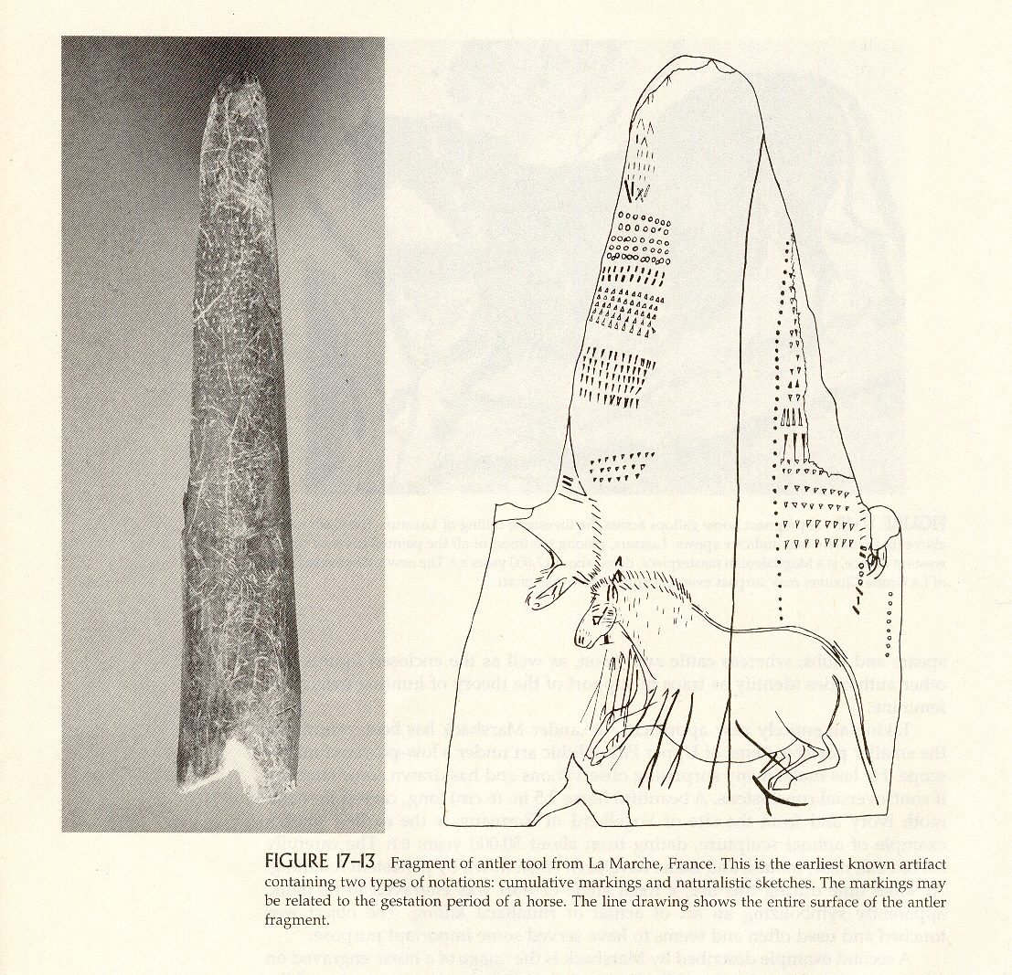
Antler Tool from La Marche, France.
Humankind Emerging, 7th Ed., p. 443.

Slide 20
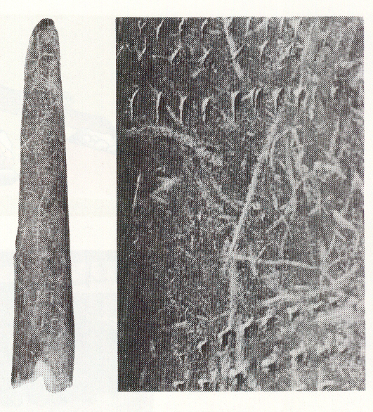
Antler Tool from La Marche, France.
People of the Earth, 10th Ed., p. 141.

Slide 21
other methods of analysis
microwear analysis
living floor analysis
phylogenetic analysis
  cladistics
seriation
ethnoarchaeology

Slide 22
living floor analysis
analysis of places where early human bands camped, leaving behind evidence of their habitation

Slide 23
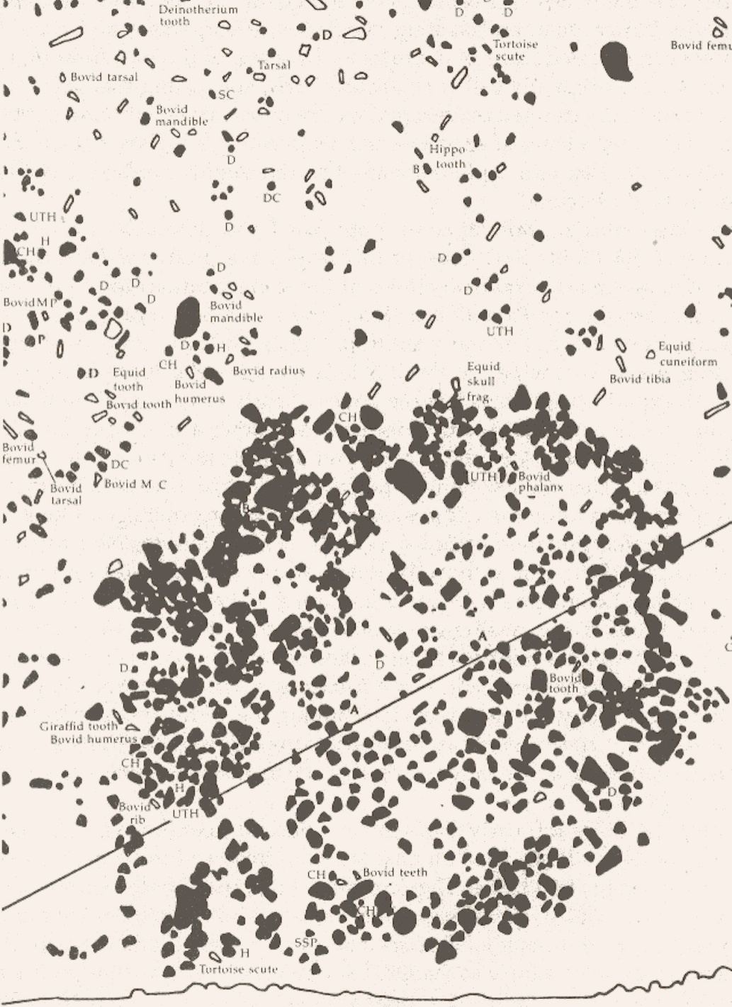
Bed I, Olduvai Gorge.
Humankind Emerging, 7th Ed., p. 282.

Slide 24
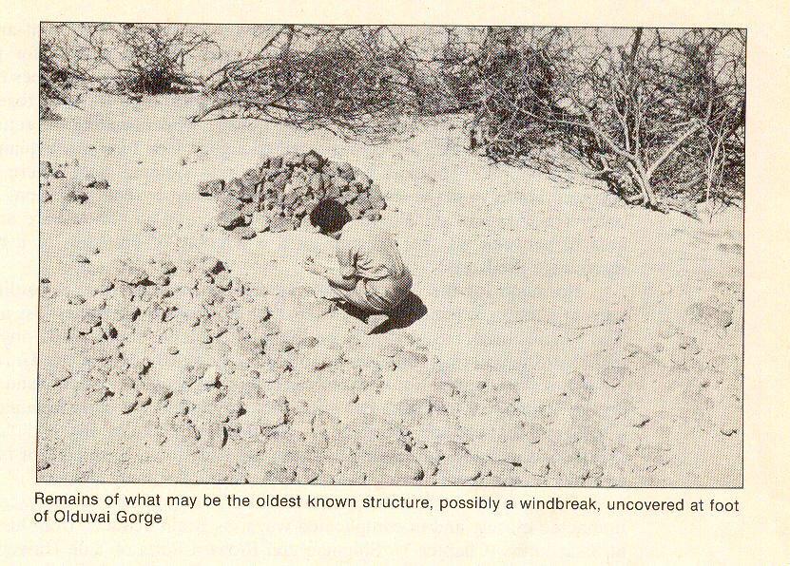
The Emergence of Humankind (4th Ed.). (Harper & Row, 1985), p. 79.

Slide 25
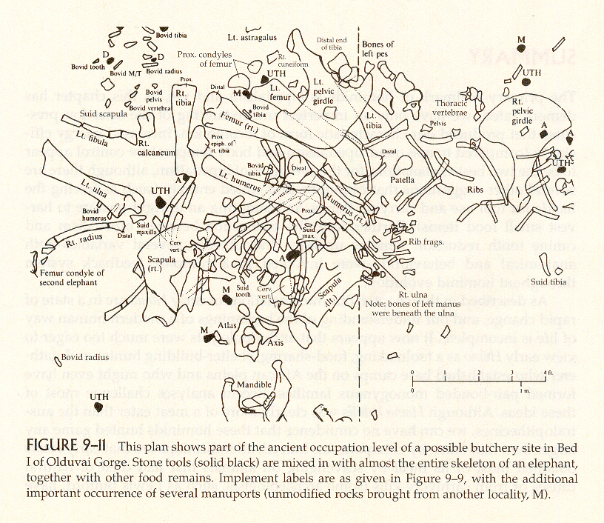
Humankind Emerging, 7th Ed., p. 283.

Slide 26
other methods of analysis
microwear analysis
living floor analysis
phylogenetic analysis
  cladistics
seriation
ethnoarchaeology

Slide 27
phylogenetic analysis
set of criteria for selecting traits and a methodology for using them to assess evolutionary relationships

Slide 28
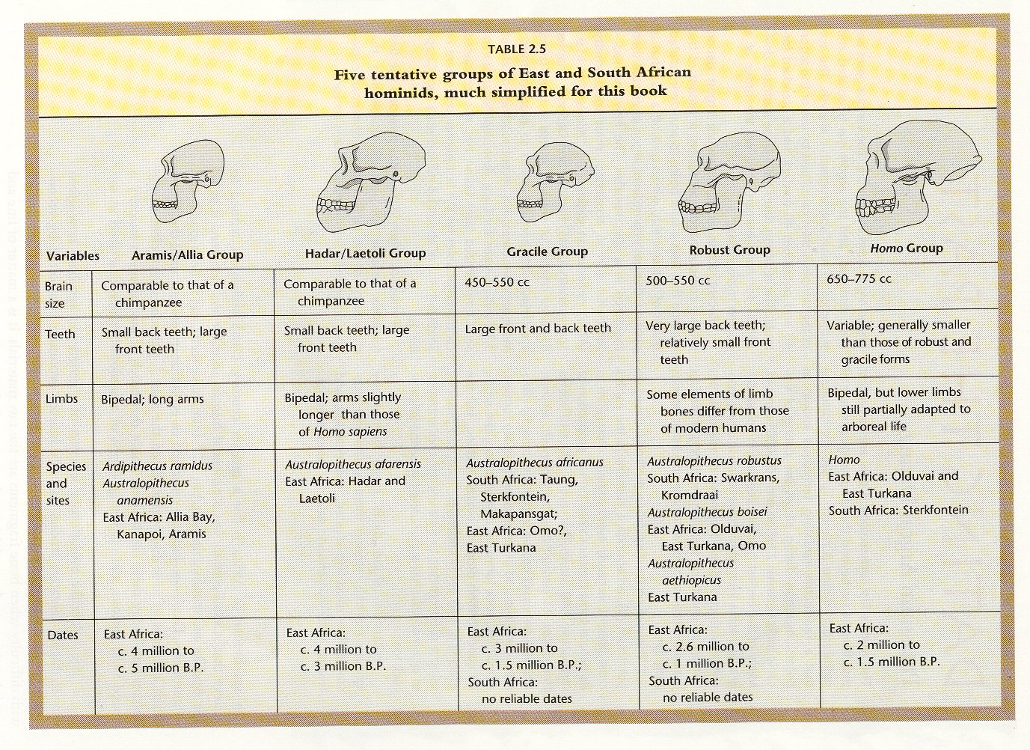
People of the Earth (10th ed). (Prentice-Hall, 2001), p. 44.

Slide 29
other methods of analysis
microwear analysis
living floor analysis
phylogenetic analysis
  cladistics
seriation
ethnoarchaeology

Slide 30
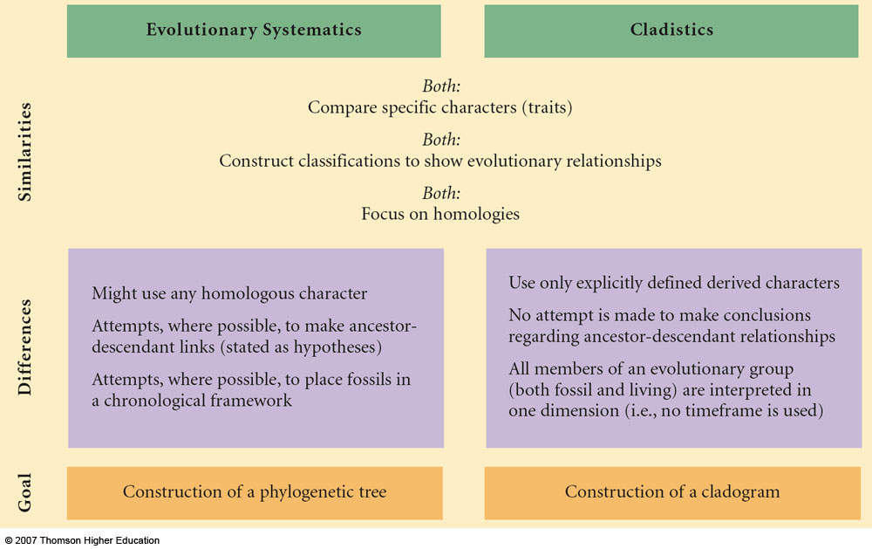
Constructing Classifications and Interpreting Relationships
Understanding Physical Anthropology and Archaeology, 9th Ed., p. 99.

Slide 31
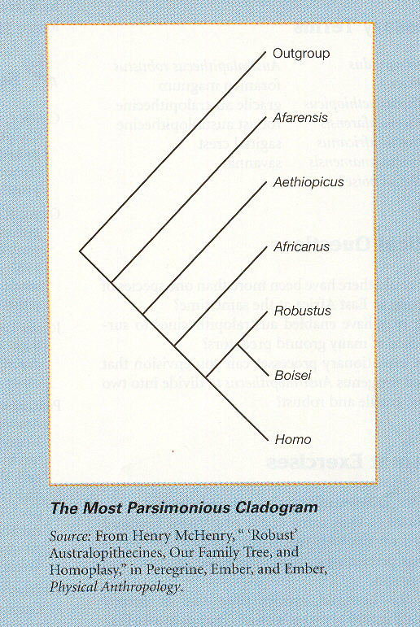
Ember, Ember and Peregrine, Physical Anthropology and Archaeology.
(Prentice-Hall, 2004), p. 101.

Slide 32
other methods of analysis
microwear analysis
living floor analysis
phylogenetic analysis
  cladistics
seriation
ethnoarchaeology

Slide 33
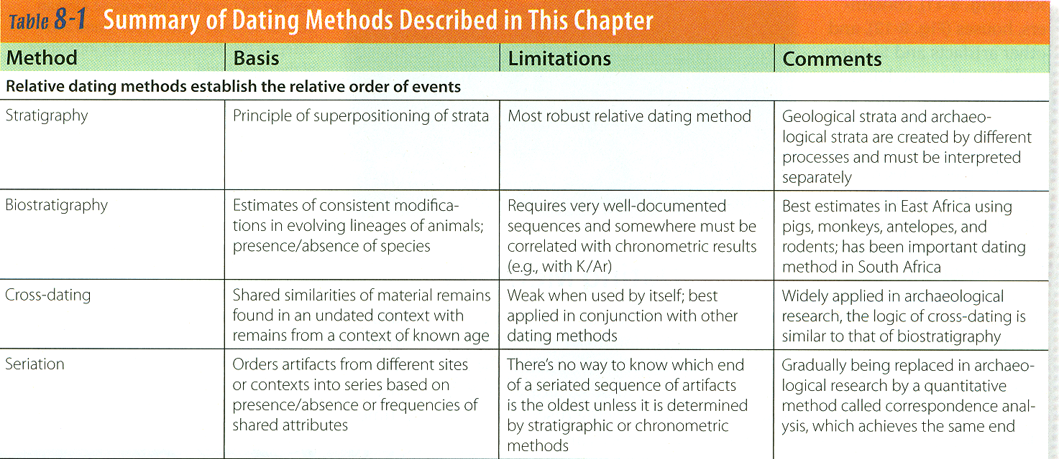
relative dating methods
Paleoanthropology is Heavily Interdisciplinary.
Understanding Humans, 11th Ed., p. 184

Slide 34
relative dating methods
Paleoanthropology is Heavily Interdisciplinary.
Understanding Humans, 11th Ed., p. 184

Slide 35
seriation
a relative dating method
based on the assumption that any artifact or style will appear, gradually increase in popularity until it reaches a peak, and
then progressively decrease

Slide 36
seriation
a relative dating method
based on the assumption that any artifact or style will appear, gradually increase in popularity until it reaches a peak, and
then progressively decrease

Slide 37
relative dating
tells us that something is
older or younger
than something else, but not by how much
tells us what came first, and, with seriation, what comes next

Slide 38
relative dating
tells us that something is
older or younger
than something else, but not by how much
tells us what came first, and, with seriation, what comes next

Slide 39
relative dating
tells us that something is
older or younger
than something else, but not by how much
tells us what came first, and, with seriation, what comes next

Slide 40
seriation
a relative dating method
based on the assumption that any artifact or style will appear, gradually increase in popularity until it reaches a peak, and
then progressively decrease

Slide 41
REM: relative methods
tell you whether something is
older / younger / the same age
relative dating methods
Paleoanthropology is Heavily Interdisciplinary.
Understanding Humans, 11th Ed., p. 184

Slide 42
Gradually being replaced in
archaeological research by a
quantitative method called
correspondence analysis,
which achieves the same end
relative dating methods
Paleoanthropology is Heavily Interdisciplinary.
Understanding Humans, 11th Ed., p. 184

Slide 43
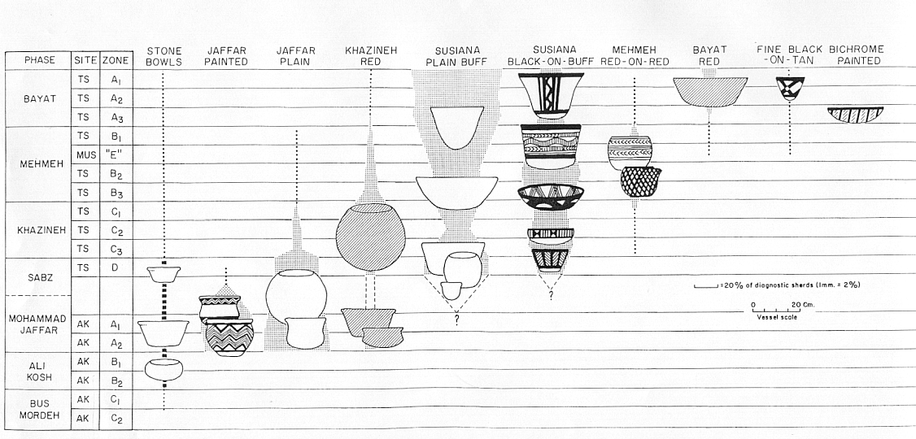
seriation
Relative dating method that orders artiacts into a temporal series based on their similar attributes or the frequency of these attributes
10th Ed. p. 190, 188
Pottery types from Deh Luran, Iran.
Source: Hole, Flannery and Neely, “Prehistory and Human Ecology
Of the Deh Luran Plain: An Early Village Sequence from
Khuzistan, Iran.” Ann Arbor: 1969, fig. 69.

Slide 44
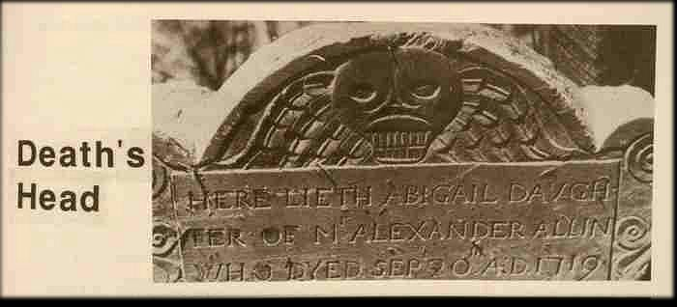
tombstones from Stoneham, Massachusetts
James Deetz. Invitation to Archaeology. The Natural History Press, 1967.

Slide 45
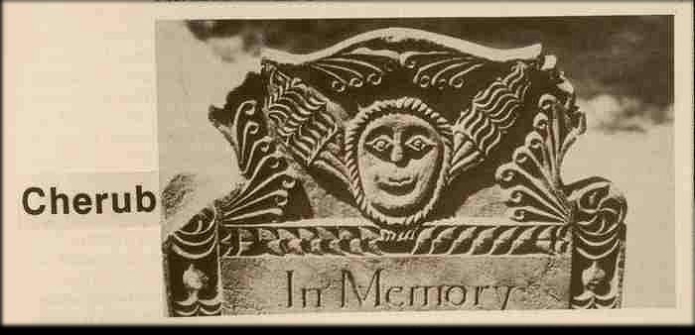
tombstones from Stoneham, Massachusetts
James Deetz. Invitation to Archaeology. The Natural History Press, 1967.

Slide 46
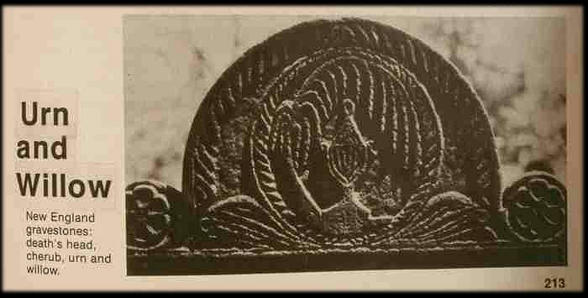
tombstones from Stoneham, Massachusetts
James Deetz. Invitation to Archaeology. The Natural History Press, 1967.

Slide 47
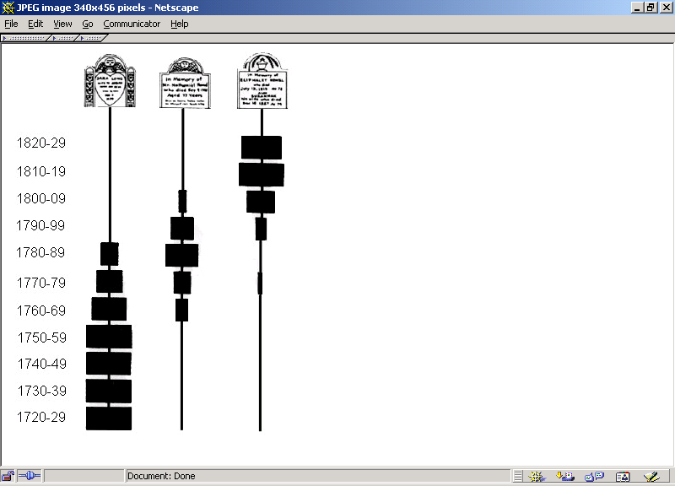
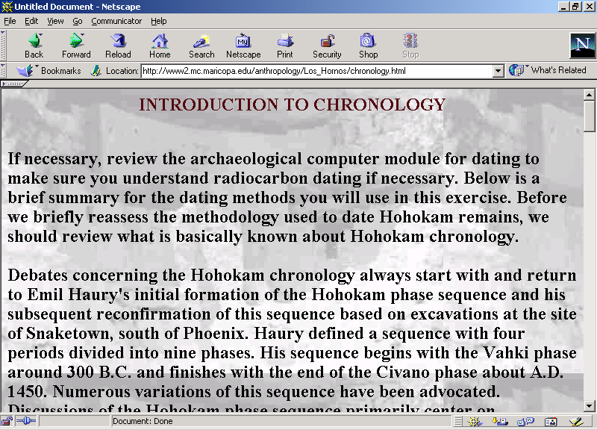
Cherub
Death’s
Head
Urn
and
Willow
= 100%
= 100%
= 100%
Mesa Community College

Slide 48
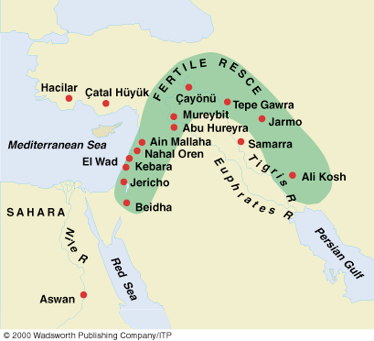
Understanding Physical Anthropology and Archaeology (9th Ed), p. 378

Slide 49
Pottery types from Deh Luran, Iran.
Source: Hole, Flannery and Neely, “Prehistory and Human Ecology
Of the Deh Luran Plain: An Early Village Sequence from
Khuzistan, Iran.” Ann Arbor: 1969, fig. 69.

Slide 50
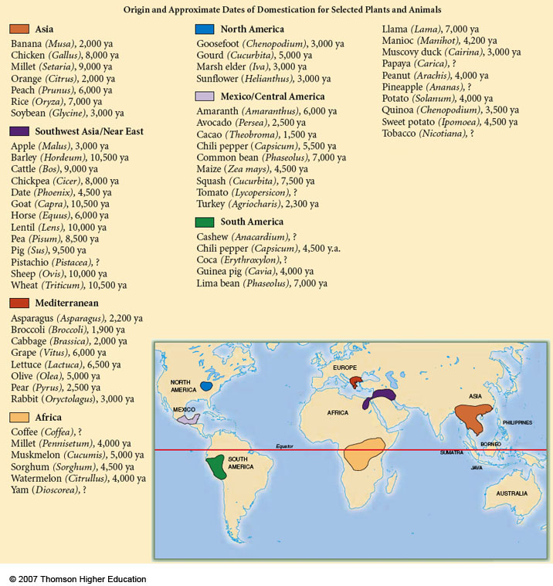
Understanding Physical Anthropology and Archaeology (9th Ed), p. 342

Slide 51
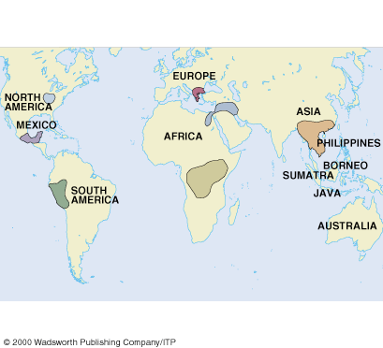
Understanding Physical Anthropology and Archaeology (9th Ed), p. 343

Slide 52
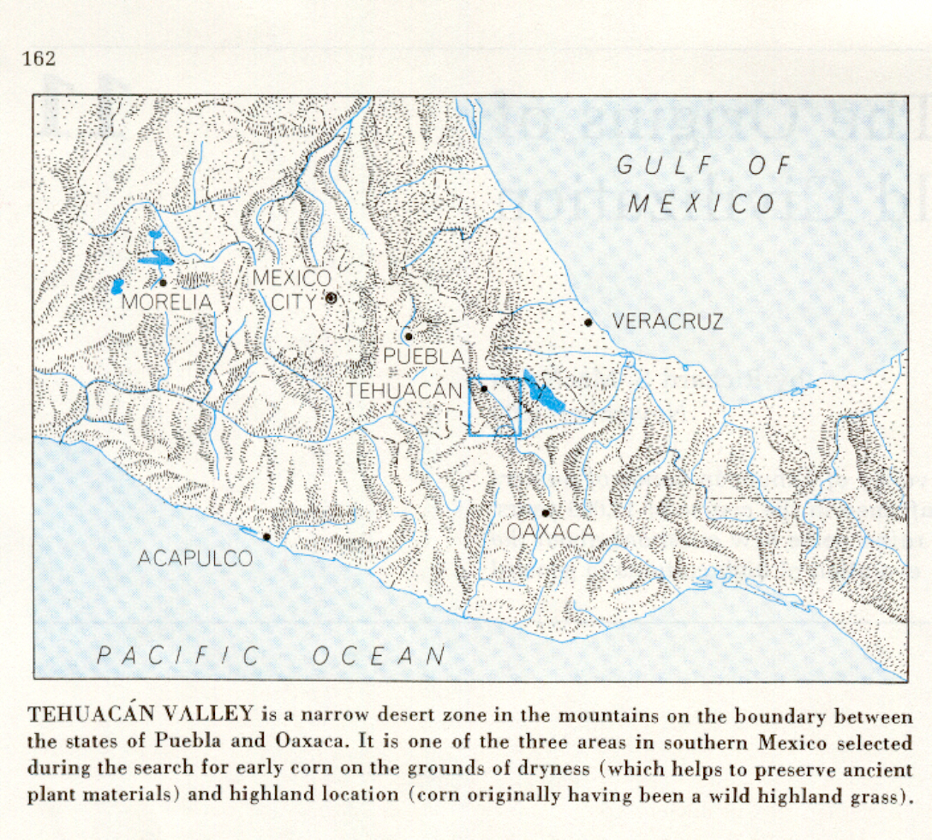
Richard S. Mac Neish, Scientific American, 1964.
Understanding Physical Anthropology and Archaeology (8th Ed), p. 417

Slide 53
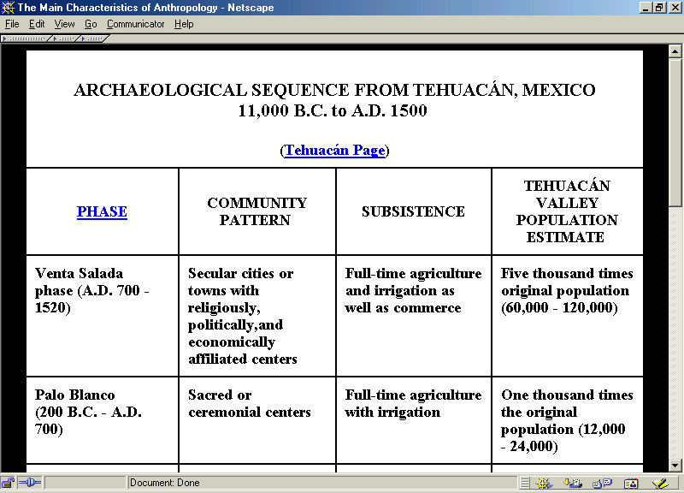

Slide 54
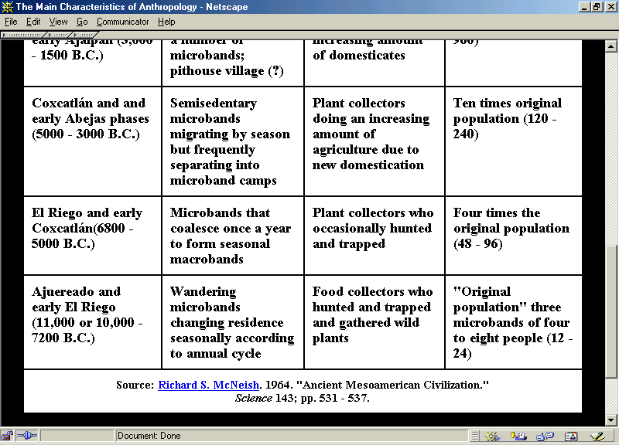
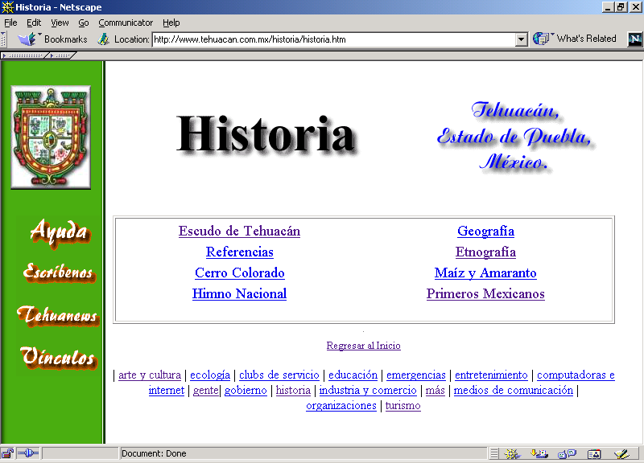

Slide 55
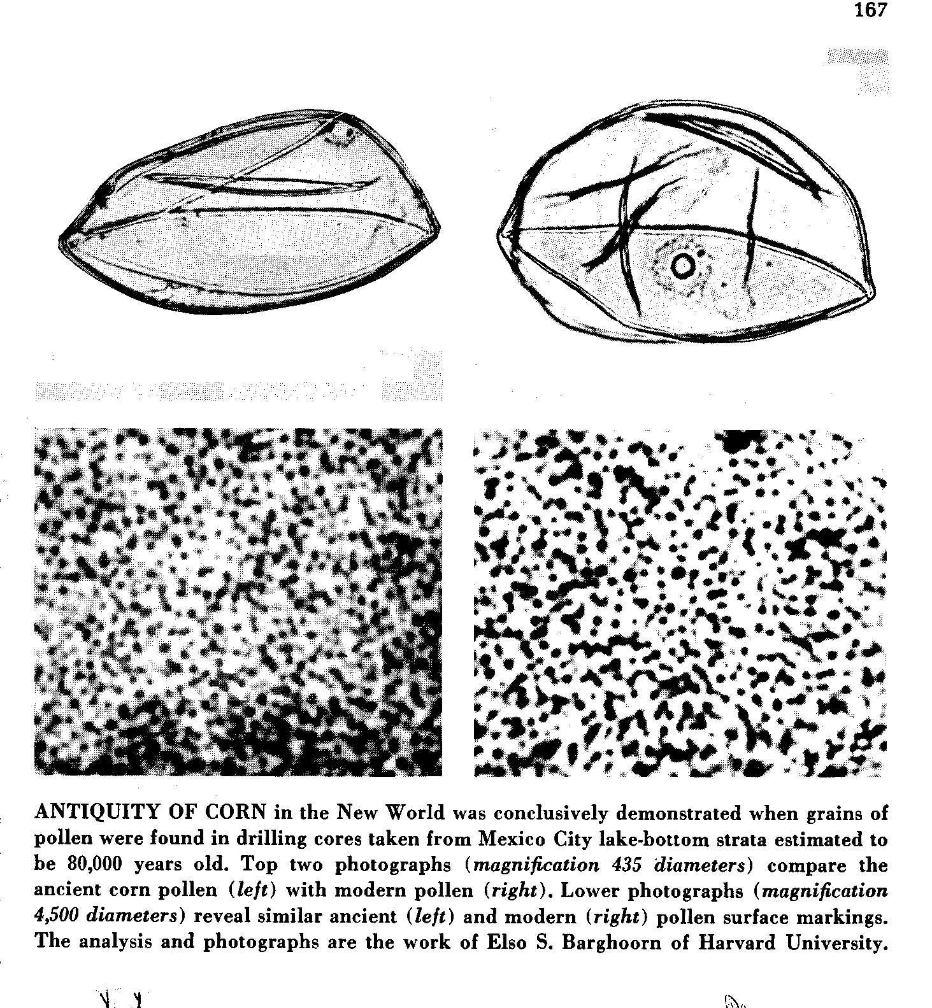
Richard S. Mac Neish, Scientific American, 1964.

Slide 56
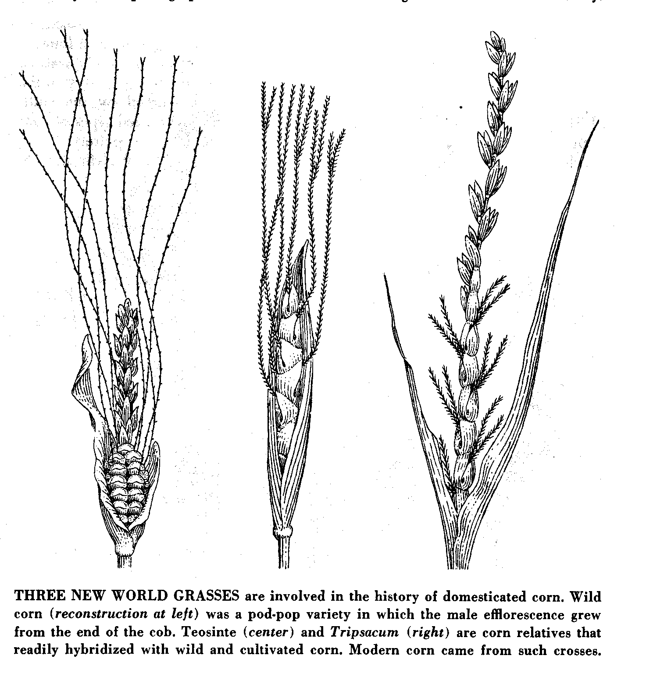
Wild corn
Teosinte
Tripsacum
wild
pod-pop
variety
Richard S. Mac Neish, Scientific American, 1964.

Slide 57
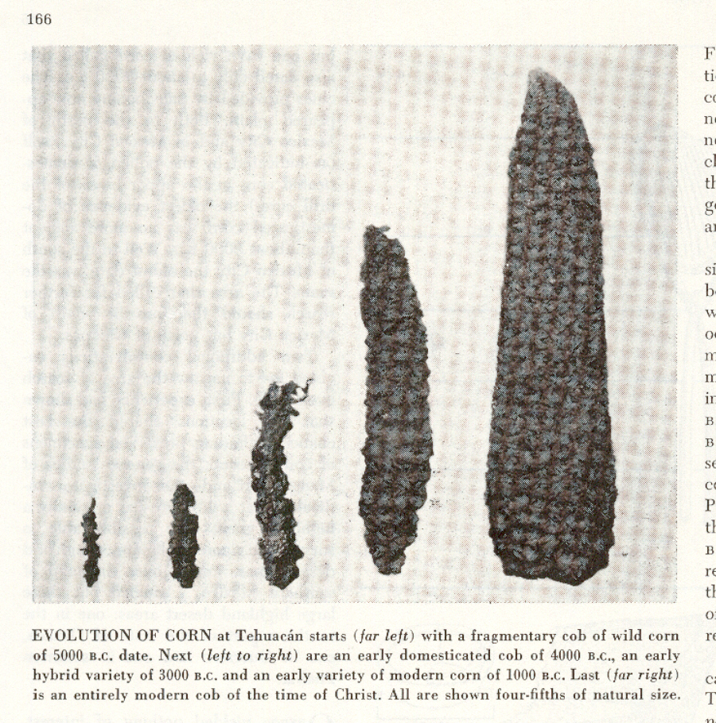
A.D. 0
1,000 B.C.
3,000 B.C.
5,000 B.C.
4,000 B.C.
Richard S. Mac Neish, Scientific American, 1964.

Slide 58
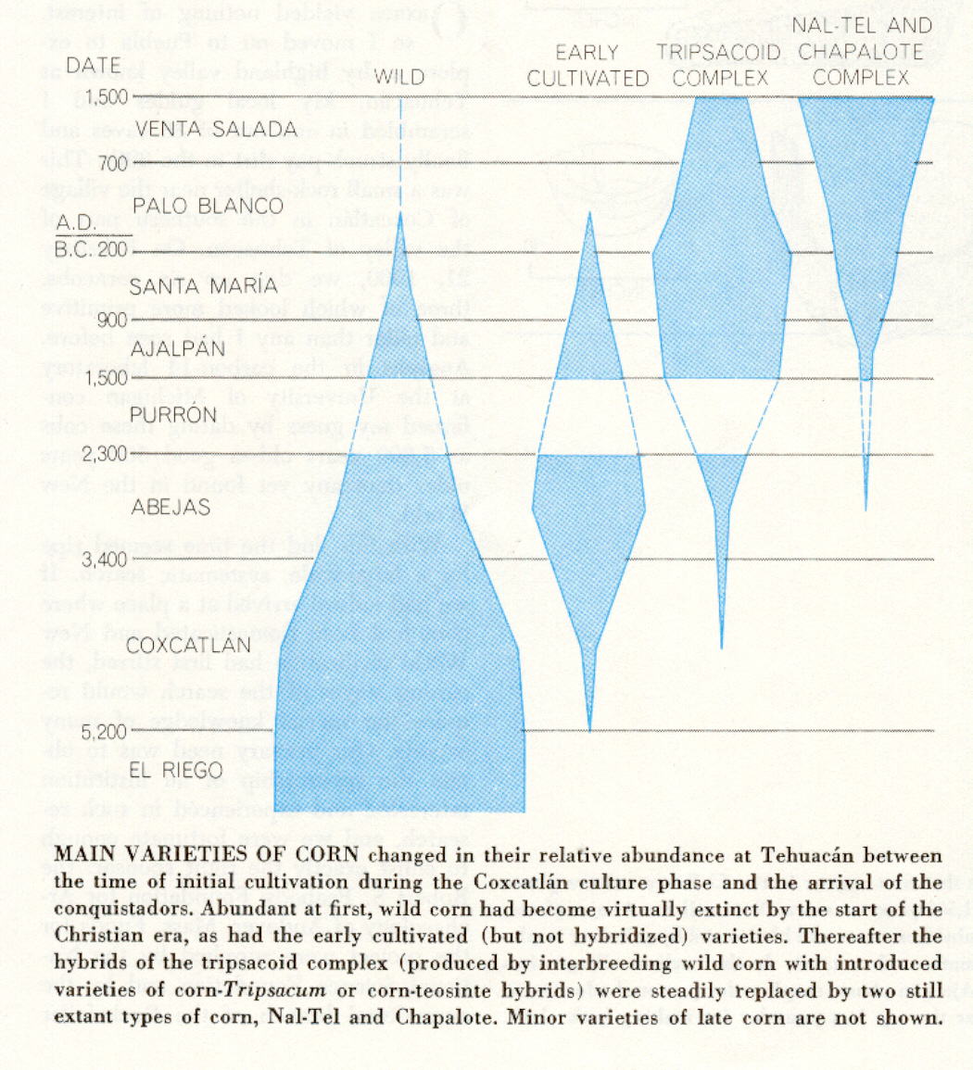
Richard S. Mac Neish, Scientific American, 1964.

Slide 59
= 100%
“seriation”
Richard S. Mac Neish, Scientific American, 1964.

Slide 60
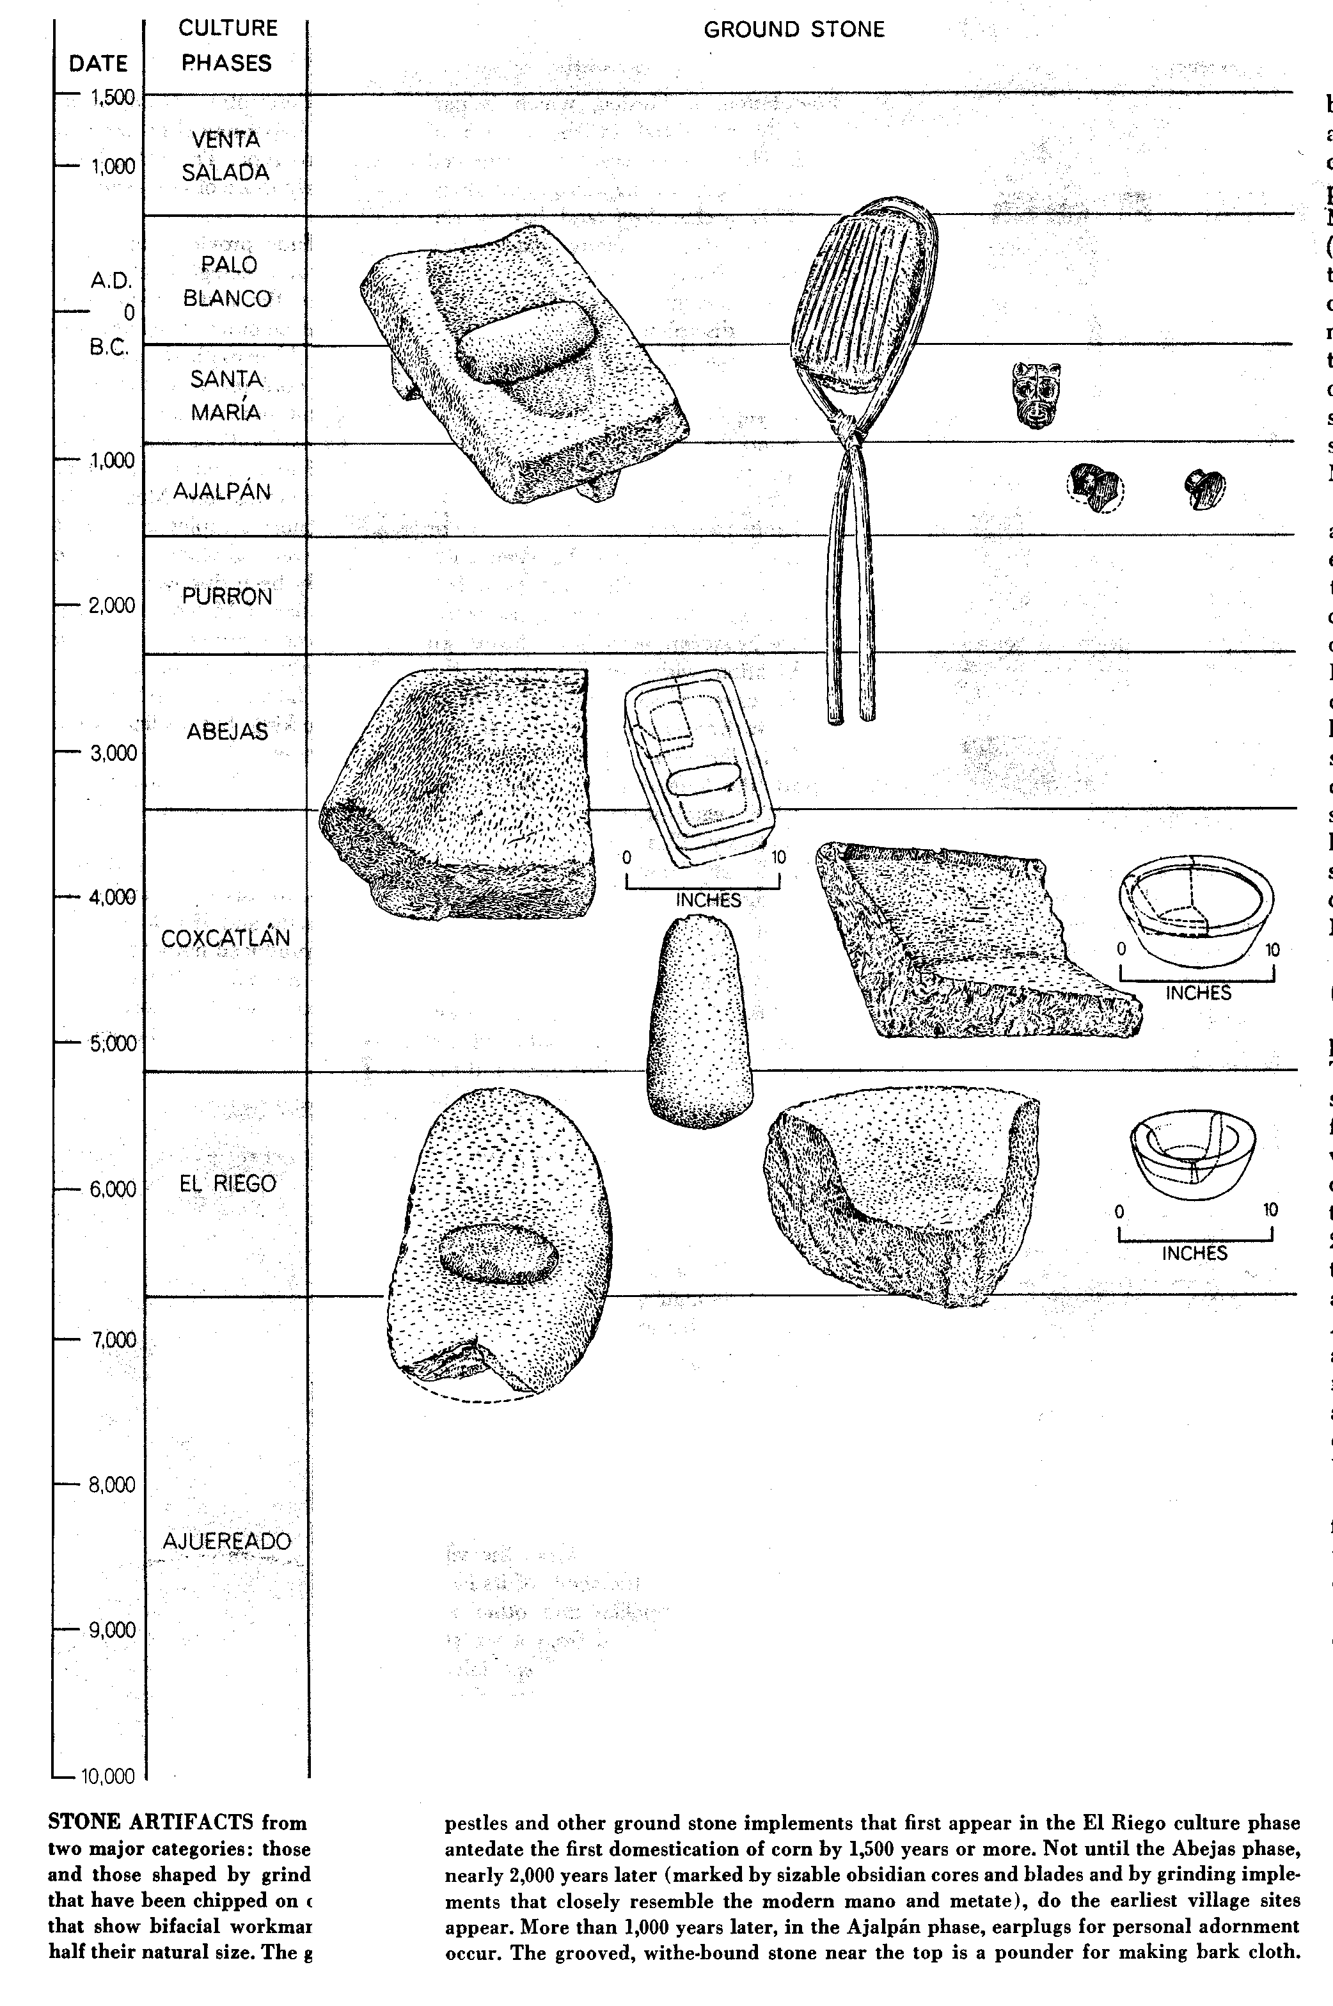
Richard S. Mac Neish, Scientific American, 1964.

Slide 61
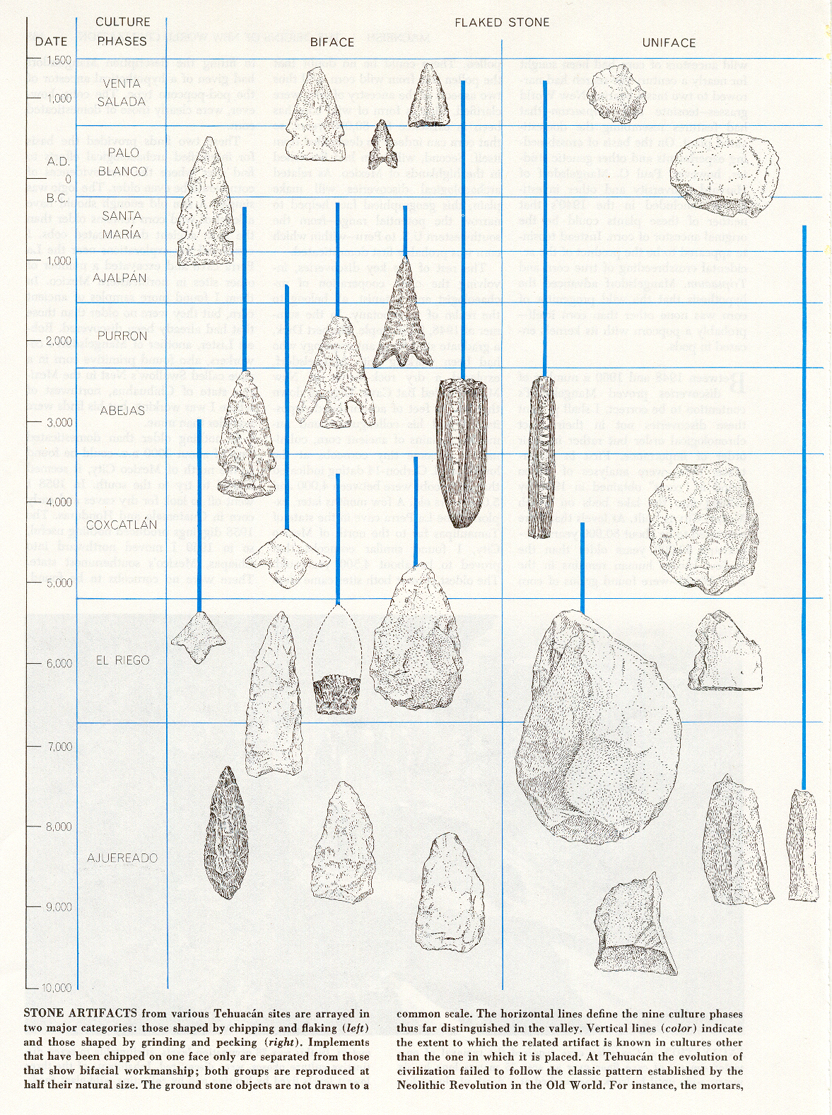
Richard S. Mac Neish, Scientific American, 1964.

Slide 62
Richard S. Mac Neish, Scientific American, 1964.

Slide 63
In the Field and Lab
other methods of analysis
microwear analysis
living floor analysis
phylogenetic analysis
  cladistics
seriation
ethnoarchaeology

Slide 64
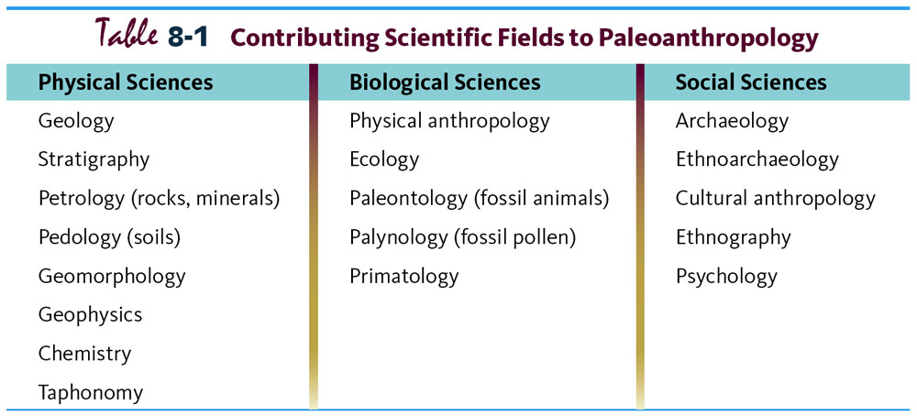
Multidisciplinary Study.
Understanding Humans, 10th Ed., p. 178.

Slide 65
Ethnoarcheological Studies of !Kung Lifeways
Understanding Physical Anthropology and Archaeology, 8th Ed., p. 347.

Slide 66
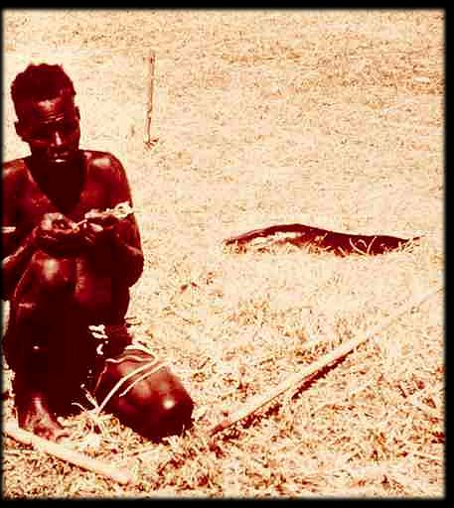

Slide 67
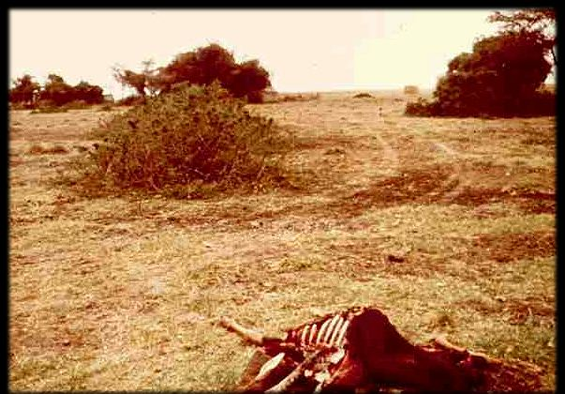

Slide 68
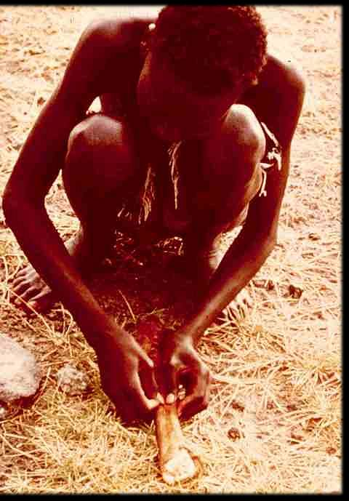

Slide 69
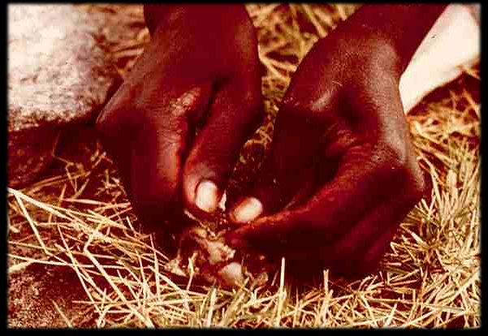

Slide 70
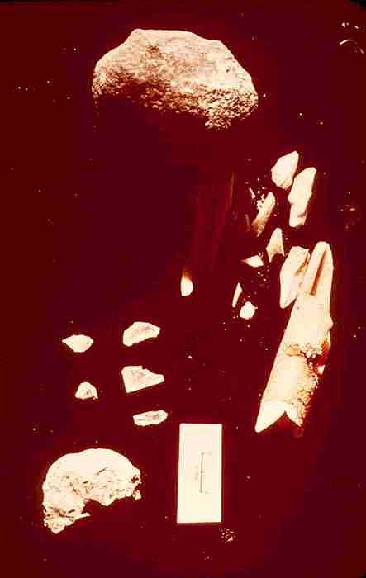

Slide 71
^{Continue on to Slide Set 11B}
Other Important Concepts

