Slide 1
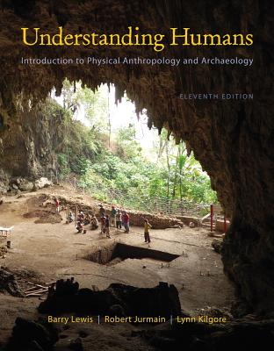
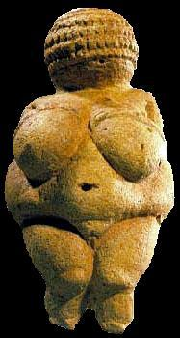
Introduction to Primates
. . . or how to make sense out of Ch. 6 and Ch. 7 of the text . . .
University of Minnesota Duluth
Tim Roufs
© 2010-2013
http://www.d.umn.edu/cla/faculty/troufs/anth1602/

Slide 2
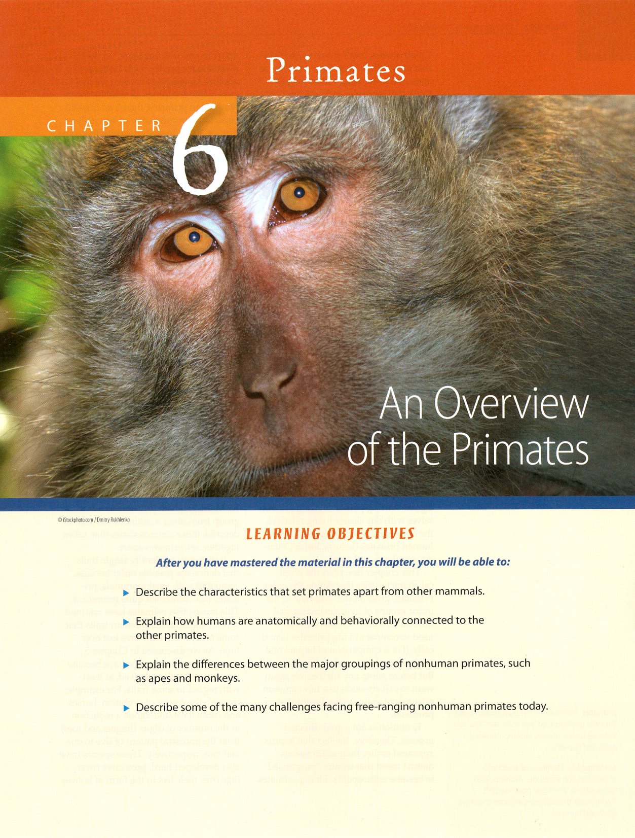

Slide 3
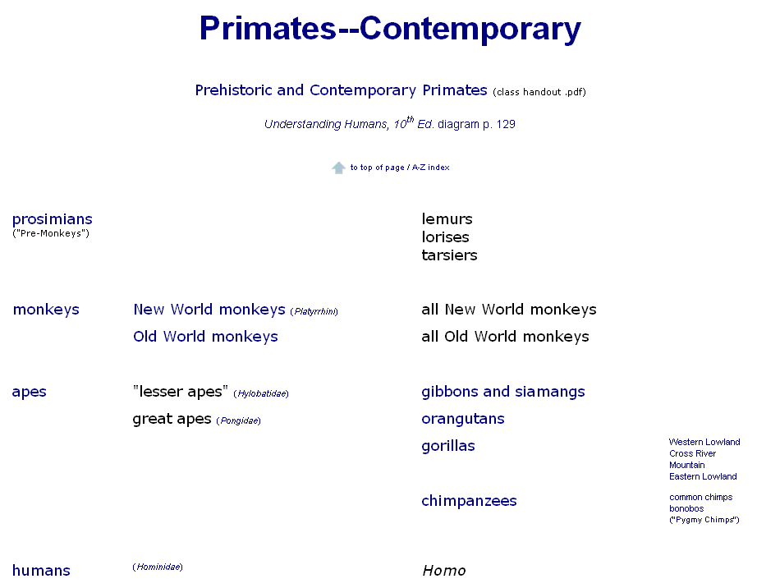

Slide 4
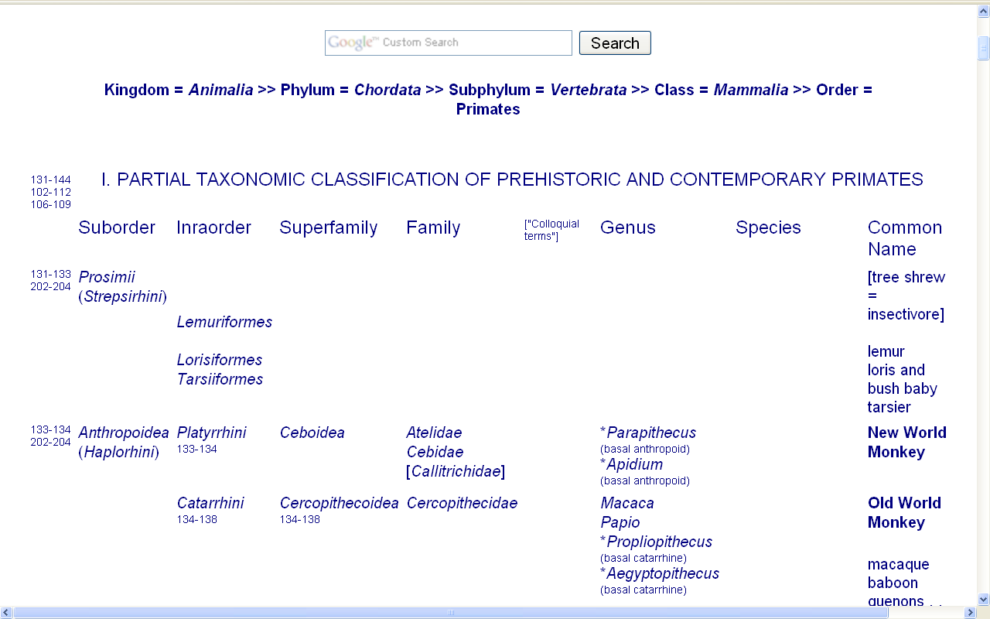

Slide 5
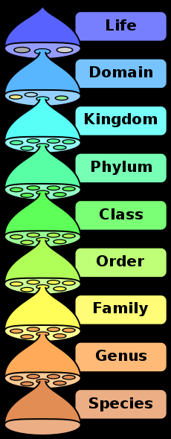
Wikipedia

Slide 6
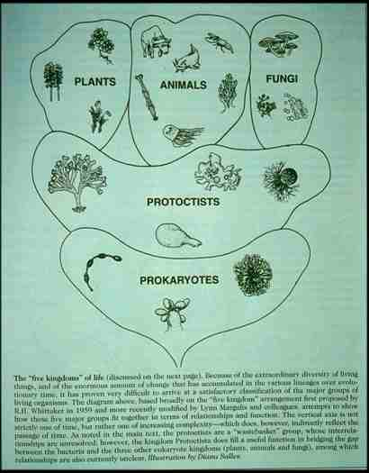

Slide 7
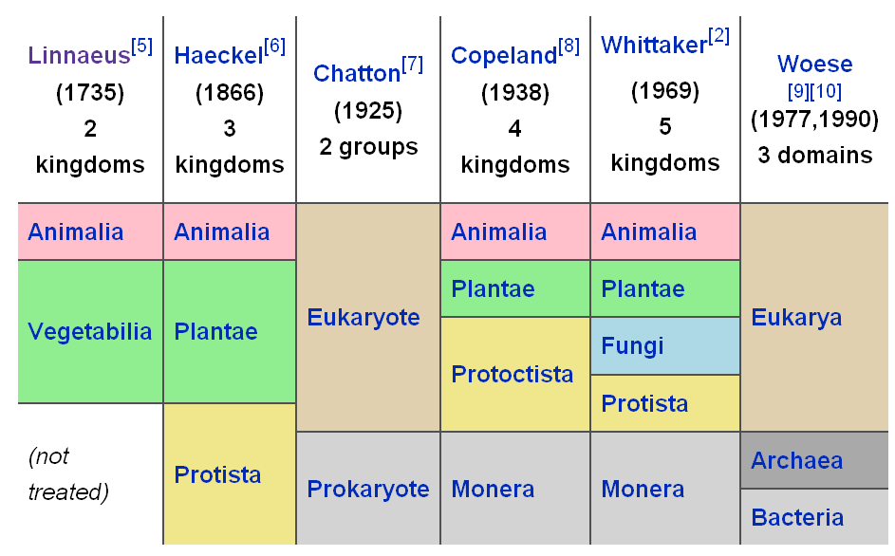
Wikipedia

Slide 8
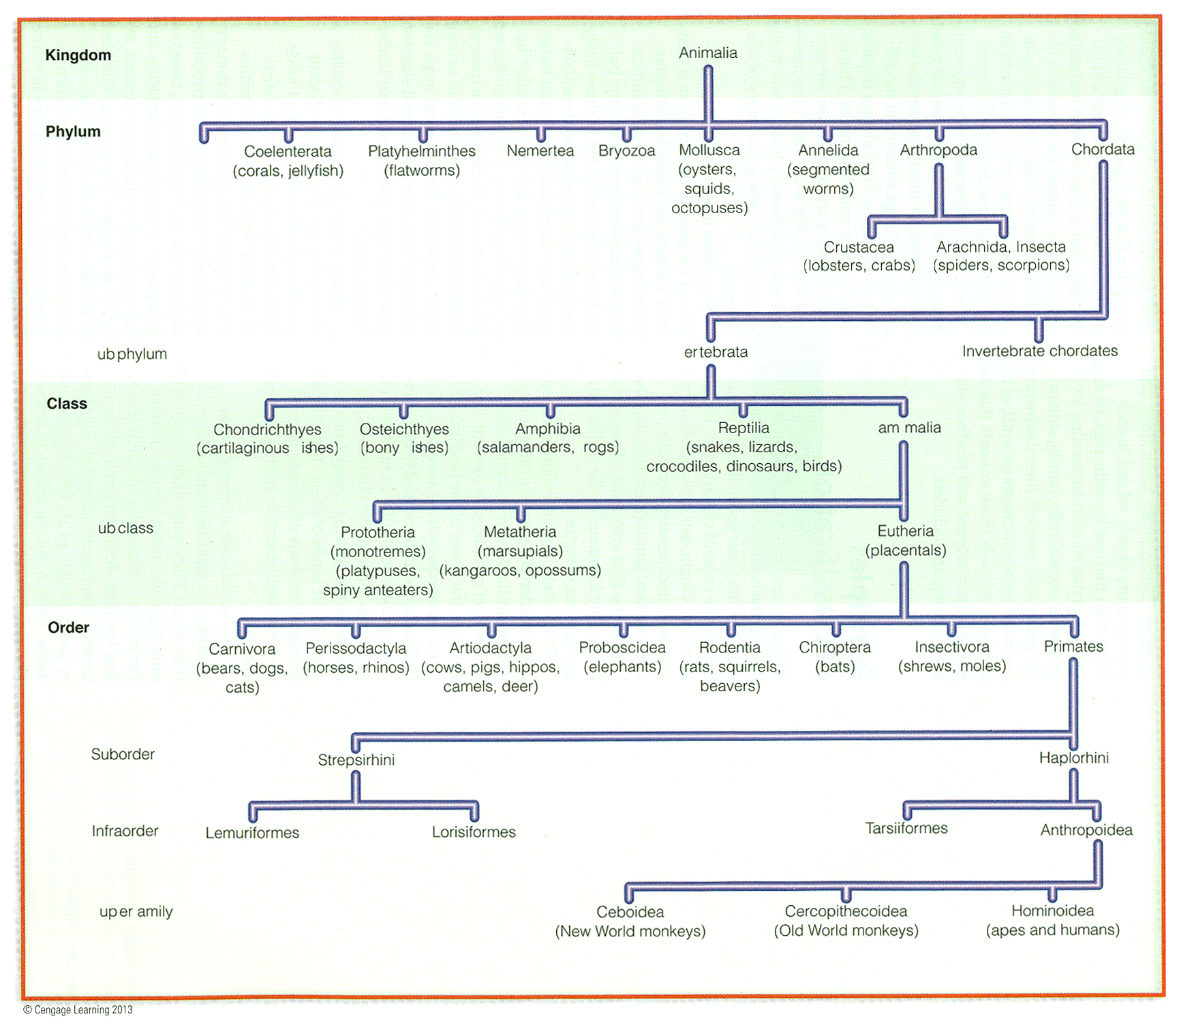
Classification chart (after Linnaeus)
Understanding Humans, 11th ed., p. 97

Slide 9
Primate taxonomic classification
Understanding Humans, 11th ed., p. 126

Slide 10
“New”
“New”
Primate taxonomic classification
Understanding Humans, 11th ed., p. 126

Slide 12
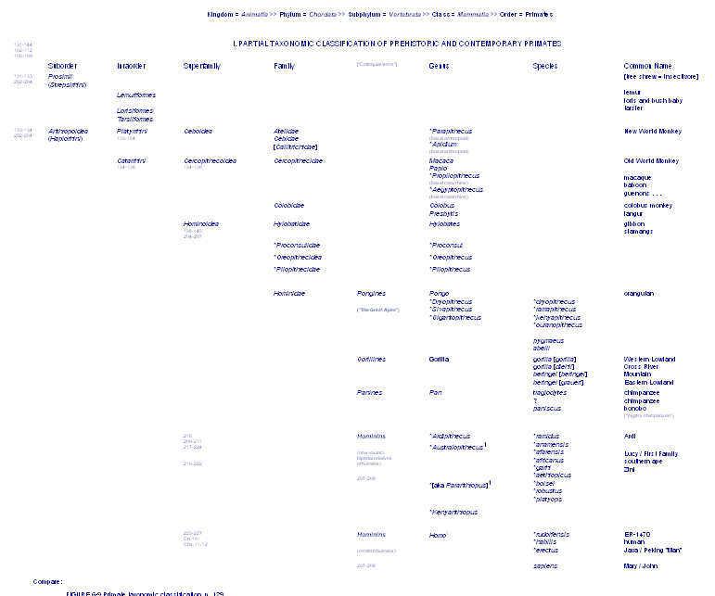
pre-monkeys

Slide 13
pre-monkeys
prosimians

Slide 14
prosimians
monkeys

Slide 15
prosimians
monkeys
apes

Slide 16
prosimians
monkeys
apes
humans

Slide 17
prosimians
monkeys
apes
humans

Slide 18
pre-monkeys
monkeys
apes
humans

Slide 19
pre-monkeys
prosimians
monkeys
monkeys
apes
apes
humans
humans

Slide 20
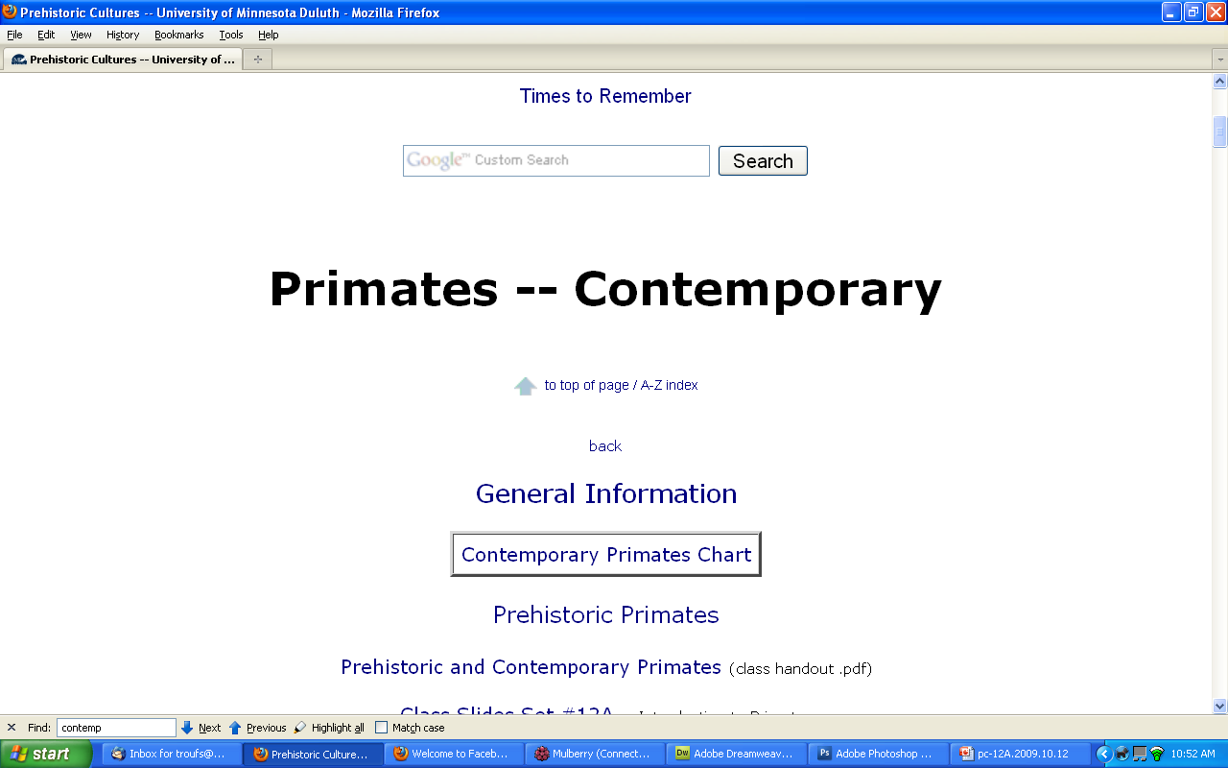
http://www.d.umn.edu/cla/faculty/troufs/anth1602/pcprim.html#title

Slide 21
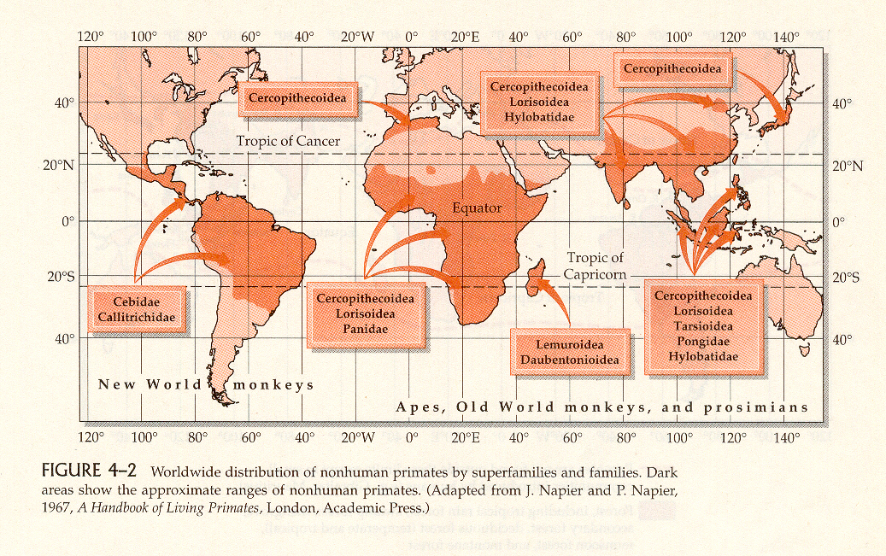
Primates are tropical and temperate climate creatures
Distribution of Nonhuman Primates
Humankind Emerging, 7t^{h} ed., p. 93

Slide 22
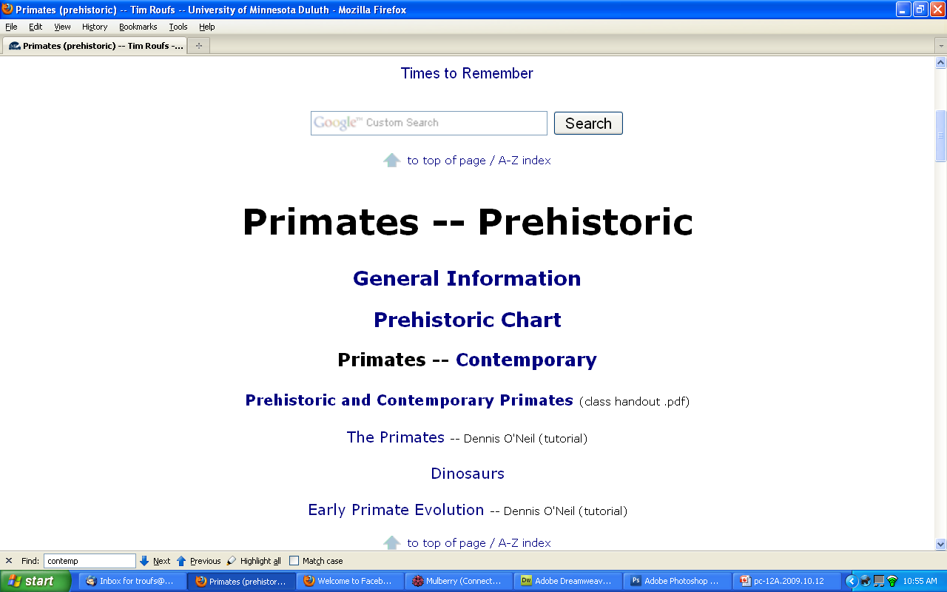
http://www.d.umn.edu/cla/faculty/troufs/anth1602/pcprimpr.html

Slide 23
“Times to Remember” WebPage

Slide 24
“Times to Remember” WebPage

Slide 25
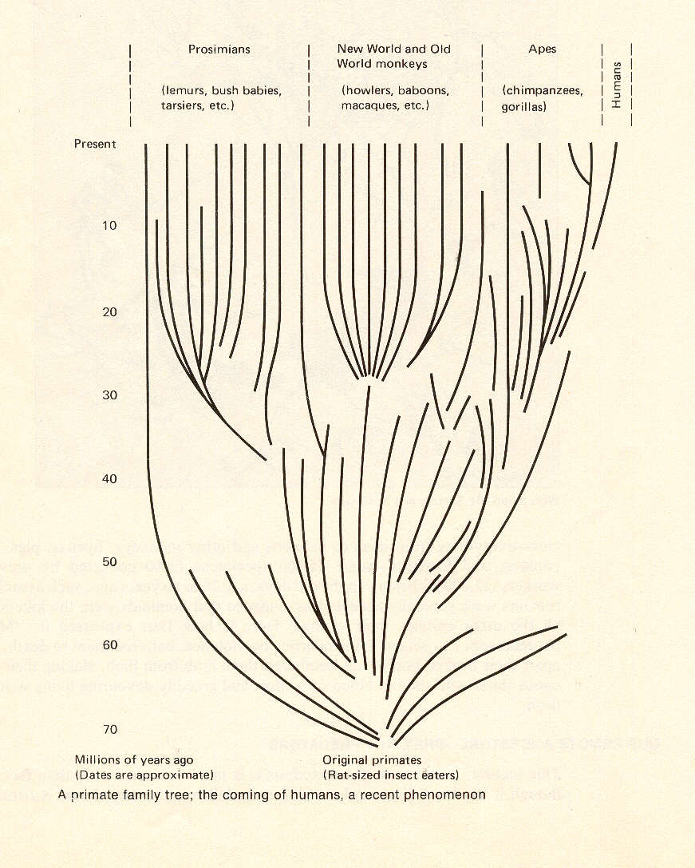
A Primate Family Tree
The Emergence of Humankind, 4th ed., p. 64

Slide 26
A Primate Family Tree
The Emergence of Humankind, 4th ed., p. 64

Slide 27
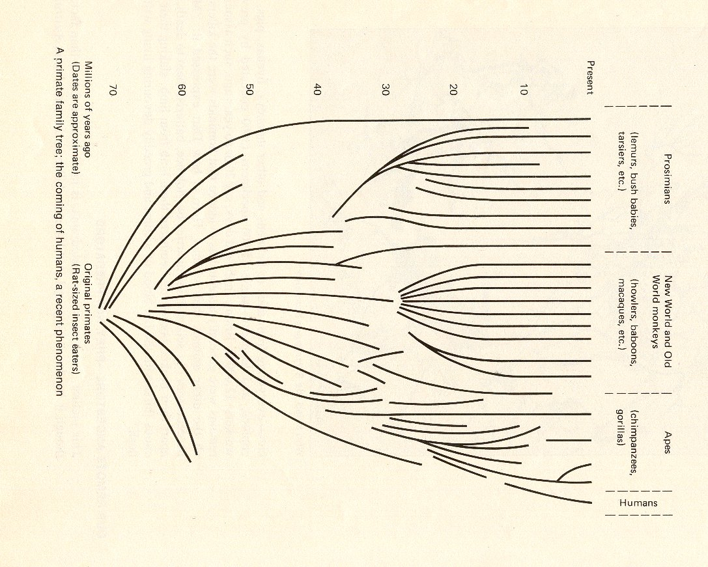
prosimians
monkeys
apes
humans
A Primate Family Tree
The Emergence of Humankind, 4th ed., p. 64

Slide 28
prosimians
monkeys
apes
humans

Slide 29
prosimians
Primate taxonomic classification
Understanding Humans, 11th ed., p. 126

Slide 30
monkeys
Primate taxonomic classification
Understanding Humans, 11th ed., p. 126

Slide 31
apes
Primate taxonomic classification
Understanding Humans, 11th ed., p. 126

Slide 32
hominoids
Primate taxonomic classification
Understanding Humans, 11th ed., p. 126

Slide 33
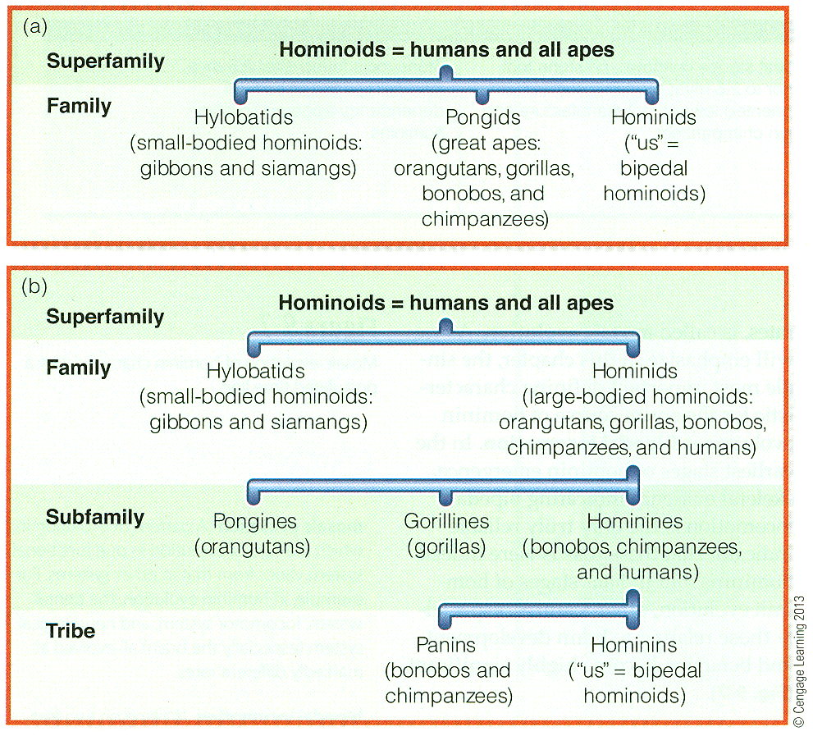
traditional classification
revised classification
Understanding Humans, 11th ed., p. 204

Slide 34
hominoids
revised classification of hominoids
Primate taxonomic classification
Understanding Humans, 11th ed., p. 126

Slide 35
hominoids
revised classification of hominoids
note two
additional levels of classification
Primate taxonomic classification
Understanding Humans, 11th ed., p. 126

Slide 36
revised classification of hominoids
Homininae
note two
additional levels of classification
Primate taxonomic classification
Understanding Humans, 11th ed., p. 126

Slide 37
one more thing
to pay attention to, concerning early primates . . .

Slide 38
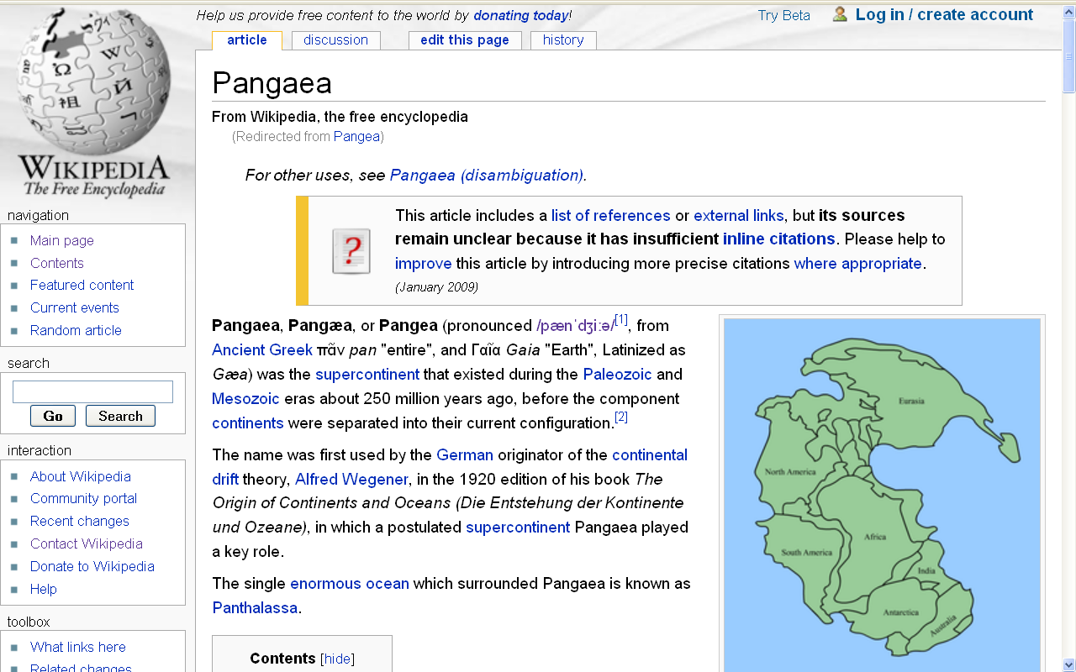
Wikipedia

Slide 39
Pangea
the original “supercontinent” . . .
Wikipedia

Slide 40
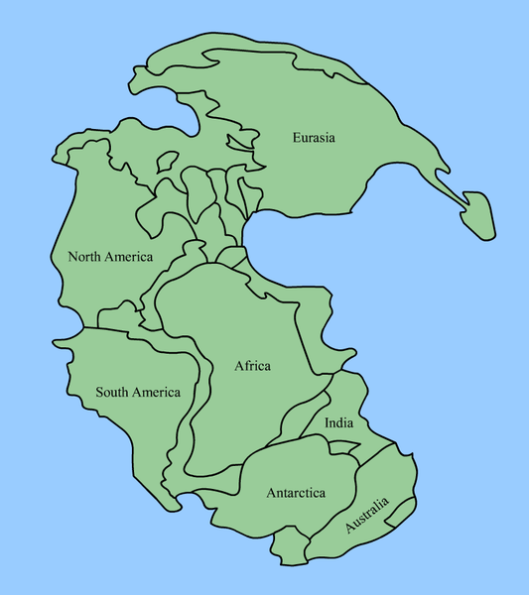
Pangea
Wikipedia

Slide 41
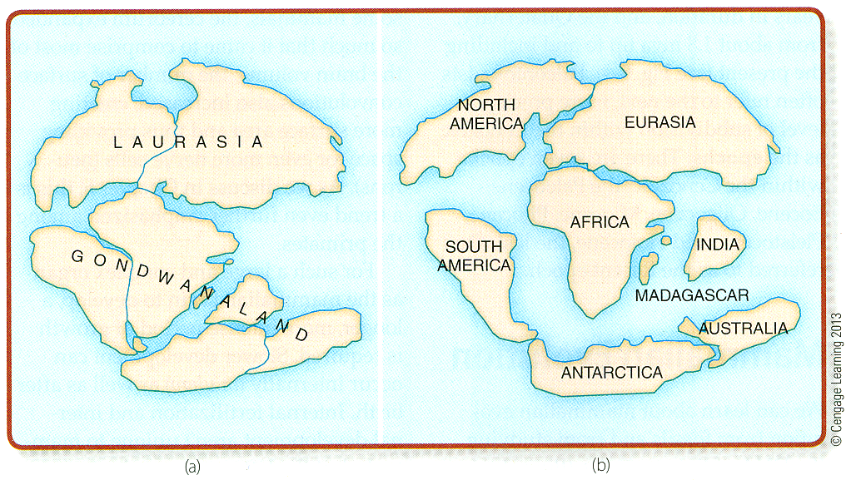
Continental drift
Mesozoic (ca. 125 m.y.a.) Cenozoic (ca. 65 m.y.a.)
Understanding Humans, 11th ed., p. 109

Slide 42
Pangea
Continental drift
Mesozoic (ca. 125 m.y.a.) Cenozoic (ca. 65 m.y.a.)
Understanding Humans, 11th ed., p. 109

Slide 43
ca. 65 mya
Continental drift
Mesozoic (ca. 125 m.y.a.) Cenozoic (ca. 65 m.y.a.)
Understanding Humans, 11th ed., p. 109

Slide 44
Pangea Split
|

Slide 45
Pangea Split
|
“Island Effect”

Slide 46
Pangea Split
|
“Island Effect”
|

Slide 47
Pangea Split
|
“Island Effect”
|
New Adaptations

Slide 48
Pangea Split
|
“Island Effect”
|
New Adaptations
|
New Orders of Creation

Slide 49
tree life
|
physical modifications
|

Slide 50
earliest primates =
prosimians
(pre-monkeys)

Slide 51
improved grasping hand
improved opposability
more elaborate brains
smelling becomes secondary
color vision
larger eyes
eyes moved forward
|

Slide 52
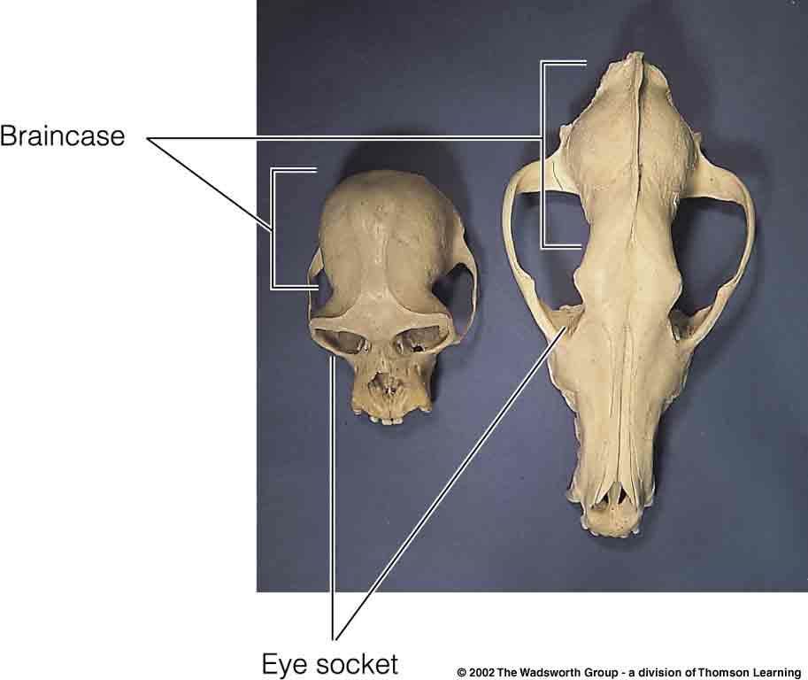
Gibbon Red Wolf
Understanding Humans, 10th ed., p. 122

Slide 53
All of this required increased coordination of senses

Slide 54
monkeys use food more efficiently than apes

Slide 55
monkeys use food more efficiently than apes
|
need for apes to encounter wider and more varied environments

Slide 56
monkeys use food more efficiently than apes
|
need for apes to encounter wider and more varied environments
|
greater variety of environments

Slide 57
microenvironments

Slide 58
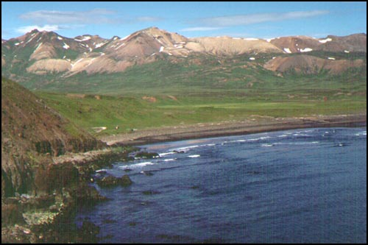
microenvironments

Slide 59
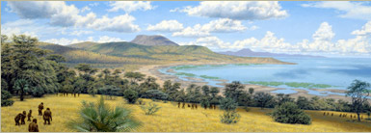
microenvironments
The African Savannah Illustration by Jay H. Matternes
http://www.amnh.org/exhibitions/atapuerca/africa/branches.php

Slide 60
multiplicity of alternatives

Slide 61
multiplicity of alternatives
|
need for deliberation

Slide 62
multiplicity of alternatives
|
need for deliberation
|
requires more time

Slide 63
multiplicity of alternatives
|
need for deliberation
|
requires more time
|
causes delay

Slide 64
multiplicity of alternatives
|
need for deliberation
|
requires more time
|
causes delay
|

Slide 65
therefore life becomes less automatic
and one depends to a greater extent on learning . . .

Slide 66
CULTURE
(learned behavior)

Slide 67
Detailed information on primates
is available on the class website at
www.d.umn.edu/cla/faculty/troufs/anth1602/

Slide 68
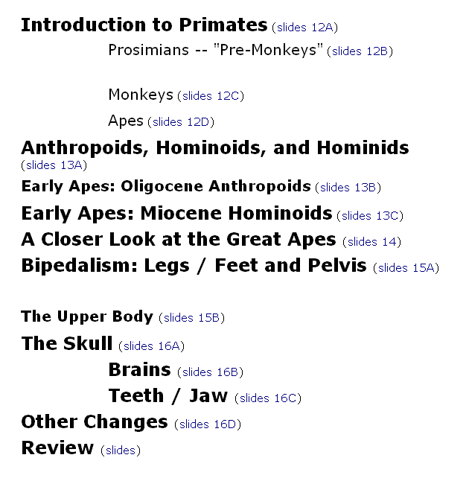

Slide 69
Primate taxonomic classification
Understanding Humans, 11th ed., p. 126

