Slide 1
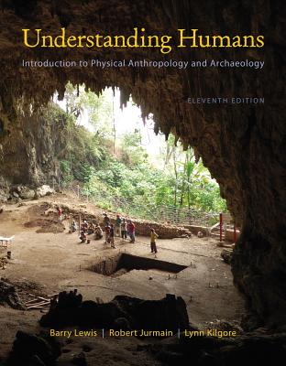
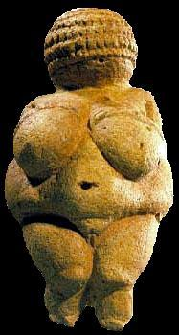
Class Slides Set 21
Tools and Technologies II
University of Minnesota Duluth
Tim Roufs
© 2010-2013
http://www.d.umn.edu/cla/faculty/troufs/anth1602/

Slide 2
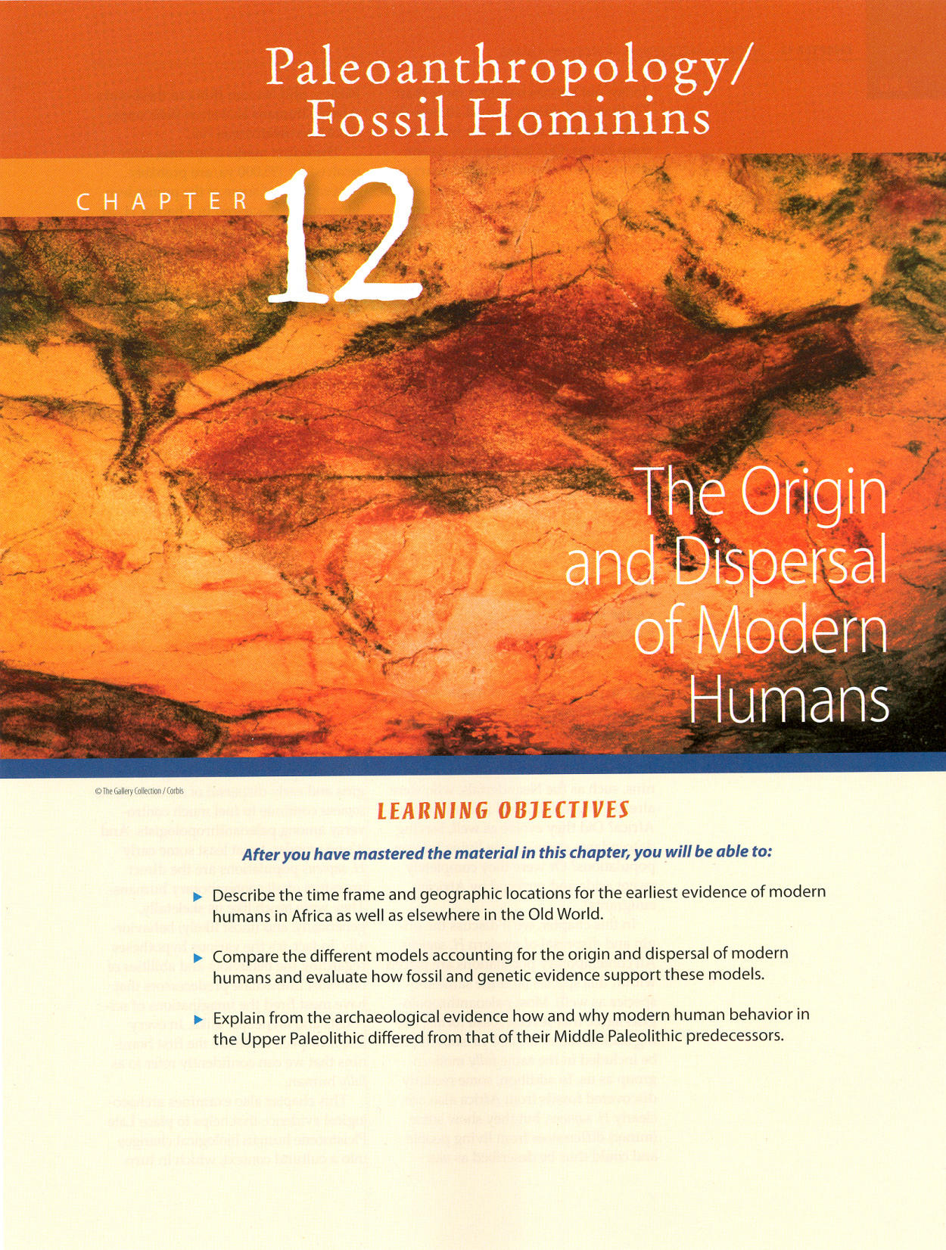
. . . or how to make sense out of Ch. 12 of the text . . .

Slide 3
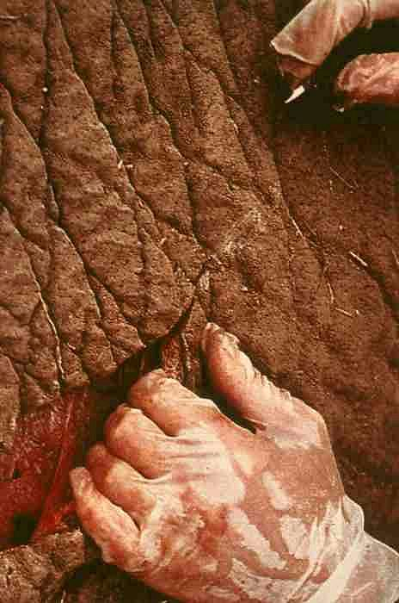
Tools and Technologies II
Making and Using Lithic Tools

Slide 4
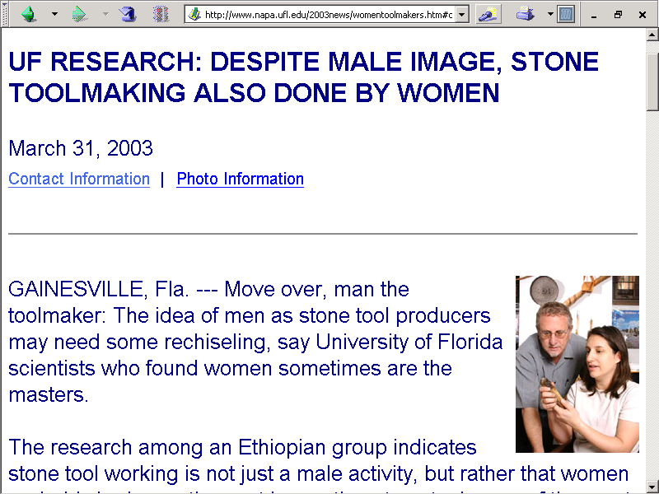
www.napa.ufl.edu/2003news/womentoolmakers.htm#contact

Slide 5
Lithic Tools and Technologies
lithic tools
basic types
basic techniques of manufacture
basic too uses
Upper Paleolithic traditions

Slide 6
Lithic Tools and Technologies
lithic tools
basic types
basic techniques of manufacture
basic too uses
Upper Paleolithic traditions

Slide 7
Lithic Tools and Technologies
lithic tools
basic types
basic techniques of manufacture
basic too uses
Upper Paleolithic traditions

Slide 8
Lithic Tools and Technologies
lithic tools
basic types
basic techniques of manufacture
basic too uses
Upper Paleolithic traditions
basic types
basic techniques of manufacture
stone on stone
baton technique
pressure flaking

Slide 9
Glossary
all of the techniques
are based on the
“cone principle”

Slide 10
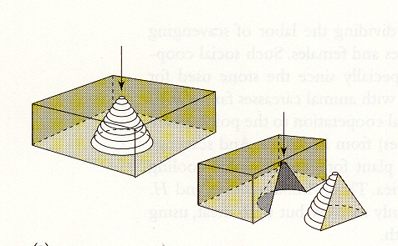
Cone Fractures
“Lithic Technology: Tools for Life”
Brian M. Fagan and George H. Michaels
Fagan, People of the Earth, 10th Ed., p. 62

Slide 11
Lithic Tools and Technologies
lithic tools
basic types
basic techniques of manufacture
stone on stone
baton technique
pressure flaking

Slide 12
Lithic Tools and Technologies
lithic tools
basic types
basic techniques of manufacture
stone on stone
baton technique
pressure flaking

Slide 13
Lithic Tools and Technologies
lithic tools
basic types
basic techniques of manufacture
stone on stone
anvilstone
hammerstone

Slide 14
Lithic Tools and Technologies
lithic tools
basic types
basic techniques of manufacture
stone on stone
anvilstone
hammerstone

Slide 15
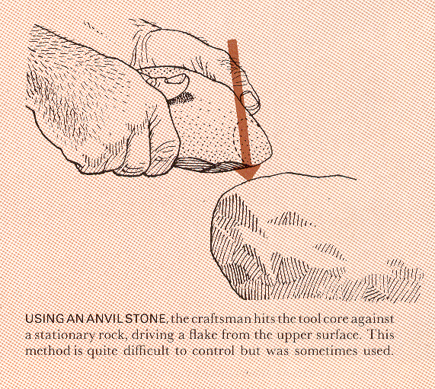
Life Nature Library, Early Man, p. 110

Slide 16
Lithic Tools and Technologies
lithic tools
basic types
basic techniques of manufacture
stone on stone
anvilstone
hammerstone

Slide 17
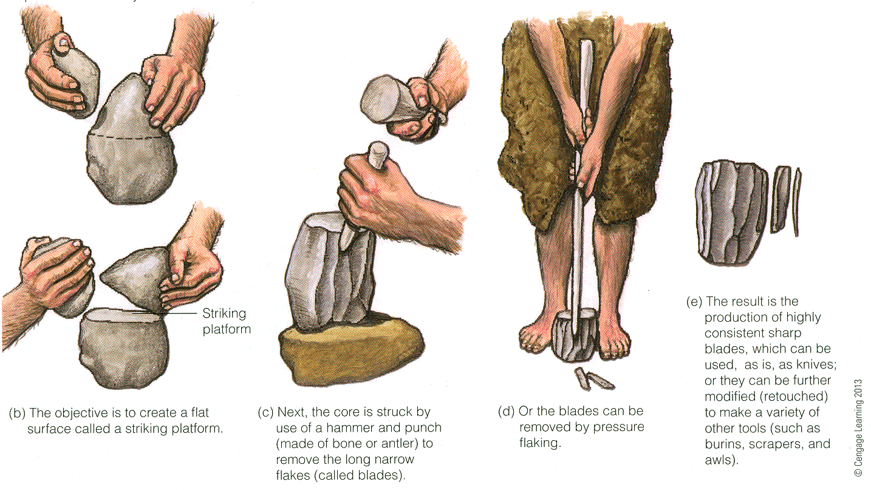
Direct percussion, striking a core with a hammerstone.
Understanding Humans, 11th Ed., p. 299

Slide 18
Percussion flaking using a hammer stone and punch.
Understanding Humans, 11th Ed., p. 299

Slide 19
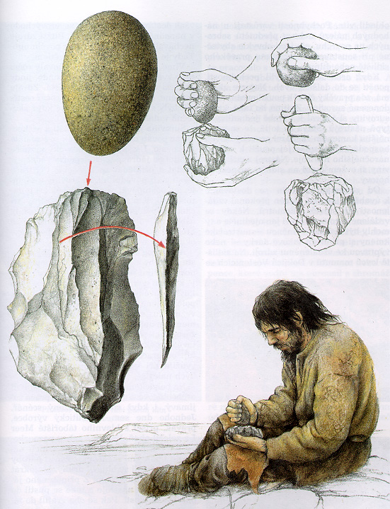

Slide 20
Lithic Tools and Technologies
lithic tools
basic types
basic techniques of manufacture
stone on stone
baton technique
pressure flaking

Slide 21
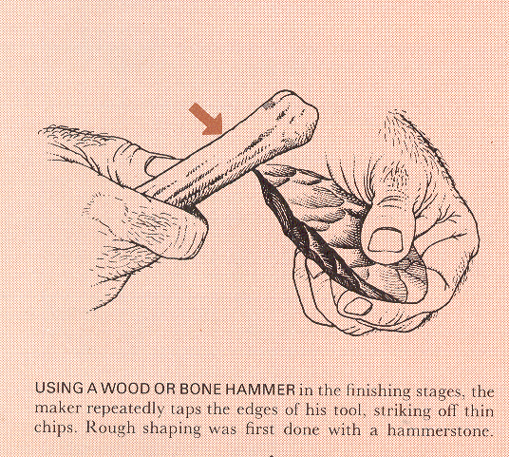
Life Nature Library, Early Man, p. 111.

Slide 22
Lithic Tools and Technologies
lithic tools
basic types
basic techniques of manufacture
stone on stone
baton technique
pressure flaking

Slide 23
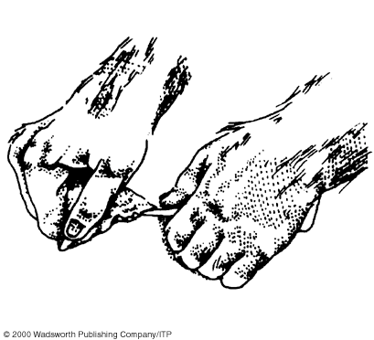
Pressure flaking, using an antler tip.
Understanding Physical Anthropology and Archaeology (8th Ed), p. 351

Slide 24
Pressure flaking.
Understanding Humans, 11th Ed., p. 299

Slide 25
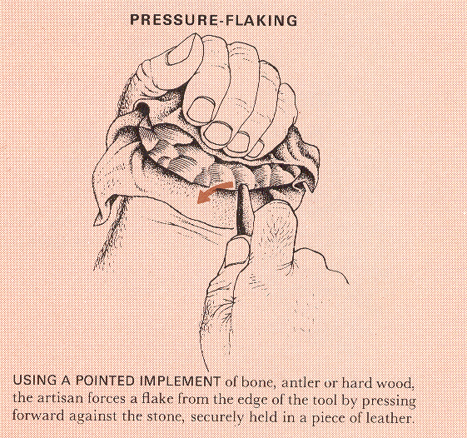
Life Nature Library, Early Man, p. 111

Slide 26
Glossary
blade flakes
blade points
other blade tools

Slide 27
Glossary
making blades using
the Levallois technique

Slide 28
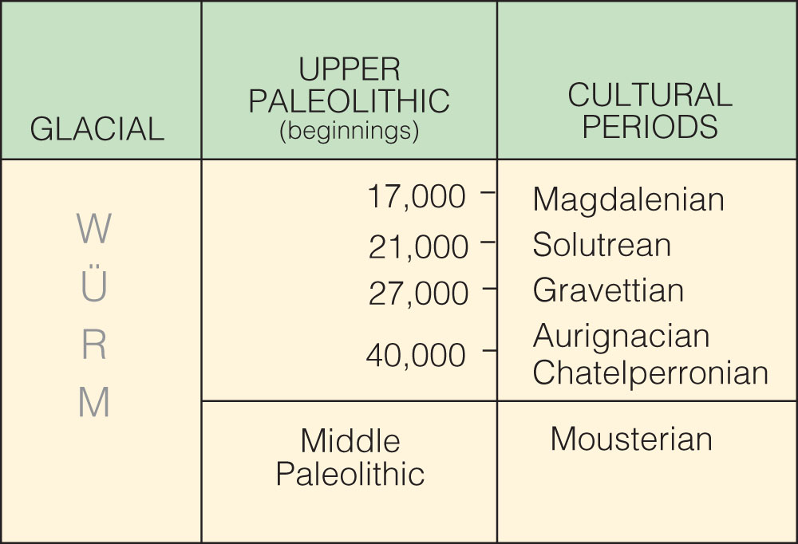
is the “culture”
the technique is called “Levallois”
Cultural periods of the European Upper Paleolithic.
Understanding Humans, 10th ed., p. 257

Slide 29
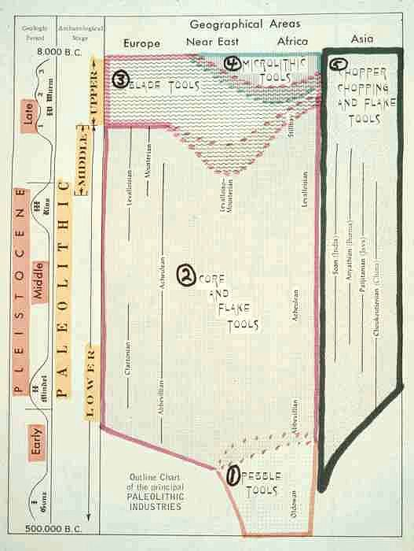

Slide 30
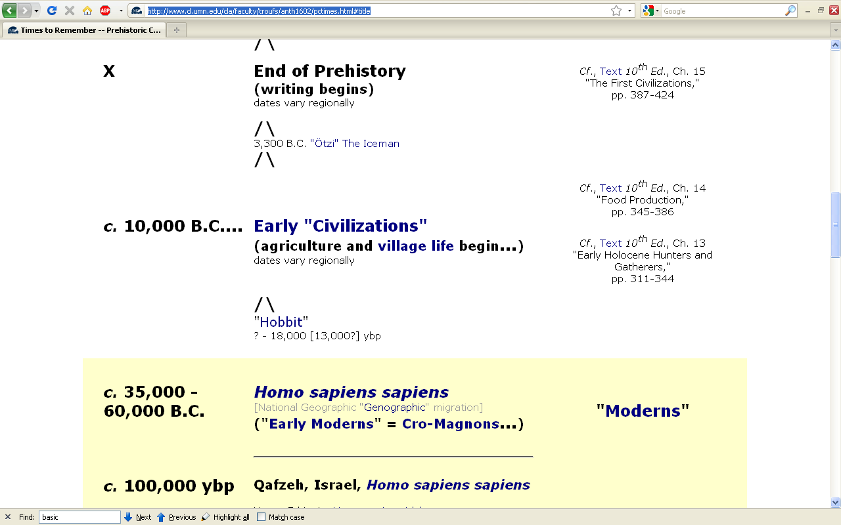
http://www.d.umn.edu/cla/faculty/troufs/anth1602/pctimes.html

Slide 31
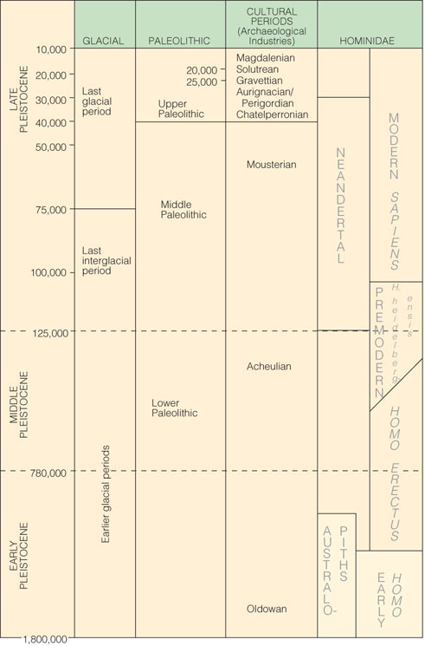
Pleistocene Subdivisions, Archaeological Industries and Hominids
Understanding Humans, 10th ed., p. 267

Slide 32
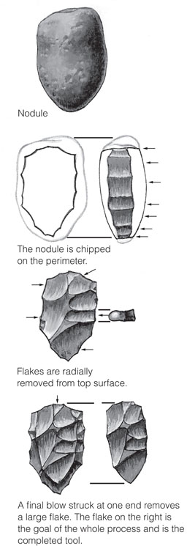
The “Levallois” technique
Understanding Humans, 10th ed., p. 265c

Slide 33
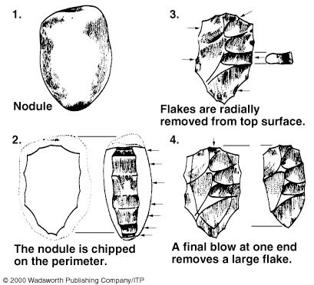
The “Levallois” technique
Understanding Humans, 11th ed., p. 261

Slide 34
The “Levallois” technique
Understanding Humans, 11th ed., p. 261

Slide 35
Glossary
making blades using the
“punch blade technique”
from a
“prepared core”

Slide 36
Pressure flaking.
Understanding Humans, 11th Ed., p. 299

Slide 37
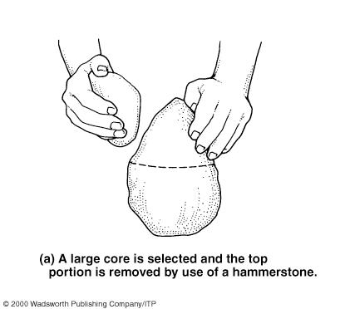
The punch blade technique.
Understanding Physical Anthropology and Archaeology (9th Ed), p. 291

Slide 38
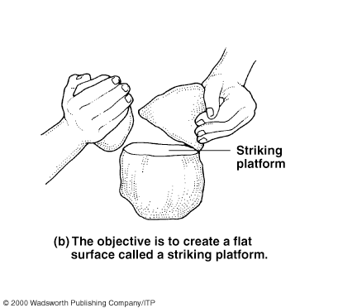
The punch blade technique.
Understanding Physical Anthropology and Archaeology (9th Ed), p. 291

Slide 39
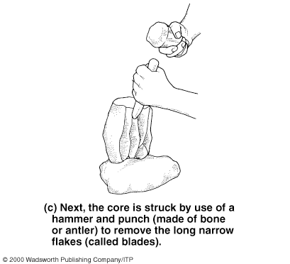
The punch blade technique.
Understanding Physical Anthropology and Archaeology (9th Ed), p. 291

Slide 40
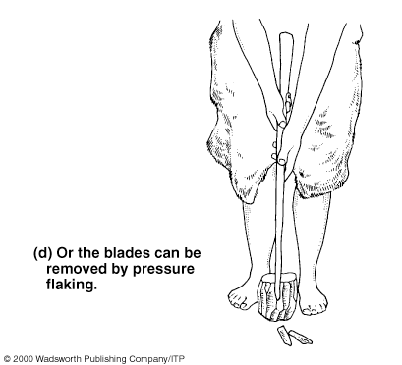
The punch blade technique.
Understanding Physical Anthropology and Archaeology (9th Ed), p. 291

Slide 41
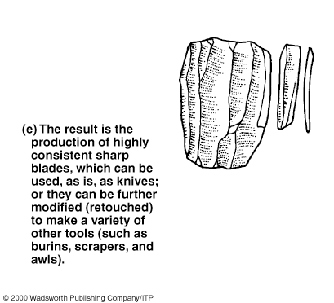
prismatic
blade
The punch blade technique.
Understanding Physical Anthropology and Archaeology (9th Ed), p. 291

Slide 42
Lithic Tools and Technologies
from blades
other types of tools
are made

Slide 43
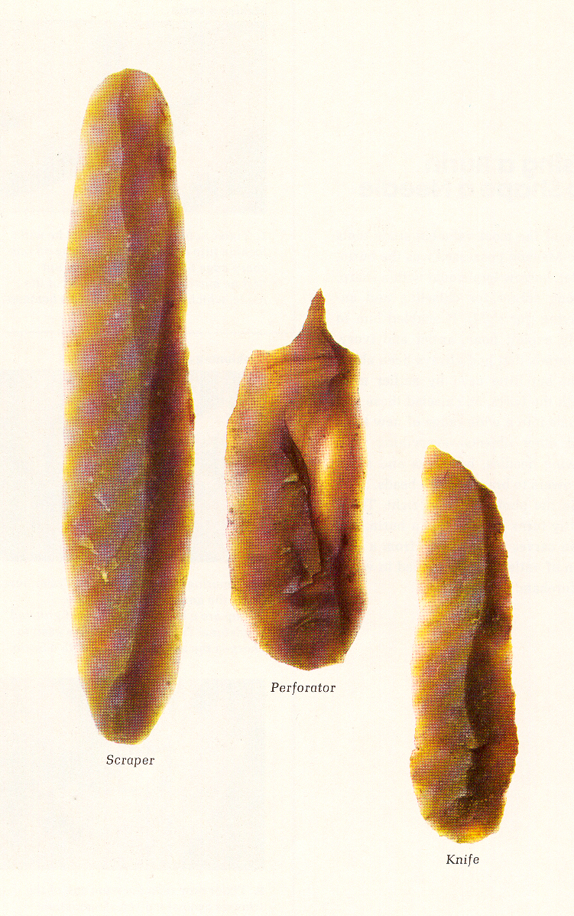
The Emergence of Man (Time-Life, 1973), p. 87

Slide 44
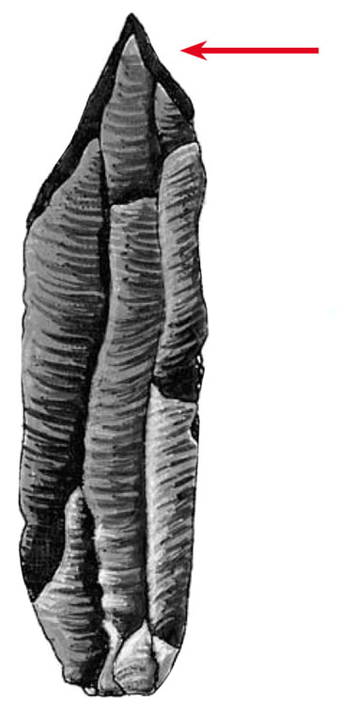
Burin.
Understanding Humans, 11th Ed., p. 299

Slide 45
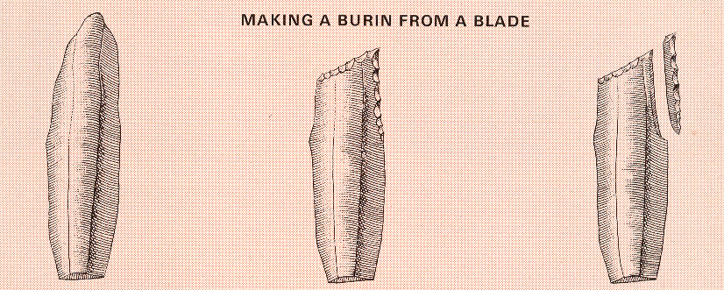
fluting
Life Nature Library, Early Man, p. 113

Slide 46
Lithic Tools and Technologies
steps in making stone tools
increase in number
over time

Slide 47
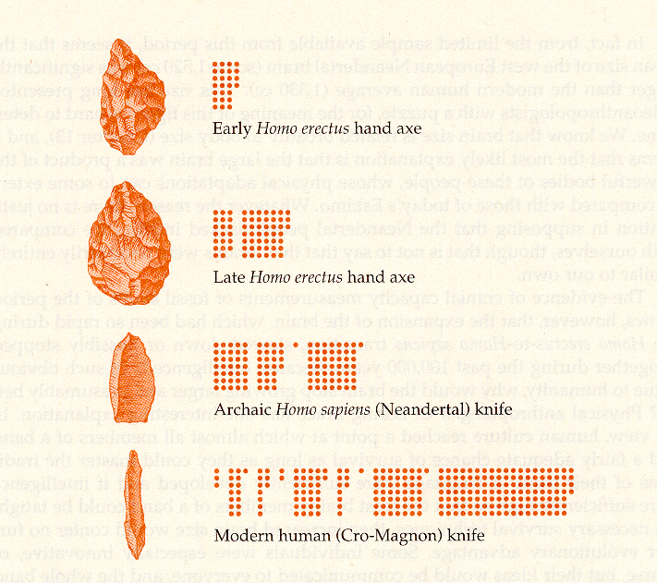
Humankind Emerging, 7th Ed., p. 432

Slide 48
Lithic Tools and Technologies
stone tool effectiveness

Slide 49
National Geographic, November 1985

Slide 51
Lithic Tools and Technologies
efficient of use of raw materials improves

Slide 52
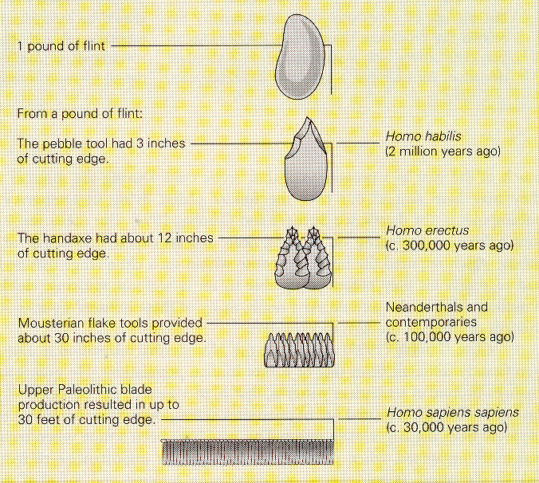
Brian Fagan, People of the Earth, 10th Ed., p. 102

Slide 53
Lithic Tools and Technologies
lithic tools
basic types
basic techniques of manufacture
basic too uses
Upper Paleolithic traditions

Slide 54
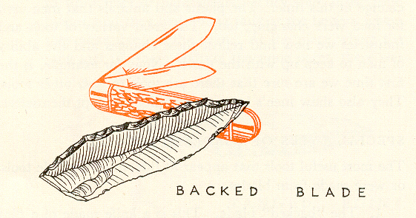
Braidwood, Prehistoric Men 2nd Ed. (Chicago Natural History Museum, 1951), p. 65

Slide 55
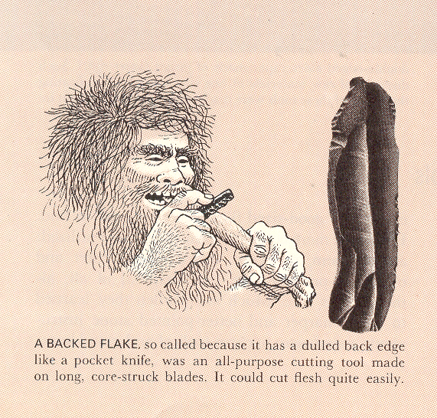
Life Nature Library, Early Man, p. 115

Slide 56
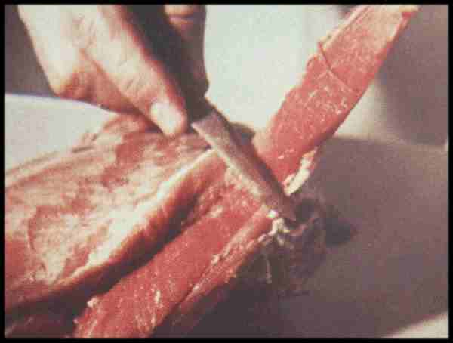
Life Nature Library, Cro-Magnon, p. 87

Slide 57
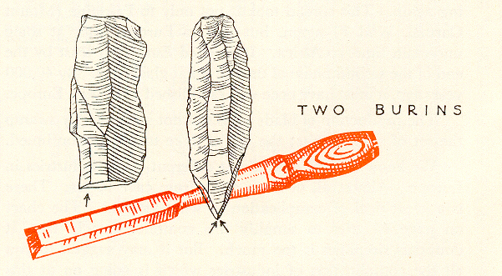
Braidwood, Prehistoric Men 2nd Ed. (Chicago Natural History Museum, 1951), p. 66

Slide 58
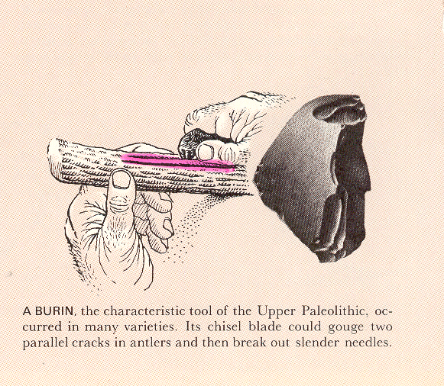
Life Nature Library, Early Man, p. 114

Slide 59
www.hominids.com/donsmaps/lioncamp.html

Slide 60
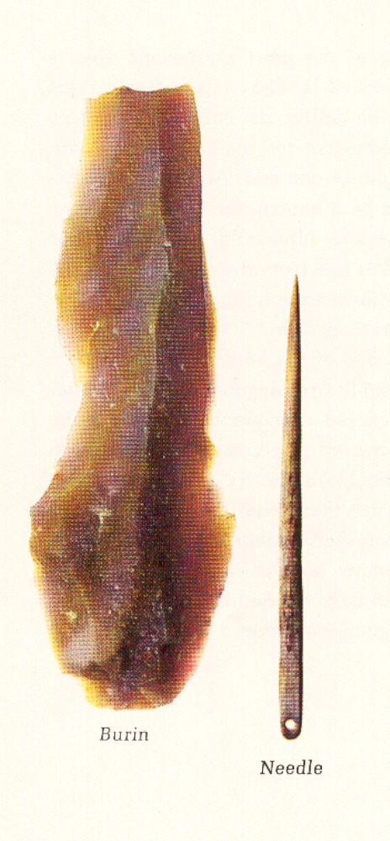
The Emergence of Man (Time-Life, 1973), p. 89

Slide 61
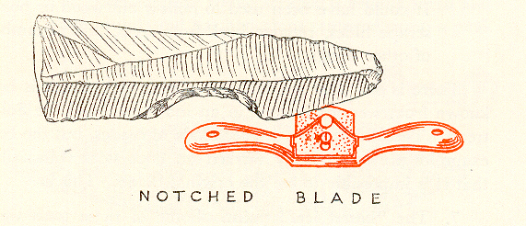
Braidwood, Prehistoric Men 2nd Ed. (Chicago Natural History Museum, 1951), p. 67

Slide 62
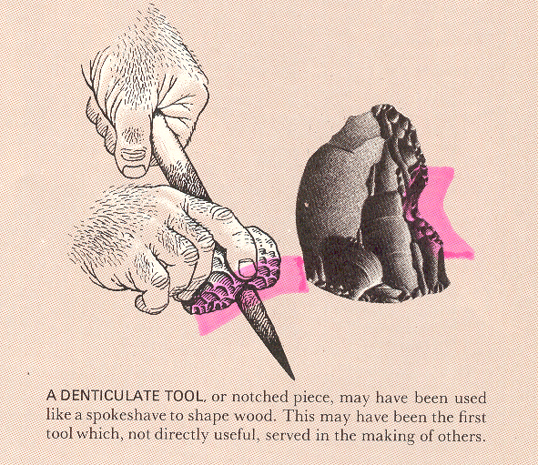
Life Nature Library, Early Man, p. 115

Slide 63
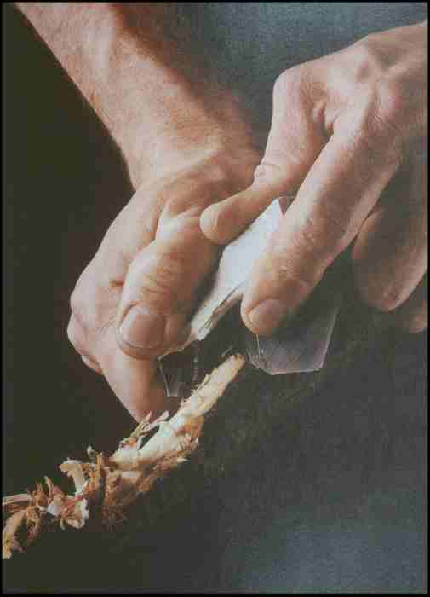
Trimming Wood with flint.
Ascent to Civilization, p. 95

Slide 64
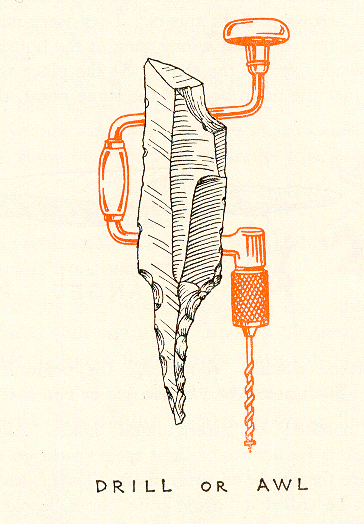
Braidwood, Prehistoric Men 2nd Ed. (Chicago Natural History Museum, 1951), p. 68

Slide 65
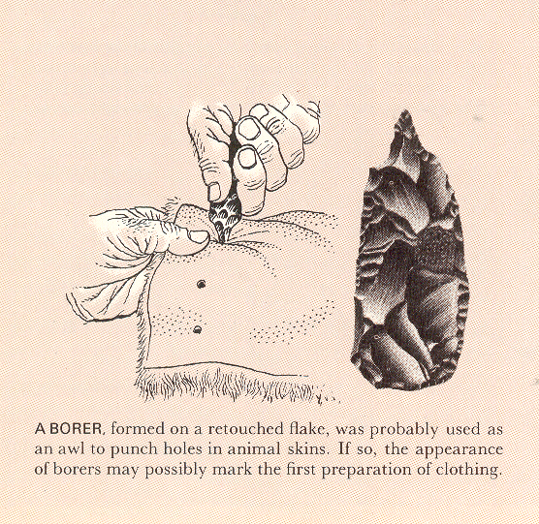
Life Nature Library, Early Man, p. 114

Slide 66
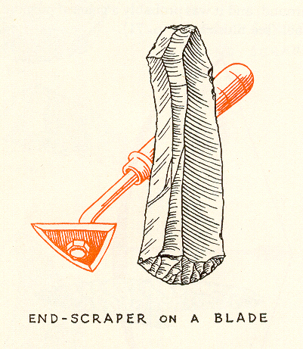
Braidwood, Prehistoric Men 2nd Ed. (Chicago Natural History Museum, 1951), p. 69

Slide 67
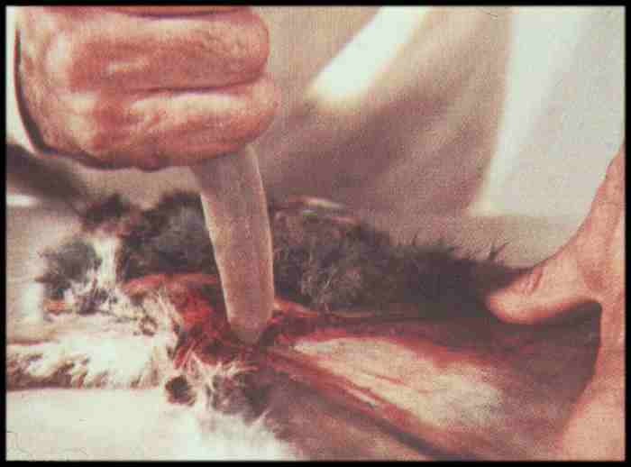
Life Nature Library, Cro-Magnon, p. 87

Slide 68
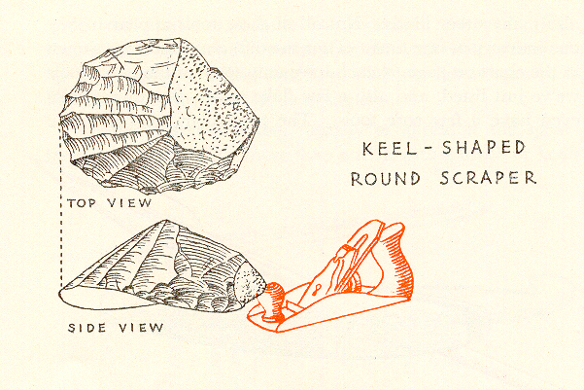
Braidwood, Prehistoric Men 2nd Ed. (Chicago Natural History Museum, 1951), p. 71

Slide 69
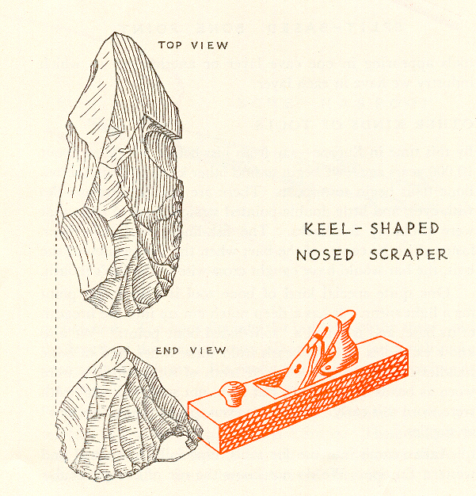
Braidwood, Prehistoric Men 2nd Ed. (Chicago Natural History Museum, 1951), p. 71

Slide 70
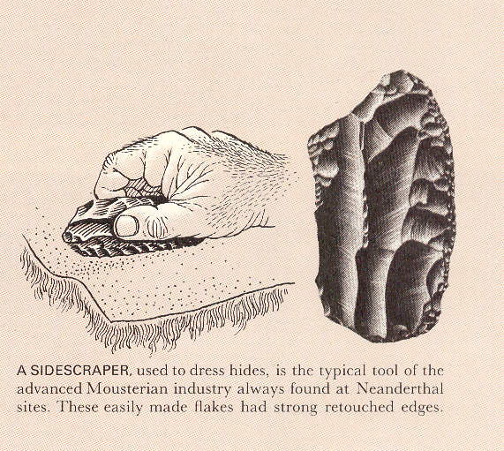
Life Nature Library, Early Man, p. 114

Slide 71
Lithic Tools and Technologies
lithic tools
basic types
basic techniques of manufacture
basic too uses
. . . and sometimes it is difficult
to determine just exactly
what
a tool is used for . . .

Slide 72
Lithic Tools and Technologies
lithic tools
basic types
basic techniques of manufacture
basic too uses
. . . and sometimes it is difficult
to determine just exactly
what
a tool is used for . . .

Slide 73
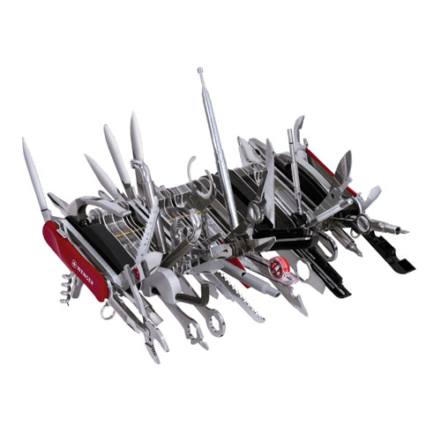
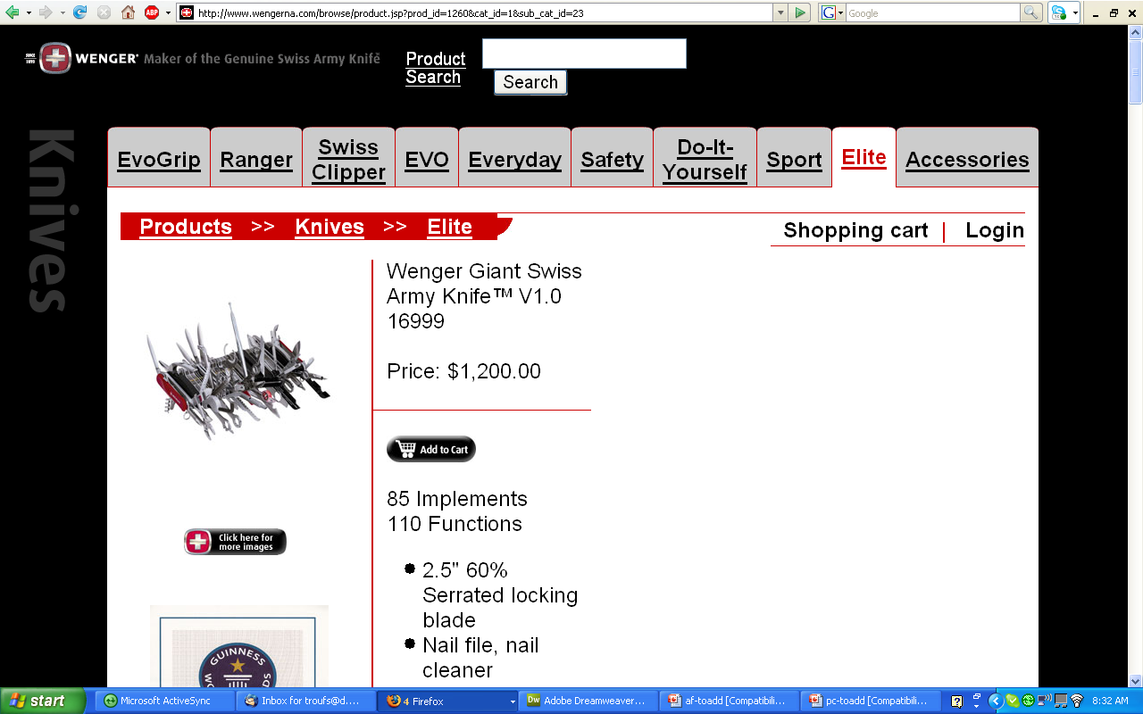
www.wengerna.com/browse/product.jsp?prod_id=1260&cat_id=1&sub_cat_id=23
Notes:
73

Slide 74
Lithic Tools and Technologies
. . . technical terms abound . . .
papageienschnabelklingenedhohlkratzerbohrerschraber

Slide 75
Lithic Tools and Technologies
. . . spears . . .

Slide 76
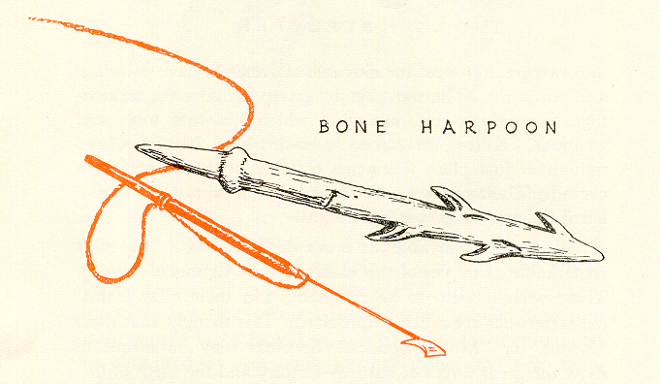
Magdalenian
Braidwood, Prehistoric Men 2nd Ed. (Chicago Natural History Museum, 1951), p. 73

Slide 77
is the “culture”
the technique is called “Levallois”
Cultural periods of the European Upper Paleolithic.
Understanding Humans, 10th Ed., p. 257

Slide 78
Neandertal
is the “culture”
Cultural periods of the European Upper Paleolithic.
Understanding Humans, 10th Ed., p. 257

Slide 79
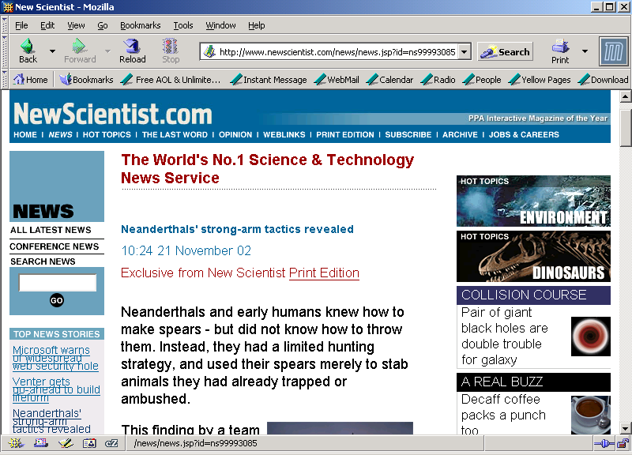
www.newscientist.com/news/news.jsp?id=ns99993085

Slide 80
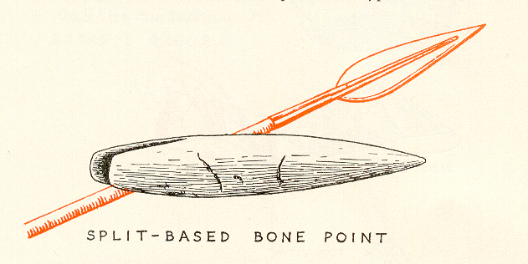
Braidwood, Prehistoric Men 2nd Ed. (Chicago Natural History Museum, 1951), p. 72

Slide 81
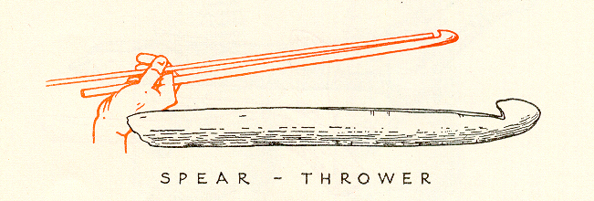
Braidwood, Prehistoric Men 2nd Ed. (Chicago Natural History Museum, 1951), p. 73

Slide 82
Magdalenian Spear-thrower (atlatl). Note the carving..
Understanding Humans, 11th Ed., p. 298

Slide 83
www.worldatlatl.org/

Slide 84
Lithic Tools and Technologies
. . . and sometimes
the prehistoric uses
may have been different
than the ones that immediately come to mind . . .

Slide 85
Magdalenian Spear-thrower (atlatl). Note the carving..
Understanding Humans, 11th Ed., p. 298

Slide 86
But tool uses are not always obvious . . .
Life Nature Library, Cro-Magnon, p. 67

Slide 87
Life Nature Library, Cro-Magnon, p. 67

Slide 88
Glossary
. . . other terms . . .

Slide 89
Braidwood, Prehistoric Men 2nd Ed. (Chicago Natural History Museum, 1951), p. 67

Slide 90
Braidwood, Prehistoric Men 2nd Ed. (Chicago Natural History Museum, 1951), p. 70

Slide 91
Glossary
microliths
small stone tools usually produced from narrow blades punched from a core
“micro” = “small”
“lith” = “stone”

Slide 92
Glossary
microliths
small stone tools usually produced from narrow blades punched from a core
“micro” = “small”
“lith” = “stone”

Slide 94
Glossary
compound (composite)
made of several parts
e.g., spear, harpoon, sickle, hammer . . .

Slide 95
Composite Tool: A hafted scraper.
Understanding Humans, 11th Ed., p. 271

Slide 96
Brian Fagan, People of the Earth, 10th ed., p. 213

Slide 97
Braidwood, Prehistoric Men 2nd Ed. (Chicago Natural History Museum, 1951), p. 79

Slide 100
Sickle with embedded row of small flint blades.
Understanding Humans, 11th Ed., p. 337

Slide 101
Glossary
polyhedral stone
one having many faces
is generally used for pounding things

Slide 102
Life Nature Library, Early Man, p. 115

Slide 104
Life Nature Library, Early Man, p. 114

Slide 105
Life Nature Library, Early Man, p. 183

Slide 106
Lithic Tools and Technologies
lithic tools
basic types
basic techniques of manufacture
basic too uses
Upper Paleolithic traditions

Slide 107
Glossary
tradition
horizon

Slide 108
Glossary
tradition
similarity of elements over considerable time in a delimited area
site, locality or region

Slide 109
10th p. 257
Upper
Paleolithic
traditions
(SW France)

Slide 110
is the “culture”
the technique is called “Levallois”
Cultural periods of the European Upper Paleolithic.
Understanding Humans, 10th Ed., p. 257

Slide 111
Solutrean blade
Understanding Humans, 10th Ed., p. 304

Slide 112
^{Solutrean blade.}
Understanding Physical Anthropology and Archaeology (9th ed), p. 289.

Slide 113
Solutrean blade
Understanding Physical Anthropology and Archaeology (9th Ed.), p. 289

Slide 114
Braidwood, Prehistoric Men 2nd Ed. (Chicago Natural History Museum, 1951), p. 68

Slide 115
^{Clovis}
^{Folsom}
^{Plano}
^{Dalton}
Major types of North American Paleo-Indian projectile points.
Understanding Physical Anthropology and Archaeology (9th Ed.), p. 315

Slide 117
Next: Tools and Technologies III
Upper Paleolithic Traditions
Life Nature Library, Cro-Magnon, p. 60.

